Slide 1
How the West was Won?
Unit VI: The Gilded Age 1866-1898

Slide 2
Essential Question: How did rapid mechanization in industrial and agriculture American society transform the United States and bring it into the modern age?
Students Can:
Discern how westward expansion impacted Native Americans
Evaluate how the economy of the west was transformed by the rise of industrialization
Demonstrate how American government displayed a plutocracy during the Gilded Age
Agenda
Factors of Native America disappearance
The Decline of the Range
DBQ defense
Homework
The Rise and Fall of the Populist Movement – pages 613-624
DBQ Rough drafts due Friday

Slide 3
Reflection of American Expansion
How were the lives of the Plains Indians in the second half of the nineteenth century affected by technological developments and government actions?

Slide 4
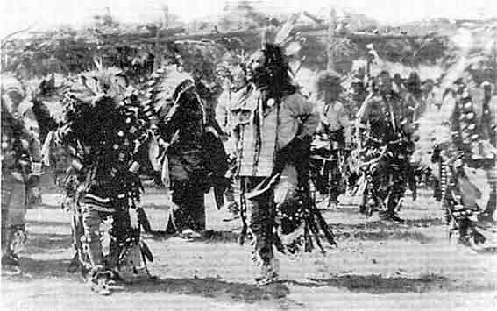
The Fight Against Oppression

Slide 5
Land Cessation

Slide 6
Native Americans: 19thCentury
Removal (West of the Mississippi R.)(1830s-40s)
Concentration (1860s-1880s)
Indian Wars
Reservations
Assimilation (1880s-1930s)
Dawes Act

Slide 7
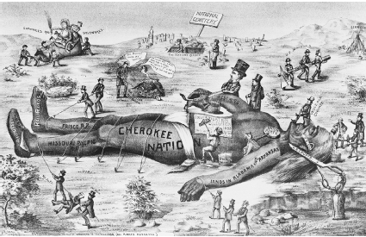
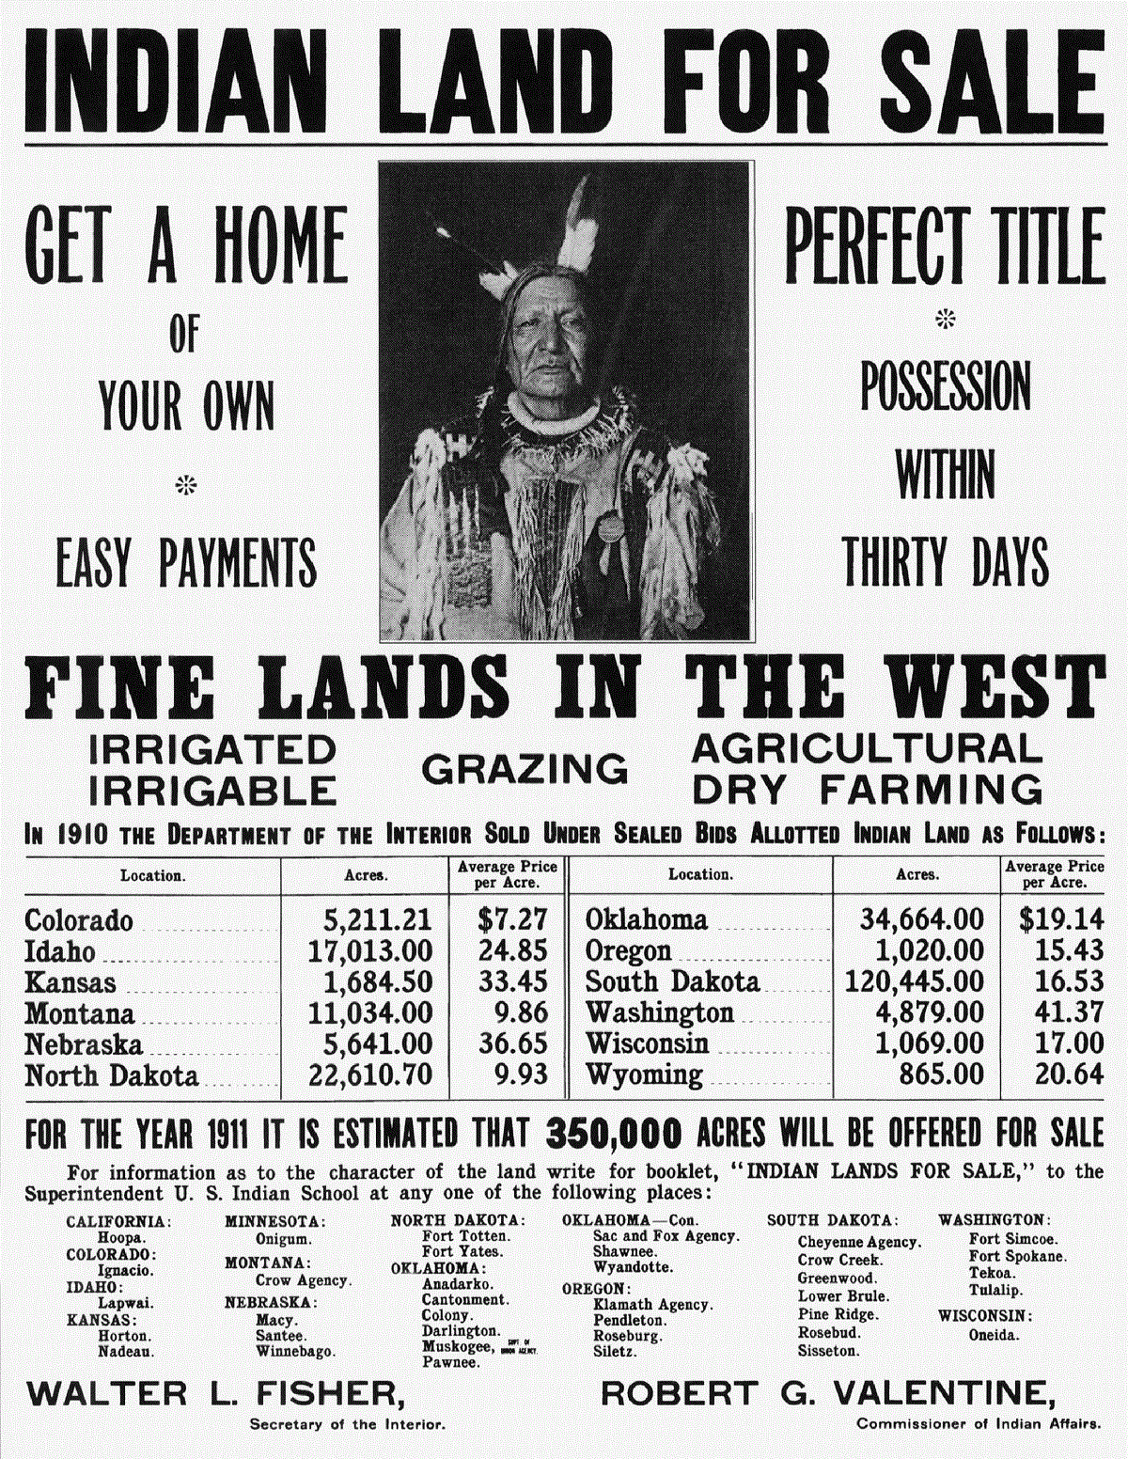
Historic synthesis: analyze the two documents and decipher parallels and contrast between the two time periods
1820-1840
1880s-1930s

Slide 8
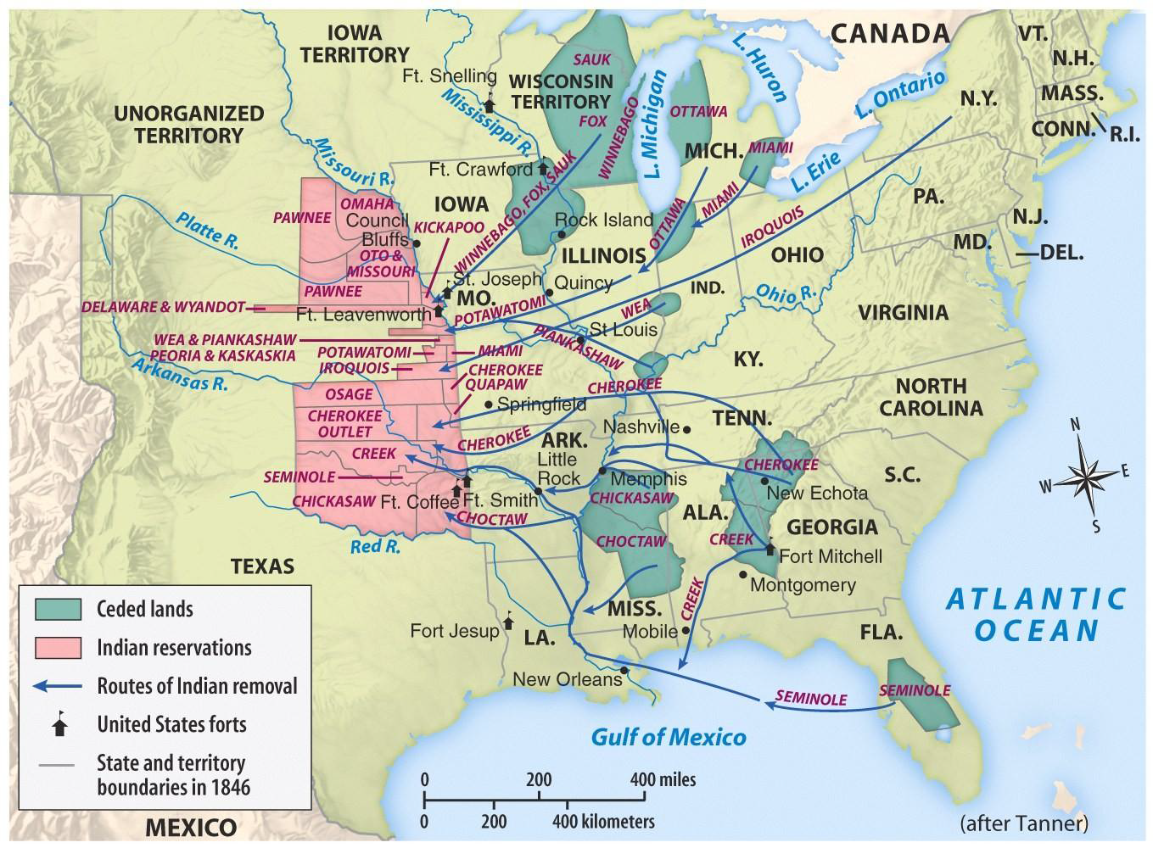
Indian Removal (1820-1843)

Slide 9
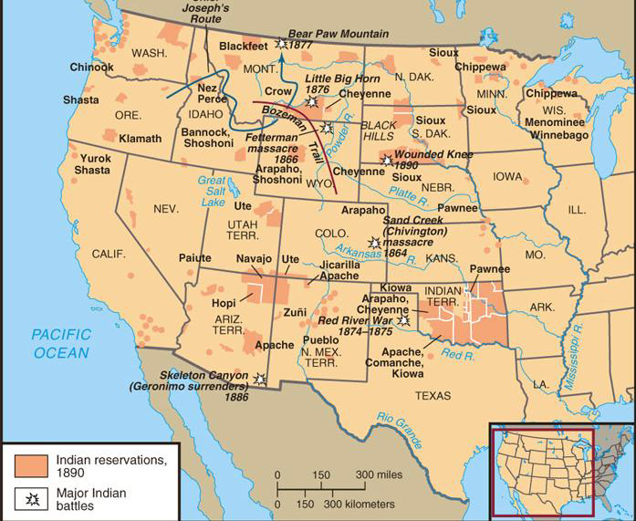
INDIANS Reservations “Concentration” Bureau of Indian Affairs
Treaty of Fort Laramie 1851 & Fort Atkinson 1853 (Reservation system)
Protect settlers
Issues:
Starvation
Graft: Bureau of Indian Affairs agents selling Natives supplies

Slide 10
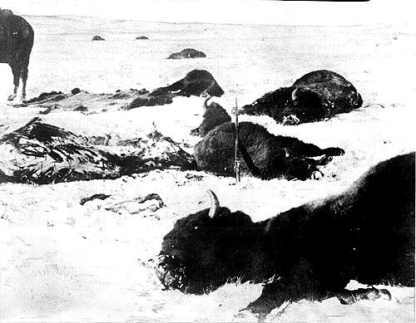
Dead Buffalo, 1872
Causes:
Railroads
Western expansion

Slide 11
INDIANS Conflicts ►Battle of Little Big Horn ► Sand Creek Massacre ►Sitting Bull ►George Armstrong Custer ►Crazy Horse
Other Conflicts
Fetterman Massacre
Red River War

Slide 12
The Ghost Dance Movement, 1890 ► White man go away ► The BUFFALO return ► Ancestors return
Cause of the Wounded Knee Massacre

Slide 13
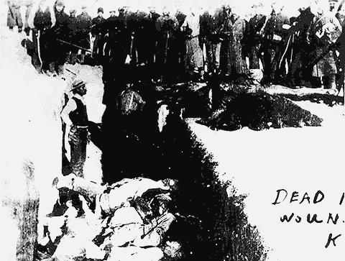
Troops Burying Bodies, Wounded Knee

Slide 14
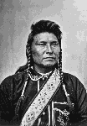
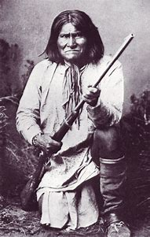
Fight Against Concentration
Chief Joseph, Leader of the Nez Perce
Geronimo: Apache
Resisted government policy of reservation
Native Americans lose: RRs, disease, loss of the buffalo, & war

Slide 15
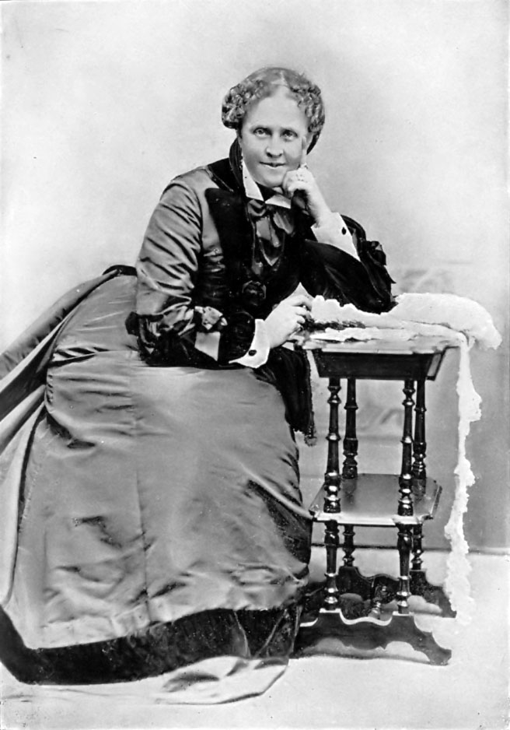
A Century of Dishonor, 1881
If I can do one hundredth part for the Indian that Mrs. Stowe did for the Negro, I will be thankful. – Helen Hunt Jackson
Argues against government abuse of Natives
Propose assimilation
Notes:
included red ink packet to all members of Congress - blood is on your hands
Jackson also wrote a book summarizing and condemning state and federal Indian policy, as well as the history of broken treaties. Because she was in poor health, she wrote with haste.A Century of Dishonor, calling for significant reform to government policy towards Native Americans, was published in 1882.^{[6]} Jackson sent a copy to every member of Congress with an admonishment printed in red on the cover, "Look upon your hands: they are stained with the blood of your relations." To her disappointment, the book had little impact on government policies and actions.

Slide 16
INDIANS ►Assimilation ►Dawes Severalty Act(1883)
What other western settlement policy is this similar to?

Slide 17
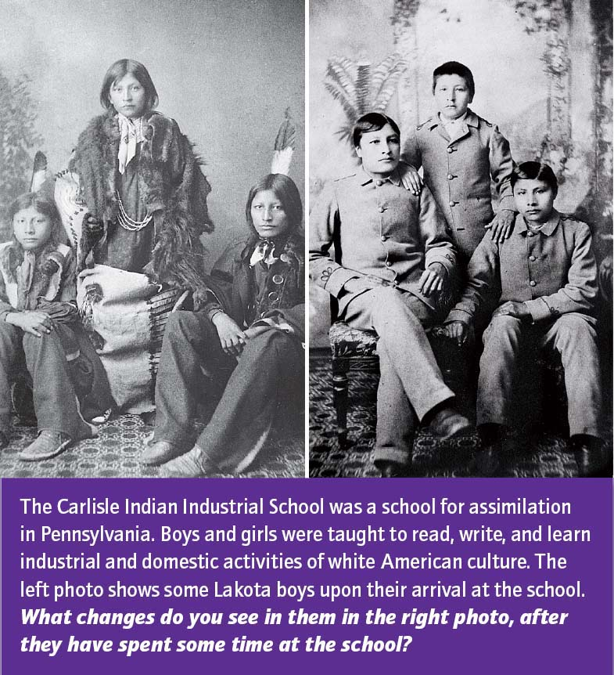

Slide 18
BIG BUSINESS in America
Prompt: In the post–Civil War United States, corporations grew significantly in number, size, and influence. Analyze the impact of big business on the economy and politics and the responses of Americans to these changes. Confine your answer to the period 1870 to 1900.
THESIS DEFENSE
Claim
Three Bases: How do the Seven Documents fit
How are you using the documents – describe, explain, or HIPP
Historic Contextualization (must focus on the topic and connect ideas)
Causation before the time period
Immediate effect: during the time period
Long term effect: after the time period

Slide 19
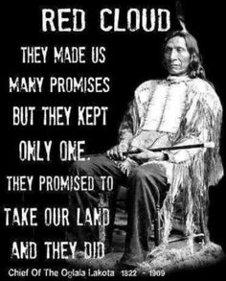
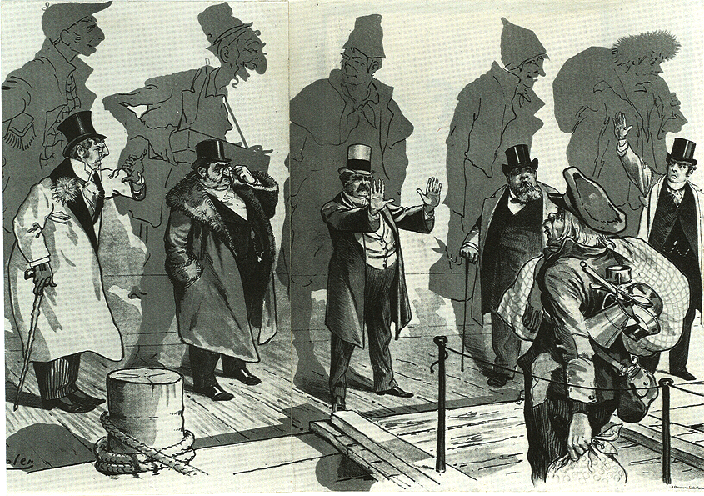
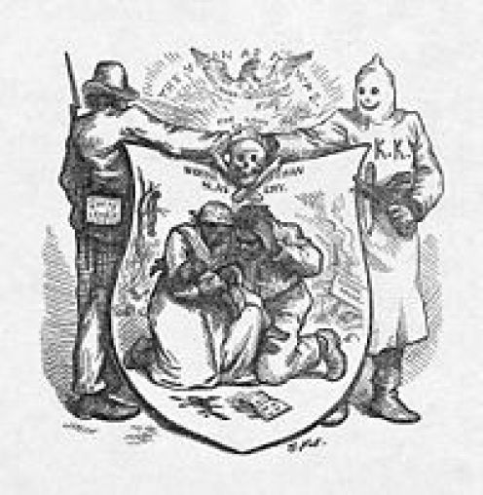
Historic Parallelism – Complex history
14th Amendment: Defines who are citizens of the U.S. and that they have equal protection under the law
Historic Parallels (draw comparisons between different times or groups in history) – must show how their circumstances are similar
Compare the two of the following groups: Native Americans, Immigrants, and Freedmen – (must use historic facts)

Slide 20
Historic synthesis: Non-Americans faced similar dilemmas in the United States during the Gilded Age
Native Americans
Immigrants

Slide 21
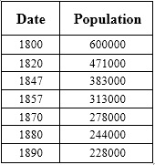
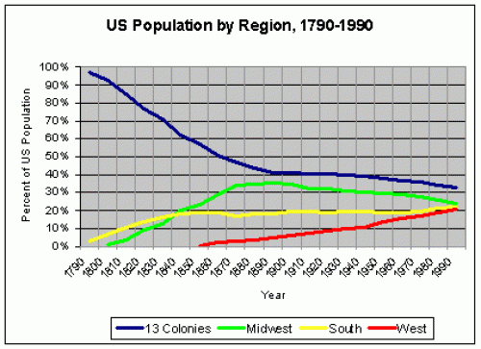
Western Expansionism

Slide 22
Essential Question: How did rapid mechanization in industrial and agriculture American society transform the United States and bring it into the modern age?
Students Can:
Discern how westward expansion impacted Native Americans
Evaluate how the economy of the west was transformed by the rise of industrialization
Demonstrate how American government displayed a plutocracy during the Gilded Age
Agenda
The Turner Thesis
Home on the Range
A Safety Valve Test
Homework
Historic Parallelism due Wednesday (Natives, Immigrants, and Freedmen)
Gilded Age Quiz: Friday 2/9

Slide 23
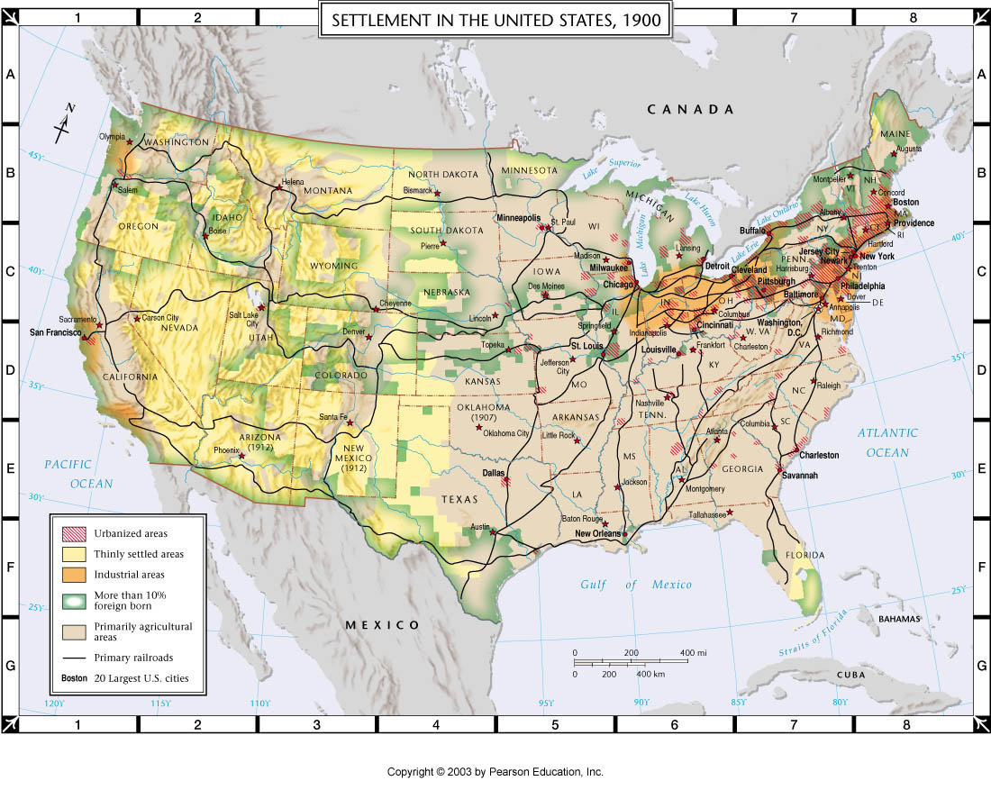
The Turner Thesis
"The existence of an area of free land, its continuous recession, and the advance of American settlement, explain American development. . . So long as free land exists, the opportunity for a competency exists, and economic power secures political power.” - Fredrick Jackson Turner, “Frontier Thesis” 1893

Slide 24
Essential Questions
1. What factors shaped the economic and social development of the West beyond the Mississippi?
► rugged individualism,
► the natural environment,
► market forces,
► the federal government,
► other cultures
2. For whom and to what extent was the American West a land of opportunity from 1865 to 1900?

Slide 25
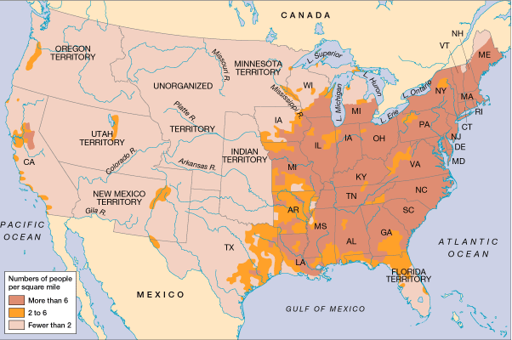
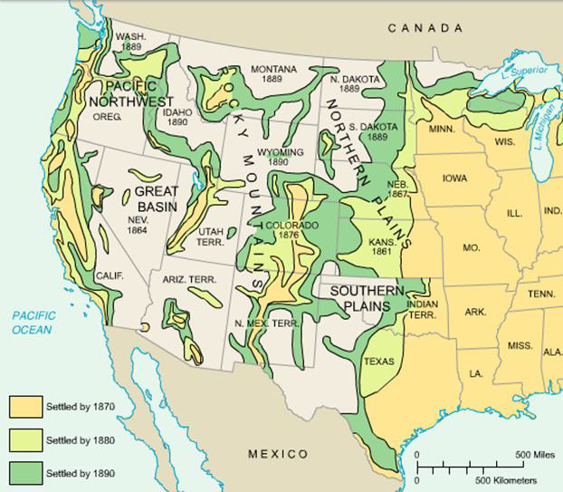
The “West” ►Changing meanings of “THE WEST” ►“Great American Desert”
U.S. Population and Settlement, 1850
U.S. Population Change from 1870 - 1890

Slide 26
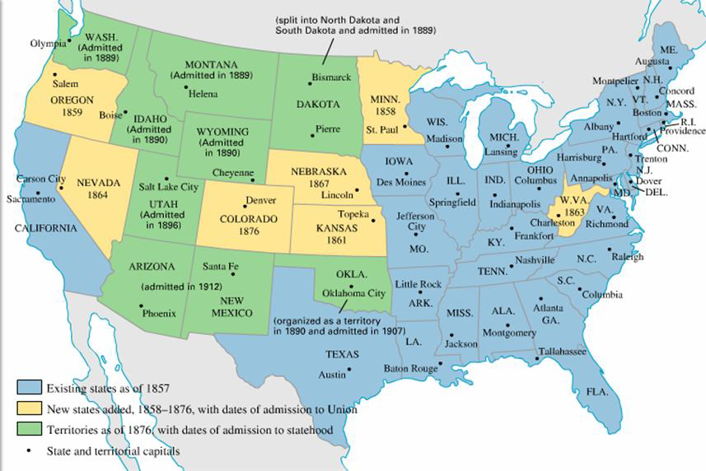
The United State 1857-1912

Slide 27
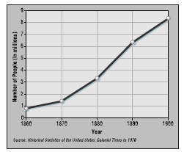
Population Growth of the West 1860-1900

Slide 28
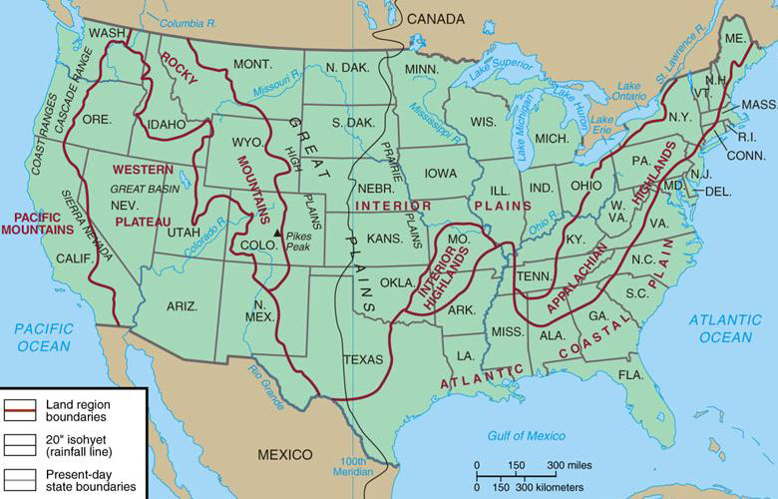
The United State 1857-1912
A variety of cultures coming from many
directions shaped the West
►Europeans
►Indians
►Hispanic
Tejanos
Californios
►Asian
“Coolies”
“tongs”
Chinese Exclusion Act

Slide 29
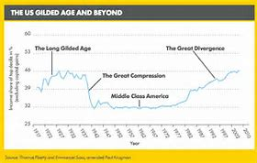
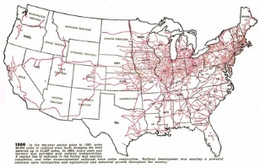
The American Dream
The West was the safety valve for the American dream
Factors:
Government intervention: Homestead Act 1862, Morrill Land Grant Act, Transcontinental RR
Technology: steel plow, dry farming, wind mill
Industrialism: need for raw materials and new markets
Immigration

Slide 30
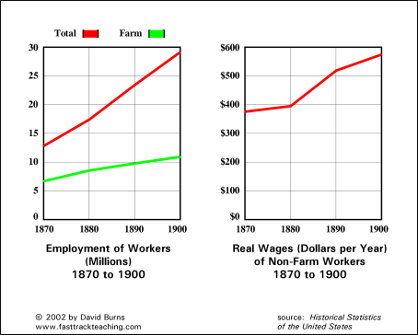
American West Economic Power
West - Provides raw materials (food, mineral wealth, some corporate influence – Armour & Co. Meat Packing Chicago)
East – Manufacturing finish goods, banking, railroads

Slide 31
The Safety Valve
To what extent did the West, during the Gilded Age, provide a safety valve for the achieving the American Dream?
Construct a PERSIA Chart to demonstrate your answer
Important note: the west was impacted by a variety of factors, such as market forces, rugged individualism, government intervention, and technology
P
E
R
S
I
A
Side 2
Side 1

Slide 32
The Grange Collection
Briefly explain the point of view of the artist from the perspective of Western farmers. (Cite one specific development from 1865 to 1900 to support your conclusions)

Slide 33
The Changing American Landscape
Describe ONE factor that caused the change in population in the United States from 1860 to 1900.
Explain positive change to either rural or urban landscape, as a result of the population change.
Explain how population change of the United States from 1860 to 1900 led to one of the following conflicts.
The common man vs. industrialists
Culture differences
Power of government

Slide 34
Economics of the West
Miners | Ranchers
Railroads | Farmers
Develop a master chart combining your individual charts.
Create arguments that support or counter the settlers view points.
Include historic content to support your views.

Slide 35
Controlling the West
Provide historic facts that support why the following groups need control in the West
Farmers
Miners
Ranchers
Railroads

Slide 36
MINERS

Slide 37
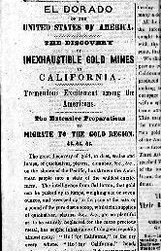
California Gold Rush
►Gold is discovered at Sutter’s Mill in 1848
►Word of the gold strike reaches the rest of the US by late 1848
►In 1849, over 80,000 Americans flock to the gold fields
►San Francisco grows to 50,000 people by 1855

Slide 38
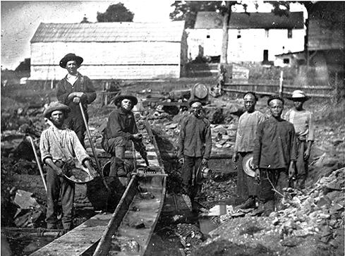
Miners, California, 1852

Slide 39
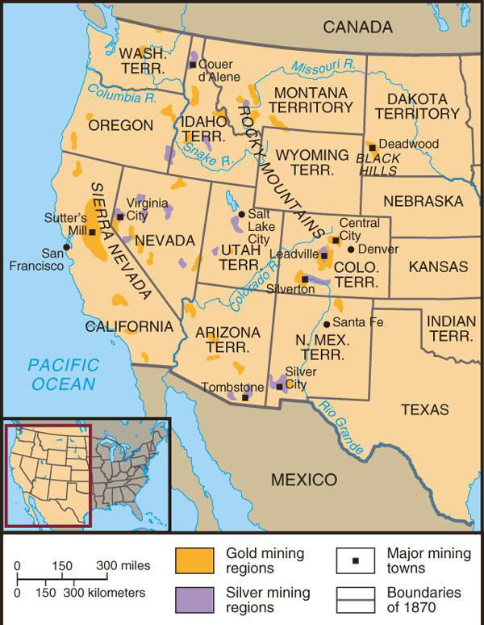
MINERS
►Comstock Load
►Black Hills
►Boomtowns
►Ghost towns
Mining Regions of the West

Slide 40
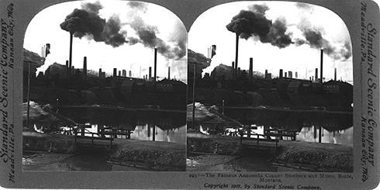
Copper Smelting, Butte, Montana
Individual miners looking to get rich were many of the first settlers
Large mining companies, often based in East, end up dominating mining
Products of Western mining fuel the developing industrial economy

Slide 41
RAILROADS

Slide 42
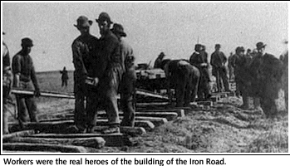
Workers for the Union Pacific

Slide 43
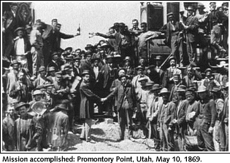
Promentory, 1869: Who is missing?

Slide 44
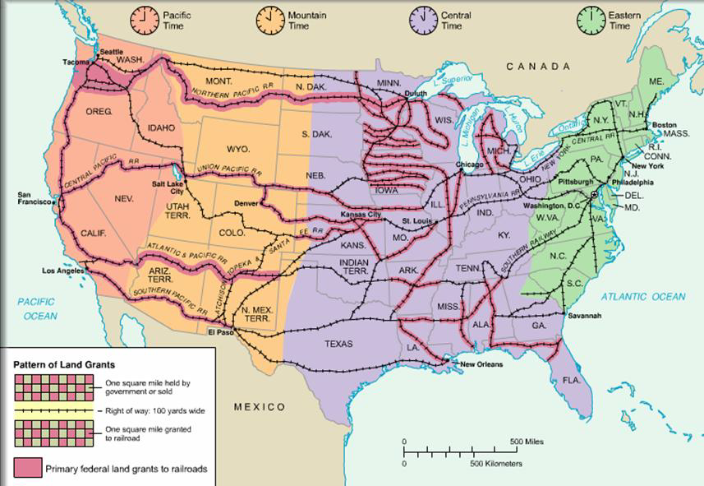
Transcontinental Railroads and Federal Land Grants, 1850-1900

Slide 45
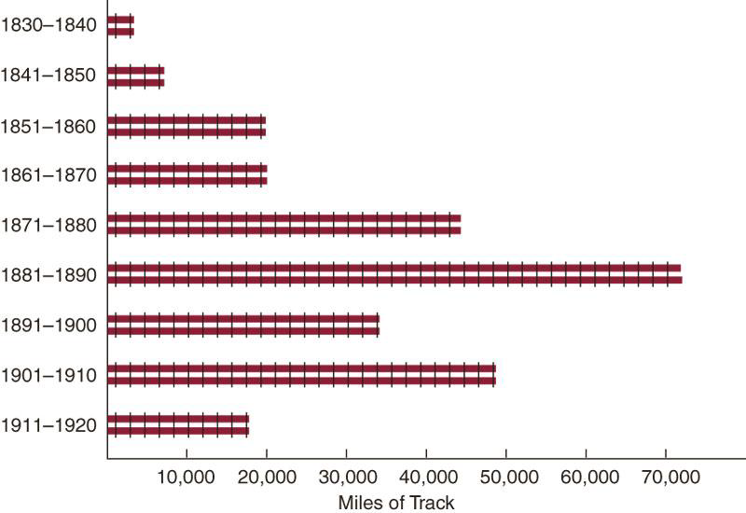
RAILROAD CONSTRUCTION, 1830-1920

Slide 46
Ranchers &
Cowboys

Slide 47
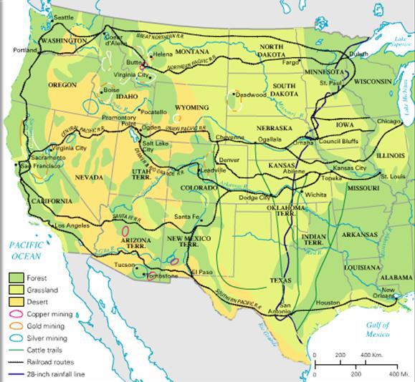
RANCHERS
►“long drives”
►range wars
►barbed wire, Joseph Glidden
►What fuels the development of large-scale cattle ranching?
►Why does the golden age of ranching end? Who ends up dominating the industry?

Slide 48
FARMERS

Slide 49
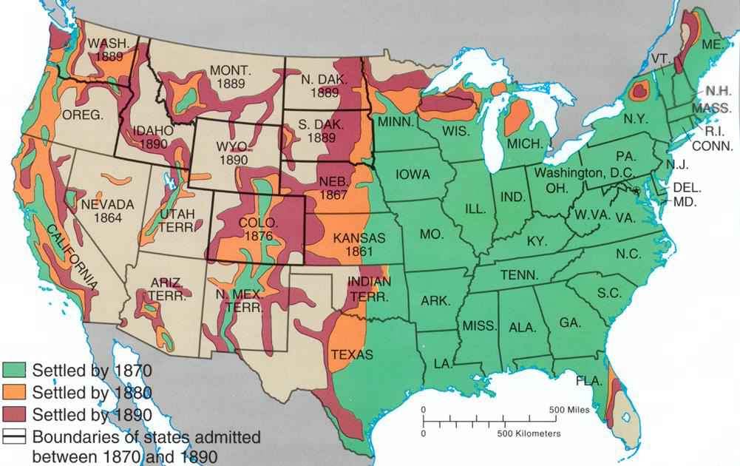
Frontier Settlement 1870-1890

Slide 50
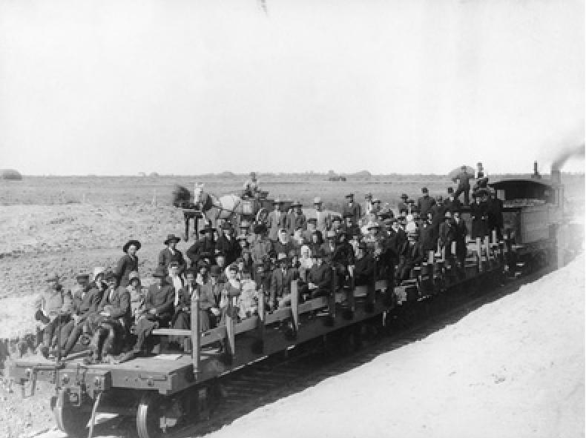
FARMERS
►Homestead Act, 1862 ►Role of railroads
►Morrill Land Grant Act , 1862 ►Sodbusters
Kansas emigrants
Kansas Collection, University of Kansas Libraries

Slide 51
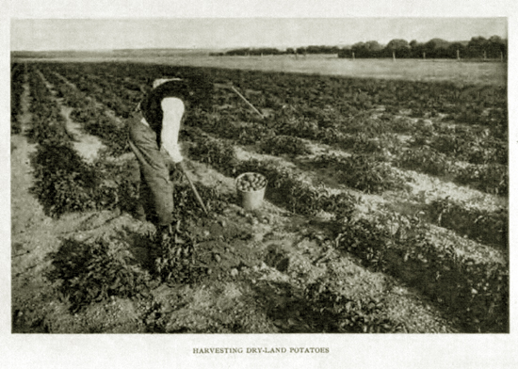
FARMERS
Innovation: dry farming

Slide 52
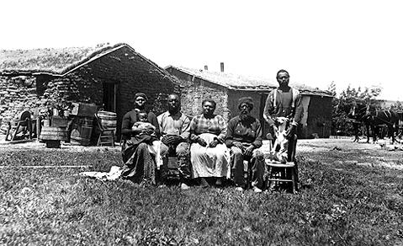
Exodusters, Shores Family, Nebraska, 1887

Slide 53
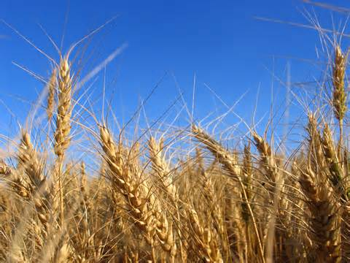
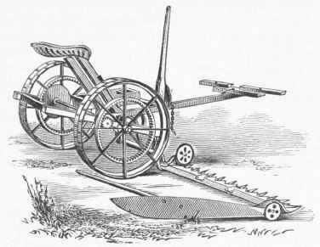
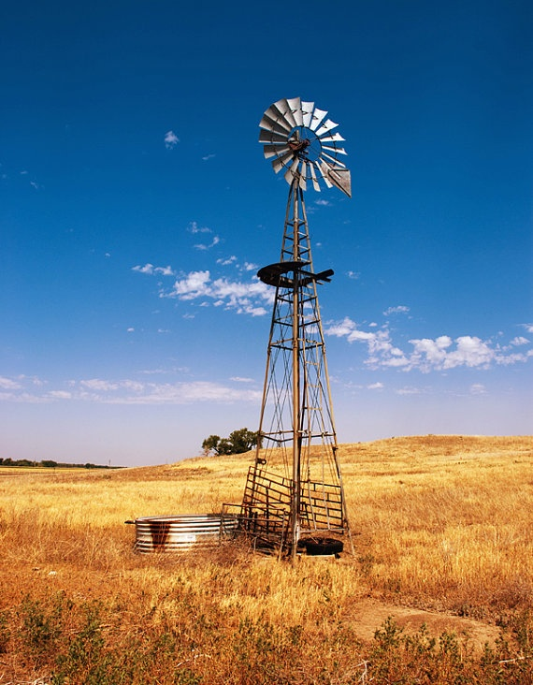
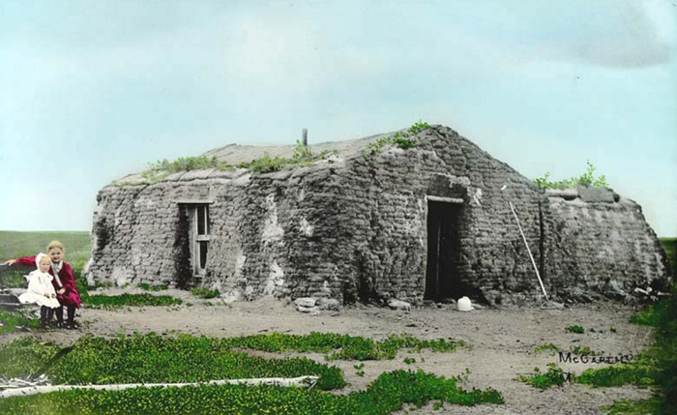
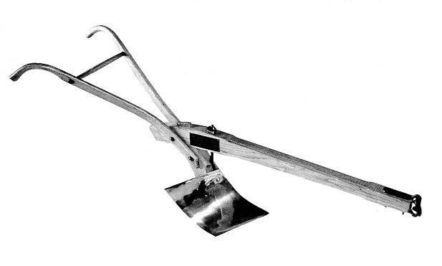
Farmers
Major innovations

Slide 54
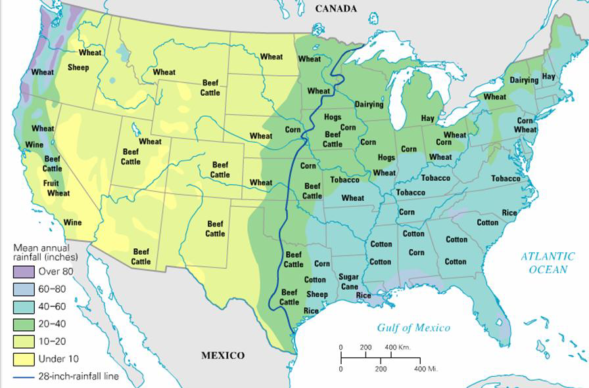
The Farmers’ Complaints
►Weather: drought, blizzards, etc
►Declining crop prices
►Railroad rates / railroad monopolies
►debt
►Money supply
►High tariffs
Who dominates farming
by 1900?
What kind of farms?
Opportunity?
Role of Industrial
market economy?
Agricultural Regions, 1900

Slide 55
Essential Question: How did rapid mechanization in industrial and agriculture American society transform the United States and bring it into the modern age?
Students Can:
Discern how westward expansion impacted Native Americans
Evaluate how the economy of the west was transformed by the rise of industrialization
Demonstrate how American government displayed a plutocracy during the Gilded Age
Agenda
The Cross of Gold Connection
Rise of the Farmers
We Be DBQing
Homework
Read pages 656 – 665 Roots of Progressivism
Gilded Age Quiz: Friday 2/9

Slide 56
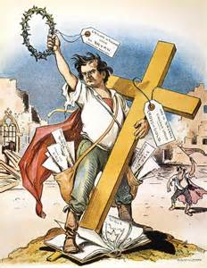
Cross of Gold Speech
“Having behind us the producing masses of this nation and the world, supported by the commercial interests, the laboring interests, and the toilers everywhere, we will answer their demand for a gold standard by saying to them: You shall not press down upon the brow of labor this crown of thorns, you shall not crucify mankind upon a cross of gold.”
- William Jennings Bryan, 1893

Slide 57
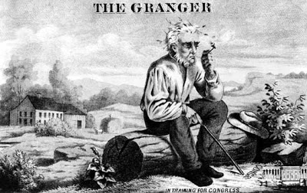
Farmers Organize
Issues: debt, high taxation, the natural environment, & abuse by the railroads
Organizations
Greenback Labor Party (currency)
The Grange 1875: Oliver H. Kelley
Setup farmers co-ops & “Grange Laws”
Wabash v. Pacific Railroad Co.: states
can’t regulate interstate commerce
Interstate Commerce Act 1887 (Interstate
Commerce Commission & RR regulation)
Farmers Alliance 1870:
socialize and push farmers agenda
Excluded: tenant farmers, share croppers,
& farm laborers

Slide 58
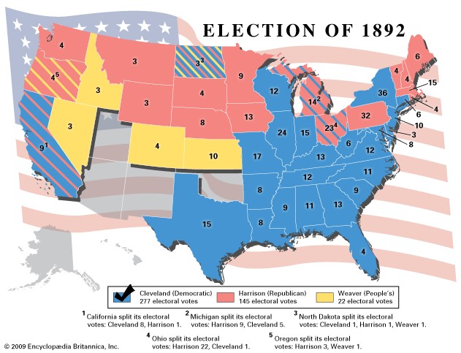
Populists Movement
The People’s Party (Populist) 1891
Omaha platform: coinage of silver, gov. control of the railroads, 8 hour work day, & 17th Amendment
1892 Election – James B. Weaver
Panic of 1893
Farmers struggle to pay debts
Coxey’s Army (paper currency)

Slide 59
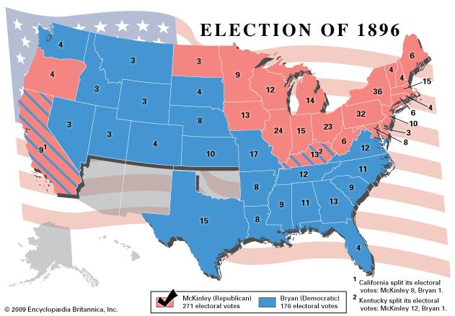
Election of 1896 – Death of the Populists Movement
Democrats unite with
Populist to defeat Rep.
William Jennings Bryan (D)
“Cross of Gold Speech”
William McKinley (R)
Election of 1896 decided:
Gold Standard Act 1900
Dingley Tariff Bill (46.5%)
Panic of 1893 ended in 1897
Death of the Populists

Slide 60
Take it to the D to B to Q
Prompt: In the post–Civil War United States, corporations grew significantly in number, size, and influence. Analyze the impact of big business on the economy and politics and the responses of Americans to these changes. Confine your answer to the period 1870 to 1900.
RULES:
Documents cannot leave the room in away (No pictures, etc.)
You must use 7 out of 10 documents
You must have HIPP for 4 out of 7 documents

Slide 61
Take it to the D to B to Q
Prompt: In the post–Civil War United States, corporations grew significantly in number, size, and influence. Analyze the impact of big business on the economy and politics and the responses of Americans to these changes. Confine your answer to the period 1870 to 1900.
Step 1: Question simplification
Step 2: Document analysis:
Identify main idea
Identify prior knowledge (facts in & implied by the docs.)
Identify POV and purpose

Slide 62
The Grange Collection
Briefly explain the point of view of the artist from the perspective of Western farmers or Northern Industrialist. (Cite one specific development from 1865 to 1900 to support your conclusions)

Slide 63
Period 6: 1865 – 1898 - The transformation of the United States from an agricultural to an increasingly industrialized and urbanized society brought about significant economic, political, diplomatic, social, environmental, and cultural changes.
Key Concept 6.1: Technological advances, large scale production methods, and the opening of new markets encouraged the rise of industrial capitalism in the United States
Key Concept 6.2: The migration that accompanied industrialization transformed both urban and rural areas of the United States and caused dramatic social and cultural change
Key Concept 6.3: The Gilded Age produced new cultural and intellectual movements, public reform effort, and political debates over economic and social policies
Essential Question: How did rapid mechanization in industrial and agriculture American society transform the United States and bring it into the modern age?
Students Can:
Evaluate the impact of western expansionism in altering the American west
Discern contributing factors for the growth of laissez faire capitalism and its impact on the West
Agenda
The Populists
Controlling the West Discussion
Homework
Prompt break down and plan

Slide 64
How the West was Won?
Discussion questions: evaluate the conflict that westward expansion created during the latter part of the 19th center.
Meet as group; settlers, Native Americans, and industrialists. Formulate arguments that promote your interests.
Divided into groups of three (1 settler, 1 Native American, and 1 industrialist)
Discuss the following and reach consensus based on factual content
Who should control the west because it is moral right and proper?
Who should control the west because it is in the best interest for the welfare of the United States?
Explain who are the real winners and losers in the west?

Slide 65
__ 1. Why have many historians labeled the period following the Civil War until the turn of the century the Gilded Age?
Most Americans saw a rise in the standard of living and greater prosperity
The idea of equality becomes an achievable goal during this time period
While the U.S. saw great prosperity many American’s lived in poverty and were taken advantage of by industrialization
Labor unions were able to achieve improved working conditions, such as the eight hour work day
America had survived a major internal conflict and look forward to the rebirth of Democracy

Slide 66
__ 2. How did Tammany Hall reflect the late 19th century?
By supporting the farmers and their need for greater protection by the federal government
By encouraging the creation the Civil Service reform in government
Corrupt politics that encourage the use of the patronage and graft
American nativism attitudes to increased immigration
The growth of corporate interest in politics

Slide 67
__ 3. How did corporations avoid state regulation of their activities?
The utilize the 14th Amendment to gain rights of a person
The had the courts interpret the Sherman Anti-trust Act to protect interstate commerce
They supported political machines, such as Tammany Hall
They created vertical and horizontal integration
They were granted special status in Pollack v. The Farmers Trust & Loan decision

Slide 68
__ 4. Which piece of legislation dramatically altered the live of nomadic Plains Indian tribes, such as the Sioux and the Navajo?
Homestead Act
Interstate Commerce Act
Pacific Railways Act
Morrill Land Grant Act
Dawes Severalty Act

Slide 69
__ 5. Labor unions, Populists, and debtors saw in the brutual Pullman episode _________________.
Proof of an alliance between big business and the federal government
A strategy by which united working class action could succeed
The need for a socialist party in the United States
The potential of the federal government as a counterweight to big business
The crucial role of middle class public opinion in labor conflicts

Slide 70
THE MYTH
THE MYTH

Slide 71
Essential Question
4.“Popular fascination with the cowboy, the pioneer, and the stories of Horatio Alger in the period 1870-1915 reflected Americans’ uneasiness over the transition from an agrarian to an industrial society.”
Assess the validity of this statement.

Slide 72
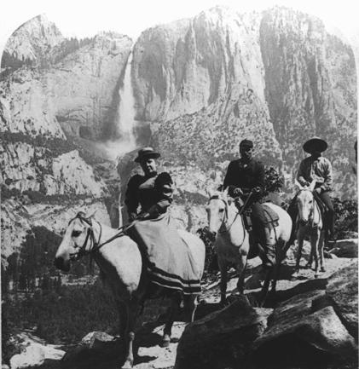
Turn of the
Century tourist
At
Yosemite

Slide 73
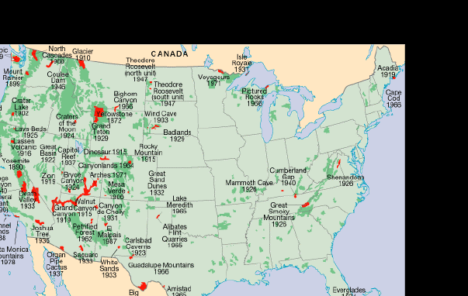
Establishment of National Parks & Forest

Slide 74
MYTHS &MEANINGS OF THE WEST
Buffalo Bill Cody and Sitting Bull, 1884
►Buffalo Bill’s Wild West Show
►Helen Hunt Jackson
►Frederick Jackson Turner
Buffalo Bill & Sitting Bull

Slide 75
Fredrick Jackson Turner “Frontier Thesis”
“The existence of an
area of free land, its
continuous recession
and the advance of
settlement westward,
explain American
Development.”
Why was this a new
interpretation at the time?
How accurate is it?

