Slide 1
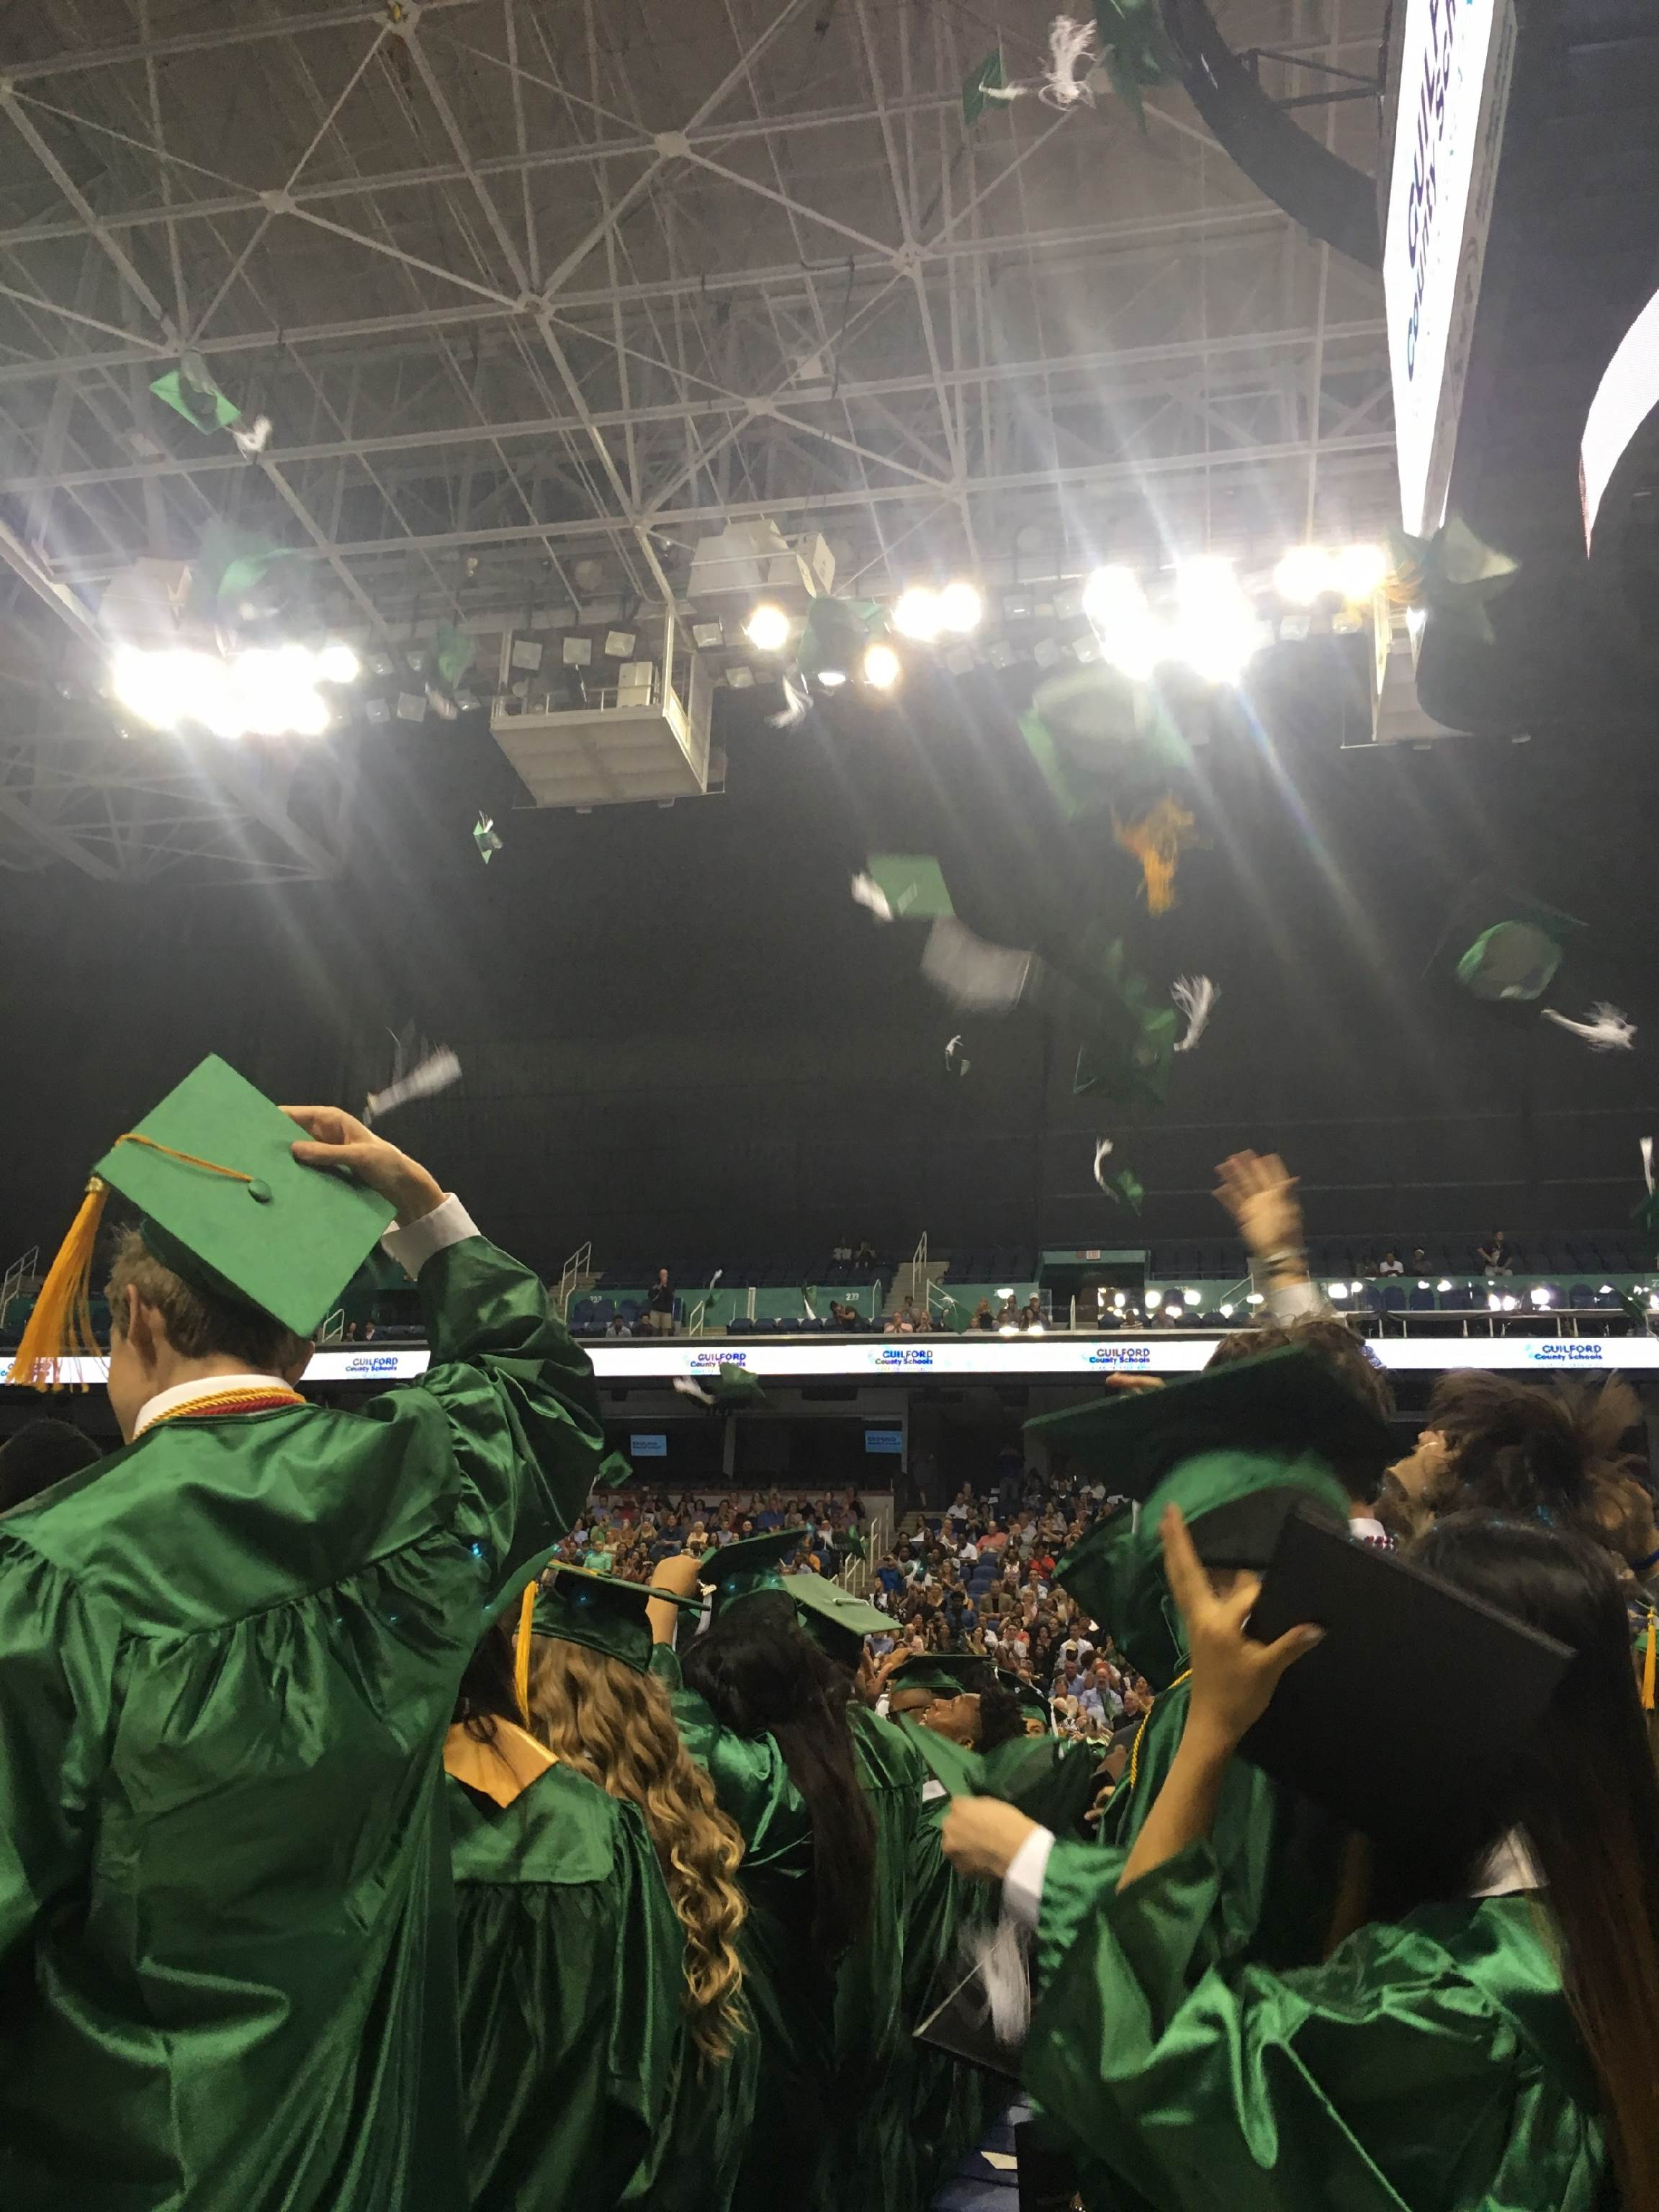
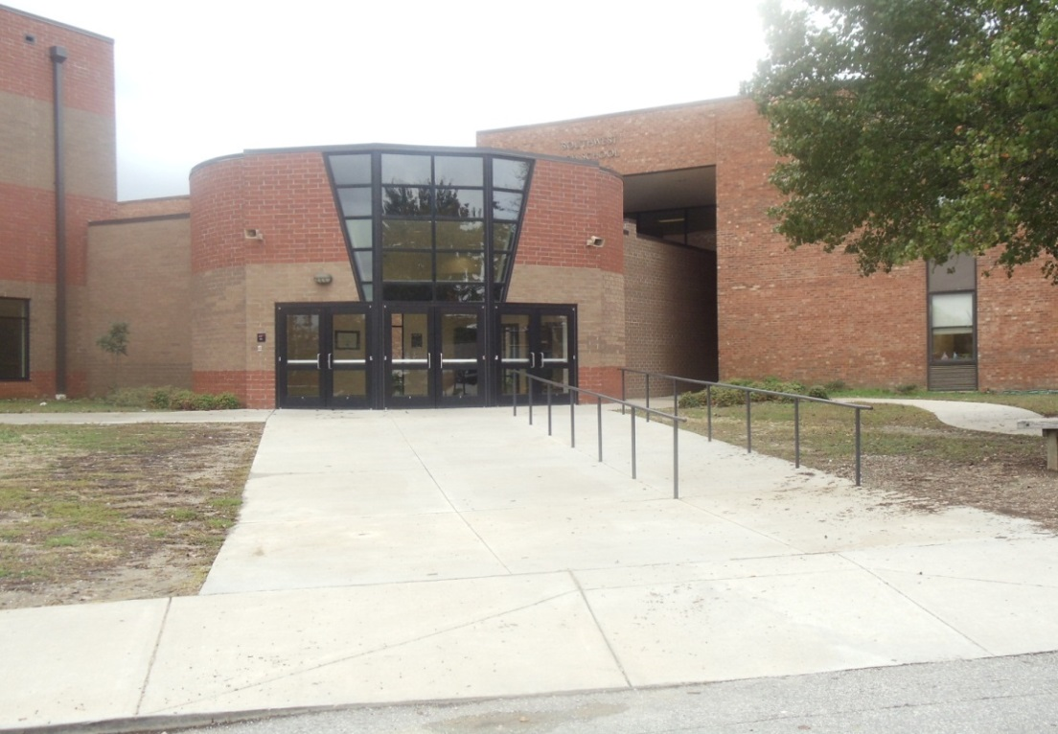
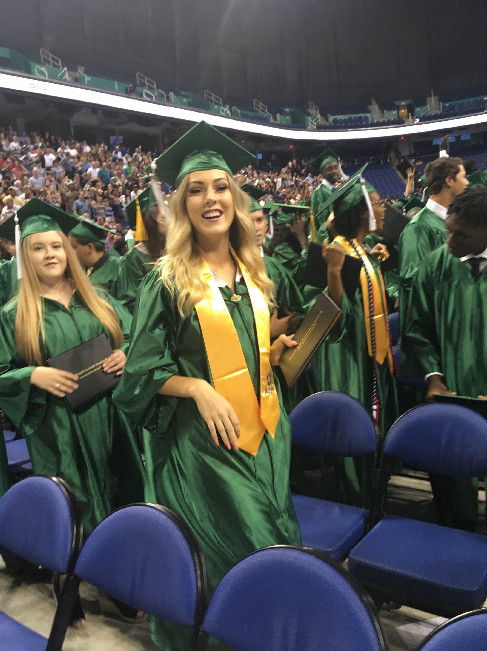
Rising 9th Grade Information Welcome to the Ranch! Class of 2029!!
FOR THE GRADUATING CLASS OF 2022!
Southwest Guilford High School

Slide 2
Some Differences between
Middle School and High School
Absences and tardies count against you (per period)
CP (aka Regular), Honors, and AP level classes
Classes = Credits
You have to pass your classes to move up grade levels
GPA is important (For an A > AP = 5.0, Honors = 4.5, CP = 4.0)
4 classes 1st semester and 4 NEW classes 2nd semester
You will have students in other grade levels in your classes
No teaming – all classes are separate
You can get ISS per period – called Restoration Station (RS)
A lot more course options to choose from
Possibilities for college credit (AP, CCP, and GAP)
EOC’s instead of EOG’s (Plus the ACT and SAT)
Numerous extracurricular activities (sports, clubs, etc.)
Notes:
EOC’s:
Math 1
Biology
English 2
Math 3

Slide 3
Southwest is a block schedule school – there are four classes first semester and four different classes second semester for a total of eight classes a year.
Each class passed = 1 credit
Promotion Requirements Students will be required to meet current promotion requirements as determined by board policy:
High Schools 9–12 Block Schedule for Incoming Freshmen:
• 10th Grade – 5 credits
• 11th Grades – 10 credits
• 12th Grades – 15 credits
Students need to earn at least 5 out of 8 credits to be promoted from 9th to 10th grade!
Graduation – A minimum of 22 credits and successful completion of any other state standards must be earned, according to School Board Policy IHF.

Slide 4
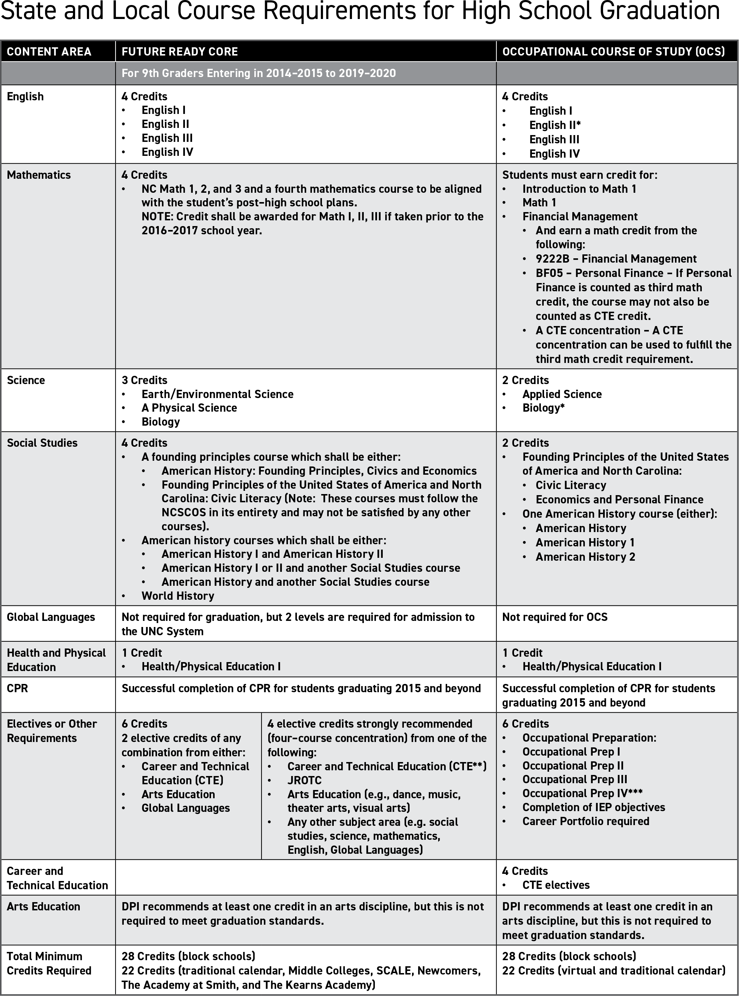
22 Credits are needed to graduate on a block schedule.

Slide 5
Future Ready Core: Graduation Requirements
The Core (Classes required for graduation)
4 credits of English (English I, II, III, IV)
4 credits of Mathematics (Math 1, Math 2, Math 3, and one additional Math)
4 credits of Social Studies (Founding Principles of the USA & NC Civic Literacy or AP Government, World History or AP World History, American History or AP US History, and Economics and Personal Finance)
3 credits of Science (Earth/Environmental, Biology, and 1 physical science)
1 credit of Physical Education/Health 1 including CPR TRAINING
(16 required core credits)

Slide 6
Future Ready Core: Graduation Requirements
22 Credits to Graduate – 16 Required Courses =
6 Additional Elective Credits
2 credits from a World Language, Computer Programming, or additional core classes.
*Most Universities still require/recommend these two credits be in World Language.
4 credit Concentration in one Career Cluster or Arts Program *(Recommended)
Students (at block schools) have room for up to 16 electives credits with up to 32 credits (or more) total.
Students need a minimum of 22 credits to graduate!

Slide 7
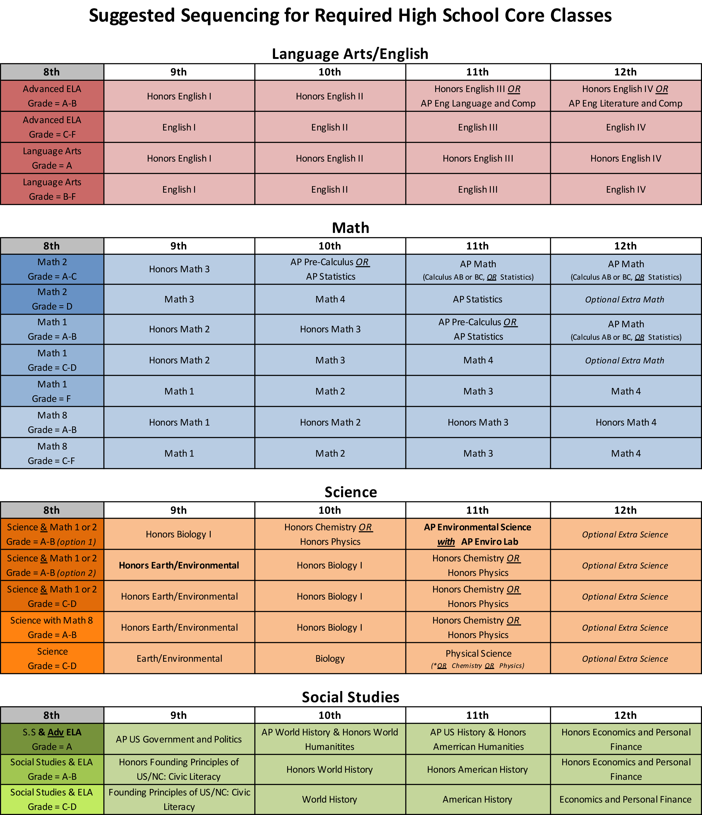
Core Courses Common Sequences

Slide 8
GCS High School Registration Book
Available online through GCSNC.com
It has descriptions of all GCS courses listed
You need to utilize this book when selecting your classes for next year so that you are well informed of the course content and prerequisites.
You can also review information about credits, graduation requirements, special GCS programs, and more.

Slide 9
Career Clusters –
CTE Concentrations
GCS offers 15 of the 16 National Career Clusters, and SW has 11
1. Agriculture, Food, & Natural Resources
2. Architecture & Construction
3. Arts, A/V Technology, & Communications
4. Business Management & Administration
5. Education & Training
6. Finance
7. Government & Public Administration
8. Health Science
9. Hospitality & Tourism
10. Human Services
11. Information Technology
12. Law, Public Safety, Corrections, & Security
13. Manufacturing
14. Marketing
15. Science, Technology, Engineering, & Mathematics
16. Transportation, Distribution, & Logistics

Slide 10
AP Class Offerings
AP AFRICAN AMERICAN HISTORY
AP BIOLOGY (Full year)
AP CALCULUS AB (Full year)
AP COMPARATIVE GOVERNMENT AND POLITICS
AP COMPUTER SCIENCE
AP COMPUTER SCIENCE PRINCIPLES
AP ENGLISH LANG AND COMPOSITION (Full year)
AP ENGLISH LIT AND COMPOSITION (Full year)
AP ENVIRONMENTAL SCIENCE (Full year)
AP EUROPEAN HISTORY
AP HUMAN GEOGRAPHY
AP LATIN
AP PRE-CALCULUS
AP PSYCHOLOGY
AP SPANISH LANGUAGE
AP STATISTICS
AP STUDIO ART: DRAWING
AP UNITED STATES HISTORY (Full year)
AP US GOVERNMENT AND POLITICS
AP WORLD HISTORY (Full year)
Notes:
AP African American History will be a new official AP course.
AP Seminar will be new to Southwest.
Freshmen are only allowed to take Human Geography and Government & Politics, maybe also Seminar

Slide 11
Freshman Elective courses typically offered at SWHS Freshman Focus (first semester) and PE/Health are Required for all freshman
CTE ELECTIVES
Accounting I Honors
Business Essentials Honors
Entrepreneurship I Honors
Marketing
Sport and Event Marketing 1
Microsoft Excel Honors
Drafting 1
Engineering Technology 1 (prefer you have Math 1 first)
Computer Science 1 Honors
Child Development
Digital Design & Animation 1
Adobe Visual Design
Interior Design Fundamentals
WORLD LANGUAGES
Latin 1
French 1
Spanish 1 (or Spanish 2, if level 1 was completed in middle school)
CULTURAL ARTS (you may double up & take these year-round)
Chorus (Beginning, Intermediate, or Honors)
Theater Arts (Beginning)
Visual Arts 1 (Beginning)
Band (Must be currently enrolled at Middle School)
Orchestra (Must be currently enrolled at Middle School)
Jazz Band
Piano
Dance
ACADEMIC ELECTIVES
Speech/Debate Honors
Creative Writing 1
Intro to Social Justice & Racial Equality
African American History Honors
Journalism Newspaper
ADVANCED PLACEMENT LEVEL
AP Human Geography

Slide 12
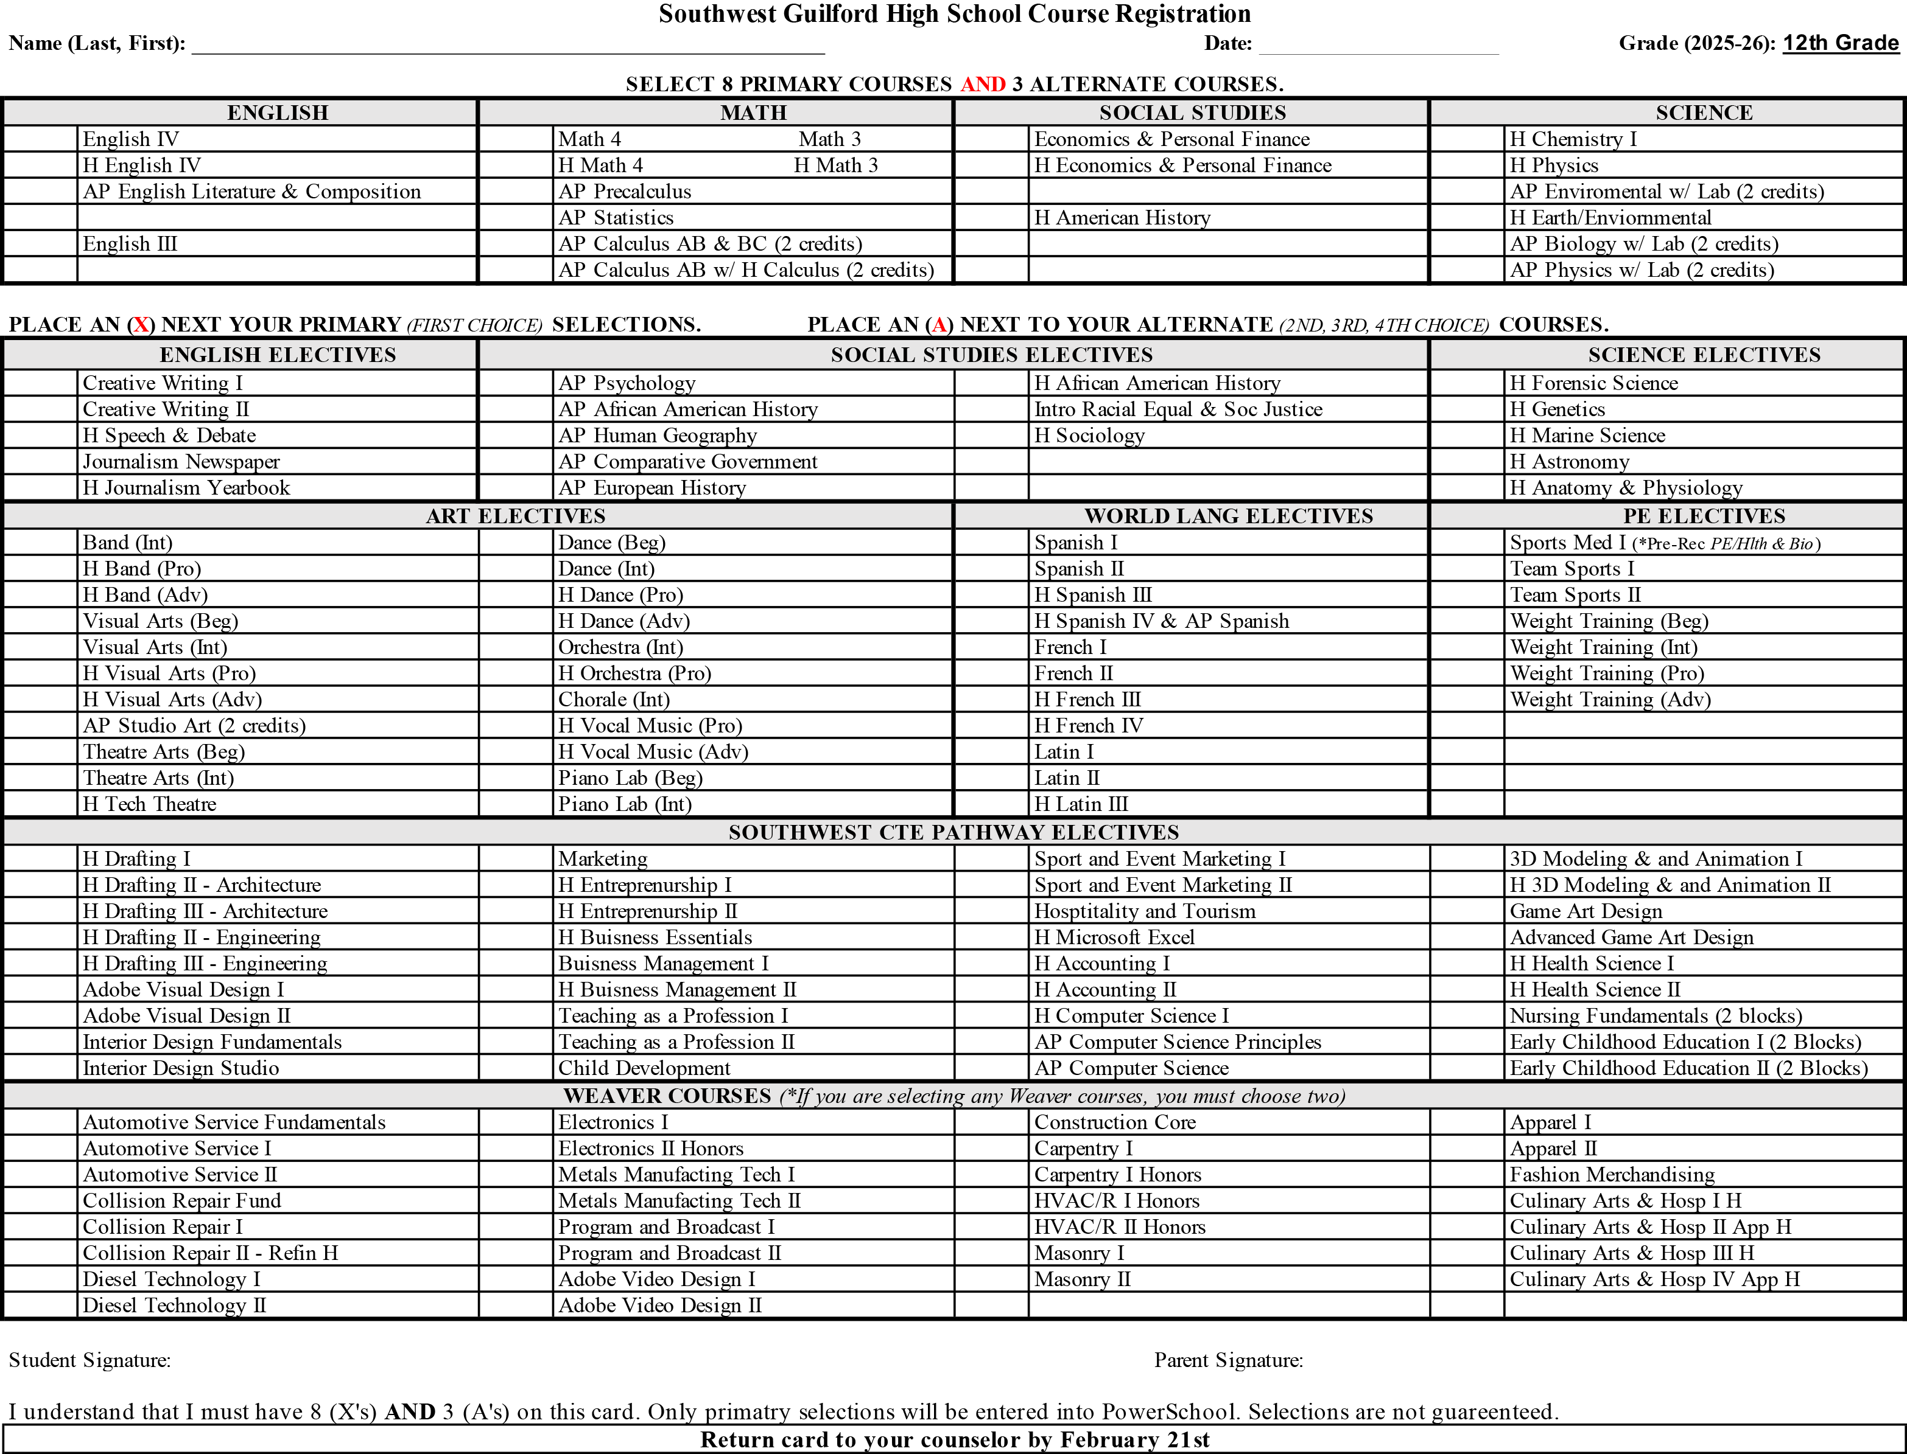
Notes:
CTE offers a variety of courses that are pathways to jobs/careers right out of high school. Students should definitely look at what all the CTE department has to offer!
When Discussing the CTE Department Options, Mention Game Art Design and how this course is a first step in the development of video games.
Drafting is the first step to becoming an engineer, architect, or builder. We offer CERTIFICATION credentials in AutoCAD and Revit.
Digital Design and Animation is a course in which students learn how to create 3D digital assets like those used in video games and film. In Game Design students use Unreal Engine to create games. The courses we offer are Digital Design and Animation (DDA) I and II. DDAII focuses exclusively on 3D Modeling and Animation. We also offer Game Art and Design and Advanced Game Art and Design. Students interested in Game Design must take DDAI first.
Child Development is a prerequisite course to Early Childhood Education

Slide 13
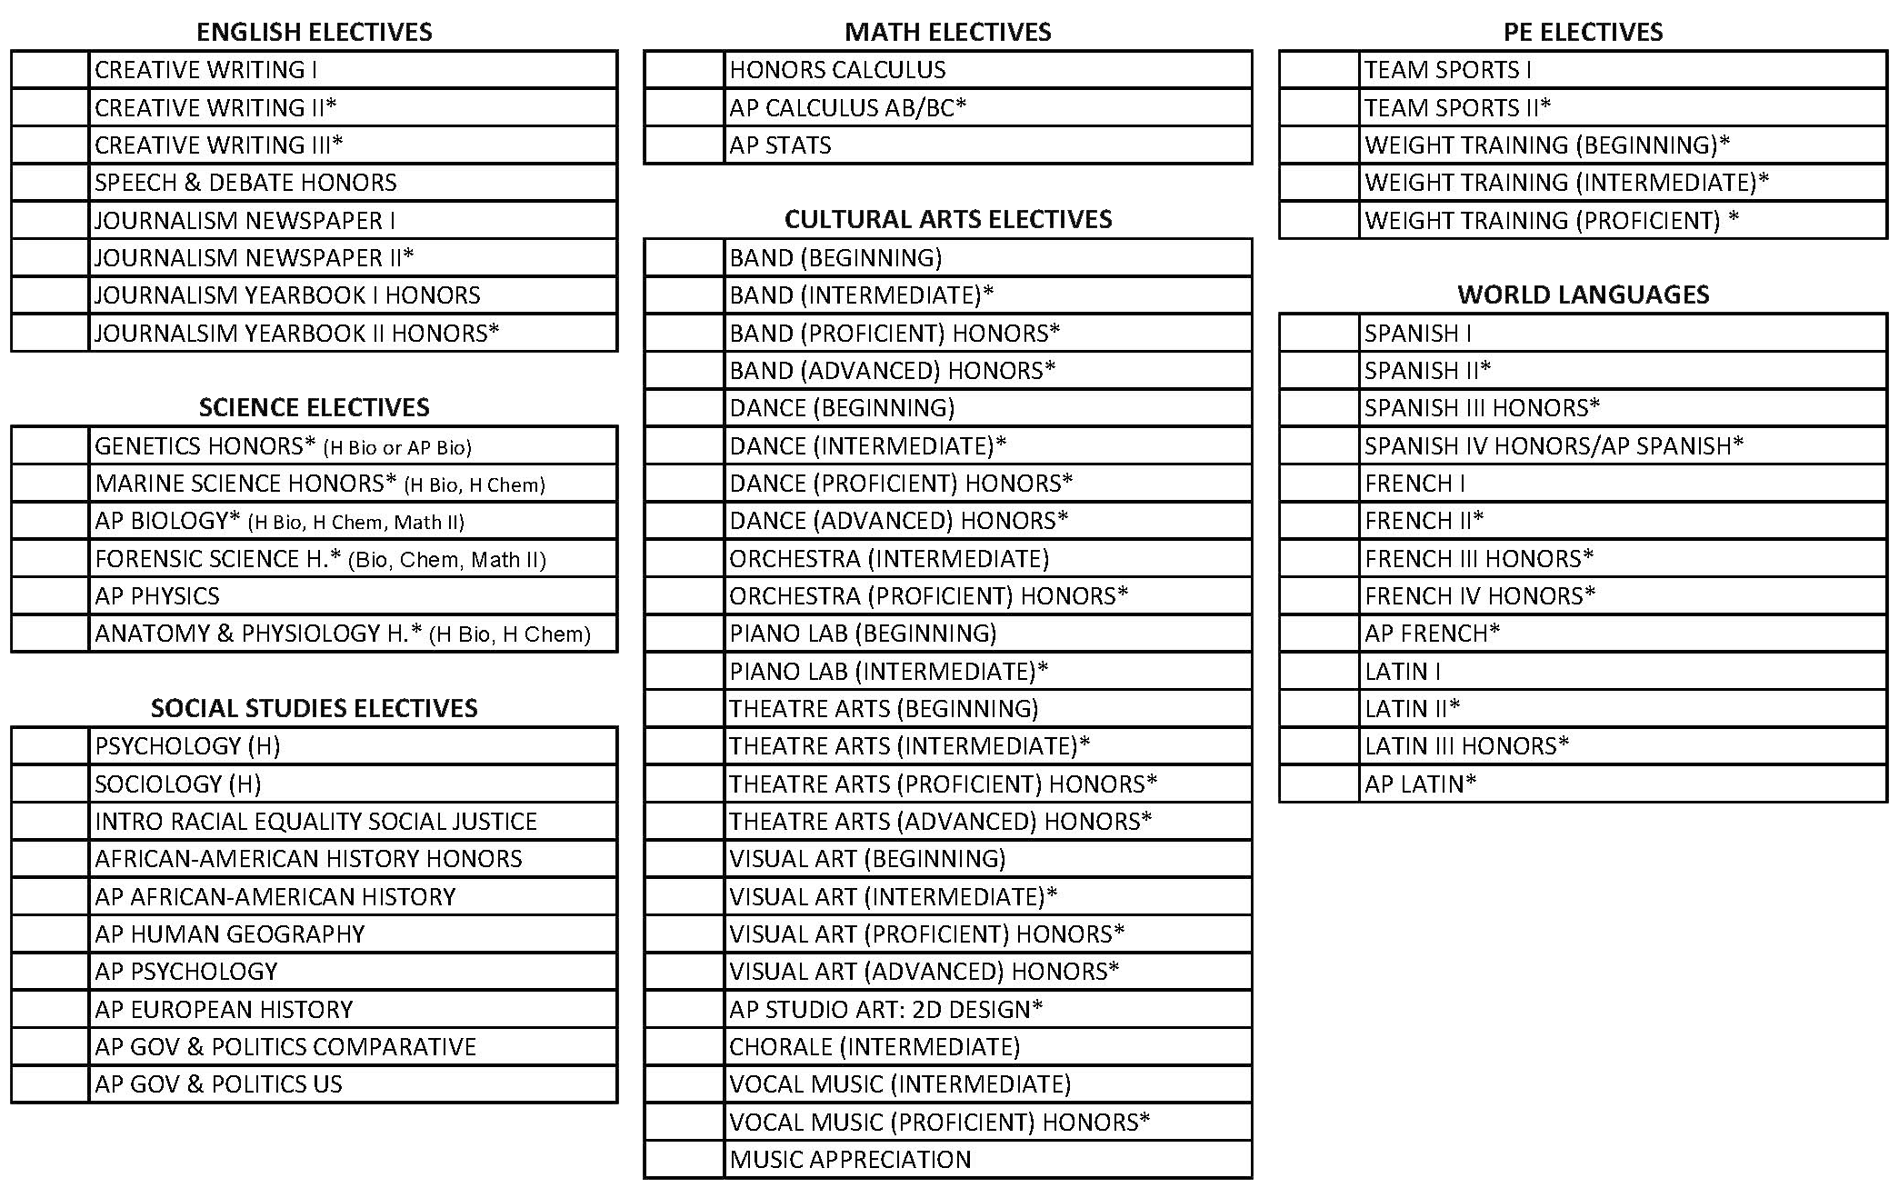

Slide 14
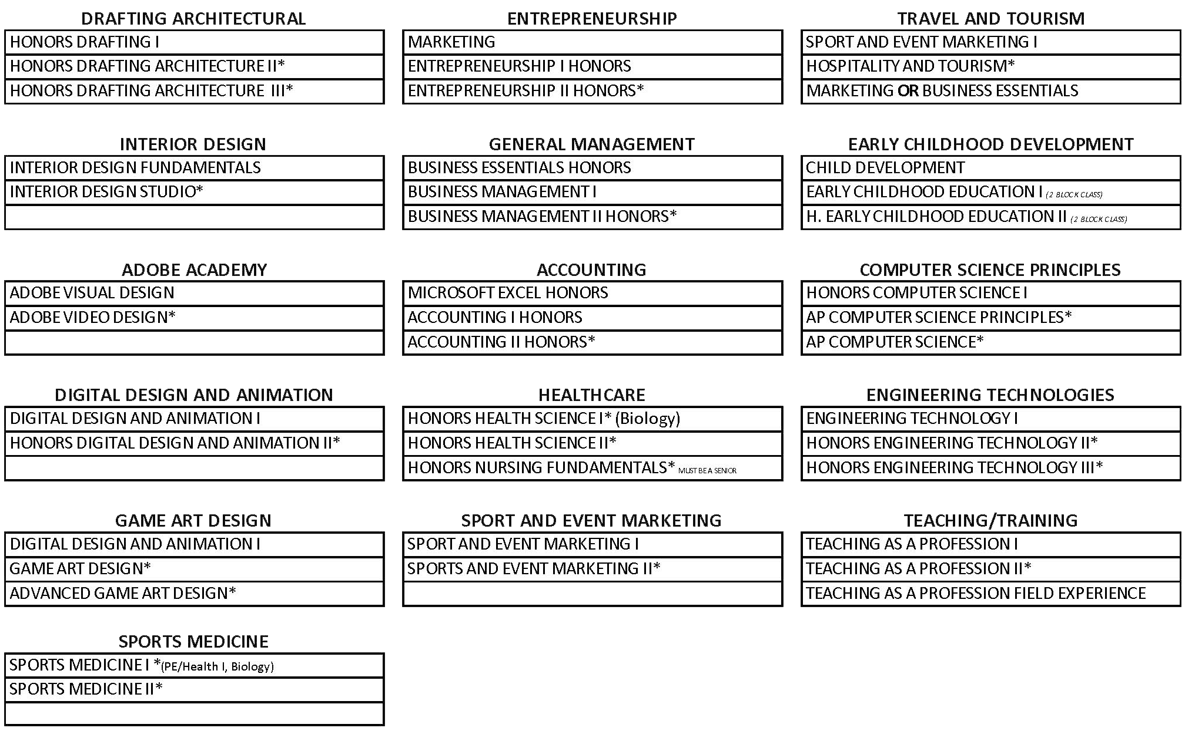
Notes:
CTE offers a variety of courses that are pathways to jobs/careers right out of high school. Students should definitely look at what all the CTE department has to offer!
When Discussing the CTE Department Options, Mention Game Art Design and how this course is a first step in the development of video games.
Drafting is the first step to becoming an engineer, architect, or builder. We offer CERTIFICATION credentials in AutoCAD and Revit.
Digital Design and Animation is a course in which students learn how to create 3D digital assets like those used in video games and film. In Game Design students use Unreal Engine to create games. The courses we offer are Digital Design and Animation (DDA) I and II. DDAII focuses exclusively on 3D Modeling and Animation. We also offer Game Art and Design and Advanced Game Art and Design. Students interested in Game Design must take DDAI first.
Child Development is a prerequisite course to Early Childhood Education

Slide 15
SAMPLE SCHEDULE
First Semester (Fall)
Block 1 – English 1
Block 2 – Drafting 1
Block 3 – PE/Health
(Lunch determined by 3rd block class)
Block 4 – Earth Science Honors
Second Semester (Spring)
Block 1 – Civics Honors
Block 2 – Chorus
Block 3 – Math 1
(Lunch determined by 3rd block class)
Block 4 – Digital Design & Animation
Classes are each 90 minutes long
We try to balance schedules with 2 core classes and 2 electives each semester

Slide 16
(Current) Daily Schedule at SWHS

Slide 17
Mr. Schnaith-Ivan will review each students’ course selection as well as their subsequent schedule (created in July) to ensure students have eight classes and are on the correct sequence for each subject, making changes as needed.
Scheduling occurs over the summer and is done initially by the computer with a focus on core/academic classes first and then electives. This means a student might not always get their very first choice of electives due to availability and popularity.
Please also be aware that the timing and/or availability of courses as well as what teachers are teaching each period may change as it is necessary to constantly balance classes – especially for second semester. Course change requests are possible once the semester begins, but only to ask to swap elective classes.

Slide 18
You will register yourself for classes in the PowerSchool Portal
February 14-23 for student entry, and Counselors have until March 28th to make any adjustments.
Talk at home and with current teachers when making class choices. Online registration can be accessed from home.
Mrs. Martin will work with students to help them select and/or review their course choices in PowerSchool.
You need to be honest with yourself and know your own work ethic! Challenge yourself, but don’t overdo it.
Be sure you have the correct prerequisites before selecting a class. (*Math and Spanish)
Be sure to sign up for what you want (or someone else will get to pick for you).
You are submitting your course preferences, but not all course selections can be honored due to numbers and availability.

Slide 19
Attendance is Vital Big change from Middle School
You have only 90-Days in each class! Be at school!!
Attendance and tardies are recorded each period/block.
More than 3 absences during a grading period will greatly impact your grades in a negative way!
If you must be absent…
To excuse your absence, you must bring a note to Ms. Taylor in attendance OR email her at taylora13@gcsnc.com
Communicate via email to teachers when you are (going to be) absent and work on assignments through CANVAS while absent.
Please do NOT schedule family vacations or trips out of the country when school is in session and especially at the end of the semesters when testing is not being conducted.
Notes:
Here are the unexcused tardies/absences:
Missed Bus (not late bus)
Traffic (Unless advised by Administration that there was an accident in the area)
Car Trouble
Oversleeping
Family Event
Family Issue
Personal Issue
Not having a note at all
Excused would be:
Dr’s Note
Dentist/Orthodontist Notes
DMV
Funeral/Death in Family
Out of town/Vacation
College Visit
School activity
Court
Illness/Injury
Volunteering

Slide 20
More Information
For more information for you and your parents, come to the Family Night on Thursday, February 13th, at Southwest High School from 6:00-8:00pm.
You will get the chance to speak with teachers and coaches to learn more about the great opportunities at SWGHS.
We’ll see you at the High School soon, where you’ll get the chance to tour the school, talk to some students, and hear some more about what makes your future school so great. We look forward to having you join us.

Slide 21
OTHER OPTIONS

Slide 22
All available courses in Power School during registration.
Students need to choose at least 2 courses in Power School if they are interested in attending Weaver Academy.
Students who are selected will take two classes at Weaver AND two classes at Southwest each day.
You do not have the choice as to morning or afternoon, it is based on the classes you get.
Transportation will be available between home, Weaver, and Southwest.

Slide 23
Career and College Promise Dual enrollment with GTCC Junior and Senior Year
Must have a 2.8 cumulative unweighted GPA minimum
Take classes at GTCC while taking classes at Southwest
Forms and information are available on the Southwest High School Counseling Website under Registration
Passing the class with a C or higher earns students high school and college credit for the course, and is recognized by all NC University system schools.

Slide 24
Get paid for time spent in class. Apprentices are able to earn money on the job as soon as they start the apprenticeship program while also taking college classes at no cost.
Get paid for 8,000 hours of one-the-job and classroom training during the 4-year program
Earn an Associate of Applied Science (AAS) from Guilford Technical Community College with free tuition, books, and fees
Have the option after apprenticeship graduation to transfer degree credits to most state four-year universities in order to earn a bachelor’s degree
Obtain specialized certification and experience that is recognized and sought by employers
Student Apprenticeship Requirements
Minimum unweighted GPA of 2.5 – 2.8
Must be a high school junior or senior to apply
Math 1, Math 2, and Math 3
Good attendance (No more than 5 absences per year)

Slide 25
High School Athletics
To play sports, students must maintain their eligibility:
Maintain a 2.0 GPA or better (that’s a C average)
Pass at least 3 of 4 classes the previous semester
Not miss more than 13.5 days (54 periods) previous semester
Behave appropriately in school
Have a current sports physical signed by a doctor before being able to participate in work-outs or try-outs
Fall Sports:
*August 1st
Football
Volleyball
Cross-Country
Soccer (Boys’)
Tennis (Girls’)
Golf (Girls’)
Winter Sports:
*End of October
Basketball
Swimming/Diving
Wrestling
‘Indoor’ Track
Spring Sports:
*Mid-February
Track
Baseball
Softball
Lacrosse
Soccer (Girls’)
Tennis (Boys’)
Golf (Boys’)

Slide 26
Clubs at Southwest
Asian Culture Club | Mode
Battle of the Books | Hunt
Beta Club | Davis
Black Cultural Alliance (BCA) | Montgomery
Chess Club | Von Steen
Cowboys that Care | Hunt
Drama Club | Taylor
Environmental Club | Mode
Fellowship of Christian Athletes | Hinson
Fiber Arts Club | Hunt
Fishing Club | Lovett
French Club | Hagler
Game Club | Flynt
GSA | Philpott, VanScoyk
Health Occupations Students of America (HOSA) | Canon, Dusek
Latin Club | Heffner
K Pop | Lee
Minecraft Club | Bakers
Model United Nations | Spillman
Multicultural Club | Montgomery
Muslim Student Association | Wesney
Ping Pong Club | Funderburg
Prom Committee | Culler
SAVE Promise Club | Hunt, Pemberton, Frank
Social Justice Club | Hunt, A. Johnson
Spanish Club | Palma
STARSS | Haith
Student Council | Phillips, Vanscoyk
National Honor Society | Corriher

Slide 27
Southwest Dress Code
Tops
Acceptable: | Prohibited: includes but not limited to
Long & short sleeve shirts/dresses/jackets Collared shirts School spirit shirts T-shirts with school appropriate messaging Hooded and crewneck sweatshirts with school appropriate messaging All tops must cover the entire midsection, front and back, and extend to the waistband Skirts/dresses hemlines must hit at least the top of knees Appropriate coverage must be worn underneath or on top of shirts, tops, and dresses | Tank tops, sleeveless tops, & spaghetti straps Shirts/apparel with offensive slogans or pictures (drugs, alcohol, guns, weapons, gangs, profanity, etc.) Shirts/dresses that expose cleavage & midsection Shirts/clothing that are “see-through” Strapless & sleeveless dresses Cut-off sleeveless shirts

Slide 28
Southwest Dress Code
Bottoms
Acceptable: | Prohibited: includes but not limited to
Pants & shorts must fit properly on the hips and be secured Shorts hemlines must fall to at least fingertip length (front, back, & side) Dress pants, khaki pants, jeans, and athletic style warm-ups or sweatpants Leggings & yoga pants may be worn with a top that covers to at least fingertip length | Undergarments must be covered at all times; no sagging Pants with writing across the backside Pajama pants Holes or shredded areas above the knee that exposes skin or underwear Slits must not extend higher than fingertip length Biker shorts

Slide 29
Southwest Dress Code
Headgear, Footwear and Other Items
Acceptable: | Prohibited: includes but not limited to
Hijabs or other religious headwear Hats, hoods, and toboggans may only be worn outside All students must wear shoes Masks can be plain, patterned, or have school appropriate messaging | Du’rags, sweatbands, or bandanas are never to be worn on campus Earbuds, headphones, and Beats are Not allowed in the hallways Hats, hoods, bonnets, and toboggans may NOT be worn inside the building Bedroom slippers/shoes Masks with offensive slogans or pictures (drugs, alcohol, guns, weapons, gangs, profanity, etc.)

Slide 30
Administrators’ Expectations – Leave middle school behavior behind!
Cell phones must be out of sight in your backpack during class (not just in your pocket)
Ear buds and headphones not only allowed during class
Always be respectful to classmates and other students
Keep hands to self and respect others personal space
Always be compliant and respectful to adults in the building – even if they aren’t your teacher
Follow dress code every day
BE ON TIME for school and for each class
Be where you are supposed to be in the building during the school day
Seek help and assistance from your teachers, Mrs. Robinson, or Mr. Schnaith-Ivan when needed!
Notes:
Keep hands to self / respectful to teachers and others / being in class and not in restrooms or other parts of building / talking to adults when needing assistance / being compliant when redirected and no cell phones during the day and no hoodies!

Slide 31
Contacts
Mrs. Cheryl Robinson
Freshman Academy Principal/Administrator
robinsc@gcsnc.com
Mr. Ryan Schnaith-Ivan
Freshman Academy Counselor
schnair@gcsnc.com
336-819-2973
Mr. Keith Pemberton
School Social Worker
pemberk@gcsnc.com
Coach Brindon Christman
Athletic Director (sports related questions) christb2@gcsnc.com

