Slide 1
U.S. Congress
Unit II – Branches of Government

Slide 2
Focus for today
2.1 Congress: The Senate and the House of Representatives
EQ: How do the institutions of government articulate democracy and interact with various linkage institutions to carry out republicanism?
Students can:
Decipher how the design of Congress carries out the founders’ beliefs about the need for a Constitutional republic.
Assess how democratic the U.S. Congress is as a lawmaking body
Agenda
Building a Bicameral Legislature
Incorporating the Madisonian Model of Government
Dissecting Congressional Design
Homework: Amending a Dysfunctional Legislature

Slide 3
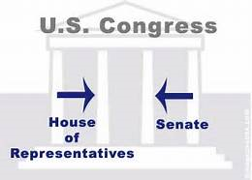
Guiding Questions
How is the Republican form of government impacted by the Madisonian Model, the political landscape, and linkage institutions?

Slide 4
The Madison Republic
“In Republics, the greatest danger is, the majority may not sufficiently respect the rights of the minority”
- James Madison, Federalist 10
Explain three reasons why the founders established U.S. Congress as a bicameral legislature with different methods of representation?
Separation of Powers
Checks & Balances
Republic = Blocking Tyranny of the Mob

Slide 5
The Federalist Argument
The Federalist Argument for the Congress Structure
Under the proposed Constitution, the federal acts will take effect without the necessary intervention of the individual States. They will depend merely on the majority of votes in the federal legislature, and consequently each vote, whether proceeding from a larger or smaller State, or a State more or less wealthy or powerful, will have an equal weight and efficacy: in the same manner as the votes individually given in a State legislature, by the representatives of unequal counties or other districts, have each a precise equality of value and effect; or if there be any difference in the case, it proceeds from the difference in the personal character of the individual representative, rather than from any regard to the extent of the district from which he comes.
- James Madison, Federalist 54
Why did the Founders want representation by population in the House of Representatives?

Slide 6
The Federalist Argument
The Federalist Argument for the Congress Structure
The qualifications proposed for senators, as distinguished from those of representatives, consist in a more advanced age and a longer period of citizenship. A senator must be thirty years of age at least; as a representative must be twenty-five. And the former must have been a citizen nine years; as seven years are required for the latter. The propriety of these distinctions is explained by the nature of the senatorial trust, which, requiring greater extent of information and stability of character, requires at the same time that the senator should have reached a period of life most likely to supply these advantages; and which, participating immediately in transactions with foreign nations, ought to be exercised by none who are not thoroughly weaned from the prepossessions and habits incident to foreign birth and education. The term of nine years appears to be a prudent mediocrity between a total exclusion of adopted citizens, whose merits and talents may claim a share in the public confidence, and an indiscriminate and hasty admission of them, which might create a channel for foreign influence on the national councils.
- James Madison, Federalist 62
Why does the Constitution set more stringent guidelines for who is eligible to be a Senator?

Slide 7
Compromise Built Congress
Why was the Great Compromise a significant agreement in making the Constitution?

Slide 8
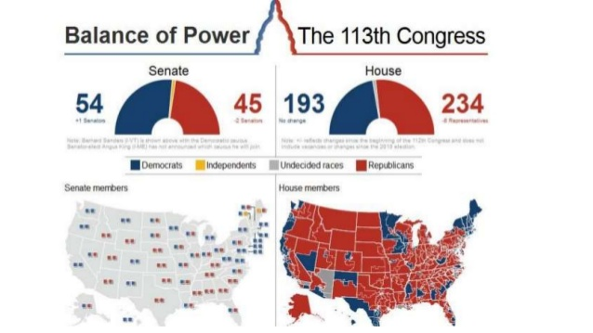
Why Republicanism
Bicameral legislature = Madisonian Model
House of Representatives
Representation by population (435 members)
2-year terms
Directly elected by the people
Age: 25 years or older
Senate
Equal representation (100 members)
6-year staggered terms
Elected by state legislatures (17 Amendment)
Age: 30 years or older

Slide 9
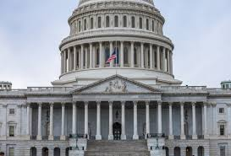
Purposeful Design
House of Representatives v. Senate
House of Representatives
Senate
More responsive to public opinion
Directly elected by population
Represents districts
Shorter term – elected every 2 years
Insulated from public opinion
Originally elected by state legislatures
Represents the state (more diverse)
Longer term – elected every 6 years (staggered 1/3 every 2 years) - consistency
Proximity
Block tyranny of the mob
Proximity
Elitism
Check & balance
Check & balance

Slide 10
Representation
113th Congressional Demographics
81 % Male
82% White
87% Christian
114th Congress demographics
80% Male
80% White
80% Christian
115th Congressional demographics
79.5% Male
79% White
87% Christian

Slide 11
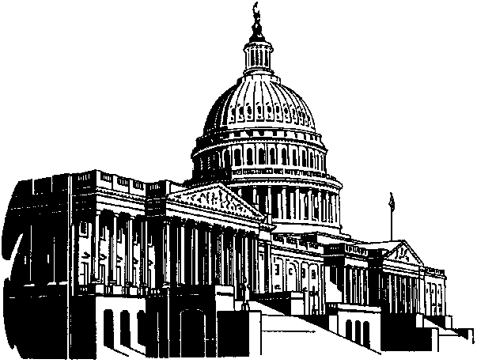
Congressional Representation
Trustee Role
Substantive Representation
Members of Congress are trusted to make decisions based on their experience in government
When legislators advocate for certain groups (Ted Kennedy advocated for the poor even though he was from a wealthy family)
Delegate Role
Descriptive Representation
Members of Congress make decisions based on the desires of their constituents
An elected body resembles a representative sample of the voters they represent constituency of 50% women and 20% blacks, for example, should have 50% female and 20% black legislators.

Slide 12
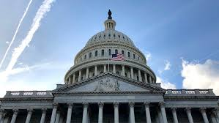
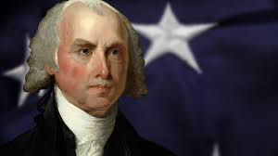
The Madison Design
Dissecting ideas of Article I of the U.S. Constitution
Explain how the founders integrated the Madisonian Model into the structure, qualifications, and powers granted to Congress under the U.S. Constitution.
Build a government with authority to govern, but limits power to prevent tyranny!
Senate: jury for impeachment
Bicameralism
Congress: power to declare war
HOR: 2-year terms

Slide 13
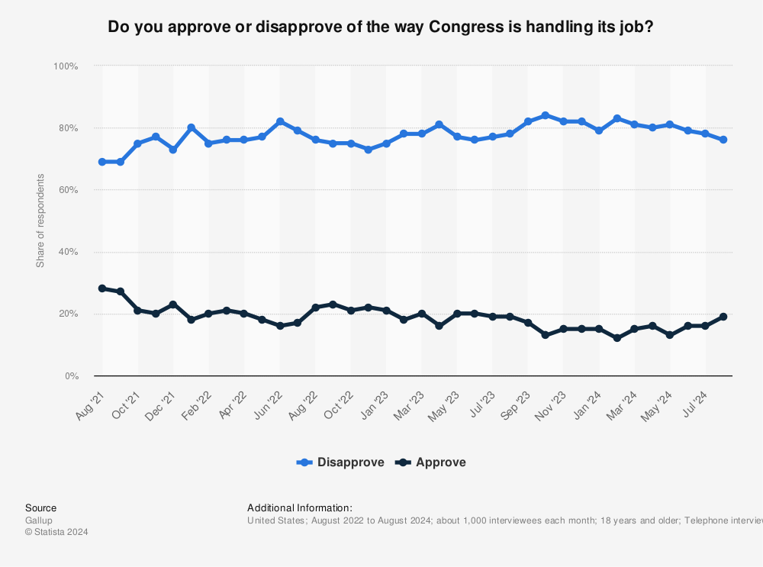
A Dysfunctional Legislature
Congressional Approval Rating
Prompt: Evaluate the bicameral legislature, U.S. Congress, in its current form achieves needed legislation to meet the needs of the people.

Slide 14
Critiquing Congressional Design
The Founding Fathers designed Congress as a bicameral legislature as the law-making body for the United States. Their intent was that all legislation would properly balance the needs of Americans population without infringing upon the minority.
Prompt: Develop a critique of the design of Congress and its ability to make public policy and evaluate whether it effectively balances the majority without infringing upon the minority.
Use at least one piece of evidence from one of the following foundational documents.
Brutus I
Federalist 10

Slide 15
Defend this HOUSE!!!!
House of Representatives
Senate
The House of Representatives better meets the will of the people in legislation, therefore better safeguards the power to govern
Federalist Paper 53-54
http://www.foundingfathers.info/federalistpapers/fedindex.htm
The Senate better meets the will of the people in legislation, therefore better safeguards the power to govern
Federalist Paper 63-64
http://www.foundingfathers.info/federalistpapers/fedindex.htm

Slide 16
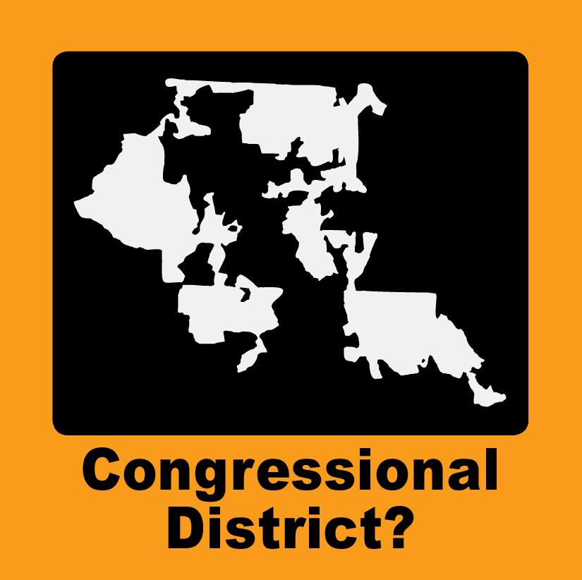
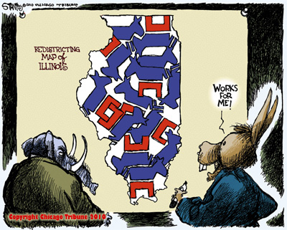
House – The Voice of the People
Representative of the people through legislative districts
US Census completed every 10 years
Reapportionment - reassigns representation based on the state’s population (Ex. NC has gained 2 seats)
Redistricting – states draw legislative districts (Single Member Districts)
Issue gerrymandering: districts that violate the principle of one man, one vote (Baker v. Carr - 1962)

Slide 17
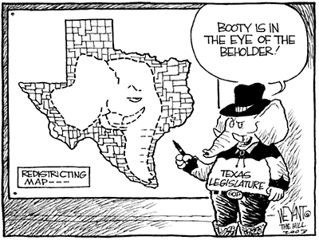
Supreme Court limits on redistricting
Protect one man one vote principle of democracy
Districts must be equally populated.
Lines must be contiguous or connected.
Redistricting cannot dilute minority voting strength.
District lines cannot be drawn solely based upon race.
Districts must be compact.
Communities of interest must be protected.

Slide 18
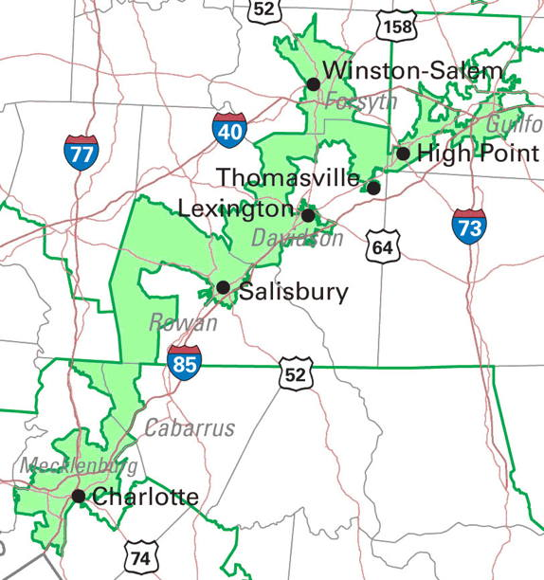
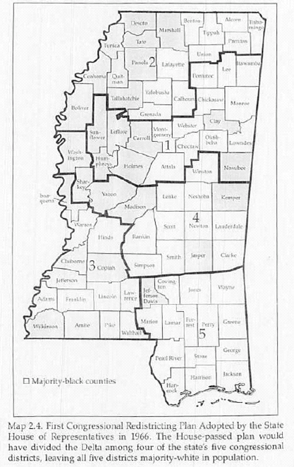
Which is a malapportioned district & why?
Majority-Minority District (Packing)
Cracking District
Two ways to gerrymander (malapportionment) voting districts

Slide 19
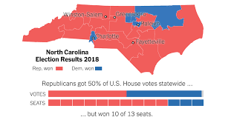
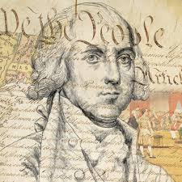
SCOTUS Rulings on Gerrymandering
Evaluate how SCOTUS has interpreted the concept of “One Man, One Vote” to determine what is considered gerrymandering
Baker v. Carr (1962)– REQUIRED SUPREME COURT CASE
Wesberry v. Sanders (1964)
Reno v. Shaw (1995)– REQUIRE SUPREME COURT CASE
Rucho v. Common Cause (2019)
Harper v. Moore (2023)
Alexander v. The South Carolina Chapter of the NAACP (2023)
A Representative democracy checks the power of factionalism
Evaluate whether gerrymandering nullifies Congress’ ability to control the effects of factionalism.

Slide 20
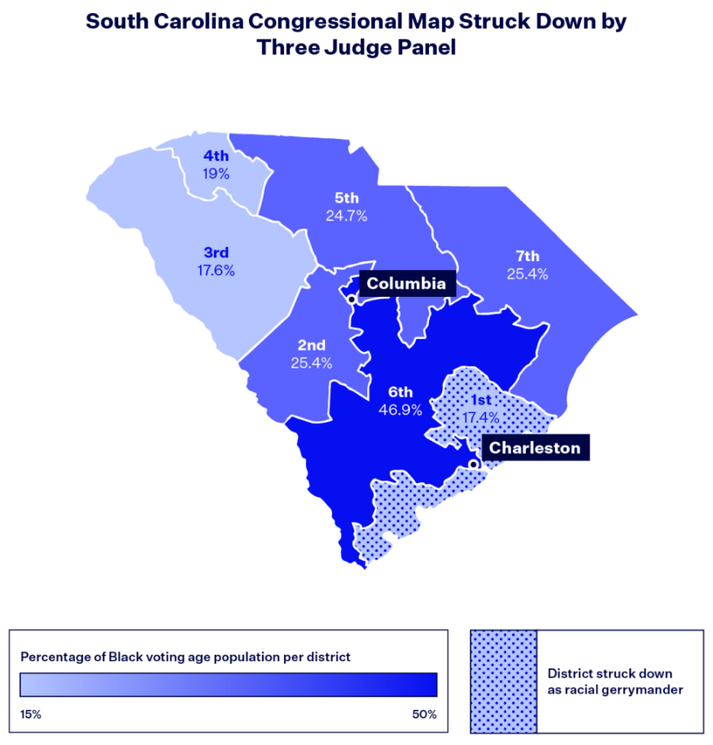
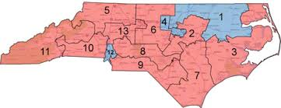
The Principle of One Man One vote
Evaluate whether South Carolina has violated the principle of “One Man, One Vote” in the SCOTUS case Alexander v. The SC Chapter of the NAACP.
Rucho v. Common Cause

Slide 21
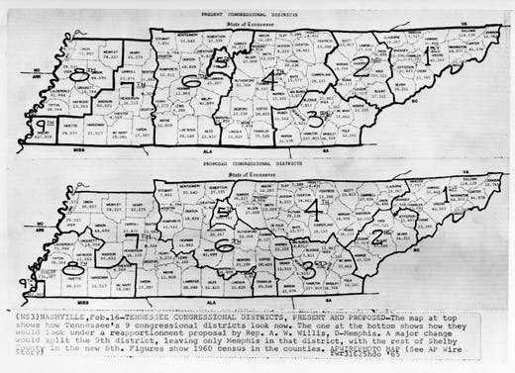
Guidepost of Legislative district
Baker v. Carr 1962 – One man, one vote
Landmark Case of Civil Rights & Voting Rights
Factors: Is issues of voting a political question or a questions of justice
The 14th Amendment equal protection clause
Redistricting is a matter of justice

Slide 22
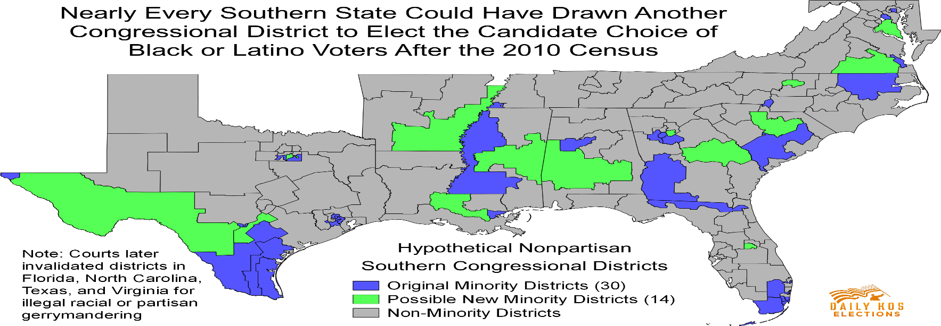
Factors of Gerrymandering
Race has been a large factor in redistricting
Packing Districts: drawing a voting district to concentrate minority representation (Majority-Minority Districts)
Voting Rights Act of 1965 state have to come up with a fair electoral system
Reno v. Shaw (1993): Majority-minority district are constitutional if a state can show reason why it is needed (Strict Scrutiny) – Race can be considered as one of the factors

Slide 23
Focus for today
2.1 Congress: The Senate and the House of Representatives
EQ: How do the institutions of government articulate democracy and interact with various linkage institutions to carry out republicanism?
Students can:
Decipher how the design of Congress carries out the founders’ beliefs about the need for a Constitutional republic.
Assess how democratic the U.S. Congress is as a lawmaking body
Agenda
Two Distinct Houses
Dissecting a Bicameral Legislature
Amending a Dysfunctional Legislature
Homework: Amending a Dysfunctional Legislature

Slide 24
Demonstrating Bicameralism
Congress creates to distinct houses with a focus of lawmaking.
Identify the statements as (H) House of Representatives, (S) Senate, (B) Both, or (N) Neither
House of Representatives
Senate
How does the design of Congress assist in maintain the goals of the Constitution and of Federalist 10?

Slide 25
The Madison Design
Dissecting ideas of Article I of the U.S. Constitution
Explain how the founders integrated the Madisonian Model into the structure, qualifications, and powers granted to Congress under the U.S. Constitution.
Build a government with authority to govern, but limits power to prevent tyranny!
Senate: jury for impeachment
Bicameralism
Congress: power to declare war
HOR: 2-year terms

Slide 26
A Dysfunctional Legislature
Congressional Approval Rating
What makes Congress so dysfunctional?
Prompt: Evaluate the bicameral legislature, U.S. Congress, in its current form achieves needed legislation to meet the needs of the people.

Slide 27
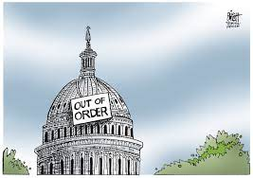
Reform a broken system
Prompt: Evaluate whether the bicameral legislature in its current form achieves the needed legislation to meet the public policy demands for the United States.
28th Amendment: construct a new amendment that will allow Congress to better able to pass legislation to respond to public policy issues we face.
28th Amendment – reform
Argumentative thesis that defends the change
Evidence that supports the change
Counterargument against the change

Slide 28
Focus for today
2.1 Congress: The Senate and the House of Representatives
EQ: How do the institutions of government articulate democracy and interact with various linkage institutions to carry out republicanism?
Students can:
Decipher how the design of Congress carries out the founders’ beliefs about the need for a Constitutional republic.
Assess how democratic the U.S. Congress is as a lawmaking body
Agenda
Why Congress Matters
Powers of Congress
Dissecting Congressional Design
Homework: Amending a Dysfunctional Legislature

Slide 29
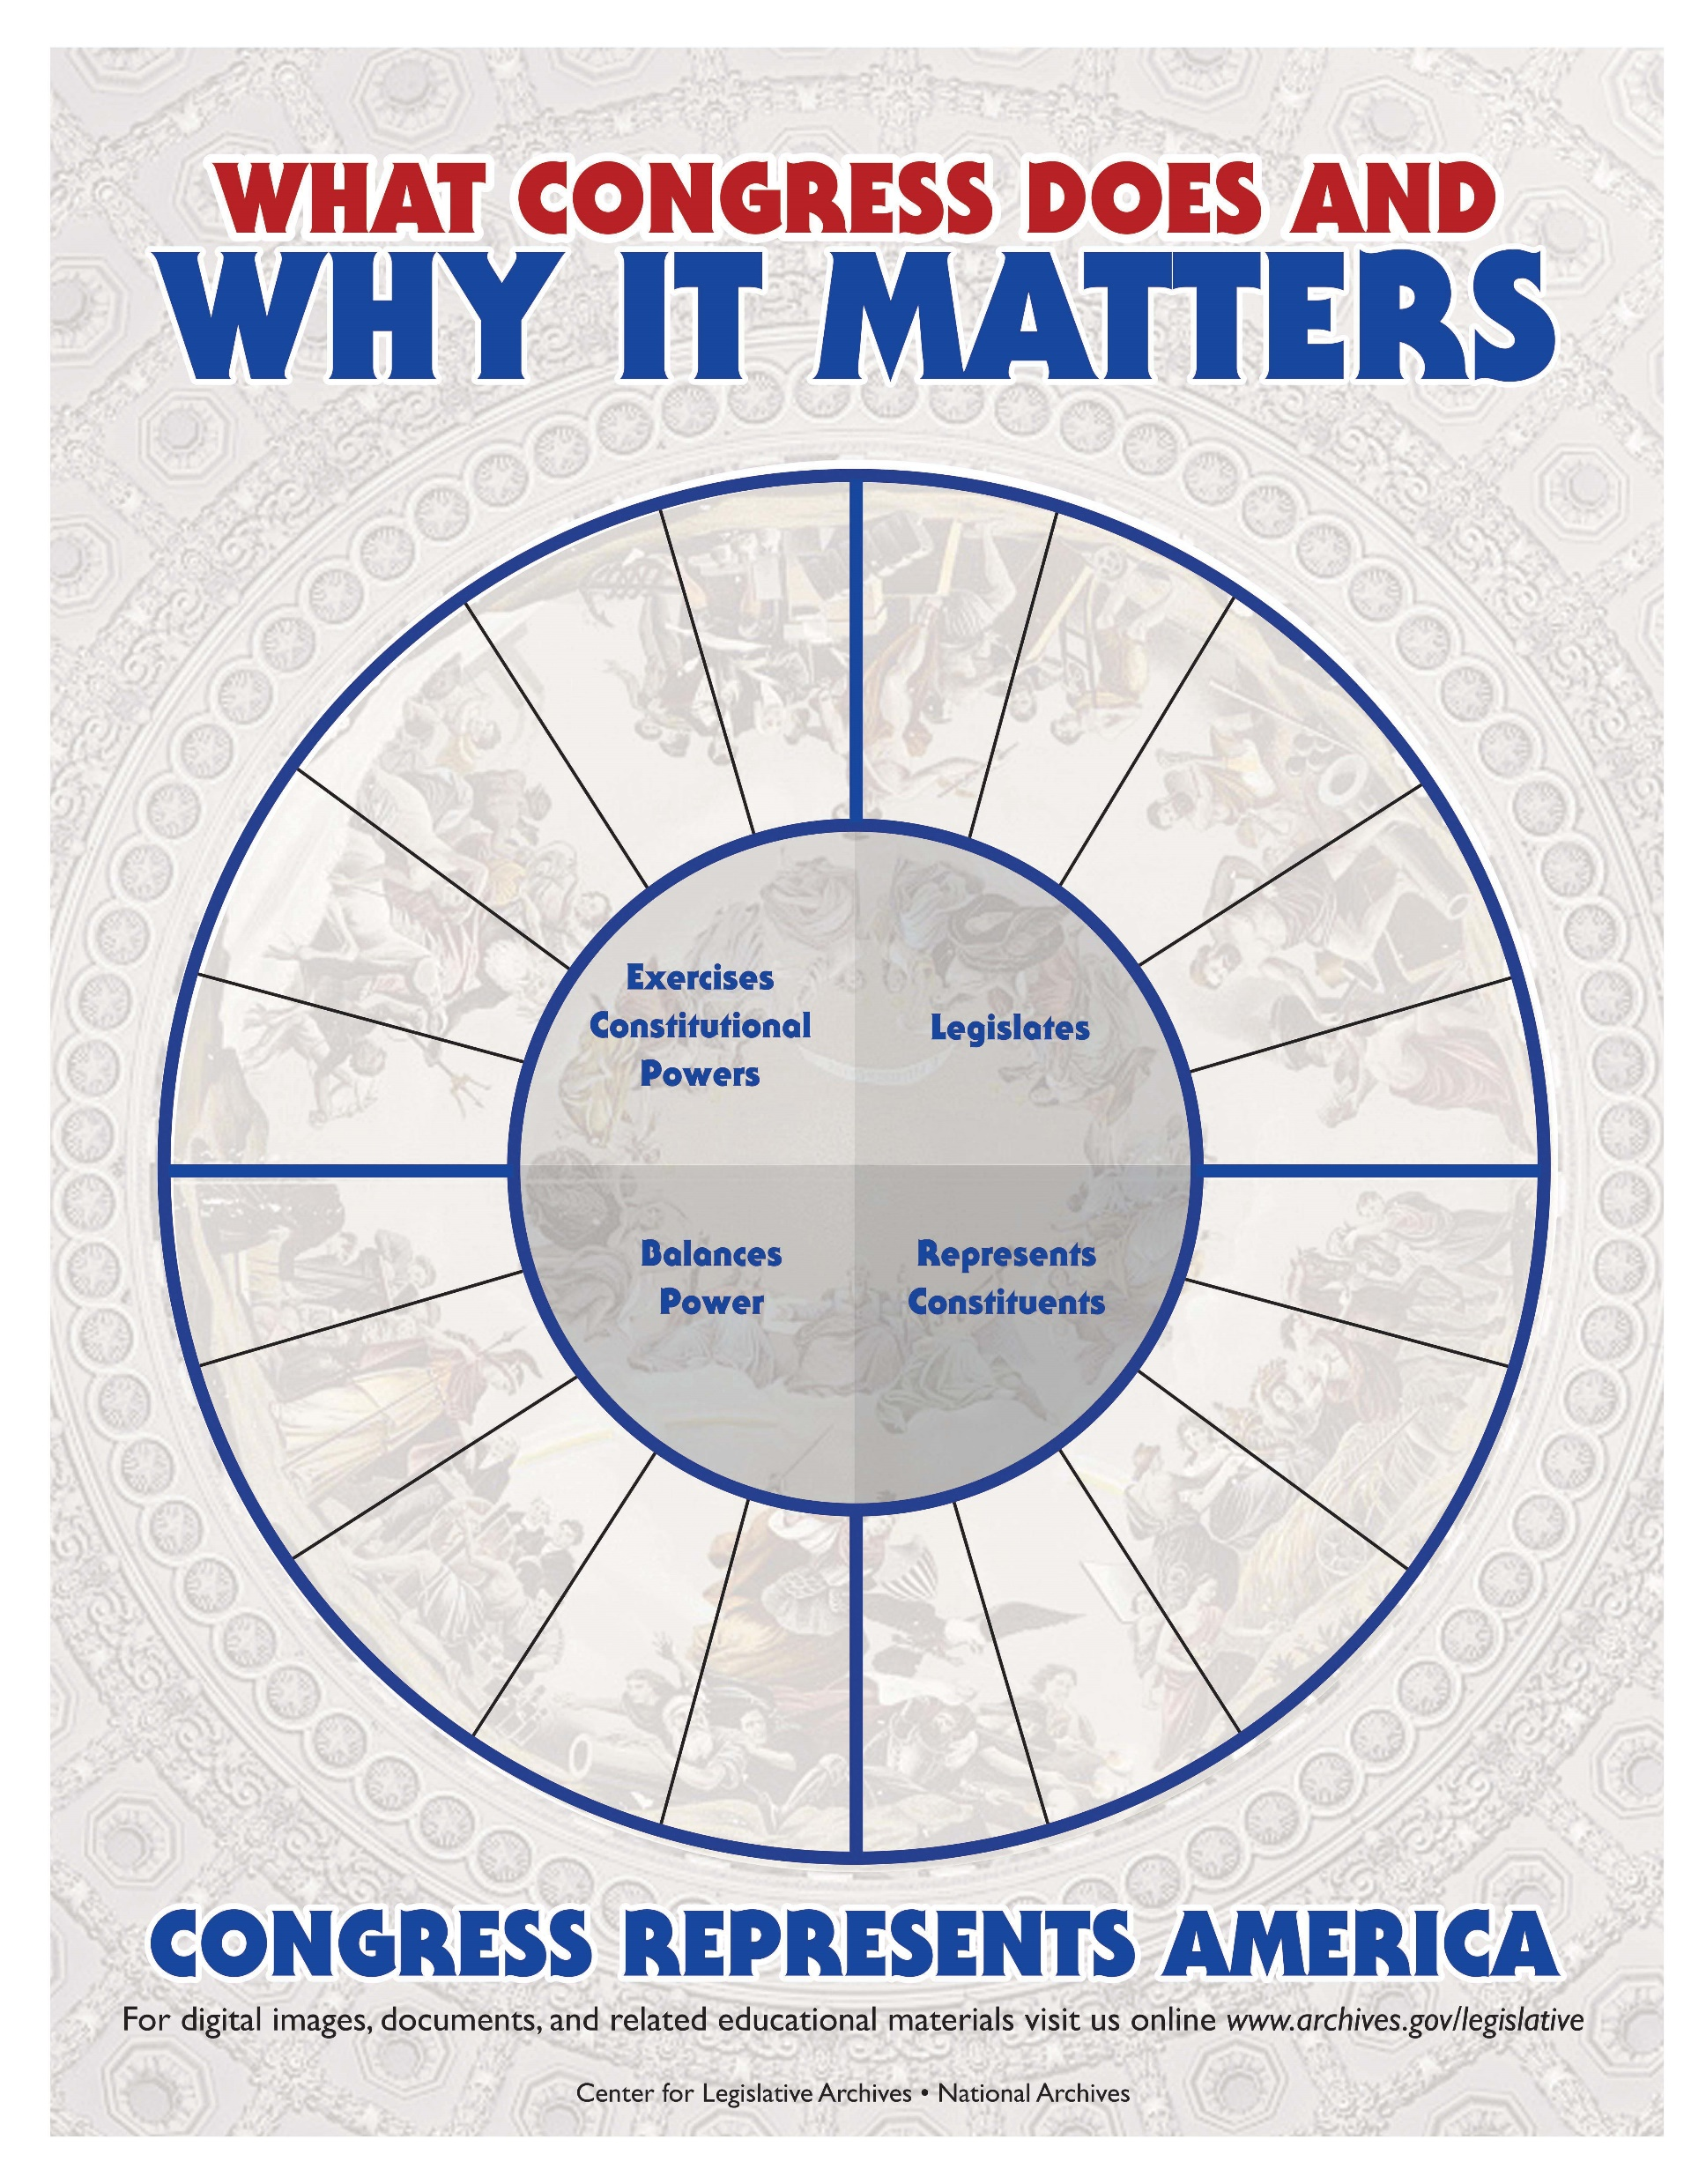
Congressional Authority
Give examples of how Congress is a vital piece of our Constitutional republic.
Exercises Constitutional Powers
Legislates
Balances Power
Represents Constituents

Slide 30
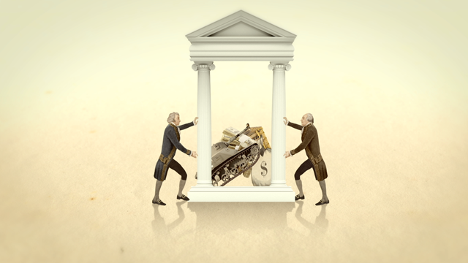
Powers Assigned to Congress
Article I, Section 8 of the Constitution: enumerated powers (expressed or delegated powers)
Congressional powers well defined (suppose to be the most powerful branch of government)
Examples:
Power of the purse (tax & spend)
Lawmaking
Declare war
Oversights/Investigation
Regulate interstate commerce
Evaluate whether James Madison’s or Brutus I opinion on federal power is correct.
The powers of the federal government are few and well defined!

Slide 31
Powers of Congress
Lawmaking: override and re-write laws declared unconstitutional
Power of the Purse: (tax laws) appropriates $$ to legislative programs (President must spend the $$)
Declare War: Can stop Commander in Chief
Power of the Purse
War Powers Act
Congressional Powers (Delegated Powers)
Oversight/Investigation: Laws are being executed as they were intended
Watergate Scandal
Bureaucratic oversight & budget hearing
Advice & Consent: Treaties and President appointees require Senate approval

Slide 32
Denied Powers
Privilege of the Writ of Habeas Corpus shall not be suspended, unless when in Cases of Rebellion or Invasion the public Safety may require it. - Article I, Section 9, U.S. Constitution
Constitutional blocks against Congress (Federalist argument)
DENIED POWERS
DENIED!
Cannot favor one state over another
Cannot suspend writs of habeas corpus
Cannot pass bills of attainder
Cannot pass ex-post-facto laws

Slide 33
Stretching the Authority of Congress
“To make all Laws which shall be necessary and proper for carrying into Execution the foregoing Powers, and all other Powers vested by this Constitution in the Government of the United States, or in any Department or Officer thereof.”
- Article I, Section 8, Clause 18
Necessary & Proper Clause (Elastic Clause) = Implied Powers
Delegated power – Maintained an Army & Navy is stretched to include an Air Force (Necessary & Proper Clause)
Other examples
Federal Reserve Bank
Regulating pollution
Regulating the internet

Slide 34
Imperial Congress
Powers of Congress
Formal powers: written into the U.S. Constitution
Informal powers: interpreted within the Constitution , similar to necessary & proper clause
Power | Formal Power | Informal Power
War Power | Declare war for the common defense | Refuse to appropriate funds, investigate and expose, threaten to impeach
Treaty Power | Ratify treaties (2/3rd vote in Senate) | Issue resolutions condemning the actions of world leaders
Appointment power | Approve and appoint ambassadors (majority vote) | Issue resolutions condemning appointments, rejects later appointments

Slide 35
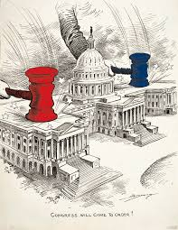
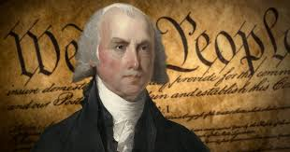
Congressional Authority
Examine how Congress has utilized it authority under the U.S. Constitution to resolve public policy issues of the United States.
“The powers delegated by the proposed Constitution to the federal government are few and defined. Those which are to remain in the State governments are numerous and indefinite.”
- James Madison, Federalist 45
Evaluate whether Congress follows the beliefs of James Madison in Federalist 45.

Slide 36
Reform a broken system
Prompt: Evaluate whether the bicameral legislature in its current form achieves the needed legislation to meet the public policy demands for the United States.
28th Amendment: construct a new amendment that will allow Congress to better able to pass legislation to respond to public policy issues we face.
28th Amendment – reform
Argumentative thesis that defends the change
Evidence that supports the change
Counterargument against the change

Slide 37
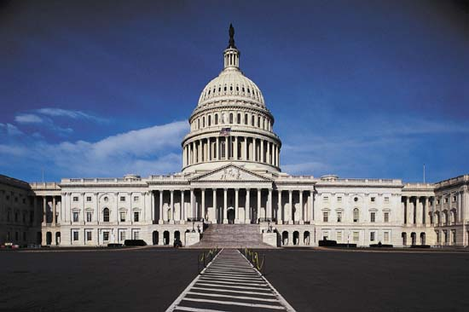
Separation of Powers
Senate
House of Representatives
Jury for impeach trial
Elects the V.P. if the Electoral College cannot
Ratifies treaties – (Foreign relations committee ****)
Approves presidential appointees (Judiciary committee***)
Passes the articles of impeachment
Starts all tax and appropriation bills – (Ways and Means Committee ***)
Selects the President if the Electoral College cannot
Due centralized power structure the rules committee is very powerful

Slide 38
Focus for today
2.1 Congress: The Senate and the House of Representatives
EQ: How do the institutions of government articulate democracy and interact with various linkage institutions to carry out republicanism?
Students can:
Decipher how the design of Congress carries out the founders’ beliefs about the need for a Constitutional republic.
Assess how democratic the U.S. Congress is as a lawmaking body
Agenda
Issue of Dysfunction
Powers of Congress
Dissecting Congressional Design
Homework: Amending a Dysfunctional Legislature

Slide 39
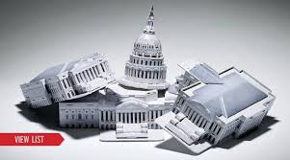
Issues of Dysfunction
A Dysfunctional Branch
Explain how the following impact Congress and the work of lawmaking.
Incumbency Advantage
Gerrymandering
Senate Filibuster

Slide 40
Congressional Trend
Incumbency: a member of congress who is running for re-election or re-elected multiple times
Identify two trends the graph demonstrates?
Explain two factors that cause these trends to continue?

Slide 41
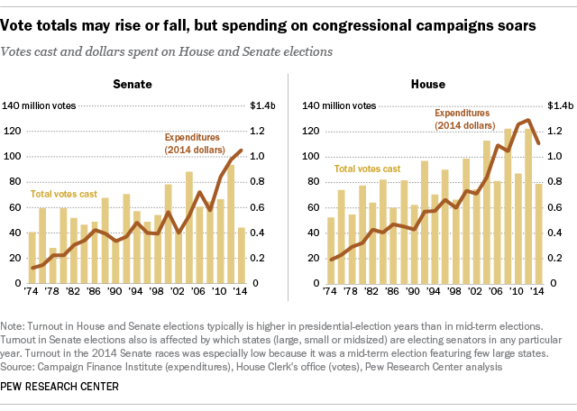
Cost to Run
Cost to run for HOR in 2012: $1,689,580
Average of $2,315 per day of campaigning
Cost to run for Senate in 2012: $10,476,451
Average of $14,351 per day of campaigning
War Chest: incumbents have the $$$ to run – all current campaign donations are to pay for the next election cycle

Slide 42
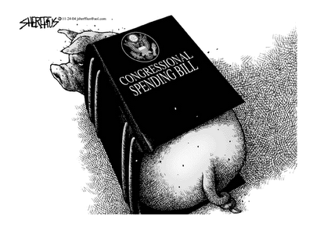
If $$ Could Squeal
Incumbency advantage of helping your state or district
Pork-barrel spending: wasteful government spending to benefit only one state/district
Examples:
$500,000 for the Sparta, NC Teapot Museum
$15,000 to study the effects of alcohol on mice
$14 Billion to relocate an above ground highway
$223 Million to build a bridge in Alaska to help 50 people

Slide 43
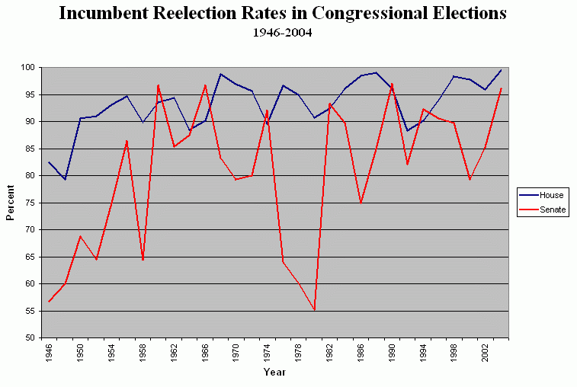
Incumbent on Winning
Safe Seats: senate or representative seats that are either unopposed or likely to be re-elected
Tactics of being re-elected
Franking privileges: free mail
Legislative staff
Casework: helping the people
Pork Barreling: $$$ back to the constituents
War chest – campaign funds
Free access to a TV studio
Credit claiming

Slide 44
DATA Analysis
Incumbency: a member of congress who is running for re-election or re-elected multiple times
Analyze factors that explain the trend
Evaluate how the trend impacts the work of Congress

Slide 45
Congressional Authority
Examine how Congress has utilized it authority under the U.S. Constitution to resolve public policy issues of the United States.
“The powers delegated by the proposed Constitution to the federal government are few and defined. Those which are to remain in the State governments are numerous and indefinite.”
- James Madison, Federalist 45
Evaluate whether Congress follows the beliefs of James Madison in Federalist 45.

Slide 46
Reform a broken system
Prompt: Evaluate whether the bicameral legislature in its current form achieves the needed legislation to meet the public policy demands for the United States.
28th Amendment: construct a new amendment that will allow Congress to better able to pass legislation to respond to public policy issues we face.
28th Amendment – reform
Argumentative thesis that defends the change
Evidence that supports the change
Counterargument against the change

Slide 47
Focus for today
2.1 Congress: The Senate and the House of Representatives
EQ: How do the institutions of government articulate democracy and interact with various linkage institutions to carry out republicanism?
Students can:
Decipher how the design of Congress carries out the founders’ beliefs about the need for a Constitutional republic.
Assess how democratic the U.S. Congress is as a lawmaking body
Agenda
Powers of Congress
Rubric Review - Argumentative Essay Re-write
Dissecting Congressional Design
Homework: Amending a Dysfunctional Legislature

Slide 48
Congressional Authority
Examine how Congress has utilized it authority under the U.S. Constitution to resolve public policy issues of the United States.
“The powers delegated by the proposed Constitution to the federal government are few and defined. Those which are to remain in the State governments are numerous and indefinite.”
- James Madison, Federalist 45
Evaluate whether Congress follows the beliefs of James Madison in Federalist 45.

Slide 49
Focus for today
2.1 Congress: The Senate and the House of Representatives
EQ: How do the institutions of government articulate democracy and interact with various linkage institutions to carry out republicanism?
Students can:
Decipher how the design of Congress carries out the founders’ beliefs about the need for a Constitutional republic.
Assess how democratic the U.S. Congress is as a lawmaking body
Agenda
I’m Just a Bill
Lawmaking Factors
Amending a Dysfunctional Branch
Homework: Amending a Dysfunctional Legislature

Slide 50
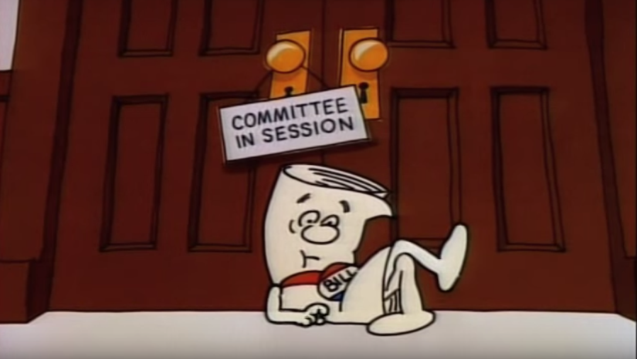
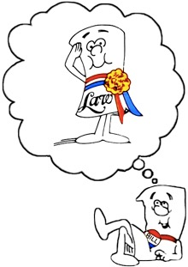
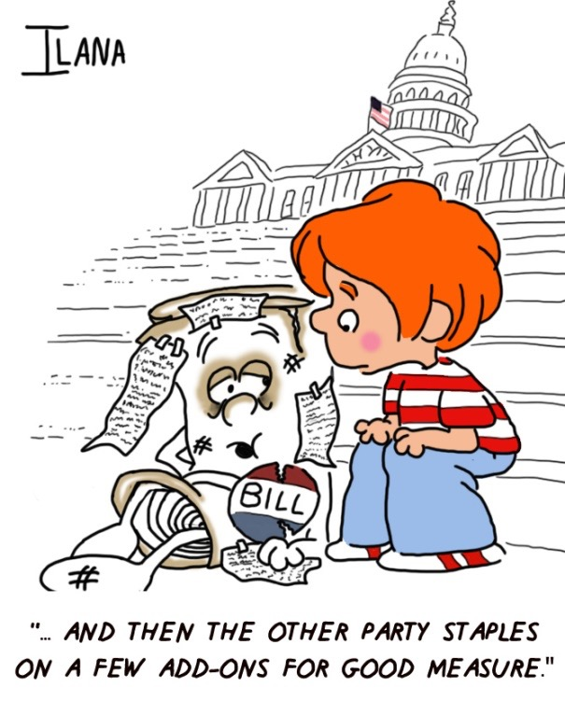
The Story of the Bill that became a LAW
The process to create legislation the governs the United States
How legislation is made?
How does bicameralism design of Congress influence the lawmaking process?
Why would Federalist defend the process of lawmaking

Slide 51
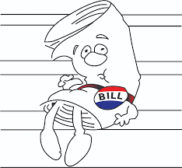
Montesquieu’s Rule
Lawmaking authority
“We pour our coffee into a saucer to cool it, we pour our legislation into a senatorial saucer to cool it”
- George Washington
Lawmaking is not made in haste
Bicameralism – Separation of powers & Checks & Balances
Bills can start in either house (except tax & appropriation bills)
Must pass both house in identical forms

Slide 52
The Rule of the Majority
Party polarization – when Congress become gridlocked due to political party differences
Political Party’s influence on legislation
Majority party: (political party with the most seats in a house of Congress)
Key leadership roles
Majority seats on committees
Minority party: watch dog (point out mistakes of the majority party)

Slide 53
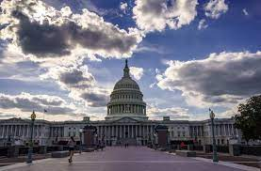
Central vs. Decentral Power
HOR - Centralized
Senate - Decentralized
More Members – 435
Central leader – Speaker of the House
Controlled debates
Rules Committee – scheduled time for debates
Open v. Closed Rule – allowing or denying riders
Start all tax and appropriation bills
Fewer members = 100
Filibuster – No timed debate
Vice President – tie breaker vote
President pro Tempore – operational leader
Focuses more on foreign policy (power of approval & removal)

Slide 54
Reform a broken system
Prompt: Evaluate whether the bicameral legislature in its current form achieves the needed legislation to meet the public policy demands for the United States.
28th Amendment: construct a new amendment that will allow Congress to better able to pass legislation to respond to public policy issues we face.
Amendment guidelines:
Set guidelines to fix the issues (Example - No person shall be elected to the office of the President more than twice, and no person who has held the office of President, or acted as President, for more than two years of a term to which some other person was elected President shall be elected to the office of the President more than once.

Slide 55
28th Amendment
28th Amendment – Title ________________________
Write out the actual amendment
Thesis – Claim argument on why the amendment is necessary and give TWO bases reasons on why your amendment repairs the issue
Defend each bases
Counter-Claim
List Bases
Provide bulleted statements that use AP content reasons and/or foundational documents to defend your thesis claim
Write a counter argument
Provide bulleted statements that use AP content reasons and/or foundational documents to defend your counter claim
Refutation – defend your thesis and provide another piece of evidence that defends your claim

Slide 56
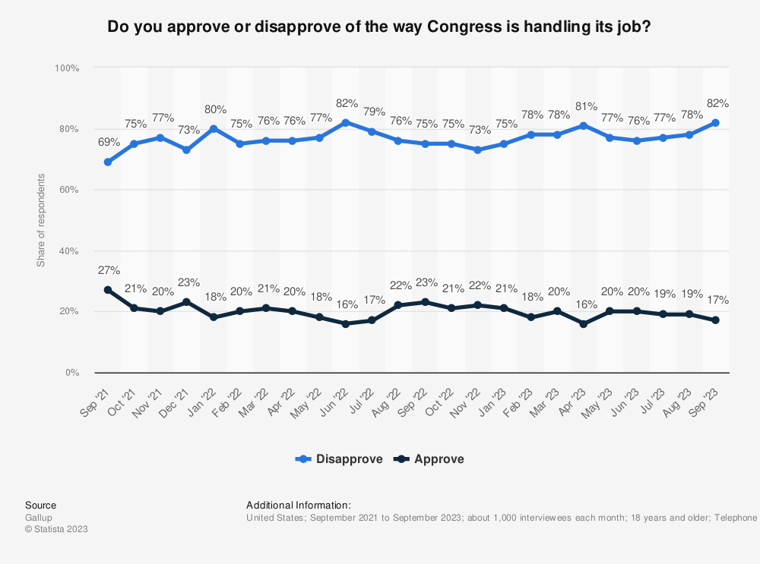
DATA Analysis
Identify a trend in the graph.
Explain a factor that supports the trend you identified in part A
Take a position on whether Congress should be a unicameral legislature instead of a bicameral design.

Slide 57
Focus for today
2.1 Congress: The Senate and the House of Representatives
EQ: How do the institutions of government articulate democracy and interact with various linkage institutions to carry out republicanism?
Students can:
Decipher how the design of Congress carries out the founders’ beliefs about the need for a Constitutional republic.
Assess how democratic the U.S. Congress is as a lawmaking body
Agenda
Stalemate
Party Leadership
Legislative Races
Homework: Amending a Dysfunctional Legislature

Slide 58
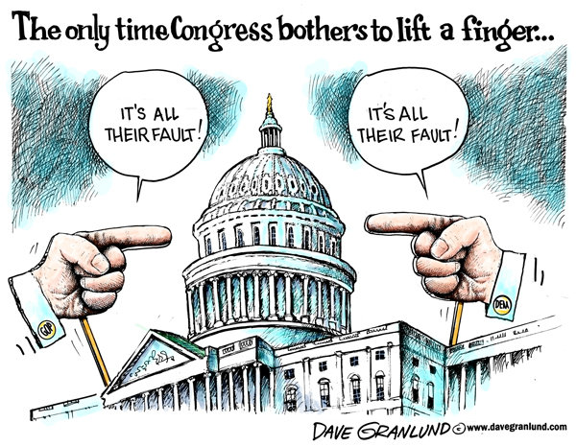
STALEMATE
The Legislative Process
Many political scientist and Americans believe that Congress is broken
Identify and explain TWO factors that creates gridlock in the lawmaking process.
Explain how the following might impact a member of Congress vote on a potential piece of legislation.
Trustee Role
Delegate Role

Slide 59
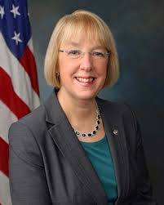
Congressional Leadership
Organizing by political party and House of Congress
Speaker of the House: central leader of the HOR (majority party)
Pulls bills from the hopper
Assigns bills to a committee
Has some say in who serves on committees
Senate Leaders:
Vice President: Tie breaker vote only
President pro Tempore: most senior member of the majority party

Slide 60
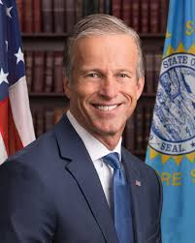
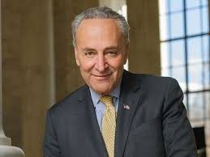
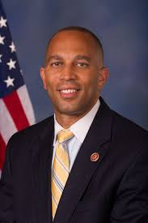
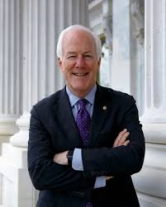
Congressional Leadership
Organizing by political party and House of Congress
Floor leaders: Voice of the party, desires legislation that represents their party views (Both Houses)
Majority Floor Leader
Minority Floor Leader
Party Whip: Encourages party members to vote together on legislation (Both Houses)
Majority Party Whip
Minority Party Whip

Slide 61
Reform a broken system
Prompt: Evaluate whether the bicameral legislature in its current form achieves the needed legislation to meet the public policy demands for the United States.
28th Amendment: construct a new amendment that will allow Congress to better able to pass legislation to respond to public policy issues we face.
Amendment guidelines:
Set guidelines to fix the issues (Example - No person shall be elected to the office of the President more than twice, and no person who has held the office of President, or acted as President, for more than two years of a term to which some other person was elected President shall be elected to the office of the President more than once.

Slide 62
28th Amendment
28th Amendment – Title ________________________
Write out the actual amendment
Thesis – Claim argument on why the amendment is necessary and give TWO bases reasons on why your amendment repairs the issue
Defend each bases
Counter-Claim
List Bases
Provide bulleted statements that use AP content reasons and/or foundational documents to defend your thesis claim
Write a counter argument
Provide bulleted statements that use AP content reasons and/or foundational documents to defend your counter claim
Refutation – defend your thesis and provide another piece of evidence that defends your claim

Slide 63
Focus for today
2.1 Congress: The Senate and the House of Representatives
EQ: How do the institutions of government articulate democracy and interact with various linkage institutions to carry out republicanism?
Students can:
Decipher how the design of Congress carries out the founders’ beliefs about the need for a Constitutional republic.
Assess how democratic the U.S. Congress is as a lawmaking body
Agenda
Amending a Dysfunctional Branch
Congressional Holiday
Homework: No Homework – Happy Holidays

Slide 64
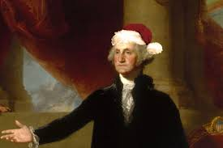
A Government Holiday
Holidays actually exist because the federal government recognizes them. Congress passes legislation and the President signs them into law.
Government Holiday Tree
Design an ornament that reflects and idea that symbolizes the idea how citizenship and government unites us
Use a symbol that represents ideas and concepts we have covered in Civics
The holiday spirit is symbolized by colors, so color your ornament.
You ornament may reflect any holiday celebrated
during this time period
The Constitution provides reason for the season

Slide 65
Focus for today
2.1 Congress: The Senate and the House of Representatives
EQ: How do the institutions of government articulate democracy and interact with various linkage institutions to carry out republicanism?
Students can:
Decipher how the design of Congress carries out the founders’ beliefs about the need for a Constitutional republic.
Assess how democratic the U.S. Congress is as a lawmaking body
Agenda
Bicameral Lawmaking
Committees on Committees
Bill to Law Race
Homework: Amending a Dysfunctional Legislature

Slide 66
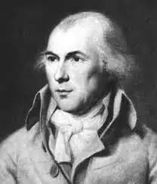
Bicameralism shapes Legislation
“In republican government, the legislative authority necessarily predominates. The remedy for this inconveniency is to divide the legislature into different branches; and to render them, by different modes of election and different principles of action, as little connected with each other as the nature of their common functions and their common dependence on the society will admit. It may even be necessary to guard against dangerous encroachments by still further precautions.”
- James Madison, Federalist 51, 1788
The Madisonian Model at work!
Explain ONE way that the centralized process of the House of Representatives causes them to handle legislation differently then the Senate.
Explain ONE way that the decentralized process of the Senate causes them to handle legislation differently then the House of Representatives.

Slide 67
Congressional Committees
Committees have been used since Congress’ inception
Purpose: make lawmaking efficient
Use – get public feedback on laws & investigation
Conference Committee: two house – rectify the differences between pieces of legislation
Standing committee – permanent one house
Types of Committees
Select Committee – Temporary one house
Joint Committee – temporary two-house committee

Slide 68
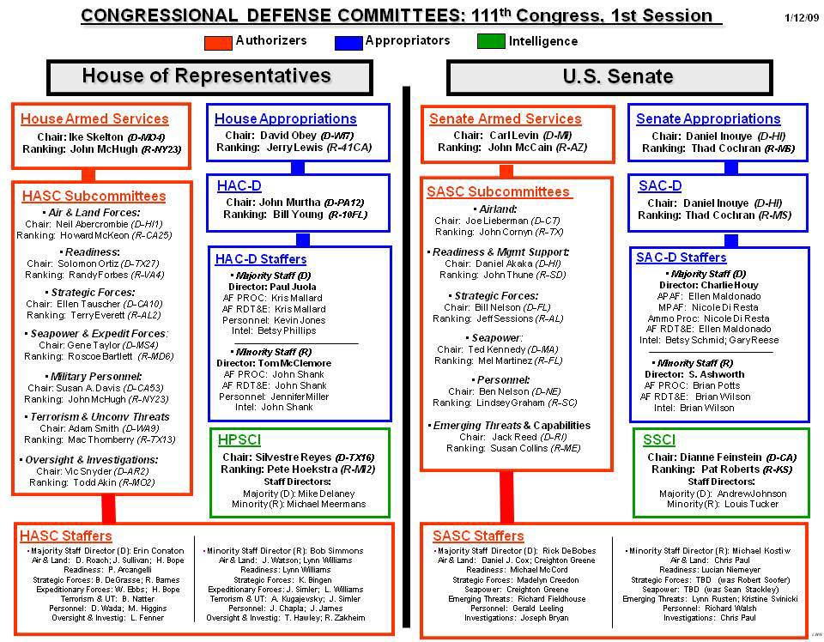
Seniority vs the Party
Seniority System: longest serving get priority on committee chair assignments (majority party gets committee chairs and most seats)
Committee assignments
Incumbency advantage: serve on committees that deal with issue important to state or district

Slide 69
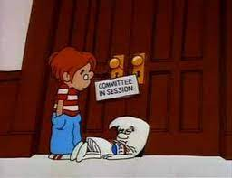
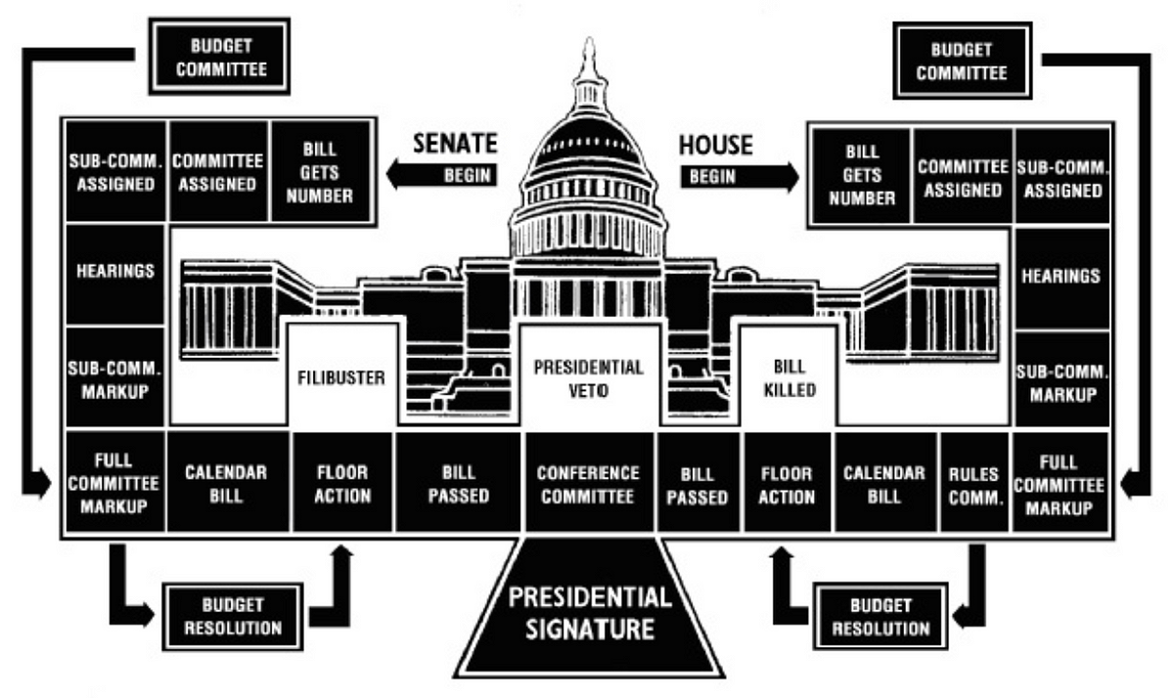
Committee on Committees
Advantages
Disadvantages
Efficiency – simplifies the lawmaking process
Allows legislature to focus on set areas of expertise
Makes Congress members better policy makers
Weeds out weak legislation
Time & $$$ wasted (gridlock)
Conflicting policies generated by different committees
Desire to control committees leads to partisanship
Easier to kill legislation (pigeonholing)

Slide 70
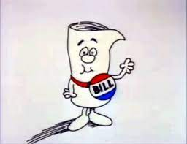
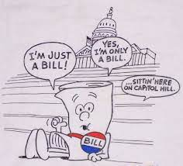
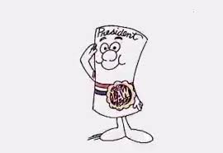
Legislative Race
Demonstrate the process for how a bill becomes of a law. Get checked off once you have the process in the correct order.
Rules for the process
Bills must pass both houses in identical forms
The process is very similar in both houses (You will have two cards that state the same thing)
There are some minor differences between the two houses in the legislative process

Slide 71
Focus for today
2.1 Congress: The Senate and the House of Representatives
EQ: How do the institutions of government articulate democracy and interact with various linkage institutions to carry out republicanism?
Students can:
Decipher how the design of Congress carries out the founders’ beliefs about the need for a Constitutional republic.
Assess how democratic the U.S. Congress is as a lawmaking body
Agenda
Bill to Law Race
Ratification National Convention
To Amend or Not To Amend
Homework: Tax and Spend – Formulating a Federal Budget

Slide 72
Other Factors of Lawmaking
Lawmaking factors
Logrolling: members of Congress exchange support for each other’s proposed legislation to ensure passage of bills
Specialization: standing committees focus on a specific topic – Ex. Agriculture Committee or Ways & Means Committee
Explain how Congressional lawmaking has made both above practices necessary.
For EACH of the Congressional leadership position and explain how they could impact the passage of legislation within Congress.
Speaker of the House
Party Whip

Slide 73
Legislative Race
Demonstrate the process for how a bill becomes of a law. Get checked off once you have the process in the correct order.
Rules for the process
Bills must pass both houses in identical forms
The process is very similar in both houses (You will have two cards that state the same thing)
There are some minor differences between the two houses in the legislative process

Slide 74
Focus for today
2.1 Congress: The Senate and the House of Representatives
EQ: How do the institutions of government articulate democracy and interact with various linkage institutions to carry out republicanism?
Students can:
Decipher how the design of Congress carries out the founders’ beliefs about the need for a Constitutional republic.
Assess how democratic the U.S. Congress is as a lawmaking body
Agenda
Spending Trends
Fiscal Policy
Budget Hero
Homework:

Slide 75
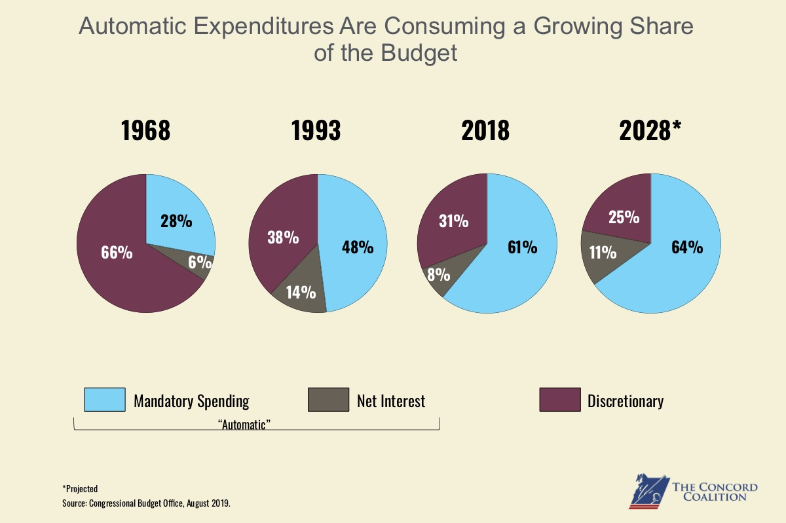
Congressional Spending trends
Use the graph above to answer A and B
Identify and explain a trend demonstrated in the pie charts above.
Using your knowledge of United States politics, identify one nonbudgetary barrier AND explain how this barrier hinders the creation of new policy initiatives.

Slide 76
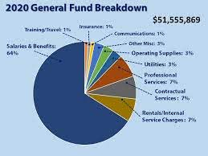
Federal Budget process
Building a FISCAL BUDGET: US Gov. budget year – October 1 – September 30
Congress’ power of the purse
(tax & spending)
Federal budget
Authorization Bills – assigns projects & contracts
Appropriation Bills – assigns $$$$ (13 bills must be passed

Slide 77
Federal Spending
Mandatory vs. Discretionary Spending
Federal Spending Influencers: President, Bureaucracy, Interest Groups, Political Parties, & Voters
Mandatory Expenditures: required federal spending
Social Security
Medicare
2/3rds of the FEDERAL BUDGET
Discretionary Expenditures: Congress decides what is important
Defense
Education
1/3rdsof the FEDERAL BUDGET

Slide 78
Pile it On
The National Debt of the U.S.
Identify factors that make it difficult for the U.S. government to balance the national budget

Slide 79
To tax or not to tax
Taxation: controversial power (Revolutionary War, Articles of Confederation, Partisanship)
All tax & appropriation bills originate in the HOR
Sources of Revenue
Income Tax
Excise Tax
Estate Tax
Fees & license

Slide 80
The Party Matters
Partisan & Representational Issues of Taxing & Spending
Democrats – tax wealthy to provide services to those in need
Republicans – Cut taxes, encourage business investment, cut the debt
Delegate vs. Trustee role: cut taxes, keep federal programs, deal with the debt (confusing message)
Impact: GRIDLOCK/HYPERPLURALISM

Slide 81
Fiscal Policy – How stimulating
Fiscal Policy: using the power of taxing & spending to stimulate the economy
Contractionary Fiscal Policy: raise taxes & cut government spending
Goal: making the economy shrink
Issue: Upsets voters
Expansionary Fiscal Policy: cut taxes & raise government spending
Goal: making the economy grow (CARES ACT of 2020)
Issue: created debt

Slide 82
The Fiscal Ship
Can you achieve what Congress has not been able to?
Attempt to balance the federal budget
Raise taxes or cut spending
Follow or break with the party
Delegate or Trustee
Get re-elected or voted out of office

Slide 83
Focus for today
2.1 Congress: The Senate and the House of Representatives
EQ: How do the institutions of government articulate democracy and interact with various linkage institutions to carry out republicanism?
Students can:
Decipher how the design of Congress carries out the founders’ beliefs about the need for a Constitutional republic.
Assess how democratic the U.S. Congress is as a lawmaking body
Agenda
28th Amendment National Convention
Ratification Vote
Congressional Study Guide
Homework: Study for a Congressional Argumentative Essay

Slide 84
Ratification Convention
Evaluate whether proposed Amendments will repair the dysfunction that besieges Congress in executing its duties as the national lawmaker.
For each Amendment
Record the main idea of the Amendment would repair dysfunction within the U.S. Congress
Summarize main arguments for the Amendment
Ask questions of the presenters – remember if Amendment is added to the U.S. Constitution it becomes bending to the nation.

Slide 85
Focus for today
2.1 Congress: The Senate and the House of Representatives
EQ: How do the institutions of government articulate democracy and interact with various linkage institutions to carry out republicanism?
Students can:
Decipher how the design of Congress carries out the founders’ beliefs about the need for a Constitutional republic.
Assess how democratic the U.S. Congress is as a lawmaking body
Agenda
Prompt Break Down
Plan your argument
Thesis writing
Homework: Review Congress Notes for Essay writing

Slide 86
Essay Prompt
There is a debate over the use of the Senate filibuster in the national legislative process. Take a position on whether the filibuster is beneficial or detrimental to policy making in the United States Congress.
Use at least piece of evidence of from one of the following foundational documents
Article I of the U.S. Constitution
Federalist 10
Federalist 51
YOU SUBMIT YOUR ARGUMENT PLANNER AT THE END OF THE PERIOD

Slide 87
Essay Prompt
Following the steps
Step 1: Analyze and strip prompt – What am I being asked? What are the TWO sides?
Step 5: Thesis development: write claim (do NOT restate the prompt) develop a line of reasoning that supports claim and explains how it will be defended
DO NOT DOCUMENT DUMP
Step 2: Brainstorm (2 Minutes) recall all relevant content information (write down as many as you can)
Step 3: Foundational document analysis – author, main idea, relevance to the prompt (content connection)
Step 4: Organize argument – Place foundational documents on the planner and add – in any other content concepts (organize into potential argumentative points

Slide 88
Focus for today
2.1 Congress: The Senate and the House of Representatives
EQ: How do the institutions of government articulate democracy and interact with various linkage institutions to carry out republicanism?
Students can:
Decipher how the design of Congress carries out the founders’ beliefs about the need for a Constitutional republic.
Assess how democratic the U.S. Congress is as a lawmaking body
Agenda
Planner Re-evaluation
Making the Grade
Plan to essay comparison
Homework: Presidential Powers and Roles

Slide 89
Essay Prompt
There is a debate over the use of the Senate filibuster in the national legislative process. Take a position on whether the filibuster is beneficial or detrimental to policy making in the United States Congress.
Use at least piece of evidence of from one of the following foundational documents
Article I of the U.S. Constitution
Federalist 10
Federalist 51
Re-evaluate your plan – make any changes you desire

Slide 90
Making the Grade
Scoring Essays
1 Pt. Thesis – defensible claim that responds to the prompt with a line of reasons (No restating or Document Drops)
3 Pts. Evidence
1 pt. identifying one piece of evidence relevant to the topic
2 pts. The evidence is specific and supports the claim
3 pts. Provides two pieces of specific & relevant evidence that supports the claim (At least one must be a foundational document)
1 pt. Explains how and why the evidence supports the claim or thesis
1 pt. Responds to an opposing or alternate perspective using a refutation, concession, or rebuttal

Slide 91
Essay Comparison
Evaluate your argumentative essay plan – compare it to the essays you scored
Identify and explain - what are your strengths of your plan
Identify and explain – what areas of improvement (How would adjust your writing?)
Evaluate how grading an essay has taught you to how to write an argumentative essay
Contemplating writing argumentative essays

