Slide 1
WWI – America Breaks Tradition
Unit 7
Government Activism in Foreign Policy

Slide 2
Agenda
Essential Question: How has America’s views been redefined by economic necessities, cultural notions, and national security during the turn of the 20th century?
Students can:
Decipher how did the evolution of industrial capitalism change American society in the 1890s to 1945 era
Evaluate how politicians and reformers responded to industrial changes, in the course of doing so, fundamentally change the role of government, especially the federal government, in the lives of Americans
Determine the transformation that occurred in the role of the U.S. on the world stage from 1890 to 1945
Agenda
Breaking America’s neutrality habit
Debating U.S. Interventionism
Six Degrees of Intervention
Homework: WWI Home Front Propaganda

Slide 3
WWI Government Activism
Developing WWI propaganda and explain how it supported war mobilization and whether it created great government activism in Americans’ lives.
The Fuel Administration under Harry Garfield was designed to promote fuel rationing and controlling fuel prices during WWI. It promoted volunteerism by encouraging rationing in the form of Heatless Mondays and assisted in the passage of day light savings time. But it gave government greater authority in the U.S. economy by being able to set prices and transportation costs for coal.

Slide 4
Take Up The Sword of Justice
Why has the United States always stood for neutrality since Washington’s presidency?
What is the exception that the United States is always willing to make when dealing with European conflicts?

Slide 5
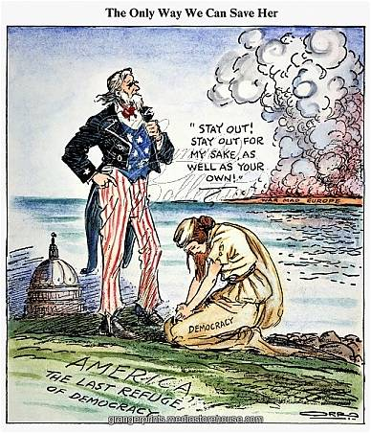
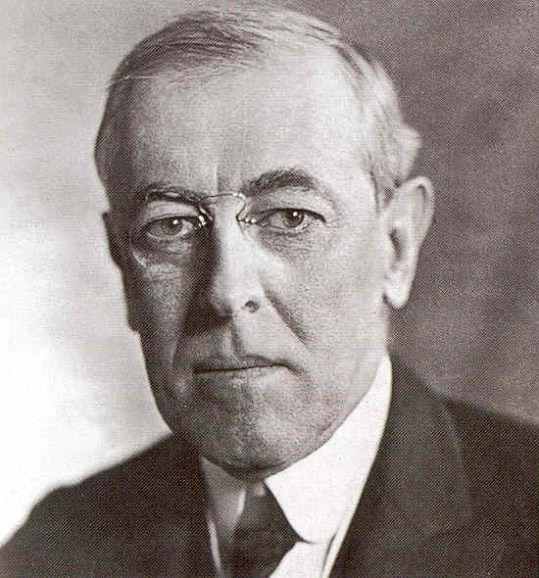
Essential Questions
How did President Woodrow Wilson view of the proper role of US government challenge traditional American democratic views?
A War to End ALL WARS!

Slide 6
World At War
Major causes: Militarism, Alliances, Industrialism/Imperialism, & Nationalism (M.A.I.N)
Timeline to WWI (Don’t Copy Timeline)
June 28, 1914 Archduke Franz Ferdinand assassinated in Sarajevo
July 23 Austria issues ultimatum to Serbia
July 25 Serbia responds to ultimatum; Austrian ambassador to Serbia immediately leaves Belgrade France promises support to Russia in the event of war
July 28 Austria declares war on Serbia
July 30 Russia orders general mobilization of troops
August 1 Germany declares war on Russia France and Germany order general mobilization
August 3 Germany declares war on France
August 4 Britain declares war on Germany

Slide 7
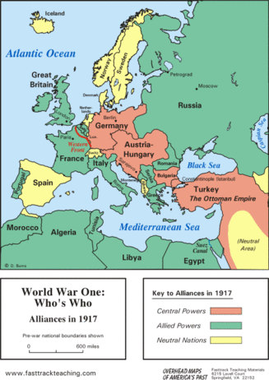
Sides
Allied Powers
Great Britain, France, Russia, Italy & Japan (US - 1917)
Central Powers
Germany, Austria-Hungary, & Ottoman Empire (Turkey)

Slide 8
Upholding tradition
President Wilson – Declaration of Neutrality and open trade with both sides
Council of National Defense (1916) (War mobilization effort)
Civilian Advisory Commissions formed in states
American recession prior to WWI (JP Morgan bails out & War = Trade)
Issues with American neutrality
German unrestricted submarine
Lusitania May 28, 1915 (128 Americans killed)
Sussex Pledge 1916 (Germany pledges to end unrestricted submarine warfare)

Slide 9
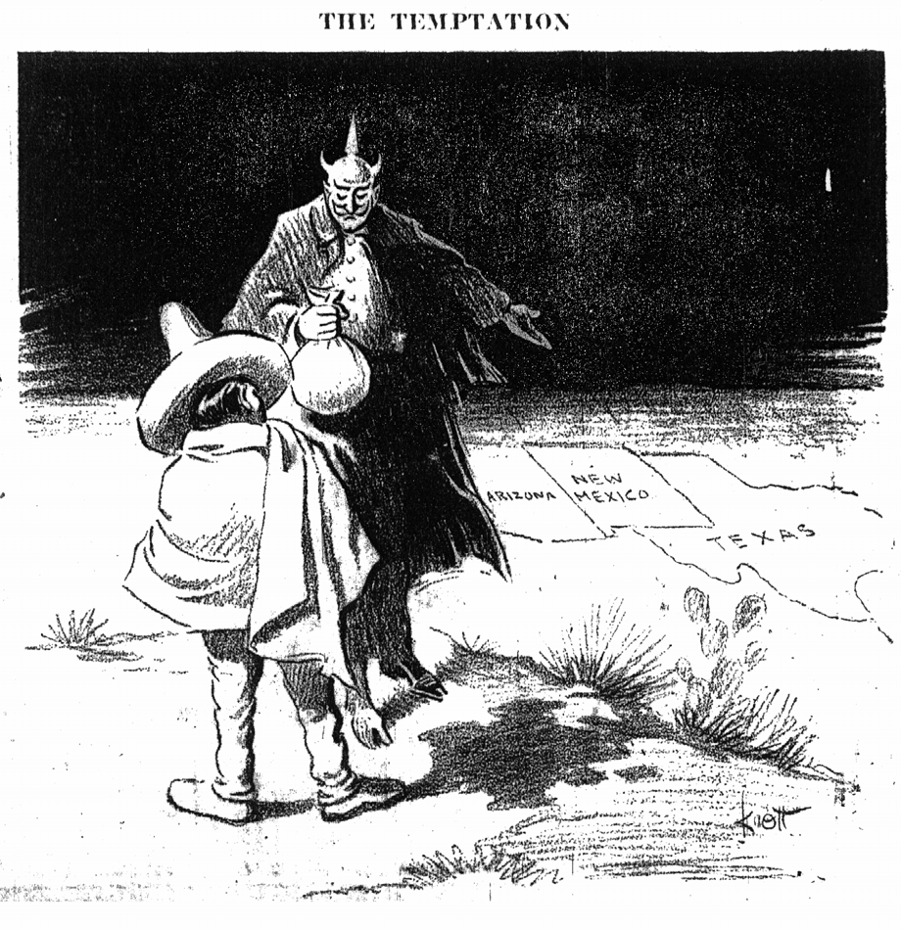
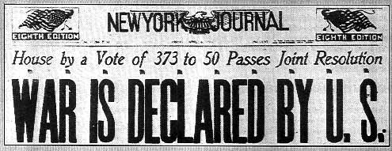
America joins the war
U.S. Breaks Neutrality
Germany returns to unrestricted sub warfare (British Blockade + US Trade with Allies)
**Bolshevik Revolution Treaty of Brest Litovsk 1917 (Russia out of WWI)
Zimmerman Telegram 1917: German alliance with Mexico

Slide 10
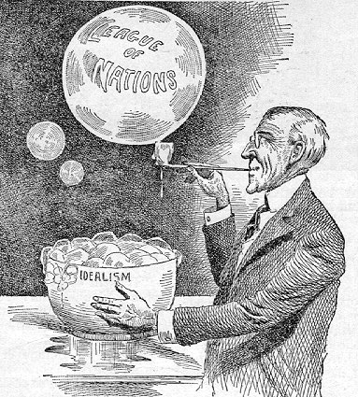
Wilson’s War to END all Wars
14 Points of Peace (1918) – idealism of the war (A WAR TO END WAR)
No secret treaties
Freedom of the Seas
Removal of economic barriers among nations
Reduction of armaments
Adjustment of colonial claims in the benefit of the territory to end imperialism
Self-determination
League of Nations to safeguard the world through collective security

Slide 11
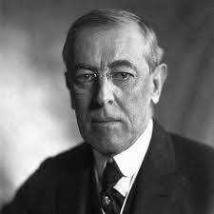
U.S. Interventionism
“This is not after all a conventional war, a struggle between predacious powers; it is a war to end all wars.”
- Woodrow Wilson
Demonstrate how the turn of the 20th century led the United States to violate the Washingtonian precedent of neutrality
1. Place the following events in chronological order
- Zimmerman Telegraph - Selective Service Act
- Platt Amendment - Roosevelt Corollary
- Sinking of the Lusitania - US Recession
2. Explain how all 8 items are transforming the role the US plays in world affairs and causing the US to enter WWI

Slide 12
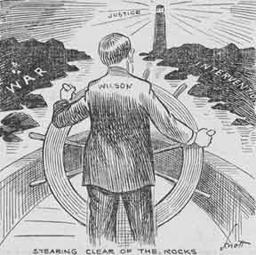
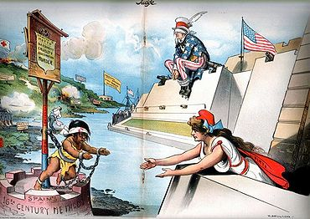
U.S. Interventionism
Evaluate whether it was proper for the United States to support interventionists (imperialistic) foreign policy at the turn of the 20th century.

Slide 13
Manifest Destiny Parallels Imperialism?
Similarities
Differences
Political
Economic
Social
Political
Economic
Social

Slide 14
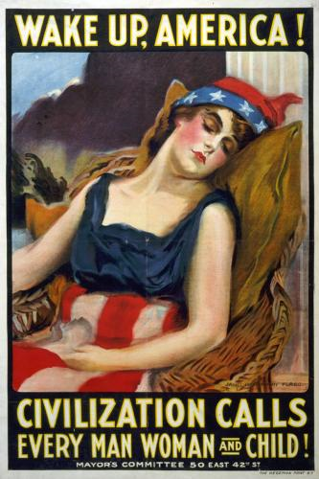
Violating Neutrality
Assess the relative influence of the following in the United States’ decision to declare war on Germany and violate its 100-year precedent of remaining neutral.
Read the historical analysis of US entrance into WWI and find historic arguments that support the following five categories.
German Naval Policy
Woodrow Wilson’s Moral Diplomacy
Allied propaganda
America’s claim: We are a world power
U.S. economic interest

Slide 15
Peace Without Victory
That service is nothing less than this, to add their authority and their power to the authority and force of other nations to guarantee peace and justice throughout the world. Such a settlement cannot now be long postponed. It is right that before it comes, this government should frankly formulate the conditions upon which it would feel justified in asking our people to approve its formal and solemn adherence to a League for Peace. I am here to attempt to state those conditions.
The present war must first be ended; but we owe it to candor and to a just regard for the opinion of mankind to say that, so far as our participation in guarantees of future peace is concerned, it makes a great deal of difference in what way and upon what terms it is ended. The treaties and agreements which bring it to an end must embody terms which will create a peace that is worth guaranteeing and preserving, a peace that will win the approval of mankind, not merely a peace that will serve the several interests and immediate aims of the nations engaged. We shall have no voice in determining what those terms shall be, but we shall, I feel sure, have a voice in determining whether they shall be made lasting or not by the guarantees of a universal covenant; and our judgment upon what is fundamental and essential as a condition precedent to permanency should be spoken now, not afterwards when it may be too late.

Slide 16
Agenda
Essential Question: How has America’s views been redefined by economic necessities, cultural notions, and national security during the turn of the 20th century?
Students can:
Decipher how did the evolution of industrial capitalism change American society in the 1890s to 1945 era
Evaluate how politicians and reformers responded to industrial changes, in the course of doing so, fundamentally change the role of government, especially the federal government, in the lives of Americans
Determine the transformation that occurred in the role of the U.S. on the world stage from 1890 to 1945
Agenda
The Home Front Effect
Changing to American society
Debating interventionism
Homework:
A Turning Point in History
Unit VIIA Test – Tuesday, 3/12

Slide 17
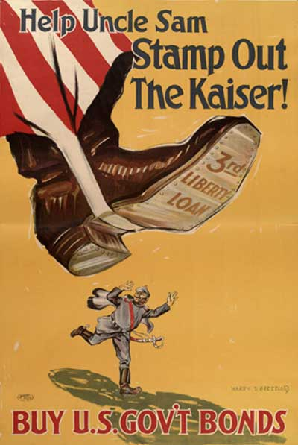
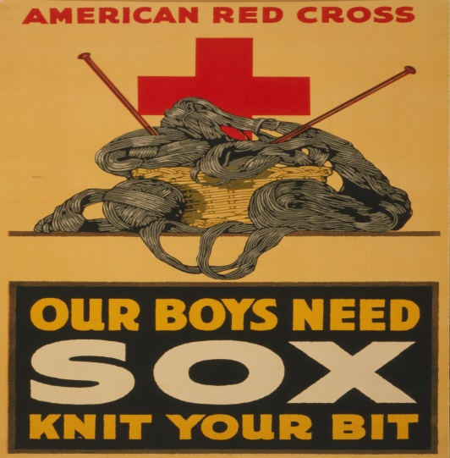
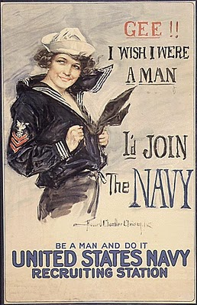
Propaganda
Based on your assigned topic – evaluate to what extent did WWI mobilization increase the power of the US government in the lives of Americans.

Slide 18
WWI 1st for America
A War to End all Wars
Selling the War Effort (Propaganda): Committee of Public Information (George Creel)
Progressivism beliefs of Wilson utilized in war mobilization
Government activism: government regulations (compliance required
Volunteerism: support the war effort (patriotic duty)

Slide 19
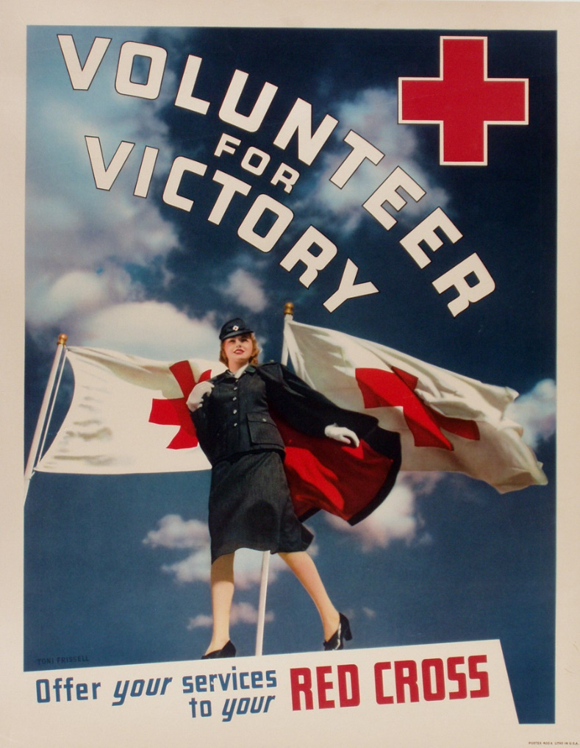
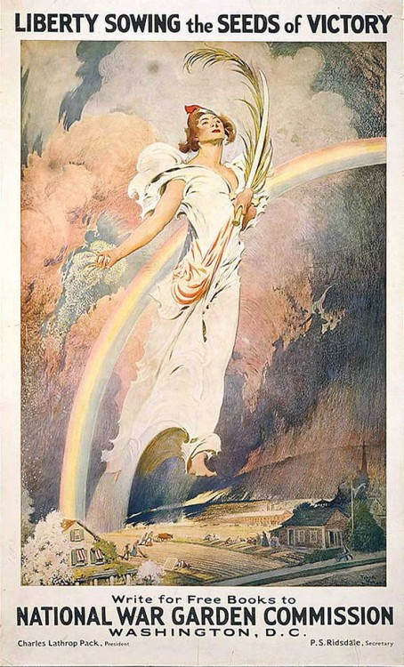
Volunteerism
Federal government asks Americans and business to support the war effort (volunteerism)
Rationing
Victory Gardens
Red Cross donations

Slide 20
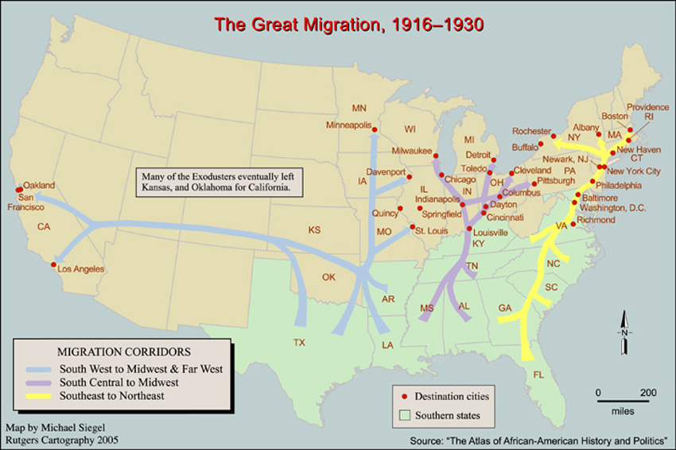
Great Migration
The Great Migration: Escape segregation & sharecropping

Slide 21
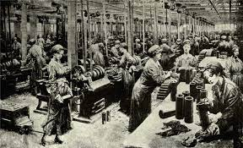
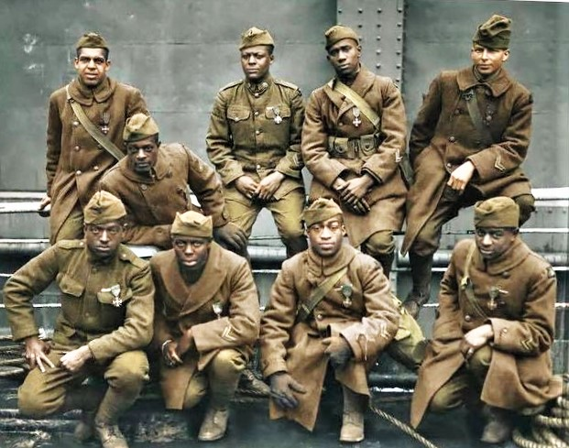
Opportunity
Women: factory workers 19th Amendment
African Americans (promote equality)
Great Migration – urbanization movement (Strike breakers)
Booker T Washington Harlem Hell Fighters
(Atlanta Compromise – earn equality)

Slide 22
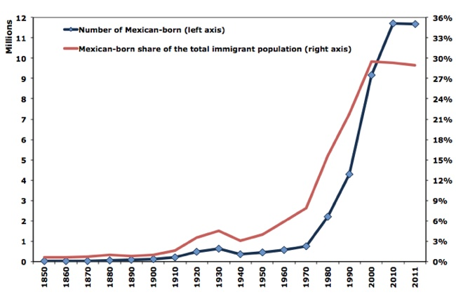
New Pattern of Migration
Mexican immigration 1910-1930 (tripled) – farm labor

Slide 23
WWI 1st for America
A War to End all Wars
American 1st
Breaks neutrality
Establishes a draft – Selective Service Act
Liberty Bonds: pays for war
Government takes an active role in mobilization the economy for the war effort
War Industries Board (Bernard Burch)
Committee for Public Information (George Creel)
Food Administration (Herbert Hoover)
Fuel Administration
National War Labor Board (Taft)

Slide 24
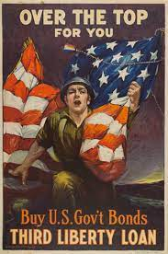
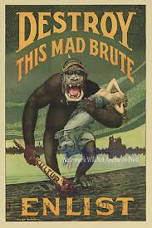
The Loss of Laissez Faire?
The Progressive Era had given the federal government the belief and power to take a more activist approach to American life.
Prompt: Evaluate to what extent WWI expanded the beliefs in Progressive idea that the federal government should solve problems that business and private individualize could or would not handle.

Slide 25
The Home Front
Government gained more power inside the U.S.
Committee for Public Information (CPI) – George Creel (Sell the war effort) – Fund the war effort “Liberty Bonds”
War Preparations
Selective Services Act – The draft
War Industries Board (WIB) –
Bernard Burch (organize the economy)
National War Labor Board – settle
labor disputes
8-hour work day
unions still not recognized
Food Administration – Herbert Hoover
Encourage patriotism (meatless Mondays & victory gardens)
Rationing

Slide 26
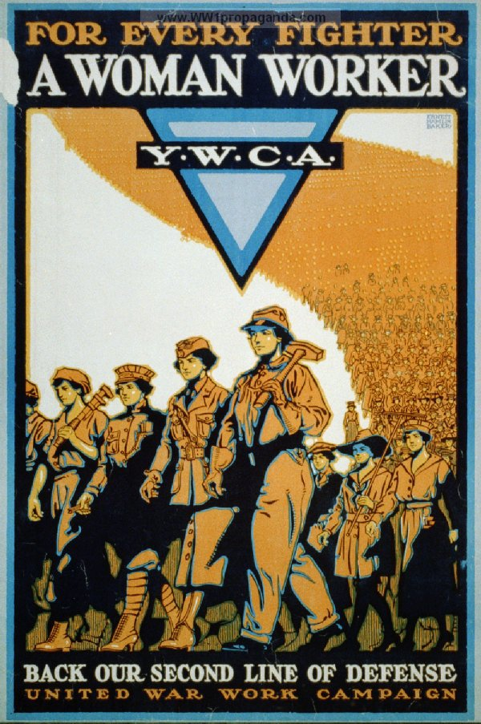
Transformative Effects of War
Fear of Socialism (Eugene V. Debs & Wobblies)
Denial of Rights (limiting the 1st Amendment)
Espionage Act 1917 – (Schenck v. United States)
Sedition Act 1918
Women
Mobilized as factory workers (Wilson supports 19th Amendment) Women forced to give up jobs after the war (Sheppard-Towner Maternity Act 1921)
Women’s Peace Party (Alice Paul & Jane Addams)

Slide 27
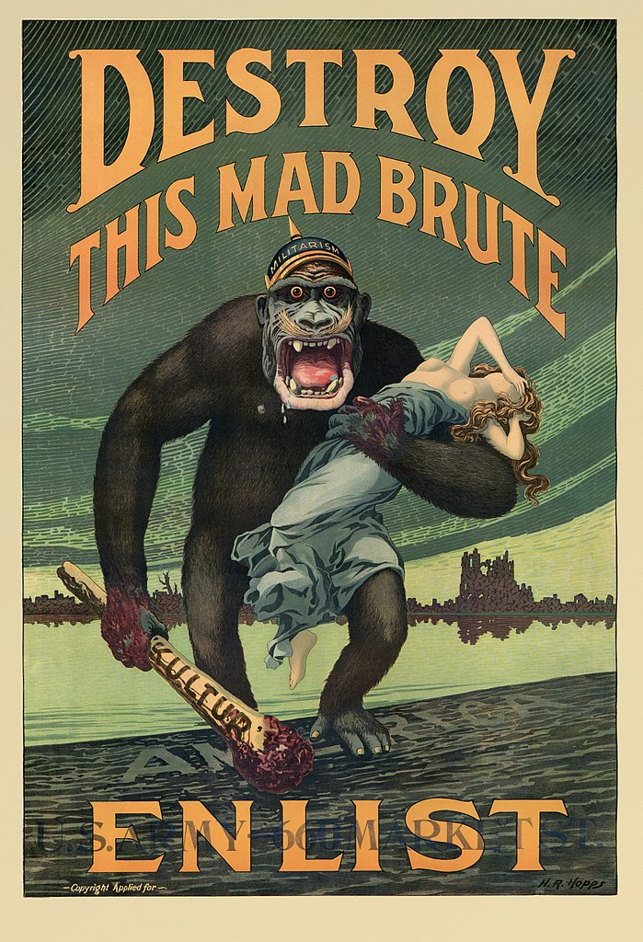
Down with the Krauts
Anti-German sentiment builds in America (rise of nativism)
Changing of German last names
Liberty Cabbage (Sauerkraut)
18th Amendment – No Beer

Slide 28
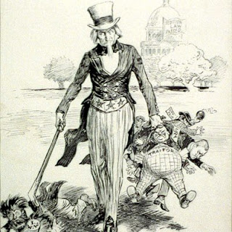
Limiting Civil Liberties
Espionage and Sedition Acts: prevent supporting the enemy (disloyal, abusive, profane, & scurrilous language)
Schenck v. US: Government can limit free speech (clear & present danger test)
Eugene V. Debs
Anti-German Sentiment:
American Protection League

Slide 29
Connections
Identify and explain two major social changes that happened as a result of America’s mass mobilization for WWI?

Slide 30
Crisis and U.S. Government Intervention
Evaluate whether US government intervention in American’s lives during WWI had a positive or negative impact on the nation
Work in groups of four and use your propaganda posters to construct a chart to illustrate the positive and negatives of government intervention in the “home front” during WWI.
Construct an argument as to whether it was positive or negative.
Compare your argument to other interventions by the US government – Executive Order 9066, Smith Act, or US Patriot Act (explain the connection)

Slide 31
Government Intervention
Government intervention during crisis has been done in the least obtrusive way in order to protect national security and meet the demands of war.
Americans should allow the federal government to limit Constitutional rights during war time in order to protect us from potential threats.
The American economy has benefitted from US involvement in war.
The United States involvement in war has provided opportunities for different groups in America to improve their status in society.
The United States should take on its role as a superpower, because we have the economy, democratic ideals, and military mite to build a better world

Slide 32
Agenda
Essential Question: How has America’s views been redefined by economic necessities, cultural notions, and national security during the turn of the 20th century?
Students can:
Decipher how did the evolution of industrial capitalism change American society in the 1890s to 1945 era
Evaluate how politicians and reformers responded to industrial changes, in the course of doing so, fundamentally change the role of government, especially the federal government, in the lives of Americans
Determine the transformation that occurred in the role of the U.S. on the world stage from 1890 to 1945
Agenda
The Loss of Laissez Faire
War of all of Horrors
Remember the Falling
Homework: Treaty of Versailles

Slide 33
The Loss of Laissez Faire?
The Progressive Era had given the federal government the belief and power to take a more activist approach to American life.
Prompt: Evaluate to what extent WWI expanded the beliefs in Progressive idea that the federal government should solve problems that business and private individualize could or would not handle.

Slide 34
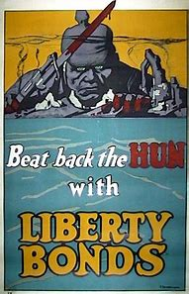
Home Front Quiz
Don’t Let the Huns get YOU – 15 minutes

Slide 35
Industrialize Warfare
Industrialize Warfare
Machine gun
Camouflage
Poison gas & gas masks
Airplanes
Bombs
Tanks

Slide 36
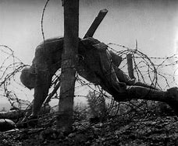
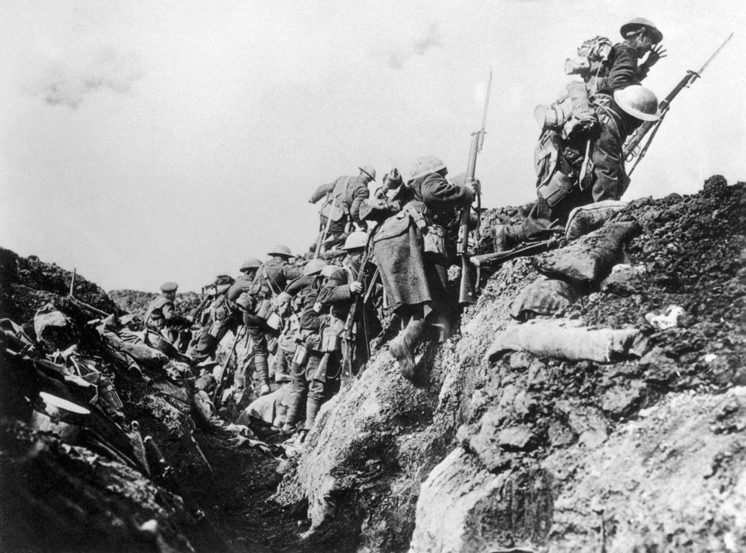
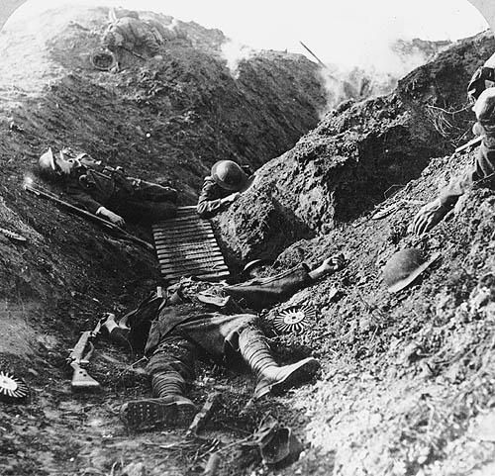
This NO MAN’s Land
Trench Warfare STALEMATE

Slide 37
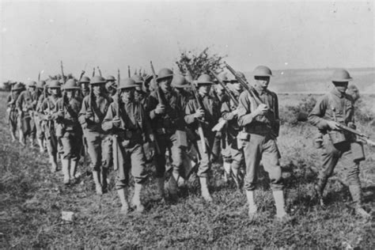
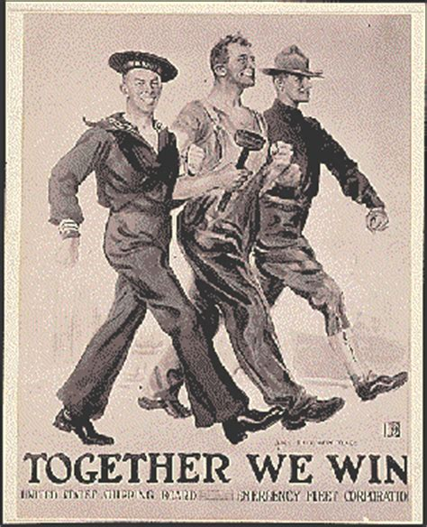
America at War
1917: Allies running out of new recruits
Selective Service Act 1917: the Draft
American Expeditionary Force (The Doughboys)
General John Perishing

Slide 38
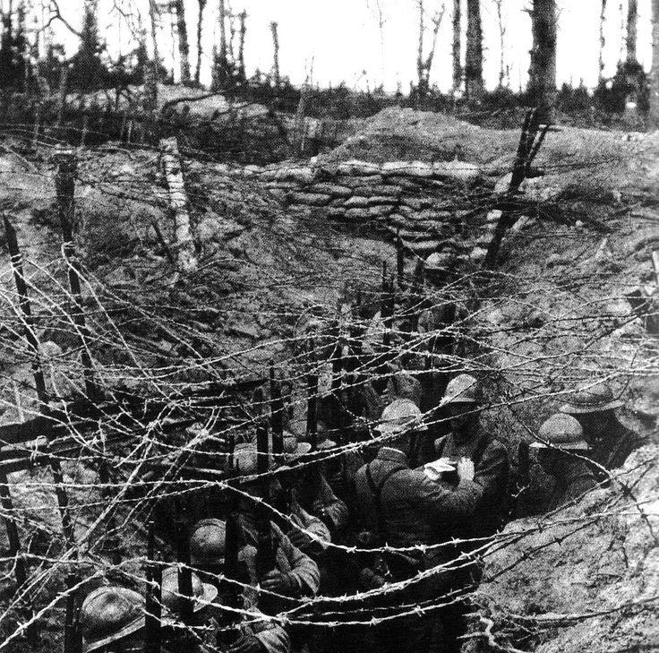
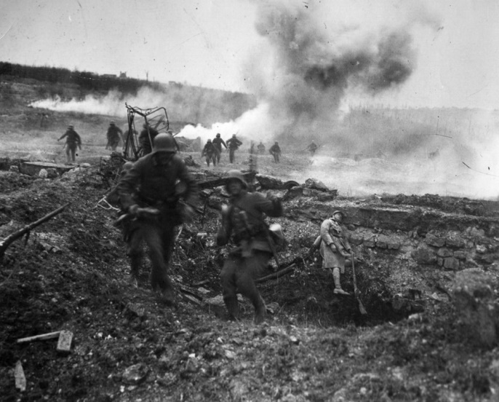
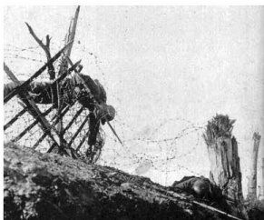
Greenfields of France
Construct a HAPPY Analysis of The New Crusade & Green Fields of France (contrast perspectives)
Explain the writers view of the WWI. (Connect to outside facts from your term sheet to support your conclusions)
What is the writer’s response to Wilson’s argument of “a war to end all wars”?
How do those that fought in the great war feel about the purpose of WWI when it was over?

Slide 39
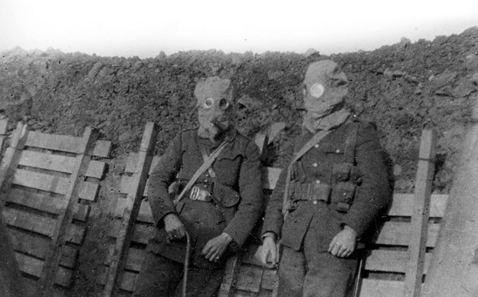
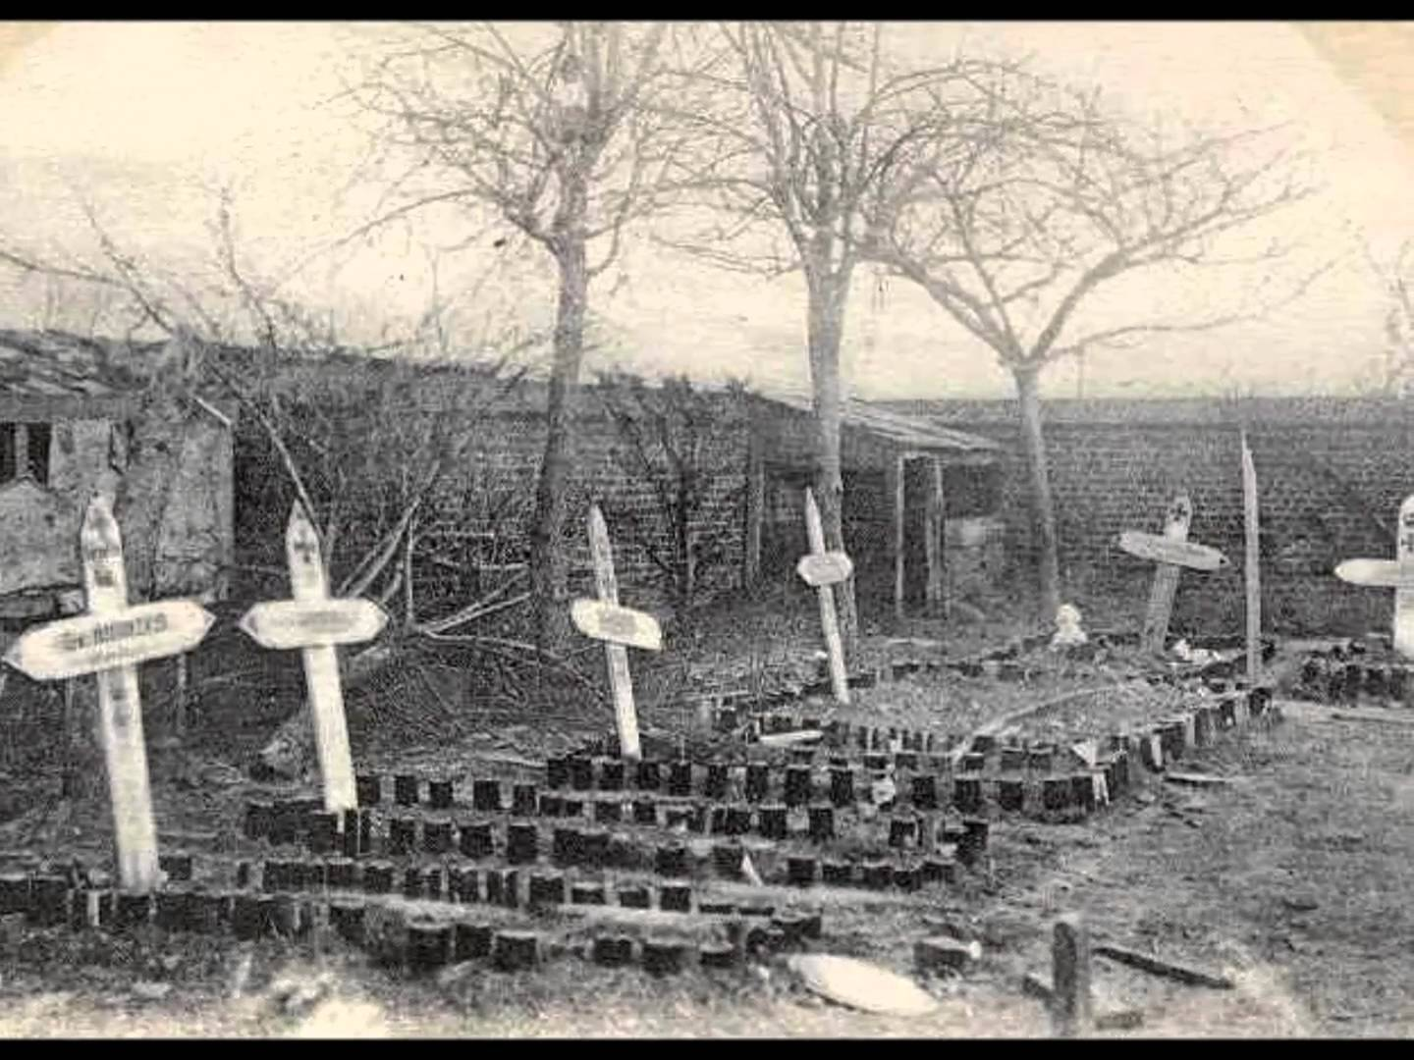
Remember the Falling
In the Green Fields of France

Slide 40
Agenda
Essential Question: How has America’s views been redefined by economic necessities, cultural notions, and national security during the turn of the 20th century?
Students can:
Decipher how did the evolution of industrial capitalism change American society in the 1890s to 1945 era
Evaluate how politicians and reformers responded to industrial changes, in the course of doing so, fundamentally change the role of government, especially the federal government, in the lives of Americans
Determine the transformation that occurred in the role of the U.S. on the world stage from 1890 to 1945
Agenda
Wilson’s Idealism Test
Versailles Peace Conference
To intervene or not to intervene – that is the question
Homework:
Return to Normalcy
Unit VIIA Test – 3/12

Slide 41
Wilson’s Plan
Wilson’s 14 Points of Peace
I. Open covenants of peace, openly arrived at, after which there shall be no private international understandings of any kind but diplomacy shall proceed always frankly and in the public view.
V. A free, open-minded, and absolutely impartial adjustment of all colonial claims, based upon a strict observance of the principle that in determining all such questions of sovereignty the interests of the populations concerned must have equal weight with the equitable claims of the government whose title is to be determined.
XIV. A general association of nations must be formed under specific covenants for the purpose of affording mutual guarantees of political independence and territorial integrity to great and small states alike.
“War with no clear victor”
Why did most of Wilson’s Points of Peace get rejected by the other members of the Big 4?

Slide 42
The Covenant of Wilsonian Idealism
“I take the liberty of urging upon you the desirability of accepting the reservations now passed. . . .
I have the belief that with the League once in motion it can within itself and from experience and public education develop such measures as will make it effective. I am impressed with the desperate necessity of early ratification.
The delays have already seriously imperiled the economic recuperation of Europe. In this we are vitally interested from every point of view. I believe that the Covenant will steadily lose ground in popular support if it is not put into constructive operation at once because the American public will not appreciate the saving values of the Covenant as distinguished from the wrongs imposed in the Treaty. . . .”
Herbert Hoover to Woodrow Wilson, November 19, 1919.
Explain the difference between Wilson, Irreconcilables', and Reservationists’ views of the Treaty of Versailles.

Slide 43
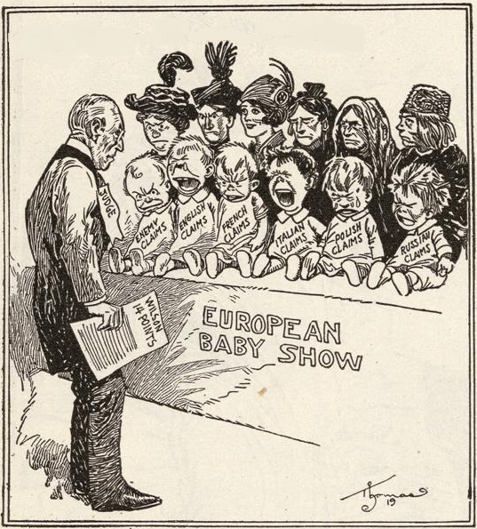
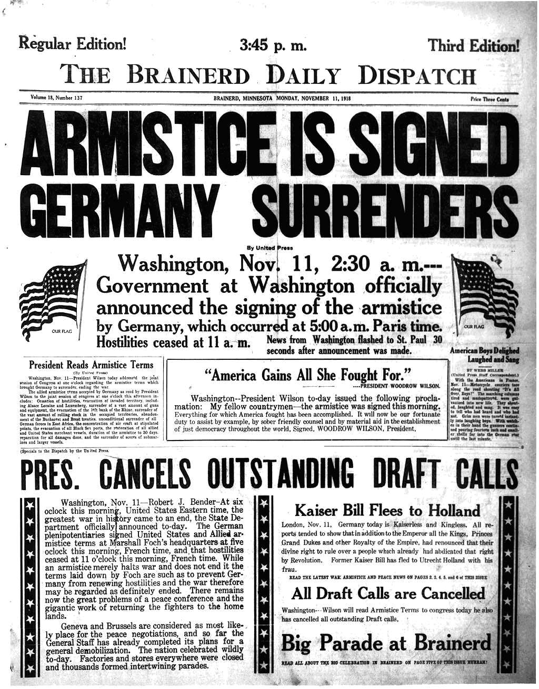
Armistice Day
Armistice, Nov. 11, 1918
US Forces provide needed fresh forces
Pres. Wilson’s a War to End All Wars – 14 Points of Peace

Slide 44
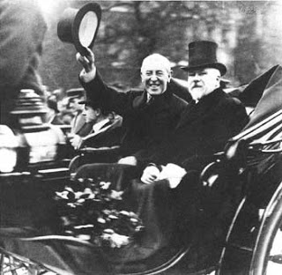
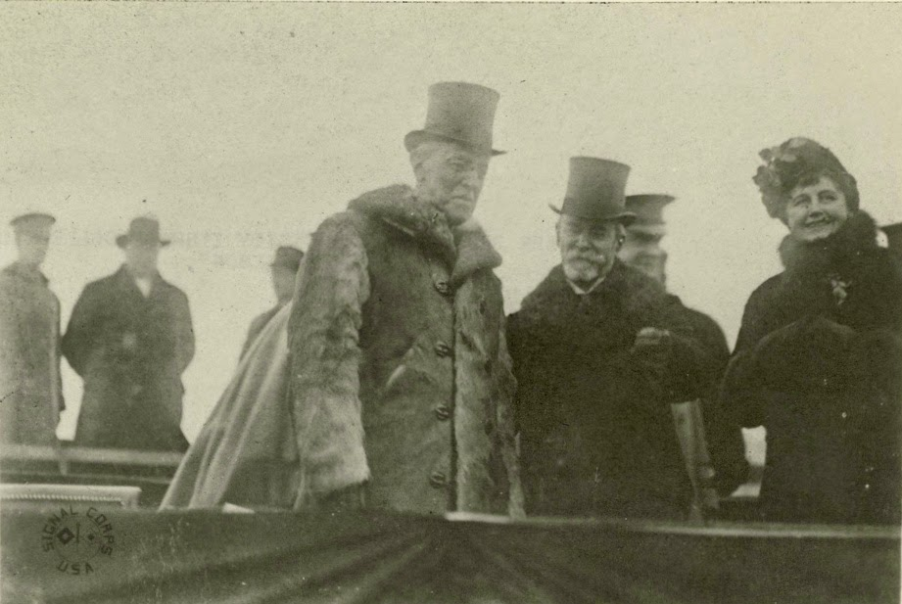
Election 1918
Wilson seeks to bring the Democrats to power
1918 Election results: Republicans majority in Congress
Wilson’s snubs Republican majority by not inviting Senator Henry Cabot Lodge to the Paris Peace negotiations (Loses congressional backing) Wilson Grandstanding

Slide 45
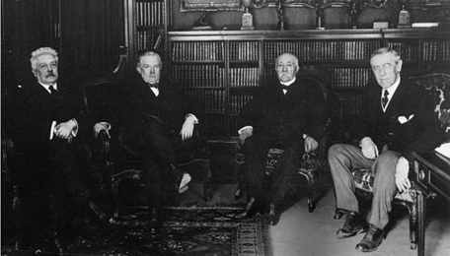
Paris Peace Conference
The Big Four: Wilson (US), Vittorio Orlando (Italy), David Lloyd George (Great Britain), and Georges Clemenceau (France)
Motivating factor for quick peace negotiations – Bolshevik Revolution (Fear of the Red Scare)
Wilson's Plan: 14 Points of Peace – Self determination, A League of Nations, Freedom of the Seas, etc…
Germany not allowed at Paris Peace Conference (Support Wilson’s 14 Points of Peace

Slide 46
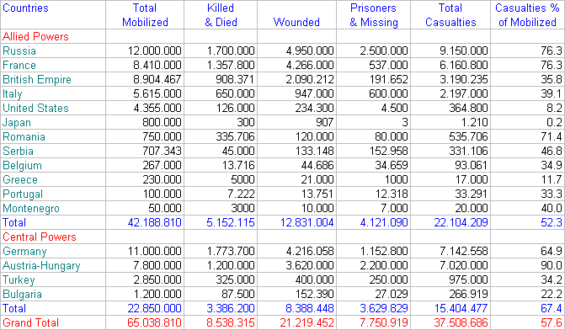
Industrial War Destruction

Slide 47
WWI Data

Slide 48
WWI Data

Slide 49
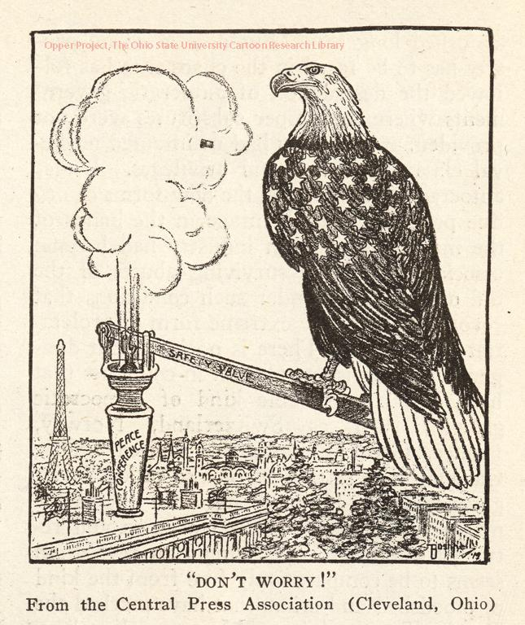
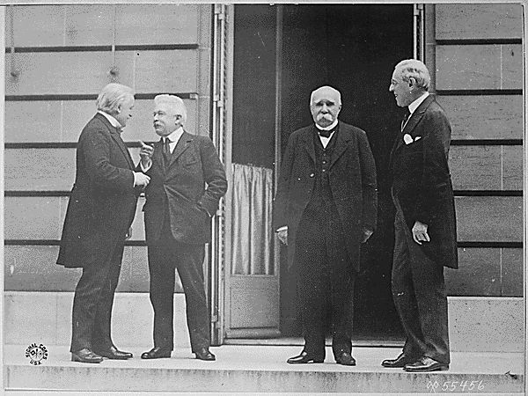
Treaty of Versailles
Treaty of Versailles
Germany gets the blame and pay reparations
Wilson 14 points of Peace rejected, except League of Nations
Issue: League of Nations puts US
involved in entangle alliances

Slide 50
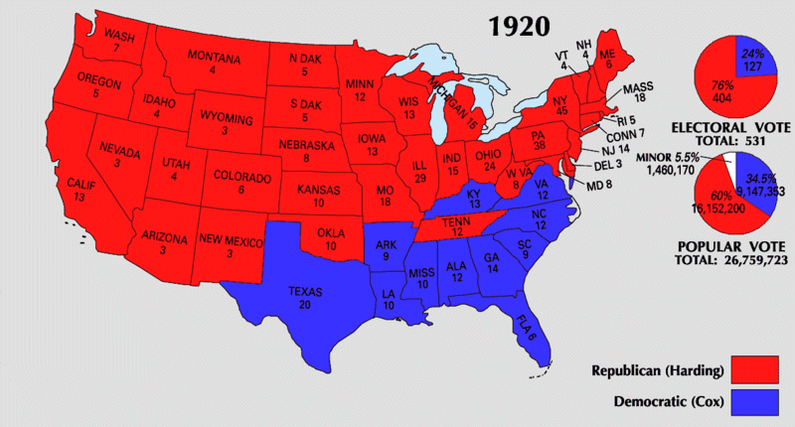
Treaty of Versailles Rejection
Wilson had created political division
Impact of the WWI – Industrial war caused horrible death
Irreconcilables – isolationism (stay out of European mess)
Republican Snub
Reservationists (Henry Cabot Lodge) – Title X violates US Constitution
Election of 1920 referendum
election – Republicans Wins
Treaty of Versailles rejected

Slide 51
A turning point?
Prompt: Evaluate the extent to which United States in World War I (1917 – 1918) marked a turning point in the nation’s role in world affairs.
Decipher how the WWI did promote a turning point
HAPPY analysis of cartoons at the end of WWI
Consider the views of Wilson, the American Public, Reservationists, and the Irreconcilables

Slide 52
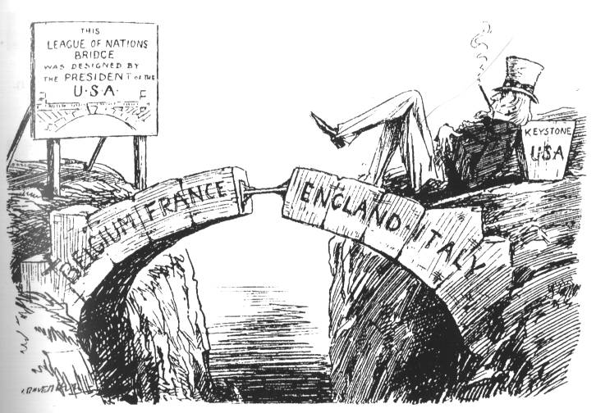
“The Gap in the Bridge, 1919
Complete a HAPPY Analysis

Slide 53
Imperialistic Debate
Prompt: Evaluate whether it was proper for the United States to support interventionists (imperialistic) foreign policy at the turn of the 20th century.
Use facts, statistics, passed examples to support conclusions (quotes work to)
Roles:
Opening Argument – one person
Crossfire 1 – 3 people
Summarizer 1 – 1 person
Crossfire 2 – 3 people
Summarizer 1 – 1 person
Crossfire 3 – 3 people
Closing arguments – 1 person

Slide 54
“The Gap in the Bridge, 1919
Wilson’s POV
Irreconcilables’ POV
Reservationists’ POV

Slide 55
“The Gap in the Bridge, 1919
League of Nations
Irreconcilables
Isolationism
Treaty of Versailles
Reservationists
Article X
Woodrow Wilson
14 Points of Peace
The Big Four

Slide 56
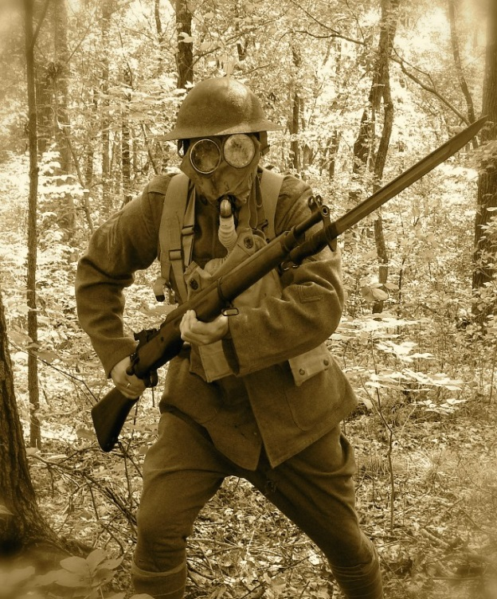
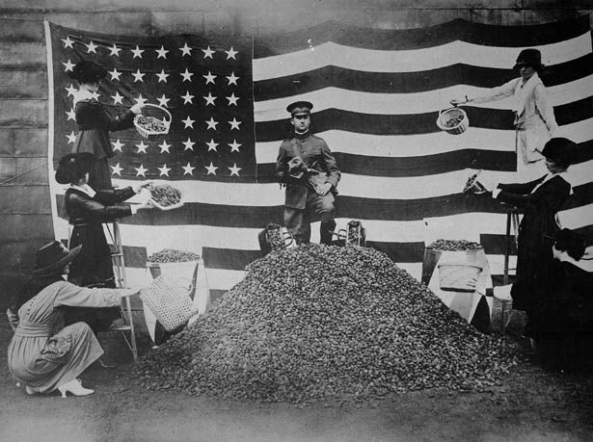
Lessons WWI Teaches
WWI brought the United States to the forefront of international politics, and teaches historian some very important lessons about the development of America in the future.
Identify and explain three important lessons that US involvement in WWI has taught us about how America reacts to a crisis.

Slide 57
WWI and US on the World Stage
Summarize the view points of the United States after WWI via the following groups
Woodrow Wilson
Irreconcilables
Reservationists
1920 Presidential Election theme – “A return to Normalcy”

