Slide 1
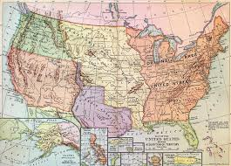
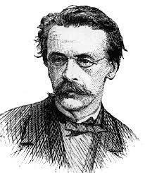
Manifest Destiny
Unit V: 1844-1877
This here is MY LAND! Your land is actually MY LAND!

Slide 2
Essential Question: How did the development of America expansionism lead to greater sectionalism and the unresolved issues of federal power and citizenship in the United States?
Students can:
Explain factors that contributed to Manifest Destiny and its influence on the development of the United States
Determine how Manifest Destiny contributes to the growth of sectionalism within the United States
Agenda
American Progress
An Expansionism Attitude
Texas Independence
Homework
Objective 10 Reading Questions – due Fri. 12/6

Slide 3
Guiding Question
How did the development of America expansionism lead to greater sectionalism and the unresolved issues of federal power and citizenship in the United States?
Evaluate to what extent was aggressive imperialism pursued by Americans at the expense of others during the period of 1812 to 1860?

Slide 4
American Progress, John Ghast, 1872
Historic Contextualization – theme: Migration & Settlement
“It is our manifest destiny to overspread and to possess the whole of the continent which Providence has given us for the development of the great experiment of liberty and federated
self-government entrusted to us”
“Manifest Destiny”
John O’Sullivan, editor of the New York Post, arguing for the annexation of Texas, July, 1845
“It is our manifest destiny to overspread and to possess the whole of the continent which Providence has given us for the development of the great experiment of liberty and federated self-government entrusted to us”
“Manifest Destiny”
John O’Sullivan, editor of the New York Post, arguing for the annexation of Texas, July, 1845

Slide 5
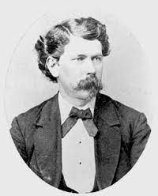
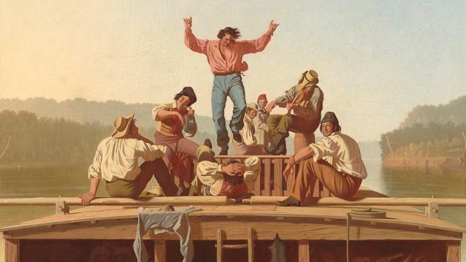
No Attitude
“. . . Our manifest destiny to overspread and to possess the whole continent which Providence has given us for the development of the great experiment of liberty and federated self-government entrusted to us.”
- John O’Sullivan, New York journalist, 1845
New attitude: Ethnocentrism
Evaluation of a culture as a traditional standard to judge others by
AMERICA!!
Driving ethnocentric views
Development of the Constitutional Republic
Conquering the frontier
Advances of technology
Establishment of a new culture

Slide 6
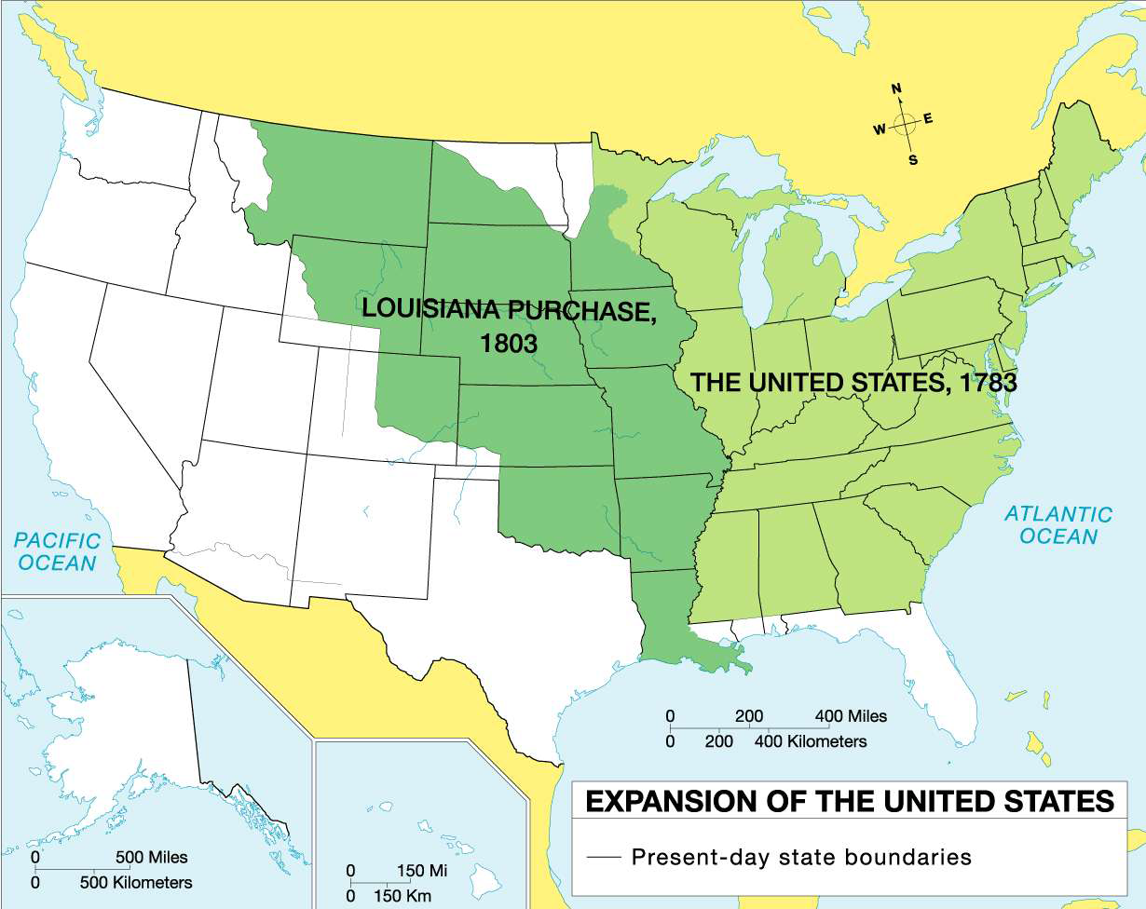
United States by 1803
Evaluate how western migration has affected the development of the United States from 1800 – 1850.

Slide 7
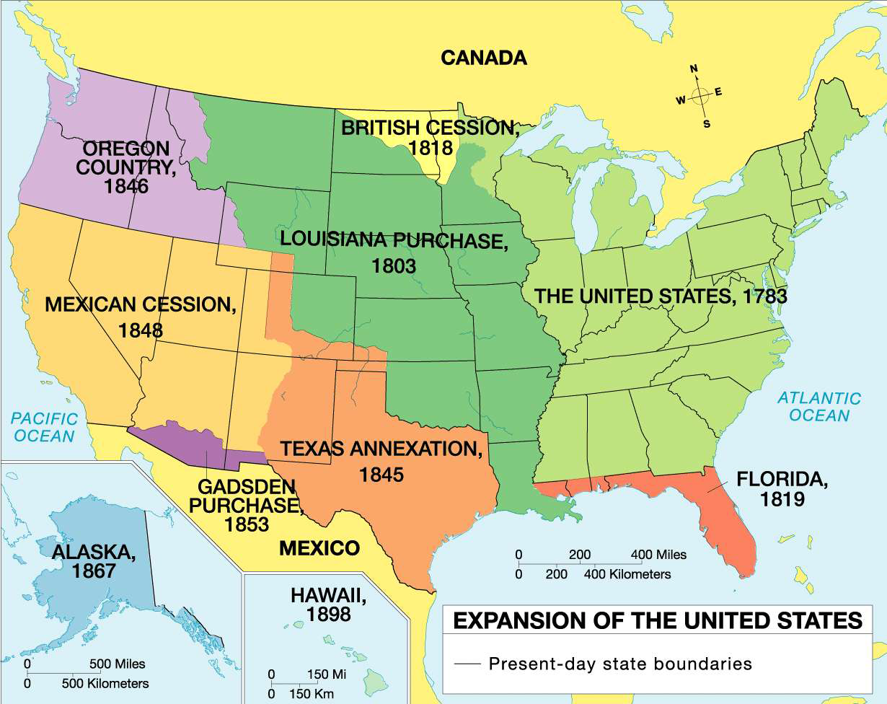
United States by 1898
Evaluate how western migration has affected the development of the United States from 1840 - 1898.

Slide 8
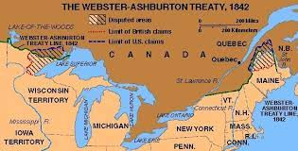
U.S. v. England
United States Issues:
Debt – Panic of 1837
Slavery – Creole Incident (1841)
Disputes between Canada & U.S.
Carolina Incident (1839-42)
Aroostook War (1838-39) - Border Dispute (Maine & Canada)
Webster-Ashburton Treaty (1842)
U.S gains part of Maine & Minnesota (Mesabi Range – iron ore for industrial revolution)

Slide 9
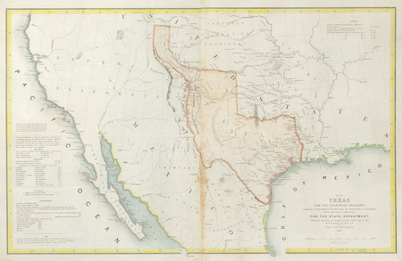
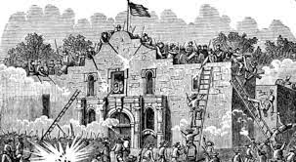
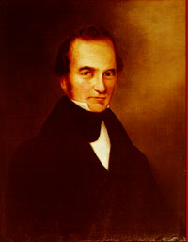
The Lone Star Republic
Factors for Texas settlement: opportunity for the common man (King Cotton)
Mexican Rules for Settlement:
NO SLAVERY
Accept Catholicism
Subservient to Mexican authority
War for Texas Independence (1838-39)
Explain why Texans sought independence from the Mexico in 1838.
Stephen Austin
Remember the Alamo

Slide 10
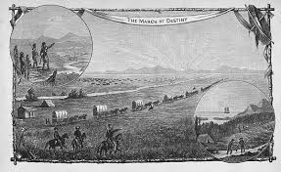
Manifest Destiny Effect
March of Destiny by Frank Triplett, 1883
Historic Contextualization – theme migration & settlement

Slide 11
Contributing Factors for Manifest Destiny
Manifest Destiny: the belief that God has ordain the Americans should control the continent from sea to shining sea
Evaluate why America pursued a policy of manifest destiny from 1812 to 1867
Contributing Factors
Cultural influence
Political influence
Economic influence
Environmental influence
Religious influence
Technology influence

Slide 12
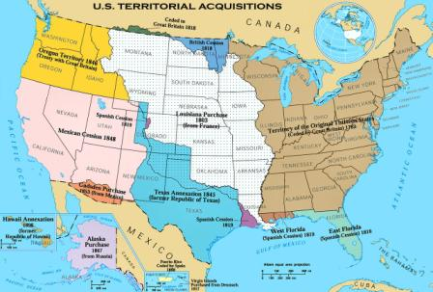
Contribution to Manifest Destiny
American Expansionism
Cultural: Ethnocentrism (John O’Sullivan)
Religion: expansion of Christianity & religious freedom (Mormons & Missionaries)
Politics: Free v. Slave Territory, Common Man
Economic: New Resources & Markets
Area: land butchery (Cotton soil deplete)

Slide 13
Manifest Destiny Impact
Evaluate the benefits and the determents of Manifest Destiny
Benefits – Manifest Destiny
Determents – Manifest Destiny

Slide 14
Essential Question: How did the development of America expansionism lead to greater sectionalism and the unresolved issues of federal power and citizenship in the United States?
Students can:
Evaluate factors that contributed to Manifest Destiny and its influence on the development of the United States
Determine how Manifest Destiny contributes to the growth of sectionalism within the United States
Agenda
The Donner Party – Let’s Eat
California Dreaming
Manifest Destiny – The Mexican Cessation
Homework: Objective 10 Reading Questions

Slide 15
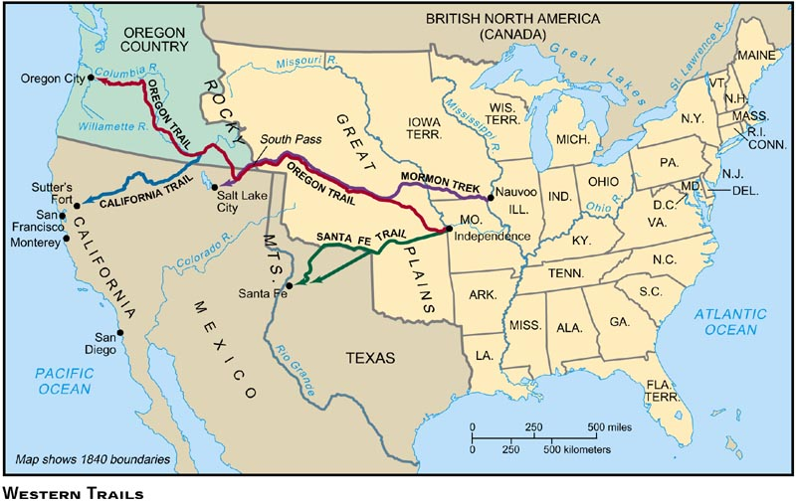
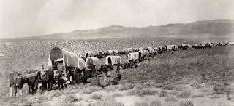
Never Eat with the Donner Party
Western Migration
The Donner Party – having you for dinner
Trails of Western Migration – Opportunity and religious freedom
Oregon Trail
Santa Fe Trail
Mormon Trail

Slide 16
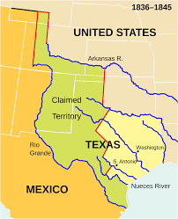
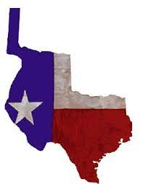
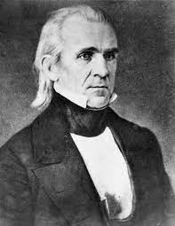
Causation of Mexican American War
Debates over Texas
Texas denied annexation (1839) – offset the balance free & slave states
- Mexico threaten war if annexed
Texas claims
Lone Star Republic
Election of 1844 - James K. Polk (Manifest Destiny campaign promise)
Annexation of Texas (maintains neutrality)
Attempts to purchase California/New Mexico territory (Mexico rejects offer)
Mexico claims

Slide 17
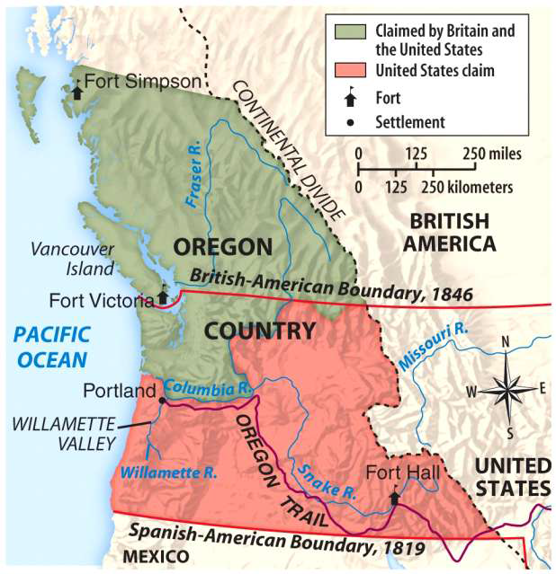
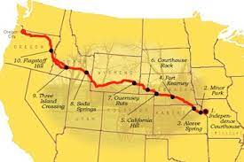
Oregon Territorial Dispute
Oregon Trail – Fertile farmland & missionaries (issue joint occupation w/ England)
Sectionalism: Maintaining the balance of free v. slave territory (TEXAS)
54’- 40” or FIGHT! – board dispute with England
Compromise: 49th Parallel (sold out for Texas)

Slide 18
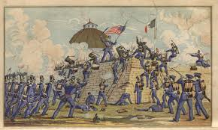
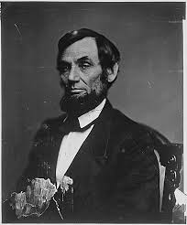
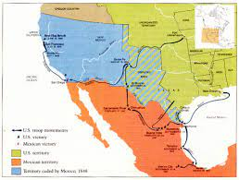
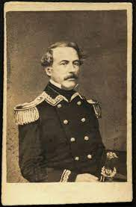
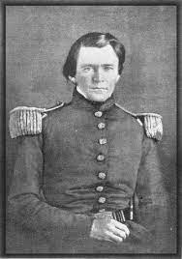
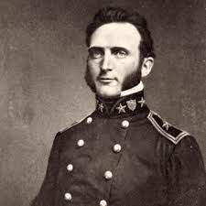
Mexican American War
Mexican American War (1846 – 1848)
Opposition to war (N. Whigs – Spot Resolution)
Thoreau's “Civil Disobedience”
Rise of sectional tensions – Wilmot Proviso
Treaty of Guadalupe Hidalgo 1848 (Nicholas Trist Deal)
U.S. double in size (California, New Mexico, Arizona, Texas)
“Provided, That, as an express and fundamental condition to the acquisition of any territory from the Republic of Mexico by the United States, by virtue of any treaty which may be negotiated between them, and to the use by the Executive of the moneys herein appropriated, neither slavery nor involuntary servitude shall ever exist in any part of said territory, except for crime, whereof the party shall first be duly convicted.”

Slide 19
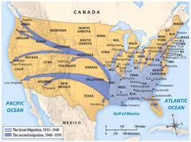
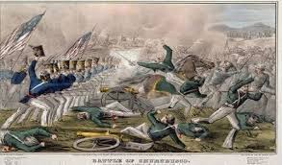
Westward Expansion
Evaluate factors that encourage westward expansion from 1840 - 1850
Identify and explain economic factors that cause the rise of Manifest Destiny in the U.S. from 1840 – 1850.
Evaluate whether the Mexican-American War was fought for legitimate reasons.

Slide 20
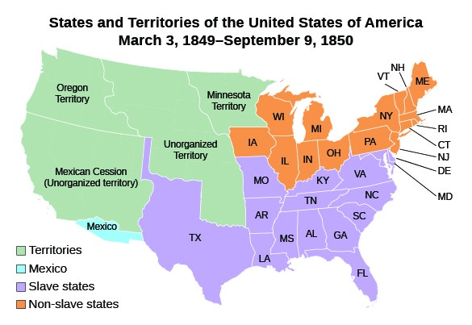
U.S. Territory 1850
Territory Accession

Slide 21
Contributing Factors for Manifest Destiny
Manifest Destiny: the belief that God has ordain the Americans should control the continent from sea to shining sea
Evaluate why America pursued a policy of manifest destiny from 1812 to 1867
Contributing Factors
Cultural influence
Political influence
Economic influence
Environmental influence
Religious influence
Technology influence

Slide 22
Rise of Sectionalism
1850 – 1861

Slide 23
Essential Question: How did the development of America expansionism lead to greater sectionalism and the unresolved issues of federal power and citizenship in the United States?
Students can:
Evaluate factors that contributed to Manifest Destiny and its influence on the development of the United States
Determine how Manifest Destiny contributes to the growth of sectionalism within the United States and issues of unresolved federal power
Agenda
The Effects of Manifest Destiny
Feeding Sectional Division
Political Cartoons of Political Division
Homework: Objective 10 Reading Questions due 12/6

Slide 24
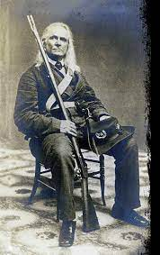
Guiding Question
How did the development of America expansionism lead to greater sectionalism and the unresolved issues of federal power and citizenship in the United States?
“This. . . Momentous election . . . Will serve to show whether these southern states are to remain free, or to be politically enslaved – whether the institution of slavery on which the social and political existence of the south rests, is to be secured by our resistance, or . . . abolished in a short time as the certain result of our present submission to northern domination.”
- Edmund Ruffin, Virginia Slaveholder and Secessionist

Slide 25
Manifest Destiny Impact
Evaluate the benefits and the determents of Manifest Destiny
Benefits – Manifest Destiny
Determents – Manifest Destiny

Slide 26
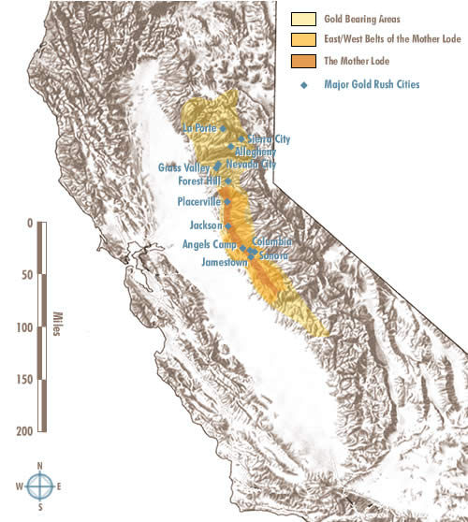
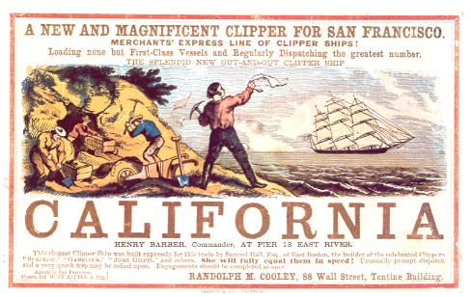
There is GOLD
GOLD RUSH
1849 – Sutter’s Mill (Gold!!!) Speculators rush to California (49ers)
1850: California applies for statehood
Offsets the balance of free v. slave territories

Slide 27
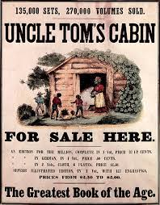
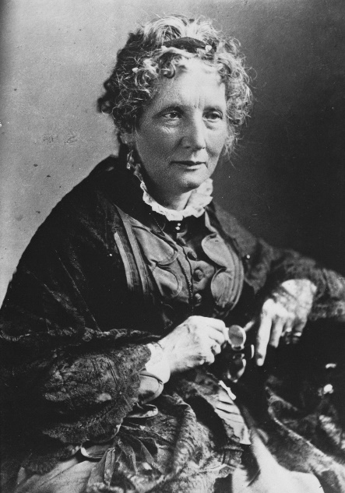
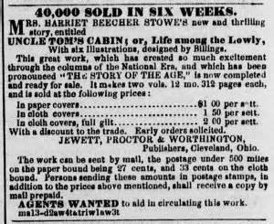
Awakening the North to Abolition
Uncle Tom’s Cabin by Harriet Beecher Stowe (1852)
“Scenes of blood and cruelty are shocking to our ear and hear. What man has the nerve to do, man has not the nerve to hear.”
Impending Crisis of South by Hinton Helper – statistical impact of slavery on non-slave holding population

Slide 28
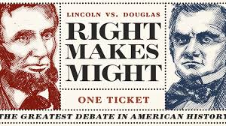
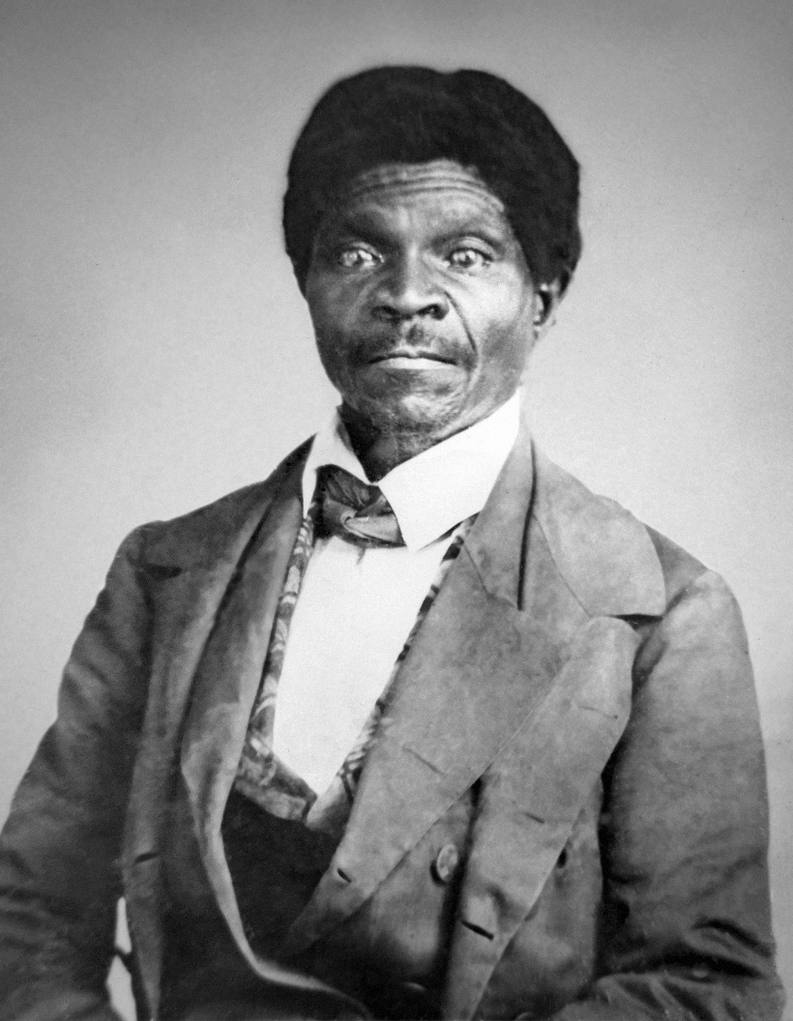
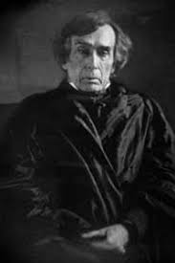
Slavery, A Federalism Issue
Federalism = Division of power between state & federal government
Dred Scot v. Sanford 1857
Ruling: Slaves = property therefore have NO Rights
Missouri Compromise = Unconstitutional (State right issue)
Allows slavery to expand in the North
Lincoln-Douglas Debate (1858)
Illinois Senate Race for Congress
Freeport Doctrine: Don’t pass laws that support slavery to ban slavery (Stephen Douglas)
Lincoln’s “House Divide Speech” – We cannot be half slave, half free
Dred Scot
Justice Roger Taney

Slide 29
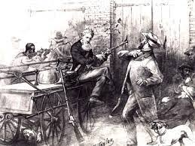
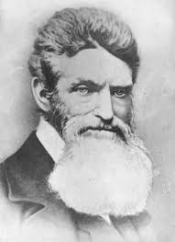
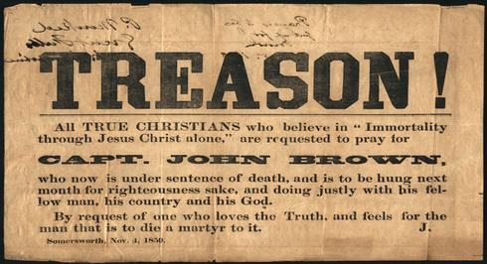
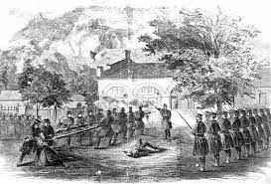
A Marty or A Lunatic
Scaring Southerners – John Brown’s Raid on Harper’s Ferry (1857)
Goal: Obtain guns for a mass slave rebellion
“I, John Brown am quite certain that the crimes of this guilty land will never be purged away but with BLOOD.”
Northerners’ view – Marty for Slavery
Southerners’ view – Treason

Slide 30
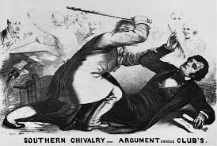
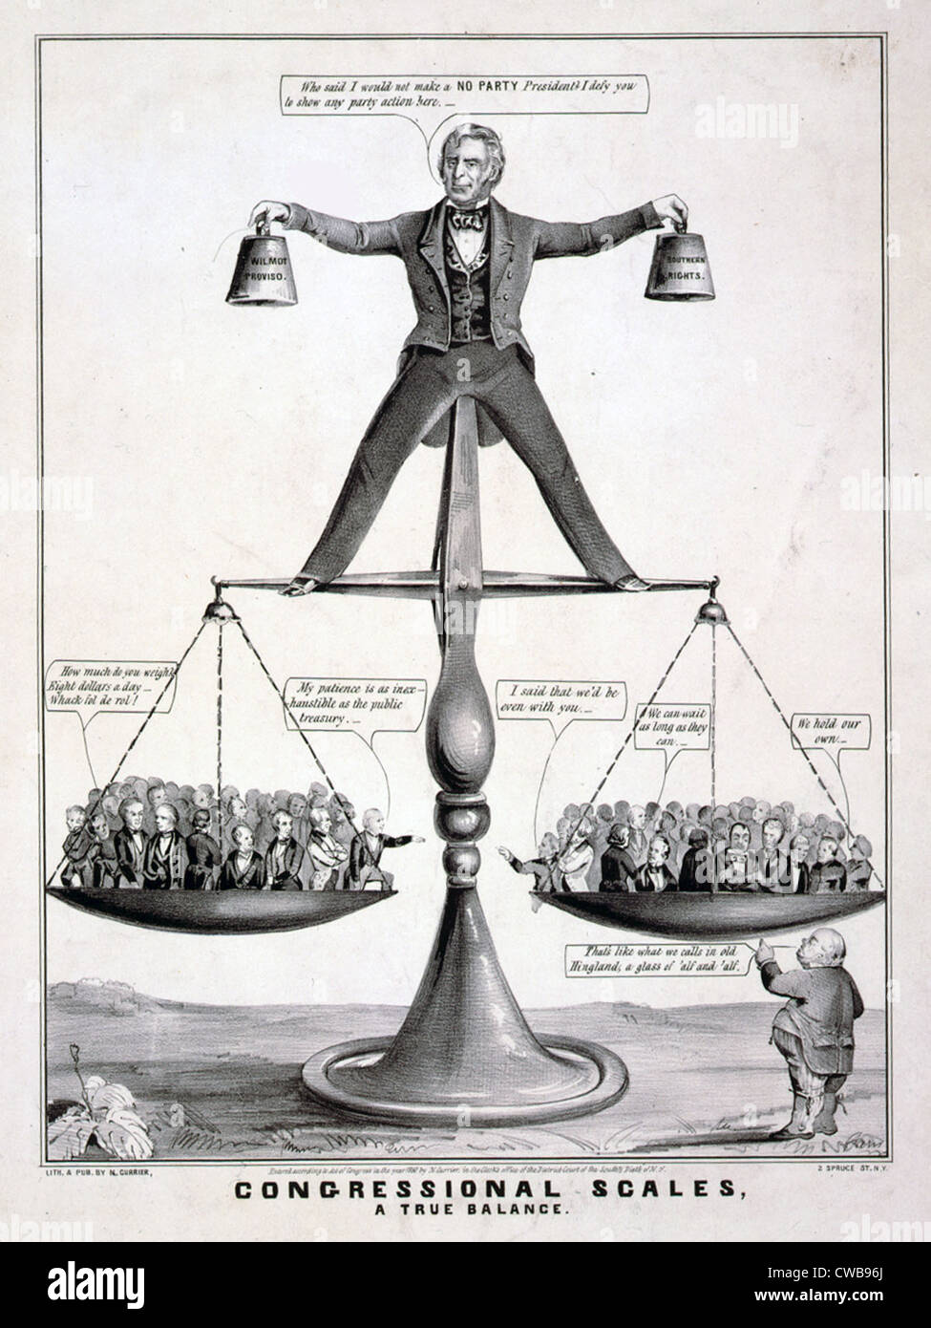
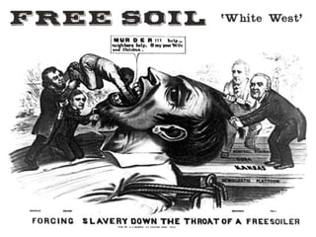
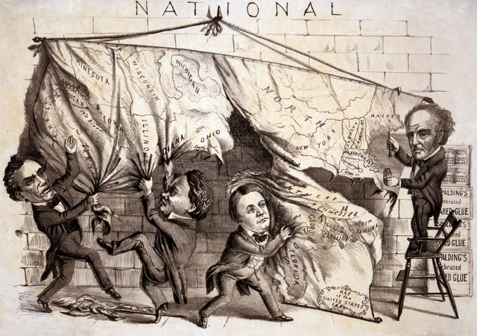
Political Cartoons of Political Division
Evaluate why sectional tensions exploded from 1850 to 1860 leading the United States to Civil War in 1861.

Slide 31
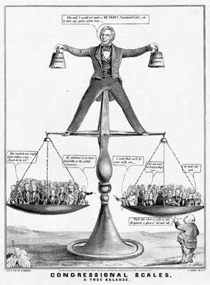
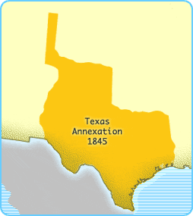
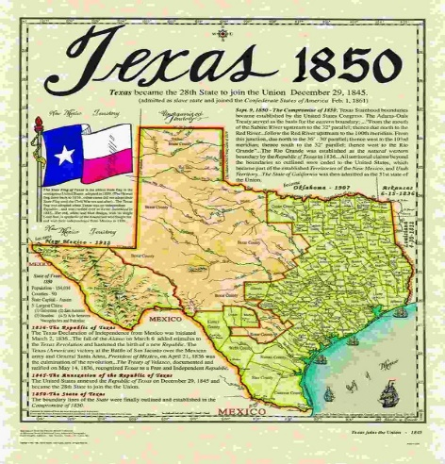
Compromise, Compromise, Compromise
Congressional Scales, “A True Balance”, 1850
Cause: California Gold Rush
Deal – COMPROMISE OF 1850
California enters as a free state
Popular sovereignty
Fugitive Slave Act (1850)
Slave trade banned in Washington D.C.
Texas $10 million for border dispute

Slide 32
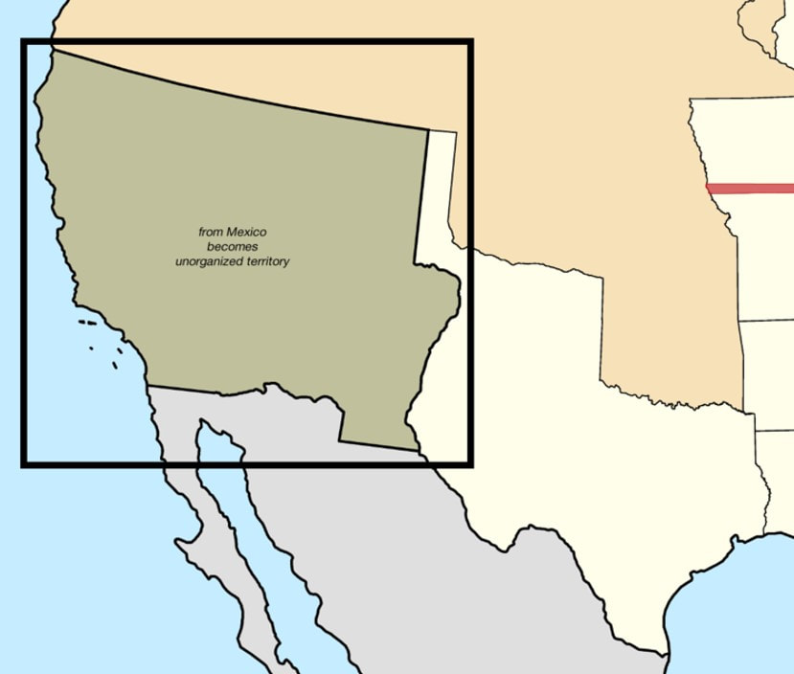
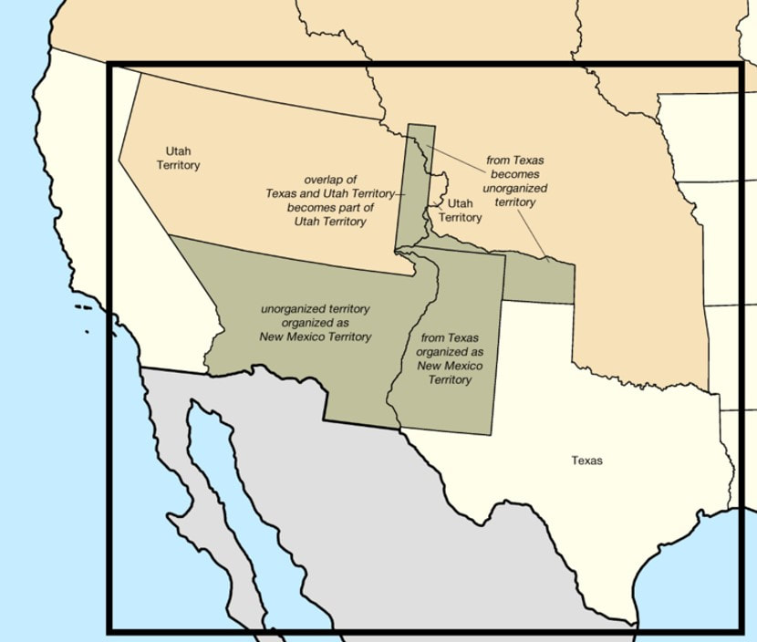
Transformation of Texas
Compromise of 1850 Effect on Texas
Compromise 1850 – Texas’ Lost Slave Territory

Slide 33
Compromise of 1850

Slide 34
Growing Tension
Sectional Tensions increase
Development of the Transcontinental Railroad (Gadsden Purchase - 1853)
Fugitive Slave Act 1850 (Northern Opposition)
Slave NOT expanding
Priggs v. Pennsylvania 1842
Personal Liberty Laws – Northern States nullify Fugitive Slave Act
Rise of the Free-Soil Party (Abolitionists)
Ostend Manifesto (1854)

Slide 35
Awakening the North to Abolition
Uncle Tom’s Cabin by Harriet Beecher Stowe (1852)
“Scenes of blood and cruelty are shocking to our ear and hear. What man has the nerve to do, man has not the nerve to hear.”
Impending Crisis of South by Hinton Helper – statistical impact of slavery on non-slave holding population

Slide 36
A Marty or A Lunatic
Scaring Southerners – John Brown’s Raid on Harper’s Ferry (1857)
Goal: Obtain guns for a mass slave rebellion
“I, John Brown am quite certain that the crimes of this guilty land will never be purged away but with BLOOD.”
Northerners’ view – Marty for Slavery
Southerners’ view – Treason

Slide 37
The Impending Crisis
Develop a timeline that illustrates how Manifest Destiny brought the end of nationalist passions and gave rise to sectional divisions.
Requirements:
Events need to be in chronological order
Each event, person, law etc. . . – explanation of how they led to an impending crisis
Color coding according to Presidential Administration – You can create a timeline for each presidency
Nationalism to Sectionalism

Slide 38
Essential Question: How did the development of America expansionism lead to greater sectionalism and the unresolved issues of federal power and citizenship in the United States?
Students can:
Evaluate factors that contributed to Manifest Destiny and its influence on the development of the United States
Determine how Manifest Destiny contributes to the growth of sectionalism within the United States
Agenda
The Periodization of a Sectional Crisis
No Compromise
Impending Crisis Timeline
Homework: Impending Crisis Timeline (Reading assignments on canvas)

Slide 39
Periodization
Periodization: the chronology of events in a time period
Put the following events in chronological order (As a group) – Explain the significance of each event as a cause of the sectional divisions growing in the US.
Compromise of 1850 - Kansas Nebraska Acts
Caning of Charles Sumner - Creation of the Republican Party
Annexation of Texas - Missouri Compromise
California Gold Rush - Uncle Tom’s Cabin Publication
Treaty of Guadalupe Hidalgo - Mexican-American War
The Progression of an Impending Crisis

Slide 40
Forcing Slavery Down Northerners’ Throat
commonly called the Compromise Measures (Missouri Compromise), is hereby declared inoperative and void; it being the true intent and meaning of this act not to legislate slavery into any Territory or State, nor to exclude it therefrom, but to leave the people thereof perfectly free to form an regulate their domestic institutions in their own way, subject only to the Constitution of the United States
- Kansas-Nebraska Acts 1854
Kansas-Nebraska Acts 1854 (Transcontinental Railroad)
Stephen Douglas organizes Kansas-Nebraska territory
Bleeding Kansas
Free-soilers vs. Border Ruffians
John Brown armed with Beecher’s Bibles (Crusade to end slavery)
“I, John Brown am quite certain that the crimes of this guilty land will never be purged away but with BLOOD.”

Slide 41
Crimes Against Kansas
Charles Sumner speech “Crimes Against Kansas”
Douglas (who was present in the chamber) was a "noise-some, squat, and nameless animal...not a proper model for an American senator." Butler was a pimp who
took "a mistress who, though ugly to others, is always lovely to him; though polluted in the sight of the world, is chaste in his sight—I mean, the harlot, Slavery."
The Caning of Charles Sumner - 1854

Slide 42
Evaluating Change in Sectionalism
Goal: Explain why compromise fails to resolve sectional differences between the North & South after 1850
Sectional Debate 1853 – 1859
HIPP each document for point of view
Explain political causes of the Civil War
Evaluate why the North and South are no longer able to compromise over the expansion of slavery.

Slide 43
Rise of the Republican Party
Republican Party (1854)
Cause: Kansas Nebraska Acts (Expansion of
Slavery)
Beliefs: Free soil, No Expansion of Slavery
Formed by:
Northern Whigs
Free Soil Party
Northern Democrats
The Know Nothing Party

Slide 44
Essential Question: How did the development of America expansionism lead to greater sectionalism and the unresolved issues of federal power and citizenship in the United States?
Students can:
Evaluate factors that contributed to Manifest Destiny and its influence on the development of the United States
Determine how Manifest Destiny contributes to the growth of sectionalism within the United States
Agenda
Document Analyzation
The Final Straw
No compromise
Homework: Impending Crisis Timeline (Reading assignments on canvas)

Slide 45
HIPP the POV
“Dividing the National Map”, 1860
John Bell
Constitutional Union
John Breckenridge
Southern Democrat
Abraham Lincoln
Republican
Stephen Douglas
Northern Democrat

Slide 46
Economic Sectionalism
PANIC OF 1857 – caused by Gold Rush (inflates currency), land speculation for Transcontinental Railroad, & over production of grain
Effect
Damages industrial north economy
NO IMPACT on KING COTTON (Supports secession)
Remedies for Panic
Homestead Act: 160 acres of land .25 cents an acre
Tariffs of 1857: Lowered tariffs

Slide 47
Slavery, A Federalism Issue
Federalism = Division of power between state & federal government
Dred Scot v. Sanford 1857
Ruling: Slaves = property therefore have NO Rights
Missouri Compromise = Unconstitutional (State right issue)
Allows slavery to expand in the North
Lincoln-Douglas Debate (1858)
Illinois Senate Race for Congress
Freeport Doctrine: Don’t pass laws that support slavery to ban slavery (Stephen Douglas)
Lincoln’s “House Divide Speech” – We cannot be half slave, half free
Dred Scot
Justice Roger Taney

Slide 48
Election of 1860
Nation divided over the issue of slavery
Abraham Lincoln wins – Not a single Southern Vote
Immediate secession of deep south states (SC, TX, AL, MS, GA, FL, & LA)
Abraham Lincoln
Republican
John Bell
Constitutional Union
Stephen Douglas
Northern Democrat
John Breckenridge
Southern Democrat
√

Slide 49
One Last Effort to Save the Union
Crittenden Compromise: Bring back the balance of free v. slave states
Return the 36’30 line (expansion of the US into Cuba and Latin America)
Slavery protected by the federal government
Free v. Slave determined by popular sovereignty
Let me POCKET VETO this plan

Slide 50
Evaluating Change in Sectionalism
Goal: Explain why compromise fails to resolve sectional differences between the North & South after 1850
Sectional Debate 1853 – 1859
HIPP each document for point of view
Explain political causes of the Civil War
Evaluate why the North and South are no longer able to compromise over the expansion of slavery.

Slide 51
Rise of the Republican Party

