Slide 1
Voting in American Democracy
Democratic Influencer – Unit V

Slide 2
Enduring understanding: Factors associated with political ideology, efficacy, structural barriers, and demographics influence the nature and degree of political participation.
Learning Obj. 5.1: Describe the voting rights protections in the Constitution and in legislation
Learning Obj. 5.2: Explain the roles that individual choice and state and federal laws play in voter turnout in elections.
Essential Question: How our government institutions and public policies are influenced by the unelected linkage institutions.
Students can:
Determine how the expansion of enfranchisement has impacted participation in American political landscape
Evaluate the legitimacy of factors that limit and encourage voter participation
AGENDA
Political Participation
Casting a Ballot
The Value of a Ballot
Homework
80 Million Voters Won’t Vote (AP Gov website)
Unit IV Test Wed. 3/22

Slide 3
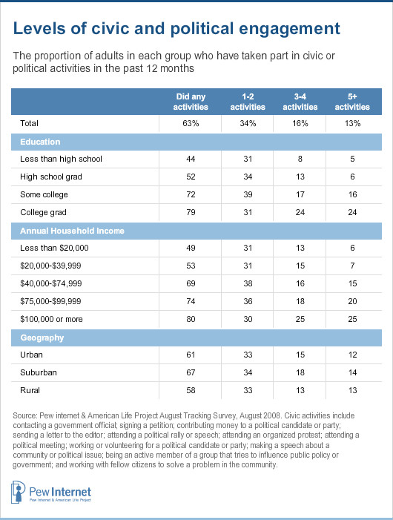
Engagement in Democracy
Identify and explain ONE factor that increases political participation rates in the U.S. democracy.
Identify and explain ONE factor that inhibits political participation in United States
Explain how decline in trust of American government has led to a decline political participation in the U.S..

Slide 4
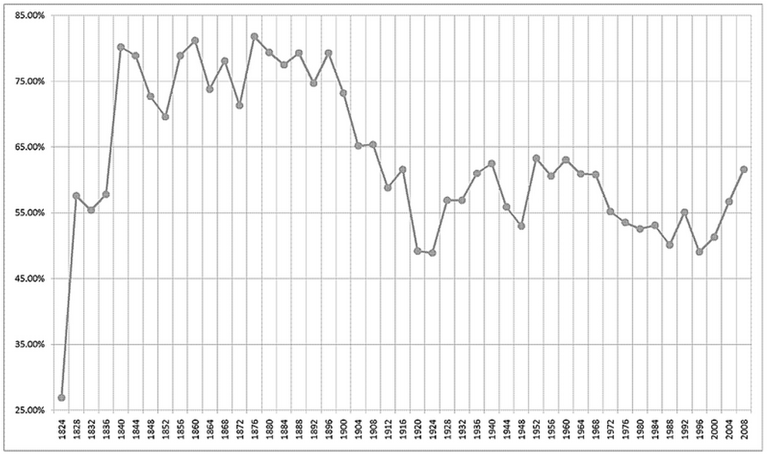
Voter turnout
Analyze the voter turnout graphs
1. Identify and explain demographic factors influence voter turnout rates.
2. Why have voter turnout rates been declining in the United States?

Slide 5
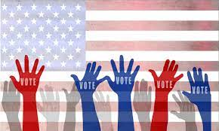
Voice in Government
Voting = core values (popular sovereignty) – bases of democracy
Electorate – eligible voters in the U.S.
Enfranchisement & election laws (reserve powers for states)
Original Voters – White Males, at least 21 years old, & owned property
Anyone who registers and is at least 18 years old

Slide 6
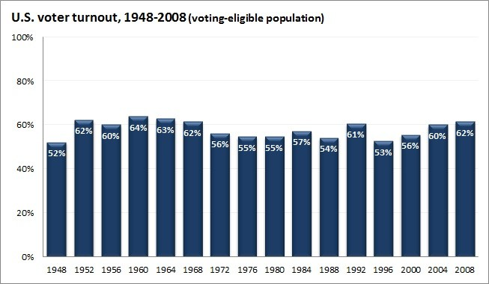
Expanding Suffrage
Suffrage = voting rights
15th Amendment – African Americans
17th Amendment – direct election of senators
19th Amendment – Women
23rd Amendment – Washington DC
24th Amendment – No poll taxes
26th Amendment – 18 year old
What explains America’s has seen a low voter turnout despite expansion of enfranchisement too more groups?

Slide 7
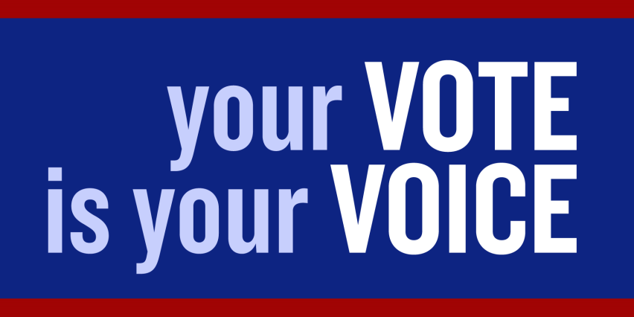
Voters in America
The American voter study, 1950 (follow up study 1988, Ideologues grew to 18%)
Ideologues - 12% of the population (Vote based on ideology)
No issue content - 22% of the population (Vote this candidate looked better)
Group Benefit- 42% of the population (Vote on the party that gave the voter a benefit)
Nature of the times - 24% of the population (Vote based how America is doing)

Slide 8
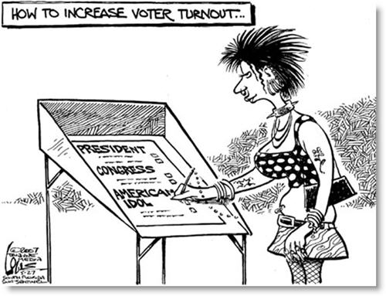
What my votes states
Ballots cast:
Clothes pin vote: today many voters that the candidates don’t match their expectation, so they choose the one they feel is the least offensive
Prospective voting: voting for candidate and what he could potentially do (Obama 2008 elections)
Retrospective voting: evaluating the candidates record and overall achievements (Obama 2012)

Slide 9
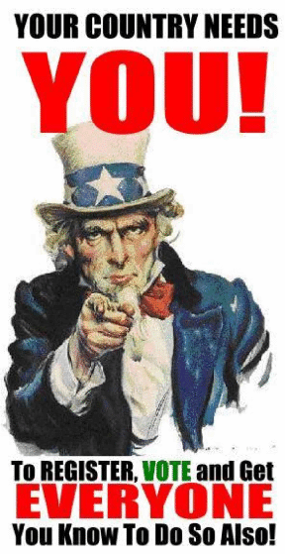
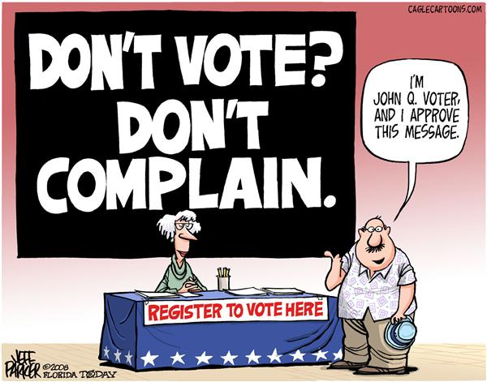
The Value of Voting in America
To what extent does voting in United States’ elections have a value in its political landscape and institutions.
Does one vote matter?
Does the election system work?
How much control is giving to the federal
government over the process?
Do American’s have a high or low political efficacy?

Slide 10
Enduring understanding: Factors associated with political ideology, efficacy, structural barriers, and demographics influence the nature and degree of political participation.
Learning Obj. 5.1: Describe the voting rights protections in the Constitution and in legislation
Learning Obj. 5.2: Explain the roles that individual choice and state and federal laws play in voter turnout in elections.
Essential Question: How our government institutions and public policies are influenced by the unelected linkage institutions.
Students can:
Determine how the expansion of enfranchisement has impacted participation in American political landscape
Evaluate the legitimacy of factors that limit and encourage voter participation
AGENDA
80 Million Won’t Vote
Factors for Voting
Encouraging the voice of the people
Homework
Study for Unit IV Test
Unit IV Test Wed. 3/23

Slide 11
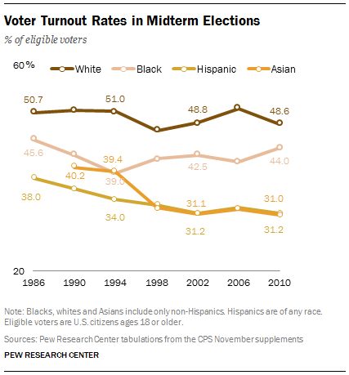
Institutional of Voting
80 Million Voters will not vote in the next election.
What factors contribute to the argument in the article?

Slide 12
Voting Eligibility
VAP: Voter Age Population – old enough to vote
VEP: Voter Eligible Population – old enough to vote and legally register to vote
1. What are the requirements to be a member of the voter eligible population?

Slide 13
The Voice of the People
The Value of Voting
Government works on the consent of the governed
Evaluates elected leaders
Failure to vote
Registration process (#1 reason)
Too many elections
Voter apathy
Election day on a Tuesday

Slide 14
Registration Impact

Slide 15
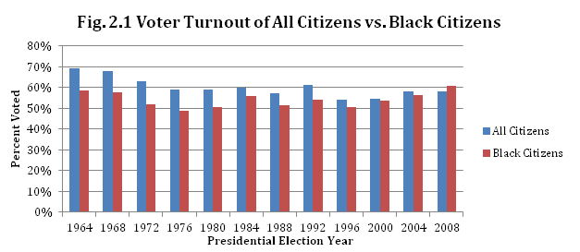
Voter Turnout
How effectively has the expansion of suffrage changed voter turnout rates?
African Americans
Women
18 year old

Slide 16
Voter turnout rights
Strong Voter Turnout
Women (19th Amendment) – out vote men (Gender Gap)
Elderly
Higher SES (Education #1 factor)
Religious
Poor Voter Turnout
1. 18-24 demographic – 26th Amendment
2. Civil rights movement has had little impact on African American turnout (Exception highly educated)
24th Amendment
Voting Rights Act 1965
Smith v. Allwright 1944

Slide 17
Who is going to vote (VAP – Voter age population that votes)
FACTORS that determine who votes
1. Education level
2. Age
3. Race
4. Gender (Gender Gap)
5. Martial Status
6. Government job?
7. Religious v. non-religious

Slide 18
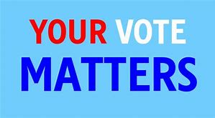
Validity of Voting
Prompt: Evaluate the validity of voting in American elections and determine whether it matters
Develop arguments as to whether is worthwhile in the United States
Consider past historical data on voter turnout
Does ONE VOTE really determine an election
Evaluate how the following laws deal with issues of voter turnout
Voting Rights Act of 1965
Voting Accessibility for the Elderly and Handicapped Act of 1984
National Voter Registration Act 1993
Help America Vote Act 2002
?

Slide 19
Enduring understanding: Factors associated with political ideology, efficacy, structural barriers, and demographics influence the nature and degree of political participation.
Learning Obj. 5.1: Describe the voting rights protections in the Constitution and in legislation
Learning Obj. 5.2: Explain the roles that individual choice and state and federal laws play in voter turnout in elections.
Essential Question: How our government institutions and public policies are influenced by the unelected linkage institutions.
Students can:
Determine how the expansion of enfranchisement has impacted participation in American political landscape
Evaluate the legitimacy of factors that limit and encourage voter participation
AGENDA
Unit IV Review
Unit IV Test
The Value of Voting
Homework
Encouraging People to Vote

Slide 20
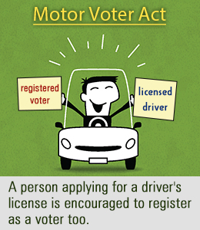
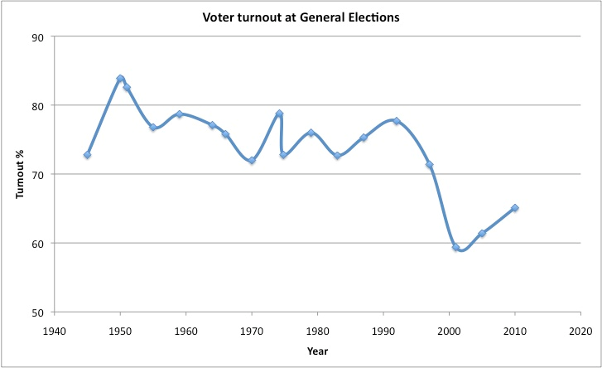
Fixing the voter turnout
National Voter Registration Act 1993 (Motor Voter Law)
Early voting
Same day registration
Get Out to Vote Drives

Slide 21
Motor VOTER CRASH
National Voter Registration Act (Motor Voter)
Allowed eligible voters to register at DMV’s or by mail
Impact
Increased voter registration
Only raised voter turnout by 2% (failure)

Slide 22
Depressing voter turnout
Voter Turnout Year Presidential Election
18-24 25 & Older All Voters
1972 Nixon/McGovern 52% 68% 55%
1976 Carter/Ford 44% 65% 54%
1980 Reagan/Carter/Anderson 43% 69% 53%
1984 Reagan/Mondale 44% 69% 53%
1988 Bush/Dukakis 40% 66% 50%
1992Clinton/Bush/Perot 49% 71% 55%
1996 Clinton/Dole 36% 62% 49%
2000 Bush/Gore/Nader 36% 63% 51%
2004 Bush/Kerry 47% 66% 55%
SOURCES: FEDERAL ELECTION COMMISSION; CENSUS BUREAU; CENTER FOR INFORMATION & RESEARCH ON CIVIC LEARNING & ENGAGEMENT
How can American society and government improve voter turnout in order to expand the effectiveness of populism?

Slide 23
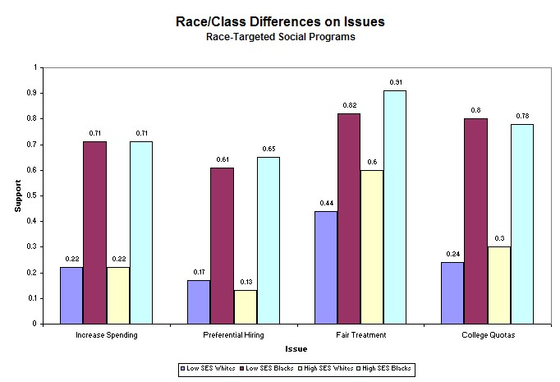

Slide 24
Enduring understanding: Factors associated with political ideology, efficacy, structural barriers, and demographics influence the nature and degree of political participation.
Learning Obj. 5.1: Describe the voting rights protections in the Constitution and in legislation
Learning Obj. 5.2: Explain the roles that individual choice and state and federal laws play in voter turnout in elections.
Essential Question: How our government institutions and public policies are influenced by the unelected linkage institutions.
Students can:
Determine how the expansion of enfranchisement has impacted participation in American political landscape
Evaluate the legitimacy of factors that limit and encourage voter participation
AGENDA
The Mandate of Voting
Barriers to Vote
The Value of Voting
Homework
The value of Voting in America

Slide 25
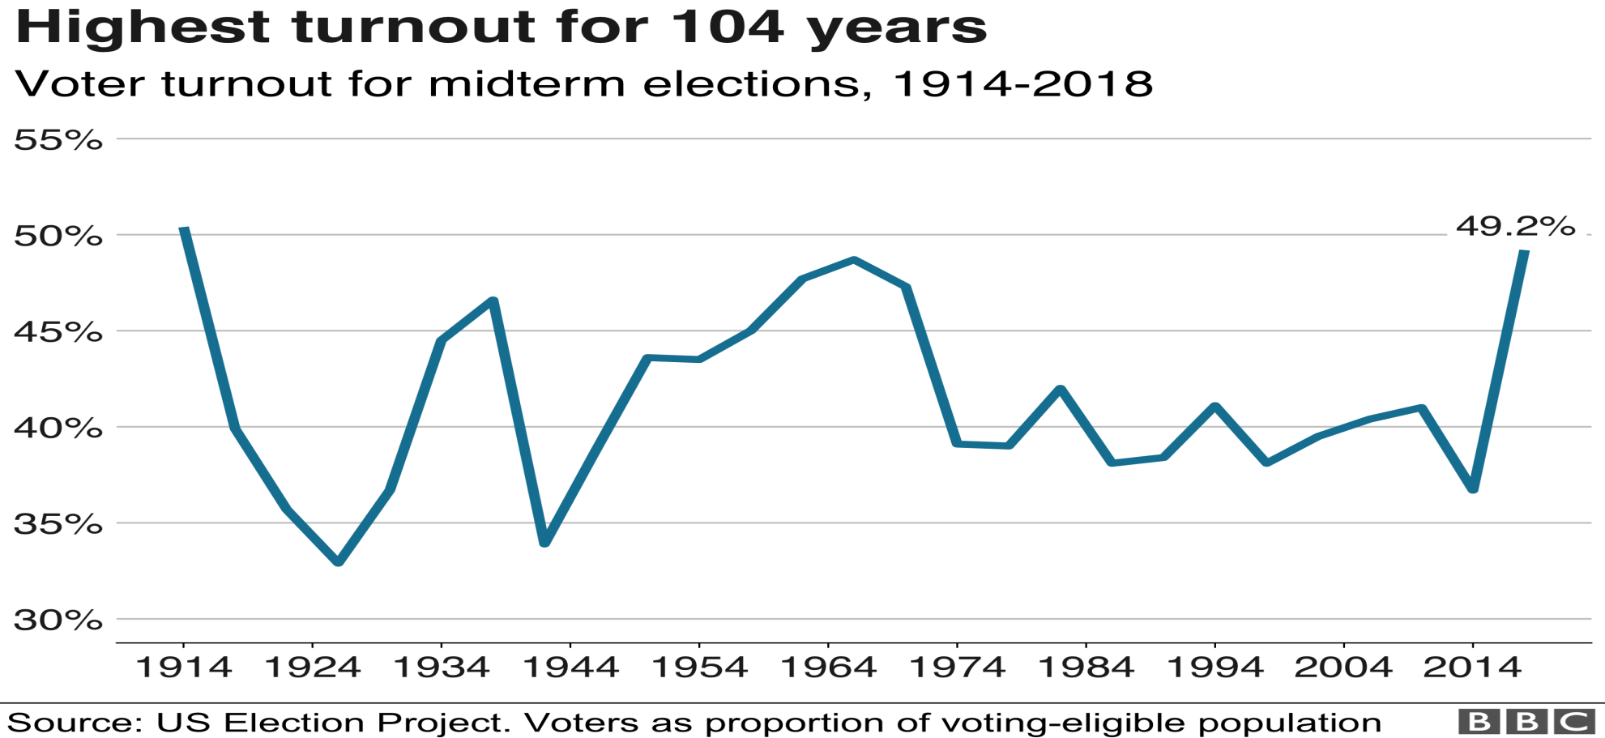
Mandatory Voter Law
Debate on Mandatory Voting Law
Evaluate whether the United States government should pass a mandatory voter law

Slide 26
The Truth About Voter Turnout
US voter turnout compared to Europe
Ranked 31 out of 35 countries
Voter turnout rates can be misleading
No registration requirement
No regulation and election fraud (illegal voting was high in 1800s)
Europe has mandatory voting laws
Negative Attack Ads have no impact on voter turnout

Slide 27
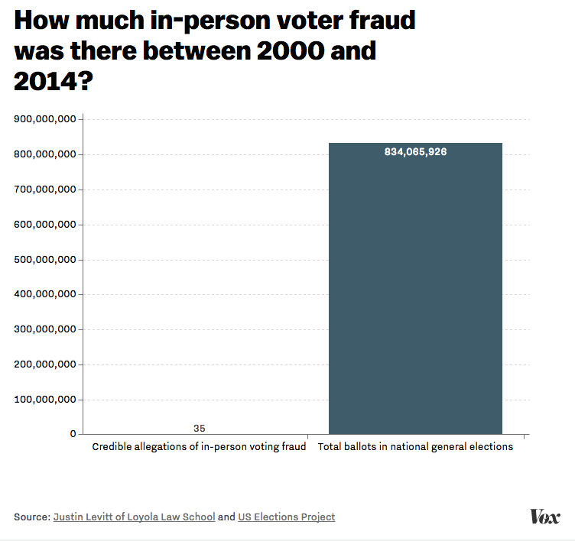
Stopping Voter Fraud
The US has utilized a number voter fraud prevention strategies to end the problem
Australian Ballot: government printed ballots that are cast in secret
Voter registration process
Pollster
Guidelines for when voters must register by
Procedures for counting the return
Problem – discourage people from voting

Slide 28
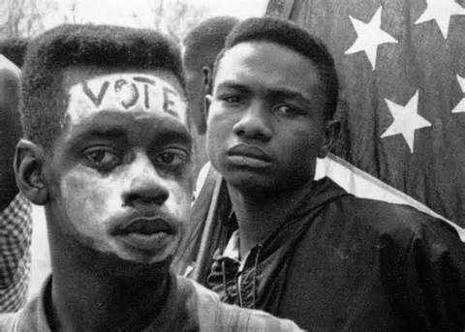
Prohibiting Voter Discrimination
Supreme Court interpreted of the 15th Amendment (United States v. Reese, United States v. Cruikshank, and Ex parte Yarbrough)
Burden of proof was fell on African Americans
Denial of Suffrage
Literacy Test
Poll taxes
Grandfather Clause
White Primaries
Intimidation
Expanding the power of the federal government protections
Civil Rights Act 1957
Civil Rights Act of 1964
Voter Rights Act of 1965

Slide 29
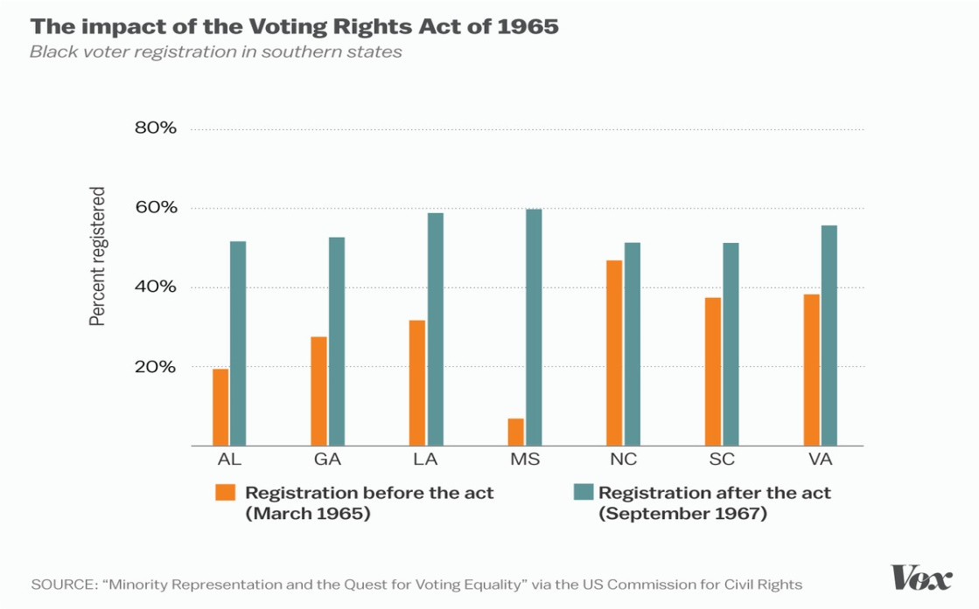
Changing the Voter Tide
SEC. 2. No voting qualification or prerequisite to voting, or standard, practice, or procedure shall be imposed or applied by any State or political subdivision to deny or abridge the right of any citizen of the United States to vote on account of race or color.
- Voting Rights Act of 1965
Burden of proof placed on the states to limit or restrict voting rights
Shelby County v. Holder 2013
Voting Rights Act of 1965 Preclearance for changing voter laws declared unconstitutional
New Debate: Requirement of Voter ID

Slide 30
The Layout of the Voter
Impact of Voter ID laws
Baker v. Carr
McCrory v. Harris
Bethune Hill v. Virginia State Board of Elections
Constitutional issue: equal protection clause of the 14th Amendment
Access to the polls (Voting Rights Act of 1965)
Court precedent of One Man One Vote (Baker v. Carr)

Slide 31
Debate over Voter ID laws
Voting Integrity
Discriminatory

Slide 32
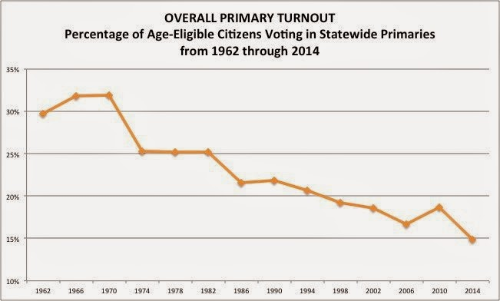
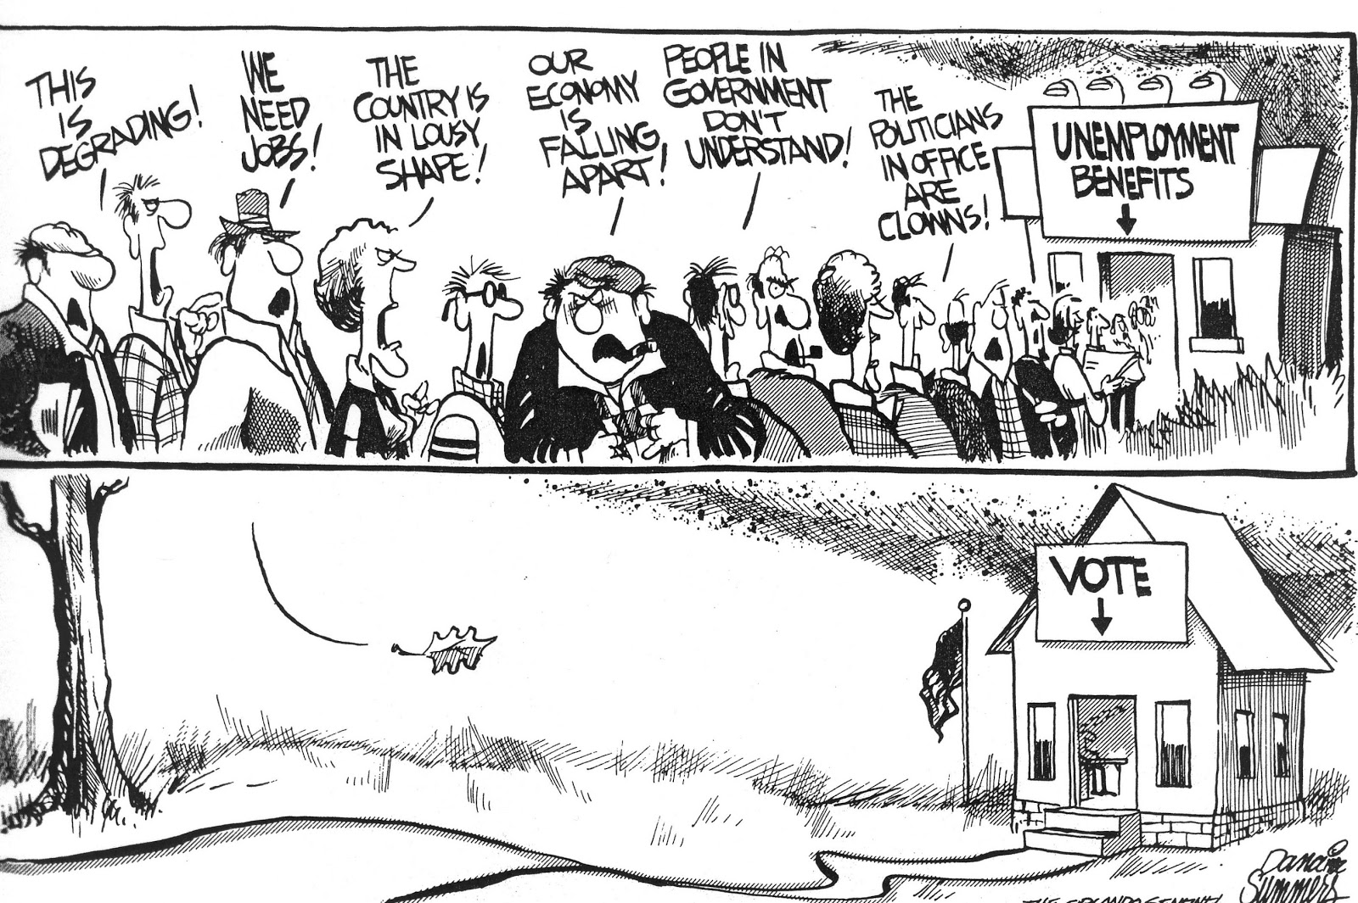
Trending Downward?
Declining voter turnout
Factors
Weaken of party identification
Growth of Candidate Centered Politics
Increase in distrust since the 1950s
Increased voter apathy
Voter registration process (#1 reason)
What piece of legislation was passed to combat issues with voter registration?
How effective was the legislation in improving voter turnout in the United States?

Slide 33
The Value of Voting in America
To what extent does voting in United States’ elections have a value in its political landscape and institutions.
Does one vote matter?
Does the election system work?
How much control is giving to the federal
government over the process?
Do American’s have a high or low political efficacy?

Slide 34
Validity of Voting
Prompt: Evaluate the validity of voting in American elections and determine whether it matters
Develop arguments as to whether is worthwhile in the United States
Consider past historical data on voter turnout
Does ONE VOTE really determine an election
?

Slide 35
Potential Power of the People
What is the potential power of the people in determining the direction of the nation through voting?
Evaluate factors that give voting legitimacy
Evaluates factors that detracting from voting

Slide 36
The Layout of the Voter
Impact of Voter ID laws
Baker v. Carr
McCrory v. Harris
Bethune Hill v. Virginia State Board of Elections
How much of a factor has African American voter suppression altered election returns in the modern era?
How has the Supreme Court adjudication attempted to grant greater accessible to the polls and the voice of minority voice?

Slide 37
Voter Turnout
Rough 50% of eligible voters did not participate in the 2016 general election
Turnout rates decline for midterm elections
Turnout rates further decline for primary elections

Slide 38
Unit V: Influencers of American Democracy (Voting)
Enduring understanding: Factors associated with political ideology, efficacy, structural barriers, and demographics influence the nature and degree of political participation.
Learning Obj. 5.1: Describe the voting rights protections in the Constitution and in legislation
Learning Obj. 5.2: Explain the roles that individual choice and state and federal laws play in voter turnout in elections.
Essential Question: How our government institutions and public policies are influenced by the unelected linkage institutions.
Students can:
Determine how the expansion of enfranchisement has impacted participation in American political landscape
Evaluate the legitimacy of factors that limit and encourage voter participation
AGENDA
The Value of Voting Discussion
VEP v. VAP
Homework
Voting essay quiz study

Slide 39
The Value of Voting in America
To what extent does voting in United States’ elections have a value in its political landscape and institutions.
Does one vote matter?
Does the election system work?
How much control is giving to the federal
government over the process?
Do American’s have a high or low political efficacy?

Slide 40
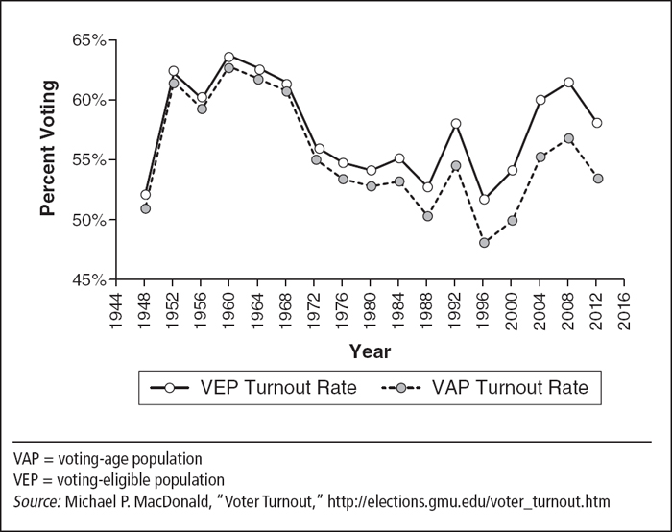
VEP in America
Describe three factors that would explain the differences between voting eligible populations and voting age population

Slide 41
Unit V: Influencers of American Democracy (Voting)
Enduring understanding: Factors associated with political ideology, efficacy, structural barriers, and demographics influence the nature and degree of political participation.
Learning Obj. 5.8: Explain how different process work in a U.S presidential elections
Learning Obj. 5.9: Explain how different process work in a Congressional elections
Essential Question: How does various unelected groups influence the political process, the political landscape and the United States governing institutions?
Students can:
Determine how the expansion of enfranchisement has impacted participation in American political landscape
Evaluate the legitimacy of factors that limit and encourage voter participation
Decipher how federal policies on campaigning and electoral rules continues to be contested by both sides of the political spectrum
AGENDA
Argumentative Essay
Setting the guidelines for presidential elections
Homework
Presidential Marathon

Slide 42
Argumentative Essay Prompt
1. In the United States, voting allows citizens to participate in the political process. Develop an argument that explains whether the value of a vote matters in American democracy.
Use at least one piece of evidence from one of the following foundational documents:
Suffrage Amendments
Brutus I
Martin Luther King, Jr’s. Letter from a Birmingham Jail
In your essay, you must
Articulate a defensible claim or thesis that responds to the prompt and establish a line of reasoning
Support your claim or thesis with at least TWO pieces of accurate and relevant evidence
One piece of evidence must come from any other foundational document not used as your first piece of evidence, or it may be from knowledge of course concepts
A second piece of evidence can come from any other foundational document not used as your piece of evidence, or may be from your knowledge of course concepts.
Use reasoning to explain why your evidence supports your claim or thesis
Respond to an opposing or alternative perspective using refutation, concession, or rebuttal

Slide 43
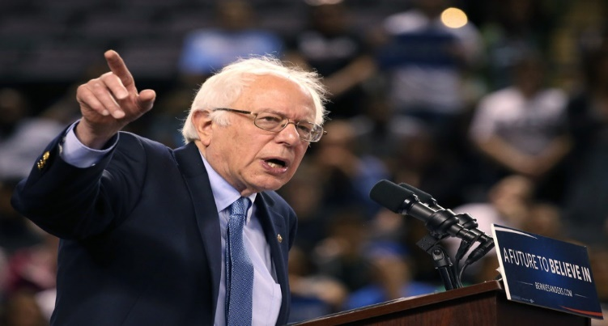
Evaluating the Primary System
The NOMINATION process is RIGGED!
The NOMINATION process is RIGGED!
Evaluate whether nomination process for selecting presidential candidates is biased and therefore undemocratic.
Winning the Big Mo
Horse Race Journalism
Party Rules for assigning delegates
Nomination elections
National Convention is meaningless

Slide 44
Unit V: Influencers of American Democracy (Voting)
Enduring understanding: Factors associated with political ideology, efficacy, structural barriers, and demographics influence the nature and degree of political participation.
Learning Obj. 5.8: Explain how different process work in a U.S presidential elections
Learning Obj. 5.9: Explain how different process work in a Congressional elections
Essential Question: How does various unelected groups influence the political process, the political landscape and the United States governing institutions?
Students can:
Determine how the expansion of enfranchisement has impacted participation in American political landscape
Evaluate the legitimacy of factors that limit and encourage voter participation
Decipher how federal policies on campaigning and electoral rules continues to be contested by both sides of the political spectrum
AGENDA
How Democratic
Getting the Big Mo
Presidential Marathon
Homework
Presidential Marathon

Slide 45
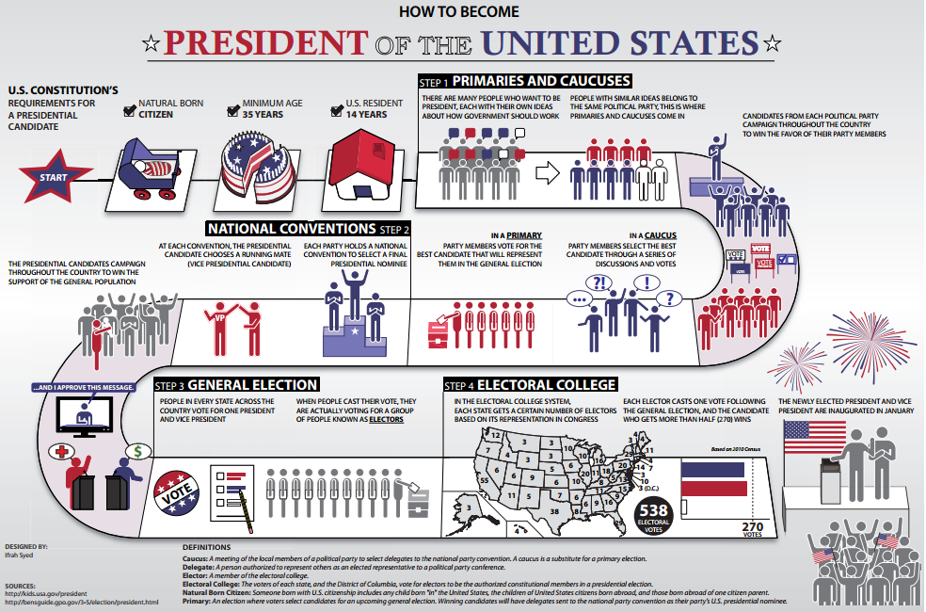
How Democratic?
Republican Party rules permit winner-take-all primaries. Describe one consequence of this rule for the Republican nomination process.
The Democratic Party has used superdelegates in the presidential nominating process since 1984. Explain why the use of superdelegates increases the influence of party leaders in the Democratic nomination process.

Slide 46
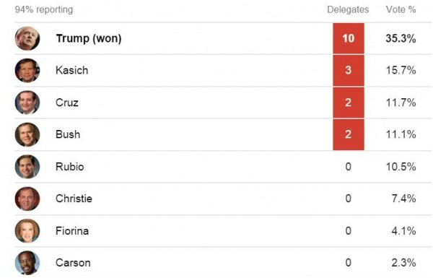
The Power of the “Big Mo”
How do early victories in the first two nomination elections shape the selection of the president of the United States?

Slide 47
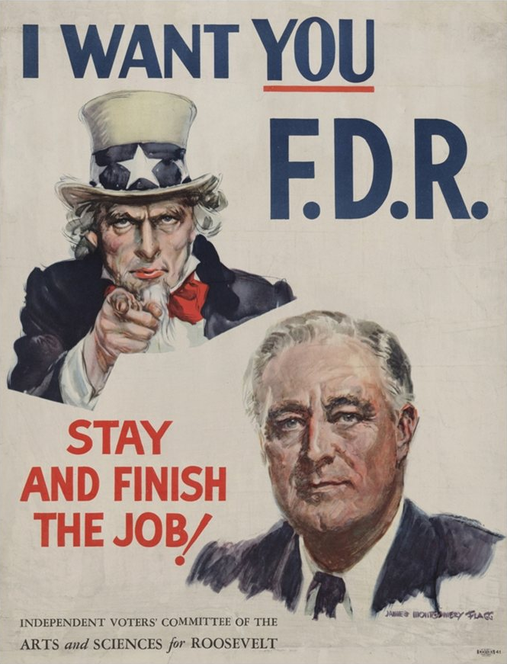
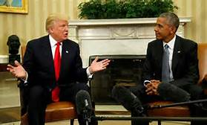
I want to be POTUS
Step 1: Form an exploratory committee & build public interest
Step 2: Formally announce your candidacy
Step 3: Nominating elections (all 50 states)
Step 4: General Election

Slide 48
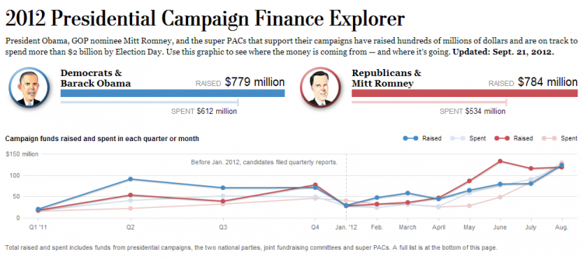
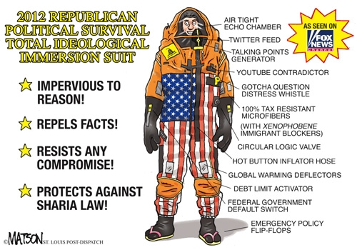
Winning a Presidential Victory
Promoting Candidate Centered Politics INCREASED CAMPAIGN COST
Mass Media (Need for Media Advisors)
Photo-ops
Debates
Horse Race Journalism
Sound bites
Political Consultants
Campaign chair
Lawyers
Pollster (Public Opinion Polls)
Media Advisors
Campaign Finance
PACs
Super PACs
Internet fundraising

Slide 49
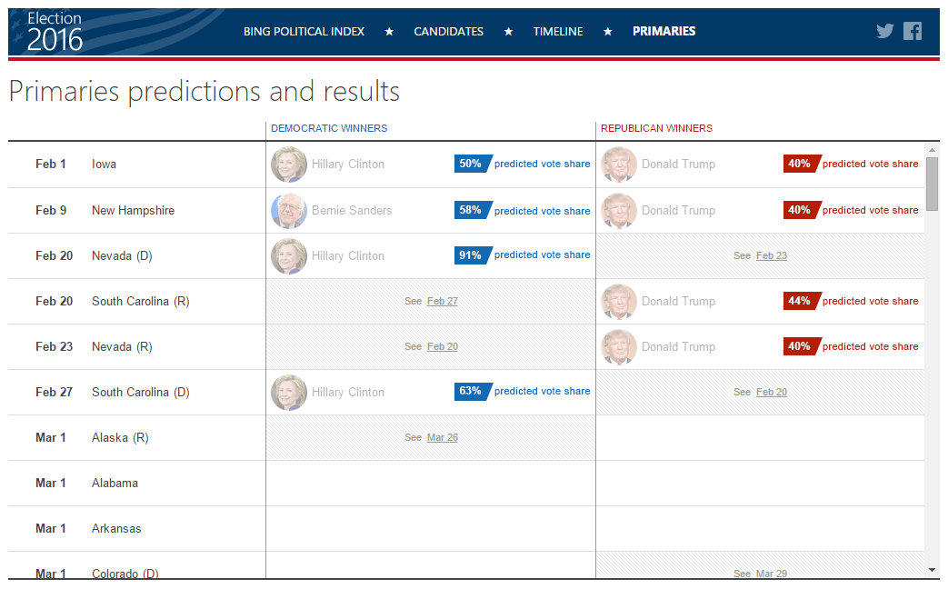
Nomination Elections
Progressive reforms empowered the people to select the presidential candidate (primary system, Australian ballot)
Goal collect delegates to the convention (1144 winner-take-all system for Republicans & 2118 proportional system for the Democrats)
Nominating elections (states choose process)
Open primaries
Closed primaries
Blanket primaries
Caucuses

Slide 50
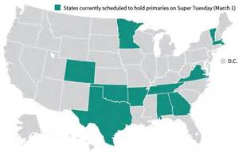
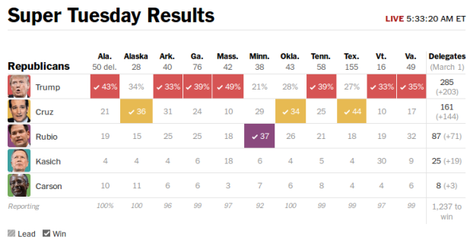
A Truly Democratic Process?
Building the Big Mo
Iowa Caucus & New Hampshire Primaries – winners have the best shot on winning on Super Tuesday
Super Tuesday – Up to 52% of the delegates are up for grab
Frontloading: states attempt to move up their nominating elections to have greater say in selecting the party nominee

Slide 51
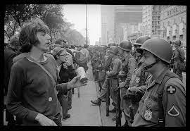
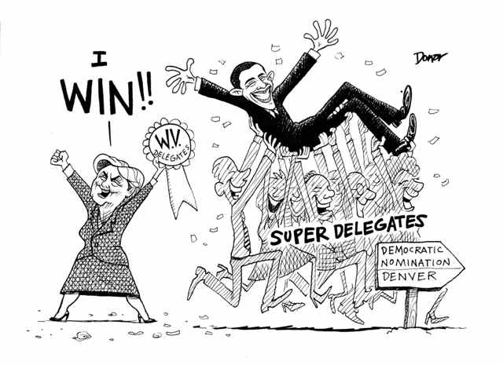
The Voice of the Party
Democrat Party being representative of their constituency (more diverse supporters)
1968 National Convention – Chicago Seven Riots
Fraser-McGovern Commission:
Goal: make the nomination process more representative of supporters of the Democratic Party
Impact: fractionalized the party
Super-delegates: 15% of the delegate slots were set aside for public officeholders and party officials (peer review of the nomination elections)

Slide 52
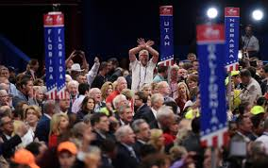
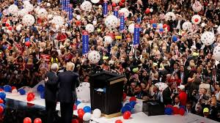
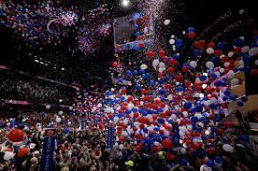
The Big Reveal
Political Party National Convention
Delegates select the ticket (Delegates chosen by nomination elections)
The TICKET announced (President and Vice President Candidate)
The PLATFORM finalized (stances on issues)
Build Big Mo for the general election

Slide 53
Evaluating the Primary System
The NOMINATION process is RIGGED!
The NOMINATION process is RIGGED!
Explain TWO reasons why both Republican and Democratic candidates have argued the nomination process to win the presidency is rigged
Winning the Big Mo
Horse Race Journalism
Party Rules for assigning delegates
Nomination elections
National Convention is meaningless

Slide 54
Unit V: Influencers of American Democracy (Voting)
Enduring understanding: Factors associated with political ideology, efficacy, structural barriers, and demographics influence the nature and degree of political participation.
Learning Obj. 5.8: Explain how different process work in a U.S presidential elections
Learning Obj. 5.9: Explain how different process work in a Congressional elections
Essential Question: How our government institutions and public policies are influenced by the unelected linkage institutions.
Students can:
Determine how the expansion of enfranchisement has impacted participation in American political landscape
Evaluate the legitimacy of factors that limit and encourage voter participation
Decipher how federal policies on campaigning and electoral rules continues to be contested by both sides of the political spectrum
AGENDA
270 to Win
An Alumni of the Electoral College
The Electoral College Debate
Homework
Presidential Marathon debate prep

Slide 55
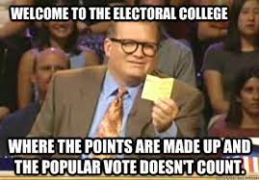
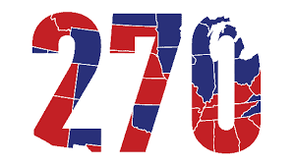
Popular Sovereignty in Democracy
Explain TWO reasons why the founders include the Electoral College in the original Constitution.
Explain why the Electoral College limits the people from directing influencing the national government.

Slide 56
General vs. Nominating
Nominating Election
General Election
Focus on those who identify with the party and its values
Media has heavy influence in outcome (horse race journalism)
Winning the Big Mo.
Requires campaigning in every state
Appeal to political party supporters
Deals with a lower voter turnout
Winning delegates to the National Convention
Focuses on moderate America (win independent voters)
Has a higher voter turnout
Campaign efforts focus on swing states
Attacks ads (mudslinging)
Winner-take-all system

Slide 57
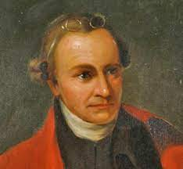
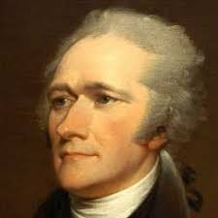
Walk Down To Electoral College
The Great Constitutional Debate: Who should elect the president? (The People or Congress)
Electoral Compromise
Check & Balance (Never has gone against the popular vote)
Check against tyranny of the mob
The people select the electors and therefore pass on their will to an appropriate body!
- Publius, Federalist 68
The use of the Electoral College will block the will of the people!
- Republicus, Anti-federalist 72

Slide 58
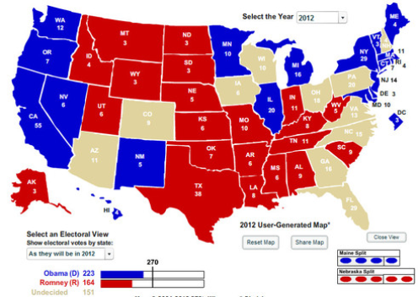
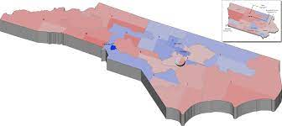
Building a College of Electors
Electoral College value per state = 2 senators + total number of reps in the House
(Ex. NC value 16 = 2 senators + 14 representatives)
State’s popular vote chooses the slate of electors that votes in the Electoral College (Winner-take-all system)
Total Electors = 538
Winner needs 270 electors
Democrat slate of 16 Electors
Republican slate of 16 Electors
NC Voters decide

Slide 59
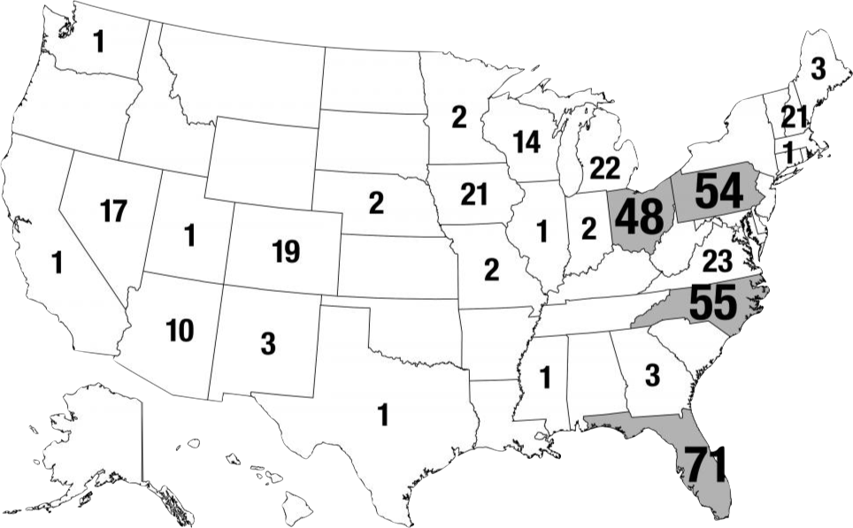
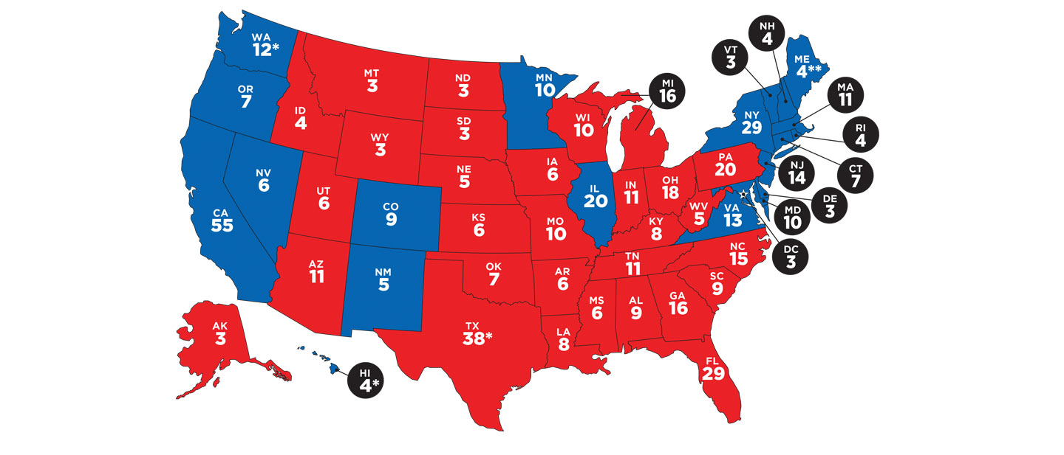
Plan your strategy
2016 Election Campaign for President
Why was the Electoral College included in the original Constitution?
What would it take to get rid of the Electoral College?
How would repeal of the Electoral College impact presidential elections?
Electoral College Values by state
Why did these states get the most visit for the Republican and Democrat candidates for President?

Slide 60
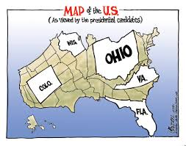
The Swinging States
Presidential General Election Campaign Strategy: Swing States
2020 Presidential Campaign
Ohio worth = 20 Electoral Votes
Campaign visit: 48
California worth = 54 Electoral Votes
Campaign visit: 1
NC worth = 15 Electoral Votes
Campaign visit: 55
Texas worth = 40 Electoral Votes
Campaign visit: 1

Slide 61
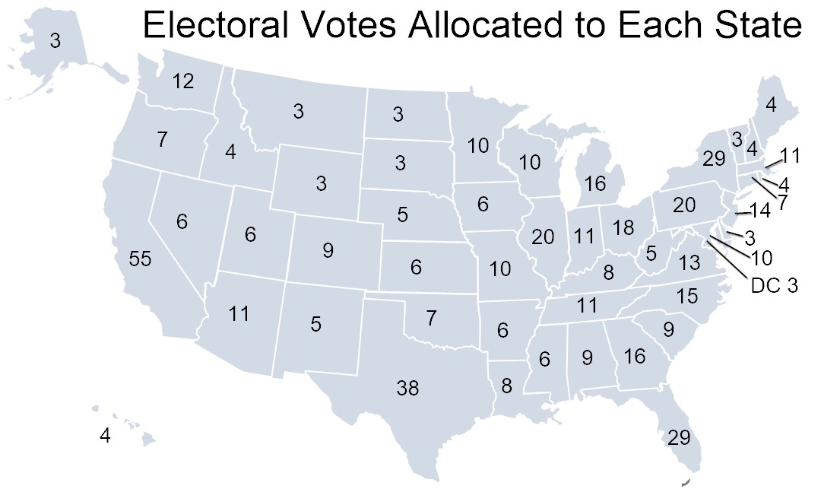
Should I stay or should I go?
The framers of the Constitution created the electoral college as the means of electing the president.
Take a position on whether the Constitution should be amended to abolish the electoral college and replace it with a direct popular vote.
Use at least one piece of evidence from one of the following foundational documents:
Article I of the United States Constitution
Article II of the United States Constitution
The Federalist 51
Relevant to American elections?
Out of date in American elections?

Slide 62
Evaluating the Primary System
The NOMINATION process is RIGGED!
The NOMINATION process is RIGGED!
Evaluate whether nomination process for selecting presidential candidates is biased and therefore undemocratic.

Slide 63
Unit V: Influencers of American Democracy (Voting)
Enduring understanding: Factors associated with political ideology, efficacy, structural barriers, and demographics influence the nature and degree of political participation.
Learning Obj. 5.8: Explain how different process work in a U.S presidential elections
Learning Obj. 5.9: Explain how different process work in a Congressional elections
Essential Question: How our government institutions and public policies are influenced by the unelected linkage institutions.
Students can:
Determine how the expansion of enfranchisement has impacted participation in American political landscape
Evaluate the legitimacy of factors that limit and encourage voter participation
Decipher how federal policies on campaigning and electoral rules continues to be contested by both sides of the political spectrum
AGENDA
Who’s More Democratic
Congressional Elections Factor
Turnout in an Election
Homework
Bling-Bling Nation

Slide 64
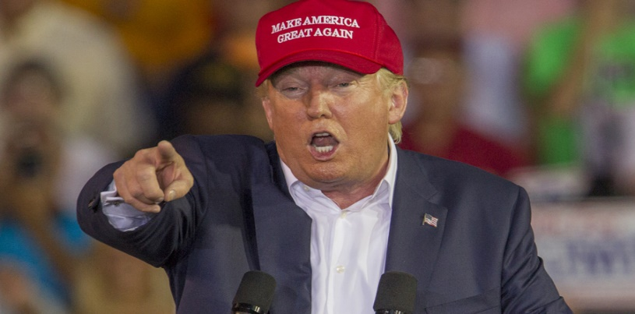
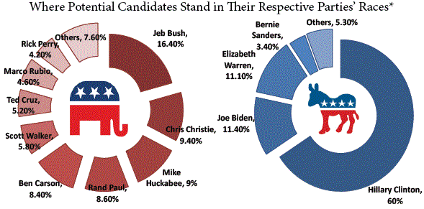
Nomination Process
Evaluate whether nomination process for selecting presidential candidates is biased and therefore undemocratic.
Highlight reforms that have been made to the nomination process
Evaluate its strengths and weaknesses
The NOMINATION process is RIGGED!
The NOMINATION process is RIGGED!

Slide 65
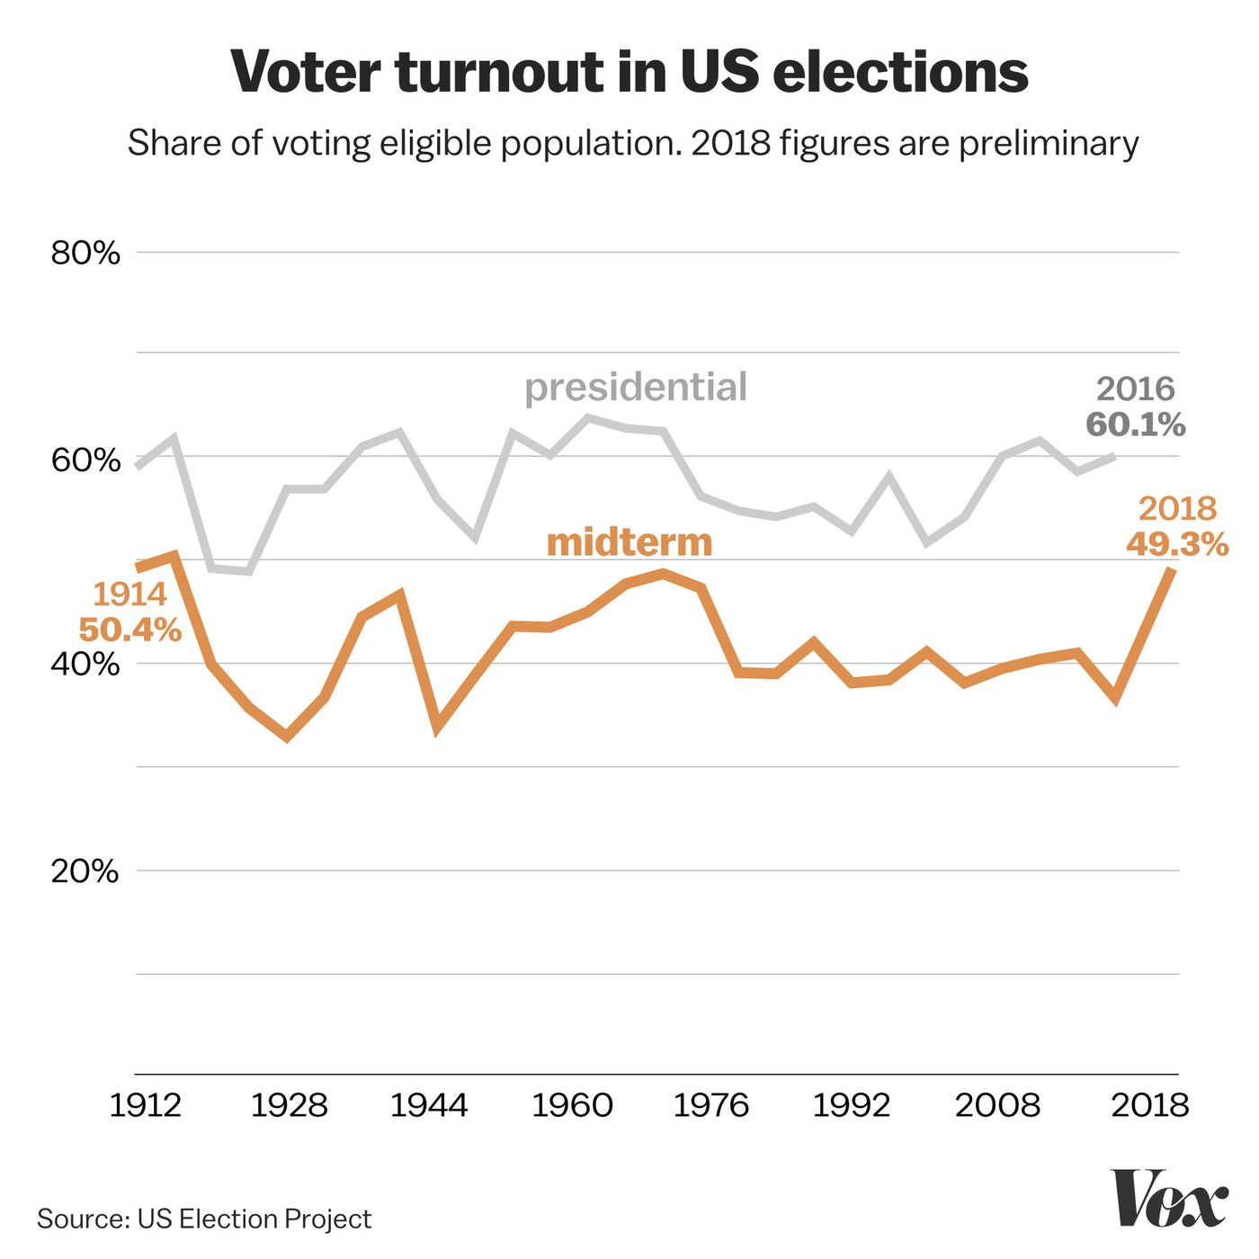
Congressional Elections
Factors that shape Congressional Elections
Generate a list of factors that influence Congressional Elections
Consider the following:
Article I of the Constitution
Senate v. House of Representatives
Presidential Elections v. Midterms
Mass Media Coverage
Representation of the People
Interest Groups
Campaign Finance
Advantages
Voter turnout rates

Slide 66
Turnout the Vote
Presidential Elections v. Midterm Elections Turnout
Identify TWO major trends in voter turnout illustrated by the graph.
How the following impact midterm elections for Congress
Incumbency
Committee Assignments
C. Explain ONE major difference between a presidential campaign and a congressional campaign for elected office

Slide 67
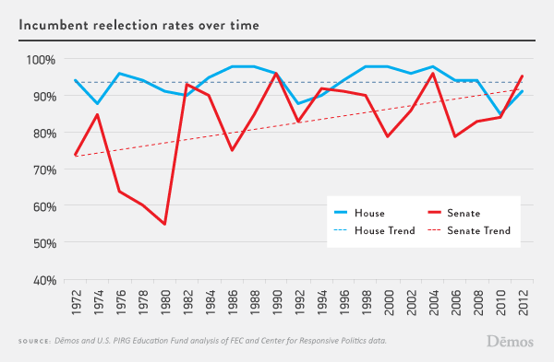
Incumbency
Congressional Incumbency = High Re-election
Name Recognition
War chest (PACs & Super PACs back the incumbent)
Staffers
Pork barreling and casework = CREDIT CLAIMING

Slide 68
Presidential coattails
Presidential approval rating and presidential elections impact on congressional elections
Presidential Coattail Effect – voters support president’s party in congressional elections (debatable)
Lame Duck – A President who does not win a second term or cannot run for re-elections

Slide 69
Gerry Man Again
One party rule of state legislatures
Gerrymandering safe districts in the House of Representatives
General Elections are not competitive
Primary Elections are competitive for an open seat

Slide 70
To Debate or Not to Debate
Debating an opponents – Presidential candidate yes vs. Congressional candidates NO
Incumbents & Frontrunners have the advantage (name recognition)
Gaffes could legitimize an opponent

Slide 71
Contrasting Campaigns
Presidential Campaigns v. Congressional Campaigns
Congressional Elections
Presidential Elections

Slide 72
Elected Position Campaigns
Congressional Elections
Presidential Elections
Very one sided (incumbency advantage)
Fewer people vote in midterm elections
Taking Credit (pork-barreling)
Can blame the politics of Washington (duck responsibility)
Presidential Coattail effect
More competitive (winner rarely gets more than 55% of the vote)
More voters
Greater media coverage

Slide 73
Unit V: Influencers of American Democracy (Voting)
Enduring understanding: Factors associated with political ideology, efficacy, structural barriers, and demographics influence the nature and degree of political participation.
Learning Obj. 5.8: Explain how different process work in a U.S presidential elections
Learning Obj. 5.9: Explain how different process work in a Congressional elections
Essential Question: How our government institutions and public policies are influenced by the unelected linkage institutions.
Students can:
Determine how the expansion of enfranchisement has impacted participation in American political landscape
Evaluate the legitimacy of factors that limit and encourage voter participation
Decipher how federal policies on campaigning and electoral rules continues to be contested by both sides of the political spectrum
AGENDA
The Politics of Campaign Finance
Political Speech v. Political Integrity
Money changes everything
Homework
Roles of Political Parties

Slide 74
Money Changes Everything
Explain the difference between Hard Money and Soft Money in political campaign finance.
Explain ONE factor that has promoted the growth of campaign finance in American elections
Explain why it is hard to limit money’s influence on election campaigns

Slide 75
The Bling, Bling of Campaigning
Increasing cost of campaigning
Political Consultants
Campaign Ads (mudslinging)
Social Media
Public Opinion Polls
Mass Media
Winning Independents’ Votes

Slide 76
Do-Nation Democracy
Money is the life’s blood of any campaign (new way for political participation)
Issue: promoting free speech vs. protecting the integrity of elections
I will gladly take a check!
Trump is my man!
He is on my side!
How about a contribution?
Michael Bloomberg
$152,509,750 Total contributions for 2019/2020
Sheldon Adelson
$218,168,500 Total contributions for 2019/2020

Slide 77
Election Reform Act of 1974
Created the Federal Elections Commission to over see elections
Buckley v. Valeo: establish that campaign contributions are protected by the 1st Amendment free speech, but they can be limited, EXCEPT if it your own $$$
Magical Word Test: limits expressed advocacy ads by interest groups (ex. vote for, elect, vote against)
- Full disclosure of campaign contributions
Establish limits on campaign contributions given to the candidate (Hard Money)
Prevents contributions from foreign interests and limits the amount that can be donated to a candidate per election cycle ($2000 per candidate)
- Established federal elections matching funds (tax payer dollars – if you accept the money you take restrictions on the amount of $$ you can raise)

Slide 78
Bipartisan Campaign Act of 2002
McCain-Feingold Law
Bans soft money donations to national party (national parties, candidates, and federally elected officials cannot solicit soft money donations)
Limits campaign ads by interest groups (60 days prior to general election & 30 days prior to a nominating elections)
Upheld by McConnell v. FEC – protection of the integrity of elections

Slide 79
Money Adapts
PACs – Political Action Committees
Super PACs
Electioneering by interest groups, unions & corporation
Can donate money to candidates ($5000 per elections limit on hard $$$)
Can donate money to political party ($15,000 per year)
Donation limit to PACs ($5000 per year)
Electioneering by interest groups, unions, & corporations – Caused Citizens United v. FEC decision (Issue Advocacy)
Cannot donate money to political parties or candidates
No donation limits

Slide 80
Issue Advocacy Ads
Issue Advocacy Ads: created by SUPER PACS (independent expenditures)
Only regulation (magic word test)

Slide 81
Citizens United v. FEC
Question before the Court: The issues on appeal were whether, as applied to Hillary, (1) § 441b's prohibition on corporate independent election expenditures was constitutional and (2) BCRA's disclaimer, disclosure, and reporting requirements were constitutional.
Citizens United vs. FEC - The First Amendment prevents the government from putting limits on independent expenditures giving by SUPER PACS

Slide 82
Super PACS since Citizens United
Which democratic group think theory does the rise of dark money re-enforce?
Citizens United vs. FEC effect – RISE OF SUPER PACS (unlimited contributions “DARK MONEY)

Slide 83
Money Changes Everything
Use your content knowledge to complete both free responses
Is campaign donations FREE SPEECH or supporting Elite Theory of Democracy?

Slide 84
VEP in America

