Slide 1
Urbanization and Immigration
Unit VI – Industrial Revolution

Slide 2
Essential Question: How did rapid mechanization in industrial and agriculture American society transform the United States and bring it into the modern age?
Students can:
Determine factors that caused the growth of American cities
Evaluate how the rise of urbanization transformed the U.S. landscape
Agenda for Today
Gilded Review
Gilded Politics and Industrialism
Urban Sprawl
Homework:
Three Waves of Immigration Continuity & Change

Slide 3
Guiding Question 1
Identify and analyze the factors that changed the American city in the second half of the nineteenth century.

Slide 4
Guiding Question 2
What key changes did urbanization bring to America? In what ways was America becoming a consumer and leisure society?

Slide 5
Guiding Question 3
Analyze the primary causes of the population shift from the rural to an urban environment in the United States between 1875 and 1925.

Slide 6
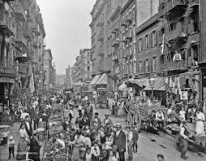
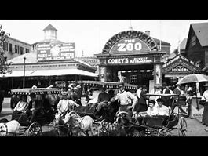
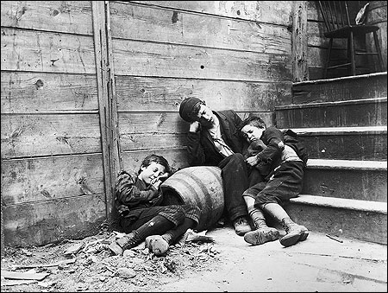
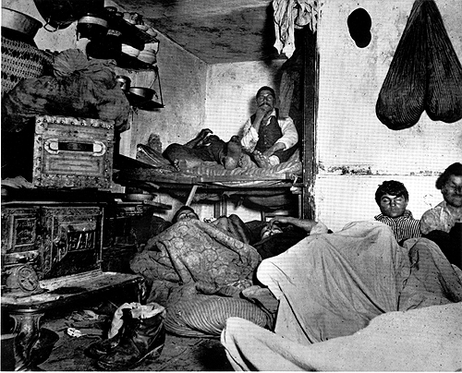
Bright Lights, Big City

Slide 7
Essential Question: How did rapid mechanization in industrial and agriculture American society transform the United States and bring it into the modern age?
Students can:
Determine factors that caused the growth of American cities
Evaluate how the rise of urbanization transformed the U.S. landscape
Agenda for Today
Bright Lights, Big City Going Through My Head
Urban rather than rural
The Urban Concept
Homework:
Laissez Faire Debate – Tuesday 2/4
Reading - The Plight of the Native Americans – pages 594-604
Unit VI Test – Wednesday 2/12

Slide 8
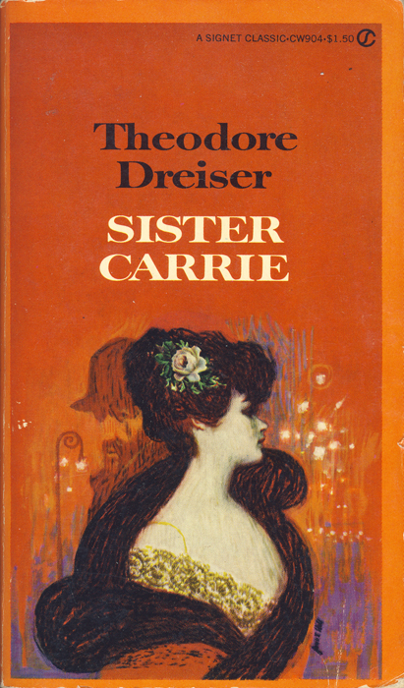
“[Department stores] were along the line of the most effective retail organization, with hundreds of stores coordinated into one and laid out upon the most imposing and economic basis. They were handsome, bustling, successful affairs, with a host of clerks and a swarm of patrons. Carrie passed along the busy aisles, much affected by the remarkable displays of trinkets, dress goods, stationery, and jewelry. Each separate counter was a showplace of dazzling interest and attraction. She could not help feeling the claim of each trinket and valuable upon her personally.”
Sister Carrie, Theodore Dreiser, 1900
Explain Dreiser’s point of view in regard to urbanization during the Industrial Age.

Slide 9
Patterns in Urban Growth in Turn-of-the-Century America

Slide 10
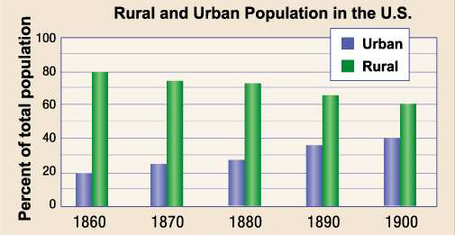
Population Shift
What factors contributed to the population shift America saw during the Gilded Age?

Slide 11
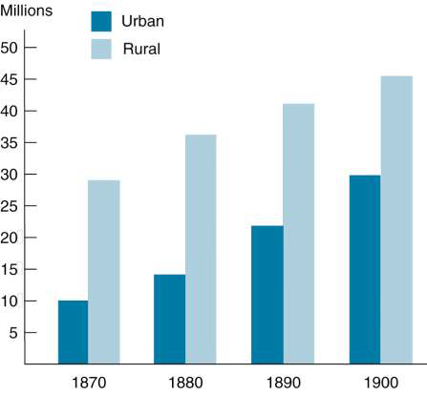
Urbanization
Urbanization (Causation)
industrialization
mechanization
American dream
urban culture (excitement)
African Americans (escape
sharecropping)
gateways for immigrants

Slide 12
Population Growth from 1860-1900

Slide 13
Late 19th Urbanization: Individual Cities

Slide 14
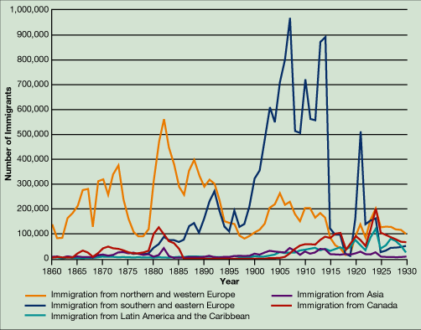
Annual Immigration to the United States, 1860-1930

Slide 15
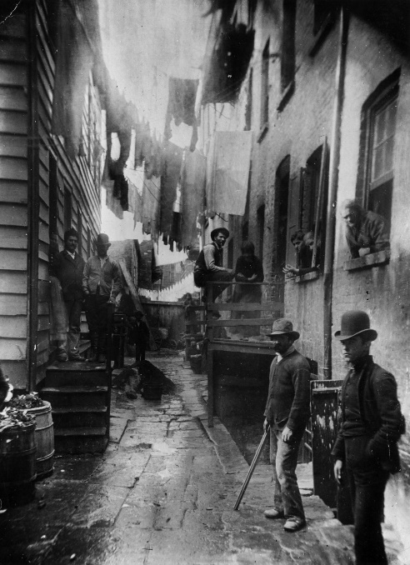
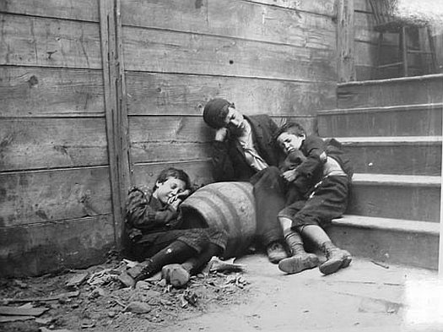
Welcome to the Jungle
Life in the City
Dumbbell Tenements: overcrowded, unsanitary, and full of crime living areas for working class
Jacob Riis, “How the Other Half Live” exposed urban poverty

Slide 16
Rise of Cities in America
The ripple effect of urbanization
Causes
Urbanization Effect
Innovations
Reform
Economic
Culture
Political

Slide 17
Essential Question: How did rapid mechanization in industrial and agriculture American society transform the United States and bring it into the modern age?
Students can:
Determine factors that caused the growth of American cities
Evaluate how the rise of urbanization transformed the U.S. landscape
Agenda for Today
Looking Backwards
Bring US your Tried Masses?
Urbanization Mirror
Homework:
Historic Contextualization re-writes
Study for Quiz
Gilded Age Quiz – 2/1/19
Immigration debate POV research

Slide 18
Welcome to America
Joseph Keppler, “Looking Backward” 1893

Slide 19
Coming to America
Explain what the graph implies. Be sure to include historic facts from your reading.

Slide 20
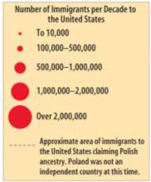
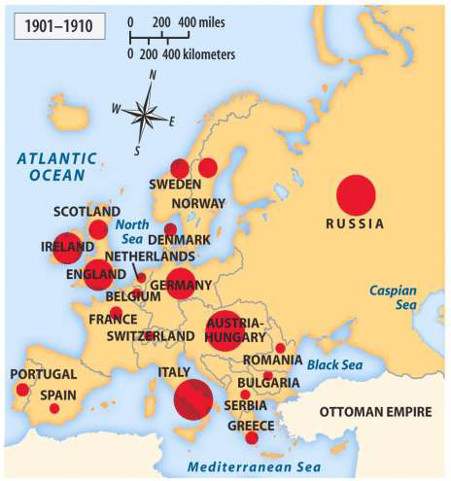
Late 19th Century Immigration
Poverty (Chinese)
Famine (Irish)
Religious persecution (Jewish)
Political upheaval (Armenians)
Push factors
Pull factors
American dream (opportunity)
Family
Freedom (Religious)
Democracy
Sources of European Immigration to the United
States, 1870-1910 (Henretta, America’s History 4e)

Slide 21
Two classes of immigrants
1st wave immigrants “Old Immigrants”
Northern & Western European
Have $$$$
Have Skill
Assimilate
2nd Wave Immigrants “New Immigrants”
Southern & Eastern European
Poor & unskilled
Non-democratic
Issues with assimilation

Slide 22
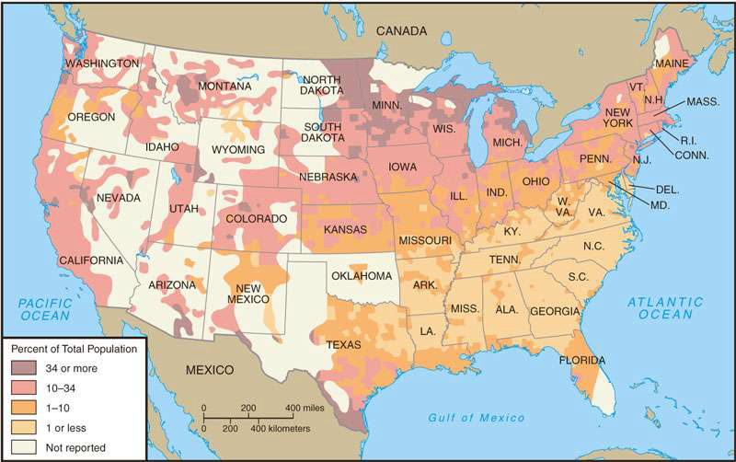
Foreign-born Population, 1890

Slide 23
Population Composition of Selected Cities, 1920

Slide 24
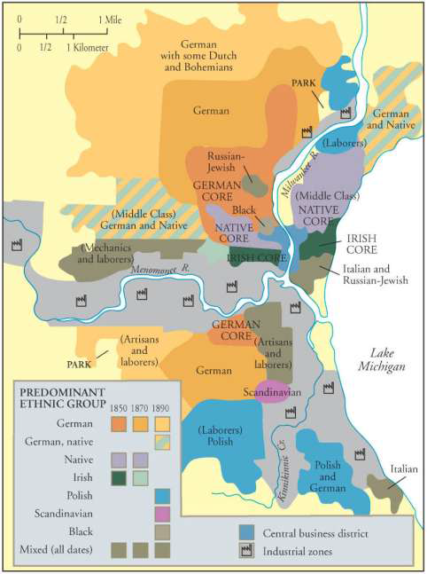
Urbanization
“immigrant ghettoes”
Why?
Ethnic and Class Segregation
in Milwaukee, 1850-1890.

Slide 25
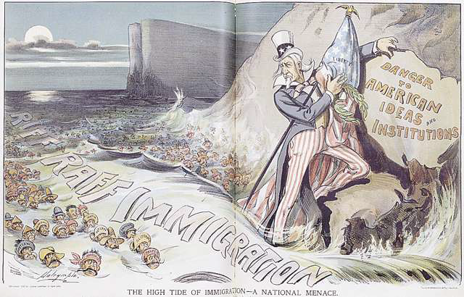
Efforts at Exclusion
Xenophobia / nativism (Why?)
Chinese Exclusion Act (1882)
Contract Labor Act (1885)
Restrictions on “undesirable” persons
American Protective Association
XENOPHOBIA

Slide 26
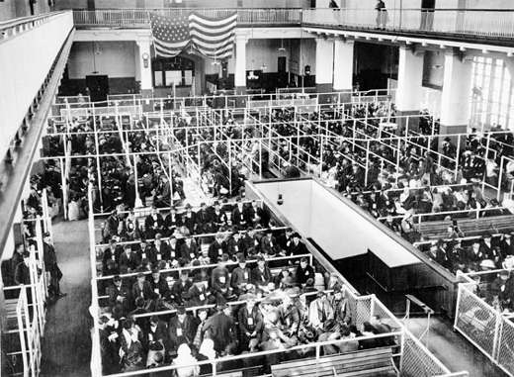
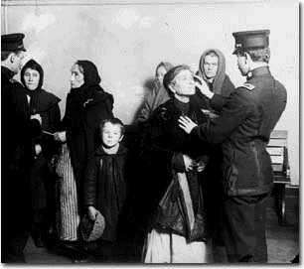
Ellis Island – Gateway for Immigration
Immigrants
Landing at Ellis
Island, c. 1900
(National Archives)
Examination of immigrants at Ellis Island Copyright 1997 State Historical
Society of Wisconsin
Ellis Island ~Examination Room (New York Public Library)

Slide 27
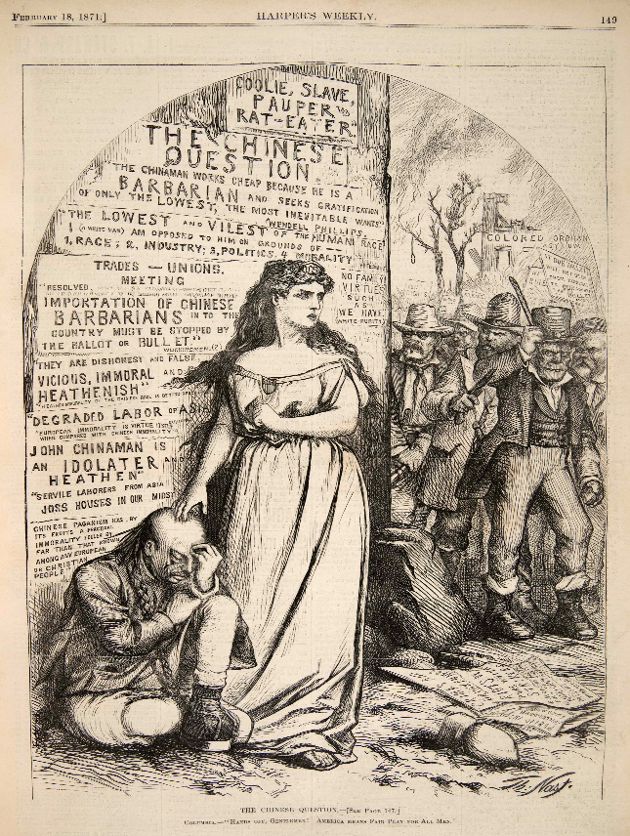
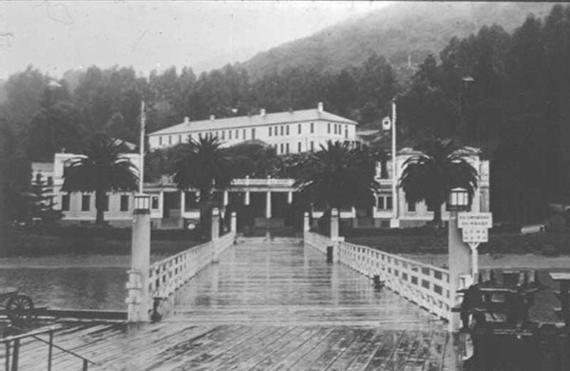
Angel Island
“Birds of Passage” – Not planning to permanently stay
Asian immigrants – “undesirables” (tougher standards for immigration

Slide 29
Essential Question: How did rapid mechanization in industrial and agriculture American society transform the United States and bring it into the modern age?
Students can:
Determine factors that caused the growth of American cities
Evaluate how the rise of urbanization transformed the U.S. landscape
Agenda for Today
Gilded Age Review
Assessment of the Gilded Age
Brave New World Concept
Homework:
Brave New World Concept Questions

Slide 30
“That’s What’s the Matter” Boss Tweed “As Long As I Count the Votes, What You Going to do about it? Say?
The Ballot

Slide 31
DBQ Warm up
Prompt: Evaluate to what extent Urbanization during the period of 1870 to 1900 reflects the Gilded Age.

Slide 32
Changing the Urban Landscape

Slide 33
Essential Question: How did rapid mechanization in industrial and agriculture American society transform the United States and bring it into the modern age?
Students can:
Determine factors that caused the growth of American cities
Evaluate how the rise of urbanization transformed the U.S. landscape
Agenda for Today
Sister Carrie’s view
Transformative state of urbanization
Urbanization Mirror
Homework:
Read pages 604-613 Complete terms 10-24
Industrial Revolution Concept Cube – 2/5/18
Gilded Age Quiz – 2/7/18

Slide 34
“What old illusion of hope is not here forever repeated! Says the soul of the toiler to itself, "I shall soon be free. I shall be in the ways and the hosts of the merry. The streets, the lamp, the lighted chamber set for dining are for me. The theatres, the halls, the parties, the ways of rest and the paths of song—these are mine in the night." Though all humanity be still enclosed in the shops, the thrill runs abroad. It is in the air. The dullest feel something which they may not always express or describe. It is the lifting of the burden of toil.”
- Theodore Dreiser, “Sister Carrier” 1900
How does Sister Carrier evaluate an aspect of the Gilded Age
It demonstrate how labor power is ineffective against the industrialists
It promotes urbanization as a glorious adventure
It demonstrates how urban life led to new societal problems
It promoted woman’s equality in the United States

Slide 35
“What old illusion of hope is not here forever repeated! Says the soul of the toiler to itself, "I shall soon be free. I shall be in the ways and the hosts of the merry. The streets, the lamp, the lighted chamber set for dining are for me. The theatres, the halls, the parties, the ways of rest and the paths of song—these are mine in the night." Though all humanity be still enclosed in the shops, the thrill runs abroad. It is in the air. The dullest feel something which they may not always express or describe. It is the lifting of the burden of toil.”
- Theodore Dreiser, “Sister Carrier” 1900
Which of the following challenged the ideas presented in Sister Carrie?
Gospel of Wealth by Andrew Carnegie
Struggling Upward by Horatio Alger
How the Other Half Live by Jacob Riis
The Atlanta Compromise by Booker T. Washington

Slide 36
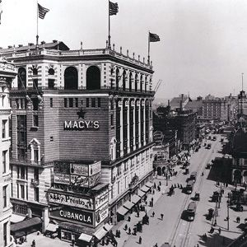
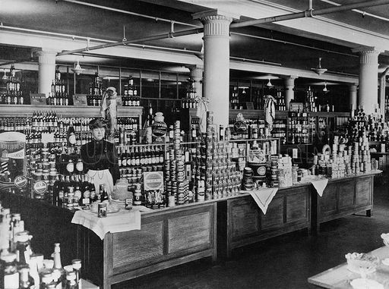
Convenient Consumerism
Convenient consumerism: Americans buys what they need and replaces goods
Ex. City – cheap ready-made clothes v. rural mending clothes
Department Stores: Macy’s & Sears

Slide 37
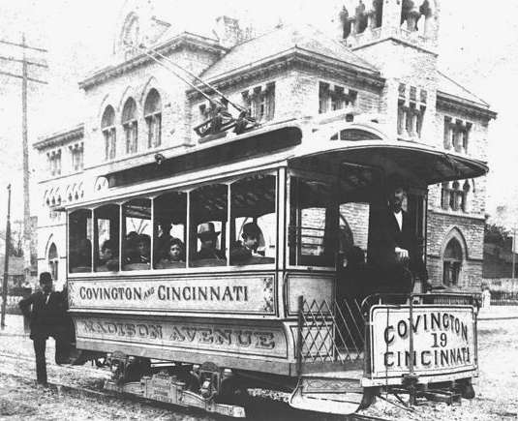
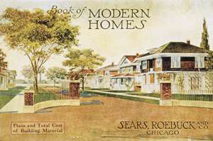
Changes in the Urban Landscape
“walking” cities
mass transit
Suburbs
“streetcar suburbs”
Madison Avenue Trolley, Covington, 1892

Slide 38
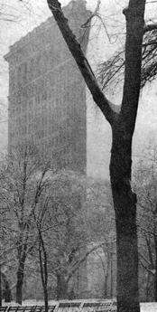
Attempts to Create Order
Skyscrapers (innovation)
Louis Sullivan – Chicago
Other important innovations
Safety Elevator (Elisha Otis)
Electricity (Edison & Westinghouse)

Slide 39
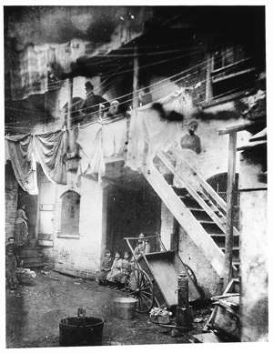
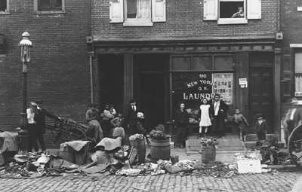
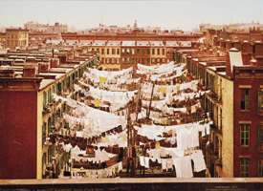
Changes to the Urban Landscape
Yard of tenement at Park Place, New York City (Library of Congress)
Urban problems
Sanitation, pollutions, & overcrowding
Slums
Dumbbell Tenements
Jacob Riis – “How the Other Half Lives”
Tenement clotheslines, New York City (Library of Congress))
Poor Immigrant Neighborhood, Philadelphia, 1915)

Slide 40
CRISIS & REFORM

Slide 41
Reform in the Gilded Age?
Reformers began to examine major issues created by industrialization and urbanization towards the end of the 19th century. But reform challenged America’s belief in laissez faire capitalism.
Ex. Bakershop Act (New York City 1895) – Bakers could only work 10 hours per day and 60 hours a week
Lochner v. New York 1905 constitutional question: What is the test for determining whether legislation which seeks to impose restrictions upon an individual’s general right to make a contract in relation to his business is not invalid under the Due Process Clause of the Fourteenth Amendment?

Slide 42
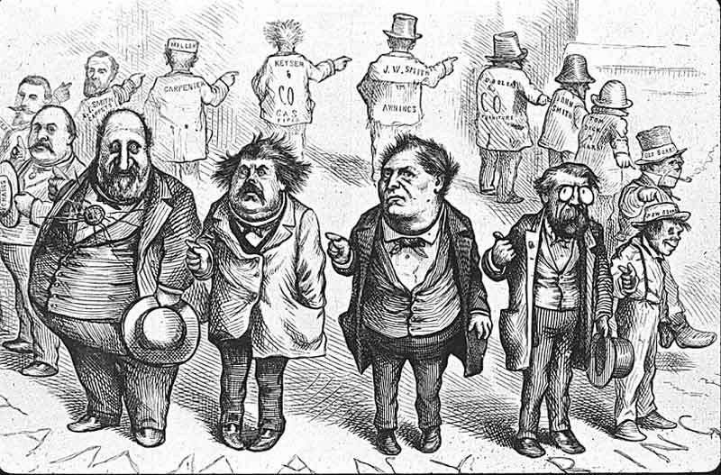
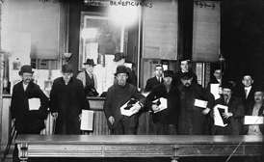
Big City Government & “Bosses”
urban political machines
political boss
William M. Tweed
Tammany Ring
Boss George B. Cox
patronage
Bowery men with gift from Ward Boss Tim Sullivan, Feb., 1910 (Library of Congress)

Slide 43
Leisure, Culture, and Education

Slide 44
Period 6: 1865 – 1898 - The transformation of the United States from an agricultural to an increasingly industrialized and urbanized society brought about significant economic, political, diplomatic, social, environmental, and cultural changes.
Key Concept 6.1: Technological advances, large scale production methods, and the opening of new markets encouraged the rise of industrial capitalism in the United States
Key Concept 6.3: The Gilded Age produced new cultural and intellectual movements, public reform effort, and political debates over economic and social policies
Essential Question: How did rapid mechanization in industrial and agriculture American society transform the United States and bring it into the modern age?
Students can:
Discern how did industrialization change Americans’ lives during the Gilded years?
Evaluate how and why did Americans struggle over the power and purpose of government?
Agenda for Today
Brochure Layout
Building brochure
This is not the Gilded Age
Homework:
Complete reading and terms

Slide 45
The Changing American Landscape
Describe ONE factor that caused the change in population in the United States from 1860 to 1900.
Explain positive change to either rural or urban landscape, as a result of the population change.
Explain how population change of the United States from 1860 to 1900 led to one of the following conflicts.
The common man vs. industrialists
Culture differences
Power of government

Slide 46
Brochure Layout
(Front cover) Title - Thesis – Image that represent your topic Student Names | (Middle) Citation Author Document Year | (Historic Synthesis) Main idea Primary source document Paragraph defense
Political Main idea Primary source document Paragraph defense | Economic Main idea Primary source document Paragraph defense | Social Main idea Primary source document Paragraph defense

Slide 47
Essential Question: How did rapid mechanization in industrial and agriculture American society transform the United States and bring it into the modern age?
Students can:
Discern how did industrialization change Americans’ lives during the Gilded years?
Evaluate how and why did Americans struggle over the power and purpose of government?
Agenda for Today
Gilded Effect
Social cultural transformation
What can you prove
Homework:
Read The Economy of the West – pages 604-613
Rough draft for DBQ due Friday

Slide 48
Urbanization
To what extent did urbanization during the period of 1870 to 1900 reflect the Gilded Age?
Thesis
15 facts by bases

Slide 49
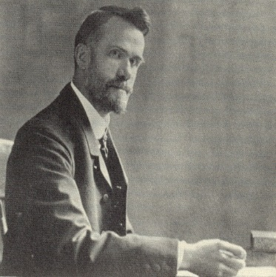
The Social Gospel
The social gospel is the old message of salvation, but enlarged and intensified. The individualistic gospel has taught us to see the sinfulness of every human heart and has inspired us with faith in the willingness and power of God to save every soul that comes to him. But it has not given us an adequate understanding of the sinfulness of the social order and its share in the sins of all individuals within it. It has not evoked faith in the will and power of God to redeem the permanent institutions of human society from their inherited guilt of oppression and extortion. Both our sense of sin and our faith in salvation have fallen short of the realities under its teaching. The social gospel seeks to bring men under repentance for their collective sins and to create a more sensitive and more modern conscience. It calls on us for the faith of the old prophets who believed in the salvation of nations.
- Walter Rauschenbusch, “A Theology of the Social Gospel”

Slide 50
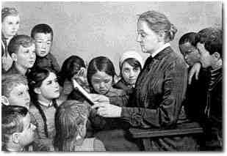
Battling New Economic & Social Problems
YMCAs and YWCAs
Salvation Army
“deserving poor” “undeserving poor”
Social Gospel
Walter Rauschenbusch, Christianity and the Social Crisis
Settlement Houses
Hull House
Jane Addams

Slide 51
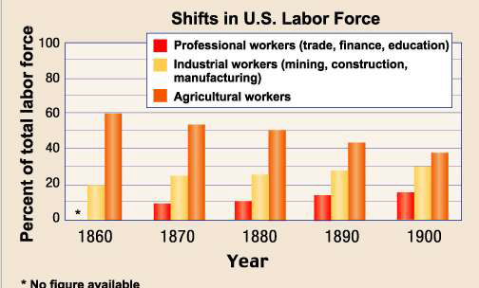
Development of Mass Consumption
“white collar” - catalogs
ready-made clothing - chain stores
prepared food - department stores
(shopping as a leisure activity)

Slide 52
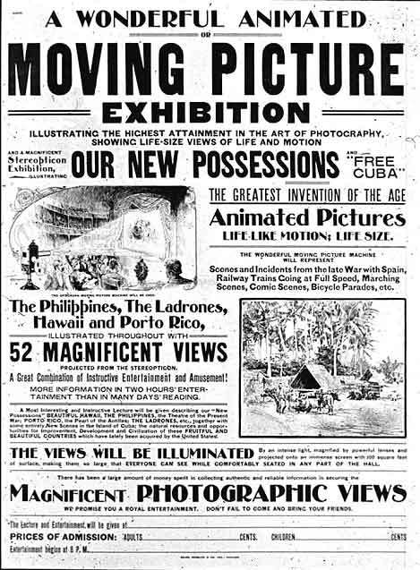
Mass Culture: Leisure in the Consumer Society
“leisure”
baseball - “national pastime”
amusement parks
Coney Island
newspapers
“yellow journalism”
William Randolph Hurst
Joseph Pulitzer
Moving Picture Exhibition, 1900

Slide 53
High Culture: Art, Literature & Education
“high culture”
armory show (1914)
Charles Darwin
Education:
compulsory attendance laws
“kill the Indian, save the man” (assimilation)
Carlisle Indian Industrial School
Colleges: land grant institutions (Morrill Act)
new female institutions (Vassar and Wellesley)

Slide 54
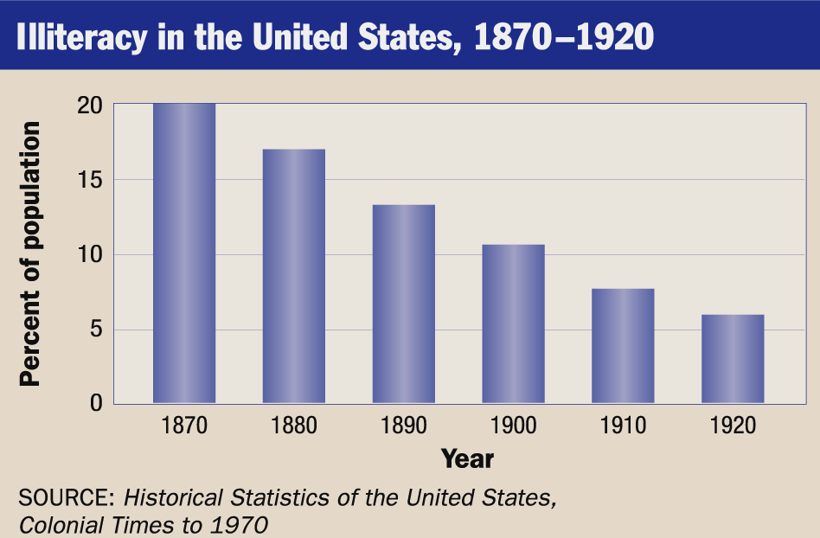
Education- Illiteracy in the US

Slide 55
BIG BUSINESS in America
Prompt: In the post–Civil War United States, corporations grew significantly in number, size, and influence. Analyze the impact of big business on the economy and politics and the responses of Americans to these changes. Confine your answer to the period 1870 to 1900.
Plan of action:
What can you prove based on the documents?
What connections do the documents establish?
What facts support your ideas

Slide 56
BIG BUSINESS in America
The Thesis Formula: X. However, A and B. Therefore, Y. NOTE: These are not necessarily standalone sentences, they are concepts.
‘X’ represents the strongest point against your argument. We call this the counter-argument (it does not have to be a counter-argument, it can qualify as well).
‘A and B’ represent the two strongest points for your argument. We call these your organization categories.
‘Y’ represents the position you will be taking – in other words, your stand on the prompt.
NOTE: INCLUDE MODIFYING ADVERB in your assertion with regard to the prompt.

Slide 57
Period 6: 1865 – 1898 - The transformation of the United States from an agricultural to an increasingly industrialized and urbanized society brought about significant economic, political, diplomatic, social, environmental, and cultural changes.
Key Concept 6.1: Technological advances, large scale production methods, and the opening of new markets encouraged the rise of industrial capitalism in the United States
Key Concept 6.3: The Gilded Age produced new cultural and intellectual movements, public reform effort, and political debates over economic and social policies
Essential Question: How did rapid mechanization in industrial and agriculture American society transform the United States and bring it into the modern age?
Students can:
Discern how did industrialization change Americans’ lives during the Gilded years?
Evaluate how and why did Americans struggle over the power and purpose of government?
Agenda for Today
Bro, sure!
The Gilded Age Reflection
To Gilded Age or Not to Gilded Age – That is the question
Homework:
Gilded Age Reflection

Slide 58
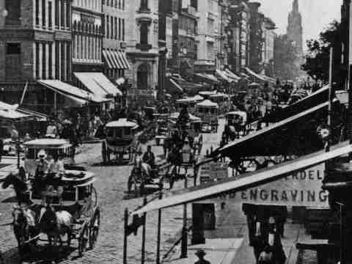
Gilded Age Profile
Clarify your profile’s view point on the following topics: (be very clear where they stand)
Immigration
Labor Unions
Urbanization
Currency
Tariffs
Government Corruption

Slide 59
Laissez Faire Capitalism
Explain your characters perspective of one of the following laws federal laws from the Gilded Age.
Sherman Anti-trust Act 1890: authorized federal action against any "combination in the form of trusts or otherwise, or conspiracy, in restraint of trade."
Interstate Commerce Act 1887: required railroad rates be “reasonable and just”, RR companies must publicize rates, and prohibited short and long haul discriminator fares, and established the Interstate Commerce Commission (ICC) to monitor compliance

Slide 60
Assignment
Evaluate the Lochner case and its ramification for the Gilded Age and the development of the United States as a nation
One page essay
Include facts and remnants of our discussion
This opinion paper so support it

