Slide 1
2.3 INDIAN OCEAN TRADE 600 -1450 C.E.

Slide 2
Improved transportation technologies and commercial practices led to an increased volume of trade and expanded the geographical range of existing trade routes, including the Indian Ocean, promoting the growth of powerful new trading cities.
Context

Slide 3
Indian Ocean Network
700 C.E.—knew how to use monsoons (seasonal winds), rise of Islam and its acceptance of merchants (unlike China)
1000-1200—increased trade (revival of China)
Silk Roads declined after Mongols defeated; Indian Ocean trade picked up
surged during 13th & 14th centuries

Slide 4
Indian Ocean Trade 600-1450 C.E.
Ming renewed focus on Indian Ocean Trade with the voyagers of Zheng He
by the 13th century, the Bantu people arrived on the east coast where their language merged with Arabic languages from Muslim traders→formed Swahili languages.

Slide 5
Indian Ocean Trade
Zone 1--west coast of India to Persian Gulf and East coast of Africa
Zone 2--east coast of India to islands of Southeast Asia
Zone 3--South China Sea
the Indian Ocean trade network included sailors from China, Malaysia, Southeast Asia and Persia.

Slide 6
Indian Ocean Trade
probably most important trade network
trade was between towns and cities, not states
sea transport is cheaper
more bulk goods (instead of luxury) traded: textiles, pepper, timber, rice, sugar, wheat
enabled people to concentrate their efforts on economic activities best suited to their regions

Slide 7
Products that Contributed to Indian Ocean Commerce
Mediterranean—ceramics, glassware, wine, gold, olive oil
East Africa—ivory, gold, iron goods, slaves, quartz, leopard skins
Arabia—frankincense (desired far beyond Indian Ocean world), myrrh, perfumes
India—grain, ivory, precious stones, cotton textiles, spices, timber
SE Asia—tin, sandalwood, cloves, nutmeg, mace
China—silks, porcelain, tea
https://youtu.be/a6XtBLDmPA0 crash course option

Slide 8
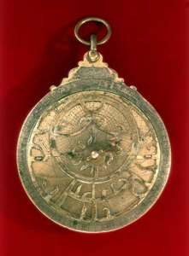
Technology
Chinese Junk
Magnetic Compass
Astrolabe

Slide 9
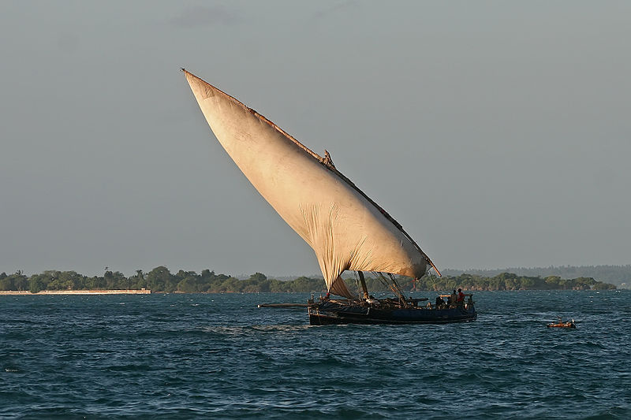
Lateen Sail (on dhow)
believed to have been used in the eastern Mediterranean as early as the 2nd century CE, possibly imported from Egypt or the Persian Gulf.
its effective use by the Arabs caused its rapid spread throughout the Mediterranean, contributing significantly to the resurgence of medieval commerce.
combined with the square sail, it produced the ocean-conquering full-rigged ship.

Slide 10
Monsoons (seasonal winds)
monsoon changes were crucial:
Nov-Feb blew to SW
April-Sept blew to NE
key was regularity
sailors used the monsoon winds to chart their course and carry out voyages that linked sections from East Africa to Southern China
limited sailing time→ development merchant diasporic communities
The expansion and intensification of long-distance trade routes often depended on environmental knowledge, including advanced knowledge of the monsoon winds.

Slide 11
Major Trading Cities
key ports—Swahili city-states of East African coast; Mecca; Hormuz, Persia; Calicut, India; Melaka (Malacca), Malaysia, Canton (Guangzhou), China

Slide 12
Effect—Growth of States
Southeast Asia and East Africa, trade stimulated political change as aspiring rulers used wealth derived from trade to construct larger & more centrally governed states or cities

Slide 13
Swahili States
city-states (like Greece)--each city was politically independent, generally governed by its own king
competed with other cities
commercial centers that accumulated goods from interior & exchanged them for products of distant civilizations (e.g. Chinese porcelain & silk, Persian rugs, Indian cottons)
Islam voluntarily and widely adopted
syncretism—family lineage traced through mother (controlled property) & father (Muslim custom)
neither Islam nor Swahili culture penetrated much beyond the coast until 19th century
Notes:
Swahili was grammatically an African tongue within the larger Bantu family of languages, but it was written in Arabic script and contained a number of Arabic words.

Slide 14
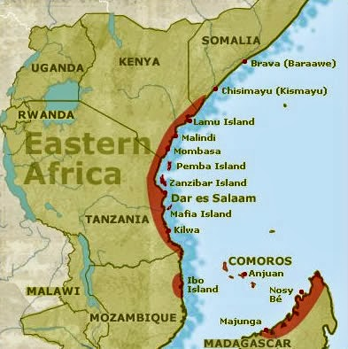
Swahili Civilization
earlier ancestors lived in small farming & fishing communities, spoke Bantu languages, traded with Arabian, Greek & Roman merchants
8th century, civilization took shape as set of commercial city-states stretching along East African coast, from present-day Somalia to Mozambique
gold, ivory, quartz, leopard skins, sometimes slaves acquired from interior societies, as well as iron & process timber manufactured along coast sold in Arabia, Persia, India→merchant class, villages became sizable towns, clan chiefs became kings

Slide 15
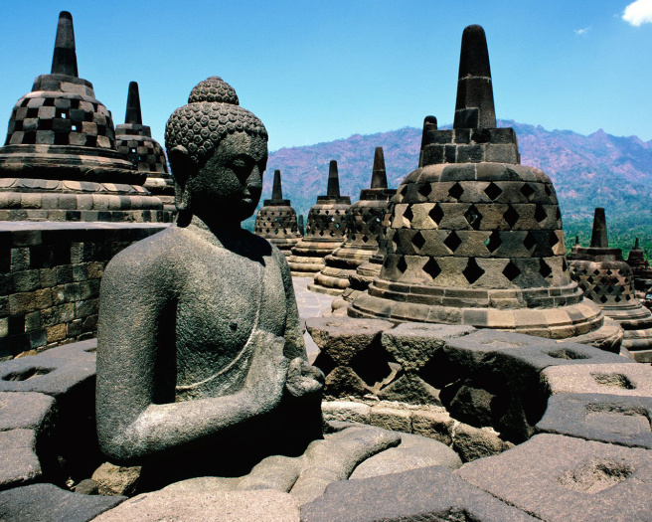
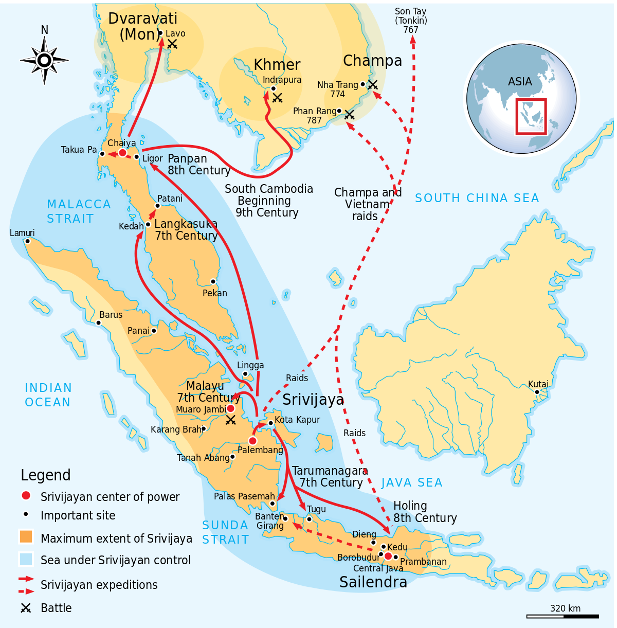
Kingdom of Srivijaya
Malay peninsula in southeast Asia
Buddhist kingdom
plentiful supply of gold, access to source of highly sought-after spices (e.g. cloves, nutmeg, mace) & taxes levied on passing ships provided resources to attract supports, fund bureaucracy, create military and naval forces
important kingdom for the diffusion of Buddhism across the region—center of Buddhist observance & teaching

