Slide 2
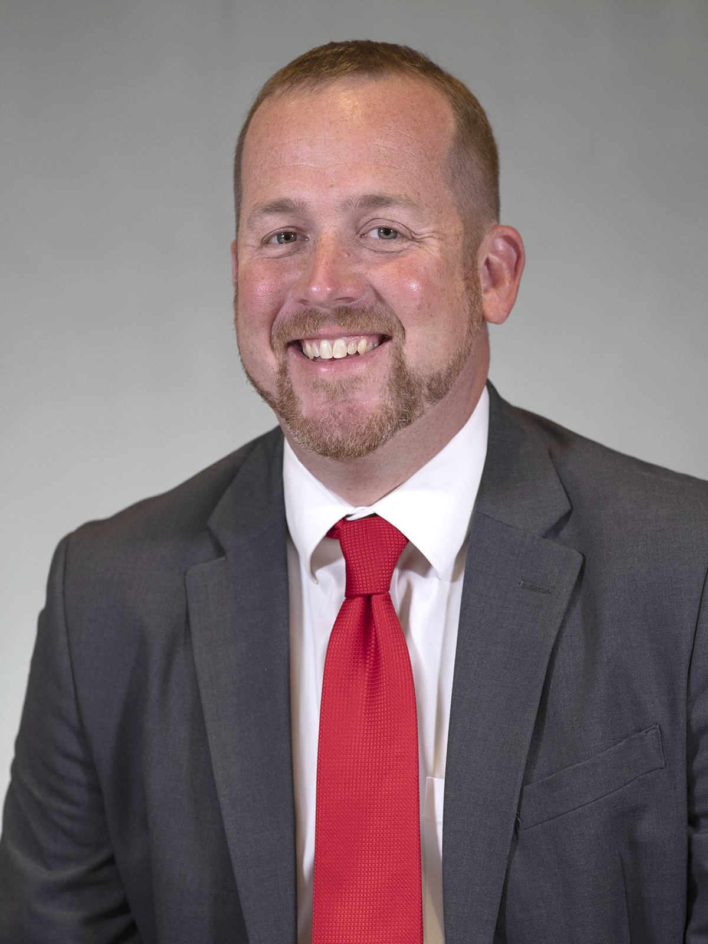
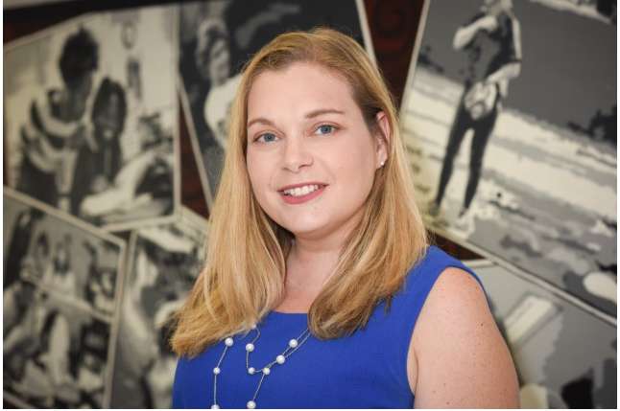
Erik Naglee
Principal, Page High School
GCS Principal of the Year 2020-2021
Piedmont Triad Principal of the Year 2020-2021
336-370-8200
nagleee@gcsnc.com
Elizabeth Hackney
AP/IB Coordinator, Page High School
336-370-8200
hacknee@gcsnc.com

Slide 3
About Guilford County Schools
GCS is the third-largest district in North Carolina, serving nearly 72,000 students across 125 schools in urban, suburban and rural areas. Because we are a larger district, we are able to offer opportunities that smaller districts, charter and private schools just can't. We have 48 magnet and choice schools with 66 programs, from Science, Technology, Engineering and Math (STEM) to performing or visual arts, advanced academics, Spanish immersion, Montessori, health sciences or aviation.
We also offer 187 Career and Technical Education courses in 50 schools, including programs in culinary arts, business, nursing, computers, and automotive technology, among others.
High schools across GCS offer more than 30 Advanced Placement courses. These college-level classes prepare students for the higher-level courses they will take after graduating from high school and moving on to colleges and universities.
GCS also offers the prestigious International Baccalaureate program at four high schools - and it's open to all students who qualify. Only a small number of districts in North Carolina are authorized by the International Baccalaureate Organization to offer the Diploma Programme, and GCS has been a part of it since 1996.
Nine early and middle colleges allow students to earn up to two years of college credit while attending high school - and it's free.
Personalizing learning is what we are all about, and we are committed to personalizing learning for each of our students.

Slide 4
About Page High School
Walter Hines Page High School opened its doors in 1958 and is a very large, urban, and diverse high school with an excellent academic, athletic, and artistic reputation. Classes operate on a traditional schedule and the school focuses on providing equitable opportunities for all students to achieve success in high school and in their future career. Page’s students are known for their great school spirit and their desire to make a difference in their community.
WHAT WE OFFER
Various CTE electives in Business, Nursing, Electrical Trades, Digital Media, and more
Many art electives (band, chorus, orchestra, theater, arts)
Honors, AP and IB courses
NJROTC
POINTS OF PRIDE
We are a very diverse campus
91.3% Graduation Rate for 2021-2022
Our senior classes document over 24,000 hours of service
Last year’s seniors received over $17 million in grants and scholarships
Many of our athletic teams often go to championship rounds, playoffs, and win conferences Band and orchestra students are often invited to participate in all-county and all-regional activities
Students go to colleges across the country, from community college, to Service Academies, to Ivy League schools

Slide 8
What Admissions’ Officers Think about IB
“IB is well known to us for its excellent preparations. Success in an IB program correlates well with success at Harvard. We are always pleased to see the credentials of the IB Diploma Programme on the transcript.” Marlyn McGrath Lewis Director of Undergraduate Admission Harvard University
“One of the advantages of the IB curriculum is its structure and quality. It is a coordinated program, well established, well known and well respected. We know the quality of IB courses, and we think the IB curriculum is terrific.” Christoph Gutting Director of Undergraduate Admission Duke University

Slide 9
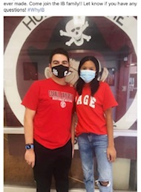
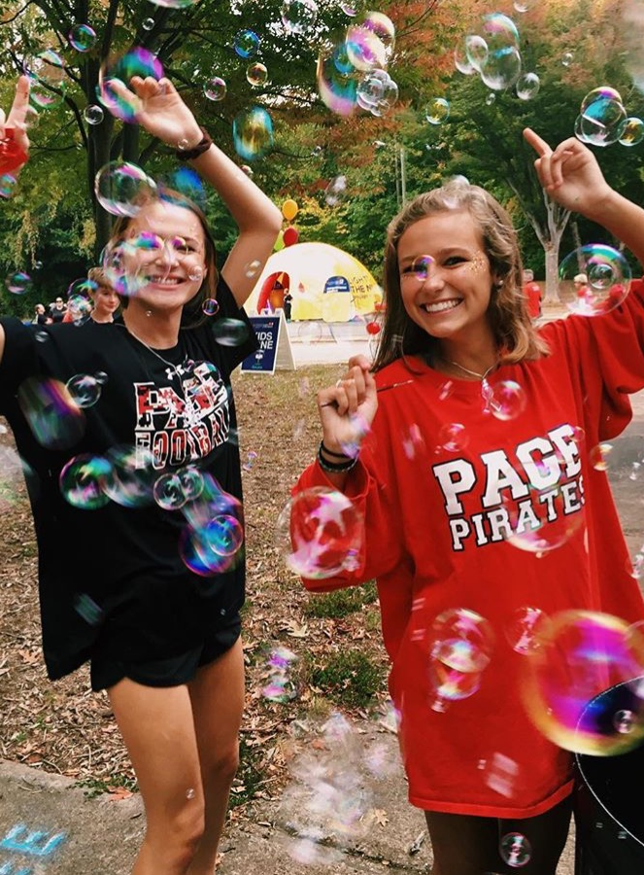
Page IB Alumni
* World Travelers—many study abroad and receive global internships
* Attend universities in North Carolina, out of state (including Ivy League universities), and out of the country
* Some of the current colleges: Duke, Brown, Yale, NYU, UVA, Emory University, Harvard, NC A&T, UNC-CH, NC State, Wake Forest, Davidson College, Temple University, Cornell, West Point
* Have received the Morehead Scholarship, the Robertson Scholarship, the BN Duke Scholarship, the Park Scholarship, the Jefferson Scholarship, and many others
* Are involved in their communities and campuses
* Are varsity, junior varsity, and club athletes
* Participate in the visual and performing arts on their campuses

Slide 10
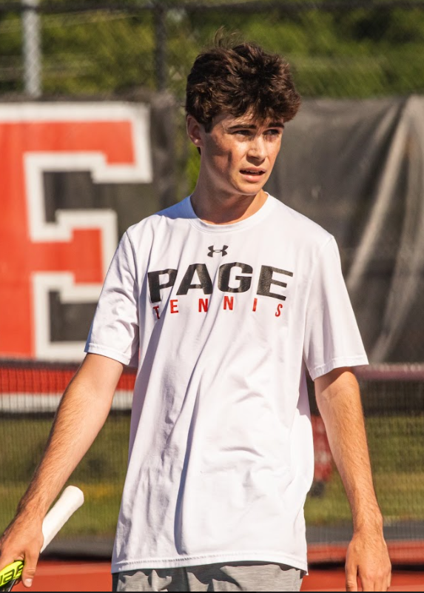
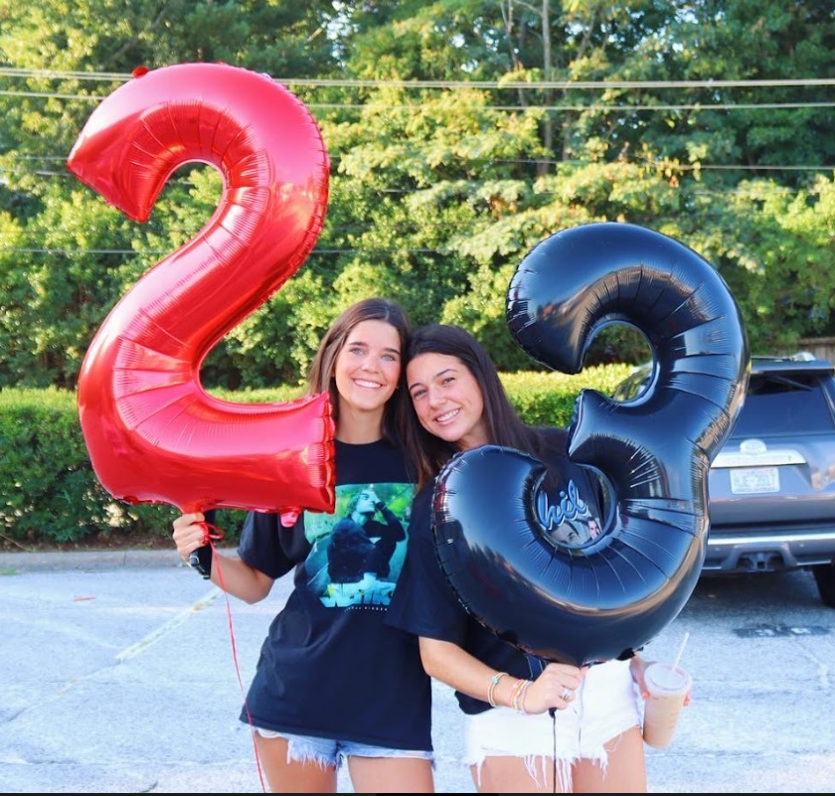
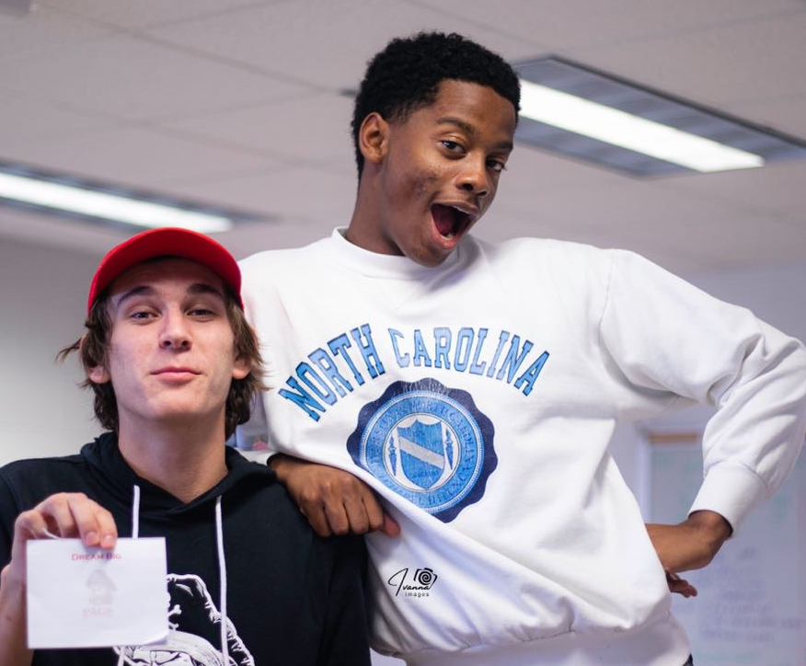
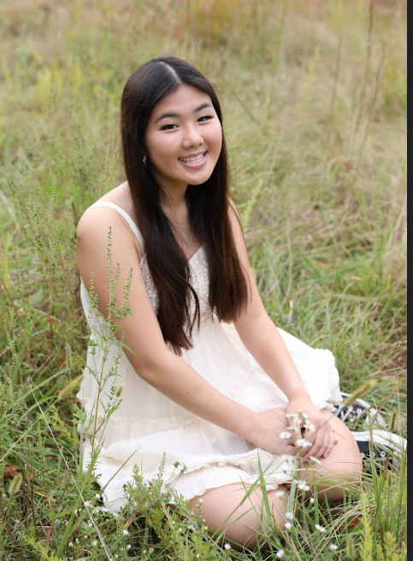
Why our students picked IB
To anyone considering IB, know that it will be challenging, stressful, and you will question very often why you decided to do it. However, it is beyond rewarding and the close knit classroom environment and relationships you will build makes it worth it. Your IB teachers and peers understand what you are going through and it is comforting knowing everyone is in the same boat. As for the curriculum and course work, IB is extremely challenging but in the end pushes you to become a better student. Ranging from writing skills, presentation etiquette, in-depth analysis, and so much more, IB propels each student to strive for their very best, improving their character as a student and a person simultaneously. You are able to develop skills that will take you far in life, aid you through college, and keep you balanced in your work and life realms. As the senior class begins to find out their future in college acceptance letters, after four years of extremely hard work and diligence, I know that the bond we have made is unmatched and will carry us through the next stages of our life. To choose IB is to choose to challenge yourself academically while taking steps to prepare to face college with an established foundation of hard work, determination, and confidence.
I chose the IB program as I knew it would challenge me throughout my high school education while also preparing me for college. Over the past year and half I have been able to earn college credit, as well as better my time management, communication, critical thinking, and writing skills. This program has also helped prioritize service and community involvement within my life, through CAS (creativity, activity, service) assignments. I will forever be thankful for the program, all it has taught me, and the supportive people it surrounded me with.

Slide 11
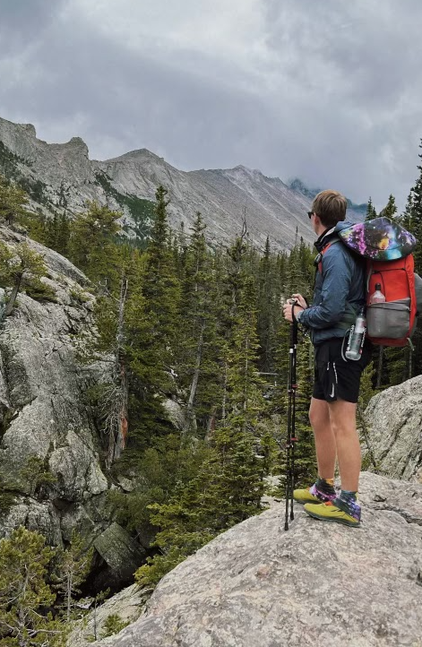
How does the IB Programme Come together
IB Students take 13 courses during their Junior and Senior Years from the Six Academic Areas
Students must take one course from each of the six subject areas (students can choose to forgo the arts and take two courses in another subject area)
Three courses (no more than four) must be taken at the Higher Level (HL)
The other courses must be taken at the Standard Level (SL)
The IB Core
Theory of Knowledge
Creativity, Action, and Service
Extended Essay

Slide 13
6 Courses taken at SL and HL Levels * SL= 1 Year Course * HL= 2 Year Course
Group 1: Studies in Language and Literature | Group 2: Language Acquisition | Group 3: Individuals and Societies | Group 4: Sciences | Group 5: Mathematics | Group 6: The Arts**
IB English HL (Jr and Sr years) | -IB French SL -IB Latin SL -IB Spanish SL/HL | IB History of Americas SL/HL (Jr and Sr years) -IB Philosophy SL/HL -IB Psychology SL/HL | -IB Biology HL -IB Chemistry SL -IB Environmental Systems & Societies SL - IB Physics - IB Sport and Exercise Health Sciences | -IB Math Applications SL -IB Mathematics Analysis SL/ HL | - IB Film SL/ HL - IB Music SL/HL -IB Visual Art SL/HL -IB Theater SL/HL
**Arts: May be omitted for a second science, language acquisition, or individuals and society

Slide 14
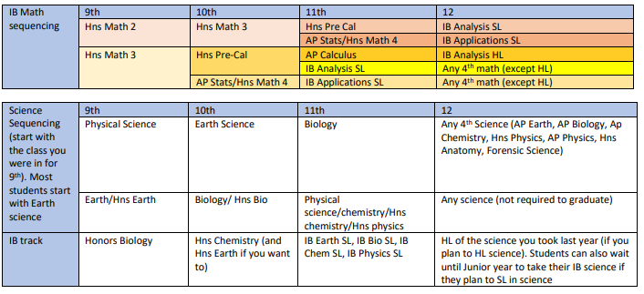
Math and Science Sequencing
*
* AP Pre-Cal beginning 2023-24

Slide 15
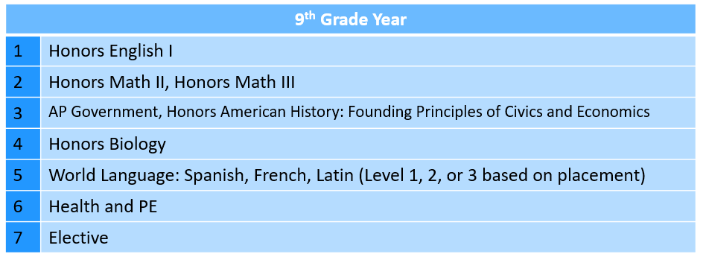
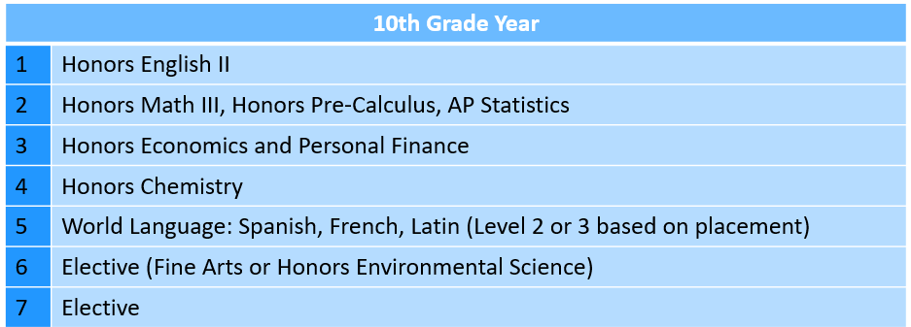
Sample Student Schedules
* AP Pre-Cal beginning 23-24

Slide 16
Students wishing to apply for the IB Programme should:
Successfully complete Algebra I or Math I prior to ninth grade
Score a level IV or V on all End of Grade/End of Course tests taken in middle school
Submit free responses which address the IB Learner Profile, Mission Statement, and personal interests
Provide two recommendations from teachers of a core subject
Maintain A’s and B’s in core courses; English/Language Arts, Mathematics, Science, and Social Studies

Slide 17
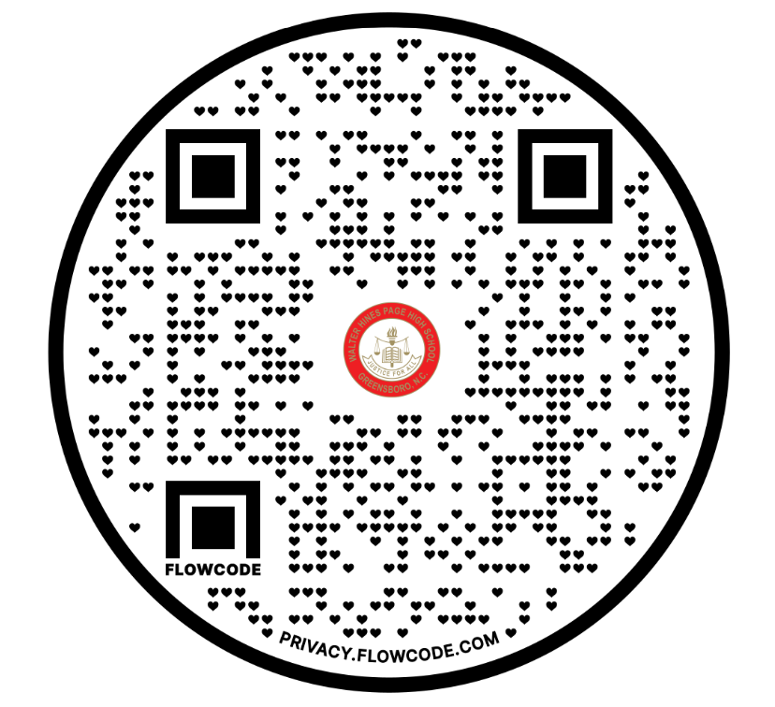
Interested in joining us? Apply Today!
Scan for link to Page IB Website
• For technical assistance with SchoolMint, contact support@schoolmint.com.
• For SchoolMint or How to Apply, contact the Student Assignment Office (336-370-8303).
• For general questions about the Choice Programs, contact the Choice Office (336-370-3293).

Slide 18
Thank you for your time!
To Learn More,
Contact Us!
Hacknee@gcsnc.com Nagleee@gcsnc.com
336-370-8200
Please scan to sign in.

