Slide 1
NCED cloud directions

Slide 2
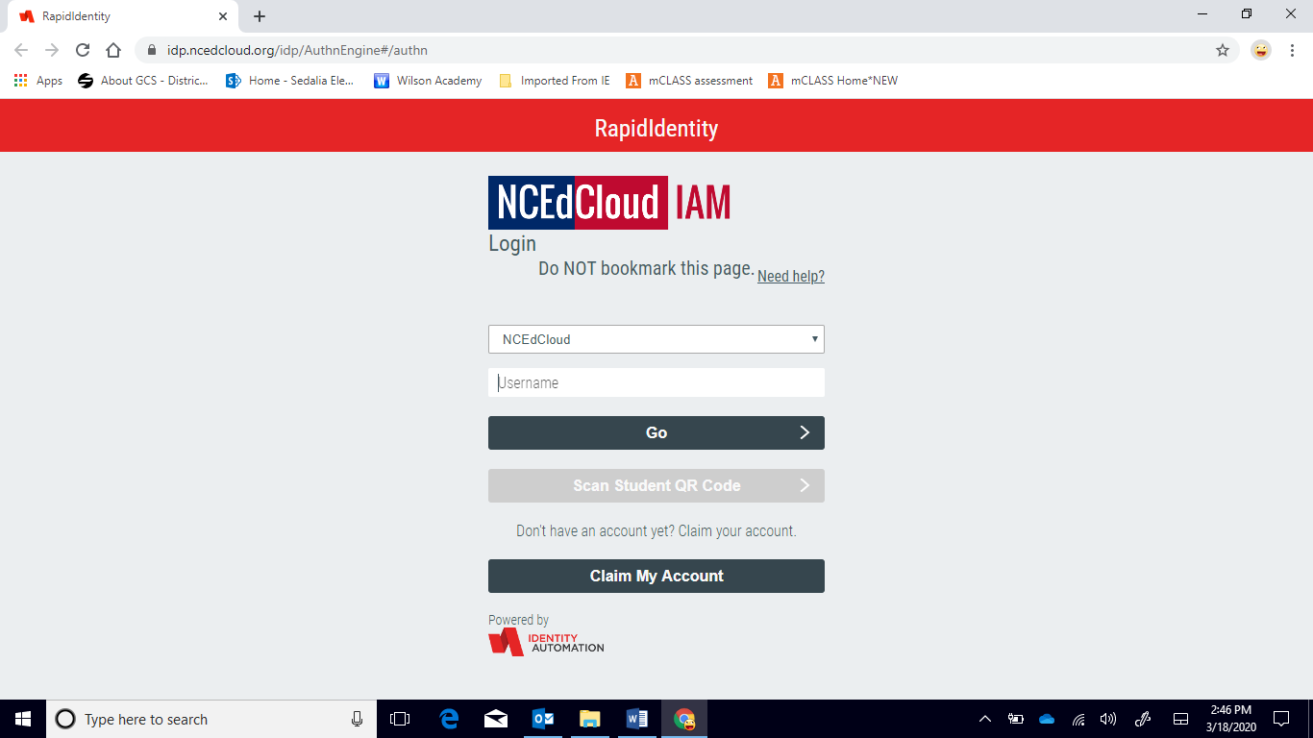
Log into NCED cloud: ncedcloud.org
Username is the student number
Password is Read2020

Slide 3
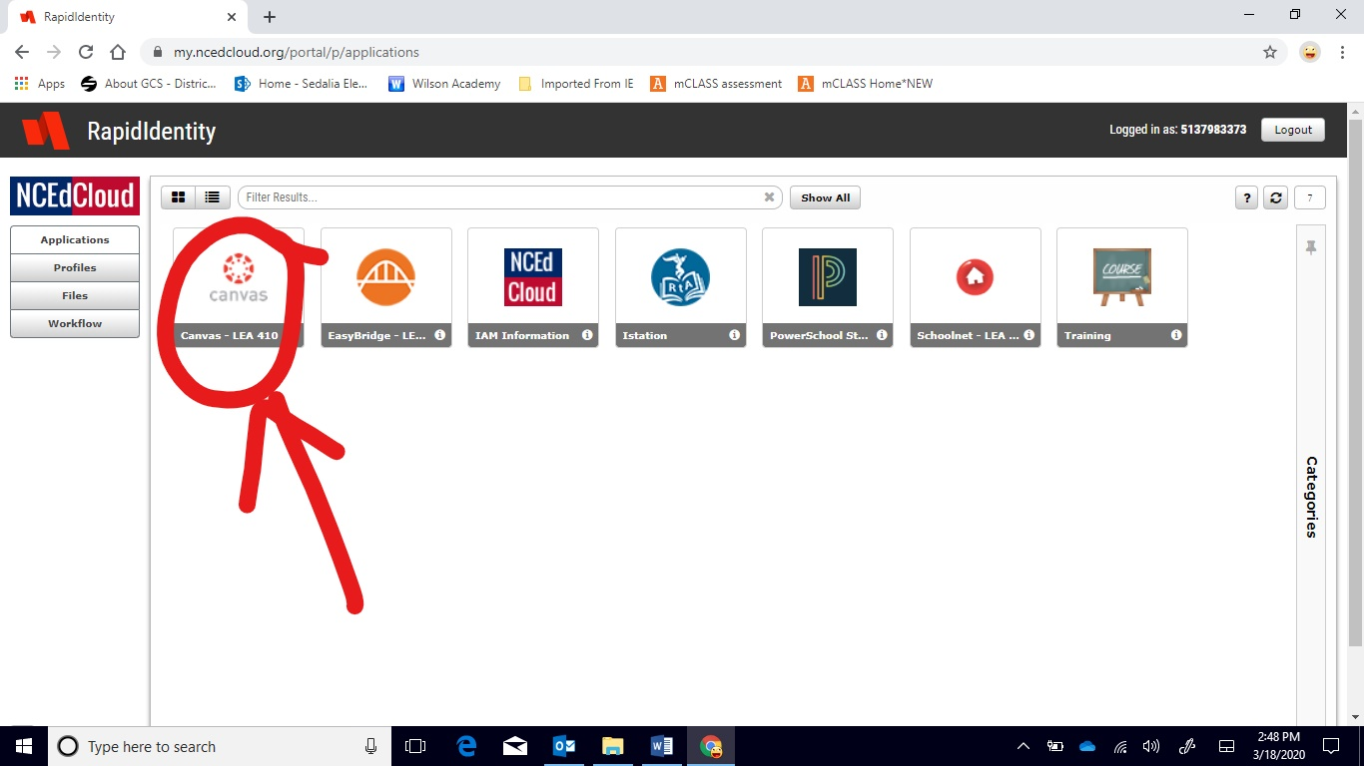
Click on the red Canvas icon

Slide 4
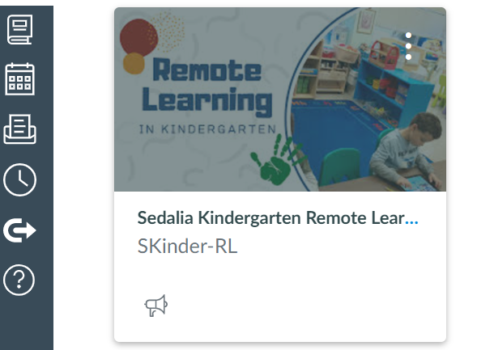
Click on Remote Learning Kindergarten:

Slide 5
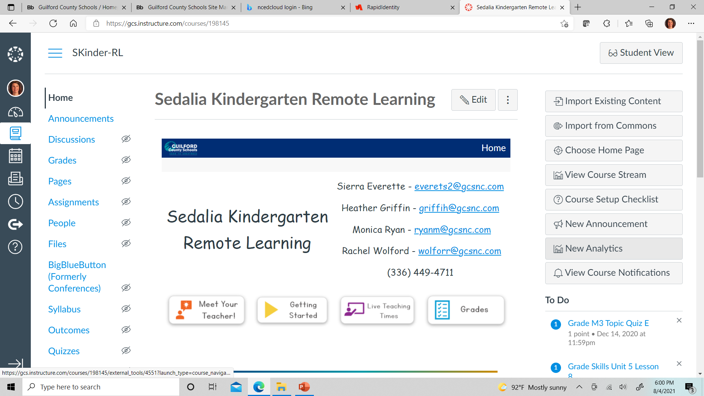
You Will See:

Slide 6
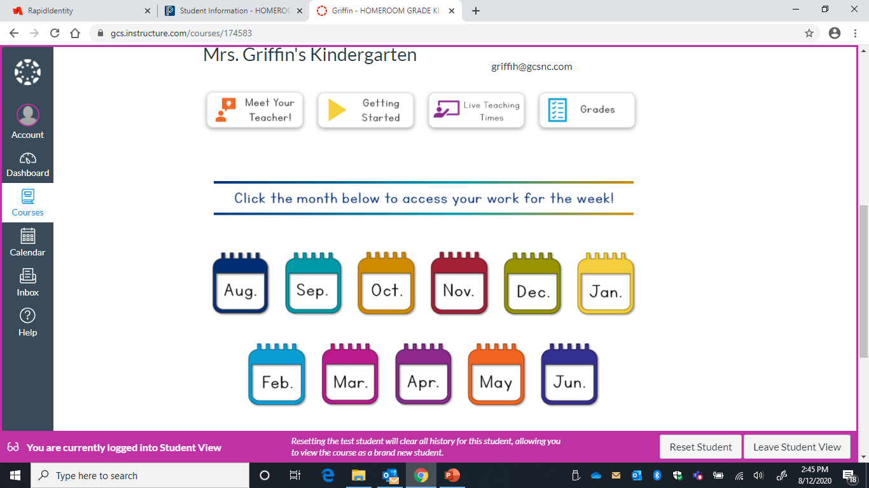
Scroll down, and click on items:

Slide 7
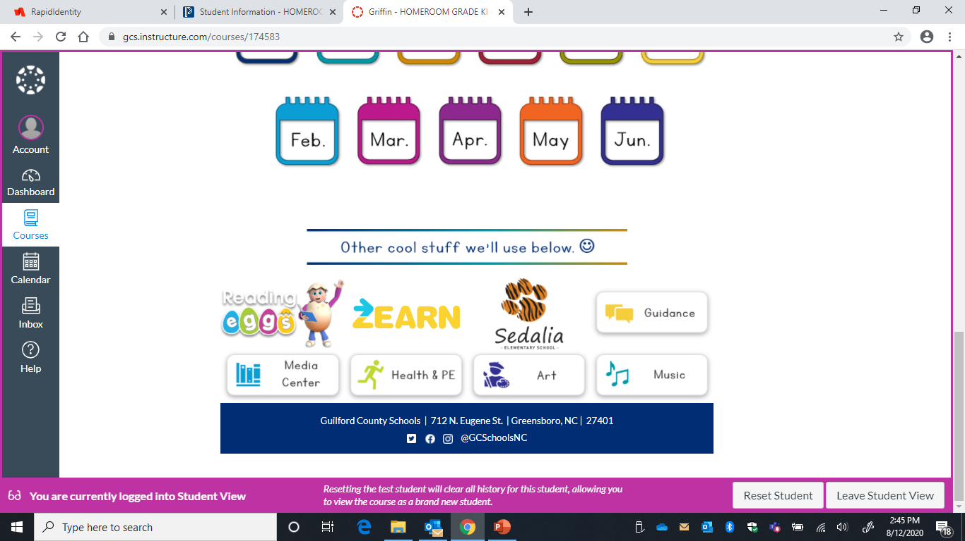
Links for Other pages and Specials Classes:

Slide 8
We will use this format if school is remote! Check canvas for announcements and to see daily lessons. Thank you in advance for supporting learning at home. I am available throughout the day by email & Dojo if you have any questions! Live teaching times will take place through our Microsoft Team.

