Slide 1
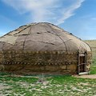
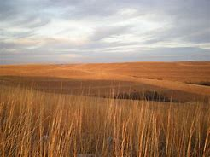
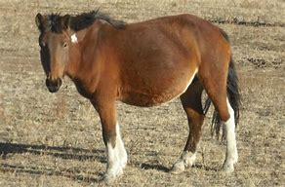
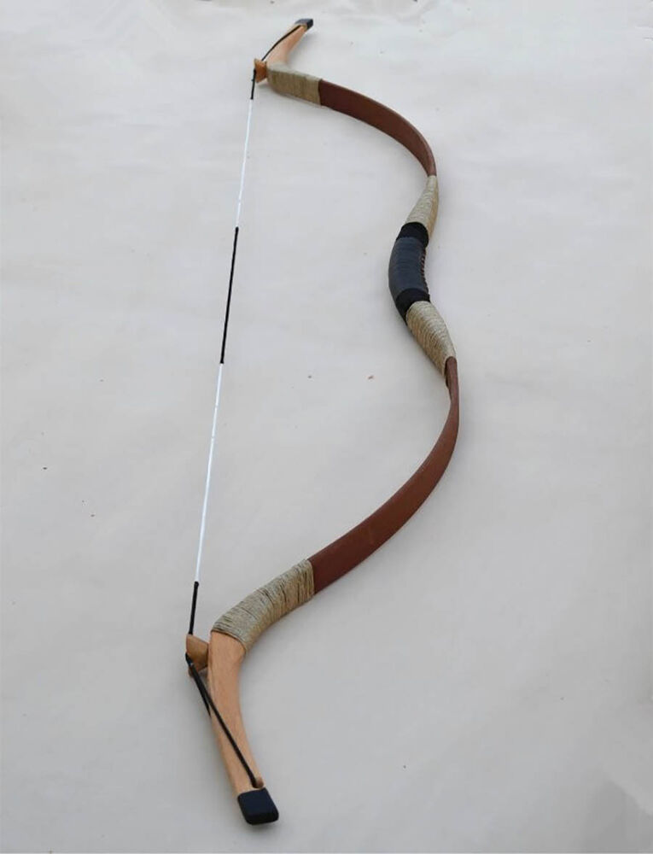
U2.2 The Mongol Empire and the Modern World pp. 85-91

Slide 2
Civilizations write history
Is this statement true?
How does this statement impact our understanding of nomadic peoples?
“Barbarian” word splash

Slide 3
Crash Course Video https://www.youtube.com/watch?v=szxPar0BcMo&list=PLBDA2E52FB1EF80C9&index=18&t=0s
In your note book write down a response to each of these questions
who?
what?
where?
how?
why?
…as you watch this 13 minute video

Slide 4
Class time for Trade Network Charts
Due tomorrow
So take a picture of pages you still need

Slide 5
Mongol Notes EQ: How did Eurasian empires grow over time? How did this expansion affect trade and communication?
Context: Civilizations attacked by the Mongols in the 13th century wrote about how savage and barbaric the Mongols were. A balanced story emerges when we learn more about their culture and trade
Geography: homeland was in the Gobi desert, NW of China. The Asian Steppes was their highway to empire

Slide 6
Genghis Khan
Temujin: united the warring clans earning the title “ruler of all”: GENGHIS KHAN
Skills: great warrior, psychological warfare, adaptable, and tolerant until provoked
Khan/Khanate: ruler/empire
Pax Mongolica: Mongol Peace: 1250-1350 unprecedented exchange of culture, peoples, ideas, diseases, and trade

Slide 7
The Mongol Empire: Khanates all led by grandsons of Genghis
Golden Horde: led by Batu
Conquered Russia: burned Kiev, made a deal with Moscow
→ Moscow raised taxes on peasants in order to raise tribute to keep Golden Horde away; becomes capital of Russia eventually
Long-term impact:
Moscow as capital
Free peasants become enslaved serfs
Reliance on autocratic rule
Severed ties with western Europe

Slide 8
Islamic Heartlands
Helegu (grandson) burns Bagdad in 1258, ending the Caliphate, creating Il-khanate empire
Defeated by Mamluks in Egypt, stopping their advance in N. Africa
Over time, Mongols get absorbed by Islamic Persian culture

Slide 9
Yuan Dynasty: Mongols Rule China 1271-1368
Kublai Khan: another grandson→ becomes Sinified
Acts like a Chinese emperor
Builds a capital city, Beijing
Marginalizes the Confucists, allowing all religions, creating a truly cosmopolitan culture
Mongol women had more rights that all others in this era (re-marry, tended flocks)

Slide 10
Long-Term Impact
Largest land empire, ever.
Pax Mongolica created a major exchange of trade between Asia, Africa, and Europe
Ideas, plants, animals were exchanged, but so was the Bubonic Plague
Centralized rule became more common
Fighting techniques, including guns and cannons

Slide 11
Answer the EQ on a ½ sheet of paper
Ticket out the Door
EQ: How did Eurasian empires grow over time? How did this expansion affect trade and communication?

