Slide 1
Living a Financial Life
Unit VI – Credit Management

Slide 2
Essential Standard: EPF.MCM.3 Understand the concepts and factors that enable individuals to make informed financial decisions for effective resource planning and money management.
Essential Question: Evaluate how various financial factors impact adult life decisions
Students Can:
Calculate monthly income in order to plan a budget
Handle life responsibilities based on the situation they are assigned, and adapt to financial changes to meet budgetary demands
AGENDA:
Having a plan
That is the story of my life
Making a family
HOMEWORK:
Family check up
Current Events Journal #3

Slide 3
GET A LIFE REALITY
Adulting: the practice of behaving in a way characteristic of a responsible adult, especially the accomplishment of mundane but necessary tasks.
32% of 18-24 year olds still live with their parents
42% of American adults aren’t saving for retirement
Currently, 45 million in the U.S. borrowed to pay for college. This equates to $1.5 trillion.
2018 Credit Card debt = $830 Billion (average household debt $6,577
Explain why understanding the need for financial planning is important for your longevity?

Slide 4
Life Story
The life you have left is a gift. Cherish it, enjoy it now, to the fullest. Do what matters, now.
- Leo Babauta
Complete part II
Design and cut out children and pets
Be sure to design your pets & children appropriately

Slide 5
Essential Standard: EPF.MCM.3 Understand the concepts and factors that enable individuals to make informed financial decisions for effective resource planning and money management.
Essential Question: Evaluate how various financial factors impact adult life decisions
Students Can:
Calculate monthly income in order to plan a budget
Handle life responsibilities based on the situation they are assigned, and adapt to financial changes to meet budgetary demands
AGENDA:
A Taxing Recall
Calculating your Monthly Income
Making a family
HOMEWORK:
Family check up
Current Events Journal #3

Slide 6
Recalling Income Tax
What type of tax is income tax?
A. Progressive B. Regressive C. Proportional D. Excise
2. What form do you fill out to establish your withholdings from your paycheck?
A. W2 B. 1099 C. W4 D. 1040
3. Which form does your employer send to you by the end of January so you can file your taxes?
A. W2 B. 1099 C. W4 D. 1040
4. Which form do you fill out in order to file your taxes with the IRS?
A. W2 B. 1099 C. W4 D. 1040
5. When do you have to complete your tax filing with the IRS?
A. Jan. 31 B. Feb. 14 C. March 31 D. April 15

Slide 7
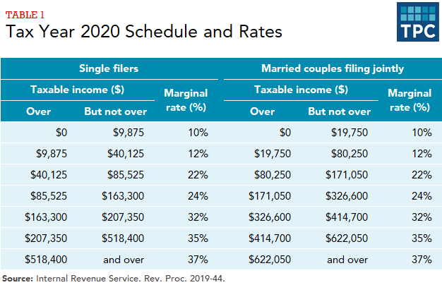
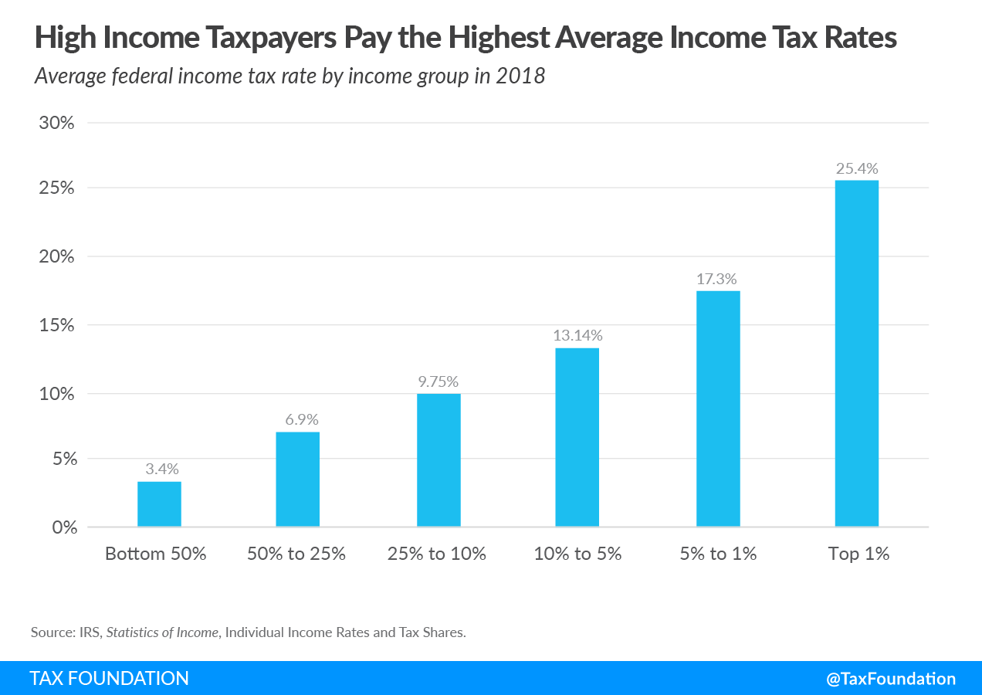
TAXES!!!!!!!
Breaking your tax payment vs. the benefit they create
Explain how we benefit from the taxes we pay as a faction of our income over time.
Tax to Benefit Ratio
Distribution of Wealth

Slide 8
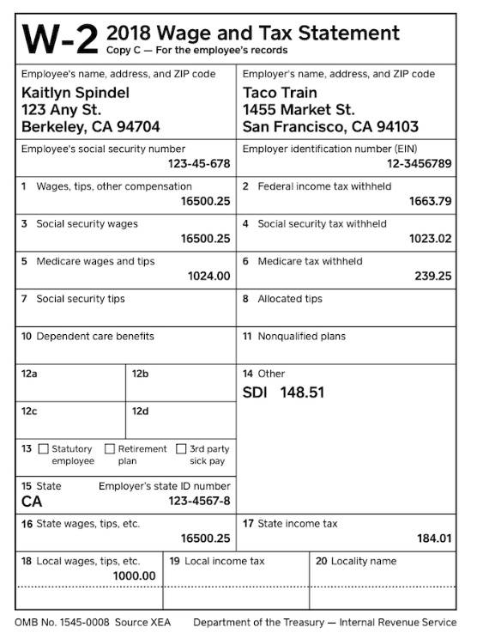
TAX MAN
Income tax: created by 16th Amendment in 1913 (Progressive Tax)
Withholding - Pay-as-you-earn basis (withheld from paychecks)
Evaluated on Adjusted Gross Income: Total income – deductions & credits
Deductions (school loans, charitable giving, medical expenses)
Credits (family, energy efficiency home improvements)
W-4: Establishes your withholdings from your paycheck
W-2: has the total amount of withholdings taken from your paycheck
We tax with your consent!

Slide 9
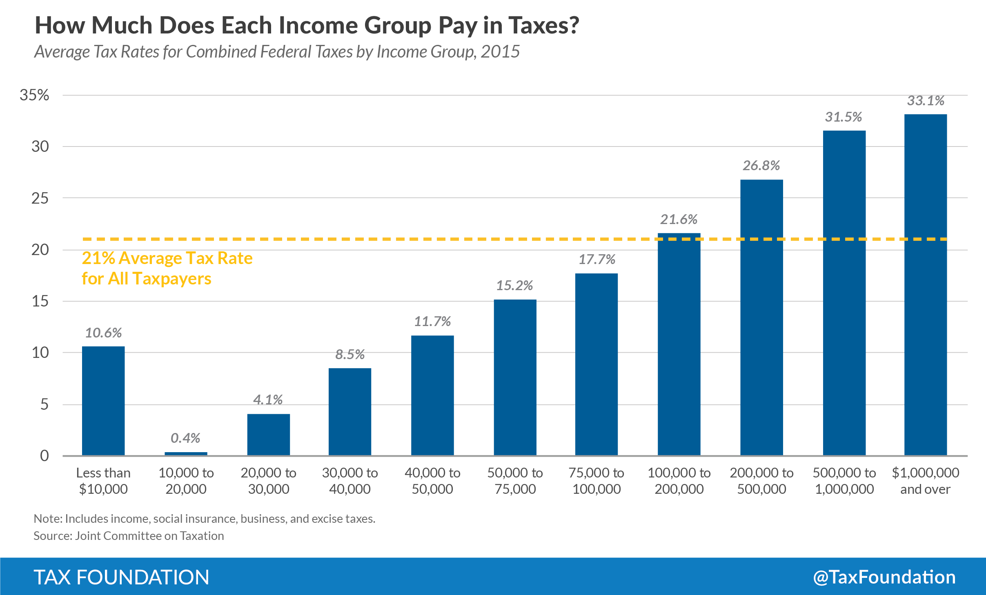
Who Pays What

Slide 10
Tax Time - FEDERAL
Use the chart to calculate your federal income tax
STEP 1
Take your yearly income and subtract the standard deduction ($13,850 for single or $27,700 for married filing jointly)
Salary – Standard Deduction = Taxable Income
Tax rate | on taxable income from . . . | up to . . .
10% | $0 | $11,000
12% | $11,001 | $44,725
22% | $44,726 | $95,375
24% | $95,376 | $182,100
32% | $182,101 | $231,250
35% | $231,251 | $578,125
37% | $578,126 | And up

Slide 11
Tax Time - FEDERAL
Use the chart to calculate your federal income tax
STEP 2
Identify the tax bracket your income falls under (Remember there are two brackets – Single Filers and Married Filers) – be sure to look under the correct chart
Ex. Taxable income for a single filer making $32,000 falls in the 12% bracket, but also includes 10% bracket)
Tax rate | on taxable income from . . . | up to . . .
10% | $0 | $11,000
12% | $11,001 | $44,725
22% | $44,726 | $95,375
24% | $95,376 | $182,100
32% | $182,101 | $231,250
35% | $231,251 | $578,125
37% | $578,126 | And up

Slide 12
Tax Time - FEDERAL
Use the chart to calculate your federal income tax
STEP 3
The first part of the taxable income is calculated at the 10% rate
Get the difference between the 10% and 12% tax rates
Ex. $32,000 - $11,000 = $21,000
Tax rate | on taxable income from . . . | up to . . .
10% | $0 | $11,000
12% | $11,001 | $44,725
22% | $44,726 | $95,375
24% | $95,376 | $182,100
32% | $182,101 | $231,250
35% | $231,251 | $578,125
37% | $578,126 | And up

Slide 13
Tax Time - FEDERAL
Use the chart to calculate your federal income tax
STEP 4
Calculate your federal income tax per year
Tax = (.10 x $11,000) + (.12 x $21,000)
Tax = $1,100 + $2,520
Income Tax = $3,620 for a single filer making $32,000 per year
Tax rate | on taxable income from . . . | up to . . .
10% | $0 | $11,000
12% | $11,001 | $44,725
22% | $44,726 | $95,375
24% | $95,376 | $182,100
32% | $182,101 | $231,250
35% | $231,251 | $578,125
37% | $578,126 | And up

Slide 14
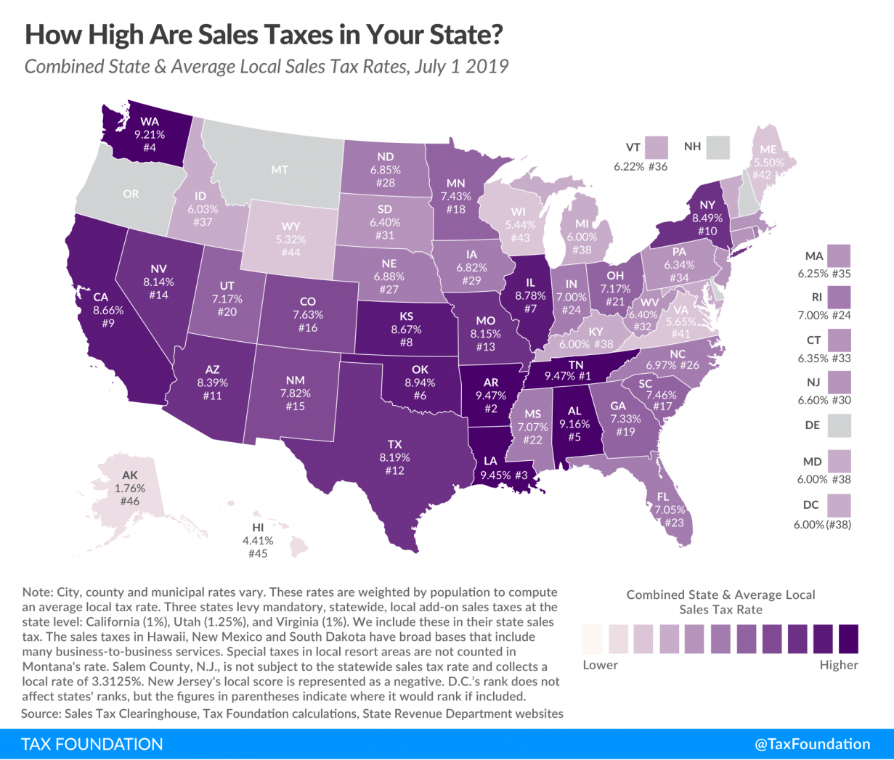
Tax Time - STATE
Calculate State Tax Income
Multiple your income by 4.45%
That is your state income tax
State income tax = salary x 4.45%
Ex. $32,000 X .00445 = $1,424

Slide 15
How RICH are You?
Calculating your monthly income
Subtract BOTH the federal and state taxes from your income….
$32,000 – ($3,620 federal income tax + $1,424) = $26,965
Then divide by 12 ($26,965/12 = $2,247.08)
This is how much money you have PER MONTH

Slide 16
Insurance
Policies and Strategies

Slide 17
Life has Risk
Liability: life has risks and disadvantages, which never go away
Managing Risk:
Insurance: a coverage contracts that companies which protections people against loss
Types of Insurance
Purpose of Insurance:
Protects your property, family, and health
Assist in managing financial risk
Types of Insurance:
Property
Health
Disability
Credit

Slide 18
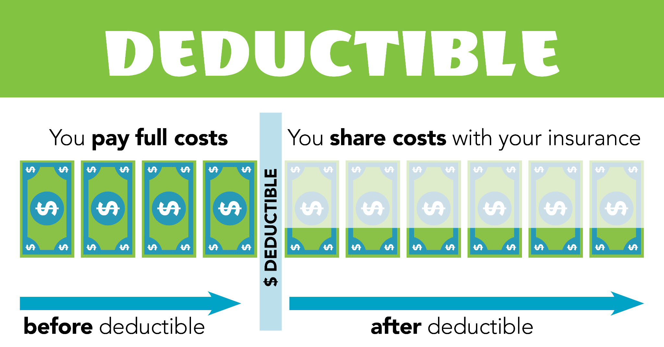
Speaking Insurance
Important words of Insurance
Premium: the actual cost per month of insurance
Deductible: the amount of $$ you pay out of pocket before insurance coverage pays
Filing a Claim: a formal request to an insurance company for coverage or compensation because of loss
Coverage: what a policy covers (Ex. Injury for auto accidents or health physicals)

Slide 19
Homeowners
Homeowners policy: protects your home and personal belonging from incidents (inclement weather damage, fire, injuries on the property, and lawsuits)
COVERAGE:
Home repairs
Living expense if your home is destroyed
Injuries or damage occurring on your property
Be better protected from MAYHEM like ME!

Slide 20
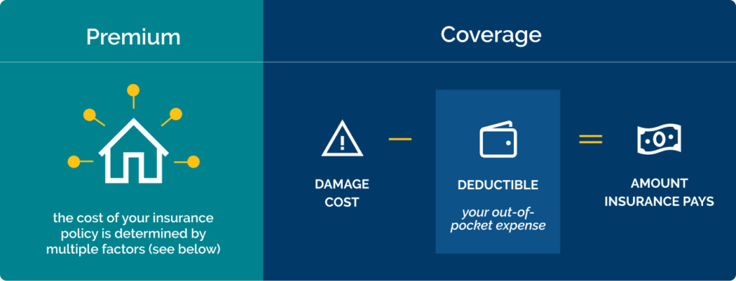
Protect this HOUSE!!!
Homeowners Guideline
Your HOME is your largest asset
Technically, homeowners' insurance is only required when mortgaging a home
File a claim when need (Can cause rates to rise)
Loss covered after deductible is paid up to amount insured (update policy)

Slide 21
Coverage
Homeowner’s policy coverage
COVERED
Fire or smoke damage
Falling trees
Theft
Roof or Foundational Issues
NOT COVERED
Pest/termite damage
Flooding & Hurricanes (can get flood policy)
Mold
Earthquakes

Slide 22
Renter’s Insurance
Renter’s Insurance: protects your belongs if apartment is damaged or broken into

Slide 23
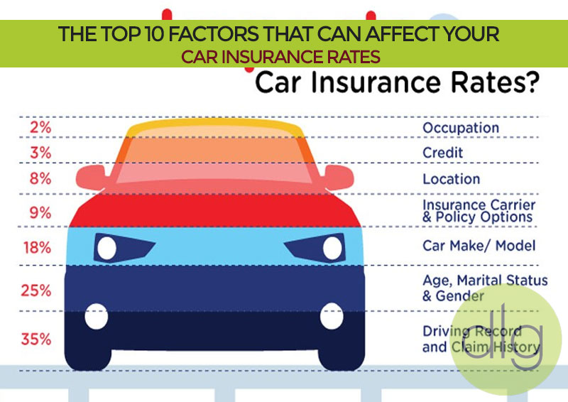
Auto Coverage
Types of auto policy coverage
Liability coverage
Legally required coverage
Financially protects you if you are liable for an accident
Covers – repairs to vehicle and medical bills
Comprehensive Coverage
Covers the other person’s vehicle and your own
Covers acts of nature as well as car collisions

Slide 24
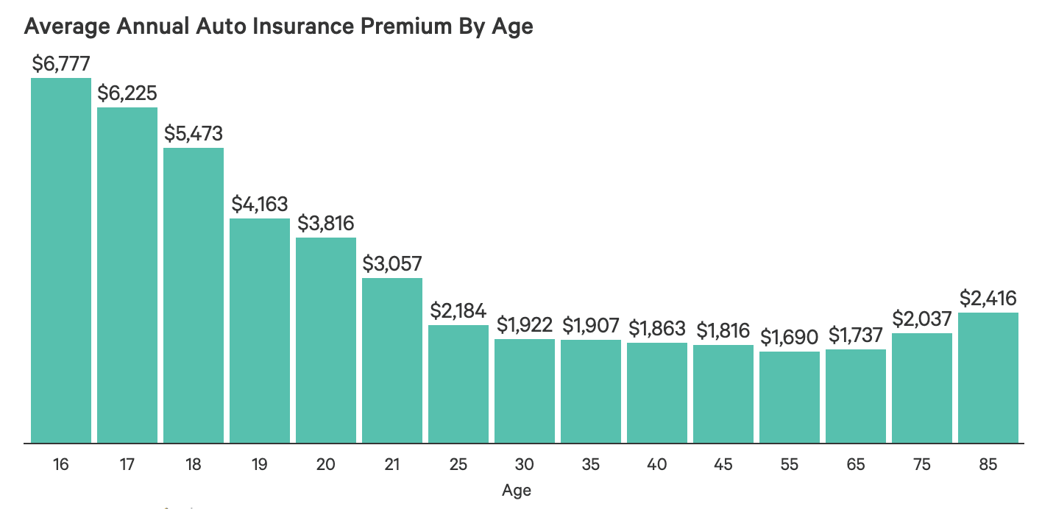
Auto Premium by Age
What auto insurance costs you because of your age

Slide 25
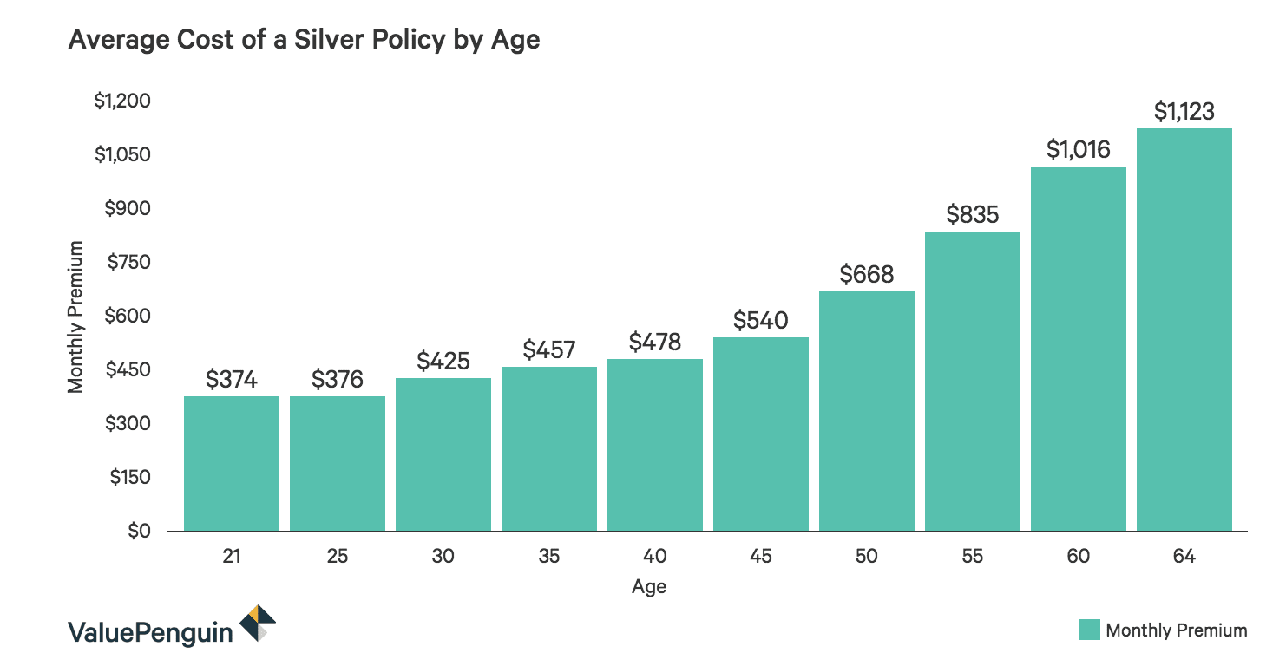
Special Coverage
Silver policies include – roadside assistance, trip interruption coverage and rental car re-imbursement

Slide 26
Essential Standard: EPF.MCM.3 Understand the concepts and factors that enable individuals to make informed financial decisions for effective resource planning and money management.
Essential Question: Evaluate how various financial factors impact adult life decisions
Students Can:
Calculate monthly income in order to plan a budget
Handle life responsibilities based on the situation they are assigned, and adapt to financial changes to meet budgetary demands
AGENDA:
Calculate State Income Tax
Other types of Insurance
Insurance Case Study
HOMEWORK:
Get a Life Project
Current Events Journal #3

Slide 27
Tax Time - STATE
Calculate State Tax Income
Multiple your income by 4.45%
That is your state income tax
State income tax = salary x 4.45%
Ex. $32,000 X 0.0445 = $1,424

Slide 28
Covering your health
Health insurance: a coverage plan that pays for medical bills in exchange for a monthly premium
Deductible: a set amount that a person must pay before medical insurance will cover doctor’s bills
Guidelines for Medical Insurance
Two types of plans
70/30 – (insure pays 70% and you pay 30% of the cost)
80/20 – (insure pays 80% and you pay 20% of the cost)
Max out of pocket: policy set a maximum amount a policy holder will pay
Coverage Options

Slide 29
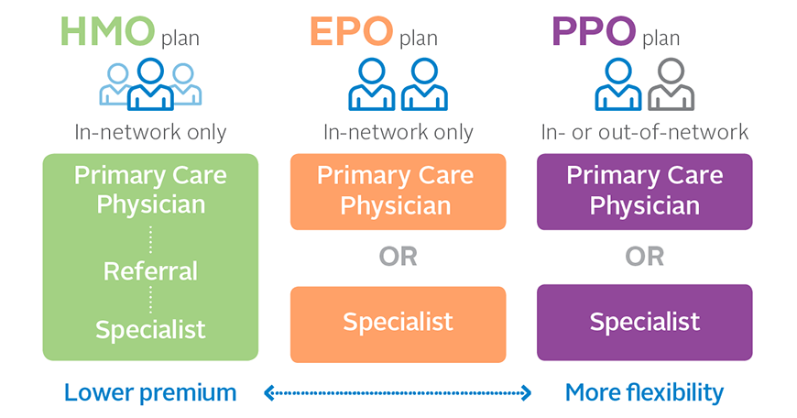
Health Maintenance
Health insurance covers:
Preventative care: vaccines, physicals, breast cancer screenings etc.
Co-pay: extra cost you must pay for going to specialists for medical evaluations (ex. X-rays)
In-network: insurance companies have preferred medical providers; make sure the doctor you see is accepted by your health insurer provider.

Slide 30
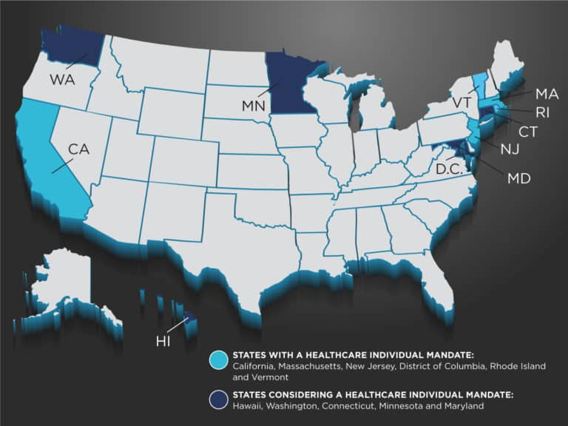
Health Insurance Legality
Health insurance is not legally required (2019)
Some states may impose a tax penalty if you do not have health insurance
California, D.C., Massachusetts, New Jersey, Rhode Island, Vermont
Health Insurance 101

Slide 31
Talk About Life
Life Insurance: provides money to beneficiaries after a person passes away (cover left over bills, funeral expenses, etc.)
Two Types of Life Insurance
Term Life: covers a fixed amount and is cheaper to purchase
Permanent Insurance: last until end of life, can appreciate, & more expensive to purchase
Not covered – if the person dies by the following:
Criminal activity – driving why intoxicated
High risk activities - skydiving

Slide 32
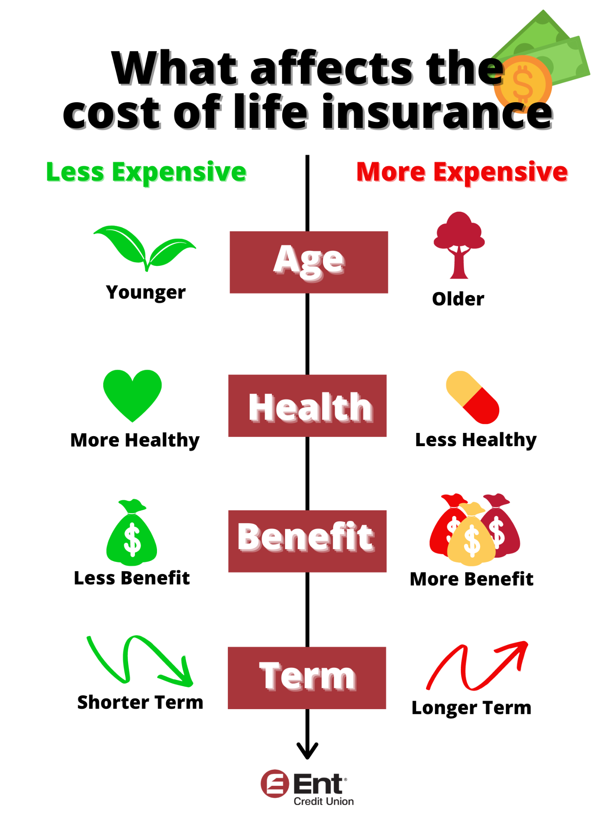
Factors of Life
Factors that impact how much you pay for life insurance
The death benefit amount: Ex. $50,000, $100,000, or $500,000
Age
Gender (women pay less)
Health (more health risk = higher premium)
Tobacco use
Family health history
Lifestyle & occupation

Slide 33
Disabled - there is coverage for that
Disability Insurance: provides income assistance if you are unable to work
Short Term Disability: (covers 3 – 6 months)
Pregnancy, cancer, mental health issues, etc.
Usually cover 70% of your income
Long Term Disability: (covers 5, 10, or 20 years)
Usually cover 40 - 70% of your income
Did you say AFLAC!

Slide 34
Love those PETS
Pet Insurance: covers medicine, diagnostic tests, hospitalization and other expenses if your pet gets hurt or sick.
Cost $47 per month
Types: accident & illness
I am NOT going to the vet!
I am too sick to get out of bed!

Slide 35
Be a World Explorer
Travel Insurance: protects from risk and financial loss while traveling
Covers minor & major issues:
Missed fight connections
Lost luggage
Injury while traveling
Cost: 5 – 6% of your trip

Slide 36
Essential Standard: EPF.MCM.3 Understand the concepts and factors that enable individuals to make informed financial decisions for effective resource planning and money management.
Essential Question: Evaluate how various financial factors impact adult life decisions
Students Can:
Calculate monthly income in order to plan a budget
Handle life responsibilities based on the situation they are assigned, and adapt to financial changes to meet budgetary demands
AGENDA:
Calculating Home & Transportation Costs
Insurance Case Study
A place to call home
Ride of a lifetime
HOMEWORK:
Get a Life Project
Current Events Journal #3

Slide 37
How Much Can I Afford
Calculating the amount to spend on housing and transportation
Housing:
.30 x monthly salary = Spending for housing
Auto:
.15 x monthly salary = Transportation cost

Slide 38
Insurance – Find the Right Coverage
Mayhem is just around the corner
Like a Good Neighbor
Use the links and graphics to assist the customer with finding the right coverage at the right price
Buddling can help you save!
Mind blowing savings!

Slide 39
A Place To Call Home
Mortgage payment calculations – use the mortgage calculator on bankrate.com to calculate
A good rule of thumb: your mortgage payment should not be more than 30% of you monthly payment
Payment calculations:
Include in your payment
Interest rate is based on your FICO credit score
Property taxes: use the price of the house to calculate on the following website https://smartasset.com/taxes/north-carolina-property-tax-calculator#4y8YRuxr5G
Homeowner’s policy will cost you $209 per month

Slide 40
It is a lovely place
Screenshot your home or apartment
Include important details
Number of bedrooms
Cost
Square footage
Location (Address)
Loan calculations
Apartment
Square footage
Number of bedrooms
Rent per month
If Utilities are included
For sale
$169,900
3bed
2bath
0.32acre lot0.32 acre lot
607 N Elam Ave, Greensboro, NC 27408
Property type
Single family
Time on Realtor.com
29 days
Year built
1956

Slide 41
A ride of lifetime
Transportation: you need purchase or lease an automobile (If married you need two cars and in some cases, kids will need one as well)
- Use the Auto Loan Calculator on bankrate.com
- Remember to set the parameters for your car purchase
Interest rate (Based on your credit score) & were whether it is new or used
Number of months
Used or new car

Slide 42
It is a lovely place
Screenshot your Automobile
Include important details
If a lease
Image of ad
Price per month
Down payment
Miles limitation
If a purchase
Image of the car
You loan calculations
2024 Honda Accord EX
$28,500

Slide 43
Essential Standard: EPF.MCM.3 Understand the concepts and factors that enable individuals to make informed financial decisions for effective resource planning and money management.
Essential Question: Evaluate how various financial factors impact adult life decisions
Students Can:
Calculate monthly income in order to plan a budget
Handle life responsibilities based on the situation they are assigned, and adapt to financial changes to meet budgetary demands
AGENDA:
Checking out Checkbooks
Insurance Case Study
A place to call home
Ride of a lifetime
HOMEWORK:
Get a Life Project
Current Events Journal #3

Slide 44
Check Writing
How to write a check – Bill: Moses Cone Hospital $250.65
Name __________________________ 10____
7101 Spencer-Dixon Rd. Date:________________________
Greensboro, NC 27455
PAY TO THE
ORDER OF____________________________________________________________________ $
___________________________________________________________________________DOLLAR
Bank of America
FOR______________________________ _______________________________
:0002688941: 12345678:

Slide 45
Managing your Bank Balance
Fill out the budget below– ENTER EACH TRANSACTION AND CALCULATE THE BALANCE
#7701: Dentist - $45.00
You get $35.00 for your birthday
#7702: Brakes repaired - $125.67
#7703: Car insurance - $256.45
Calculate your new balance
Check # | Date | Description of transaction | Debit (-) |  | Deposit (+) |  | $ Balance

Slide 46
Essential Standard: EPF.MCM.3 Understand the concepts and factors that enable individuals to make informed financial decisions for effective resource planning and money management.
Essential Question: Evaluate how various financial factors impact adult life decisions
Students Can:
Calculate monthly income in order to plan a budget
Handle life responsibilities based on the situation they are assigned, and adapt to financial changes to meet budgetary demands
AGENDA:
Surprise, Surprise!
Protecting Your Values
A place to call home
Ride of a lifetime
HOMEWORK:
Get a Life Project
Current Events Journal #3

Slide 47
Surprise, Surprise!
Surprise Bill Day - Everyone has good days and bad days in life.
For your additional bill
For your additional money
Keep your surprise card
Be sure to include the amount your monthly budget
Write a check to cover the expense
Keep your surprise card
If it is like birthday money show the deposit in your check book accounting
If it raise – you must redo your taxes to reconfigure your monthly budget

Slide 48
Am I Covered
Review the renter’s insurance policy
Evaluate what is covered and when it is covered

Slide 49
Essential Standard: EPF.MCM.3 Understand the concepts and factors that enable individuals to make informed financial decisions for effective resource planning and money management.
Essential Question: Evaluate how various financial factors impact adult life decisions
Students Can:
Calculate monthly income in order to plan a budget
Handle life responsibilities based on the situation they are assigned, and adapt to financial changes to meet budgetary demands
AGENDA:
Household Consumption & Debt
Debt Repayment
Protecting Your Values
Life Project
HOMEWORK:
Get a Life Project
Current Events Journal #3

Slide 50
Debt Repayment

Slide 51
Household Debt
Identify trends in the graph above.
Explain why those trends have occurred in the timeframe of 2011 through 2021?
How will a trend you identify impact families in 2021?

Slide 52
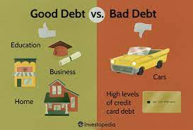
I Owe, I Owe, So off to work I go
Handling debt is essential for financial FREEDOM
Dealing with Debt
Understanding Debt
GOOD Debt
Increases your net worth and enhances life
Ex. Student loans, mortgage
BAD Debt
Used to pay of a rapidly depreciating asset or consumption good
Ex. Credit card debt, car loan

Slide 53
Showing Grace
Grace period: set amount of time after due date that a payment may be made without penalty (usually 15 days)
Your payment is LATE!

Slide 54
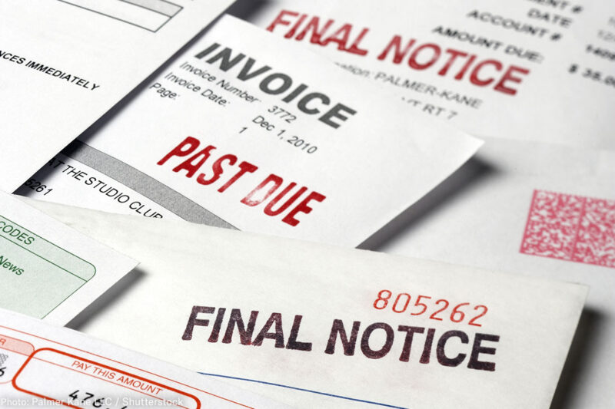
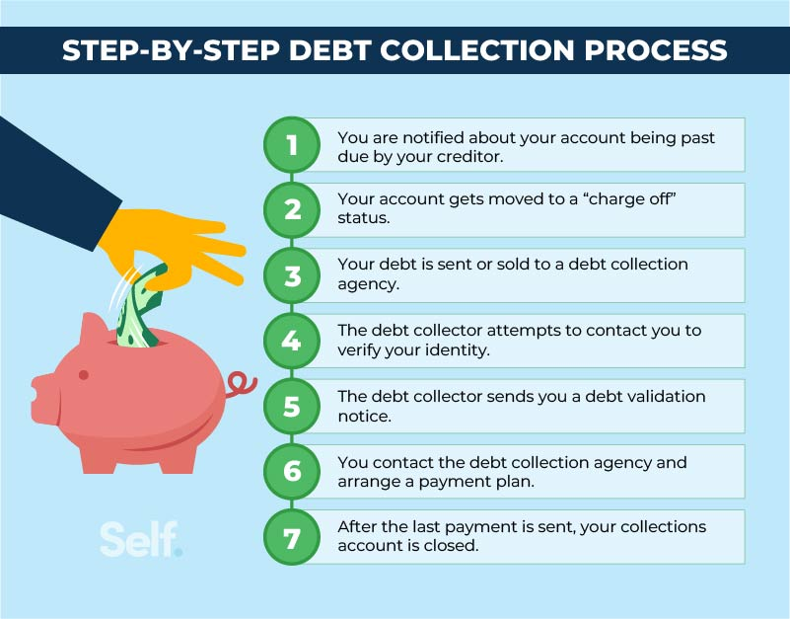
You have been sent to COLLECTIONS
Debt Collections: a payment for a bill is more than 120 days past due
Bill will be assigned to a debt collector
Negative market on your credit score
Dealing with debt collections
Confirm the debt is actually yours (30 days to dispute a debt)
Explore payment options
Get debt repayment plan in writing

Slide 55
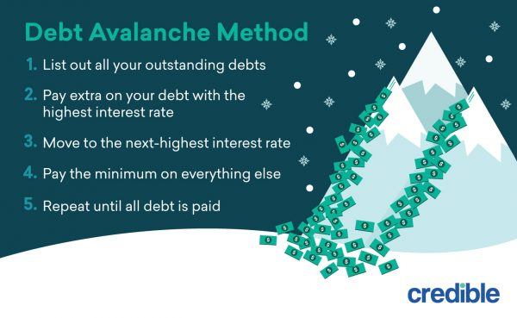
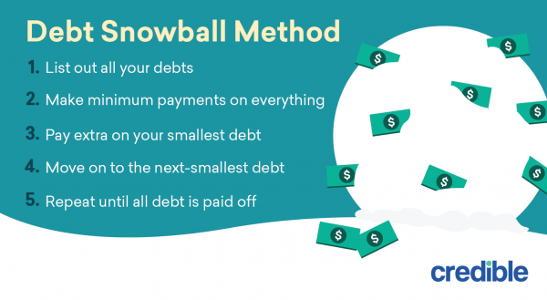
Attacking Debt
Avalanche Method
Payoff your highest interest rate debt first
Once that is paid off – pay your next highest rate interest debt
Snowball Method
Pay off smaller debt first
Once the paid off – roll the payment into another debt

Slide 56
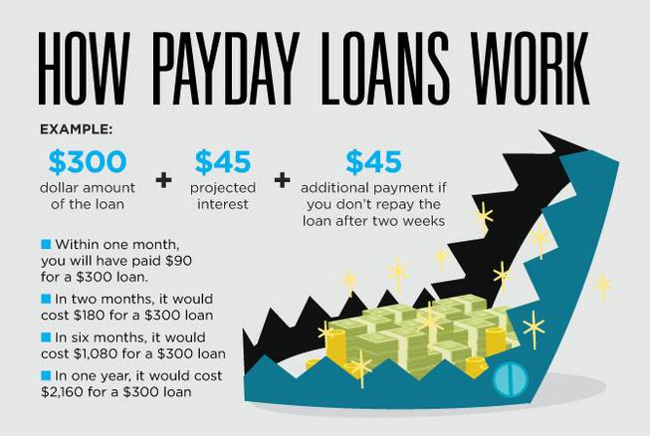
Quick Fix or Debt Builder
Payday Loans: borrowing against your next paycheck (carry a high interest rate)
Warning: can lead to a cycle of debt (if you don’t pay it off by the next paycheck the interest rate will cost you more)
No credit benefit (default hurts your credit score)

Slide 57
Dangers of Pay Day Loans by State

Slide 58
Consolidate It
Debt Consolidation: taking out a loan to combine multiple debts into one payment
Consolidation loan sources: personal loan, home equity loan, credit card transfer
Consolidation Loan Debate
PRO
Lower monthly payment & interest rate
CON
Can hurt your credit in the long run

Slide 59
Am I Covered
Review the renter’s insurance policy
Evaluate what is covered and when it is covered

Slide 60
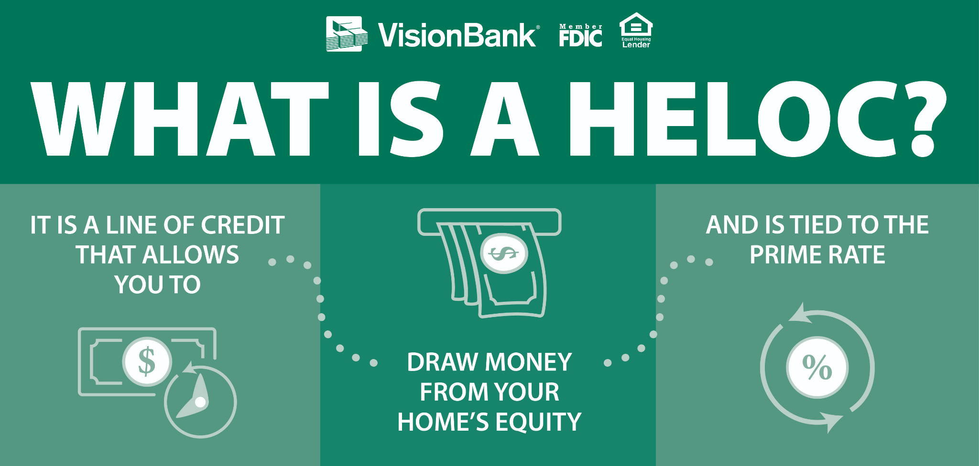
Your House Has VALUE
Home equity loan: allows you to borrow money using the equity in your home as collateral. (lump sum loan)
Equity = the value of a house – what you owe
Home Equity Line of Credit (HELOC)
Borrow against the equity in your house (like a credit card)
Pay back some or all in installments
Warning – not intended for small purchases

Slide 61
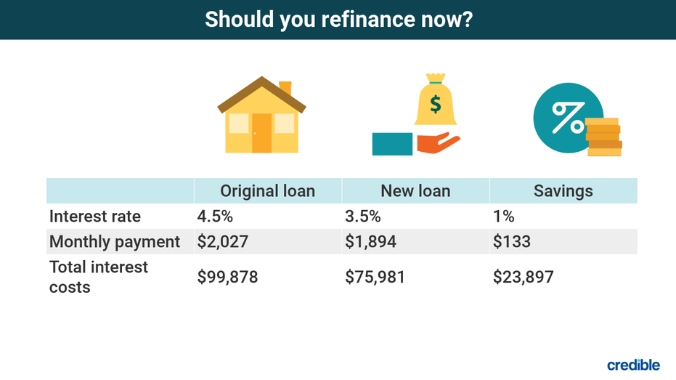
Refi
Refinancing: A process used to change the interest rate or terms of a current mortgage (applies to cars TOO)
Can lower you monthly payments
Change from an adjustable to a fixed rate loan
Warning: can restart your term (Another 30 years)

Slide 62
Let’s Make it a Personal Loan
Personal Loan: a lump sum loan that works on installment

Slide 63
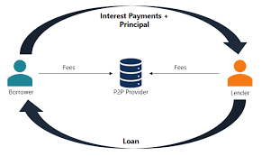
Borrowing from another
Peer to peer lending: allows people to lend money to another without going through a bank
Internet Transaction
P2P Lending Websites
Connects investors with borrowers
Sets interest rates & terms
Investors get a higher rate of return than a savings account
Risk = HIGH – higher default rate

Slide 64
Do you need some assistance
Credit counseling: provides consumers who may feel overburdened by debt with guidance on consumer credit, money management, debt management, and budgeting.
Credit counselors negotiate with creditors to reduce fees & interest rates to reduce payments
Does negatively impact FICO credit score
GOAL: AVOID BANKRUPTCY

Slide 65
Bankruptcy

Slide 66
How it WORKS
The INS & OUTS of Bankruptcy
Bankruptcy

Slide 67
File for a Chapter
Bankruptcy: a legal process where an individual is declaring he or she can no longer pay outstanding debts
Steps in filing for bankruptcy
Petition a federal court (Judge determines whether you are eligible)
Evaluation of assets – what can be used to pay debts
WARNING: DOES NOT ERASE ALL DEBTS

Slide 68
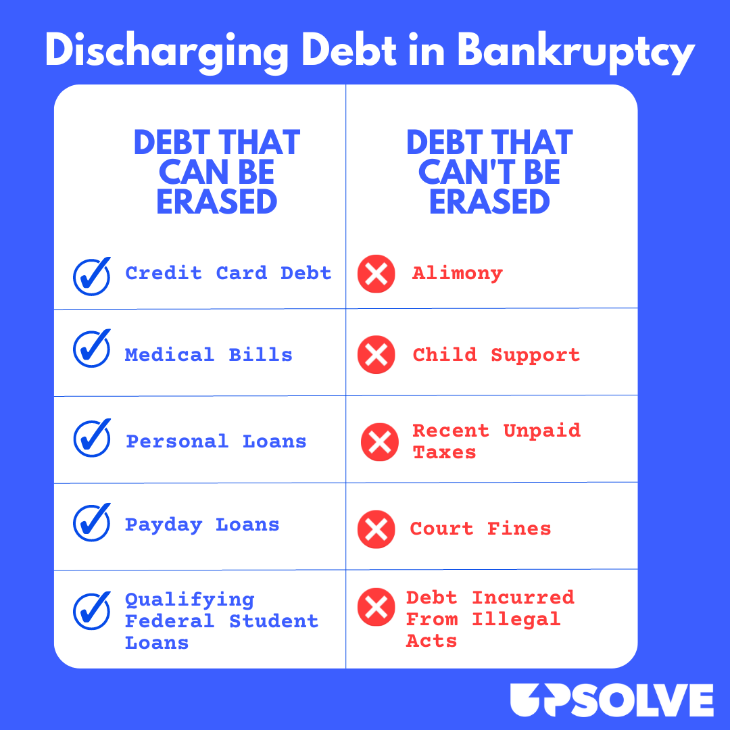
It’s CHAPTER 7
Chapter 7 – most common form of bankruptcy
Understanding Chapter 7
Has income requirements
Allows one to dispose of unsecure debts (credit cards & medical bills)
Requires liquidation of assets (2nd homes, investments, family heirlooms)

Slide 69
Requirements for Chapter 7
Income eligibility requirements

Slide 70
Chapter 11
Chapter 11 Bankruptcy: businesses file with the goal of reorganizing and remaining in business
Requires a plan for cutting costs and finding new revenue sources to return to profitability

Slide 71
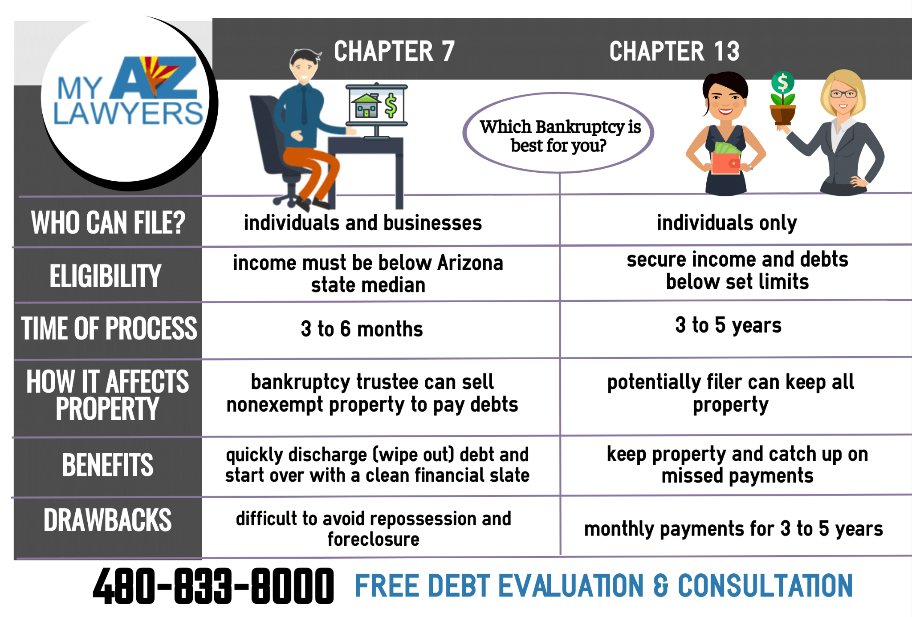
Chapter 13
Chapter 13 bankruptcy – if a person’s or business income does not qualify for chapter 7
Wage Earners Plan – create a workable debt repayment plan
Installment payment – over 3 to 5 years
Debtor is allowed to keep assets

Slide 72
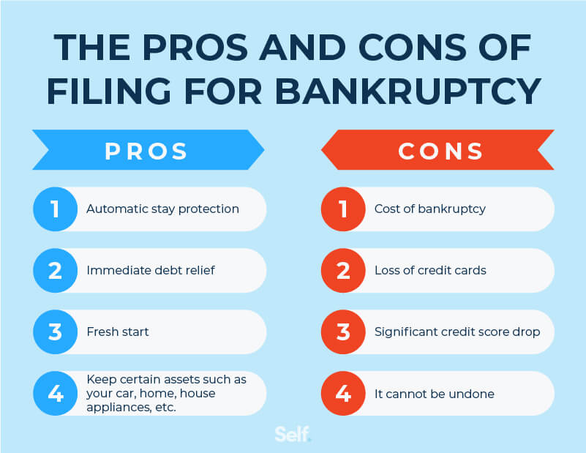
No Golden Road
Cons of declaring bankruptcy
Stains credit score for 7 to 10 years
Difficult to borrower
Requires the lose of assets
Doesn’t erase all debts (reorganizes debts)

Slide 73
Auto Coverage

