Slide 1
Mindset Activity

Slide 2
What is Success?
Make a list
How do you achieve success?
Make a list

Slide 3
What About Failure?
Does Failure Help Achieve Success?

Slide 4
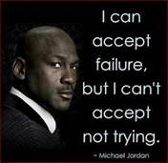

Slide 8
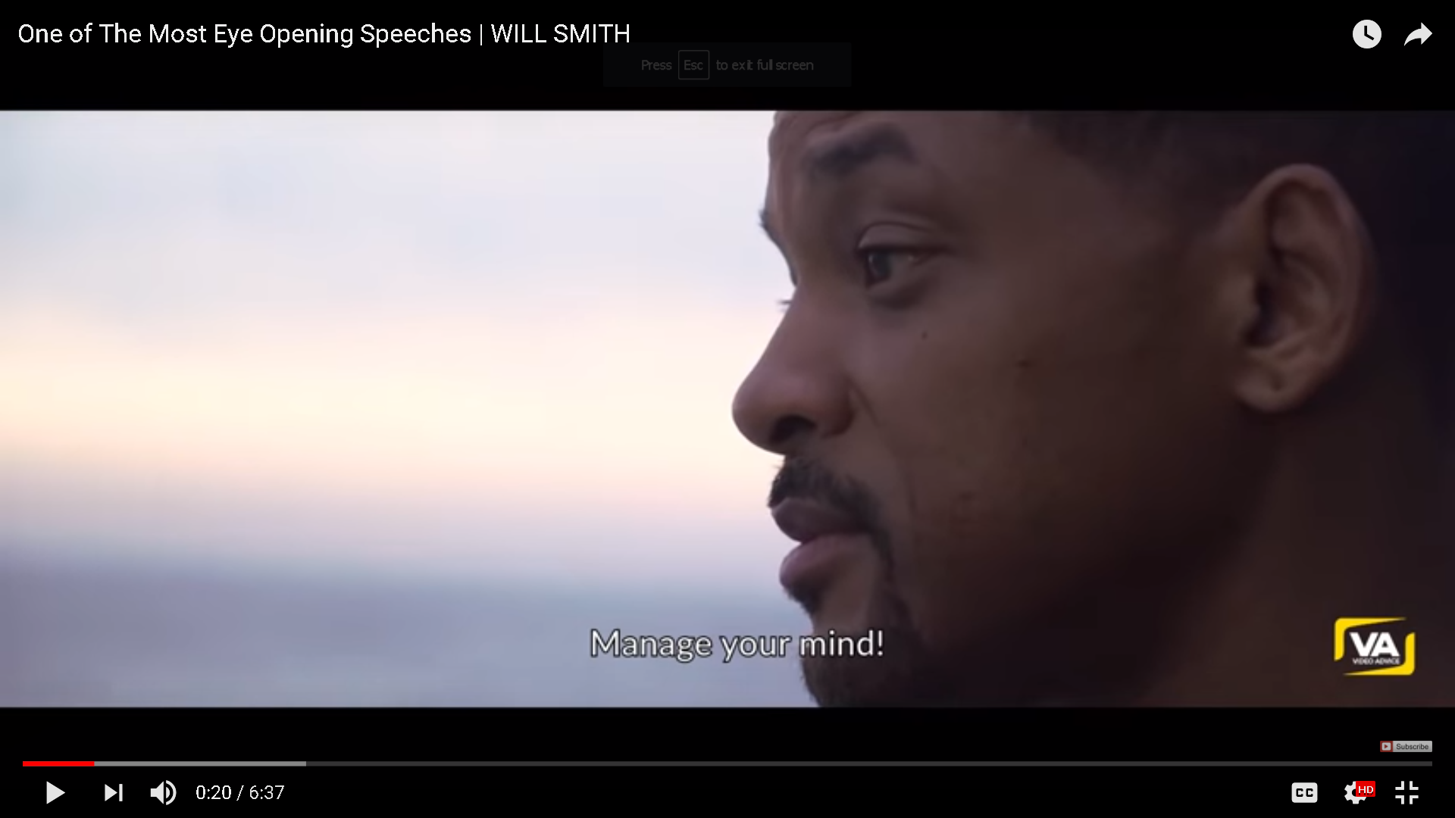
Change Your Mind
Click on link to show video

Slide 10
Hand out Post Its or Index cards
Write down 3 things that you want to do, but are afraid to try.
Write down 3 things that are keeping you from doing them.
Write down what you need to do to accomplish these goals.

Slide 11
MindSet Challenge
By the end of the semester you will accomplish each thing on your list.
Each time we meet we will celebrate your accomplishments because you are amazing!

