Slide 1
EQ: How did certain land-based empires develop and expand in the period 1450-1750?
U3 Top1: Land-Based Empires

Slide 2
context
Multi-ethnic States reached a peak of wealth and influence during this era by having direct political control over large regions and overland trade routes
Expansion: using war States competed for territory size. SHE: Qing China tripled size by 1911
Centralization: States collected tributes from neighbors to pay for warriors and bureaucratic elites, monumental architecture and art
Belief Systems: Tied to Political power, Faiths often clashed. SHE: Shi’a Safavids warred with Sunni Mughals
After 1750: ethnic identity, expanding oceanic trade routes and the rise of corporations led to a decline
Gunpowder Empires: refers to large, multi-ethnic states in SW, Central, and South Asia that used firearms to conquer and control

Slide 4
Europe
Gutenberg Printing Press: increased literacy
Russia:
1. Culturally Linked to the West but Ivan IV (“the Terrible”) expanded to the east, toward Mongol lands
2. Control of the Volga River gave Russia access to trade with Persia and Byzantine Empire

Slide 5
East Asia
Ming Dynasty (1368-1644) re-established ethnic Chinese control
Qing Dynasty (1644-1911) led by Manchu warriors from north (Manchuria)
Emperor Kangxi: expanded lands including a protectorate over Tibet
Emperor Qianlong: scholar in poetry, art; expanded lands east into Muslim lands (Uighurs)
Conflicts with West: force to sell trading rights to British (Canton) by 1750

Slide 6
Rise of the Islamic Gunpowder Empires
Similarities of the 3 G-Powder Empires
Turkish descent & language, use of guns, and filled power vacuum left by Mongols
Tamerlane: set stage for Turkic empires; used ghazi ideal: Muslim holy warrior

Slide 7
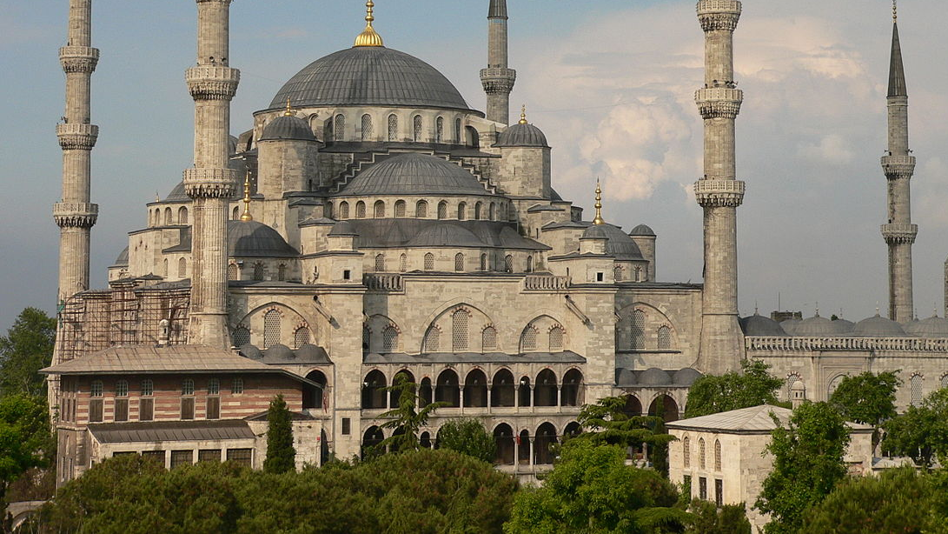
The Ottoman Empire (Turkish & Sunni)
1. Largest & most enduring of the Islamic Land-based empires
Mehmed II: conquered Constantinople (and renamed it Istanbul…feel like singing? https://www.youtube.com/watch?=vsQrKZcYtqg
2. Expanded into Eastern Europe peaking at “gates of Vienna”; led by Suleiman I

Slide 8
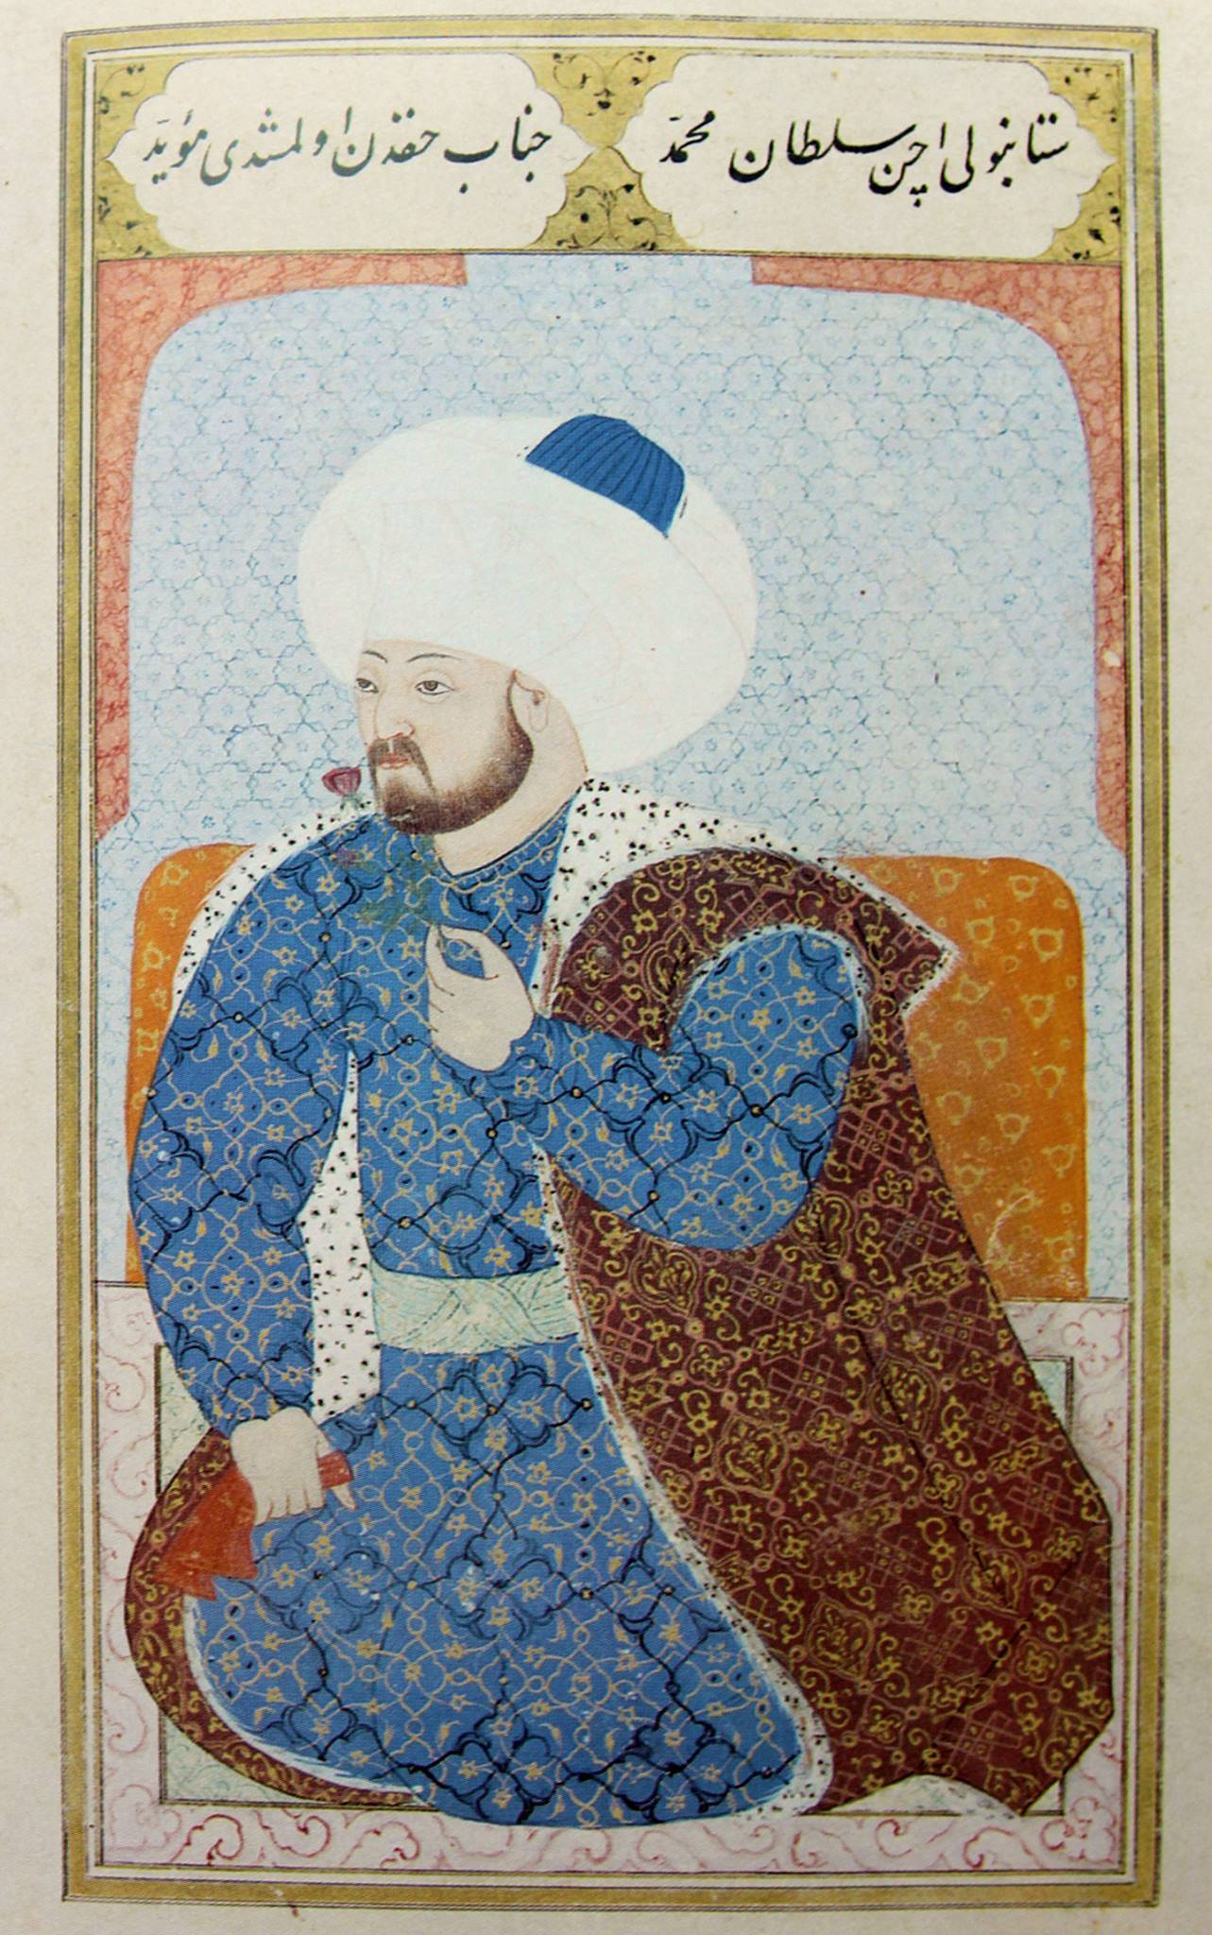
Ottoman “Miniature Painting”
Istanbul

Slide 9
The Safavids (Persian and Shi’ite)
Ismail—founder (15 years old -what have YOU done?) proclaimed Shah, or ruler
Weakness—no navy or natural defenses
Abbas the Great (Shah Abbas I) led empire to it height
Fought Ottomans over trade routes and religious differences (origin of Iran-Iraq modern conflicts)

Slide 11
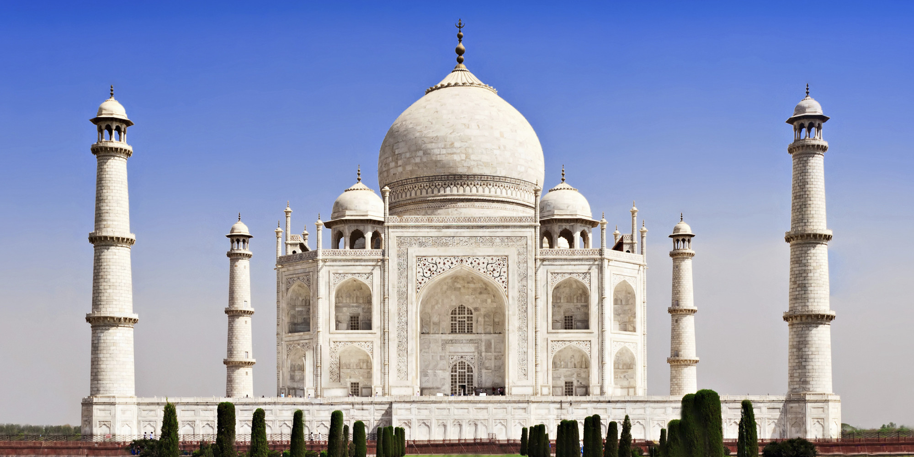
The Mughal Empire
Babur and Akbar (16th century) were best leaders. Akbar “the Great” gave Indians a sense of unity
Based in India, this Islamic empire was challenged to keep Hindus happy
Akbar created a syncretic religion- “Divine Faith”, but it faded after his death.
Sikhism was a lasting syncretic blend of Hindu and Islam
Architecture also showed syncretism—Taj Mahal →

Slide 12
Decline of the Gunpowder Empires
All 3 declined as western Europe rose
Reasons
Ottomans: Weak Sultans & Battle of Lepanto sea battle loss to Catholics
Safavids: weak Shahs and beaten by Ottomans and Russians
Mughals: corruption and too many expensive wars

Slide 13
Map of the gunpowder Empires (p. 150)
Outline
Label
Lightly shade

