Slide 1
Federal Bureaucracy
Unit IV – Branches of Government

Slide 2
5.B.5: Explain how the president ensures that executive branch agencies and departments carry out their responsibilities in concert with the goals of the administration
EQ: How do the institutions of government articulate democracy and interact with various linkage institutions to carry out republicanism
Students Can:
Evaluate how democratic is a government by proxy
Agenda:
Presidential Review
Quiz on the executive branch
Homework:
Bureaucracy Hierarchy

Slide 3
5.B.5: Explain how the president ensures that executive branch agencies and departments carry out their responsibilities in concert with the goals of the administration
EQ: How do the institutions of government articulate democracy and interact with various linkage institutions to carry out republicanism
Students Can:
Evaluate how democratic is a government by proxy
Agenda:
Perception of a Bureaucracy
A Government by Proxy
Re-Write FRQs and LEQ
Homework:
Study for Presidential Quiz

Slide 4
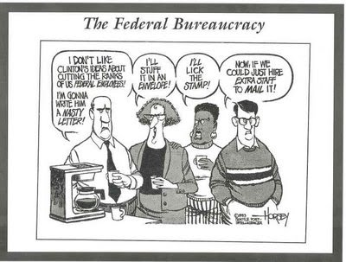
A Vision of the Federal Bureaucracy
What impression do American’s have about the federal bureaucracy?

Slide 5
The Un-elected
Bureaucracy: runs the day-to-day operations of government & implements (enforces) laws (GOVERNMENT BY PROXY – NOT ELECTED OFFICIALS)
Federal Gov. = largest employer in America
Two Types of Bureaucrats
Political appointees: 4,000 federal government workers
Civil Servants: (hired & permanent employees) – 2.1 million government employees
Issue: Loyalty (President vs. Agency) – do they support the President’s policy agenda

Slide 6
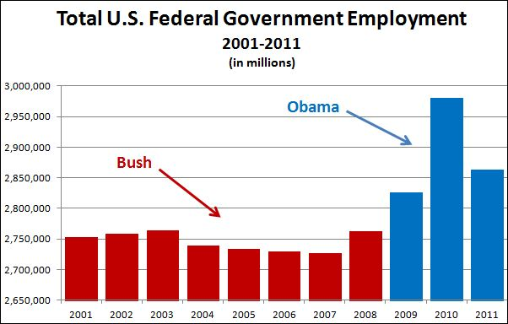
Government employment

Slide 7
American Bureaucracy
Purpose: implement public policy by administrative agencies
Limitation: overlapping jurisdictions
Ex. egg: if it is in a shell the USDA oversees it, but if it is cracked the Department of Agriculture handles it. And if it creates food poisoning well than the CDC handles it.
Who knew the egg was so complicated!

Slide 8
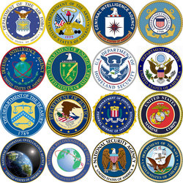
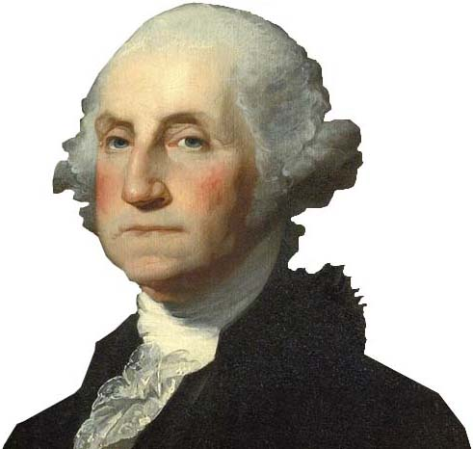
Informal Government
Bureaucracy – Interpretation of Article II (President Washington)
Constitutional Powers creates a bureaucracy
Presidential appointment (w/ Senate consent)
Enforcement of law
Madisonian Model
Bureaucracy – implement laws (rules for enforcement)
Overlapping jurisdiction (check & balance)
Expanding the Madisonian Model

Slide 9
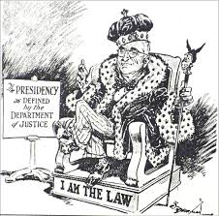
Delegated Authority
The power of the bureaucracy: Bureaucratic or Administrative discretion
Congress delegates authority to enforce laws (agency writes special rule the have the power of law)
Bureaucracy can go beyond and above the law with its rules
Clean Air Act: granted the Environmental Protection Agency the power to regulate air pollution. (Congress did not clarify what is “Air Pollution”)
Evaluate whether bureaucratic discretion expands the imperial Presidency.

Slide 10
Bureaucratic Design
A large, complex organization composed of appointed officials, where authority is divided among several managers and/or departments
Government Corporations
U.S. President
White House Office
Executive Agencies
Executive Offices of the President
Regulatory Boards & Commissions
Cabinet
How does the complex web of the bureaucracy still uphold the ideas of the Madisonian model?
Explain how Congress can limit the authority of the federal bureaucracy.

Slide 11
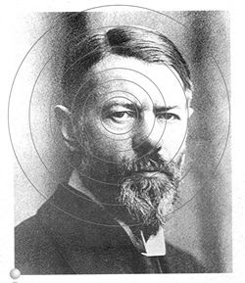
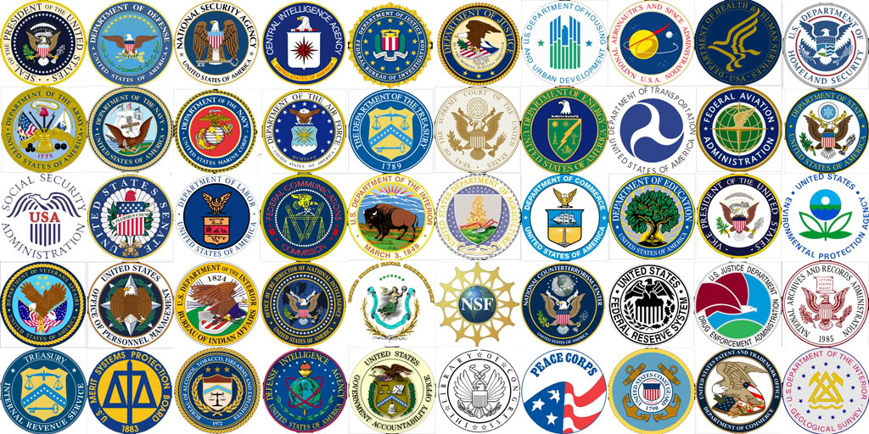
A True Bureaucracy
Max Weber’s Model: bureaucracy was the “rational way” for modern society to conduct business
Factors:
Hierarchical structure
Task specialization
Extensive rules
Merit system
Impersonality
Max Weber – German Sociologist

Slide 12
Constitutional Conflict
Debating modern adaption
Bureaucratic Reform
The system is outdated, and it would be better if one agency oversaw specific aspects of society. This would streamline the process and use resources more efficiency
Founders’ View
Many fear a single agency would impose onerous new regulations, product recalls, and fines, and could be used empire building bureaucrats to expand their budgets and regulatory authority

Slide 13
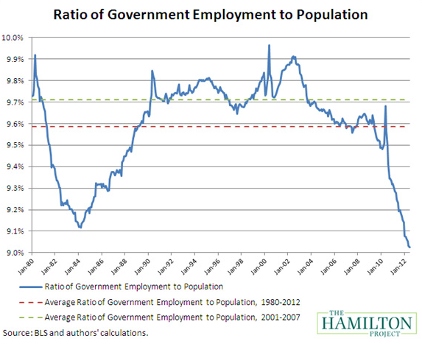
Trending
Bureaucratic Trends
Explain TWO causes for the trend displayed in the ratio of Government Employment to Population chart.
Explain the potential negative impact of this trend.

Slide 14
5.B.5: Explain how the president ensures that executive branch agencies and departments carry out their responsibilities in concert with the goals of the administration
EQ: How do the institutions of government articulate democracy and interact with various linkage institutions to carry out republicanism
Students Can:
Evaluate how democratic is a government by proxy
Agenda:
Who Gets the Job
The Bureaucrat
Bureaucracy Infographic
Homework:
Hi, I am from the Federal Government – due Wed. 12/13

Slide 15
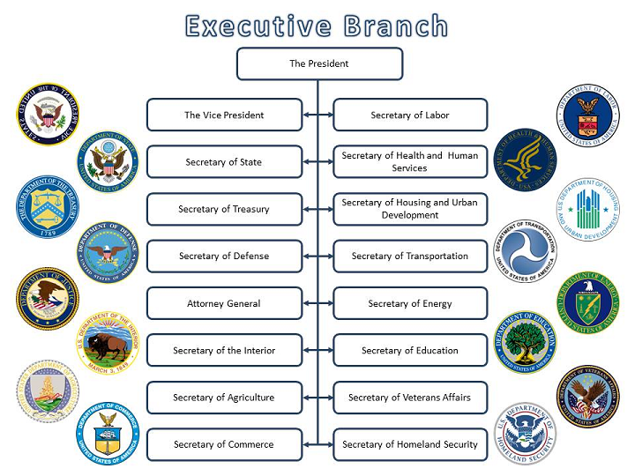
Who Gets The JOB
Cabinet: 15 departments that advise the president on public policies (foreign & domestic)
Appointed by the President with advice and consent of Senate
Examine the resumes President George HW Bush cabinet
Determine which cabinet post they were appointed to
Evaluate what factors are utilized in the appointment of members of the Presidential cabinet.

Slide 16
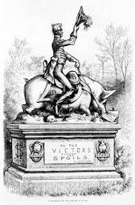
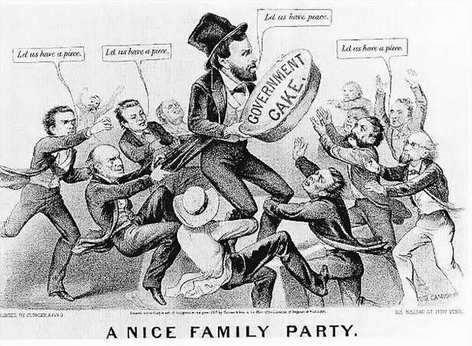
To the Victor Go the SPOILS
Spoils system: (patronage) appointing political supports to government positions
Issue:
Unqualified people serving in government
Growth of political corruption
Evaluate the political cartoons on the Spoil System
Why did the spoil system create problems and therefore is no longer employed?

Slide 17
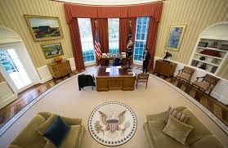
It’s about the FLOW
President administrative structures to control the flow of information reaching the President
Pyramid structure: hierarchical system the reports to the Chief of Staff (The Gate Keeper)
Wheel & Spoke structure: uses several assistants to direct information (greater access to the President)
Ad hoc structure: organize presidential advisors and task force and ranks them in importance
Access to the Oval Office

Slide 18
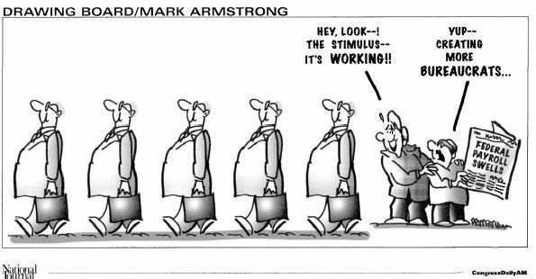
Bureaucrat
Two types: appointees and civil servants (The Plum Book)
Appointees:
With the advice and consent of Senate
Usually last an average of two years
Civil Servants: permanent federal employees
Pendleton Act 1883: merit system
Office of Personnel Management (oversees the hiring process)
Hatch Act 1939: civil servants cannot take part in political campaigns

Slide 19
Challenging the Bureaucrat
Explain TWO major factors that have driven the need to reform of the federal bureaucracy of the United States.
Patronage
Spoils system
Pendleton Act
Hatch Act
Recent Trend – Devolution Revolution
Civil Service Reform Act
National Performance Review

Slide 20
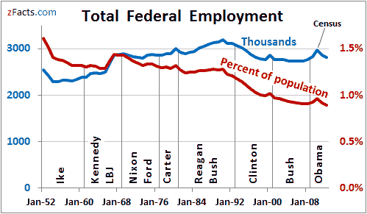
Debunking the Myth
The Pendleton Act (hiring by merit) was passed to ensure the federal government followed the Madisonian Model of Government.
Explain how the rules dealing with civil servants controls a government by proxy and re-enforces the Madisonian Model.

Slide 21
Civil Servants
Impact of Devolution Revolution

Slide 22
Testing the Madisonian Model
How does the idea of a government by proxy maintain the concept of the Madisonian Model of Government established by the U.S. Constitution?
How does the structure of the federal bureaucracy prompt independence from other branches of government?

Slide 23
Upholding the Principle of Limited Government
Prompt: Evaluate whether the current position of the President of the United States has become the imperial presidency and thus destroyed the concept of the Madisonian Model of government. Provide evidence and arguments based on founding documents and your knowledge of the Presidency as established in modern times.
Limited Government
Imperial Presidency

Slide 24
A Government by Proxy
Madisonian Model was created to achieve three goal.
Evaluate whether a government by proxy uphold or undermine the Madisonian Model of Government
Hire a Bureaucrat: evaluate through the following factors
Plum Book
Pendleton Act
Hatch Act
Whistle Blowers Protection Act
The Civil Service Reform Act

Slide 25
5.B.5: Explain how the president ensures that executive branch agencies and departments carry out their responsibilities in concert with the goals of the administration
EQ: How do the institutions of government articulate democracy and interact with various linkage institutions to carry out republicanism
Students Can:
Evaluate how democratic is a government by proxy
Determine factors that impact the implementation of federal laws
Agenda:
Discretionary Authority Debate
Guidelines for Implementation
War on Drugs
Homework:
Hi, I am from the government due Wednesday 12/13

Slide 26
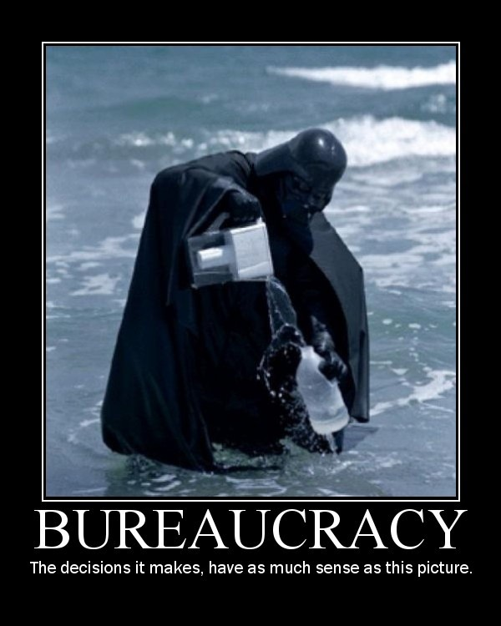
The Purpose of the Bureaucracy
Identify and explain TWO reasons why Congress grants federal agencies bureaucratic discretion.
Identify TWO ways in which Congress can limit bureaucratic discretion.

Slide 27
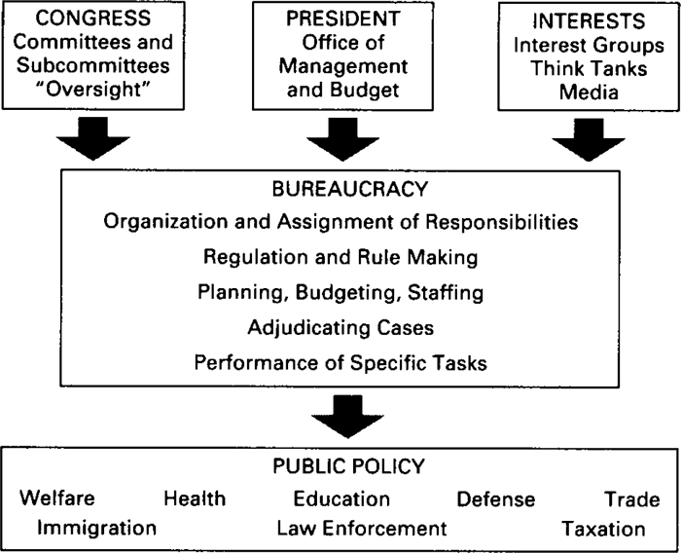
Implementation
Implementation = enforcement of the law by Bureaucratic agencies
Discretionary Authority: Bureaucratic Agencies determine the rules for enforcing a law
Clayton Anti-trust Act – monopolies in industry are illegal (a single business provides a product or service)
Federal Trade Commission determines what is or is not a monopoly)

Slide 28
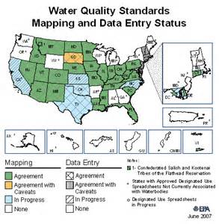
Policy-Making Discretion
Congress grants policy-making discretion
Agencies have the expertise
Scapegoat
Efficiency
Easier to come to an agreement
Congressional checks on bureaucratic discretion
Power of the purse
Oversight & investigation hearings (Government Accountability Office – GAO)
Lawmaking (Administrative Procedure Act)
Senate confirmation of appointments

Slide 29
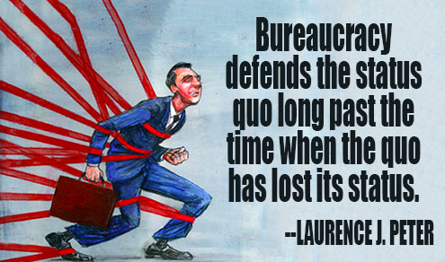
Issues with Implementation
Red tape: complex rules and procedures that must be followed to get something done.
Conflict: agencies seem to be working against other agencies.
Duplication: two or more agencies seem to be doing the same thing.
Imperialism: when agencies grow without regard to benefit or cost.
Waste: spending more than is necessary.

Slide 30
Public Policy

Slide 31
The War on Drugs
Identify different agencies task with controlling aspects of the Controlled Substances Act and explain their actual discretionary authority.
Dissect how discretionary authority and checks and balances impacts the implementation of the Control Substances Act.
Control Substance Act of 1970: (1) Many of the drugs included within this subchapter have a useful and legitimate medical purpose and are necessary to maintain the health and general welfare of the American people. (2) The illegal importation, manufacture, distribution, and possession and improper use of controlled substances have a substantial and detrimental effect on the health and general welfare of the American people. (3) A major portion of the traffic in controlled substances flows through interstate and foreign commerce. Incidents of the traffic which are not an integral part of the interstate or foreign flow, such as manufacture, local distribution, and possession, nonetheless have a substantial and direct effect upon interstate commerce
Why does Congress grant discretionary authority to a variety of agencies?
How does having multiple agencies support the arguments of Federalist 51? How can the President control a bureaucratic agency?
Why can’t the President control the bureaucratic agencies that implement the Controlled Substance Act?

Slide 32
Bureaucratic Authority
Evaluate whether bureaucratic discretion creates a usurpation of power by the executive branch
Federalist 51
The U.S. Constitution
Brutus I
Demonstrate an argument for and one against

Slide 33
I Fought the Law
Trumping Bureaucratic Overreach
The current President of the U.S. has promised to get rid of two regulation for everyone that is passed by Congress. You and a part will be completing an implementation assessment of an assigned public policy regulation to determine which could be eliminated and which need to be continuously implemented.
Select ONE of the following public policy to evaluate
Clean Air Act 1970
Elementary and Secondary Education Act 2001
Civil Rights Act of 1964
USA Patriot Act 2001
Americans with Disabilities Act 1990
Voting Rights Act 1965
Federal Election Campaign Act 1972
Welfare Reform Act 1976
Anti-terrorism & Effective Death Penalty Act 1996
Control Substance Act 1970
Immigration Act 1990
Brady Handgun Prevention Act 1993

Slide 34
5.B.5: Explain how the president ensures that executive branch agencies and departments carry out their responsibilities in concert with the goals of the administration
EQ: How do the institutions of government articulate democracy and interact with various linkage institutions to carry out republicanism
Students Can:
Evaluate how democratic is a government by proxy
Determine factors that impact the implementation of federal laws
Agenda:
Discretionary Authority Usurped
To Regulate or not to Regulate?
Power struggle
Homework:
Hi, I am from the government due Wed. 12/13

Slide 35
To Regulate or Deregulate
Why should the federal government pass and enforce regulations?
What are the counter-arguments for deregulation?

Slide 36
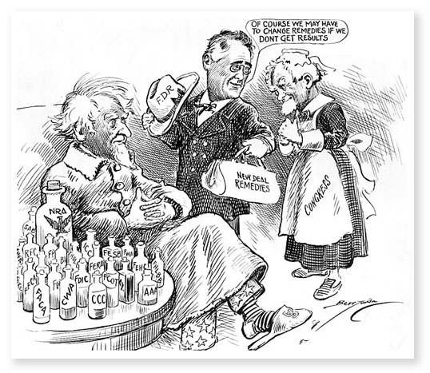
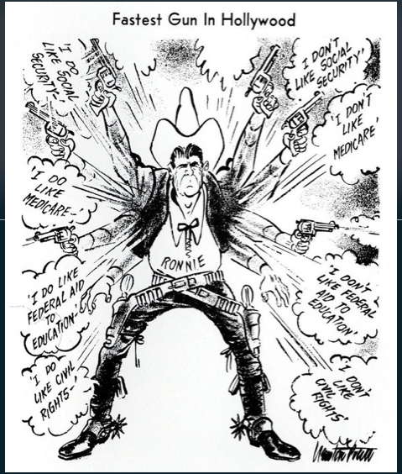
Regulation Debate
Debate: Should the U.S. government regulate (put rules on) the market economy?
Great Depression: Regulation need to correct the market economy
Devolution Revolution – deregulate (remove rules) and allow the free market to work

Slide 37
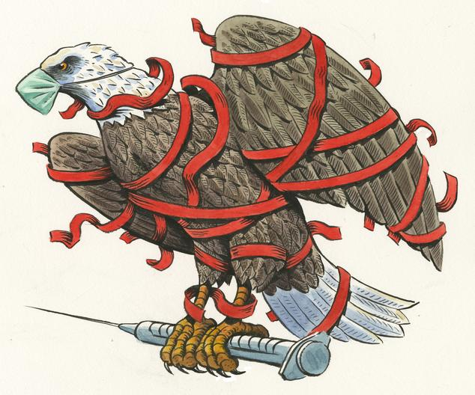
To Regulate or To Deregulate
Regulation
Deregulation (Privatization)
Protects market competition, labor, & consumers
Provide services not offered by the private sector
Promotes efficiency
Environmental protection increased (Clean Air Act, Clean water Act)
The natural forces of laissez faire regulate the economy
Causes prices to rise
Hurts American competitive advantage aboard
Many regulations fail to achieve their goal

Slide 38
Implementation – Regulation Debate
Regulation
Deregulation (Privatization)
Promotes & protects market competition
Provide services not offered by the private sector
Promotes efficiency
Protects consumer & labor safety
Environmental protection increased (Clean Air Act, Clean water Act)
Avoids agency capture (regulatory capture): bureaucracy corrupted by industries to do their bidding
Big government – cost $$$ (devolution revolution)
The natural forces of laissez faire economy control industry
Causes prices to rise
Distort markets
Hurts American competitive position aboard
Many regulations have failed to protect anything
Ex. Banking, airlines, telecommunications

Slide 39
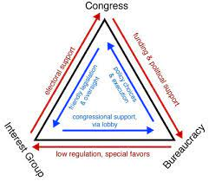
The Politics of Regulation
Client Politics: when an interest groups benefits at the expense of the public (Iron Triangles & Issue Networks)
Creates Agency (regulatory) capture
Discretionary authority is used to benefit the businesses instead of the public welfare.

Slide 40
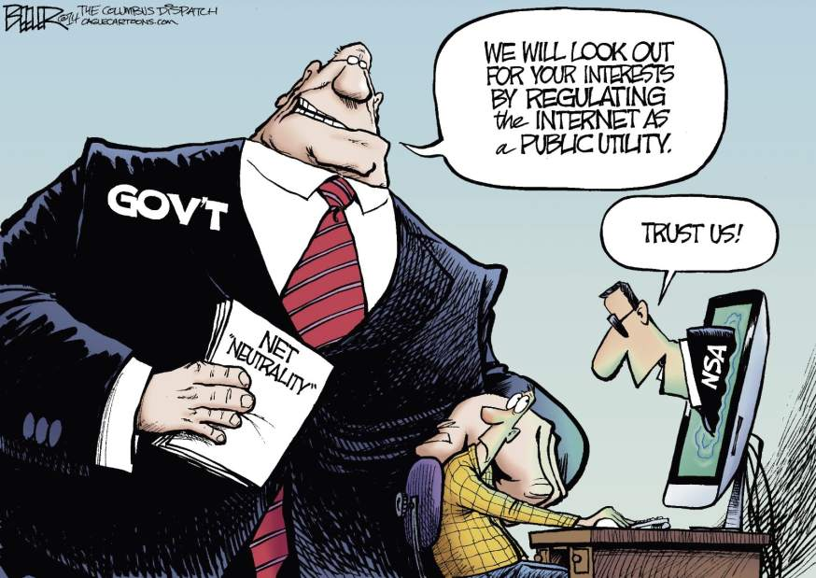
Failures of Regulation
Why regulation fails
Programs Design: agency does not have the authority to enforce the law
Lack of Clarity: the law itself is unclear on what it is trying to achieve
Lack of Resources: agency is under funded
Administrative Routine: red tape is too complex
Administrative discretion: inconsistent enforcement by bureaucrats
Fragmentation: authority to regulate to divided between different agencies

Slide 41
Evaluating Legitimate Implementation
WHY GOVERNMENT FAILS
Cause | Explanation
Program Design | Ex. Congress establishes an agency to round the corners of squares.
Lack of Clarity | Ex. Title IX – “No person in the United States shall, on the basis of sex, be excluded from participation in, be denied the benefit of, or be subjected to discrimination under any education program or activity receiving federal assistance”
Lack of Resources | Ex. U.S. troops had insufficient number of body armor and armored Humvees and trucks to protect against road side bombs
Administration Routine | Standard Operating Procedures = RED TAPE
Administrative discretion | Street level bureaucrats have discretion to implement = slippage (lack of consistency)
Fragmentation | Implementation of laws spread out between different agencies (support tobacco farmers while discouraging smoking)

Slide 42
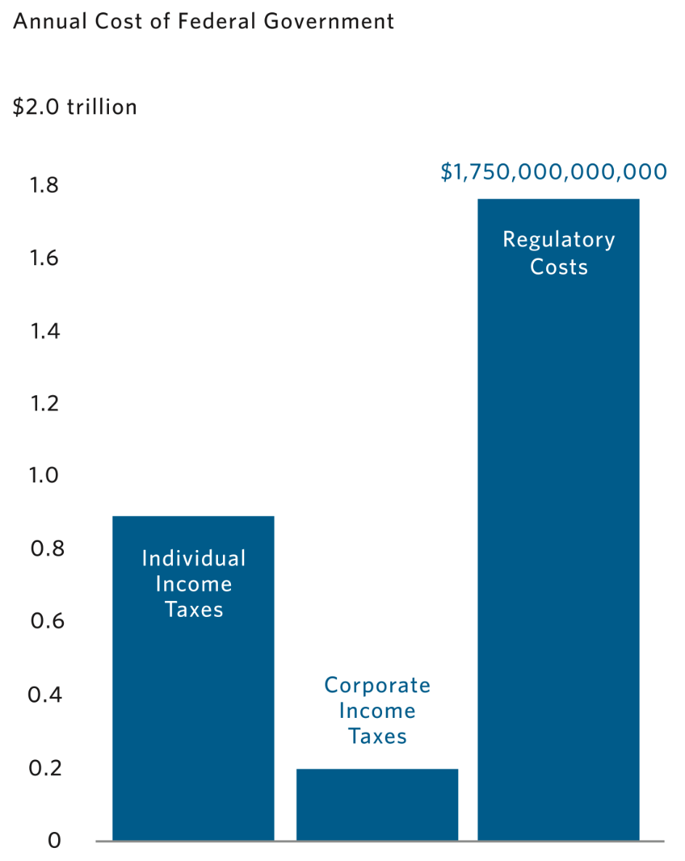
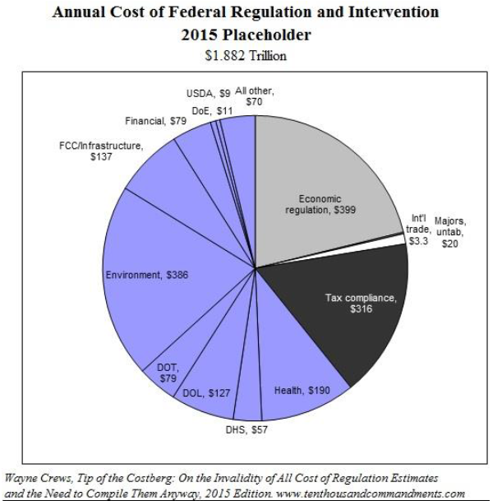
Tax Dollars at Work

Slide 43
The War on Drugs
Identify different agencies task with controlling aspects of the Controlled Substances Act and explain their actual discretionary authority.
Dissect how discretionary authority and checks and balances impacts the implementation of the Control Substances Act.
Control Substance Act of 1970: (1) Many of the drugs included within this subchapter have a useful and legitimate medical purpose and are necessary to maintain the health and general welfare of the American people. (2) The illegal importation, manufacture, distribution, and possession and improper use of controlled substances have a substantial and detrimental effect on the health and general welfare of the American people. (3) A major portion of the traffic in controlled substances flows through interstate and foreign commerce. Incidents of the traffic which are not an integral part of the interstate or foreign flow, such as manufacture, local distribution, and possession, nonetheless have a substantial and direct effect upon interstate commerce
Why does Congress grant discretionary authority to a variety of agencies?
How does having multiple agencies support the arguments of Federalist 51? How can the President control a bureaucratic agency?
Why can’t the President control the bureaucratic agencies that implement the Controlled Substance Act?

Slide 44
Bureaucratic Authority
Evaluate whether bureaucratic discretion creates a usurpation of power by the executive branch
Federalist 51
The U.S. Constitution
Brutus I
Demonstrate an argument for and one against

Slide 45
5.B.5: Explain how the president ensures that executive branch agencies and departments carry out their responsibilities in concert with the goals of the administration
EQ: How do the institutions of government articulate democracy and interact with various linkage institutions to carry out republicanism
Students Can:
Evaluate how democratic is a government by proxy
Determine factors that impact the implementation of federal laws
Agenda:
Federalist 51
Bureaucratic Power & Reform
Power struggle
Homework:
Funko Pop Repair – due Friday
Unit IIB Test 12/19

Slide 46
Bureaucratic Authority
Explain how the design of the bureaucracy upholds the ideas of checks and balance and separation of powers in federalist 51.

Slide 47
Ways to Regulate
Command and Control
Incentive system
Government tells businesses what goals to achieve
Government checks to see if businesses are achieving those goals
Government punishes violators for non-compliance
Government rewards those who follow the regulations
Promote efficiency instead of legislative enforcement
Ex. Tax breaks for limiting pollutions
Explain which system would be supported by Devolution Revolution.

Slide 48
Legislative veto
Congressional Influence
YOU DECIDE
Legislative Veto: requirement that executive decisions be evaluated by Congress
Congress can veto rules (by vote in one house or both)
INS v. Chadha
Does Congress have the ability to stripe the authority of the Attorney General to make decision over whether to deport a non-citizen via one house veto?
Determine the constitutionality of this question
Decision: Legislative veto is unconstitutional
Congress does Not have the power of the VETO
One House of Congress cannot decide any action for Congress

Slide 49
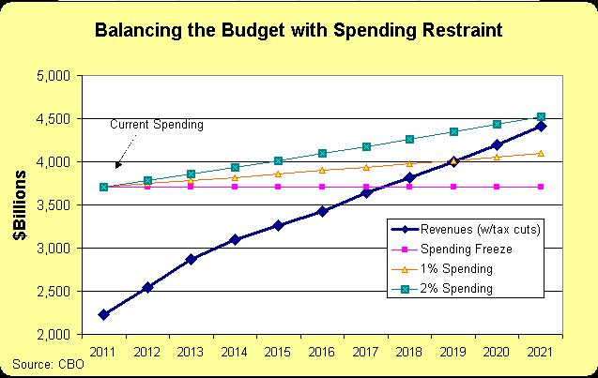
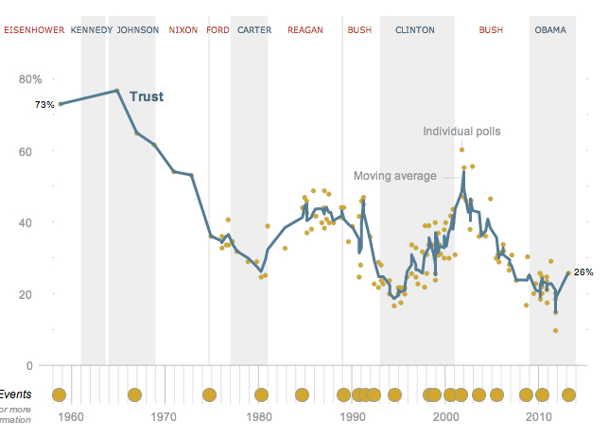
Reforming the Bureaucracy
Sunshine Laws
Sunset laws (reauthorization)
Contracting out (private sector)
Oversight/investigations (Congress)
Power of the Purse (Congress)
Government Performance Act & Results 1997 (efficiency)
Change law (Congress)
Negotiated Rule Maker Act (1990) – publication of new regulations

Slide 50
The War on Drugs
Identify different agencies task with controlling aspects of the Controlled Substances Act and explain their actual discretionary authority.
Dissect how discretionary authority and checks and balances impacts the implementation of the Control Substances Act.
Control Substance Act of 1970: (1) Many of the drugs included within this subchapter have a useful and legitimate medical purpose and are necessary to maintain the health and general welfare of the American people. (2) The illegal importation, manufacture, distribution, and possession and improper use of controlled substances have a substantial and detrimental effect on the health and general welfare of the American people. (3) A major portion of the traffic in controlled substances flows through interstate and foreign commerce. Incidents of the traffic which are not an integral part of the interstate or foreign flow, such as manufacture, local distribution, and possession, nonetheless have a substantial and direct effect upon interstate commerce
Why does Congress grant discretionary authority to a variety of agencies?
How does having multiple agencies support the arguments of Federalist 51? How can the President control a bureaucratic agency?
Why can’t the President control the bureaucratic agencies that implement the Controlled Substance Act?

Slide 51
Bureaucratic Authority
Evaluate whether bureaucratic discretion creates a usurpation of power by the executive branch
Federalist 51
The U.S. Constitution
Brutus I
Demonstrate an argument for and one against

Slide 52
I Fought the Law
Trumping Bureaucratic Overreach
The current President of the U.S. has promised to get rid of two regulation for everyone that is passed by Congress. You and a part will be completing an implementation assessment of an assigned public policy regulation to determine which could be eliminated and which need to be continuously implemented.
Select ONE of the following public policy to evaluate
Clean Air Act 1970
Elementary and Secondary Education Act 2001
Civil Rights Act of 1964
USA Patriot Act 2001
Americans with Disabilities Act 1990
Voting Rights Act 1965
Federal Election Campaign Act 1972
Welfare Reform Act 1976
Brady Handgun Prevention Act 1993

Slide 53
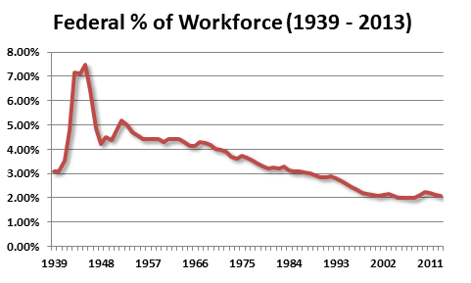
Wasting Away in Washington DC?
Many have argued that due to the growth of regulation the federal government has become too wasteful with taxpayers’ dollars and to involve in Americans’ lives.
“The Era of Big Government is Over.” – President Bill Clinton
“This is a major threat to your jobs and we’re going to get rid of this threat,” – President Donald Trump
Evaluate whether your assigned public policy has promoted wasteful spending and too much federal government intervention creating “Big Government”.
“Federal gov. employs 2.07% of the American workforces” – Hardhatters.com

Slide 54
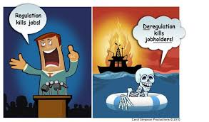
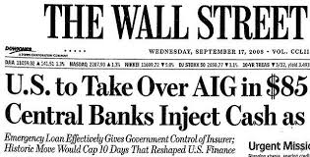
Regulators
Evaluate whether the United States’ government should take an active rule in the market economy through the creation and enforcement of regulation.
Factors to consider:
U.S. Constitution, Article I & II
Federalism
Historic evidence

Slide 55
Issue Advocacy

Slide 56
5.B.5: Explain how the president ensures that executive branch agencies and departments carry out their responsibilities in concert with the goals of the administration
EQ: How do the institutions of government articulate democracy and interact with various linkage institutions to carry out republicanism
Students Can:
Evaluate how democratic is a government by proxy
Determine factors that impact the implementation of federal laws
Agenda:
Discretionary Authority
A Bureaucratic Maze
Public policy issue advocacy
Homework:
Hi, I am from the government due Tuesday 12/22

Slide 57
Bureaucratic Design
A large, complex organization composed of appointed officials, where authority is divided among several managers and/or departments
Government Corporations
U.S. President
White House Office
Executive Offices of the President
Executive Agencies
Cabinet
Regulatory Boards & Commissions
Congress

Slide 58
Structure of the White House
Pyramid Structure
Wheel & Spoke Structure
Gatekeeper: Chief of Staff
Hierarchy structure that flows through one person
Adv. – orderly flow of information
Disadv. – potential for misinformation
Several assistance report to the president
Adv. President is given a lot of information
Disadv. – hard to manage and creates confusion

Slide 59
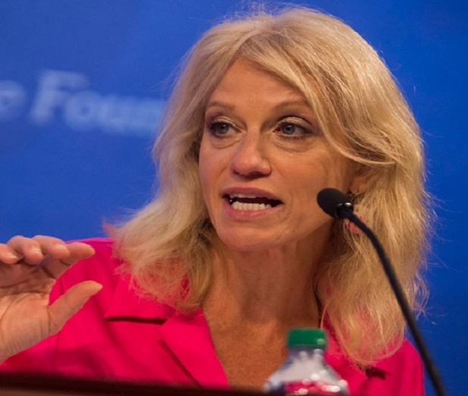
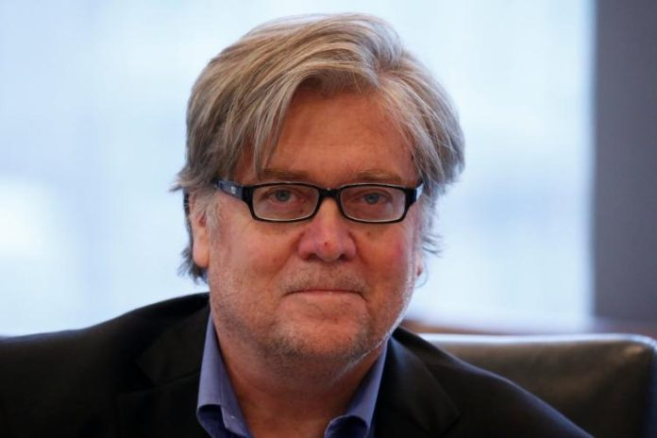
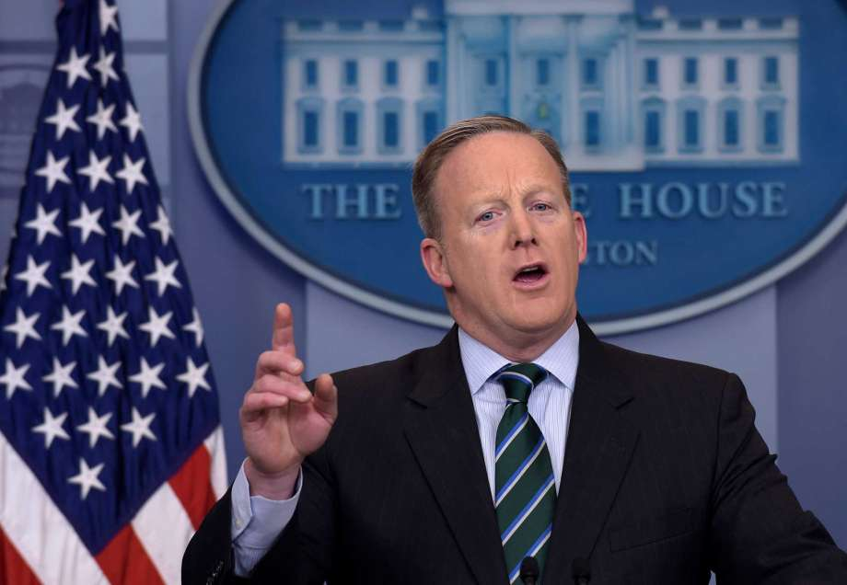
Office of the White House
President’s inner circle of close advisors and staff members (Not appointed)
Chief of Staff
Press Secretary
Special Advisors to the President
Key Advisor
The Gate Keeper
The Messenger

Slide 60
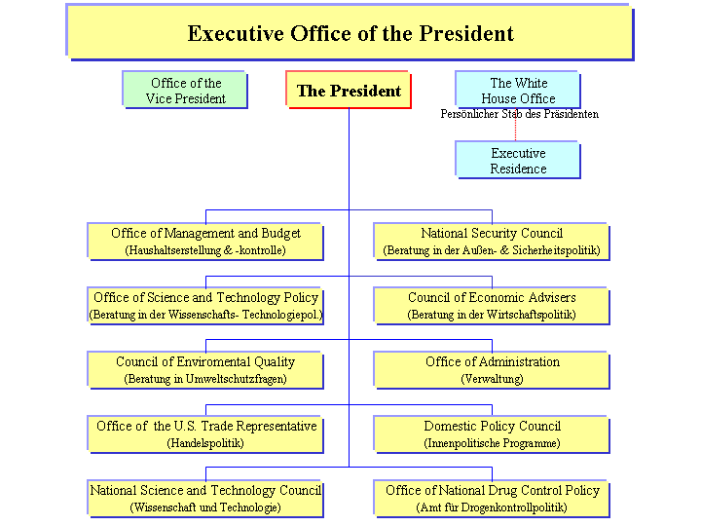
Executive Office of the President
The big three - heads do not go through appointment process (key advisors)
National Security Council
Council of Economic Advisors
Office of Budget & Management

Slide 61
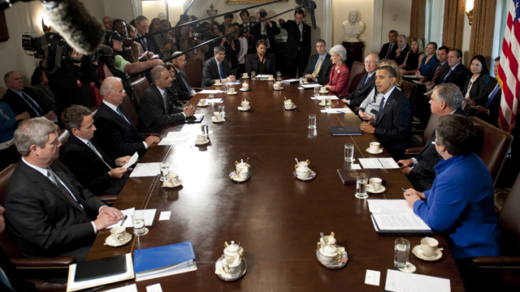
Cabinet
Line organizations (directly accountable to the president)
Created by Congress
President appoints/fires
Lead by a secretary (except Justice)
Issue: civil servants in the department are loyal to the department & create implementation rules

Slide 62
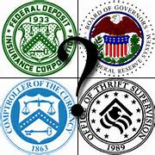
Independent Agencies
Not located in a department
Report to a President (appoints head)
Congress decides location in bureaucracy
Regulatory Agencies (established by Congress to deal with complexities of law)
Combine powers – make rules, enforce rule, & judge disputes
Appointed by the president, but report to Congress
President can fire but only by the rules specified in its creation
Federal Reserve
FBI
CIA

Slide 63
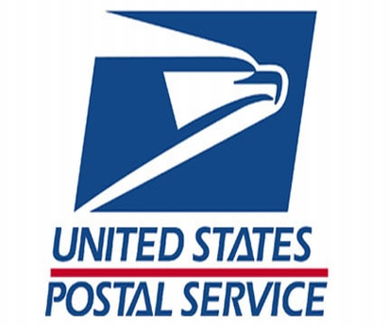
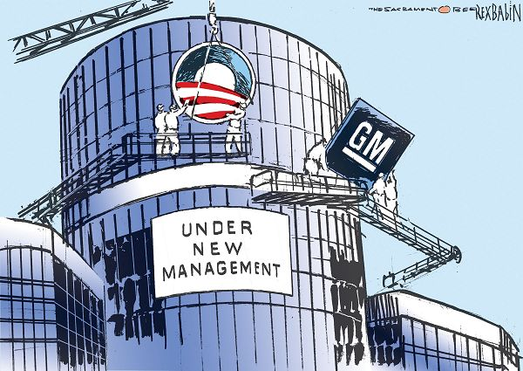
Government Corporations
Government run business
Run by a board of directors and provides a service
Ex. Post Office & Amtrak
Controversy over bailouts

Slide 64
Implementation
The United States Congress and the President have the power to enact federal laws. The federal bureaucratic agencies have the responsibility to execute federal law. However, in the carrying out of these laws, federal agencies have policy-making discretion.
Explain two reasons why Congress gives federal agencies policy-making discretion in executing federal laws.
Describe two ways that Congress ensures the federal agencies follow legislative intent.

Slide 65
5.B.5: Explain how the president ensures that executive branch agencies and departments carry out their responsibilities in concert with the goals of the administration
EQ: How do the institutions of government articulate democracy and interact with various linkage institutions to carry out republicanism
Students Can:
Evaluate how democratic is a government by proxy
Determine factors that impact the implementation of federal laws
Agenda:
Bureaucracy Check
Iron Triangles the Triforce of Policy
Implementation of the Law
Homework:
Review the Bureaucracy
Bureaucracy, Implementation of the Law
Unit IIB Test 12/19

Slide 66
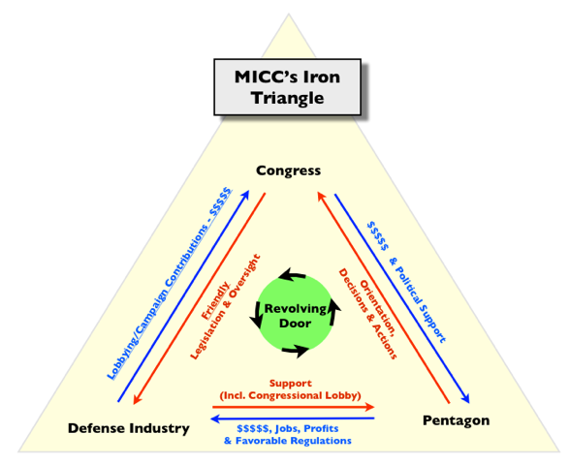
Playing the Iron Triangle
Goal: Demonstrate how Iron Triangles influence the implementation of the law

Slide 67
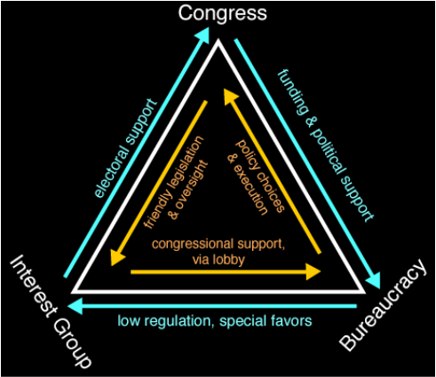
Iron Triangles
Iron Triangles – three-way alliance between Congressional committees, Bureaucratic agency, and interest groups.
USE the following to achieve goals
Campaign contributions
Agency’s budget
Fair enforcement of laws
Can undermine Presidential directives

Slide 68
Issue Networks
Issue Networks - Adaptation of an iron triangle
More than one interest groups are concerned with an area of public policy
Bureaucratic agencies are supervised by multiple Congressional committees & sub-committees
More groups are involved with public policy (staffers, experts, media, etc.)
Expands influence – President and the courts
Can create gridlock

Slide 69
Madisonian Model
Interest Group – Agency Capture
Presidency cut out
The public is cut out
How do iron triangles or issue network violate principles of the madisonian model?

Slide 70
Draw an Iron Triangle
Draw an Iron Triangle for the Control Substances Act
Illustrate how it is a relationship between groups
Demonstrate how each group has to give to receive benefits and how it impact the implementation of public policy
Assignments:
1 person find a bureaucratic agency
1 person find a congressional committee
1 person find an interest group
1 person design the triangle – Use the whole sheet of paper (include an illustration of each member benefits from the relationship)

Slide 71
5.B.5: Explain how the president ensures that executive branch agencies and departments carry out their responsibilities in concert with the goals of the administration
EQ: How do the institutions of government articulate democracy and interact with various linkage institutions to carry out republicanism
Students Can:
Evaluate how democratic is a government by proxy
Determine factors that impact the implementation of federal laws
Agenda:
Bureaucracy FRQ
Iron Triangles the Tri-force of Policy
Implementation of the Law
Homework:
Bureaucracy, Implementation of the Law
Unit IIB Test 12/19

Slide 72
Draw an Iron Triangle
Draw an Iron Triangle for the Control Substances Act
Illustrate how it is a relationship between groups
Demonstrate how each group has to give to receive benefits and how it impact the implementation of public policy
Assignments:
1 person find a bureaucratic agency
1 person find a congressional committee
1 person find an interest group
1 person design the triangle – Use the whole sheet of paper (include an illustration of each member benefits from the relationship)

Slide 73
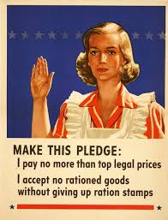
Implementation – How To
Design a poster to illustrate how to implement a law
Title: Including the name of the law
An illustration that represents the assigned law
An overview of the law and its purpose
A list of four agencies or departments that Implement the law with an explanation duplication or overlapping jurisdictions
An example of how bureaucratic discretion is utilized to implement the law, as well as why the authority is granted by Congress
Highlight at least TWO Congressional checks and TWO Presidential checks on the bureaucracy
A design that illustrates how an iron triangle or issue network influences the implementation of the law

Slide 74
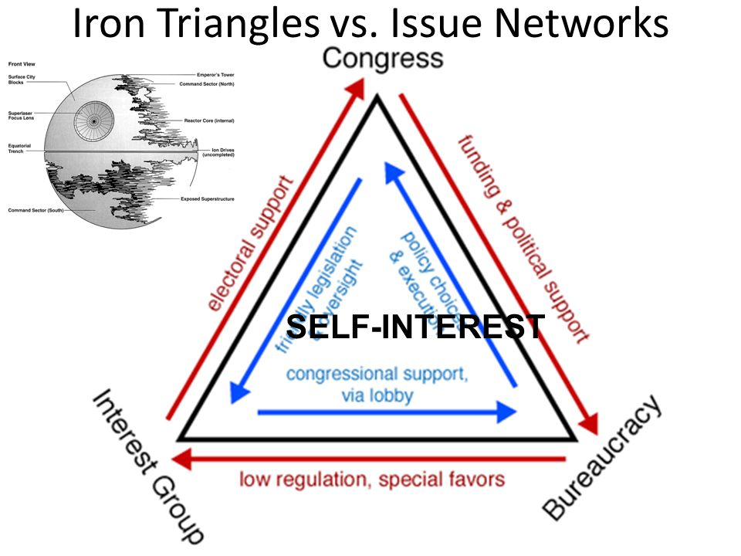
Madisonian Model of Government
How do iron triangles promote the Madisonian Model of Government?
How do iron triangles/issue networks subvert the Madisonian Model of government?

Slide 75
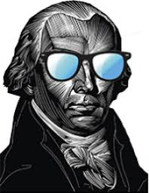
The Linkage Institution Faction
Explain how interest groups can influence both policy making and policy implementation in order to achieve their goals.
Explain TWO ways that Congress can impact bureaucratic digression in the implementation of laws.
“If a faction consists of less than a majority, relief is supplied by the republican principle, which enables the majority to defeat its sinister views by regular vote. It may clog the administration, it may convulse the society; but it will be unable to execute and mask its violence under the forms of the Constitution.”
- James Madison, Federalist 10
Bureaucratic Agency
IRON TRIANGLES
Interest Groups
Congressional Committee

Slide 76
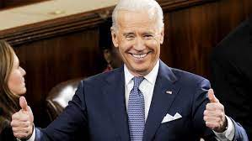
Presidential Review
Form groups of 4
Work together to complete Presidential Challenge
Success in APGOPO!

Slide 77
America’s War on Drugs
Evaluate the effectiveness of bureaucratic agencies in implementing the laws of the United States
Demonstrate how different branches of government and linkage institutions play a role in creating and enforcing the law.
Determine whether the auxiliary precautions of the Madisonian Model are working effectively to govern the United States in the modern era

Slide 78
Implementation – How To
Design a poster to illustrate how to implement a law
Title: Including the name of the law
An illustration that represents the assigned law
An overview of the law and its purpose
A list of four agencies or departments that Implement the law with an explanation duplication or overlapping jurisdictions
An example of how bureaucratic discretion is utilized to implement the law, as well as why the authority is granted by Congress
Highlight at least TWO Congressional checks and TWO Presidential checks on the bureaucracy
A design that illustrates how an iron triangle or issue network influences the implementation of the law

Slide 79
5.B.5: Explain how the president ensures that executive branch agencies and departments carry out their responsibilities in concert with the goals of the administration
EQ: How do the institutions of government articulate democracy and interact with various linkage institutions to carry out republicanism
Students Can:
Evaluate how democratic is a government by proxy
Determine factors that impact the implementation of federal laws
Agenda:
Bureaucratic Terms
Controlling a Bureaucracy
Examples Implementation
Homework:
I fought the Law – due Tuesday 12/6
Unit IIB Test (Executive & Bureaucracy) Thursday, December 8th

Slide 80
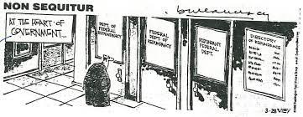
Perspective of the Bureaucracy
Bureaucracy viewed as inefficient management & enforcement of the law
FACTOR –
federal Bureaucracy reports to both the President & Congress (DIVIDED GOVERNMENT)
Duplication – Multiple agencies implementing the same law
Inconsistent implementation
Low level bureaucrats hesitate to act

Slide 81
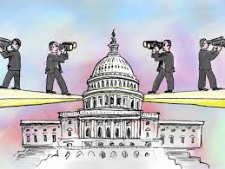
Checks & Balances
Constitutional Question: Does bureaucratic discretionary authority violate the constitutional principle of separation of powers
Congressional Checks & Balances
Oversights & Investigation (congressional committees)
Ex. what goals have been achieved
Power of the Purse
Authorization Bill
Appropriation Bill

Slide 82
Checks & Balances
Constitutional Question: Does bureaucratic discretionary authority violate the constitutional principle of separation of powers
President
Regulatory review process (Office of Information & Regulation)
Duplication: no one agency has complete authority of implementing a law
Appointment
Executive orders

Slide 83
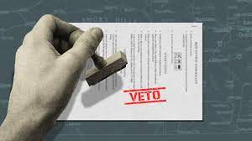
Constitutional Question
Legislative veto – a requirement where certain agencies actions/decision wait for 30 or 90 days before being enacted
Allows one house of Congress to reject a decision made by an agency in the enforcement of law
INS v. Chadha: Legislative Veto declared unconstitutional
CONGRESS

Slide 84
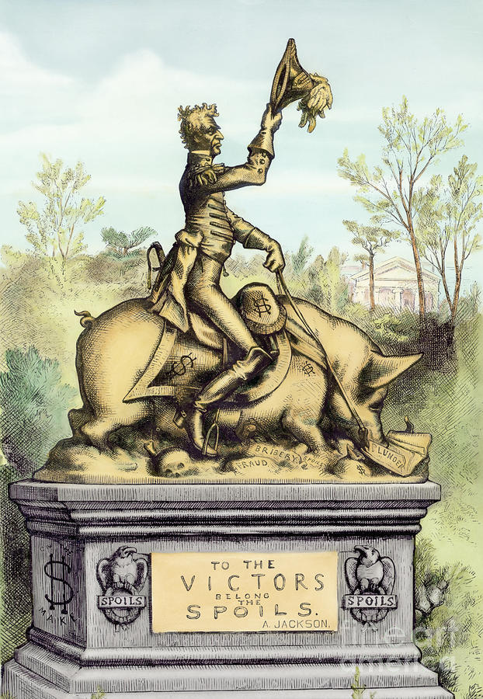
Reforming the system
Fighting corruption
Pendleton Act – established merit based employment in the civil service
Hatch Act – civil servant barred from campaigning for candidates
Whistleblower Protection Act: prevents a federal agency from retaliating against an employee who reports on potential corruption

Slide 85
Reforms of the Bureaucracy
Limiting appointments to 6-12 years. After the appointment expires, the bureaucrat would then have to go through reexamination and their performance would be reviewed for possible rehire.
Making it easier to fire a bureaucrat. Civil service rules that are meant to protect workers from partisan politics have made it difficult to fire anyone for poor performance. Reformers want to remove those rules.
Rotating professionals between agencies and from outside. Reformers believe that this practice would bring new blood to agencies and encourage workers to get a broader view of government service.
Rewarding employee initiatives and fewer rules. The bureaucracy is criticized for having rigid rules that restrict new ideas and individual initiatives. Reformers suggests that rules be streamlined and modernized, and that suggestions from employees should be encouraged and rewarded.
Emphasizing customer satisfaction. Government bureaucrats are often criticized for not caring about their customers. Unlike private businesses, government agencies do not have to compete for customers, so their clients are not given the attention they deserve.

Slide 86
5.B.5: Explain how the president ensures that executive branch agencies and departments carry out their responsibilities in concert with the goals of the administration
EQ: How do the institutions of government articulate democracy and interact with various linkage institutions to carry out republicanism
Students Can:
Evaluate how democratic is a government by proxy
Determine factors that impact the implementation of federal laws
Agenda:
Executive Order
I Fought the Law
Homework:
I fought the Law – due Tuesday 12/6
Unit IIB Test (Executive & Bureaucracy) Thursday, December 8

Slide 87
Bureaucratic Boom!
The federal bureaucracy as part of the executive branch exercises substantial independence in implementing governmental policies and programs. Most workers in the federal bureaucracy are civil-service employees who are organized under a merit system.
Describe one key characteristic of the merit system.
For each of the following, describe one factor that contributes to bureaucratic independence.
The structure of the federal bureaucracy
The complexity of public policy problems
C. For each of the following, explain one Constitutional provision that it can use to check the bureaucracy.
Congress
The courts
Interest groups

Slide 88
5.B.5: Explain how the president ensures that executive branch agencies and departments carry out their responsibilities in concert with the goals of the administration
EQ: How do the institutions of government articulate democracy and interact with various linkage institutions to carry out republicanism
Students Can:
Evaluate how democratic is a government by proxy
Determine factors that impact the implementation of federal laws
Agenda:
January 6th – A Test of Democracy
I Fought the Law
A Bureaucratic Test
Homework:
I fought the Law – due Friday 1/8
Unit II B/C - Executive Branch Test (President and Bureaucracy)– 1/12

Slide 89
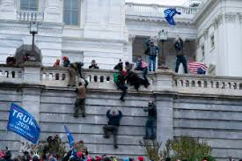
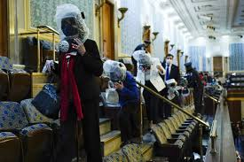
January 6, A Test of American Democracy
The rule of Democracy or Mob Rule?
Rules:
Respect will be maintained – agree to disagree
This discuss of how our Constitutional democracy deals with challenges of modern society
Allow ideas and opinions to be heard, discussed and debated
Evaluate how the Madisonian Model, established by the U.S. Constitution, held up and stemmed the tide of factionalism.

Slide 90
Senate Certification Debate
THIS MORNING, I PLANNED TO TALK ABOUT THE LESSON OF 1801, BECAUSE I'M KIND OF A HISTORY NERD, AND I WANTED TO CELEBRATE THE GLORIES OF THE PEACEFUL TRANSITION OF POWER ACROSS OUR NATION'S HISTORY. IT FEELS A LITTLE NAIVE NOW TO TALK ABOUT WAYS AMERICAN CIVICS COULD UNITE US AND BRING US BACK TOGETHER. 1801 BLEW EVERYONE'S MIND OVER THE WORLD. JOHN ADAMS LOSES TO THOMAS JEFFERSON AND ADAMS WILLINGLY LEAVES THE EXECUTIVE MANSION AND MOVES BACK TO MASSACHUSETTS AND JEFFERSON PEACEFULLY ASSUMES POWER AND PEOPLE ALL OVER EUROPE SAID THAT MUST BE FAKE NEWS, BAD REPORTS. THERE IS NO WAY ANYONE IN THE EXECUTIVE WOULD LAY OUT THE POWER AND ADAMS IN DEFEAT DID SOMETHING GLORIOUS TO GIVE US A GIFT.
- Rep. Senator Ben Sasse of Nebraska

Slide 91
Senate Certification Debate
TO MY COLLEAGUES THAT WHAT WE ARE DOING HERE TONIGHT IS ACTUALLY VERY IMPORTANT BECAUSE FOR THOSE WHO HAVE CONCERNS ABOUT THE INTEGRITY OF OUR ELECTIONS, THOSE WHO HAVE CONCERNS ABOUT WHAT HAPPENED IN NOVEMBER, THIS IS THE APPROPRIATE MEANS, THIS IS THE LAWFUL PLACE WHERE THOSE OBJECTIONS AND CONCERNS SHOULD BE HEARD. THIS IS THE FORUM THAT THE LAW PROVIDES FOR OUR LAWS, PROVIDES FOR FOR THOSE CONCERNS TO BE REGISTERED. NOT THROUGH VIOLENCE, NOT BY APPEALING FROM BALLOTS TO BULLETS, BUT HERE IN THIS LAWFUL PROCESS. AND TO THOSE WHO SAY THIS IS JUST A FORMALITY TODAY, AN ANTIQUE CEREMONY THAT WE HAVE ENGAGED IN FOR A COUPLE OF HUNDRED YEARS, I CAN'T SAY THAT I AGREE, I CAN'T SAY THAT OUR PRECEDENTS SUGGEST THAT.
- Rep. Senator Josh Hawley of Missouri

Slide 92
Senate Certification Debate
FAIRLY OR NOT, THEY WILL BE REMEMBERED FOR THEIR ROLE IN THIS SHAMEFUL EPISODE IN AMERICAN HISTORY. THAT WILL BE THEIR LEGACY. I SALUTE SENATOR LANKFORD, LOEFFLER, BRAUN, AND DAINES AND I'M SURE OTHERS WHO, IN THE LIGHT OF THE DAY'S OUTRAGE, HAVE WITHDRAWN THEIR OBJECTION. FOR ANY WHO REMAIN INSISTENT ON AN AUDIT IN ORDER TO SATISFY THE MANY PEOPLE WHO BELIEVE THAT THE ELECTION WAS STOLEN, I'D OFFER THIS PERSPECTIVE -- NO CONGRESSIONAL AUDIT IS EVER GOING TO CONVINCE THESE VOTERS, PARTICULARLY WHEN THE PRESIDENT WILL CONTINUE TO SAY THAT THE ELECTION WAS STOLEN. THE BEST WAY WE COULD SHOW RESPECT FOR THE VOTERS WHO WERE UPSET IS BY TELLING THEM THE TRUTH.
- Rep. Senator Mitt Romney of Utah

Slide 93
I Fought the Law
Trumping Bureaucratic Overreach
The current President of the U.S. has promised to get rid of two regulation for everyone that is passed by Congress. You and a part will be completing an implementation assessment of an assigned public policy regulation to determine which could be eliminated and which need to be continuously implemented.
Select ONE of the following public policy to evaluate
Clean Air Act 1970
Elementary and Secondary Education Act 2001
Civil Rights Act of 1964
USA Patriot Act 2001
Americans with Disabilities Act 1990
Voting Rights Act 1965
Federal Election Campaign Act 1972
Welfare Reform Act 1976
Anti-terrorism & Effective Death Penalty Act 1996
Control Substance Act 1970
Immigration Act 1990
Brady Handgun Prevention Act 1993

Slide 94
The Madisonian Model STRIKES BACK
A dependence on the people is, no doubt, the primary control on the government; but experience has taught mankind the necessity of auxiliary precautions. This policy of supplying, by opposite and rival interests, the defect of better motives, might be traced through the whole system of human affairs, private as well as public.
- James Madison, Federalist 51, 1788
Explain TWO ways the structure of federal bureaucracy maintains the Madison’s argument for “auxiliary precautions” as the controller of tyrannical power.
Explain ONE way that federal bureaucracy upholds the idea of an imperial executive branch argued by many Anti-federalists?

Slide 95
Unit IV: Institution of the National Government: Congress, President, Bureaucracy, and Judiciary
The major formal and informal arrangement of powers
Relationships among the four branches and varying balances of power
Linkages between the four branches and the following
Public opinion and voters
Interest groups
Political parties
The media
State and local government
EQ: How do the institutions of government articulate democracy and interact with various linkage institutions to carry out republicanism
Students Can:
Evaluate how democratic is a government by proxy
Evaluate whether the federal bureaucracy power to regulate undermines the Madisonian Model of Government
Agenda:
FRQ Deconstruction
Implementing Public Policy Project
Homework:
I Fought the Law – Due 2/20/19
Executive Branch Test, Wednesday, February 26

Slide 96
Deconstruction
Free Response Question
The US Congress and the President together have the power to enact federal law. Federal Bureaucracy has the responsibility to execute federal law. However, in the carrying out of these laws, federal agencies have policy-making discretion:
Explain two reasons why Congress gives federal agencies policy-making discretion in executing federal laws.
Choose one of the bureaucratic agencies listed below. Identify the policy making area over which it exercises policy-making authority, and give one specific example of how it exercise policy-making discretion.
Environmental Protection Agency (EPA)
Federal Communication Commission (FCC)
Federal Reserve Board (Fed.)
C. Describe two ways in which Congress federal agencies follow legislative intent.

Slide 97
Unit IV: Institution of the National Government: Congress, President, Bureaucracy, and Judiciary
The major formal and informal arrangement of powers
Relationships among the four branches and varying balances of power
Linkages between the four branches and the following
Public opinion and voters
Interest groups
Political parties
The media
State and local government
EQ: How do the institutions of government articulate democracy and interact with various linkage institutions to carry out republicanism
Students Can:
Evaluate how democratic is a government by proxy
Evaluate whether the federal bureaucracy power to regulate undermines the Madisonian Model of Government
Agenda:
Bureaucratic discretion divide
Homework:
Bureaucratic Challenge
Executive Branch Test, Wednesday, February 26

Slide 98
Unit IV: Institution of the National Government: Congress, President, Bureaucracy, and Judiciary
The major formal and informal arrangement of powers
Relationships among the four branches and varying balances of power
Linkages between the four branches and the following
Public opinion and voters
Interest groups
Political parties
The media
State and local government
EQ: How do the institutions of government articulate democracy and interact with various linkage institutions to carry out republicanism
Students Can:
Evaluate how democratic is a government by proxy
Evaluate whether the federal bureaucracy power to regulate undermines the Madisonian Model of Government
Agenda:
Limited Government
Grading LEQ
Guidelines for a bureaucracy
Homework:
Seven Big Cases in 2020
Executive Branch Test, Wednesday, February 26

Slide 99
Limited Government
Ambition must be made to counteract ambition. The interest of the man, must be connected with the constitutional rights of the place. It may be a reflection on human nature, that such devices should be necessary to control the abuses of government. But what is government itself, but the greatest of all reflections on human nature? If men were angels, no government would be necessary. If angels were to govern men, neither external nor internal controls on government would be necessary. In framing a government which is to be administered by men over men, the great difficulty lies in this: you must first enable the government to control the governed; and in the next place oblige it to control itself.
- Publius, Federalist 51, 1788
Identify and explain two ways the bureaucracy is limited by a system of checks of balances
Explain how what you identified in part A supports the ideas of Federalist 51

Slide 100
Big 7 in 2020
Evaluate the following between the cases
What is the bases for why these cases were accepted?
What major issues SCOTUS have clarify for the federal government?
How does politics impact the work of the federal judiciary?

Slide 101
Grading an Essay
Rubric Guidelines
Thesis (1 pt.)– defendable claim that responds to, but does not restate the prompt – Must also show line of reasoning – 3 bases (One must be a counter argument)
Evidence (0-3 pts)
1 pt. provides a piece of relevant evidence
2 pts. provides a pieces of evidence that supports the claim or thesis (2 pts can’t be given if the essay does NOT have a defensive thesis)
3 pts. Uses two pieces of evidence to support thesis (ONE must be from the foundational document) – Here again, if they do not have a defendable thesis the essay cannot be given 3 pt.
Explanation (1 pt.) - Explains how or why the evidence supports the thesis
Alternative perspective (1 pt.) – must have an alternative perspective and either refutes, concedes, or rebuts the perspective

Slide 102
Executive Lingo
Use the terms to demonstrate how the executive branch (President and Bureaucracy) are effected or carry out the following topics
Topics
Implementation
Legislative checks
Executive checks
Formal vs. informal powers
Public opinion
Judicial checks

Slide 103
5.B.5: Explain how the president ensures that executive branch agencies and departments carry out their responsibilities in concert with the goals of the administration
EQ: How do the institutions of government articulate democracy and interact with various linkage institutions to carry out republicanism
Students Can:
Evaluate how democratic is a government by proxy
Determine factors that impact the implementation of federal laws
Agenda:
Kahoot review
Implementation of the Law
Bureaucratic check-in
Homework:
Study for Unit IIB Test
Unit IIB Test 12/19
Implementation of the law due 12/20

Slide 104
5.B.5: Explain how the president ensures that executive branch agencies and departments carry out their responsibilities in concert with the goals of the administration
EQ: How do the institutions of government articulate democracy and interact with various linkage institutions to carry out republicanism
Students Can:
Evaluate how democratic is a government by proxy
Determine factors that impact the implementation of federal laws
Agenda:
Unit IIB Review
Unit IIB Test
Implementation of the Law
Homework:
Implementation of the law due 12/20

Slide 105
Implementation – How To
Design a poster to illustrate how to implement a law
Title: Including the name of the law
An illustration that represents the assigned law
An overview of the law and its purpose
A list of four agencies or departments that Implement the law with an explanation duplication or overlapping jurisdictions
An example of how bureaucratic discretion is utilized to implement the law, as well as why the authority is granted by Congress
Highlight at least TWO Congressional checks and TWO Presidential checks on the bureaucracy
A design that illustrates how an iron triangle or issue network influences the implementation of the law

Slide 106
Challenge Question
1. Most federal bureaucrats are hired in which of the following ways?
They are awarded positions by the political party in power
They take an examination to prove their qualifications
They are appointed to a position by the president
They work in the legislative branch and then move to the bureaucracy
They pay a fee for a position

Slide 107
Challenge Question
2. The president exercises his influence over the federal bureaucracy in which of the following ways?
By hiring interest groups to influence certain agencies
By appointing administrators sympathetic to his policy agenda
By writing guidelines for agency programs
By frequently removing administrators from office
By having federal judges disband agencies

Slide 108
Challenge Question
3. Which court case stated that Congress’ use of a legislative veto was unconstitutional, since it violated the sanctity of separation of powers?
Nixon v. United States B. INS v. Chadha
C. New York v. Clinton D. Munn v. Illinois
E. Boumediene v. Bush

Slide 109
Challenge Question
4. All of the following are characteristic of the US government bureaucracy EXCEPT ___________.
Federal agencies are responsible to both Congress and officials in the executive branch.
Federal agencies share responsibilities with organizations at state and local levels of government.
All US government agencies are part of the 15 cabinet departments.
US government agencies regulate privately owned enterprises, rather than operate publicly owned ones.
Government agencies in the US operate under closer public scrutiny than agencies in most other countries.

Slide 110
Challenge Question
5. What does the Hatch Act regulate?
the president’s impoundment of funds
the appointment of independent counsels
the hiring firing of members of the bureaucracy
interstate commerce
political participation of federal civilian employees

Slide 111
Challenge Question
6. What is meant by the President using the bullying pulpit?
Using the power and influence of his office to exert pressure
Calling upon members of his cabinet to influence legislation
Using his veto power to reject legislation
Signing a piece of legislation into law
Taking a trip to a foreign country to sign a treaty

Slide 112
Challenge Question
7. Why have Presidents argued the War Powers Resolution violates the Constitution?
Congress has used a legislative veto which they are not grant the ability use under the Constitution
The Supreme Court has hinted they would rule it unconstitutional through earlier ruling
This violates the principle of federalism
The Federalist Papers stated quiet clearly that the power of veto belongs only to the Supreme Court
The authority to govern the military is only given to high military officers in times of war

Slide 113
Challenge Question
8. Which of the following is NOT a formal power assigned to the President by the Constitution?
Commander in Chief of the military
signing statements
appointment with the advice and consent of Senate
to faithfully execute all laws
receive Ambassadors

Slide 114
Challenge Question
9. How does an executive order differ from legislation?
Executive orders are submitted by the President to Congress for approval; bills are submitted by Congress to the President for approval
Executive orders have the force of law but do not have to be approved by Congress
Executive orders expire after five years
Executive orders require ratification by the Senate but not the House
The Supreme Court cannot rule on the constitutionality of an executive order

Slide 115
Challenge Question
10. Which of the following amendments limited the President to two terms or a max of 10 years?
12th Amendment
17th Amendment
22nd Amendment
25th Amendment
27th Amendment

