Slide 1
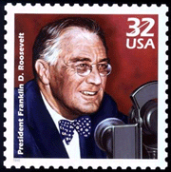
Franklin D. Roosevelt and the New Deal
Redefined Democracy:
Political Rights  Economic Security  Social Justice

Slide 2
Agenda
Unit 7 – LO.J: Explain the cause of the Great Depression and its effects on the economy
Unit 7 – LO.K: Explain how the Great Depression and the New Deal impacted American political, social, and economic life overtime
Essential Question: How has America’s views been redefined by economic necessities, cultural notions, and national security during the turn of the 20th century?
Students can:
Decipher how did the evolution of industrial capitalism change American society in the 1890s to 1945 era
Evaluate how politicians and reformers responded to industrial changes, in the course of doing so, fundamentally change the role of government, especially the federal government, in the lives of Americans
Agenda:
The Great Crash
Economic turning point
The New Deal Remedy
Homework:
The Three Rs – pages 773-781 Complete chart

Slide 3
Essential Question
Why did the United States government and reformers respond to economic upheavals of the 1930s, laissez faire capitalism, and the Great Depression by transforming the nation into a limited welfare state?

Slide 4
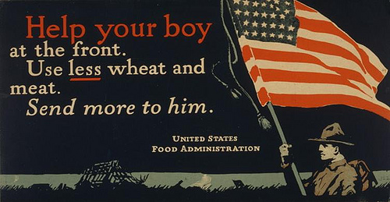
Herbert Hoover
Defeats Al(cohol) Smith in 1928
Mellonite – supports laissez faire views
that continued the economic boom
Belief in volunteerism
Encourage corporations to raise wages
& market standardization
Self regulation economic growth

Slide 5
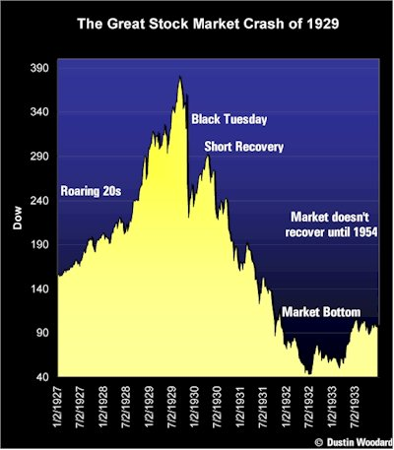
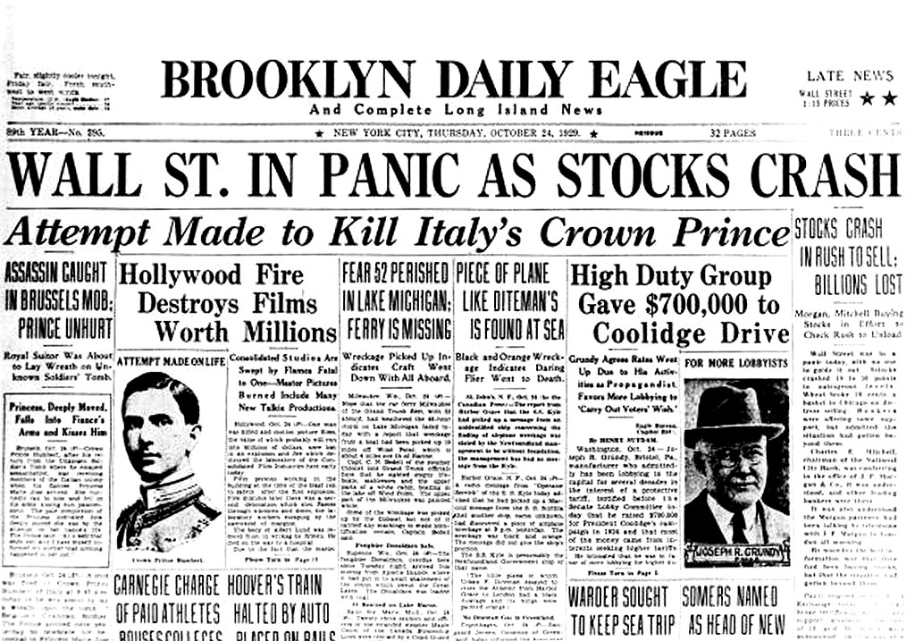
Black Tuesday & Thursday
The Great Crash of 1929
Black Thursday (October 24)

Slide 6
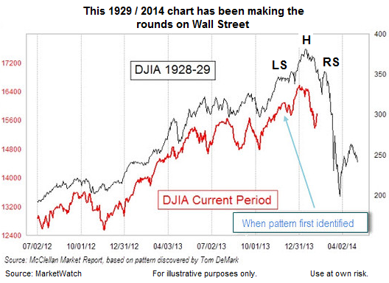
Stock Index – the fall of market

Slide 7
Contributing factors
Laissez Faire policies
of Mellonites – No regulation & Trickle-Down Economics
Debt: buying on installment & margin
Stock speculation – buying on margin
Tariffs – Hawley Smoot Tariff
Surplus: Mechanization in
factories & agriculture

Slide 8
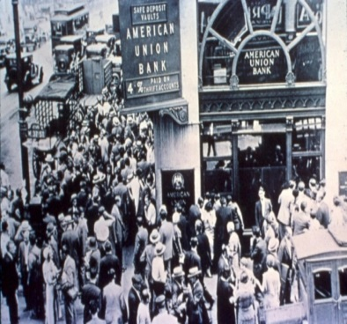
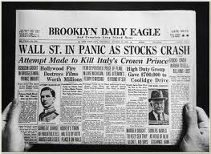
Stock Market Crash – Economic impact
Black Thursday & Tuesday, October 1929 – Stock losses $14 Billion
Layoffs to save business
Unemployment at 25% by 1933
Hawley Smoot Tariff stops global trading and ends German reparations
Consumer spending dies off
Bank Runs: mass withdraws kills banking
Bank CRASH – Money is gone

Slide 9
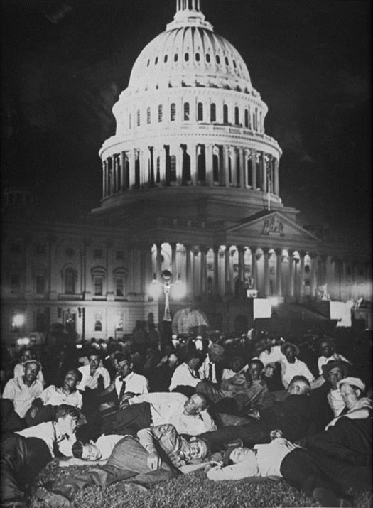
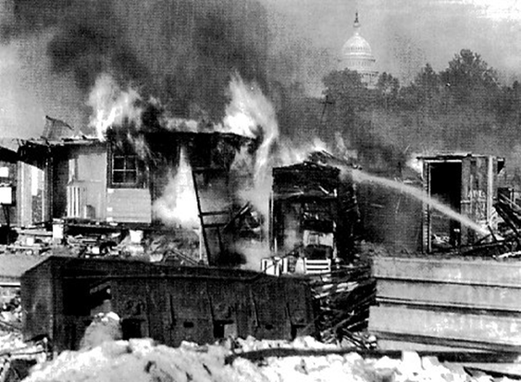
Bonus Army
World War Compensation Adjustment Act 1924
The Bonus Army – partial payment of benefit
Congress rejects their pleas
General Douglas MacArthur chases
the Bonus Army Out of Washington

Slide 10
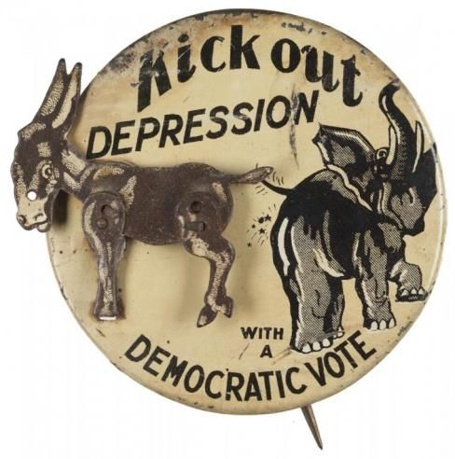
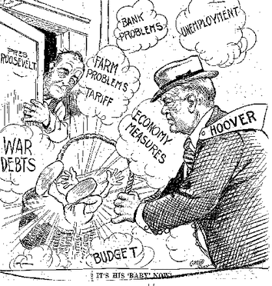
Hoover’s Responses
Herbert Hoover Plan for Recovery
Volunteerism: encourage business to keep employees
Hawley Smoot Tariff 1929 (FAILED)
Reconstruction Finance Corporation (RFC) – grant loans to state & local governments, banks, and railroads (trickle down economics – Mellonism) FAILS
Hoover Dam (public works program)

Slide 11
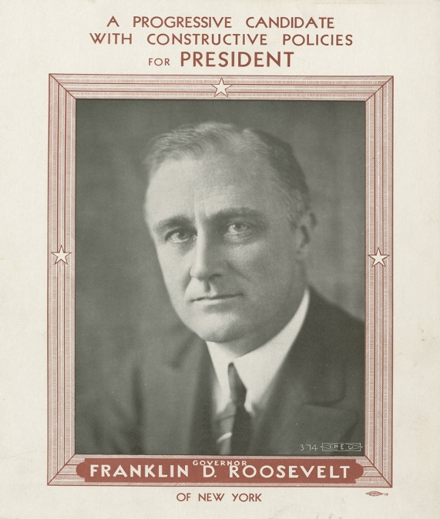
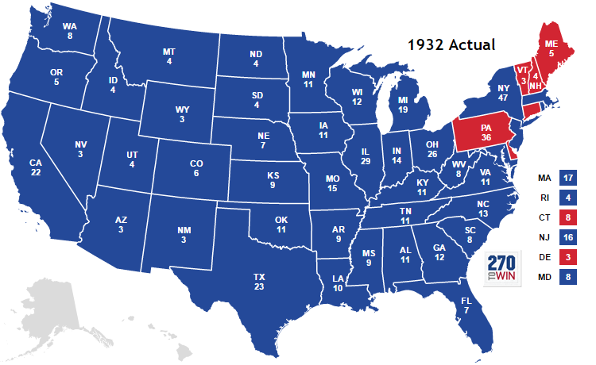
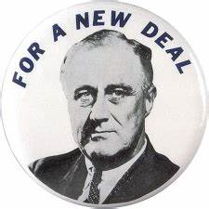
1932 Election
Franklin D. Roosevelt (D) defeats Herbert Hoover (R)
New Deal coalition – new supporter of Democrats:
African Americans
blue collar workers
Bankers
Industrialist
farmers
Intellectuals
Southerners
20th Amendment: Inauguration of President moved to January 20

Slide 12
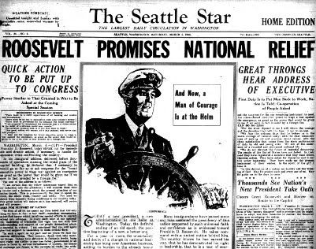
Critical Elections
Elections where the political parties themselves go through significant change themselves
Death of a political party and a new political party forms
A shift in voter preferences and high voter turnout
Usually happens when the US is involved in a national crisis
Critical Elections in the US: 1800, 1828, 1860, 1896, 1932 & 1980 (debatable)

Slide 13
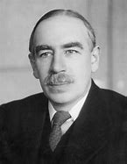
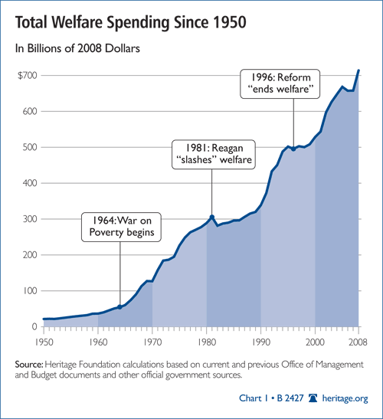
Welfare State
Rise of Keynesian Economic theory:
Issue with Keynesian Economics
Government should deficit spend to stimulate economic growth
FDR called PRIME THE PUMP
Creates the “LIMITED WELFARE STATE”
People rely on government programs
Debt
Expands government power

Slide 14
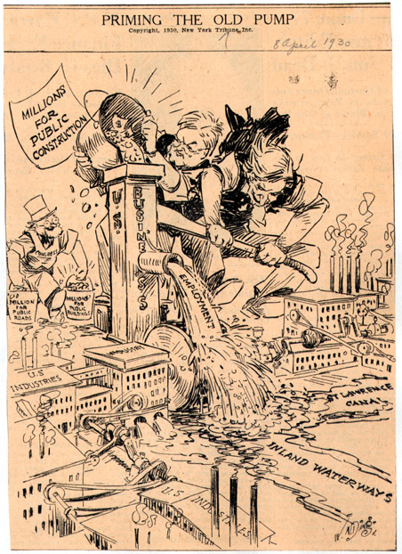
Purposes of the New Deal
Keynesian Economic Theory: (John M. Keynes) government deficit spends in order to “prime the pump” of the economy
Three Rs or Alphabet Soup
Relief:
provide jobs for the unemployed
protect farmers from foreclosure
Recovery:
Get the economy back into high gear
Reform:
regulate banks
abolish child labor
conserve farm lands
Overall objective: Use government to save capitalism

Slide 15
Test your know - HIPP
“Just in case they ever wanted to slow down”
Des Moines Register, March 5, 1936

Slide 16
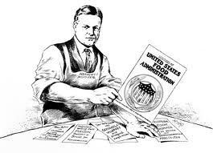
Who is the real Herbert Hoover?
View 1
View 2

Slide 17
Agenda
Unit 7 – LO.J: Explain the cause of the Great Depression and its effects on the economy
Unit 7 – LO.K: Explain how the Great Depression and the New Deal impacted American political, social, and economic life overtime
Essential Question: How has America’s views been redefined by economic necessities, cultural notions, and national security during the turn of the 20th century?
Students can:
Decipher how did the evolution of industrial capitalism change American society in the 1890s to 1945 era
Evaluate how politicians and reformers responded to industrial changes, in the course of doing so, fundamentally change the role of government, especially the federal government, in the lives of Americans
Agenda:
Can I get a remedy?
Fireside Chat on a New Deal
A limited welfare state v. Progressivism
Homework:
Read pages 781-792 (Industry, Labor, Farmer, and Banker)

Slide 18
The Crash Effect
Demonstrate how the Stock Market Crash of 1929 transformed the United States politically, economically, and socially.
Homework: Read pages 773-781 on New Deal 1 – construct chart on how it was intended to bring the 3Rs – relief, reform, & recovery (explain how)
Stock Market Crash Effect
Political Effect – government & democracy
Economic effect – the economy
Social effect – people’s norms

Slide 19
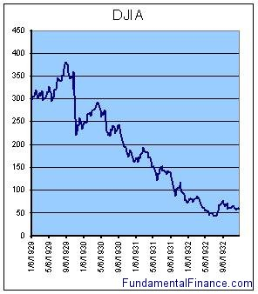
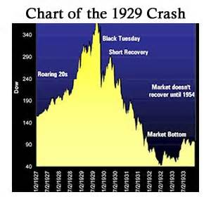
Contributing Factors
What factors contributed to the downfall of the US economy in the 1930’s?

Slide 20
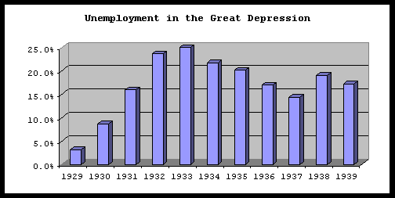
New Deal Effects
Evaluate the impact of the New Deal under the guidance of President Roosevelt

Slide 21
The New Deal Remedy

Slide 22
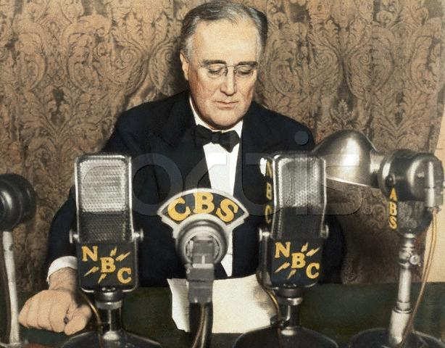
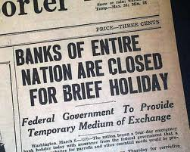
FDR’s first steps
FDR use of Mass Media to restore confidence
Inaugural address: “The only thing we
have to fear is fear itself….”
Banking holiday: (stop the bank runs)
Fireside Chat “power of radio”
Right click on the image to hear a FDR Fireside Chat

Slide 23
Purpose of the New Deal
Keynesian Economic Theory: (John M. Keynes) government deficit spends in order to “prime the pump” of the economy
Three Rs or Alphabet Soup
Relief:
provide jobs for the unemployed
protect farmers from foreclosure
Recovery:
Get the economy back into high gear
Reform:
regulate banks
abolish child labor
conserve farm lands
Overall objective: Use government to save capitalism

Slide 24
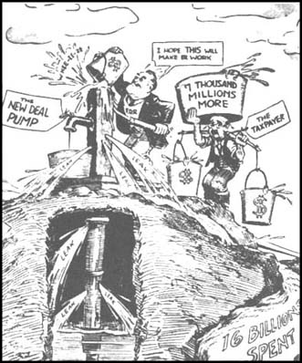
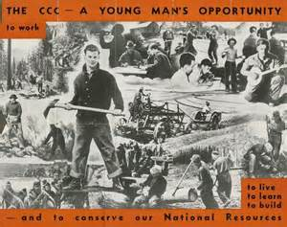
R=Relief
Immediate Action:
Bank Runs end: Bank Holiday & Emergency Banking Act
Emergency cash: Federal Emergency Relief Act
Jobs: Civil Works Administration & Civilian Conservation Corps

Slide 25
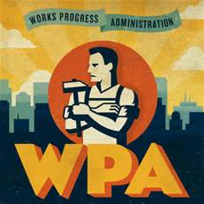
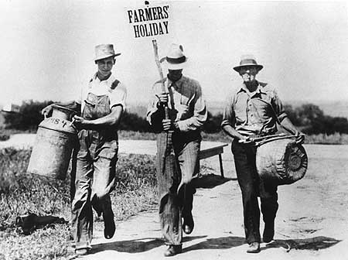
R=Recovery
“Prime the pump” – Temporary programs to restart the flow of consumer demand Keynesian Economic Theory
Farmers: Agriculture Adjustment Act: farm subsidies (Declared unconstitutional – Butler v. U.S.)
Industry: National Industrial Recovery Administration: set new regulations for businesses (declared unconstitutional – Schechter Poultry v. U.S.)
Common Man: Homer Owners Loan Corps., Works Progress Administration, & Tennessee Valley Authority

Slide 26
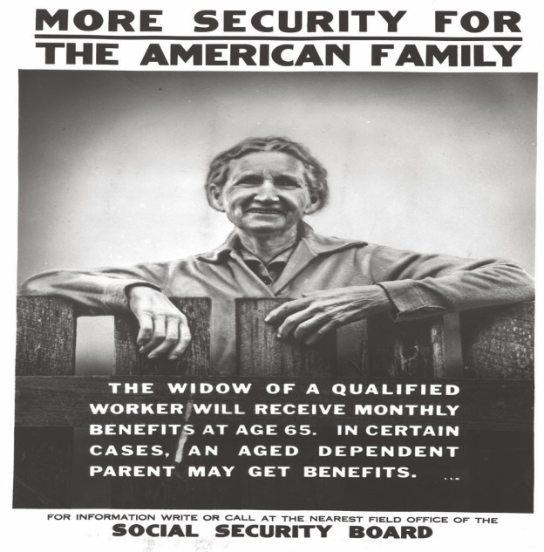
R=Reform
Permanent programs to avoid another depression and protect citizens
Stocks: Securities and Exchange Commission
Trust in Banking: FDIC
Retirees: Social Security Act
Labor: Wagoner Act (Labor Unions legalized)
Environment: Soil Conservation Act

Slide 27
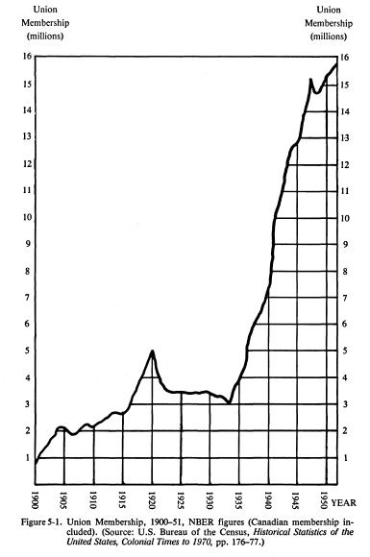
Labor Union Membership

Slide 28
The Second New Deal, 1935:
Works Progress Administration
Spent $4.8 billion
Employed 8.5 million
put people to work using their existing talents
Wagner National Labor Relations Act
Guaranteed unions right to organize & bargain collectively
Est. National Labor Relations Board to supervise elections & mediate disputes

Slide 29
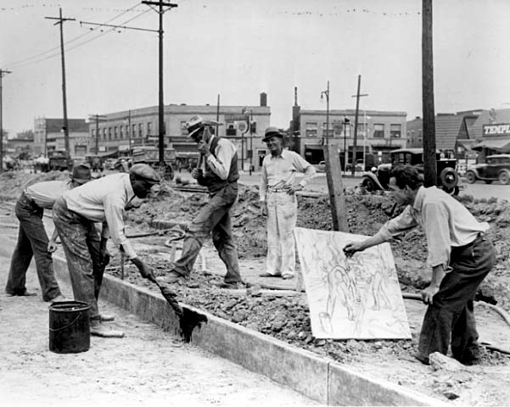
The W.P.A. at Work

Slide 30
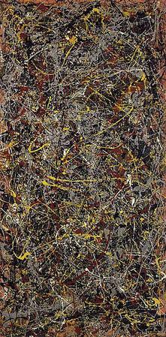
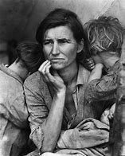
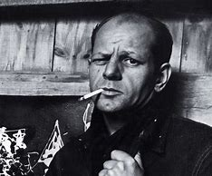
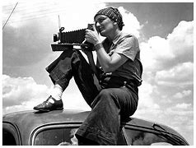
A New Deal Culture
Works Program Administration (Federal Art Project) – allowed Americans to see the culture of the Great Depression
Jackson Pollock
Dorothea Lange

Slide 31
Group Activity: Recovery, Relief, & Reform
Classify the New Deal programs into FDR’s three goals (Relief, Recovery, and Reform)
Mission | Programs | Reason
Relief: ease the plight of citizens
Recovery: to restore economic health
Reform: to correct the ills and prevent future economic problems
FDIC | SEC | AAA | TVA
CCC | NRA | PWA | WPA
REA | NRLB (Wagoner Act) | Social Security | Fair Labor Standards Act
US Housing Authority

Slide 32
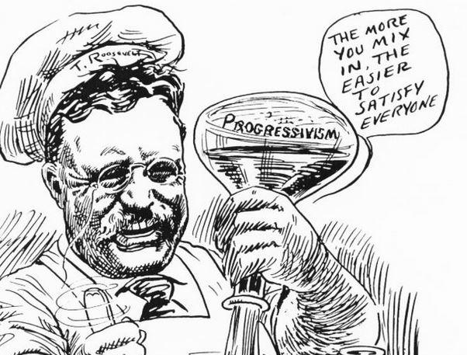
Fundamental Shift
Prompt: Despite artificial similarities, the domestic programs of the New Deal constituted a fundamental departure from those of the Progressive Era. Assess the validity of this generalization.
Find comparisons and differences to Progressive Age
Develop a thesis

Slide 33
Historic Parallelism – Complexity Point
Drawing comparisons between two different time periods (requires one to show a direct comparison between the two eras of time)
Western expansion during Manifest Destiny and Imperialism were both motivated by American ethnocentric views. (Topic sentence) The ideal of Manifest destiny was based on the views of John L. O’Sullivan in “The Great Nation of Futurity” in which he argued we were God’s chosen race to dominate the whole of America from sea to shining sea. This mirrors the argument used during imperialism by Josiah Strong in “Our Country” who stated the protestant Anglo-Saxon race of America had a duty spread the gospel beyond the borders of the United States. In both cases the idea that are race and belief in Christianity makes us superior to race, such as Native American tribes of the west, and Hispanic cultures of Latin America. This is further supported by Social Darwinist views that America was a developed nation due to its industrial capacity to mass produce goods. The Native American culture could only act as hunter gather societies and South Americans were basic agricultural societies that could not match or factory based economy.

Slide 34
A Fundamental Departure
Prompt: Despite artificial similarities, the domestic programs of the New Deal constituted a fundamental departure from those of the Progressive Era. Assess the validity of this generalization.
New Deal
Progressivism

Slide 35
Agenda
Unit 7 – LO.J: Explain the cause of the Great Depression and its effects on the economy
Unit 7 – LO.K: Explain how the Great Depression and the New Deal impacted American political, social, and economic life overtime
Essential Question: How has America’s views been redefined by economic necessities, cultural notions, and national security during the turn of the 20th century?
Students can:
Decipher how did the evolution of industrial capitalism change American society in the 1890s to 1945 era
Evaluate how politicians and reformers responded to industrial changes, in the course of doing so, fundamentally change the role of government, especially the federal government, in the lives of Americans
Agenda:
Feel’n the Blues
Hipp’n out the Dirty 30s
The Social Plight of the 1930s
Homework:
pages 792-799: FDR’s declining approval

Slide 36
Welcome to the Blues
Right click on the link below to hear the BLUES
BLUES MUSIC - The Sound of the Depression
How did Blues Music represent the feeling of the Great Depression?
How do the Blues differ from the 1920s Jazz?
Skip James “Hard Time Killing Floor Blues”
African American culture influencing America

Slide 37
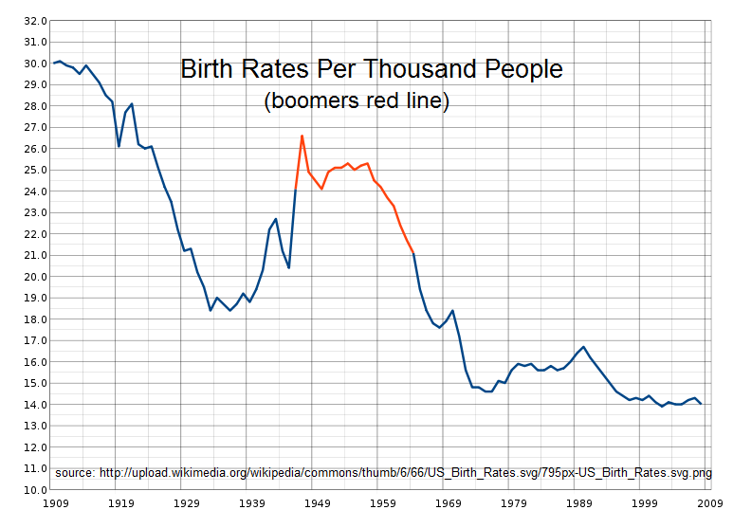
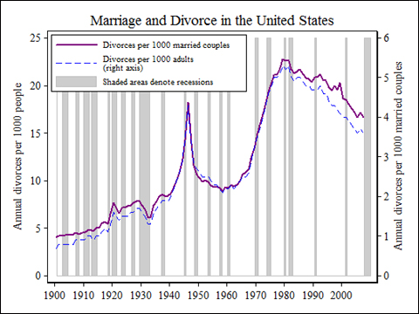
Feel’n the Blues
Depression’s social impact
Birth rates decline = acceptance of birth control
Divorce rates increase = “poor man’s divorce”

Slide 38
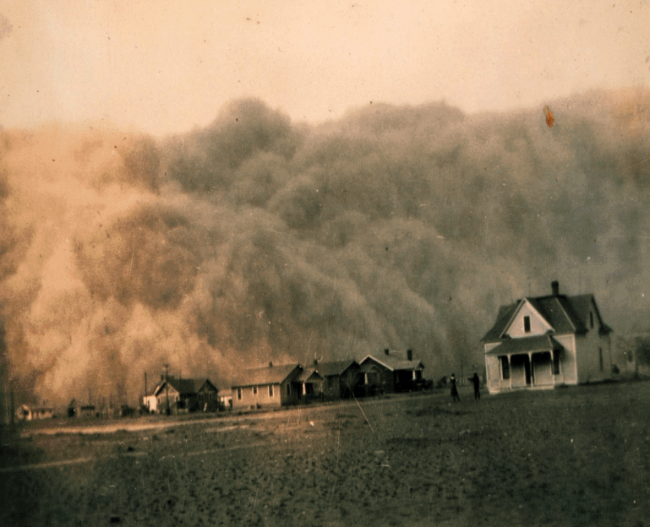
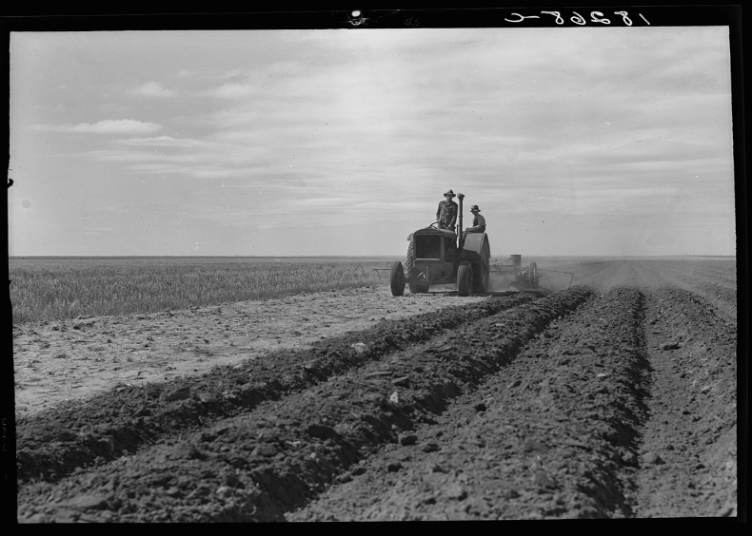
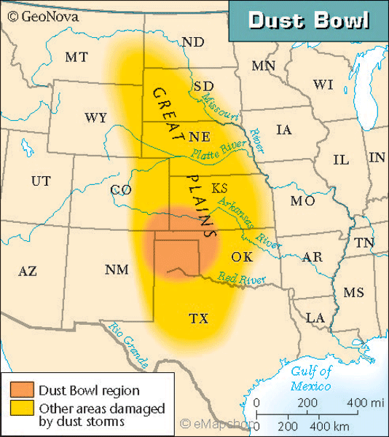
Dust Bowl
Environmental disaster in the Midwest
Dry farming technique created during Manifest Destiny
Drought and dry farming technique

Slide 39
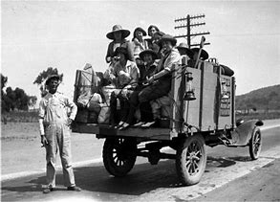
Feel’n the Blues
Voices of the Great Depression Dust Bowl
John Steinbeck: Grapes of Wrath
Woody Guthrie “I Ain’t Got No Home”
California or BUST!
Dustbowl forces western migration: Okies and Arkies

Slide 40
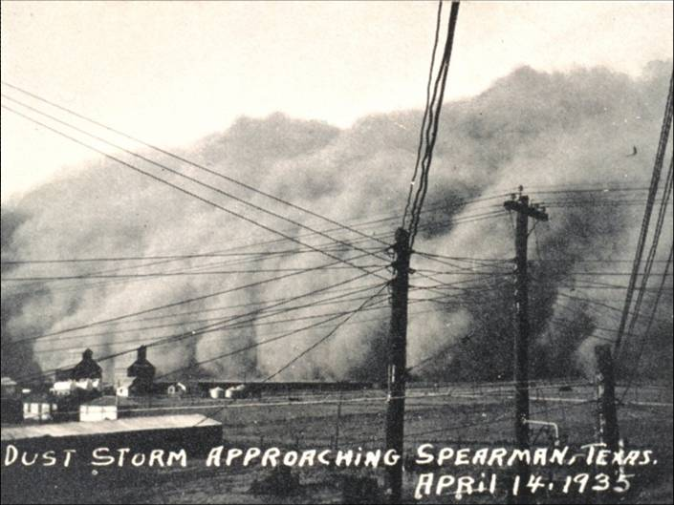
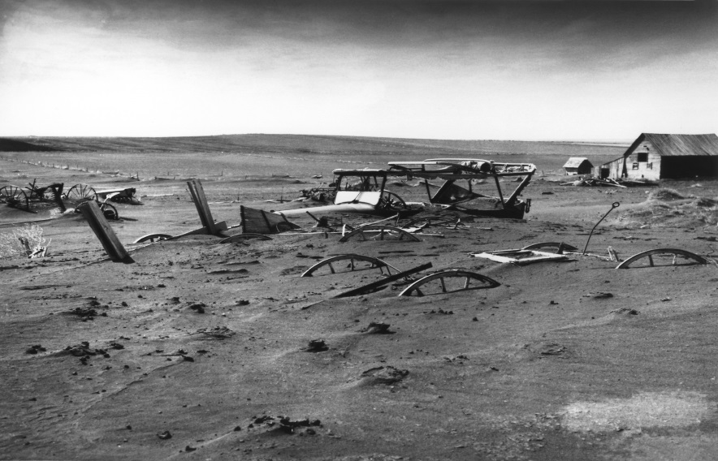
Environmental disaster
Impacts
Resettlement Administration & 2nd Agricultural Adjustment Act
Indian Reorganization Act: preserve Native American culture

Slide 41
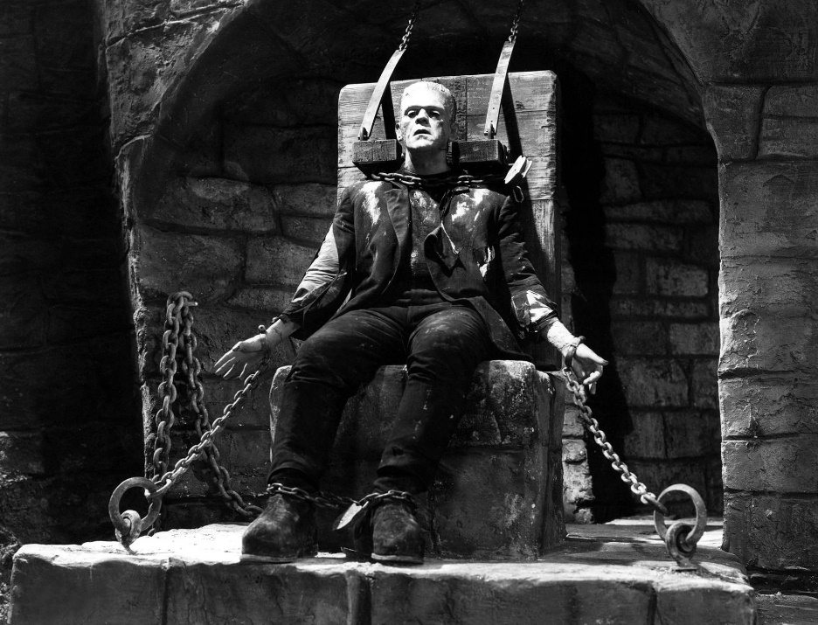
Feel’n the Blues
Gone with the Wind 1939
- Overcoming adversity
Frankenstein 1931
- Horror movies: demonstrate our fears of the Great Depression Era

Slide 42
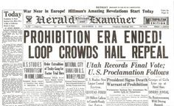
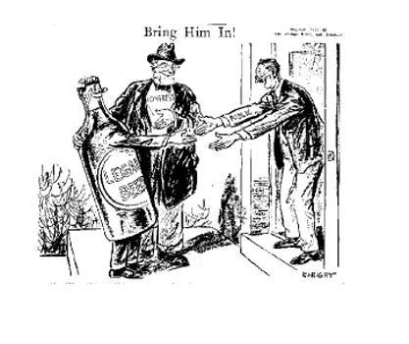
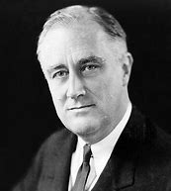
Have a Drink on Me!!
End of Prohibition
Beer & Wine Revenue Act 1933: levied taxes on the federal sales tax
21st Amendment: repeals the 18th Amendment
“What America needs now is a drink”

Slide 43
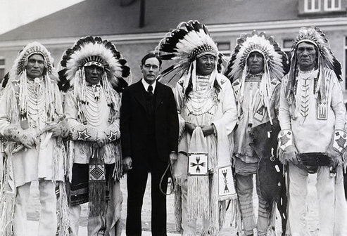
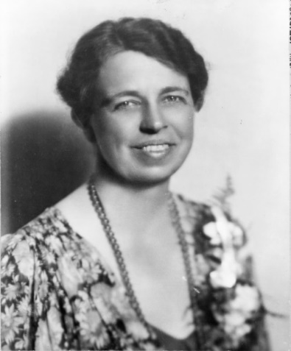
Opportunity Comes
Women advancement
Eleanor Roosevelt: promoter of the New Deal
Sec. of Labor: Francis Perkins
Mary McLeod Bethune – African American Affairs office
Indian Reorganization Act: federal government returns tribal designation

Slide 44
The Emissary of the Neal Deal
“Since you get more joy out of giving joy to others, you should put a good deal of thought into the happiness that you are able to give”
Eleanor Roosevelt

Slide 45
Social Change of the Great Depression
How did the New Deal Era change the lives of the following
Women
Labor Unions
Farmers
African Americans
Banks
Elderly
Environment
Veterans

Slide 46
Make a chart, then get into groups
Name of group or event | Who/What were it/they? | Why do they matter to the Great Depression?
Okies
Families
Minorities
The Bonus Army
The Dust Bowl
Hoovervilles

Slide 47
Agenda
Essential Question: How has America’s views been redefined by economic necessities, cultural notions, and national security during the turn of the 20th century?
Students can:
Decipher how did the evolution of industrial capitalism change American society in the 1890s to 1945 era
Evaluate how politicians and reformers responded to industrial changes, in the course of doing so, fundamentally change the role of government, especially the federal government, in the lives of Americans
Agenda:
FDR’s Strikes out
The Detractors of the New Deal
FDR’s Gets Schooled
Homework:
Reading pgs. 800-820: evaluate America’s belief in isolationism Six Degree of Separation due Thursday 3/21
LEQ rough draft due Wednesday – 3/20
Final draft due Monday 3/25

Slide 48
1936 Election

Slide 49
Court Packing
Court Packing: FDR response to Supreme Court rulings
Four Horsemen (Conservative Justices)
Butler v. U.S. (AAA – Unconstitutional)
Schechter Poultry Co. v. U.S. (NRA – Unconstitutional)
Political damages FDR

Slide 50
FDR’s Presidency
New Deal
Court Packing
United States v. Butler
Schechter v. United States
Four Horseman
Conservative
Supreme Court
HIPP analysis of the “Trying to Change the Ump”

Slide 51
The Second New Deal (cont.):
Social Security Act (limited Welfare State)
Social Security Admin. Provides pensions to elderly & disabled
Financed by flat payroll tax
Aid to Dependent Children (later AFDC) was 1st federal direct welfare program
Issue businesses cutback in order to pay Social
Security tax leading rise in unemployment in
1937
Republican party revived
Slumping economy: FDR resorts to blame &
huge government spending (Debt)
Notes:
“Soak the Rich” Tax
Increased income, inheritance, gift & excess profits taxes
Didn’t really redistribute

Slide 52
Populist Critics of the New Deal
Populist critics of the New Deal
Dr. Francis Townsend: $200 per month for people over 60
Father Charles Coughlin: Union for Social Justice – nationalize U.S. Industry
FDR Steering the Ship to Recovery
Sen. Huey Long: “Share the wealth” – redistribution of wealth $5,000 to every family

Slide 53
Approval Change – 1940 Election

Slide 54
Saving FDR
The seeds of WWII
Growth in unrest in Europe & Asia yield economic opportunity for the United States (Japanese invasion of Manchuria, Italy’s invasion of Ethiopia, & German Blitzkrieg)
America will become “The Arsenal of Democracy”
WWII mobilization

Slide 55
New Deal Legacy
Cons
Pros
Failed to fix the Great Depression (1937 – new recession)
Court packing scheme limited its success
Revival of the Republican Party 1938
Hatch Act (no political campaigning for bureaucrats
Creation of the welfare state
Arguments against (socialism and bureaucratic meddling)
Debt – deficit spending
Stop the worst of the Great Depression
Curbed corrupt practices by capitalists
Preserved democracy

Slide 56
FDR gets Schooled
Evaluate the legacy of the New Deal and its ability to rebuild the U.S. economy from the Great Depression
FDR Report Card
Grade Class Reason
___ Economics
___ Civics
___ History

Slide 57
New Deal Impact
The Great Depression and the New Deal had tremendous effect on U.S. society. For your assign group explain how the Great Depression and the New Deal impacted them.
Role of Government
Elderly
African Americans
Environment
Women
Labor
Agriculture
Banks

Slide 58
Three R’s of Alphabet Soup
Relief – immediate action | Recovery – prime the pump | Reform – prevent future issues
Beer Act | Unemployment Relief Act | Glass-Stegall Act (FDIC)
Emergency Banking Act | Agricultural Adjustment Act (AAA) | Security Exchange Commission
Federal Emergency Relief Act (FERA) | National Industry Recovery Act (NIRA) | Social Security Administration
Civilian Conservation Corps (CCC) | Works Progress Act (WPA) | National Labor Relations Act (NLRB)
Civilian Works Administration (CWA) | Tennessee Valley Authority (TVA) | Soil Conversation Act

