Slide 1
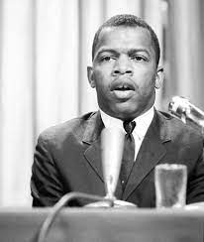
American Citizenry
Unit 7 – Civic Literacy
“Democracy is not a state. It is an act…”
- Rep. John Lewis

Slide 2
UNIT 7 - CITIZENSHIP
CL.B.1.4 Explain how individual values and societal norms contribute to institutional discrimination and the marginalization of minority groups living under the American system of government
CL.C&G.3.1 Differentiate citizenship and civic participation in terms of responsibilities, duties, and privileges of citizens
CL.G.1.2 Explain geopolitical and environmental factors which affect civic participation and voting in various regions of the United States
ESSENTIAL QUESTION: How do citizens of the United States engage in civic participation and combat errors within American democracy?
STUDENTS CAN:
Define who is a citizen of the United States
Decipher differences between privileges, responsibilities, and duties of citizenship
Evaluate the legitimacy of barriers to American citizenship
AGENDA:
A Purposeful Citizen
It’s a privilege, duty and a responsibility
Citizenship summary
HOMEWORK:

Slide 3
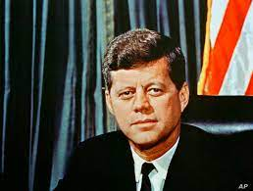
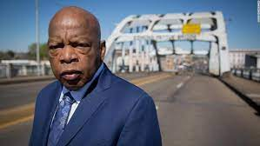
The Purpose Citizenship
“And so, my fellow Americans: Ask not what your country can do for you - ask what you can do for your country.”
- President John F. Kennedy, 1961
“When you see something that is not right, not just, not fair, you have a moral obligation to say something. To do something. Our children and their children will ask us, ‘What did you do? What did you say?’ For some, this vote may be hard. But we have a mission and a mandate to be on the right side of history.”
- Representative John Lewis, 2019
Perspective on American Citizenship
Define what it means to be a citizen of the United States in your own words.
Compare the quote by President Kennedy and Representative John Lewis
What are some similarities in their views of citizenship?
What is a reason that their views of citizenship would be different?

Slide 4
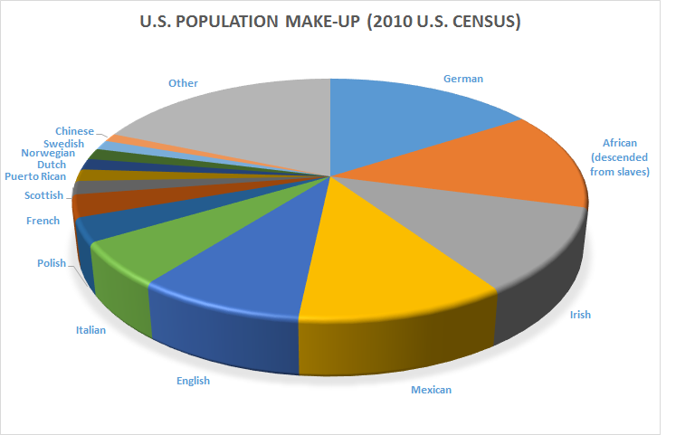
E Pluribus Unum
E Pluribus Unum – “Out of many, one”
Citizen – a legally recognize member of a nation
The United State has one of the most diverse populations
We have a shared political culture & history
Liberty
Equality
Populism
Individualism
Laissez Faire

Slide 5
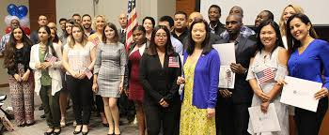
American Citizens
Citizen – a legally recognize member of a nation
American Citizens (Two types)
“All persons born or naturalized in the United States and subject to the jurisdiction thereof, are citizens of the United States and of the State wherein they reside. No State shall make or enforce any law which shall abridge the privileges or immunities of citizens of the United States; nor shall any State deprive any person of life, liberty, or property, without due process of law; nor deny to any person within its jurisdiction the equal protection of the laws.”
- 14th Amendment, U.S. Constitution
Born an American Citizen
Naturalization: become an American citizen
Cannot be President or Vice President

Slide 6
UNIT 7 - CITIZENSHIP
CL.B.1.4 Explain how individual values and societal norms contribute to institutional discrimination and the marginalization of minority groups living under the American system of government
CL.C&G.3.1 Differentiate citizenship and civic participation in terms of responsibilities, duties, and privileges of citizens
CL.G.1.2 Explain geopolitical and environmental factors which affect civic participation and voting in various regions of the United States
ESSENTIAL QUESTION: How do citizens of the United States engage in civic participation and combat errors within American democracy?
STUDENTS CAN:
Define who is a citizen of the United States
Decipher differences between privileges, responsibilities, and duties of citizenship
Evaluate the legitimacy of barriers to American citizenship
AGENDA:
Citizenship Test
It’s a privilege, duty and a responsibility
Citizenship summary
HOMEWORK:

Slide 7
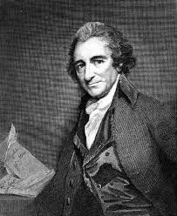
Citizens of E Pluribus Unum
Which Constitutional Amendment defines who is a citizen of the United States?
What are two ways a person can become an American citizen?
What are the fives values that all Americans believe in as a citizen?
“Our citizenship in the United States is our national character. Our citizenship in any particular state is only our local distinction. By the latter we our known at home, by the former we are known to the world. Our great title is AMERICANS - our inferior one varies with the place.
- Thomas Paine

Slide 8
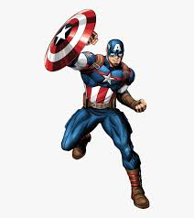
Demonstrating Citizenship
We hold these truths to be self-evident, that all men are created equal, that they are endowed by their creator with certain unalienable rights, that among these are life, liberty and the pursuit of happiness. That to secure these rights, Governments are instituted among men, deriving their just powers from the consent of the governed.
- Thomas Jefferson, Declaration of Independence, 1776
Democracy requires active participation
Building the Values of America
Liberty
Equality
Popular sovereignty
Individualism
Laissez faire

Slide 9
Actions of Citizens
Three classifications
DUTIES: These are actions, a citizen MUST do to stay within the law.
RESPONSIBILITIES: These are actions a citizen should do on a voluntary basis to be a good citizen.
Privileges: These are actions, a citizen is allowed to do in recognition of being a good citizen (they can be denied)
What are examples of duties, responsibilities, and privileges of citizenship?

Slide 10
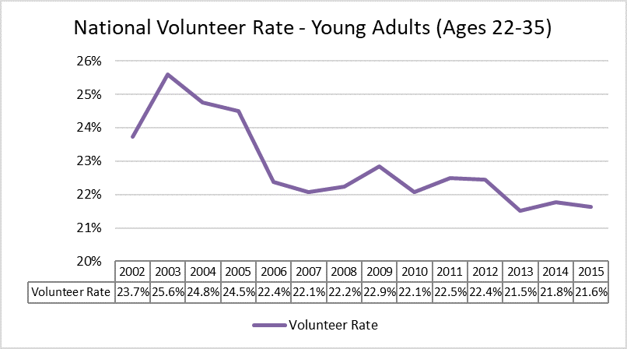
Challenges of American Citizens
Analyze the graph below
What are some contributing factors to the trend depicted in the graph above?
Why is the trend illustrated in the graph above a bad sign for American democracy?

Slide 11
Duty or Responsibility of Citizenship
Identify if the following examples are responsibilities or duties: (D) Duty or (R) Responsibility
Register for the draft
Pay taxes
Attending school until the age of 16
Be able to recite the Pledge of Allegiance
Serving on a jury
Respect other’s rights
Removing your hat during the Pledge of Allegiance
Running for elected office
Volunteering
Obeying the law

Slide 12
UNIT 7 - CITIZENSHIP
CL.C&G.3.3 Summarize the changes in process, perception, and the interpretation of United States citizenship and naturalization
CL.G.1.1 Explain how views on freedom and equality influence legislation and public policy on issues of immigration, migration and the environment
ESSENTIAL QUESTION: How do citizens of the United States engage in civic participation and combat errors within American democracy?
STUDENTS CAN:
Explain factors that have impacted immigration to the United States
Evaluate the legitimacy of barriers to American citizenship
AGENDA:
The New Colossus
A Test of Citizenship
Establishing a Standard
HOMEWORK:

Slide 13
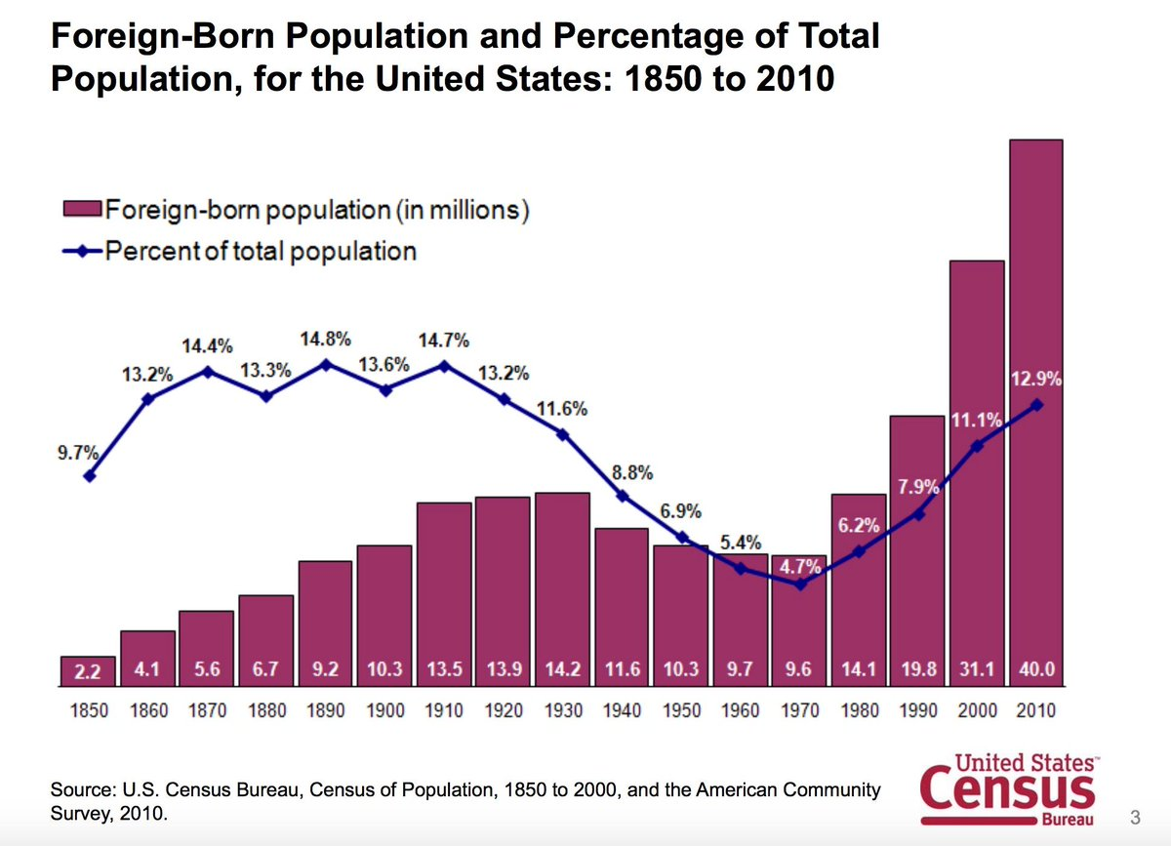
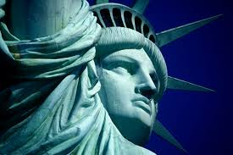
A Nation of Immigrants?
“From her beacon-hand
Glows world-wide welcome; her mild eyes command The air-bridged harbor that twin cities frame. "Keep, ancient lands, your storied pomp!" cries she With silent lips. "Give me your tired, your poor, Your huddled masses yearning to breathe free, The wretched refuse of your teeming shore. Send these, the homeless, tempest-tost to me, I lift my lamp beside the golden door!“
- Emma Lazarus, Nov. 2, 1883 (Statue of Liberty)
The United States is founded by immigrants

Slide 14
American Culture
TWO IDEAS OF AMERICAN CULTURE
MELTING POT THEORY
MULTI-CULTURAL THEORY
American culture melts different cultures into being an American
- Everyone, including Native Americans, are immigrants: people moving from one place to settle in another
Despite many cultures coming to America we remain separate in our own cultural ways
Ex. – Chinatown or Little Italy (Latino-American, Asian American, or African American)
Toss-Salad Theory

Slide 15
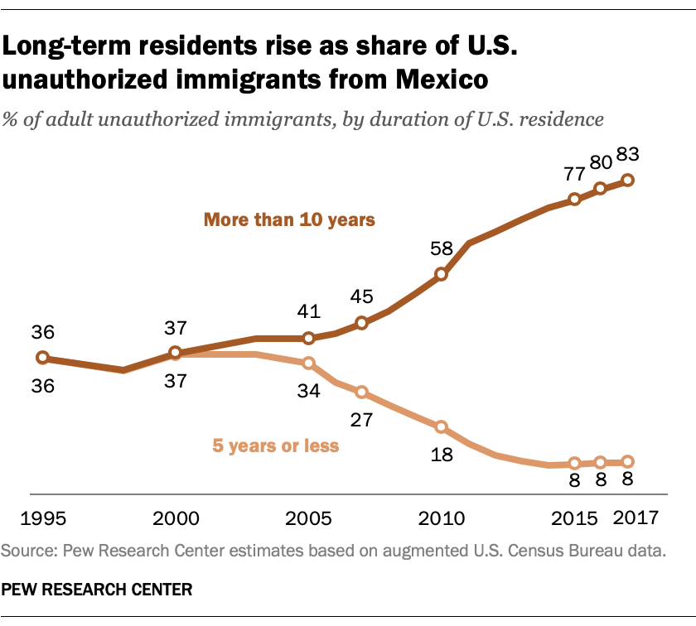
Becoming American
Naturalization: the process to gain American citizenship
Regulatory Agency – U.S. Citizenship & Immigration Service
Status of Immigration
Alien: a non-citizen of the U.S. (hold citizenship in another country)
Come here for work, study, or to visit
Immigrant: a person who has permanently moved to the U.S.
Legal Aliens - documented
Illegal Aliens - Undocumented

Slide 16
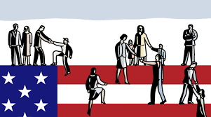
Citizenship
Citizenship status
American citizenship status is permanent (unless you choose expatriation)
Citizens Can
Aliens Cans & Can’ts
Hold jobs & own property
Must pay taxes
Full Constitutional protections of rights
Vote
Run for elected office
Can own property & hold a job
Must pay taxes
CANNOT
Vote
Run for elected office

Slide 17
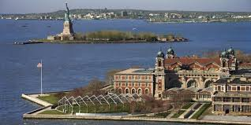
Building American Culture
“The interaction of disparate cultures, the vehemence of the ideals that led the immigrants here, the opportunity offered by a new life, all gave America a flavor and a character that make it as unmistakable and as remarkable to people today as it was to Alexis de Tocqueville in the early part of the nineteenth century.”
- John F. Kennedy, “A Nation of Immigrants”, 1963
The United States has been shaped by immigration even before the discovery of the new world. Demonstrate how different culture immigrated here over the long history of America by completing a timeline of immigration.
Consider how your own family has been impacted by immigration and the culture ideas and traditions that your family cherishes.

Slide 18
UNIT 7 - CITIZENSHIP
CL.C&G.3.3 Summarize the changes in process, perception, and the interpretation of United States citizenship and naturalization
CL.G.1.1 Explain how views on freedom and equality influence legislation and public policy on issues of immigration, migration and the environment
ESSENTIAL QUESTION: How do citizens of the United States engage in civic participation and combat errors within American democracy?
STUDENTS CAN:
Explain factors that have impacted immigration to the United States
Evaluate the legitimacy of barriers to American citizenship
AGENDA:
Civic engagement
A Test of Citizenship
Mandating Americans be informed
HOMEWORK:
Complete your response to mandating Americans be informed

Slide 19
Challenges of American Citizens
Analyze the graph below
What are some contributing factors to the trend depicted in the graph above?
Why is the trend illustrated in the graph above a bad sign for American democracy?
Terms – Citizenship, civic responsibilities, democracy, civic engagement, and government

Slide 20
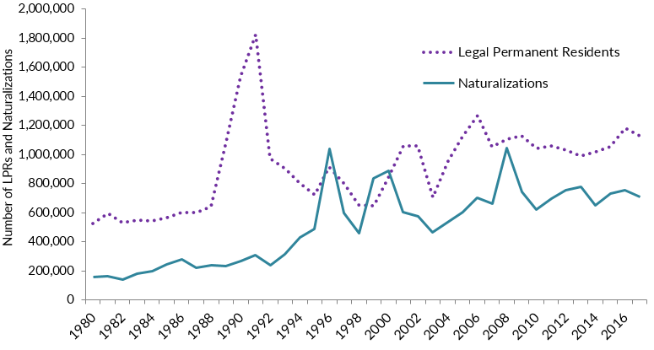
The Process of becoming
Naturalization process
Step 1: File a Declaration of Intent with the USCIS
Step 2: Residency Live in the U.S. for 5 years (3 years if married to American Citizen)
Take U.S. Citizenship Exam
Step 3: File for Citizenship
Step 4: Interview with the USCIS official
Moral character
Do you qualify
Step 5: Take the Oath of Loyalty
Must be able to read and speak English
Must have knowledge of the history of our country

Slide 21
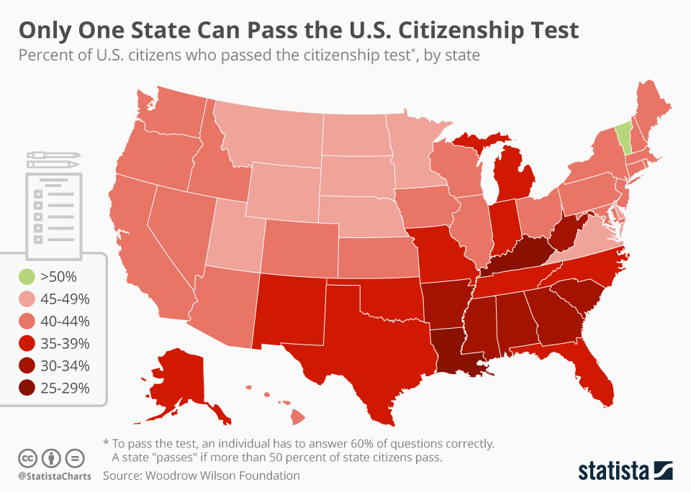
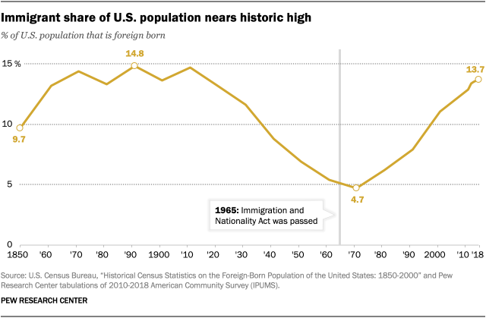
Qualifying for Citizenship
U.S. Citizenship Exam – Passing score – 60%
In 2018 only 36% of 1000 American adults passed a sample test
Immigrants are asked 10 out of 100 questions. They must get 6 out 10.

Slide 22
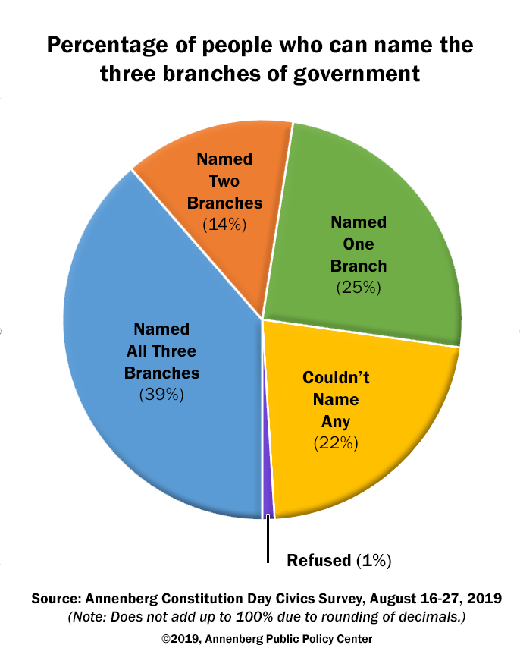
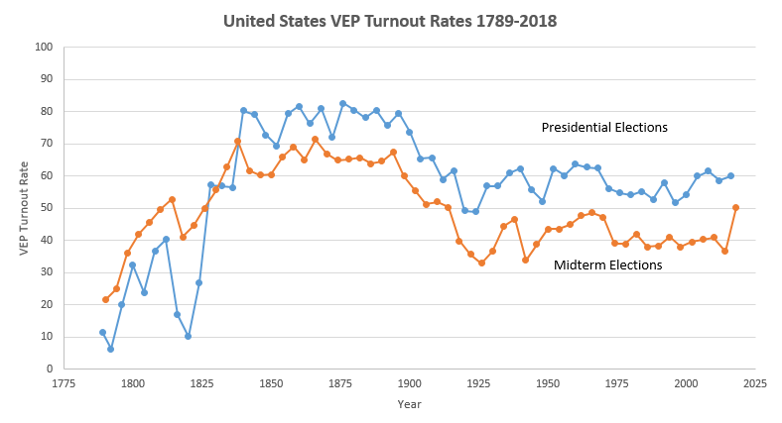
Being Good Stewarts of Citizenship
Civic Engagement in the United States
Voter Turnout Rights
Civic Knowledge of Americans

Slide 23
Mandatory testing?
Debating whether the Citizenship Test should be mandatory for natural born citizens
Citizenship Standard
Evaluate whether the United States should require all high school students to pass a citizenship test as a graduation requirement in order to encourage civic engagement.
Consider the graphs at the beginning of class
Use terms and ideas from what we have learned this week in your response

Slide 24
UNIT 7 - CITIZENSHIP
CL.C&G.3.3 Summarize the changes in process, perception, and the interpretation of United States citizenship and naturalization
CL.G.1.1 Explain how views on freedom and equality influence legislation and public policy on issues of immigration, migration and the environment
ESSENTIAL QUESTION: How do citizens of the United States engage in civic participation and combat errors within American democracy?
STUDENTS CAN:
Explain historic factors that have impacted immigration to the United States
Evaluate the legitimacy of barriers to American citizenship
AGENDA:
Who gets in
American Immigrant Song – A battle of POV
One Barred Out
HOMEWORK:
American Immigrant Song
Quiz on citizenship and immigration – Friday, September 3

Slide 25
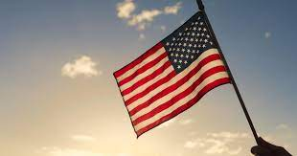
Who Gets In?
Evaluate the candidates who wish to immigrate to the United States and determine who would be accepted. Rank them 1-10 using each number once. (1 definite accepted to 10 definitely denied)

Slide 26
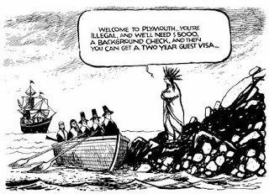
Who is allowed in?
United States current guidelines for legal immigration to the United States
Restriction: currently only 675,000 immigrants allowed into the U.S. per year
Priority status:
Immigrants with family in the U.S.
Immigrants with special skills (benefit U.S. economy)
Current Debate: Dreamers – children brought illegally to the U.S., who have never lived in their country of origin (Dream Act – don’t deport if they are law abiding taxpaying people)

Slide 27
History of Barriers
Immigration restriction legislation
1882 – Chinese Exclusion Act – 1st Anti-immigration Law
1924 – National Origins Act (stricter Quotas)
1995 – Wet Foot, Dry Foot Policy - Cubans can stay if they make to land
1921 – Emergency Quota Act - limit the number of immigrants
1966 – Cuban Adjustment Act (Allows Cubans to apply for citizenship)
2012 – Deferred Action for Childhood Arrivals

Slide 28
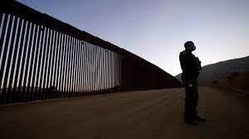
Controlling Immigration
Immigration and Customs Enforcement (ICE) & Border Patrol
Restricting Access to the United States
Quotas – limit the number immigrants allowed into the U.S.
Border Patrol
LIFE ACT 2000 – Quota 675,000
Factors for restricting immigration
National Security
Economic – job competition

Slide 29
Point of View on immigration
The Great Debate: How should the United States view immigration to the United States?
Side 1: ________________
Side 2: ________________

Slide 30
Understanding Point of View
Frank Leslie Illustrated Newspaper, 1882
Primary Source Analysis:
Historic Contexts: When was the cartoon created?
Intended Audience: Who was the political cartoon created for?
Purpose: What is the message of the political cartoon?
POV: Who created the document and why is significant?
The Only One Barred Out.
Enlightened American Statesmen, - “We must draw the line somewhere, you know”

Slide 31
UNIT 7 - CITIZENSHIP
CL.C&G.3.3 Summarize the changes in process, perception, and the interpretation of United States citizenship and naturalization
CL.G.1.1 Explain how views on freedom and equality influence legislation and public policy on issues of immigration, migration and the environment
ESSENTIAL QUESTION: How do citizens of the United States engage in civic participation and combat errors within American democracy?
STUDENTS CAN:
Explain historic factors that have impacted immigration to the United States
Evaluate the legitimacy of barriers to American citizenship
AGENDA:
Push & Pull Factors of Immigration
Analytical Reading
DACA Deconstruction
HOMEWORK:
Current Events Journal#1 Due Thursday, September 2
Quiz on immigration and citizenship – Friday September 3

Slide 32
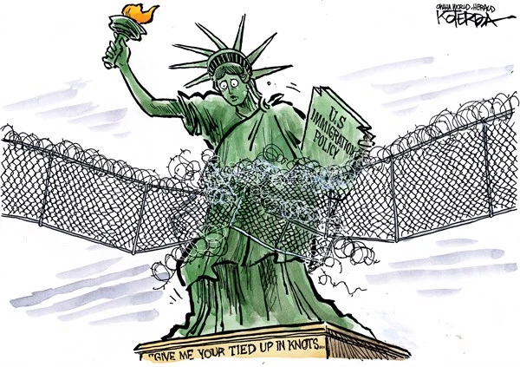
Understanding Point of View
Evaluate the perspective of the political cartoon using HIPP analysis
Historic Contexts: When was the cartoon created?
Intended Audience: Who was the political cartoon created for?
Purpose: What is the message of the political cartoon?
POV: Who created the document and why is significant?
Jeff Koterba, Omaha Herald, 2018

Slide 33
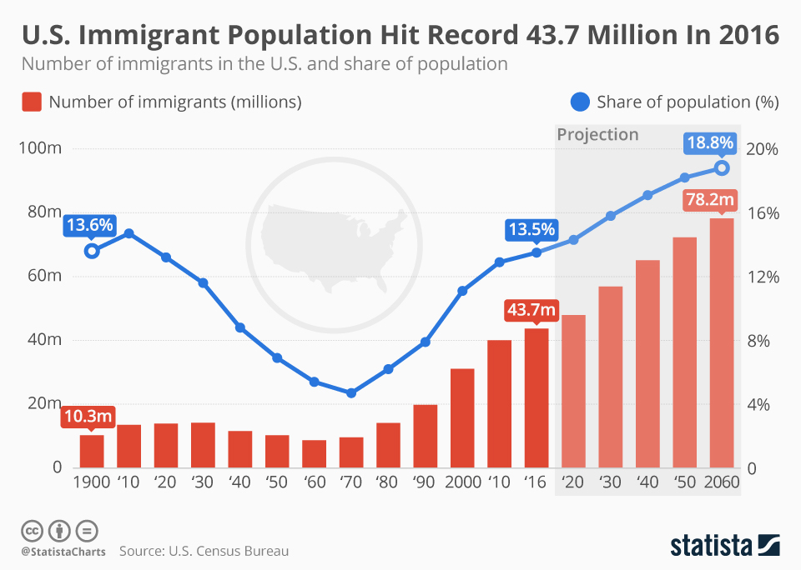
Immigration Factors
Identify the following as push or pull factor of immigration
War
Employment opportunity
Environmental or natural disaster
Authoritarian government (dictator)
Protection of civil liberties (rights)
Gender inequality
Adequate healthcare and education
Pull Factors – pull you towards
Push Factors – push you away

Slide 34
Current Events Journal
Summarizing articles – Identifying important elements
Article Title, Author, and Source
Article’s Main Idea or Argument
Who, When, & Where is the issue taking place?
How is the event or issue impacting the place?
Why is this event or issue important?
What is the societal impact of this event or issue?

Slide 35
UNIT 7 - CITIZENSHIP
CL.C&G.3.3 Summarize the changes in process, perception, and the interpretation of United States citizenship and naturalization
CL.G.1.1 Explain how views on freedom and equality influence legislation and public policy on issues of immigration, migration and the environment
ESSENTIAL QUESTION: How do citizens of the United States engage in civic participation and combat errors within American democracy?
STUDENTS CAN:
Explain historic factors that have impacted immigration to the United States
Evaluate the legitimacy of barriers to American citizenship
AGENDA:
Editorial Comments
Op-ed writing
Citizen & Immigration Review
HOMEWORK:
Current Events Journal#1 Due Friday, September 3
Quiz on immigration and citizenship – Friday September 3

Slide 36
Understanding the Article
What is the main idea of the article?
2. What is DACA?
3. What are the guidelines for handling immigration under DACA
4. What does President Biden want to do with people who are protect by DACA?
5. What is the debate over DACA?

Slide 37
Revisions
Summarizing articles – Identifying important elements
Article Title, Author, and Source
Things to look for:
Can you find the Who, When, Where, and Why
Are there facts from the story
Do sentences make sense (spelling, word choice, punctation, etc. . . )
Article’s Main Idea or Argument
Who, When, Where & Why is the issue taking place?
How is the event or issue impacting the place?
Why is this event or issue important?
What is the societal impact of this event or issue?

Slide 38
Op-Ed Writing
Op-ed – writing and exploring your opinion on current events
Understand what you think about a topic.
How does the topic impact or potentially impact your life?
Are your thoughts positive or negative towards the topic?
Explain why your thoughts positive or negative towards the topic.
A Civic Connection
How does the topic and article connect to what we are exploring in civics?
Identify terms or concepts that we have covered that relate to the topic
Explain their relevance to the topic of the current event

Slide 39
DACA Challenge
Making connections
Start with a statement that describes your opinion – Avoid the following phrases – I believe and I think (Replace with – The decision by President Biden to continue DACA is (right or wrong)
What terms or concepts we have learned about are connected to the article?
Utilize ideas and concepts from the class and the article to explain your opinion

Slide 40
UNIT 7 - CITIZENSHIP
CL.G.1.2 Explain geopolitical and environmental factors which affect civic participation and voting in various regions of the United States
CL.H.1.5 Explain how the experiences and achievements of minorities and marginalized peoples have contributed to the protection of individual rights and “equality and justice for all” over time
CL.H.1.6 Exemplify ways individuals have demonstrated resistance and resilience to inequities, injustice, and discrimination within the American system of government over time
ESSENTIAL QUESTION: How do citizens of the United States engage in civic participation and combat errors within American democracy?
STUDENTS CAN:
Demonstrate how the debate over equality has been a major factor impacting American citizenship
Explain how different groups have utilize tactics to influence equality in public policy
Explain how the federal government has attempted to rectify issues of equality through executive, legislative, and judicial authority
AGENDA:
Quiz Review/Citizenship and Immigration Quiz
Content Connections
Baseline for Civil Rights
HOMEWORK:
Current Events Journal#1 due Tuesday, September 7

Slide 41
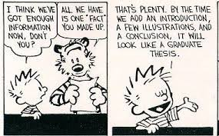
Content Connections
Making connections in writing with content
Calvin’s big mistake
Vocabulary & Concept connections to DACA
Identify terms connected to DACA
Explain their connections

Slide 42
UNIT 7 - CITIZENSHIP
CL.G.1.2 Explain geopolitical and environmental factors which affect civic participation and voting in various regions of the United States
CL.H.1.5 Explain how the experiences and achievements of minorities and marginalized peoples have contributed to the protection of individual rights and “equality and justice for all” over time
CL.H.1.6 Exemplify ways individuals have demonstrated resistance and resilience to inequities, injustice, and discrimination within the American system of government over time
ESSENTIAL QUESTION: How do citizens of the United States engage in civic participation and combat errors within American democracy?
STUDENTS CAN:
Demonstrate how the debate over equality has been a major factor impacting American citizenship
Explain how different groups have utilize tactics to influence equality in public policy
Explain how the federal government has attempted to rectify issues of equality through executive, legislative, and judicial authority
AGENDA:
Establishing a core value
Baseline for Civil Rights
Stand & Deliver
HOMEWORK:
Stand and Deliver

Slide 43
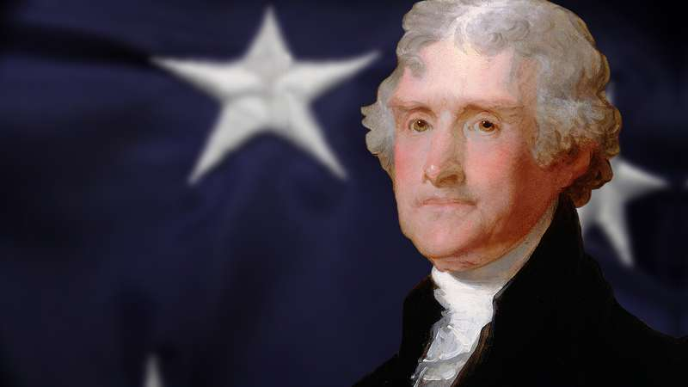
Citizenship Test
“We hold these truths to be self-evident, that all men are created equal, that they are endowed by their Creator with certain unalienable Rights, that among these are Life, Liberty and the pursuit of Happiness. That to secure these rights, Governments are instituted among Men, deriving their just powers from the consent of the governed.”
- Thomas Jefferson, “Declaration of Independence”, 1776
Define in your own words what it means to be an “equal” as a citizen of the United States
Consider what privileges granted to all citizens

Slide 44
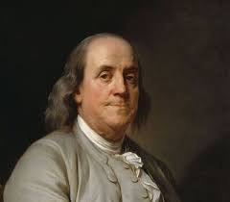
Let’s Be Civil
“Freedom is not a gift bestowed upon us by other men, but a right that belongs to us by the laws of God and nature.”
- Ben Franklin
Civil Liberties
Rights guaranteed to the people
Limit placed on government power
Civil Rights
Guarantees of social opportunity and protection under the law, regardless of race, ethnicity, gender, or religion

Slide 45
14th = Equality
All persons born or naturalized in the United States and subject to the jurisdiction thereof, are citizens of the United States and of the State wherein they reside. No State shall make or enforce any law which shall abridge the privileges or immunities of citizens of the United States; nor shall any State deprive any person of life, liberty, or property, without due process of law; nor deny to any person within its jurisdiction the equal protection of the laws.
- 14th Amendment, U.S. Constitution
14th Amendment
Equal protection clause – states cannot deny privileges
Due process clause – states cannot deny life, liberty, or property without due process

Slide 46
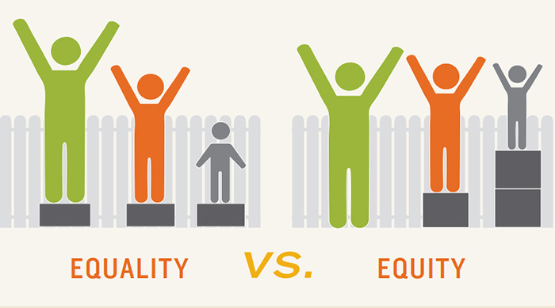
Equality????
A Complicated Debate
4 ways to view
Equality: everyone at the same level
VS.
Equity: qualities of justness, fairness, impartiality and even handedness
How should our government create policy policy to deal with equality?
Equality of opportunity – everyone has an equal chance
Equal starting points – hard to achieve due to difference in economic level
Equality between groups – differences between wealthy and poor
Equality of result – a minimum floor everyone reaches

Slide 47
Stand & Deliver
”Injustice anywhere is a threat to justice everywhere.”
Prompt: Evaluate whether the fight against inequality in the United States has led to a more inclusive society.
Develop a placard of a defender of equality in American history
Demonstrate how civil rights has incorporated multiple issues in throughout the United States
Evaluate how successful various civil rights movements have been at achieving greater inclusivity in the United States

Slide 48
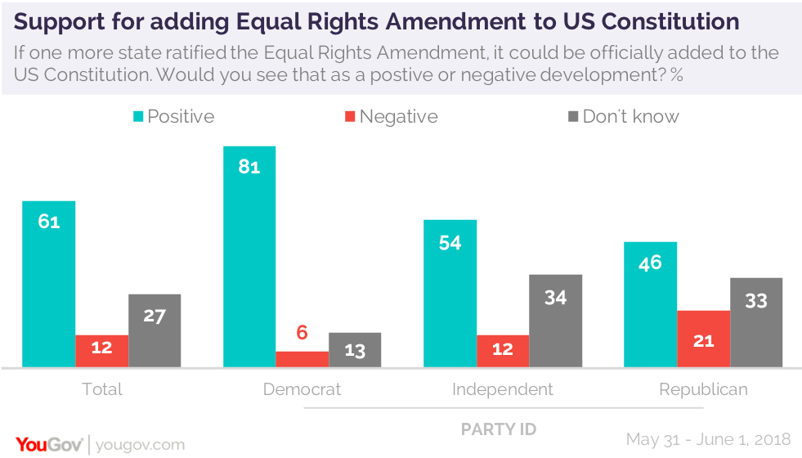
Debating Equality
Evaluate whether the United States should pass an amendment to the U.S. Constitution that mandates equality for all citizens of the United States?

Slide 49
Issue & Region
For your assigned defender of equality identify the following:
What issue(s) is your person or group working on to bring about greater equality in the United States?
What region of the country is the person or group working to support civil rights?

Slide 50
UNIT 7 - CITIZENSHIP
CL.G.1.2 Explain geopolitical and environmental factors which affect civic participation and voting in various regions of the United States
CL.H.1.5 Explain how the experiences and achievements of minorities and marginalized peoples have contributed to the protection of individual rights and “equality and justice for all” over time
CL.H.1.6 Exemplify ways individuals have demonstrated resistance and resilience to inequities, injustice, and discrimination within the American system of government over time
ESSENTIAL QUESTION: How do citizens of the United States engage in civic participation and combat errors within American democracy?
STUDENTS CAN:
Demonstrate how the debate over equality has been a major factor impacting American citizenship
Explain how different groups have utilize tactics to influence equality in public policy
Explain how the federal government has attempted to rectify issues of equality through executive, legislative, and judicial authority
AGENDA:
A Constitutional Challenge to the Equal Protection Clause
Clarifying Equal Protection Under the Law
Stand & Deliver
HOMEWORK:
Stand & Deliver – Due: September 13th

Slide 51
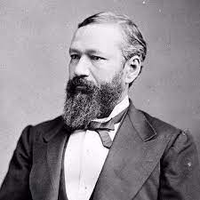
Constitutional Challenges
All persons born or naturalized in the United States and subject to the jurisdiction thereof, are citizens of the United States and of the State wherein they reside. No State shall make or enforce any law which shall abridge the privileges or immunities of citizens of the United States; nor shall any State deprive any person of life, liberty, or property, without due process of law; nor deny to any person within its jurisdiction the equal protection of the laws.
- 14th Amendment, U.S. Constitution
Plessy v. Ferguson 1896
Question before the court: Does the Louisiana's Separate Cars Act violate the 14th Amendment equal protection clause?
Answer: No law grants equal access to all races therefore no race is seen as inferior – Establishes the doctrine of “separate but equal”
Homer Plessy

Slide 52
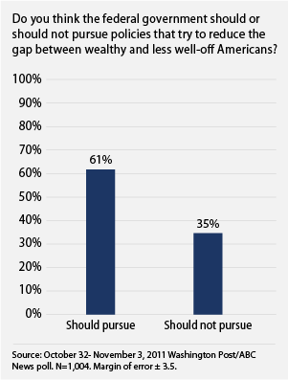
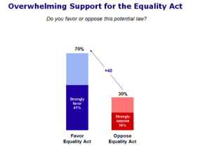
Issues of Inequality
Civil Rights Movement
Factors of Inequality
Suffrage = voting rights
Wealth
Employment
Education
Housing
Gender
Marriage
Athletics
Due process of law

Slide 53
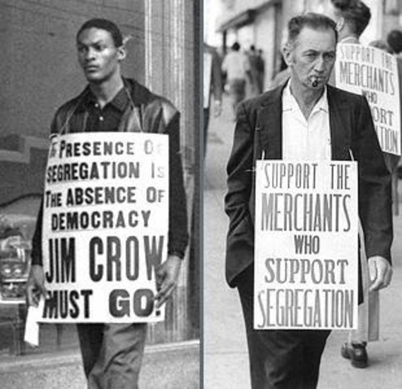
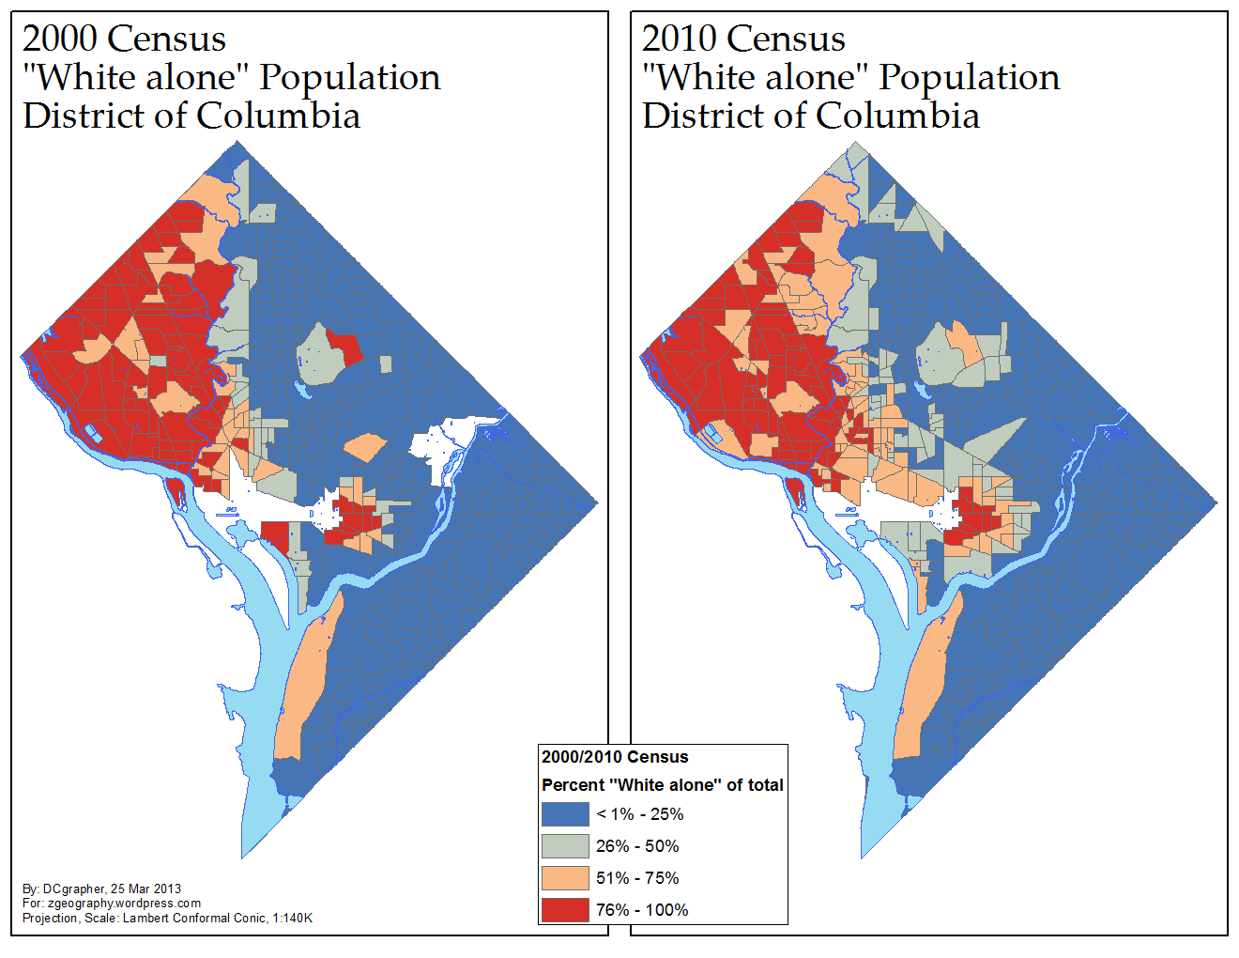
Are in equality?????
Two types of segregation
De Jure Segregation:
Segregation by law
“Jim Crow”, black codes, & slave codes
De Facto Segregation:
Segregation established by tradition & upheld by society
Different races living in different neighborhoods

Slide 54
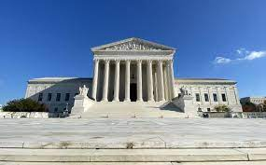
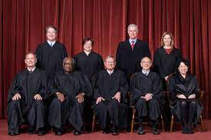
Guidelines for Equal Protection
U.S. Supreme Court guidelines for evaluating equal protection under the law
Suspect Classification: Race, National Origin, & Religion
Rational Bases: “A Compelling Reason” – example physical differences between genders
Fundamental Right: specific rights recognized by SCOTUS as needing extra protection from government power (ex. Marriage & Voting)

Slide 55
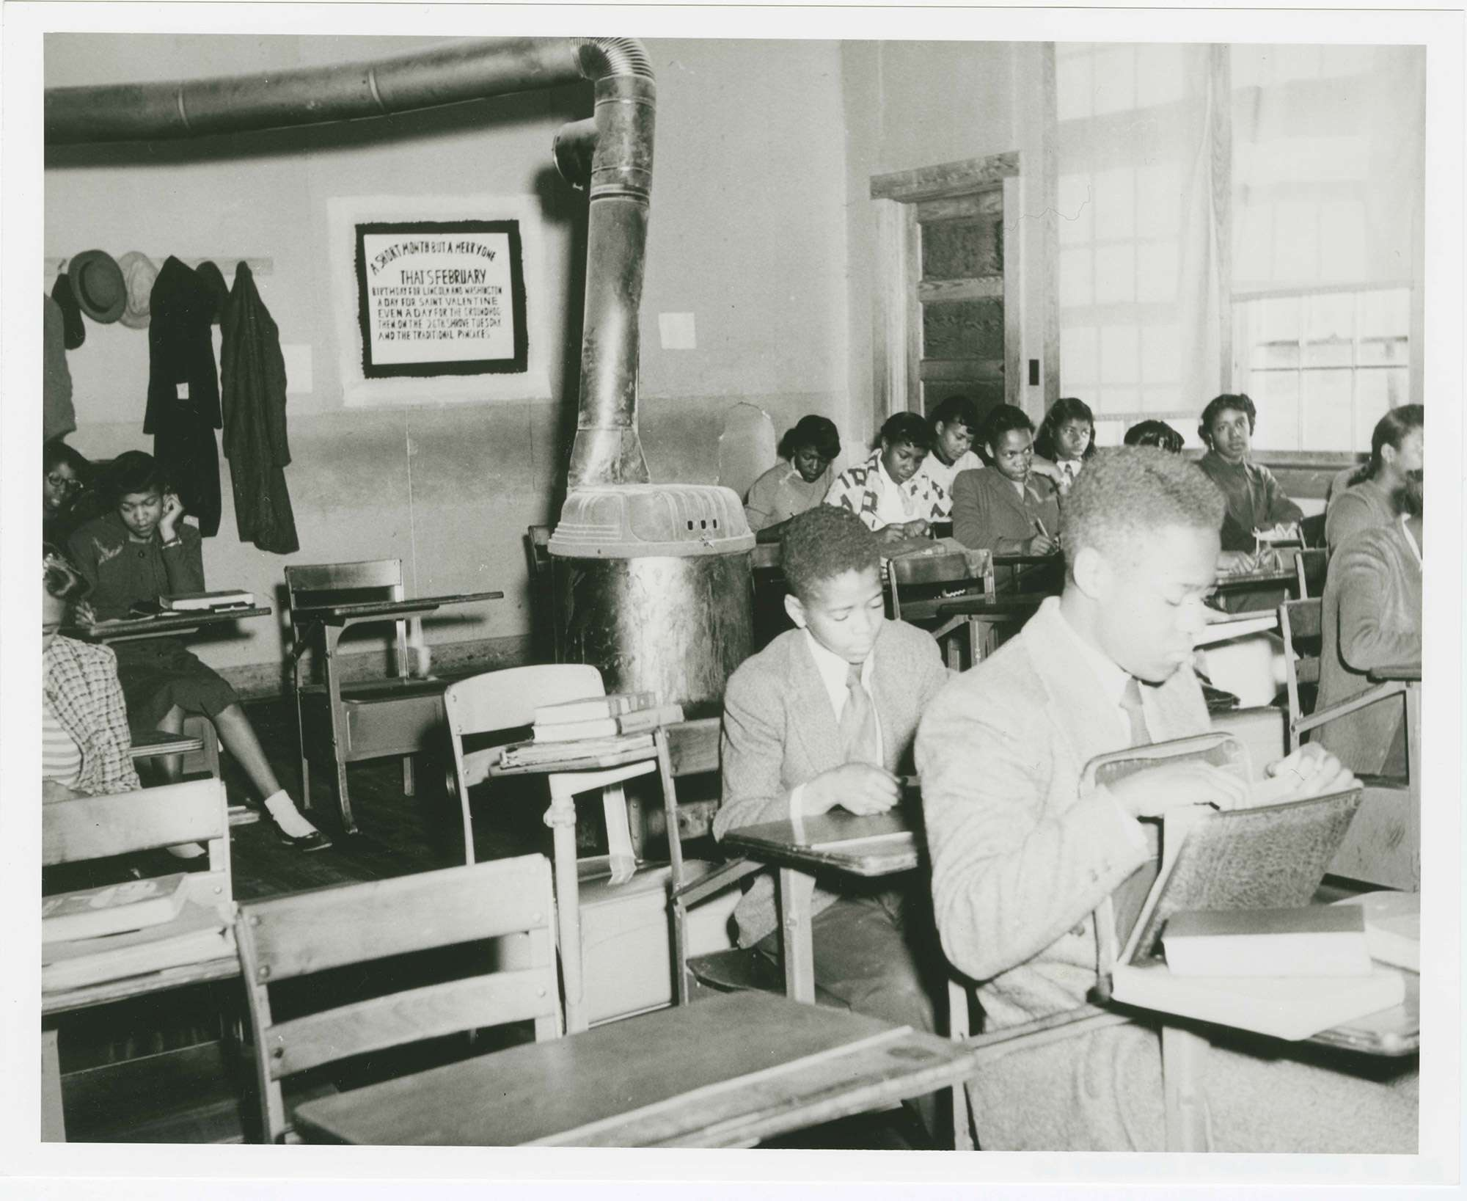
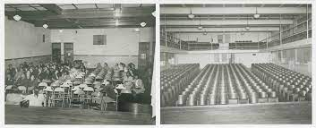
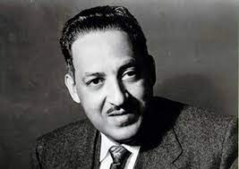
The Doctrine of Separate But Equal
Brown v. Board of Education I 1954
Question before the court: Does the segregation of public education based solely on race violate the Equal Protection Clause of the Fourteenth Amendment?
Answer: “separate but equal” facilities are inherently unequal and violate the protections of the Equal Protection Clause of the Fourteenth Amendment.
Thurgood Marshall

Slide 56
Stand & Deliver
”Injustice anywhere is a threat to justice everywhere.”
Prompt: Evaluate whether the fight against inequality in the United States has led to a more inclusive society.
Develop a placard of a defender of equality in American history
Demonstrate how civil rights has incorporated multiple issues in throughout the United States
Evaluate how successful various civil rights movements have been at achieving greater inclusivity in the United States

Slide 57
UNIT 7 - CITIZENSHIP
CL.G.1.2 Explain geopolitical and environmental factors which affect civic participation and voting in various regions of the United States
CL.H.1.5 Explain how the experiences and achievements of minorities and marginalized peoples have contributed to the protection of individual rights and “equality and justice for all” over time
CL.H.1.6 Exemplify ways individuals have demonstrated resistance and resilience to inequities, injustice, and discrimination within the American system of government over time
ESSENTIAL QUESTION: How do citizens of the United States engage in civic participation and combat errors within American democracy?
STUDENTS CAN:
Demonstrate how the debate over equality has been a major factor impacting American citizenship
Explain how different groups have utilize tactics to influence equality in public policy
Explain how the federal government has attempted to rectify issues of equality through executive, legislative, and judicial authority
AGENDA:
Legal Lines of Jim Crow
Perspective of a Civil Rights Movement
The Fight for American Equality
HOMEWORK:
Stand and Deliver due, Monday, Sept. 13
Unit I Test, September 17

Slide 58
Perspectives of Jim Crow
Compare the two experts and evaluate how they impact the civil rights of American citizens in the united States
All freedmen, free negroes and mulattoes in this State, over the age of eighteen years, found on the second Monday in January, 1866, or thereafter, with no lawful employment or business, or found unlawfully assembling themselves together, either in the day or night time, and all white persons so assembling themselves with freedmen, free negroes or mulattoes, or usually associating with freedmen, free negroes or mulattoes, on terms of equality, or living in adultery or fornication with a freed woman, free negro or mulatto, shall be deemed vagrants, and on conviction thereof shall be fined in a sum not exceeding, in the case of a freedman, free negro or mulatto, fifty dollars, and a white man two hundred dollars, and imprisoned at the discretion of the court, the free negro not exceeding ten days, and the white man not exceeding six months....
Mississippi Black Codes, 1866 (Vagrancy Laws)
“No person of any race other than white Caucasian race shall own, use or occupy any building or any lot, except that this covenant shall not prevent occupancy by domestic servants of a different race domiciled (living) with an owner or tenant.”
- Columbia Forrest, Covenant of Arlington County, Virginia, 1942

Slide 59
Voice of the people
“The true way and the easiest way to make our government entirely consistent with itself, and give every loyal citizen the elective franchise”
- Frederick Douglass
“Everybody counts in applying democracy. And there will never be a true democracy until every responsible and law-abiding adult in it, without regard to race, sex, color or creed has his or inalienable and unpurchasable voice in government.
- Elizabeth Cady Stanton
Popular sovereignty = government of the people
Suffrage = right to vote
Disenfranchisement = denying the right to vote or representation in government

Slide 60
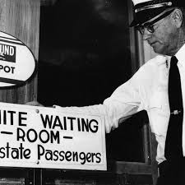
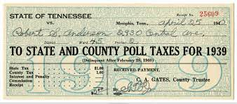
Limiting Voice of the People
Disenfranchising Citizens
Black Codes/Jim Crow Laws
(Segregation)
Literacy Test
Poll Taxes
Grandfather Clause

Slide 61
Protecting suffrage rights
Most later constitutional amendments deal with expanding suffrage rights
15th Amendment: African American Suffrage
“The right to vote is the most powerful instrument devised by man for breaking down injustice and destroying walls which imprison men because they are different from other men”
19th Amendment: Women Suffrage
23rd Amendment: Washington D.C. Suffrage
26th Amendment: 18-year-old Suffrage
Synder Act: Native American suffrage

Slide 62
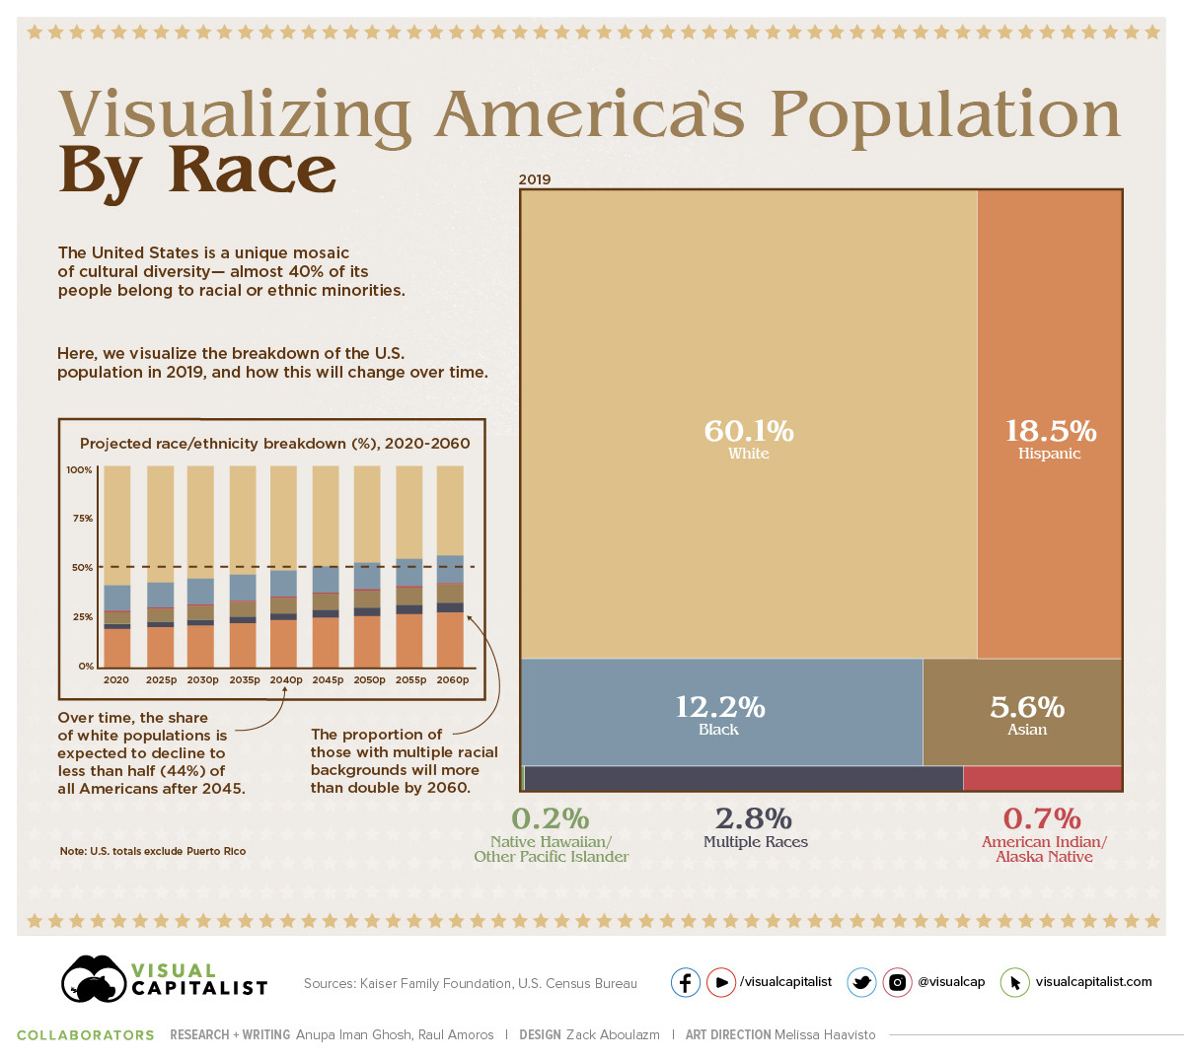
Diversity in America
Diversity in the U.S.
U.S. Census - counts the population every 10 years
Used in for representation and distribution aid to states from the federal government

Slide 63
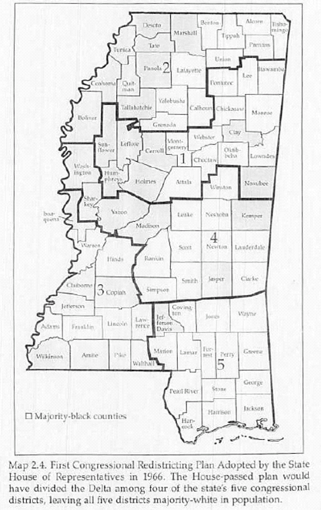
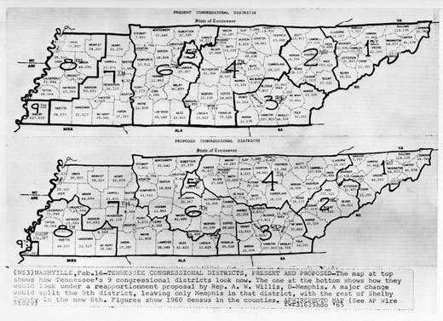
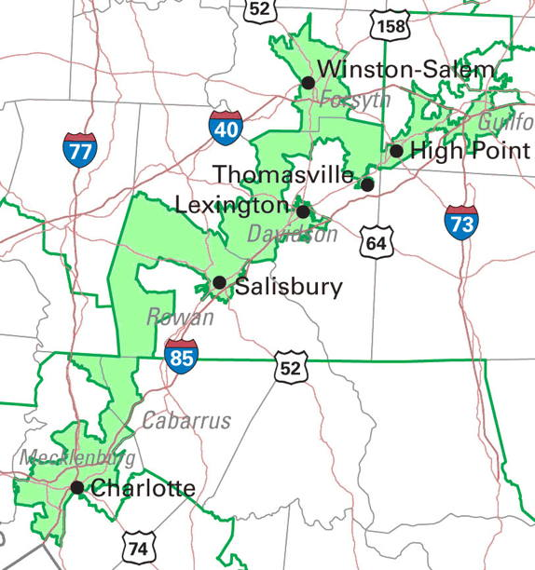
Barriers to voice in Government
Gerrymandering: drawing voter districts to grant one group greater political voice then another in the House of Representatives (Denies the principle of one man one vote – Baker v. Carr 1962)

Slide 64
Stand & Deliver
”Injustice anywhere is a threat to justice everywhere.”
Prompt: Evaluate whether the fight against inequality in the United States has led to a more inclusive society.
Develop a placard of a defender of equality in American history
Demonstrate how civil rights has incorporated multiple issues in throughout the United States
Evaluate how successful various civil rights movements have been at achieving greater inclusivity in the United States

Slide 65
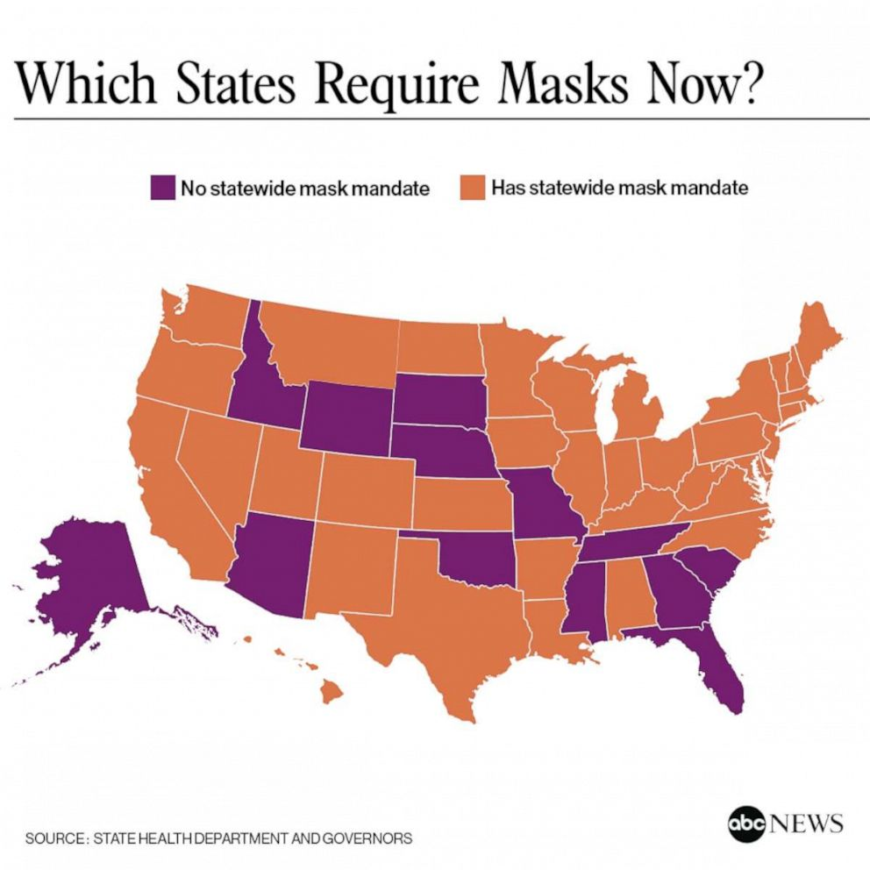
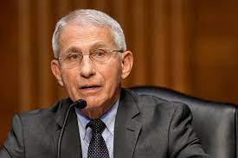
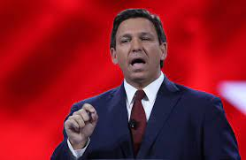
Current Debate
Do state or business vaccine and mask mandates create inequality issues?????????
“Masking & getting vaccines protects the American public”
“People should be allowed to make decisions about masking and vaccines for themselves”

Slide 66
UNIT 7 - CITIZENSHIP
CL.C&G.3.3 Summarize the changes in process, perception, and the interpretation of United States citizenship and naturalization
CL.G.1.1 Explain how views on freedom and equality influence legislation and public policy on issues of immigration, migration and the environment
ESSENTIAL QUESTION: How do citizens of the United States engage in civic participation and combat errors within American democracy?
STUDENTS CAN:
Explain historic factors that have impacted immigration to the United States
Evaluate the legitimacy of barriers to American citizenship
AGENDA:
Never forget
A Tactic of Change
A Letter from a Birmingham Jail
HOMEWORK:
Stand & Deliver

Slide 67
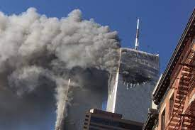
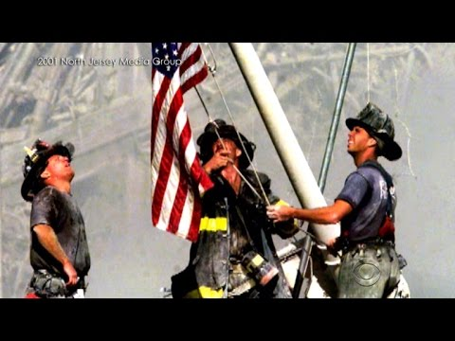
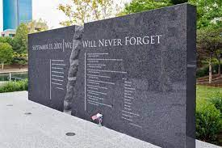
A Day of Reflection
Tomorrow is the 20th Anniversary of 9/11 – take a moment to remember those the lost their lives so tragically
NEVER FORGET

Slide 68
The March of Civil Rights
Evaluate why the Civil Rights Movement used civil disobedience to bring about social change in the United States
Reverend C.T. Vivian on Civil Disobedience

Slide 69
Tactics of Civil Rights
“One has a moral responsibility to disobey an unjust law!”
Bring change through peaceful methods
“Civil disobedience becomes a sacred duty when a state becomes lawless or corrupt. And a citizen who barters with such a state shares with its corruption and lawlessness”
- Mahatma Ghandi
Civil disobedience: using non-violent protest to promote change against injustice
Sit-ins
Protest marches
Boycotts
Hunger strikes

Slide 70
Image of Civil Disobedience
The stand against injustice
Montgomery Bus Boycott
Freedom Riders
Rosa Parks
Greensboro Four - Sit-ins

Slide 71
Impact of Civil Disobedience
Laws and actions the change American society
Brown v. Board I (1954) & Brown v. Board II (1957) – ended segregated schools
Civil Rights Act of 1964 – banned segregation in public places and discrimination in hiring
Voting Rights Act of 1965 – allowed the federal government to intervene and end voting discrimination
24th Amendment: outlawed poll tax
Title IX – ends gender inequality in education and sports

Slide 72
Letter from a Birmingham Jail
”Injustice anywhere is a threat to justice everywhere.”
Explain and summarize how A Letter from a Birmingham Jail defines and argues Dr. Martin Luther King “Injustice anywhere is a threat to justice everywhere.”

Slide 73
Stand & Deliver
”Injustice anywhere is a threat to justice everywhere.”
Samples:
Use specific facts to demonstrate parts
Crazy Horse lead a revolt to stop western expansion (lacks specific details)
Crazy Horse fought against the U.S. military at the Battle of Little Bighorn 1876 by unifying plains Indians. His efforts was an attempt to stop the westward expansion movement of Manifest Destiny in which Native Americans were losing their tribal lands to white settlement and the development of railroads.

Slide 74
UNIT 7 - CITIZENSHIP
CL.C&G.3.3 Summarize the changes in process, perception, and the interpretation of United States citizenship and naturalization
CL.G.1.1 Explain how views on freedom and equality influence legislation and public policy on issues of immigration, migration and the environment
ESSENTIAL QUESTION: How do citizens of the United States engage in civic participation and combat errors within American democracy?
STUDENTS CAN:
Explain historic factors that have impacted immigration to the United States
Evaluate the legitimacy of barriers to American citizenship
AGENDA:
Recalling the Civil Rights
Stand and Deliver Round Robin
Civil Rights Commonalities
HOMEWORK:
Unit Study Guide
Unit Test – Friday, Sept. 17

Slide 75
Civil Rights recall
1. Identify two specific ways that civil rights have been denied to African Americans during the era of Jim Crow south (1870-1970)? (CL.G.1.2 )
2. Which part of the U.S. Constitution is supposed to prevent states from denying equality to U.S. citizens? (CL.H.1.6)
3. Identify two ways the federal laws or constitutional amendment that have protected people from inequality? (CL.H.1.6)

Slide 76
Stand & Deliver Round Robin
”Injustice anywhere is a threat to justice everywhere.”
Round Robin
If you are a ONE you will stay in your seats
If you are a TWO you will rotate to left after four minutes
Share the following
Issue(s) of equality that your person or group worked to end
Tactic(s) used to fight against inequality
Change - how did the person or group help to end inequality or why was change not achieved

Slide 77
Stand & Deliver in Common
”Injustice anywhere is a threat to justice everywhere.”
Use the chart to examine the following:
What tactics do different rights movements have in common?
What civil rights issues are common between different equality movements

Slide 78
UNIT 7 - CITIZENSHIP
CL.C&G.3.3 Summarize the changes in process, perception, and the interpretation of United States citizenship and naturalization
CL.G.1.1 Explain how views on freedom and equality influence legislation and public policy on issues of immigration, migration and the environment
ESSENTIAL QUESTION: How do citizens of the United States engage in civic participation and combat errors within American democracy?
STUDENTS CAN:
Explain historic factors that have impacted immigration to the United States
Evaluate the legitimacy of barriers to American citizenship
AGENDA:
Stand and Deliver Round Robin
Civil Rights Commonalities
Free Response Writing
HOMEWORK:
Free Response Plan
Unit Test – Friday, Sept. 17

Slide 79
Stand & Deliver Round Robin
”Injustice anywhere is a threat to justice everywhere.”
Round Robin
If you are a ONE you will stay in your seats
If you are a TWO you will rotate to left after four minutes
Share the following
Issue(s) of equality that your person or group worked to end
Tactic(s) used to fight against inequality
Change - how did the person or group help to end inequality or why was change not achieved

Slide 80
Stand & Deliver in Common
”Injustice anywhere is a threat to justice everywhere.”
Use the chart to examine the following:
What tactics do different rights movements have in common?
What civil rights issues are common between different equality movements

Slide 81
Task Verb
Writing free response question success – pay attention to the task verbs
The following are task verbs that are commonly used in free-response questions.
Compare: provide a description or explanation of similarities and/or differences
Define: provide a specific meaning for a word or concept
Describe: provide the relevant characteristics of a specified topic
Explain: provide information about how or why a relationship, process, pattern, position, or outcome occurs using reasoning/evidence.
Identify: indicate or provide information about a specified topic without elaboration or explanation.

Slide 82
FRQ - Steps to Success
Step 1 – Analysis
The first three FRQs will have a stimulus which critical to respond understanding what is being asked. (Strip the stimulus for important clues
The Question - highlight key words within the question and simplify what the question is asking
Task Verbs (Qualify): identify, describe, explain, and analyze
Step 2 – Plan
Quick plan each part (A, B, C, etc . . .) – NO REPEATING IDEAS – one time only
Bulleted examples (be factual – Great Compromise, 1st Amendment
Step 3 – Write – use complete sentences and paragraphs (bulleted points or outlines DO NOT earn points)
Step 4 – Proofread – make sure you have no glaring errors (correct if you do – don’t re-write the whole thing), and you have met the guidelines of the action verbs with an example

Slide 83
Task Verb Challenge
Answer these questions about ice cream.
Define Ice Cream.
Describe your favorite ice cream.
Compare ice cream to other types of desert.
Identify an example of ice cream.
Identify a second example of ice cream.
Explain how ice cream changes over time.
Explain criticisms of ice cream.

Slide 84
Free Response Question
We hold these truths to be self-evident, that all men are created equal, that they are endowed by their Creator with certain unalienable Rights, that among these are Life, Liberty and the pursuit of Happiness. That to secure these rights, Governments are instituted among Men, deriving their just powers from the consent of the governed.
Declaration of Independence, July 4th, 1776
1. The United States has expanded the meaning of equality first defined by the excerpts from the Declaration of Independence above.
Describe the difference between civil rights and civil liberties.
Identify the primary clause of the Fourteenth Amendment that is used to extend civil rights.
Identify and explain how TWO of the following have been denied civil rights within the United States.
Describe a specific legislative action or court ruling has extended civil rights to more Americans.

Slide 85
UNIT 7 - CITIZENSHIP
CL.C&G.3.3 Summarize the changes in process, perception, and the interpretation of United States citizenship and naturalization
CL.G.1.1 Explain how views on freedom and equality influence legislation and public policy on issues of immigration, migration and the environment
ESSENTIAL QUESTION: How do citizens of the United States engage in civic participation and combat errors within American democracy?
STUDENTS CAN:
Explain historic factors that have impacted immigration to the United States
Evaluate the legitimacy of barriers to American citizenship
AGENDA:
FRQ Writing
Letter From A Birmingham Jail
Equal Rights Amendment
HOMEWORK:
Equal Rights Amendment Argument
Unit Test – Friday, Sept. 17

Slide 86
Task Verb Challenge
Answer these questions about ice cream.
Define Ice Cream.
Describe your favorite ice cream.
Compare ice cream to other types of desert.
Identify an example of ice cream.
Identify a second example of ice cream.
Explain how ice cream changes over time.
Explain criticisms of ice cream.

Slide 87
FRQ - Steps to Success
Step 1 – Analysis
The first three FRQs will have a stimulus which critical to respond understanding what is being asked. (Strip the stimulus for important clues
The Question - highlight key words within the question and simplify what the question is asking
Task Verbs (Qualify): identify, describe, explain, and analyze
Step 2 – Plan
Quick plan each part (A, B, C, etc . . .) – NO REPEATING IDEAS – one time only
Bulleted examples (be factual – Great Compromise, 1st Amendment
Step 3 – Write – use complete sentences and paragraphs (bulleted points or outlines DO NOT earn points)
Step 4 – Proofread – make sure you have no glaring errors (correct if you do – don’t re-write the whole thing), and you have met the guidelines of the action verbs with an example

Slide 88
Free Response Question
We hold these truths to be self-evident, that all men are created equal, that they are endowed by their Creator with certain unalienable Rights, that among these are Life, Liberty and the pursuit of Happiness. That to secure these rights, Governments are instituted among Men, deriving their just powers from the consent of the governed.
Declaration of Independence, July 4th, 1776
1. The United States has expanded the meaning of equality first defined by the excerpts from the Declaration of Independence above.
Describe the difference between civil rights and civil liberties.
Identify the primary clause of the Fourteenth Amendment that is used to extend civil rights.
Identify and explain how TWO of the following have been denied civil rights within the United States.
Suffrage
Education
Economic opportunity
D. Describe a specific legislative action or court ruling has extended civil rights to more Americans.

Slide 89
FRQ
Question A: Answer must show the difference between Civil Rights and Civil Liberties (must have both) = 1 pt.
Question B: Must identify the exact clause of the 14th Amendment = 1pt.
Question C: Must have two of the following = 1 pt.
Jim Crow Laws
Literacy Test
Poll Taxes
Intimidation
Question D: 1 pt.
24th Amendment
Any Amendment extends suffrage
Civil Rights Act of 1964
Voting Rights Acts of 1965
Title IX
Brown v. Board

Slide 90
Letter from a Birmingham Jail
”Injustice anywhere is a threat to justice everywhere.”
Explain and summarize how A Letter from a Birmingham Jail defines and argues Dr. Martin Luther King “Injustice anywhere is a threat to justice everywhere.”

Slide 91
Amendment to the Constitution
Ratification Process: Article V – U.S. Constitution
Proposal – 2/3rd vote in both houses of Congress
Ratification – 3/4th vote of state legislature
Prompt: Evaluate whether the United States should pass an amendment to the U.S. Constitution that mandates equality for all citizens of the United States?
What is the bases of why this is potentially needed
Identify the pros of an equal rights amendment
Identify the cons of an equal rights amendment

Slide 92
UNIT 7 - CITIZENSHIP
CL.C&G.3.3 Summarize the changes in process, perception, and the interpretation of United States citizenship and naturalization
CL.G.1.1 Explain how views on freedom and equality influence legislation and public policy on issues of immigration, migration and the environment
ESSENTIAL QUESTION: How do citizens of the United States engage in civic participation and combat errors within American democracy?
STUDENTS CAN:
Explain historic factors that have impacted immigration to the United States
Evaluate the legitimacy of barriers to American citizenship
AGENDA:
Debating a Constitutional Amendment
Unit Review
Quick Fire Questions
HOMEWORK:
Study for Unit Test – Citizenship and Civic Engagement
Unit Test – Friday, Sept. 17

Slide 93
Amendment to the Constitution
Ratification Process: Article V – U.S. Constitution
Proposal – 2/3rd vote in both houses of Congress
Ratification – 3/4th vote of state legislature
Prompt: Evaluate whether the United States should pass an amendment to the U.S. Constitution that mandates equality for all citizens of the United States?

Slide 94
Challenge Questions
The first requisite of a good citizen in this republic of ours is that he shall be able and willing to pull his own weight.
- Theodore Roosevelt
According to the quote how should citizens of the United States view their role in our republican form of government?
A citizen should be active in their country through service and participation in our democracy
Citizens should just enjoy the privileges granted them by the U.S. Constitution
Citizens should have a very limited role and expect to have no say in government
The government should provide social welfare programs for its citizenry and represent their wishes

Slide 95
Challenge Questions
2. Which of the following represents a pull factor for immigration?
Immigrants desire to escape war torn countries in which their lives are threaten
Many third world countries have high rates of poverty and immigrants struggle to survive
Immigrants desire to have freedoms preserved by the U.S. Constitution
Natural disasters, such as earthquakes have destroyed their home country

Slide 96
Challenge Questions
“To refuse to qualified women and colored men the right of suffrage and still count them in the basis of representation is to add insult to injury as it is unreasonable.”
- Susan B. Anthony
3. How has the United States repaired the “insult to injury” reference in Susan B. Anthony’s quote?
Through the passage of Title IX legislation
Supreme Court ruling in cases, such as Brown v. Board
The development of federal agency such as the Federal Election Commission
The passages of Constitutional Amendments, such as the 15th and 19th Amendment.

Slide 97
Challenge Questions
4. The grandfather clause and literacy test were similar in that both were designed to __________________.
drive the carpetbaggers permanently from the South
force southern leaders to agree to Northern leaders views on Reconstruction
Prevent African Americans in the South from voting
Stop former slaves from obtaining an education

Slide 98
Challenge Questions
The quotations below are from two United States Supreme Court decisions
“Separation of the races does not place a badge of inferiority upon one group over another, thus it is not a violation of the 14th amendment.” (1896)
“To separate children in grade school and high school from other of similar age and qualifications solely because of their races generates a feeling of inferiority as to their status. . . That may effect their lives and minds in a way unlikely ever undone.” (1954)
5. The difference in opinion between the rulings best shows ___________.
A change in judicial philosophy and public attitudes
The persistent efforts of the major political parties to increase equal opportunity
A recognition that democracy depends on economic equality for all citizens
The refusal of the Supreme Court to deal with controversial issues

Slide 99
UNIT 7 - CITIZENSHIP
CL.C&G.3.3 Summarize the changes in process, perception, and the interpretation of United States citizenship and naturalization
CL.G.1.1 Explain how views on freedom and equality influence legislation and public policy on issues of immigration, migration and the environment
ESSENTIAL QUESTION: How do citizens of the United States engage in civic participation and combat errors within American democracy?
STUDENTS CAN:
Explain historic factors that have impacted immigration to the United States
Evaluate the legitimacy of barriers to American citizenship
AGENDA:
Challenge questions
Unit Test – Citizenship and Civic Engagement
HOMEWORK:

