Slide 1
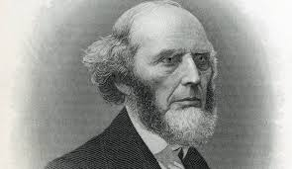
The Ferment of Reform & Culture
What is this sin I see before me!
Age of Reform 1790 - 1850

Slide 2
Essential Question: How did revivalism challenge and impact the Antebellum period of the early 19th century United States?
Students can:
Explain how American culture reflected themes of the nation from 1800 to 1850
Evaluate factors that caused the desire amongst Americans to reform society during the Antebellum period
Agenda
The TWO Views of America
An Awakening of American Culture
Age of Reform Speed Dating
Homework:
Reading Objective 9 Questions due 11/21
Age of Reform Speed Dating Profile – Due 11/22

Slide 3
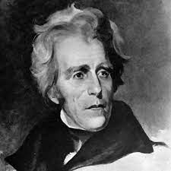
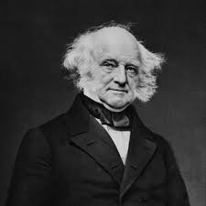
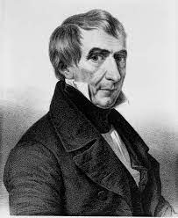
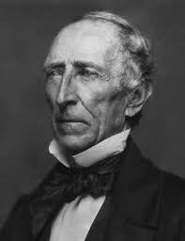
A National Development
Market Revolution 1820 – 1850
How did events under President Jackson, Van Buren, Harrison and Tyler influence the Market Revolution and your assigned region’s economy and cultural issues?
Andrew Jackson
Martin Van Buren
William Harry Harrison
John Tyler

Slide 4
A National Development
Prompt: Analyze the impact of the market revolution (1815-1860) on the economies of TWO of the following regions.
Northeast
Midwest
South
Historical Context:
Causation
Immediate impact
Long term cause
Transformation impacts: (Can be bulleted)
Identify and explain and use factual knowledge to support
Short Answer Question:
Answer on the back (must answer in complete sentences)

Slide 5
Defining American 1800-1850
Demonstrate how the United States from 1800 to 1850 represented to different distinct ideas; unity and division.
Unity
Division

Slide 6
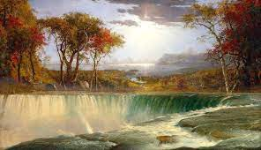
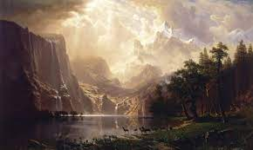
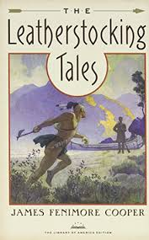
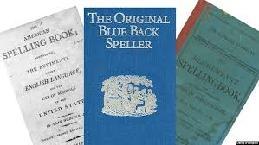
Celebrating America
Cultural Nationalism: themes of western expansion and pride in America (fervent nationalism)
Artist & Writers: focused on intuition, feelings, individual acts of heroism, & the study of nature
Literary Movements
Transcendentalism – idealistic system of thought based on unity of all creations, innate goodness of humanity, supremacy of insight & experience
Romanticism (inspiration, subjectivity, and the primacy of the individual)
Hudson River School

Slide 7
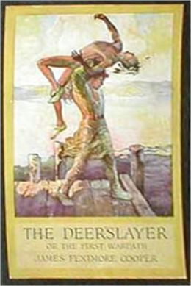
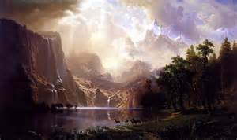
Cultural Impact – American Voice
Voices of Cultural Nationalism
Hudson River School: landscape painters (frontier spirit)
Romanticism Writers
Knickerbocker Society
James Fenimore Cooper: Leatherstocking Tales
Washington Irving: The Legend of Sleepy Hollow
Edgar Allen Poe (anti-nationalism)
North American Review (magazine)
Blueback Spellers & McGuffey Readers (school textbooks)

Slide 8
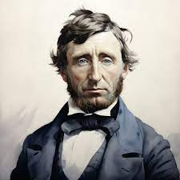
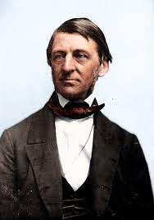
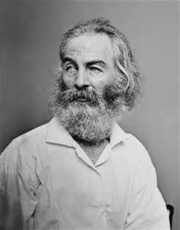
Transcendentalism
Transcendentalism focuses on self-reliance (Rugged individualism)
Ralph Waldo Emerson (founder): writer, unitary minister, & lyceum lecturer
Transcendentalist Writers:
Henry David Thoreau:
“Resistance of Civil Disobedience” (1839)
Walden (1854)
Walt Whitman:
Leaves in the Grass
The only person you are destined to become, is the person you decide to be.
Resist unjust laws!

Slide 9
Essential Question: How did revivalism challenge and impact the Antebellum period of the early 19th century United States?
Students can:
Evaluate factors that caused the desire amongst Americans to reform society during the Antebellum period
Decipher impacts of social reform movements within the United States
Agenda
Historic Parallels
A Revivalist Movement
Age of Reform Speed Dating
Homework:
Research Your Reform Movement
Unit IV Test – 12/11

Slide 10
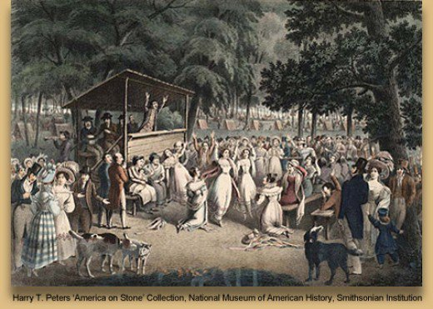
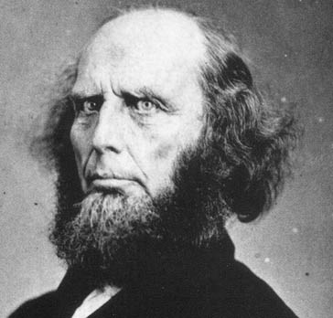
Essential Question
How did revivalism challenge and impact the Antebellum period of the early 19th century United States?
“Away this religion of resolutions! It is a snare of death, away with this effort to make the life holy while the heart has not in it the love of God. Oh! That men would learn to look directly at Christ through the Gospel.”
- Charles Grandison Finney

Slide 11
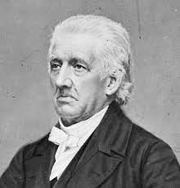
A National Development
Predict how the transformation of the national economy and the focus of American Democracy will cause the following quote.
“The aim of the Second Great Awakening was to remedy the evils of society and create a better world.”

Slide 12
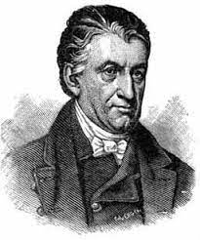
A New Awakening
Second Great Awakening (Late 18th Century – Early19th Century)
Revival Movement based on the reassertion of traditional Calvinist (Puritan) views on predestination & original sin
Causation
“The aim of the 2nd Great Awakening is to remedy the evils of society and creation of a better world!” (Utopian Society)
Growing emphasis of democracy and the individual (Common Man)
Backlash against rationalism Preaching relied on emotionalism
Market Revolution People feared greed & sin
Escapism Getting way from urban and manufacturing setting (Transportation Revolution)

Slide 13
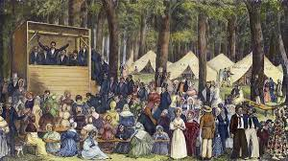
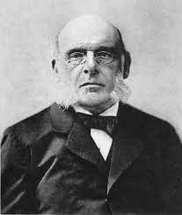
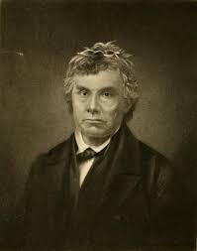
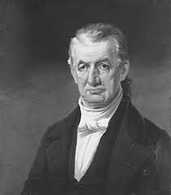
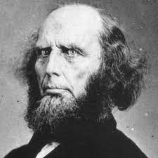
Revival Movement
Tent Revival: Take religion to the masses in less formal settings
Goal: counter the perversions of religion, promote the creation of a perfect society (Utopian Society), & end sin (Revival Movement)
Camp Meetings
Timothy Dwight
Peter Cartwright
(Methodist)
Lyman Beecher
Charles Grandison Finney
Preachers of the Revival Movement

Slide 14
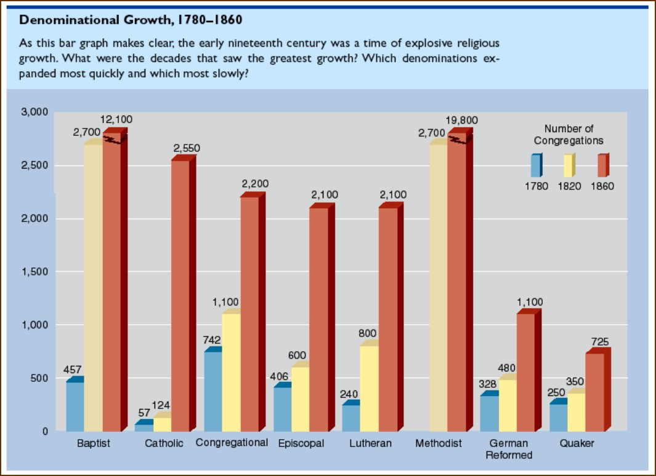
Growth of Religion 1780 - 1860

Slide 15
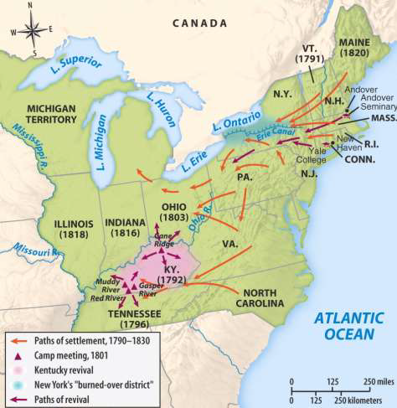
Religion to the MASSES
Revivalism in the Frontier
Burned over district (Hell & Brimstone Revivals) – Western NY
Camp Meetings by Charles Grandison Finney

Slide 16
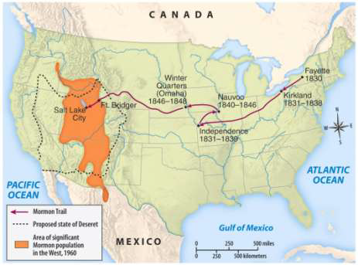
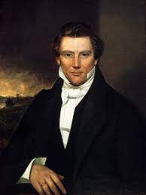
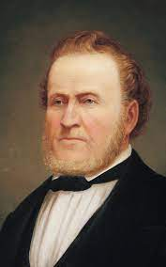
Growth of New Denominations
New Denominations
Millerites: End of the world & 2nd coming of Jesus (Seventh Day Adventist)
Mormons (Church of Later Day Saints)
Founder: Joseph Smith
Major issue: belief in polygamy
Brigham Young – Mormon Trail to Utah (New Zion - westward expansion)
Mormon Trail – New Zion
Joseph Smith
Brigham Young

Slide 17
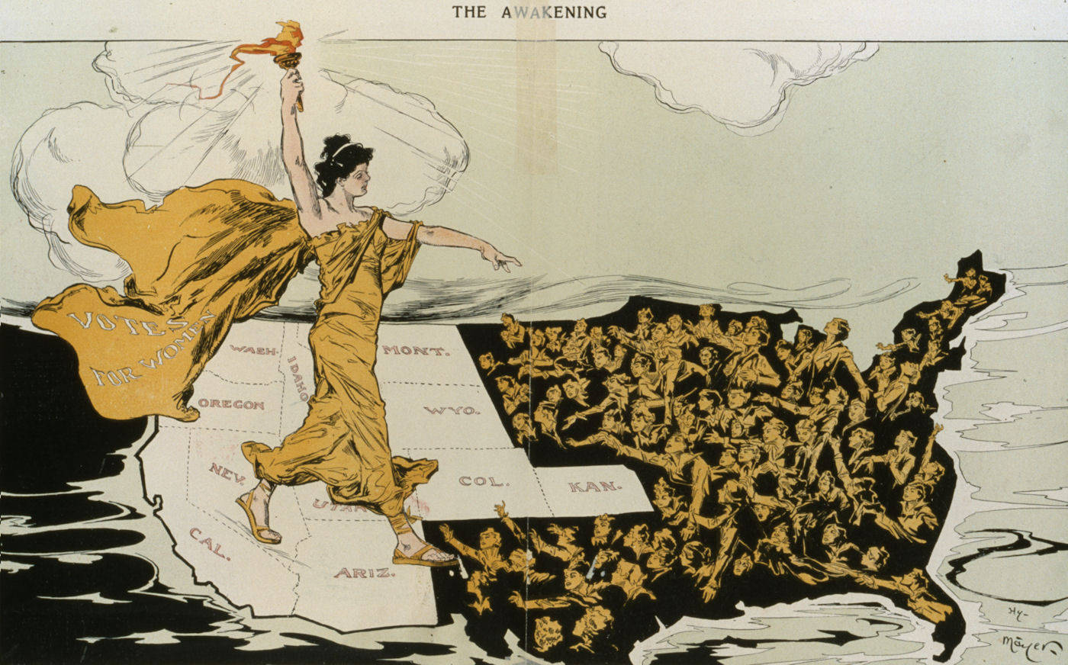
Effects of Revivalism
Rise of perfectionism: saw both individuals and society at large as capable of indefinite improvement
Emerging middle class – reform is a badge of honor
Age of Reform - Reforms become radicalized
Suffrage
Abolitionism
Prohibition
Public Education
Asylum & Penitentiary
Utopian Societies

Slide 18
Essential Question: How did revivalism challenge and impact the Antebellum period of the early 19th century United States?
Students can:
Explain how American culture reflected themes of the nation from 1800 to 1850
Evaluate factors that caused the desire amongst Americans to reform society during the Antebellum period
Agenda
Objective 9 Reading Question
Rise of Reform
Reformers Speed Dating
Homework:
Reformers Speed Dating due 11/22

Slide 19
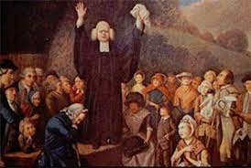
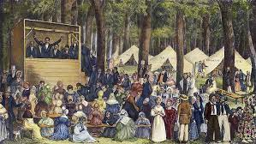
Rise of a Great Awakening
Historic Parallel
What factors lead to the rise of the First Great Awakening (1730)?
How is the Second Great Awakening (1840) similar to the First Great Awakening?
How is the Second Great Awakening different than the First Great Awakening
Similarities
Both were a call back to religion (liberal ideas infiltrating traditional practices
Both had heavily resonated with those in the frontier
Less effective with well educated & prosperous congregations
Differences
(1st Great Awakening) – God’s grace was the only way to earn salvation
(2nd Great Awakening) - Salvation could be achieved through good work and make better the world a better place

Slide 20
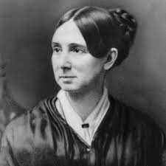
Rise of Reform
Antebellum Period:1820 -1861
Market Revolution
Jacksonian Democracy
Cause of the Age of Reform
2nd Great Awakening
“In a world where there is so much to be done, I felt strongly impressed that there must be something for me to do.”
- Dorothea Dix
Enlightenment & Liberalism

Slide 21
Rise of Reform
“Spiritual Reform From Within”
[Religious Revivalism]
Social Reforms & Redefining the Ideal
of Equality
Transcendentalism
Utopian Societies
Women’s Rights
Temperance
Abolitionism
Asylum & Penal Reform
Education
Move from persuasion to political action

Slide 22
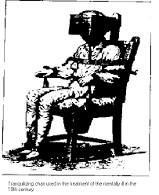
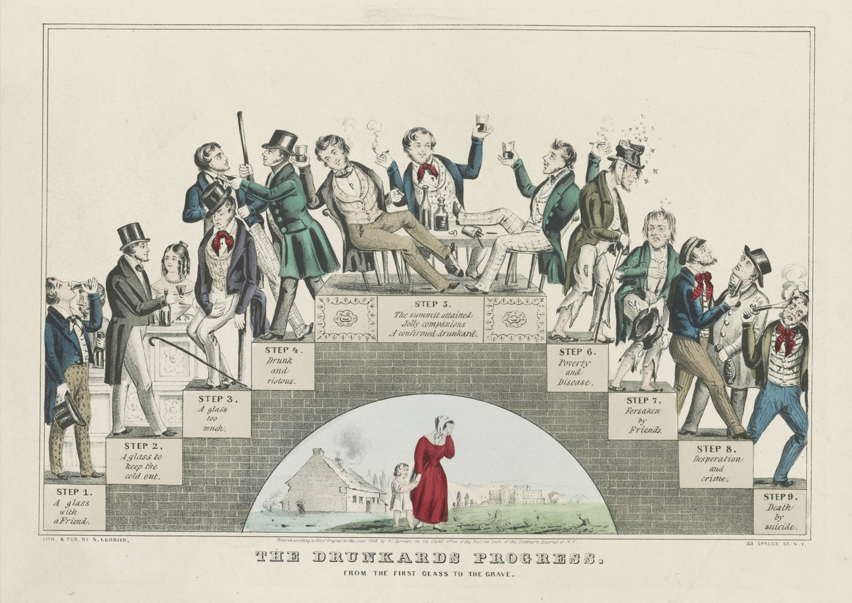
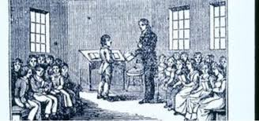
Reform Movement Goals
Reform Movements = Jeremiad Sermons on immortality in America
Temperance Movement – Goal ban the production, sale, and use of alcohol (The Old Deluder)
Public Education Movement – establish public schools for children to educate the common as a moral to prepare for voting
Asylum & Penitentiary Movement – raise up the mentally disabled to the level of common man by removing them from prisons.

Slide 23
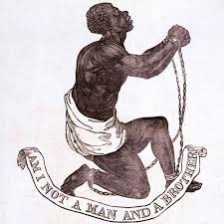
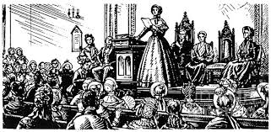
Reform Movement Goals
Reform Movements = Jeremiad Sermons on immortality in America
Women Rights Movement – gain the right of suffrage and equal treatment under the law
Utopian Societies – To establish perfect societies and escape the brutalities of the Market Revolution
Abolitionism – end the brutality of slavery and free African Americans from bondage that did not fit within a Constitutional republic

Slide 24
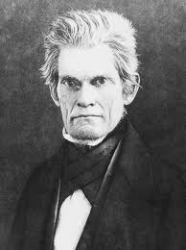
In Defense of Slavery
“A large portion of the Northern States believed slavery to be a sin, and would consider it as an obligation of conscience to abolish it …. where two races of different origin, and distinguished by color, and other physical differences, as well as intellectual, are brought together, the relation now existing in the slaveholding States between the two, is, instead of an evil, a good–a positive good. . . . compare his condition with the tenants of the poor houses in the more civilized portions of Europe–look at the sick, and the old and infirm slave, on one hand, in the midst of his family and friends, under the kind superintending care of his master and mistress, and compare it with the forlorn and wretched condition of the pauper in the poorhouse.”
- Slavery a Positive Good, John C. Calhoun, 1837
Southern Attitudes defending the institution of slavery
Biblical defense: Earning conversion for their labor
Slave labor treated better than wage labor

Slide 25
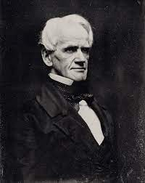
Public Education Movement
Modern Public Schools - creating a system of tax supported schools – education key to democracy and economic growth
Horace Mann (Sec. of Ed. Massachusetts)
Compulsory attendance
Teacher training
Public schools' curriculum
Reading, Writing, Arithmetic, & Morality
Noah Websters’ “Blue Back Spellers” & William McGuffey’s “McGuffey Readers”

Slide 26
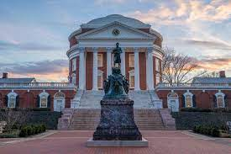
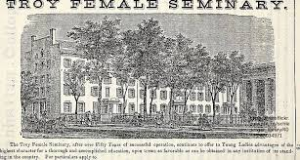
Expansion of Education
Secondary Education
Universal public education: (UNC & UVA)
By 1860 every state offered free public education to whites.
US had one of the highest literacy rates in the world (80%).
Women colleges (Troy Female Seminary)
University of Chapel Hill
University of Virginia
Troy Seminar – Emma Willard

Slide 27
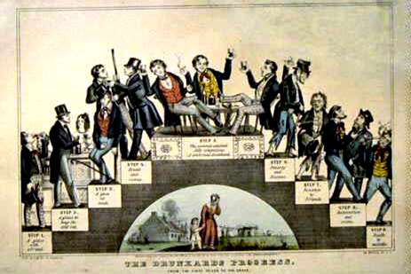
Rise of Reform
A Christian reform movement to end the power of the Demon Rum – “The Old Deluder” (American Temperance Society – 1826)
Washingtonians – recovering alcoholics arguing for temperance
Impact – Neal Dow’s Maine Law
Drunkard’s Progress 1846
“From the first glass to the grave

Slide 28
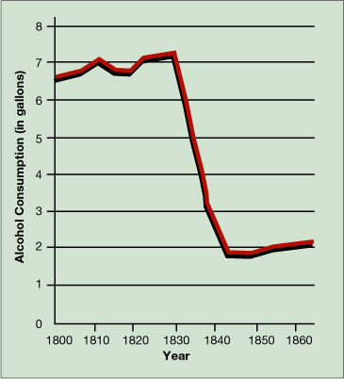
The Temperance Transformation
Per Capita Consumption of Alcohol, 1800-1860

Slide 29
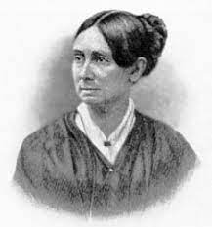
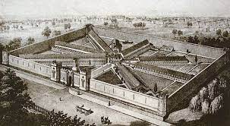
Penitentiary & Asylum Reform
Growth of the Prison Population (Mental Disabled & Paupers)
Mentally insane treatment – Dorothea Dix (create the benevolent empire)
Institutions for treatment of mentally disabled
School for the Deaf – Thomas Gallaudet
School of the Blind – Dr. Samuel Gridley Howe
End debtors’ prison
Asylum movement & Auburn system: use structure and discipline to bring about morality

Slide 30
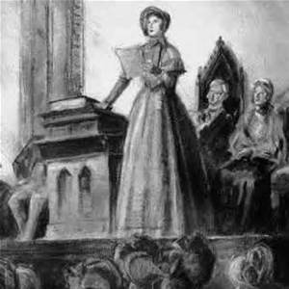
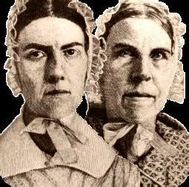
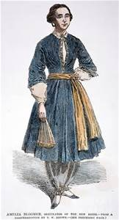
Transformation of Republican Motherhood
Duty of Women: to civilize men and raise the family with an understanding morality and democracy
2nd Great Awakening: Women largest converts Reform Movement (Domestic Feminism)
Women Reformers
Catherine Beecher – Teaching
Suffragist: Lucretia Mott, Elizabeth Cady Stanton, Susan B. Anthony
Abolitionism: Grimke Sisters

Slide 31
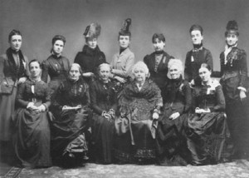
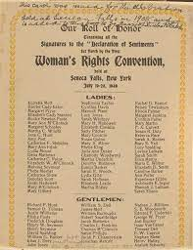
The Jeremiah Sermon on Women’s Equality
We hold these truths to be self-evident; that all men and women are created equal; that they are endowed by their Creator with certain inalienable rights; that among these are life, liberty, and the pursuit of happiness; that to secure these rights governments are instituted, deriving their just powers from the consent of the governed. Whenever any form of Government becomes destructive of these ends, it is the right of those who suffer from it to refuse allegiance to it, and to insist upon the institution of a new government, laying its foundation on such principles, and organizing its powers in such form as to them shall seem most likely to effect their safety and happiness.
- Declaration of Sentiment, 1848
Seneca Falls, 1848
Birth of Women’s Equality Movement
Declaration of Sentiment – equality & suffrage

Slide 32
Distribution of Slave Population

Slide 33
Questioning Slavery
Abolitionism – Quaker belief of equality
Achieving an end to slavery
Gradual emancipation
American Colonization Society 1816 (Back to Africa – Liberia)
Radical Abolitionism – for equality
2nd Great Awakening Abolitionism
Theodore Dwight Weld – “American Slavery as it is”
Lane Seminary (Lane Rebels) – Theodore Weld, Catherine, Harriet, & Henry Ward Beecher

Slide 34
Reaction to Abolitionism
Southerner Defense of Slavery
Northern Rejection of Abolitionism
John C. Calhoun’s “Slavery as a Positive Good” (1837)
Biblical support of slavery
Slave masters encourage Christianity
Better than wage slavery in Northern factories
Extremist views of radical abolitionist unpopular
Rev. Elijah Lovejoy – killed
William Lloyd Garrison - beaten up
Slavery & the South under attack
Nat Turner Rebellion (1831)
Stricter slave codes
Gag Rule

Slide 35
Radical Abolitionism
Radical Abolition Movement (Beacon Upon A Hill)
William Lloyd Garrison – Liberator 1831 (Nat Turner Revolt)
American Anti-slavery Society 1833 - Wendell Phillips (The Abolition Golden Trumpet),
David Walker, Sojourner Truth, and Frederick Douglas
Political impact: Liberty Party 1840, Free Soilers 1848, & Republican Party 1850

Slide 36
Rise of the underground railroad
Conductor – Harriet Tubman
Northern Support of Abolitionism
Underground Railroad
Free Soiler Party
Priggs v. Pennsylvania (1842) – Fed gov. in charge of enforcing Fugitive Slave Act Liberty Laws

Slide 37
A Southern Defense of Slavery
Paying their dues for salvation
John C. Calhoun, "Slavery a Positive Good," Delivered in a Speech in the U. S. Senate, February 6, 1837
I hold that in the present state of civilization, where two races of different origin, and distinguished by color, and other physical differences, as well as intellectual, are brought together, the relation now existing in the slaveholding States between the two, is, instead of an evil, a good. a positive good . . .
Southern Response: John C. Calhoun’s “Slavery a Positive Good”
Justify slavery via the Bible
Contrast it to factory laborers
Gag rule (Free speech & press)
Growing disunion

Slide 38
Educating the North
Harriet Beecher Stowe’s “Uncle Tom’s Cabin” (1852)
“So, you are the little lady who wrote the book that started this great war”
- Abraham Lincoln
“You ought to be ashamed, John! Poor, homeless, houseless creatures! It’s a shameful, wicked, abominable law, and I’ll break it, for one, the first time I get a chance; and I hope I shall have a chance, I do! Things have got to a pretty pass, if a woman can’t give a warm supper and a bed to poor, starving creatures, just because they are slaves, and have been abused and oppressed all their lives, poor things!”

Slide 39
Essential Question: How did revivalism challenge and impact the Antebellum period of the early 19th century United States?
Students can:
Evaluate factors that caused the desire amongst Americans to reform society during the Antebellum period
Decipher impacts of social reform movements within the United States
Agenda
Goal of Reform
Rise of Reform
Reformers Speed Dating
Homework:
Reformers Speed Dating due 12/7
Unit IV Test – 12/12

Slide 40
Awaken From Sin
A. Select ONE of the following factors and explain how it contributed to the rise of the Second Great Awakening
Democratic growth of the U.S.
Mechanization
Challenges to Christianity
Rugged individualism
B. Identify and explain ONE reform movement that supports the topic you selected in part A
C. Explain ONE factor that will limit the ability of social reform to achieve its goal during the Antebellum Reform Movement.

Slide 41
Utopian Societies
Utopian Society Movement: the practice of perfectionism
Shakers (simplicity of life) Mother Ann Lee – separation of the sexes
Brook Farm (Transcendentalists)
Oneida Community: (United community of perfectionism – Jesus Millennial Kingdom
New Harmony - Robert Owen (Transcendentalist intellectuals)
Margaret Fuller
Shakers
Oneidas

Slide 42
Rise of Romanticism
Romanticism reaction to the Market Revolution and a celebration of American victory in the War of 1812 & Western Expansion
Romantic Period Writers
Washington Irving – “Legend of Sleepy Hollow”
James Fenimore Cooper – “The Leatherstocking Tales” (celebration of the frontier
Edgar Allen Poe – “The Raven” (individual experiences)
Herman Melville – “Moby Dick” (clash cultural conflicts)

Slide 43
Essential Question: How did revivalism challenge and impact the Antebellum period of the early 19th century United States?
Students can:
Explain how American culture reflected themes of the nation from 1800 to 1850
Evaluate factors that caused the desire amongst Americans to reform society during the Antebellum period
Agenda
Reformers Speed Dating
Matching Reformers to Movements
Homework:
Review Unit IV for DBQ Monday

Slide 44
Speed Dating
Today you meet a variety of reformers from the Age of Reform
Select a question you wish to discuss during your 4 minutes (2 minutes each) time period
Complete the chart for each reformer you meet
Name of Reformer
Reform Movement
Major contributions
When you hear the music rotate to your left on seat if you face the back wall

Slide 45
Match the Reformer to the movement
Reform Movements
Abolitionism - Asylum/Penal Reform - Public Education - Temperance
Utopian Societies - Transcendentalism - Women’s Rights
Neal Dow and Maine Law - Lucretia Mott & Seneca Falls
John Humphrey Noyes & Oneida - Frederick Douglass & The North Star
Ralph Waldo Emerson & Henry David Thoreau - Brook Farm & John Owens
Elizabeth Cady Stanton & Declaration of Sentiment - The Old Deluder & American Temperance
Horace Mann, Troy Seminary
Dorothea Dix
William Lloyd Garrison & The Liberator

Slide 46
Speed Dating
Explain TWO major factors that led to the rise of the Age of Reform from 1820 – 1860.
Evaluate the goal(s) and the success of the following movements during the Age of Reform from 1820 to 1850.
Women’s Reform Movement
Abolitionism

Slide 47
Essential Question: How did revivalism challenge and impact the Antebellum period of the early 19th century United States?
Students can:
Evaluate factors that caused the desire amongst Americans to reform society during the Antebellum period
Decipher impacts of social reform movements within the United States
Agenda
DBQ breakdown
Document analysis
Thesis and Historical Contextualization
Homework:
DBQ Writing – complete planner

Slide 48
Unit IV DBQ
Prompt: Evaluate to the extent to which the United States developed a national identity from 1800 -1855.
Historical Thinking Skill
Categories
Time period
Brainstorm – Recall important ideas and factors from the time period
Document analysis
Tone of the document – positive or negative?
Main idea of the Document
HIPP Analysis – include facts in and implied in the document

Slide 49
Unit IV DBQ
Prompt: Evaluate to the extent to which the United States developed a national identity from 1800 -1855.
Category 1
Category 2
Category 3
Documents
Documents
Documents
Thesis – Although X, A + B claim y

Slide 50
Unit IV DBQ
Prompt: Evaluate to the extent to which the United States developed a national identity from 1800 -1855.
Historical Contextualization
Causation factor – Must before 1800 and relate to the ideas in your thesis
Theme? (remember to center this around a theme and your ism or ation words
Immediate fact – CANNOT be anything relating to what you will write in the body paragraphs

Slide 51
Essential Question: How did revivalism challenge and impact the Antebellum period of the early 19th century United States?
Students can:
Evaluate factors that caused the desire amongst Americans to reform society during the Antebellum period
Decipher impacts of social reform movements within the United States
Agenda
DBQ Writing
Homework:
No Homework – Thanksgiving Holiday

