Slide 1
MCHP LIONS
Getting ready for the
act

Slide 2
MCHP LIONS
Sally Shipley,
GCS
School Social Worker

Slide 3
March 1, 2022 Tuesday
All Juniors will take the test
Be at school by 11 am
4 hours of testing
Please do not be late.

Slide 4
March 1, 2022
There is only one 10-minute break.
Bring a snack and water for this break.
Transition time in between sections
time to take a breath.
not a full break.

Slide 5
Students will not have their phones
We will have lunch first, as usual.
Buses will run on their normal schedules
IT'S AN ALL-DAY event
Students do not need a heavy book bag

Slide 6
ACT Scores
19/20 is an average score
and it is the new baseline score for colleges as of this school year
A perfect score is 36

Slide 7
ACT Scores
Percentile | English | Math | Reading | Science | Composite
99th (Best) | 35+ | 34+ | 35+ | 35+ | 34+
90th (Excellent) | 30-31 | 27-28 | 31-32 | 28 | 29
75th (Good) | 24 | 24-25 | 25-26 | 23-24 | 24-25
50th (Average) | 19-20 | 18-19 | 20 | 19-20 | 19-20
25th (Poor) | 14 | 15-16 | 15-16 | 15-16 | 15-16
10th (Very Poor) | 10-11 | 14 | 12 | 13 | 13
1st (Poorest) | 7 and below | 12 and below | 9 and below | 9 and below | 10 and below
https://blog.prepscholar.com/what-is-a-good-act-score-2021

Slide 8
Percentile | English | Math | Reading | Science | Composite
99th (Best) | 35+ | 34+ | 35+ | 35+ | 34+
90th (Excellent) | 30-31 | 27-28 | 31-32 | 28 | 29
75th (Good) | 24 | 24-25 | 25-26 | 23-24 | 24-25
50th (Average) | 19-20 | 18-19 | 20 | 19-20 | 19-20
25th (Poor) | 14 | 15-16 | 15-16 | 15-16 | 15-16
10th (Very Poor) | 10-11 | 14 | 12 | 13 | 13
1st (Poorest) | 7 and below | 12 and below | 9 and below | 9 and below | 10 and below

Slide 9
ACT Scores
Some colleges are test optional.
Students choose 4 schools to send scores to on the bubble pages.
Sending scores later costs $16 per college/university

Slide 10
ACT Prep Class
Students WERE SELECTED IF THEY SCORED A 17 OR BELOW ON THE pRE-ACT
Some students self-selected for the course

Slide 11
ACT Prep Class
studied all topics
Reviewed practice questions
Final exam was a full practice test

Slide 12
ACT @ GCS
1 free administration of the ACT
For 11th graders
Family can seek other opportunities.
Online registrations

Slide 13
Pre- ACT is offered in the fall for free
9, 10 and 11th graders take the pre-act

Slide 14
Pre- ACT is offered in the fall for free
9, 10 and 11th graders take the pre-act

Slide 15
PSAT @ MCHP
Pre SAT is given in the fall
9, 10 & 11th graders

Slide 16
SAT @ MCHP
SAT will be given in the spring.
11th graders take the test
April, 2022

Slide 17
Subjects of the Test
English
Math
Reading
Science

Slide 18
English

Slide 19
English Portion * 75 multiple choice questions * 45 minutes * 36 seconds per question * Questions are connected to a passage they read.

Slide 20
English Portion Focus: * Sentence Structure * Grammar and Usage * Punctuation * Rhetorical Skills

Slide 21
Math

Slide 22
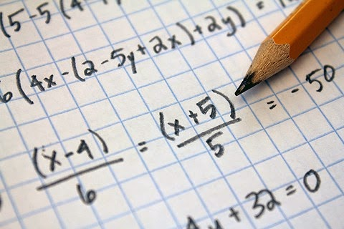
Math
60 multiple choice questions
60 minutes
1 minute per question!
Not going to have time for every question

Slide 23
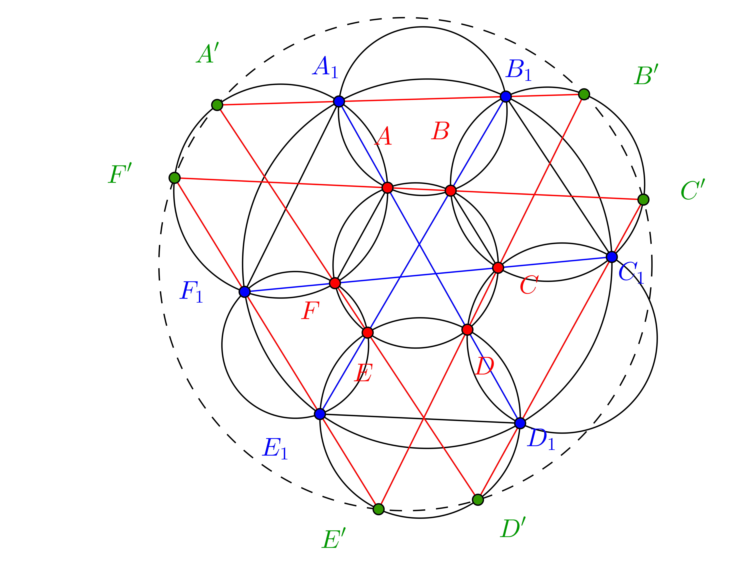
Do not rush through the early problems on the test to save time for the problems near the end.
Remember that all questions on the ACT are worth the same to the scoring machine, so you should set a pace that allows you to answer the early problems carefully without sacrificing speed.

Slide 24
Math Strategies
* Know how to estimate- this will improve your efficiency and score!
* Learn how to use a calculator – graphing functions and matrix problems

Slide 25
Math Strategies
* Be sure to eliminate the wrong answers.
* If you find yourself spending too much time on a problem early in the test, skip it and come back to it later.

Slide 26
Math Content
Focus is on:
Algebra I and II,
Arithmetic,
Geometry,
Trigonometry
7th-11th grade math

Slide 27
MATH Strategies
Language of Math
Words in the questions

Slide 28
Reading

Slide 29
Reading
* 40 multiple choice
* 35 minutes
* Less than 1 min to answer each question

Slide 30
Reading
4 Types of passages to read:
Prose – interesting, hard questions, takes the most time.
Social Sciences – history, civics
Humanities – arts, culture
Natural Sciences – biology, ecology

Slide 31
Science

Slide 32
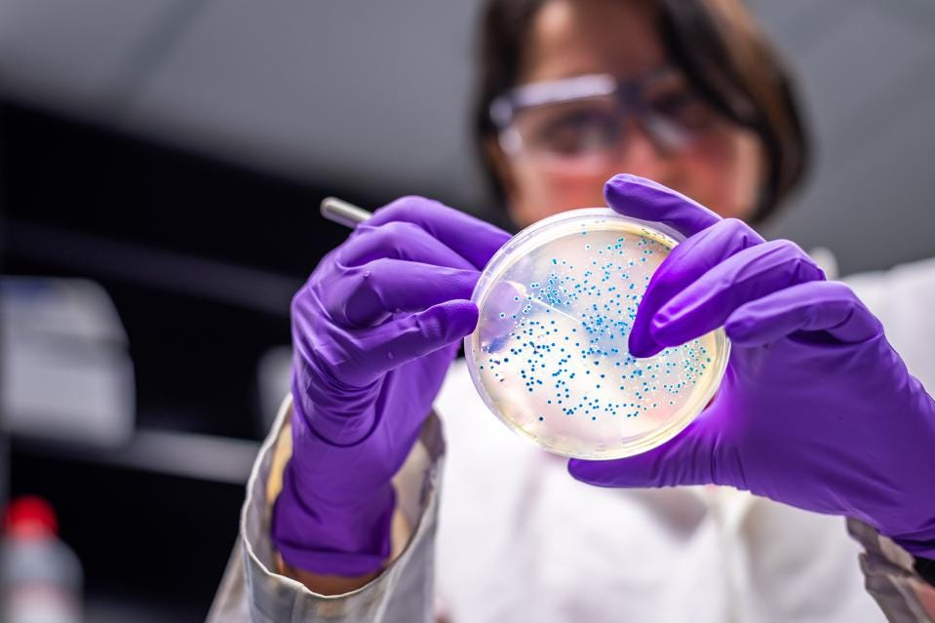
Science
Read and understand charts and graphs
Basic understanding of the scientific method

Slide 33
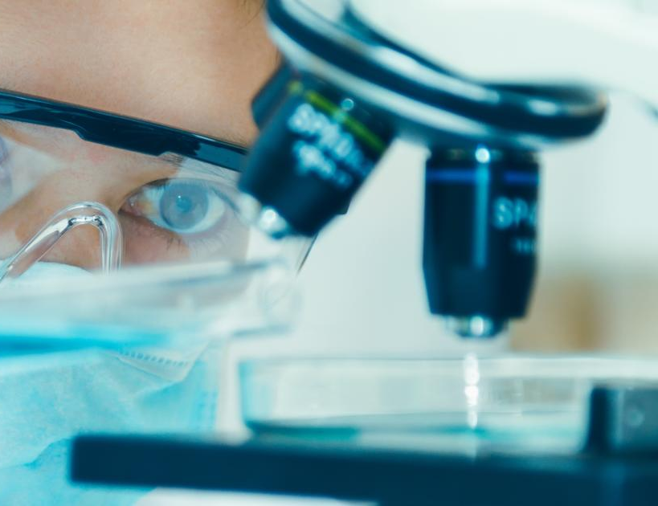
Science
Opposites – when you encounter 2 answer choices that are direct opposites, one will almost always be the correct answer.

Slide 34
Strategies for all sections

Slide 35
Generally – easier to harder. No rushing. You can skip a question and come back to it before you leave that section. Stay chill. Take full breaths.

Slide 36
Know yourself. Do your best for that day. Stay focused. No time to waste.

Slide 37
Answer Every Question.
There is no penalty for wrong answers.
Pick a letter for the day and use that letter every time you guess.

Slide 38
Answer Every Question.
You MUST answer every question in each section BEFORE you move on to the next section.
You CANNOT go back and do that later. And you cannot move forward before the teacher starts that section.

Slide 39
Use the process of elimination.
Read all the choices.
See if you can rule any out.

Slide 40
Keep an eye on the clock.

Slide 41
Timing
Test 1 – English, 45 minutes
Test 2 – Math, 60 minutes
Test 3 – Reading, 35 minutes
Test 4 – Science, 35 minutes
Each section gets a 5-minute warning.

Slide 42
Time
If students leave the room for a bathroom break, they DO NOT get that time back.

Slide 43
Time
There is one 10 minute break.
Students can take a snack and water out to the hallway.

Slide 44
Time
Please be on time.
A student cannot enter the testing room after testing has begun.
See you at
11 am :)

Slide 45
Daily Routines
At breakfast or dinner students can review 1 or 2 questions in each section of the test.
Eat a balance of protein, vegetables and carbohydrates to have energy for 4 hours of testing.

Slide 46
Daily Routines
S L E E P
S L E E P S L E E P S L E E P S L E E P S L E E P
ZZZZZZZZZZZZZZZZZZZZZZZZZZZZZZZZZZZZZZZZZ

Slide 47
Weekend Before the Test
Yes, take a practice test saturday.
Use results to study on sunday.
Complete & submit
college & MCHP assignments.

Slide 48
What to review with your student....
This slide show!
Knowing simple facts about the test will increase their knowledge so they know what to expect.
Family plan to be at school by 11 am.

