Slide 1
THIS or THAT
SUPERBOWL EDITION

Slide 2
How to play...
Pick your “This or That” picture on each slide.
Watch the example so you know how to do the exercise
Do the exercise for 20 seconds

Slide 3
THIS
THAT
OR

Slide 4
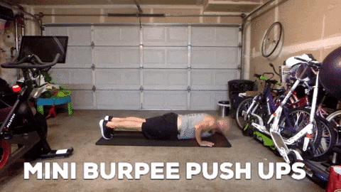
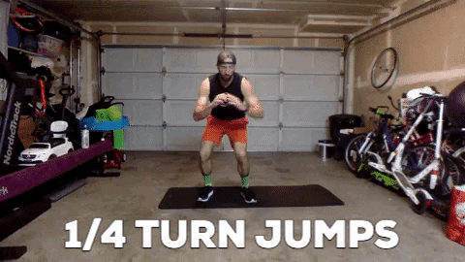
THIS
THAT
OR

Slide 5
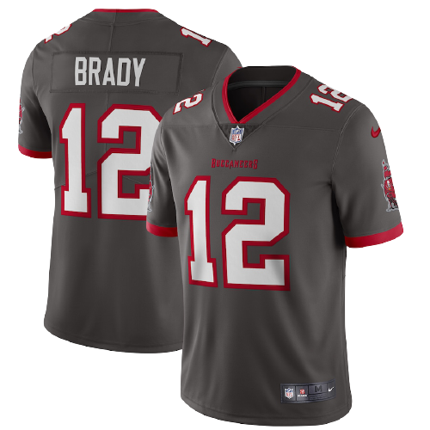
THIS
THAT
OR

Slide 6
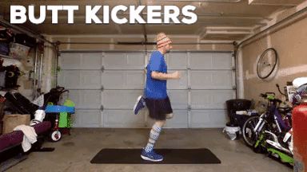
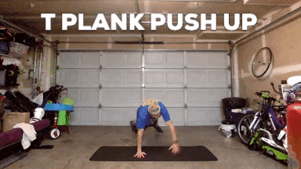
THIS
THAT
OR

Slide 7
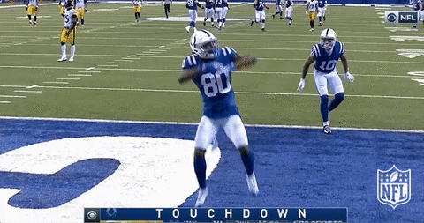
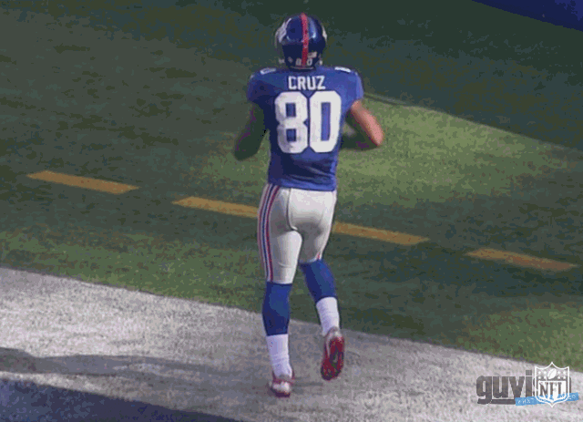
THIS
THAT
OR

Slide 8
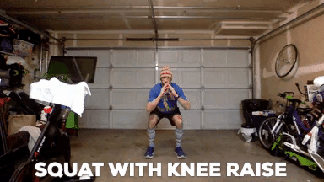
THIS
THAT
OR

Slide 9
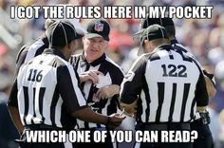
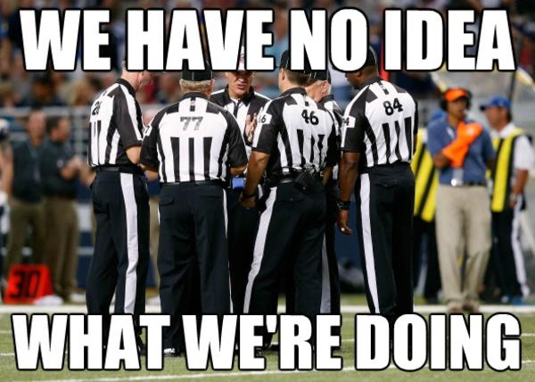
THIS
THAT
OR

Slide 10
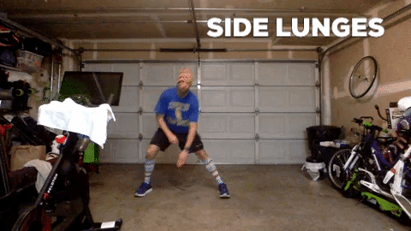
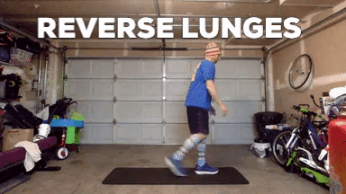
THIS
THAT
OR

Slide 11
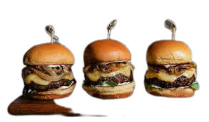
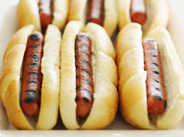
THIS
THAT
OR

Slide 12
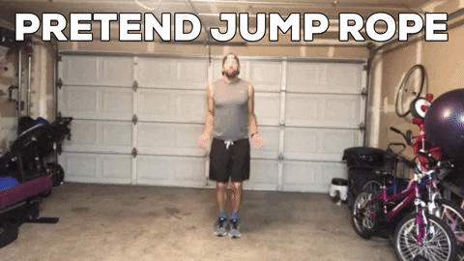
THIS
THAT
OR

Slide 13
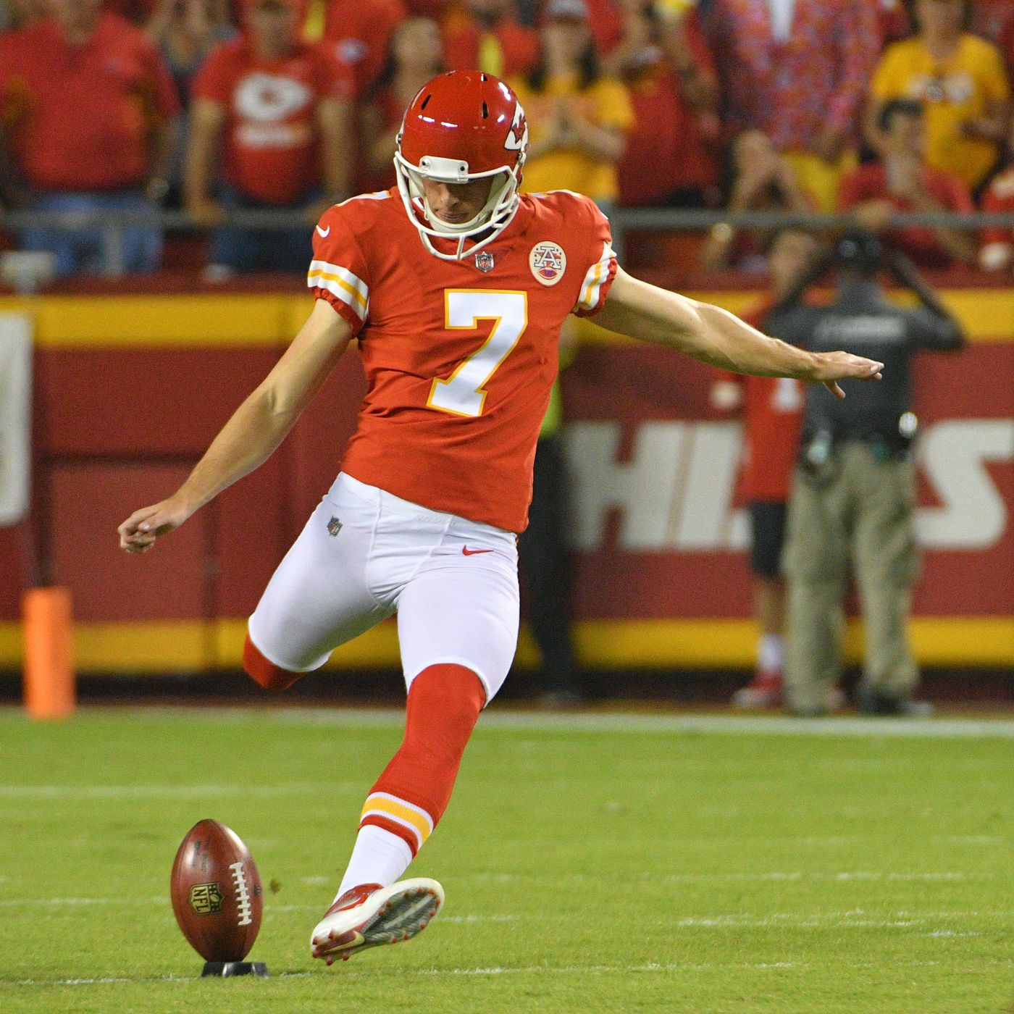
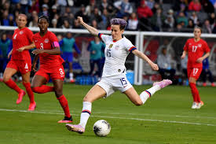
THIS
THAT
OR

Slide 14
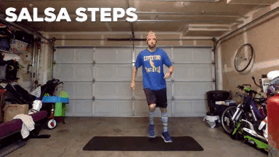
THIS
THAT
OR

Slide 15
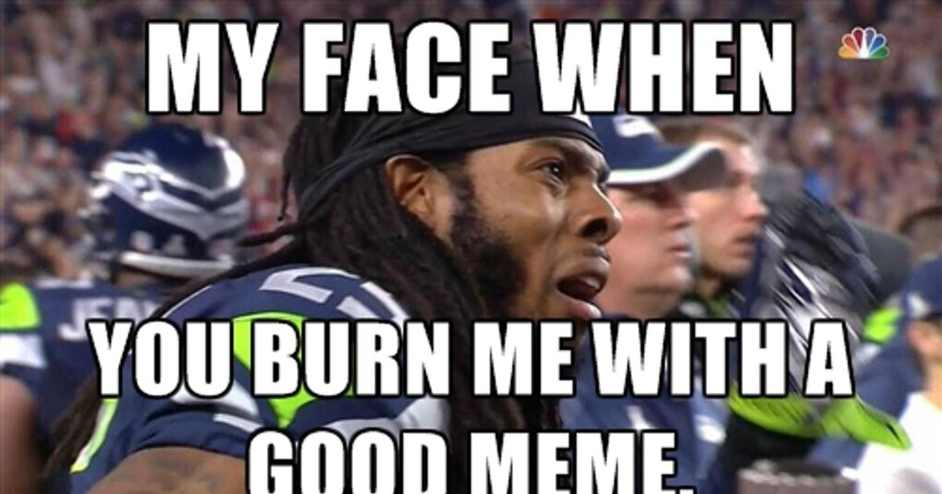
THIS
THAT
OR

Slide 16
THIS
THAT
OR

Slide 17
THIS
THAT
OR

Slide 18
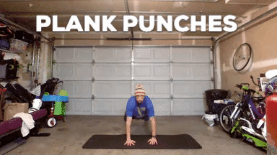
THIS
THAT
OR

Slide 19
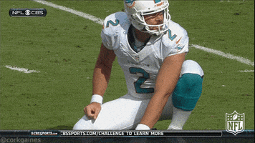
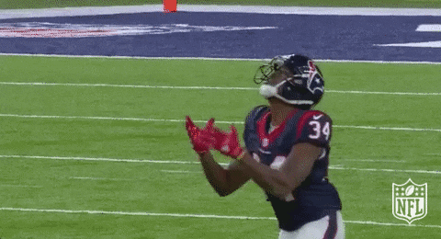
THIS
THAT
OR

Slide 20
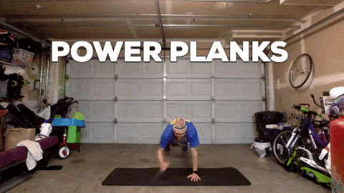
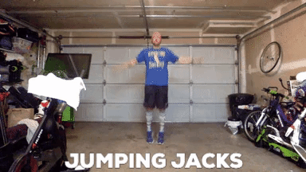
THIS
THAT
OR

Slide 21
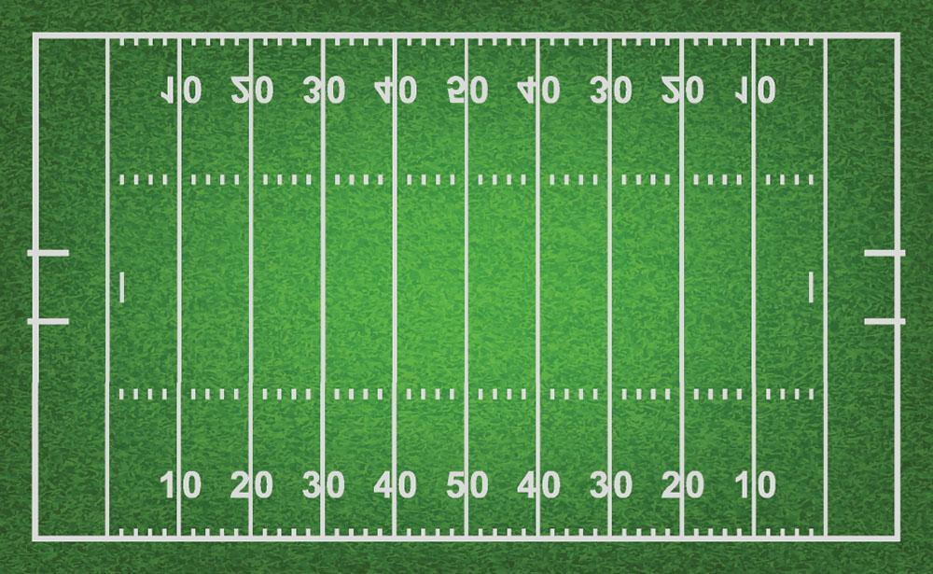
THIS
THAT
OR

Slide 22
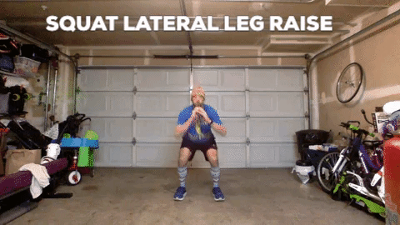
THIS
THAT
OR

