Slide 1
Reconstruction Era
Rebuilding America Post-Civil War (1865-1877)

Slide 2
Today’s Focus
E.Q. How effective was Reconstruction at rebuilding the union and achieving transformation of American society
Students can:
Evaluate the effectiveness of the Civil War Amendments
Decipher whether the former confederacy was rebuilt into the “New South”
Determine the short- and long-term impacts of Reconstruction on the United States
Agenda
The Columbia Question
Contextualization of Reconstruction
The Best Laid Plans
Homework:
Reconstruction DBQ

Slide 3
Today’s Focus
E.Q. How effective was Reconstruction at rebuilding the union and achieving transformation of American society
Students can:
Explain the effects of government policy during Reconstruction on society from 1865 -1877
Explain why and how Reconstruction resulted in continuity and change in regional and national understanding of what it meant to be an American
Agenda
The Columbia Question
Contextualization of Reconstruction
Three Plans of Reconstruction
Homework:
Read James MacGregor Burns article “Reconstruction, The Revolution that Failed” pages 1-5 – respond to prompt 1
Unit V Test, Thursday 1/11

Slide 4
HIPP Perspective of Reconstruction
Evaluate what problems Reconstruction must deal with in the aftermath of the Civil War. “Pardon. Franchise Columbia. -- "Shall I trust these men, and not this man?“ by Thomas Nast
PARDON
Columbia – “Shall I Trust These Men?”
FRANCHISE
And Not This Man?

Slide 5
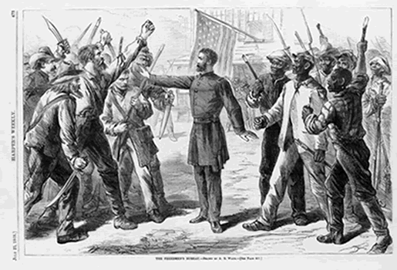
Guiding Question
Key Concept 5.3: The Union victory in the Civil War and the contested reconstruction of the South settled the issue of slavery and secession, but left unresolved many questions about the power of the federal government and citizenship rights.
How did the Civil War & Reconstruction change the United States politically, socially and economically?
Some historians have called Reconstruction a “Glorious Failure”? How accurate is this description?

Slide 6
Evaluate the point of view of Puck’s political cartoon “The Strong Government” vs. “The Weak Government” as a perspective of the success of Reconstruction.

Slide 7
Key Questions of Reconstruction
Reconstruction 1865-1877
4. What branch of government should control the process of Reconstruction?
1. How to bring the South back into the Union?
2. How to rebuild the South after its destruction during the war?
3. How to integrate and protect newly emancipated freedmen?
1. How to bring the South back into the Union?

Slide 8
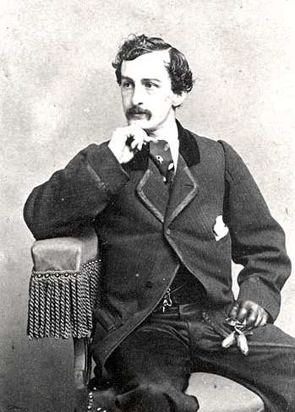
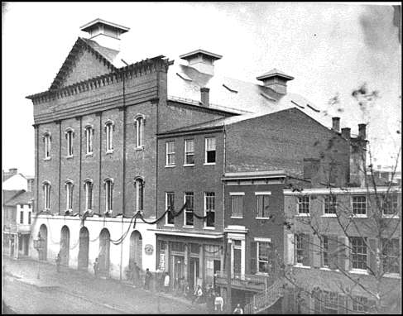
The Fate of Reconstruction
Lincoln’s Assassination (April 14, 1865)
John Wilkes Booth
Lincoln’s death – who will oversee Reconstruction and what objectives will it attempt to achieve
Ford’s Theater, April 1865
John Wilkes Booth, 1862

Slide 9
Presidential Reconstruction Assisting the former slaves
Thirteenth Amendment (Ratified Dec. 1865)
“Neither slavery nor involuntary servitude, except as punishment for crime whereof the party shall have been duly convicted, shall exist within the United States or any place subject to their jurisdiction.”
“Congress shall have power to enforce this article by appropriate legislation.”
What is the exception of the 13th Amendment in dealing with servitude?

Slide 10
Civil War Promotes an Industrial Economy
REPUBLICAN ADVANTAGE
Growth of Wealth in the Industrial North
Market Revolution a major factor Union victory
War profiteering funds new industrial growth
Morrill Tariff 1861
Westward expansion
Transcontinental RR
Homestead Act
Southerner cash crop economy pays the price

Slide 11
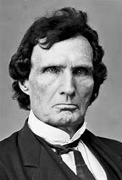
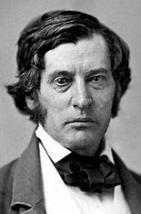
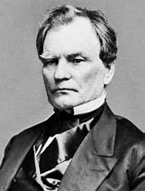
Rise of the Radical Republicans
Goal: the immediate and complete eradication of slavery
BLAMED the SOUTH for CIVIL WAR
Support industrial northern economy
Thaddeus Stevens
Charles Sumner
Benjamin Wade

Slide 12
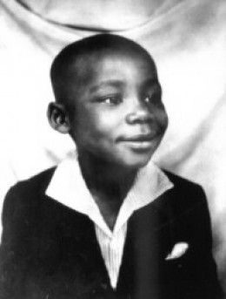
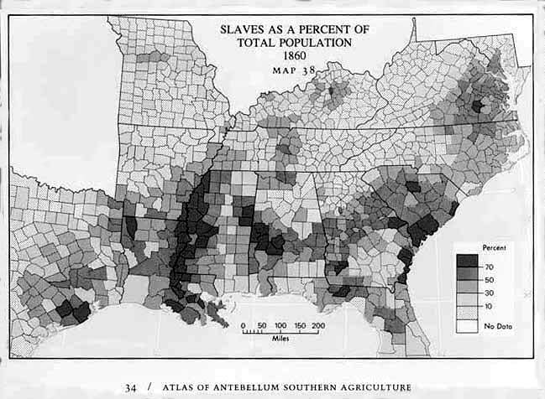
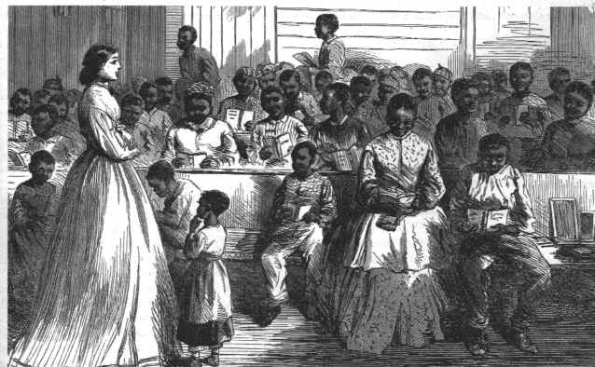
Education of Freedmen
13th Amendment freed – 3,950,546 slaves
Who is this famous graduate of a freedmen’s school?
Freedmen’s Bureau 1865
Provides food, clothing, and medical assistance to freedmen & poor whites
Establishes public schools in the South

Slide 13
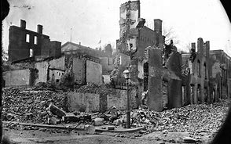
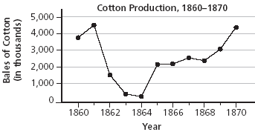
The South in the Aftermath of WAR
Civil War Destroys the South economically
Southern economy
Total war and Union blockade destroys the South
13th Amendment end slavery (Freedmen still seen as inferior)

Slide 14
Stages of Reconstruction
1. Presidential Reconstruction (1863-1866)
2. Congressional (or Radical) Reconstruction (1867-1877)
3. Redemption (1877-1900)
(creation of the “New South”)

Slide 15
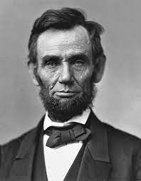
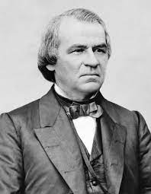
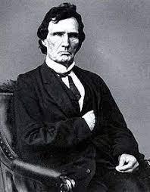
Plans for Reconstruction
Compare the three plans for reconstruction to determine how they answered the 4 main questions of reconstruction
How should the South re-enter the Union?
How should the South be rebuilt after the Civil War
How should freedmen be integrated into society?
What branch had the authority to regulate reconstruction
Lincoln’s 10% Plan
Johnson’s Plan
Radical Republicans’ Plan

Slide 16
DBQ Re-Write
Two Paragraphs
Introduction:
Must have a valid historic contextualization centered around a theme that supports your thesis
Must have causation, immediate effect, and long-term effect
Defense paragraph
Must defend a bases of your thesis
Must demonstrate proper use of two documents (HIPP level) and defend the argument of your thesis
Must include three to four facts per documents
Due Tuesday, Jan 9 (NO LATES ACCEPTED)

Slide 17
The McPherson Test
“[In the Civil War,] great issues were at stake, issues about which Americans were willing to fight and die, issues whose resolutions profoundly transformed and redefined the United States. The Civil War was a total war in three senses: it mobilized the total human and material resources of both sides, it ended not in negotiated peace but in total victory by one side and unconditional surrender by the other, it destroyed the economy and social system of the loser and established those of the winner as the norm for the future . . . The North went to war to preserve the Union; it ended by creating a nation.”
James McPherson, historian, “A War That Never Goes Away,” American Heritage, March 1990
1. What must Reconstruction achieve in order to support McPherson’s belief in the excerpt above? (Cite two examples)

Slide 18
DBQ - prompt
Prompt: Civil War and it’s cost in lives was supposed to bring about a rebirth of the United States fomented by Reconstruction. Evaluate the degree in which historians’ assessment that Reconstruction was a failed revolution is the correct view of the time period from 1865 to 1877?
You must use all FOUR documents

Slide 19
HIPPY STATEMENTS
Break down the four documents
Be sure to explain purpose and make to connections in the documents and inferred by the documents
Document C: Henry Adams Statement
In September I asked the boss to let me go to Shreveport. He said, "All right, when will you come back?" I told him "next week." He said, "You had better carry a pass." I said, "I will see whether I am free by going without a pass."
I met four white men about six miles south of Keachie, De Soto Parish. One of them asked me who I belonged to. I told him no one. So him and two others struck me with a stick and told me they were going to kill me and every other Negro who told them that they did not belong to anyone. One of them who knew me told the others, "Let Henry alone for he is a hard-working nigger and a good nigger." They left me and I then went on to Shreveport. I seen over twelve colored men and women, beat, shot and hung between there and Shreveport.

Slide 20
HIPPY STATEMENTS
Document C: Henry Adams Statement
In September I asked the boss to let me go to Shreveport. He said, "All right, when will you come back?" I told him "next week." He said, "You had better carry a pass." I said, "I will see whether I am free by going without a pass."
I met four white men about six miles south of Keachie, De Soto Parish. One of them asked me who I belonged to. I told him no one. So him and two others struck me with a stick and told me they were going to kill me and every other Negro who told them that they did not belong to anyone. One of them who knew me told the others, "Let Henry alone for he is a hard-working nigger and a good nigger." They left me and I then went on to Shreveport. I seen over twelve colored men and women, beat, shot and hung between there and Shreveport.
- Source: Former slave Henry Adams made this statement before the U.S. government in 1880 about the early days of his freedom after the Civil War
Henry Adams, freedmen from Shreveport Louisiana, explains to the U.S. government in 1880 that lynching and intimidations, by groups, such as the KKK, was used to keep African Americans as second-class citizens and limit their equality in the South proving that Reconstruction has failed to achieve its goals.

Slide 21
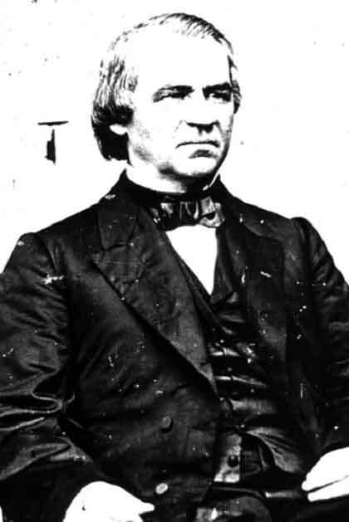
Presidential Reconstruction
Andrew Johnson
Johnson’s Reconstruction Plan:
Amnesty upon simple oath
Exceptions: Confederate government officials, military officers & those with property over $20,000.
Pardons
2) New state constitutions -
repudiate Slavery, Secession, and Confederate debts.
Process: Provisional governors, elections
for constitutional conventions.

Slide 22
Today’s Focus
E.Q. How effective was Reconstruction at rebuilding the union and achieving transformation of American society
Students can:
Explain the effects of government policy during Reconstruction on society from 1865 -1877
Explain why and how Reconstruction resulted in continuity and change in regional and national understanding of what it meant to be an American
Agenda
Reconstruction, The Revolution That Failed
From President to Congressional Reconstruction
Three Plans of Reconstruction
Homework:
Read James MacGregor Burns article “Reconstruction, The Revolution that Failed” pages 6-11 – respond to prompt 2
Unit V Test, Thursday 1/11

Slide 23
The Challenges of Reconstruction
Reconstruction was an opportunity for the United States to be returned to the foundational ideas of the Declaration of Independence and the U.S. Constitution.
Explain why TWO factors that hampered efforts of Reconstruction in the following areas.
Prior to 1866
The passage and implementation of the 15th Amendment
2. Evaluate the impact of Reconstruction Amendments (13th, 14th, & 15th Amendment).
Success
Failures

Slide 24
Replacing Lincoln
17th President (1865-1869) – Andrew Johnson
Southern Democrat (Tennessee)

Slide 25
Johnson’s Failure
All freedmen, free negroes and mulattoes in this State, over the age of eighteen years, found on the second Monday in January, 1866, or thereafter, with no lawful employment or business, or found unlawfully assembling themselves together, either in the day or night time, and all white persons so assembling themselves with freedmen, free negroes or mulattoes, or usually associating with freedmen, free negroes or mulattoes, on terms of equality, or living in adultery or fornication with a freed woman, free negro or mulatto, shall be deemed vagrants, and on conviction thereof shall be fined in a sum not exceeding, in the case of a freedman, free negro or mulatto, fifty dollars, and a white man two hundred dollars, and imprisoned at the discretion of the court, the free negro not exceeding ten days, and the white man not exceeding six months....
Mississippi Black Codes, 1866 (Vagrancy Laws)
Johnson re-empowers the south
Pardons 13,500 former confederates
Black Codes passed by Southern States
Vetoes – Freedmen’s Bureau Act & Civil Rights Act of 1866

Slide 26
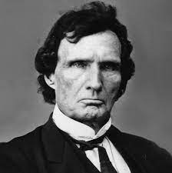
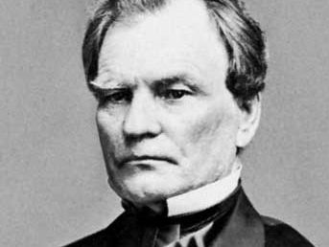
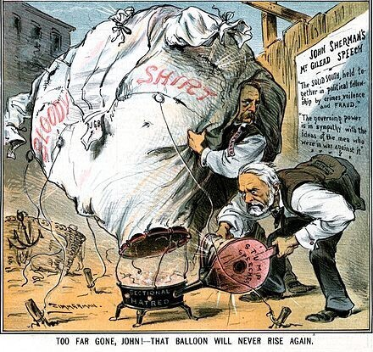
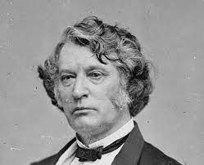
Rise of the Radical Republicans
Congressional Election of 1866 – Radical Republicans gain control of Congress (3-1 margin)
Wave the Bloody Shirt Campaign – remind northerners of southern treason
Override Johnson’s Veto
Freedmen Bureau Act 1866 – expands and extend Freedmen’s Bureau
Civil Rights Act of 1866 – grants citizenship to freedmen

Slide 27
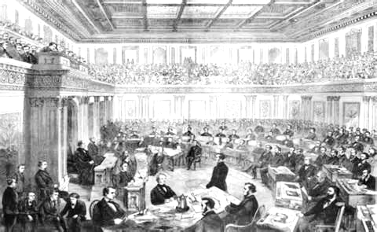
Impeachment of Andrew Johnson
Impeachment
Tenure of Office Act: Congress controls the firing of presidential cabinet members
Johnson impeached (gives power to Radical Republicans)

Slide 28
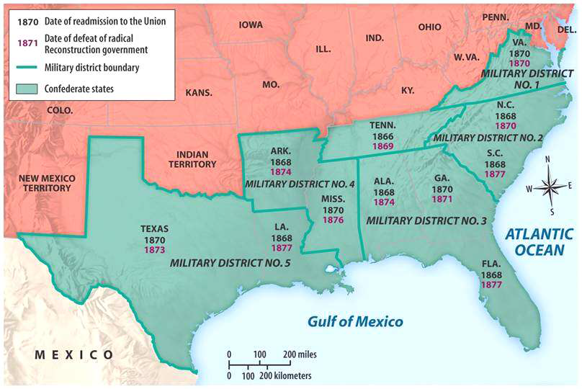
Congressional Reconstruction
Military Reconstruction Act of 1867 – Placed former confederate states under military occupation

Slide 29
Civil Rights Protection
All freedmen, free negroes and mulattoes in this State, over the age of eighteen years, found on the second Monday in January, 1866, or thereafter, with no lawful employment or business, or found unlawfully assembling themselves together, either in the day or night time, and all white persons so assembling themselves with freedmen, free negroes or mulattoes, or usually associating with freedmen, free negroes or mulattoes, on terms of equality, or living in adultery or fornication with a freed woman, free negro or mulatto, shall be deemed vagrants, and on conviction thereof shall be fined in a sum not exceeding, in the case of a freedman, free negro or mulatto, fifty dollars, and a white man two hundred dollars, and imprisoned at the discretion of the court, the free negro not exceeding ten days, and the white man not exceeding six months....
Mississippi Black Codes, 1866 (Vagrancy Laws)
14th Amendment (1868)
Citizenship
Equal protection under the law (block black codes)
Due process clause: states can’t deny life, liberty, or property
Bans former confederates from holding elected office

Slide 30
Plans for Reconstruction
Compare the three plans for reconstruction to determine how they answered the 4 main questions of reconstruction
How should the South re-enter the Union?
How should the South be rebuilt after the Civil War
How should freedmen be integrated into society?
What branch had the authority to regulate reconstruction
Lincoln’s 10% Plan
Johnson’s Plan
Radical Republicans’ Plan

Slide 31
Challenges of Reconstruction
Stress testing Reconstruction 1865-1877
What was the motivating factor of Lincoln’s 10% Plan?
Why did Radical Republicans reject Lincoln’s 10% Plan?
Identify and explain THREE factors caused Johnson’s Plan to fail and by rejected by Radical Republicans?
How did Congressional Reconstruction attempt to achieve the goals of Reconstruction?

Slide 32
Congressional Reconstruction
What is the Radical Plan?
Reconstruction Acts of 1867:
Constitutions and governments set up under Johnson thrown out
“Ironclad oath”
New state constitutions - with black suffrage Ratification of Thirteenth & Fourteenth Amendments
Military supervision: voter registration, constitution making, governments

Slide 33
Congressional Reconstruction
Why do the Radicals in Congress take control?
How?
Dec. 1865 - Congress bars Southern Senators and Congressmen elected under Johnson’s plan
Joint Committee on Reconstruction created.
March 1866 – Congress passes the Freedmen’s Bureau renewal bill and the 1866 Civil Rights Act over Johnson’s vetoes (1st veto overrides in U. S. history)
Nov. 1866 – After Johnson made a disastrous tour around the north pushing his plan, voters give Republicans 3-1 majorities in both houses and control of every northern state.

Slide 34
Reconstruction Plans
Plans | Leaders | Plan Requirements | Impact
Lincoln’s 10% Plan | President Lincoln | 10% of a state’s population take an oath of loyalty Returns all property, except slaves | Wade-Davis Bill (attempt to alter it) Lincoln’s assassination killed it
Johnson’s Plan | President Johnson | Amnesty upon oath (except Confederate officers & people owning property worth $20,000 repudiate Slavery, Secession, and Confederate debts. | Allowed former confederates to be re-elected Johnson’s impeached for violating the Office of Tenure Act
Congressional Reconstruction ******* | Radical Republicans – Charles Sumner & Thaddaeus Stevens | Reconstruction Act of 1867: Military occupation of the South Ironclad oath of loyalty Ratification of the 14th Amendment | Hindered by Redeemers & KKK Compromise of 1877 ends Reconstruction

Slide 35
Reconstruction GOALs
In your notes demonstrates why the four following goals have to be achieved in order for Reconstruction to be successful
1. Protect new African American Freedmen
2. Rebuild Southern economy
3. Reintegrate the South back into the Union
4. Which Branch of Government will control Reconstruction

Slide 36
Today’s Focus
E.Q. How effective was Reconstruction at rebuilding the union and achieving transformation of American society
Students can:
Evaluate the effectiveness of the Civil War Amendments
Decipher whether the former confederacy was rebuilt into the “New South”
Determine the short- and long-term impacts of Reconstruction on the United States
Agenda
Documents! SCORE
Historical Contextualization Stimulates a DBQ
Reconstruction Document Analysis
Homework:
Reconstruction DBQ

Slide 37
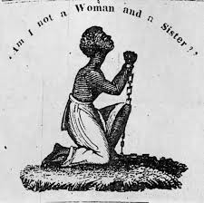
HIPP Analysis
Scoring on HIPP analysis
1 pt. (describing) This engraving represents the idea of abolitionism
2 pt. (explaining) The engraving promotes abolitionism during the Era of Reform and shows how slaves are held in bondage and counted as property
3 pt. (HIPP statement) Patrick Reason in 1835 wanted Americans to support the idea of abolitionism and women’s suffrages during the Age of Reform to demonstrate the immorality of holding people as second-class citizens by denying the ideas of equality, liberty, and populism.
Remember – NEVER start a writing about a document with the phrase “IN DOCUMENT A” – Always use either the name of the document or the creator of the document.

Slide 38
Reconstruction in contexts
Prompt: Civil War and it’s cost in lives was supposed to bring about a rebirth of the United States fomented by Reconstruction. Evaluate the degree in which historians’ assessment that Reconstruction was a failed revolution is the correct view of the time period from 1865 to 1877?
Intro paragraph: Construct your introduction paragraph by developing your historic contextualization
Remember to connect ideas in your historic contextualization
Causation – event leading to reconstruction prior to 1865
Immediate effect – event in the period 1865 – 1877 that demonstrates the effects of Reconstruction (remember to select something that will not be used as evidence in your body paragraphs)
Long term effect – event after 1877 which demonstrates how Reconstruction influenced the United States going forward
Remember – writing your historic contextualization DO NOT WRITE the CAUSATION of reconstruction was _____________. Writing is not bulleted format

Slide 39
Today’s Focus
E.Q. How effective was Reconstruction at rebuilding the union and achieving transformation of American society
Students can:
Evaluate the effectiveness of the Civil War Amendments
Decipher whether the former confederacy was rebuilt into the “New South”
Determine the short- and long-term impacts of Reconstruction on the United States
Agenda
Radical Rejection
Reconstruction Document Analysis
Civil War SAQ – Due today
Homework:
Reconstruction DBQ

Slide 40
Today’s Focus
E.Q. How effective was Reconstruction at rebuilding the union and achieving transformation of American society
Students can:
Explain the effects of government policy during Reconstruction on society from 1865 -1877
Explain why and how Reconstruction resulted in continuity and change in regional and national understanding of what it meant to be an American
Agenda
Reconstruction, The Revolution That Wasn’t
The Challenges of Freedmen Rights
Reconstruction Perspective
Homework:
DBQ Re-writes
The Reconstruction, The Revolution That Wasn’t
Unit V Test, Thursday 1/11

Slide 41
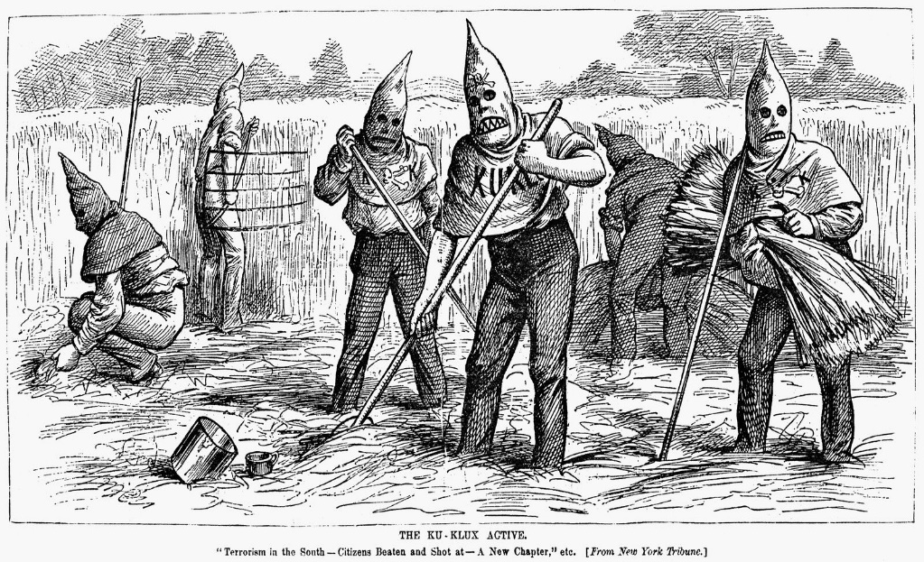
The Revolution that Wasn’t
In roughly 50 words use the following terms to explain why historians, such as James Burns, argued that Reconstruction was a failure
Fourteenth Amendment
Reconstruction Acts of 1867
Black Codes
Sharecropping
Election of 1876
Granger, “Terrorism in the South”, 1880

Slide 42
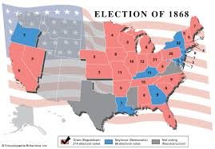
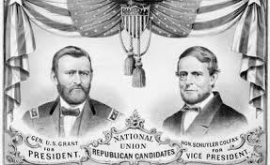
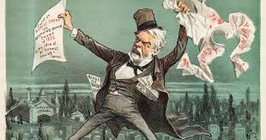
Another War Hero President
Election 1868: President Ulysses S. Grant (18th President)
Factors for Grant’s Victory
Freedman Citizenship vs. Democrat’s “Negro Supremacy”
G.A.R. = Grand Army of the Republic (Veterans’ Pensions)
Wave the Bloody Shirt Campaign

Slide 43
Protecting the Freedmen
13th Amendment 1865
Civil Rights Act (Enforcement Acts) 1875
Freedmen’s Bureau 1865
KKK Acts 1871
Civil Rights Act of 1866
15th Amendment 1870
Reconstruction Act of 1867
14th Amendment 1868
How did Southerners undermine federal government protections for freedmen?

Slide 44
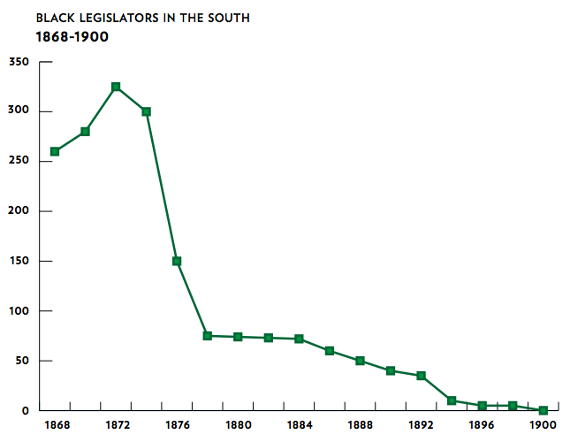
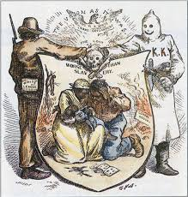
1st Black Senators & Congressmen, 1872
15th Amendment (African Americans enfranchisement)
Poll Taxes, Literacy Test, & Grandfather Clause used to limit enfranchisement
Intimidation by (KKK, Whiteman’s League, & Knights of the Camelia)

Slide 45
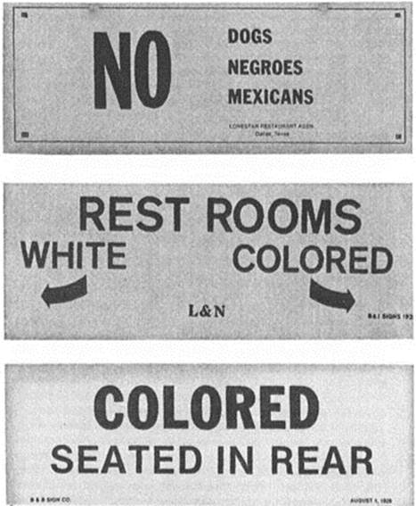
Segregation
Civil Rights Act of 1875: (only a legislative victory)
Not discrimination in public accommodations
African Americans cannot be excluded from juries
United States v. Stanley 1883: Congress does not have the authority to regulate public accommodations
Black Codes – promoted segregation

Slide 46
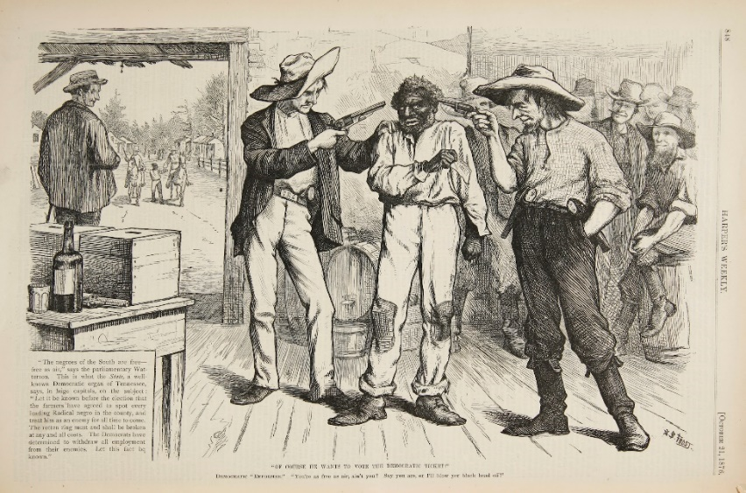
KKK Got to Go Away
I met four white men about six miles south of Keachie, De Soto Parish. One of them asked me who I belonged to. I told him no one. So him and two others struck me with a stick and told me they were going to kill me and every other Negro who told them that they did not belong to anyone. One of them who knew me told the others, "Let Henry alone for he is a hard-working nigger and a good nigger." They left me and I then went on to Shreveport. I seen over twelve colored men and women, beat, shot and hung between there and Shreveport.
Henry Adams
Wave the Bloody Shirt Campaign
KKK or Force Acts 1870 & 71
Influencing, intimidation of African American voters
or registration a felony offense
- U.S. Military enforcement

Slide 47
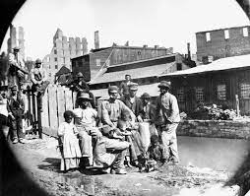
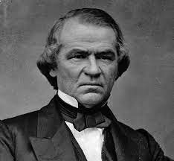
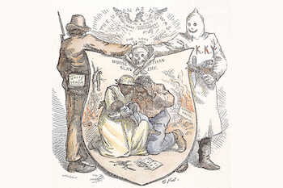
Reconstruction Perspective
Reconstruction was a point in American history where the United States could reset the nation back to the foundational ideas of the Declaration of Independence and the Constitution.
Evaluate why historians consider Reconstruction, the Revolution that failed.
Examine the perspectives of the following four groups
Freedmen
Radical Republicans
Reconstruction Presidents
Redeemers

Slide 48
Congressional Reconstruction
1. Why were both Lincoln’s 10% Plan and Johnson’s Plan for Reconstruction rejected by Radical Republicans?
2. How was the Reconstruction Acts of 1867 different from both Lincoln’s and Johnson’s Plan?
3. Why did the Radical Republicans fail to bring about a Revolution in America after the Civil War?

Slide 49
Thaddeus Stevens Hallmark
“No government can be free that does not allow all its citizens to participate in the formation and execution of her laws”
Select ONE of the following and explain how it supported Thaddeus Stevens view of Reconstruction.
14th Amendment
15th Amendment
KKK Acts of 1871
B. Explain ONE way in which Radical Republican Plans for Reconstruction caused the failure of a revolution.

Slide 50
DBQ - prompt
Prompt: Civil War and it’s cost in lives was supposed to bring about a rebirth of the United States fomented by Reconstruction. Evaluate the degree in which historians’ assessment that Reconstruction was a failed revolution is the correct view of the time period from 1865 to 1877?
Success
Failure
What is achieve? How can you turn it into a bases for a thesis
Why is it a failure? How can you turn it into a bases for a thesis

Slide 51
Today’s Focus
E.Q. How effective was Reconstruction at rebuilding the union and achieving transformation of American society
Students can:
Evaluate the effectiveness of the Civil War Amendments
Decipher whether the former confederacy was rebuilt into the “New South”
Determine the short and long term impacts of Reconstruction on the United States
Agenda
Impeding progress of Reconstruction
Hey Ho! Reconstruction Got to Go!
Thesis Face OFF
Homework:
Reconstruction DBQ
Unit V test – Wed. 3/3

Slide 52
Impeding Progress
Identify factors that caused the downfall of Reconstruction
Reintegrate the South
Rebuild the South
Integrate freedmen into society
What Branch Controls Reconstruction

Slide 53
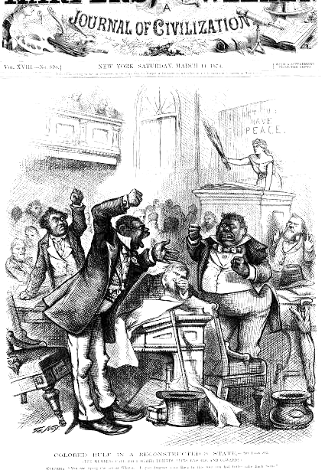
Congressional Reconstruction
Reconstruction Governments
• “carpetbaggers”
• “scalawags”
• freedmen
“The IGNORANT CLASS” – Southern attitude

Slide 54
Rise of the Redeemers
Amnesty Act of 1872: removed all restrictions against former confederate leaders
Rise of the REDEEMERS (ex confederate leaders)
“ignorant class”

Slide 55
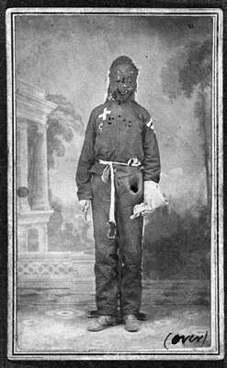
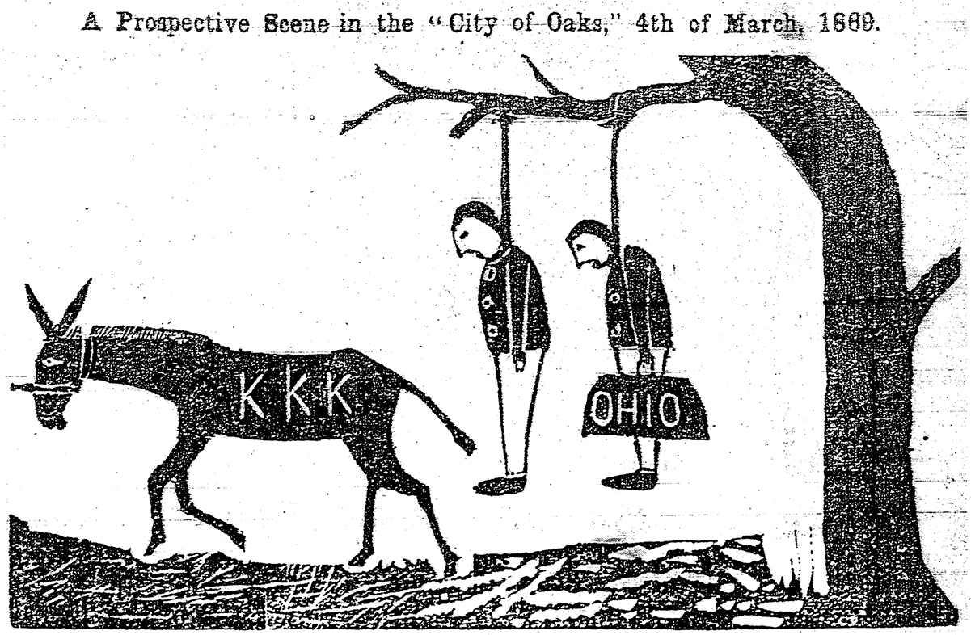
Racial Violence & intimidation
How does the South regain control?
Knights of the White Camellia
White Leagues
Ku Klux Klan
Mississippi Klansman, 1871
(Courtesy of Mr. Herbert Peck, Jr.)
Intimidation - Lynching

Slide 56
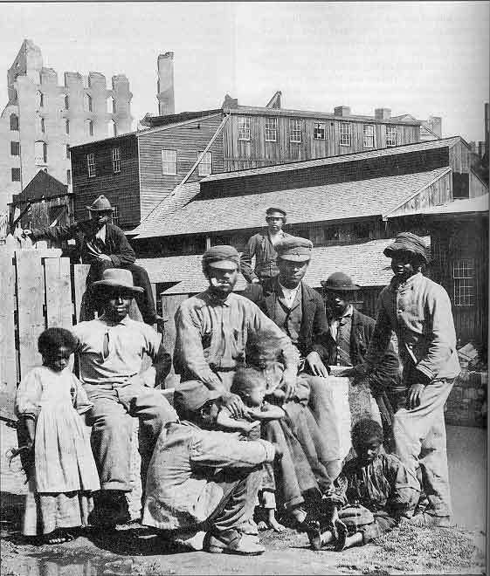
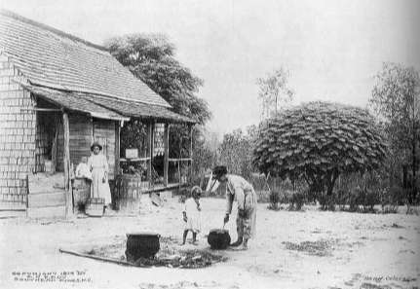
Congressional Reconstruction
Economic failure of Reconstruction
“40 Acres & a mule” (never happened – freedmen have NO economic power)
Tenant farming
Share cropping
Crop lien system
Freedmen in Richmond, Virginia, 1865
Sharecropper’s cabin, North Carolina, 1914

Slide 57
Tenancy & Crop Lien System
FURNISHING MERCHANT | TENANT FARMER | LANDOWNER
Loans tools & seed @ up to 60% interest to farmer to plant spring crop Also provides food, clothing, etc. on credit until the harvest. Holds “lien” on part of future crops | Plants crop, harvests in fall. Turns over up to ½ of crop to owner as rent. Gives remainder of crop to merchant to pay debt. | Rents land to tenant in exchange for ¼ to ½ of tenant farmer’s future crop.

Slide 58
SHARECROPPING & THE CYCLE OF DEBT
Poor whites & freedmen have
no jobs, homes, or $ to buy land
Sharecropper cannot
leave farm as long as he
is in debt to landlord.
Poor whites & freedmen
sign contracts to work
landlord’s acreage for
part of the crop.
At harvest, sharecropper
owes more to landlord
than his share of the crop
is worth.
Landlord keeps track of
the $$ that sharecroppers
owe for housing and food.

Slide 59
Grantism
Graft: Using political position to steal (GRANTISM) – The Era of GOOD STEALING
GRANTISM
President Grant ignores political corruption
Credit Mobilier Scandal
Whiskey Ring Scandal

Slide 60
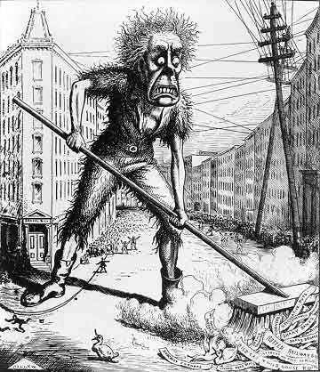
Economic Panic
PANIC of 1873
Employment 14%
18,000 business failed
Northern Population: why spend $$ on Reconstruction
Reconstruction losing momentum
Evaluate whether Northerners ever truly supported equality for freedmen.

Slide 61
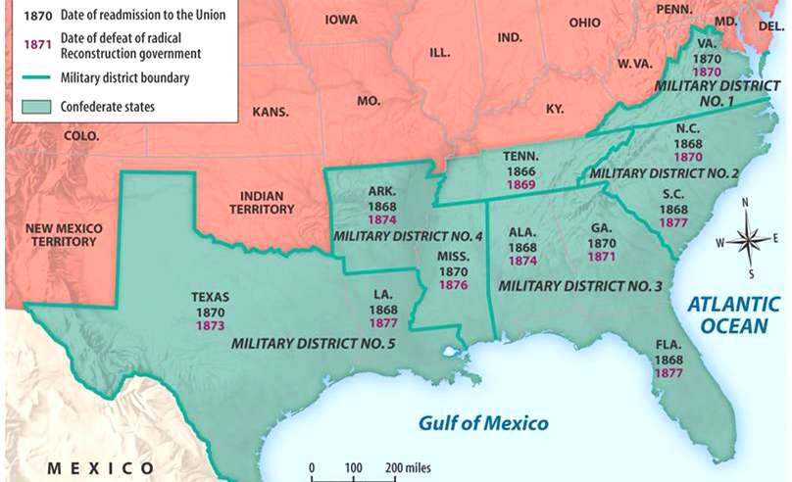
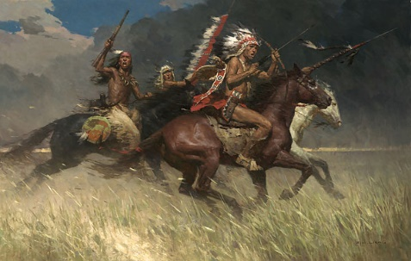
The Failure of Federal Enforcement
Failure of Military
Native American conflicts in the West
Wounded Knee Massacre
Little Big Horn

Slide 62
DBQ - prompt
Prompt: Civil War and it’s cost in lives was supposed to bring about a rebirth of the United States fomented by Reconstruction. Evaluate the degree in which historians’ assessment that Reconstruction was a failed revolution is the correct view of the time period from 1865 to 1877?
Success
Failure
What is achieve? How can you turn it into a bases for a thesis
Why is it a failure? How can you turn it into a bases for a thesis
Thesis Formula: X-HOWEVER (counter-argument), A+B (two support bases) Therefor Y (claim that responds to the prompt)

Slide 63
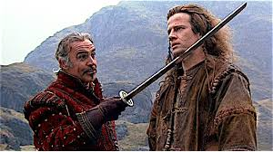
There can be only one
Prompt: Civil War and it’s cost in lives was supposed to bring about a rebirth of the United States fomented by Reconstruction. Evaluate the degree in which historians’ assessment that Reconstruction was a failed revolution is the correct view of the time period from 1865 to 1877?
Remember in APUSH there can only be ONE!
Each member of the group write a thesis
Eliminate theses until one stands
Factors for elimination
Vagueness
Uses documents
Too narrow
Doesn’t respond to the prompt

Slide 64
Today’s Focus
E.Q. How effective was Reconstruction at rebuilding the union and achieving transformation of American society
Students can:
Evaluate the effectiveness of the Civil War Amendments
Decipher whether the former confederacy was rebuilt into the “New South”
Determine the short and long term impacts of Reconstruction on the United States
Agenda
Two perspective of Reconstruction
The Compromise that Let Freedmen in a State of Enslavement
DBQ Body Building
Homework:
Reconstruction DBQ due 3/1
Unit V test – Wed. 3/3

Slide 65
Brief explain ONE historic perspective expressed by the artist about the change from the period of 1869 -1877 to the period 1877-1881
Briefly explain how ONE specific event or development led to the historic change suggested by the images

Slide 66
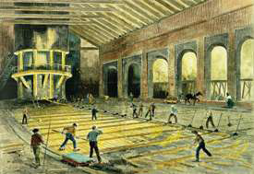
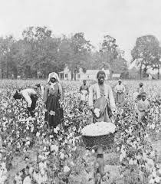
Redemption VS. the New south 1877-1900
% of Farms Share-cropped by county
Pig iron, Birmingham, 1877 (Harper's Weekly, March 26, 1877)
New South (Economics)
Some manufacturing (Textiles & Steel)
James B. Duke – American Tobacco Co. (Cigarettes)
Old South
Cash crops
Sharecropping & Tenant Farming (crop lien system)

Slide 67
Slaughterhouse Cases 1873
The next observation is more important in view of the arguments of counsel in the present case. It is, that the distinction between citizenship of the United States and citizenship of a state is clearly recognized and established....
It is quite clear, then, that there is a citizenship of the United States, and a citizenship of a state, which are distinct from each other, and which depend upon different characteristics or circumstances in the individual.
We think this distinction and its explicit recognition in this Amendment of great weight in this argument, because the next paragraph of this same section, which is the one mainly relied on by the plaintiffs in error, speaks only of privileges and immunities of citizens of the United States, and does not speak of those of citizens of the several states. The argument, however, in favor of the plaintiffs, rests wholly on the assumption that the citizenship is the same and the privileges and immunities guaranteed by the clause are the same. — Slaughterhouse Cases: 83 U.S. 36, 73–74 (1873)
14th Amendment does not apply to states

Slide 68
United States v. Cruikshank 1876
“There is in our political system a government of each of the several States, and a Government of the United States. Each is distinct from the others, and has citizens of its own who owe it allegiance, and whose rights, within its jurisdiction, it must protect. The same person may be at the same time a citizen of the United States and a citizen of a State, but his rights of citizenship under one of those governments will be different from those he has under the other.”
“The Government of the United States, although it is, within the scope of its powers, supreme and beyond the States, can neither grant nor secure to its citizens rights or privileges which are not expressly or by implication placed under its jurisdiction. All that cannot be so granted or secured are left to the exclusive protection of the States”
United States v. Cruikshank 1876
14th Amendment does not apply to states

Slide 69
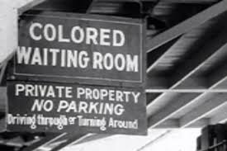
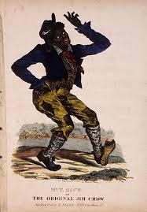
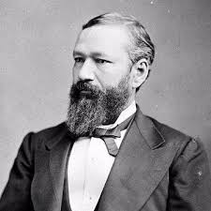
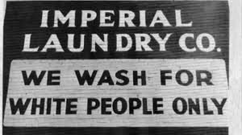
Building Jim Crow
Jim Crow = Legalized Segregations
14th Amendment does NOT apply to the states
Slaughterhouse Cases 1873
Plessy v. Ferguson 1896
U.S. v. Cruikshank 1876
The argument also assumes that social prejudices may be overcome by legislation, and that equal rights cannot be secured to the negro except by an enforced commingling of the two races. We cannot accept this proposition. If the two races are to meet upon terms of social equality, it must be the result of natural affinities, a mutual appreciation of each otherís merits, and a voluntary consent of individuals. . . .
- Justice Brown, Plessy v. Ferguson 1896
Homer Plessy

Slide 70
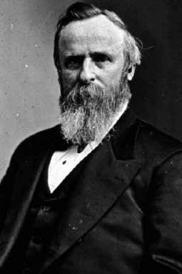
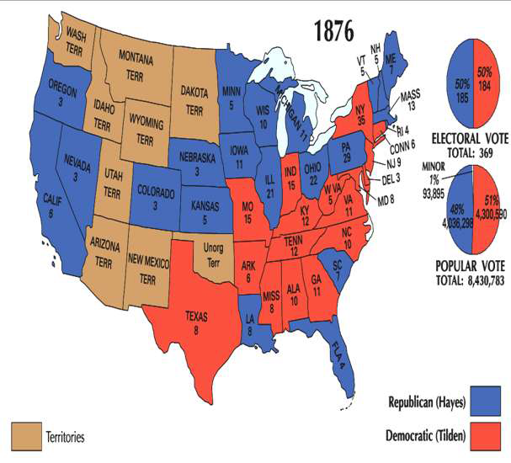
End of Reconstruction
Why?
Election of 1876 – No winner
Rutherford B. Hayes v. Samuel
Tilden
Rutherford B. Hayes

Slide 71
Killing reconstruction
Home-rule in the South
“The whole South—every state in the South—had got into the hands of the very men that held us as slaves.”
- Henry Adams, Black Louisianan
Compromise of 1877
R.B. Hayes (R) president of the U.S.
Military withdrawn from the South (No more Republican interference)
Redeemers appointed to key cabinet positions

Slide 72
The death of Reconstruction
NO SIGNIFICANT CIVIL RIGHTS LEGISTION FOR THE 100 YEARS

Slide 73
Two Views of Freedmen Integration
The First Vote
Colored Rule in a Reconstructed State

Slide 74
DBQ Body building
Body Paragraph Format – use the same format for all three body paragraphs.
Topic Sentence – Use the first bases of your thesis and connect it to your thesis (DO NOT use a document at all in your opening sentence)
Thesis – American labor during the Industrial Revolution were somewhat effective at combating repression through unionization and political engagement. However the federal government’s pro laissez stance limited the passage of effective regulation in the U.S. economy.
Paragraph Topic Sentence: During the Gilded Age America’s laboring class developed unions to seek redress from abuses caused by factory and corporate owners.

Slide 75
DBQ Body building
Body Paragraph Format – use the same format for all three body paragraphs.
Supporting the thesis with HIPP analysis
The Order of Knights of Labor (POV) reaches out to the unskilled laborers (intended audience) in factories to encourage them to join the ranks of their labor movement and fight for the right of collective bargaining to limit the power of robber barons, such as Andrew Carnegie and Nelson Rockefeller, in order to be granted the opportunity to earn a fair wage and a safe working conditions. (purpose) (Document C)
Source: Knights of Labor Constitution, 1878
The alarming development and aggressiveness of the power of great capitalists and corporations under the present industrial system will inevitably lead to the pauperization and hopeless degradation of the toiling masses. It is imperative, if we desire to enjoy the full blessings of life, the unjust accumulation and this power for evil of aggregated wealth shall be prevented. This mush-desired object can be accomplished only by the united efforts of those who obey the divine injunction: "In the sweat of thy face shalt thou eat bread.“ Therefore we have formed the Order of the Knights of Labor for the purpose of organizing, educating and directing the power of the industrial masses.

Slide 76
DBQ Body building
Body Paragraph Format – use the same format for all three body paragraphs.
Topic sentence – use a bases from your thesis
1st HIPP Analysis – You only need to focus on one aspect of HIPP (POV, Intended Audience, Historic Context, Purpose) provide evidence using facts and explain how it supports your thesis bases argument
Connector sentence to setup next HIPP
2nd HIPP Analysis – You only need to focus on one aspect of HIPP (POV, Intended Audience, Historic Context, Purpose) provide evidence using facts and explain how it supports your thesis bases argument)
Analysis sentence to conclude the paragraph – Therefore __________ was a contributing factor for the failure/success of Reconstruction.
Use this format for all three body paragraphs

Slide 77
DBQ - prompt
Prompt: Civil War and it’s cost in lives was supposed to bring about a rebirth of the United States fomented by Reconstruction. Evaluate the degree in which historians’ assessment that Reconstruction was a failed revolution is the correct view of the time period from 1865 to 1877?
Success
Failure
What is achieve? How can you turn it into a bases for a thesis
Why is it a failure? How can you turn it into a bases for a thesis
Thesis Formula: X-HOWEVER (counter-argument), A+B (two support bases) Therefor Y (claim that responds to the prompt)

Slide 78
Today’s Focus
Period 5: 1844 – 1877 – As the nation expanded and its population grew, regional tensions, especially over slavery, led to civil war – the course and aftermath of which transformed American society.
Key Concept 5.3: The Union victory in the Civil War and the contested reconstruction of the South settled the issue of slavery and secession, but left unresolved many questions about the power of the federal government and citizenship rights.
E.Q. How effective was Reconstruction at rebuilding the union and achieving transformation of American society
Students can:
Evaluate the effectiveness of the Civil War Amendments
Decipher whether the former confederacy was rebuilt into the “New South”
Determine the short and long term impacts of Reconstruction on the United States
Agenda
A Change of Attitude
POV on Reconstruction
Slavery is DEAD????
Homework:
Read pages 380-392: complete terms and prep journal reponse
Unit V Test – Wednesday, Jan. 15

Slide 79
Legacy of Reconstruction
Legacy of Reconstruction
Evaluate the legacy of reconstruction from all four perspectives
Highlight trends that happen during Reconstruction
Identify factors that led to the downfall of Reconstruction and be able to explain them
Prompt: To what extend did Reconstruct resolve issues that led to the Civil War?

Slide 80
Today’s Focus
Period 5: 1844 – 1877 – As the nation expanded and its population grew, regional tensions, especially over slavery, led to civil war – the course and aftermath of which transformed American society.
Key Concept 5.3: The Union victory in the Civil War and the contested reconstruction of the South settled the issue of slavery and secession, but left unresolved many questions about the power of the federal government and citizenship rights.
E.Q. How did disunion resolve issues of federalism and transform American society
Students can: Evaluate whether Reconstruction was a glorious failure of the United States
Image of Reconstruction
Legacy of Reconstruction
Evaluation of Reconsrtruction
Homework:
Read Reconstruction Amendments by Eric Foner
Tutoring: Thursday afterschool & Friday Morning
Important Date - Unit V Test – Friday 1/20/17

Slide 81
Why did many question whether slavery had really died during the Reconstruction period from 1865-1877?

Slide 82
Perspective of Reconstruction
Questions | Executive | Radical Rep. | Freedmen | Redeemers
Goal?
Outcome?
Legacy?
Summary of the Legacy of Reconstruction – support using historic facts) What was reconstruction supposed to achieve? Political Economic Social 2. How effective was Reconstruction at achieving stated goals? 3. Why do many argue Reconstruction failed? (Is this even an accurate statement)

Slide 83
Rise of the redeemers
Redeemers: pre-war Democrats who wanted to eliminate government intervention in the South (reconstruction) and disenfranchised the freedmen voice in government

Slide 84
Judicial blocks of Reconstruction
Slaughterhouse Cases 1873: 14th/15th Amendment do not protect individual rights against discrimination by their own state government. (most citizenship rights stayed with state governments)
U.S. v. Reese & U.S. v. Cruikshank 1876: weakened federal power to enforce the Force Acts

