Slide 1
American Colonization 1607-1754
Unit II - Formation of an American Identity

Slide 2
AP 2.1: Contextualization of European Colonization
AP 2.2: European colonization influence on the New World
EQ: How did the colonization period formulate an American identity that builds momentum towards independence?
Students can:
Validate factors that led to colonization movement by the European superpowers
Contrast how various European cultures influenced the development of the New World
Agenda
Contrasting Euro Native Relations
Here Comes the Rest of Europe
AP Classroom
Homework
Study for Quiz on Pre-Columbian Age (Unit I)
Unit I Quiz (Monday, Sept. 9)

Slide 3
European Relations with Native Americans
Spanish | Dutch | French | English

Slide 4
AP 2.1: Contextualization of European Colonization
AP 2.2: European colonization influence on the New World
EQ: How did the colonization period formulate an American identity that builds momentum towards independence?
Students can:
Validate factors that led to colonization movement by the European superpowers
Contrast how various European cultures influenced the development of the New World
Agenda
Unit I Quiz Review
Unit I Quiz
Contrasting European Colonization
Homework
Formation of the 13 Colonies
Unit I & II Test – Monday September 16

Slide 5
Euro Colonization
Contrast European colonization efforts in the New World
Determine whether they were similar or different
SPANISH
FRENCH
ENGLISH
DUTCH

Slide 6
AP Classroom
Register for AP Classroom:
Sign into AP central student account
3rd Period: Class Code - QM9PNV
4th Period: Class Code - JXWDYY

Slide 7
Essential Question
How does European colonization establish a specific American identity that will lead to the Independence movement after 1763.
Making of an American

Slide 8
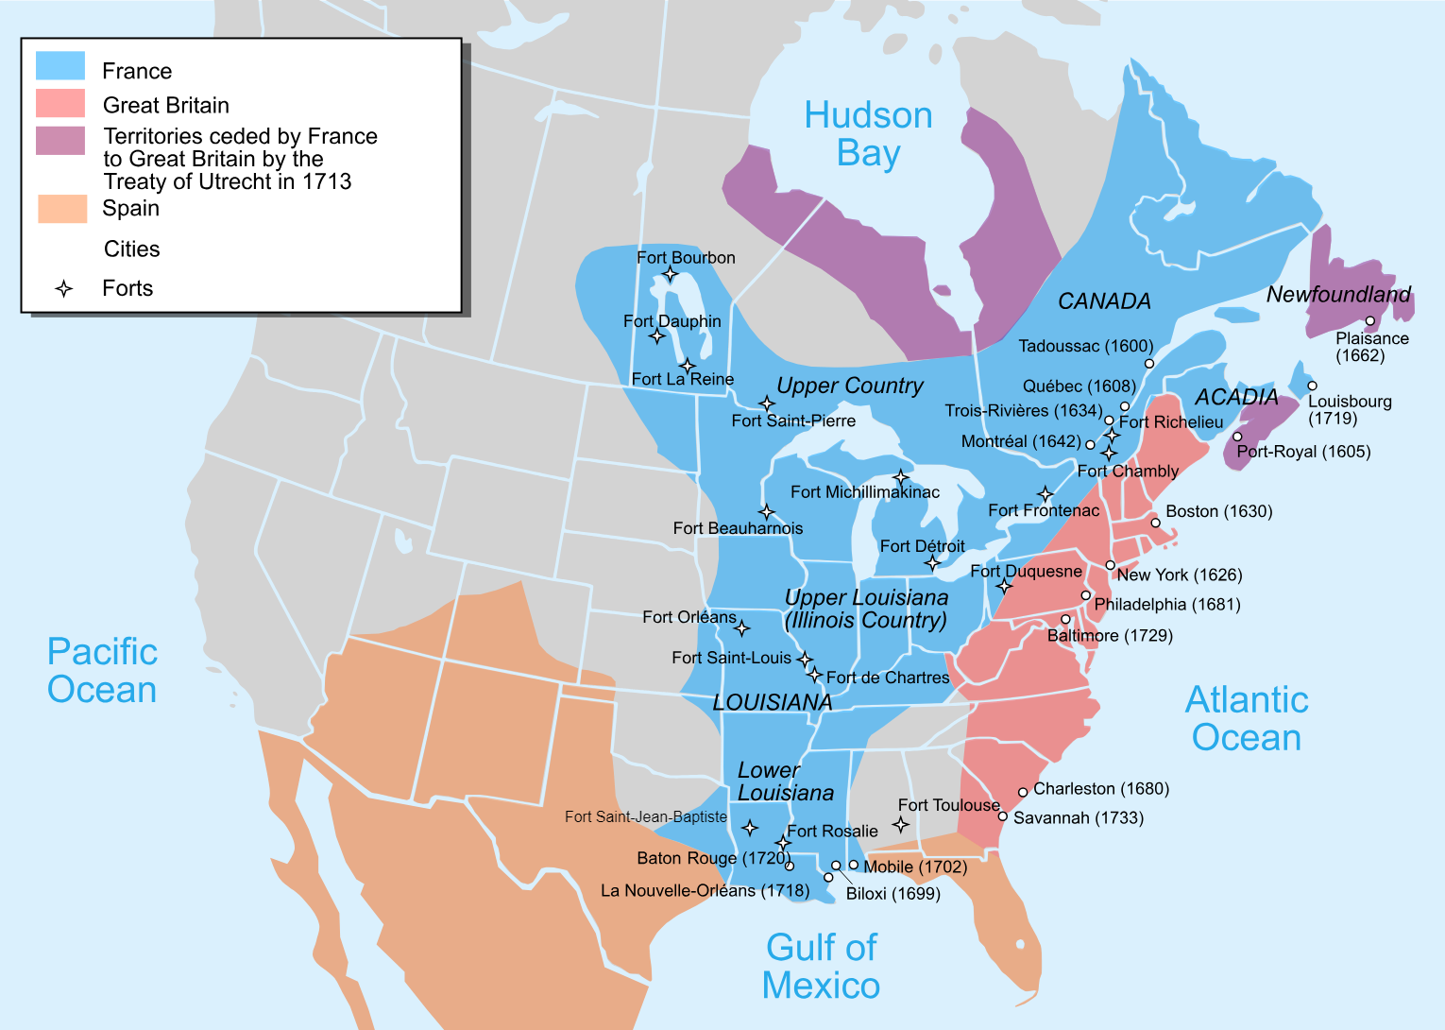
Contexts Causation
Identify and explain TWO causation factors that lead to the colonization movement of the 17th century.

Slide 9
American Identity – Who We Are
Liberty
Populism
We claim freedom as our right (dissenter seeking religious freedom)
People have the power to govern themselves
Salutary Neglect
Equality
Laissez Faire
Individualism
All are equal – No Aristocracy
Opportunity: land, raw materials, joint stock co.
We can earn $$ without government interference
- Triangle trade
How does the colonization period engrain these five ideas into English settlers?

Slide 10
American Identity – Who We Are
Liberty
Populism
Equality
Laissez Faire
Individualism
The American identity forms the causes of independence:
Warning signs – Bacon’s Rebellion, Leisler Rebellion, & Ipswich and Topsfield resist assessments
How does the colonization period engrain these five ideas into English settlers?

Slide 11
AP 2.1: Contextualization of European Colonization
AP 2.2: European colonization influence on the New World
EQ: How did the colonization period formulate an American identity that builds momentum towards independence?
Students can:
Validate factors that led to colonization movement by the European superpowers
Contrast how various European cultures influenced the development of the New World
Agenda
Contrasting Euro Native Relations
Here Comes the Rest of Europe
AP Classroom
Homework
Complete your slides for assigned colony
Unit I Quiz (Monday, Sept. 9)

Slide 12
Colonization Comparison
Identify the following statements as D – Dutch, E – English, F – French, S – Spanish, or A - All
___ 1. Focus on colonizing Canada and Midwest part of the U.S., in order to take advantage of the fur trade.
___ 2. Belief in mercantilism
___ 3. Work with Native Americans to develop trade
___ 4. Establish Catholic missionaries in Santa Fe and various parts of the Southwest to support the Salvation of Souls
___ 5. Focused on cash crop agriculture as a main commodity of trade
___ 6. Intermarried with the Natives Americans
___ 7. Relationship starts off positive but usually ends up in conflict, such as the Powhatan Wars and King Philip's War, to control land.
___ 8. Used the encomienda system
___ 9. Used Jesuit priest to establish a few missionaries
___ 10. Settled along the eastern seaboard of the United States

Slide 13
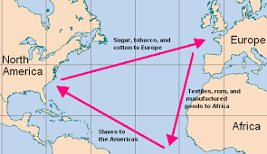
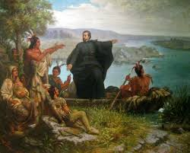
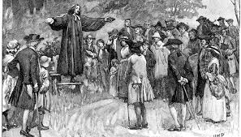
European Conquest of the New World
Establish America as the Land of Opportunity & Freedom
Mercantilism: creates a global competition between Spain, France, Netherlands, & Great Britain
Expansion of Christianity:
Salvation of Souls (Catholicism)
Free exercise of religion: Quakers, Puritans, Separatists, Baptist, Presbyterians, Catholics, & Jewish
New World source of raw materials (Cash crops, fur, timber, pitch, etc.) & new markets
Triangle Trade Routes

Slide 14
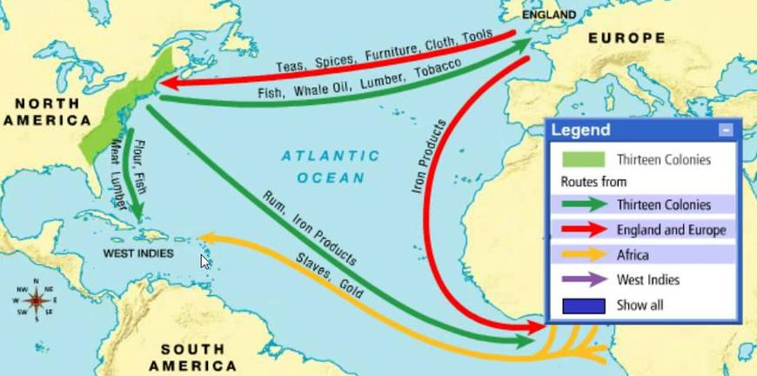
Mercantilism in the New World
Establishment of the Triangle Trade
Navigation acts of 1660 – England requires all trade to go through British ports (Smuggling – American resistance)
Middle Passage
America a sources of untapped resources (Columbian Exchange)
Mercantilism – colonies supply natural resources & are new markets for finish goods
Middle passage – African slave trade (labor intensive work)

Slide 15
The British Invasion
English Smack Talk
11588: England defeats the Spanish Armanda (Sir Francis Drake – Piracy)
Factors encouraging English exploration and colonization
Mid 16th Century primogeniture law enacted (1st born gets inheritance
2nd & 3rd Sons formed Joint Stock Companies to invest in colonization
Enclosure movement: high population of landless poor
Protestant Reformation: battle over control of the Church of England

Slide 16
Permanent Settlements in the New World

Slide 17
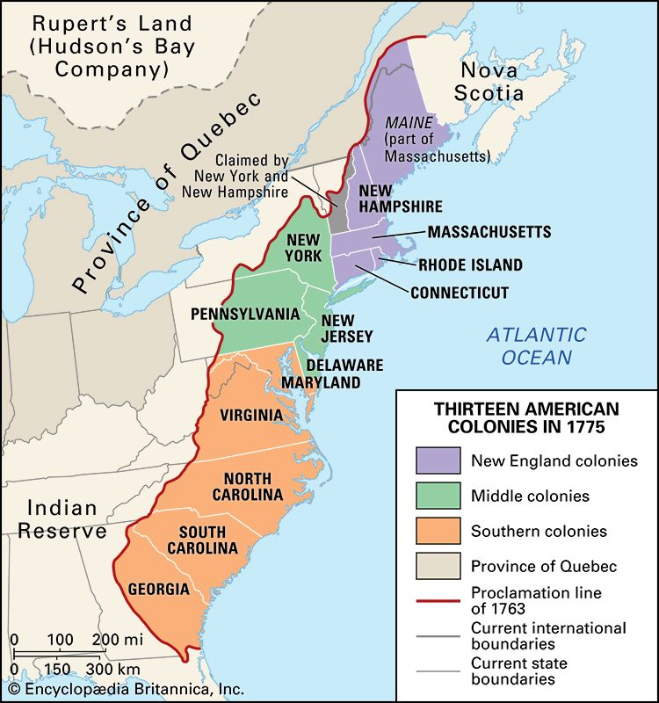
Salutary Neglect Effect
Salutary Neglect: British government allowed the colonies develop without their guidance (1607-1754)
13 Colonies development
3 distinct regions: New England, Middle, & Southern Colonies
Influencers of development: geography, Native Americans, and religion
Trade Routes 1600-1700

Slide 18
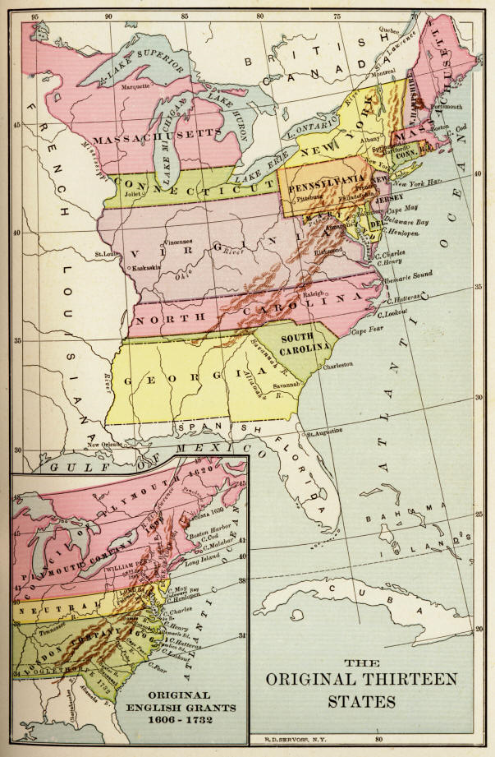
Forming a New Nation
Colonization and settlement: engraining a new identity
Reasons for settlement: expansion of Christianity & quest for opportunity
Regional differences: culture, economy, & politics
Conflicts with the Natives (epidemics & loss of land)
Survival was difficult – untapped & untamed resources (need for labor)

Slide 19
AP 2.1: Contextualization of European Colonization
AP 2.2: European colonization influence on the New World
EQ: How did the colonization period formulate an American identity that builds momentum towards independence?
Students can:
Validate factors that led to colonization movement by the European superpowers
Contrast how various European cultures influenced the development of the New World
Agenda
Eyes of Labor
From Headright to Slavery
A Colony Slide
Homework
Formation of the 13 Colonies
Unit I & II Test (Thursday, Sept. 19)

Slide 20
The Trial of John Punch
Whereas Hugh Gwyn hath by order from this Board Brought back from Maryland three servants formerly run away from the said Gwyn, the court doth therefore order that the said three servants shall receive the punishment of whipping and to have thirty stripes apiece called Victor, a dutchman, the other Scotchman called James Gregory, shall first serve out their times with their master according to their Indentures, and one year apiece after their time of service is Expired. By their said Indentures in recompense of his Loss sustained by their absence and after that service to their said master is Expired to serve the colony for three whole years apiece, and that the third being a negro named John Punch shall serve his said master or his assigns for the time of his natural life here or elsewhere.
- Sentencing of three indenture servants, VA Court 1640
Explaining what the verdict demonstrates about Virginia Colony.

Slide 21
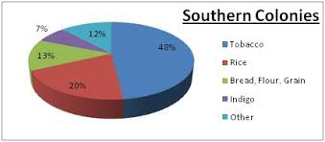
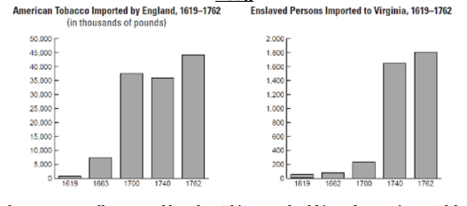
First Labor Force
Cash Crop Agriculture impact
Indenture Servants: 13 colonies first labor source
Headright System: landowners given 50 acres for bring over indenture servants

Slide 22
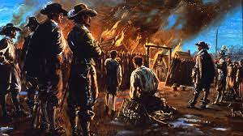
Labor Turning Point
Bacon’s Rebellion - 1676
Impact – Rise of African Enslavement
Land & opportunity are becoming scarce in the Virginia colonies
Landless population (former indenture servants) involved in the fur trade and settling in Native American lands
Lord Berkely (British Governor of VA) cracks down on the non-native fur trade Bacon’s Rebellion 1676

Slide 23
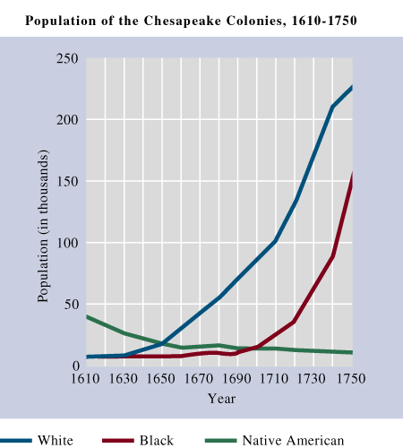
Southern Man
Evaluate trends in the graph
Identify and explain a trend demonstrated in the graph
Identify and explain another trend illustrated by the graph.

Slide 24
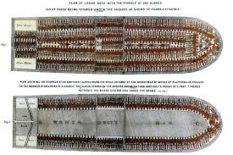
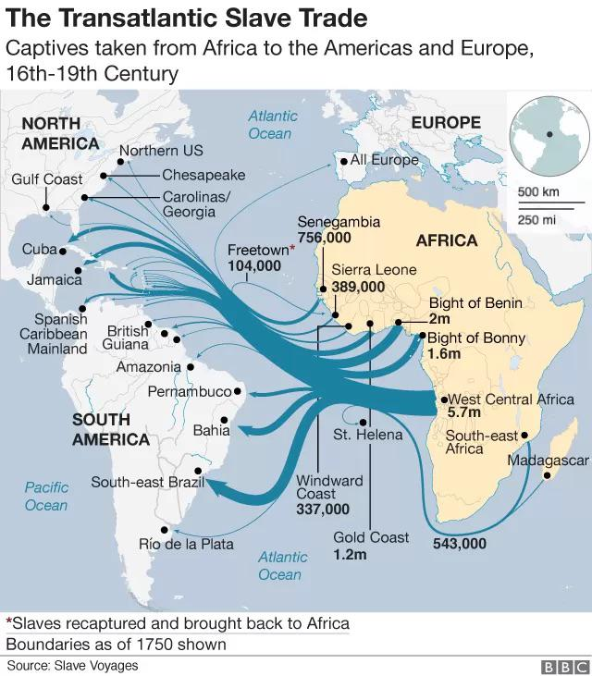
Slave Trade
Development of slave trade
“Close Packing”
15 – 20 Million slaves transported to the New World (Middle Passage)
Largest slave importers Caribbean & Brazil (Sugar Plantations)
1619 Slave first appearance in 13 Colonies

Slide 25
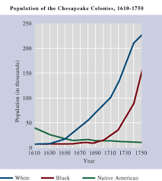
Legalizing Slavery
Rise of Slave Codes
Fear of slave rebellions leads to codifying slavery
Barbados Slave Codes 1661
Virginia Slave Codes 1705
Stono Rebellion 1739
Negro Act 1740

Slide 26
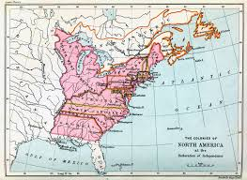
Colonial Slide Instructions
Complete your colony with your group. Answer each question and section with detail (complex sentences). Not unsimilar to how you would a SAQ
For each SLIDE, provide a picture.
As far as identifying a corresponding primary source, it must be from the colony and from the period. These will function as your notes to the original 13 colonies. GOOD LUCK

Slide 27
Slavery in America
Explain how the change depicted in the graph above will transform the Chesapeake region politically, socially, and economically during as the region moves into the 18th century.

Slide 28
AP 2.1: Contextualization of European Colonization
AP 2.2: European colonization influence on the New World
EQ: How did the colonization period formulate an American identity that builds momentum towards independence?
Students can:
Decipher how various European cultures influenced the development of the New World
Contrast how colonial regions became distinct regions but allow for the development of the American identity
Agenda
Regional identifier
Short Answer Question Writing
Making the Grade
Homework
Greed & Creed
Unit I & II Test, Thursday, September 19

Slide 29
It’s a Regional Thing
Identify the following statements as N – New England, M – Middle Colonies, S – Southern Colonies, or A – All
__ 1. Puritan work ethic and religious beliefs caused lack of religious tolerations
__ 2. Development of self government based on popular sovereignty
__ 3. The bases for economic development was reliant on cash crop agriculture, such as tobacco, rice, and indigo
__ 4. Most inclusive and ethnically diverse because of settlement by Quakers
__ 5. Supported the development of triangle trade with Europe and the West Indies
__ 6. Governed by a landed gentry class, known as cavaliers.
__ 7. Had a diverse economy from grain farming, fur trade, ironworking, to merchant trading
__ 8. Developed poor relations with the Natives because conflicts over land and cultural disagreements

Slide 30
How to answer an SAQ
Steps to success:
Read stimulus (if it has it) identify important related facts. (Some will have stimulus, and some will not)
Read the questions – strip apart the questions
Plan your response – what specific historic evidence (SHE) can I use in a response to each questions (NO REPEATING)
Write your response
Underline the task verbs
Underline important information that assists you in answer the question
What is the question really asking

Slide 31
Task Verbs
Compare: Provide a description or explanation of similarities and/or differences.
Describe: Provide the relevant characteristics of a specified topic.
Evaluate: Judge or determine the significance or importance of information, or the quality or accuracy of a claim.
Explain: Provide information about how or why a relationship, process, pattern, position, situation, or outcome occurs, using evidence and/or reasoning. Explain "how" typically requires analyzing the relationship, process, pattern, position, situation, or outcome; whereas, explain "why" typically requires analysis of motivations or reasons for the relationship, process, pattern, position, situation, or outcome.
Identify: Indicate or provide information about a specified topic, without elaboration or explanation.
Support an argument: Provide specific examples and explain how they support a claim.

Slide 32
Writing Your Response
Use the ACE Method
A = Answer the prompt: (you can turn the question into your opening sentence)
C = Cite your evidence: (SHE – Specific Historic Evidence) – define or describe SHE
E = Expand: connect your evidence to the larger context
Reminders:
Write in complete sentences (usually two – three sentences)
No DOUBLE DIPING on Evidence

Slide 33
Writing Your Response
Format for Short Answers Questions
Label each response: A. B. C.
Leave a space between each response
A.
B.
C.

Slide 34
AP 2.1: Contextualization of European Colonization
AP 2.2: European colonization influence on the New World
EQ: How did the colonization period formulate an American identity that builds momentum towards independence?
Students can:
Decipher how various European cultures influenced the development of the New World
Contrast how colonial regions became distinct regions but allow for the development of the American identity
Agenda
Regional identifier
Short Answer Question Writing
Making the Grade
Homework
Unit I Progress Check
Unit I & II Test, Thursday, September 19

Slide 35
SAQ Grading
Grading SAQ
Underline where they have used specific historic evidences (facts)
Determine whether they have answered the question and met the guidelines of the task verb
Describe: Provide the relevant characteristics of a specified topic
Explain: Provide information about how or why a relationship, process, pattern, position, situation, or outcome occurs, using evidence and/or reasoning..

Slide 36
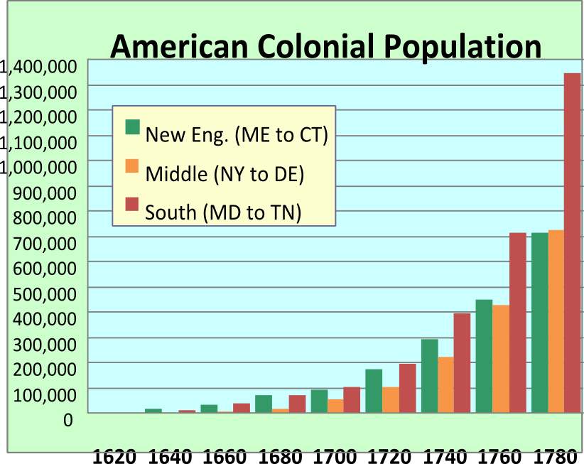
English Expansionism
US population doubled every 25 years through the 1800s.
Native American declining because conflicts & epidemics

Slide 37
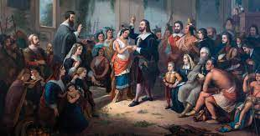
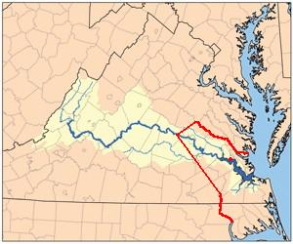
Chesapeake Relations with the Natives
1608-1609 Native/English relations decline (English starvation, rival allies, expanding their territory)
1st Powhatan War 1610 (Lord de la Ware’s Ultimatum)
2nd Powhatan War 1622
3rd Powhatan War 1644
Results: Peace Treaty of 1646: Natives lose land to the English and the two cultures live in separate regions
What event in 1676 caused continued conflict with the native Americans in the Chesapeake region?
Natives
English
Treaty of Middle Plantation 1676
Bacon’s Rebellion (1676)
Natives placed on reservation
Peace Treaty of 1646

Slide 38
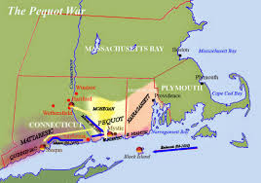
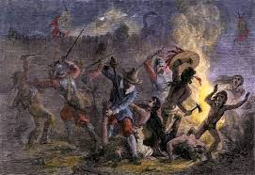
New England Relations
“Let the whole Earth be filled with his Glory! Thus the LORD was pleased to smite our Enemies in the hinder Parts, and to give us their Land for an Inheritance: Who remembered us in our low Estate, and redeemed us out of our Enemies Hands: Let us therefore praise the LORD for his Goodness and his wonderful Works to the Children of Men!”
- Brief History of the Pequot War, John Mason
Pequot War 1636-1637 - The Pequot Tribe destroyed
Puritan view: Native Americans = Savages
(How is the Pequot War similar to the Powhatan Wars in Virginia?)

Slide 39
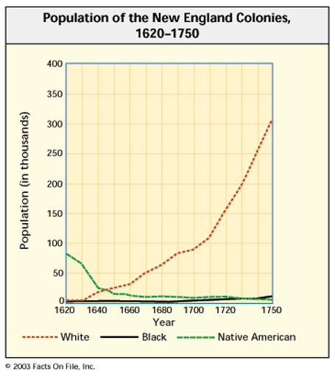
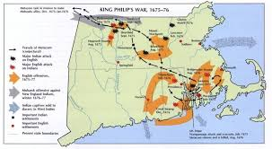
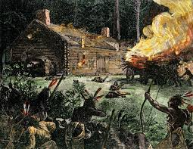
Metacom’s war
King Philip’s (Metacom) War 1675
Prompt: Evaluate the cause of the King Philip’s War using historic documents
Use evidence from the text to corroborate
your answer

Slide 40
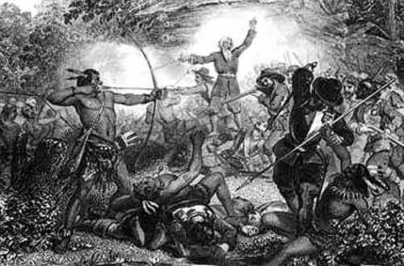
Puritans v. Native Americans
Pequot War 1636-1637
Conflicts over English colonist expansion & Natives viewed as savages
Pequot tribe wiped out
King Philip’s 1675-1676
Metacom (King Philip) leads a last-ditch effort to stop English colonial expansion (alliance of Wampanoag, Nipmuck, Pocumtuck and Narragansett
What part of New England has good relations with the Native Americans????

Slide 41
Settlers Relations w/ Natives
“Various are the reports and conjectures of the causes of the present Indian war. Some impute it to an imprudent zeal in the magistrates of Boston to christianize those heathen before they were civilized and enjoining them the strict observation of their laws.... Some believe there have been vagrant and Jesuitical priests, who have made it their business, for some years past, to go from Sachem to Sachem, to exasperate the Indians against the English and to bring them into a confederacy, and that they were promised supplies from France and other parts to extirpate [eradicate] the English nation out of the continent of America.”
- Edward Randolph, report of King Philip’s War (Metacom’s War) in New England, 1676
HIPP the Document:
P = Prior knowledge facts
H = Historic Contextualization (time period)
I = Intended Audience
P = Purpose (use the prior knowledge facts you identified in describe the document purpose)
P = Point of View

Slide 42
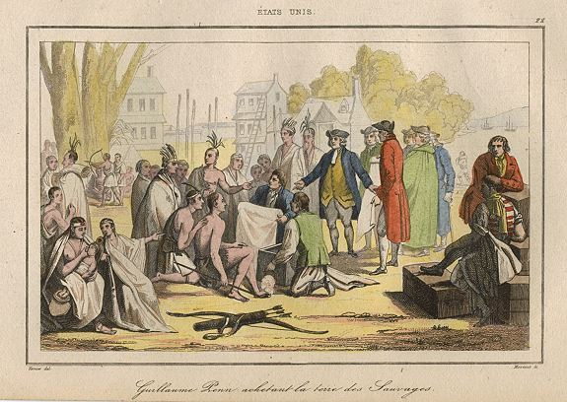
Native Americans Relations
Middle Colonies
Quakers belief – all are equal
William Penn purchases land from Native Americans

Slide 43
Settlers Relations w/ Natives
“[By September] most of our chiefest men [were] either sick or discontented, the rest being in such despair as they would rather starve and rot with idleness than be persuaded to do anything for their own relief without constraint. Our victuals being now within eighteen days spent, and the Indian trade decreasing, I was sent to the mouth of the river to Kegquouhtan, an Indian town, to trade for corn, and try the river for fish, but our fishing we could not effect by reason of the stormy weather. The Indians, thinking us near famished, with careless kindness offered us little pieces of bread and small handfuls of beans or wheat for a hatchet or a piece of copper. In like manner I entertained their kindness and in like... offered them like commodities, but the children, or any that showed extraordinary kindness, I liberally contented with free gift of such trifles as well contented them.”
John Smith, English explorer relating events in the Virginia colony, 1608
HIPP the Document:
P = Prior knowledge facts
H = Historic Contextualization (time period)
I = Intended Audience
P = Purpose (use the prior knowledge facts you identified in describe the document purpose)
P = Point of View

Slide 44
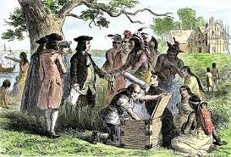
A Different Relation in the Middle
I have sent my commissioners to you about to a league of the peace, left [We?] desire you to be kind to my them people, and receive these Presents and Tokens which I have sent to you, as a Testimony of my Good will to you, and my resolution to live Justly peaceably and friendly with you, I am your Friend.
- William Penn, Letter from William Penn to the Kings of the Indians in Pennsylvania
HIPP Document – P = Prior Knowledge Facts, H = Historic Contextualization (time period), I = Intended Knowledge, P = Purpose, P = Point of View
Explain the purpose of the document and how it impacts relations with the Native Americans in the Middle Colonies.
Quakers believe in toleration towards all. (William Penn buys land from the Native Americans)

Slide 45
AP 2.1: Contextualization of European Colonization
AP 2.2: European colonization influence on the New World
EQ: How did the colonization period formulate an American identity that builds momentum towards independence?
Students can:
Decipher how various European cultures influenced the development of the New World
Contrast how colonial regions became distinct regions but allow for the development of the American identity
Agenda
The Beacon of Light
A Puritan Flavor for New England
Is There a Witch Among US???
Homework
First Great Awakening
Unit I & II Test, Thursday, September 19

Slide 46
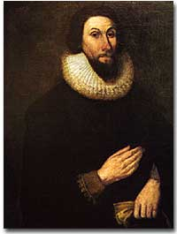
The Beacon of Light
Cultural Foundation for America
“for we must Consider that we shall be as a City upon a Hill, the eyes of all people are upon us; so that if we shall deal falsely with our God in this work we have undertaken and so cause him to withdraw his present help from us, we shall be made a story and a byword through the world, we shall open the mouths of enemies to speak evil of the ways of God and all professors for Gods sake; we shall shame the faces of many of gods worthy servants, and cause their prayers to be turned into Curses upon us till we be consumed out of the good land whether we are going”
- John Winthrop, Model of Christian Charity, 1630, Massachusetts Bay Colony
HIPP Excerpt
The City Upon a Hill (Beacon of Light)
The call back to morality (A continuity theme)
Jeremiad Sermons: Calling us back to the Beacon of Light

Slide 47
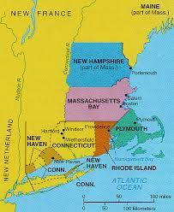
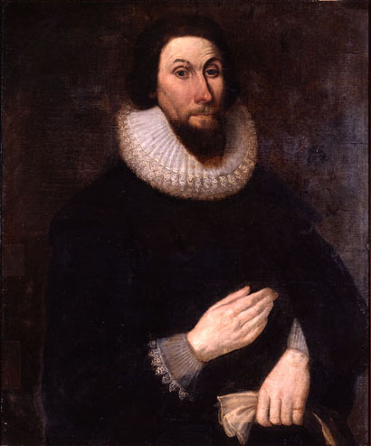
Puritanism
Bases for the faith - John Calvin’s “Institutes of Christian Religion” (Calvinism) – your life has preordained by God (predestination)
Visible Saints (The Elect) – ideal Puritan (freemen, church members)
Work hard
Be Christian in act & thought
Sacrifice to glorify God and to be saved
Congregations Church: Taxed supported churches paid for members and non-church members (Theocracy)
John Winthrop, Founder of the Massachusetts Bay Colony

Slide 48
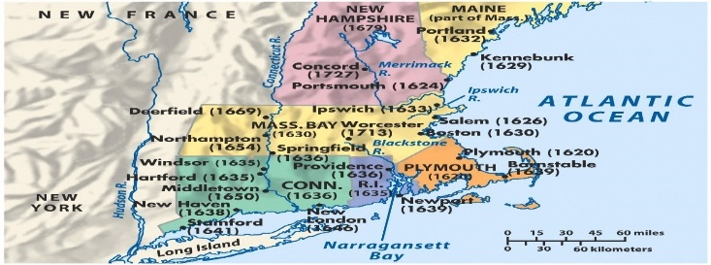
Covenant with God
Puritan stronghold?
Rapid population growth in New England colonies
Expanding frontier to provide land for growth
Decrease in the number of Visible Saints
Half-way Covenant 1662: children of visible saints could be Baptist (goal – increase church membership)
How will the growth of the population of Massachusetts Bay Colony impact the Puritan faith?
Impact:
More women join the church (moral keepers)
Puritan faith weakens

Slide 49
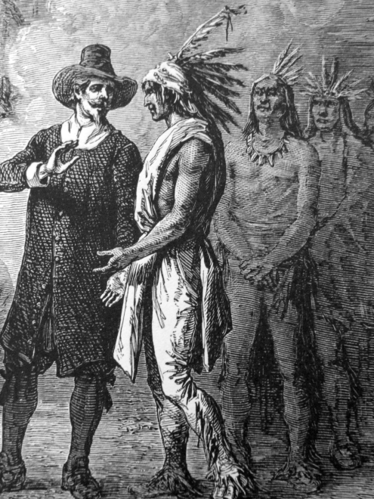
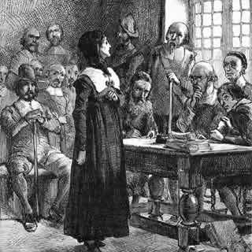
Puritan Rejects
The Rhode Island Sewer: Founded by Roger Williams – Religious toleration for all (any faith, Native Americans, etc..)
Anne Hutchinson: challenged Puritan predestination & Covenant by Grace
Charged with antinomianism (violating the moral teachings)

Slide 50
Metacom’s war
King Philip’s (Metacom) War 1675
Prompt: Evaluate the cause of the King Philip’s War using historic documents
Use evidence from the text to corroborate
your answer

Slide 51
Witches in NE
“Humbly craving continually your prayers and help in this distressed case, -so, praying Almighty God continually to prepare you, that you may be a terror to evil-doers.” -Thomas Putnam
What is the actual cause of the Salem Witch Trials of 1692-93?
Salem Witch Trials 1692-93
Witchcraft ___????_____

Slide 52
Witches in NE
“Humbly craving continually your prayers and help in this distressed case, -so, praying Almighty God continually to prepare you, that you may be a terror to evil-doers.” -Thomas Putnam
What is the actual cause of the Salem Witch Trials of 1692-93?
Salem Witch Trials 1692-93
Puritan value: live a frugal life to enhance God
Jeremiad Sermons: calling out immorality to return colony back to “a city upon a hill”
Growing class stratification – (Poor v. Wealthy) rise of a merchant class (Not Living the Puritan Life)

Slide 53
A democratic spirit
“And that also there shall be a Counsel established here in England which shall in like manner consist of thirteen parsons to be, for that purpose, appointed by us, our heires and successors, which shall be called our Counsel of Virginia; and shall from time to time have the superior managing and direction onelie of and for all matters that shall or may concern the government, as well of the said several Colonies as of and for any other part”
- 1st Virginia Charter, 1606
England empowers self government (Salutary Neglect)
Colonial charters
Distance from England
Creation of democracy (Populism)
Mayflower Compact
House of Burgesses

Slide 54
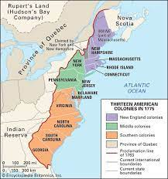
Planting the Seeds of Americanism
Evaluate the extent to whether colonization America effectively established an American political culture
Construct an infomercial to promote immigration to an American colonial region.
Look at this Amazing new land
Promote those core value advantages
Make it the new HIP place to be
Include warnings – “Don’t forget the Natives”
Infomercial - ShamWOW

Slide 55
AP 2.1: Contextualization of European Colonization
AP 2.2: European colonization influence on the New World
EQ: How did the colonization period formulate an American identity that builds momentum towards independence?
Students can:
Decipher how various European cultures influenced the development of the New World
Contrast how colonial regions became distinct regions but allow for the development of the American identity
Agenda
A Sinner in an Angry God’s Hands
A Cultural Movement in America
Unit II Progress Check
Homework
Unit I & II Review Guide
Unit I & II Test, Thursday, September 19

Slide 56
Sermon of the New Light
The use of this awful subject may be for awakening unconverted persons in this congregation. This that you have heard is the case of every one of you that are out of Christ.-That world of misery, that lake of burning brimstone, is extended abroad under you. There is the dreadful pit of the glowing flames of the wrath of God; there is hell's wide gaping mouth open; and you have nothing to stand upon, nor any thing to take hold of, there is nothing between you and hell but the air; it is only the power and mere pleasure of God that holds you up.
You probably are not sensible of this; you find you are kept out of hell, but do not see the hand of God in it; but look at other things, as the good state of your bodily constitution, your care of your own life, and the means you use for your own preservation. But indeed these things are nothing; if God should withdraw his hand, they would avail no more to keep you from falling, than the thin air to hold up a person that is suspended in it.
- Jonathan Edwards, “A Sinner in an Angry God’s Hand”, 1741
Explain the purpose of Jonathan Edwards “A Sinner in an Angry God’s Hand”
HIPP

Slide 57
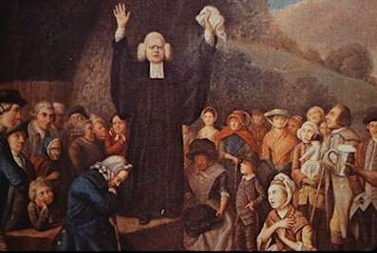
1st Great Awakening
‘Oh what joy – joy unspeakable – joy full and big with glory was my soul filled when the weight of sin came off, and an abiding sense of the pardoning love of God and a full assurance of faith broke in on my soul.” – George Whitefield
1st Great Awakening - Religious Revival Movement (1730-1770)
unifying cultural experience
Evangelicalism (new birth) – we are all sinners, who can ask for salvation
Causation
George Whitfield
People not going to church
Enlightenment

Slide 58
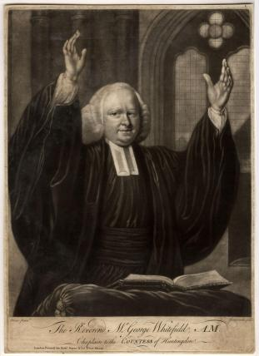
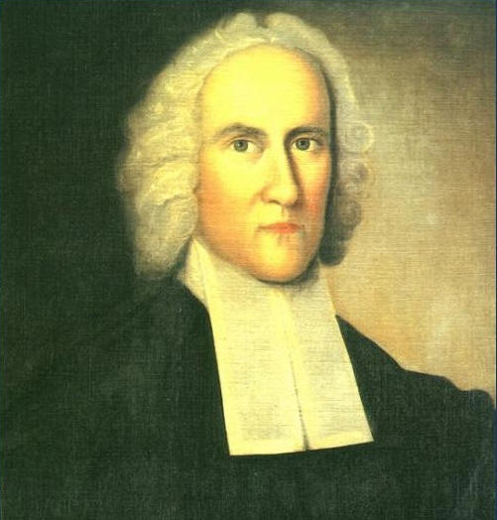
Religious Transformation
Christianity Debate
Old Lights
Resist the Great Awakening & emotionalism
New Lights
Support the Great Awakening & emotionalism
Congregationalists (New England)
Anglicanism (Chesapeake)
Methodists
Presbyterians
Baptists
New Lights idealism: Anybody could be born again; traditional church leadership did not have the authority to decide who belongs.
How will the ideas of the of the New Lights shape the American beliefs in the core value of equality?
George Whitefield
“The Great Orator”
Jonathan Edwards
“A Sinner in the Hands of Angry God”

Slide 59
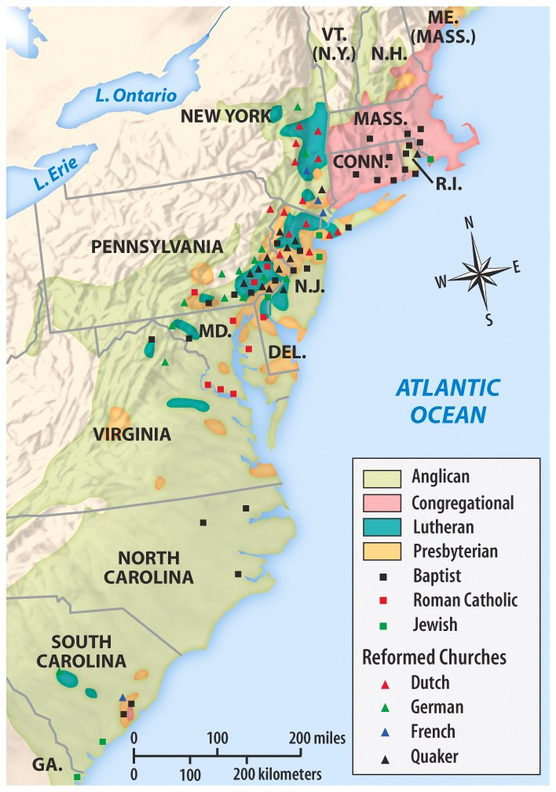
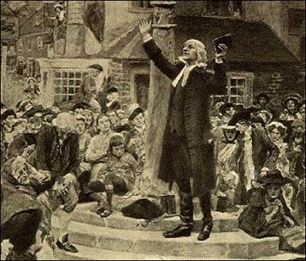
Challenge Tradition
Impact on American Colonies
Question authority – (Great Awakening - based on faith and Enlightenment based on reason)
Educate yourself (Read the Bible)
William & Mary College, Princeton, & Dartmouth open to train ordained ministers
Emotionalism - religion is personal (revivalist)

Slide 60
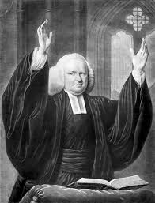
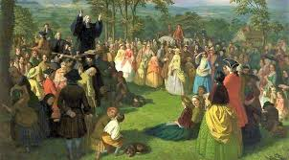
All Hail, The Great Orator
Evaluate what makes George Whitefield so popular during the First Great Awakening
PREACH!!
He is the King of the Sermon
Practice the skills of document analysis
HIPP documents
Make a claim about Whitefield’s popularity
George Whitefield
“The Great Orator”

Slide 61
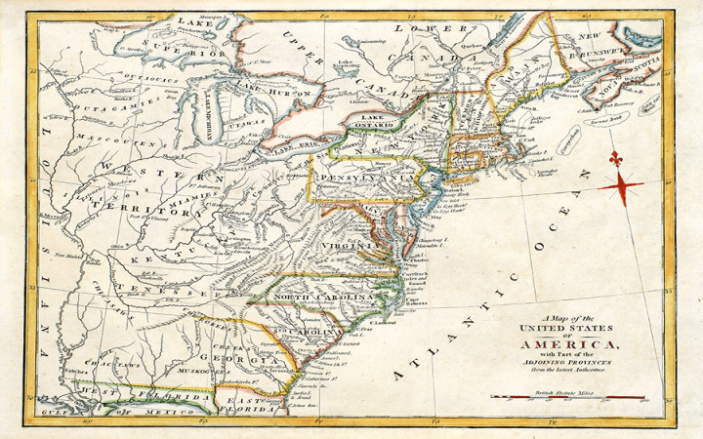
AP Practice
Evaluate how the colonization period shaped the development of the United States.
Unit II Progress Check

Slide 62
AP 2.1: Contextualization of European Colonization
AP 2.2: European colonization influence on the New World
EQ: How did the colonization period formulate an American identity that builds momentum towards independence?
Students can:
Validate factors that led European to expand their influence in the thirteen colonies.
Evaluate how environmental factors influenced the development of the three colonial regions
Critiques whether British salutary neglect had a positive influence on the development of the thirteen colonies
Compare the colonial regions to determine how English colonization influence their development
Agenda
AP Classroom Results
Challenging Salutary Neglect
Review for Unit I & II Test
Homework
Unit I & II Review Guide
Unit I & II Test, Thursday, September 19

Slide 63
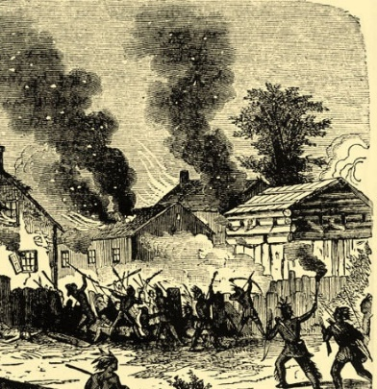
A Rebellious Spirit
How did the governance by Sir Edmund Andros cause colonists to protest the Dominion of New England?
Dominion of New England 1686-89
Governor Sir Edmund Andros
English control of colonial government
Tax support Anglican Church (Boston's Old South Meeting House )
Mercantilism (Navigation Act of 1660)
King Philips War 1675-76
Violating the American Identity
Protest
smuggling ()
Ipswich and Topsfield resist assessments (No taxation without representation)
Leisler Rebellion (NY) – overthrow of British authority
Glorious Revolution ends the Dominion

Slide 64
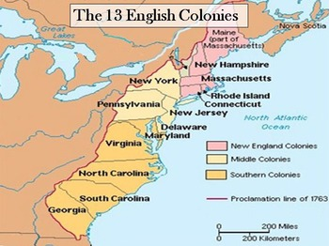
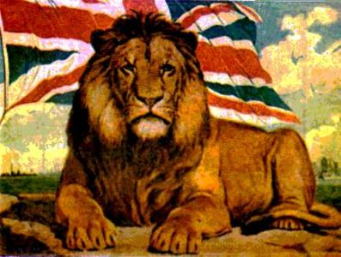
English Authority
Regulation of American trade
Navigation Act of 1696: All slave trade must be done on English ships
Wool Act 1699: America cannot export wool to England

Slide 65
Building our Democratic Mind
We see men’s deeds destroyed, judges arbitrarily displaced, new courts erected without consent of the legislature, by which it seems to me trial by juries are taken away when a governor pleases. . . .
- Roman Statesman, New York Weekly Journal 1735
Zenger Case of 1735:
Charge: writing seditious and defamatory statements against a Crown appointee, NY Governor William Cosby
Ruling: Freedom of the Press – Zenger is Not Guilty

Slide 66
English Tyranny???
Evaluate which how more of impact in the development of America political cultural core values. (50 words or less)
Dominion of New England
1st Great Awakening

Slide 67
AP 2.1: Contextualization of European Colonization
AP 2.2: European colonization influence on the New World
EQ: How did the colonization period formulate an American identity that builds momentum towards independence?
Students can:
Validate factors that led European to expand their influence in the thirteen colonies.
Evaluate how environmental factors influenced the development of the three colonial regions
Critiques whether British salutary neglect had a positive influence on the development of the thirteen colonies
Compare the colonial regions to determine how English colonization influence their development
Agenda
Historic contextualization – related or relevant
Colonial Economy 101
Colonial Core Summary
Homework
Read pages 63-70 in AMSCO (Continue to research your region)
Planting the American Seed Infomercial due September 20

Slide 68
Historic Contextualization – a narrative skill
Star Wars “A New Hope”

Slide 69
Historic Contextualization
Star Wars – Related or Relevant
Anakin Skywalker as a pod racer
The battle between Anakin and Obi One
Luke Skywalker grouping up
Darth Vader and the Power of the Sith

Slide 70
Historic Contextualization
Prompt: Evaluate the extent to whether colonization America effectively established an American political culture
Historic contextualization: what was going on during the period that caused the historic event. How did that historic event impact America, and what was its long-term effects?
Remember your historic contextualization needs to connect to the ideas of setting up core values of American political culture
Explain what caused English colonization to start happen in 1607?
How did English colonization influence the development of the New World from 1607 to 1754?
How did English colonization change the New World after 1754?

Slide 71
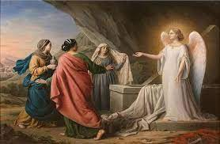
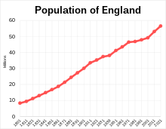
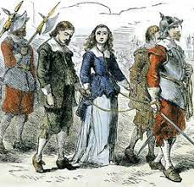
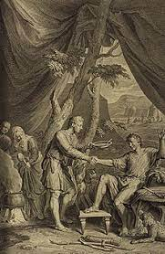
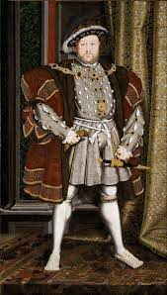
Historic Contextualization
Prompt: Evaluate the extent to whether colonization America effectively established an American political culture
- Relevant or Related – to causation
Mercantilism
Rise of Catholicism
Over population
Primogeniture
Rise of the Tudors
Rise of Dissenters

Slide 72
Colonial Economics 101
Colonial Economics 101
Evaluate factors of region that influenced economic development
Consider
Geography & Environment
Mercantilism
Laissez Faire
Individualism
Trade Routes 1600-1700

Slide 73
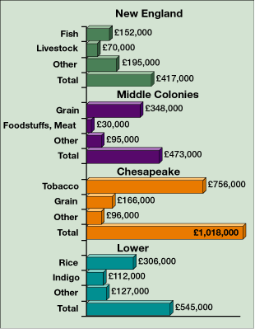
Value of Colonial Exports by Region, Annual Average, 1768–1772
Notes:
Faragher, Out of Many, 3rd Ed.; http://wps.prenhall.com/hss_faragher_outofmany_ap/

Slide 74
Immigration to American Colonies from 16th to 17th century

Slide 75
Opportunity or Laissez Faire
BUILDING THE AMERICAN DREAM
Establish a core relevance
Explain how the following supported the establishment of either laissez faire or individualism in your assigned colonial region
Geography
Mercantilism
Immigration

Slide 76
AP 2.1: Contextualization of European Colonization
AP 2.2: European colonization influence on the New World
EQ: How did the colonization period formulate an American identity that builds momentum towards independence?
Students can:
Validate factors that led European to expand their influence in the thirteen colonies.
Evaluate how environmental factors influenced the development of the three colonial regions
Critiques whether British salutary neglect had a positive influence on the development of the thirteen colonies
Compare the colonial regions to determine how English colonization influence their development
Agenda
Population shift
African Slave Arrive in the Colonies
Planting the American Seed
Homework
King Philip’s War Discussion question
Planting the American Seed Infomercial due September 26

Slide 77
Salutary Neglect Effect
Development of popular sovereignty in the colonies
SELF GOVERNMENT
Evaluate factors of region that influenced development of popular sovereignty
Consider
Geography & Environment
Salutary neglect
Who has a voice in government
Trade Routes 1600-1700

Slide 78
AP 2.1: Contextualization of European Colonization
AP 2.2: European colonization influence on the New World
EQ: How did the colonization period formulate an American identity that builds momentum towards independence?
Students can:
Validate factors that led European to expand their influence in the thirteen colonies.
Evaluate how environmental factors influenced the development of the three colonial regions
Critiques whether British salutary neglect had a positive influence on the development of the thirteen colonies
Compare the colonial regions to determine how English colonization influence their development
Agenda
Getting HIPP on History
Native America Theme
Planting the American Seed
Homework
Planting the American Seed Infomercial due September 26

Slide 79
Give ME LIBERTY!
The power of liberty as a factor of colonization
Puritans
The Freedom Core
Evaluate factors of region that influenced how liberty became a core value (can be mixed with equality)
Consider
Religious Dissenters
How do religious groups govern a region
Toleration of other religions
What supports the ability to practice religion in a region
Catholics
Quakers
Trade Routes 1600-1700
Presbyterians

Slide 80
AP 2.1: Contextualization of European Colonization
AP 2.2: European colonization influence on the New World
EQ: How did the colonization period formulate an American identity that builds momentum towards independence?
Students can:
Validate factors that led European to expand their influence in the thirteen colonies.
Evaluate how environmental factors influenced the development of the three colonial regions
Critiques whether British salutary neglect had a positive influence on the development of the thirteen colonies
Compare the colonial regions to determine how English colonization influence their development
Agenda
Visible Saints
A Witch or A Non-Believer
Homework
HIPP Documents for your region
Planting the American Seed Infomercial due September 26

Slide 81
A Religious Core
Prompt: Evaluate to what extent religious freedom was a major factor in the development of the American colonization.
Side 1::
Side 2::

Slide 82
AP 2.1: Contextualization of European Colonization
AP 2.2: European colonization influence on the New World
EQ: How did the colonization period formulate an American identity that builds momentum towards independence?
Students can:
Validate factors that led European to expand their influence in the thirteen colonies.
Evaluate how environmental factors influenced the development of the three colonial regions
Critiques whether British salutary neglect had a positive influence on the development of the thirteen colonies
Compare the colonial regions to determine how English colonization influence their development
Agenda
Societal Rank
A Culture of America
Planting the American Seed
Homework
HIPP Documents for your region
Planting the American Seed Infomercial due September 26

Slide 83
Risk v. Reward
Life in the colonies – The STRUGGLE to SURVIVE
Warning
Evaluate factors of region that challenged colonial survival
Consider
Geography & Environment
Native Americans
Who is not welcome
Famine
Average Life Expectancy at Age 20 During the Seventeenth Century
Married Women in Middlesex County, Virginia | 39
Married Men in Middlesex County, Virginia | 48
Women in Andover, Massachusetts | 62
Men in Andover, Massachusetts | 64
Women in Plymouth, Massachusetts | 62
Men in Plymouth, Massachusetts | 69
Trade Routes 1600-1700

Slide 84
Societal Rank and File
America was colonize based on several ideas the form our core values.
Explain ONE major factor that brought settlers to the 13 colonies.
Based on the social hierarchy evaluate the legitimacy of ONE of the following core values.
Equality
Liberty
Opportunity

Slide 85
Social Stratification
Population of Colonial America
American melting pot – mostly English, but a mixture of other ethnicities
The American Dream – Rags to Riches
Social Hierarchy
Upper – Cavaliers, Visible Saints, merchants, officials, & clergy
Yeoman, Tradesmen
Indenture servants
Slaves

Slide 86
The Education of America
New England: public education – Puritans (Biblical moral society – City Upon a Hill)
College: Harvard 1636
Middle: private education – parochial private schools
College: Penn 1740 (Quaker), Princeton 1746
All 13 colonies had apprenticeships to learn a trade skill
Southern: Plantation class hired tutors
College: William & Mary 1693 (Anglican)

Slide 87
Planting the American Seed
Colonial Informercial
Rubric Back Check
Title page
Historic contextualization – have all 3 parts
Map of the region – ID all colonies in the region
Region differences – focus on ways your region is unique and demonstrates the core values
Warnings: show the difficulties of survival in the region
Be factual in all parts
Include images in your presentation

Slide 88
AP 2.1: Contextualization of European Colonization
AP 2.2: European colonization influence on the New World
EQ: How did the colonization period formulate an American identity that builds momentum towards independence?
Students can:
Validate factors that led European to expand their influence in the thirteen colonies.
Evaluate how environmental factors influenced the development of the three colonial regions
Critiques whether British salutary neglect had a positive influence on the development of the thirteen colonies
Compare the colonial regions to determine how English colonization influence their development
Agenda
Finding the Core Values
Colonial Informercial
A Colonial Comparison
Homework
Colonial Free Response
Unit II Test – Tuesday, Oct. 3

Slide 89
Finding Core Values in the Colonies
Prompt: Evaluate the extent to whether colonization America effectively established an American political culture
Find an example of the core values in your region
Liberty
Equality
Laissez Faire
Popular sovereignty
Individualism

Slide 90
Finding Core Values in the Colonies
Prompt: Evaluate the extent to whether colonization America effectively established an American political culture
How true is the claim that English colonization established American political culture?
Claim: An argumentative statement that answers the prompt without re-stating it

Slide 91
Regional Comparison
Colonial Informercials
Complete your Colonial Region research from the informercials
Geography
Politics
Economy
Social/Cultural
Unique features
Relations with other cultures

Slide 92
Colonial Comparison
Prove the following statements true or false
A major reason for settling the 13 colonies is the promotion of religious toleration.
The colonial regions with the greatest blending of cultures was the Chesapeake region.
Enslaved Africans were most needed in the middle colonies.
Salutary neglected led to the creation of democratic governments forming all 13 colonies
European migration into the 13 colonies resulted in conflict with the Native American populations
Environment was a major factor in the development in economic opportunity.
Individualism was a primary motivating factor settlement in the 13 Colonies.
Slavery was allowed in all colonies of the Chesapeake

Slide 93
Georgia Penal Colony
Georgia – Founded by James Oglethorpe
Two Primary Purposes
Debtor’s prison (No Slavery allowed)
Buffer colony (Protection from Spanish colonies

Slide 94
AP 2.1: Contextualization of European Colonization
AP 2.2: European colonization influence on the New World
EQ: How did the colonization period formulate an American identity that builds momentum towards independence?
Students can:
Validate factors that led European to expand their influence in the thirteen colonies.
Evaluate how environmental factors influenced the development of the three colonial regions
Critiques whether British salutary neglect had a positive influence on the development of the thirteen colonies
Compare the colonial regions to determine how English colonization influence their development
Agenda
A sinner in Angry Gods Hands
It’s a Great Awakening in American Colonies
The Power of George Whitefield
Homework
Dominion of New England
Unit II Test – Tuesday, Oct. 3

Slide 95
Classifying History
Prompt: Evaluate the relative importance of causes of population movement to colonial British America in the period from 1607 to 1754.
Analyze prompt:
Historic skill
Categories
Time Period

Slide 96
Classifying History Brain Storm
Prompt: Evaluate the relative importance of causes of population movement to colonial British America in the period from 1607 to 1754.
SPICE T: allows a writer to organize facts to determine what to argue in response to the prompt:
TOPIC Sentence 1:
TOPIC Sentence 2:
(S) Social
(P) Political
(I) Interaction w environment
(C) Culture
(E) Economy
(T) Technology
HOWEVER:

Slide 97
Thesis Writing
A thesis is an argument or a stand you take on a particular subject. It should not resemble a sentence in your textbook, but rather explain your point of view and why it matters.
The thesis formula: X however, A, B, and C. Therefore Y.
X-the strongest point against your argument (could be historic context and not your thesis)
Or
X-the strongest point of your argument that you will clarify with A, B, and C to prove Y.
A, B, C – the three strongest point that explain in your essay
Y – the position you will taking throughout the essay (this could affect of X)

Slide 98
Thesis Thunder Dome
Prompt: Evaluate the relative importance of causes of population movement to colonial British America in the period from 1607 to 1754.
Can your thesis survive?

Slide 99
Colonies Economic
English mercantilism: colonies a source of raw materials and markets
New England: rum, timber, fishing, fur, iron, & shipbuilding
Middle: grain, timber, ship, cattle, fur, and iron
Chesapeake: cash crop agriculture (tobacco, rice, indigo)

Slide 100
Mercantilism Effect
Triangle Trade
Middle Passage – African slave trade
Navigation Acts 1660: English seeks to control colonial trade Smuggling (American resistance)

Slide 101
Charters of the New World
IN THE NAME OF GOD, AMEN. We, whose names are underwritten, the Loyal Subjects of our dread Sovereign Lord King James, by the Grace of God, of Great Britain, France, and Ireland, King, Defender of the Faith, &c. Having undertaken for the Glory of God, and Advancement of the Christian Faith, and the Honour of our King and Country, a Voyage to plant the first Colony in the northern Parts of Virginia; Do by these Presents, solemnly and mutually, in the Presence of God and one another, covenant and combine ourselves together into a civil Body Politick, for our better Ordering and Preservation, and Furtherance of the Ends aforesaid: And by Virtue hereof do enact, constitute, and frame, such just and equal Laws, Ordinances, Acts, Constitutions, and Officers, from time to time, as shall be thought most meet and convenient for the general Good of the Colony; unto which we promise all due Submission and Obedience.
- Mayflower Compact, 1620
HIPP Document
- Evaluate how this document defines the political relationship between colonist and England

Slide 102
Democracy in the Colonies
Direct Democracy:
Town Meetings (Churches)
Mayflower Compact
Puritan Theocracy
New Hampshire - Fundamental Orders (1st Constitution)
Representative Democracy:
Aristocracy – landed gentry (Cavaliers)
House of Burgesses

Slide 103
Democracy in the Colonies
Representative Democracy:
William Penn’s “Framework of Government”
New Jersey’s “Consent & Agreement”

Slide 104
American Identity
Prompt: “The English founded colonies to escape oppression in England.” Assess the validity of this statement.
Building a thesis
Oppression
S:
P:
I:
C:
E:
T:

Slide 105
Thesis exercise
thesis formula: X however, A, B, and C. Therefore Y.
Underline and label the four steps in thesis below (there can be overlap)
Between 1910 and 1930, African Americans migration from rural South to urban northern cities significantly increased due to greater job opportunities and emerging cultural changes. However, African Americans still faced racial discrimination and segregation in both regions.

Slide 106
The Thesis Statement
Specificity—How much do I say?
Compare and contrast the colonies at Jamestown and Plymouth.
Too General
The two colonies had important similarities due to their common roots, but the differences were numerous. In looking at both values and economics, it is plain to see that the colonies were more different than they were the same. (thesis)
Notes:
This one has a thesis, but it is too general. It could go in many different directions.
Note that students should identify their thesis by writing “(thesis)” after the thesis statement.

Slide 107
The Thesis Statement
Specificity—How much do I say?
Compare and contrast the colonies at Jamestown and Plymouth.
Too Detailed
The colonies of Jamestown and Plymouth were conceived with a similar DNA. The colonists in both places were British citizens who were loyal to the king, and they were founded by a royal charter. They also experienced similar challenges in their early years such as severe hunger, rampant disease and the ravages of harsh weather. On the other hand, there were distinct differences in both values and economics. Jamestown was firmly Anglican, while the Plymouth colonists were Puritans who wanted to reform the church. Likewise, the purpose of Plymouth was to glorify God and set an example to believers of all nations. Jamestown was quite different as its was purely an economic venture. Another important difference was geography. Jamestown was situated in a region suitable for agriculture, while the harsh winters and stark landscape of Plymouth led colonists to other pursuits such as fishing and shipbuilding. Considering the impact of these factors, history clearly shows a distinctly different pattern of development between the two colonies that far outweighs any similarities. (thesis)
Notes:
This has a reasonably strong thesis, and it clearly lays out the main points.
However, it goes overboard with detail in the introduction. It would soak up too much time, and it develops detail that should be discussed in the body.

Slide 108
The Thesis Statement
Specificity—How much do I say?
Compare and contrast the colonies at Jamestown and Plymouth.
Just Right!
The commonalities of British history and culture along with the difficult early experiences of Jamestown and Plymouth show many similarities in the establishment of the two colonies. However, differences in their founding principles and goals, as well as the geographical factors unique to each colony, gave each a distinctly different pattern of development. (thesis)
Hiro Sheridan. Uploaded on April 25, 2007, https://www.flickr.com/photos/hirosheridan/472864498
Notes:
This one has a fairly good balance.
It has a clear thesis, and it introduces the main points clearly.

Slide 109
Thesis exercise
Prompt: “The English founded colonies to escape oppression in England.” Assess the validity of this statement.
thesis formula: X however, A, B, and C. Therefore Y. (Use your PERSIA charts to sort out A, B, C, and X
DON’T RESTATE THE PROMPT
Claim (Therefore Y) responds to the prompt
A, B, & C support your claim
X However – counters your claim
Thesis can be more than one sentence

Slide 110
Annotation
Opportunity: Timber, shipbuilding, whaling, merchants
Liberty: Quakers religious toleration in Pennsylvania
Populism: House of Burgesses – representative democracy

Slide 111
Chesapeake Region
Demonstrate how the geography Chesapeake region influenced each of the following:
Political
Economic
Social cultural

Slide 112
Chesapeake Region
Geography: warm climate, fertile land
Jamestown 1607: Established by the Virginia Co. (Joint Stock Co.)
Cash Crop Agriculture economy
1618 – first slaves in Jamestown
House of Burgesses – representative democracy
Social class: landed aristocracy (Cavaliers)

Slide 113
Tobacco Gold
John Rolfe: introduces tobacco to Virginia in 1610
Jamestown becomes profitable
Cash crop agriculture
Geniture class – Cavalier (landed aristocracy - plantations)
Labor intensive crop – indenture servants, eventually slaves
House of Burgesses – representative democracy (land the base of power)

Slide 114
Cash Crop Agriculture

Slide 115
Tobacco Prices 1618-1710
Notes:
Pojer

Slide 116
Value of Colonial Exports by Region, Annual Average, 1768–1772
Notes:
Faragher, Out of Many, 3rd Ed.; http://wps.prenhall.com/hss_faragher_outofmany_ap/

Slide 117
Unit I Prep
1. Brief explain how ONE of the following factors in Europe in the early 16th century helped bring about a period of exploration and colonization of lands across the sea?
Religion
Trade
Technology

Slide 118
An American Identity Exist Here
Chesapeake Region
New England Region
Liberty
Equality
Individualism
Populism
Laissez Faire
Liberty
Equality
Individualism
Populism
Laissez Faire

Slide 119
Defining the Chesapeake Region
Political: Representative democracy governed by aristocracy
House of Burgesses 1618
Economics: export economy focused on cash crops: tobacco, rice, & indigo
Plantations
Social: strong landed aristocracy – cavaliers
Slavery
Religiously tolerant: Anglican, Presbyterian, Baptist, & Methodist
Very few major cities

Slide 120
Breaking the stereotype
Maryland:
Establish as a safe haven for Catholics by Lord Baltimore.
Acts of Toleration 1649
North Carolina:
Settled by Scot-Irish mostly
Did NOT have a Cavalier class
Cherokee nation thrive in western half
Georgia:
Founded by James Oglethorpe as debtor prisoner colony
NO SLAVERY ALLOWED

Slide 121
Southern Man
Explain three impacts of the Chesapeake Region’s focus on cash crop agriculture economy.
Political –
Economic –
Social –

Slide 122
Regional Distinctions
Regional Qualifiers
Determine and explain which colonial region; New England or Chesapeake, is being described by the following statements
Religious toleration
Cash crop agriculture
Merchant class
Education is highly valued
Social class hierarchy
Townships and cities create communities
Theocracy
Relationship with the Natives

Slide 123
A Sinner in the Hands of an Angry God’s
So that, thus it is that natural men are held in the hand of God, over the pit of hell; they have deserved the fiery pit, and are already sentenced to it; and God is dreadfully provoked, his anger is as great towards them as to those that are actually suffering the executions of the fierceness of his wrath in hell, and they have done nothing in the least to appease or abate that anger, neither is God in the least bound by any promise to hold them up one moment; the devil is waiting for them, hell is gaping for them, the flames gather and flash about them, and would fain lay hold on them, and swallow them up; the fire pent up in their own hearts is struggling to break out: and they have no interest in any Mediator, there are no means within reach that can be any security to them.
In short, they have no refuge, nothing to take hold of, all that preserves them every moment is the mere arbitrary will, and uncovenanted, unobliged forbearance of an incensed God.
- Jonathon Edwards, “A Sinner in the Hands of an Angry God” 1741

Slide 124
The Beacon of Light
“God of Israel is among us, when ten of us shall be able to resist a thousand of our enemies, when he shall make us a praise and glory, that men shall say of succeeding plantations: the lord make it like that of New England: for wee must Consider that wee shall be as a City upon a Hill, the eyes of all people are upon us; so that if wee shall deal falsely with our god in this work wee have undertaken and so cause him to withdraw his present help from us, wee shall be made a story and a byword through the world, wee shall open the mouths of enemies to speak evil of the ways of god and all professors for Gods sake; wee shall shame the faces of many of gods worthy servants, and cause their prayers to be turned into Curses upon us till wee be consumed out of the good land whether wee are going:” - John Winthrop, Massachusetts Bay Colony, 1630

Slide 125
New England Region

Slide 126
Proving Your Point
Prompt: Evaluate the following statement: Although America was largely settled by people originally from England; by the early 1700s, our American identity demonstrated major regional differences and distinctions. (TRUE or FALSE)
Building a Plan – What do I have to prove? What facts are the evidence that supports my conclusion?
1. English colonists believe in the American values: liberty, equality, populism. Individualism, and laissez faire
2. English colonists believe in the American values, but have different definitions of what those values mean based on regional differences
3. Historic synthesis: what are the odd anomalies that prove my conclusions are not 100% true

Slide 127
New England Region
Geography: colder climate, rocky terrain
Plymouth Bay Colony 1620: religious dissenters colony (Separatists lead by William Bradford)
Massachusetts Bay Colony 1630: Puritans lead by John Winthrop
Government: Mayflower Compact (town meetings – Direct Democracy)
Dominant religion: Puritanism & Separatists
Economy: Lumber, Whaling, Shipbuilding, Merchants

Slide 128
Puritans vs. Pilgrims
Puritans
No separation of church & state
Arrival 1629-30
Upper Class
Pilgrims - Separatists
separation of church & state
Arrival 1620
Lower Class

Slide 129
Puritans v. Native Americans
Pequot War 1636-1637
Conflicts over English colonist expansion & Natives viewed as savages
Pequot tribe wiped out
King Philip’s 1675-1676
Metacom (King Philip) leads a last ditch effort to stop English colonial expansion (alliance of Wampanoag, Nipmuck, Pocumtuck and Narragansett

Slide 130
EQ: How did the colonization period formulate an American identity that builds momentum towards independence?
Students can:
Evaluate how differing demographic and geographic factors impact colonization of the New World by Europeans
Decipher how British’s governance over the 13 original colonies developed close economic ties with America while feeding the seeds resistance
Determine factors that establish conflict between Native Americans and English settlers
Agenda
Proof of the Middling Sort
Ins and Outs of the Colonial Region
Religious freedom in the American Colonies
Homework
Read pages 66-76: Explanation how the Chesapeake regions reliance on cash crop agriculture influenced their culture (Multiple reasons need to be given)
Study for SAQ quiz on the Colonial Region

Slide 131
Middle Colonial Region

Slide 132
Contributing Factor
Demonstrate how the Middle Colonies development was impacted by ONE of the following:
Liberty
Individualism

Slide 133
Middling Sort Assumption
The Middle Colonial Region demonstrates aspects of the New England and Chesapeake regions, while having the most diverse culture.
Identify 8 facts that supports the prompt.

Slide 134
Other Immigrants
New Netherlands (NY) (Protestants)
Established as a trading outpost by Henry Hudson for the Dutch
New Amsterdam established Native American conflicts – Wall Street
Diverse culture – French, English Dutch, Scots. & Jewish
New Sweden (Del.)
Original settled by the Swedish
Taken over by the Dutch
English take over
Dutch surrendered NY to the English after the Duke of York threatened to invade

Slide 135
Middling Sort
Blended economy
Merchant traders in NY, Trenton, Philadelphia
Bread basket colonies: grain farms
Fur trade
Urban Population
Philadelphia most advanced city
Middle Colonies had desirable land
Diverse populations
Quakers: Society of Friends (William Penn)
Religious toleration (No Catholics or Jewish)
Buy land from Native tribes
Anti-slavery

Slide 136
EQ: How did the colonization period formulate an American identity that builds momentum towards independence?
Students can:
Evaluate how differing demographic and geographic factors impact colonization of the New World by Europeans
Decipher how British’s governance over the 13 original colonies developed close economic ties with America while feeding the seeds resistance
Determine factors that establish conflict between Native Americans and English settlers
Agenda
A Colonial Dissection Quiz
Ins and Outs of the Colonial Region
Terms of the Time
Homework
Read pages 76-83 – Demonstrate how Puritanism is lose its hold on the New England Colonies
Vocabulary terms for your colonial region

Slide 137
Terminology for Propaganda Poster
Explain the significance of each term (Only complete the ones for your colonial region for the propaganda poster)
New England Region: Terms: 20-36 & 46-51
Middle Colonies: 11, 12,19, 36, 38-42, 46 ( Add Frame of Government of the Province of Pennsylvania and Letters from William Penn to the King of the Indians)
Chesapeake Region:1-18, 43-46
Bring Poster Board to class

Slide 138
An American Identity
Out of Many, One – This has become synonymous with United States, since we are a diverse culture, but still consider ourselves American
Use one of the values of our American identity and demonstrate it is present in all three colonial regions, despite their distinctive characteristics.
Liberty
Equality
Populism
Laissez Faire
Individualism

Slide 139
EQ: How did the colonization period formulate an American identity that builds momentum towards independence?
Students can:
Evaluate how differing demographic and geographic factors impact colonization of the New World by Europeans
Decipher how British’s governance over the 13 original colonies developed close economic ties with America while feeding the seeds resistance
Determine factors that establish conflict between Native Americans and English settlers
Agenda
Reshaping Colonial America
Propagandizing American Thesis
A factual advertising
Homework
Read pages 84-95 Profile American colony

Slide 140
Re-shaping American Colonies

Slide 141
Re-shaping American Colonies
Our good God is working of miracles. Five witches were lately executed, impudently demanding of God a miraculous vindication of their innocency. Immediately upon this, our God miraculously sent in five Andover witches, who made a most ample, surprising, amazing confession of all their villainies, and declared the five newly executed to have been of their company, discovering many more, but all agreeing in Burroughs being their ringleader, who, I suppose, this day receives his trial at Salem, whither a vast concourse of people is gone, my father this morning among the rest. Since those, there have come in other confessors; yea, they come in daily. About this prodigious matter my soul has been refreshed with some little short of miraculous answers of prayer, which are not to be written; but they comfort me with a prospect of a hopeful issue.

Slide 142
EQ: How did the colonization period formulate an American identity that builds momentum towards independence?
Students can:
Evaluate how differing demographic and geographic factors impact colonization of the New World by Europeans
Decipher how British’s governance over the 13 original colonies developed close economic ties with America while feeding the seeds resistance
Determine factors that establish conflict between Native Americans and English settlers
Agenda
Thesis Throw Down
Propagandizing American Colonies
A factual advertising
Homework
Complete the American Dream Project

Slide 143
Thesis Throw Down
Prompt: Evaluate the following statement. The colonization of America established a nation based on set values and distinctive regional differences.
Guidelines:
No restating the prompt
Must include a premise: America has successfully construct a democratic government through ________________________
Must include three basis to demonstrate how you prove your premise: incorporation of the ideas of the Enlightment, limiting tyranny of the central government, and encourage experimentation by state governments

Slide 144
Thesis Writing
Requirements: Must answer the topic question and present your opinion on the subject
TWO BIG NO-Nos:
Restating the topic questions
Writing – In my opinion, I believe, or I think
Samples:
George Washington set many important precedents as president.
The precedents that Washington set as America’s first president greatly benefited the American political system.
The Revolutionary War brought about change in American society.
The Revolutionary War ushered in a slew of wide-ranging and permanent political and social changes in American society.
Write a propaganda thesis for the following prompt: Evaluate the following statement. The colonization of America established a nation based on set values and distinctive regional differences.

Slide 145
Propagandizing the Colonies
Fact statements that sell
Use your brain drain and find facts that you can connect to support your thesis:
Thesis
The sledge-o-matic is the greatest kitchen tool ever designed, as a result of its multiple uses, ergonomic design, and simplicity
Fact statement
The amazing sledge-o-matic crushes watermelons, juliennes fries, and juices tomatoes.

Slide 146
EQ: How did the colonization period formulate an American identity that builds momentum towards independence?
Students can:
Evaluate how differing demographic and geographic factors impact colonization of the New World by Europeans
Decipher how British’s governance over the 13 original colonies developed close economic ties with America while feeding the seeds resistance
Determine factors that establish conflict between Native Americans and English settlers
Agenda
Mapping Colonial America
It’s a Regional Thang
The Land of the Oppressed
Homework
Colonial Region SAQ

Slide 147
EQ: How did the colonization period formulate an American identity that builds momentum towards independence?
Students can:
Evaluate how differing demographic and geographic factors impact colonization of the New World by Europeans
Decipher how British’s governance over the 13 original colonies developed close economic ties with America while feeding the seeds resistance
Determine factors that establish conflict between Native Americans and English settlers
Agenda
Religious Freedom of the New World
It’s a Regional Thang
The Foundation of American Morales
Homework
A Colonial Comparison

Slide 148
Our Religious Tides
Evaluate whether the statement is a similarity or difference between the colonial regions
Religious toleration was critical to the foundation of the American colonies
Christianity established the morals of the American

Slide 149
American Identity
Prompt: “The English founded colonies to escape oppression in England.” Assess the validity of this statement.
Thesis:
Defense:

Slide 150
The Foundation of an American Identity
How has the Thirteen Original Colonies supported creation of an American identity?
Liberty
Equality
Popular Sovereignty
Individuality
Laissez Faire

Slide 151
EQ: How did the colonization period formulate an American identity that builds momentum towards independence?
Students can:
Evaluate how differing demographic and geographic factors impact colonization of the New World by Europeans
Decipher how British’s governance over the 13 original colonies developed close economic ties with America while feeding the seeds resistance
Determine factors that establish conflict between Native Americans and English settlers
Agenda
A Colonial Comparison
The Beacon of Light
Exploitation in the 13 Colonies
Homework
Exploitation in the 13 Colonies
Comparison SAQ

Slide 152
The Ins and Outs
Form groups of three (must have a member from each of the following: New England Colonies, Middle Colonies, and Chesapeake Colonies)
Break down the documents “Ins and Outs” using HIPP
New England Documents 4, 6, & 7
Middle Colonies: Documents 5 & 8
Chesapeake Colonies Documents 1, 2, & 3
Determine who has power and who is powerless in the colonies and write a justification for each

Slide 153
Sermons in America
Puritan Jeremiad Sermon: A Sinner in the Hands of an Angry God
“There is nothing that keeps wicked men at any one mo­ment out of hell, but the mere pleasure of God…” “God certainly has made no promises either of eternal life, or of any deliverance or preservation from eternal death, but what are contained in the covenant of grace, the promises that are given in Christ, in whom all the promises are yea and amen.”
“Your wickedness makes you as it were heavy as lead, and to tend downwards with great weight and pressure to­wards hell; and if God should let you go, you would imme­diately sink and swiftly descend and plunge into the bot­tomless gulf…”
Jonathan Edwards
Explain the rise of jeremiad sermons in New England region in the late 1600’s and its impact on the region.

Slide 154
EQ: How did the colonization period formulate an American identity that builds momentum towards independence?
Students can:
Evaluate how differing demographic and geographic factors impact colonization of the New World by Europeans
Decipher how British’s governance over the 13 original colonies developed close economic ties with America while feeding the seeds resistance
Determine factors that establish conflict between Native Americans and English settlers
Agenda
The Noble Savage
Growth of Inequality
Who’s in & Who’s out?
Homework
First Great Awakening Reading
Unit II Test Wednesday, October 2

Slide 155
The Noble Savage
The Indians in this Part of America appear to have been some of the least improved of the human Species, without any Learning or Knowledge in any of the politer Arts of Life, even without Iron and the Improvements which depend on that. The strange Destruction of this People, now since the Wars ceased, and within Memory, is very remarkable. Their insuperable Aversion to the English industry and Way of Life, the Alteration from the Indian Method of living, their Laziness, and their universal Love of Strong Drink, have swept them away in a wonderful Manner. So that there are now above twenty English to one Indian in the Colony. Their few miserable Remainders are left, as Monuments of the Anger of a righteous God, . . .
- Rev. John Callender, 1739
HIPP Document:
Evaluate how English Colonization of the 13 Colonies influenced the relationship between settlers and Native Americans.

Slide 156
Relations with the Natives
1608-1609 Native/English relations decline (English starvation, rival allies, expanding their territory)
1st Powhatan War1610 (Lord de la Ware’s Ultimatum)
2nd Powhatan War 1622
3rd Powhatan War 1644
Results: Peace Treaty of 1646: Natives lose land to the English and the two cultures live in separate regions
Treaty of Middle Plantation1676
- Natives placed on reservation
Chesapeake Region
Natives
English
Peace Treaty of 1646

Slide 157
Puritans v. Native Americans
Pequot War 1636-1637
Conflicts over English colonist expansion & Natives viewed as savages
Pequot tribe wiped out
King Philip’s 1675-1676
Metacom (King Philip) leads a last ditch effort to stop English colonial expansion (alliance of Wampanoag, Nipmuck, Pocumtuck and Narragansett)

Slide 158
Middle Colonies v. Native Americans
Goodness unto you, which I hear, hath been matter of Trouble to you, and caused great Grudgings and Animosities, Sometimes to the Shedding of blood, which hath made the great God Angry. but I am not such a man, as is well known in my own Country: I have great love and regard towards you, and I desire to [win?] and gain your Love & freindship by a kind, just and peaceable life; and the People I send are of the same mind, & Shall in all things behave themselvs accordingly; and if in any thing any Shall offend you or your People, you shall have a full and speedy Satisfaction for the same ^by an equal number on both sides
- A Letter to the King of the Indians in Pennsylvania, William Penn, 1681

Slide 159
Slavery in America
Explain how the change depicted in the graph above will transform the Chesapeake region politically, socially, and economically during as the region moves into the 18th century.

Slide 160
Slavery
African slavery appears in Jamestown 1619
Barbados Slave Codes 1661: legal codification of slavery
Virginia Slave Codes 1705: clarified the difference between indenture servants and African slaves
Stono Rebellion 1739: 1st slave rebellion in America
Harsher slave codes

Slide 161
The Ins and Outs
Form groups of three (must have a member from each of the following: New England Colonies, Middle Colonies, and Chesapeake Colonies)
Break down the documents “Ins and Outs” using HIPP
New England Documents 4, 6, & 7
Middle Colonies: Documents 5 & 8
Chesapeake Colonies Documents 1, 2, & 3
Determine who has power and who is powerless in the colonies and write a justification for each

Slide 162
Equality in the Colonies
Powerful
Unequal

Slide 163
Colonization Walk Back
Assess the validity of the statement. The British policy of salutary neglect from 1607 to 1750 was a critical factor in shaping American independence.

Slide 164
EQ: How did the colonization period formulate an American identity that builds momentum towards independence?
Students can:
Evaluate how differing demographic and geographic factors impact colonization of the New World by Europeans
Decipher how British’s governance over the 13 original colonies developed close economic ties with America while feeding the seeds resistance
Determine factors that establish conflict between Native Americans and English settlers
Agenda
Colonial FRQ
Colonial Distinction plan
Thesis Thunder Doom
Homework
Profiling the American Colonies

Slide 165
Re-evaluation of the American Identity
Puritan Faithful New England?
Cavalier Economic Opportunity

Slide 166
EQ: How did the colonization period formulate an American identity that builds momentum towards independence?
Students can:
Evaluate how differing demographic and geographic factors impact colonization of the New World by Europeans
Decipher how British’s governance over the 13 original colonies developed close economic ties with America while feeding the seeds resistance
Determine factors that establish conflict between Native Americans and English settlers
Agenda
Poster construction
Building an American
A colonial factor
Homework
Read pages 95-105 and complete the Profiling the American Colonies Chart

Slide 167
Plan for Colonial Distinctions
Develop thesis for the following prompt: America’s and England’s relationship during the early half of the 18th century was based on the belief that colonists thought they were English citizens and economic equals. To what extent did America’s connection to its English’s mother dissipate during the early 18th century?
PERSIA | FACTS
P
E
R
S
I
A

Slide 168
Plan for Colonial Distinctions
 | New England | Middle | Chesapeake
Liberty
Equality
Populism
Individualism
Laissez Faire
Historic Synthesis
Develop thesis for the following prompt: Evaluate the following statement: Although America was largely settled by people originally from England; by the early 1700s, our American identity demonstrated major regional differences and distinctions.

Slide 169
EQ: How did the colonization period formulate an American identity that builds momentum towards independence?
Students can:
Evaluate how differing demographic and geographic factors impact colonization of the New World by Europeans
Decipher how British’s governance over the 13 original colonies developed close economic ties with America while feeding the seeds resistance
Determine factors that establish conflict between Native Americans and English settlers
Agenda
Profiling American Colonists
Colonial demographics
Rise of the American Spirit
How American are WE
Homework
The American Spirit

Slide 170
Profiling the American Colonist
Profile an American Colonists
Demographic features
Religion
Occupations
Political beliefs
Ethnicities
Cultural values

Slide 171
Demographics of America
American population
Average age of American colonists: 16 years old
Population density on the coastal regions of America (95% of the pop.)

Slide 172
Social Stratification
Population of Colonial America
American melting pot – mostly English, but a mixture of other ethnicities
The American Dream – Rags to Riches
Social Hierarchy
Upper – Cavaliers, merchants, officials, & clergy
Yeoman
Indenture servants
Slaves

Slide 173
American Economy
Triangle Trade
British mercantilism
Colonies enrich England
Navigation Act 1660 – America cannot trade with anyone but England
Wool Act 1699 – No exports of wool from the American Colonies
Molasses Act 1733 – tax on sugar to protect British monopoly

Slide 174
Gauge Mericanism
Ice Cold English Citizen
Hot Blooded American
Choose two:
Government
Liberty
Trade
Equality
Individualism
Religion
Culture
Based on your topic where would place the majority of the colonists? Put two facts to support your placement.

Slide 175
EQ: How did the colonization period formulate an American identity that builds momentum towards independence?
Students can:
Evaluate how differing demographic and geographic factors impact colonization of the New World by Europeans
Decipher how British’s governance over the 13 original colonies developed close economic ties with America while feeding the seeds resistance
Determine factors that establish conflict between Native Americans and English settlers
Agenda
Creating an America
Andros’ Rules
The American Spirit
Homework
Practice test – Unit II (AP account)
American Rebellion
Unit II Test Wednesday, October 2

Slide 176
Dominion of New England
“Whereas we have been presented with the humble address of our Governor and Company of our Colony of Rhode Island and Providence Plantation within our Territory and Dominion of New England, bearing date the 3d day of June last, wherein they take notice of our writ of quo warranto against their Charter, and thereupon declaring their resolution not to stand suit with us, have submitted themselves and their Charter to our Royal determination. Our will and pleasure is, and we do hereby authorize and empower you, upon your arrival in those parts, to demand, in our name, the surrender of their said Charter into your hands, in pursuance of their said declaration and address, and, taking our said Colony of Rhode Island and Providence Plantation, under your Government, to exercise the like powers and authorities in reference to the same, as we have given and granted unto you by our commission under the great Seal of England, for the Government of other Colonies, within our said Territory and Dominion of New England, assuring our good subjects of our Colony and plantation aforesaid, of our Royal countenance and protection in all things,”
- Instructions to Sir Edmund Andros, 1686

Slide 177
Colonization Walk Back
Assess the validity of the statement. The British policy of salutary neglect from 1607 to 1750 was a critical factor in shaping American independence.
Thesis development
Historic Contextualization
PERSIA | FACTS
P
E
R
S
I
A

Slide 178
Plan for Colonial Distinctions
Develop thesis for the following prompt: America’s and England’s relationship during the early half of the 18th century was based on the belief that colonists thought they were English citizens and economic equals. To what extent did America’s connection to its English’s mother dissipate during the early 18th century?
PERSIA | FACTS
P
E
R
S
I
A

Slide 179
Fatal Attraction
Prompt: America’s and England’s relationship during the early half of the 18th century was based on the belief that colonists thought they were English citizens and economic equals. To what extent did America’s connection to its English’s mother dissipate during the early 18th century?
Loyal English Subjects
Identify factors that keep American colonists loyal to the king and country during the first half of the 18th century.
Select ONE of those factors and explain why it made American colonists retain their loyalty to England.

Slide 180
EQ: How did the colonization period formulate an American identity that builds momentum towards independence?
Students can:
Evaluate how differing demographic and geographic factors impact colonization of the New World by Europeans
Decipher how British’s governance over the 13 original colonies developed close economic ties with America while feeding the seeds resistance
Determine factors that establish conflict between Native Americans and English settlers
Agenda
A Sinner in the Hands of an Angry God
The Great Awakening
Salutary Neglect effect
Homework
Read - What was the Dominion of New England (link on Website)
American Rebellious Spirt
Unit II Test Wednesday, October 2

Slide 181
Colonization Walk Back
Assess the validity of the statement. The British policy of salutary neglect from 1607 to 1750 was a critical factor in shaping American independence.
Thesis Thunder Dome

Slide 182
Regionalized View
For your assigned region complete the following:
Colonies of the region
Individualism: (ways to achieve the American dream
Liberty: Freedom
Populism: self government
Equality:
Laissez Faire: traded commodities
Unique factors: (Does not fit the model)
Demographics
Major groups
The class or group with power

Slide 183
EQ: How did the colonization period formulate an American identity that builds momentum towards independence?
Students can:
Evaluate how differing demographic and geographic factors impact colonization of the New World by Europeans
Decipher how British’s governance over the 13 original colonies developed close economic ties with America while feeding the seeds resistance
Determine factors that establish conflict between Native Americans and English settlers
Agenda
Unit I in Review
A Reflection on Salutary Neglect
Rebel, Rebel! An American Spirit
Homework
Themes in the Colonial Period

Slide 184
Government – We don’t need no stinking government
“If no restrictions were placed on the colonies, they would flourish” – Prime Minister Robert Walpole 1721-1742
Salutary Neglect: The English policy of not strictly enforcing parliamentary laws on the American colonies
American colonies
English Monarchy & Parliament
What was the short term and long-term impact of British’s salutary neglect?

Slide 185
Age of Enlightenment
Age of Enlightenment (Age of Reason) – 1715-1789
Challenge the authority of the Monarchy and Church
John Locke – Social Contract (government)
Thomas Hobbes – Tyranny of the Mob
Ideas for Declaration of Independence & U.S. Constitution

Slide 186
Shaping an American Faith
Analyze the influence of ONE of the following on the development of a democratic society in the English colonies during the period from 1607 to 1745.
Bacon’s Rebellion
1st Great Awakening
Zenger Case

Slide 187
Shaping Democracy
All mankind. . . . being all equal, no one ought to harm another in his life, health, liberty, or possessions.” John Locke
Dominion of New England 1686-1689
Bacon’s Rebellion 1676
Enlightenment Philosophy: Natural laws of good government
John Locke
Jean Jacques Rousseau
Thomas Hobbes
Salutary Neglect: POPULISM – Mayflower Compact & House of Burgesses
Free Press: Zenger Case

Slide 188
EQ: How did the colonization period formulate an American identity that builds momentum towards independence?
Students can:
Evaluate how differing demographic and geographic factors impact colonization of the New World by Europeans
Decipher how British’s governance over the 13 original colonies developed close economic ties with America while feeding the seeds resistance
Determine factors that establish conflict between Native Americans and English settlers
Agenda
The Proof is in the facts
American Rebel spirit – Rubric Evaluation
Five finger review
Homework
Study for Unit II Assessment

Slide 189
PROOF!!!!!!
Prove the following statements are correct
American colonies failed to uphold the Puritan concept of “The Beacon of Light”
Geography was a major factor for the development of the Chesapeake region
Equality existed in all three colonial regions
English colonization had a negative impact on the Native American population of the New World

Slide 190
False Evidence Against America
1. America was only colonized by the English
2. Populism had no impact in development of America as a nation
3. The geography of America caused all the colonial regions to be the same.
4. American colonists honored Native American culture
5. The Puritan religion gained strength in America
6. The American colonial economy supported the equal treatment of workers
7. Religion was unimportant to the development of a distinctive American culture
8. The colonial economy of America held no value to the English
9. America failed to provide opportunity to English immigrants
10. American did not support equality during colonization.

Slide 191
Thematic APUSH
CUL–1.0: Explain how religious groups and ideas have affected American society and political life.
POL–1.0: Explain how and why political ideas, beliefs, institutions, party systems, and alignments have developed and changed.
WXT–1.0: Explain how different labor systems developed in North America and the United States, and explain their effects on workers’ lives and U.S. society.
NAT–1.0: Explain how ideas about democracy, freedom, and individualism found expression in the development of cultural values, political institutions, and American identity.
MIG–1.0: Explain the causes of migration to colonial North America and, later, the United States, and analyze immigration’s effects on U.S. society.
GEO–1.0: Explain how geographic and environmental factors shaped the development of various communities, and analyze how competition for and debates over natural resources have affected both interactions among different groups and the development of government policies.
WOR–1.0: Explain how cultural interaction, cooperation, competition, and conflict between empires, nations, and peoples have influenced political, economic, and social developments in North America.

Slide 192
EQ: How did the colonization period formulate an American identity that builds momentum towards independence?
Students can:
Evaluate how differing demographic and geographic factors impact colonization of the New World by Europeans
Decipher how British’s governance over the 13 original colonies developed close economic ties with America while feeding the seeds resistance
Determine factors that establish conflict between Native Americans and English settlers
Agenda
Unit II in Review
Colonization Assessment part I
Homework
The Ohio River Rumble:

Slide 193
Unit II Pre-assessment
“[New Englanders] are at present a numerous and thriving people in 20 years more are likely . . . To be mighty rich and powerful and not at all careful of their dependence upon old England . . . I take the way of roughness and peremptory orders with force to back them, to be utterly unadvisable. For they are already too strong to be compelled . . .and though I apprehend them yet not at that point to cast us off voluntarily and of choice; yet I believe if we use severity towards them in their government civil or religious, that they will (being made desperate) set up for themselves and reject us.”
- Earl of Sandwich, “Comments Upon New England,” 1671
1. Which of the following best reflected by the above passage?
New England was threatening the world trade dominance of Great Britain in the late 17th century
The majority of American colonists favored separation from Great Britain in 1671
Britain’s inability to provide the colonists with adequate defense from American Indians led colonist to issue the Declaration of Independence
Some colonists were beginning to feel a sense of identity separate from Great Britain by the late 17th century

Slide 194
Unit II Pre-assessment
“[New Englanders] are at present a numerous and thriving people in 20 years more are likely . . . To be mighty rich and powerful and not at all careful of their dependence upon old England . . . I take the way of roughness and peremptory orders with force to back them, to be utterly unadvisable. For they are already too strong to be compelled . . .and though I apprehend them yet not at that point to cast us off voluntarily and of choice; yet I believe if we use severity towards them in their government civil or religious, that they will (being made desperate) set up for themselves and reject us.”
- Earl of Sandwich, “Comments Upon New England,” 1671
2. The above passage indicates that the New England colonies _____________.
Were operating outside the British mercantilist system
Rejected the Anglican Church, leading to English repression
Dominated trade with the American Indians, reducing British’s profits
Were dependent on Great Britain for raw materials

Slide 195
Unit II Pre-assessment
“[New Englanders] are at present a numerous and thriving people in 20 years more are likely . . . To be mighty rich and powerful and not at all careful of their dependence upon old England . . . I take the way of roughness and peremptory orders with force to back them, to be utterly unadvisable. For they are already too strong to be compelled . . .and though I apprehend them yet not at that point to cast us off voluntarily and of choice; yet I believe if we use severity towards them in their government civil or religious, that they will (being made desperate) set up for themselves and reject us.”
- Earl of Sandwich, “Comments Upon New England,” 1671
3. Which of the following best represents a reason for the development of the New England colonies as expressed by the Earl of Sandwich?
The commitment of the British troops to protect the New England colonists from American Indians allies to the French
The continued naval dominance of the Spanish fleet
British preoccupation with internal and European affairs
The failure of New England to provide England with useful raw materials

