Slide 1
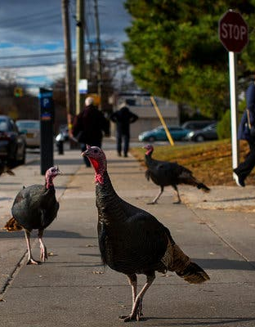
The Agenda 1. Bellringer on FRQ skills 2. Notes Lesson on the Columbian Exchange 3. classwork on specific P.A.I.D.
Homework: read actively pp. 209-214 by Thursday
It is bad joke Wednesday!
November 20, 2019

Slide 2
Skills Bellringer Use any sheet of paper you have
P. 217 “Think as a Historian” box
The skill→ Identifying evidence in an argument
Work alone to do both 1 and 2
Now turn to a neighbor and discuss

Slide 3
The Columbian Exchange
Defined: the global diffusion of plants (crops), animals (including humans), ideas, and diseases (P.A.I.D.)
After 1492 the continuous voyages between hemispheres brought vast changes as flora and fauna were available to all parts of the globe

Slide 4
Demographic Impact (4.1 I) Amerindians had no resistance to germs brought into their hemisphere 1. disease spread rapidly, killing the majority of the people 2. S.H.E. → Small pox, influenza, typhus 3. Europeans died of Malaria
Make this
Environmental Impact (4.1 I)
Introduction of European Livestock greatly altered the environment and culture of Americas
Invasive species with no natural predator included: HORSE, cattle, pigs, and sheep
On a positive note meat, milk, hides and wool were useful, as well as a ridable large animal!

Slide 5
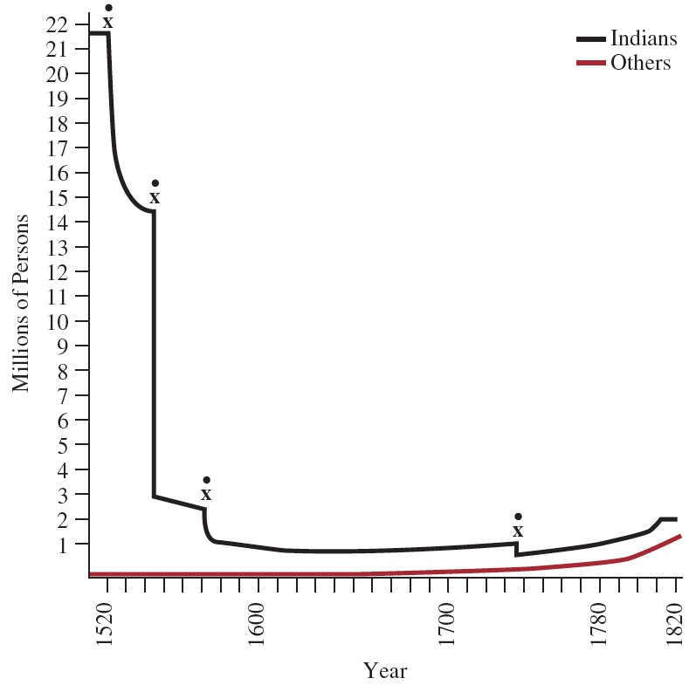
Note
From 1530-1550 Native Population in the Americas declined from 21.7 million down to 3 million people.
What accounts for this?
Comparing the RED and Black lines, what does this chart tell you about the pace of Afro-European migration in this 1st Global Age?

Slide 7
Food for Thought… handout
Step 1: Create Groups of 3 people
Step2: Choose a food item from me
Step 3: Research! Divy up the 6 bullet points in part 2. Then look it up.
TIP: combine points 1 and 2 cause they are easier
Step 4: Present! (next _____TUESDAY________)
→What does engaging mean to you???
Meet now for 5 minutes

Slide 8
Objective: Explain the causes of the Columbian Exchange and its effects on the Eastern and Western Hemispheres.
Go to my website and find the tab for Unit 4: Transoceanic Connections.
Select the word document labeled “Columbian Exchange and Spanish Conquest”
Begin using the information & links to answer the 25 questions.
This is DUE FRIDAY (homework grade)

Slide 9
classwork
Use your text, your knowledge, and the readings to answer the prompt below
Compare America with either Asia or Africa in how the Columbian Exchange affected the environment and demographics.
Tips & Helpful Questions
How did any new world food impact the population of Africa or Asia?
How did the introduction of any old word animal affect the American environment?

