Slide 1
Transitioning to High School and the Registration Process

Slide 2
Terminology
Course Selections:
Courses that students select that make up their school schedule
High School Four Year Plan:
A plan that helps your son/daughter map out the coursework for his/her high school years
Prerequisites:
the required completion of a course before enrolling in another course
Future Ready Core:
The mission of the North Carolina State Board of Education that every public school student graduates from high school, globally competitive for work and postsecondary education as well as prepared for life in the 21st century. All students are expected to meet the requirements outlined under the Future-Ready Core Course of Study

Slide 3
Terminology
Career Clusters:
Career clusters contain courses within a focused technical area that provide students with the knowledge needed to make educated choices about career goals and the post-secondary education needed to reach those goals
High School Transcript:
is an essential document that includes some of the pertinent information such as:
courses taken while attending secondary school
number of credits earned and term a specific course was taken
final grades
weighted average
standardized test scores

Slide 4
Terminology
Honors /Advanced Placement (AP):
courses that have a more demanding and rigorous curriculum than regular classes. The AP program offers able and ambitious students an opportunity to study college-level coursework; the national AP exam is required of all students enrolled in an AP course. Many colleges grant college credit or advanced placement based on AP exam scores. Honors/AP courses receive weighted credit in computing GPA
International Baccalaureate (IB) Program:
offers a rigorous, two-year course of study for high school students. IB provides successful candidates an internationally recognized diploma and preparation for study in the world’s most demanding colleges and universities
College Courses:
A program through a collaborative partnership with area colleges and universities. Students begin an approved rigorous course of study preparing them for dual-enrollment as high school seniors and first-year college students

Slide 5
Terminology
Credit by Demonstrated Mastery:
Uniquely qualified students may demonstrate mastery of a course’s content and earn pass/fail credit for the course; this is two-phase process that includes taking an assessment and completing an artifact or performance task
Virtual Learning:
Apex Learning Virtual School (ALVS), North Carolina Virtual Public School (NCVPS), and Guilford County Schools Virtual Public School (GCSVPS) provide students with expanded academic options by offering online courses at NO COST to your student

Slide 6
Terminology
Diploma Endorsements:
Students enrolled in North Carolina high schools have the opportunity to earn endorsements to their High School Diploma beginning with the graduating class of 2014-2015. Endorsements are not required to graduate, but are an additional recognition from the state
Career and College Promise:
a program designed to provide seamless dual enrollment for eligible North Carolina high school juniors and seniors in order to accelerate completion of college certificates, diplomas, and associate degrees. These degrees lead to college transfer or provide entry-level job skills

Slide 7
Graduation Requirements

Slide 8
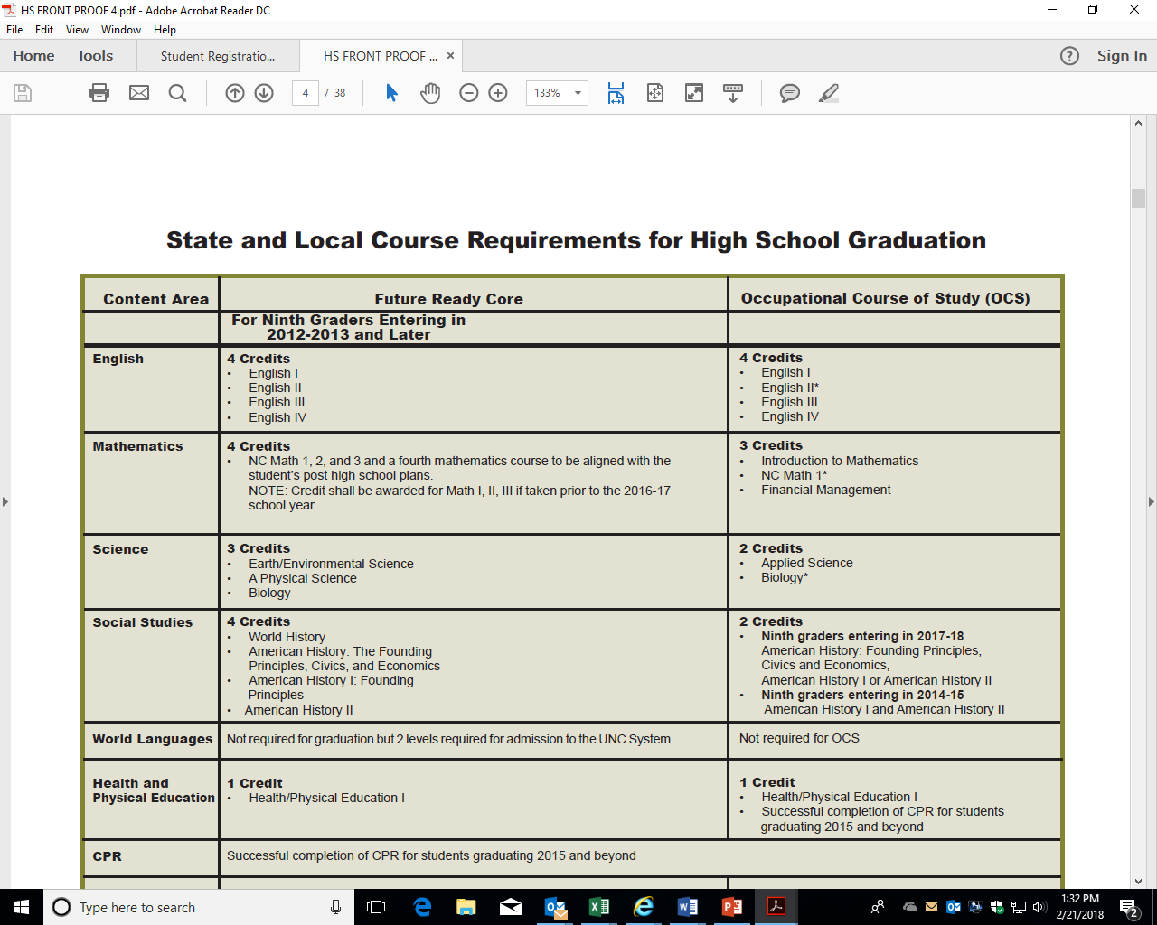
State and Local Course Requirements for High School Graduation

Slide 9
State and Local Course Requirements for High School Graduation

Slide 10
High School Four Year Plan

Slide 11
(SAMPLE) High School Four Year Plan This is just a SAMPLE Four Year Plan, refer to the Graduation Chart
Grade 9 | Grade 10 | Grade 11 | Grade 12
English I English I Honors | English II English II Honors | English III Engligh III Honors | English IV English IV Honors
NC Math 1 NC Math Honors | NC Math 2 NC Math 2 Honors | NC Math 3 NC Math 3 Honors | Choose a 4th Math
World History World History Honors | Am. History: Civics Am. History Civics Honors | American History I American History I Honors | American History II American History II Honors
Earth Science Earth Science Honors | Biology Biology Honors | Chemistry Chemistry Honors | Elective
Health/PE | Elective | Elective | Elective
Elective | Elective | Elective | Elective

Slide 12
Student Registration Process
The information below will help you register for courses for the following year. This will happen in the Spring.
The Registration Toolbox is a webpage that provides pertinent information to complete the registration process. To view the Registration Timeline, go to www.gcsnc.com and search for Registration Toolbox.
Your son/daughter will receive a Guilford County Schools’ Middle or High School Registration Book.
The registration book contains information about the multitude of choices in GCS and is designed to help you and your son/daughter make the best choices for his/her middle or high school education and post-secondary opportunities.
Refer to the Registration Toolbox for online versions on the registration books.

Slide 13
Student Registration Process
Student’s opportunity to request appropriate courses
Choose courses that align with plans after high school.
What kind of work do I want to do as an adult?
Military, four year university, community college or career?
What courses will help me achieve my post-secondary goal?
What are my long-term goals and what choices will help me soar to greatness?

Slide 14
Important Tips

Slide 15
What students should know and understand before transitioning to and while attending high school:
• Know how to calculate your GPA (Grade Point Average)
• Know how to read a transcript
• Understand the meaning and importance of a course credit
• Know your high school graduation requirements
• Understand and complete a High School Four Year Plan
• Know the attendance policy
• Have an understanding of the Career Clusters and Course Concentrations

Slide 16
What students should know and understand before transitioning to and while attending high school:
• Have an understanding of High School Options
• Understand the meaning and importance of various curriculum options, such as
a) Honors / Advanced Placement (AP)
b) International Baccalaureate (IB)
c) College Courses
d) Credit by Demonstrated Mastery
e) Virtual Learning
f) Diploma Endorsements
g) Career and College Promise

