Slide 1
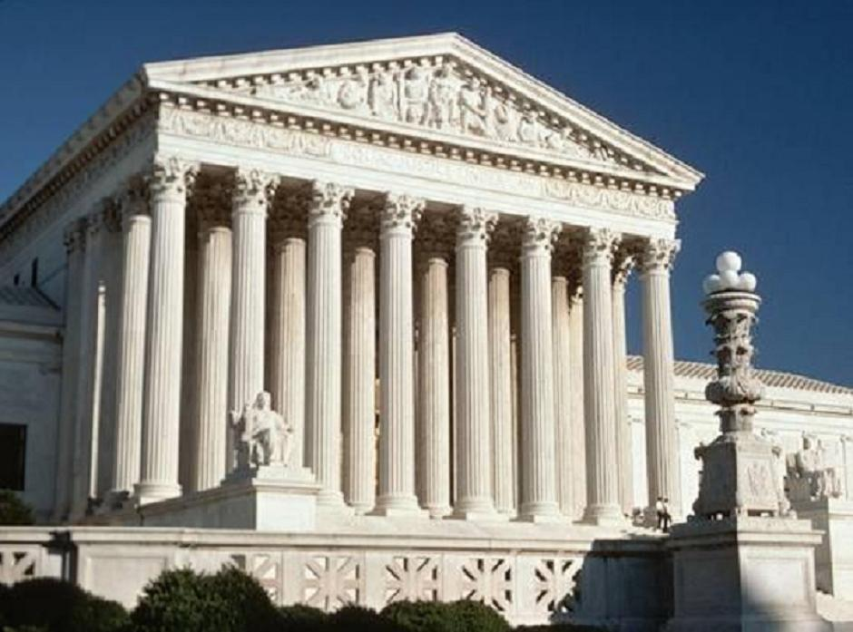
Federal Judiciary Branch
Unit IID – Branches of Government

Slide 2
Enduring Understanding 5.C: The design of the judicial branch protects the court’s independence as a branch of government, and the emergence and use of judicial review remains a powerful judicial practice
Essential Questions: Evaluate the role of the federal judiciary within the confines of our democratic institutions
Students can:
Evaluate how the judiciary branch works within the Madisonian Model to balance government authority with rights protected by the Constitution
Agenda
The Necessity of Article III
Establishing a Judicia Branch
Judiciary Critique
Homework: No Homework

Slide 3
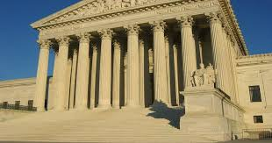
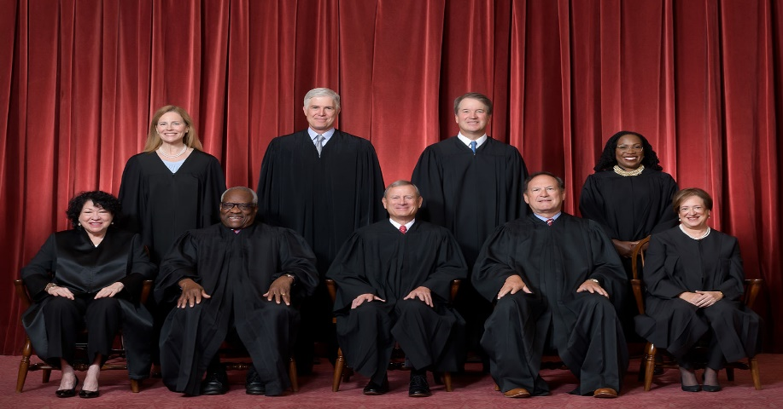
The Judiciary Effect
How does the Supreme Court of the United States (SCOTUS) impact the founders’ intent of the design U.S. Constitution?
A Constitutional Court
The Power of the NINE
This week in SCOTUS history

Slide 4
The Judiciary Effect
Why is it important to have a federal judiciary?
Colorado Court Disqualifies Trump for Engaging in Insurrection
No person shall be a Senator or Representative in Congress, or elector of President and Vice-President, or hold any office, civil or military, under the United States, or under any State, who, having previously taken an oath, as a member of Congress, or as an officer of the United States, or as a member of any State legislature, or as an executive or judicial officer of any State, to support the Constitution of the United States, shall have engaged in insurrection or rebellion against the same, or given aid or comfort to the enemies thereof.
- 14th Amendment, Section 3
[The Congress shall have Power . . . ] To make all Laws which shall be necessary and proper for carrying into Execution the foregoing Powers, and all other Powers vested by this Constitution in the Government of the United States, or in any Department or Officer thereof.
To establish a uniform Rule of Naturalization
- Article I, Section 8, U.S. Constitution
Texas Law on Immigration

Slide 5
Factors of a Judiciary Branch
Again, there is no liberty if the judiciary power be not separated from the legislative and executive. Were it joined with the legislative, the life and liberty of the subject would be exposed to arbitrary control; for the judge would be then the legislator. Were it joined to the executive power, the judge might behave with violence and oppression.
- Baron von Montesquieu, The Spirit of Laws, 1748
Why Article III:
Enlightenment ideas – the weakest branch unless connected to another branch
Major failure of the Articles of the Confederation
Can’t enforce laws (no courts to interpret the law)
Can’t resolve disputes

Slide 6
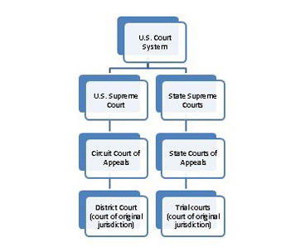
Adversary System of Justice
Adversary system of law = one v. one (defense v. prosecution)
Other Participants:
The American population
Attorneys
Interest Groups
Why is the adversary system the ideal way to meet the goal of “establish justice”?

Slide 7
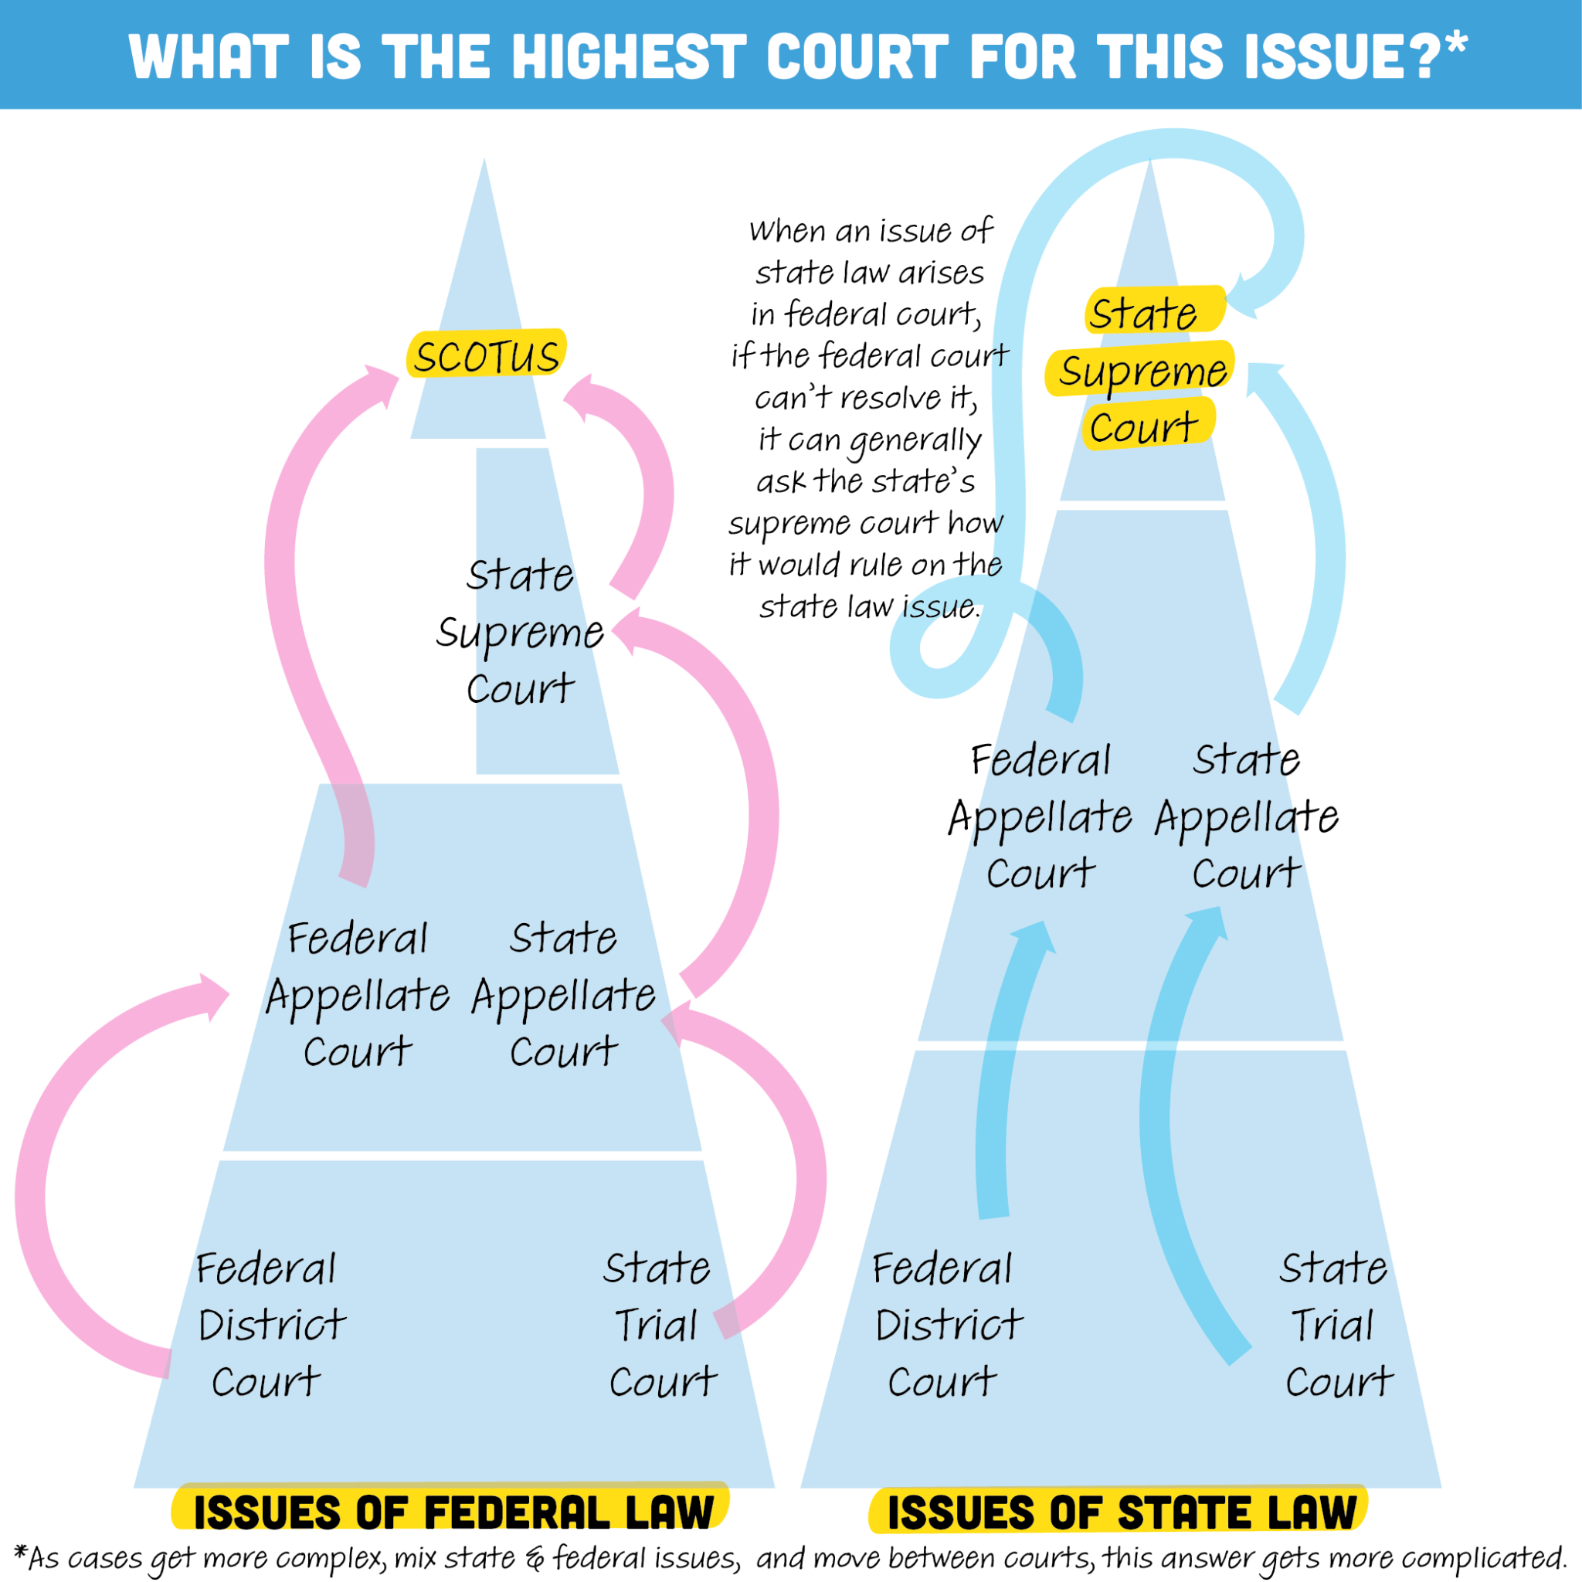
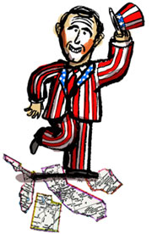
Dual Court System
Adjudication of the law through judicial federalism
Jurisdiction determine by the legal issue
Exclusive jurisdiction: (Federal ONLY!)
U.S. Constitutional questions
State v. State
Cases against states involving federal laws

Slide 8
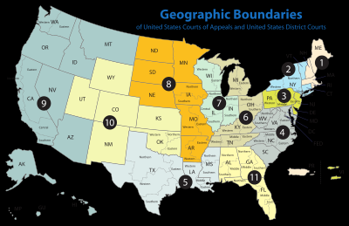
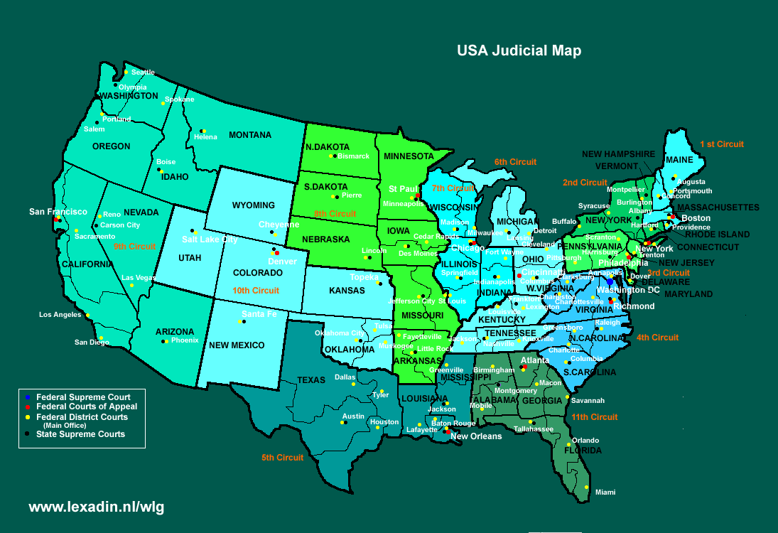
Federal Court Structure
Article III of the U.S. Constitution: Established a Supreme Court
Congress has the authority to establish lower federal courts and their jurisdiction
Judiciary Act 1789: District Courts
Evarts Act 1891: Appeals Courts
How does Article III allow Congress to limit the authority of the U.S. Supreme Court?

Slide 9
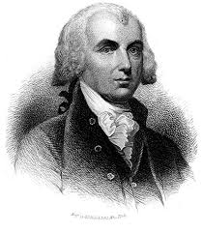
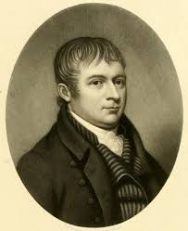
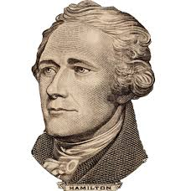
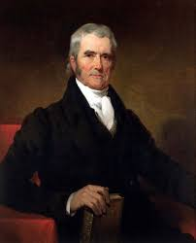
Judiciary Critique
Evaluate how effective were the Founders in constructing a federal judiciary in order to maintain a limited government
Article III
Brutus I
Federalist 78
Marbury v. Madison

Slide 10
Enduring Understanding 5.C: The design of the judicial branch protects the court’s independence as a branch of government, and the emergence and use of judicial review remains a powerful judicial practice
Essential Questions: Evaluate the role of the federal judiciary within the confines of our democratic institutions
Students can:
Evaluate how the judiciary branch works within the Madisonian Model to balance government authority with rights protected by the Constitution
Agenda
Article III True/False
A Three-Tiered System
Judiciary Critique
Homework: The Weakest Branch Debate

Slide 11
True/False of Article III
Evaluate the following statements about Article III of the U.S. Constitution as either true or false
Article III tells us that the federal courts will hear cases arising under the U.S. Constitution.
Article III tells us the specific qualifications that judges must meet to get a job in the Federal courts, including age limits, citizenship requirements, and residency guidelines.
Article III defines the crime of treason and explains the process for finding someone guilty of this crime.
Article III tells us exactly how many inferior, or lower, courts there need to be.
Article III tells us that there will be one Supreme Court but doesn’t say how large or small that court will be.

Slide 12
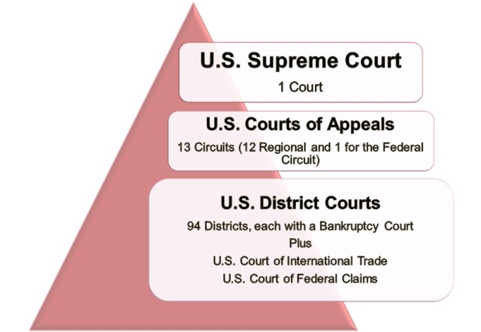
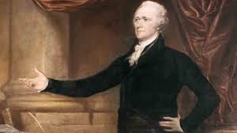
Jurisdiction
Jurisdiction – the authority of a federal court to hear a case
Types of Federal Jurisdiction (impact how cases are handled)
Original: first to hear
Appellate: on appeal
Exclusive: federal only
Concurrent: both state
& federal
Thinking like a founder!
Why does the U.S. Constitution define the jurisdiction of the U.S. Supreme Court?

Slide 13
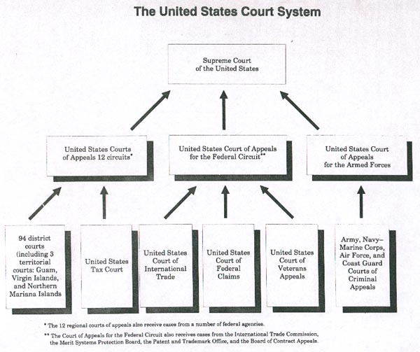
Federal Court Structure

Slide 14
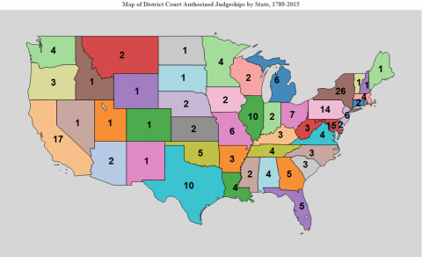
District Court – Accessible Justice
Judiciary Act of 1789 – creation of DISTRICT COURTS (one per state = accessible to the people)
Original Jurisdiction: (1st to hear cases – trial courts)
Efficiency – determines the facts of the case & SCOTUS docket is limited
Original Jurisdiction Examples
Federal Law
Treaties
Constitution
Federal Gov. (Litigant)
THE HAMMER – (District Courts)
Judicial Stats:
94 courts
663 judges (Lifetime tenure)

Slide 15
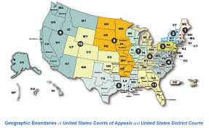
Appellate Court – Clarify the Law
Evarts Act of 1891 – creation of APELLATE COURTS (Established geographic circuits)
Appellate Jurisdiction: (Constitution Questions)
Regions impact view of the Constitution (Conservative v. Liberal or Activist v. Restraint)
Decisions – uphold, overturn, & remand
THE Clarifier – (Appellate Courts)
Judicial Stats:
13 circuits
3 judge panels – (Lifetime tenure)

Slide 16
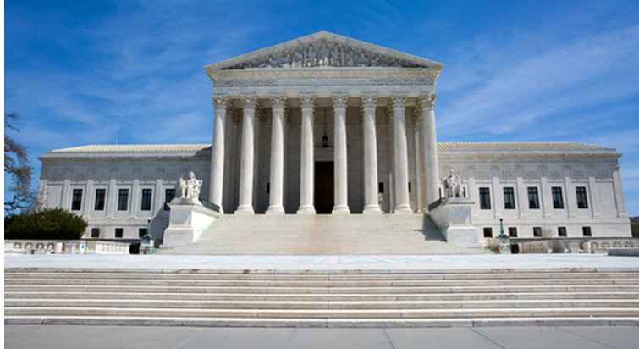
SCOTUS
Article III of the US Constitution – 1 SUPREME COURT
Appellate Jurisdiction: (Constitution Questions)
Original jurisdiction
Cases – U.S. v. State
Cases involving more than two states
Cases involving foreign diplomats
Cases involving citizens of different states
El Supremo– (SCOTUS)
Judicial Stats:
1 Court
9 Justices – (Lifetime tenure)
Power – Judicial Review

Slide 17
Judiciary Critique
Evaluate how effective were the Founders in constructing a federal judiciary in order to maintain a limited government
Article III
Brutus I
Federalist 78
Marbury v. Madison

Slide 18
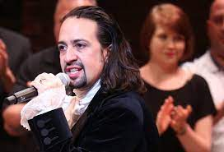
Hamilton’s Raps on the Judiciary
Annotate Alexander Hamilton’s defense of the design of the federal judiciary in FEDERALIST 78
The Supreme Court
Doesn’t distort
A Constitutional Tort
Consider the following:
Why is the judiciary branch the weakest of three branches?
How does the judiciary promote consistence under the law?
Why should the court NOT consider the views of the American public?
How is SCOTUS shielded from public opinion?

Slide 19
Federal Court Structure
Article III Dissection
Ideas of the Founders | Evidence
Checks & Balances
Separation of Powers
Blocking tyranny of the mob
Federalist viewpoint
Anti-federalist counters

Slide 20
The hierarchy of the judiciary
Organize the following statements under the correct tier of the federal judiciary.
District Courts
Appellate Courts
Supreme Court
Lifetime tenure - Determine the facts of a case
Panel of judges - Appeals heard on constitutional ???s
Judicial Review - Jury trial
Set precedents - Judges are appointed

Slide 21
Enduring Understanding 5.C: The design of the judicial branch protects the court’s independence as a branch of government, and the emergence and use of judicial review remains a powerful judicial practice
Essential Questions: Evaluate the role of the federal judiciary within the confines of our democratic institutions
Students can:
Evaluate how the judiciary branch works within the Madisonian Model to balance government authority with rights protected by the Constitution
Agenda
Political Football of Judicial Nominee
Don’t get Borked!
Judicial Autopsy
Homework: Judicial Autopsy

Slide 22
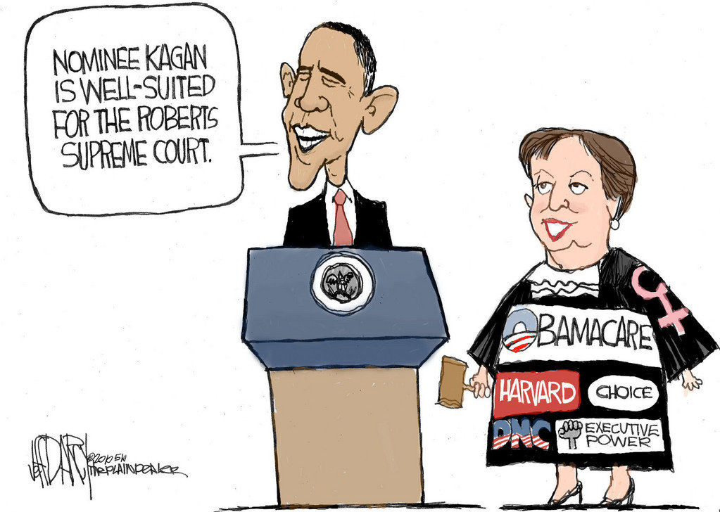
The Political Football
Controlling the Court
Identify and explain why judicial appointments create gridlock in in the federal government.
Explain two ways that federal court judges are protected from public opinion.
Why does the political ideology of a federal judge matter in the interpretation of the Constitution?

Slide 23
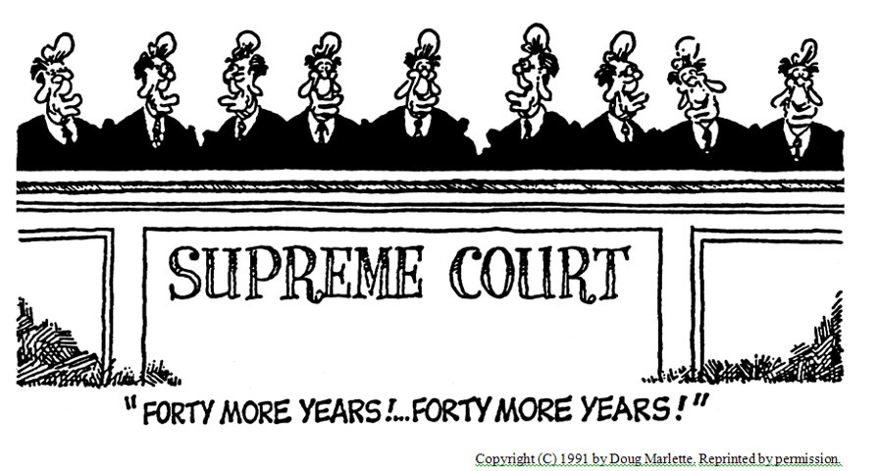
Judicial Appointments
Legacy of Presidents on the federal judiciary
Judicial Activism (Constitution is interpretable) or Judicial Restraint (the original intent)
Judicial precedents impact American society – (uniformity of the law)

Slide 24
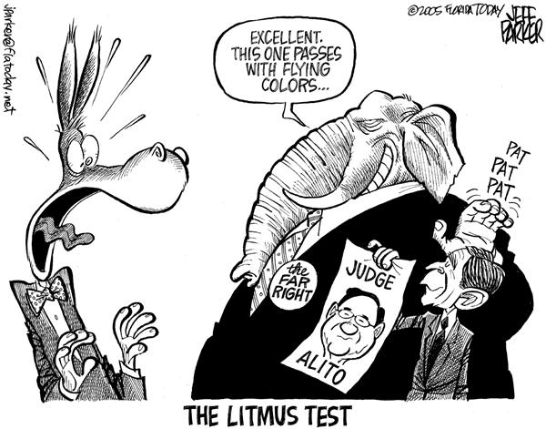
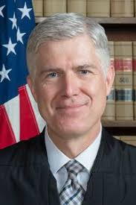
Appointment Process
U.S. Constitution: Appointed by the President with consent of Senate
850 judges – all serve for life (can be impeached for high crimes ONLY)
Process:
Dept. of Justice short list
Nominees are vetted (American Bar Association rating, background check, decisions read)
Announcement (interest groups litmus test – liberal or conservative)
Confirmation hearing
Liberal
Conservative

Slide 25
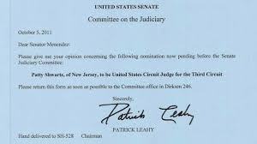
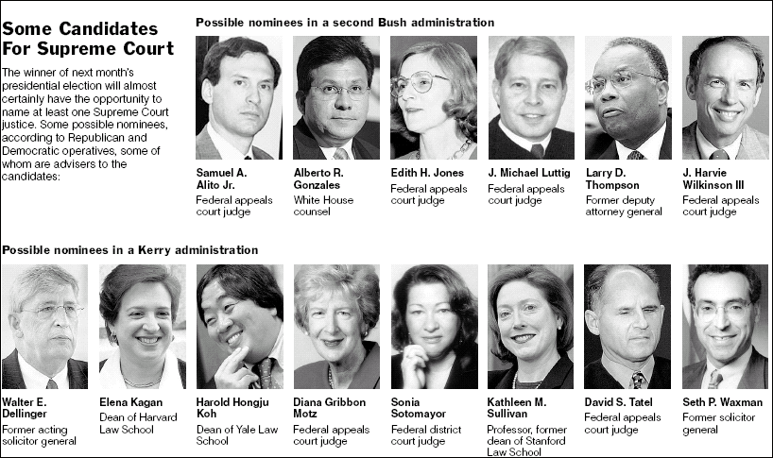
Court Appointment Differences
President seeking prior approval
Senatorial courtesy: president getting feedback on potential
nominees
Blue slips: Senate feedback on nominees
Blue Slips

Slide 26
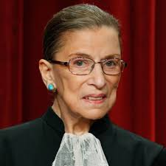
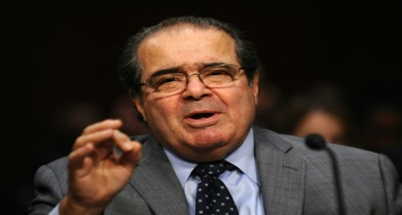
Liberal or Conservative
Political ideology impacts judicial precedents (binding to the whole nation)
Federal nomination rejection rate 20%
Current Supreme Court – 6 Conservatives + 3 Liberals
Judicial Activism: the court expands its power and makes laws with precedents – Ex. Roe v. Wade “privacy”
- Issue may not have the expertise & violates separation of powers
Judicial Restraint: follows the written word of the U.S. Constitution
Ex. Clinton v. NYC – No line-item veto
Issue: America is a society that adapts (Civil Rights)

Slide 27
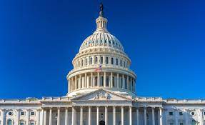
Judicial Autopsy
Analyze the Supreme Court nominee and evaluate his/her effect on the interpretation of the Constitution
What will my campaign supporters say?
Will my constituents like him?
Is he Conservative or Liberal?
Will he protect right to choose or life?

