Slide 1
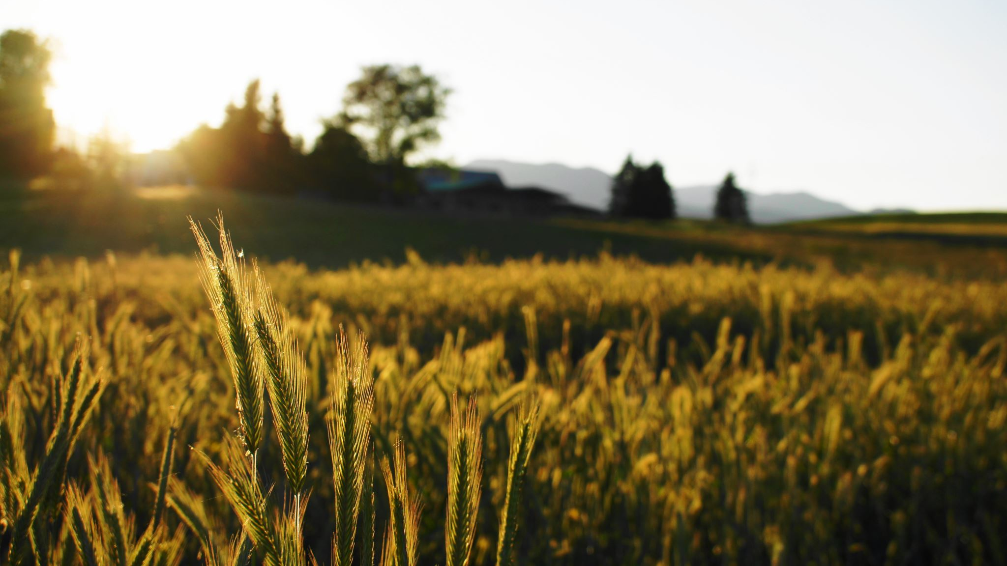
State Building in the Americas and Africa 1200-1450
Topics 1.4 & 1.5

Slide 2
Gov: Cahokia-monumental “mound” built by Chiefs known as The Great Sun” Chief SOC: priests & nobles { power gap Artisans/merchants/farmers slaves (P.O.W.s) matrilineal society: tracing ancestry/social rank through mother’s family
North Americans: The Mississippian
Chaco & Mesa Verde

Slide 3
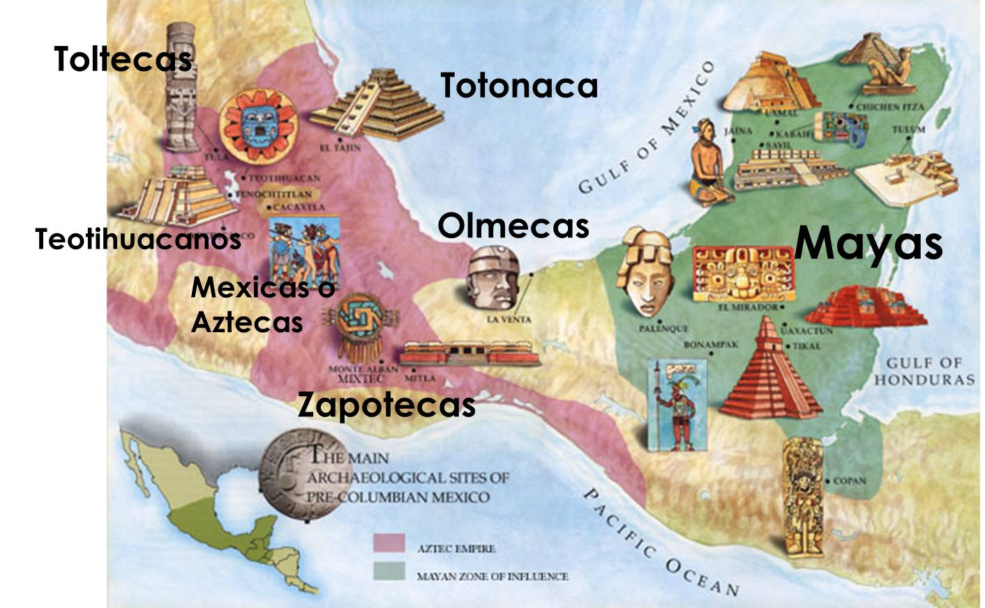
Meso-America
The Maya
GOV: organized as city-states, each ruled by their own king
War was common between city-states to supply captives for human sacrifice
CDI: religion was nature gods (sun, rain, corn). Temple ceremonies appeased gods through captives being killed as offerings
TEC: priests used temples height to observe stars to make accurate calendars (for harvests)

Slide 4
Corn-War connection: war brought POWs. P.o.w.s were sacrificed to appease the rain god. Rain god made rain to grow corn
Note the heart offering to the skies (rain god lived in skies)

Slide 5
12/21/2012 → The End of the world watch this video to answer the questions
https://www.youtube.com/watch?v=0pAWDWH5ve0

Slide 6
Meso-America
The Aztecs (AKA “the Mexicas”)
GOV: an empire ruled from Tenochtitlan, a city built on a lake by draining part of it for agriculture
A Great Speaker led a theocracy (rule by religious leaders)
Tribute was forced from neighbors, creating a Tribute Empire
TEC: built floating gardens called chinampas
CDI: religion was similar to Mayans—human sacrifice to appease gods

Slide 7
South American Andes
The Inca
GOV: a large empire along the Pacific coast, in the highlands of the Andes mountains
Was a tribute empire: MITA system required neighbors to send workers to work Incan lands for 8 days a month
CDI: Religion similar to Aztecs, worshipped the sun god, Inti (and other things in nature “animism”)
Temple of the Sun-center of religion
Royal Ancestor veneration: like Egyptians, the Inca mummified their dead leaders, believing that a preserved body provided immortality

Slide 8
TEC: quipo was knotted string used to keep count/records
Carpa Nan was the massive road system through the Andes, 25,000 . Used by gov to military rule (no horses so there were runners to send messages)
Waru– terraces cut into mountain side for farming fields

Slide 9
Decline & Fall
Mississippians, Chaco, Mesa Verde, and the Mayans all abandoned their lands due to climate change (an extended dry spell). Agriculture collapsed.
Aztecs declined due to 1) low TEC-no wheels or pack animals to help in agriculture
2) expanding empire too far (overstretched) 3) arrival of Spanish (guns, germs, and steel)
Inca declined as a brutal civil war was occurring just as the Spanish arrived in 1532

Slide 10
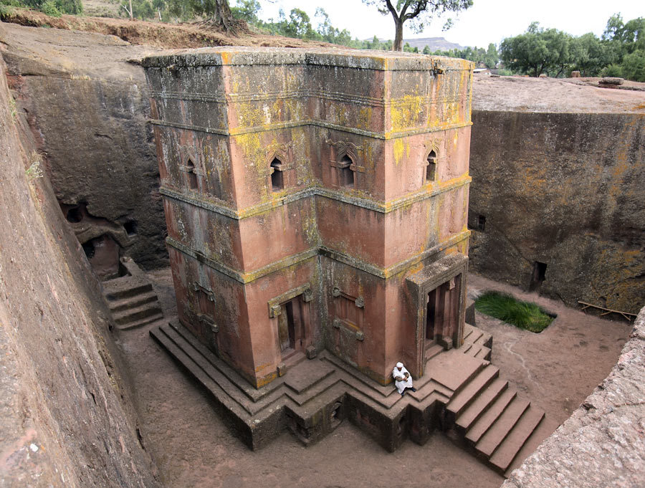
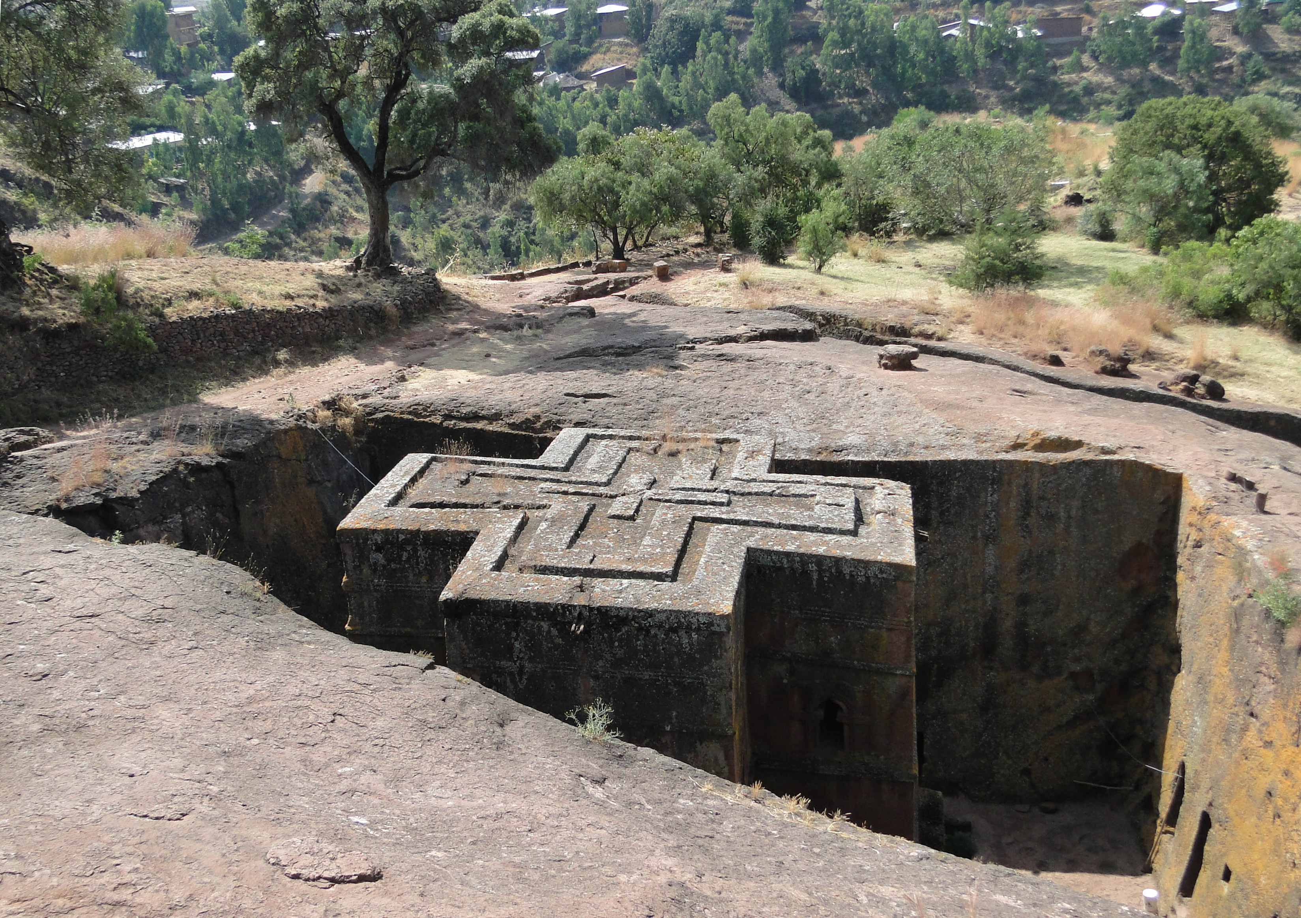
Africa GOV
West: Ghana-Mali-Songhai are the 3 gold-salt kingdoms
Continuity: Mali ruled as our course begins in 1200, dominating the Trans-Saharan network
East: the Zanj, or the Islamized trading cities along the Indian Ocean coast, were part of the IOTN in 1200.
Great Zimbabwe: an interior Stone Walled city of 20,000, declined over time due to over-farming/ruining the environment
Ethiopia: a Christian land remained along the Red Sea coast; known for its Rock Churches

Slide 11
Africa SOC & CDI
SOC: organized around kinship, age and gender
Patriarchy with some matrilineal tradition
Slavery: tribal competition led to many POWs being enslaved locally, but the Trans-Saharan slave trade grew as Islamic merchants penetrated the Sub-Sahara
CDI:
Griot: a story teller kept the history of their people.
Change over time: as Islam grew traditional African customs blended with Islamic traditions

