Slide 1
Unit II
Macroeconomics

Slide 2
Essential Standard:
EPF.F.E.2.2 Summarize basic microeconomic indicators and how they vary over the course of a business cycle.
Essential Question: Decipher how changes in the U.S. economy influences choices made about consumption, production and public policies
Students Can:
Describes the phases of the business cycle
Utilizes economic indicators to explain how the U.S. economy is performing
Agenda
Unit I challenge questions
Phase of the U.S. Ecocnomy
Homework:
Study for Unit I Test

Slide 3
Essential Standard:
EPF.F.E.2.2 Summarize basic microeconomic indicators and how they vary over the course of a business cycle.
Essential Question: Decipher how changes in the U.S. economy influences choices made about consumption, production and public policies
Students Can:
Describes the phases of the business cycle
Utilizes economic indicators to explain how the U.S. economy is performing
Agenda
Reading the Economic Wave
Phase of the U.S. Economy
Cartoons of the economic phases
Homework:
Cartoons of the economic phases due Friday, September 29
Current Events Journal #1 due October 25

Slide 4
Reading the Economic Wave
How would the following situations impact American consumers and job seekers?
Many manufacturers are closing, as a result of cheaper labor prices in Mexico, Malaysia, and China. Many small towns are losing small retailers and housing prices in the area are continuously falling.
Due to the OPEC limiting the supply of oil gas prices have begun to climb dramatically. Many grocery stores and retail stores are raising prices to cover the increased cost of shipping.
American businesses are seeing banner years in their profit margins. Because of this many corporations are investing in new opportunities to expand their businesses and purchasing new equipment.

Slide 5
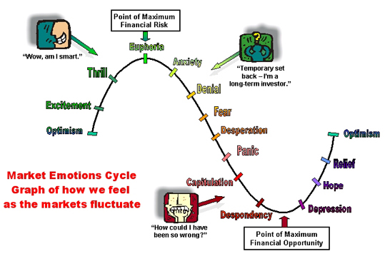
Performance of the Economy
Business Cycle: An economist model for evaluating the health of the U.S. market economy
Reading the economy
Economic indicators are benchmark that tell the economic health
Employment
Gross Domestic Product
Stock Market
Purchases of Capital Goods

Slide 6
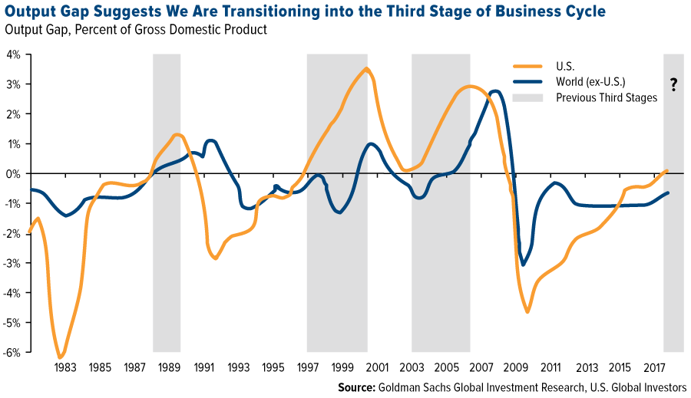
Phases of the Economy
Issue: The Business Cycle is a prediction model (Economists can only guess when the economy will transition from one phase to the next)

Slide 7
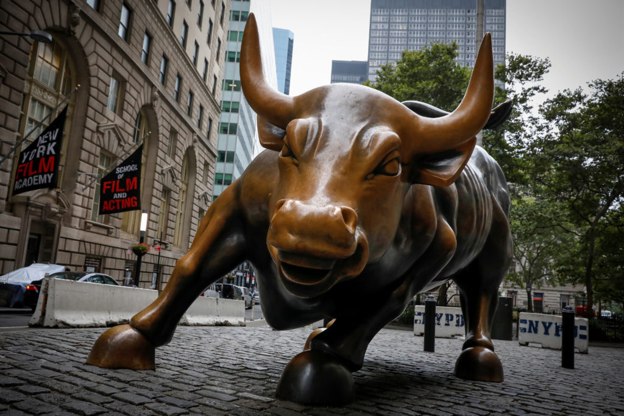
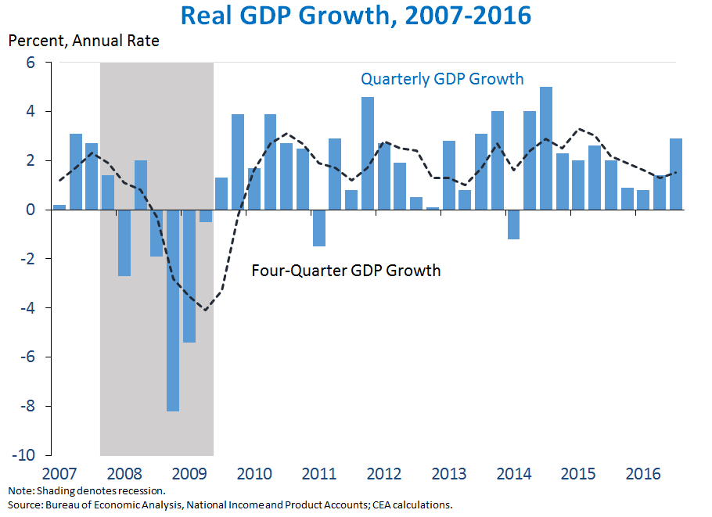
Growth in the economy
Expansion phase: the economy is growing
Goods & services are being sold
JOBS, JOBS, JOBS
Consumer confidence is high
Stock market is BULLISH

Slide 8
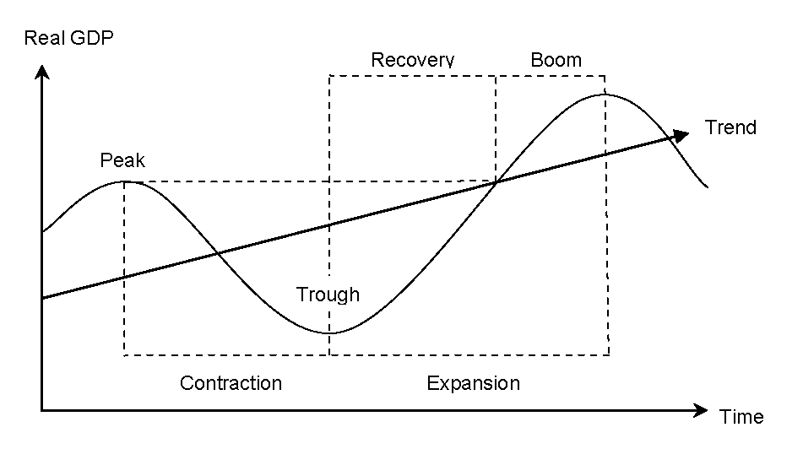
Measure Economic Performance
D.
A. Expansionary
B.
C.

Slide 9
Demand causes expansion
How can the government cause aggregate demand to shift to the right and extend an expansionary phase of the business cycle?

Slide 10
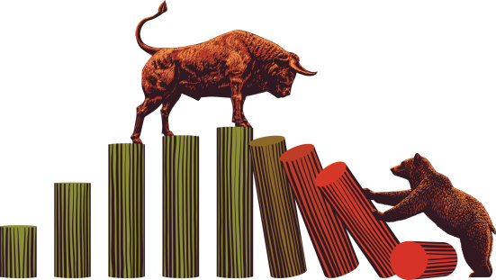
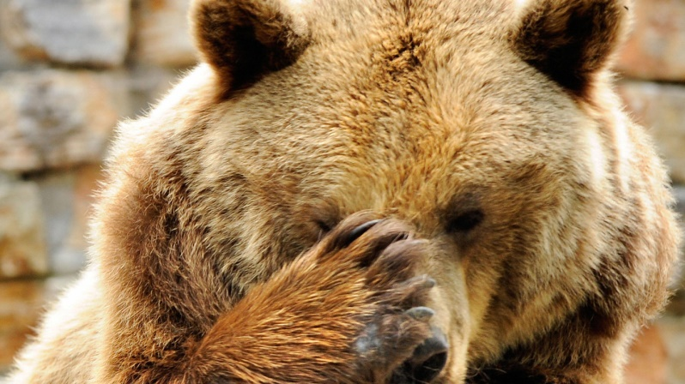
Economic BAD Times
Contraction Phase - The economy is declining – BAD TIMES
Production rates are declining
Businesses laying off employees
Consumer save $$$ (fear of loss of work)
Stock market is Bearish
Recession migraine

Slide 11
Measure Economic Performance
D.
A. Expansion
B. Contraction
C.

Slide 12
Causing an economic slow down
Why would the government want to cause a contraction in the economy?
How can government cause the economy to contract?

Slide 13
- Inflation
- Interest rates are high
- Low unemployment 4%
Peak
Contractionary
Expansionary
Expansionary
A recession occurs when real GDP falls for two consecutive quarters.
Long-run trend of real GDP
Trough
- Deflation
- Interest rates are low
- High unemployment +6%

Slide 14
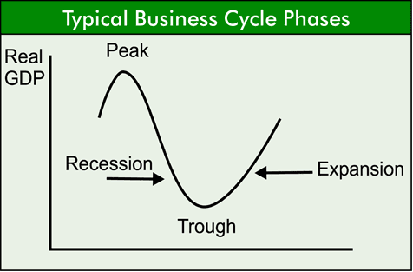
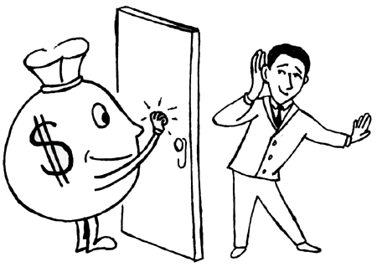
Trough Phase
The economy bottoms out and begins a cycle of growth
TOUGH PHASE: - Price, demand, supply, and competition have adjusted to get rid of economic dead weight (weak businesses, surplus goods and services, and consumers want fewer products)

Slide 15
Measure Economic Performance
D.
A. Expansion
B. Contraction
C. Trough

Slide 16
Peak Phase
The economy tops out and begins a cycle of contraction
PEAK PHASE: The economy is cannot expand to provide more jobs or expand production.
The economy is responding to an issue (ex. Housing market crashes)
The economy will start decline

Slide 17
Measure Economic Performance
D. Peak
A. Expansion
B. Contraction
C. Tough

Slide 18
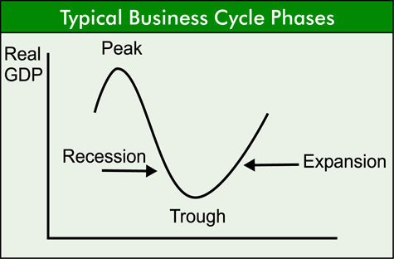
Peak Phase
The economy has hit max production
There is no more growth or jobs
Once the economy has hit its high point it must start to decline and contract
We never know what is going to cause economic slow down until it has happened (housing market or too many .coms)
End of the economic growth

Slide 19
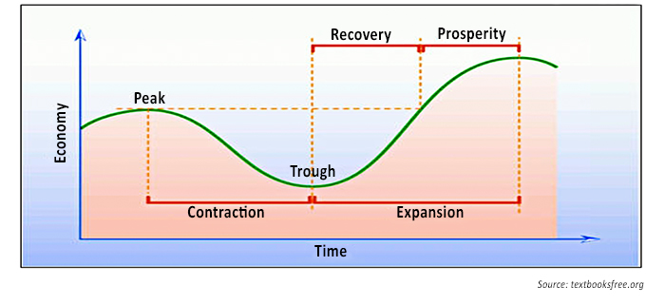
Reading the Trail Blazes of the Economy
Which phase of the economy is represented by the following indicators: C = Contraction, T = Tough, E = Expansion, or P = Peak
Automobile report profit losses for the fourth quarter in row
Unemployment rate rises 7.5% during 2007
The President proposes a tax refund of $400 for every married couple and another $400 for every child
Gas prices are rapidly rising as result of the OPEC oil embargo

Slide 20
Essential Standard:
EPF.F.E.2.2 Summarize basic microeconomic indicators and how they vary over the course of a business cycle.
Essential Question: Decipher how changes in the U.S. economy influences choices made about consumption, production and public policies
Students Can:
Describes the phases of the business cycle
Utilizes economic indicators to explain how the U.S. economy is performing
Agenda
Diagnosing Economic Phases
Cartoons of the economic phases
What Phase is it?
Homework:
Cartoons of the economic phases due Friday, September 29
Current Events Journal #1 due October 25

Slide 21
Reading the Trail Blazes of the Economy
Choose a partner
Write the one phase of the business cycle on each of the index cards
Expansion - Peak
Contraction - Trough
Read each scenario and discuss your answer with your partner
Place an X in the box of the correct phase of the business cycle
Hold up the corresponding index card when the teacher calls for it

Slide 22
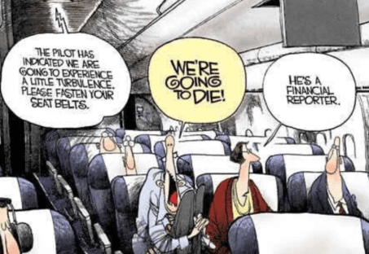
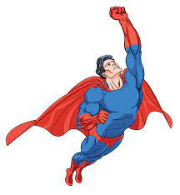
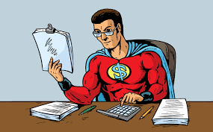
Business Cycle Comic
Design a comic strip made up of three to four cells that illustrates the scenario
Highlight the phase of the business cycle of each scenario
Use text blurbs to create dialog

Slide 23
What Phase is it?
Scenario 1: Taylor has been thinking about buying a new surfboard and has been saving the money from her part-time job for the last couple of years. She finally has enough to get the surfboard but when she visits the store, she discovers that the prices of surfboards have gone up by 10% over the past two years.
Scenario 3: Bhakti owns a chain of bakeries. Over the past few years, sales have been getting lower and lower – she recently had to close one of her stores and let the employees go. If sales don’t increase, Bhakti is worried that she might have to close more stores.
Scenario 5: Bhakti owns a chain of bakeries. Over the past few years, sales have been getting lower and lower – she recently had to close one of her stores and let the employees go. If sales don’t increase, Bhakti is worried that she might have to close more stores.

Slide 24
Essential Standard:
EPF.F.E.2.2 Summarize basic microeconomic indicators and how they vary over the course of a business cycle.
Essential Question: Decipher how changes in the U.S. economy influences choices made about consumption, production and public policies
Students Can:
Describes the phases of the business cycle
Utilizes economic indicators to explain how the U.S. economy is performing
Agenda
The Current Economic Forecast
An Indication of Economic Performance
Who is unemployed?
Homework:
Cartoons of the economic phases due Friday, September 29
Current Events Journal #1 due October 25

Slide 25
Economic Indicators
Markers of Economic Performance

Slide 26
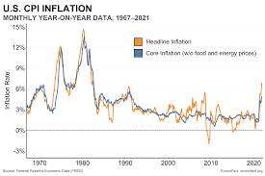
Economic Watch
What the economic data says about the forecast for the U.S. economy?
What phase of the economy is our current economy?
How will inflation impact our economic future?
CNN – Market Watch

Slide 27
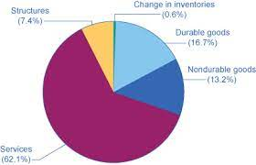
Indications of the Business Cycle
Economic Indicators: various data measurements that are used to determine the health of the U.S. economy.
Leading Indicators: fast changing (early warning signs)
Stock Market
Consumer goods orders
Capital good orders
Application for unemployment
Lagging Indicators: slow changing (long term effects)
Unemployment rate
Corporate profits
GDP
Income & Wages

Slide 28
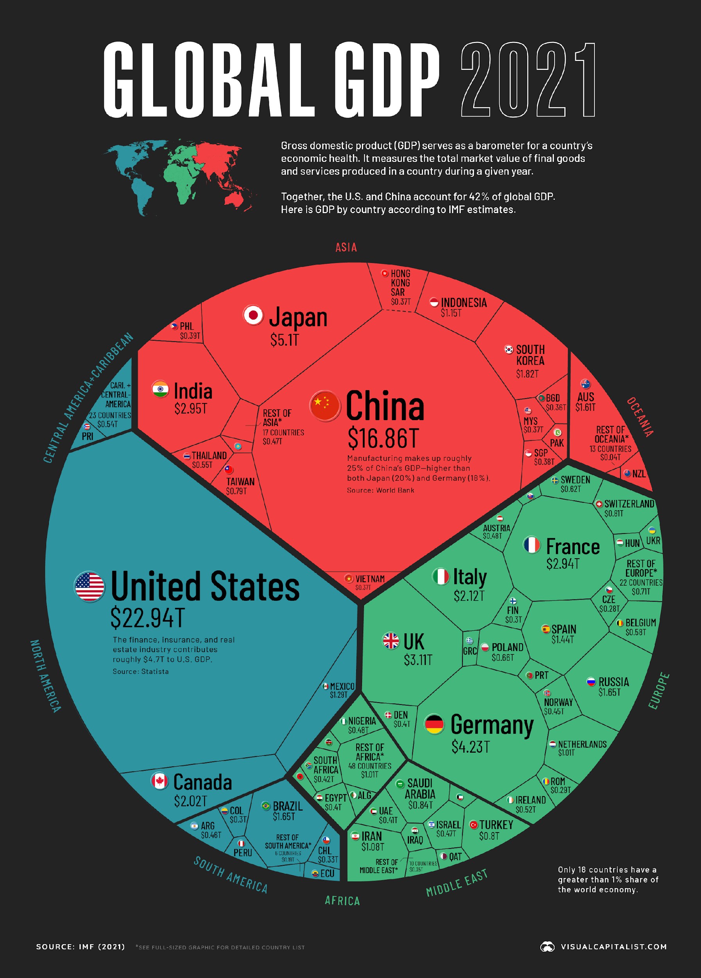
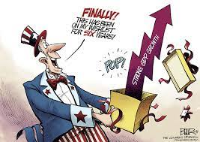
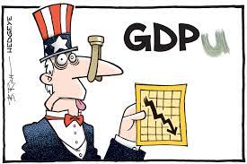
Productions of a Nation
Gross Domestic Product: (GDP) measures the DOLLAR value of all FINAL goods & services produced in one year’s time.
Per Capita GDP: A nations GDP divided by its population
GDP = Consumption + Investments + Government Spending + Net Exports

Slide 29
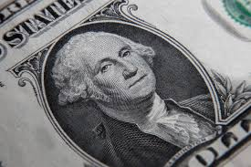
Current GDP Readings
I don’t lie, I distort!
$20.49 Trillion – GDP 2018
$54,541.70 – GDP per capita 2018
$17,998 Trillion – REAL GDP 2018
1. Why is there a difference between GDP and Real GDP?
Real GDP: measure production, but removes price distortion (inflation)

Slide 30
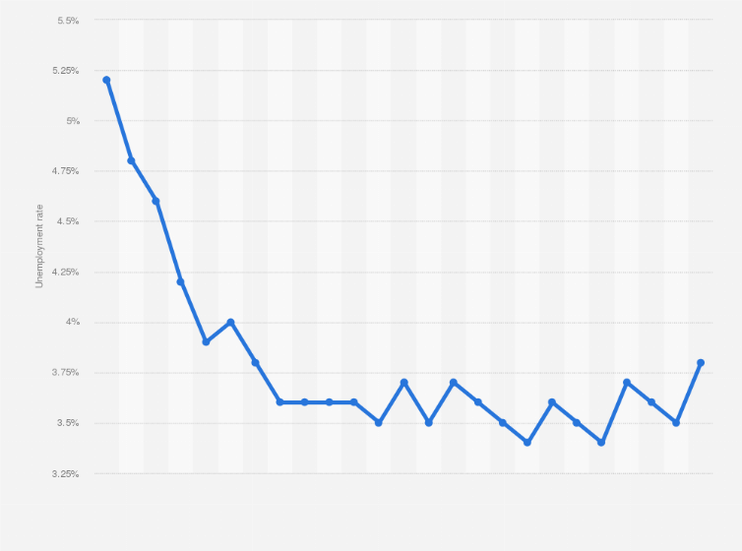
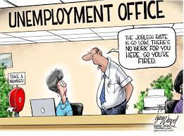
You Got a JOB!!!!!
Natural unemployment rate – there will always be a percentage of the population that will be unemployed (anything under 5% is considered normal)
Bureau of Labor Statistics
Measurement: Civilian Labor Force – anyone 16 years old or older actively seeking employment
Formula: Unemployment Rate = Number of Unemployed / Total Labor Force
U.S. Unemployment Rate: 3.8% = 6.4 Million Americans

Slide 31
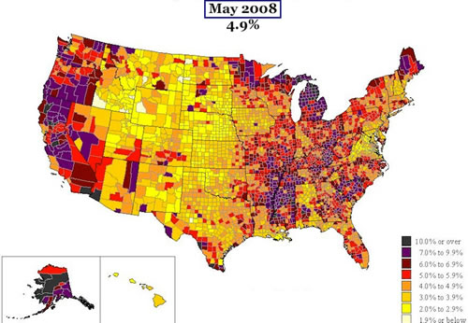
Unemployment

Slide 32
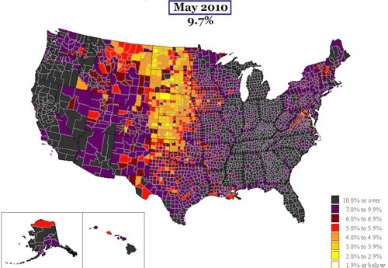
Unemployment

Slide 33
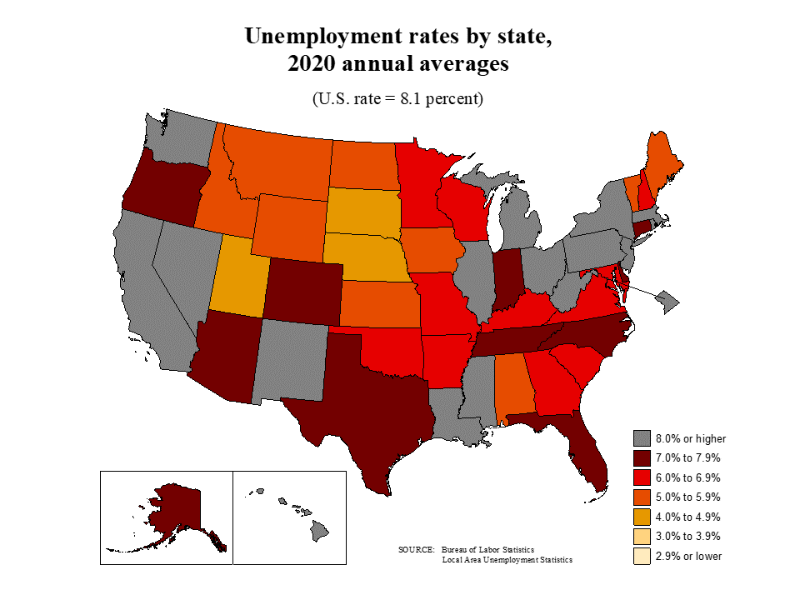

Slide 34
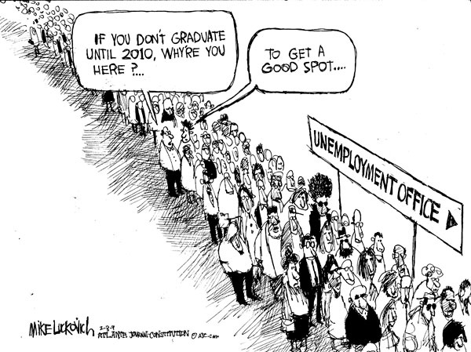
Unemployment Data
Civil Labor Force: Unemployment Types
Cyclical unemployment
Frictional unemployment
Seasonal unemployment
Structural unemployment
DOES NOT Consider under-employment (people overqualified for the job they have)

Slide 35
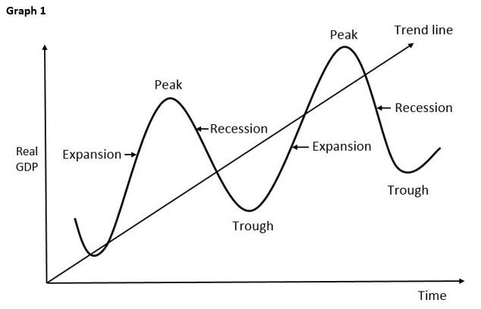
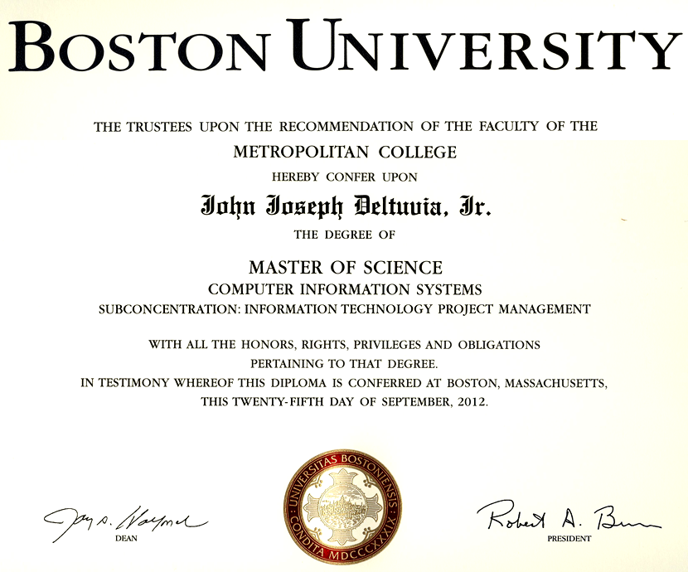
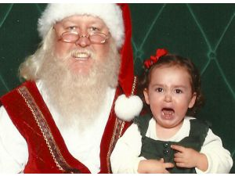
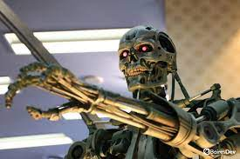
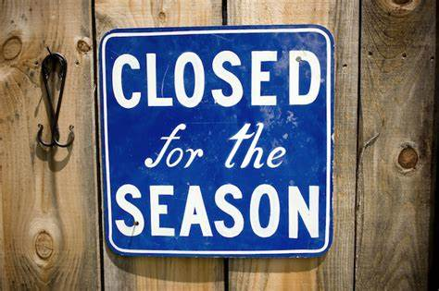
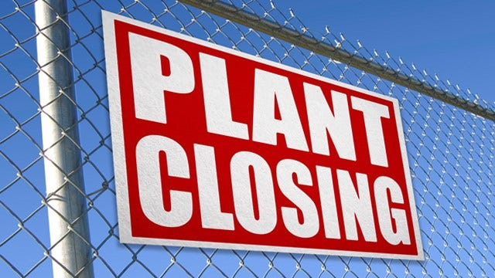
The Seekers of Jobs
Cyclical unemployment
Frictional unemployment
Unemployment that follows the business cycle
Temporarily unemployed by choice or leaving for another job
You’ve been terminated
Seasonal unemployment
Structural unemployment
Automation
Jobs only available during certain times of the year
Job skills don’t match the job market

Slide 36
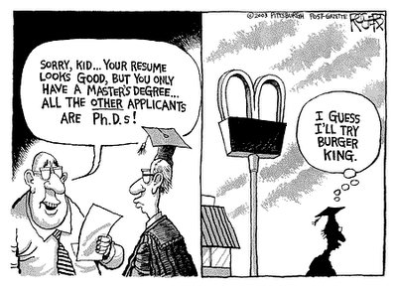
Are You Overqualified
Underemployment: Getting part time work when looking for full time work
Over-qualification- skills and education beyond the job requirements

Slide 37
Essential Standard:
EPF.F.E.2.2 Summarize basic microeconomic indicators and how they vary over the course of a business cycle.
Essential Question: Decipher how changes in the U.S. economy influences choices made about consumption, production and public policies
Students Can:
Describes the phases of the business cycle
Utilizes economic indicators to explain how the U.S. economy is performing
Agenda
Who is unemployed
The Horror of Rising Prices
Comics of the Business Cycle
Homework:
Cartoons of the economic phases due Monday, October 2
Current Events Journal #1 due October 25

Slide 38
Types of Unemployment
Identify the following types of unemployment
- F = Frictional - S = Structural - C = Cyclical - SE = Seasonal
__ 1. The closing of Christmas tree lots after Christmas Eve
__ 2. The closing of textile mills in NC and moving them to Latin America
__ 3. A person who leaves his/her job to get a Masters of Business Administration (MBA)
__ 4. The growth of unemployment because of a recession in the economy
__ 5. The use of automation allows a factory or business to have fewer employees
__ 6. The closing of waterparks every labor day
__ 7. Retailers letting go of workers because their sales have decreased
__ 8. People leaving their job to relocate to another part of the country and look for a new job.

Slide 39
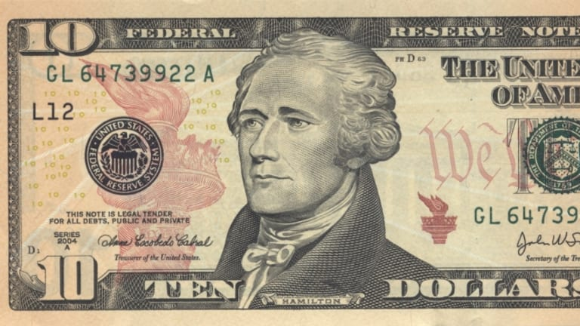
Like Aaron Burr, I’m dropping Hamiltons
Fiat Money: paper money made legal by government law (Value = depends on the strength of the economy)
What is the purpose of money?
Medium of exchange
Stores value
Measures worth or value

Slide 40
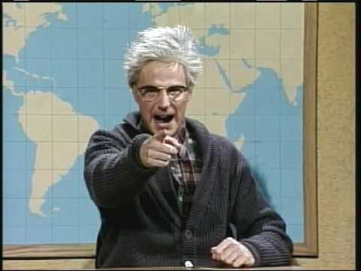
VALUE of $$$$
Money has value because we accept it, but what is its ability to purchase
Hershey Bar
1908 .02
1936 .05
1955 .08
1970 .15
1986 .40
1995 .65
2004 .80
2015 1.08
Back in my day, Hershey bars cost a NICKEL
Creeping inflation

Slide 41
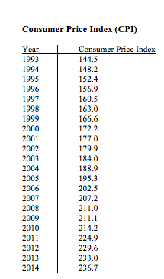
PRICES BE RAGING
Inflation: Persistent rise in price so that outpaces people's income
Measured by the Consumer Price Index (CPI)
Factors causing inflation
DEMAND PULL THEORY: Demand is greater than supply causes price to rise
COST PUSH THEORY: cost to produce products rises causing price to rise (Ex. Minimum Wage)

Slide 42
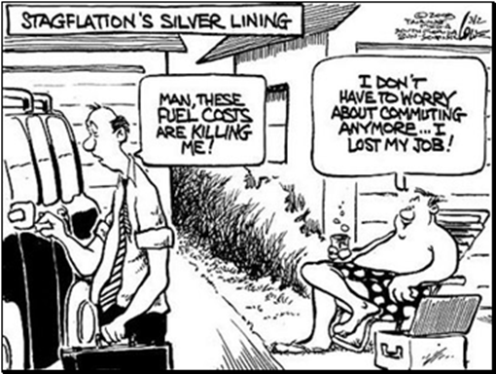
When it get’s UGLY
Stagflation: prices are rising but the economy is in contraction (Cost Push theory inflation)
Hyper-inflation: too much money in the economy (Quantity theory inflation)

Slide 43
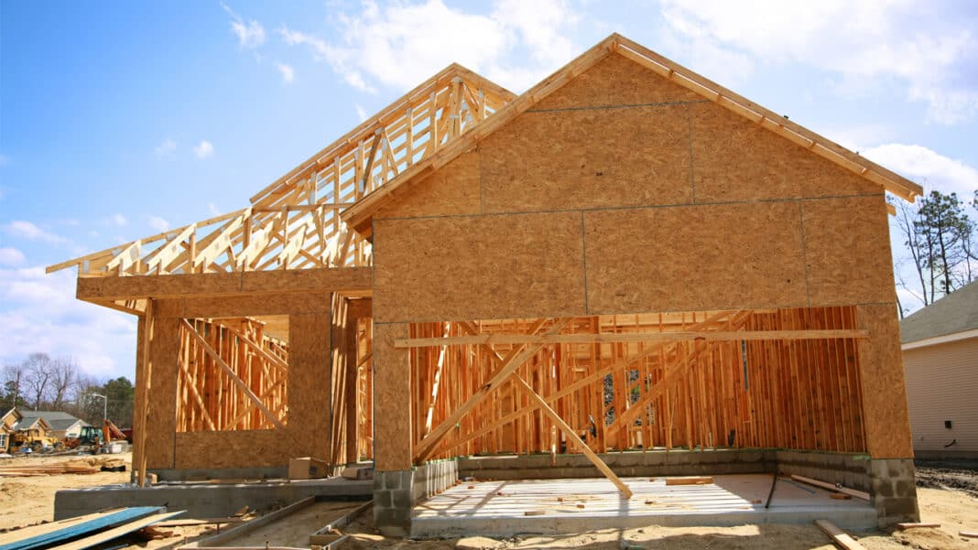
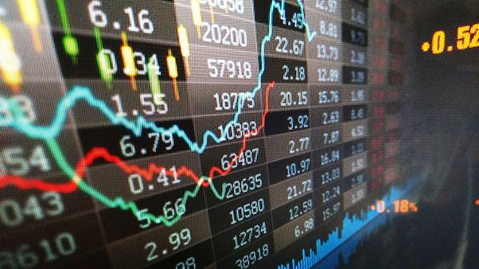
Other Important Indicators
Interest rates
Stock prices
Bull market
Bear market
Business profits
Consumer spending
Housing construction
Industrial activity

Slide 44
Essential Standard:
EPF.F.E.2.2 Summarize basic microeconomic indicators and how they vary over the course of a business cycle.
Essential Question: Decipher how changes in the U.S. economy influences choices made about consumption, production and public policies
Students Can:
Describes the phases of the business cycle
Utilizes economic indicators to explain how the U.S. economy is performing
Agenda
It is just a phase
Theories of Government intervention
Indicators of economic phases
Homework:
Current Events Journal #1 due October 25

Slide 45
Diagnosing the Economy
Identify the phase of the business cycle and the issue within the economy
1. The civil labor force is registering a high jobless rate in the in response to real GDP falling for ten straight months in row. Retailers are closing stories and manufacturers are cutting their capital orders.
2. The consumer price index is recording record high price change despite an increasing unemployment rate. Many have argued that the embargo placed on the United States by OPEC is adding much instability in the economy.
3. US economy has had one of the lowest employment rates in history, but stock investors are getting bearish on the future. Many businesses are raising prices because they cannot meet consumers’ desire for their products.

Slide 46
Economic Theory
Government Role in the Boom & Bust Cycle

Slide 47
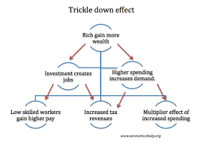
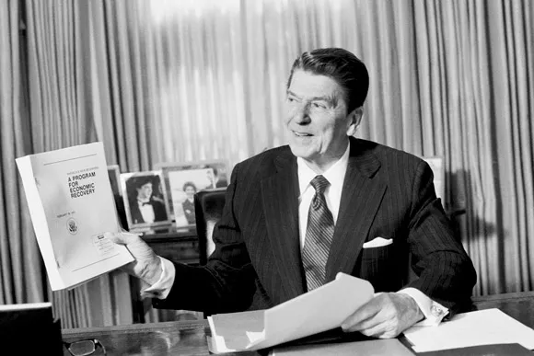
Stimulate Supply
Supply-side Economic Theory: (trickle down or Reaganomics) lower taxes (especially for the wealthy) will cause investment in new businesses creating JOBS! JOBS! …..
What if we cut taxes?
Money “trickles down” from wealthy to the poor & middle class

Slide 48
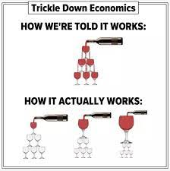
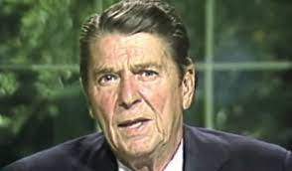
Critique of Reaganomics
Weaknesses of Supply Side Economics
?#%&&?
Growth of wealthy of inequality
Businesses don’t have to invest the money
Government has less revenue = cuts to government programs
Wealth Inequality in the U.S.

Slide 49
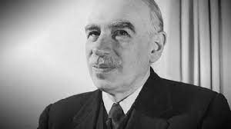
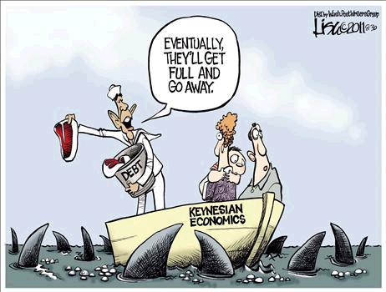
Let’s Raise Demand
Keynesian Economic Theory: (Demand-side theory)
Government should create demand through deficit spending and government programs, as well as tax cuts for the middle class
How about we let government spend to promote demand?
Criticism:
Creates debt (raise gov. spending and lower taxes)
Causes inflation (too much $ in the economy)
John Maynard Keynes

Slide 50
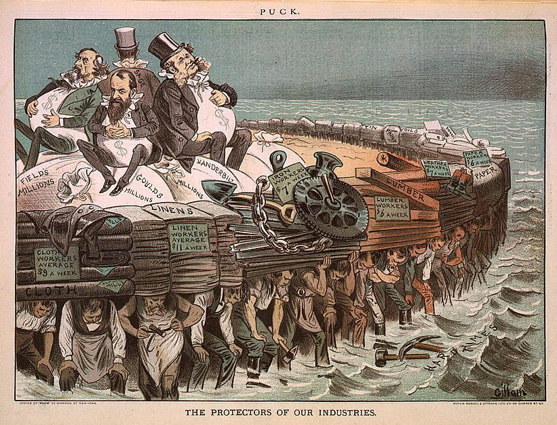
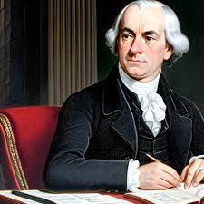
It’s the CLASSIC
Classical Theory: (Laissez faire) advocates government non-intervention. (DO NOTHING)
Allow supply, demand, price, and competition adjust (Natural forces of the market system)
Criticism
If there are no rules businesses can unintentionally hurt (negative externality)
Wealth inequality
Monopolies can exist
Do nothing and let chips fall as they will!!!
Adam Smith
Gilded Age 1865 - 1900

Slide 51
Essential Standard:
EPF.F.E.2.2 Summarize basic microeconomic indicators and how they vary over the course of a business cycle.
Essential Question: Decipher how changes in the U.S. economy influences choices made about consumption, production and public policies
Students Can:
Describes the phases of the business cycle
Utilizes economic indicators to explain how the U.S. economy is performing
Agenda
The Federal Reserve’s Economic Roll
The Fed’s Influence
Unit I reteach
Homework:
Current Events Journal #1 due October 25

Slide 52
Monetary Policy
The Federal Reserve Stimulates the U.S. Economy

Slide 53
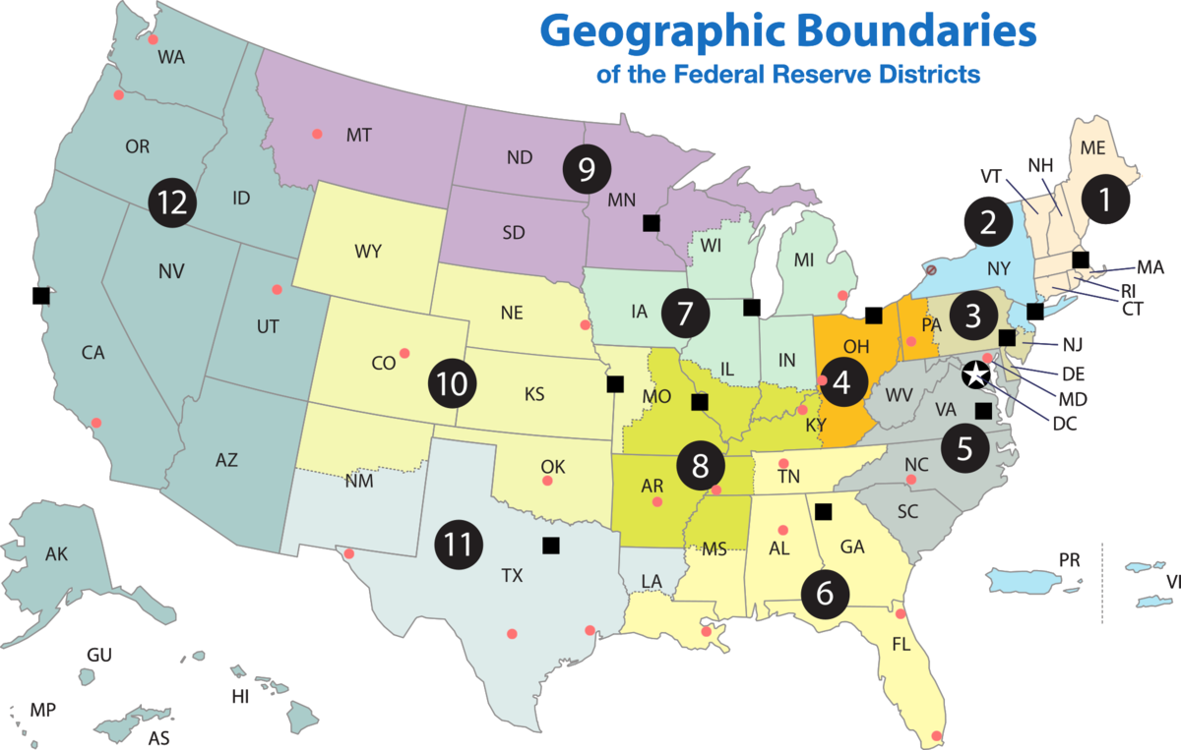
Getting into the economy
Federal Reserve: provides price stabilization and oversight in dealing with banking
How does the Federal Reserve make the economy expand and contract?
Created in 1913:
Establish to deal with economic panics of the 1800s
Created 12 Reserve Banks & Board of Governors
2. How does the federal reserve system create consumer confidence in banks?
3. How does the federal reserve system support the security of payments made by consumers?
Chicago Federal Reserve Bank Link
Independent Agency: reports to Congress instead of the President

Slide 54
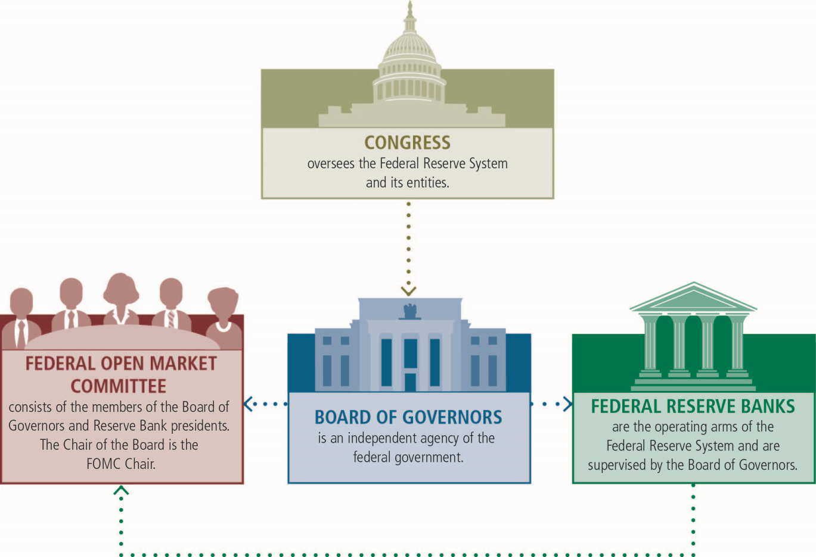
Fed Functions
Federal Reserve Functions:
Regulate & Supervise financial institutions
Operating the nation’s payment system
Establish and implement the monetary policy

Slide 55
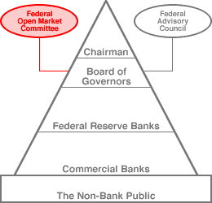
Economists at Work
Stimulating the economy:
Federal Open Market Committee: Board of Governors
& 12 Bank Presidents
MONETARY POLICY

Slide 56
Tool Time
The Federal Reserve Monetary Policy TOOLS:
Discount Rate: the prime interest rates the Federal Reserve charges banks to borrow from it
Open Market Operations: the buying & selling of bonds to put $ into or out of the economy
Reserve Requirement: the amount of extra $$$ member banks must keep on hand at all times

Slide 57
Essential Standard:
EPF.F.E.2.2 Summarize basic microeconomic indicators and how they vary over the course of a business cycle.
Essential Question: Decipher how changes in the U.S. economy influences choices made about consumption, production and public policies
Students Can:
Describes the phases of the business cycle
Utilizes economic indicators to explain how the U.S. economy is performing
Agenda
Unit I Reteach – shifters
Monetary Policy
The Power of the Federal Reserve
Homework:
Current Events Journal #1 due October 25
Unit I retest – Tuesday, October 10

Slide 58
Supply & Demand
Draw the Supply & Demand Graph
Price | Quantity of Demand | Quantity of Supply
$10 | 500 | 200
$20 | 450 | 250
$30 | 400 | 300
$40 | 350 | 350
$50 | 300 | 400
$60 | 250 | 450
$70 | 200 | 500

Slide 59
Supply & Demand Shifters
Shifts in supply and demand
Supply = producers, businesses, manufactures, etc…
Demand = consumers, buying, etc…
Shift right = increase
Shift left = decrease

Slide 60
Keep it in Reserve
Adjusting the reserve requirement
The amount of money banks must keep
on hand to cover deposits
Banks are required to keep a certain amount of money in their banks
If a bank goes below the requirement they must
Borrow from each other
Borrow from the Fed. (the Fed. Charges a higher interest rate)
Currently, the marginal reserve requirement equals 10 percent of a bank's demand and checking deposits.

Slide 61
To Lend or To Save
Interest Rates: the fee to borrow money from the bank and credit cards
Discount rate: the prime rate that the Federal Reserves charges banks to borrow money
Federal Funds Rate (FFR)
Money banks lend each other (called “overnight rate”)
FFR = 2% as of 04/08, .25% as of 12/2011, 5.33% as of 9/23
Discount Rate (DR)
Money the Fed lends banks if they get into trouble
DR: 2.25% as of 4/08
DR: .75% as of 12/2011
DR: 5.5% as of 2023

Slide 62
Buy/Sell
Open Market Operations
Buying selling of government bonds & securities
Bonds = government debt (IOU – lending to the government)
Government use the $ to fund special projects or run the day-to-day operations
Different types of bonds (Example: U.S. treasury EE bonds. If these are held for 20 years, they double in value. So, if you purchase one in 2023 at a $10,000 face value, in 2043 if will be worth $20,000)

Slide 63
Federal Reserve Stimulation
Investigate how the Federal Reserve can influence the U.S. Economy and cause it to expand or contract.
Use the links on the assignment to answer the questions.
Which phase of the business cycle should the Federal Reserve use expansionary monetary policy?
Which phase of the business cycle should the Federal Reserve use contractionary monetary policy?

Slide 64
Essential Standard:
EPF.F.E.2.2 Summarize basic microeconomic indicators and how they vary over the course of a business cycle.
Essential Question: Decipher how changes in the U.S. economy influences choices made about consumption, production and public policies
Students Can:
Describes the phases of the business cycle
Utilizes economic indicators to explain how the U.S. economy is performing
Agenda
Unit I Reteach –basics of economics
Monetary policy guidelines
Monetary policy practice
Homework:
Current Events Journal #1 due October 25
Unit I retest – Tuesday, October 10

Slide 65
Let’s Expand the Economy
Expansionary Monetary Policy: goal is to make the economy grow by encouraging spending
Open market operations – buy back bonds
Reserve requirement – lower the amount (encourage more lending by banks)
Discount rate – lower the prime rate (encourage spending)
PUT $$$$ into the ECONOMY

Slide 66
Save that Money for a Rainy Day
Contractionary Monetary Policy: goal is to make the economy shrink by encouraging savings
I said NO spending!
Open market operations – sell bonds
Reserve requirement – raise the amount (encourage banks not to lend money)
Discount rate – raise the prime rate (encourage saving)
TAKE $$$$ out of the ECONOMY

Slide 67
Tight or Loose with the $$$$
Loose Monetary Policy
Borrowing is easy
Consumers buy more
Business expansion
Unemployment decreases
Production is increases
Tight Monetary Policy
Borrowing is difficult
Consumers buy less
Business postpone expansion
Unemployment increases
Production is reduced

Slide 68
Essential Standard:
EPF.F.E.2.2 Summarize basic microeconomic indicators and how they vary over the course of a business cycle.
Essential Question: Decipher how changes in the U.S. economy influences choices made about consumption, production and public policies
Students Can:
Describes the phases of the business cycle
Utilizes economic indicators to explain how the U.S. economy is performing
Agenda
Monetary policy assessment
Fiscal Policy
Monetary & Fiscal policy practice
Homework:
Study for Unit I Retest
Unit I retest – Tuesday, October 10

Slide 69
Federal Reserve Stimulus
Identify the problem with the economy and the business cycle phase for each scenario. Then choose the proper monetary policy type and make the proper adjustments.
Scenario 1: The U.S. economy has seen the real GDP decrease for seven month in row.
Problem with the economy:
Phase of the business cycle
Type of monetary policy:
Reserve requirement adjustment:
Interest rate adjustment:
Bond market:

Slide 70
Federal Reserve Stimulus
Identify the problem with the economy and the business cycle phase for each scenario. Then choose the proper monetary policy type and make the proper adjustments.
Scenario 2: During the 2020 fiscal year U.S. ports could not empty container ships fast enough due to limitations of COVID-19. Because of the shortage stores had to raises their prices to restrain the high demand for goods.
Problem with the economy:
Phase of the business cycle
Type of monetary policy:
Reserve requirement adjustment:
Interest rate adjustment:
Bond market:

Slide 71
Fiscal Policy
The Congress & President Stimulates the U.S. Economy

Slide 72
Let’s Get FISCAL
FISCAL POLICY: Congress and the President use taxation & government spending to stimulate the economy
Clause 1. The Congress shall have Power To lay and collect Taxes, Duties, Imposts and Excises, to pay the Debts and provide for the common Defence and general Welfare of the United States; but all Duties, Imposts and Excises shall be uniform throughout the United States;
- Article I, Section 8, U.S. Constitution
Taxation (INCOME TAX, PAYROLL TAX, CAPITAL GAINS TAX)
Government Spending (TARP FUNDS, PORKBARREL PROJECTS)

Slide 73
GOV wants GROWTH
EXPANSIONARY FISCAL POLICY goal: to make the economy grow by encouraging spending
Tax cuts or rebates to give Americans more money
TARP STIMULUS – Troubled Asset Relief Program 2009
Increase government spending to provide jobs
The Economic Growth and Tax Relief Reconciliation Act of 2001

Slide 74
Danger! Will Robinson
U.S. Debt = $33 Trillion
EXPANSIONARY FISCAL POLICY = Deficit Spending (DEBT )

Slide 75
GOV Coming Down on the Economy
CONTRACTIONARY FISCAL POLICY goal: shrink the economy by removing money for the economy
Raising taxes to take $$ out of the economy
Decrease government spending to remove money from the economy
Elected politicians decided fiscal policy (Raising TAXES angers the electorate)
Lawmaking process is slow, which slows response to economic decline

Slide 76
Essential Standard:
EPF.F.E.2.2 Summarize basic microeconomic indicators and how they vary over the course of a business cycle.
Essential Question: Decipher how changes in the U.S. economy influences choices made about consumption, production and public policies
Students Can:
Describes the phases of the business cycle
Utilizes economic indicators to explain how the U.S. economy is performing
Agenda
Unit I Retest
Government Spending
Fiscal policy practice
Homework:
Current Events Journal due 10/25

Slide 77
Changing Taxation Policy
Review economic theories of government involvement in the U.S. market economy
Whose taxes should be lowered according to each theory?
Supply-side economics
Keynesian economics

Slide 78
The Government Purse
Government Expenditures (Expenses)
Discretionary Expenditures – Government has a choice on how much it spends (Ex. Military, FBI, EPA regulations)
Government Spending = Government priority

Slide 79
The Government Purse
Government Expenditures (Expenses)
Mandatory Expenditure – Government must spend on items because they are entitlements
Discretionary Expenditures
Mandatory Expenditures
Biggest issue for balancing the budget

Slide 80
Mandatory Expenditures
Government entitlements: government programs that are granted to citizens (and sometimes non-citizens). - (SAFETY NET)
Contributory
Non-Contributory
Social Security
Medicare
Unemployment insurance
Medicaid
Pell Grants (College)
SNAP – Food Stamps
Welfare or Temporary Assistance to Needy Families
Paid for by Payroll Taxes (FICA)

Slide 81
PORK-BARRELING
$200,000 for Tattoo removal program
$223 Million for the Bridge to NO WHERE
$500,000 for the Sparta, NC Teapot Museum
$3.4 Million for a Turtle Crossing in Florida
$15,000 Drunken Mice Study
Why does our government spend money that only benefits a district or state?

Slide 82
Debt CLOCK Runnings
Current U.S. Debt $33 Trillion and counting
Does Debt Matter
How will the United States growing debt influence the economy in the future?
Why does the U.S. government continuously spend money when causes increase deficit spending?
How does government spending provide a stimulus to the economy?

Slide 83
Essential Standard:
EPF.F.E.2.2 Summarize basic microeconomic indicators and how they vary over the course of a business cycle.
Essential Question: Decipher how changes in the U.S. economy influences choices made about consumption, production and public policies
Students Can:
Describes the phases of the business cycle
Utilizes economic indicators to explain how the U.S. economy is performing
Agenda
Stimulating the Economy
Government Regulation of the Economy
Homework:
Quiz on Unit II – Tuesday, October 17
Current Events Journal due 10/25

Slide 84
Stimulating the US Economy
The economy is shutting down due to an outbreak of COVID 19, which has force Americans to stay home. This has caused a dramatic rise to businesses closing. The President and advisors are seeking to give small business relief to allow them keep operating during this tough time.
Should the government use Fiscal or Monetary policies?
If fiscal, should the policy be tight or loose? If monetary, should the policy be expansionary or contractionary?
What would they do with their tools?

Slide 85
Stimulating the US Economy
2. A worldwide pandemic has slowed the supply chain of goods and services traded on the international market. As the economy recovers prices rapidly in creased to the rise of demand and limited supply goods. The Federal Reserve is meeting to discuss their response.
Should the government use Fiscal or Monetary policies?
If fiscal, should the policy be tight or loose? If monetary, should the policy be expansionary or contractionary?
What would they do with their tools?

Slide 86
Government Influence on the Economy
How much influence should government have on a market economy?

Slide 87
The Government & Businesses
Government power in the U.S. economy
Classic Theory (Laissez Faire) – government should remain hands off the U.S. economy
Advantage: Competition encourages better quality products & lower prices
Regulation: government rules to protect competition and consumers
Ex. Passing Ant-trust laws
Ex. Evaluating and approving businesses mergers
Standard Oil Company
Sherman Anti-trust law

Slide 88
Businesses Merger
Vertical Mergers - the merging of two companies that produce different goods or services for one specific finished product
Ex. Ice Cream company mergers with a dairy farm
These mergers lead to trusts
Two types of business merger
Horizontal Mergers - the merging of two companies that have similar products or services
Can cause a monopoly

Slide 89
Trust
Trusts: when one board of directors controls several companies that help make the same product
Ex. Standard Oil Trust & Carnegie Steel

Slide 90
Regulating Competition
Federal Trade Commission: regulatory agency that evaluates whether merger limits competition
Created by Clayton Anti-trust Act 1914
Reason to allow regulations
To provide consumer, labor, & environmental protections
To provide consequences for non-compliance

Slide 91
Corporate Mergers
Some mergers can benefit consumers.
Corporate mergers will lower average prices, which leads to:
Lower prices
More reliable products and services
More efficient industry

Slide 92
Too MUCH GOVERNMENT
Deregulation: removing of government rules on a product or market
Reasons
Increase cost of products
Limits choices for consumers
Can limit efficiency
Industries that have been deregulated
Airlines
Banking
Natural gas
TV Broadcasting

Slide 93
Property Protections
Government regulation of property in order to encourage innovation
Trademarks: can be any word, phrase, symbol, or combination of things that distinguishes you from your competition
Copyrights: allows a business or creator to own intellectual property (Ex. Books, Music, Software, etc. . .)
Last forever – Webster’s Still own the rights to publish the Dictionary
Patents: Grants exclusive right to exclude others from making, using, importing, and selling the innovation for a limited time period
Have to be renewed
Examples: pharmaceuticals

Slide 94
5th Amendment
Eminent Domain: (5th Amendment) government can purchase private property for public use (must pay market value)
Reasons for eminent domain
Roads
Schools
Economic development

Slide 95
Current Events Journal
Headline: Inflation remained elevated in July at 3.2% — and prices are unlikely to return to pre-pandemic levels anytime soon
Concept Paragraph: Connecting relevant EPF vocabulary to the main idea of the article
What vocabulary terms come to mind when you read the headline?
What phase of the business cycle is the economy in?
What is the problem with the economy?
What government agency or branch can respond to this problem?
What should be adjusted and how should it be adjusted to repair the economy?

Slide 96
Current Events Journal
Headline: Inflation remained elevated in July at 3.2% — and prices are unlikely to return to pre-pandemic levels anytime soon
Opinion Paragraph: What is your opinion about how the economic is being handled?
Think about how the government and the Federal Reserve must respond to the situation. How will that effect consumers, business, and employees?
Are the response to the economic issue actually working?
Start paragraph off with the following opener: I believe _______________ because __________________________. Go into detail about why you believe the government’s response is appropriate or not.

Slide 97
Essential Standard:
EPF.F.E.2.2 Summarize basic microeconomic indicators and how they vary over the course of a business cycle.
Essential Question: Decipher how changes in the U.S. economy influences choices made about consumption, production and public policies
Students Can:
Describes the phases of the business cycle
Utilizes economic indicators to explain how the U.S. economy is performing
Agenda
Unit II Review
Types of Businesses
Business Chart
Homework:
Study for Quiz on Unit II
Quiz on Unit II – Tuesday, October 17
Current Events Journal due 10/25

Slide 98
Unit II Review
Answer the following review questions
What does Real GDP measure?
What type of unemployment would be represented by people who work in the steel industry who lost their job because steel is no longer produced inside the U.S.?
What phase of the business cycle has the U.S. economy entered if GDP has decline for three months straight and the unemployment has risen as well during the same period of time?
What monetary policy should be used to combat inflation in the U.S. economy? What are the three adjustments that need to be made to the monetary policy to fix the economy?
What are the two things adjusted under the fiscal policy?

Slide 99
Types of Businesses
Sole Proprietorship, Partnership, Corporation, and Non-Profit

Slide 100
Its Business
Three functions of business
Producers
Intermediaries
Services

Slide 101
Business Forms
Three main types of business
Sole Proprietorship: One Owner
Partnership: two or more owners (legally defined roles)
Corporations: Large business with multiple owners (stockholders)

Slide 102
The Risk of Doing Business
The risk of opening a business
UNLIMITED LIABILITY
Responsible for all debts and hazards of business
Can cost you everything
All other for-profit businesses
LIMITED LIABILITY
Responsible for the amount you invest in a business
Risk: $$$ you put in
Corporations only

Slide 103
ODD Ball Business Forms
NON-PROFITS (Tax id – 501C3)
All profits are used to support the charitable cause.
Tax EXEMPT
Examples: YMCA, Churches, United Way

Slide 104
ODD Ball Business Forms
COOPERATIVES
Owned by its members
Provide goods or services at low prices for its members
Examples: State Employees Credit Union, American Electric Cooperatives

Slide 105
Business Forms
Break Down Business Forms
Assign everybody a form of business
Break down the business form
How many owners?
How is the form setup?
Advantages and Disadvantages (categorize your answers to these questions)
How easy is it to raise capital to grow the business?
Does it have limited or unlimited liability? (Explain what that means for the business form)
How difficult is it to open?
What are the requirements to open?
Who gets the profits?
Who makes the business decisions?

Slide 106
Essential Standard:
EPF.F.E.2.2 Summarize basic microeconomic indicators and how they vary over the course of a business cycle.
Essential Question: Decipher how changes in the U.S. economy influences choices made about consumption, production and public policies
Students Can:
Describes the phases of the business cycle
Utilizes economic indicators to explain how the U.S. economy is performing
Agenda
Types of Businesses Assessment
Circular Flow of Economic Activity
Sweet Opportunities
Homework:
Current Events Journal due 10/25

Slide 107
What’s my business
Identity type of business from the descriptor below (S) sole proprietorship, (P) partnership, (C) corporation, or (N) Non-profit
___ 1. Allowed to sell stock
___ 2. Has unlimited liability and owned by one business owner
___ 3. Tax-exempt
___ 4. Requires a lawyer to put together who is responsible for what in running the business
___ 5. Requires charter to establish the business’ legal rights
___ 6. This type of business comes with all the risk of ownership
___ 7. Most businesses are this type of business
___ 8. This type of business has limited liability

Slide 108
Sweet Opportunities
Advise the following four clients on which type of business would be best for them to open in order to achieve their goals.
Identify factors the owner does not want deal with in running a business
Identify the type of business that works best with their demands
Explain TWO ways the business type you’ve identified meets the owner’s desire.
Explain ONE disadvantage of the business type that will affect how the business owner will have to operate his/her business.

Slide 109
Circular Flow of Economic Activity
Model of the Market Economy of the U.S.

Slide 110
Circular Flow Model of a Market Economy
Circular Flow of Economic Activity: demonstrates the interaction between consumers, businesses, government, and trade to deal with scarcity

Slide 111
Agents in the Circular Flow
Four Agents who interact in a circular flow of economic activity
CONSUMERS
BUSINESSES
GOVERNMENT
FOREIGN COUNTRIES

Slide 112
Consumer/Households
Consumers 3 roles in the economy
Buy goods and services
Provide labor in exchange for wages
Citizens – pay taxes

Slide 113
Business Sector
Business in the Circular Flow
Provide goods and services in return for profit.
Consumes FOPs from the factor market in exchange for money

Slide 114
Government Sector
Role of the Government in the Market Economy
Provides legal framework for economic activity.
Also, a producer and consumer.
Gets tax money from business and consumer sector

Slide 115
Circular Flow at Work
You the individual (represents households) work at the Electrolux industrial factory in exchange for wages.
Electrolux is the Factor Market that sells ovens to Nestle.
Nestle is the Business that makes Willy Wonka Candy which it sells to Kroger.
Kroger is the Product Market where you purchase candy using your income.

Slide 116
Foreign Sector
International trade
Scarcity makes nations trade for resources, goods and services
Provides better, different, or cheaper goods and services and the resources we need to produce.
We both sell and consume international items in exchange for money

Slide 117
Agents of the Circular Flow Model
Circular Flow of Economic Activity - Markets
Product Market: Businesses (supply) sells goods & services to consumers (demand) (Consumer Sovereignty, & voluntary exchange)
Factor Market: Consumers (supply) the factors of production (Land, Labor, & Capital) for income to Businesses (Demand)

Slide 118
Essential Standard:
EPF.F.E.2.2 Summarize basic microeconomic indicators and how they vary over the course of a business cycle.
Essential Question: Decipher how changes in the U.S. economy influences choices made about consumption, production and public policies
Students Can:
Describes the phases of the business cycle
Utilizes economic indicators to explain how the U.S. economy is performing
Agenda
Following the Flow
Transaction in a Circular Flow
Unit II Recall
Homework:
Current Events Journal due 10/25

Slide 119
Circular Flow Model
Economic Resources Owned by Households | Income Type
Business Sector
Consumer Sector

Slide 120
Circular Flow Model Review
Identify the location on the circular flow model where the transaction takes place
1. The gov’t purchases a new submarine
2. McDonalds buys beef for their hamburgers
3. A shoe factory decides to increases production
4. Sam receives his first paycheck
5. Sam then purchases a new laptop
6. The gov’t decides to increase taxes
7. Identify what is taking place in each of the 4 “flows”?

Slide 121
Essential Standard:
EPF.F.E.2.2 Summarize basic microeconomic indicators and how they vary over the course of a business cycle.
Essential Question: Decipher how changes in the U.S. economy influences choices made about consumption, production and public policies
Students Can:
Evaluate how and why nations trade
Determine when nations should trade
Agenda
Label Check
Factors of Trade
Absolute v. Comparative Advantage
Homework:
Current Events Journal due 10/25

Slide 122
International Trade
A Global Economy

Slide 123
Labels Tell the Story
Partner up in groups of threes
Check the labels on t-shirts, jackets, shoes, lunchboxes, and bookbags
Region of the World | Number of items
United States
South America
Asia
Remember, no one nation knows how to make a pencil!
The Life Cycle of a T-shirt
The Pencil Lesson

Slide 124
Why Nations Trade
#1 Factor for why nations trade: SCARCITY
Trade Influences the Globe
GLOBALIZATION: is the increasing connectivity of the world, this has made trade more beneficial
Benefits of Trade
Increase choices
Greater potential for growth for companies
Cheaper goods due to SPECIALIZATION

Slide 125
Terms of Trade
Trade influence on the U.S.
Exports v. Imports
EXPORTS: goods & services we sell to other countries
IMPORTS: goods & services we buy from other countries

Slide 126
Trade has VALUE
Favorable v. Unfavorable Balance of Trade
BALANCE OF TRADE: the difference between the value of a nation’s exports and the value of its imports
TRADE SURPLUS: When a country exports more than it imports
TRADE DEFICIT: When a country imports more than it exports

Slide 127
It’s ALL Connected
Trade connects all nations of the World
INTERDEPENDENCE: business, regions, & nations where they are dependent for supply of resources (factors of production) to produce goods and services
What happens in ONE nation impacts all nations.
War in Ukraine & Israel

Slide 128
To Trade or Not To Trade?
Countries specialize in goods or services that they can produce efficiently
Evaluating whether nations should trade:
ABSOLUTE ADVANTAGE: the ability to produce a greater amount of goods or services with the same number of resources as a competitor.
COMPARATIVE ADVANTAGE: the ability to produce goods and services at lower opportunity cost than a trade partner.

Slide 129
Want to Trade
Absolute Advantage practice
Brazil’s absolute advantage _____________________
U.S. absolute advantage _______________________

Slide 130
Want to Trade
Comparative Advantage practice
INPUT CHART
United States should produce ______
Chile should produce _______

Slide 131
Wanna Trade
Comparative Advantage practice – output chart
United States should produce ______
Chile should produce _______
 | Pizza production per day | Salad production per day
United States
Chile

Slide 132
Essential Standard:
EPF.F.E.2.2 Summarize basic microeconomic indicators and how they vary over the course of a business cycle.
Essential Question: Decipher how changes in the U.S. economy influences choices made about consumption, production and public policies
Students Can:
Evaluate how and why nations trade
Determine when nations should trade
Agenda
Comparative v. Absolute Advantage
Protectionism v. Free Trade
Trade Sanctions to Shape Foreign Diplomacy
Homework:
Current Events Journal due 10/25
Unit II Test, Tuesday, Oct. 31

Slide 133
Calculating a Comparative Advantage
Nation | Car | Phones | Opportunity Cost
United States | 80 | 20
China | 60 | 100
United States OC for making 1 car =_____
China OC for making 1 car =_____
What should United States produce?
United States OC for making 1 phone =_____
China OC for making 1 phone =_____
What should China produce?
How does calculating the comparative advantage for producing goods further support why nations should trade?

Slide 134
Preventing Trade
Protectionist viewpoint: limit competition for products domestically, allowing local businesses to succeed by creating higher prices for imported goods.
Barriers to Trade
Tariffs
Embargoes
Quotas
Product Standards

Slide 135
Economic pressure

Slide 136
Trade Barrier
Tariffs: a tax on an imported good
Done to product a domestic producer
Hurts consumers

Slide 137
Trade Barrier
Embargo: a complete ban on trade
Usually done to punish a country
Ex- the U.S. and Cuba
The U.S. implemented an embargo on Cuba in the 1960s after Fidel Castro's coup and installment of a communist regime.
In 2015 Obama began rolling back those trade restrictions, but they have never been fully lifted for various reasons
97% of the world’s governments oppose the US sanction

Slide 138
Trade Barrier
Import Quota: limits on the amounts of imports and exports that will be allowed
Ex- in the 1970s we put quotes on the number of Japanese made cars that could be sold within the U.S.
Product Standards: countries have certain laws that regulate the way things can be sold and what those items can contain
Ex- the U.S. does not allow toys to be sold that contain lead paint, China violated this
In 2007 more than 21 million toys made in China were recalled

Slide 139
Free Trade Zone
Free trade prospective: remove all barriers to trade and all resources and finish goods cross borders freely
Trade Blocs: agreements made between a group of nations to promote free trade
Ex. NAFTA, European Union
GATT: General Agreement on Trade & Tariffs
NAFTA: North American Free Trade Agreement
CAFTA: Central American Free Trade Agreement

Slide 140
American Free Trade Zone
NAFTA/USMCA: (1994) – ended trade barriers between the U.S., Canada, & Mexico
Renegotiated in 2020
NAFTA impact

Slide 141
Trade Sanctions Foreign Policy
The United States currently blocks trade from the following countries
Cuba
Iran
North Korea
For Each Country
Evaluate why these nations have been placed under trade sanctions.
Determine the impact of those sanctions on the country.
Evaluate how effective trade sanctions are as a tool of foreign diplomacy.

Slide 142
Essential Standard:
EPF.F.E.2.2 Summarize basic microeconomic indicators and how they vary over the course of a business cycle.
Essential Question: Decipher how changes in the U.S. economy influences choices made about consumption, production and public policies
Students Can:
Evaluate how and why nations trade
Determine when nations should trade
Agenda
The Lingo of Trade
NC economy
Trade Sanctions to Shape Foreign Diplomacy / Retesting/Make up Quizzes
Homework:
Current Events Journal due 10/25
Unit II Test, Tuesday, Oct. 31

Slide 143
NC ECONOMY
Home grown goodness in our own backyard

Slide 144
Trade Lingo
Review major ideas of trade
What is the major reason nation’s trade with one another?
What must a nation do to achieve a favorable balance of trade?
What term describes a nation’s ability to produce goods and services with a lower opportunity cost than another nation?
What type of protectionist policy is being instituted if a nation bans the use of lead paint on products imported to a nation?
What does free trade zones remove to promote trade between countries?
What trade bloc does the United States belong to?

Slide 145
Build Blocks of NC
NC economy is based on a variety of industries that trade domestically and internationally
NC Top Industries
Agriculture (hogs, tobacco, blueberries)
Film industry
Textiles
Furniture
Financial services (Bank of America)

Slide 146
Farming in NC
NC Agriculture Industry
19% of NC Economy
20% of NC employment
Most common farmed commodities
Hogs
Sweet potatoes
Tobacco
Soybeans
Christmas Trees

Slide 147
Tobacco
Cash Crops of NC

Slide 148
Hogs

Slide 149
Merry Christmas
Christmas Tree Farming

Slide 150
Other Cash Crops
Soybeans & Cotton

Slide 151
Textiles
NC Textiles
1920s NC was centered of the textile industry
NC currently exports over 1 billion dollars in textile goods globally each year (20% of the U.S. Market)

Slide 152
Textile impact on the US Economy

Slide 153
NC is not IKEA
Furniture Industry
1900s High Point the furniture capital of the world
Foreign competition and outsourcing weakened NC furniture industry
High Point Furniture Market (bi-annual event)
$6 Billion impact on NC economy

Slide 154
You Seen NC in the Movies
NC Film Commission (1980)
Why Film in NC
Tax break & incentives
No charge for property use
NC has various terrains (Mountains, Piedmont, Coastal)

Slide 155
NC Famous Films
Set your streaming service

Slide 156
Take it to the Bank
Financial Services: Charlotte has become a major U.S. financial center and is the 2nd largest banking center, following NY

Slide 157
BANKING

Slide 158
Trade Sanctions Foreign Policy
The United States currently blocks trade from the following countries
Cuba
Iran
North Korea
For Each Country
Evaluate why these nations have been placed under trade sanctions.
Determine the impact of those sanctions on the country.
Evaluate how effective trade sanctions are as a tool of foreign diplomacy.

Slide 159
Essential Standard:
EPF.F.E.2.2 Summarize basic microeconomic indicators and how they vary over the course of a business cycle.
Essential Question: Decipher how changes in the U.S. economy influences choices made about consumption, production and public policies
Students Can:
Evaluate how and why nations trade
Determine when nations should trade
Agenda
Macro Practice
Trade Sanctions to Shape Foreign Diplomacy
NC Economy opportunities
Homework:
Make up missing assignments from the 1st Quarter
Unit II Test, Tuesday, Oct. 31

Slide 160
Macro Practice
Test your skills at Macro economics
Identify the phase of the business cycle for the following examples:
The unemployment rate has continued to climb over the past three months
The Federal Reserve has raised interest rates in response to rising prices because of high demand
The stock market has changed from a bear market to a bull market and unemployment has stopped increasing.
2. How should the Federal Reserve react to the following economic situation?
The CPI has measured another jump in prices. Many consumers are paying more for groceries, clothing, and entertainment.
What is the economic problem?
What policy needs to be adjusted? Is it contractionary or expansionary?
What adjustments need to be made (identify all the adjustments)

Slide 161
Trade Sanctions Foreign Policy
The United States currently blocks trade from the following countries
Cuba
Iran
North Korea
For Each Country
Evaluate why these nations have been placed under trade sanctions.
Determine the impact of those sanctions on the country.
Evaluate how effective trade sanctions are as a tool of foreign diplomacy.

Slide 162
NC Economic Opportunities
Three Opportunities in NC economy
Examine three new opportunities in the NC economy and the prospects for future employment
Choose three new categories in the NC economy we did not cover in class
Research and find why there is great potential in the job market in NC

Slide 163
Essential Standard:
EPF.F.E.2.2 Summarize basic microeconomic indicators and how they vary over the course of a business cycle.
Essential Question: Decipher how changes in the U.S. economy influences choices made about consumption, production and public policies
Students Can:
Evaluate how and why nations trade
Determine when nations should trade
Agenda
Macro Practice
Labor Unions – fight for the working class
Role of Labor Unions Today
Homework:
Make up missing assignments from the 1st Quarter
Unit II Test, Tuesday, Oct. 31

Slide 164
Macro Practice
Test your skills at Macro economics
Identify the types of unemployment
A textile worker in NC after the textiles were outsourced to overseas nations, sch as Bangladesh
A lifeguard at a lake resort after the summer ends
A person who temporarily leaves to job force to get his/her MBA
A mass increase in unemployment since the economy is
2. How should the U.S. Government react to the following economic situation?
Due to the failure of online (internet businesses) the economy is seeing mass lay-offs. Real GDP has fallen for six months straight.
What is the economic problem?
What policy needs to be adjusted? Is it contractionary or expansionary?
What adjustments need to be made (identify all the adjustments)

Slide 165
LABOR UNIONS
Or, get out your throwin’ bricks. We won’t take this abuse much longer

Slide 166
You Got to Fight
Labor Unions: a group who fights for the interest of workers
Higher pay
Benefits
Workplace safety
Guarantee jobs
Power: Collective bargaining – the ability to negotiate labor contracts for a group

Slide 167
Types of Union
Two types of Union
Craft/Trade Unions
Workers who perform the same skills
Ex: newspaper writers
Industrial Unions
Different types of workers from the same industry
EX: United Auto Workers

Slide 168
Union Tactics
Union Power
Collective Bargaining – officials from union and company meet to discuss new contracts
Mediation – 3rd party is brought in to help reach compromise
Arbitration – 3rd party listens to both sides and comes up with solution which both sides agree to accept
Former UAW President Gary Jones, left, and Bill Ford, executive chairman of Ford Motor, shake hands at Ford World Headquarters to begin negotiations for a new contract, July 15, 2019.

Slide 169
Unions Playing Hard Ball
Tougher Tactics to win against industrial owners
Strike – absolute refusal to work
Boycott – encourage the public not to purchase the company’s goods & services
Picketing – drawing attention by lining up/preventing worker access

Slide 170
What NO NEW TV SHOWS
Writers Guide of America Writers’ Strike

Slide 171
Employers Strikes Back
Tactics of Company Owners
Injunctions – legal order to halt a specific activity
Can be used to prevent picketing/striking
Lockout – “reverse strike” – company prevents workers from entering building until they accept contract terms
MLB 2021, NFL 2011, NBA 2011, NHL 2013

Slide 172
Labor Arrangements
Labor Union Arrangements
Closed Shop – workers must join union before hired (now illegal)
Union Shops – hired with flexibility in joining after start date
Modified Union Shop – workers don’t HAVE to join, but must remain in union once joining
You don’t have to join a union

Slide 173
Legislation
Legal guidelines for the right to organize a union
Clayton Act (1914) – gave legal support to peaceful strikes and boycotts
Taft-Hartley Act (1947) – declared closed shops illegal
Right-to-Work Laws – prevent mandatory union membership (22 states, including NC)
National Labor Relations Board (NLRB) – makes sure that unions are brought into workplace only if majority of workers request it.

