Slide 1
Good Day Class! It is Bad Joke Wednesday, 1/8/20
Why did Karl Marx hate Earl Grey tea?
Because all property is theft
Today’s Plan
Discuss Homework
2. New material-docs and notes on 5.1 “The Enlightenment”
3. Document analysis

Slide 2
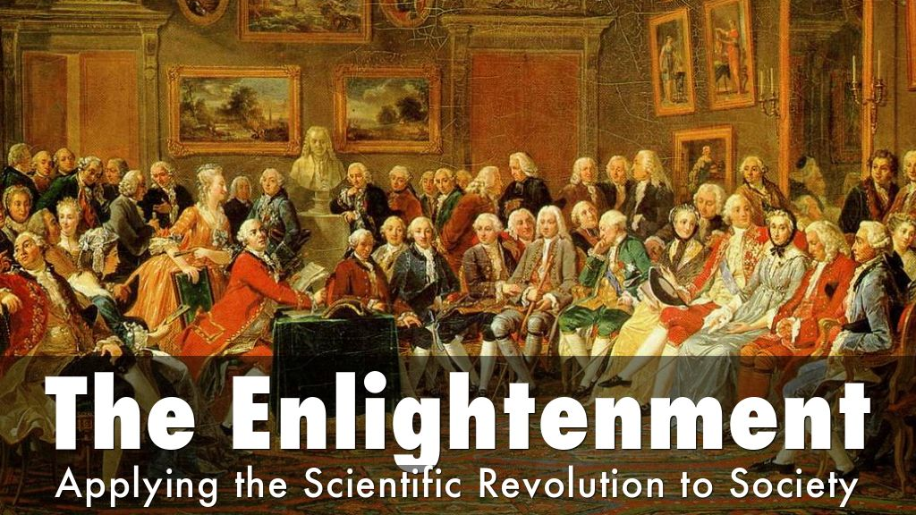
Good day class. It is Friday, 1/17/20
What are the Natural Laws that govern society?
What is the Natural State of Man? Good or evil?
Let’s Review

Slide 3
Defining the Enlightenment Through Documents
Read Handout instructions aloud
1. carefully read and annotate
2. do question # 1 (at bottom) with your neighbor
3. do question # 2 by yourself
Share out
Now define “Enlightenment” in a sentence

Slide 4
Context
Global trade networks continued to integrate people with new technology between 1750-1900.
The Industrial Revolution, beginning in Great Britain, caused manufacturing output to skyrocket. The need for raw materials for machinery led to Imperialism
Nationalism and global migration were two of the results of industrialization

Slide 5
What is the natural state of man?
The Enlightenment is the Idea that REASON can eliminate injustice
John Locke: basically good, can learn from mistakes, therefore can GOVERN himself
Thomas Hobbes: basically weak, therefore susceptible to evil, needs a strong government to protect him from himself.
Philosophes: Montesquieu, Voltaire, Rousseau: society corrupted human nature “man is born free, but everywhere in chains”
→ Social Contract idea

Slide 6
What is the natural state of economics?
Natural laws of supply, demand, and the law of self preservation suggest an un-regulated free trade system
Adam Smith “The Wealth of Nations” 1776
Laissez faire: “hands off” leave alone” = the government STAYS OUT of economic affairs—no regulations or tariffs
Foundation for Capitalism: economic system in which the means of production (factories) are privately owned and worked for profit
How is capitalism different from Mercantilism?

Slide 7
ISMs
Deism: a divinity sets natural laws in motion (the watchmaker)
Conservatism: traditional institutions provide solutions
Utopian Socialism: system of public or direct worker ownership of the means of production; relied on ideal communities (see Fabian Society)
Classical Liberalism: natural rights, constitutional gov’t., laissez faire
Feminism: movement for rights and equality based on Enlightenment ideas
Abolitionism: free slaves and end serfdom
Zionism: desire of Jews to reestablish a homeland in the Middle East

Slide 8
Good day class It is *bad joke* Wednesday 1/22/20
WHY was the Teacher wearing sunglasses in class?
‘Cause his students were so bright!
Today’s Plan
1. Long View
2. Notes on chapter 2
3. Class time for Enlightenment Movements handout

Slide 9
The Big Picture
70
…School days until the Exam

Slide 10
5.2 Nationalism and Revolutions
WRITE this EQ to the right of 5.2 Nationalism & Revolutions
EQ: What were the causes and effects of the various revolutions between 1750-1900?

Slide 11
American and French Revolutions
The ideals of the Enlightenment inspired the American Revolution (1776)
→ Free market ideas that opposed mercantilism
→ Dec. of Independence built on “inalienable rights of life, liberty, and pursuit of happiness”
These ideals and the American example inspired the French Revolution (1789)
→ peasants rose against nobles to eliminate unjust tax burden
→ Bastille Day (7/14/1789), Dec. of Rights of Man and Citizen, and liberte, egalite, et fraternite all key ideas in establishing a Republic in France by 1792

Slide 12
New Zealand Wars native Maori revolt against British (1860s-72) over land and freedom * British win
The Haitian Revolution 1804 (Caribbean, in North America) was inspired by Napoleon Bonaparte and the Enlightenment
→ only successful slave (Maroons) revolution
Led by Toussaint L’Ouverture
Comparing Haitian and French Revs
Similar: roots in Enlightenment of natural rights
Different: restraints on Haitians were more severe

Slide 13
Creole Revolutions in Latin America
Creoles resented being treated less than their parents, the Peninsulares
Lead the lower classes against Peninsulares during the Napoleonic wars (1805-1815)
Bolivar Revolutions
Simon Bolivar was a creole in Venezuela (northern South America
→ Jamaica Letter: 1815 inspired Latin America by applying Enlightenment to Latinos
→ by 1825 all of South America was independent from Spain and Portugal
Propaganda Movement: inspired by the Enlightenment, young Filipinos visiting Europe, returned to begin Philippine Revolution in 1896 (East Asia)

Slide 14
Nationalism and Unification in Europe
Use pages 290-293 to take notes on your own

Slide 15
Enlightenment Movements Document Analysis
Historical Thinking Skill: Identify a claim/and/or argument in a text-based or non-text-based source
1. Think-Pair Share → 1st Doc, by Locke.
Look over the document alone, write down thoughts about how this doc fits into the ideas of the Enlightenment. Next, jot first reactions to the 2 questions What traditional ideas… & What new ideas…
Pair with your neighbor to discuss responses. Share out
2. Individually read the other docs, following the same procedure, but without sharing.
Read quietly the instructions

Slide 16
Review Example

Slide 17
Review Example

