Slide 1
American History X
What you thought you knew is only what you were taught

Slide 2
APUSH 1.1: Explain the context for European encounters in the Americas from 1491 to 1607
APUSH 1.2: Explain how and why various native populations in the period before European contact interacted with the natural environment in North America
Essential Question: How did the interaction between Native Americans, Europeans, and Africans impact the development of the New World.
Students can:
Demonstrate how the diverse geography of the New World cause the development of difference Native Cultures.
Evaluate whether first contact between the Native Americans and Europeans had a positive influence on the development of the New World.
Assess how different European cultures shaped the development of the New World.
Agenda
AP Classroom
The First Americans
Seven Nation Army
Homework:
Seven Nation Army

Slide 3
APUSH the Movie
It’s Epic

Slide 4
Words have Meaning
What does this word really mean?
HISTORY
"an account of what has happened in the life and development of a people, country, institution, etc., usually with an analysis and explanation."
HIS-STORY
How does the re-phrasing of the word history change our understanding of its meaning?

Slide 5
American History X
History = His-story
Who writes the history we study?
What are their strengths and weaknesses that impact their recording of historical events?
Whose story was not told?
History is an interpretation of events that is shaped by perspective.
“We are not makers of history. We are made by history.” Dr. Martin Luther King Jr.
“What is history but a fable agreed upon?” Napoleon Bonaparte
“History will be kind to me for I intend to write it.” Winston Churchill
Statue of George Washington, Smithsonian Museum of American History

Slide 6
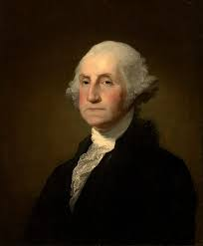
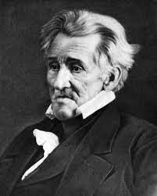
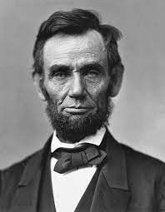
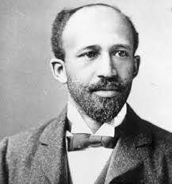
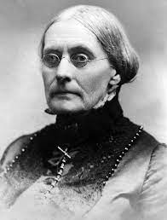
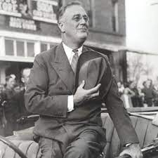
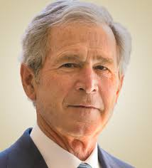
Do You Know Your History
Can you identify the following people and explain how they influenced the development of the United States?
Person #1
Person #2
Person #3
Person #4
Person #5
Person #6
Person #7
Person #8

Slide 7
Power of the People?
“The new American political system based on these doctrines had scarcely gone into effect before it began to incur opposition from many sources. The close of the Revolutionary struggle removed the prime cause for radical agitation and brought a new group of thinkers into prominence. When independence had been gained, the practical work to be done was the maintenance of social order, the payment of the public debt, the provision of a sound financial system, and the establishment of conditions favorable to the development of the economic resources of the new country. The men who were principally concerned in this work of peaceful enterprise were not the philosophers, but men of business and property and the holders of public securities. For the most part, they had had no quarrel with the system of class rule and the strong centralization of government which had existed in England. It was on the question of policy, not of governmental structure, that they had broken with the British authorities. By no means all of them, in fact, had even resisted the policy of the mother country, for within the ranks of the conservatives were large numbers of Loyalists who had remained in America, and, as was to have been expected, cherished a bitter feeling against the Revolutionists, especially the radical section which had been boldest in denouncing the English system root and branch. In other words, after the heat and excitement of the War of Independence were over and the new government, state and national, was tested by the ordinary experiences of traders, financiers, and manufacturers, it was found inadequate, and these groups accordingly grew more and more determined to reconstruct the political system in such a fashion as to make it subserve their permanent interests.”
- Charles Beard, “Framing the Constitution” 1912

Slide 8
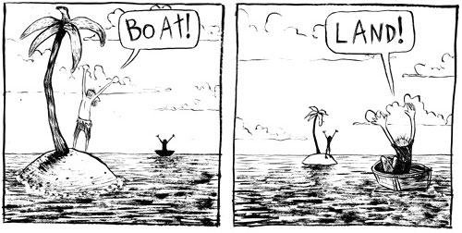
POV
Summer Assignment
HIPP your summer assignment
Discuss with a partner how that changed your understand of the time period, which is the focus of the reading.
Summarize the importance of point of view in explaining history

Slide 9
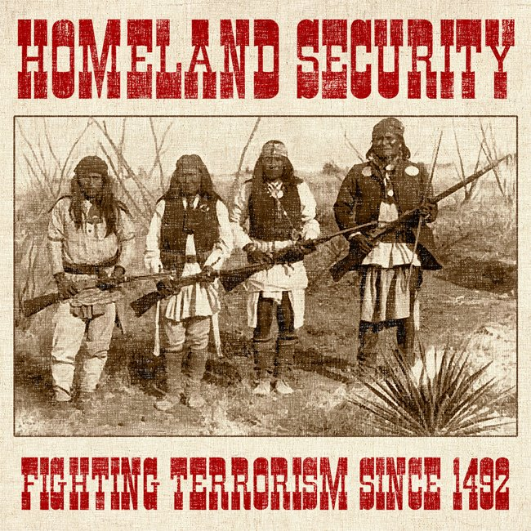
Point of View – Give me some POV
Why is point of view an important historic thinking skill to evaluate?
HIPP
Historic Contextualization:
Intended Audience
Point of View
Purpose

Slide 10
POV
POV = Point of View
Fairy Tale POV
Roles: Reader, Recorder, Time keeper/Task Manager, and Speaker
Read assign fairy tale
Determine whether it’s a primary source (1st hand account) or a secondary source (analysis of the events)
Explain the POV of the main character
Evaluate it’s reliability

Slide 11
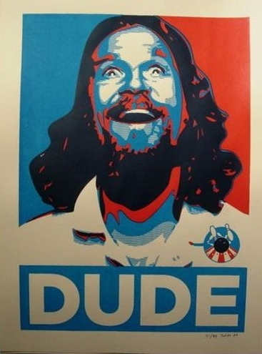
Reading is an active sport
Building recall through reading
Analytical skill
Write down main idea
Provide SHE (Specific Historic Evidence)
Summarize what you read

Slide 12
Unit I 1450-1607
The New World – Convergence of three worlds

Slide 13
APUSH 1.1: Explain the context for European encounters in the Americas from 1491 to 1607
APUSH 1.2: Explain how and why various native populations in the period before European contact interacted with the natural environment in North America
Essential Question: How did the interaction between Native Americans, Europeans, and Africans impact the development of the New World.
Students can:
Demonstrate how the diverse geography of the New World cause the development of difference Native Cultures.
Evaluate whether first contact between the Native Americans and Europeans had a positive influence on the development of the New World.
Assess how different European cultures shaped the development of the New World.
Agenda
AP Classroom
The First Americans
Seven Nation Army
Homework:
Seven Nation Army

Slide 14
AP Classroom
Go to https://myap.collegeboard.org/ to setup your AP student account
Create an account if you do not have one already
Class joiner codes
3rd Period: RDZZ2G
4th Period: 7AQ2M6

Slide 15
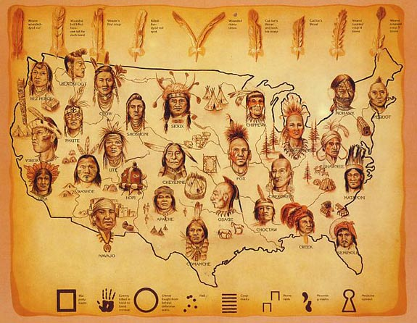
Essential Question
How did the New World’s diverse environment impact the development of Native American culture’s?

Slide 16
Early Migration
1st Wave:12,000 – 10,000 BC Hunter Gathers – following Herds
2nd Wave:10,000 – 8,000 BC Paleo-Indians – new technology to adapt to environmental changes
First American Migration
13,000 BC to 1492
3rd Wave:3,000 BC Archaic Age – Inuit and Aleutians: boats, skill hunters
Hunter gather societies
Splintered into tribal groups as resources became scarce
Environment a key factor in their distinctive cultures

Slide 17
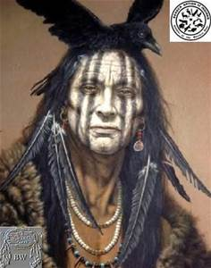
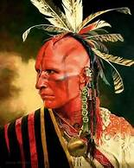
Creation Story of the Seneca
Sky-woman as having borne first a daughter, who, without any knowledge of a man, became that earth-mother of the twins Good and Evil. That daughter died giving birth to the twins, and she was buried by her mother, the Sky-woman.
Sky-woman said to her grandson the good-mined-spirit, "Now you must go and seek your father. When you find him, you must ask him to give you power."
She pointed to the East and said to him, "He lives in that direction. You must go on and on, until you reach the limits of this huge island. Then continue onward, as you must paddle upon the waters, until you come to a high mountain, which rises straight up out of the water. You must climb this mountain to the summit. There you will see a wonderful being, sitting on the highest peak. You must say to him, 'I am your son.'
"Your father is the Sun, and through you, he is also the father of mankind, because of your earthly origin from my daughter."
Animism: living things have spirits

Slide 18
First American Societies Prior to 1492
What factors created unique cultural differences amongst Native American cultures, such as language and technology?

Slide 19
Scared Sisters
“In late spring, we plant the corn and beans and squash. They're not just plants- we call them the three sisters. We plant them together, three kinds of seeds in one hole. They want to be together with each other, just as we Indians want to be together with each other. So long as the three sisters are with us we know we will never starve. The Creator sends them to us each year. We celebrate them now. We thank Him for the gift He gives us today and every day.”
Chief Louis Farmer (Onondaga)

Slide 20
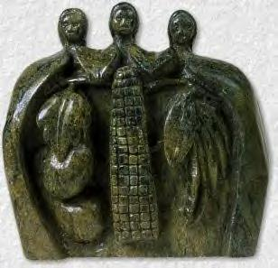
Three Sisters - Horticulture
Three Sisters: Corn (Maize), Beans, & Squash
Horticulture (Maize Culture): transformed Native American cultures and allowed for technological advancement
Major component of the Columbian Exchange

Slide 21
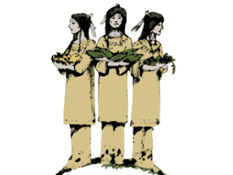
Change in the New World
1 fact on the impact of the Three Sisters (list impact on the board)
 | Political
Economic | Social
Squash
Beans
Maize

Slide 22
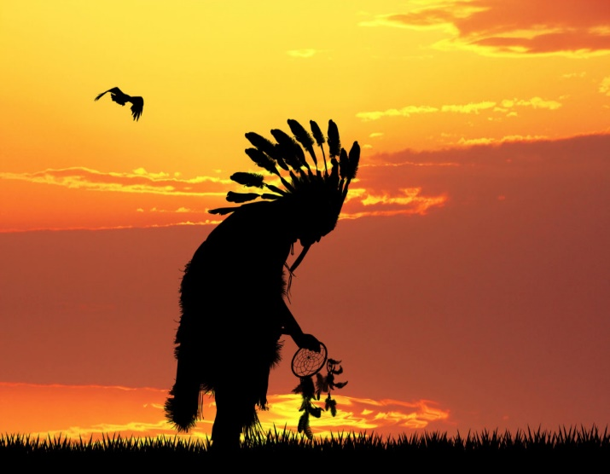
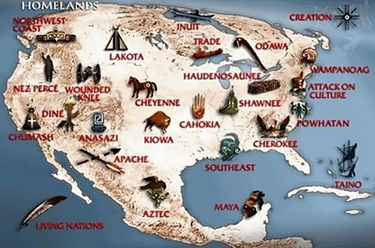
Seven Nation Army
Prompt: Evaluate the validity of the following statement: Native American nations were a product of their environment that they inhabited prior to first contact with European explorers.

Slide 23
Agriculture Societies v. Hunter Gathers
Prompt: Evaluate the validity of the following statement: Native American nations were a product of their environment that they inhabited prior to first contact with European explorers.
Write a SHE (specific historic example) statement to answer the prompt:
SHE Statements:
Andrew Jackson expanded the presidential powers by expanding the use of veto to reject laws passed by the United States Congress
Jackson, also, refused to enforce the Marshal decision in Worchester v. Georgia by placing the civilized tribes, like the Cherokee, on the Trail Tears.

Slide 24
APUSH 1.1: Explain the context for European encounters in the Americas from 1491 to 1607
APUSH 1.2: Explain how and why various native populations in the period before European contact interacted with the natural environment in North America
Essential Question: How did the interaction between Native Americans, Europeans, and Africans impact the development of the New World.
Students can:
Demonstrate how the diverse geography of the New World cause the development of difference Native Cultures.
Evaluate whether first contact between the Native Americans and Europeans had a positive influence on the development of the New World.
Assess how different European cultures shaped the development of the New World.
Agenda
A Cultural Comparison
Natives vs. Euros
Seven Nation Army
Homework:
Seven Nation Army

Slide 25
Essential Question
How did the New World’s diverse environment impact the development of Native American culture’s?

Slide 26
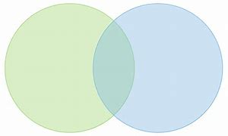
Contrasting Cultures
Prior to first contact with Europeans Native American cultures inhabited the New World.
A. Explain a major difference between hunter-gather and maize cultures societies.
B. Explain one major similarity between hunter-gather and maize culture societies?
Hunter-Gathers
Maize Culture
1 Difference
1 Difference
1 Similarity

Slide 27
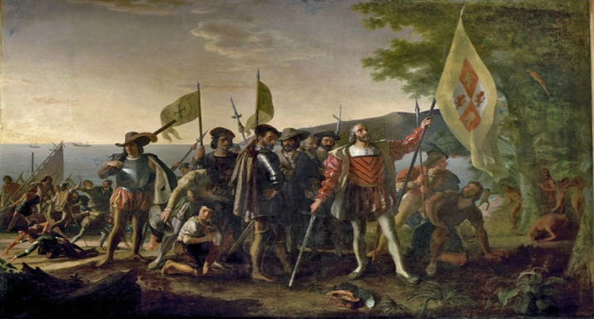
Two Views
Europeans
“And God blessed them. And God said to them, “Be fruitful and multiply and fill the earth and subdue it, and have dominion over the fish of the sea and over the birds of the heavens and over every living thing that moves on the earth.” Genesis 1:28
Native Americans
Animism – belief all living things have a spirit
Impact: Native Americans lived in balance with their environment
Property = communal
Buffalo:
Muscle – Meat
Hides – clothing/shelter
Bones – knifes
Manure – burned for heat
Organs - medicine
Laissez Faire – resources are used to earn a profit
Private property (No sharing)
GOD, GLORY, & GOLD (Spanish 3 G’s)

Slide 28
Seven Nation Army
Prompt: Evaluate the validity of the following statement: Native American nations were a product of their environment that they inhabited prior to first contact with European explorers.

Slide 29
Agriculture Societies v. Hunter Gathers
Prompt: Evaluate the validity of the following statement: Native American nations were a product of their environment that they inhabited prior to first contact with European explorers.
Write a SHE (specific historic example) statement to answer the prompt:
SHE Statements:
Andrew Jackson expanded the presidential powers by expanding the use of veto to reject laws passed by the United States Congress
Jackson, also, refused to enforce the Marshal decision in Worchester v. Georgia by placing the civilized tribes, like the Cherokee, on the Trail Tears.

Slide 30
APUSH 1.1: Explain the context for European encounters in the Americas from 1491 to 1607
APUSH 1.2: Explain how and why various native populations in the period before European contact interacted with the natural environment in North America
Essential Question: How did the interaction between Native Americans, Europeans, and Africans impact the development of the New World.
Students can:
Demonstrate how the diverse geography of the New World cause the development of difference Native Cultures.
Evaluate whether first contact between the Native Americans and Europeans had a positive influence on the development of the New World.
Assess how different European cultures shaped the development of the New World.
Agenda
A Cultural Comparison
Natives vs. Euros
Seven Nation Army
Homework:
Seven Nation Army

Slide 31
Seven Nation Army
Prompt: Evaluate the validity of the following statement: Native American nations were a product of their environment that they inhabited prior to first contact with European explorers.

Slide 32
Native to the Region

Slide 33
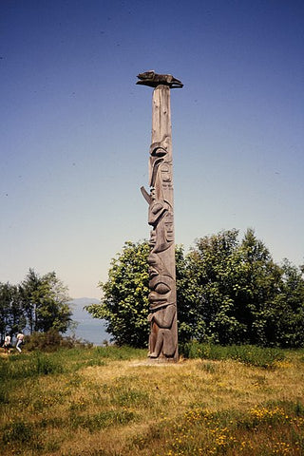
Seven Nation Army Tracking
Prompt: Evaluate the validity of the following statement: Native American nations were a product of their environment that they inhabited prior to first contact with European explorers.
Geographic region
Description of the geography region
Example tribe(s)
Two environmental adaptation

Slide 34
APUSH 1.1: Explain the context for European encounters in the Americas from 1491 to 1607
APUSH 1.2: Explain how and why various native populations in the period before European contact interacted with the natural environment in North America
Essential Question: How did the interaction between Native Americans, Europeans, and Africans impact the development of the New World.
Students can:
Demonstrate how the diverse geography of the New World cause the development of difference Native Cultures.
Evaluate whether first contact between the Native Americans and Europeans had a positive influence on the development of the New World.
Assess how different European cultures shaped the development of the New World.
Agenda
SAQ 1, 2, 3 Guide
An Environment of Natives
The Contextualization 1st Contact
Homework:
The Black Legend Reading – AMSCO pages 14-16, 19-21, & 23-25

Slide 35
Essential Question
How did the New World’s diverse environment impact the development of Native American culture’s?

Slide 36
APUSH Task Verbs
Compare: provide a description or explanation of similarities and/or differences
Define: provide a specific meaning for a word or concept
Describe: provide the relevant characteristics of a specified topic
Explain: provide information about how or why a relationship, process, pattern, position, or outcome occurs using reasoning/evidence.
Evaluate: form idea about.
Draw a conclusion: Use available information to formulate an accurate statement that demonstrates understanding based on evidence. Sometimes phrased as, “what is the most appropriate conclusion?”.
Apply: relate the term to a give scenario or example in a way that shows you understand what the term/concept means.

Slide 37
Short Answer Question Writing
Prior to first contact with Europeans, Native Americans were influenced by the geography and the environment they inhabited.
Briefly describe ONE way that one Native American society adapted to its environment prior to European contact.
Demonstrate TWO ways of how distinctive environments of the New World caused apparent cultural differences between tribes in different geographic location within the Americas.
Explain ONE factor that influence Native American that is NOT caused by the environment.

Slide 38
Horticulture Empire
Cahokia
Hohokam & Anasazi
Mississippi River Delta
Mound builders
Stayed hunter gather society longer (horticulture 800 AD)
Not United – Chiefdoms
Destroyed by De Soto (war and epidemics)
Mesoamerica
Cotton
Irrigation systems
Survived: Hopi, Acoma, and Zuni Pueblos
Advanced civilizations
Horticulture
Over-population
Soil depletion and over hunting
Demise of civilization (civil war)

Slide 39
Breaking Down the SAQ
A Secret to success in APUSH
AP Central Secret Files
Yeah!!!

Slide 40
Contrasting Regions
Prompt: Evaluate the validity of the following statement: Native American nations were a product of their environment that they inhabited prior to first contact with European explorers.
Region
Region

Slide 41
Agriculture Societies v. Hunter Gathers
Prompt: Native American societies were diverse societies prior to first contact with Europeans. Compare and contrast how the environment impacted Native American cultures.
Write 5 specific historic evidence statements (3 contrast and 2 comparison)
1. While the Aleut developed spears and boats to hunt aquatic mammals in the cool and rocky Aleutian islands the Anasazi of the arid southwest developed irrigation ditches to cultivate maize, beans, and squash.
2. All native American tribes believed in animism shown through creation stories. (Add specific tribes from two different regions to strengthen statement)

Slide 42
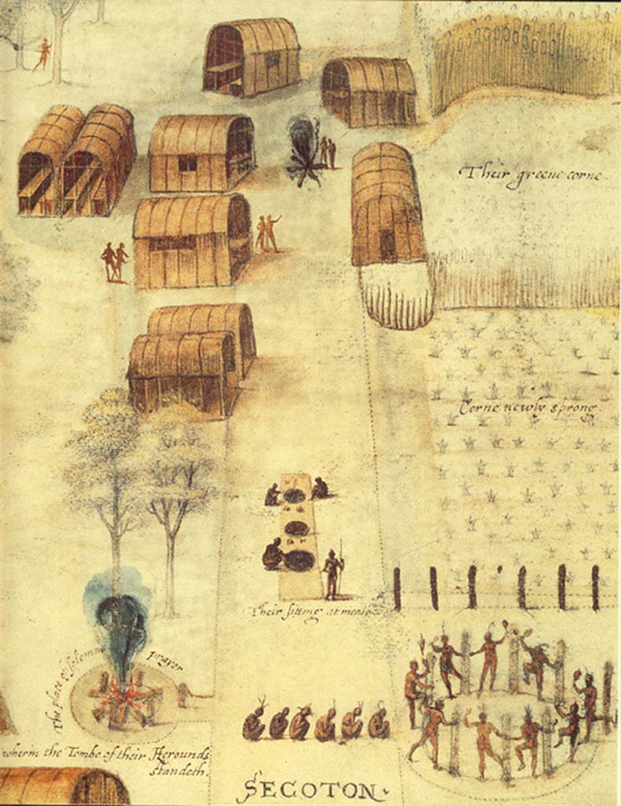
Compose a SHE statement that reflects how the environment influenced the development of the Native American culture.
The Algonquin Village of the Secotan, by John White 1585

Slide 43
Walk this Way
Six Degrees of Separation: Demonstrate through 6 events how Native American culture developed through the Ice Age to First Contact
Ice Age: As result of the Earth cooling a land bridge formed between Asia to modern day Alaska enabling migration across the Bering Sea.
Event B:
Event C:
Event D:
Event E:
First Contact: Christopher Columbus arrival in the New World had a detrimental effect on Native Americans, since Spanish Conquistadors, such as Cortez, search for gold and glory with the promise to find new converts to Catholicism brought conflict and epidemics destroying a large majority of the First Americans.

Slide 44
Historic Contextualization
Historical thinking skill that involves the ability to connect historical events and processes to specific circumstances of time and place as well as broader regional, national, or global processes.
You put historical contextualization as part of a paragraph (usually part of the introduction) to demonstrates that historic events happened as result of what is going on in the time period.
Cause of the event ____________________________
Short term effect ______________________________
Long term effect ______________________________

Slide 45
Can I Get a 3
Peer editing of an FRQ
Explain how the New World provided an environment for population expansion utilizing a Native American nation or tribe.
Must explain: food supply = population growth with an example (underline the facts)
B. Demonstrate how distinctive environments of the New World caused apparent cultural differences between tribes in different geographic location within the Americas.
Must identify two geographic regions by name and two tribes within those regions (underline the facts)
Must explain how the environment shaped their lives (underline the facts)
C. Explain ONE factor that influence Native American that is NOT caused by the environment.
Must have a specific Native American culture and actual example of a change NOT related to the environment with explanation

Slide 46
APUSH 1.1: Explain the context for European encounters in the Americas from 1491 to 1607
APUSH 1.2: Explain how and why various native populations in the period before European contact interacted with the natural environment in North America
Essential Question: How did the interaction between Native Americans, Europeans, and Africans impact the development of the New World.
Students can:
Demonstrate how the diverse geography of the New World cause the development of difference Native Cultures.
Evaluate whether first contact between the Native Americans and Europeans had a positive influence on the development of the New World.
Assess how different European cultures shaped the development of the New World.
Agenda
Get HIPP to Historic Perspective
Contextualizing European Perspective
Putting History on Trial
Homework:
Writing a historical contextualization
Unit I Test, Tuesday, September 12

Slide 47
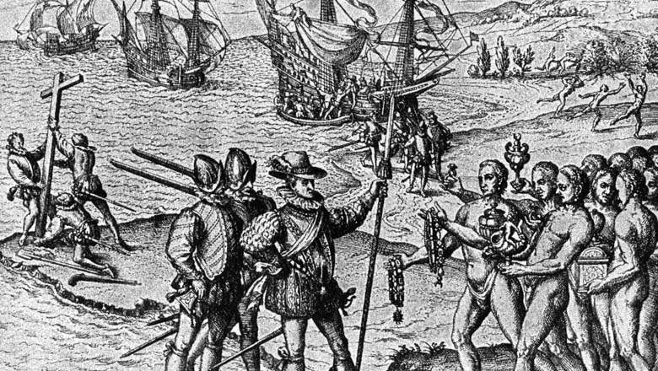
Essential Question
How did the interaction of Native American, African, and European culture impact the development of the New World?

Slide 48
Get HIPP to History
P-HIPP analysis of primary source material
P – Prior Knowledge: what do I already know
H – Historic Contextualization: how does this relate to the time period
I – Intended Audience: who was the document created for?
P – Purpose: Why was the document created
P – Point of View: Who created the document

Slide 49
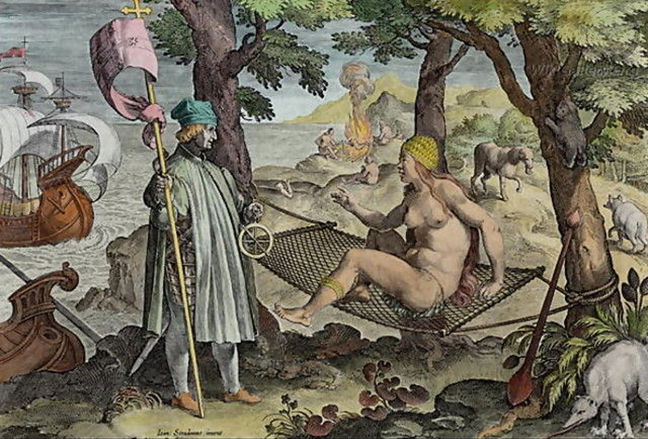
“Discovery of America” by Jan van der Straet

Slide 50
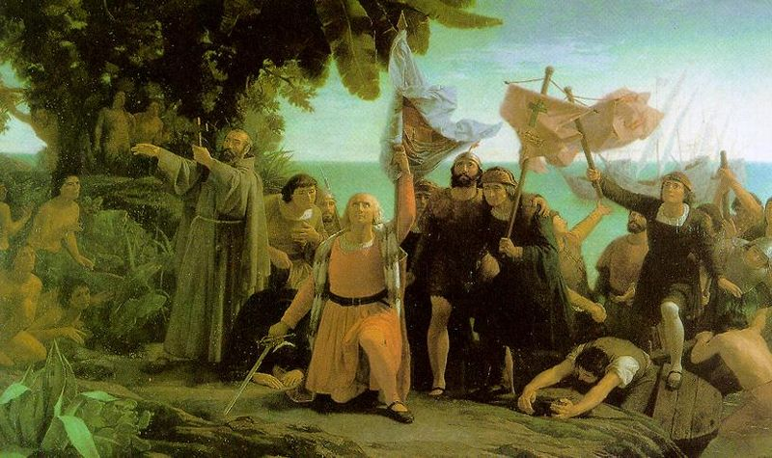
1492
Historic contextualization
Why Europeans finally able to reach the New World in 1492?
REMEMBER: History does not just happen (cause & effect)
Connect contextualization to your thesis
Causation: event happening prior to the time stamp
Immediate impact: event happening during to the time stamp
Long term impact: events happening after to the time stamp

Slide 51
1492 Causation
Historic Contextualization
Age of Exploration
Italian Crusades: Exotic items from Asia (expensive) – Northwest Passage
Renaissance: A new age of learning & willingness to challenge established ideas
New Technology: Prince Henry’s navigation school, carvel ships, map making, & compass
Protestant Reformation: (Martin Luther) Catholicism seeking to spread its influence & religious freedom for others
Long Term effect – 1607???????????

Slide 52
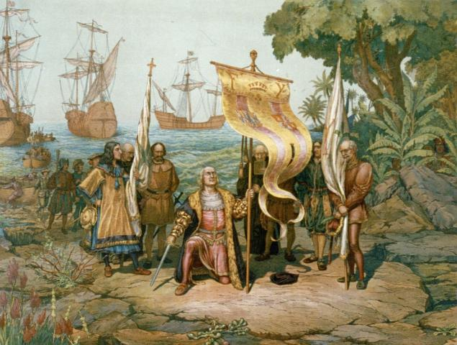
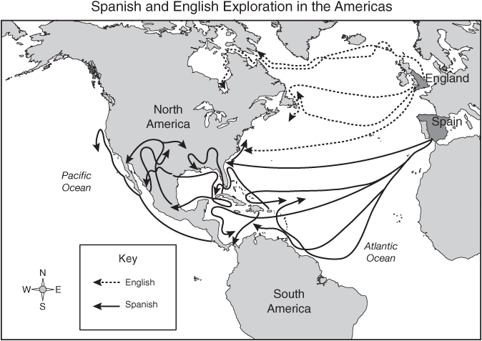
Other Motivations to Explore
Mercantilism: “Money = Power” & in limited supply
Spain, France & England are competing to gain world domination ($$ is key – Eldorado, silver, De Soto & Cortez fortune seekers)
Salvation of Souls: Spanish Sells exploration to spread Christianity (Catholicism)

Slide 53
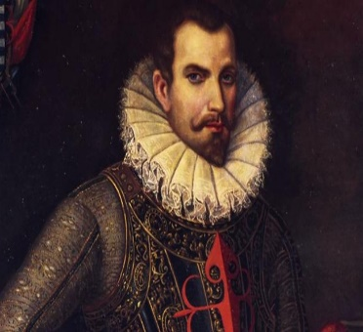
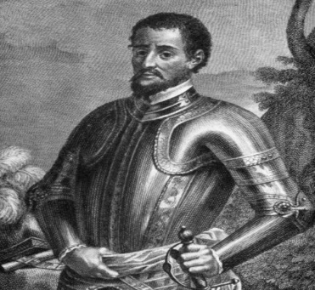
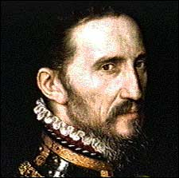
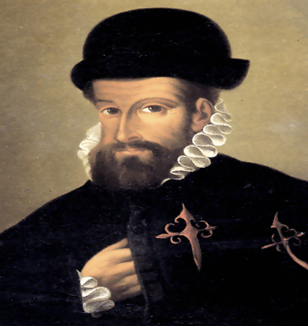
No One Expects The Spanish Inquisition
Spanish Exploration
Conquistador motivation: Gold, Glory, & God (Three Gs)
Encomienda system: enslavement & conversion of Native population
Hernando Cortez
Hernando De Soto
Francisco Coronado
Francisco Pizarro

Slide 54
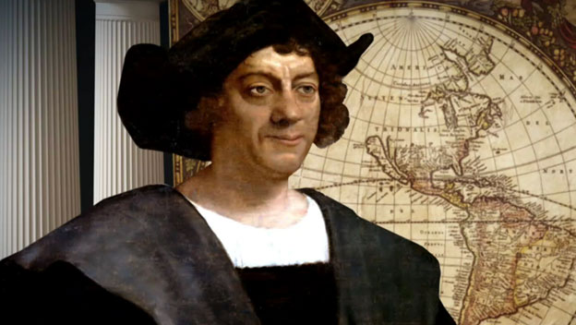
History on trial
Prompt: Evaluate the extent to which trans-Atlantic voyages in the period of 1491 to 1607 affected the Americas.
Christopher Columbus
Hernando De Soto
Hernando Cortez
Francisco Coronado
Two Sides to Every History
SIDE 1:
SIDE 2:

Slide 55
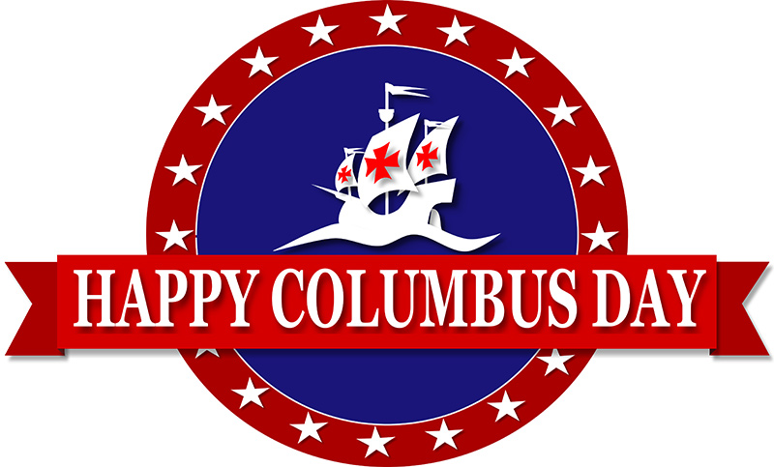
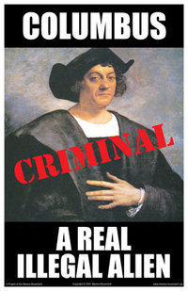
The Black Legend Trial
or
Prompt: Evaluate the extent to which trans-Atlantic voyages in the period of 1491 to 1607 affected the Americans.
HIPP documents
Compose SHE statements that argue your perspectives

Slide 56
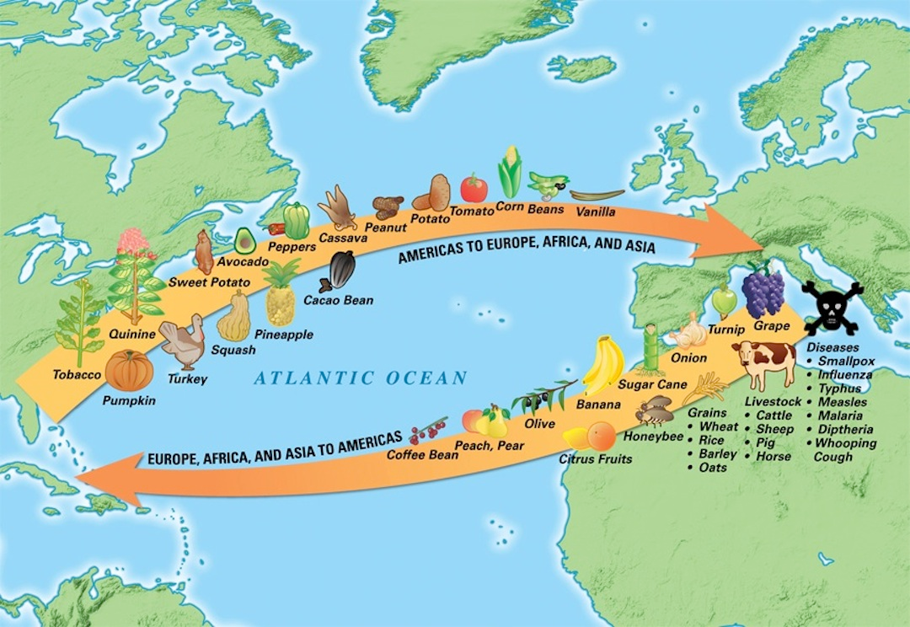
Columbian Exchange
How does the establishment of the Columbian Exchange effect Europe and the Americas during the period after 1492?
Further the globalization of the economy: exchange of new commodities
Destroys Native American population (smallpox, war, etc.)
Creates a two new cultures: Mestizos & Mulattos
Increases the need for African slaves
Eradicates famine in Europe

Slide 57
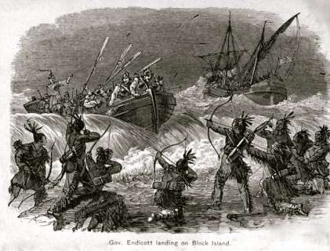
Two Words Collide
Causation and Conflict
Demonstrate through ONE of the following reasons why Native Americans and Europeans will become a history of conflict. Be sure to justify your answer through the use of specific factual information.
Politics and power
Economics
Religion
Social/cultural
Intellect and technology
Area

Slide 58
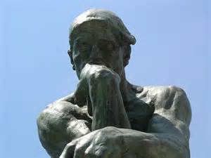
Van der Straet Perspective
Point of View: Using historical thinking skills to develop a persuasive new understanding of the past. Use contradictory evidence to prove a point.
Write two fact based statements that support Jan van der Straet’s assessment of discovery of America.
Write two fact based statements that contradict Jan van der Straet’s assessment of discovery of America (Historic synthesis)
You mean that there is more than one way to look at history??????

Slide 59
Two Worlds Collide

Slide 60
APUSH 1.1: Explain the context for European encounters in the Americas from 1491 to 1607
APUSH 1.2: Explain how and why various native populations in the period before European contact interacted with the natural environment in North America
Essential Question: How did the interaction between Native Americans, Europeans, and Africans impact the development of the New World.
Students can:
Demonstrate how the diverse geography of the New World cause the development of difference Native Cultures.
Evaluate whether first contact between the Native Americans and Europeans had a positive influence on the development of the New World.
Assess how different European cultures shaped the development of the New World.
Agenda
Get HIPP to Historic Perspective
Impacting the New World
Putting History on Trial
Homework:
The European Effect
Unit I Test, Tuesday, September 12

Slide 61
Essential Question
How did the interaction of Native American, African, and European culture impact the development of the New World?

Slide 62
Modern Historic Interpretation
Use HIPP to interpret the following engraving
Engraving by Flemish engraver Theodor de Bry taken from a 16th-century Dutch edition on A Short Account of the Destruction of the Indies by Bartolome de las Casas

Slide 63
1492
Historic contextualization
Why Europeans finally able to reach the New World in 1492?
REMEMBER: History does not just happen (cause & effect)
Connect contextualization to your thesis
Causation: event happening prior to the time stamp
Immediate impact: event happening during to the time stamp
Long term impact: events happening after to the time stamp

Slide 64
Modern Historic Interpretation
P – Prior Knowledge
H – Historic Contextualization
I – Intended Audience
P – Purpose
P – Point of View
Use HIPP to interpret the following political cartoon

Slide 65
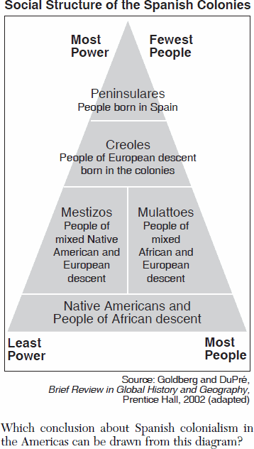
Spanish Caste System
Impact of Spanish Exploration
Encomienda System: system of slavery based on the agreement that they will be converted to Christianity
Aristocracy
Sub-Aristocracy
Commoners
Laborers
Encomienda System (Natives only)
Evaluate the impact of Spanish Exploration on the New World.

Slide 66
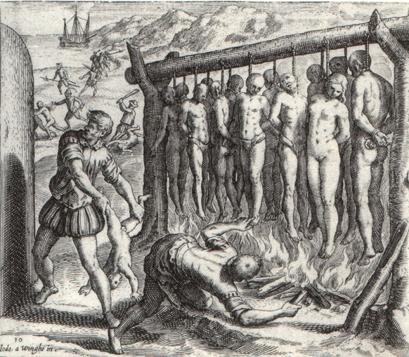
Citizens v. Salvages
Primary purpose of exploration - Salvation of Souls (Spanish Missionaries established in the new world)
…”They made a gallows just high enough for the feet to nearly touch the ground, and by thirteens, in honour and reverence of our Redeemer and the twelve Apostles, they put wood underneath and, with fire, they burned the Indians alive.” Bartolome De Las Casa
New Law 1542: outlawed forced servitude of Native Americans and tried to put an end to the encomienda system
1545 Spain revoked the “No hereditary rule clause” of the encomienda system

Slide 67
History on trial
Prompt: Evaluate the extent to which trans-Atlantic voyages in the period of 1491 to 1607 affected the Americans.
Christopher Columbus
Hernando De Soto
Hernando Cortez
Francisco Coronado
Two Sides to Every History
SIDE 1:
SIDE 2:

Slide 68
Formula for Thesis Writing
Analyze how modern-day Americans should evaluate Spanish exploration of the New World to determine whether we as a nation should continue to venerate Columbus Day.
Basic complex-split thesis formula
Although ________________, ultimately (claim responding to prompt specifying 3 examples).
USE PERSIA to organize thoughts
P - political
E – economic
R – Religious
S – social/cultural
I – Intellectual
A – Area

Slide 69
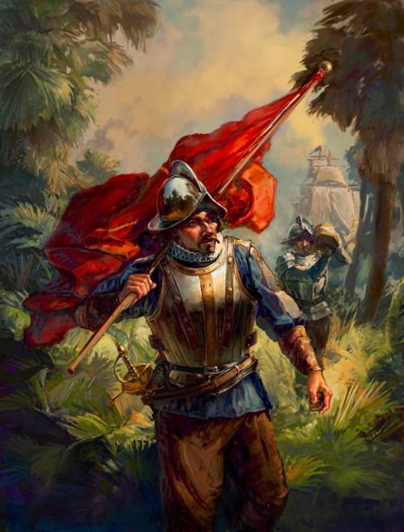
Verdict
Prompt: Analyze how modern-day Americans should evaluate Spanish exploration of the New World to determine whether we as a nation should continue to venerate Columbus Day.
Verdict: (Thesis) written argumentative statements
Evidence:
Documents – Historic contextualization statement (SHE statement)
Outside evidence (SHE statements)
3rd Paragraph counter arguments
HERO
?
WAR CRIMINAL

Slide 70
May it Please the Court
Evidence statements
1. As a result of first contact between Europeans and the New World death rates increased.
2. The Columbian Exchange that resulted from first contact between two worlds explosive evolution
3. First contact between European and Native Americans caused explosive evolution of the Columbian Exchange. Epidemics of small pox and influenza caused mass genocide of Native American populations, such as the Arawaks, and evasive species, such as the dandelion, caused the eradication of vital food sources altering the ecology of America

Slide 71
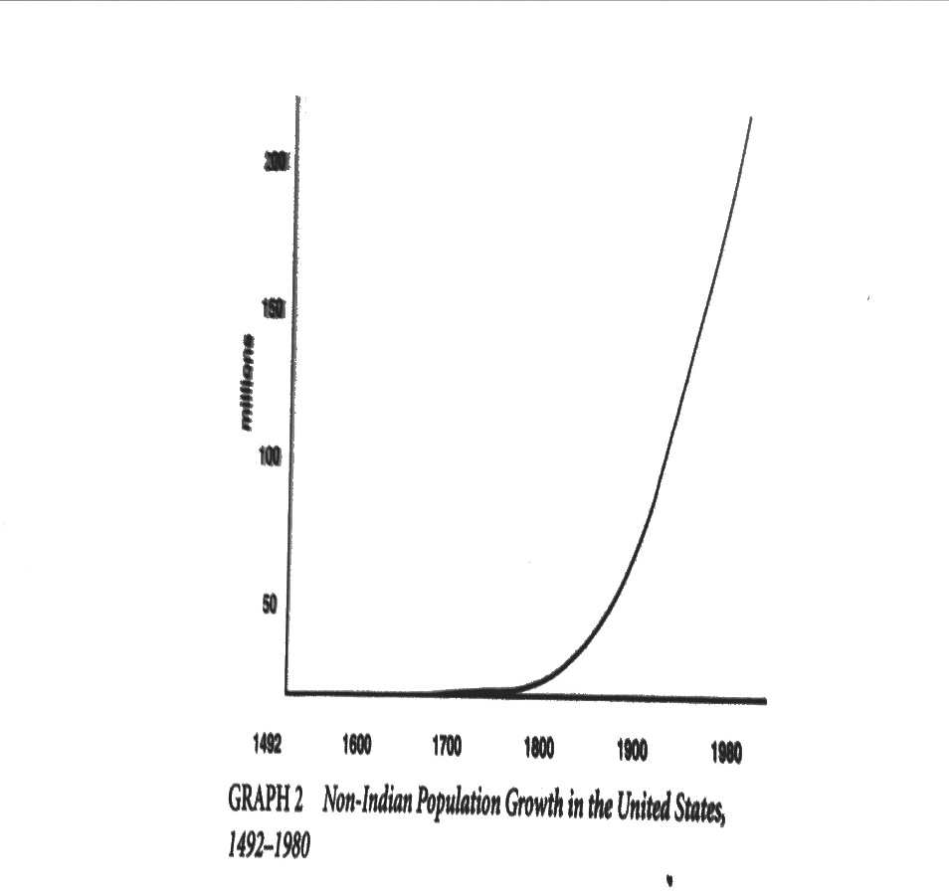
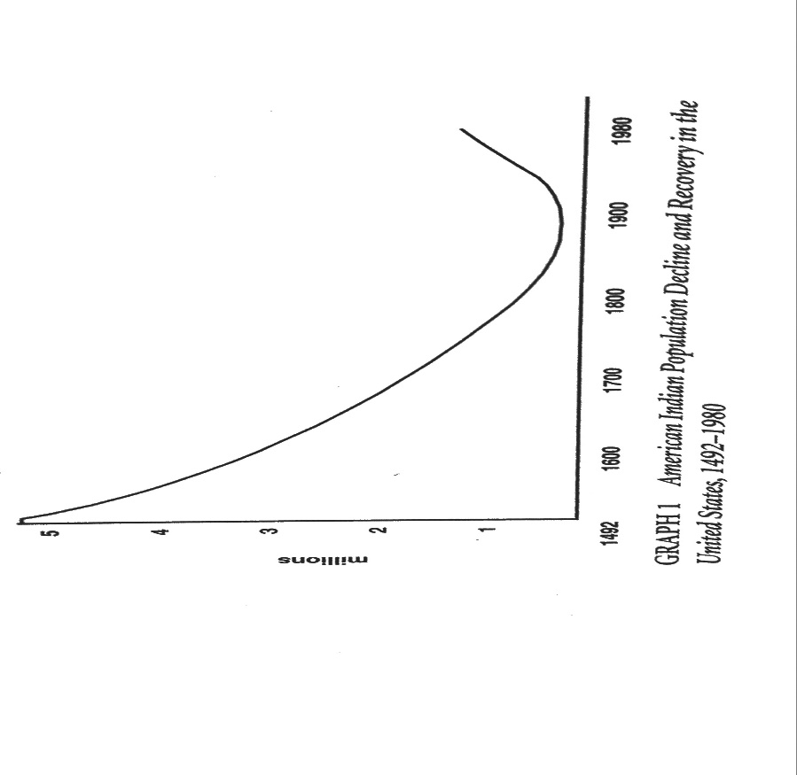
Think Like a Historian
What can be deduced from the two population charts?

Slide 72
APUSH 1.1: Explain the context for European encounters in the Americas from 1491 to 1607
APUSH 1.2: Explain how and why various native populations in the period before European contact interacted with the natural environment in North America
Essential Question: How did the interaction between Native Americans, Europeans, and Africans impact the development of the New World.
Students can:
Demonstrate how the diverse geography of the New World cause the development of difference Native Cultures.
Evaluate whether first contact between the Native Americans and Europeans had a positive influence on the development of the New World.
Assess how different European cultures shaped the development of the New World.
Agenda
A European Claim
Thesis writing
Impacting the New World
Homework:
The Black Legend Debate – Thesis Writing
Unit I Test, Tuesday, September 12

Slide 73
Essential Question
How did the interaction of Native American, African, and European culture impact the development of the New World?

Slide 74
European Interactions
Contrast European impact on the New World with the following statements. Use specific historic examples to support your conclusions.
Evaluate which European nation had the worst relationship with the American Indian population of the New World.
Evaluate which European nation had the best relationship with the American Indian population.
Describe how capitalism was a motivating factor for each of the following European nations.
Spanish
French
English

Slide 75
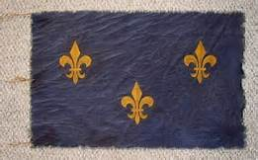
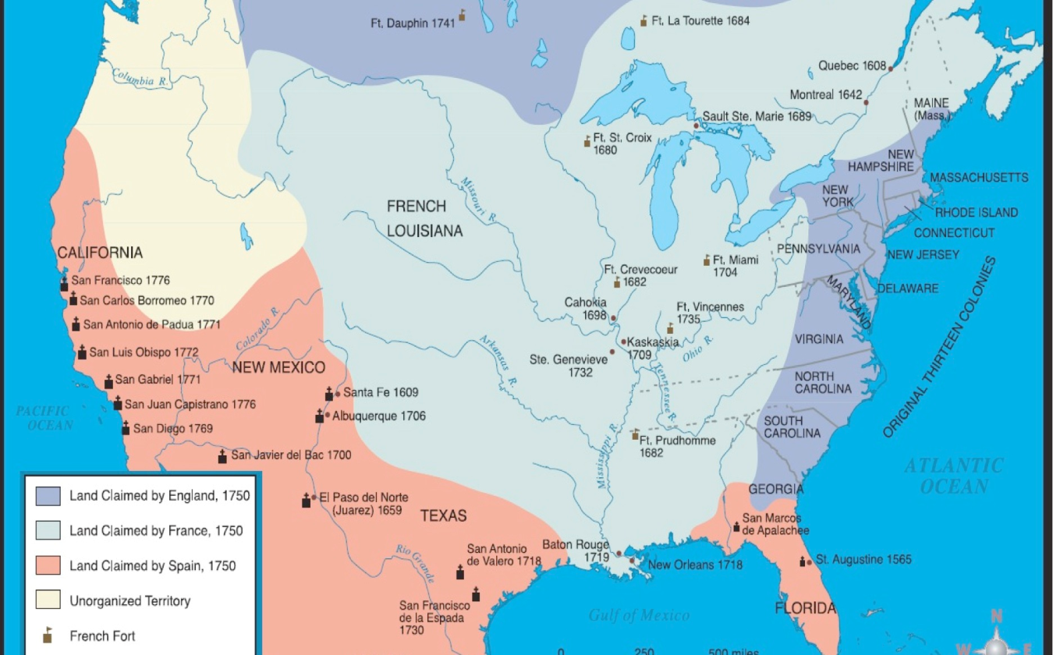
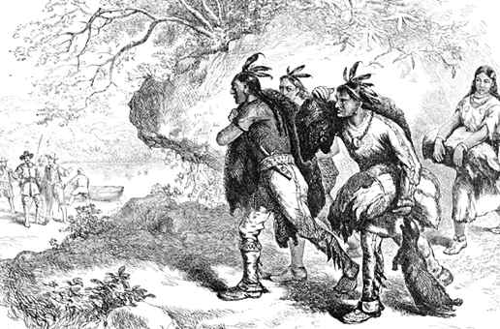
Here Come the French
Motivation: World Super Status (Competition with Spain, England & France)
Mercantilism: Fur Trade (Relationship with the Native Americans)
Quebec – Fur Trade Outpost
European Land Claims by 1750

Slide 76
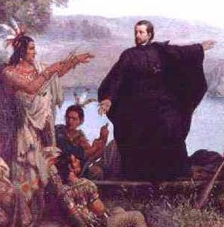
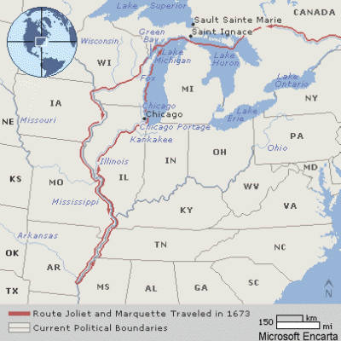
The French Imprint in America
Fur Trade built a relationship with the Native Americans
Spread of Christendom – Jesuit Priests
(Catholicism)
Intermarriage (Fur traders earn status with tribes)
Quebec (Joint Stock Company)/New France (Royal Colony): Crown supported
Created tribal rivalries (Samuel de Champlain)
Destruction of beaver & deer population
Jacques Marquette

Slide 77
The British Invasion
English Smack Talk
11588: England defeats the Spanish Armanda (Sir Francis Drake – Piracy)
Factors encouraging English exploration and colonization
Mid 16th Century primogeniture law enacted (1st born gets inheritance
2nd & 3rd Sons formed Joint Stock Companies to invest in colonization
Enclosure movement: high population of landless poor
Protestant Reformation: battle over control of the Church of England

Slide 78
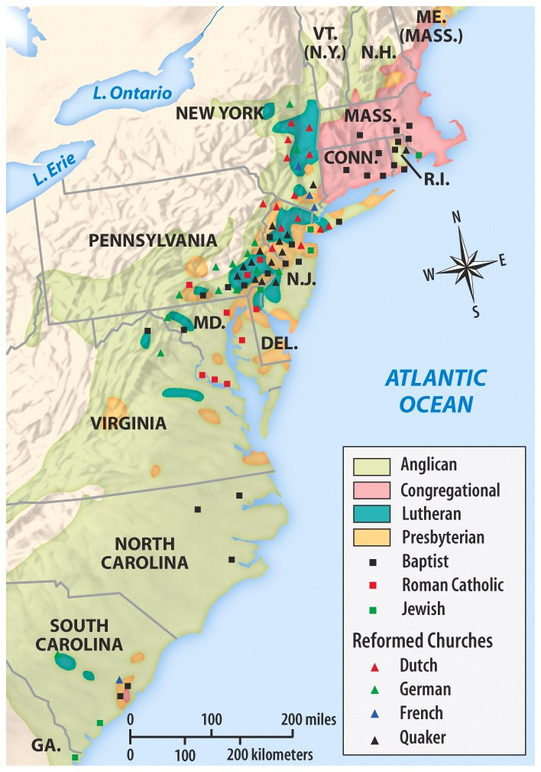
4 Waves of English Migration
Congregational: Puritans & Pilgrims – Dissenters (religious freedom)
Quakers: Dissenters (religious freedom)
Cavaliers: Aristocracy – wealthy by land (No power in England)
Lowlander Backwoodsmen: Scots-Irish (poor)

Slide 79
Permanent Settlements in the New World

Slide 80
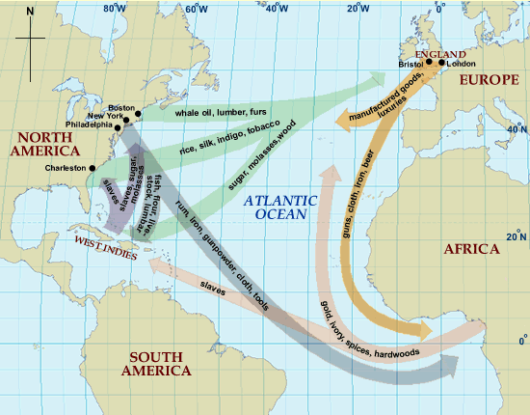
The Rise of the American Merchant, 1750
Triangle Trade
Notes:
Henretta, America’s History 5e from http://www.bedfordstmartins.com/mapcentral

Slide 81
History on trial
Prompt: Evaluate the extent to which trans-Atlantic voyages in the period of 1491 to 1607 affected the Americans.
Christopher Columbus
Hernando De Soto
Hernando Cortez
Francisco Coronado
Two Sides to Every History
SIDE 1:
SIDE 2:

Slide 82
The Legitimacy of the Black Legend
Prompt: Evaluate the extent to which trans-Atlantic voyages in the period of 1491 to 1607 affected the Americas.
Positive
Negative

Slide 83
Formula for Thesis Writing
Prompt: Evaluate the extent to which trans-Atlantic voyages in the period of 1491 to 1607 affected the Americas.
Basic complex-split thesis formula
Although ________________, ultimately (claim responding to prompt specifying 3 examples).
USE PERSIA to organize thoughts
S – Social
P – Political
I – Interaction w/ Environment
C – Cultural
E – Economic
T - Technology

Slide 84
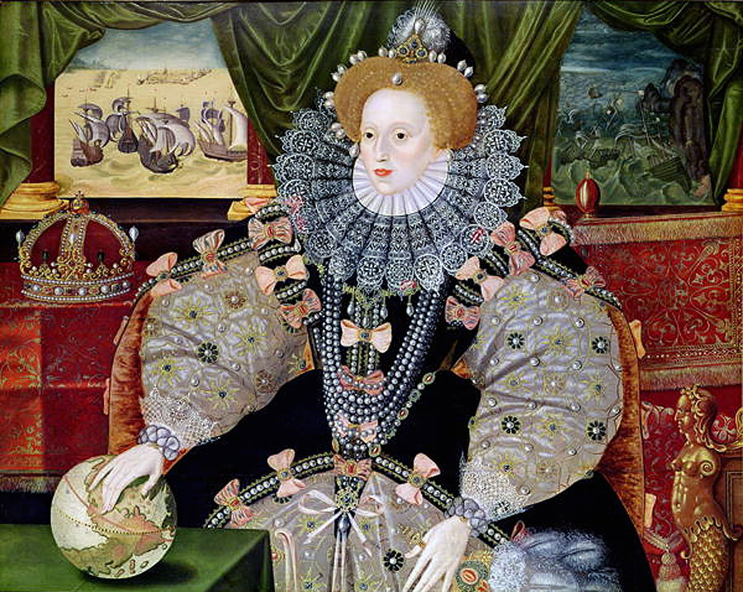
Europeans on the move
European dominion over the New World
Treaty of Tordesillas 1494 (division of the New World between Spain & Portugal)
French exploration of Newfoundland 1524 (Giovanni da Verrazano)
Defeat of the Spanish Armada 1588 by England (New World Power)
English take over

Slide 85
Facts of the Case
Bartolome De Las Casa Encomienda system Mesitzos
Conquistador Hernando Cortes Mulattos
Salvation of Souls God, Glory, & Gold Epidemics
African Slave Trade Columbian Exchange Black Legend
Caste system New Law 1542 Aztecs
Christopher Columbus Vasco Balboa Maize Culture
Hernando De Soto Ponce de Leon Mercantilism
Francisco Pizzaro Discovery of America Treaty of Tordesillas
New World Jan van der Straet Middle Passage
A Short Account of the Destruction of the Indies, 1542 Northwest Passage
Anything listed on the Columbian Exchange Renaissance
Aarawak Incas Protestant Reformation
Carvel Compass Astrolabe
Age of Exploration Spanish Portuguese
Christianity Catholicism Silk Road
Nobel Savage

Slide 86
APUSH 1.1: Explain the context for European encounters in the Americas from 1491 to 1607
APUSH 1.2: Explain how and why various native populations in the period before European contact interacted with the natural environment in North America
Essential Question: How did the interaction between Native Americans, Europeans, and Africans impact the development of the New World.
Students can:
Demonstrate how the diverse geography of the New World cause the development of difference Native Cultures.
Evaluate whether first contact between the Native Americans and Europeans had a positive influence on the development of the New World.
Assess how different European cultures shaped the development of the New World.
Agenda
African Influence
African Enslavement Impact
Impacting the New World
Homework:
Read pages 34-36 Add the Dutch Influence on your chart
Unit I Test, Tuesday, September 12

Slide 87
Essential Question
How did the interaction of Native American, African, and European culture impact the development of the New World?

Slide 88
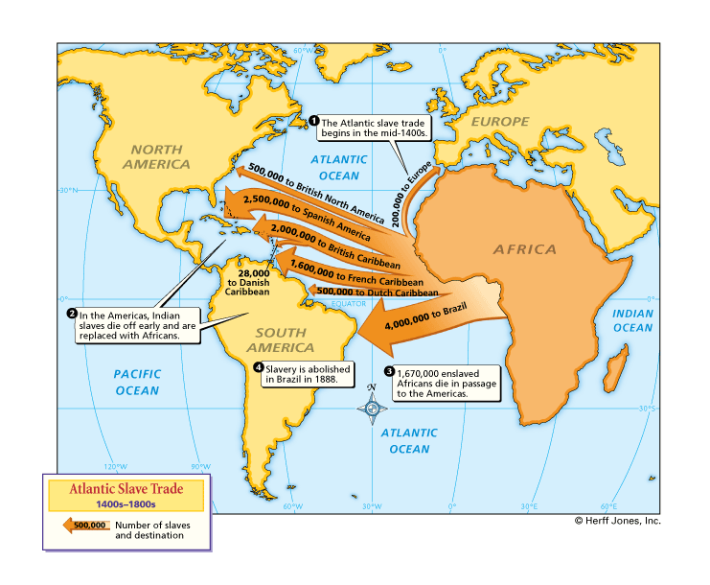
A Convergence
400 Years of Slave Trade
Importation of 15 to 20 Million Africans to the Americas
FACTORS FOR THE PERCULAR INSTITUTION
Why were African slaves a necessity for the development of the New World?
How did the introduction of African slavery transform the New World?
Politically
Economically
Socially

Slide 89
African Slave Importation
Importation of African Slaves:
Native population declining
Suggested by Bartolome De Las Cass
Easier too control (don’t know the land)

Slide 90
Impact of African Slave Trade
Political: Barbados Slave Codes 1661: slave resistance (Haitian independence)
Other resistance: breaking tools and maintaining culture
Economic: Middle Passage – major component of the Triangle Trade (Mercantilism)
Social: blending of cultures
Mulattos
Religion (Vondun in Haiti)

Slide 91
The Legitimacy of the Black Legend
Prompt: Evaluate the extent to which trans-Atlantic voyages in the period of 1491 to 1607 affected the Americas.
Positive
Negative
S
P
I
C
E
T

Slide 92
Thesis Writing
An argumentative statement that answers the prompt
A thesis will nearly always have multiple steps or supporting parts
A strong thesis expresses one main idea. e.g., "Nixon overall was a bad president because..." "The New Deal was an effective policy in terms of....“
What is your overall answer in response to the prompt or topic at hand?
One of the reasons a thesis even exists is to tie these multiple pieces together.
What are the sub-points or Categories of Analysis of your argument
Its NOT a restatement of the prompt
Ex: Jacksonian democrats successfully portrayed themselves as guardians of American ideals and did indeed achieve a remarkable degree of success in protecting those ideals.
.

Slide 93
Thesis Writing
A thesis is an argument or a stand you take on a particular subject. It should not resemble a sentence in your textbook, but rather explain your point of view and why it matters.
The thesis formula: X however, A, B, and C. Therefore Y.
X-the strongest point against your argument (could be historic context and not your thesis)
Or
Y – the claim you will taking throughout the essay (this could affect of X)
A & B– the two strongest point that explain in your essay
Despite [counter argument], because [evidence 1] and [evidence 2] my argument.

Slide 94
Thesis exercise
thesis formula: X however, A, B, and C. Therefore Y.
Underline and label the four steps in thesis below (there can be overlap)
Between 1910 and 1930, African Americans migration from rural South to urban northern cities significantly increased due to greater job opportunities and emerging cultural changes. However, African Americans still faced racial discrimination and segregation in both regions.

Slide 95
Build a thesis
thesis formula: X however, A, and B. Therefore Y.
What is your claim (Y) – what are you going to argue (remember you CANNOT restate the prompt)
What is your two pieces of evidence you will use to defend your claim (A and B)
What is your counter claim (X)
Prompt: Evaluate the extent to which trans-Atlantic voyages in the period of 1491 to 1607 affected the Americas.

Slide 96
APUSH 1.1: Explain the context for European encounters in the Americas from 1491 to 1607
APUSH 1.2: Explain how and why various native populations in the period before European contact interacted with the natural environment in North America
Essential Question: How did the interaction between Native Americans, Europeans, and Africans impact the development of the New World.
Students can:
Demonstrate how the diverse geography of the New World cause the development of difference Native Cultures.
Evaluate whether first contact between the Native Americans and Europeans had a positive influence on the development of the New World.
Assess how different European cultures shaped the development of the New World.
Agenda
AP Account
Impacting the New World
A Euro Contrast
Homework:
Unit I Progress Check
Unit I Test, Thursday, September 14

Slide 97
Essential Question
How did the interaction of Native American, African, and European culture impact the development of the New World?

Slide 98
AP Classroom
Go to https://myap.collegeboard.org/ to setup your AP student account
Create an account if you do not have one already
Class joiner codes
3rd Period: RDZZ2G
4th Period: 7AQ2M6

Slide 99
European Precedent’s
If we accept the Black Legend is true, what precedents have the Europeans established that will influence the development of the New World?

Slide 100
4 Waves of English Migration
Congregational: Puritans & Pilgrims - Dissenters
Quakers: Dissenters
Cavaliers: Aristocracy – wealthy by land (No power in England)
Lowlander Backwoodsmen: Scots-Irish (poor)

Slide 101
Euro Colonization
Contrast European colonization efforts in the New World
Determine whether they were similar or different
SPANISH
FRENCH
ENGLISH
DUTCH

Slide 102
The English Imprint on the New World
English settlements:
Roanoke 1585
Jamestown 1607
Plymouth 1620
Economic impacted: agrarian societies – Cash crop farming – Tobacco
Social:
Transplanted their culture: (y’all = All ye all)
Religious dissenters
Native American relations: Savages
- Killed Native Americans
Powhatan Wars: 1610-1614, 1622-1626, & 1644-1646
King Philips War: 1675-1678
Pequot War: (1636-1637)

Slide 103
1. Why would the Iroquois of the Eastern Woodlands be of great value to the French when they arrived in the mid-1500s?
Their advance societies had the mapmaking skills to lead the French to the Northwest Passage to Asia
Iroquois relied on hunter gather and agriculture societies which provided the French with deerskins and the three sisters
The Iroquois unity as tribe made it easier for the French to conquer them
Because of the Iroquois vast numbers they provided large numbers to be converted by French Jesuits

Slide 104
All the wars called conquests were and are most unjust and truly tyrannical. We have taken over all the kingdoms of New Spain. Our king, with all the power God gave him cannot justify the wars and robberies against the Indians. All the gold and silver, pearls and other riches brought to Spain and trade among Spaniards in the New World all is stolen save perhaps very little that came from the islands and places we have already depopulated. Those who stole it and today steal it by conquests cannot be saved unless they restore it, The natives in any or all the areas we have invaded in the new world have acquired the right to make just war upon us and erase us from the face of the earth and this right will last until Day of Judgement. By all reasoning, the Indians who never harmed nor were subject to Christians freely possess and rule their own lands and no one can make just war upon them. From the beginning until now Spain’s entire invasion of the new world has been wrong and tyrannical. And from 1510 on no Spaniard there can claim good faith as an excuse for wars discoveries or the slave trade. - A Short Account of the Destruction of the Indie, 16th Century, Bartholomew De las Casa
2. How did the institution of the encomienda system support the primary goals of the Spanish exploration in the New World, which is being challenged by the excerpt above?
Native Americans intermixed with Europeans further supporting the creation of a Spanish caste system
It required Spanish to convert Native Americans to Christianity before they could be enslaved to work church related projects, such as digging mines
It abolished the Spanish practice of enslavement of Native Americans in order to create a peaceful co-existence between the cultures
The encomienda system established an economy based on capitalism

Slide 105
3. How did contact with Europeans impact Native Americans during the Age of Exploration?
The European acceptance of the horse into their culture
The death of millions of Native Americans, who had little resistance to European diseases
The introduction of into the New World of such plants as potatoes, tomatoes, and beans
The use of tobacco by Native Americans

Slide 106
The Black Legend Debate
Prompt: How should modern American society evaluate Spanish exploration of the New World during the Age of Exploration?
Christopher Columbus
Hernando De Soto
Hernando Cortez
Francisco Coronado

Slide 107
The British are coming!
Motivating factors: World power status, mercantilism, over-population, & dumping ground – (Poor, dissenters, prisoners)
Colonization Factors:
Primogeniture laws (Joint Stock Co. = Virginia Co.) Jamestown 1608
Enclosure Movement
Over-population
Protestant Reformation (Battle over the Anglican Church)

Slide 108
The Rise of the American Merchant, 1750
Notes:
Henretta, America’s History 5e from http://www.bedfordstmartins.com/mapcentral

Slide 109
Today’s Focus
Essential Question: How did the convergences of three cultures, the red, the white, and the black create a new world that lead to a national identity known as American?
Students can:
Explain how the environment of America transformed Native American culture
Compare and contrast Native Culture to that of European Culture
Discern how interaction of Native American, African, and European culture impacted the new world
Agenda
Unit I test
Homework
Colonization and Settlement 1585-1763 by John Demos (APUSH Website - Unit II)

Slide 110
Two Truths & A Lie
Read the following statement and determine which statements are true and which is the lie
Many Spanish used the new world to gain status back in Spain
The English saw new world as a place to support freedom of religion
The French, for the most part, sought good relations with the Native American population of the new world.

Slide 111
The Columbus Effect
Deliberating how to view past historic events
Prompt: Evaluate whether United States should to continue to honor Columbus Day as a national day of remembrance.
Rules:
2 on 2 debate
Respect each other sides (No name calling allowed)
Deliberate utilizing historic facts (you may use your debate planner
No interrupting a person while they are speaking
Debate time: 10 minutes (points will be deducted if you are judge to be off topic)

Slide 112
Verdict
Historic Verdict
Innocent – A true renegade of history who should be venerated for his accomplishment in History
Guilty – misdemeanor of fraud: who should only be noted in history textbooks for crossing the Atlantic
Guilty – Felony: Crimes against humanity – A false idol who unleased mass genocide, enslavement, and environmental destruction.

Slide 113
Hinge Check
1. How did contact with Europeans impact Native Americans during the Age of Exploration?
The European acceptance of the horse into their culture
The death of millions of Native Americans, who had little resistance to European diseases
The introduction of new plants into the New World of such plants as potatoes, tomatoes, and beans
The use of tobacco by Native Americans

Slide 114
Hinge Check
2. One of the main factors that enabled Europeans to conquer native North Americans with relative ease was __________.
The pacifistic nature of native North Americans
The settled agriculture societies of North America
The absence of dense concentration of native populations or complex nation-states in North America
The use of Native American guides

Slide 115
Hinge Check
3. Which of the following was NOT a contributing factor that enabled Europeans to reach the New World in 1492?
The desire to gain profits off of the spice and silk trade with Asia
The introduction of new navigation technology, such as carvel ships and Prince Henry’s Navigation School
The desire to expand the African slave trade
A new cultural sense of willingness to challenge established ideas, as a result of the Renaissance

Slide 116
Today’s Focus
Essential Question: How did the convergences of three cultures, the red, the white, and the black create a new world that lead to a national identity known as American?
Students can:
Explain how the environment of America transformed Native American culture
Compare and contrast Native Culture to that of European Culture
Discern how interaction of Native American, African, and European culture impacted the new world
Agenda
Secrets to Multiple Choice
Defending your assessment of Unit I
Do You Know Jack about Unit I?
Homework
Complete European Trifecta part
Unit I Test Friday

Slide 117
APUSH Skill
Breaking down multiple choice questions
AP Central Secret Files

Slide 118
Today’s Focus
Essential Question: How did the convergences of three cultures, the red, the white, and the black create a new world that lead to a national identity known as American?
Students can:
Explain how the environment of America transformed Native American culture
Compare and contrast Native Culture to that of European Culture
Discern how interaction of Native American, African, and European culture impacted the new world
Agenda
Term Test
Pre-Columbian Perspective
Degree of truth
Homework
Study for Unit I Test
Unit I Test Friday

Slide 119
Positive or Negative
Positive impact
Negative impact
Place your fact on the line where demonstrates the degree of impact on the new world.
Be able to support the placement with facts

Slide 120
True or Plain Bull
Completely true
Completely False
Place your argumentative statement on the perspective line of truthfulness
Explain with facts your argument

Slide 121
Decipher the Multiple Choice
Stimulus
“[The land in the New World] is a marvel; the mountains and hills, and plains, and fields, and land, so beautiful and rich for planting and sowing, for breeding of cattle of all sorts, for building of towns and villages…there are many spiceries, and great mines of gold and other metals. The people of this island, and of all the others I have found and seen, or not seen, all go naked, men and women, just as their mothers bring them forth….as soon as I arrived in the Indies, in the first island that I found, I took some of them by force to the intent they should learn [our speech] and give me information of what there was in those parts.”
Letter from Christopher Columbus to Luis de Santángel, 1493

Slide 122
Decipher the Multiple Choice
__ 1. European conquest of the Americas flourished in this period for all of the following reasons except?
A) | The introduction of widespread and deadly epidemics
B) | Cultural and linguistic differences between Europeans and natives
C) | Technological inferiority of Native Americans
D) | Sophisticated and advanced cultures in pre-contact America which had adapted to diverse environments

Slide 123
Decipher the Multiple Choice
__ 2. Which of the following cultural and economic shifts was NOT a result of the events described in the passage?
A) | Europeans increasingly isolated themselves and tried to maintain cultural and political autonomy.
B) | Europeans increasingly exploited Native Americans for labor.
C) | Europeans dramatically altered their views of the social, political, and economic relationships between themselves and natives.
D) | There was an increased debate over how Native Americans should be treated by Europeans.

Slide 124
Decipher the Multiple Choice
__ 3. Which of the following occurred as a result of the kind of encounter seen in the passage?
A) | Europeans increasingly isolated themselves and tried to maintain cultural and political autonomy.
B) | Europeans increasingly exploited Native Americans for labor.
C) | Europeans dramatically altered their views of the social, political, and economic relationships between themselves and natives.
D) | There was an increased debate over how Native Americans should be treated by Europeans.

Slide 125
Decipher the Multiple Choice
__ 4. Which of the following had the most significant impact on developing the economy (as described in the passage), which would evolve between 1491 and 1607?
A) | The growth of racially mixed populations in the Americas
B) | The development of sophisticated transportation networks
C) | Increasingly complex cultural exchanges between Europeans and natives
D) | The introduction of slave labor and the encomienda system

Slide 126
Value of Colonial Exports by Region, Annual Average, 1768–1772
Notes:
Faragher, Out of Many, 3rd Ed.; http://wps.prenhall.com/hss_faragher_outofmany_ap/

Slide 127
Tobacco Prices 1618-1710
Notes:
Pojer

Slide 128
Population: Age
Population Structure by Gender and Age:
British Mainland Colonies, 1760s, and United States, 1980s
Average of colonist = 16 years old
Notes:
J. Jones, P. Wood, et al, CREATED EQUAL: A Social and Political History of the US, http://wps.ablongman.com/long_jones_ce_1/0,7283,494555-,00.html

