Slide 1
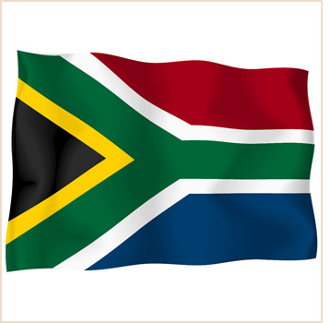
South Africa: Resistance and End to Apartheid

Slide 2
End of Apartheid
Apartheid: meaning “apartness”, was the system used by the South African white government to exploit and dominate the country’s black population.
Racial Segregation: From 1948-1994
Goal of Apartheid: Keep whites and blacks apart so that whites could control Africa’s wealth.

Slide 3
How was Apartheid achieved?
Although apartheid can be traced back to the colonization of the British it did not become law until 1948.
1948 elections, the National Party campaigned for the Apartheid Laws

Slide 4
Practice of Apartheid
1. Legislation passed prohibiting miscegenation (mixed-race marriage.)
2. Individuals were classified into different ethnic groups:
-White
-Black
-Asian
-Coloured (mixed race)
3. The Groups Area Act: 1950 designed to geographically separate the racial groups.

Slide 5
Homelands
The Black majority were forced to live in “homelands” that were largely without plumbing or electricity
Blacks would no longer be citizens of South Africa; rather they would become citizens of independent “homelands”.
About 13% of the land was divided into 10 homelands for blacks- 80% of the population
Homelands prevented non-white people from having a vote.

Slide 6
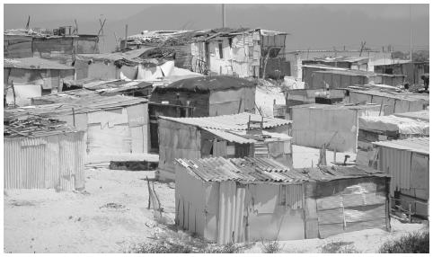
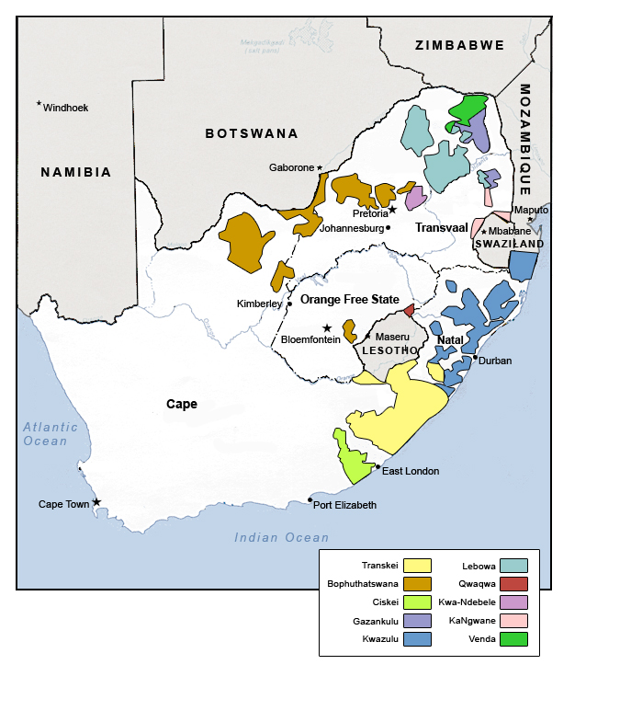
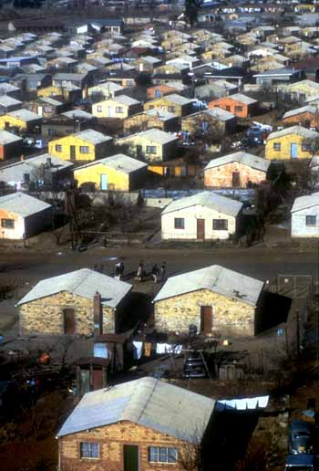

Slide 7
Separate but Equal? HARDLY!
Education, medical care, and other public services were sometimes claimed to be separate but equal, but those available to non-white people were inferior
Black people could not live or work in white areas unless they had a pass-nicknamed dompas (dumb pass in Afrikaans)

Slide 8
Apartheid Laws
Trains and buses were segregated.
Public beaches, libraries, swimming pools were racially segregated
Black people were not allowed to employ white people
Black police were not allowed to arrest whites
Cinemas and theaters in “white areas” were not allowed to admit blacks.
Taxis, graveyards, parks, pedestrian crossings, public toilets were also segregated

Slide 9
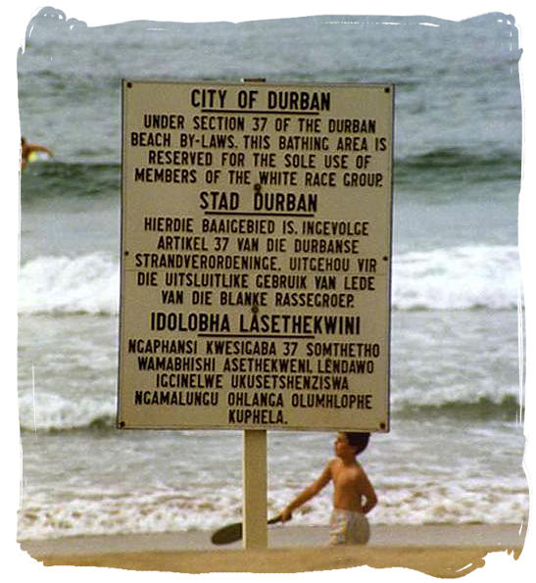
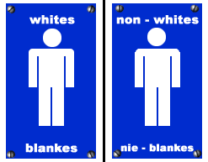

Slide 10
Passbooks
Colored people had to carry identity documents, which prevented them from migrating to white South Africa.
Black people were prohibited from living in or visiting ‘white towns’

Slide 11
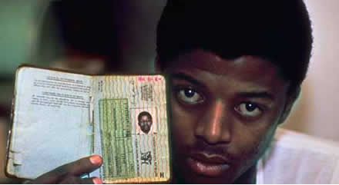

Slide 12
The ANC (African National Congress)
They advocated open resistance in the form of strikes, acts of public disobedience, and protest marches
They adopted a Freedom charter, which had a vision of non-racial democratic state

Slide 13
The Sharpeville Massacre
A group of ANC members broke away from the white government and formed the more militant Pan Africanist Congress (PAC)
They wanted to have a series of nationwide demonstrations against the apartheid laws.
In 1960, they gathered in a township called Sharpeville to protest against the ID cards.
The crowd converged on the local police station, singing and offering themselves up for arrest for not carrying their passbooks.

Slide 14
Sharpeville Massacre cont.
A group of 300 police opened fire on the demonstrators, killing 69 and injuring 186.
All victims were black and most had been shot in the back
The government then banned ANC and the PAC

Slide 15
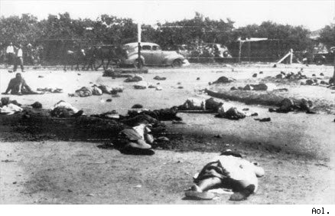

Slide 16
Resistance Underground
The ANC decided to take up armed resistance to the government
The Prime Minister declared a state of emergency and forces could jail people without a trial.
Over 18,000 demonstrators were arrested, including many leaders of the ANC and PAC
Together with ANC leader Nelson Mandela, they were charged with treason in 1964 and sentenced to life imprisonment.

Slide 17
Resistance
The trial condemned by the UN Security Council and the international community started to force sanctions against the South African Government
For example, they banned trade, which was an economic sanction.
Sports teams were banned from international competition
Tourism was boycotted

Slide 18
How did South Africans resist apartheid?
Through civil disobedience, strikes, boycotts, nonviolent demonstrations, armed struggle, and calling on the international community to withdraw investments from South Africa.

Slide 19
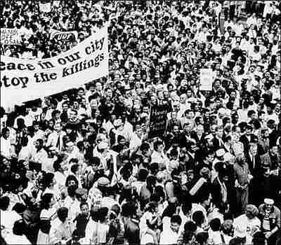

Slide 20
State of Emergency 1986-1990
1986, the South African government decided that the antiapartheid movement was threatening all-white rule and cracked down on resistance.
More than 20,000 people were arrested.
Resistance increased despite the harshness of the state of emergency.

Slide 21
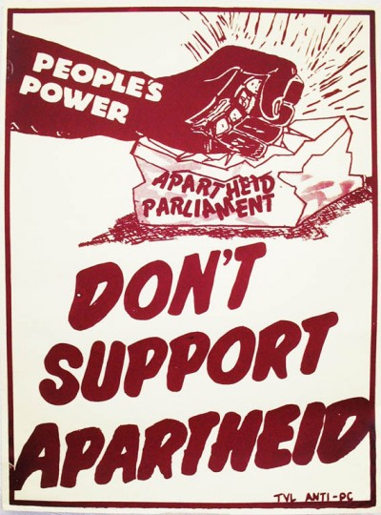

Slide 22
ANC (African National Congress)
In 1990 the government legalized the ANC, South Africa’s largest antiapartheid party.
The government released the the ANC party’s leaders from prison.

Slide 23
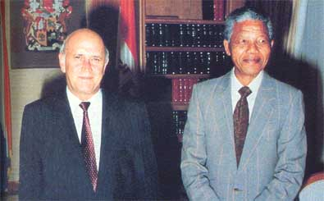
F.W. Clerk, South African President meets with Nelson Mandela, leader of the ANC.

Slide 24
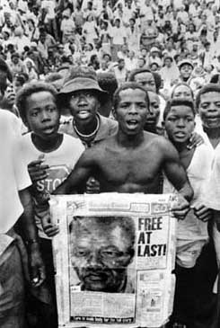
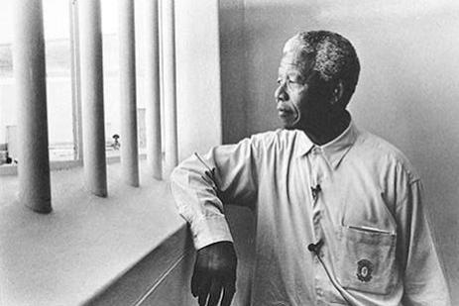
Nelson Mandela
Nelson Mandela was released from prison after serving 27 years for resisting apartheid.
Mandela was symbolic as the leader of antiapartheid resistance.

Slide 25
Culmination of Resistance: A True Democracy in South Africa
The South African government agreed to hold all-party elections in 1994.
Elections began April 27, 1994 and lasted for 5 days.

Slide 26
April 1994 Election Results
The ANC won 63% of the 20 million votes cast
Nelson Mandela elected as South Africa’s first black president.
By May 1996 the ANC and other South African parties agreed to write a new constitution

Slide 27
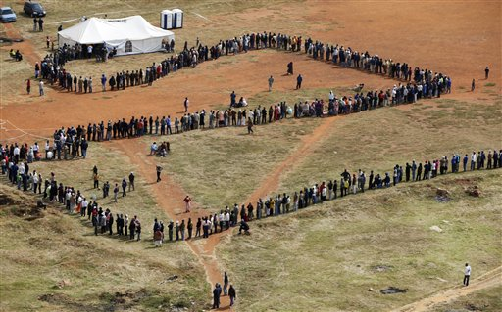
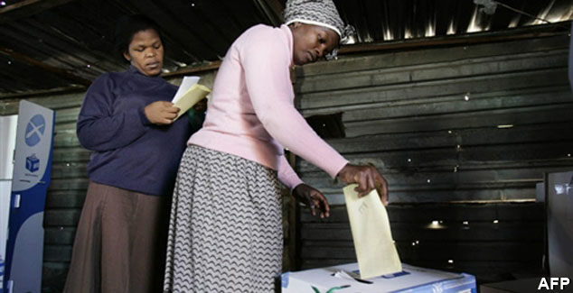

Slide 28
New Challenges for South Africa
Country still suffered from economic inequality
1996, the majority of the money, property and high level jobs were still in the hands of the white minority

