Slide 1
1970s Disco & Disappointment
Unit VIII
Do the Stagflation!

Slide 2
8.8: explain the various U.S. response to international developments caused by Cold War.
8.9: Explain the causes and effects of continuing policy debate about the role of the federal government over time.
Essential Question: How was America’s national identity transformed domestically and international, as a result of the Cold War era?
Students can:
Evaluate the rise of new liberalism influence American domestic policy both in the area of civil rights and the limited welfare state
Demonstrate how post WWII world transformed America socially, politically, and economically
Agenda
Distrust in Government
The Nixon Years
The Fight for Equality
Homework: The Age of Reagan

Slide 3
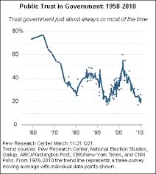
Do you trust U.S. Government
Public Opinion – Trust in the U.S. Government
Identify and explain TWO factors that support the trend in the public opinion poll.
How will this view influence American politics as the nation during the 1980s?

Slide 4
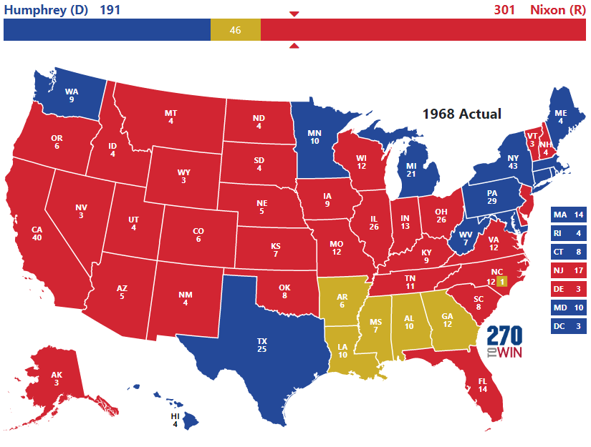
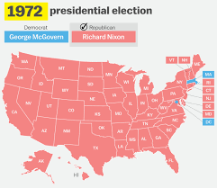
Political Realignment
Nixon’s transforms the solid south into Republican conservativism
Making the South Conservative!
Nixon’s “Silent Majority”
Election of 1972
Southern strategy: Rise of the conservative Republican south
Americans tired of civil rights, protest, liberal court, & excesses of the youth counterculture

Slide 5
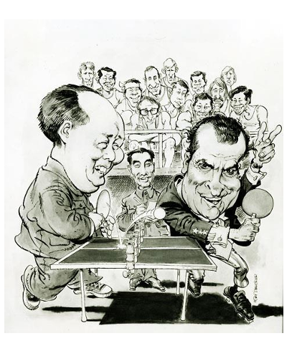
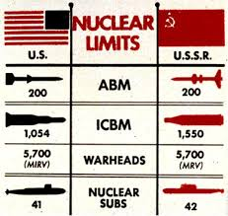
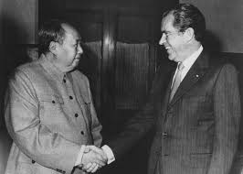
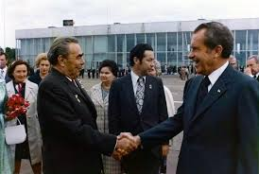
Cold War Change
New Cold War Strategy:
Détente: engage with communist countries through trade to lower tensions, and used rivalry between China & USSR against each other
That Forrest Gump can play!
Ping-Pong Diplomacy (1972)
Opens relations between the U.S. & China
U.S. formally recognizes China
US Moscow Summit (1972)
Nixon 1st president to visit Moscow
SALT I Treaty – Nuclear Arms reduction

Slide 6
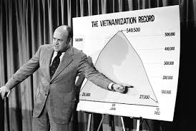
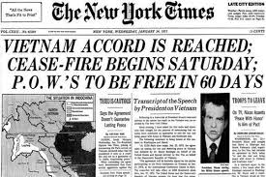
Vietnam Challenge
Vietnam Conflict – Peace with honor
Vietnamization Policy: draw down U.S. troops and turn the fighting over to the S. Vietnamese
Scandal:
My Lai Massacre 1968
Kent State Massacre 1970
Pentagon Papers 1970
End of Vietnam War – Paris Peace Accord 1973

Slide 7
New Federalism
The Burger Court
Roe v. Wade (legalized abortion)
U.S. v. Nixon – limits the power of the presidency (Watergate Scandal)
Swann v. CMS: Busing can be used to integrate schools
Challenging the Social Welfare State
New Federalism
Revenue sharing – used block grants to empower the states to handle social welfare
?
Environmental Policies
Clean Air & Water Act
Endanger Species Act
Affirmative Action
Philadelphia Plan

Slide 8
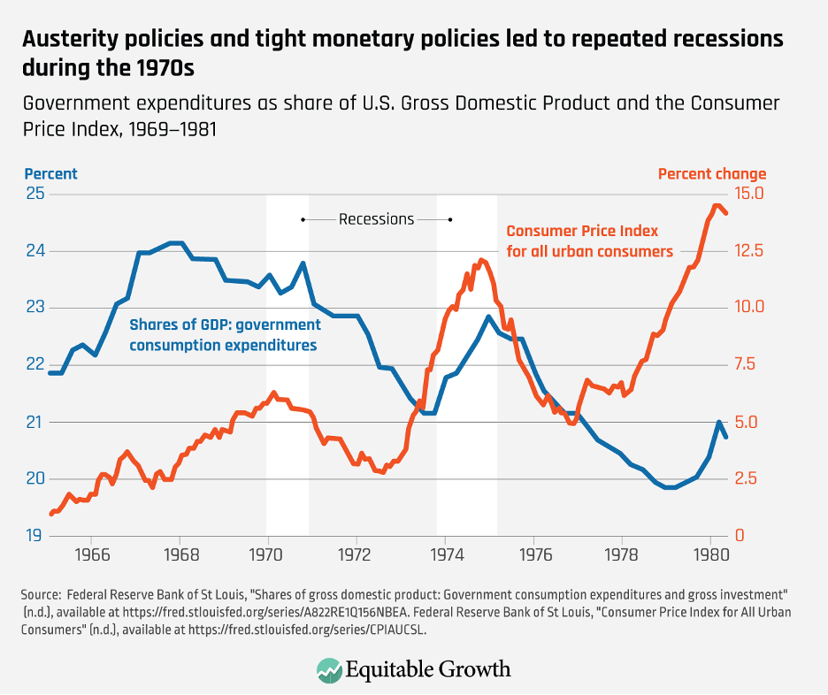
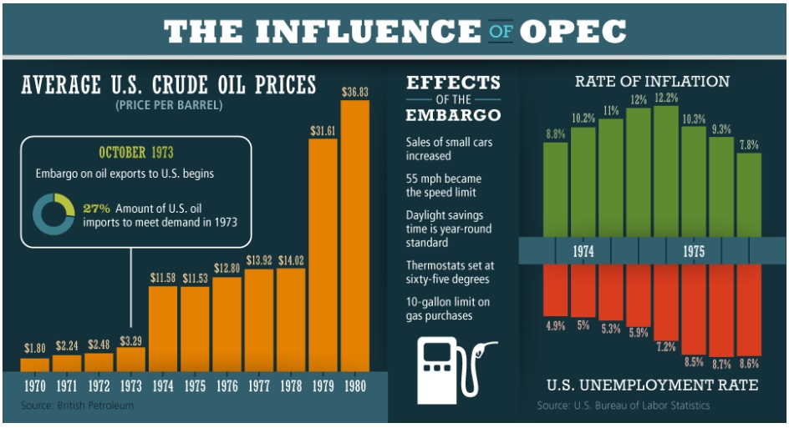
The Bust of a Boom Economy
End of prosperity
1970s American prosperity ends
Stagflation: a period of high inflation low economic growth
Cause: OPEC Oil Embargo
Nixon’s Response
90-day wage & price freeze
US dollar taken off the gold standard

Slide 9
A Conservative Revolution
Evaluate the historical contextualization that gave rise to a new conservative movement that culminated with the election of President Ronald Reagan in 1980 to determine which factor had the great influence on the time period.
Determine and explain which factor was the major reason for the development of the conservative revolution that culminated in the election of Ronal Reagan as President of the United States in 1980?
Growth of the Welfare State
Stagflation in the U.S. Economy
Civil Rights & Equality Movements
New Liberalism
Cold War Failures
Excesses of the Youth Counterculture
Distrust in American Government

Slide 10
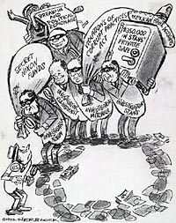
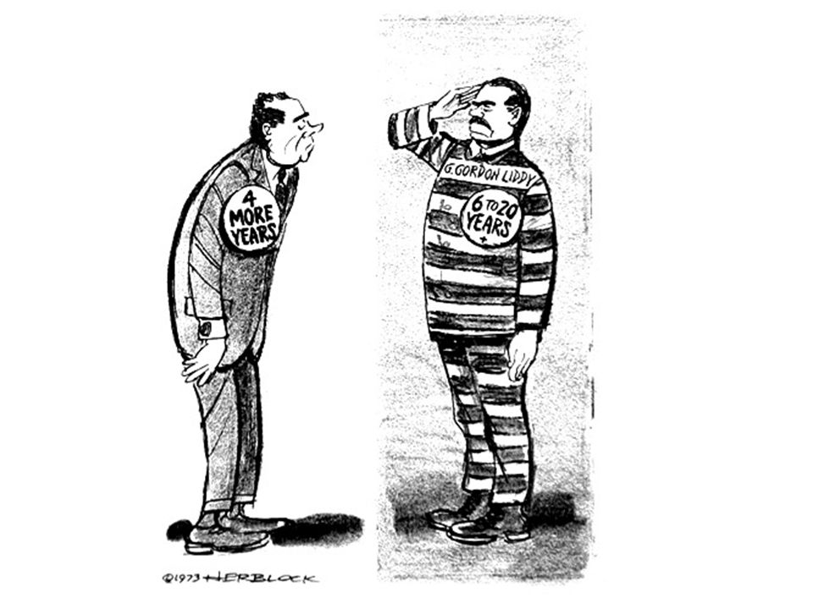
Scandal, Scandal, Scandal
Watergate Scandal 1972-1974
Watergate Break-in
Plumbers attempt to plant bugs in Democrat National Headquarters
CREEP – Committee to Re-elect the President

Slide 11
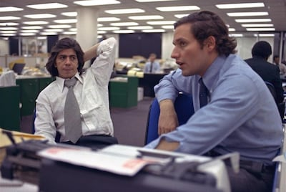
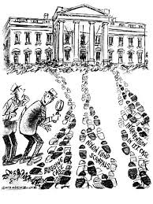
Power of Mass Media
Washington Post finds connection between Watergate break in & President Nixon
“The fact of the Watergate cover-up is not nearly as interesting as the step into making the cover-up. And when you understand the step, you understand that Richard Nixon lied. That he was a criminal.”
- Bob Woodward
Reporters Woodward & Bernstein
Deep Throat – secret FBI informant
Undercover – presidential coverup

Slide 12
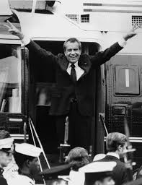
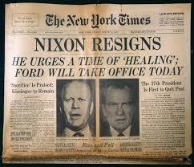
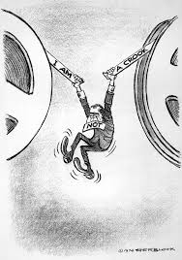
I am NOT a Crook!
President Nixon resigns 1974
I am NOT a CROOK!
Congress investigates Nixon coverup
Secret tapes of the Oval Office
U.S. v. Nixon – President can’t claim executive privileges to cover up crime

Slide 13
8.8: explain the various U.S. response to international developments caused by Cold War.
8.9: Explain the causes and effects of continuing policy debate about the role of the federal government over time.
Essential Question: How was America’s national identity transformed domestically and international, as a result of the Cold War era?
Students can:
Evaluate the rise of new liberalism influence American domestic policy both in the area of civil rights and the limited welfare state
Demonstrate how post WWII world transformed America socially, politically, and economically
Agenda
POV & Purpose
70s give rise to Moral Majority
Historic Contextualization for Conservative Revolution
Homework: Unit I Review Guide

Slide 14
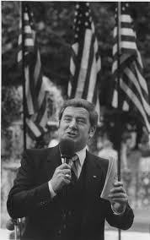
POV & Purpose
We must reverse the trend America finds herself in today. Young people between the ages of twenty-five and forty have been born and reared in a different world than Americans of years past. The television set has been their primary baby-sitter. From the television set they have learned situation ethics and immorality—they have learned a loss of respect for human life. They have learned to disrespect the family as God has established it. They have been educated in a public-school system that is permeated with secular humanism. They have been taught that the Bible is just another book of literature. They have been taught that there are no absolutes in our world today. They have been introduced to the drug culture. They have been reared by the family and the public school in a society that is greatly void of discipline and character-building. These same young people have been reared under the influence of a government that has taught them socialism and welfarism. They have been taught to believe that the world owes them a living whether they work or not.
- Jerry Falwell, television evangelist and founder of the Moral Majority, Listen, America!, 1980
Rev. Jerry Falwell

Slide 15
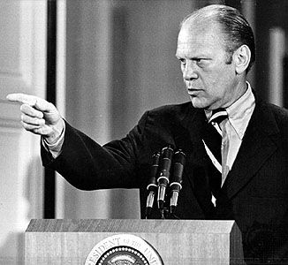
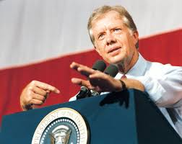
Ford & Carter Years
Presidents of the 1970s: Gerald Ford 1974-76 & Jimmy Carter 1976-80
My fellow Americans, our long national nightmare is over.”
My fellow Americans, I am a Washington outsider – not part of the corruption
38th President Gerald Ford (25th Amendment – succession)
Pardons Nixon (loses creditability with Americans
39th President Jimmy Carter
Washington outsider who does not know how earn Congressional support

Slide 16
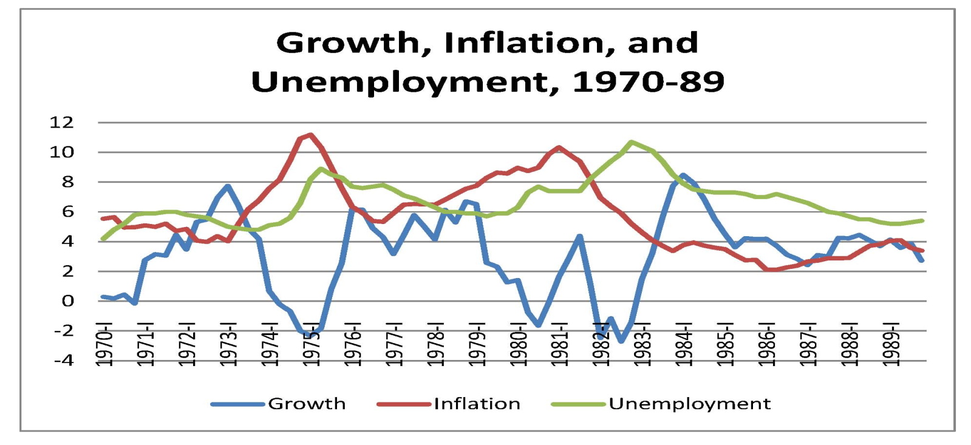
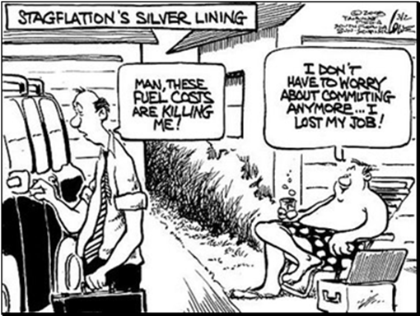
Stagflation Buries the U.S. Economy
Battling stagflation
President Ford
WHIP - (Ford’s whip inflation now) – grassroots initiative to encourage savings (FAILURE)
President Carter
Expand the money supply (cause inflation to worsen – Fed. Raises interest rate)
Conservation of energy

Slide 17
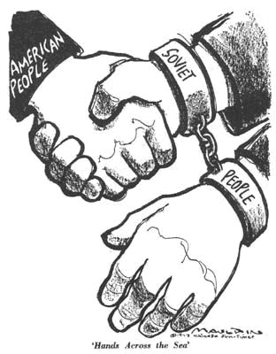
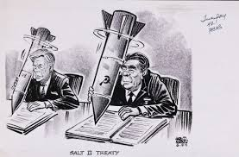
Cold War Failures
President Ford & Carter continue the policy of détente
Helsinki Accords: (Ford) recognize the Soviets eastern border, open more trade, & promise of Soviet reforms on human rights
SALT II (Carter) – Limits U.S. & Soviet nuclear arsenal
Congress fails to ratify the treaty
Panama Canal Treaty (returns Panama Canal to Panama 2000)
FAILED – No Human rights reform

Slide 18
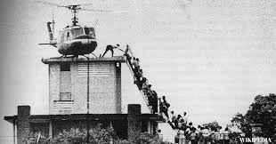
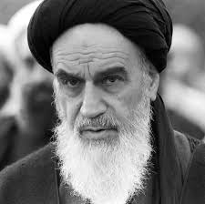
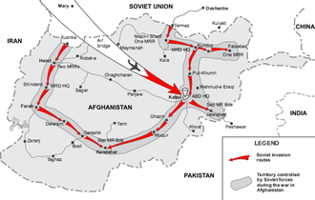
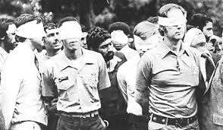
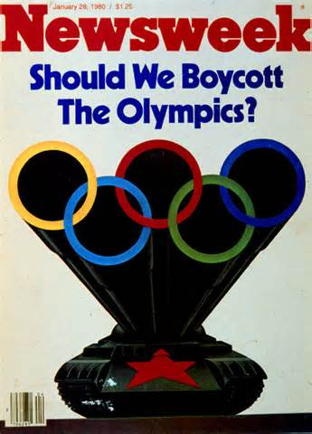
Further Damaging American Creditability
American responses weaken American foreign policy
Fall of Saigon (1975)
US containment failure
Iranian Hostage Crisis (1979)
Rise of the Ayatollah & Islamic state
50 American hostages held 444 days
Soviet Invasion of Afghanistan (1979)
U.S. boycotts the Moscow Olympics

Slide 19
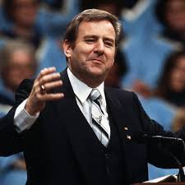
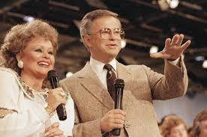
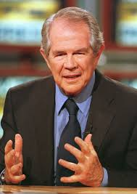
Evangelicals Call for Morality
Moral Majority Movement: Evangelical Christians
“The Bible is not just a book of stories, but a for how we should our lives.”
- Jerry Falwell
Rev. Jerry Falwell
Rev. Jim & Tammy Faye Baker – PTL Network
Rev. Pat Robertson – The 700 Club
Goals of the Moral Majority Movement
Focus on family values: prayer in school, nuclear family, end the sexual revolution
Challenge new liberalism: Pro-Life, Anti-gay rights

Slide 20
A Conservative Revolution
Evaluate the historical contextualization that gave rise to a new conservative movement that culminated with the election of President Ronald Reagan in 1980 to determine which factor had the great influence on the time period.
Determine and explain which factor was the major reason for the development of the conservative revolution that culminated in the election of Ronal Reagan as President of the United States in 1980?
Growth of the Welfare State
Stagflation in the U.S. Economy
Civil Rights & Equality Movements
New Liberalism
Cold War Failures
Excesses of the Youth Counterculture
Distrust in American Government

