Slide 1
Foraging a National Economy
1790-1860
Westward expansion & Industrialism
Antebellum Period 1820-1860

Slide 2
Agenda
Unit 4E: Explain the causes and effects of innovations in technology, agriculture, and commerce over time
4.2: Revolutions in commerce, innovation, agriculture, an d transportation influence efficiency in production
4.2 – II & III: Changes in the production of goods led to social transformation within the U.S.
Essential Question: How did the development of the market revolution dramatic alter the development of the United States from 1820 to 1860?
Students can:
Decipher how innovation was a primary factor in the development of a national economy
Evaluate social changes as a result of mechanization
Determine how economic development led to a division of labor and expansion
Agenda
Wiggin Out
The Post Jackson Effect
Jackson – Champ or Chump
Homework:
The Innovation Effect (Reading Quiz in class tomorrow)

Slide 3
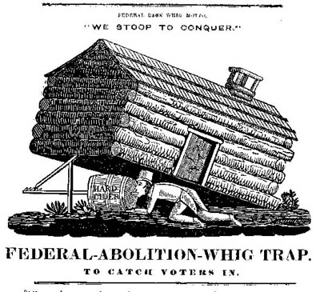
Getting Whigged Out
Explain the historic context of the “Log Cabin Hard Cider” campaign in 1840
Consider the factors that support Harrison’s campaign for president

Slide 4
Emergence of the two-party system
Two Party System – Impact of the Bank War
Democrats: Andrew Jackson, Martin Van Buren, & James K. Polk
Whigs: The Great Triumvirate – Henry Clay, John C. Calhoun, & Daniel Webster
 | Democrats 1832-1960 | Whigs 1832-1854
Major beliefs | State & local power Opposition to privilege & monopoly (no Banks & low tariffs) Opportunities for the Common Man (cheap land, Western expansion) Freedom from government interference | National power Economic development (internal improvements, Bank of the U.S., high tariffs) Social reform
Supporters | South & West Northeastern artisans & laborers Small farmers & plantation owners | New England, Mid-Atlantic, Midwest Wealthy and middling merchants Many middling farmers Some Large Southern planters

Slide 5
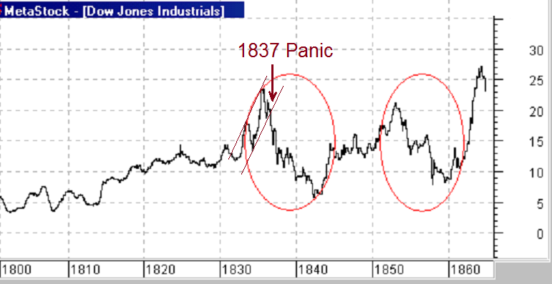
Panic of 1837
Explain contributing factors and impact of the Panic of 1837

Slide 6
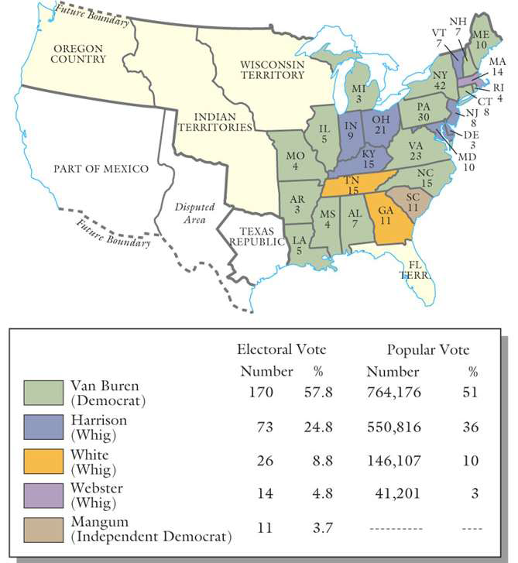
Election of 1836
Martin Van Buren “the Little Magician” elected
Weakness: riding Andrew Jackson’s coattails

Slide 7
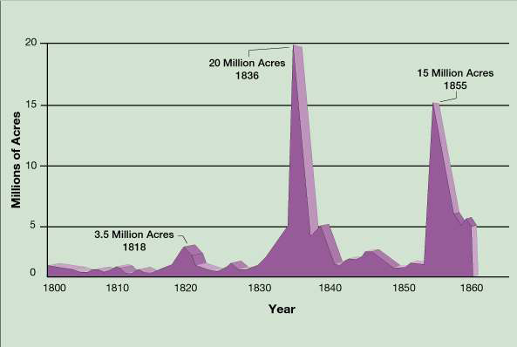
Panic of 1837
Contributing factors: land speculation, Bank War, wheat crop failure, and Specie Circular Law
Whigs: expand credit, raise tariffs, and subsidies for internal improvement
Divorce Bill (Van Buren) establishes the independent treasury

Slide 8
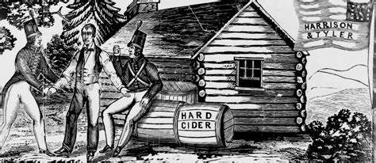
Election of 1840
President #9: William Harry Harrison (W) (dies 1 month into his presidency
President #10: John Tyler (W) rejects Whig ideas
Vetoes a re-chartering of the National Bank Bill

Slide 9
Andrew Jackson – Champ or Chump of the Commo Man
Prompt: Andrew Jackson presented himself a champion of the Common Man after the corrupt bargain denied him the presidency in 1824. To what extent did Andrew Jackson’s presidency live up to his claim?
CHAMP
CHUMP

Slide 10
Agenda
Essential Question: How did the development of the market revolution dramatic alter the development of the United States from 1820 to 1860?
Students can:
Decipher how innovation was a primary factor in the development of a national economy
Evaluate social changes as a result of mechanization
Determine how economic development led to a division of labor and expansion
Agenda
A Factor of Change
Factors of the Market Revolution
The Innovation Effect
Homework:
Objective 8 Question due 11/13
Quiz on Unit IV – 11/14

Slide 11
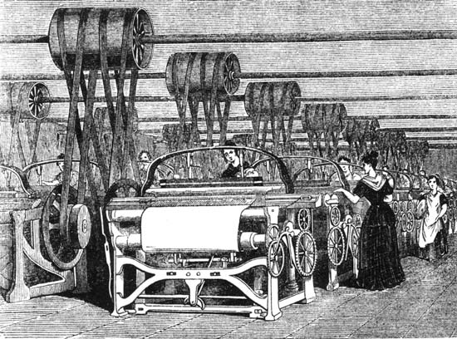
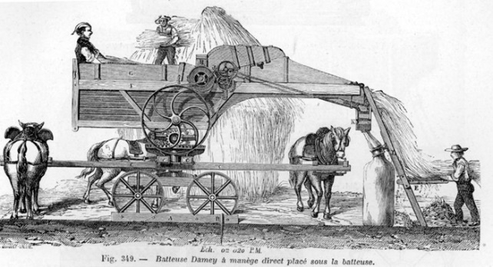
Forging a National Economy
Essential Question: How did the development of the market revolution dramatic alter the development of the United States from 1820 to 1850?

Slide 12
Regional Effect
Because they believe that the Tariff Law passed by Congress at the last session, and all other acts of which the principal object is the protection of manufactures, or any other branch of domestic industry, if they considered as the exercise of a supposed power in Congress to tax the people at its own good will and pleasure, and to apply the money raised to objects not specified in the Constitution, is a violation of these fundamental principles, a breach of a well-defined trust, and a perversion of the humble powers vested in the Federal Government for federal purposes only.
- S.C. Exposition and Protest, 1828 by JC Calhoun
Hipp Analysis
Explain how the development of the Market Revolution impacts sectionalism.

Slide 13
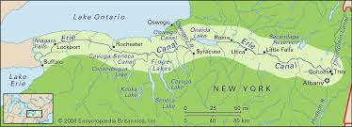
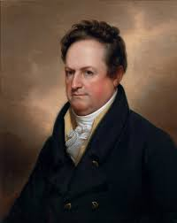
A Factor of Change
Explain how the development of the Erie Canal is leading factor in the Market Revolution from 1820 to 1850.
Clinton’s Ditch
How is it promoting economic change?
How is it promoting social change?

Slide 14
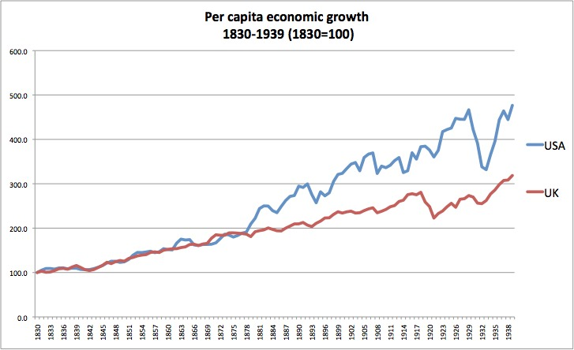
Contributing to a National Economy
Market Revolution – changing from subsistence farming and handmade goods to manufacturing and cash crop agriculture
Forging a national economy factors
Abundance of resources
Population growth (9M in 1820 → 30+M in 1860)
Innovation & mechanization
Internal improvements – canals & RRs
Innovation in banking & legal practices
Capital ($$) – from Europe (esp. England)
MARKET REVOLUTION
(not yet an industrial revolution)

Slide 15
US Economic Growth Factors

Slide 16
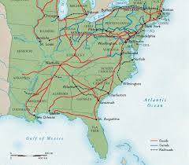
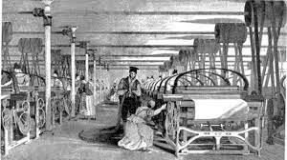
Economic Change Factors
Driving forces allowing for the Market Revolution
Innovation: new technology moves work from home to factory
Transportation Revolution connecting east to west
Agriculture Revolution: using technology to expand crop yields
Communication Revolution: using technology to send information faster

Slide 17
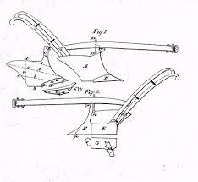
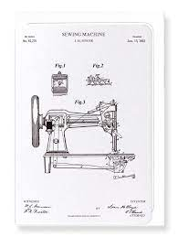
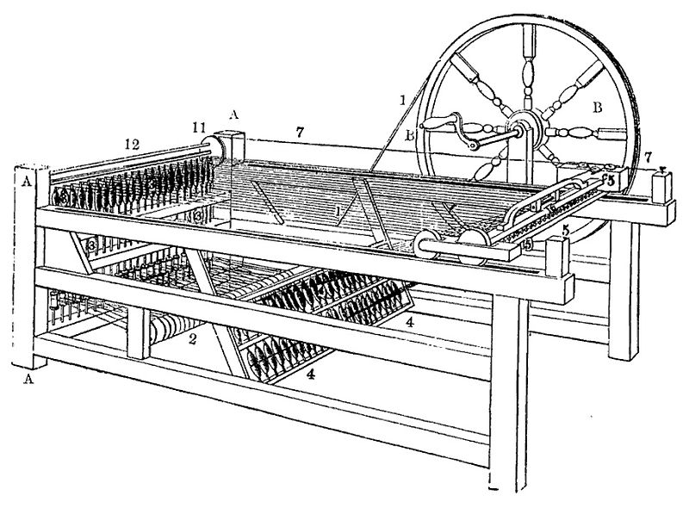
Protection of Property
The Congress shall have Power To promote the Progress of Science and useful Arts, by securing for limited Times to Authors and Inventors the exclusive Right to their respective Writings and Discoveries
- Article I, Section 8, Clause 8, U.S. Constitution
Patents: grants an inventor exclusive rights to own, produce and sell new technology
Patents Approved:
•1800: 41
•1860: 4,357
Sewing Machine
(Isaac Singer)
Steel Plow
(John Deere)
Spinning Jenny
(James Hargreaves)

Slide 18
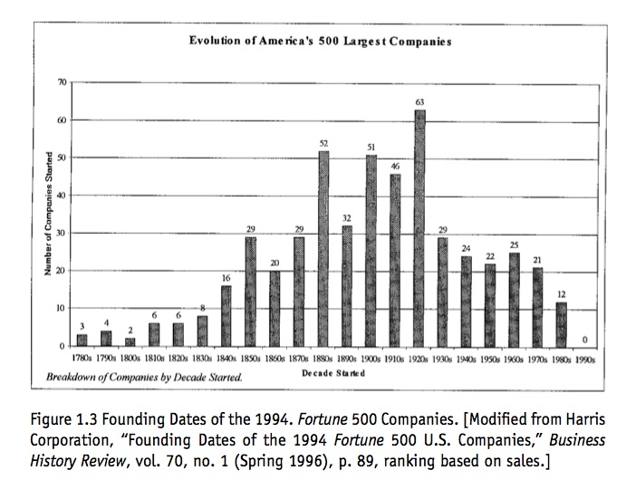
New Business form
New business structure: CORPORATIONS
States allowed to charter corporations
Advantages
Limited Liability (only risk what you invest)
Sell Stock (shares of ownership – raise capital quickly)
Growth of corporations: 1800 only 20 corporations – 1817 over 1800 corporations existed

Slide 19
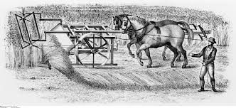
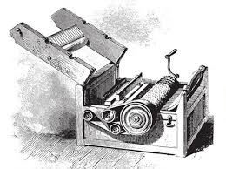
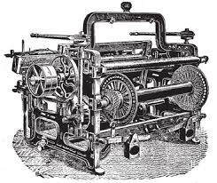
Innovations of the Market Revolution
Innovation is a primary factor for the rise of the Market Revolution and changes to the U.S. economy.
Explain how innovation transformed America during the Market Revolution.
Innovations
Cotton Gin
Steele Plow
Steam Engine
Mechanical Reaper
The Factory System
Spinning Jenny
Telegraph
For your assigned innovation
Inventor’s Name
Patent Holder:
Explanation of what the innovation actually does
Image
Answer the 4 questions

Slide 20
MEAL Plan
MEAL PLAN – HOW TO write body paragraphs in defense of a thesis
Topic sentence that re-states thesis claim and base that supports it
M = Main idea
Specific, relevant, and correct example that answer the question to support your
argument.
E = Evidence
Explain connections between evidence and thesis claim
A = Analysis
Answer how and why evidence/argument answers the question
L = Link

Slide 21
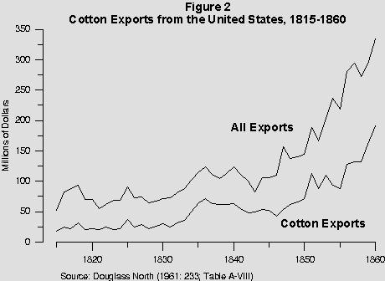
Economic output
Describe three factors that support the growth of the United States economy from 1820 to 1860 (Antebellum Period)?

Slide 22
The Innovation Effect
For each of the following regions identify an innovation and explain how it impacted the area during the market revolution from 1820 to 1850.
North
West
South

Slide 23
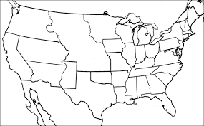
Regional Autopsy
Works in groups of 3 (Each person takes a region)
Dissect how the Market Revolution transformed the region (Both positively and negatively)
Major factor that drives the regions economy
Innovations that are important to the region
Why different revolutions were important to the region
Social/cultural impact
Three Regions:
North
South
West

Slide 24
Agenda
Essential Question: How did the development of the market revolution dramatic alter the development of the United States from 1820 to 1860?
Students can:
Decipher how innovation was a primary factor in the development of a national economy
Evaluate social changes as a result of mechanization
Determine how economic development led to a division of labor and expansion
Agenda
Unit 8 Reading Questions
Revolutions of the Market Revolution
A Sense of Unity
Homework:
Study for Jefferson through Jackson Quiz
Quiz on Unit IV – 11/14

Slide 25
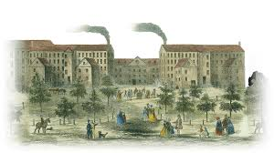
Revolutions of an Industrial Economy
The development of an industrial economy was built upon various changes. Examine how changes in the 1800s led to the creation of an industrial economy in the United States.
Agricultural Revolution
Labor Revolution
Transportation Revolution
Marginalization & Sectionalism
Market Revolution
Industrial Revolution

Slide 26
Transformation of the American Economy
Evaluate how the Market Revolution developed a sense of unity during the period 1800 to 1855.
Side 1 -
Side 2 -

Slide 27
Market Revolution

Slide 28
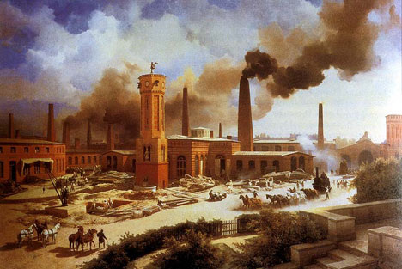
Industrialization
Factory System
Rise of Corporations
Technological Innovations
Labor
Old Northwest

Slide 29
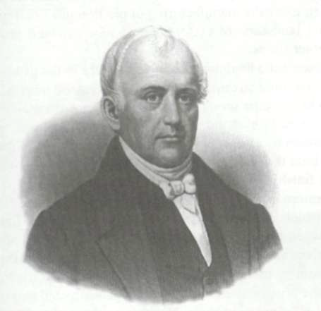
Slater’s Mill
Sam Slater with the backing of Moses Brown open the first textile mill in America
Creates cotton fiber shortage 1791
Eli Whitney’s Cotton Gin 1793
King Cotton
Northern industrialization
Father of the Factory System

Slide 30
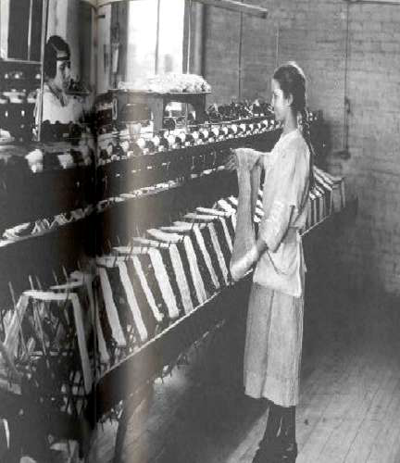
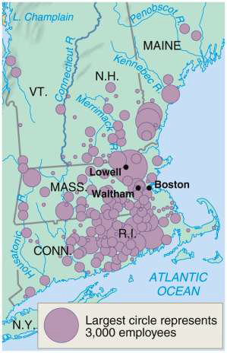
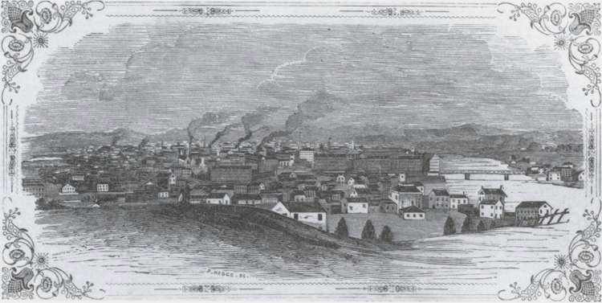
Lowell or Waltham Factory System
Francis Cabot Lowell
1st Dual-purpose textile plant
2 other innovations
Lowell Girls – female factory labor
Factory towns – Factory established dormitories and stores (Keeps them carefully guarded – “the weaker sex”)
Lowell, Mass 1850

Slide 31
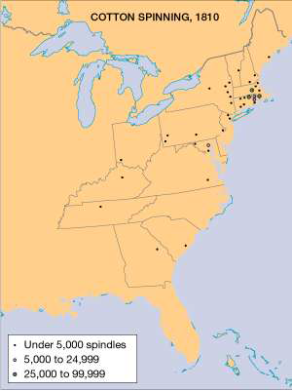
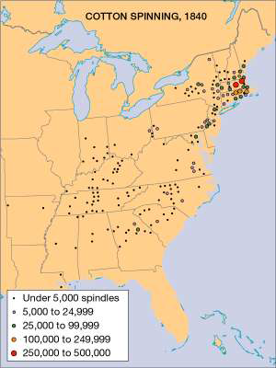
Rise of Textiles

Slide 32
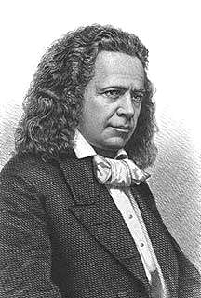
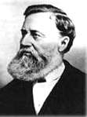
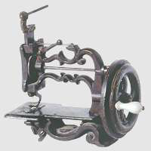
Textile innovation
Elias Howe and Isaac Singer’s Sewing Machine
Sewing Machine 1840

Slide 33
Transportation Revolution

Slide 34
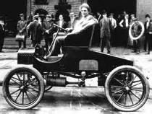
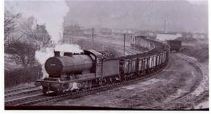
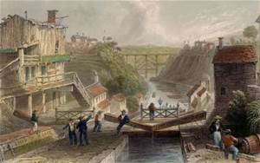
Transportation Revolutions in America
Turnpike & River Era 1790s – 1820s
Canal Era 1825-1840s
Railroad Era 1850s-1940s
Automobile Era 1920s to present
Airplane Era 1960s to present

Slide 35
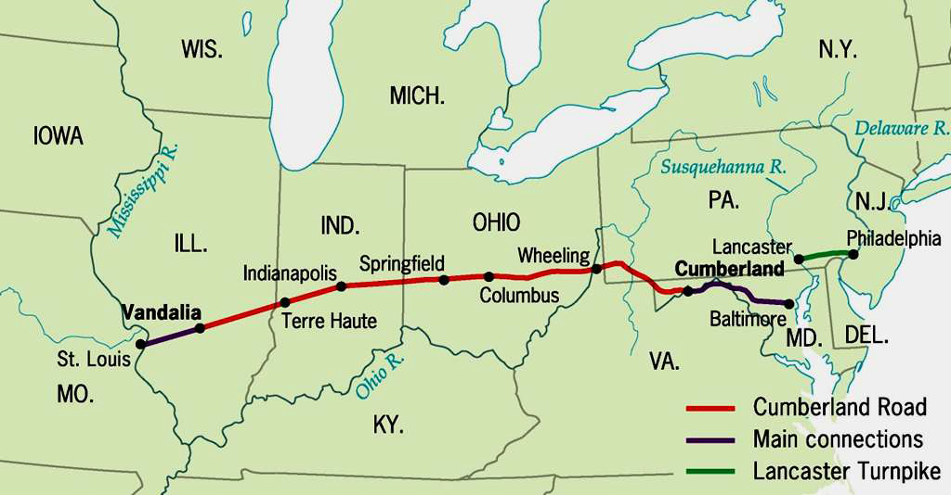
Road Revolution
Turnpikes and roads (Lancaster turnpike & Cumberland Road)
Mayesville Road veto by Jackson – states primary builder

Slide 36
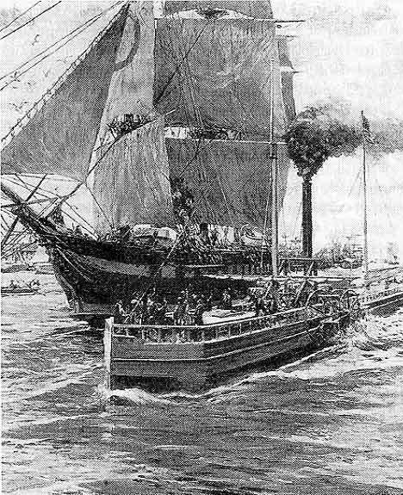
Steam technology
Robert Fulton’s steamboat (The Clermont -1807)
Advantages
River commerce a tow way street
Speeds up commerce (Replaces the
Yankee clipper ship for overseas travel)
Robert Fulton’s Clermont plies the Hudson River

Slide 37
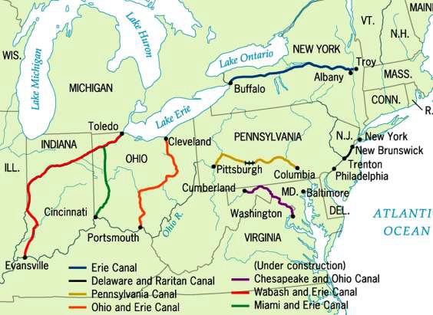
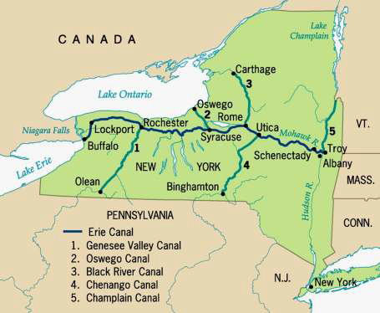
Erie Canal 1825 “Clinton’s Ditch”
Significance:
Decrease of trade
New York City becomes a central hub for commerce
Allows for greater settlement of the NW
Leads to a canal boom
Principal Canals in 1840

Slide 38
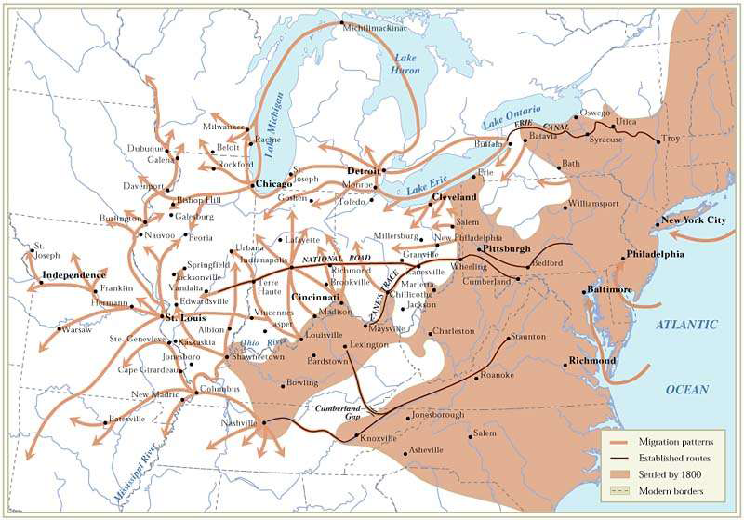
Migration patterns post 1800s

Slide 39
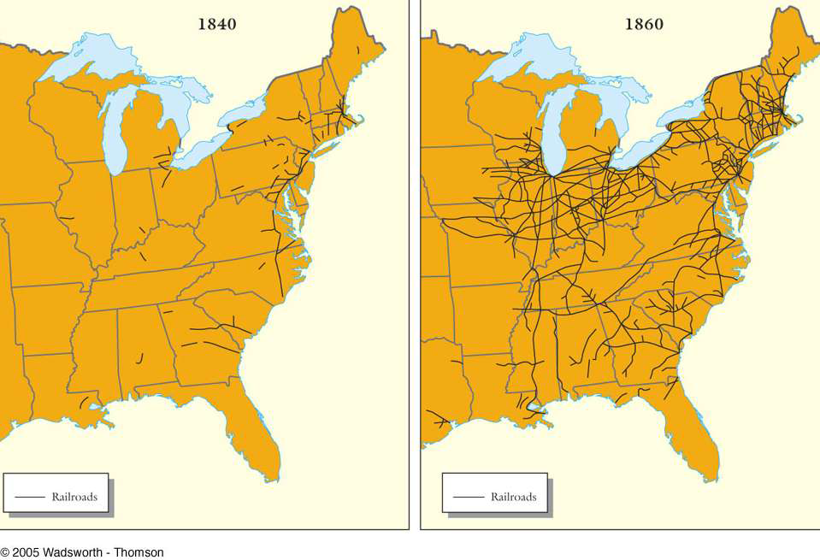
The Iron Horse
1830 rise of the railroads
Doesn’t impact the US until 1850’s & 60’s
Predominantly built in the North
Weaken canal traffic

Slide 40
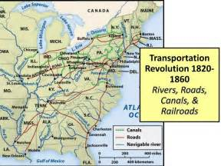
Connecting East to West

Slide 41
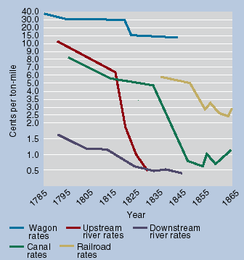
Transportation Revolution yields Market Revolution
Impacts
Reduction of freight charges
Promotes other industries (coal, iron, telegraph)
Binds East to West (West to NE)
Southern isolationism
Rise of the corporation
Division of labor
South – cash crop farming
North – manufacturing
West – grain & livestock

Slide 42
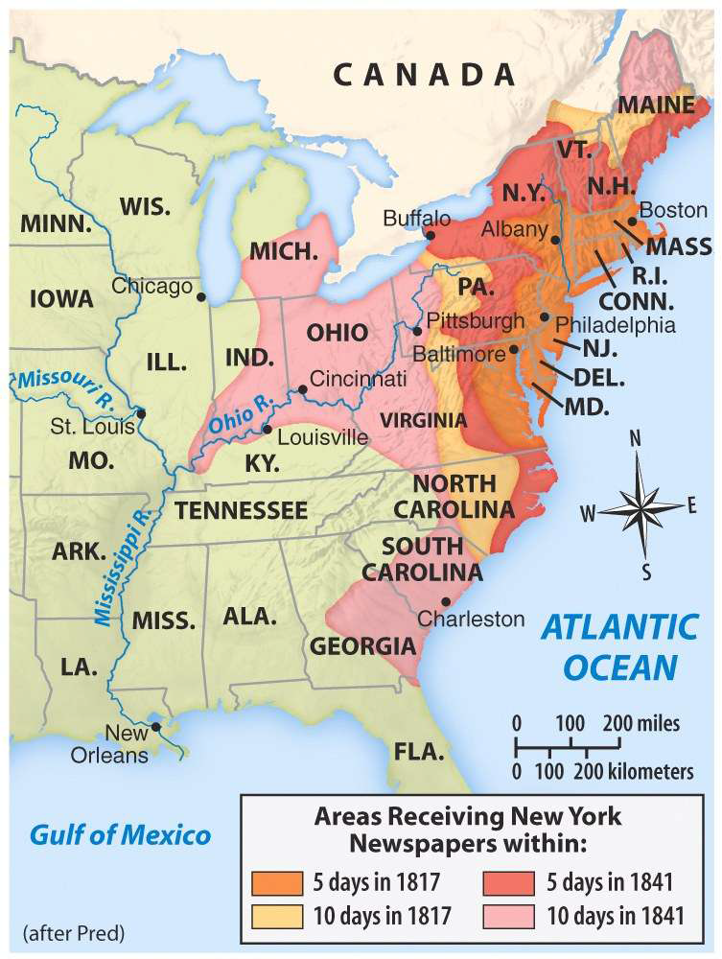
Communication Revolution
Telegraph “Talking Wire” by Samuel Morse
Trans-Atlantic Line by Cyrus Fields 1858

Slide 43
Agriculture Revolution

Slide 44
Agricultural Revolution

Slide 45
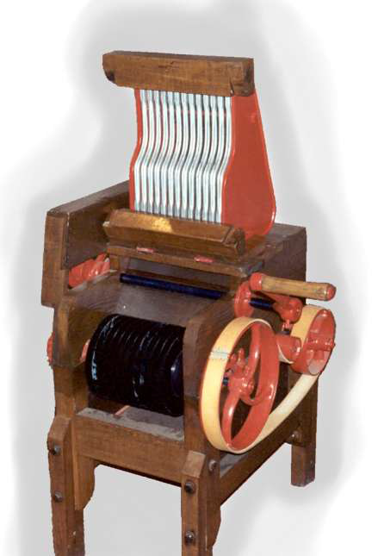
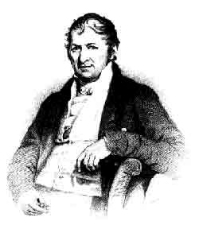
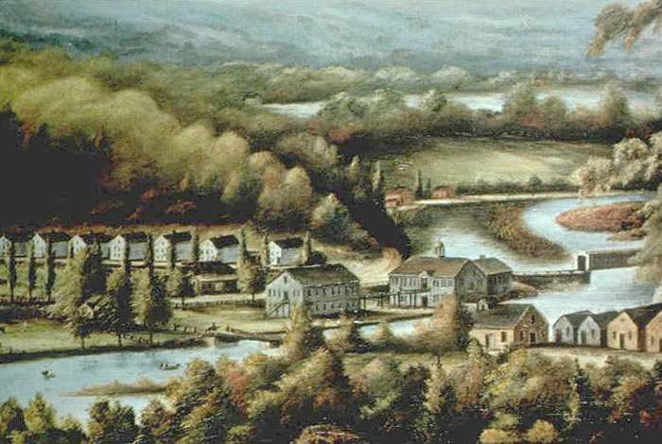
Eli Whitney
Cotton Gin 1791 (sectionalism)
Interchangeable Parts 1801

Slide 46
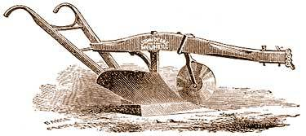
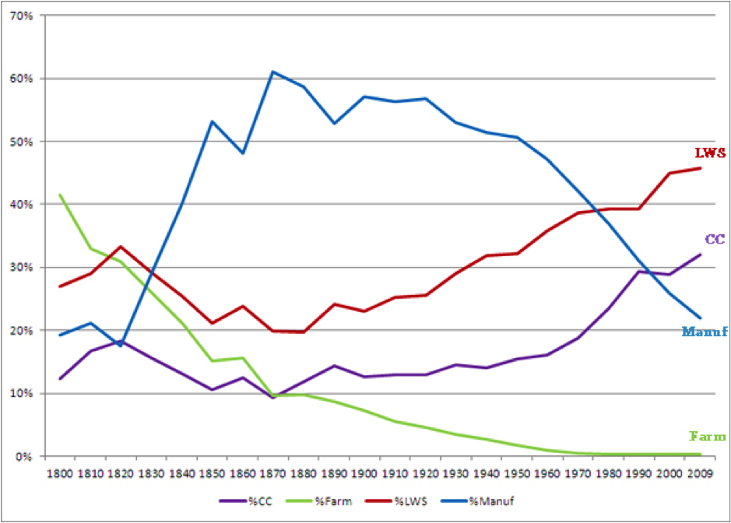
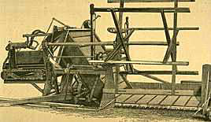
Agriculture Innovations
John Deere’s - Steele plow
Cyrus McCormick’s - Mechanical reaper
Transformation from subsistence farming to crash crop production

Slide 47
Birth of the Corporation
Corporations
– In 1800, c. 20 corps US; by 1817, over 1800
– General incorporation laws (Limited Liability Corporation)
• New York, 1848
– stock
– limited liability – protects the investor
Banking – paper banknotes
Impact – unequal distribution of wealth
Boston 1845 – 45 of the population owns 65% of the wealth
Philadelphia 1860 – top 1% own over 50% of wealth

Slide 48
Agenda
Essential Question: How did the development of the market revolution dramatic alter the development of the United States from 1820 to 1860?
Students can:
Decipher how innovation was a primary factor in the development of a national economy
Evaluate social changes as a result of mechanization
Determine how economic development led to a division of labor and expansion
Agenda
Immigrant Song
Irish & German Impact
The Innovation Effect
Homework:
Objective 8 Question due 11/13
Quiz on Unit IV – 11/14

Slide 49
Compare Perspectives
“America with us bears the character of the land of freedom and of liberty and is accounted like the land of promise flowing with milk and honey. Thus how desirable would such a place be to those laboring under Egyptian bondage increasing and seemingly to increase every day without the smallest gleam of hope. Such is the state of this Countrey and such are our sentiments with respect to America. Now my desire is that you would Substantiate your former proposal & by some means or other procure me an entrance into that land of happiness where I might by industry obtain a competence in life without being dependent on the mercenary and covetous for a miserable and wretched support;”
- Miller, Schrier, Boling, Doyle 46-47
Why were their two different views of immigration during the Market Revolution?

Slide 50
Population Growth in America
1775 - 2.5 Million
1790 - 4 Million
1820 - 10 Million
1840 - 17 Million
1860 - 32 Million
Immigration: 48ers (Germans) & Black Forties (Irish)

Slide 51
Coming to America
Immigration - major groups
Irish (Black Forties – potato famine)
German (48ers – Revolution in German)
English
What factors contribute to them coming to America?
Where are they settling?
Factors of Immigration
Steamboat (cheaper & faster transportation)
Overpopulation in Europe
Famine & Revolutions
America Dream

Slide 52
1860 US Population

Slide 53
Irish and German Demographics in NY

Slide 54
Immigrants NOT Welcome
Rise of NATIVISM (anti-immigration attitude)
Issues with immigrants:
Create job competition
Cultural differences (Alcoholics)
Anti-Catholic sentiment (Loyalty to the Pope)
Popularizing Nativism
“Awful Disclosure” by Maria Monk
The Order of the Star Spangle Banner
The Know-Nothing Party (3rd Party)

Slide 55
Innovations of the Market Revolution
Innovation is a primary factor for the rise of the Market Revolution and changes to the U.S. economy.
Explain how innovation transformed America during the Market Revolution.
Innovations
Cotton Gin
Steele Plow
Steam Engine
Mechanical Reaper
The Factory System
Spinning Jenny
Telegraph
For your assigned innovation
Inventor’s Name
Patent Holder:
Explanation of what the innovation actually does
Image
Answer the 4 questions

Slide 56
MEAL Plan
MEAL PLAN – HOW TO write body paragraphs in defense of a thesis
Topic sentence that re-states thesis claim and base that supports it
M = Main idea
Specific, relevant, and correct example that answer the question to support your
argument.
E = Evidence
Explain connections between evidence and thesis claim
A = Analysis
Answer how and why evidence/argument answers the question
L = Link

Slide 57
Agenda
Essential Question: How did the development of the market revolution dramatic alter the development of the United States from 1820 to 1860?
Students can:
Decipher how innovation was a primary factor in the development of a national economy
Evaluate social changes as a result of mechanization
Determine how economic development led to a division of labor and expansion
Agenda
Quick Review – Jefferson - Jackson
Quiz – Jefferson to Jackson
A Sense of Unity
Homework:
Objective 9 Reading Questions due 11/21

Slide 58
Agenda
Essential Question: How did the development of the market revolution dramatic alter the development of the United States from 1820 to 1860?
Students can:
Decipher how innovation was a primary factor in the development of a national economy
Evaluate social changes as a result of mechanization
Determine how economic development led to a division of labor and expansion
Agenda
A Sense of Unity
Women in the workforce
In Defense of Women
Homework:
Objective 9 Reading Questions due 11/21

Slide 59
Revolutions of an Industrial Economy
The development of an industrial economy was built upon various changes. Examine how changes in the 1800s led to the creation of an industrial economy in the United States.
Agricultural Revolution
Labor Revolution
Transportation Revolution
Marginalization & Sectionalism
Market Revolution
Industrial Revolution

Slide 60
Transformation of the American Economy
Evaluate how the Market Revolution developed a sense of unity during the period 1800 to 1855.
Side 1 -
Side 2 -

Slide 61
New Opportunity
The Lowell System (Francis Cabot Lowell)
Lowell Girls (Factory Girls) opportunity for women to enter the work force
Earn $$ for marriage or secondary income for parents
Factory towns (Waltham System)– Factory established dormitories and stores (Keeps them carefully guarded – “the weaker sex”)
Susan B. Anthony

Slide 62
Transformation of Women
Market Revolution effects
Manufacturing replaces some tasks for women (ex. Clothes making)
Decrease in # of children
Empowers Women
Economic independence (Lowell Girls & Teaching)
Domestic Feminism (more say in raising children)
Republican motherhood (teaches of democracy & morality)
Weaker Sex
Cult of Domesticity – married women’s place is in the home (Separate Spheres)
Occupations of Women Wage
Earners in Massachusetts, 1837

Slide 63
Women of the 1800s
Thesis: Although the continuance of slavery and societal expectation of subservices to men persisted in American culture (Counterclaim), the rise of sectional ideas of the Market Revolution (Base 1) and antebellum reform (Base 2) greatly changed perceptions of women in the North, South, and the West. (CLAIM)

Slide 64
Women of the 1800s
Main ideas about the life of women in the Market Revolution
- Slavery: Incidents from the Life of a Slave Girl
Facts in the document:
Implied facts that explain the document:
Point of View of the document:
Explain how it defends the thesis claim:

Slide 65
MEAL Plan
MEAL PLAN – HOW TO write body paragraphs in defense of a thesis
Topic sentence that re-states thesis claim and base that supports it
M = Main idea
Specific, relevant, and correct example that answer the question to support your
argument.
E = Evidence
Explain connections between evidence and thesis claim
A = Analysis
Answer how and why evidence/argument answers the question
L = Link

Slide 66
HIPP Document
Dear Sabrina,
. . . You have been informed I suppose that I am a factory girl and that I am at Natasha and I have wished you were here too but I suppose your mother would think it far beneath [sic] your dignity to be a factory girl. Their [sic] are very many young Ladies at work in the factories that have given up millinery [sic] dressmaking & school keeping for to work in the mill. But I would not advise any one to do it for I was so sick of it at first, I wished a factory had never been thought of. But the longer I stay the better I like it and I think nothing unforeseen [sic] calls me away I shall stay here till fall. . . . If you should have any idea of working in the factory, I will do the best, I can to get you a place with us. We have an excellent boarding place. We board with a family with whom [sic] I was acquainted with when I lived at Haverhill. Pleas [sic] write us soon and believe your affectionate Aunt
Malenda M. Edwards
Evaluate the Point of View of the document.
What facts are implied in the documents

Slide 67
Regional Autopsy
Works in groups of 3 (Each person takes a region)
Dissect how the Market Revolution transformed the region (Both positively and negatively)
Major factor that drives the regions economy
Innovations that are important to the region
Why different revolutions were important to the region
Social/cultural impact
Three Regions:
North
South
West

Slide 68
Agenda
Essential Question: How did the development of the market revolution dramatic alter the development of the United States from 1820 to 1860?
Students can:
Decipher how innovation was a primary factor in the development of a national economy
Evaluate social changes as a result of mechanization
Determine how economic development led to a division of labor and expansion
Agenda
HIP Practice
Transformation in the Workforce
In Defense of Women
Homework:
Objective 9 Reading Questions due 11/21

Slide 69
Labor Transformation
“One of the first strikes of cotton-factory operatives that ever took place in this country was that in Lowell, in October 1836. When it was announced that the wages were to be cut down, great indignation was felt, and it was decided to strike, en masse [as a whole]. This was done. The mills were shut down, and the girls went in procession from their several corporations . . . and listened to ‘incendiary’ [radical] speeches from early labor reformers.
“One of the girls stood on a pump, and gave vent to the feelings of her companions in a neat speech, declaring that it was their duty to resist all attempts at cutting down the wages. This was the first time a woman had spoken in public in Lowell, and the event caused surprise and consternation among her audience.”
Harriet Hanson Robinson, later recollections of a strike in Lowell, Massachusetts, in 1836, published in Loom and Spindle or Life Among the Early Mill Girls
Explain the point of view of the excerpt
Describe how the change from the putting out system to mass production has impacted labor in the Northeast.

Slide 70
Market Revolution Mass Production
Labor Transformation during the Market Revolution
Innovation Changes Labor
From skilled labor to unskilled labor
From putting out system to mass production
From working in the home to working in the factory
Opportunities to expand workforce

Slide 71
Fight for Labor Rights
The Factory = Slave Master
Puts skilled works v. unskilled workers
Exploitation of labor “wage slave”
Unsafe working conditions – Ex. Child labor, long hours, etc.
No job security
Labor Unions (relatively weak)
Labor Union victories:
Mill Girls Strike 1828
Commonwealth v. Hunt (1842) – legalized unions (state case)
Why are labor union weak during the market revolution?

Slide 72
Change to Society
The market economy changed:
class structure
The nature and location of work
Gender roles (Middle class)
the standard of living
Social Class structure
Working class
Rise of the middle class
Geographic mobility
Wealthy
Middle
Working
Lower
Evaluate whether there was social mobility during the period from 1800 to 1850?
Where do farmers fit?

Slide 73
Women of the 1800s
Thesis: Although the continuance of slavery and societal expectation of subservices to men persisted in American culture (Counterclaim), the rise of sectional ideas of the Market Revolution (Base 1) and antebellum reform (Base 2) greatly changed perceptions of women in the North, South, and the West. (CLAIM)

Slide 74
MEAL Plan
MEAL PLAN – HOW TO write body paragraphs in defense of a thesis
Topic sentence that re-states thesis claim and base that supports it
M = Main idea
Specific, relevant, and correct example that answer the question to support your
argument.
E = Evidence
Explain connections between evidence and thesis claim
A = Analysis
Answer how and why evidence/argument answers the question
L = Link

Slide 75
Sample MEAL Plan Paragraph
Manifest Destiny expanded sectional tensions by furthering violence over the debate of free states versus slave states. (main idea) Stephen Douglas’ Kansas-Nebraska Acts in 1854 introduced the concept of popular sovereignty to resolve on going debates of slave versus free states. It allowed voters within the territory to determine whether a state constitution would support the institution of slavery. (HIPP) But violence erupted as free soiler settlers rushed to Kansas to prevent the expansion of slavery. Soon battles between free soilers, such as John Brown, and border ruffians from Missouri who illegally voted in Kansas to expand the slavery. Therefore westward expansion caused violence to erupt over the issue of the expansion of slavery. (Link evidence to claim)

Slide 76
Agenda
Essential Question: How did the development of the market revolution dramatic alter the development of the United States from 1820 to 1860?
Students can:
Decipher how innovation was a primary factor in the development of a national economy
Evaluate social changes as a result of mechanization
Determine how economic development led to a division of labor and expansion
Agenda
Rise of Slave Population
African Americans X factor
African Americans in the Early Republic
Jackson SAQ re-writes
Homework:
Objective 9 Reading Questions due 11/21

Slide 77
Rise of Slavery
Hipp the document – Explain the trend displayed by the document

Slide 78
African American Population
African American population in the early 1800s
Freed population
North – faced discrimination and cannot vote
South – purchased freedom or emancipated (faced discrimination)

Slide 79
Southern Slave Resistance
Acts of Resistance
Work slow downs: tool sabotage
Runaway: inspired by the Bible & Missouri Compromise
Underground Railroad
Rebellion: Slave Revolts
Prosser’s Rebellion 1800
Vesey Rebellion 1822
Nat Turner Rebellion 1831

Slide 80
Regional Autopsy
Works in groups of 3 (Each person takes a region)
Dissect how the Market Revolution transformed the region (Both positively and negatively)
Major factor that drives the regions economy
Innovations that are important to the region
Why different revolutions were important to the region
Social/cultural impact
Three Regions:
North
South
West

Slide 81
The Immigration Question
From 1800-1850 America saw a dramatic increase of immigration. Evaluate its impact on this time period by creating two perspectives.
Immigration Builds America | Nativists
Support facts and ideas | Support facts and ideas
1 document APPARTs break down | 1 document APPARTs break down
Argument thesis | Argument thesis

Slide 82
Immigrant Settlers
Factors for immigration:
Overpopulation in Europe
Religious freedom
Opportunity
No aristocracy
Transportation – steam ships
Impact of immigration:
Cultural changes: abolition, Christmas tree
Labor force for industrialization
Nativism: Order of the Star Spangle Banner, Know Nothing Party

Slide 83
Changes to Society
Work & Home
Lower birthrates
“Separate Spheres”
end of cottage industry
new gender roles
“cult of domesticity”
employment opportunities
Education of women
Oberlin College
Occupations of Women Wage
Earners in Massachusetts, 1837

Slide 84
Change in the Antebellum Period
Antebellum Period 1815 to 1860 (Pre-Civil War Period)
Prompt: Analyze the impact of the market revolution (1815-1860) on the economies of two of the following regions: Northeast, Midwest, South.
Economic Change
Political Change
Social Change

Slide 85
Expansionism
Rugged Individualism: (Self Reliance)

Slide 86
Market Revolution Ripple
Choose ONE of the following and explain how your choice had an impact on America during the Antebellum Period from 1815 – 1860.
Factory System
Innovation
Immigration
Boom & Bust Cycle

Slide 87
Frontier Life
“Rugged Individualism” – Frontier requires strength to forge
Difficult to survive on the frontier
Influences Herman Melville and Ralph Emerson’s idea of self-reliance

Slide 88
Nationalism
American landscape – unique characteristic of beauty
George Catlin: painter and student of Native American life who was among the first Americans to advocate the preservation of nature; proposed the idea of a national park

Slide 89
Ecological Imperialism
Settlers impact
Tobacco depleting soil farmers move west
Fur trade (Beaver, Buffalo, Sea Otter) destroyed

Slide 90
Life in America
Rugged individualism – forging your own life based on hard work
Literary theme of American life: Ralph Waldo Emerson (Transcendentalism – self reliance) James Fenimore Copper (Leatherstocking Tales) & Herman Melville (Moby Dick)
Environmentalism: Fur trapping & “land butchery” vs. George Catlin: Yellow Stone Nation Park
George Catlin Paintings
Destruction of the Buffalo

Slide 91
Sectional economy
Describe two factors that helped maintain the Southern agrarian economy?
Explain two advantages that lead the North to industrialize.
Its beautiful bolls, And bales of rich value, the Master controls. Of “mud-stills” he prates, and would haughtily bring The world to acknowledge that “Cotton is King.”
–The Gospel of Slavery, by “Iron Gray,” [Abel C. Thomas] 1864.

Slide 92
Free Response Question
The United States undergoes a major transformation from 1800 to 1850 that will forage a national economy.
Explain two major transformation that happened from 1800 – 1850 that will lead to the formation of national economy
Identify and explain one negative aspect of America’s formation of a national economy

Slide 93
Guiding Question
“Throughout its history, the United States has been a land of refuge and opportunity for immigrants.”
Assess the validity of this statement in view of the experiences of the English, Germans, & the Irish in the 19thcentury urban Northeast.

Slide 94
Factors that Influence

Slide 95
Agenda
Essential Question: How did the development of the market revolution dramatic alter the development of the United States from 1820 to 1860?
Students can:
Decipher how innovation was a primary factor in the development of a national economy
Evaluate social changes as a result of mechanization
Determine how economic development led to a division of labor and expansion
Agenda
Westward Expansion
Building the west
Autopsy of American Economy
Homework:
Read pages 309-319 Changing America in the Market Revolution

Slide 96
Market Revolution Transformative Effect
Market Revolution Change
Political
Area
Economic
Intellectual
Religious
Social

Slide 97
A Regional Effect
Based on your region
Explain TWO major positive transformation as a result of the market revolution.
Explain TWO negative impacts of the market revolution on the region you are studying?

Slide 98
Agenda
Essential Question: How did the development of the market revolution dramatic alter the development of the United States from 1820 to 1860?
Students can:
Decipher how innovation was a primary factor in the development of a national economy
Evaluate social changes as a result of mechanization
Determine how economic development led to a division of labor and expansion
Agenda
Driving a connection between east to west
Autopsy of American Economy
Five Regionalize Changes
Homework:
Read pages 332-346 (Reformer Society Concept Map)

Slide 99
Connecting East and West
Identify and explain factors that are connecting east with west
Economic
Cultural
Technological

Slide 100
Regional Autopsy
Build your autopsy report around a central image or images that represents the region
Write analysis for each category as she (FACTS) statements (underline the facts)
Historic Contextualization written at the bottom of the poster (Only include causation and immediate effect)

Slide 101
Six Changes
Market Revolution
Agricultural Revolution
Technological Revolution
Transportation Revolution
Communication Revolution

Slide 102
Agenda
Essential Question: How did the development of the market revolution dramatic alter the development of the United States from 1820 to 1860?
Students can:
Decipher how innovation was a primary factor in the development of a national economy
Evaluate social changes as a result of mechanization
Determine how economic development led to a division of labor and expansion
Agenda
Social Change in America
Autopsy of American Economy - Five Regionalize Changes
The Market Assessment
Homework:
Read pages 332-346 Reform Society Concept Map
Unit IV B Test (Building a National Economy & Reform Society – Friday 12/6)

Slide 103
During the Antebellum period the United States was transformed by a market revolution, which began the rise of industrialism in the United States.
A. Brief explain ONE of the following in how it brought on the market revolution in America.
Transportation
Innovation
Agriculture Revolution
B. Describe a negative impact of the market revolution on the develop of the United States.
C. Evaluate how the Market Revolution impacted ONE of the following groups.
Women
Immigrants
African Americans

Slide 104
Historic Parallels – Plight of Women, Immigrants, & Slaves
Select two terms that represent two different groups and explain how they parallel each other
Cult of Domesticity Factory System Nativism
Wage slaves Anti-Catholic Strike
Plantation system King Cotton Republican Motherhood
Lowell Girls Steel Plow Awful Disclosures
Women’s Suffrage Slave Codes Sojourn Truth
Lowell Towns Unions “Rags-to-Riches stories”
Catherine Beecher Abolition 48ers
Cotton Gin Order of the Star Spangle Banner
Abolition

Slide 105
Agenda
Essential Question: How did the growth of a nation economy promote change and conflict within the United States during the first half of the 19th century?
Students can:
Evaluate whether the common man benefitted from the western expansion, the rise of the industrial economy, and greater political involvement
Decipher factors that cause geographic division within the United States
Evaluate the impact of mass production on U.S. society
Agenda
Plantation vs. Factory
Revolution in the Economy Story Board
Cause & Effect
Homework:
Read pages 287-296 Story of Immigration – Push, Pull, Not Welcome
Era of Good Feelings final draft due Tuesday
Unit IV B Test – Friday 12/9

Slide 106
Contributing Factors
1. How does your topic contribute to the graph below?
2. Describe one negative aspect of this rate shown in the graph.

Slide 107
Sectional economy
Describe two factors that helped maintain the Southern agrarian economy?
Explain two advantages that lead the North to industrialize.
Its beautiful bolls, And bales of rich value, the Master controls. Of “mud-stills” he prates, and would haughtily bring The world to acknowledge that “Cotton is King.”
–The Gospel of Slavery, by “Iron Gray,” [Abel C. Thomas] 1864.

Slide 108
Revolution in America
America begins to establish a nation economy from 1790-1850 based four major revolutions.
Identify factors of the four major revolutions
Explain the impact of those revolution on America socially and politically

Slide 109
Young America
“America is beginning to assert herself to the senses and to the immigration of her children, and Europe is receding in the same degree. . .
“Prudent man have begun to see that every American should be educated with a view to the value of land. . . The land is the appointed remedy for whatever is false . . . In our culture. The continent we inhabit is to be physic and food for our mind, as well as our body. . . .
“Gentlemen, the development of our American internal resources, the extension to the utmost of the commercial system, and the appearance of new moral causes which are to modify the state are giving an aspect of greatness to the future which the imagination fears to open.”
- Ralph Waldo Emerson , lecture and author, “The Young American,” 1844
Briefly explain the point of view by the writer about each of the following.
Railroads
Reform movements

Slide 110
Impact on the country
In the period 1815 to 1860, improvements in transportation and increased inter-regional trade should have united Americans, but instead produced sectional division and finally disunion. Discuss with reference to the impact of improved transportation and increased inter-regional trade on the Northeast (New England and Middle Atlantic states), the South, and the West.

