Slide 1
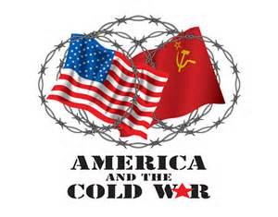
Unit 8
Cold War 1945-1980
Chapter 36-37

Slide 2
Period 8: 1945 – 1980 – After World War II, the United States grappled with prosperity and unfamiliar international responsibilities, while struggling to live up to its ideals.
Key Concept 8.1: The United States responded to uncertain and unstable postwar by asserting and working to maintain a position of global leadership, with far reaching domestic and international consequences.
Essential Question: How did new economic, social, and political forces and opportunities confront traditional patterns and assumptions in the period from 1945 to 1980?
Students can:
Decipher how Cold War tension between U.S. and USSR cause challenges to traditionally held views within American society.
Agenda
Transition in Ideological Views
The transition of Collective Security
Turning point
Homework:
Super Power Chill – read pages 862-874 decipher causes of the Cold War
Cumulative Test (Unit 6 & 7) Wed. 3/28

Slide 3
Essential Question
How was America’s national identity transformed domestically and international, as a result of the Cold War era?

Slide 4
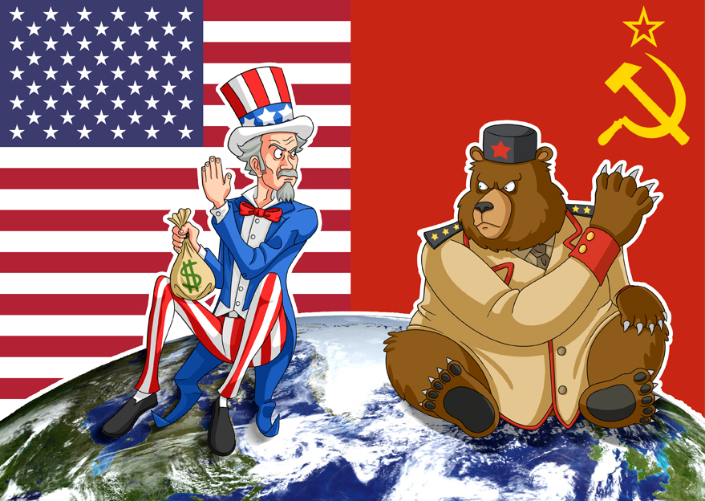
Post WWII Plans
Creating Superpowers and destroying an alliance

Slide 5
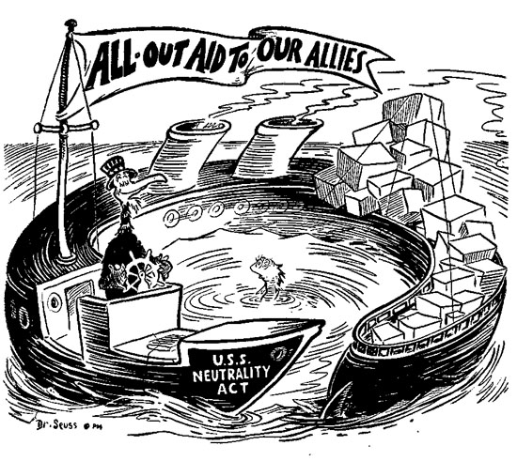
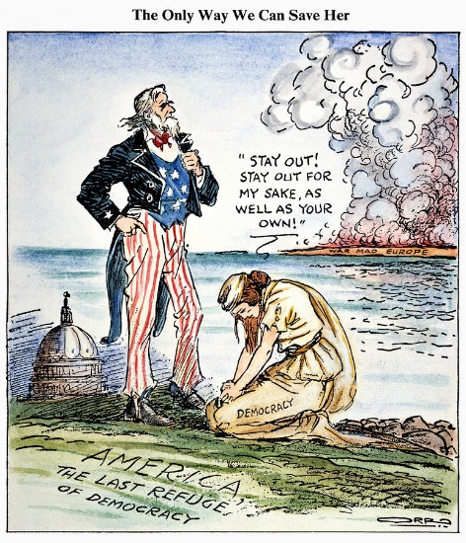
Ideological Transition
How did WWII cause a transition in America’s belief in isolation to intervention?
What did America believe to be vital interests that the nation had to become internationalist?

Slide 6
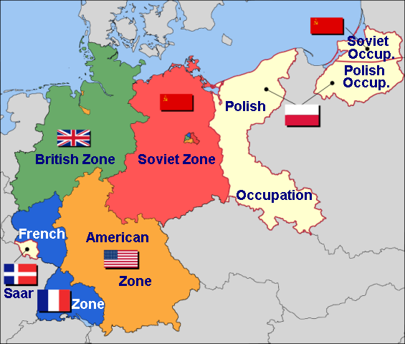
Post WWII Planning
Big Three: United States, Great Britain and USSR (Soviet Union)
Yalta Conference – Goal: COLLECTIVE SECURITY
Germany would be occupied and divided
Creation of the United Nations
Nuremberg Trials – Nazi trials
Allied issues: German industry
Soviets want war reparations
US against Germany war reparations
(Cause of WWII)

Slide 7
Collective of Security through Intervention
Post War Agreements
Bretton Woods Conference (US Superpower Status – Provides $$$)
IMF – regulate exchange rates for trade
World Bank – finance aid for recovery
United Nations
Security Council (US a permanent member)
Veto (USSR proposal to outlaw atomic bomb)

Slide 8
Period 8: 1945 – 1980 – After World War II, the United States grappled with prosperity and unfamiliar international responsibilities, while struggling to live up to its ideals.
Key Concept 8.1: The United States responded to uncertain and unstable postwar by asserting and working to maintain a position of global leadership, with far reaching domestic and international consequences.
Essential Question: How did new economic, social, and political forces and opportunities confront traditional patterns and assumptions in the period from 1945 to 1980?
Students can:
Decipher how Cold War tension between U.S. and USSR cause challenges to traditionally held views within American society.
Agenda
Containment
The Cold War Rivalry
Remedy for the Communitis
Homework:
Study for Cumulative Test
Cumulative Test (Unit 6 & 7) Wed. 3/28

Slide 9
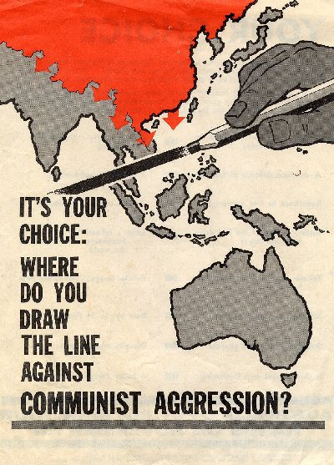
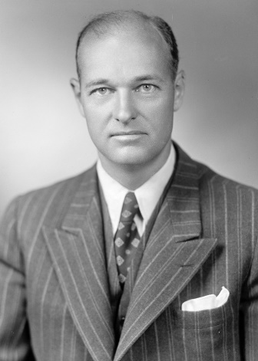
Quarantine Communism
Historic contextualization:
Containment policy – keep communism where it exists
Founder: George Kennan, Long Telegram
Causation:
Immediate impact:

Slide 10
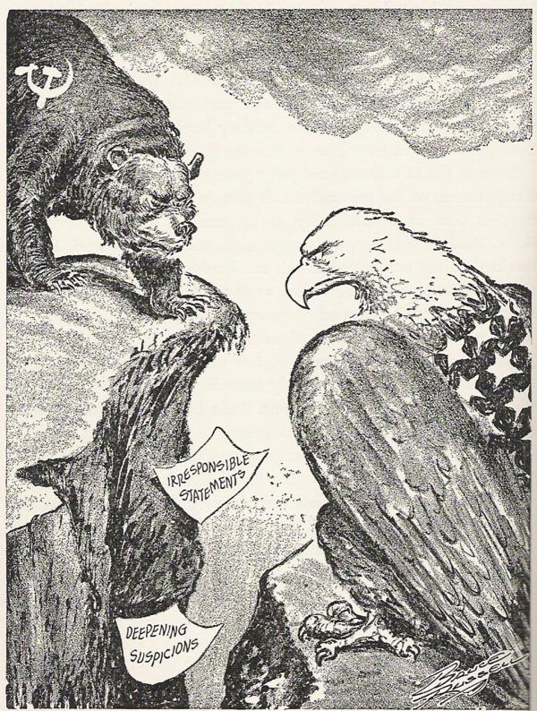
Two Super Powers
COLD WAR
Post-war plans creates a rivalry between the US & USSR
Cause: Rivalry created by post WWII plans
Impact – Cold War indirect fighting between the two nations

Slide 11
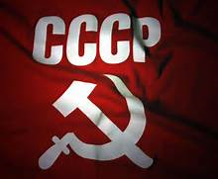
Impact of WWII – 2 Superpowers
United States
USSR – Soviet Union
Beliefs and values
- Democracy: power of the people to decide how government should work
- Free Elections
- Capitalism – free market economy
- Liberty and private property are essential
Beliefs and values
Totalitarian dictator in charge
Communism
Gov’t made all economic, political and military decisions
No freedom
No opposition (fear)
Wanted to make Eastern Europe communists states under Stalin’s control…the big problem

Slide 12
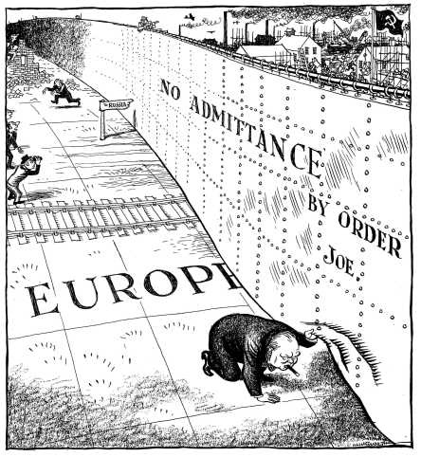
Stalin’s Iron Curtain
Iron Curtain Speech – warns the world of the creation of a Soviet sphere of influence
From Stettin in the Baltic to Trieste in the Adriatic, an iron curtain has descended across the Continent. Behind that line lie all the capitals of the ancient states of Central and Eastern Europe. Warsaw, Berlin, Prague, Vienna, Budapest, Belgrade, Bucharest and Sofia, all these famous cities and the populations around them lie in what I must call the Soviet sphere, and all are subject in one form or another, not only to Soviet influence but to a very high and, in many cases, increasing measure of control from Moscow. – Winston Churchill, 1946

Slide 13
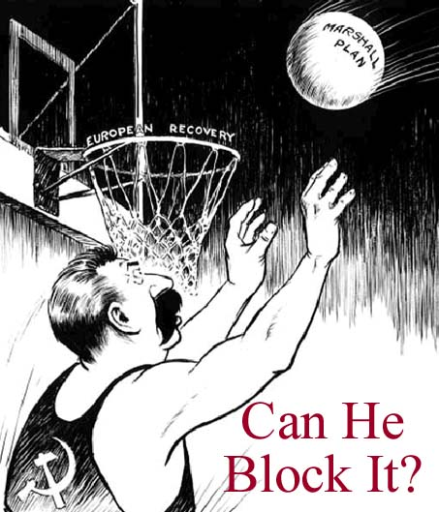
Containment Policy – Collective Security
Soviets/Iran Oil Deal
Long Telegram 1946: (George Kennan) Containment Policy (Stop the spread of Communism)
Containment Policy through economic aid
Truman Doctrine: 1947
$400 million to Greece & Turkey
U.S. promise to help nations combating Communism
Marshall Plan: 1948
Promote economic recovery in Europe
Successful stops the spread of Communism in Western Europe

Slide 14
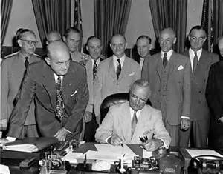
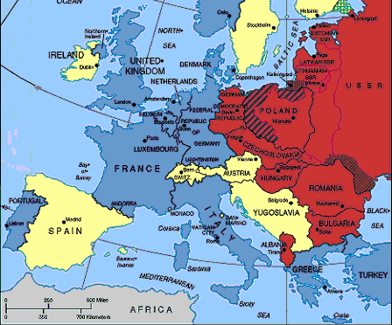
Defend America
America rearms and forms alliances
National Security Act 1947: Department of Defense, Central Intelligence Agency, Joint Chiefs, and National Security Council
Selective Service Act: Military Draft
NATO – Mutual defense pack 1948 (USSR creates the Warsaw Pact 1955)
Creation of US and Soviet spheres of influence
Soviet Satellite States
Truman signing the National Security Act
NATO Membership - 1949

Slide 15
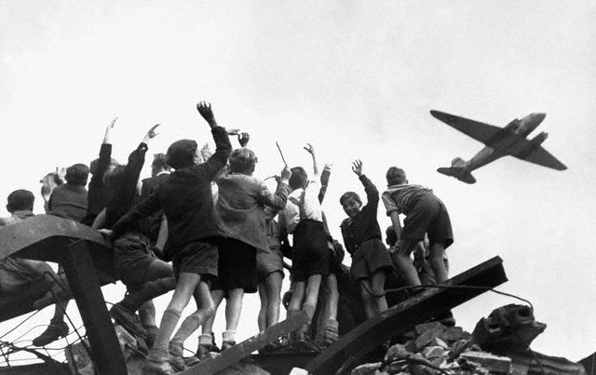
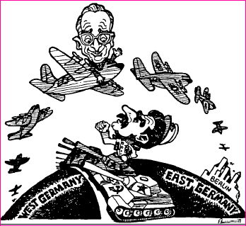
The IRON CURTAIN
Soviet desires a sphere of influence
Does not release countries it frees from Nazi Germany
1948 Blockades Berlin
Berlin Airlift 1948-49 (U.S. aid to defend democracy)
Speeds up German and Japanese recovery efforts by the US
English, American, & French occupation zones reunifed (West Germany)
Japan established as democracy under Douglas McArthur

Slide 16
Period 8: 1945 – 1980 – After World War II, the United States grappled with prosperity and unfamiliar international responsibilities, while struggling to live up to its ideals.
Key Concept 8.1: The United States responded to uncertain and unstable postwar by asserting and working to maintain a position of global leadership, with far reaching domestic and international consequences.
Essential Question: How did new economic, social, and political forces and opportunities confront traditional patterns and assumptions in the period from 1945 to 1980?
Students can:
Decipher how Cold War tension between U.S. and USSR cause challenges to traditionally held views within American society.
Agenda
From Russia with Love
Two Views of the Cold War
Atomic Fate
Homework:
Read pages 874-881 & 887-890 – Evaluate how the Cold War challenge our democratic views (provide evidence)

Slide 17
How does this change the United States?

Slide 18
Impact of WWII – 2 Superpowers
United States
USSR – Soviet Union
Beliefs and values
- Democracy: power of the people to decide how government should work
- Free Elections
- Capitalism – free market economy
- Liberty and private property are essential
Beliefs and values
Totalitarian dictator in charge
Communism
Gov’t made all economic, political and military decisions
No freedom
No opposition (fear)
Wanted to make Eastern Europe communists states under Stalin’s control…the big problem

Slide 19
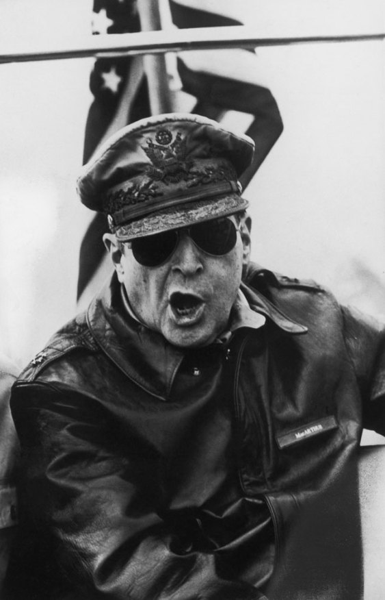
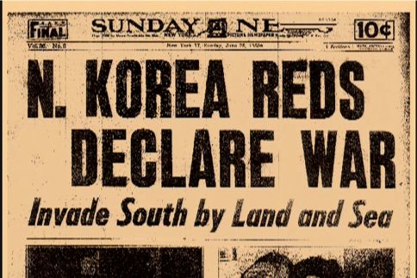
Asia Reconstruction
Japanese reconstruction – Douglas MacArthur
New Constitution requires demilitarization and democratic government
China – People’s Republic of China (Mao Zedong)
Failed US policy (backed Chiang Kai-shek)
Taiwan new Asian democracy
Korean Conflict 1950 (New Test for US Containment policy)
You will be Democratic!

Slide 20
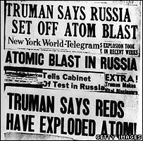
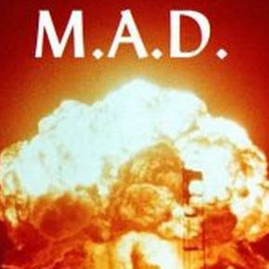
Nuclear Superpowers
Nuclear Arms Race begins 1949
Mutually Assured Destruction (MAD)
1949 USSR successfully sets off atomic bomb
1952 US creates the 1st hydrogen bomb
1953 USSR creates its own hydrogen bomb
Brinkmanship: stalemate (No one wants to be the first to fire)

Slide 21
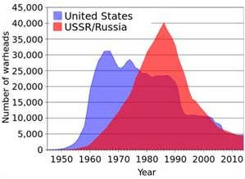
Nuclear Arms Race

Slide 22
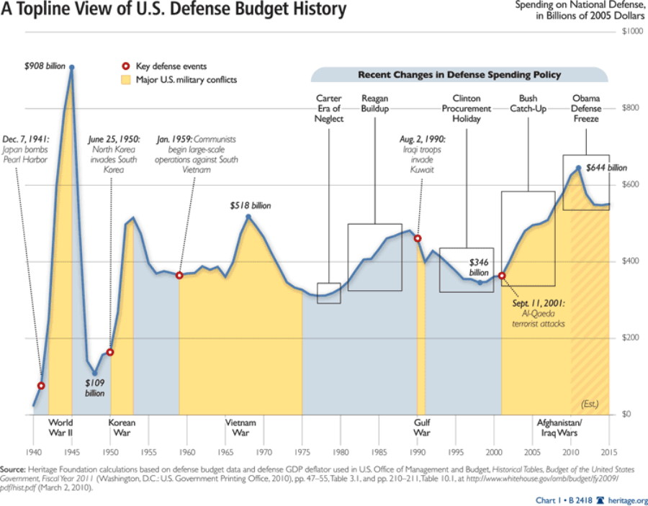
U.S. Military Spending
NSC-68: Blueprint for militarization of the Cold War to defeat USSR

Slide 23
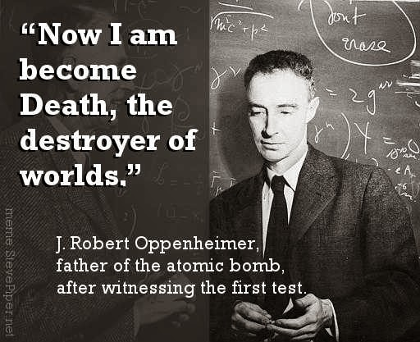
You da Bomb
The Atomic Age:
Demonstrate two ways the creation of the atomic weapons have transformed the United States in the post WWII era.
Political
Social
Economic

Slide 24
Containment Policy
Briefly explain ONE significant cause of the Cold War.
Briefly explain how ONE of the following either supported or hindered the achievements of U.S. foreign policy goals.
U.N. Security Council
Marshall Plan
NATO
C. Briefly explain the effects of ONE of the following on the Cold War.
Berlin Airlift
Fall of China
Korean War

Slide 25
US Foreign Policy
Read “The Long Telegram” by Ambassador George Kennan
Use APPARTS – Describe US Foreign Policy in regards to George Kennan Letter
Identify the significance of historic facts from 1945-1953 that represent Kennan’s policy
Berlin Airlift 1948-49 Marshall Plan Truman Doctrine
National Security Act 1947 Selective Services System
MAD NATO Japanese Reconstruction
People’s Republic of China Korean War Warsaw Pact
Develop arguments for and against his policy

Slide 26
Period 8: 1945 – 1980 – After World War II, the United States grappled with prosperity and unfamiliar international responsibilities, while struggling to live up to its ideals.
Key Concept 8.1: The United States responded to uncertain and unstable postwar by asserting and working to maintain a position of global leadership, with far reaching domestic and international consequences.
Essential Question: How was America’s national identity transformed domestically and international, as a result of the Cold War era?
Students can:
Decipher how Cold War tension between U.S. and USSR cause challenges to traditionally held views within American society.
Agenda
Are You a Commie
The Red Menace
Grade of Containment
Homework:
APUSH review videos (on website)

Slide 27
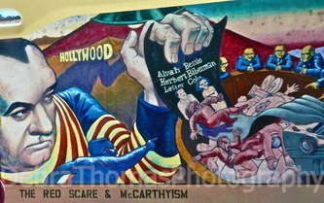
The Red Menace – Commies are in the U.S.??????

Slide 28
How does this change the United States?
1949 – 1st USSR Nuclear Test

Slide 29
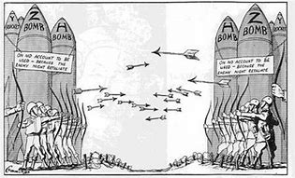
Arms Race
Arms Race: build up of Nuclear Arsenal
1952 Hydrogen Bomb – US
1953 Hydrogen Bomb – USSR
Brinkmanship: gain a tactical advantage through Nuclear Arms

Slide 30
Warning Signs of Communism
Hollywood 10 blacklisted for refusing to testify before HUAC
USSR successfully set off an atomic bomb
Alger Hiss (a gov. official) convicted of perjury
American going to church less
The Rosenbergs convicted of spying
Increased sexual freedoms from 1950 through 1960s
Civil Rights agitation

Slide 31
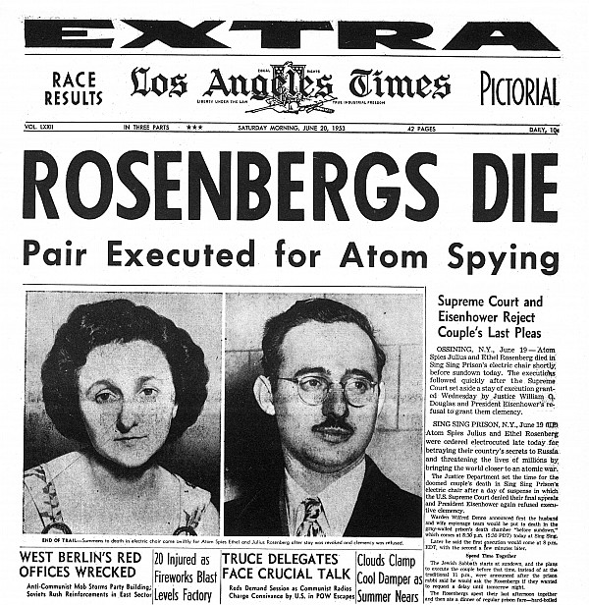
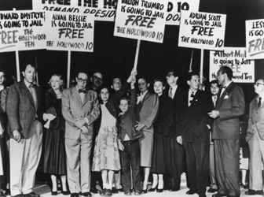
Domestic Defense against Communism
Truman’s Loyalty Review Board (No formal indictments)
Smith Act 1940 (peace time sedition act)
11 journalist convicted
Dennis v. U.S. upheld conviction
House Un-American Activity Committee (Witch Hunt)
McCarn Internal Securities Act 1950
Commies must register with the Attorney General
Investigated for subversive activity
Hollywood 10
Rosenbergs execution

Slide 32
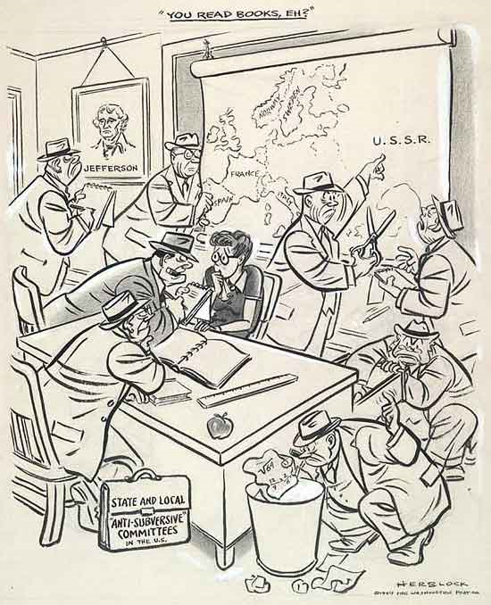
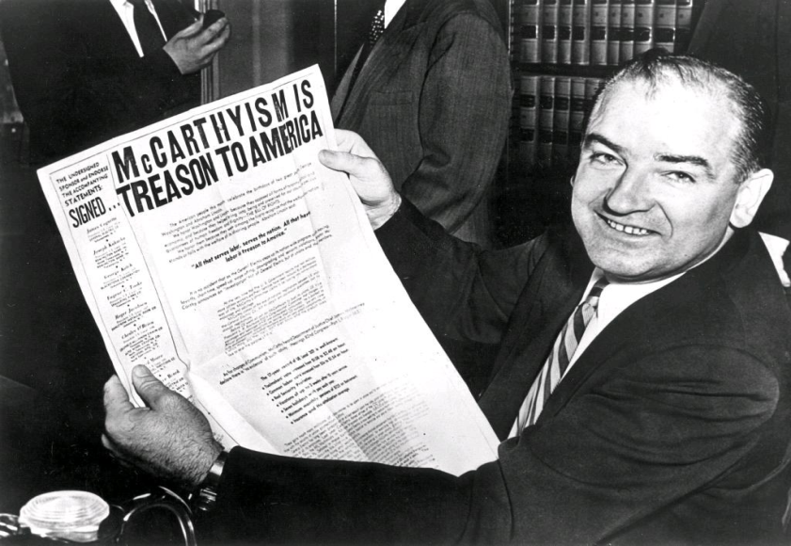
McCarthyism
Senator Joseph McCarthy (A political witch hunt to boost his re-election campaign)
1952 Accuses Sec. of State of knowingly employing 205 communist
Communist fear feed new accusations (George Marshall and Robert Oppenheimer’s wife)
1954 McCarthy accuses the US Army (35 day hearing that proves McCarthy is lying)
McCarthyism – falsely accusing someone of treason
Teachers required to take oaths of loyalty

Slide 33
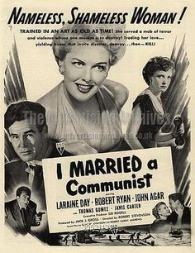
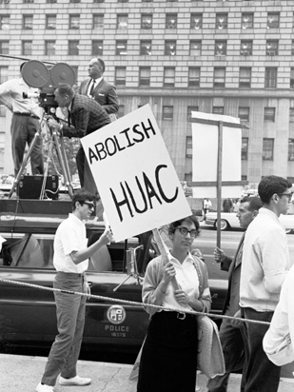
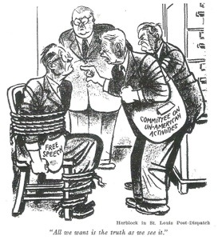
Box 1

Slide 34
Containment Policy Eval.
1. US gives $400 million to Greece and Turkey to defend against Communist influence
2. All men 18 and up must register for the draft to help heed the call of defending democracy against Communism.
3. US makes a mutual alliance with western Europe. An attack on one is an attack on all.
4. US government creates the Department of Defense, CIA, and the National Security Council to protect against the dangers of the Cold War.
5. The arms race between the US and USSR that brought peace through the threat of world annihilation.
6. The creation of the People’s Republic of China and its run away province Taiwan.

Slide 35
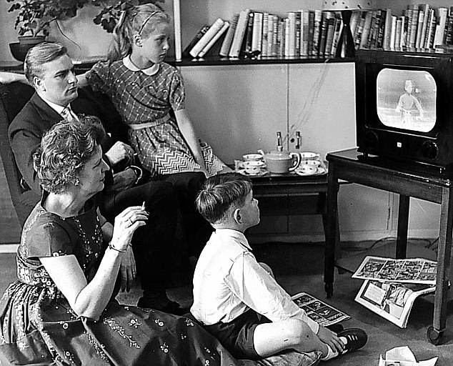
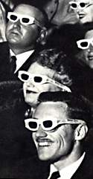
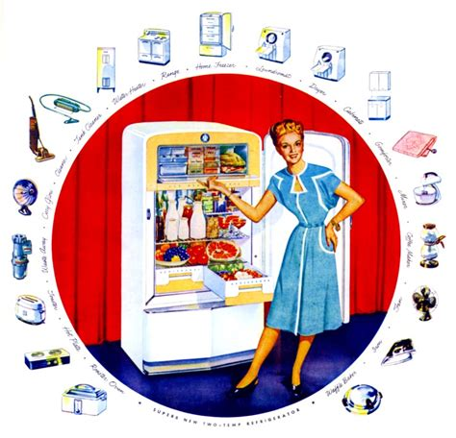
The Age of Conformity – No Commies HERE!
50’s Culture
One of these people is a commie – can you spot him/her?

Slide 36
Period 8: 1945 – 1980 – After World War II, the United States grappled with prosperity and unfamiliar international responsibilities, while struggling to live up to its ideals.
Key Concept 8.1: The United States responded to uncertain and unstable postwar by asserting and working to maintain a position of global leadership, with far reaching domestic and international consequences.
Essential Question: How was America’s national identity transformed domestically and international, as a result of the Cold War era?
Students can:
Decipher how Cold War tension between U.S. and USSR cause challenges to traditionally held views within American society.
Agenda
Father Knows Best - Conform
Consumption and Conformity
1950s is the new 1920s
Homework:
Culture of Conformity – Due Friday
890-902- Rise of Turbulence in the Wind - What factors are shaking up America in the late 1950s: explanations of events and factors that are jading America’s view of itself

Slide 37
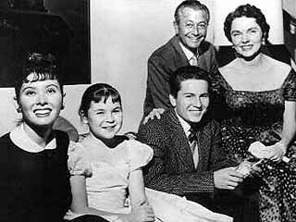
Welcome to Springfield
Father Knows Best – a reflection of 1950s culture
How did 1950’s TV culture reflect American society?
What habits did good America families demonstrate?
What was the overall message the TV program was promoting?

Slide 38
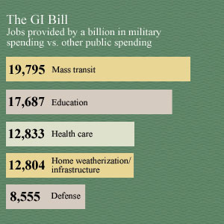
Long Term Economic Growth
Post WWII adjustment
1946-1947 price controls lifted
creating inflation
Taft Hartley Act: closed shops
outlawed and oath of loyalty (communism)
Union power weakens (South & West)
Two Decades of Economic Growth
Wartime industry sold to private interest
Employment Act 1946 (Council of
Economic Advisors)
Servicemen Readjustment Act 1944 (GI Bill)
Money for college
Low cost mortgage loans

Slide 39
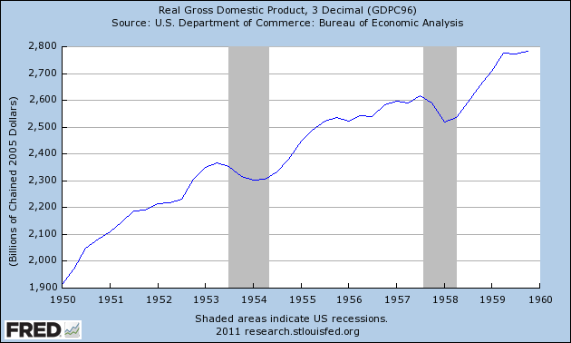
US Economy 1950-1960
GI Bill
Military spending
Diner’s Card
Taft-Hartley Act
Increased Education rate
Higher production rate in agriculture and industry
Increased home construction
Television

Slide 40
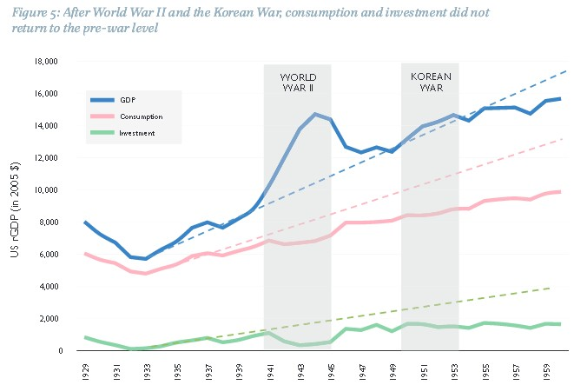
Continued Economic Growth
Government stimulation & American efficiency (Rise of White Collar Jobs)
Causes
WWII
Electronics boom (transistors)
(computers & information age
Aerospace industry (Air
Strategic command & commercial)
Military spending continues
post WWII
Low cost energy
Industrialization &
Mechanization
Increase in education
in the U.S

Slide 41
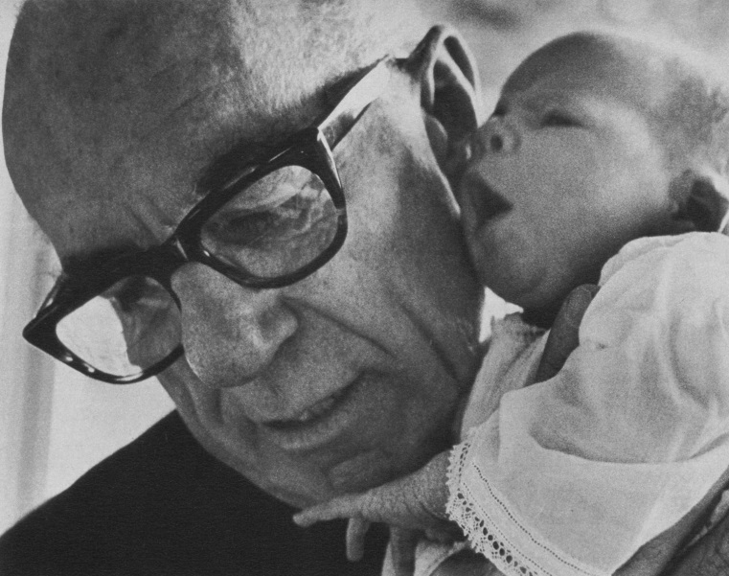
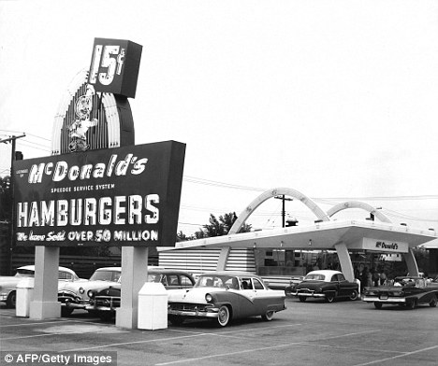
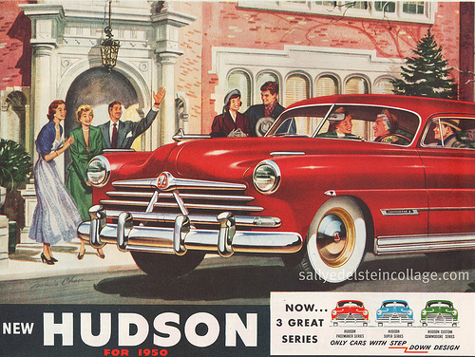
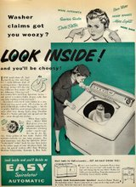
50’s Consumer Culture
Feeding economic growth
Causes of Consumer Culture
Growth of the middle class
Baby boom
Dr. Spock’s “Common Sense Baby
Book of Baby & Child Care”
Plastic credit cards (Diners Club)
Fast food - Franchise
TV (1951 7 million sold)
Rise of mass marketing
Dr. Benjamin Spock
McDonalds

Slide 42
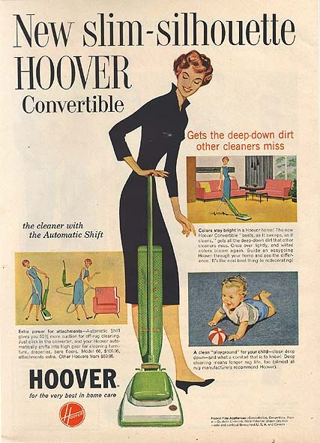
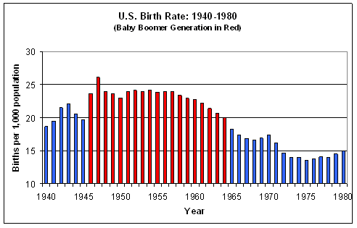
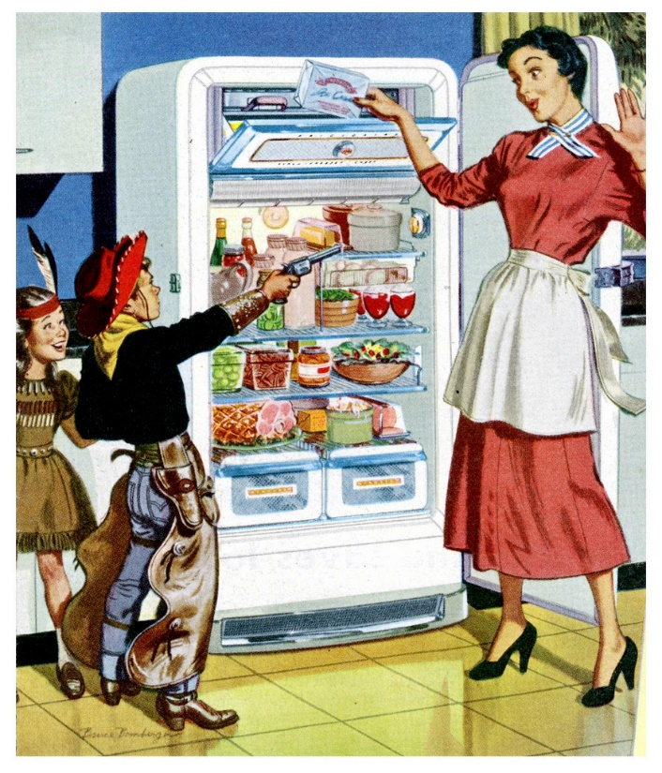
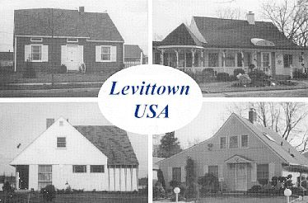
50s Conformity
1950s Life:
Live in suburbia – Levittown
Nuclear family – Baby Boom
Household need all the modern conveniences – appliances, TV, and car
Gender roles: Cult of Domesticity

Slide 43
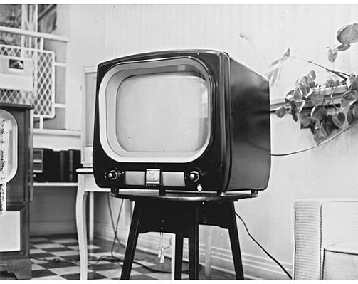
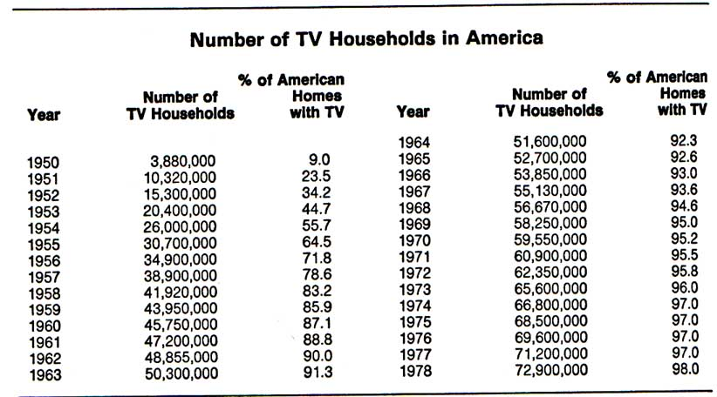
TV Generation
Television transformation
Social: promotes tele-evangelism (Billy Graham) & growth of professional sports
Sexual Revolution 1960s – Rock & Roll (Elvis Presley) & Entertainment (Marilyn Monroe)
Economic: mass marketing & consumer culture
Political: access to politics (TV ads for campaigns)

Slide 44
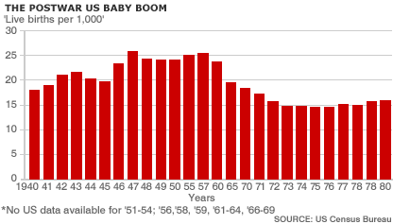
Baby boomers
Consumer Revolution
Levittown – manufactured homes
Cult of Domesticity
Rise in suburb population
Pink Collar Ghetto
Betty Friedan’s Feminist’s Mystique
Dr. Spock’s “The Common Sense Book of Baby and Child Care”

Slide 45
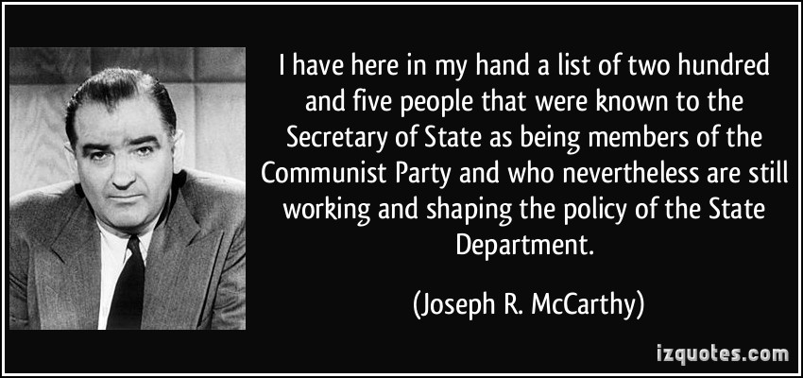
The Culture of Conformity
Joseph McCarthy & McCarthyism
HIPP: Senator Joseph McCarthy argued the during the 1950s the U.S. government has been infiltrated by communism and that America needs vigilant against the Second Red Scare.
Analysis:
As a result of the Soviet Union successfully detonation of atomic bombs America became afraid that communism was trying to take over American democracy. This had been fueled by similar witch hunts by the HUAC and the conviction the Rosenbergs for spying for USSR.

Slide 46
Pink Collar Ghetto

Slide 47
U.S. Migrating Society
Movement within America
Rustbelt to the Sunbelt ( taxes & jobs)
Growth of the Suburbs
GI Bill + tax deductions
Levittown
Eisenhower Interstate Highways System
Baby Boomers
Impact
White Flight (rise of the inner city)
Growing reliance on oil
Feeds economic growth
Rust Belt
Sun Belt

Slide 48
Baby Boomer Effect
A Baby born every 10secs.
Consumer Culture
Levittown
Cult of Domesticity

Slide 49
Period 8: 1945 – 1980 – After World War II, the United States grappled with prosperity and unfamiliar international responsibilities, while struggling to live up to its ideals.
Key Concept 8.1: The United States responded to uncertain and unstable postwar by asserting and working to maintain a position of global leadership, with far reaching domestic and international consequences.
Essential Question: How was America’s national identity transformed domestically and international, as a result of the Cold War era?
Students can:
Decipher how Cold War tension between U.S. and USSR cause challenges to traditionally held views within American society.
Agenda
We Got the Beat
Hypocrisy of the 50s
The Voice of the Beats
Homework:
Pict-o-gram of 1950s culture – Due Friday
902-911 – The Age of Camelot: compare Kennedy’s plan for the Cold War to Eisenhower’s

Slide 50
Does America Suck? – The Cold War Question
America’s argument for the Cold War: that our system of government promoted values of “liberty, equality, popular sovereignty, opportunity, and laissez faire capitalism” was far superior to Communism.
“Don’t ask him questions about his actions or questions his judgement or integrity. Remember, he is the master of the house and such will always exercise his will with fairness and truthfulness. You have no right to question him. “The Good Wife Guide”

Slide 51
Social Change
Re-enforcing Republican Motherhood
Cult of Domesticity - (50’s Sitcoms – Mom stays home)
Pink Collar Ghetto – women working as secretaries
1963 Betty Friedan’s “Feminist Mystique”
Rise of Conformity
David Riesman’s “The Lonely Man”
Kenneth Galbraith’s “Affluent Society”

Slide 52
Dissent within America
The rise of a counter culture
The Beats (Beatnik culture): writers who explored post WWII American culture
Themes: rejection of materialism, exploring psychic drugs, sexual liberation & demonstrates the human condition
Examples:
Allen Ginsberg’s “The Howl”
Jack Kerouac’s “On The Road”
William Burroughs's “Naked Lunch”
Non -conformity
Kerouac, Dylan, and Ginsberg

Slide 53
Rise of Civil Rights
Geographic Segregation
South controlled by Jim Crow Laws and intimidations (Emit Till case)
North: segregation breaking down Jackie Robinson & Wendell Willkie's “One World”
Federal Government
Executive Order 9088 – no discrimination in hiring
Executive Order 9981 – desegregates the military

Slide 54
Breaking the Barrier
Tearing down segregation
Allright v. Smith 1944 – White primaries unconstitutional
NAACP activism: Rosa Parks sparks the Montgomery Bus Boycott
NAACP cases
Sweatt v. Painter: (colleges)
Brown v. Board I: (public schools)
Brown v. Board II: all deliberate speed

Slide 55
Fighting On
Resistance: Declaration of Constitutional Principles (South refusal to integrate)
Demonstrations of Southern resistance
Little Rock Nine 1957
MLK forms SCLC to fight for voting rights
Greensboro 4 Sit-in Movement 1960
Creation of SNCC (Student movement)
Little Rock Nine
Greensboro 4

Slide 56
Period 8: 1945 – 1980 – After World War II, the United States grappled with prosperity and unfamiliar international responsibilities, while struggling to live up to its ideals.
Key Concept 8.1: The United States responded to uncertain and unstable postwar by asserting and working to maintain a position of global leadership, with far reaching domestic and international consequences.
Essential Question: How was America’s national identity transformed domestically and international, as a result of the Cold War era?
Students can:
Decipher how the rise Cold War brinksmanship impacts the United States power internationally and domestically
Demonstrate how post WWII world transformed America socially, politically, and economically
Agenda
Cold War Reality Check
New Conservativism
Homework:
902-906 & 909-916 Evaluate how Kennedy’s New Frontier and Flexible Response is different from Eisenhower’s policies
Pict-o-gram of 1950s culture – Due Thursday
Quiz on WWII – the Beginnings of the Cold War, Friday

Slide 57
Eisenhower Diplomacy
Three truths of Eisenhower diplomacy
US Soviet relations were improving under Eisenhower’s presidency
Energy became a primary concern of U.S. policy during the late 50s
America violates its Good Neighbor Policy during Eisenhower’s administration
Use historic facts to prove statements true or false

Slide 58
Korean Conflict
Korea divided at the 38th parallel
Korean Conflict 1950
UN Resolution
Truman orders military action
(No Declaration of War)
National Security Council
Resolution 68 (NSC-68)
(Military spending quadruples)
Nuclear Bomb?
Korean Conflict resolves nothing

Slide 59
Cold War Impact

Slide 60
Period 8: 1945 – 1980 – After World War II, the United States grappled with prosperity and unfamiliar international responsibilities, while struggling to live up to its ideals.
Key Concept 8.1: The United States responded to uncertain and unstable postwar by asserting and working to maintain a position of global leadership, with far reaching domestic and international consequences.
Essential Question: How was America’s national identity transformed domestically and international, as a result of the Cold War era?
Students can:
Decipher how Cold War tension between U.S. and USSR cause challenges to traditionally held views within American society.
Agenda
Ike For President
The Eisenhower Response
Cold War Transformation
Homework:
Cold War transformation of 1950s culture – Due Friday

Slide 61
New Republicanism
Conservative Revolution: balance the budget, return power to states, and curb the welfare state & military spending)
Truman’s Fair Deal - national healthcare, raise minimum wage, expand social security, & Fair Employment Practices

Slide 62
Cold War Domestic Policy
Sputnik 1957 (Space Race)
NASA Act
National Defense & Education Act (science & math education)
Fear of Communism
Interstate Highways Act: infrastructure project to promote troop movement (welfare state)
Landrum-Griffin Act 1959: corruption in unions (Jimmy Hoffa & Teamsters)
Civil Rights
Brown vs. Board I 1954 & II 1957
Civil Rights Act – Civil Rights Commission
Little Rock 9

Slide 63
Cold War Foreign Policy
Korean Conflict 1952: Korea divided at the 38th parallel
CIA coup in Iran 1953 (No USSR in the Middle East)
Suez Crisis 1956
Eisenhower Doctrine
Energy reliance
Rise of Ho Chi Minh (Independence for Indochina)
Fall of Dien Bien Phu (failure of U.S. $$)
Geneva Peace Accord – Vietnam split at 17th parallel (Ngo Dinh Diem – South Vietnam & Ho Chi Minh – North Vietnam)
Domino Theory – one falls they all fall
SEATO – 1954 US & Asian Alliance

Slide 64
Cold War Expansion and Contraction
W. Germany joins NATO
Warsaw Pact 1955
Joseph Stalin dies 1957 Nikita Khrushchev Russian Premier
Withdraws from Austria
Hungarian revolt 1957
Cuban Revolution 1959
Fidel Castro
Cuba 90 miles from the U.S.

Slide 65
Cold War Spending
Strategic Air Command: Super bombers Growth of Aerospace Industry

Slide 66
America’s Secret War
U2 Incident 1960
American spying on USSR (ICBM’s)
Francis Gary Powers
U.S. admits to spying on USSR
US/Soviet relations deteriorate

Slide 67
I like Ike
Republic values return
Issue – Korean Conflict deadlock

Slide 68
Grandfather Ike
New Republicanism – Beginning a Conservative Revolution
Goals
Balanced the federal budget
Curb military buildup
Return authority to
the states
Curb the welfare state

Slide 69
Eisenhower Domestic Programs
Cold War impacts domestic policies
New Deal and Fair Deal (Truman’s) – national healthcare,
raise minimum wage, & Fair Employment Practices
Eisenhower does not alter (too ingrained in America)
Civil Rights Act 1957: Civil Rights Commission
Landrum-Griffin Act 1959: corruption in unions
Interstate Highway Act 1956 (Major public works program)
Cold War airport
Issues: energy crisis & pollution
National Defense & Education Act 1958
Result of Sputnik
Science education a priority

Slide 70
Conservativism
Conservative Values
Promoting family values
Less federal government
intervention in the US
Return authority to the states
Protect National Security
Cut taxes
Christian values

Slide 71
Eisenhower’s Cold War
Sec. of State: John Foster Dulles
Cold War Policies
Eisenhower Doctrine: Middle East
Strategic Air Command
SEATO
Negotiate with Khrushchev
Continue Containment Policy

Slide 72
Cold War Spending

Slide 73
Cold War Policies
Cold War Issues
Warsaw Pact 1955
Hungarian Revolt put down harshly by Soviets
Strategic Air Command weakens the
Army & Navy and costs more
US need for oil drives policies
CIA Coup in Iran
Suez Crisis
OPEC formed 1960
Cold War Positives
Khrushchev replaces Joseph Stalin
Soviets free Austria
US & USSR stop atmospheric and
underground testing

Slide 74
Eisenhower Cold War Black Eyes
Sputnik 1957 (National Defense and Education Act & Space Race)
Fidel Castro spreads Communism
to Cuba (USSR Allie)
Vietnam Conflict
U.S. provides 80% of military aid
Dien Bien Phu 1954
Geneva Peace Accords 17th Parallel
Gary Powers U2 Spy plane incident

Slide 75
New Republicanism
Determine whether Eisenhower’s Administration really achieved Conservative Revolution by placing the following terms on the chart
Vietnam Eisenhower Doctrine
Interstate Highways Act Civil Rights Act of 1957
National Defense & Education Act Little Rock 9
Strategic Air Command Landrum-Griffin Act
Embargo against Cuba Ending Korean Conflict
Conservative | Liberal

Slide 76
Period 8: 1945 – 1980 – After World War II, the United States grappled with prosperity and unfamiliar international responsibilities, while struggling to live up to its ideals.
Key Concept 8.1: The United States responded to uncertain and unstable postwar by asserting and working to maintain a position of global leadership, with far reaching domestic and international consequences.
Essential Question: How was America’s national identity transformed domestically and international, as a result of the Cold War era?
Students can:
Decipher how Cold War tension between U.S. and USSR cause challenges to traditionally held views within American society.
Agenda
Equality over time
New Frontiers
Eyes on the Prize
Homework:
Review for APUSH exam units I-III (homework calendar)

Slide 77
Eisenhower’s Farwell Address 1961
Our military organization today bears little relation to that known by any of my predecessors in peacetime, or indeed by the fighting men of World War II or Korea.
Until the latest of our world conflicts, the United States had no armaments industry. American makers of plowshares could, with time and as required, make swords as well. But now we can no longer risk emergency improvisation of national defense; we have been compelled to create a permanent armaments industry of vast proportions. Added to this, three and a half million men and women are directly engaged in the defense establishment. We annually spend on military security more than the net income of all United States corporations.
This conjunction of an immense military establishment and a large arms industry is new in the American experience. The total influence – economic, political, even spiritual – is felt in every city, every Statehouse, every office of the Federal government. We recognize the imperative need for this development. Yet we must not fail to comprehend its grave implications. Our toil, resources and livelihood are all involved; so is the very structure of our society.
In the councils of government, we must guard against the acquisition of unwarranted influence, whether sought or unsought, by the military-industrial complex. The potential for the disastrous rise of misplaced power exists and will persist.
We must never let the weight of this combination endanger our liberties or democratic processes. We should take nothing for granted. Only an alert and knowledgeable citizenry can compel the proper meshing of the huge industrial and military machinery of defense with our peaceful methods and goals, so that security and liberty may prosper together.

Slide 78
Nixon v. Kennedy
John F. Kennedy defeats Richard Nixon 1960 presidential election
Factors
First TV debate
Civil Rights
TV images of Kennedy & Nixon
Notes:
Those who listened by radio believed Nixon won
Those who watched TV believed Kennedy won
Nixon
Struggling family
Attended Whittier College
Vice President under Eisenhower
Kennedy
Wealthy family
Family of politicians
Attended Harvard
Catholic
Similarities
In the Navy during WWII
Congressmen
Supported fight against Communism

Slide 79
Kennedy’s Inaugural Address
Kennedy was the youngest person ever to be elected president. His
youth helped provide the theme to his inaugural address:
“Let the word go forth…
That the torch has been passed to a new generation of Americans…
The energy, the faith, the devotion which we bring to this endeavor will light our country and all who
serve it…And so, my fellow
Americans-ask not what your country can do for you-ask what you can do for your country.”

Slide 80
Kennedy’s Policies
“We Stand on the edge of a new frontier, the frontier of the 1960’s, a frontier of unknown opportunities and perils, a frontier of unfulfilled hopes and threats. The New Frontier of which I speak is not a set of promises – it is a set of challenges.” - John F. Kennedy, Democrat Nomination Acceptance Speech, 1960
Best and Brightest: Kennedy’s top Advisors
New Frontier: focus – the economy, education, Medicare for elderly & poor, and space exploration (Space Race)
Peace Corps: youth helping
the world (containment policy)
Equal pay for equal work
NASA reach the moon
Flexible Response (massive retaliation
cannot be the focus of US defense policy)
Rebuild the military and navy
Prepare for all Cold War challenges

Slide 81
Government Spending

Slide 82
“Except for blacks, who grew increasingly militant in fighting against racial injustice, young people who were unhappy with the status quo did not much concern themselves with large political and social problems. Most educators in the 1950s detected a ‘silent generation,’ both in schools and in the burgeoning universities.”
Give one example that would support an author’s comment about young African American during the 1950s.
One factor in the postwar America that likely promoted the “silent generations” in the 1950s.
One example of social or literary criticism of conformity of the 1950s.

