Slide 1
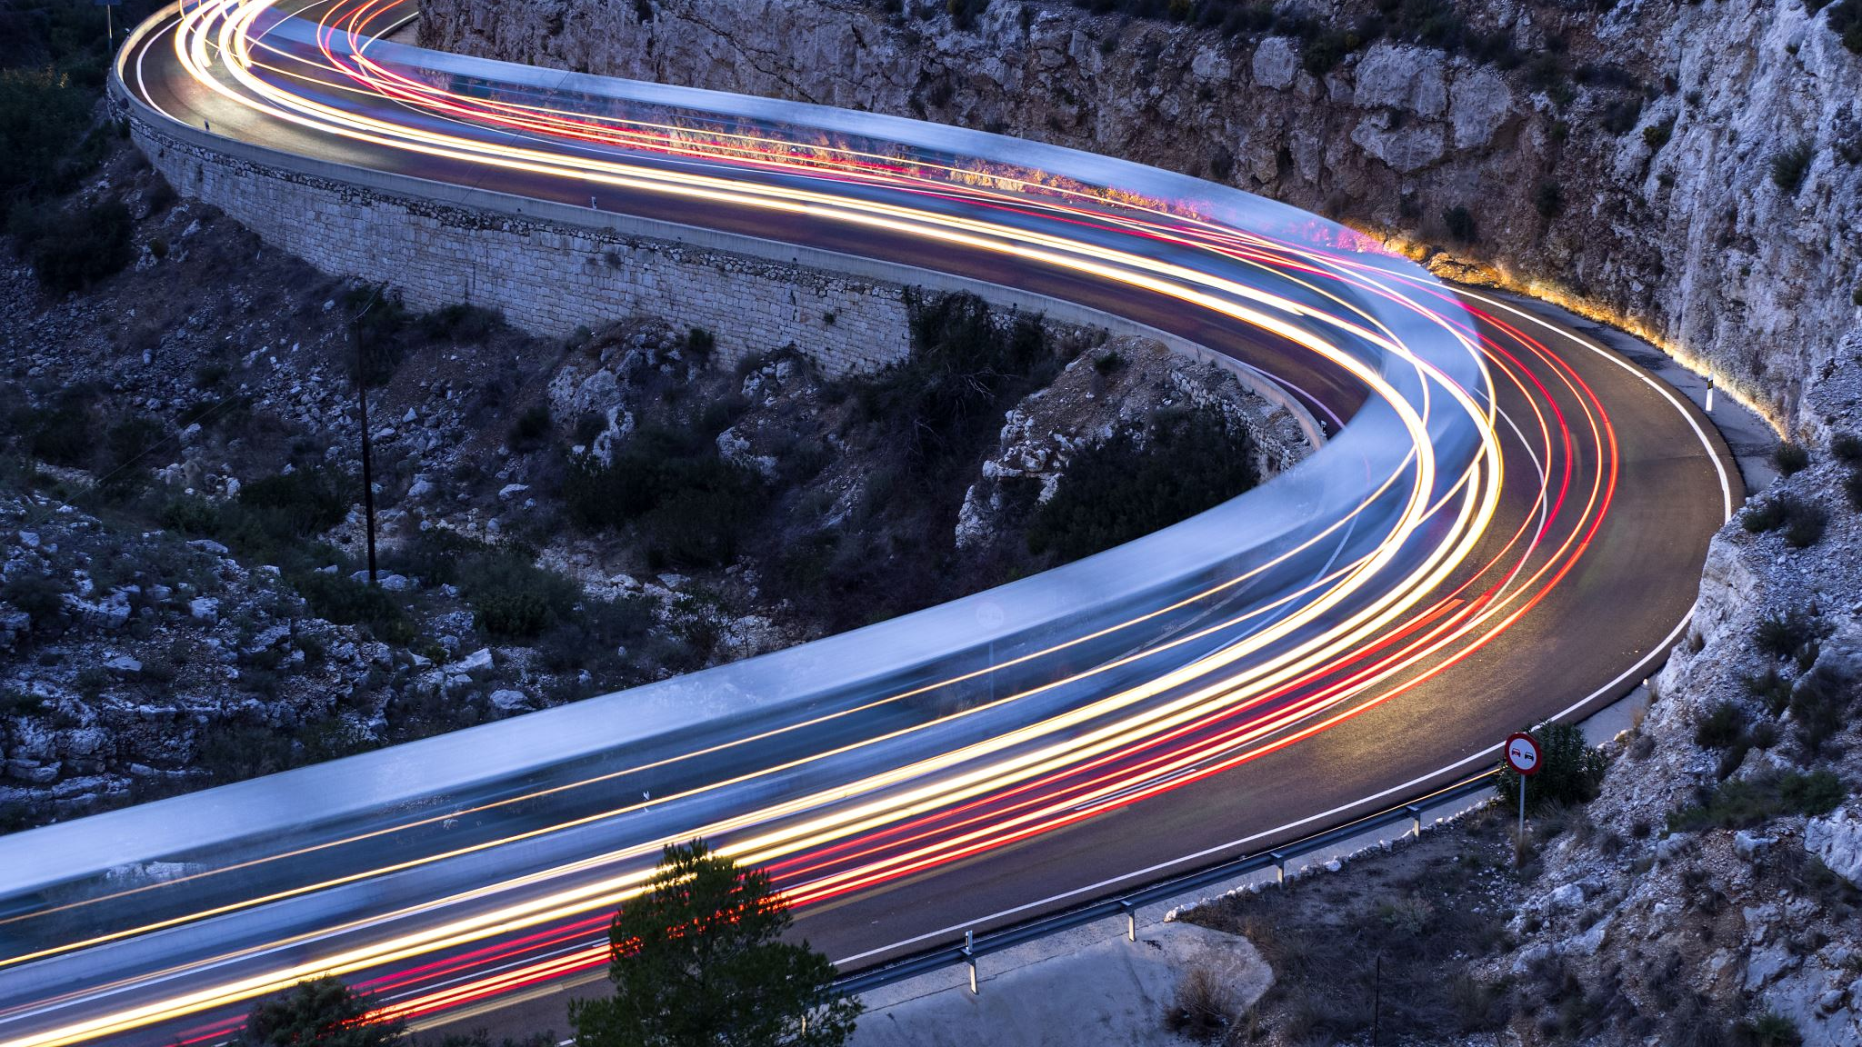
Today’s Agenda 1. Thesis practice 2. New Material→ challenges to State Power 3. Document Work
Good Monday to YOU
It is December 9, 2019

Slide 2
Thesis Practice
Develop an argument that evaluates the extent to which the systems of slavery in the era 1450-1750 showed changes and continuities over time.
Use your book and knowledge to create a Thesis/Claim for this Prompt.
TIP: “UBOW”
U → Understand prompt (read, annotate, & identify important words of the prompt)
B → brainstorm
O → Organize
W → Write

Slide 3
EQ: How did the development of state power result in external and internal challenges in the period between 1450-1750?
Context: As empires expanded, absorbing new populations, revolts challenged state power. EX: Metacom’s War→ Native Americans revolted against English (1675-8)
Rival Empires eyed each others valuable expansions, seizing them if possible

Slide 4
Resistance to Portugal in Africa
The Dutch and English pushed Portugal out of South Asia (external)
Rebellion in Ndonga allied with Dutch (external)
Anna Nzinga allied with Dutch, building Matamba into an economically strong state

Slide 5
Local resistance in Russia
Serfdom expanded as Russia claimed more land in Siberia (in contrast serfs were freed in W. Europe by 1574)
Cossacks and Peasant Rebellions: The Pugachev Rebellion (1774) was a massive serf revolt against the czar Catherine the Great. (INTERNAL)

Slide 6
Rebellion in South Asia: Hindu rebellion against Mughal empire, ending it in 1707. Maratha Empire was created as a Hindu Empire. (INTERNAL)
Revolts in the Spanish Empire
The Pueblo Revolt (1680) raged against Spanish attempts to Christianize natives in Northern New Spain. A success until Spain reconquered the area in 1692 (INTERNAL)

Slide 7
England
1. England took Jamaica from Spain (1655)
But Maroons (runaway slaves) rebelled in the Maroon Wars led by Queen Nanny (1790s- EXTERNAL)
2. Gloucester County Rebellion (Virginia 1663) Slaves and Indentured servants band together to demand freedom (INTERNAL)
3. Glorious Revolution (1688 England) Protestant forces bloodlessly remove the Catholic king James II. Monarchy permanently reduced. (INTERNAL)

Slide 8
Classwork
NEXT
Re-read your highlighted text and respond to the following prompt with a historically defensible claim
→ Explain the most significant causes of the Pueblo Revolt.
Close Reading
As you read use different colors to highlight the social, economic, and political reasons for the rebellion.

