Slide 1
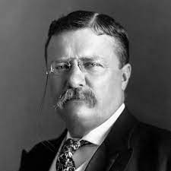
The Progressive Era
Unit VII: 1890 - 1920
“A great democracy has got to be progressive, or it will soon cease to be great or a democracy.”

Slide 2
Topic 7.4: Compare the goals and effects of the Progressive reform movement
Essential Question: Evaluate the effectiveness of social reform movements, government regulation, and political change at dealing with the ills of industrialization
Students can:
Develop a historic contextualization on the causes for the rise of Progressive Era from 1890 to 1920
Assess the effectiveness of Progressive reforms at promoting the development of the United States and dealing with the ills of industrialization, segregation, and urbanization
AGENDA
Unit VI Review
Unit VI Assessment
HOMEWORK: Origins of Progressivism

Slide 3
Topic 7.4: Compare the goals and effects of the Progressive reform movement
Essential Question: Evaluate the effectiveness of social reform movements, government regulation, and political change at dealing with the ills of industrialization
Students can:
Develop a historic contextualization on the causes for the rise of Progressive Era from 1890 to 1920
Assess the effectiveness of Progressive reforms at promoting the development of the United States and dealing with the ills of industrialization, segregation, and urbanization
AGENDA
Historical Parallel in Time
Origins of Progressivism
Striving for the Beacon of Light
HOMEWORK: Striving for the Beacon of Light

Slide 4
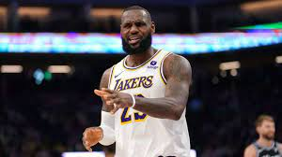
Parallel Between Times
Identify and explain similarities between the following periods; 1820-1840 Age of Reform and 1890 – 1920 Progressive Era
Are guys the same thing???
Age of Reform 1820 -1840
Progressive Era 1890 -1920
Construct a historic contextualization that focuses on the causation of the Progressive Era

Slide 5
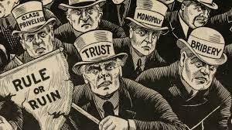
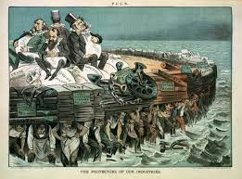
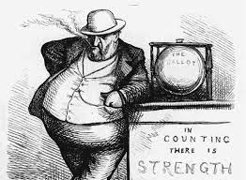
Sins of America
Immorality in America (Sins of America)
Plutocracy & political corruption
Unsafe labor conditions
Urbanization
Lack of government regulation
Pollution/Safety
Inequality

Slide 6
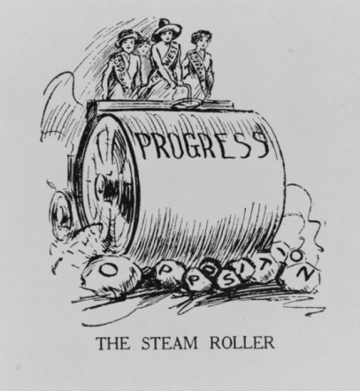
Origins of Progressivism
Progressive desires: larger role of government & greater democracy
Causation of Progressivism
Growth of the middle class
Momentum caused by labor unions & Populists
Leaders (Progressive Presidents: Roosevelt, Taft, & Wilson)
Awareness
Muckrakers (investigative journalist)
Social Gospel Movement (Walter Rauschenbusch)
I am, therefore, a Progressive because we have not kept up with our own changes of condition, either in the economic field or in the political field - Woodrow Wilson, 1912
Take us to the Beacon of Light!

Slide 7
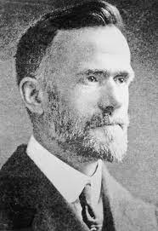
Aiming for the Beacon of Light
“The Kingdom of God is not a matter of getting individuals to heaven, but of transforming life on earth into harmony of heaven.”
- Walter Rauschenbusch, Social Gospel
Progressive Era
1890s
1901
1917
1920
Tenets of Progressive Reform
Society is need of change limit the power of big business & promote social justice
Government was the proper agent for change
Moderate reforms are better than radical reforms

Slide 8
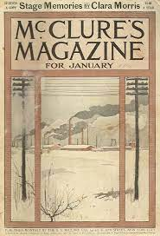
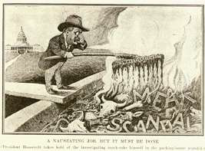
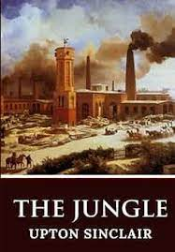
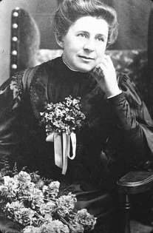
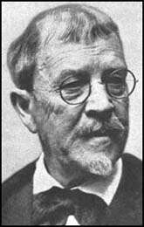
Promotes of Reform
“I aimed for the public heart, and by accident I hit in the stomach”
- Upton Sinclair, 1906
“Muckrakers” (investigative journalists)
McClure’s Magazine: promoted investigative journalism
► Jacob Riis – How the Other Half Lives (1890)
► Ida Tarbell – “The History of the Standard Oil Co.” (1902)
► Lincoln Steffens – The Shame of the Cities (1904)
► Upton Sinclair – The Jungle(1906)
Muckraker = rake up the crap of society
Ida Tarbell
Lincoln Steffens

Slide 9
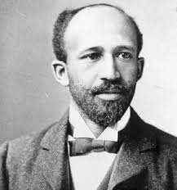
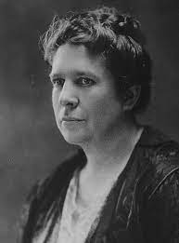
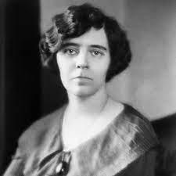
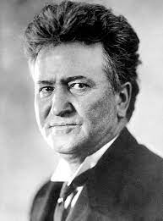
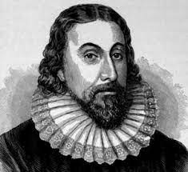
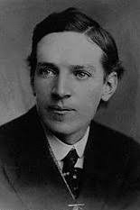
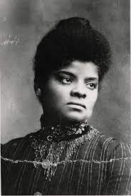
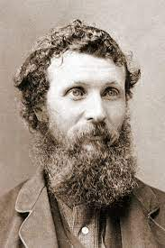
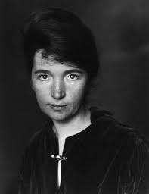
Striving for the Beacon of Light
Identify the topic the Progressive Reformer focused on and explain whether they achieved change through championing a cause.
And you thought the Puritans had faded into history. Can you see the Beacon of Light!
Champions of Progressivism

Slide 10
Topic 7.4: Compare the goals and effects of the Progressive reform movement
Essential Question: Evaluate the effectiveness of social reform movements, government regulation, and political change at dealing with the ills of industrialization
Students can:
Develop a historic contextualization on the causes for the rise of Progressive Era from 1890 to 1920
Assess the effectiveness of Progressive reforms at promoting the development of the United States and dealing with the ills of industrialization, segregation, and urbanization
AGENDA
Tragedy Promotes Reform
Municipal Reform
Striving for the Beacon of Light
HOMEWORK: Progressive Legislative Agenda

Slide 11
Municipal & State Reforms

Slide 12
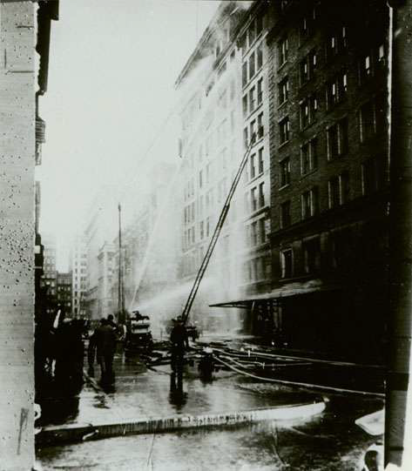
State Social Reforms
Triangle Shirtwaist
Fire
"I can't begin to tell you how disturbed the people were everywhere. It was as though we had all done something wrong. It shouldn't have been. We were sorry. Mea culpa! Mea culpa! We didn't want it that way. We hadn't intended to have 147 [sic] girls and boys killed in a factory. It was a terrible thing for the people of the City of New York and the State of New York to face."
- Francis Perkins, 1911

Slide 13
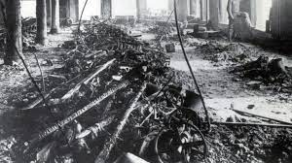
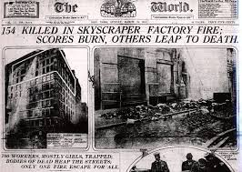
State Social Reforms
Triangle Shirtwaist Fire (1911) – 2nd largest disaster in NYC
Reforms
8-hour workdays
Workplace safety (sprinkler systems, unlocking fire exits, building inspections)
Worker’s compensation laws
National Consumer’s League (Florence Kelley)
Fight to protect women in the work force

Slide 14
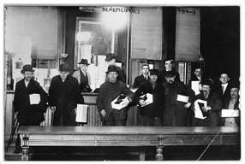
Municipal Reform
Issue: Cities controlled by party bosses
Goal: allow government to provide utilities and other public services
Reform:
Commission plan
City-council plan (hire experts to manage utilities
Shoe line – Bowery men with gifts
from ward boss Tim Sullivan, February 1910

Slide 15
Municipal Reform
Mayor
Council Member
Council Member
Council Member
Council Member
Council Member
City Services
Council-manager plan (Dayton, 1913)
Council Member
Council Member
Council Member
Council Member
Council Member
City
Manager
City Services

Slide 16
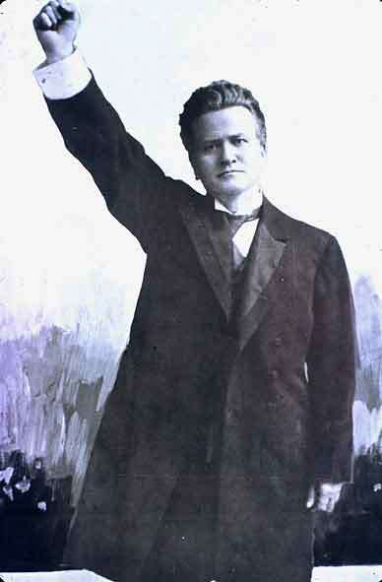
Power to the People
Graft and plutocracy made government unresponsive to the needs of the people
Political Reforms – increase the common’s voice in government
Will of the people shall rule this land!
Australian Ballots (secret ballots printed by state government)
Direct primaries (Wisconsin Plan)
Initiatives
Referendums
Recall elections
17th Amendment (1913): Direct Election of Senators
Battling Bob La Follette
Wisconsin Governor

Slide 17
Striving for the Beacon of Light
Identify and explain issues from 1866 – 1899 lead to the rise of the Progressive Movement.
Identify the topic the Progressive Reformer focused on and explain whether they achieved change through championing a cause.
And you thought the Puritans had faded into history. Can you see the Beacon of Light!
Categorize and explain how the Progressive promoted change in the following areas. (Be sure to provide actual examples for each category.
Political
Economic
Social
Environmental
Champions of Progressivism
Evaluate how the Progressive Era transformed the role of government in Americans’ lives using TWO specific examples.
Identify and explain areas that the Progressive Era failed to bring about change in the United States during the period 1890 to 1920. (Have TWO specific examples)

Slide 18
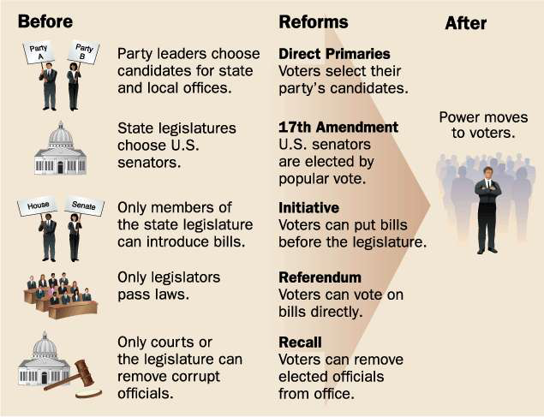
Progressive State Political Reforms

Slide 19
State Political Reform
Voter Participation
in Presidential Elections,
1876-1920

Slide 20
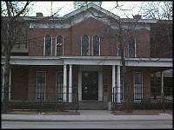
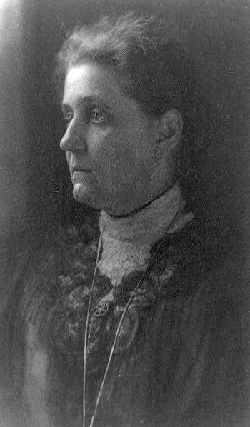
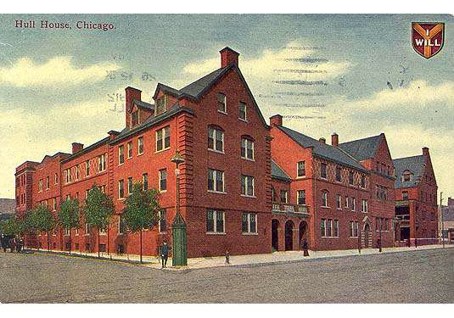
Settlement Houses
► Settlement House Movement
► Hull-House – Jane Addams
Jane Addams (1905)
Hull House (1906)

Slide 21
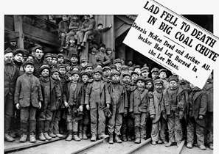
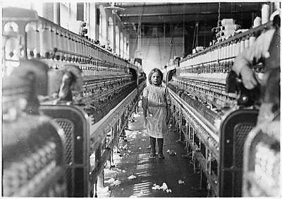
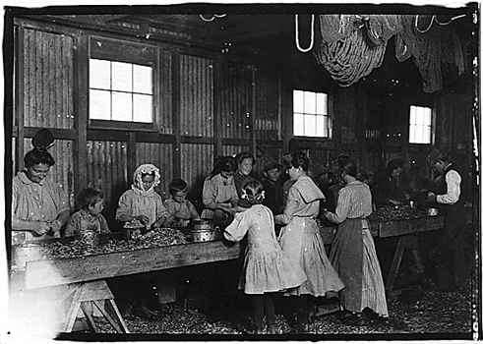
Child Labor
► Lillian Wald & Florence Kelley
► Political reforms gave a common man
► Unions condemned child labor
“Breaker Boys” Pennsylvania, 1911
Child Laborer, Newberry, S.C. 1908
Shrimp pickers in Peerless Oyster Co.
Bay St. Louis, Miss., March 3, 1911

Slide 22
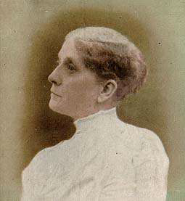
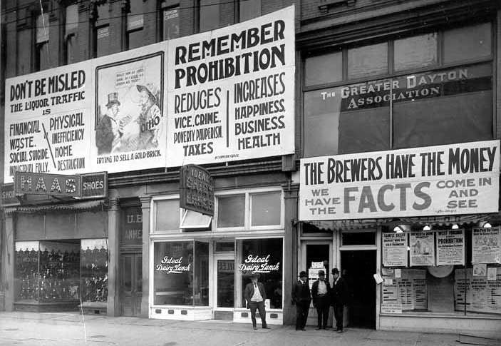
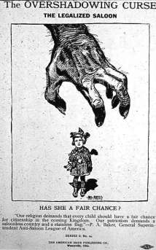
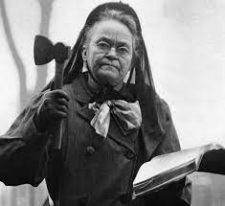
Temperance
Temperance Crusade (THE DRIES): prohibition of alcohol
Women’s Christian Temperance Union (WCTU)
Anti-saloon League
Frances Willard (1838-98),
leader of the WCTU
“Let me AXE you a question about drinking”
Carrie Nation
Anti-Salon League Campaign, Dayton Ohio

Slide 23
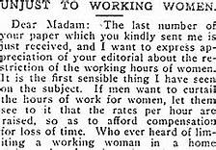
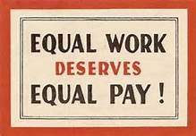
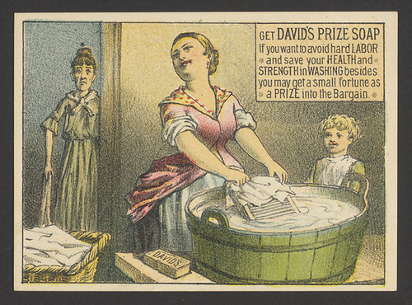
Setbacks to Progressive Movements
► Lochner v. New York 1905 – 10 workday = unconstitutional
► Muller v. Oregon 1908 – “Women, like minors, are a special class of worker that needs protection.”

Slide 24
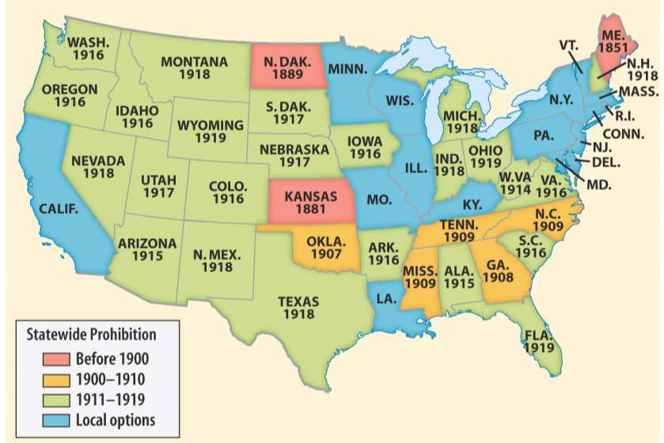
Temperance & Prohibition
18th Amendment (1919) – Prohibition of Alcohol
Prohibition on the Eve of
the 18th Amendment, 1919

Slide 25
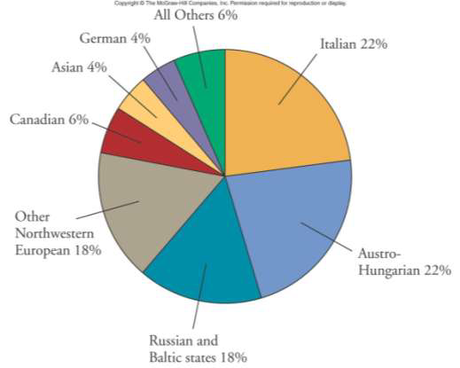
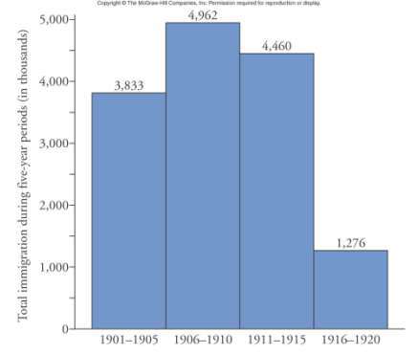
Immigration Restriction
Eugenics: promotes racial and ethnic superiority
The Passing of the Great Race – Madison Grant

Slide 26
Topic 7.4: Compare the goals and effects of the Progressive reform movement
Essential Question: Evaluate the effectiveness of social reform movements, government regulation, and political change at dealing with the ills of industrialization
Students can:
Develop a historic contextualization on the causes for the rise of Progressive Era from 1890 to 1920
Assess the effectiveness of Progressive reforms at promoting the development of the United States and dealing with the ills of industrialization, segregation, and urbanization
AGENDA
Tragedy Promotes Reform
A Progressive Presidential Transition
Champion of Progressivism
HOMEWORK: Champion of Progressivism

Slide 27
Legislative Agendas of Progressivism
Both Teddy Roosevelt and Woodrow Wilson sought to carry out reforms that Progressives had brought to light.
Identify and explain one similarity between Roosevelt’s Square Deal and Wilson’s New Freedom legislative agenda.
Identify and explain one difference between Roosevelt’s Square Deal and Wilson’s New Freedom legislative agenda.

Slide 28
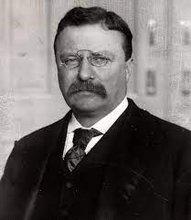
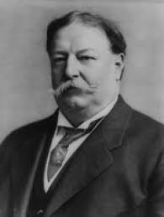
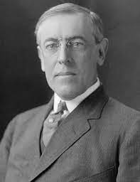
Presidents of Progressivism
26th, 27th, and 28th Presidents: Leading American in the Progressive, Imperialism, and WWI Era
26th President
Teddy Roosevelt (R)
27th President
Howard Taft (R)
28th President
Woodrow Wilson (D)

Slide 29
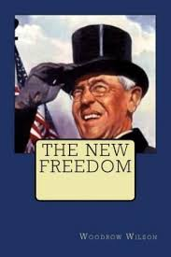
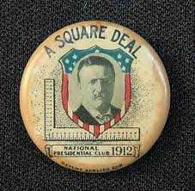
Legislative Agendas
Progressive Legislative Agendas
Teddy Roosevelt’s Square Deal (Three C’s)
Corralling Corporations
Consumer Protection
Conservation
Woodrow Wilson’s New Freedom – Triple Wall of Privilege
Trusts
Tariffs
Banks

Slide 30
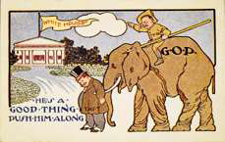
William
Howard Taft
President 1909-13
Republican
Postcard with Taft cartoon

Slide 31
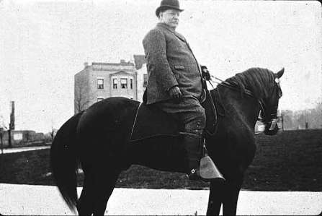
Taft’s Progressive Tests Roosevelt
Trust Busting: (99 Trust in All)
16th Amendment – Graduated Income Tax
Payne-Aldrich Tariff – Increase the tariff
Pinchot-Ballinger Affair
(Taft has) “…completely
twisted around the policies
I advocated and acted
upon.”
-Theodore Roosevelt
Taft fires Roosevelt’s appointed head of the Division of Forester
Teddy Roosevelt runs against Taft in 1912 Presidential Election

Slide 32
Election of 1912
Woodrow Wilson
Woodrow Wilson (Democrat) wins Presidential Election of 1912
Roosevelt’s Progressive Party (3rd Party spoiler) splits republican votes with Taft
Howard Taft Republican
Teddy Roosevelt – Bull Moose Party (Progressives)

Slide 33
Presidential Election of 1912

Slide 34
Factors for Change
Prompt: Which president was the greater champion of Progressive reform, Teddy Square Deal Roosevelt, or Woodrow Bashing the Triple Wall Wilson?

Slide 35
Last picture of McKinley before he was assassinated

Slide 36
Assassination of President McKinley, September 6, 1901

Slide 37
Theodore Roosevelt: the “accidental President” Republican (1901-1909)
(The New-York Historical Society)

Slide 38
Roosevelt’s “Square Deal”
► 1902 Anthracite Coal
Miners Strike
► “Square Deal”
Three C’s | Legislation | Muckraker
Consumer Protection | Meat Inspection Act of 1906 Pure Foods and Drug Act 1906 | Upton Sinclair’s “The Jungle” Dr. Wiley’s & The Poison Squad
Corralling Corporations | Enforcing Sherman’s Anti-trust Law Elkins Act 1903 Hepburn Act 1906 | Ida Tarbell “History of Standard Oil” Thorstein Veblen “The Theory of a Leisure Class”
Conservation | Newland Act 1902 | Jack London’s “Call of the Wild”

Slide 39
The “Trustbuster”
►Elkins Act 1903 (Fined RR that rebated)
► The Northern Securities Case 1904
► “Good Trust” vs. “Bad Trust”
► Hepburn Act 1906 (Expands power of the ICC)

Slide 40
Consumer Protection
► Upton Sinclair’s The Jungle
► Pure Food and Drug Act (1906)
► Meat Inspection Act (1906)
Chicago Meatpacking Workers, 1905
“A Nauseating job, but it must be done"

Slide 41
Patent Medicines

Slide 42
Conservation
►Used the Forest Reserve Act of 1891
►U.S. Forest Service (1906)
►Gifford Pinchot
►White House conference on
conservation -1908
►John Muir
Theodore Roosevelt and Gifford Pinchot, 1907
Theodore
Roosevelt &
John Muir
at Yosemite
1906

Slide 43
Conservation: National Parks & Forest

Slide 44
White House
Evaluate whether Teddy Roosevelt’s Square Deal was liberal or conservative Progressivism.
Compare one of his reforms to a muckraker or other noted progressive and evaluate whether he has met their demands.
Example Upton Sinclair’s “The Jungle”

Slide 45
William
Howard Taft
President 1909-13
Republican
Postcard with Taft cartoon

Slide 46
Taft’s Progressive Accomplishments
► trust-busting ► BUT: Caused split in
► forest and oil reserves Republican Party
► Sixteenth Amendment Payne-Aldrich Tariff (1909)
Pinchot-Ballinger Controversy
(Taft has) “…completely
twisted around the policies
I advocated and acted
upon.”
-Theodore Roosevelt

Slide 47
Election of 1912
►Woodrow Wilson
►Progressive Party
(“Bull Moose party”)
►“New Nationalism”
(Roosevelts Presidential agenda)
Woodrow Wilson

Slide 48
Woodrow Wilson
2nd Democrat president since Zachary Taylor
Southerner raised in the Confederacy
Believes Congress needs a strong leader
to guide it

Slide 49
A Democrat in the White House
Evaluate the political cartoon using APPARTS
Summarize how the political cartoon demonstrates the personal character of Woodrow Wilson and his presidency

Slide 50
Wilson
Woodrow Wilson
► “New Freedom” attack against the Triple Wall of Privilege
(Banking, Trust, & Tariffs)
► Underwood Simmons Tariff (1913)
► Federal Reserve Act (1913)
Louis Brandeis – “Other People’s Money
and How Banks Use it”
► Federal Trade Commission Act (1914)
► Clayton Anti-Trust Act (1914)
► Keating-Owen Act (1916)
Wilson at the peak of his power

Slide 51
Federal Reserve System
► Federal Reserve Act

Slide 52
Essential Question
To what extent did economic and political developments as well as the assumptions about the nature of women affect the position of American women during the period 1890-1925?

Slide 53
Topic 7.4: Compare the goals and effects of the Progressive reform movement
Essential Question: Evaluate the effectiveness of social reform movements, government regulation, and political change at dealing with the ills of industrialization
Students can:
Develop a historic contextualization on the causes for the rise of Progressive Era from 1890 to 1920
Assess the effectiveness of Progressive reforms at promoting the development of the United States and dealing with the ills of industrialization, segregation, and urbanization
AGENDA
Champion of Progressivism
Women’s Equality
Women in the Progressive Age
HOMEWORK: Women in the Progressive Era Plan

Slide 54
Champion of Progressivism
Identify the following as (S) Square Deal (Teddy Roosevelt) or (N) New Freedom (Woodrow Wilson)
__ 1. Federal Reserve Act
__ 2. Hepburn Act
__ 3. Good v. Bad Trust
__ 4. Underwood Tariff Act
__ 5. Reclamation Act
__ 6. Clayton Anti-Trust Act
__ 7. U.S. Forest Agency
__ 8. Keating-Owens Act
__ 9. Pure Foods & Drugs Act
__ 10. Trustbuster
__ 11. Meat Inspection Act

Slide 55
Women
“women’s professions” nursing, secretary, teaching, factory labor
Muller v. Oregon (1903) – Women require special treatment in the workplace
Cult of Domesticity (Separate Spheres – women place is in the home)
“New woman” – women married later, gained education, & fought for suffrage
Moral Keepers: women’s clubs focused
on the betterment of society
A local club for nurses was formed in New York City in 1894. Here the club members are pictured in their clubhouse reception area.
(Photo courtesy of the Women's History and Resource Center, General Federation of Women's Clubs.)
The Women's Club of Madison, Wisconsin conducted classes in food, nutrition, and sewing for recent immigrants. (Photo courtesy of the Women's History and Resource Center, General Federation of Women's Clubs.)

Slide 56
Women Suffrage
Susan B. Anthony & Elizabeth Cady Stanton

Slide 57
Woman Suffrage
National American Woman Suffrage
Association (NAWSA)
► Carrie Chapman Catt – (republican motherhood
argument)
Ohio Woman Suffrage Headquarters,
Cleveland, 1912

Slide 58
Women’s Suffrage before 1920

Slide 59
Women Suffrage
Suffragette Banner
1918 (Silent sentinels)
National Woman’s Party – Alice Paul
(radical movement)
Ex. Silent Sentinels
19th Amendment: Women’s Suffrage
Equality Amendment: end pay inequality, marriage inequality, property rights, etc.
National Woman’s Party members picketing in front of the White House, 1917
19th Amendment

Slide 60
Women Suffrage

Slide 61
LEQ
Prompt: Evaluate the extent to which women’s lives changed during the Progressive Era (1890–1920) of United States History.

Slide 62
Topic 7.4: Compare the goals and effects of the Progressive reform movement
Essential Question: Evaluate the effectiveness of social reform movements, government regulation, and political change at dealing with the ills of industrialization
Students can:
Develop a historic contextualization on the causes for the rise of Progressive Era from 1890 to 1920
Assess the effectiveness of Progressive reforms at promoting the development of the United States and dealing with the ills of industrialization, segregation, and urbanization
AGENDA
Editorial Moment
Women in the Progressive Age Essay
HOMEWORK: Imperialism Causation

Slide 63
LEQ
Prompt: Evaluate the extent to which women’s lives changed during the Progressive Era (1890–1920) of United States History.

Slide 64
Essential Question
Booker T. Washington and W.E.B. Du Bois offered different strategies for dealing with the problems of poverty and discrimination faced by black Americans at the end of the nineteenth and beginning of the twentieth centuries. How appropriate were each of these strategies (considering the context in which each was developed)?

Slide 65
Black Population 1920

Slide 66
African-Americans
►Booker T. Washington
►W.E.B. Du Bois
►Niagara Movement
►“talented tenth”
►NAACP
WEB Dubois
Booker T. Washington

Slide 67
Factors for Change

