Slide 1
Happy Halloween kids

Slide 2
Empires: Administration
Topic 2
Unit 3
pp. 155-163

Slide 3
Context
Centralization of power by taxing, having an army, and a universifing faith led to powerful leaders
in Europe (kings)
In Russia (czars)
In Islamic Empires (sultan or shah)
In China (Confucian emperor was restored)
The Inca and Japanese also saw strong leaders using these methods of CENTRALIZATION OF CONTROL

Slide 4
Europe
Divine right of kings: England’s King James epitomized the idea that a king was chosen by God. No human can question that-
above the law & any earthly authority
Tudor England
Justices of the peace and sheriffs helped maintain peace & enforce laws
English Bill of Rights 1688 Parliament permanently weakened the absolute power of the English monarch
Key People: Henry VIII, Elizabeth I, William and Mary

Slide 5
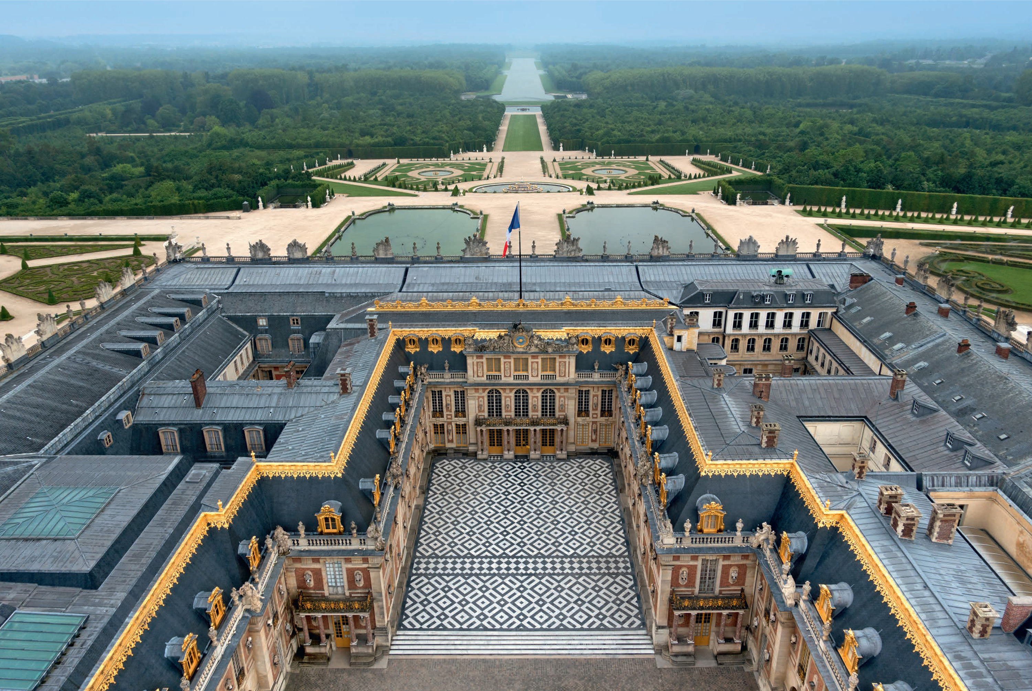
France
Absolutism: unlimited power of the Sun King (Louis XIV)
Administration led by Cardinal Richelieu and run by intendants (tax farmers)
Intendants ran each province while nobles were kept busy (having fun) at the Parisian palace of Versailles

Slide 6
Russia
Boyers (landlords) dominated Russia with almost total control over the serfs. This was an effect of taxing to pay tribute to Mongols
Ivan IV took steps to weaken the Boyers in order to consolidate his power
Took land
Force nobles to live in Moscow
oprichnina paramilitary force helped scare nobles

Slide 7
Peter the Great
Started the Romanov dynasty by forcing his sister into a convent
Centralized by…
Defending Orthodox Christian church
Created governmental provinces
Created a senate to advise local officials when he was awy

Slide 8
The Ottomans
Devshirme: Sultans selected officials to staff military/bureaucracy
Janissaries: elite foot soldiers expert with guns (Christian boys were trained)
Both systems helped integrate newly captured Christian lands into the fabric of the Empire

