Slide 1
Critical Consumerism
EPF Unit 8 – Factors that guide our purchasing decision

Slide 2
Part I: Informed Purchasing

Slide 3
Essential Standards
EPF.CC.1 Understand factors associated with consumer decision making
EPF.CC.2 Understand the rights and responsibilities of buyers and sellers under consumer protection laws
Essential Question: How does individual learn and practice good habits in the purchase of goods and services in the U.S. market economy?
Students can:
Identify what consumerism is and its impact on my buying habits
Evaluate critical consumer practices to evaluate how various factors influence my consumption choices
AGENDA
Let’s GO SHOPPING
Becoming Informed Consumer
Brand awareness
HOMEWORK:
Current Events Journal 4 – due 5/10
Stock Market Game

Slide 4
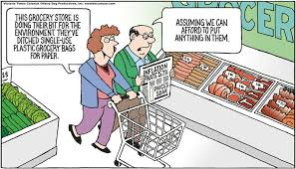
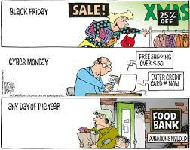
Let’s Go Shopping
You have budgeted well and have the money to go shopping for your choice of product (Clothes, shoes, new cell phone, computer, etc…)
Describe how you shop for an item you want. (Consider what factors influence your choice of product)
Now consider an item that is really important, such as an automobile. What factors should you consider in purchasing a big-ticket item, such as a car or an appliance?

Slide 5
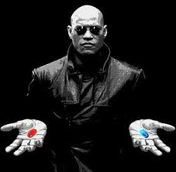
Making Choices has Impact
Consumerism: how individuals and groups choose, or support goods and services based on a variety of factors
How do I know which is better?
What factors can consumer use in selecting the right good or service?
Price
Quality
Accessibility
Safety
Satisfaction
Health benefits
Social prestige

Slide 6
Top Sellers on Amazon

Slide 7
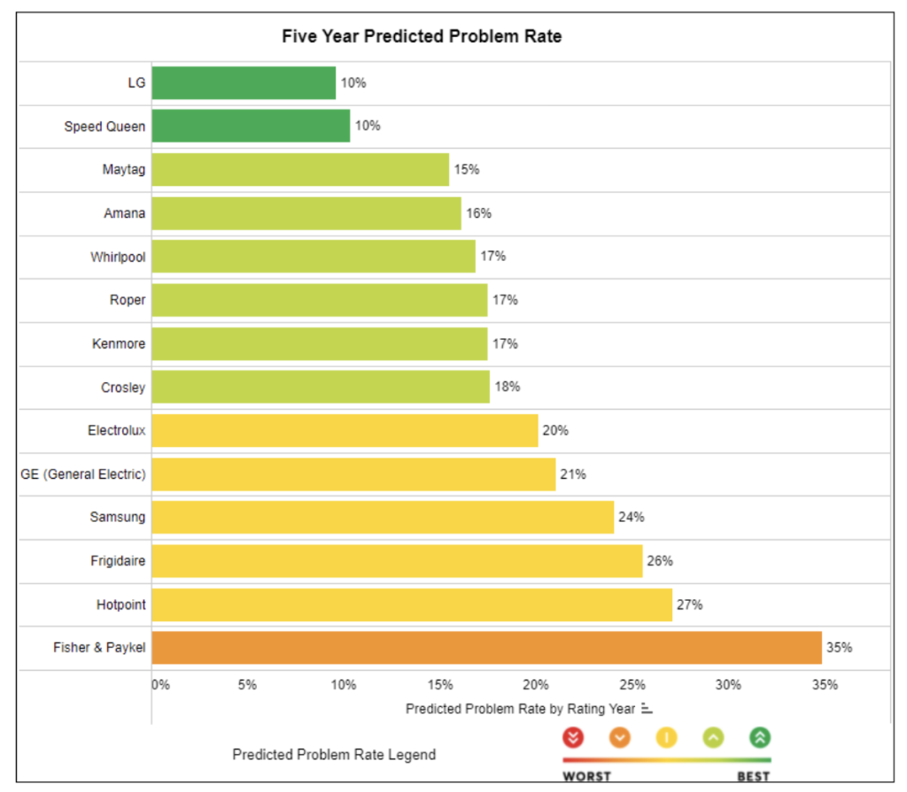
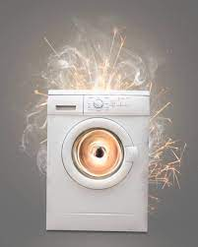
Train to be a Wise Consumer
Consumption is the sole end and purpose of all production; and the interest of the producer ought to be attended to, only so far as it may be necessary for promoting that of the consumer.
- Adam Smith, “Wealth of Nations”
Consumer education: learning how to evaluate products based on criteria
Example – how it is made, why it costs what it does, who is the intended user, and how a product is used
Agents of information for consumers
Producer of the product
Government
Firsthand accounts or testimonials
Social media
Consumer Reports

Slide 8
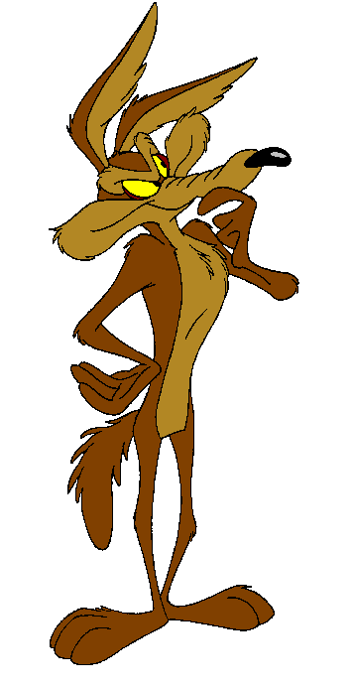
The Age of Social Media
Social Media as a source for informing a consumer – the age of information or biased opinions?
Social Media?
PROS of Social Media
CONS of Social Media
First handle accounts of product quality
Detailed and visuals on product performance
Can be expanded and updated
Marketing tool for producers
Haves vs. Have Nots mentality
Messaging to Children: you are what you consume
Not everyone uses social media
Targeting: algrorithums target users

Slide 9
Social Media Effect

Slide 10
Social Media Platform by Demographic

Slide 11
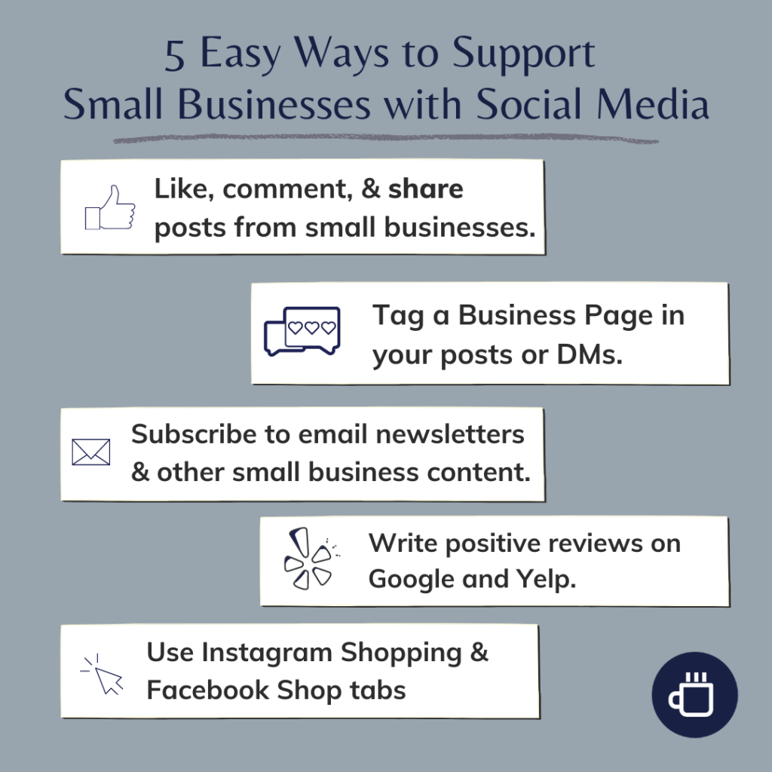
Show your social media support

Slide 12
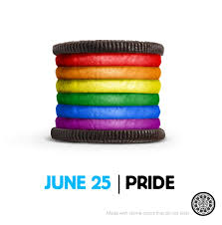
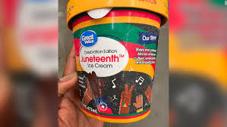
Awareness is Key
Brand awareness: The familiarity consumers are with specific products, services, and those who provide them
Factors of Brand Awareness - logos, design, entrepreneurs, and geographic/cultural origin
Can be used to raise awareness of social & political concerns
Ex. Pride month, Juneteenth, Women’s Health, Going Green, Israel vs. Palestine, etc

Slide 13
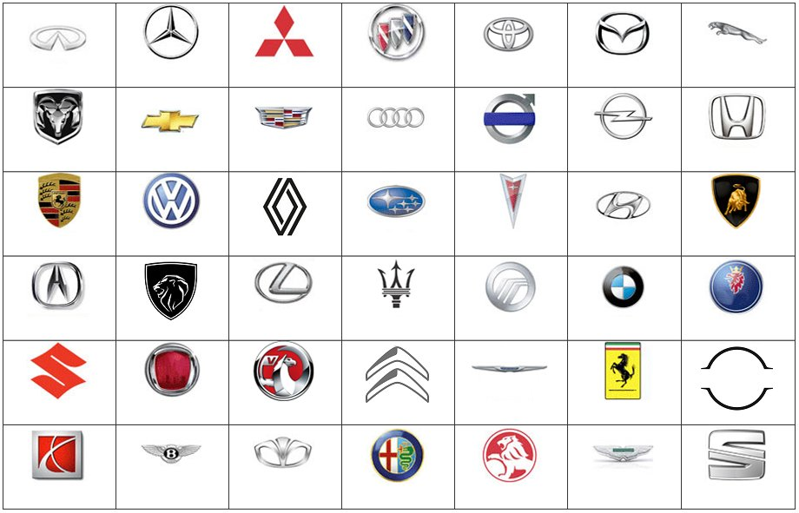
Logos – Do you know?
Logo test

Slide 14
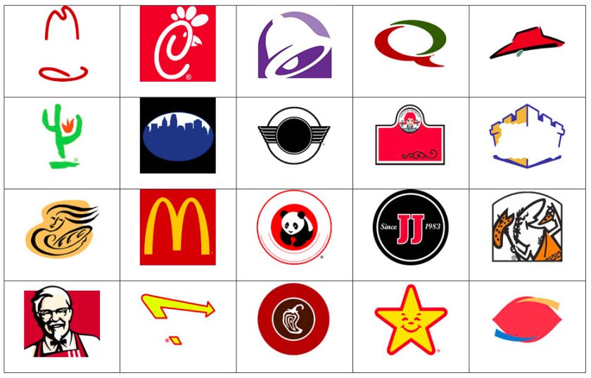
Logos – Do you know?
Fast Food Logos

Slide 15
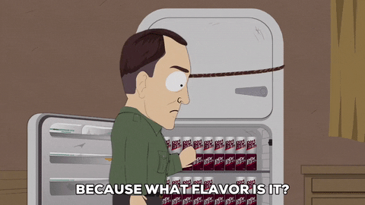
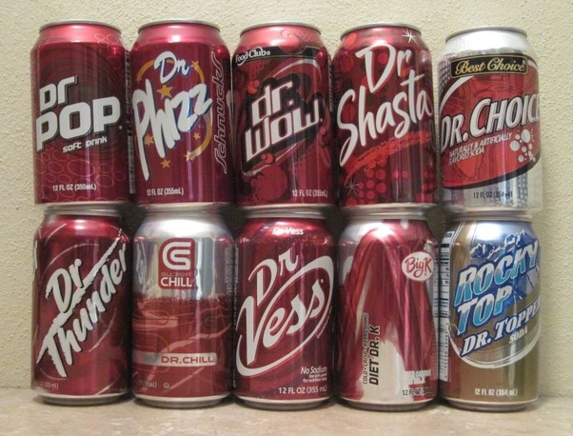
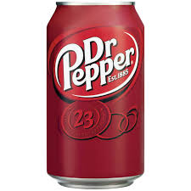
Consumer Values Products
Perceived value: is how customers evaluate the merits of a product or service based on how they meet their individual or group needs and expectations
Hypercritical in peer comparison
Name-brand vs. “Off-brand” or “Bargain-brand”
Vs.

Slide 16
Essential Standards
EPF.CC.1 Understand factors associated with consumer decision making
EPF.CC.2 Understand the rights and responsibilities of buyers and sellers under consumer protection laws
Essential Question: How does individual learn and practice good habits in the purchase of goods and services in the U.S. market economy?
Students can:
Identify what consumerism is and its impact on my buying habits
Evaluate critical consumer practices to evaluate how various factors influence my consumption choices
AGENDA
Advertisers’ BLITZ
Consumer Safety
Brand awareness
HOMEWORK:
Current Events Journal 4 – due 5/10
Stock Market Game

Slide 17
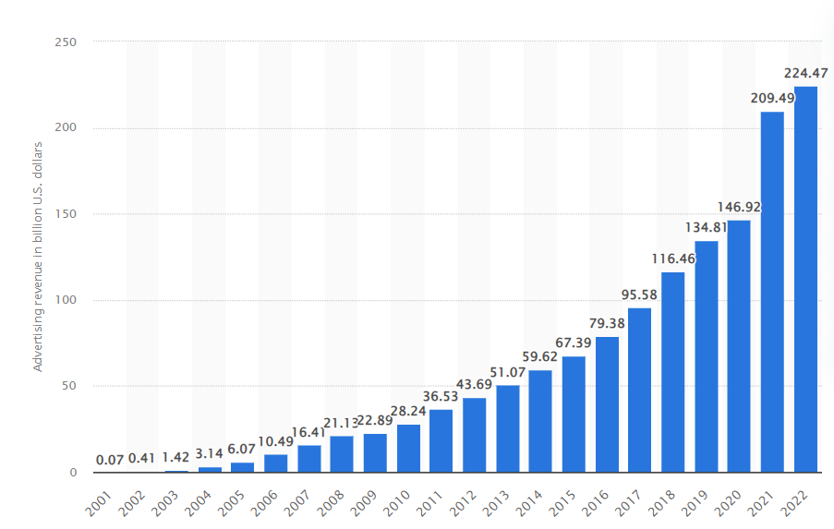
Advertisers’ Blitz
Evaluate power of advertising
Identify a trend the graph on the advertisements.
Describe ONE reason the trend in advertising exist.
How many advertisements you have seen or heard today?
Where have you seen or heard advertisements for products today?
How many ads we see 2000 -2022

Slide 18
Calculating Perceived Value
Formula for perceived

Slide 19
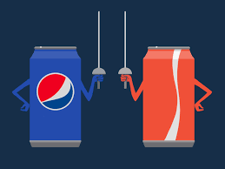
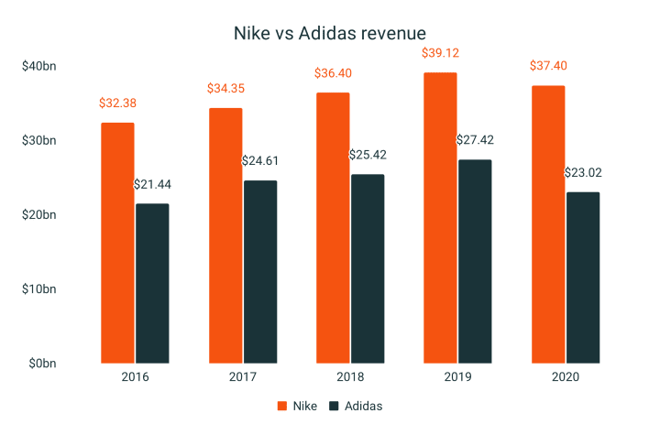
The Consumer is King
Consumers make decisions about what products or services to buy in four different styles:
Complex - Relates to expensive “big ticket” items; car, house, boat
Intensive research due to stronger commitment due to cost
Dissonance-Reducing - Intensive research because the buyer can’t pinpoint difference in value – flat screen TVs, laptops, vacations
Worry their choice may not be the best later on
Habitual - Occurs on a frequent, every-day basis
Daily - weekly - monthly: groceries, hygiene, fuel
Variety-Seeking - Happens when consumers bounce from brand to brand in product line: Crest vs. Colgate vs. Tom’s vs. Sensodyne

Slide 20
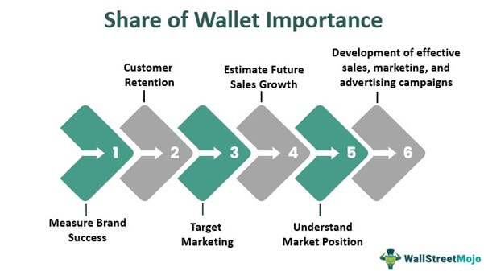
Loyalty
Customer Loyalty: producers develop a positive relationships with customers to encourage repeat purchases
Develop Share of Wallet (SOW) – the amount an average customer regularly devotes to a brand instead of a competitors
Golden Rule: Customer satisfaction = PROFIT $$$
Incentives for customer loyalty
Quality product
Discounts
Savings incentives

Slide 21
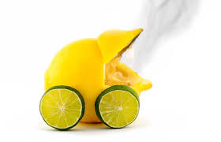
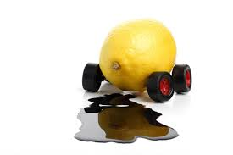
Consumer Protection
Lemon Law: legislations that protections consumers from goods and services consider unsafe or poor quality
Typically applies to automobiles and electronics
Guidelines – multiple failures

Slide 22
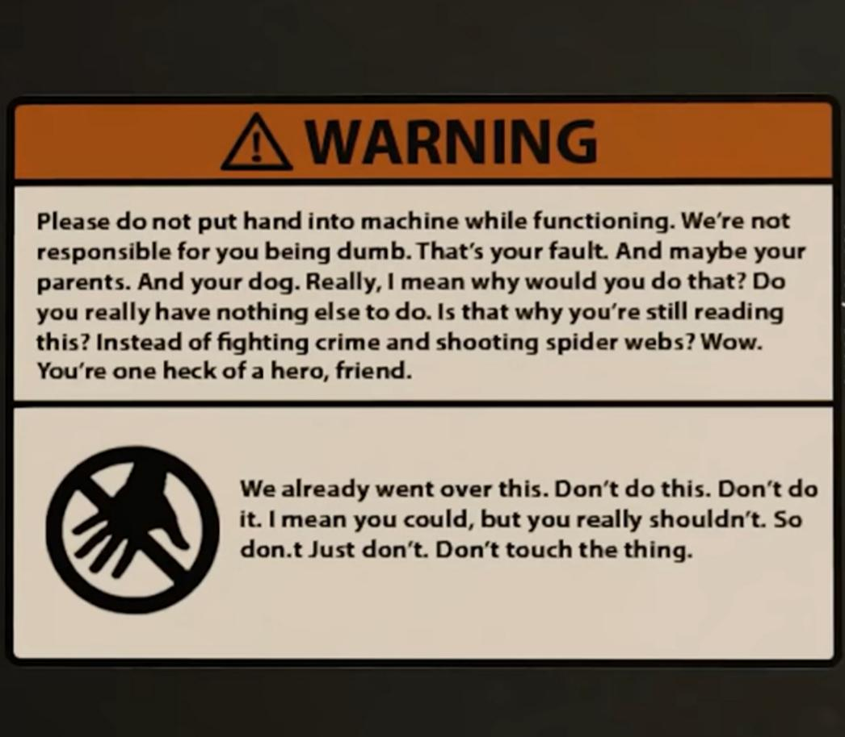
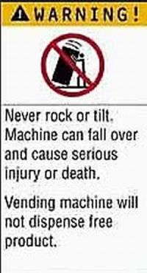
WARNING!!!!!!
Warning labels: Legal notifications directly provided and accessible to consumers by producers on their goods/services
Stated: plain verbiage (easily seen & understand)
Awareness of health risk (LIABILITY)
Images – for those who cannot read
Read manual before using

Slide 23
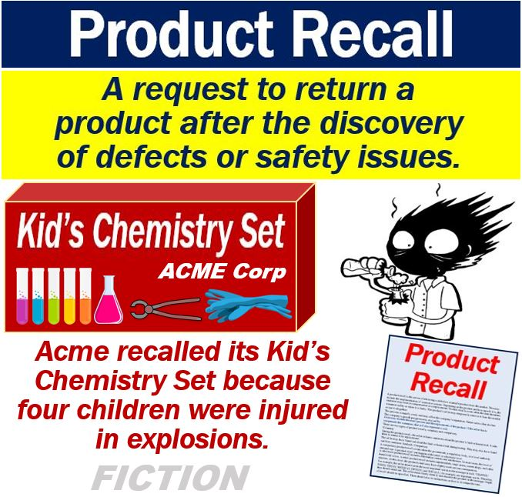
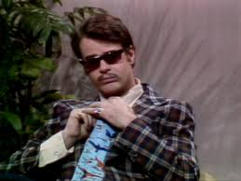
RECALL – Product Safety
Recalls: require consumers to be made aware of life-threatening defects or concerns that have been reported for any item sold in the country
Government agency over product safety: Consumer Product Safety Commission
Repair, replacement, or compensation is the usual path a producer will take to resolve the concern
Little Johnny Astronaut costume is totally safe
MAINWAY TOYS = UNSAFE

Slide 24
Rating Businesses
Better Business Bureau: serves as an agency to protect consumers from businesses that mistreat them in action, service, or financing
Nonprofit agency
Ranks businesses based on fairness, reliability & performance
Helps resolve customer business conflicts

Slide 25
Essential Standards
EPF.CC.1 Understand factors associated with consumer decision making
EPF.CC.2 Understand the rights and responsibilities of buyers and sellers under consumer protection laws
Essential Question: How does individual learn and practice good habits in the purchase of goods and services in the U.S. market economy?
Students can:
Identify what consumerism is and its impact on my buying habits
Evaluate critical consumer practices to evaluate how various factors influence my consumption choices
AGENDA
Stock Check-in
The Power of Social Media
Influence your will power to buy
HOMEWORK:
Current Events Journal 4 – due 5/10
Stock Market Game

Slide 26
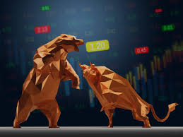
Bull or Bear Market
Check in on your investments
Invest more if you have not already spent the whole amount
Evaluate what stocks are doing well and why
Evaluate what changes you need to make to your portfolio

Slide 27
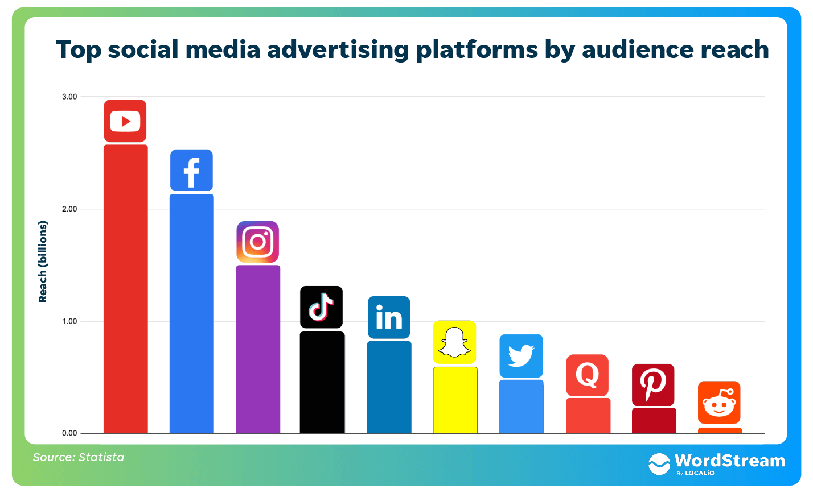
The Power of Social Media
The power of Social Media to reach customers
Social Media advertising - $1.28 Billion
Discoverability – how often internet user (Ages 16-64 years old) find products on social media = 26.8%
Retargeting – companies that use your Instagram and Facebook to target ads = 77%
How does social media advertising impact you?
Advantages of using social media
Wider reach – 5.07 Billion users
Targeting – identify specific groups to focus advertising
Improve engagement – allows for active engagement
Measurable – business can measure their results
Saves money – cheaper to advertise

Slide 28
Essential Standards
EPF.CC.1 Understand factors associated with consumer decision making
EPF.CC.2 Understand the rights and responsibilities of buyers and sellers under consumer protection laws
Essential Question: How does individual learn and practice good habits in the purchase of goods and services in the U.S. market economy?
Students can:
Identify what consumerism is and its impact on my buying habits
Evaluate critical consumer practices to evaluate how various factors influence my consumption choices
AGENDA
Consumerism check in
Guiding purchases
The Power of Social Media
HOMEWORK:
Current Events Journal 4 – due 5/10
Stock Market Game

Slide 29
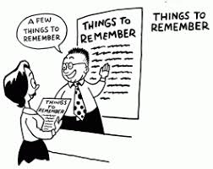
Critical Consumer Check-in
What are two factors one should consider when purchasing any good or service?
Identify two ways a consumer can become informed about a product.
Define what it is meant by brand awareness.
How can a seller or producer of a good or service create consumer loyalty to a product?
What allows one to return a product within a certain set of time after the purchase date if it fails multiple times?

Slide 30
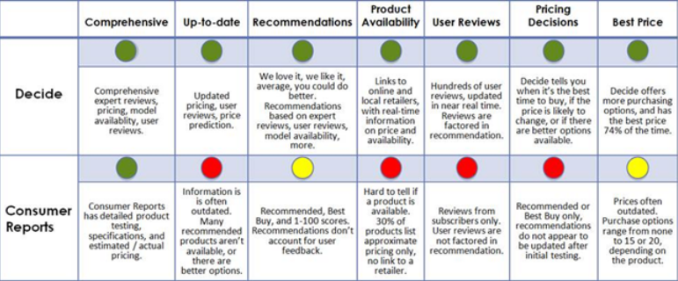
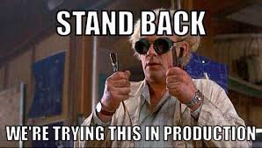
Independently Tested
Consumer Reports: provides intense research and results to consumers on all major and minor goods and services available in the U.S.
Key goal: enhance consumer decision making and maintain consumer/public safety

Slide 31
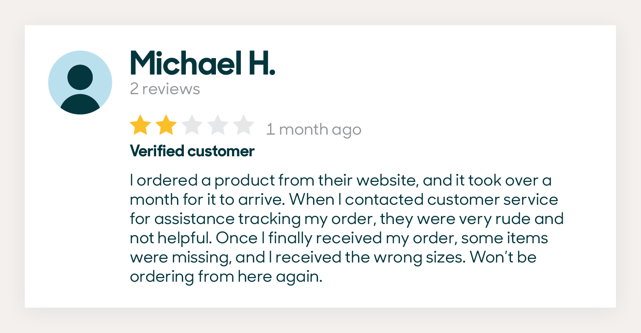
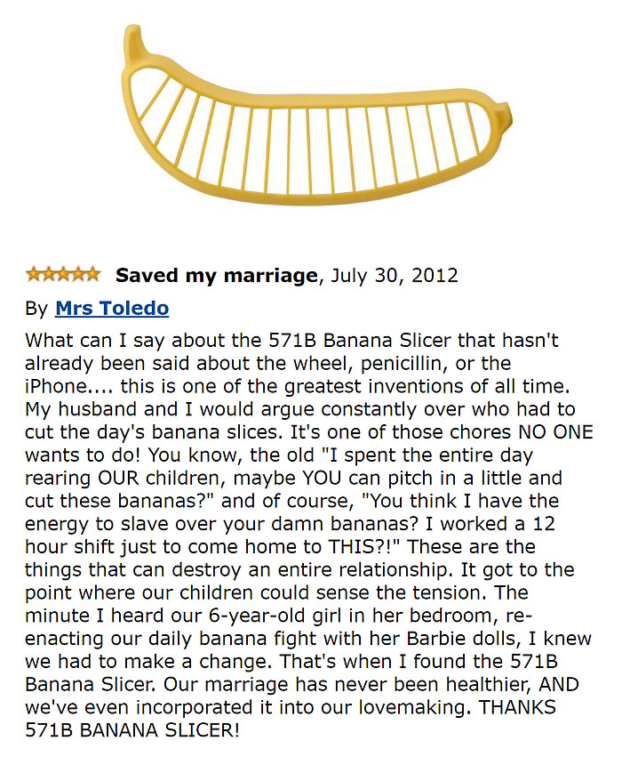
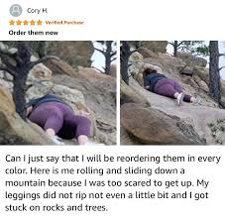
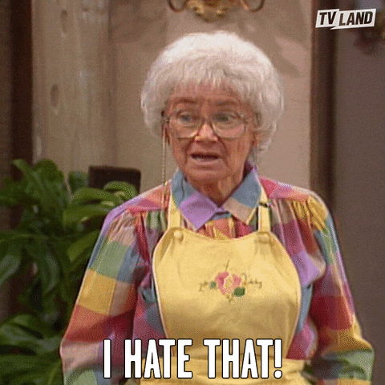
Other Product Quality Insights
Market research: online analysis of the public and its view or perception of the viability of a company and/or its goods and services
Product reviews: business are legally required to allow to custom to give feedback on goods and services
Business can leave feedback – clarify misconceptions

Slide 32
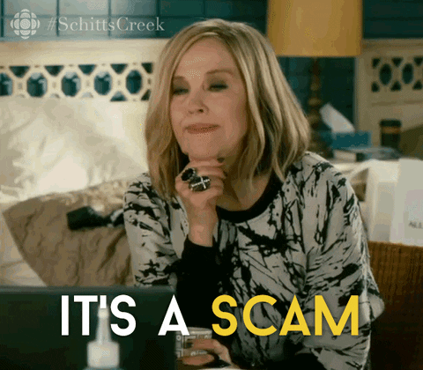
Scams, Lies, & Dirty Tricks
Fraudulent solicitation: a scam meant to scare or manipulate an individual or group into paying money, giving up personal/private information, or purchase something or face consequences
Frequently target: the elderly
Ex. Phone calls – false claims of bank errors or testing the system

Slide 33
Part II: Advertising

Slide 34
Essential Standards
EPF.CC.1 Understand factors associated with consumer decision making
EPF.CC.2 Understand the rights and responsibilities of buyers and sellers under consumer protection laws
Essential Question: How does individual learn and practice good habits in the purchase of goods and services in the U.S. market economy?
Students can:
Identify what consumerism is and its impact on my buying habits
Evaluate critical consumer practices to evaluate how various factors influence my consumption choices
AGENDA
Super Advertisements
Propaganda of Commercialism
As Seen on TV, Social Media, Billboards, and Everywhere
HOMEWORK:
Current Events Journal 4 – due 5/10
Stock Market Game

Slide 35
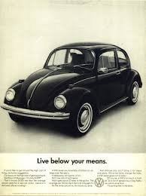
Super Ads
Evaluate what techniques that the advertiser is using to influence you as a consumer.
Volkswagen - Buggy
Pfizer
State Farm
Etrade

Slide 36
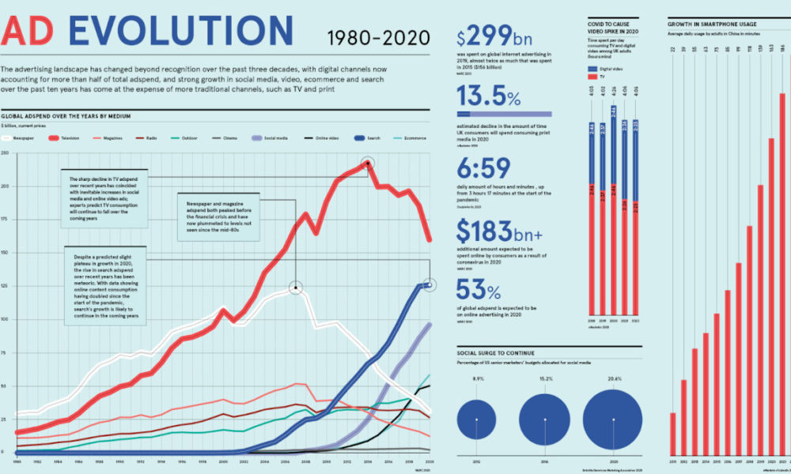
Seen it on TV, Social Media, T-shirts
Advertising: an industry that markets goods and services to encourage consumers to make purchases
Uses variety of method to entice consumers (Ex. Print, Digital, Demonstration, etc.)
Stok Coffee Ad

Slide 37
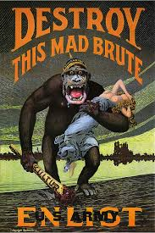
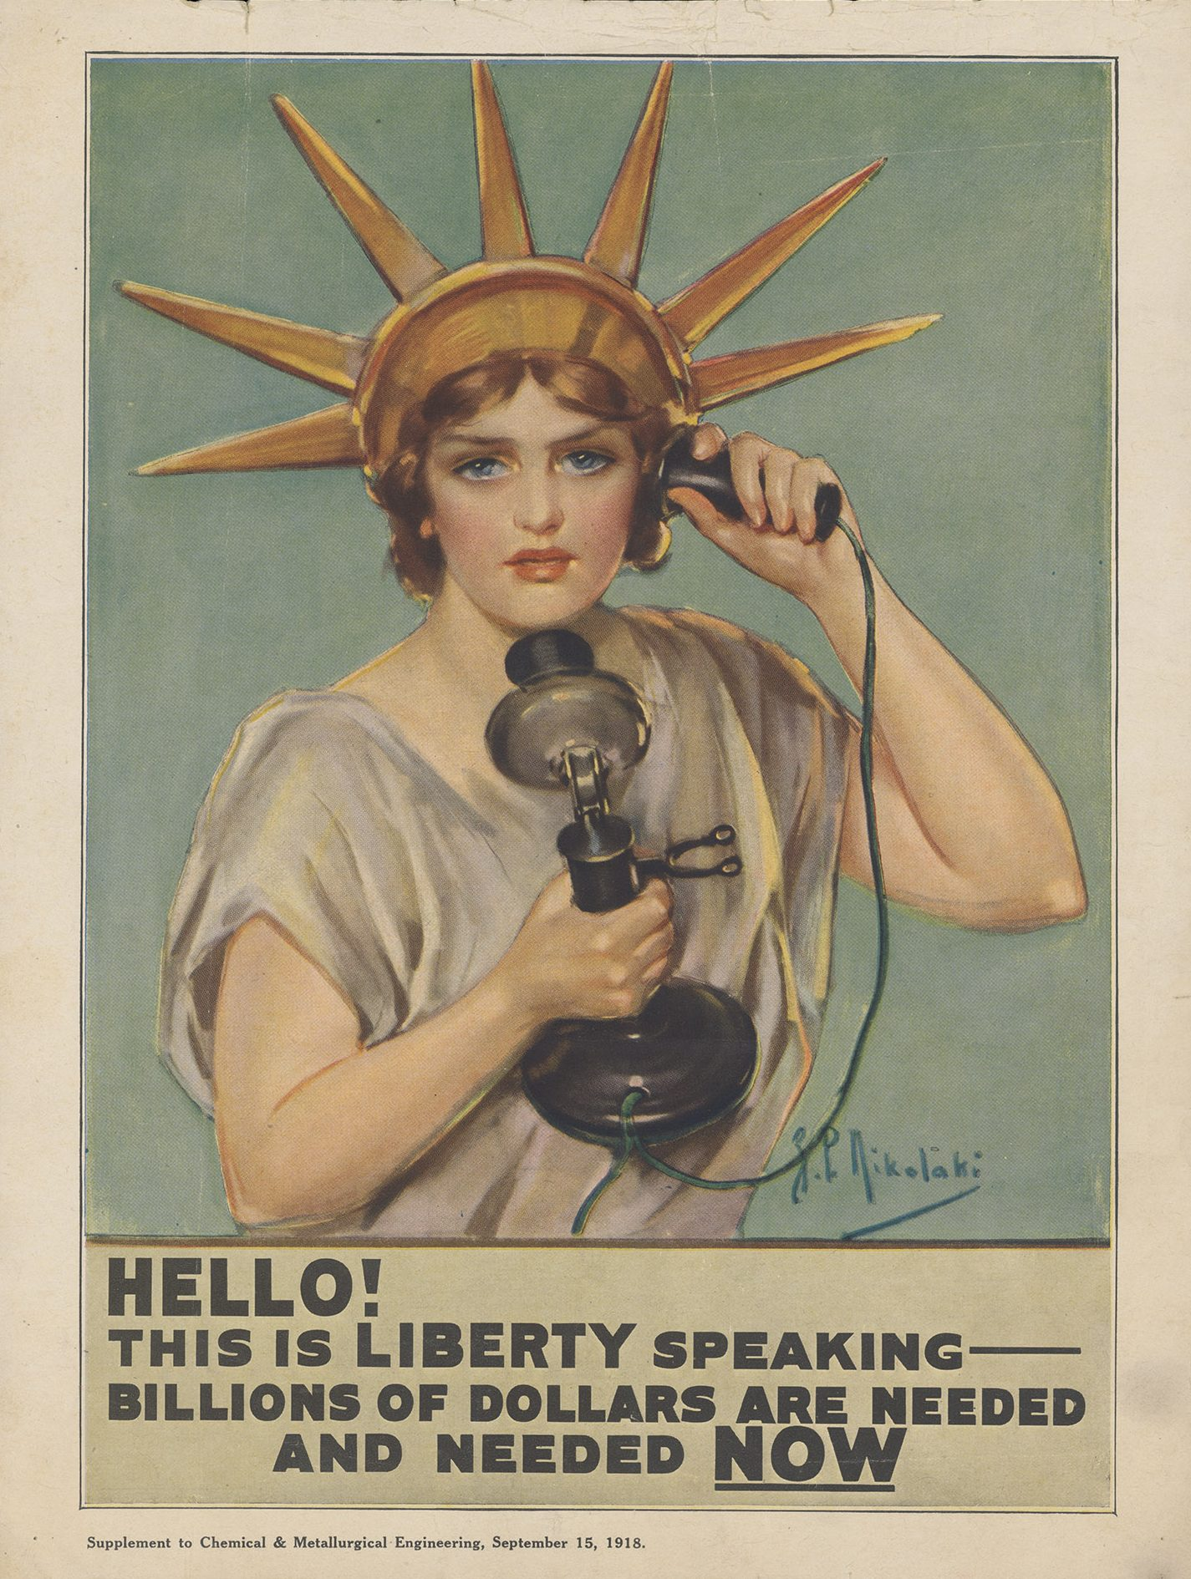
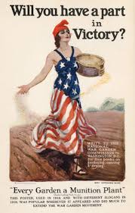
Building Enticement
Propaganda: a technique used to influence a person’s opinion, emotions, attitudes, or behavior
Effective propaganda
It appeals to emotion instead of intellect
Negative or positive messaging
Goal: TO PRESUADE

Slide 38
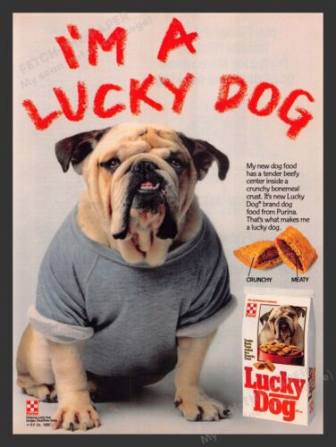
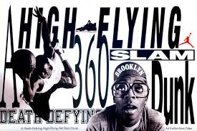
Guidelines for a Good Ad
FOUR Qualities of Good Advertisements
Attracts Attention: attractive COLORS, BOLD HEADINGS, & Pictures
Arouses interest: Good word choice
Creates desire: makes you believe you WANT IT
Cause action: sells products to target audience

Slide 39
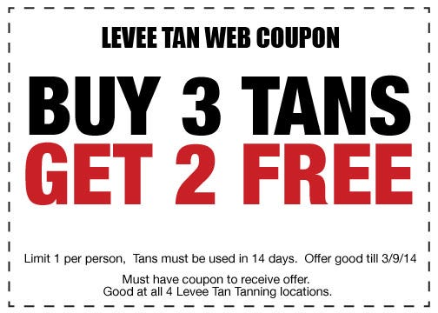
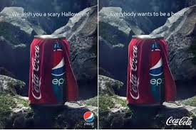
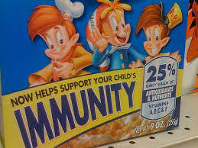
No-Nos of Advertising
Illegal advertising techniques
Bait & Switch: offering a person a desirable product and then switch it for a less desirable one
Subliminal advertising: a method using hidden message or sounds to influence buyers
False claims: using untrue statements

Slide 40
Techniques to get you to buy
Advertisers use a variety of techniques to encourage you to buy their product
Examples:
Color psychology – using color schemes to convey message
Repetition– playing an advertisement over and over again on various mediums
Body language – Using body language to transmit a message

Slide 41
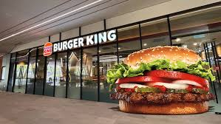
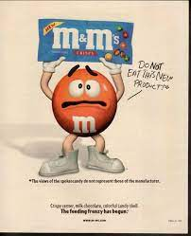
Making Choices has Impact
Other Marketing Techniques
Association– use a visual to make the viewer associate a feeling
Symbols – use a symbols to convey a message
Anthropomorphism – giving life to inanimate object

Slide 42
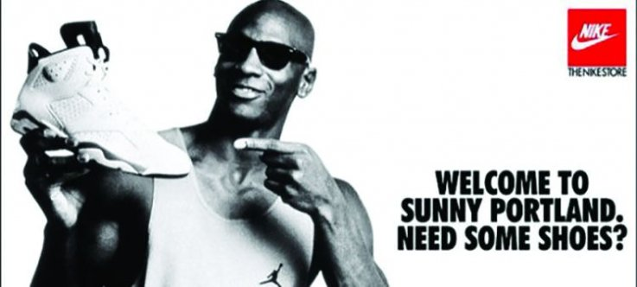
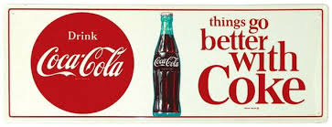
Techniques of Enticement
Techniques use to market products by advertisement
Authority bandwagon
Buzzwords
Endorsements
Facts & Figures
Fear
Glittering Generality
Free/Bargain/Reward
Loaded Words
Name calling
Plain Folks
Repetition
Testimonial
Transference
Urgency
Bundling

Slide 43
Dark Techniques

Slide 44
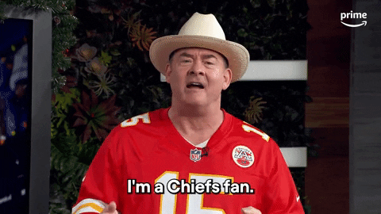
Types of Advertising
Bandwagon: everyone is doing it and if you aren’t you’re a loser who will wake up with regret and everyone laughing at you…in your room

Slide 45
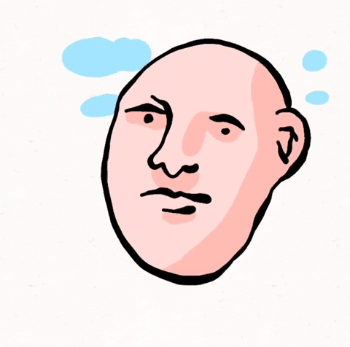
Types of Advertising
Buzzwords: unique, catchy terms meant to be seen/heard and connected to high quality/value
Bespoke; tailored to one person
Phygital; merging digital and physical experiences
Artificial Intelligence (AI)
Data
Hyperlocal; tailored to a specific geographic place
Freemium; basic level is free, good features has to be paid for

Slide 46
Types of Advertising
Endorsement: famous person said buy this, and people who like them are like, “Okay. I will. Thanks Dwayne “The Rock” Johnson”

Slide 47
Types of Advertising
Facts and Figures: A company using data points and statistics to validate quality or popularity

Slide 48
Types of Advertising
Fear- If you don’t do this bad s%^$ will happen

Slide 49
Types of Advertising
Free/Bargain/Rewards- offering incentives to come back

Slide 51
Types of Advertising
Informative - focuses on presenting factual information and increasing consumer awareness to aid informed decision-making

Slide 52
Types of Advertising
Glittering Generalities - Using words that are positive and appealing, but too vague to have any real meaning

Slide 53
Types of Advertising
Loaded Words - Words that are emotionally charged, either positively or negatively
Buzzwords, fashionable or trendy words

Slide 55
Types of Advertising
Name Calling - a person or product is linked to a negative symbol

Slide 57
Types of Advertising
Snob Appeal - makes the case that using the product means the consumer is better/smarter/richer than everyone else

Slide 59
Types of Advertising
Repetition- repeating a message multiple times in order to increase brand awareness and consumer recall.
Ex- a commercial that comes on all the time, or placing the brand in as many places as possible

Slide 60
Types of Advertising
Testimonial - a statement from a customer about how a product or service has benefitted them and often includes them recommending it.
Testimonial advertising uses these authentic customer reviews in ad copy and creative to build trust in potential customers

Slide 62
Types of Advertising
Plain Folks - using testimonials of ordinary people

Slide 63
Types of Advertising
Transference- Attempts to make the audience associate positive words, images, and ideas with a product and its users.
Can include endorsements

Slide 64
Types of Advertising
Urgency- tactic where businesses use phrasing around scarcity, immediacy, or timeliness to compel consumers to make a purchase.
“Hurry! Act now!”
Limited time only
Expires soon

Slide 66
Types of Advertising
Bundling- companies try to sell several products or services together as a combined unit
Usually a discount is provided to incentivize
Ex- bundling home and auto insurance

Slide 68
Essential Standards
EPF.CC.1 Understand factors associated with consumer decision making
EPF.CC.2 Understand the rights and responsibilities of buyers and sellers under consumer protection laws
Essential Question: How does individual learn and practice good habits in the purchase of goods and services in the U.S. market economy?
Students can:
Identify what consumerism is and its impact on my buying habits
Evaluate critical consumer practices to evaluate how various factors influence my consumption choices
AGENDA
Advertising techniques
As Seen on TV, Social Media, Billboards, and Everywhere
Product comparison
HOMEWORK:
Product comparison
Current Events Journal 4 – due 5/10
Stock Market Game

Slide 69
AD Techniques
Identify the following advertising techniques
Advertisement A
Advertisement B
Advertisement C
Advertisement D
Advertisement E
Advertisement F

Slide 70
Product Comparison
Compare two products that are competitors
3 Tasks
TASK 1 – Comparison
Pricing research
Evaluate perceived value & prestige
Construct a product review via a demo
TASK 2 – Advertising
Social media presence
Techniques used to advertise (Have examples – digital & print)
Create a unique ad for ONE of the products
TASK 3 – Consumer Protection
Official timeline of product recalls
Review by the BBB
5 testimonials of the product found online
VS.

Slide 71
Product Research
Select your product from the list
Select two competitors in the classification
Research price information
Consider:
The cost of the product – comparison shop (Amazon, Grocery stores, Walmart, Target, etc. . .)
Does it need refills – if so, how much does that cost, how often are refills needs
Maintenance & upkeep requirements/costs

Slide 72
Essential Standards
EPF.CC.1 Understand factors associated with consumer decision making
EPF.CC.2 Understand the rights and responsibilities of buyers and sellers under consumer protection laws
Essential Question: How does individual learn and practice good habits in the purchase of goods and services in the U.S. market economy?
Students can:
Identify what consumerism is and its impact on my buying habits
Evaluate critical consumer practices to evaluate how various factors influence my consumption choices
AGENDA
Stock Market Game Check-in
Product comparison Power Point Setup
Price v. Perceived Value
HOMEWORK:
Product comparison
Current Events Journal 4 – due 5/10
Stock Market Game

Slide 73
Bull or Bear Market
Check in on your investments
Invest more if you have not already spent the whole amount
Evaluate what stocks are doing well and why
Evaluate what changes you need to make to your portfolio

Slide 74
Product Comparison
Compare two products that are competitors
3 Tasks
TASK 1 – Comparison
Pricing research
Evaluate perceived value & prestige
Construct a product review via a demo
TASK 2 – Advertising
Social media presence
Techniques used to advertise (Have examples – digital & print)
Create a unique ad for ONE of the products
TASK 3 – Consumer Protection
Official timeline of product recalls
Review by the BBB
5 testimonials of the product found online
VS.

Slide 75
Product Comparison
Name(s):
Category: Vacuum Cleaners
Products: Hoover v. Shark
VS.

Slide 76
Price Analysis
Price Comparison
Market | Hoover Price | Shark Price
Amazon
Best Buy
Home Depot
Lowes
Target
Walmart

Slide 77
Perceived Value
Which is better - Shark Rotator Lift Away Vacuum or Hoover React Professional Pet Plus?
SHARK - $199.00
HOOVER - $198.99
SHARK
HOOVER
WINNER!!!

Slide 78
Part III: Consumer Safety

Slide 79
Essential Standards
EPF.CC.1 Understand factors associated with consumer decision making
EPF.CC.2 Understand the rights and responsibilities of buyers and sellers under consumer protection laws
Essential Question: How does individual learn and practice good habits in the purchase of goods and services in the U.S. market economy?
Students can:
Identify what consumerism is and its impact on my buying habits
Evaluate critical consumer practices to evaluate how various factors influence my consumption choices
AGENDA
Kahoot Scam
Scammers and Schemers
Spot the Scam
HOMEWORK:
Product comparison due 5/13
Current Events Journal 4 – due 5/10
Stock Market Game

Slide 80
Pyramid of Scandal
Ponzi Scheme: Using money from new memberships to pay higher-ranking members or early adopters fraudulently
Always falls apart eventually, but usually after defrauding a high number of people

Slide 81
Multi-Level Marketing Schemes: Same as Ponzi Schemes

Slide 82
Digital Theft
Skimming: Attaching a scanning apparatus to a card reader to steal peoples identities

Slide 83
Elder Fraud
Number 1 Target of Fraud: The Elderly
The elderly are uniquely suited to be fraud targets: they have money and are generally less-literate about technology
Scam: Generally involves pretending to be someone collecting money for a legitimate organization

Slide 84
Bait and Switch Scams
Bait-and-switch scam: the scammer advertises a deal they have no intent of honoring
Original offer: out of stock or valid no longer offered
After luring a customer in, they then try to get the customer to purchase a product that is more expensive than advertised or an inferior product to increase profit

Slide 85
Phishing
Phishing: Sending messages via email or phone in an attempt to get a person’s personal information
Pose as a bank, the IRS, or other financial institution
Identity Theft: Seek personal information
Phishing Clues - misspellings and poor grammar

Slide 86
Fake
Forgery: Altering a legal document (or a signature on a legal document) with the intent of committing fraud
Examples - fake money (counterfeiting) or artwork

Slide 87
Donation for Fake
Fake Charities: Maliciously designing a false business or organization that uses emotion and/or children to instigate people donating money that is then used for illegal or otherwise nefarious activities

Slide 88
Predatory Lending/Redlining
Redlining: A process where a financial institution or organization offers loans to individuals who realistically cannot afford to pay them back
Historically targets minority groups

Slide 89
Fraud by Phone
Telemarketing Fraud: Nefarious activity over the phone or computer used to trick innocent individuals to give sensitive information like social security numbers or banking credentials

Slide 90
Low-balling
Low-balling: involves offering a price much lower than what is considered “appropriate” or fair value
Goal is to later add more to the price
EX: A mechanic arguing a simple repair will cost more than they assumed to pull more money out of the service

Slide 91
Essential Standards
EPF.CC.1 Understand factors associated with consumer decision making
EPF.CC.2 Understand the rights and responsibilities of buyers and sellers under consumer protection laws
Essential Question: How does individual learn and practice good habits in the purchase of goods and services in the U.S. market economy?
Students can:
Identify what consumerism is and its impact on my buying habits
Evaluate critical consumer practices to evaluate how various factors influence my consumption choices
AGENDA
Product Comparison Part 2
Filming a video
Product comparison presentation
HOMEWORK:
Product comparison due 5/13
Unit 8 Test – Tuesday 5/14
Current Events Journal 4 – due 5/10
Stock Market Game

Slide 92
Product Comparison
Compare two products that are competitors
3 Tasks
TASK 1 – Comparison
Pricing research
Evaluate perceived value & prestige
Construct a product review via a demo
TASK 2 – Advertising
Social media presence
Techniques used to advertise (Have examples – digital & print)
Create a unique ad for ONE of the products
TASK 3 – Consumer Protection
Official timeline of product recalls
Review by the BBB
5 testimonials of the product found online
VS.

Slide 93
Product Demo
Which product outperformed the other in a variety of tests
Comparison Test Demo
SHARK
HOOVER

Slide 94
Advertisement
Digital Ads
Shark Ad – use free/bargains/rewards by offering special pricing for Mother’s Day and giving a gift with purchase of the product
Hoover Ad – use free/bargains/rewards by offering special pricing for Mother’s Day and grants free shipping for the purchase.

Slide 95
Creating an Advertisement
Develop your own unique ad for ONE of the products

Slide 96
Essential Standards
EPF.CC.1 Understand factors associated with consumer decision making
EPF.CC.2 Understand the rights and responsibilities of buyers and sellers under consumer protection laws
Essential Question: How does individual learn and practice good habits in the purchase of goods and services in the U.S. market economy?
Students can:
Identify what consumerism is and its impact on my buying habits
Evaluate critical consumer practices to evaluate how various factors influence my consumption choices
AGENDA
Scam Slam
Consumer Protection
Dr. Evil Corp.
HOMEWORK:
Product comparison due 5/13
Unit 8 Test – Tuesday 5/14
Current Events Journal 4 – due 5/10
Stock Market Game

Slide 97
Scam Slam
Identify the scam and tips to identify signs that tip you off

Slide 98
Scam Slam
Identify the scam and tips to identify signs that tip you off

Slide 99
Scam Slam
Identify the scam and tips to identify signs that tip you off

Slide 100
Anti-Malware
Anti-Malware: Software used to protect a user’s private information from malicious programs, viruses, or users on the internet
Often connects to a subscription that must be re-applied for continued coverage

Slide 101
Product Safety Standards
Product Safety Standards: minimal requirements deemed safe and healthy that products and services must routinely meet in order to be sold
Consumer Safety Commission - working tirelessly to keep our products and services from killing us intentionally or accidentally

Slide 102
Consumer Safety Commission
U.S. Consumer Product Safety Commission is an independent agency of the United States government. The CPSC seeks to promote the safety of consumer products by addressing "unreasonable risks" of injury; developing uniform safety standards; and conducting research into product-related illness and injury.

Slide 103
Redress
Redress: providing compensation, replacement, or some other form of justice in negligence within a sale.

Slide 104
Evil Corp
Play the Evil Corp
Challenge: Avoid getting your personal information taken by Evil Corp. – they have 29 tries
It’s like taking candy from a baby.
I will use a LASER to steal your info.

Slide 105
Essential Standards
EPF.CC.1 Understand factors associated with consumer decision making
EPF.CC.2 Understand the rights and responsibilities of buyers and sellers under consumer protection laws
Essential Question: How does individual learn and practice good habits in the purchase of goods and services in the U.S. market economy?
Students can:
Identify what consumerism is and its impact on my buying habits
Evaluate critical consumer practices to evaluate how various factors influence my consumption choices
AGENDA
Product Comparison part III
Product Comparison Work time
Rubric Review
HOMEWORK:
Product comparison due 5/13
Unit 8 Test – Tuesday 5/14
Current Events Journal 4 – due 5/10
Stock Market Game

Slide 106
Product Comparison
Compare two products that are competitors
3 Tasks
TASK 1 – Comparison
Pricing research
Evaluate perceived value & prestige
Construct a product review via a demo
TASK 2 – Advertising
Social media presence
Techniques used to advertise (Have examples – digital & print)
Create a unique ad for ONE of the products
TASK 3 – Consumer Protection
Official timeline of product recalls
Review by the BBB
5 testimonials of the product found online
VS.

Slide 107
Recall
Consumer Product and Safety Commission Recall
WASHINGTON, D.C. - The U.S. Consumer Product Safety Commission, in cooperation with the firm named below, today announced a voluntary recall of the following consumer product. Consumers should stop using recalled products immediately unless otherwise instructed. It is illegal to resell or attempt to resell a recalled consumer product.
Name of Product: Hoover® WindTunnel T-Series™ Bagless Upright Vacuum Cleaners with Cord Rewind Feature
Units: About 108,000
Importer: Hoover Inc., of Glenwillow, Ohio
Hazard: The power cord is not properly routed or securely seated in the cord rewind assembly allowing the power cord to be pulled loose. This poses fire and shock hazards.
Incidents/Injuries: Hoover has received three reports of minor burns to carpet and furniture and one report of a minor burn to a consumer's hand.
Description: This recall involves Hoover® WindTunnel T-Series™ Bagless Upright vacuum cleaners with the cord rewind feature. This feature enables the cord to wind inside the vacuum for storage. The following model numbers and manufacturing codes are included in the recall.
Check for product recalls for both products

Slide 108
Better Business Bureau Rating
BBB Rating for Shark:
BBB ratings are needed for both products

Slide 109
Testimonials
Shark Upright Vacuum Testimonial
5 Product Testimonials for each product

Slide 110
Need slides for all of these :)
Chamber of Commerce
ConsumerAffairs.com
NC Department of Justice
Predatory Lending/Redlining
Identity Theft
Federal Trade Commission (FTC)
Debt Collectors
Consumer Protection Laws
Advance Fee
Personally Identifiable Information Protection

Slide 111
Resource Page
Use these design resources in your Canva Presentation.
Fonts
Design Elements
This presentation template
uses the following free fonts:
TITLES:
PAYTONE ONE
HEADERS:
BEBAS NEUE
BODY COPY:
NUNITO
You can find these fonts online too.
Colors
#FFFFFF
#00204B
#F7D038
#E9FBFF
#A5CEDE
DON'T FORGET TO DELETE THIS PAGE BEFORE PRESENTING.

Slide 112
Making Choices has Impact

