Slide 1
Northern Guilford High
Preparing for your transition…

Slide 2
Question & Answer Session At the End!
Please use this QR code to add all questions as we go through the presentation. We will review those questions at the end of the presentation to ensure that you leave here with answers…

Slide 3
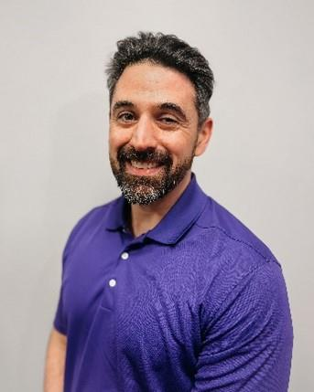
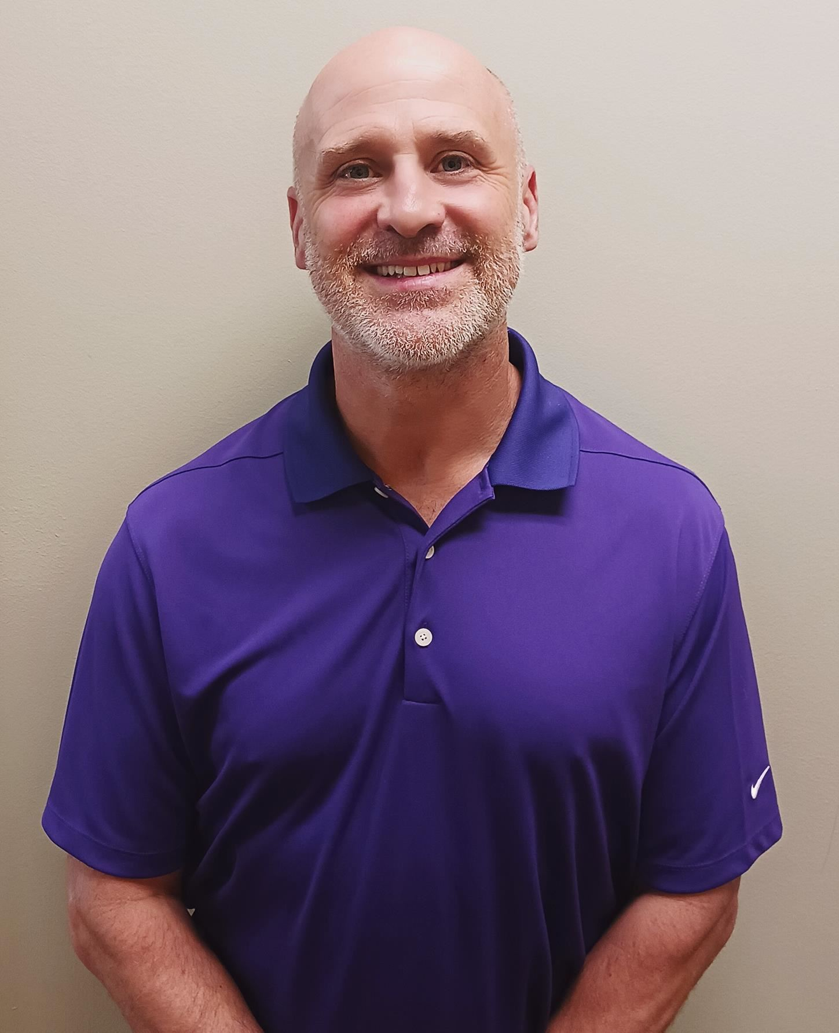
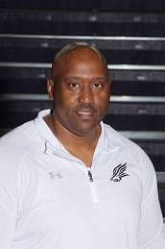
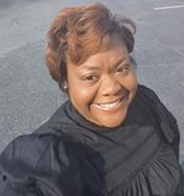
Meet the Principal and Assistant Principals:
Principal: Mr. Louis Galiotti
Assistant Principal - Mr. Timothy Wolfe
Students with Last Names beginning (A – G)
Assistant Principal – Mr. Kevin Hairston
Students with Last Names beginning (H – P)
Assistant Principal – Ms. Sharon Jacobs
Students with Last Names beginning (Q – Z)

Slide 4
Meet the Counseling Department:
Mr. Demarcus Crawford
(Last Name A-E)
Ms. Julie Cunningham
Graduation Counselor
Mrs. Kathleen Elliott
(Last Name Li-Ri)
Mr. Karim Williams
(Last Name F-Le)
Mrs. Kristin Guthrie-Stuart
(Last Name Ro-Z)
Mrs. Jan Wyrick
Counseling Secretary

Slide 5
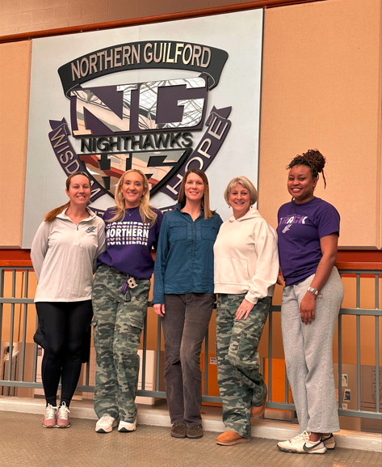
Our Student Services Team
Mrs. Smith – Career & College Manager
Mrs. Barksdale – Registrar
Ms. Hoyle – School Social Worker
Ms. Rule – Data Manager
Ms. Briana Haith - Attendance

Slide 6
Graduation Requirements per NCDPI:
What are those 22 credits?
English – must complete 4
Math – must complete 4
Science – must complete 3
Social Studies – must complete 4
Health/PE – must complete 1 combined class
Electives: must complete 6, one of which must be an ARTS course for this incoming class.
The Future Ready Course of Study requires at least 22 credits to graduate from high school.

Slide 7
Courses Required With Options:
English (4 cr) English I (H) English II (H) English III (H) or AP Lang English IV (H) or AP Lit | Math (4 cr) Math 1 (H) Math 2 (H) Math 3 (H) Math 4 (H) Or… AP Precalculus AP Statistics | Science (3 cr) Biology Earth Environmental or AP Env. Science Physical Science or Chemistry Honors | Social Studies (4 cr) Civic Literacy (H) World History (H,AP) American History (H) or AP US History Economics and Personal Finance (H)
* Physical Education/Health – 1 cr
CPR
* Students must be registered for PE over the summer by middle school counselors.

Slide 8
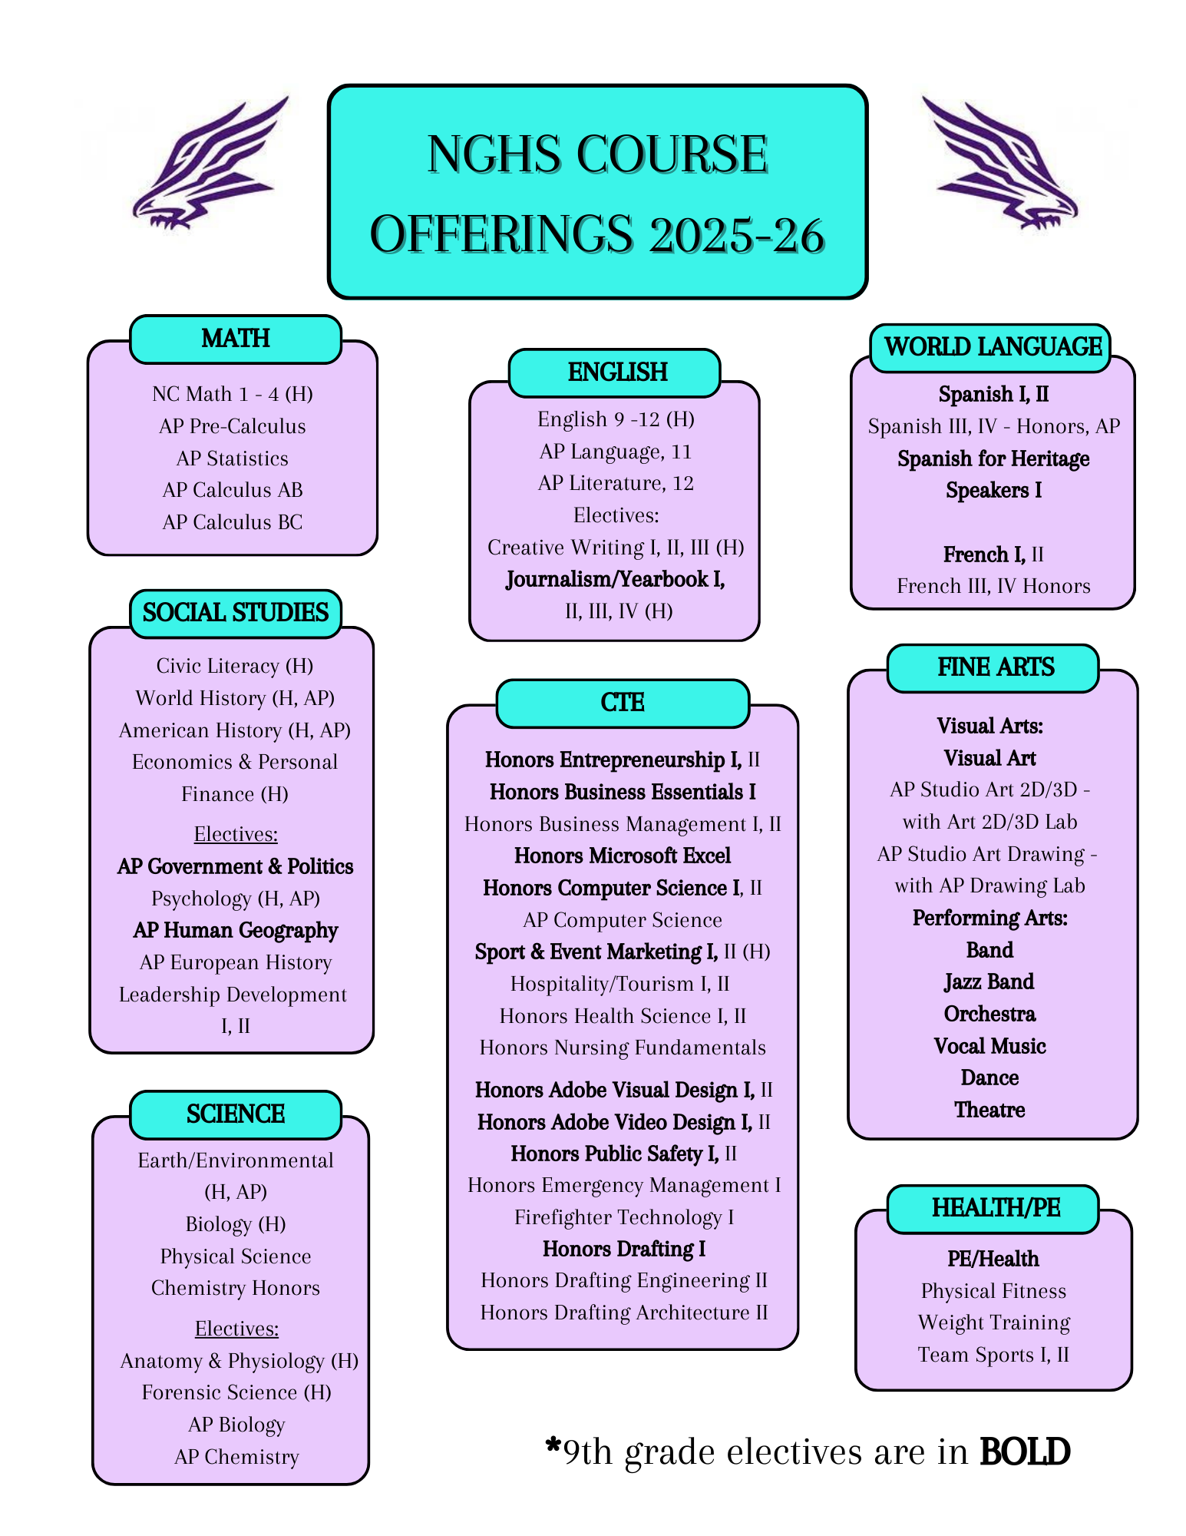
Elective Credits
Electives – Students must complete 6 credits:
1 Arts credit must be obtained between 6th and 12th grade
2 MUST be from CTE, World Language, or Arts Education.
New UNC Admissions Requirement: Eligibility requirements for admission to a school in the UNC system requires students take 2 additional academic courses from:
-English -World Language
-Math -Social Studies
-Science -Computer Science
*Completion of two sequential World Language courses is recommended.

Slide 9
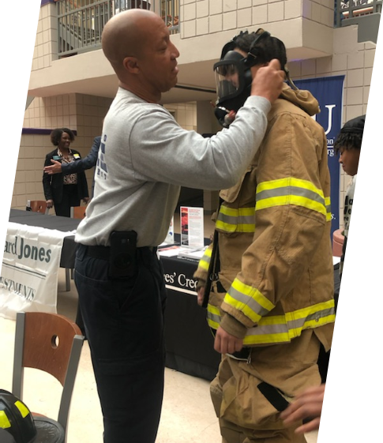
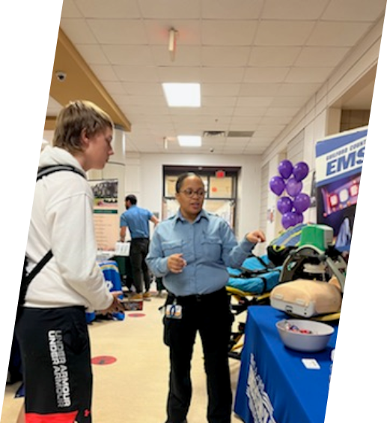
Electives for 9th Grade Students
PE/Health
Journalism/Yearbook I
CTE:
Honors Entrepreneurship I
Honors Business Essentials I
Honors Microsoft Excel
Honors Computer Science I
Sport & Event Marketing I
Honors Adobe Visual I
Honors Adobe Video I
Honors Public Safety I
Honors Drafting I
AP:
AP Human Geography
AP Government & Politics
World Language:
Spanish for Heritage Speakers I
Spanish I
Spanish II
French I
Fine Arts:
Novice Band (no experience)
Developing Band
Developing Jazz Band
Novice Orchestra (no experience)
Developing Orchestra
Novice Vocal (no experience)
Developing Vocal
Dance (by audition)
Theatre
Visual Art Beginning

Slide 10
Some Courses May Require Auditions/ Applications:
Band – your middle school band teachers
will recommend your placement.
Dance – Auditions will be February 18th, from 4:45-6:00 PM in the Dance Room at NGHS – view their Instagram page NGHS.dance
Theatre – everyone enters as 1st level
Yearbook – applications will be available through your middle school counselor. Due February 20th!

Slide 11
Standard, Honors and AP Courses
Standard Level
Honors Level
AP Level
Offers more time to acquire information
Standard pace
Preparing for post-secondary education, but cannot receive college credit.
Offers greater teacher guidance as students work to develop the necessary skills and learn relevant information
Will have less homework assigned
More rigorous than standard level classes.
Preparing for post-secondary education, but cannot receive college credit.
Greater independence in learning
Pace is considerably faster
Average homework expected is 30 minutes per night
Independent reading, projects, writing responses, and interpreting source materials.
College level work. College credit may be earned (dependent on final AP exam score and college/university you transfer to).
Fast paced, deeper understanding of material covered.
Independent learning by student.
Approximately 1 hour of homework each night.
Class discussions, formal essays, practice FRQs regularly, independent research
Must take the national exam administered in May.

Slide 12
A Typical 9th Grade Schedule:
English I (Standard or Honors)
Math I (or Math II) (Standard or Honors)
Civic Literacy (Standard or Honors)
Earth/Environmental (Standard or Honors)
OR Biology (Standard or Honors)
PE/Health
1 Elective

Slide 13
School Policies:
Late Work:
Make-Up Work:
Students can turn in assignments up to 5 school days after the due date, with a 10-point penalty for each day late. No WORK has to be accepted after 5 days. You will then receive a 0 for the assignment.
Students will have 3 school days, following their absence, to complete and turn in any missing assignments. After 3 school days, if the assignment is not turned in, it becomes late work.

Slide 14
Promotion Standards
Credits are earned when students pass a class with a 60% or higher at the end of the year. To be promoted each year, students…
9th – 10th grade:
Must earn 5 credits
10th – 11th grade:
Must earn 10 credits
11th – 12th grade:
Must earn 16 credits
12th grade – Must earn *22 credits to graduate
* to include all state requirements presented earlier.

Slide 15
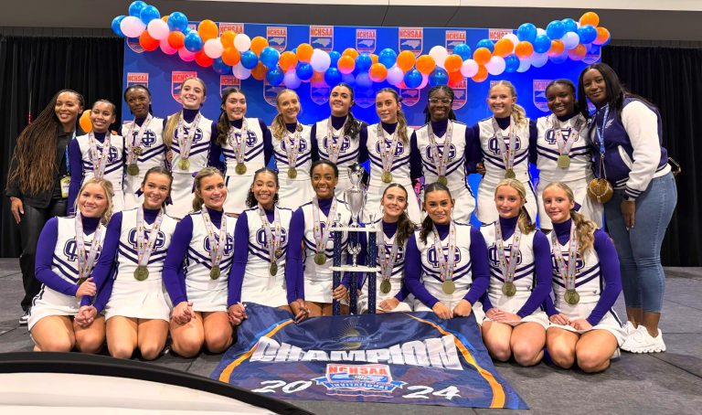
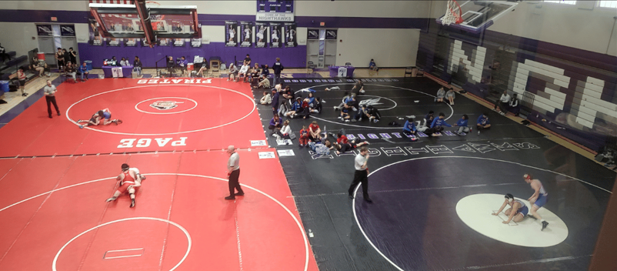
Extracurricular Activities - Athletics
Fall Sports​​ | Winter Sports | Spring Sports
Boys Soccer (JV/V) | Basketball Girls/ Boys (JV/V) | Baseball (JV/V)
Cheerleading (JV/V) | Cheerleading (JV/V) | Boys Golf
Cross Country ​ | Indoor track | Girls Soccer (JV/V)
Football (JV/V)​ | Swimming | Lacrosse (JV/V)
Girls Golf | Wrestling (JV/V) | Softball (JV/V)
Girls Tennis |  | Boys Tennis
Girls Volleyball (JV/V) |  | Track & Field

Slide 16
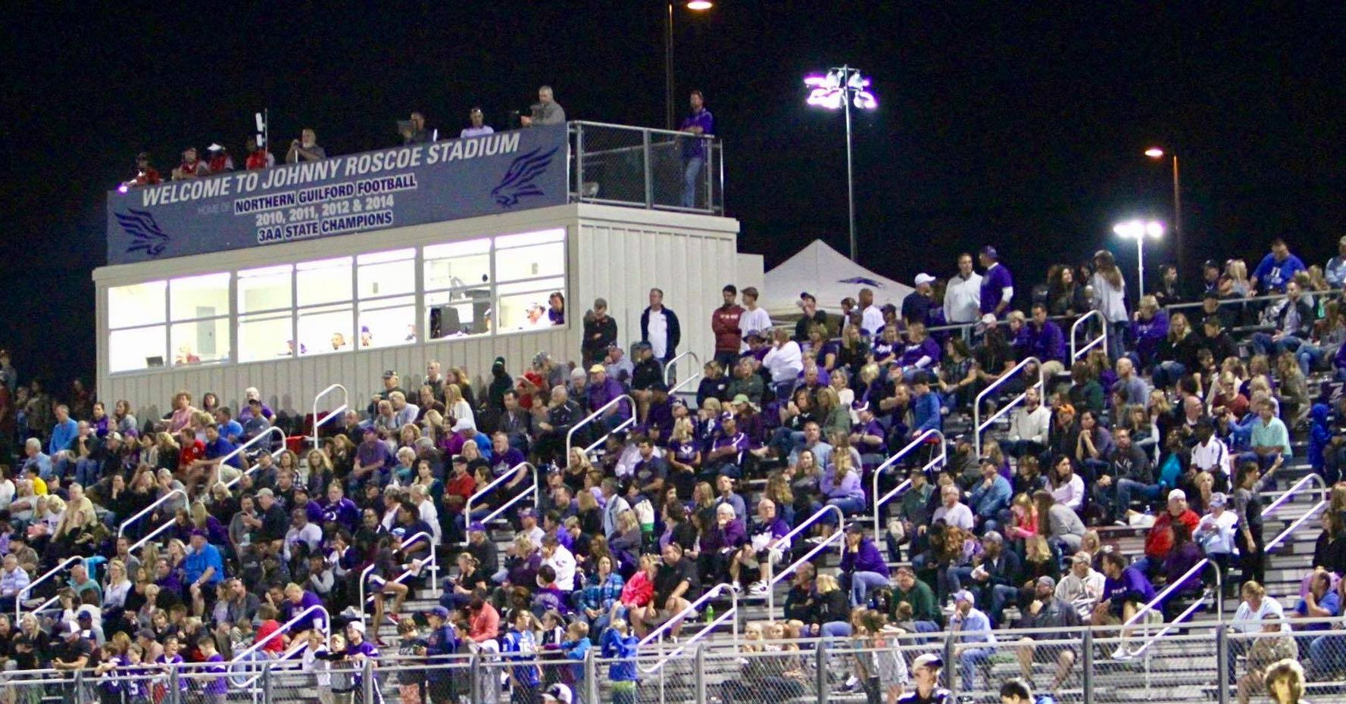
Academic Requirements for Athletics *Please see Coach Cochran each year for the most up to date information regarding athletes
All students must have a minimum 2.0 GPA and passing 70% of your classes. ​
Students cannot have more than 12 absences (for any reason) in a semester.​
Must attend more than half a day of school to practice or play.​
Up-to-date physical​

Slide 17
Extracurricular Activities - Clubs

Slide 18
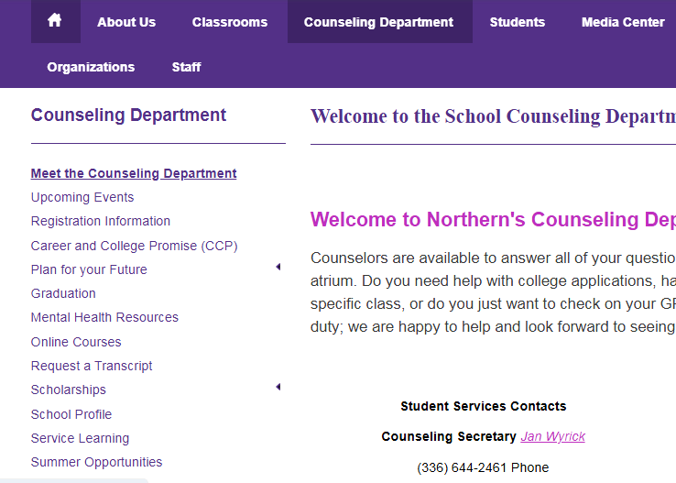
Service-Learning Hours
Not a graduation requirement!
Service-Learning Hours
* These hours do not apply to OCS/adaptive students

Slide 19
Service-Learning Hours (cont’d)
PLEASE NOTE:
You cannot begin service-learning hours until the 1st day you walk into Northern High School as a freshmen. Any hours you complete over the summer will NOT count.
ALL HOURS MUST be submitted within the semester they are completed.
PRE-APPROVAL forms must be submitted PRIOR TO beginning service for ALL PERSONAL PROJECTS

Slide 20
Driver’s Eligibility
Student must be at least 14.5 years old​
Visit the link to NC Driver’s School on Northern’s website​ - “Parents” Tab - to sign up for a class (not affiliated with GCS)
Complete the class & driving requirements​
Obtain eligibility form from Counseling Secretary Mrs. Wyrick (not counselors)​
Student must have passed 5 out of 6 classes the semester prior to requesting an eligibility certificate
Must be signed by parent/guardian​ in the counseling office

Slide 21
Planning Beyond 9th Grade…
College Admissions offices pay attention to what you do in 9th grade. Some important criteria:
Your GPA and class rank
Difficulty/rigor of courseload completed successfully
Extracurricular activities
SAT/ACT scores
Community involvement
Recommendations – make sure you make good impressions
Make it count from the start!
Thinking long-term is important from the minute you walk through our doors as a freshman.
If College is on your radar…

Slide 22
Expectations of a High School Student
Your Role and Responsibilities:
BE RESPECTFUL: participate when required, quiet when necessary
BE PUNCTUAL: you have 5 minutes to get from class to class
BE A SELF-STARTER: Is there a daily routine? Know it! Do it!
BE PREPARED: have your laptop charged, supplies needed
BE ORGANIZED: make a routine for yourself on day one. Have what you need, take notes that make sense to YOU

Slide 23
Please note:
Taking PE/Health summer before 9th grade:
Registration for new students/private or charter:
If you are planning to take PE/Health over the summer, you MUST have that conversation with your MIDDLE SCHOOL COUNSELOR; Northern Guilford High counselors cannot register you for that course since you are not considered a student with us until August 2025.
Counselors will release Sign-Up Genius links in late May for registration. Please check our Website for those links.
You must sign-up for a date and time with your alpha assigned counselor.
Registration will begin the 2nd week of July.

Slide 24
Questions...

