Slide 1
Good afternoon class it is 2/6/19 * DBQ Rubric Reflections * Paired Activities *Complete Industrial City “Plan” Read Ch. 16 this week

Slide 2
Focus Question: How did traditional village life change due to the Industrial Revolution?
Life BEFORE the Industrial Revolution
Life AFTER the Industrial Revolution
WITH a neighbor, write a brief answer to the 8 questions on the handout
Get back with your partner, write a brief answer to the same questions. Write down what stayed the same also

Slide 3
2nd Paired Activity The Urban game Activity Questions
Each partner fills out the XXI (21) questions
But must use only ONE Urban Game Summary packet

Slide 4
Good Afternoon class it’s 2/7/19 On Our Agenda 1. Notes on why industrialization started in Europe 2. Ideal City Planning activity 3. The 2nd Paired Activity a **NEW** homework opportunity

Slide 5
review
brainstorm with your neighbor
→ to create a list of 3-5 negatives that were created by the rapid urbanization of the first 100 years of industrializing

Slide 6
The Industrial Revolution
Period 5
1750-1900
Key Concept 5.1: Industrialization changed the way goods were made and consumed, with far-reaching effects on the global economy, social relations, and culture

Slide 7
I. Industrialization Phase 1
A variety of factors led to the rise of industrial production in Britain, Western Europe, and the United States (1750-1850)
Europe’s location on the Atlantic Ocean
The geographical distribution of coal, iron, and timber
European demographic changes
Urbanization

Slide 8
5. Improved agricultural productivity
6. Legal protection of private property
7.An abundance of rivers and canals
8. Access to foreign resources
9. The accumulation of capital

Slide 9
Dickensian
adjective
of Charles Dickens or his works
(resembling or suggestive of conditions described in Dickens' novels, esp) squalid and poverty-stricken working conditions were truly Dickensian
characterized by jollity and conviviality a Dickensian scene round the Christmas tree
grotesquely comic, as some of the characters of Dickens
dickens
noun
informal a euphemistic word for devil what the dickens?

Slide 10
City Planning
The sheer newness of Urbanization during the Industrial revolution led to terrible city building! Look at the mess you made!
This example helped future industrializing cities learn from these mistakes.
YOU get to be a lucky city planner in 1880. Before your village becomes an urban Dickensian nightmare, plan out your future city.
Use your handout to create
-zones
-green spaces
-transportation (still walking and horse carriages), but also railroads for transporting coal and products
-centralize your hospitals, schools, other public utilities
-you may add fire & police stations

Slide 11
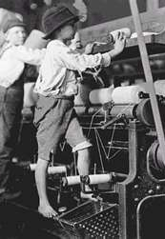
TGIF Whirlies! It’s 2/8/19-- 99 days until the AP Exam
On our Agenda
Notes on the “Rise of Machines”
Debate! Divide into sides, organize research teams, who does what…
Finish Urban Game
Paired Activity
Ideal City Plan
Open up to yesterday’s notes and Study the 9 reasons…

Slide 12
review
A variety of factors led to the rise of industrial production in Britain, Western Europe, and the United States (1750-1850)
Europe’s location on the Atlantic Ocean
The geographical distribution of coal, iron, and timber
European demographic changes
Urbanization
5. Improved agricultural productivity
6. Legal protection of private property
7.An abundance of rivers and canals
8. Access to foreign resources
9. The accumulation of capital

Slide 13
Notes continued
B. The development of machines, including steam engines and the internal combustion engine, made it possible to
Take advantage of vast new resources of energy stored in fossil fuels (coal and oil)
This fossile fuel revolution greatly increased the energy available to human societies
Machines unleash energy stored in fossilized organic materials
Connection: Humans have always affected the Environment by our need for energy
Paleolithic humans built fires from trees; there are just so many more humans in 1900

Slide 14
C. The development of the factory system
concentrated labor in a single location
Led to an increasing degree of specialization of labor
That’s all for now…close-up your notebook

Slide 15
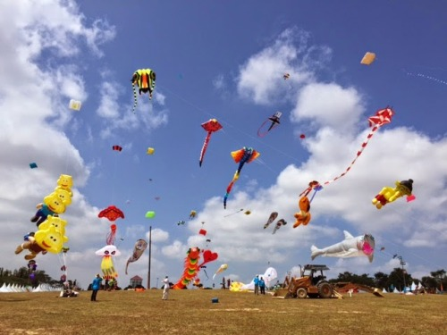
Good Afternoon Class it’s 2/12/19
On Our Agenda
SAQ reflection
The Week ahead and New Homework (due Thursday)
Notes! Social Effects of the Early I.R.
Reading Quiz
Debate Prep

Slide 16
II. Social Effects of Early Industrialization (pp. 365-370)
New social classes, including the middle class and the industrial working class, developed
New Elites – the wealthy capitalists who owned big businesses – challenged the traditional land-owning aristocrats
The Middle Class grew substantially with industrialization
Small business owners, factory managers, accountants, doctors, and lawyers
Had a comfortable lifestyle from wealth generated from industry
The Urban Lower Class included all able-bodied people, including women & children
Less skilled than previous lower class, were paid less and lived in crowded tenements
worked in factories and mines

Slide 17
B. Family Life
Major change→ separation of the work place from family life
Farm families lived and worked together
Now individualism became the norm, leading separate lives
Lower-class men and women now worked but women were paid less
Middle-class men took pride in their wives staying home; leisure time spend reading, attending lectures
Lower-class men escaped their tedious life in pubs & sports
Cult of Domesticity: middle-class women headed the home and taught that this was virtuous & ideal

Slide 18
Hello again class today is Thursday
Today’s Plan
Discuss historical origins of Valentine’s day & here in the USA
Present Closing Arguments and Declare a debate winner
Collect & discuss HW
H.T.S. practice
Notes (Second Industrial Rev.) & Crash Course video (Cap & Soc)
Paired Comparison between Socialism and Capitalism

Slide 19
hello again class today is Thursday, Feb. 14 Historically Christians celebrate “Saint Valentine”…
Today’s Plan
Discuss historical origins of Valentine’s day & here in the USA
Present Closing Arguments and Declare a debate winner
Collect & discuss HW
H.T.S. practice
Notes (Second Industrial Rev.) & Crash Course video (Cap & Soc)
Paired Comparison between Socialism and Capitalism

Slide 20
Historical Thinking Skill Practice
“The Plight of Miners”
→ note involvement of the Government;
“the end of laissez faire” and free-market capitalism
→ From 1842-1900, Western governments will pass laws requiring private industry to improve working conditions
Handout
First: THINK AS A HISTORIAN: Apply Comparison and Contrast
Second: WRITE AS A HISTORIAN: summarize info
Third: SBMC practice try something out JUST look at SOURCE on Q 1, see if you can answer correctly

Slide 21
Good Morning class it’s 2/18/19
Time is Up for SAQ test make-up and ch. 16 Quiz
Here’s the plan today
Station Rotation activity (1st period Only)
Finish the Notes on the S.I.R.
Crash Course on Capitalism/Socialism
Paired GO Chart comparing those 2 ideas & Individual Preview assignment
Homework This Week
Reading Assignment: Chapter 19 (405-424) by Thursday, the 21st
LEQ Paired Practice: p. 335 Due Wednesday (peer grading)

Slide 22
The Second Industrial Revolution: Station Rotation
1. Goal: Have a deeper understanding of the political (suffrage), economic (wages, unions), and cultural (education, living standards) impact of the Second Industrial Revolution 1850-1900.
2. Process: Each student will turn-in a question sheet. Groups will visit each of the 12 stations, find the answers, then rotate to the next station.
→Listen for a bell
3. Tip: at each station there are 2 copies; work in pairs to “divide and share”.

Slide 23
III. Industrialization Phase II “The Second Industrial Revolution” (S.I.R.) 1850-1900
Industrialization Spreads Outside of Europe
Main Areas: United States, Russia, Japan
USA develops an industrialized northeast section; becomes a leader in innovation
Russia and Japan slowly industrialize by 1900, but remain mostly agrarian
B. Significant Innovations of the S.I.R.
Bessemer Process- steel was stronger than iron; allowed for taller structures
Electrification: electricity production dramatically altered society and provided a powerful source of energy

Slide 24
3. Synthetic Dye: chemicals were used in cloth production to provide inexpensive coloring
4. Petroleum: potent fossil fuel; internal combustion engine more significant than steam engine
5. Interchangeable Parts: increased production speed and lowered costs; the assembly line at maximum output
6. Vulcanization of Rubber: raw rubber tree materials now produced into tires and other industrial parts
https://www.youtube.com/watch?v=B3u4EFTwprM&list=PLBDA2E52FB1EF80C9&index=33

Slide 25
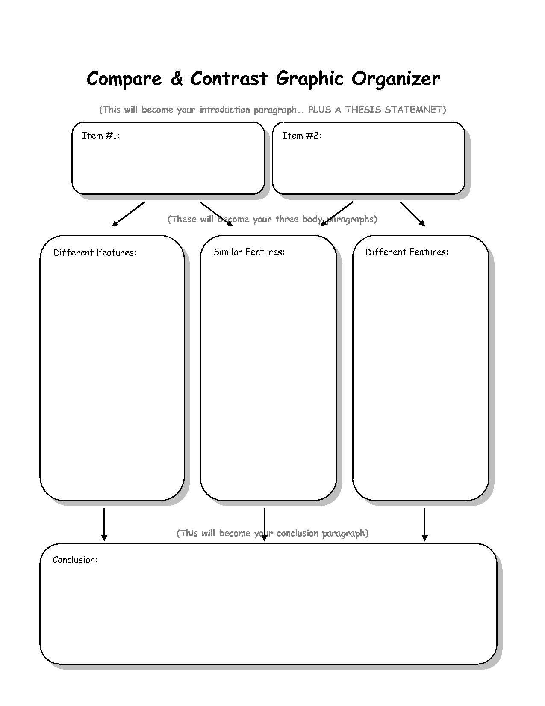
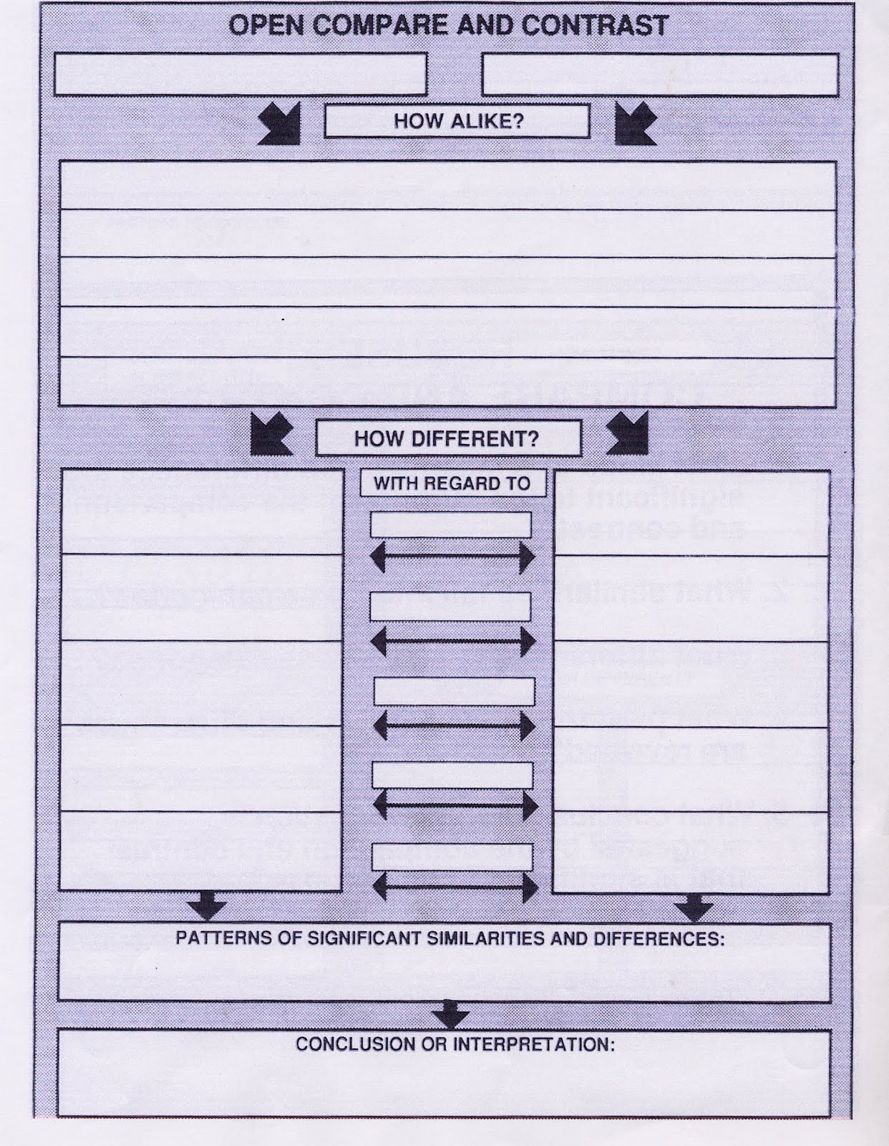
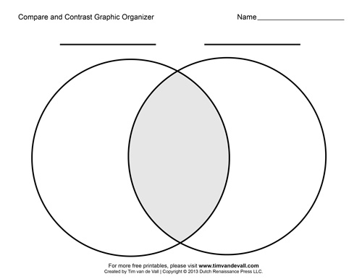
Paired Graphic Organizer Comparing Economic Systems
Use Wood text (pp 363, 368-369) to create a chart that compares Socialism with Capitalism.
Include all bold words
Define both capitalism and socialism
Be sure to discuss Marxism and Socialism separately, as distinctly different ideas (yes Marxism is a form of socialism…)
Individually: Define Imperialism (p. 405) and summarize the 4 types of Imperialism listed on p. 406

Slide 26
Reading Quiz
Identify = give me historical evidence (facts, people, events)
Explain = tell me about the concept, connect it to the question using evidence from text

Slide 27
Debate Prep
1. pick your 6 Arguments (turn in to me)
2. set your personnel
3. Outline Counter-Arguments
4. explanation of judging and winning
5. Rehearse & run-through the Rounds
Debate is tomorrow! Bring it!!

Slide 28
Meet with your Partner from the First paired Activity (Before and After the Industrial Revolution)

Slide 29
2nd Paired Activity The Urban game Activity Questions
Only ONE Answer Blanks paper is needed (put both of your names on it)
But must use only Two Urban Game Summary packets

Slide 30
2nd Paired Activity The Urban game Activity Questions
Each partner fills out their own Answer Blanks paper
But must use only ONE Urban Game Summary packet

Slide 31
Homework
“Negatives of the Industrial Revolution”

Slide 32
1st Period Debate
Team NR Team IR Judges
Zack B Logan Katie
Eliza Eliana Danny
Kendall Ananya Mr. Hill
Jake Julianna
Jennings Maddie
Madylin Emma
Leah Noah
Reanna Kat
Garrett Wil
Isabelle Jack
Carter Hannah
Roscoe Brandi
Zach S Daniel
Dyllan
Organize research teams exchange contact info write down what you know now

Slide 33
2nd Period Debate
Team NR Team IR Judges S O ------ X S
Mimi Luke Hope S O ------ X S
Francis Nathan Lee S O ------ X S
Greyson Campbell Mr. Hill S O ------ X S
Max Minan S O ------ X S
Ana Paddy S O ------ X S
Zach E Lilly
Sincere Zack M
Ayah Katelyn
Grace Ainsley
Gaby Audrey
Jacob Arman
Jessica Nick
Emma
Organize research teams exchange contact info write down what you know now

Slide 34
3rd Period Debate
Team NR Team IR Judges
Sanket Julia S Georgia
Kaleb Jeremiah Ryan
Owen Yara Mr. Hill
Bella James
Chris Reilly
Lorien Logan
Aneah Wesley
Claire Seth
Camden Karime
Nico Mia
Carl Clifton
Craig Parrish
Ella Leah
Julia H Veronica
Mallie Karina
organize research teams
exchange contact info
write down what you know now

Slide 35
5th Period Debate
Team NR Team IR Judges
Lily R Rachel Ava
Mason Victoria Tanner
Christian Joshua Mr. Hill
Aniah Laurel
Jake Charlotte
Noah Cal
Lilli Lexi
Avery Erikson
Alex Long
Hayden Jovan
Kelsey Peapod
Lauren Lucas
Ean Maggie
Eli Andi Leigh
Organize research teams exchange contact info write down what you know now

Slide 36
6th period Debate
Team NR Team IR Judges
Egan Cameron Kate
Brady Ali Jackson
Ryan Boran Mr. Hill
Sophia U Zac B
Sophia R Kiersten
Iris Christen
Preston Samantha
Noah Maura
Tatum Adam
Ben Alexis
Aiden Phillip
Anne-Joy Matthew
Ryan P Mary Katherine
Rayan Lana
Organize research teams exchange contact info write down what you know now

