Slide 1
Age of Jackson
Champion of the Common Man or Tyrant of Democracy

Slide 2
Essential Question: How did the rise of Jacksonian democracy impact the common man and promote further division within the United States?
Students can:
Evaluate whether the common man benefitted from Jacksonian democracy and the transformation in the market economy
Evaluate how Jackson’s policies further expanded debates over the role of government in the United States
Agenda
Objective 7 Question
Political Revolution of 1828
John Q, the Chump of the Common Man
Homework:
Objective 8 Questions

Slide 3
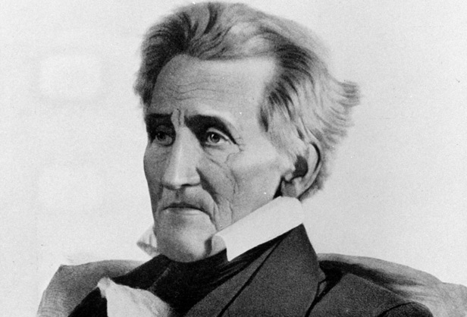
Essential Question: How did the rise of Jacksonian Democracy impact the common man and further divide the United States?
“To suppose that because our Government has been instituted for the benefit of the people it must therefore have power to do whatever may seem to conduce to the public good is an error into which even honest minds are too apt to fall.”
- Andrew Jackson, 1834

Slide 4
Getting HIPP
The electoral maps of 1820 and 1824 illustrate how the democrat-republicans were no longer a unified party because of the growth sectional divisions over slavery and the U.S. economy. Also, the election of 1824 further divided the democrat-republicans because of Andrew Jackson’s claim that the presidential election was unfairly influenced by a corrupt bargain struck between Henry Clay and John Q. Adams which took power from the common man and gave it to wealth elites.
The electoral maps of 1820 and 1824 illustrate the democratic-republicans were no longer a unified party in because candidates Andrew Jackson and John Q. Adams supported different views of government.
Document I shows how voter support has changed from the election of 1820 to election of 1824

Slide 5
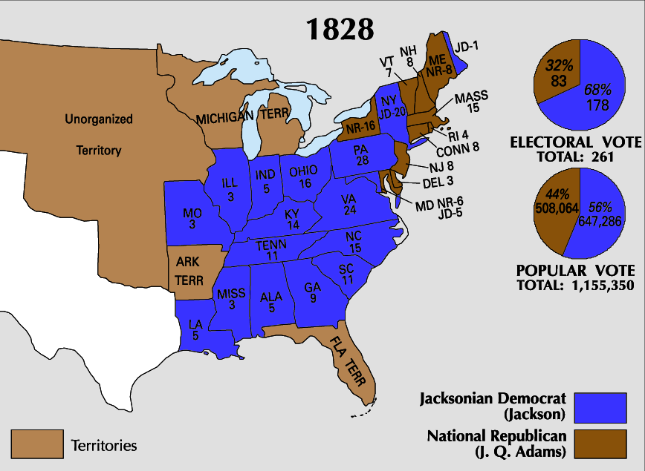
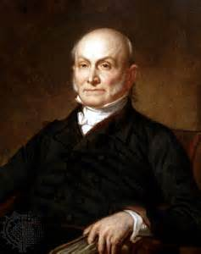
1-timer John Q
Weaknesses of John Q. Adam’s Administration
The corrupt bargain 1824 (Jackson’s mudslinging)
Doesn’t use the Spoil System (keeps the common man out of government)
Support for internal improvements, national university & observatory (Protective tariff)
Slowed land speculation (Panic of 1819 & the West)
Prohibited Indian removal in Georgia (Southern Common Man Farmer)

Slide 6
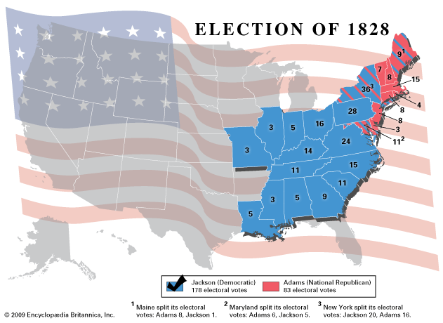
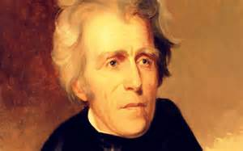
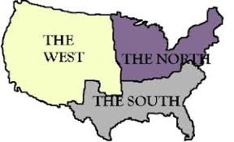
Election of 1828
Revolution of 1828 (political change)
States adopted universal white male suffrage (ends property qualification for voting)
Jackson = self made man: Common man’s HERO
Mudslinging campaigns (smear your opponent)
Political Divisions:
Jackson wins South & West (Rise of the Democrats)
Adams wins the North (Former Federalist)

Slide 7
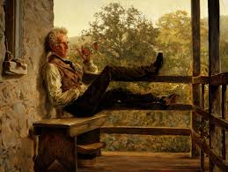
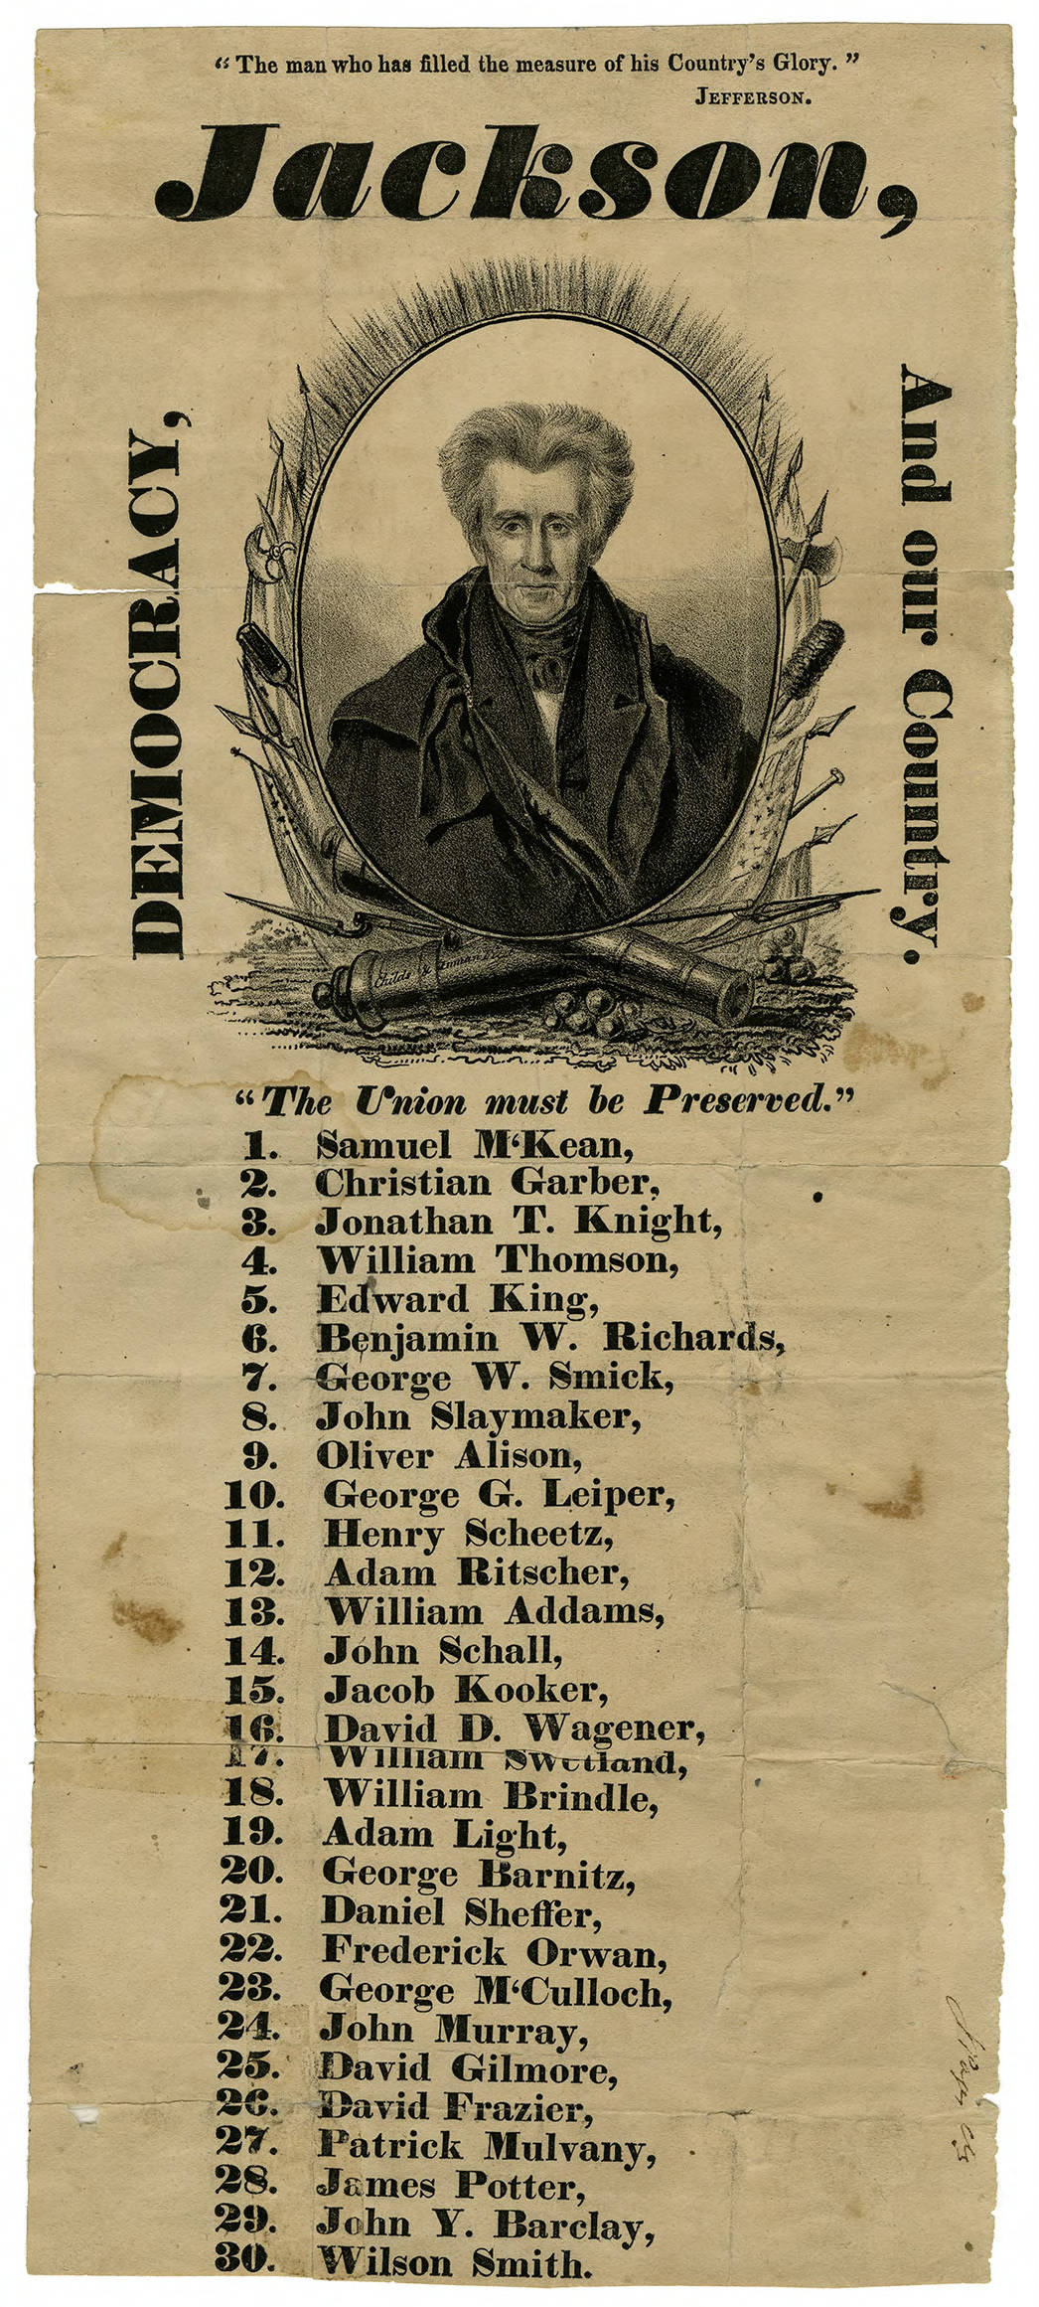
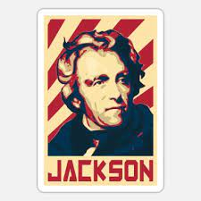
Raising the Voice of the Common man
Democracy becomes more accessible to the Common Man
Changes to Parties & Campaigns
Creation of nominating conventions
Popular vote selects slate of electors for Electoral College
Return of Two-Party System (Whig Party 1832)
Rise of Third Parties: (Workingmen’s Party & Anti-Masons)
More elected positions
Campaign focus – The Common man’s Interest

Slide 8
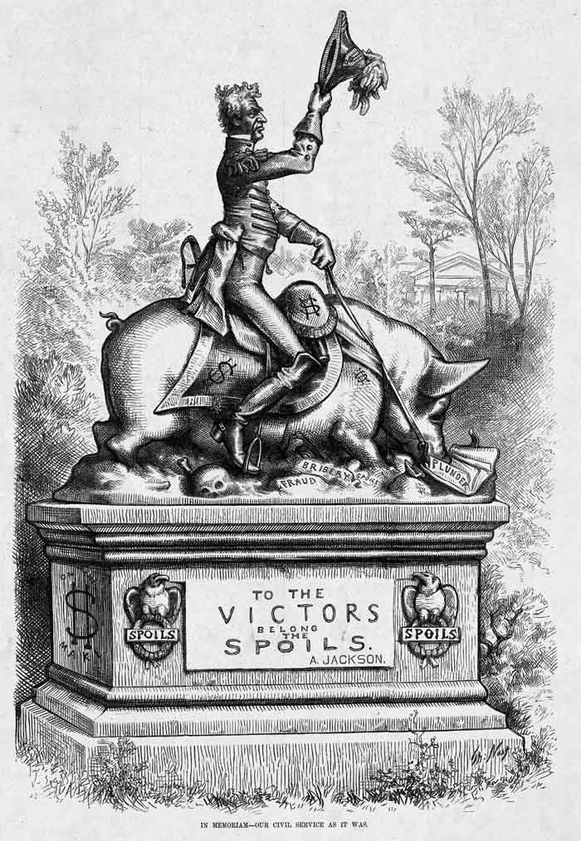
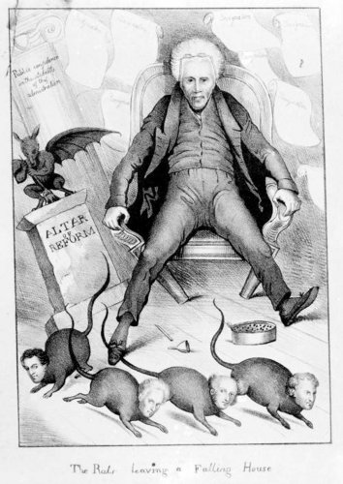
“The Victor Goes the Spoils”
Jackson’s goal: Make government more accessible to the “Common Man”
Spoil system: empower the common man by granting political positions
“TO THE VICTORS GOES THE SPOILS”
Rewards party loyalty = government jobs
Rotation in Office (Serve ONE term only)
The Petticoat Affair (1829-1831)
Jackson distrust of elites
Creation of the Kitchen Cabinet (common man advisors)
“Rats Leaving a Fallen House” by Edward William Clay, 1831

Slide 9
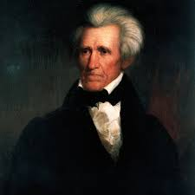
Organizing Structure
The Jacksonian Period (1824-1848) has been celebrated as the era of the “common man.” To what extent did the period live up to its characterization?
Champion
Chump
Step 1. Brainstorm: identify facts that answer the prompt
Step 2. Categorizing Facts: Connect facts to demonstrate a common ideal (PERSIA)
Step 3. Formulate a thesis – assertion that answers the prompt and used your categories as your three basis to prove the thesis true

Slide 10
Paragraph Development
Main idea: (Base of your thesis)
Topic sentence that supports your thesis
Write a specific historic evidence statement that demonstrates that supports the topic sentence
Explain how it demonstrates the main idea of the paragraph
Write a specific historic evidence statement that demonstrates that supports the topic sentence
Explain how it demonstrates the main idea of the paragraph
Failed to score
Listing facts without explanation
Repeating ideas in different ideas in different paragraphs
Countering your own point

Slide 11
Body Paragraph Defense of Thesis
Prompt: Evaluate to what extent to which U.S, participation in the First World War (1917-1918) marked a turning point in national world affairs
Thesis: World War I marked an affirmation of U.S. support of neutrality after the war. However, World War I did prompt US economic intervention and pro internationalism ideology.
Topic Sentence/Main Idea: Use a bases of your thesis (Support of neutrality)
Ex. World War I reaffirmed America’s belief in neutrality prior to U.S. involvement in the war in 1917. (Re-affirms thesis statement)

Slide 12
Body Paragraph Defense of Thesis
Prompt: Evaluate to what extent to which U.S, participation in the First World War (1917-1918) marked a turning point in national world affairs
Thesis: World War I marked an affirmation of U.S. support of neutrality after the war. However, World War I did prompt US economic intervention and pro internationalism ideology.
Identify and explain historic evidence that supports your idea
Ex. After the WWI, the United States Senate rejected the Treaty of Versailles due to strong support of reservationists and irreconcilables in U.S. Senate. Reservationists withdrew their support because Title X which would allow the US military to go to war without the consent of Congress. They believed that this violated U.S. Constitution and would pull America into European entanglements. Irreconcilable wanted complete and total isolation from Europe. These senators saw WWI as the first industrialize war which had led to mass death and destruction. Any potential alliance with Europe created by the Treaty of Versailles would cause America to be pulled into further war.

Slide 13
Thesis Defense
Thesis base – rise of division over the expansion of slavery
Identify relevant facts
Develop a topic sentence using your thesis bases
Use facts and explain connections to topic sentence
Concluding sentence: The rise of sectional divisions over the expansion disputes the idea that the period from 1816 to 1824 is aptly named the Era of Good Feelings

Slide 14
Essential Question: How did the rise of Jacksonian democracy impact the common man and promote further division within the United States?
Students can:
Evaluate whether the common man benefitted from Jacksonian democracy and the transformation in the market economy
Evaluate how Jackson’s policies further expanded debates over the role of government in the United States
Agenda
The Political Philosophies of the Jacksonian Democrats
The Bank War
Indian Removal Act
Homework:
Objective 8 Questions

Slide 15
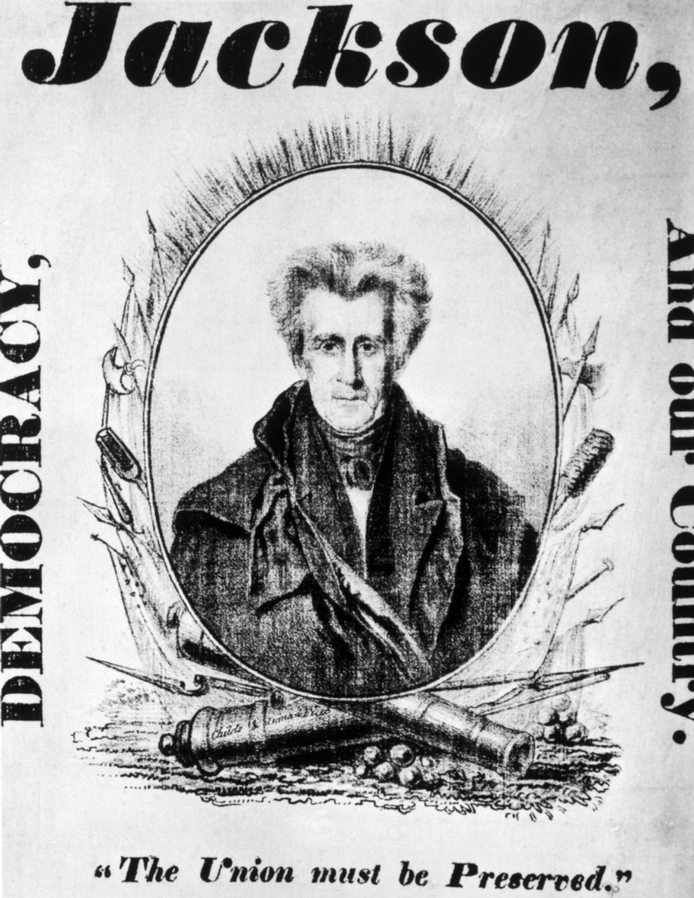
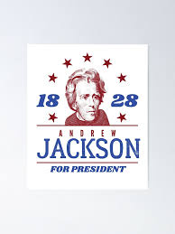
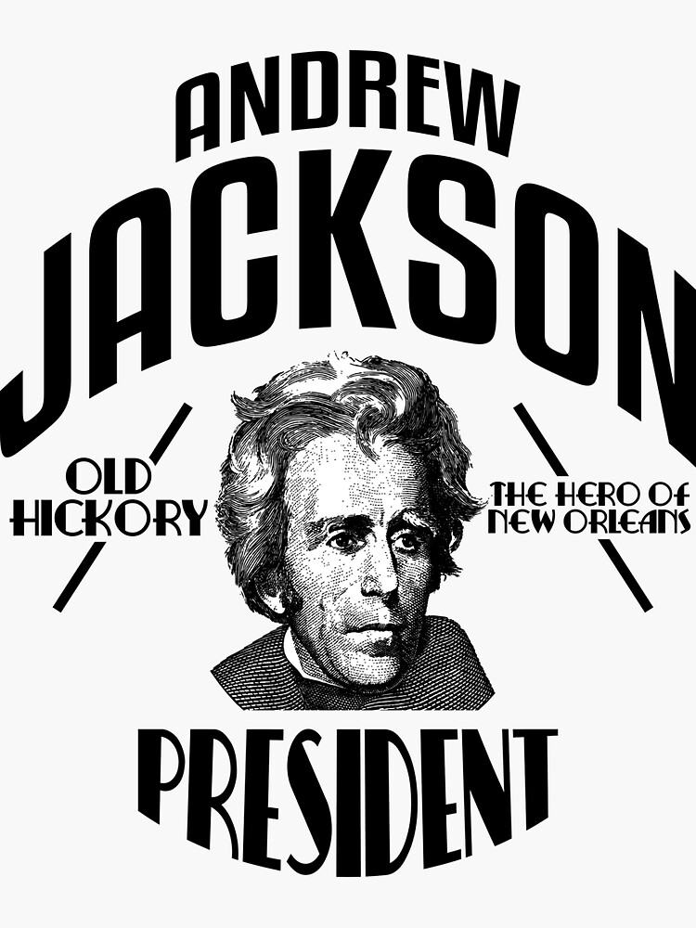
Jacksonian Beliefs
In 1828 Jackson replaced the Democrat-Republicans with the Democrats and took on the mantel of the Common Man’s Hero.
Explain the political ideology of the Jacksonian Democrats and how they champion the common man through their philosophies.

Slide 16
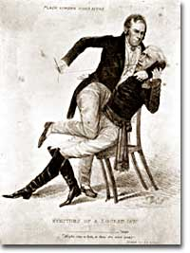
Views of Money
Andrew Jackson
Nicholas Biddle – B.U.S. President
Distrust banks (Elitist)
Unconstitutional
Bank made rich richer at the expense of the poor
National Bank wants political power
Hard currency (gold & silver) hurt the farmer
Soft money (paper currency) easier for the common man to pay of loans due to inflation
The Bank of the US promoted economic stability
Coining hard money
Cracked down on wildcat banks

Slide 17
Slaying the Many Headed Monster
"Biddle thou Monster Avaunt!! avaount I say! or by the Great Eternal I'll cleave thee to the earth, aye thee and thy four and twenty satellites. Matty if thou art true...come on. if thou art false, may the venomous monster turn his dire fang upon thee..."
"Biddle thou Monster Avaunt!! avaount I say! or by the Great Eternal I'll cleave thee to the earth, aye thee and thy four and twenty satellites. Matty if thou art true...come on. if thou art false, may the venomous monster turn his dire fang upon thee..."
"Now now you nasty varmint, be you imperishable? I swan General that are beats all I reckon, that's the horrible wiper wot wommits wenemous heads I guess..."

Slide 18
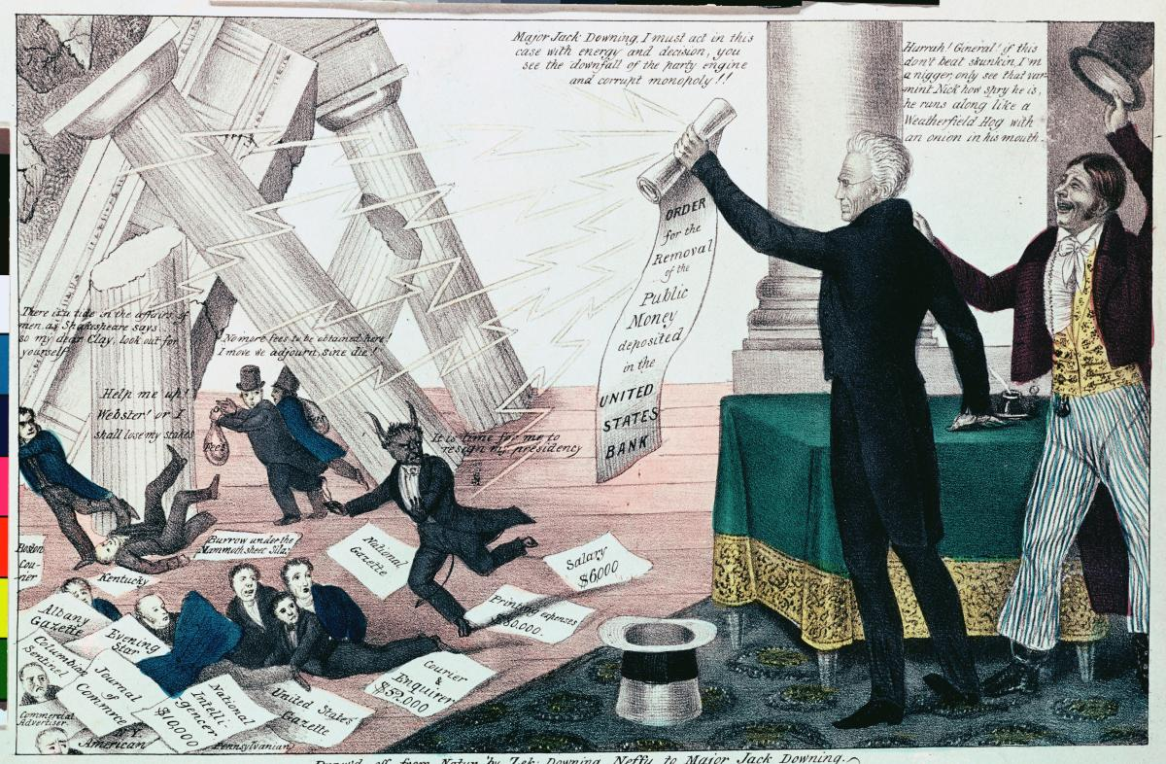
The Bank War
It is to be regretted that the rich and powerful too often bend the acts of government to their selfish purposes. Distinctions in society will always exist under every just government. Equality of talents, of education, or of wealth can not be produced by human institutions. In the full enjoyment of the gifts of Heaven and the fruits of superior industry, economy, and virtue, every man is equally entitled to protection by law; but when the laws undertake to add to these natural and just advantages artificial distinctions, to grant titles, gratuities, and exclusive privileges, to make the rich richer and the potent more powerful, the humble members of society–the farmers, mechanics, and laborers–who have neither the time nor the means of securing like favors to themselves, have a right to complain of the injustice of their Government.
- Andrew Jackson, Veto Message Against the Bank Re-chartering Act, 1832
The Bank War: Henry Clay & Daniel Webster attempt to damage Jackson’s re-election bid in 1832
Bank Re-Chartering Act of 1832 – save the 2nd National Bank of the U.S.
Andrew Jackson’s “Bank Veto Message” – (declares the bank to be unconstitutional) Jackson wins re-election
Congressional Censure of Andrew Jackson
Jackson Expands power
Ignores Supreme Court ruling (McCulloch v. Maryland)
Effect: return of the two-party system – Whig Party

Slide 19
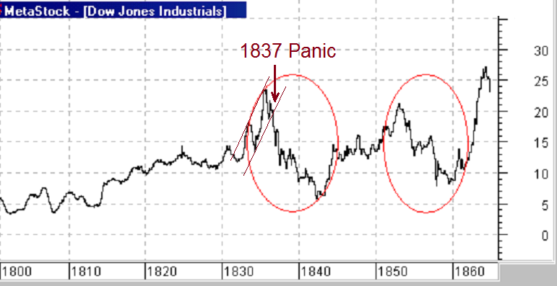
Panic of 1837

Slide 20
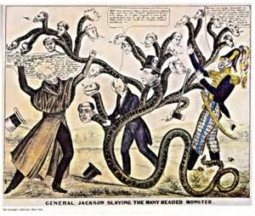
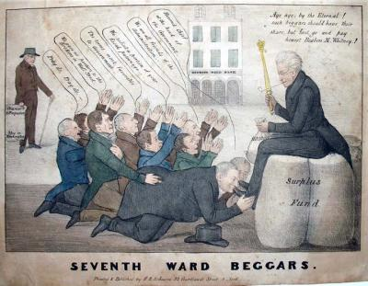
Panic of 1837
Biddle’s Bank War – raise interest rates (hurts the common man farmer – NO land speculating)
Jackson removes federal $$ from the Bank (Voter Mandate 1832)
Pet Banks or Wildcat Banks: state banks that hold federal money
Bank (Spoil system – corruption)
Flood the US economy with paper currency cause in economic cycles of booms and busts
Specie Circular Law of 1836: only hard currency can be used to by federal lands (westward expansion) Panic of 1837

Slide 21
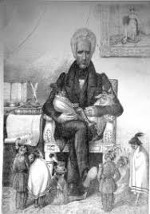
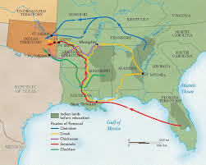
Commons Champ or Chump
Evaluate whether the Indian Removal Act supports Jackson’s claim that he was the common man’s hero.
Read article on the Indian Removal Act
Development argumentative response using at least two pieces of specific historic evidence to support your claim.
Write a counter-claim using one-piece specific historic evidence

Slide 22
Ideology of the Jacksonian Democrats
Political philosophies of the Jacksonian democrats
Prioritize policies that support the common man
Strict constructionism views of the Constitution – shrink federal power
Return power to the states

Slide 23
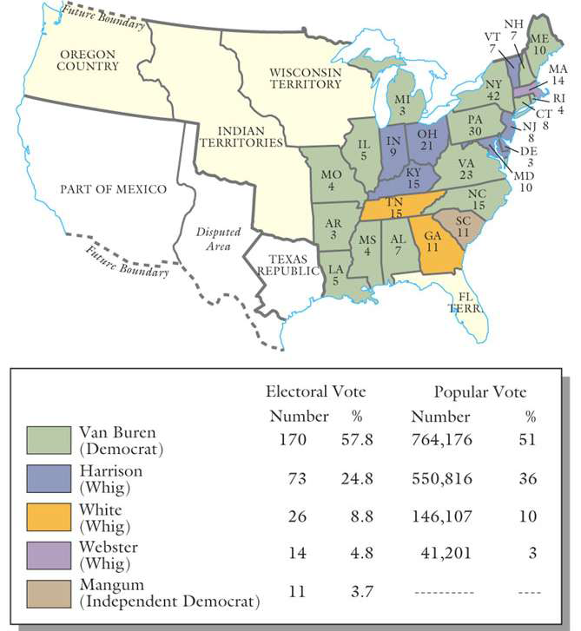
Election of 1836
Martin Van Buren “the Little Magician” elected
Weakness: riding Andrew Jackson’s coattails

Slide 24
Emergence of the two-party system
Two Party System – Impact of the Bank War
Democrats: Andrew Jackson, Martin Van Buren, & Jame K. Polk
Whigs: The Great Triumvirate – Henry Clay, John C. Calhoun, & Daniel Webster
 | Democrats 1832-1960 | Whigs 1832-1854
Major beliefs | State & local power Opposition to privilege & monopoly (no Banks & low tariffs) Opportunities for the Common Man (cheap land, Western expansion) Freedom from government interference | National power Economic development (internal improvements, Bank of the U.S., high tariffs) Social reform
Supporters | South & West Northeastern artisans & laborers Small farmers & plantation owners | New England, Mid-Atlantic, Midwest Wealthy and middling merchants Many middling farmers Some Large Southern planters

Slide 25
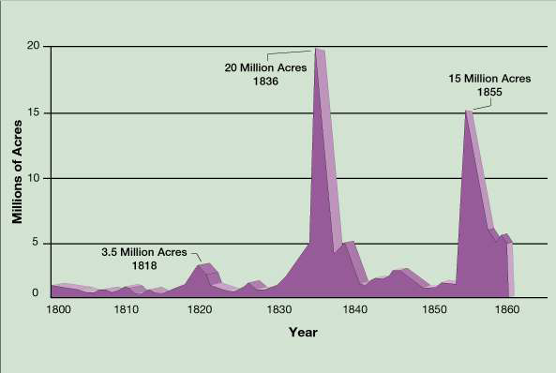
Panic #2
PANIC OF 1837
Contributing factors: land speculation, Bank War, wheat crop failure, and Specie Circular Law
Whigs: expand credit, raise tariffs, and subsidies for internal improvement
Divorce Bill (Van Buren) establishes the independent treasury

Slide 26
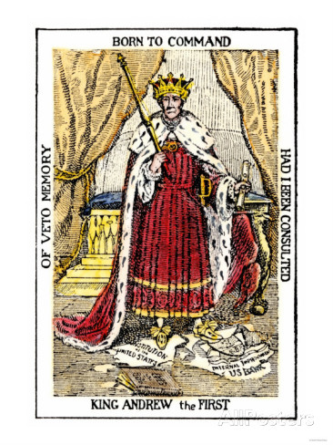
King Jackson
Evaluate the political cartoon “King Andrew the First”
Explain the perspective of the political cartoonist.
Explain how that counters the idea that President Andrew Jackson is the champion of the common man.
VETO
US Constitution
US Bank
Judiciary of the U.S.

Slide 27
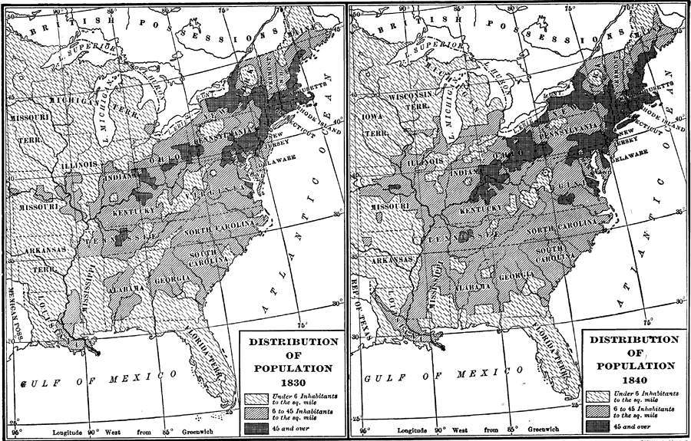
Western Expansion
Achieve the American Dream

Slide 28
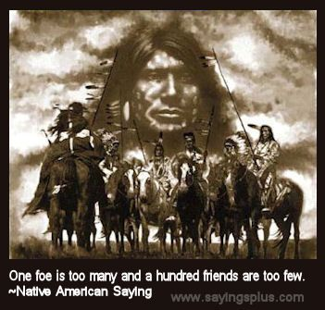
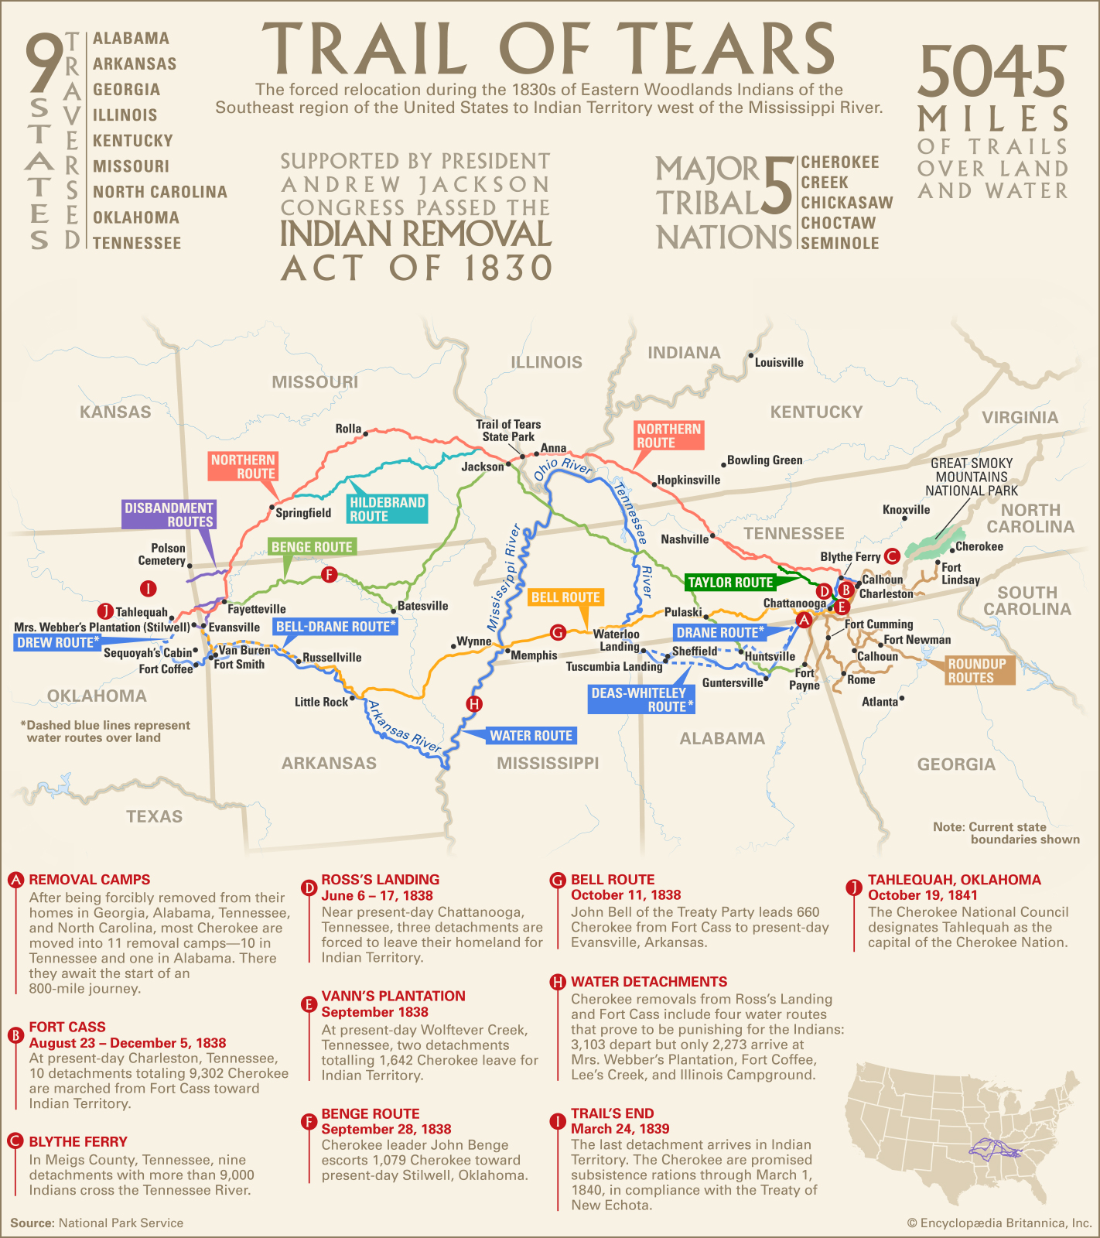
Native populations vs. Common Man
Cotton is King (Cotton Gin) Western Expansion
Indian Removal Act 1830 – push Native Americans across the Mississippi River (Five Civilized Tribes: Creek, Chickasaw, Cherokee, Choctaw, & Seminoles)
Society for Propagating the Gospel Among the Indians (assimilation)
Cherokee Nation v. Georgia 1831 & Georgia v. Worchester 1832 (Marshall precedent)

Slide 29
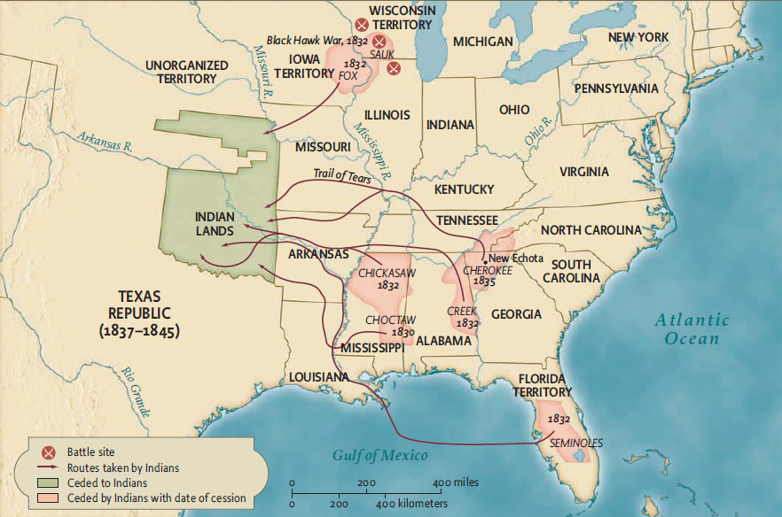
Separate Worlds
Indian Removal Act 1830
Blackhawk War
Georgia v. Worchester decision
(Jackson refuses to enforce the decision = expands presidential power)
Trail of Tears (death of 4000 Cherokees)
Seminole War 1835-1842
Thomas Nast, ”The Great White Father”, Harpers Weekly , 1836
Indian Removal Act, 1830: Trail Tears

Slide 30
Essential Question: How did the rise of Jacksonian democracy impact the common man and promote further division within the United States?
Students can:
Evaluate whether the common man benefitted from Jacksonian democracy and the transformation in the market economy
Evaluate how Jackson’s policies further expanded debates over the role of government in the United States
Agenda
Indian Removal Act – Pro Common Man?
Sectionalism in the Age of Jackson
Andrew Jackson: Common Man’s Champ or Chump
Homework:
Objective 8 Questions

Slide 31
Commons Champ or Chump
Evaluate whether the Indian Removal Act supports Jackson’s claim that he was the common man’s hero.
Read article on the Indian Removal Act
Development argumentative response using at least two pieces of specific historic evidence to support your claim.
Write a counter-claim using one-piece specific historic evidence

Slide 32
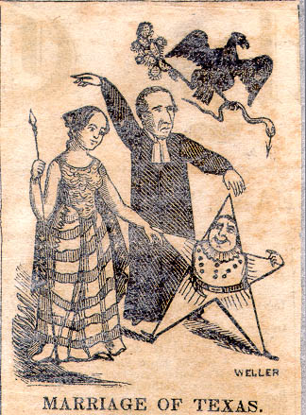
TEXAS Sectionalism
1836 Texas wins independence
TEXAS ANNEXATION
Northern Whigs block Texas
Annexation
Offset the balance of FREE vs.
SLAVE states
LONE STAR REPUBLIC 1836-1844

Slide 33
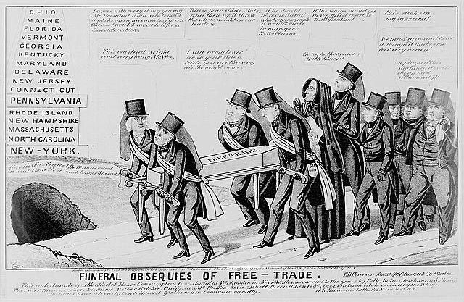
Tariffs of Abomination
(Economic Sectionalism) Tariff Debate
Growth of tariff (1824, 1828, and 1832) demonstrate the industrial north growing power
Webster-Haynes Debate 1830 - slavery influencing southern arguments against tariffs (expansion of slavery to the west)
Major argument over preserving the Union

Slide 34
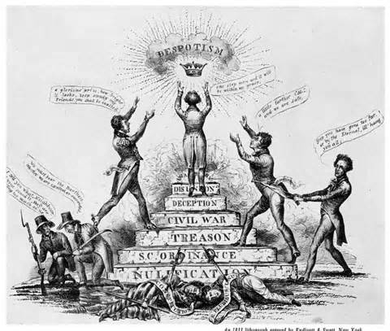
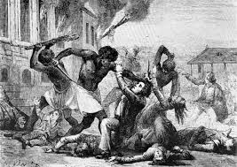
Nullification Crisis
Nullification Crisis (1832-1833: John C. Calhoun argues nullification against tariff of abominations (Tariff of 1828)
The Constitution grants to Congress the power of imposing a duty on imports for revenue, which power is abused by being converted into an instrument for rearing up the industry of one section of the country on the ruins of another. The violation, then, consists in using a power granted for one object to advance another, and that by the sacrifice of the original object. ...
- John C. Calhoun, S.C. Exposition & Protest 1828
Southern states feel threaten
Tariffs of Abomination
Slave rebellions
Denmark Vesey Rebellion (1822)
Nat Turner Rebellion (1831) – violent rebellion
“Disunion is forced by Treason”

Slide 35
Organizing Structure
The Jacksonian Period (1824-1840) has been celebrated as the era of the “common man.” To what extent did the period live up to its characterization?
Champion
Nightmare
Design an image of Jackson – with an argumentative slogan that claims what Jackson is with a line of reason (TWO reasons)
Argumentative Statements – You need to write two argumentative statements using at least 4 facts that support your claim
Write a historic contextualization for the theme nation identity or politics and power

Slide 36
Essential Question: How did the rise of Jacksonian democracy impact the common man and promote further division within the United States?
Students can:
Evaluate whether the common man benefitted from Jacksonian democracy and the transformation in the market economy
Evaluate how Jackson’s policies further expanded debates over the role of government in the United States
Agenda
Unit 4 Check-in
No Longer the Common Man’s Champion
Andrew Jackson: Common Man’s Champ or Nightmare
Homework:
Review Jackson Democracy – SAQ 11/7
Objective 8 Questions due Wednesday 11/13
Unit 4 Quiz Thursday 11/14

Slide 37
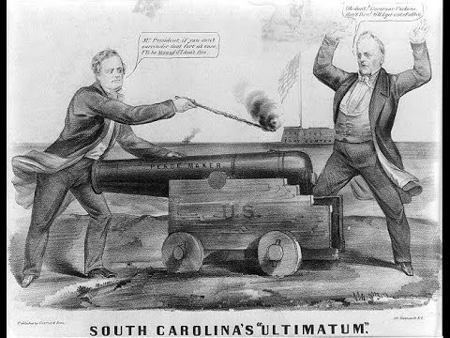
Nullification Crisis
Tariff of 1832 – Attempted to remedy southern complaints about the Tariff of 1828 (lower duty on manufactured goods from 45% to 35%)
"An act in alteration of the several acts imposing duties on imports," approved on the nineteenth day of May, one thousand eight hundred and twenty-eight and also an act entitled "An act to alter and amend the several acts imposing duties on imports," approved on the fourteenth day of July, one thousand eight hundred and thirty-two, are unauthorized by the constitution of the United States, and violate the true meaning and intent thereof and are null, void, and no law, nor binding upon this State, its officers or citizens; and all promises, contracts, . . .”
- South Carolina’s Ordinance of Nullification, 1832
S.C. Ordinance of Nullification – Threatens secession and nullifies tariff
Force Bill – Jackson threatens to use military to enforce tariff collections
Compromise Tariff – lowers the tariff over the next 8 years (Henry Clay)

Slide 38
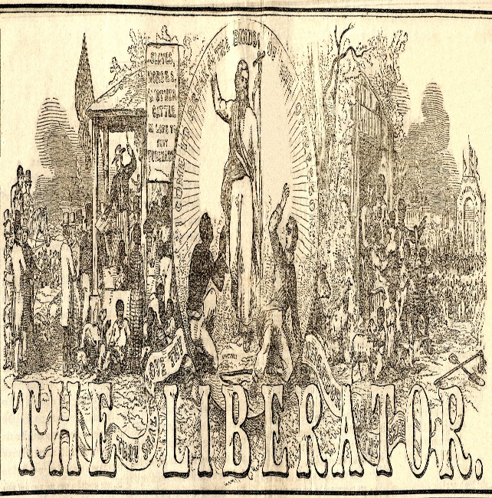
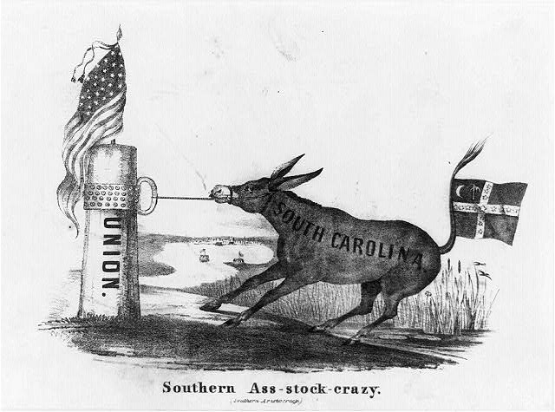
Growing Power of Sectionalism
Mailing of Anti-slave Tracts 1835 (William Lloyd Garrison)
Southern attempts to stop tracts fail (Haynes raid on Charleston post office & Calhoun’s Bill blocking their delivery)
Abolitionists Petition to end slavery 1836
Congress passes the Gag Rule (No discussion of slavery in Congress)
“The Liberator” William Lloyd Garrison’s (Radical Abolitionists)
“Southern Ass-stock crazy”

Slide 39
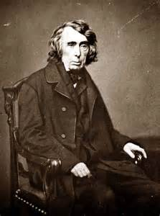
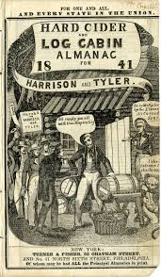
Political Change
Ending the Marshall Era
Roger Taney replaces John Marshall (1836)
Charles River Bridge v. Warren Bridge: States may alter contracts if it is in the interest of the community (overturns Dartmouth College v. Woodward)
Whigs Party = Champion the Common Man
1836 Martin Van Buren (8th President) – fails to deal with the Panic of 1837
1840 – William Henry Harrison (9th President) – “Log Cabin and Hard Cider Campaign” (Only Whig President)

Slide 40
Organizing Structure
The Jacksonian Period (1824-1840) has been celebrated as the era of the “common man.” To what extent did the period live up to its characterization?
Champion
Nightmare
Design an image of Jackson – with an argumentative slogan that claims what Jackson is with a line of reason (TWO reasons)
Argumentative Statements – You need to write two argumentative statements using at least 4 facts that support your claim
Write a historic contextualization for the theme nation identity or politics and power

Slide 41
Organizing Structure
The Jacksonian Period (1824-1840) has been celebrated as the era of the “common man.” To what extent did the period live up to its characterization?
Thesis writing
Claim Y because A + B
Claim Y answers the prompt without restating the prompt – Example of restatement: “Jacksonian period from 1824-1840 should be celebrated as the Era of the Common Man” – NO SCORE
Line of reasoning = two ways you will defend your claim (think broad categories that facts can connect to
Sample thesis: Although some support continuous neutrality (counterclaim) FDR’s policies armament trade to back the allies (A) and creation of agency that established alliances post war (B) supported the rise of interventionism during WWII (Claim)

Slide 42
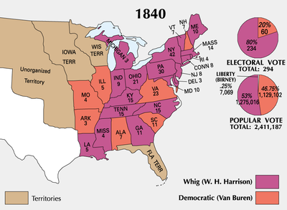
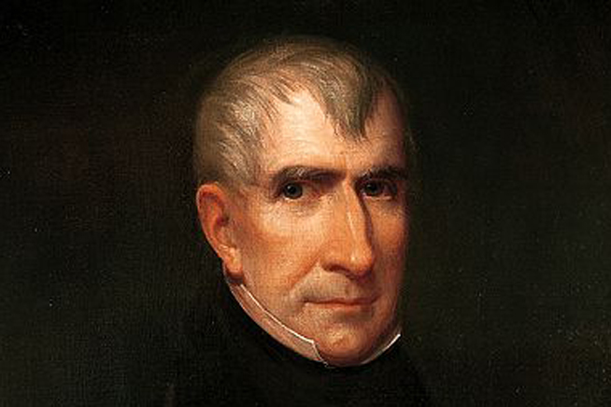
Election of 1840
In 50 words in less explain how the Election of 1840 proves Jacksonian democracy was not the Champ of the common man
Panic of 1837
Log Cabin & Hard Cider Campaign
Van Buren is no Andrew Jackson
William Harry Harrison (Whig)
Elected President 1840

Slide 43
Essential Question: How did the rise of Jacksonian democracy impact the common man and promote further division within the United States?
Students can:
Evaluate whether the common man benefitted from Jacksonian democracy and the transformation in the market economy
Evaluate how Jackson’s policies further expanded debates over the role of government in the United States
Agenda
Jacksonian Democracy SAQ
Thesis & Historical Contextualization
Andrew Jackson: Common Man’s Superhero or Nightmare
Homework:
Objective 8 Questions due Wednesday 11/13
Unit 4 Quiz Thursday 11/14

Slide 44
Organizing Structure
The Jacksonian Period (1824-1840) has been celebrated as the era of the “common man.” To what extent did the period live up to its characterization?
Champion
Nightmare
Design an image of Jackson – with an argumentative slogan that claims what Jackson is with a line of reason (TWO reasons)
Argumentative Statements – You need to write two argumentative statements using at least 4 facts that support your claim
Write a historic contextualization for the theme nation identity or politics and power

Slide 45
Organizing Structure
The Jacksonian Period (1824-1840) has been celebrated as the era of the “common man.” To what extent did the period live up to its characterization?
Thesis writing
Claim Y because A + B
Claim Y answers the prompt without restating the prompt – Example of restatement: “Jacksonian period from 1824-1840 should be celebrated as the Era of the Common Man” – NO SCORE
Line of reasoning = two ways you will defend your claim (think broad categories that facts can connect to
Sample thesis: Although some support continuous neutrality (counterclaim) FDR’s policies armament trade to back the allies (A) and creation of agency that established alliances post war (B) supported the rise of interventionism during WWII (Claim)

Slide 46
Historical Contextualization
20 – 50 years prior to 1824 what made the Common Man important to become a focal point of Jacksonian Democrats.
Remember to use a “ation” or “ism” word based on theme of politics and power
Explain the significance of that word in the development of the United States prior to 1824
Demonstrate how the word continued into the period if 1824-1840 as a significant shaper of politics
Include specific historic examples (NOT used in your argumentative statements to defend your thesis) to help explain the significance of the idea

Slide 47
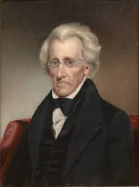
Champ or Chump
Argumentation: Andrew Jackson presented himself a champion of the Common Man after the corrupt bargain denied him the presidency in 1824. To what extent did Andrew Jackson’s presidency live up to his claim?
Support, modify, or refute this statement with specific historic evidence and write a thesis statement on the back
King Cotton - Indian Removal Act - Nullification Crisis
Georgia v. Worchester - Black Hawk War - Tariff of Abomination
Seminole Wars - John Marshall - Force Bill
Land Speculation - Common Man - SC Exposition
Five Civilized Tribes - Trail of Tears - Compromise Tariff
Expansion of executive powers - The Nullies
Society for Propagating the Gospel Among the Natives

Slide 48
Champ or Chump
Argumentation: Andrew Jackson presented himself a champion of the Common Man after the corrupt bargain denied him the presidency in 1824. To what extent did Andrew Jackson’s presidency live up to his claim?
Support, modify, or refute this statement with specific historic evidence and write a thesis statement on the back
- Whigs - Bank Re-chartering Act
Nicholas Biddle - Land Speculation
Pet Banks - Bank Veto
Election of 1832 - Panic of 1836
Divorce Bill - Election of 1840
William Harry Harrison
Log Cabin Hard Cider Campaign

