Slide 1
ROARING TWENTIES
Unit 7 – Rise & Fall of Prosperity

Slide 2
Agenda
Essential Question: How has America’s views been redefined by economic necessities, cultural notions, and national security during the turn of the 20th century?
Students can:
Decipher how did the evolution of industrial capitalism change American society in the 1890s to 1945 era
Evaluate how politicians and reformers responded to industrial changes, in the course of doing so, fundamentally change the role of government, especially the federal government, in the lives of Americans
Agenda
The Decadent 20s
Normalcy in the 1920s
American interventionist debate
Homework:
Debate Prep

Slide 3
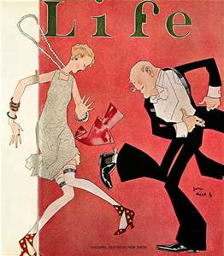
Essential Question
How did the United States war experience create a social conflict, even when it was developing a mass culture?

Slide 4
Presidential Election
Select a candidate if you live in the 1920s and one for today. Explain your selections based on each time period.
Candidate A
Candidate B
Platform
Keep America safe from radicals
Promote laissez faire (Get rid of regulations)
Support Christian values
Attack anti-American sentiment
Promote simple life in small towns
Platform
Support innovation in science and technology
Promote racial & gender equality
Promote liberty over security
Desire for businesses to innovate
Represent urbanization

Slide 5
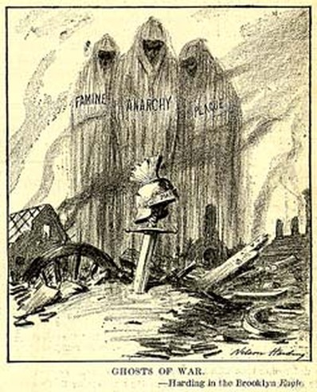
Roaring 20s
The 1920s – a decade of booming economy and cultural clash driven by lingering memories of WWI and desire to forget
Isolationism
Modernism
Anti-immigration
Booming Economy
Red Scare (Anti-Communism)
Convenient Consumerism
Laissez Faire – Mellonism (Anti-Progressivism)
The Flapper
Prohibition
Jazz Age
The Forgotten Generation
Fundamentalism

Slide 6
Roaring 20s
America shuts itself off from the world by becoming isolationists, condemning un-American activities, and slamming shut the immigration gate to focus on homegrown dizzying prosperity.
Booming 20s: increase in real
income and living standards
for most Americans
Fear of the past and WWI
New consumerism, technology,
entertainment
Hides the dangers that
America’s future holds

Slide 7
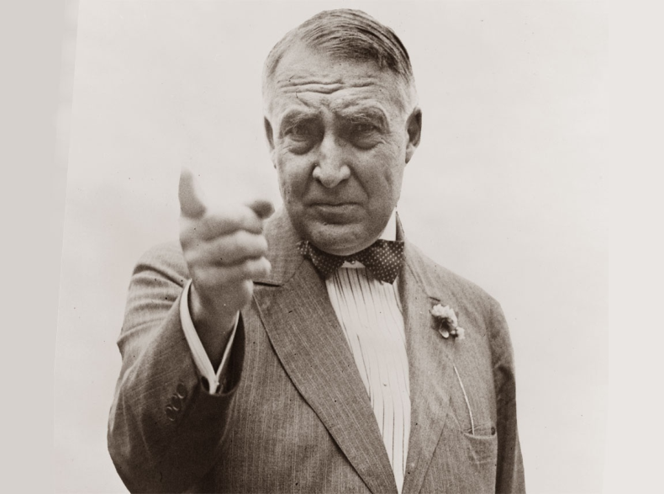
The Decadent 20s
“America's present need is not heroics but healing; not nostrums but normalcy; not revolution but restoration.” – Warren G. Harding
Isolationism
End of Progressivism
Simple small
town life
No Extremism

Slide 8
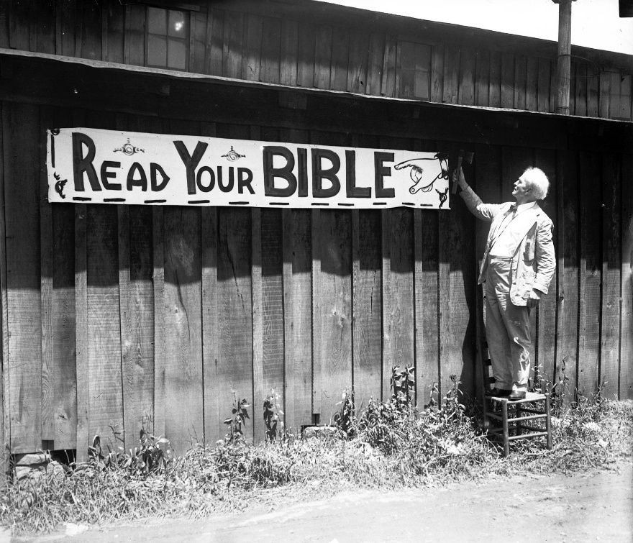
Traditional Values
Fundamentalism: return to Puritan values and direct challenge to American immorality
Prohibition
Scopes Trial
Red Scare
Nativism
Rise of the KKK

Slide 9
Imperialistic Debate
Prompt: Evaluate whether it was proper for the United States to support interventionists (imperialistic) foreign policy at the turn of the 20th century.
Use facts, statistics, passed examples to support conclusions (quotes work to)
Roles:
Opening Argument – one person
Crossfire 1 – 3 people
Summarizer 1 – 1 person
Crossfire 2 – 3 people
Summarizer 1 – 1 person
Crossfire 3 – 3 people
Closing arguments – 1 person

Slide 10
The Culture War
During the 1920s suffer from a social conflict between Conservative and Liberal political ideology.
Conservativism: pro growth economics, maintain family values, protecting national security, and limited government influence in American lives
Liberalism: government helps those in need, promote American liberties and equality, and use government authority to protect those in need
Develop a political ideology chart for 1920s social culture
For assign card write a historic explanation on a separate sheet of paper that explains how the concept promotes conservative or liberal ideology.
Place explanation on the political spectrum at the back of the room

Slide 11
Agenda
Essential Question: How has America’s views been redefined by economic necessities, cultural notions, and national security during the turn of the 20th century?
Students can:
Decipher how did the evolution of industrial capitalism change American society in the 1890s to 1945 era
Evaluate how politicians and reformers responded to industrial changes, in the course of doing so, fundamentally change the role of government, especially the federal government, in the lives of Americans
Agenda
Debate Setup
Debating American Intervention
Key Points
Homework:
Read pages pages 732-745 – profile the modernist perspective

Slide 12
Traditionalism
Traditional values provide a safe haven from a transforming society

Slide 13
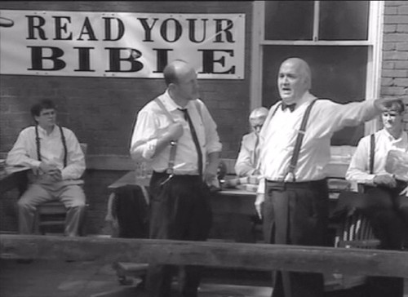
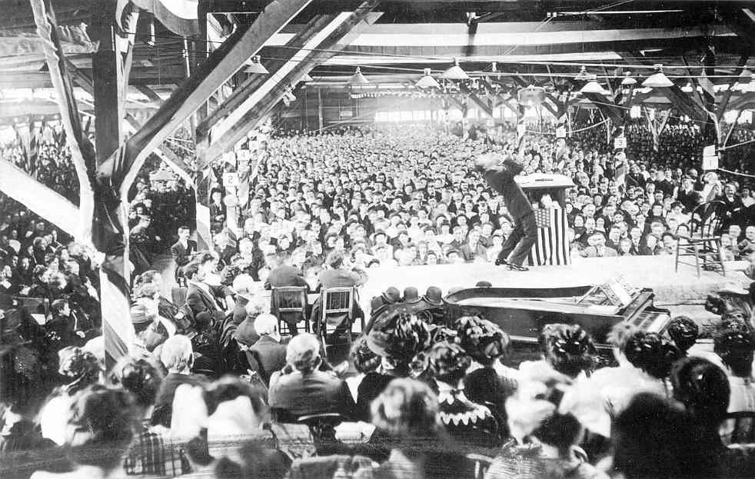
Traditionalism
Return of Puritan Christian values – Questions America’s immorality
Billy Sunday – Christian Evangelical ( Radio Sermons)
Scopes Monkey Trial 1925
Billy Sunday Revival

Slide 14
Fundamentalist Campaign
Bumper Sticker Campaign
Construct a bumper sticker that support fundamentalism values of the 1920s
Topics
Prohibition Unions
Red Scare Creationism
WWI Nativism
Requirements
Slogan supporting fundamentalism
Inclusion of two historic facts
Represents the topic
Remember some of these views are highly controversial

Slide 15
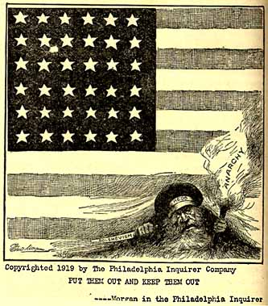
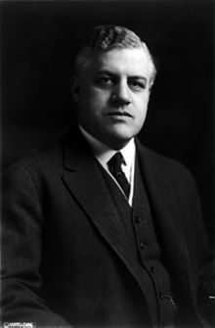
Red Scare
Memories of the Bolshevik Revolution breed fear
Anti-Red Laws: No advocate violent social change
Unions = Communism in
disguise
Palmer Raids
Mitchell Palmer – Attorney General

Slide 16
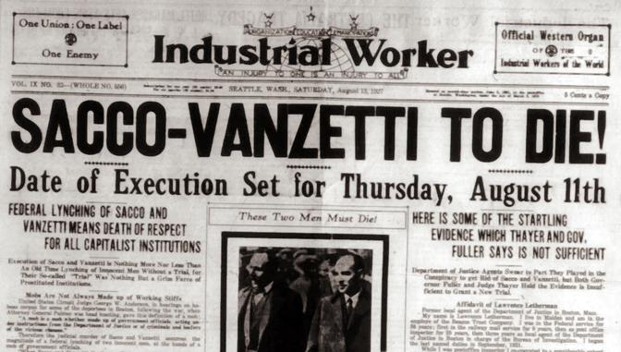
Red Scare
Sacco & Vanzetti Trial 1921 (Nativism re-emergence)

Slide 17
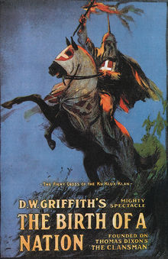
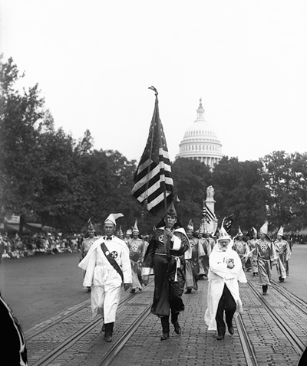
Rise of the KKK
Biblical based – Protestant Christianity
Platform Anti-
Foreign
Catholic
Black
Jewish
Pacifist
Communist
Internationalist
Anti-Evolutionist
Bootlegger
Gambling
Adultery
Birth Control
1915 – Silent Film

Slide 18
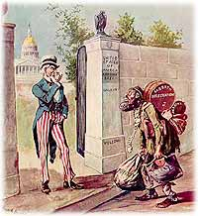
Nativism
1920s saw a new wave of immigration
“Americans believed Europe was vomiting its retched refuse”
Emergency Quota Act 1921
(3% of the population)
Immigration Act 1924
(2% of the population)
Immigration Act of 1929
(152, 547 quota)
American Dream sacrificed
US population segregated

Slide 19
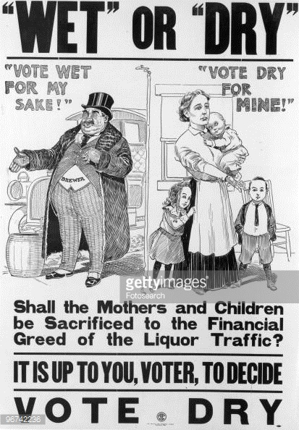
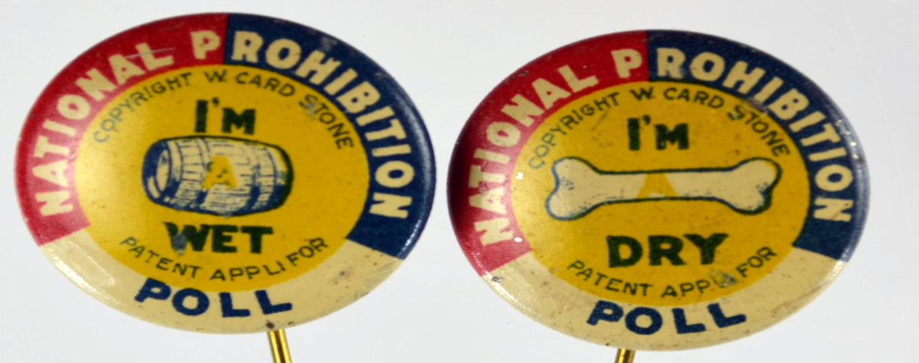
Prohibition
18th Amendment – Volstead Act (weak enforcement)
“The Drys” vs. “The Wets”
Bootleggers – Speakeasies
bath tub Gin
Golden Age of Gangster – Al
Capone
Rise of criminal activities

Slide 20
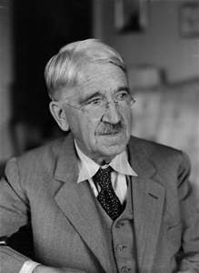
Education
Growth of mandatory education – High School
John Dewey – “Learning by doing” – science

Slide 21
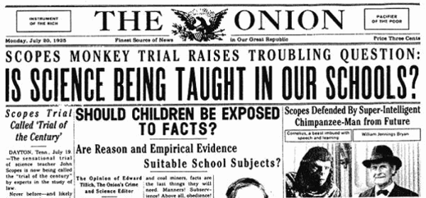
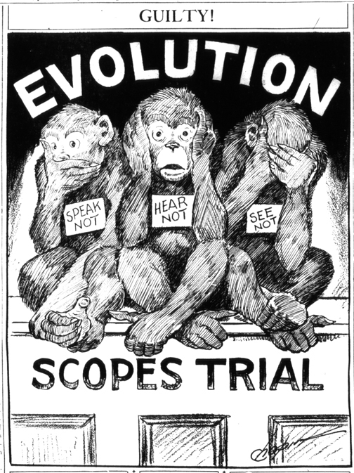
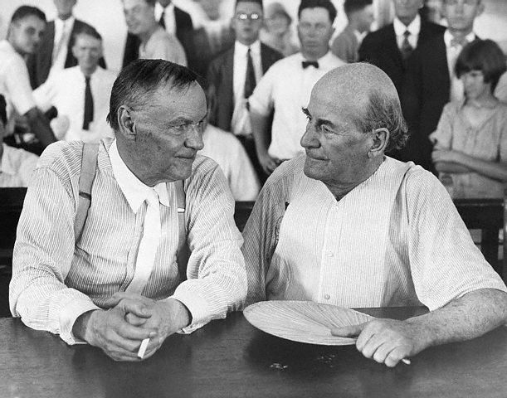
Scopes trial - Evolution
William Jennings Bryan v. Clarence Darrow
Trial makes a mockery of fundamentalist views

Slide 22
Ticket Out
Why did Americans seek the concept of Normalcy?
Explain two ways how fundamentalist upheld the idea of normalcy?

Slide 23
Modernists Facade
Embrace the future forget past traditionalism

Slide 24
Agenda
Essential Question: How has America’s views been redefined by economic necessities, cultural notions, and national security during the turn of the 20th century?
Students can:
Decipher how did the evolution of industrial capitalism change American society in the 1890s to 1945 era
Evaluate how politicians and reformers responded to industrial changes, in the course of doing so, fundamentally change the role of government, especially the federal government, in the lives of Americans
Agenda
Let’s Misbehave
Modernists Façade
A Cultural Clash
Homework:
Read assignment 3, pages 746-760 – Compare and contrast the Normalcy President and explain how they brought on the economic downfall of the 1930s
Quiz on Progressivism, imperialism, and WWI Friday 3/9

Slide 25
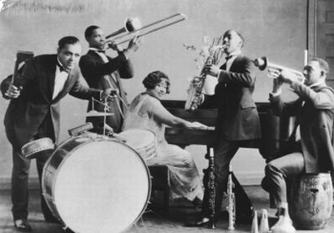
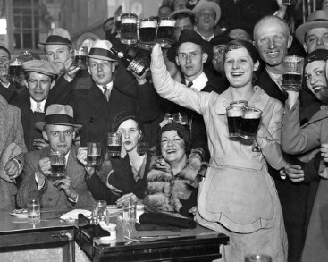
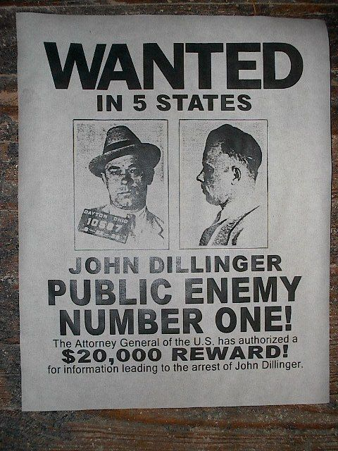
Let’s Misbehave
Why did America reject traditionalism during the 1920s?

Slide 26
The Voice of the 20s
“I couldn’t forgive him or like him, but I saw that what he had done was, to him, entirely justified. It was all very careless and confused. They were careless people, Tom and Daisy – they smashed up things and creatures and then retreated back into their money or their vast carelessness, or whatever it was that keep them together, and let other people clean up the mess they had made.” - F. Scott Fitzgerald, The Great Gatsby, 1925
Lost Generation: the disillusioned generation created by the horror of WWI
Cultural voices
F. Scott Fitzgerald
Ernst Hemingway
America needed new heroes (Babe Ruth, Charles Lindbergh, & Jack Dempsey)

Slide 27
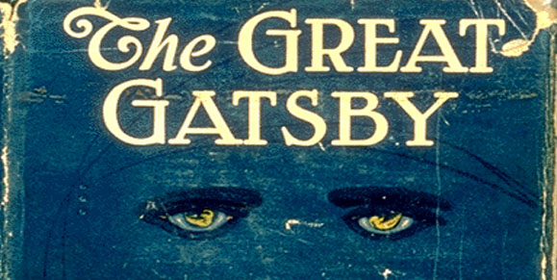
Attitude Change
The Jazz Age attitude - Live for today and don’t worry about tomorrow
Booming economy
The Wets: bootleggers, speakeasies, Al Capone (the mafia)
Mass Marketing: Bruce Burton
Consumerism: Buying on Installment (credit)
Radio
Automobile
Fordism – Automobile culture – the freedom of the road
Stock speculation: buying on margin (credit)
Sexual revolution beginnings: The Flapper & Margaret Sanger (birth control pill)
Jazz: Up tempo music
Harlem Renaissance

Slide 28
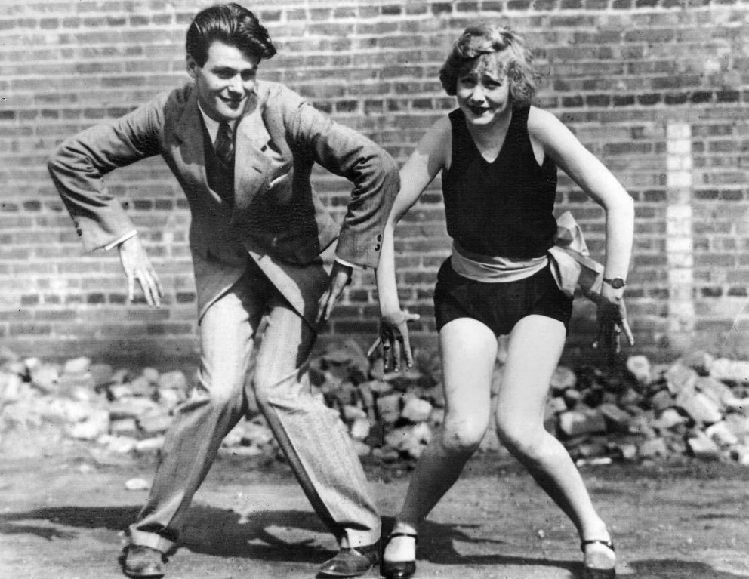
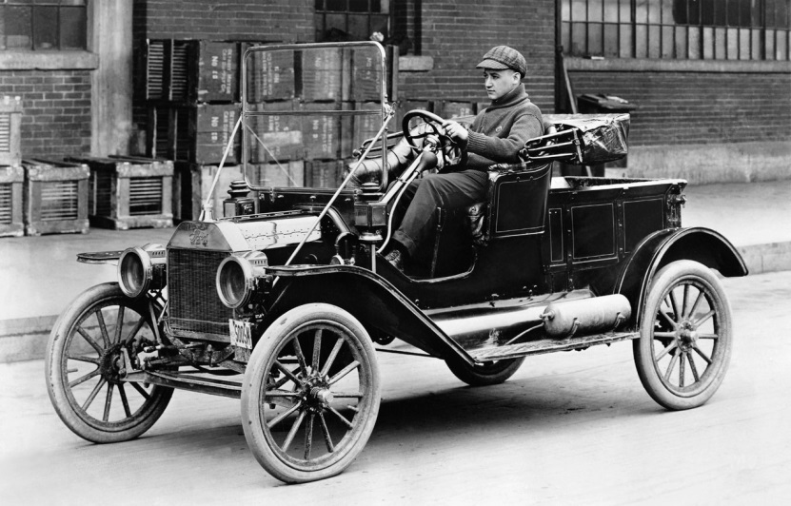
Modernism
Embrace the future, technology, and live life
BE HIP!
The Lost Generation

Slide 29
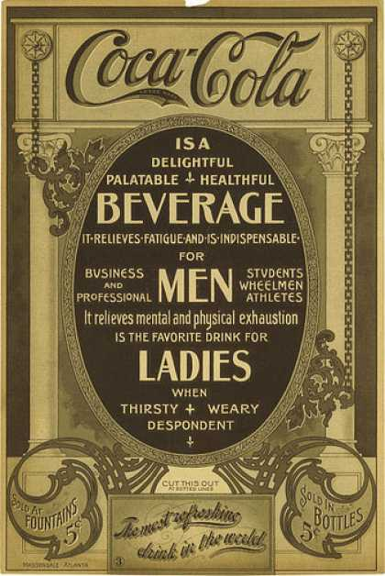
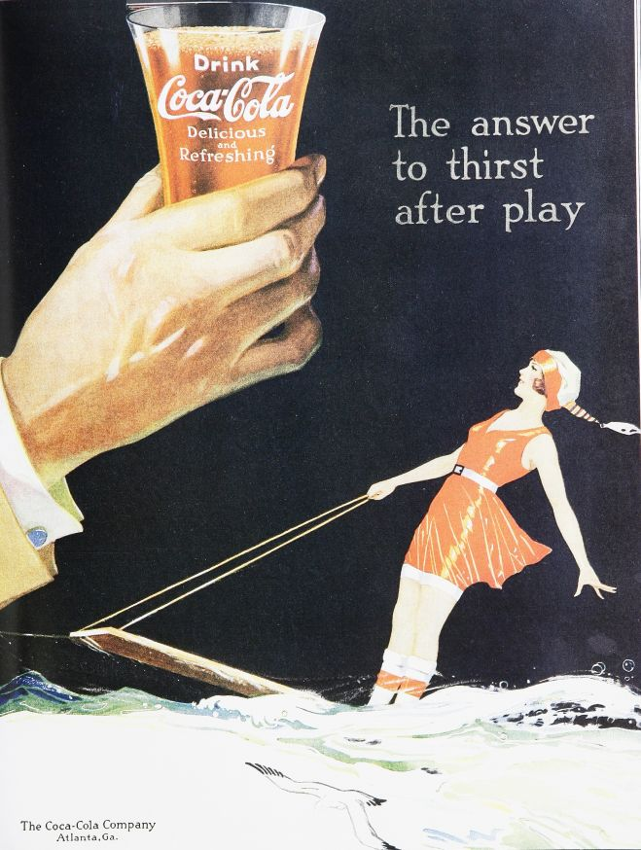
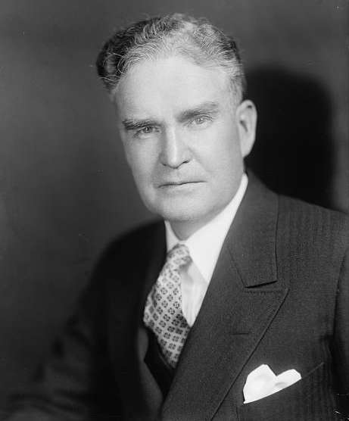
Boom Times
Post WWI Recession replaced by a booming economy
Factors
Secretary of Treasury – Andrew Mellon (Laissez Faire)
New industry – Automobiles, Electricity, & Advertising
1910 Advertisement
1920 Advertisement
Bruce Barton – inventor of mass marketing

Slide 30
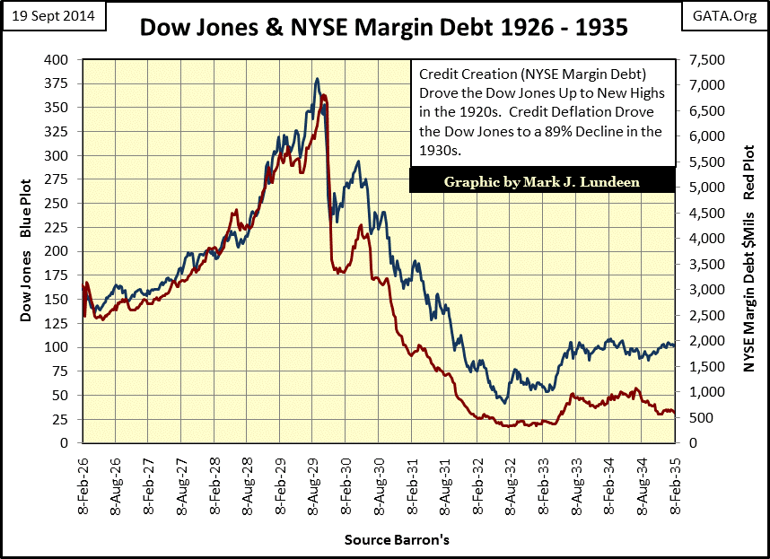
Wall Street’s Big Bull
The new “Rags to Riches” story
“Mellonites” - Andrew Mellon’s pro growth formula (Tax cuts – supply-side – laissez faire economics)
Danger signs
Buying on margin – stock
speculation
Plight of the farmers
100s of bank failures
Little regulation
Growth of America’s debt

Slide 31
CCOT – Change or Continuity over time
Prompt: To what extent did post WWI American society transform socially and economically. Confine your answer to the period 1920 to 1940.

Slide 32
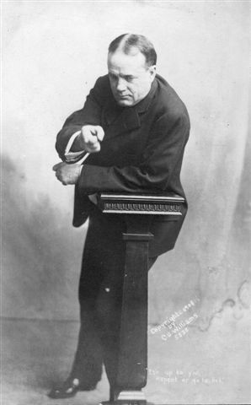
Cultural Clash of 1920s
Immigration
Equality
Prohibition
Evolution
Consumerism
Anglo Saxon Superiority
Sexuality
America’s role in the world
Mellonism
Traditionalist
Modernist
Establishing a cultural baseline for America in the post-WWI era
Demonstrate how each side point of view each topic
Include historic facts to support your conclusions

Slide 33
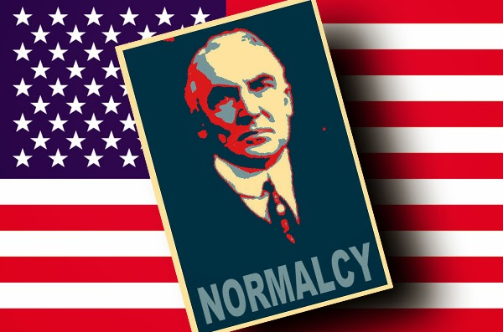
A cultural revolution
The 1920s was suppose to be a return to “NORMALCY”, or simpler times of small town America, according to President Warren G. Harding.
Evaluate whether Harding vision for America was an actual reality in the 1920s

Slide 34
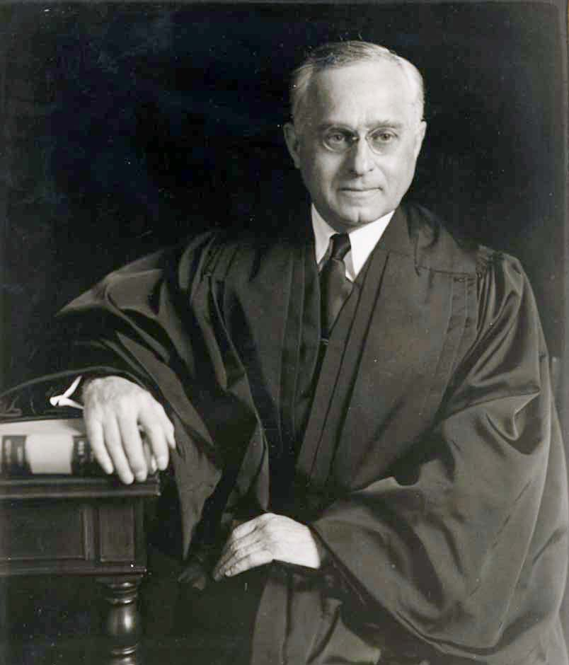
Backlash to Fundamentalism
Movement against the closing of American society
American Civil Liberties Union (1920)– Supreme Court Justice Felix Frankfurter (Protect the Bill of Rights)
Cultural Pluralism: (multiculturalism)
Horace Kellen: America a protective canopy
Randolph Bourne: Cosmopolitan interchange

Slide 35
Boom Economy

Slide 36
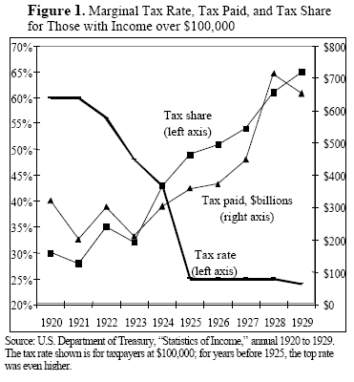
Andrew Mellon’s pro-growth plan

Slide 37
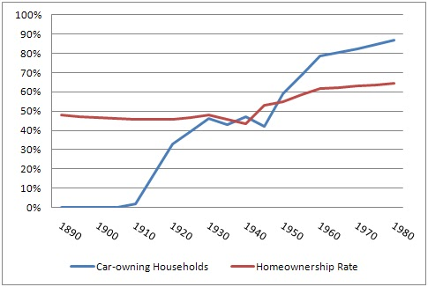
Beginnings of Car Culture
Henry Ford’s Model T DETRIOT = MOTOR CITY
Innovation: Assembly line (Taylorism and Fordism)
Secondary Industries
Highway construction & oil boom
Expands the Suburbs
Grants ladies greater freedom
Danger: Death Toll , encourage installment buying, & hurts RRs

Slide 38
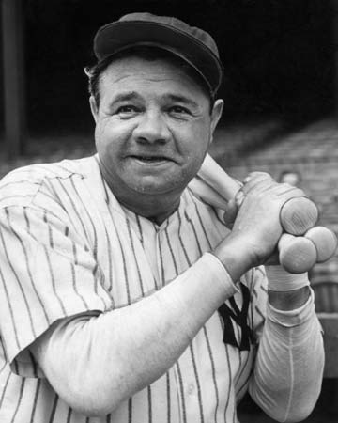
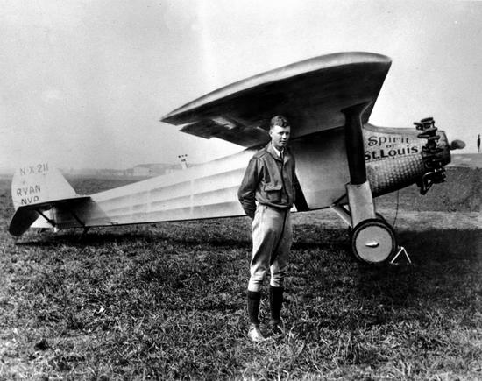
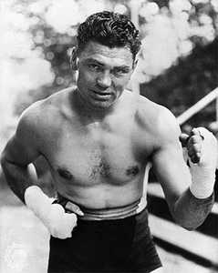
Great American Heroes
Lost Generation – WWI bred disillusionment
America searched for heroes
Jack Dempsey
Babe Ruth
Charles Lindbergh – solo trans-Atlantic flight

Slide 39
Agenda
Essential Question: How has America’s views been redefined by economic necessities, cultural notions, and national security during the turn of the 20th century?
Students can:
Decipher how did the evolution of industrial capitalism change American society in the 1890s to 1945 era
Evaluate how politicians and reformers responded to industrial changes, in the course of doing so, fundamentally change the role of government, especially the federal government, in the lives of Americans
Agenda
The Gilded Age Recall
Pop Culture of the 1920s
A Cultural Clash
Homework:
Read assignment 3, pages 746-760 – Compare and contrast the Normalcy President and explain how they brought on the economic downfall of the 1930s
Quiz on Progressivism, imperialism, and WWI Friday 3/9

Slide 40
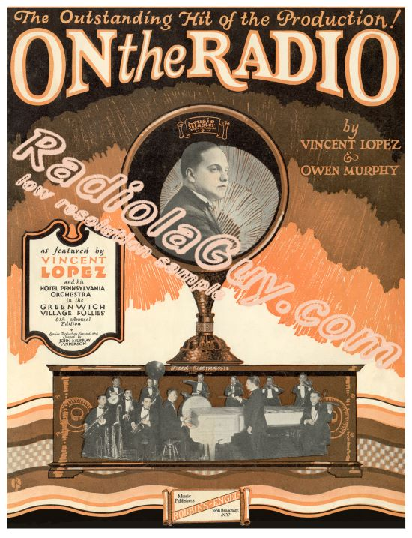
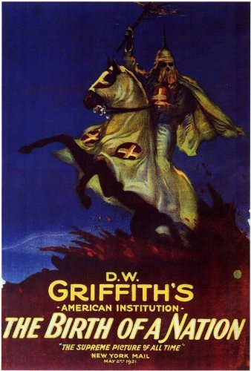
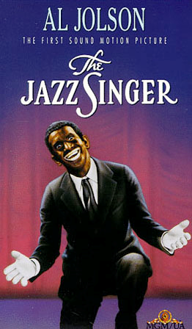
Innovation – Entertainment – Growth of Mass Culture
Movies
Radio
Broadcast takes over the airways
Connects America via Mass Culture
Mass marketing
Sports
News
Symphony
First Movies - Hollywood
The Great Train Robbery
Birth of a Nation
First Talkie “The Jazz Singer”
Movie houses = Nickelodeons
Used for propaganda

Slide 41
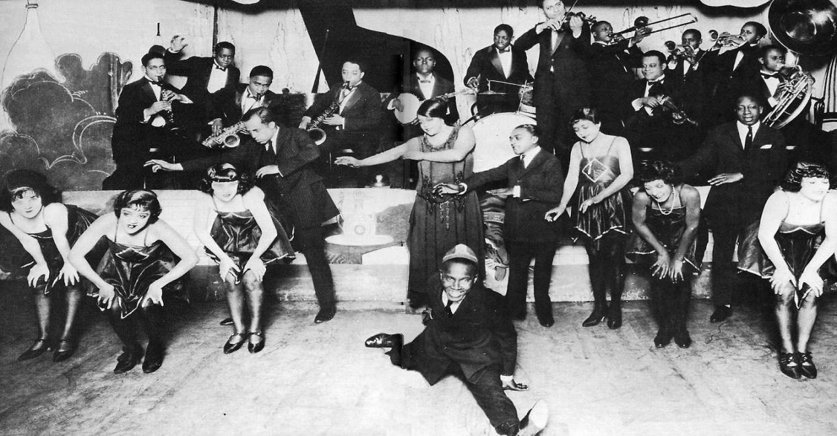
Jazz Age – Youth Cultural
Challenged old norms
Factors:
Margret Sanger – Birth Control
Sigmund Freud – Expressing
sexuality is healthy
Urban Migration
Jazz – up tempo
Women gain greater freedom
“The Flapper”

Slide 42
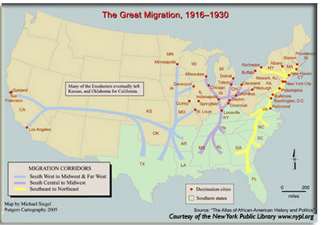
The Great Migration

Slide 43
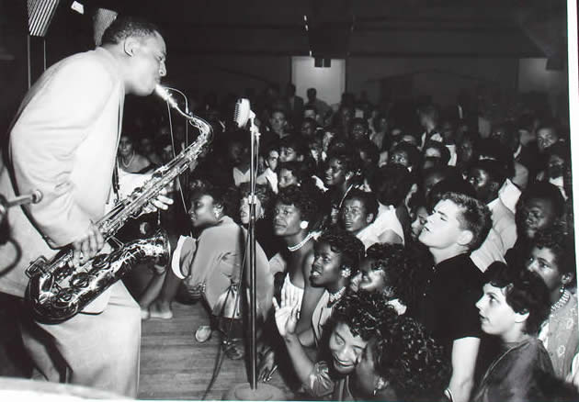
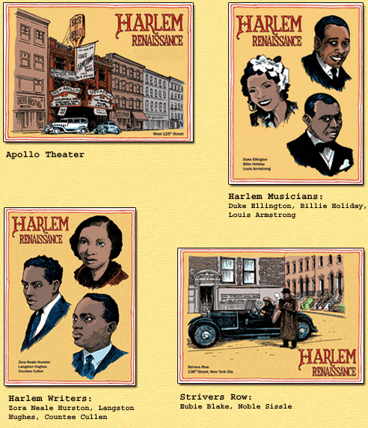
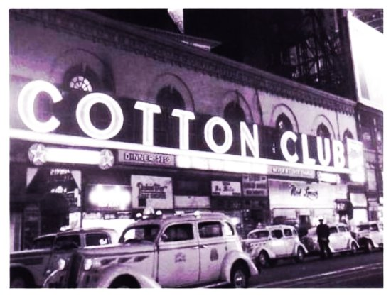
Harlem Renaissance
Great Migration RISE OF THE JAZZ AGE
Harlem, NY becomes the epi-center of African American culture
Langston Hughes – Poet
Duke Ellington – Musician
Zora Neale Hurst – Writer

Slide 44
Back to Africa Movement
United Negro Improvement Association – No equality in America – “Back to Africa Movement” – Marcus Garvey
Rise of the Nation of Islam

Slide 45
Cultural Clash of 1920s
Immigration
Equality
Prohibition
Evolution
Consumerism
Anglo Saxon Superiority
Sexuality
America’s role in the world
Mellonism
Traditionalist
Modernist
Establishing a cultural baseline for America in the post-WWI era
Demonstrate how each side point of view each topic
Include historic facts to support your conclusions

Slide 46
A cultural revolution
Evaluate to what extent the 1920s promoted a cultural revolution within the United States
Cultural Revolution
Tradition of Yester Year

Slide 47
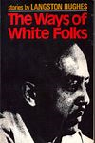
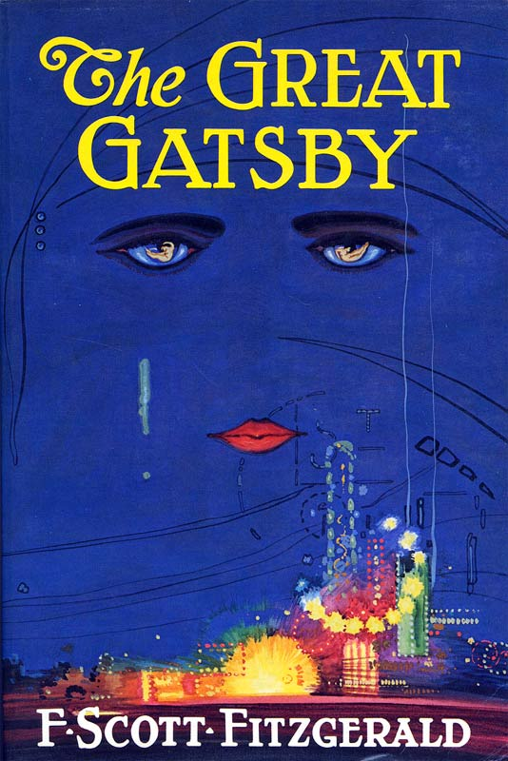
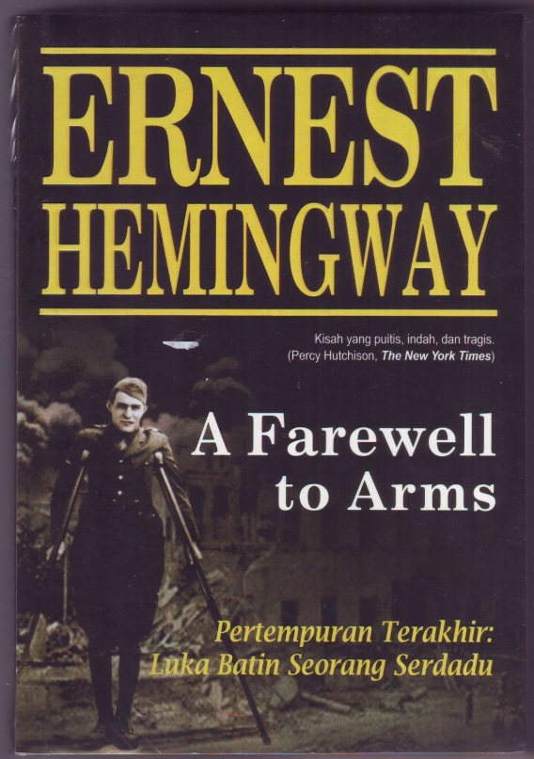
Culture Questions Society
Resentment of the ideals that had lead to WWI
“Lost Generation” youth movement had been betrayed
F. Scott Fitzgerald – “The Great Gatsby”
Ernst Hemingway – “Farewell to Arms”
Langston Hughes – “The Ways of White Folks”

Slide 48
Deciphering the Roaring 20s
Prompt: The stereotypical view of the decade following World War I is the image of the Roaring Twenties where the roaring was the sound of jazz, speakeasies and the celebration of prosperity. Historians, however, disagree with this stereotypical view and argue that the roar of the 1920s was the sound of conflict. To what degree and in what ways was the decade of the twenties defined by a clash of cultures in America?
Construct a thesis and support with 5 facts

Slide 49
Normalcy Presidents
Simpler times and laissez faire breeds destructive economic forces

Slide 50
Agenda
Period 7: 1890 – 1945 – An increasingly pluralistic United States faced profound domestic and global challenges, debated the proper degree of government activism, and sought to define its international role.
Key Concept 7.1: Growth expanded opportunity, while economic instability led to new efforts to reform U.S. society and its economic system
Essential Question: How has America’s views been redefined by economic necessities, cultural notions, and national security during the turn of the 20th century?
Students can:
Decipher how did the evolution of industrial capitalism change American society in the 1890s to 1945 era
Evaluate how politicians and reformers responded to industrial changes, in the course of doing so, fundamentally change the role of government, especially the federal government, in the lives of Americans
Agenda
Perspective of the 1920s
The Politics of Normalcy
The Culture War
Homework:
Finish Ideological Spectrums

Slide 51
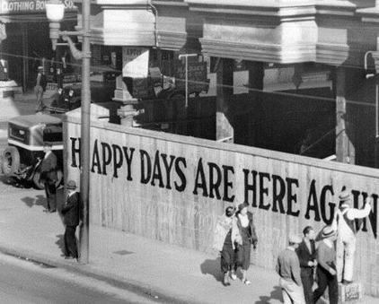
Clash of Cultures
Demonstrate how the 1920’s United States was a nation divided along cultural views.
Use one of the following to show how America was divided:
Prohibition Evolution
Immigration Role of Women
Consumerism

Slide 52
The Boom of the 20s
How would the following demographics view the prosperity of the 1920s?
Mellonites
White protestant urbanites
Farmers
African Americans

Slide 53
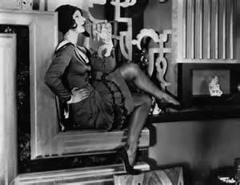
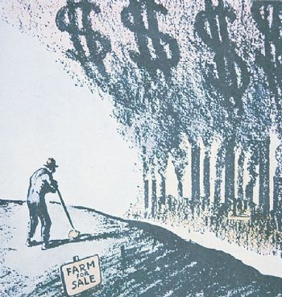
The Dichotomy of the 20s
The 1920s: Excitement & prosperity vs. fear & struggle
BIGGEST factors: WWI & Bolshevik Revolution
PROPERSITY
Middle & Upper class
White protestants
Urbanites
The Lost Generation (Great Gatsby)
STRUGGLING
Minorities & poor
Farmers
(Easy susceptible to Xenophobia & the KKK)

Slide 54
Agenda
Essential Question: How has America’s views been redefined by economic necessities, cultural notions, and national security during the turn of the 20th century?
Students can:
Decipher how did the evolution of industrial capitalism change American society in the 1890s to 1945 era
Evaluate how politicians and reformers responded to industrial changes, in the course of doing so, fundamentally change the role of government, especially the federal government, in the lives of Americans
Agenda
The Concept of Normalcy
The Pillars of Normalcy
Factors of Normalcy
Homework:
Study for Quiz on Progressivism, Imperialism, and WWI
Quiz on Progressivism, imperialism, and WWI Friday 3/9

Slide 55
Return to Normalcy
America’s present need is not heroics, but healing; not nostrums, but normalcy; not revolution, but restoration; not agitation, but adjustment; not surgery, but serenity; not the dramatic, but the dispassionate; not experiment, but equipoise; not submergence in internationality, but sustainment in triumphant nationality.
- Warren G. Harding, March 14, 1920

Slide 56
Republicans Rule the 1920s
All the presidents of the 1920s were Republican
- Warren Harding
- Calvin Coolidge
- Herbert Hoover
Warren G. Harding 1921-1923 (died in office)
Calvin Coolidge 1923-1929
Herbert Hoover 1929-1933

Slide 57
Harding’s Scandals
Harding’s Administration Scandal
Grantism – Ohio Gang
Veteran's Bureau chief caught stealing bureau funds
the Attorney General and others in the Justice Department found influence peddling
Interior Secretary Albert Fall leases government oil reserves at Elk Falls, Cal. and Teapot Dome, Wyoming to oilmen in return for $400,000 in bribes
Teapot Dome scandal becomes symbol of Harding administration

Slide 58
Silent Cal
Calvin Coolidge
Cleans up Washington DC –
removes the Ohio Gang
Pro business
Mellonite
Appoints Supreme Court Justices
that support deregulation
Adkins v. Children’s Hospital decision
(No minimum wage)
Vetoes McNary-Haugen Farm Bill
Isolationists
Refuses membership in the League of Nation
Requires European loan payment

Slide 59
Herbert Hoover
Defeats Al(cohol) Smith in 1928
Mellonite
Belief in volunteerism
Encourage corporations to raise wages
& market standardization
Self regulation economic growth

Slide 60
The Pillars of Normalcy
Evaluate how the Republican presidents of the 1920s promoted the concept of Normalcy and led America into economic depression
Isolationism (political & economic)
Mellonism
Protectionism (political & economic)

Slide 61
Factors promoting Normalcy
Select ONE of the following and demonstrate how it influenced Republican ideology of the 1920s
WWI
Bolshevik Revolution
Booming Economy
Progressivism

Slide 62
Continuity of isolationism
Washington Naval Conference: limit naval arms
Kellogg-Briand Pact: Germany, France and the United States agree to outlaw war
World Court: (Senate rejects it – isolationism)
Dawes Plan: US guarantees loans to Germany so they can pay war reparations and return France and UK can pay war debt to America

Slide 63
Trickle Down Economics
New Laissez Faire Economics: Money flows down
Andrew Mellon’s tax plan – wealth create jobs and everybody gains
Protectionism: Fordney-McCumber Tariff
35% duty on farm goods
Government thrift: Adjusted
Compensation Act: Bonus for
military veterans of WWI

Slide 64
Agenda
Period 7: 1890 – 1945 – An increasingly pluralistic United States faced profound domestic and global challenges, debated the proper degree of government activism, and sought to define its international role.
Key Concept 7.1: Growth expanded opportunity, while economic instability led to new efforts to reform U.S. society and its economic system
Essential Question: How has America’s views been redefined by economic necessities, cultural notions, and national security during the turn of the 20th century?
Students can:
Decipher how did the evolution of industrial capitalism change American society in the 1890s to 1945 era
Evaluate how politicians and reformers responded to industrial changes, in the course of doing so, fundamentally change the role of government, especially the federal government, in the lives of Americans
Agenda
Achieving Normalcy?
Normalcy or Conflict
Factors in Normalcy
Homework:
The Culture War – read article and compare the 1920s to now (print the article)

Slide 65
Normalcy – Rejecting the Past
Concept: Isolationism, Laissez Faire, or American 1st
1920s
Progressive or Imperialism
A list of 6 different facts that demonstrate concept with explanations
You may also choose 1 to 2 facts that show rejection of the concept with explanation
A list of 6 facts with explanation that demonstrate how these periods were different than the 1920s
You may also choose 1 to 2 facts that shows similarity

Slide 66
Government policies of the 1920s
Isolationism – stay neutral | Government Thrift – avoid paying or lessen government expenditures
Protectionism – protect US economy from outside competition | Laissez faire – government has little to no intervention in the US economy

Slide 67
Agenda
Essential Question: How has America’s views been redefined by economic necessities, cultural notions, and national security during the turn of the 20th century?
Students can:
Decipher how did the evolution of industrial capitalism change American society in the 1890s to 1945 era
Evaluate how politicians and reformers responded to industrial changes, in the course of doing so, fundamentally change the role of government, especially the federal government, in the lives of Americans
Agenda
Recalling Unit IV
Unit VII Quiz
The Great Crash
Homework:
Read causes and consequences of the Great Depression (APUSH Link under Unit VII
Complete notes on Hoover’s response to the Great Depression

Slide 68
Agenda
Period 7: 1890 – 1945 – An increasingly pluralistic United States faced profound domestic and global challenges, debated the proper degree of government activism, and sought to define its international role.
Key Concept 7.1: Growth expanded opportunity, while economic instability led to new efforts to reform U.S. society and its economic system
Essential Question: How has America’s views been redefined by economic necessities, cultural notions, and national security during the turn of the 20th century?
Students can:
Decipher how did the evolution of industrial capitalism change American society in the 1890s to 1945 era
Evaluate how politicians and reformers responded to industrial changes, in the course of doing so, fundamentally change the role of government, especially the federal government, in the lives of Americans
Agenda
The Culture War
Normalcy or Conflict
Hope or Disillusionment
Homework:
Read pages 760-773 – Factors of the Great Depression (Quiz tomorrow)

Slide 69
Culture War Debate
Culture War Verbal War
Construct a sentence strip that either demonstrates whether the Culture War of today mirrors that of the 1920s
Must use valid facts from the 20s and the articles to support the conclusion

Slide 70
Normalcy – Rejecting the Past
Concept: Isolationism, Laissez Faire, or American 1st
1920s
Progressive or Imperialism
A list of 6 different facts that demonstrate concept with explanations
You may also choose 1 to 2 facts that show rejection of the concept with explanation
A list of 6 facts with explanation that demonstrate how these periods were different than the 1920s
You may also choose 1 to 2 facts that shows similarity

Slide 71
Hope v. Disillusionment
How did Republican policies (laws) during the 1920s demonstrate hope and disillusionment?
Give ONE foreign policy example
Give ONE domestic policy example

