Slide 1
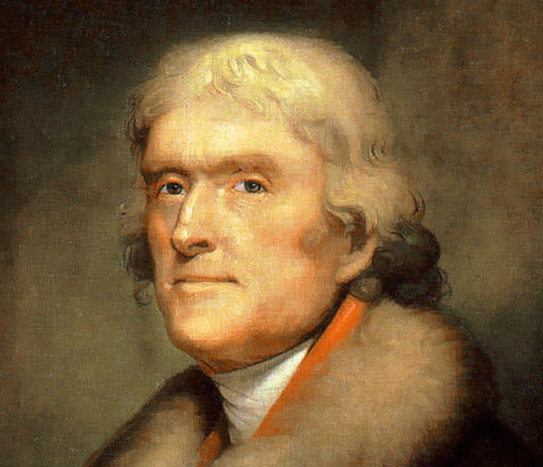
Age of Jefferson: A Political Revolution?
Unit IV
1800-1848

Slide 2
Essential Question: How did political ideological change transform public policy during Jeffersonian democracy?
Essential Question: Explain the causes and effects of policy debates in the early republic.
Students Can:
Determine whether the Revolution of 1800 resolved political conflicts over Constitutional authority
Agenda
Quick Review
Unit III Test
Homework
Jeffersonian Democracy

Slide 3
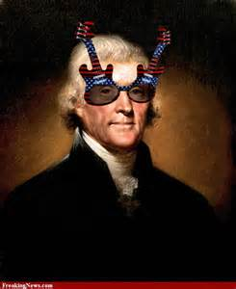
Essential Question
How effective was the Revolution of 1800 at bringing about democratic change during a period of rapid transformation in the United States?
Age of Jefferson

Slide 4
Thomas Jefferson's Inauguration 1801
We are all Republicans; we are all Federalists. If there be any among us who would wish to dissolve this Union or to change its republican form, let them stand undisturbed as monuments of the safety with which error of opinion may be tolerated where reason is left free to combat it. I know, indeed, that some honest men fear that a republican government can not be strong, that this Government is not strong enough; but would the honest patriot, in the full tide of successful experiment, abandon a government which has so far kept us free and firm on the theoretic and visionary fear that this Government, the world's best hope, may by possibility want energy to preserve itself? I trust not. I believe this, on the contrary, the strongest Government on earth
Election of 1800
Federalist v. Democratic Republicans
1st Amendment - Free Speech
Virginia & Kentucky Resolutions
Alien & Sedition Acts
Whiskey Rebellion
Evaluating a primary source document:
Why does Jefferson state the bolded words?
What is Thomas Jefferson attempting to do with his word choice?
What evidence supports our understanding of Jefferson’s words

Slide 5
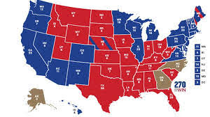
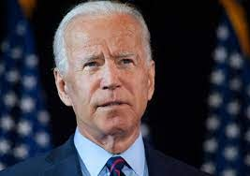
Election 2020
History Repeats
“To those who voted for President Trump, I understand your disappointment tonight. I’ve lost a couple of elections myself,” “But now, let’s give each other a chance. It’s time to put away the harsh rhetoric. To lower the temperature. To see each other again.” “To listen to each other again. To make progress, we must stop treating our opponents as our enemy. We are not enemies. We are Americans.”
- President Elect Joe Biden, 11/7/20

Slide 6
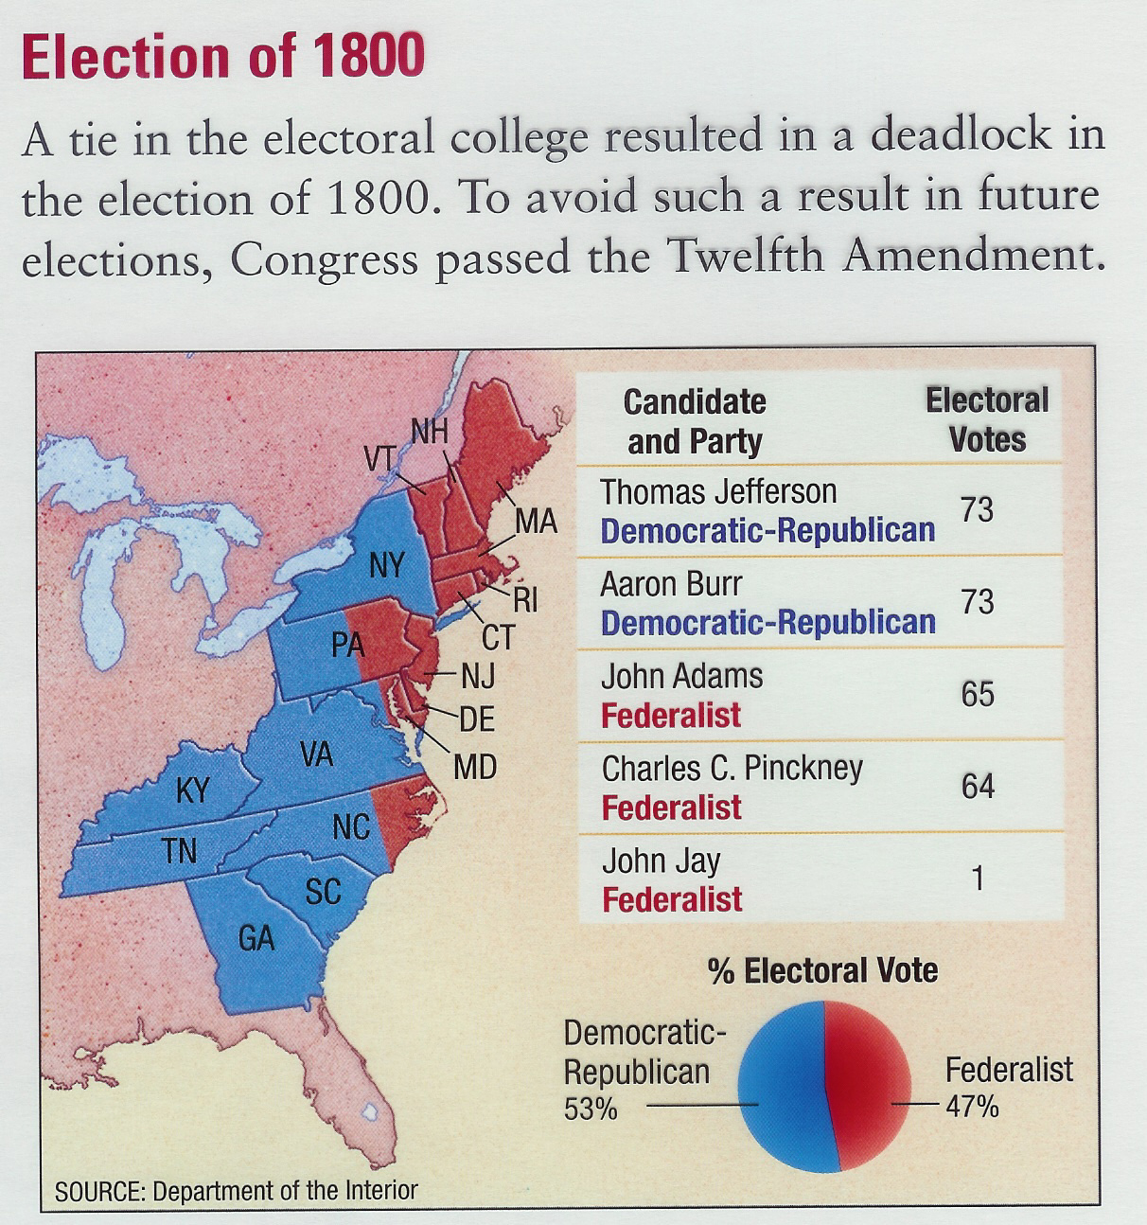
A Revolution of 1800
Revolution = 1st Peaceful transition between political parties
Issue – Tie between Thomas Jefferson & Aaron Burr
House of Representatives elects Jefferson (Alexander Hamilton)
12th Amendment: President & Vice President run together

Slide 7
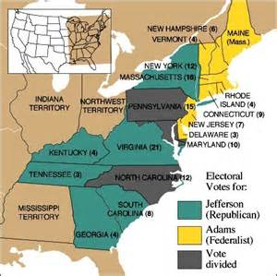
Revolution of 1800
1st Critical Election in the U.S.
Revolution of 1800 – 1st peaceful transition of political power
Disruption in the political order
Usually caused by a divisive issue & expansion of suffrage
A shift in voter support
Causes a major change in policy
Causes an enduring change in voter coalitions or the death of a political party

Slide 8
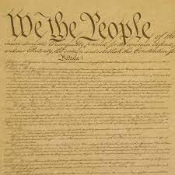
Defining a Constitution
Prompt: Explain the issues that created the greatest controversies during the ratification of the United States Constitution (1787–1788) and analyze how those issues continued to divide the nation during the two decades following ratification (1789–1800).
Develop a historic contextualization and thesis for the prompt

Slide 9
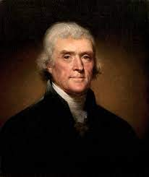
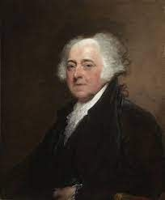
Federalist or Democrat- Republican
Election of 1800 – Taking Sides: Explain whose vision for the United States is correct at the turn of the 19th century.
Arguments against the FEDERALISTS
Arguments against Democrat-Republicans
What is your thesis argument statement?

Slide 10
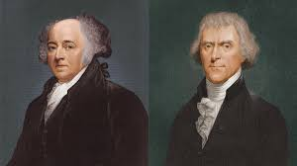
Election of 1800 - Contextualized
Background surrounding the Election of 1800 – put the history in context of the moment in time
What is a theme to build and connect events?
Causation: An event prior to 1790
Immediate Effect: An event during 1796-1800
Long Term Effect: An event after 1800

Slide 11
Essential Question: How did the development of the American republic demonstrates democratic debates over the proper authority of a governing body
Students can:
Agenda
Review Unit III
Unit III Test
Homework
Turning points – Washington’s inauguration to Jefferson
Unit III SAQ Thursday 10/31

Slide 12
The Revolution of 1800
Historians have labeled the election of 1800 as the Revolution of 1800. To what extent did Jeffersonian democracy uphold the idea that the election of 1800 was a revolution?
Use 50 words to debate the merits of whether the election of 1800 was a revolution. Your answer must contain the following facts:
Louisiana Purchase
Marbury v. Madison
Naturalization Act
Albert Galatin’s Debt Refinance Plan

Slide 13
Essential Question: How did political ideological change transform public policy during Jeffersonian democracy?
Topic 4.2: Decipher how the development of a modern democracy and celebration of new culture further spur sectional differences from 1800-1848
Topic 4.2: Explain the cause and effects of policy debates in the early republic
Students can:
Explain the cause and effects of policy debates during Jeffersonian democracy from 1800-1817
Explain the context in which the republic developed from 1800-1848
Agenda
CCOT Jefferson
Jeffersonian Public Policies
Staying true to Jeffersonian Beliefs
Homework: Jeffersonian Thesis

Slide 14
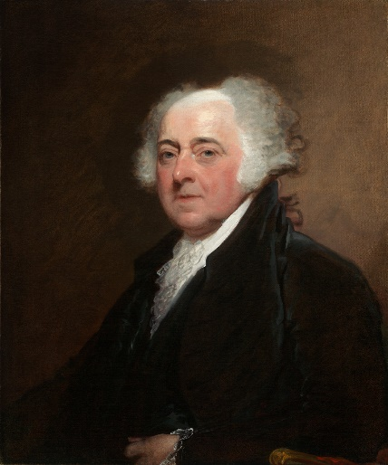
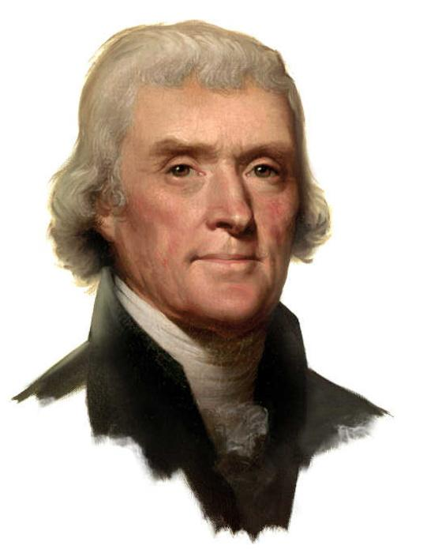
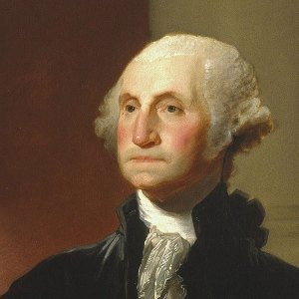
CCOT
Change or continuity over time (CCOT): analyze how changes or continuities influence the development of the United States.
1789-1797
1797-1801
1801-1809
Explain whether the following demonstrate Jeffersonian policies continuity or change from Federalist policies.
Louisiana Purchase
Marbury v. Madison

Slide 15
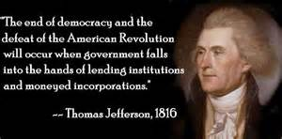
Democratic-Republican Ideology
Less federal government
Strict constructionist view
Limit federal power and promote state government authority
Pay down the debt instead of financing it
The “common man” more important than wealthy
No formal aristocrat

Slide 16
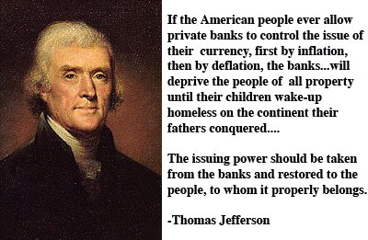
The Gallatin Plan
New Secretary of Treasury: Albert Gallatin
Dealing with American Debt
Repeals the Whiskey Tax
Pays down the debt
Keeps the National Bank
Explain whether Gallatin’s Plan demonstrates continuity or change with Federalist’s policies

Slide 17
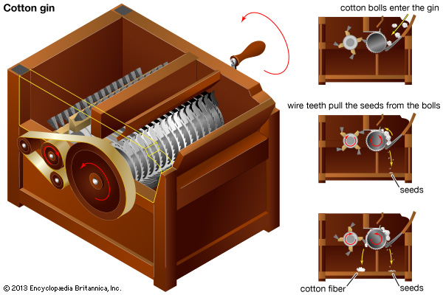
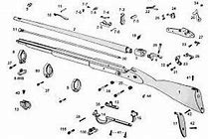
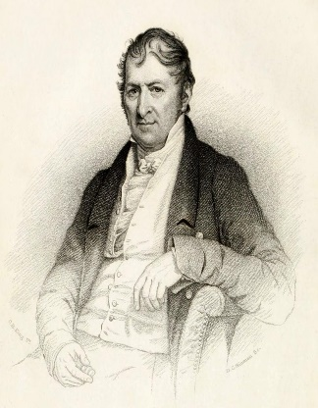
Changing Economy
Jefferson’s support for innovation
Eli Whitney
Cotton Gin 1793
Interchangeable Parts 1801
Growth of a SECTIONAL economy: Southern (King Cotton) v. Northern Industrialism

Slide 18
Jeffersonian Democracy
Prompt: Evaluate to which extent to which the Jeffersonian Republicans remained faithful to their principles of Constitutional interpretations in the years 1801-1817.
Simplify the question
Documents
Identify main idea
Identify the implied fact and explain how it responds to the prompt
HIPP or HAPPY the documents

Slide 19
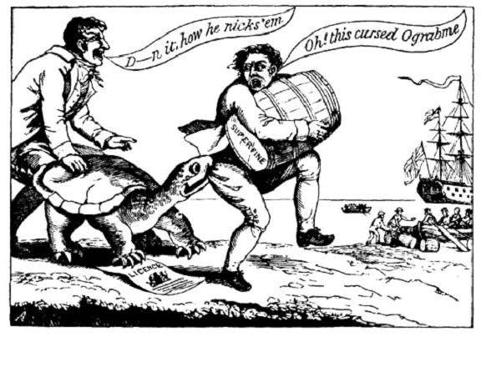
HIPP the Historic Contextualization
Superfine
License
“Ograbme” by Alexander Anderson 1807

Slide 20
Jeffersonian Democracy
Prompt: Evaluate to which extent to which the Jeffersonian Republicans remained faithful to their principles of Constitutional interpretations in the years 1801-1817.
3 Categories
Category 1
Category 2
Category 3

Slide 21
Revolutionary Jefferson
Change
Continuity
The Common man
Marbury V. Madison
Alien Act
Sedition Act
Louisiana Purchase
Tripolitania War
Mosquito Fleet
Impeachment of Samuel Chase
National Bank
Nation Debt
Excise Tax
Embargo Act
Non-intercourse act

Slide 22
Essential Question: Explain the causes and effects of policy debates in the early republic.
Students Can:
Determine whether the Revolution of 1800 resolved political conflicts over Constitutional authority
Decipher how the Judiciary Branch of the national government define the authority of the federal government in comparison to the states
Explain how the Louisiana Purchase influenced the development of the United States
Agenda
HAPPY Jefferson
Jeffersonian Policy
A Revolution or Just a Federalist
Homework: Jeffersonian Foreign Policy (Reading 182-184 on AMSCO)

Slide 23
Essential Question
How effective was the Revolution of 1800 at bringing about democratic change during a period of rapid transformation in the United States?
Age of Jefferson

Slide 24
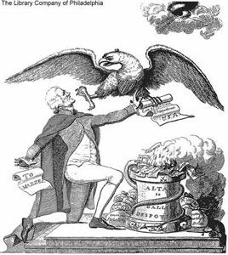
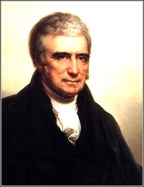
Federalist Political Play
Midnight Judges: Adams places the federal court under Federalist control (Judiciary Act of 1801)
Justice John Marshall
Marshall precedents expand federal power
Marbury v. Madison 1803: Judicial Review – US Supreme Court can declare laws unconstitutional
Loose Constructionism
“It is emphatically the province and duty of the judicial department to say what the law is” – Marbury v. Madison 1803
Impeachment of Samuel P. Chase – Sedition against Democratic-Republicans – Establish the independent judiciary

Slide 25
Essential Question: How did political ideological change transform public policy during Jeffersonian democracy?
Students can:
Explain the cause and effects of policy debates during Jeffersonian democracy from 1800-1817
Explain the context in which the republic developed from 1800-1848
Agenda
HAPPY Jefferson
Jeffersonian Foreign Policies
A Revolution or Just a Federalist
Homework: Finish Jeffersonian DBQ

Slide 26
Jeffersonian Democracy Test
HAPPY the document and write a HIPP statement
But I suppose they must then appeal to the nation for an additional article to the Constitution, approving & confirming an act which the nation had not previously authorized. The Constitution has made no provision for our holding foreign territory, still less for incorporating foreign nations into our Union. The Executive in seizing the fugitive occurrence which so much advances the good of their country, have done an act beyond the Constitution. The Legislature in casting behind them metaphysical subtleties, and risking themselves like faithful servants, must ratify & pay for it, and throw themselves on their country for doing for them unauthorized what we know they would have done for themselves had they been in a situation to do it. It is the case of a guardian, investing the money of his ward in purchasing an important adjacent territory;
- Letter from Thomas Jefferson to John Breckinridge, 1803
Use facts stated and implied in the document
Explain the relevance of one of the following
Historical Context
Intended Audience
Point of view
Purpose

Slide 27
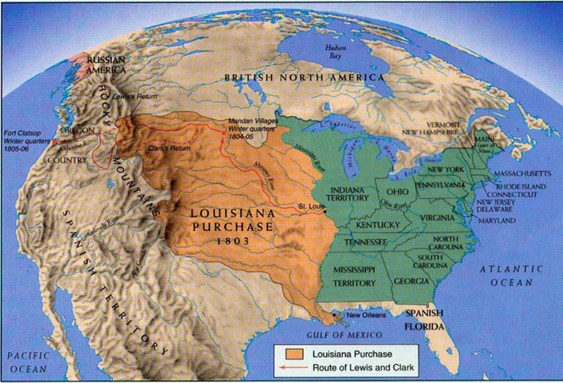
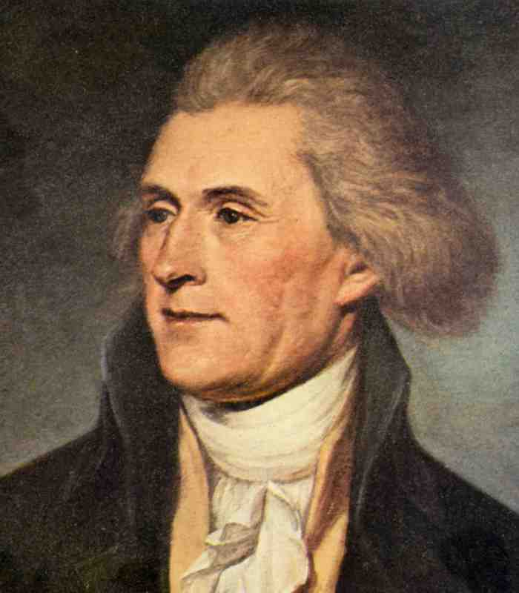
Louisiana Purchase
Louisiana Purchase 1803
Pinkney Treaty nullified (France regains the Louisiana territory
Jefferson Dilemma
Common man needs access to Mississippi River/Port of New Orleans (Cash Crop Agriculture)
NO Constitutional authority to buy land
What to do?

Slide 28
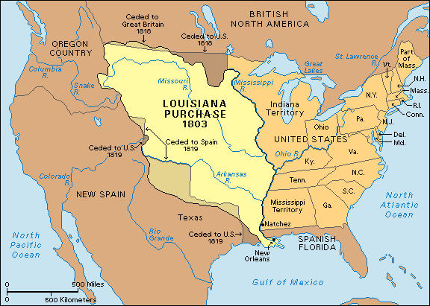
LET’s grow America
How does the Louisiana Purchase impact the development of the United States?
Doubles the size of the U.S.
Lewis & Clark Expedition (Oregon claim)
Expands SECTIONAL TENSIONS
Maintains American neutrality
Encourages further desire for westward expansion (Zebulon Pike Expedition – Colorado, Texas, & New Mexico)
US Oregon Claim
WESTWARD EXPANSION

Slide 29
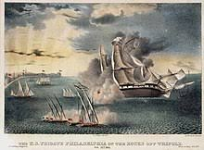
Maintaining American Neutrality
Jefferson’s Dilemma: maintaining his democratic values with a growing nation
U.S. Economy v. U.S. Military
Issue: Impressment – (France, England, & Barbary Pirates)
U.S. needs trade
Jefferson fears military power (Establishes the Mosquito Fleet)
Tripolitan War (1801-1805) – Jefferson enlarges the Navy to blockade the Mediterranean Sea and defeat the Barbary Pirates
- Allows the U.S. to maintain neutrality

Slide 30
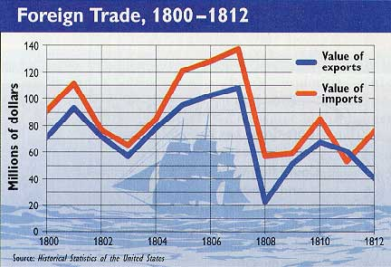
Peaceful Coercion
Napoleonic Wars (Britain v. France)
Orders of Council – impressment by French & English of U.S. sailors (Chesapeake & Leopard Incident 1807 – Britain sinks a US ship)
Embargo Act 1807 – Refusal to trade with any nation
Impact on U.S. Economy

Slide 31
Jeffersonian Democracy
Thesis = Although X, A + B claim y
Prompt: Evaluate to which extent to which the Jeffersonian Republicans remained faithful to their principles of Constitutional interpretations in the years 1801-1817.
3 Categories
Category 1
Category 2
Category 3

Slide 32
Historical Contextualization
Historical contextualization – sets the scene for the time period of the prompt (think larger picture)
Causation: What happened prior to 1801 that led to the rise of Jeffersonian democracy.
Identify an event or idea relevant to the idea of the prompt (Theme – which of the following themes are relevant to the question) (remember your isms and ations words)
Explain how the idea or event set the stage for your argument
Themes
Politics and Power - American & National identity
Work, Exchange, Economy - Geography & environment
Migration and settlement - America in the World
Regional culture -

Slide 33
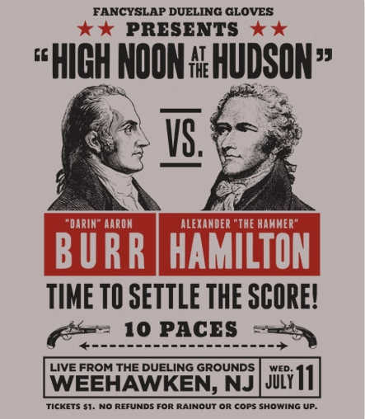
Killing the Federalists
Hamilton discredits Burr
Election of 1800
Smear campaign against Burr 1805 NY governor’s race
Hamilton-Burr Duel
Further weakens the Federalist Party
Burr plots against the US (western secession) – acquitted of treason

Slide 34
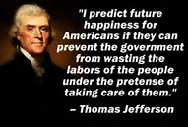
A Revolution or a Lie
Prompt: To what extent was the Revolution of 1800 aptly name? Focus on the time period of 1800 to 1815.
Requirements:
Work with a partner
Thesis
12 fact statements organized based on your thesis
Thesis
Argument assertion that answers the prompt
Three ways that you will prove your assertion correct

Slide 35
Essential Question: Explain the causes and effects of policy debates in the early republic.
Students Can:
Determine whether the Revolution of 1800 resolved political conflicts over Constitutional authority
Decipher how the Judiciary Branch of the national government define the authority of the federal government in comparison to the states
Explain how the Louisiana Purchase influenced the development of the United States
Agenda
Ograbme Historic Contextualization
Jeffersonian Foreign Policy
A Revolution or Just a Federalist
Homework: Read article on Judicial Nationalism

Slide 36
HIPP the Historic Contextualization
Historic contextualization: evaluate why the document is written in 1807.
Ograbme by Alexander Anderson 1807

Slide 37
Supporting Dem-Rep Values?
Historic parallel (synthesis) – compare Jefferson’s Louisiana Purchase to Hamilton’s debt finance plan
Use facts to support your conclusions
Comparisons between Hamilton & Jefferson

Slide 38
Promoting Democrat Republicanism
Restoring the Common Man
Pardons all sentence under the Sedition Act
Naturalization Act of 1802
Promoting the Common Man
Albert Gallatin’s Financial Plan
Repeals the Excise Tax
Pay down the debt
Keeps the National Bank
“Experience hath shewn, that even under the best forms of government those entrusted with power have, in time, and by slow operations, perverted it into tyranny.”

Slide 39
A Revolution or Same Old Story
Prompt: Historians have labeled the election of 1800 as the Revolution of 1800. To what extent did Jeffersonian democracy uphold the idea that the election of 1800 was a revolution.
Terminology:
Revolution of 1800 - Doctrine of Nullification - 12th Amendment
Judicial nationalism - Louisiana Purchase - Mosquito Fleet
Tripolitan War - Embargo Act (1807) - Non-intercourse Act
Macon’s Bill #2 - Marbury v. Madison - Fletcher v. Peck
Impressment - Martin v. Hunter-Lessee - Nation Bank
Naturalization Act of 1802 - Albert Gatlin's Debt Refinance Plan
Impeachment of Salmon P. Chase - War of 1812
Tecumseh - Battle of Tippecanoe - War Hawks

Slide 40
A Revolution or Same Old Story
Prompt: Historians have labeled the election of 1800 as the Revolution of 1800. To what extent did Jeffersonian democracy uphold the idea that the election of 1800 was a revolution.
Alien Act: The Naturalization Act of 1801 supported the pathway for immigrants to become citizens, therefore the common man, by returning the process to back to a five-year period. (Change)
The creation of the 1st National Bank:

Slide 41
A Revolution or Same Old Story
Prompt: Historians have labeled the election of 1800 as the Revolution of 1800. To what extent did Jeffersonian democracy uphold the idea that the election of 1800 was a revolution.
Thesis:
Two sentences (MAX)
Thesis formula: Claim (must respond and NOT restate the prompt) because A (reason 1) and B (reason 2). However X (Counter-claim and reason)
Type of prompt = Continuity or Change (Thesis – claim must support either change or continuity)

Slide 42
A Revolution or a Lie
Prompt: To what extent was the Revolution of 1800 aptly name? Focus on the time period of 1800 to 1815.
Requirements:
Work with a partner
Thesis
12 fact statements organized based on your thesis
Thesis
Argument assertion that answers the prompt
Three ways that you will prove your assertion correct

Slide 43
Essential Question: How did the growth of new republic promote political, social, and economical change, yet create division within America?
Students can:
Determine how the development of a national culture influences the development of the United States
Evaluate how America’s struggle to establish independent global presence leads to seek territorial expansion
Agenda
Causation of the War of 1812
The effects of 1812
The truth and lie of war
Homework
Political Factionalism in the Era of Good Feelings (onlinf under Unit IV)

Slide 44
Essential Question: Explain the causes and effects of policy debates in the early republic.
Students Can:
Determine whether the Revolution of 1800 resolved political conflicts over Constitutional authority
Decipher how the Judiciary Branch of the national government define the authority of the federal government in comparison to the states
Explain how the Louisiana Purchase influenced the development of the United States
Explain how and why American foreign policy developed and expanded overtime
Agenda
The Democrat-Republic Philosophy
Rise of War in 1812
Thesis Writing
Homework: Read The Rise of Political Factionalism and Sectionalism

Slide 45
Essential Question: How did political ideological change transform public policy during Jeffersonian democracy?
Students can:
Explain the cause and effects of policy debates during Jeffersonian democracy from 1800-1817
Explain the context in which the republic developed from 1800-1848
Agenda
The Jefferson Impact
Causes of War
Perspective on War with England
Homework: War of 1812 Debate

Slide 46
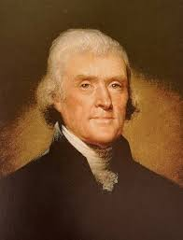
A Constitutional Republic
Evaluate how Jeffersonian Democracy has transformed the United States. Choose THREE of the following and explain how they impacted the development of the U.S.
Louisiana Purchase
Embargo Act
Midnight Judges
Marbury v. Madison
The Gallatin Plan
Revolution of 1800
Judicial Impeachments
Democrat-Republican or Federalist?

Slide 47
HIPP Statements
Writing HIPP statements
Words to avoid: “in the document” (Any part of HIPP – The Contextualization)
Ways around
In Jeffersons Letter to John Breckinridge in 1803
Make sure your document actually explains the document.
Louisiana Purchase
Loose Constructionism
Amending the Constitution to allow him to purchase the Louisiana territory

Slide 48
Factors for the War of 1812
Trade
Neutrality
Nationalism
Western Expansion
Construct a SHE statement that explains how each of the above items were contributing causes of the War of 1812.

Slide 49
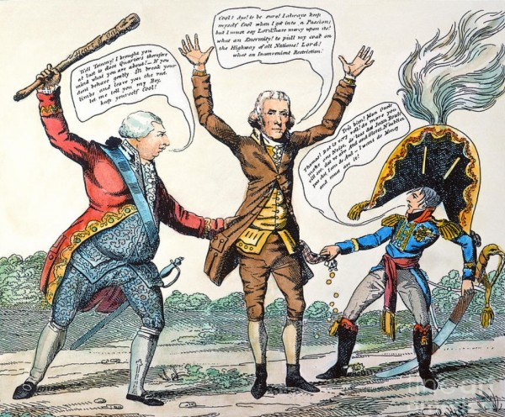
Trade
Napoleonic War: England in all out war with France
Factors:
Impressment: need sailors to fight (Chesapeake and Leopold Incident)
Orders of Council: Maintain trade supremacy (stop American re-exporting in the West Indies)

Slide 50
Growth of the American Economy
Jefferson’s policy of peaceful coercion
Trade: US challenging England’s trade
Impressment & the Orders of Council (Napoleonic Wars)
Embargo Act of 1807 (No Trade with anybody)
Non-intercourse Act 1809 (Trade with everybody but England & France)
Macon’s Bill #2 (trade with whoever stops their order of council)
FAILED
Destroys the American Economy

Slide 51
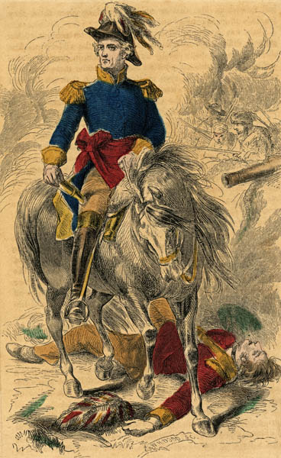
Nationalism
War Hawks: New breed of Senators & Rep. from the West & South
Want war with England (prove themselves & gain RESPECT)
End British gun running to Native Americans in the Ohio River Valley
Nationalism: Proud to be American
Henry Clay
K.Y. Senator
John C. Calhoun
S.C. Senator

Slide 52
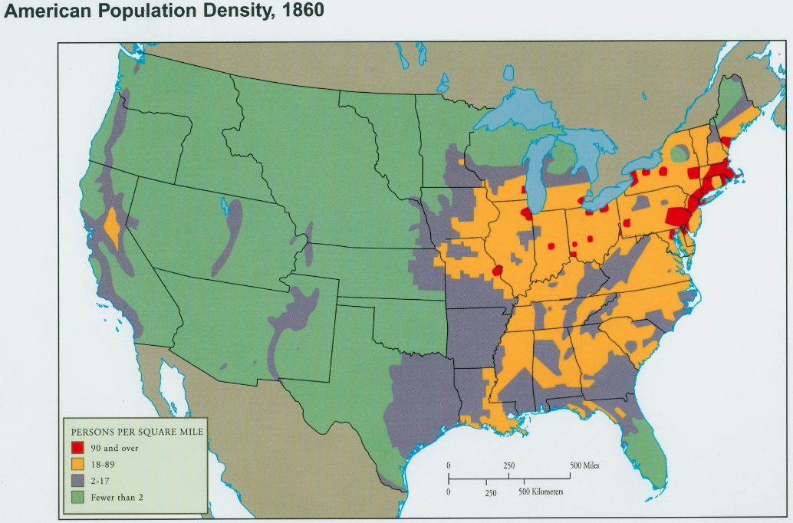
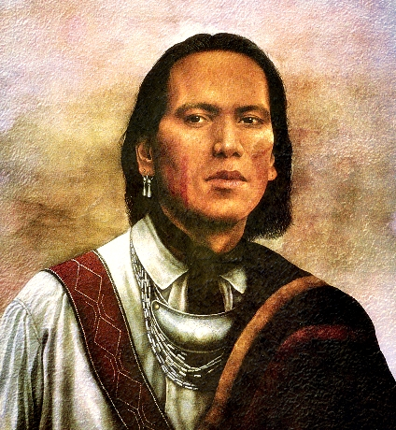
Native American Conflict
Louisiana Purchase leads to western expansion
Native American conflicts
Tecumseh & Tenskwatawa (The Prophets): preserve Native culture and stop western expansion
Battle of Tippecanoe (William Henry Harrison – War Hero)
“Let us form one body, one heart, and defend to the last warrior, our country, our homes, our liberty, and the graves of our fathers

Slide 53
A Revolution or Same Old Story
Prompt: Historians have labeled the election of 1800 as the Revolution of 1800. To what extent did Jeffersonian democracy uphold the idea that the election of 1800 was a revolution.
Thesis:
Two sentences (MAX)
Thesis formula: Claim (must respond and NOT restate the prompt) because A (reason 1) and B (reason 2). However X (Counter-claim and reason)
Type of prompt = Continuity or Change (Thesis – claim must support either change or continuity)
Jeffersonian democracy from 1800 to 1824 promoted major change because it supported the rise in status of the common man and sought to restrict the authority of the national government. However, because of the rise of judicial nationalism the Federalist ideas continued.

Slide 54
A Revolution or a Lie
Prompt: To what extent was the Revolution of 1800 aptly name? Focus on the time period of 1800 to 1815.
Requirements:
Work with a partner
Thesis: claim + A + B, However C
Thesis
Argument assertion that answers the prompt
Three ways that you will prove your assertion correct

Slide 55
Essential Question: How did the growth of new republic promote political, social, and economical change, yet create division within America?
Students can:
Evaluate how the U.S. government sought to gain influence over the western hemisphere
Decipher how the War of 1812 was a crucial factor in insuring the viability of the United States
Discern factors that led to the development of a national culture
Agenda
Another Bloody Nose for John Bull
The Reality of History and War
Jeffersonian Revolution?
Homework
Defining the Period: Era of Good Feelings

Slide 56
Essential Question: How did political ideological change transform public policy during Jeffersonian democracy?
Students can:
Explain the cause and effects of policy debates during Jeffersonian democracy from 1800-1817
Explain how and why American foreign policy developed and expanded over time.
Agenda
HIPP STATEMENT PRACTICE
War of 1812 Effects
Debating the legitimacy of the War of 1812
Homework: Reading Questions 3

Slide 57
New Homework Policy
Objective Reading Assignment
Reading covers 5 questions
Answering questions – need to be a written paragraph that answers all parts of the prompt
Must be historically accurate and historically defensible
Must use TWO pieces of evidence to support your response
One the day it is due – you will be assigned one at random to respond to (NO NOTES OR PRE-WRITTEN RESPONSES)

Slide 58
Schedule for this Week
Question 1 – Completed in class on Tuesday
Question 2 – Completed in class on Wednesday
Question 3-5: complete for homework during the week
DUE date: Monday 10/28
The Wheel will decide the question

Slide 59
HIPP Construction
That, after the experience which the United States have had of the great injustice of the British Government towards them, exemplified by so many acts of violence and oppression, it will be more difficult to justify to the impartial world their patient forbearance than the measures to which it has become necessary to resort, to avenge the wrongs, and vindicate the rights and honor of the nation.
John C. Calhoun, Report to the Committee on Foreign Relations, 1812
USE the APUSH vocabulary of the time period
Identify at least ONE implied fact
What is the document about?
Why was it written
Whose perspective is written from & Why is that important
HIPP STATEMENT: Start with the Name of the Document – describe its purpose with an implies and stated fact.

Slide 60
James Madison – President #4

Slide 61
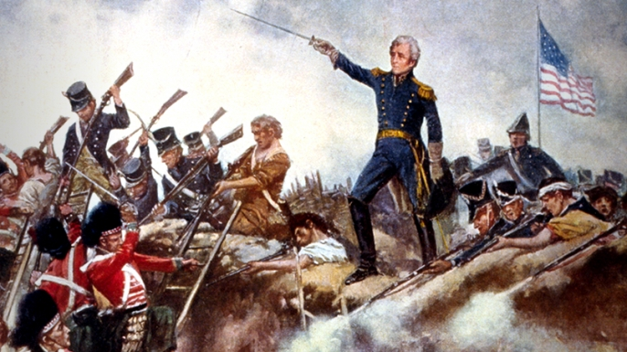
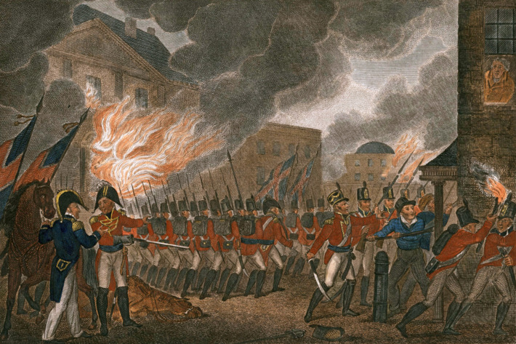
War of 1812
America’s 2nd Revolutionary War: challenge to the United States stability as a young nation
Victory at the Battle of New Orleans
Burning of Washington D.C. 1814
War of 1812 in four minutes

Slide 62
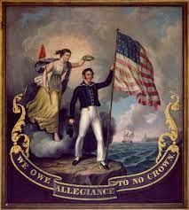
Influence of the war of 1812
U.S. a VIABLE NATION
Nationalism: Americans believe in America (National Anthem by Francis Scott Keys)
Market Revolution: transformation of the American economy (mass production)
Blockage of trade spurs industrialization
Factionalism/Secitonalism:
Warhawks (South & West) want war
New England (Federalists) against it

Slide 63
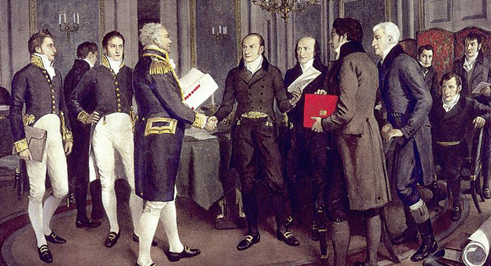
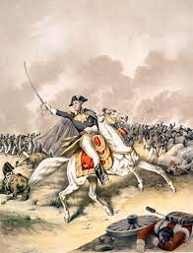
Victory???
A Resounding Victory that WASN’T
Battle of New Orleans (1815)
Treaty of Ghent (1815)
Ends War
Treaty does not resolve cause of the war nor change anything
Andrew Jackson leads Americans to a major victory of British Troops
Two Weeks after the war was over

Slide 64
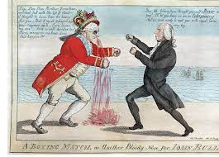
War of 1812
Debate: Evaluate whether fighting the War of 1812 was valid foreign policy decision by the United States.
War Hawks
Naval Incursion
Diplomatic Delay
Federalists

Slide 65
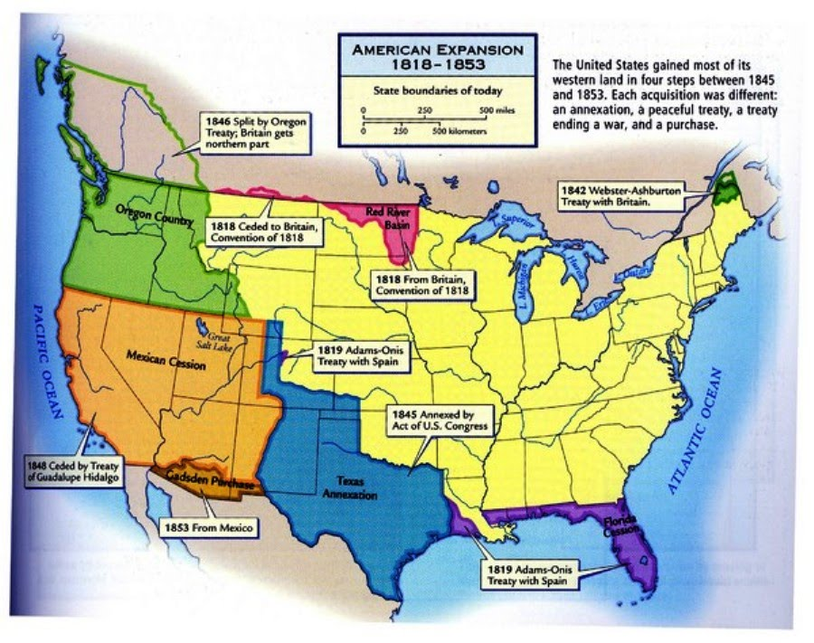
War of 1812 Effect
Westward Expansion
Ohio River Valley open for statehood
(Indiana, Illinois, Alabama, & Mississippi)
Treaty of 1818: Northern border with Canada
Connecting the east with the west
Bonus Bill: build infrastructure (roads & canals)
Vetoed – Madison (Dem. Rep. against expanding federal power)

Slide 66
DBQ Teams
Team 1 Team 2 Team 3
Thielen Leach Strider Parrish Bruce Ankney
Aidan Rajesh Chloe Horn Parker Peters
Claire Wong Trevor Ringhisen Addison Smith
Xaiver Dawkins-Baptiste Jaylen Hanna Merilissa Bewry
Miquel Rosas-Zavala
Team 4 Team 5 Team 6
Kalaura Jones Lily Mitchell Teag Molitoris
Krish Jinwala Jeffrey Gentry Emily Kemper
William Quintana Angelica Garcia Claire Lankford
Amelia Naughton Dane Kratovil Wyatt McHenry
Team 7
Stephen Voight
Emma Adams
Libby Vietor
Aanish Oza

Slide 67
DBQ Teams
Team 1 Team 2 Team 3
Aubrie Bowman Addison Tuttle Elijah Breedlove
Owen Rattray Miriam Rheder Julia Outlaw
Phyo Naing Dante Spinazzola Gabriella Harvey
Team 4 Team 5 Team 6
Audrey Lokers Sydney Hennessey Olivia Powell
Elliott Flowers Alexa Cox Raina Laissisi
Siena Weld Luisa Molina Owen Gross
Team 7
Taylor Claassen
Samuel Plunkett
Zachary Dick
Bella Barrios

Slide 68
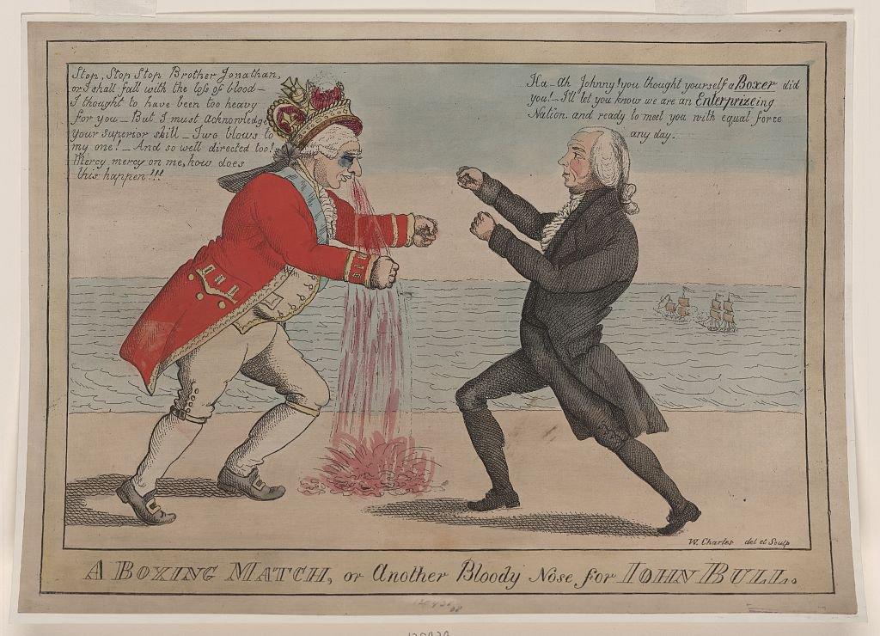
Reality of the War of 1812
Another Bloody Nose for John Bull, by William Charles, 1813
Evaluate whether the political carton “A Boxing Match, or another Bloody Nose for John Bull” is an accurate depiction of the War of 1812.

Slide 69
Essential Question: How did political ideological change transform public policy during Jeffersonian democracy?
Students can:
Explain the cause and effects of policy debates during Jeffersonian democracy from 1800-1817
Explain the context in which the republic developed from 1800-1848
Agenda
Jeffersonian Democracy Objective
The Death of the Federalist Party
Tombstone for the Federalist Party
Homework: Reading Questions

Slide 70
Jeffersonian America
Objective Question:
Thomas Jefferson’s actions as president contradicted his Democratic-Republican Political beliefs. Evaluate the legitimacy of this statement, providing 2 examples that support each side of the argument.

Slide 71
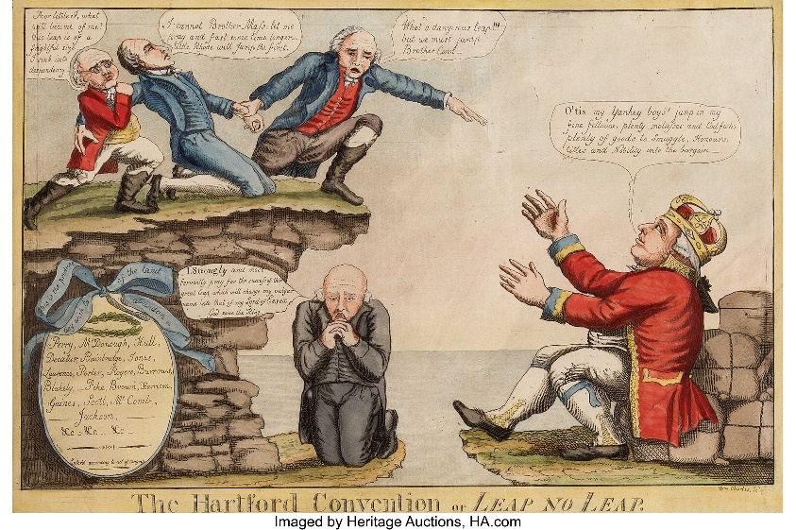
Hartford kills the federalist
Hartford Convention of 1814 (Federalist)
Northeast consider secession from the Union
Demand compensation for losses due to Embargo Act
Limit the President to one term if they are from the same state (end the Virginia Dynasty)
Effect: War of 1812 victory kills the Federalist Party

Slide 72
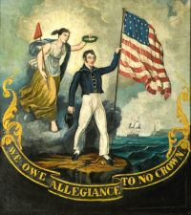
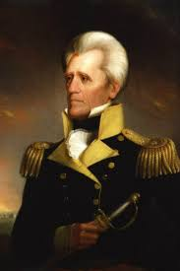
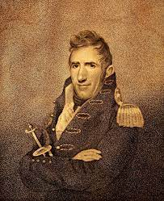
Political Effect
Rise of nascent nationalism – The Era of Good Feelings 1815 – 1824
Pride in being American (National Anthem, Celebrating the 4th of July, & enlarging the military)
Heroes of the War of 1812 become future President
Andrew Jackson (7th President)
William Henry Harrison (9th President)

Slide 73
Federalist Tombstone
In 1815 the Federalist Party died
Develop a Eulogy that honors the contributions of the Federalist Party (1787 – 1815)
Requirements
Identify two members
Explain their political views
Identify and explains three major accomplishment of the Federalists
Federalist Party
1787-1815

Slide 74
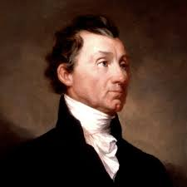
The Era of Good Feeling
Era of Good Feelings (1816-1824)
Period on national purpose and unity in the United States
President #5 - James Monroe
Prompt: Historians have traditionally labeled the period after the War of 1812 the “Era of Good Feelings.” Evaluate the accuracy of this label, considering the emergence of nationalism and sectionalism.

Slide 75
Are You Ready
The positions of loose construction and strict construction of the Constitution were first established in letters written by Hamilton and Jefferson to President Washington. The letters concerned?
A. consolidating the national, state, and foreign debt and paying them at face value
B. an appropriate response to the Whiskey Rebellion
C. our obligations to France under the Treaty of 1778
D. the issue of creating a Bank of the United States

Slide 76
Question 2
What did Washington's Farewell Address in 1796 state?
A. warmly endorsed the appearance of two contending political parties in America
B. warned against the dangers of permanent foreign alliances
C. was delivered to a joint session of Congress by Washington himself
D. proposed a two-term limitation on the presidency

Slide 77
Question 3
The international incident known as the XYZ Affair involved?
A. a French foreign minister's demand for a bribe before he would meet with American envoys
B. the British refused to evacuate their forts on American territory
C. the British seizure of American crewmen from a U. S. Navy warship in Chesapeake Bay
D. General Andrew Jackson's incursion into Spanish-held Florida

Slide 78
Question 4
Which of the following granted the United States access to the Mississippi and the Port of New Orleans in exchange for Florida?
A. Jay Treaty
B. Pinckney Treaty
C. Treaty of Ghent
D. Adams-Onis Treaty

Slide 79
Question 5
What is the Revolution of 1800 referring to?
A. The election of Thomas Jefferson
B. The French Revolution that brought democracy to the country
C. John Marshall’s establishment of judicial review
D. The peaceful transition of power from one party to another

Slide 80
Question 6
The continued impressment of American sailors resulted in which of the following?
A. The election of the War Hawks into Congress in 1810.
B. The loss of Spanish held Florida to the Americans.
C. The increased popularity of the Federalist party.
D. Thomas Jefferson losing the election when he ran for president a second time.

Slide 81
Question 7
Why was the war of 1812 significant to the United State?
A. it showed that the nation seemed sure to endure.
B. it represented a clear victory over the British forces.
C. it allowed the Federalists to regain political power.
D. it launched a new wave of Indian resistance.

Slide 82
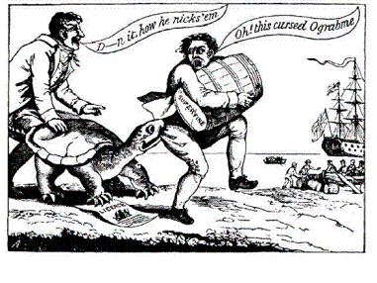
Question 8
Which of the following laws is this political cartoon attacking?
A. Proclamation of Neutrality
B. Alien Act
C. Embargo Act
D. Sedition Act

Slide 83
Question 9
Match the individual with his office in the new government.
A- Thomas Jefferson
B - Alexander Hamilton
C - Henry Knox
1. attorney general
2. secretary of state
3. secretary of war
4. secretary of treasury

Slide 84
Question 10
The Virginia and Kentucky Resolutions were based on which principle?
A. the states’ right to nullify acts of the federal government
B. the Supreme Court’s right to nullify acts of Congress
C. Congress’ right to nullify acts of the states
D. the president’s right to nullify rulings of the Supreme Court

Slide 85
Marshall’s Influence
Research the following Marshall’s decisions.
Marbury v. Madison 1803
McCulloch v. Maryland 1819
Gibbons v. Ogden 1824
Explain the precedent and its significance to the United States?
How did Adams appointment of the Midnight Judges impact the United States? (be sure to support with examples)

