Slide 1
Building A Revolutionary Cause
Unit III – 1754-1800

Slide 2
SAQ
“Single acts of tyranny may be ascribed to the accidental opinion of a day; but a series of oppressions, begun at a distinguished period, and pursued unalterably through every change of ministers, too plainly prove a deliberate and systematical plan of reducing us to slavery.”
A Summary View of the Rights of British America, Thomas Jefferson, 1774
Use the excerpt above to respond to A, B, and C
Briefly explain Thomas Jefferson’s point of view in the excerpt above and one factor that supports his view during the time period from 1763 – 1776.
Explain ONE way that the Colonial Period from 1607-1754 had caused American colonist to develop ideas that separate them from the British
Briefly explain ONE British’s counterargument to Thomas Jefferson point of view in the period from 1763-1776.

Slide 3
Essential Question: How did growing debate over political and economic control over the colonies contribute to the separation between the English and America?
Students can:
Evaluate how growing economic and political competition between the British, French, and Indians created conflict in America
Propose arguments as to how increase American interest in self-government in the face of renewed British imperialism led to colonial independence movement and war
AGENDA
Unit I & II Review
Unit I & II Test
A Clash of Empires
Homework
A Clash of Empires

Slide 4
French & Indian War Catalyst
Causation: Evaluate how the French & Indian War was cause the American independence movement
Cause 1:
Effect 1:
Cause 2:
Effect 2:
Cause 3:
Effect 3:

Slide 5
Thesis Thunder Dome
Prompt: Evaluate the relative importance of causes of population movement to colonial British America in the period from 1607 to 1754.
Can your thesis survive?
Each group member construct a thesis
Claim that responds to the prompt
Must have a line of reasoning (bases that demonstrate how you will defend your claim)
Evaluate which one is the best – An does not restate the prompt

Slide 6
Be FACTUAL
Prompt: Evaluate the relative importance of causes of population movement to colonial British America in the period from 1607 to 1754.
Use historic evidence to support your topic sentences (bases of your thesis) and explain how they validate your claim
- Native Americans and early colonists had good relations
- Spanish encomienda system enslaved Native Americans to support its desire to gain resources, such as gold, silver, and sugar in South America and the Caribbean. Therefore, Spanish relations with the American Indian population often resulted in conflict.

Slide 7
Essential Question: How did growing debate over political and economic control over the colonies contribute to the separation between the English and America?
Students can:
Explain how growing economic and political competition between the British, French, colonists, and Indians created conflict in America
Propose arguments as to how increase American interest in self-government in the face of renewed British imperialism led to colonial independence movement and war
AGENDA
Historical Contextualization – Causation
War Shapes Colonial Perspective
Turning Point in History
Homework:
6 Degrees of Independence

Slide 8
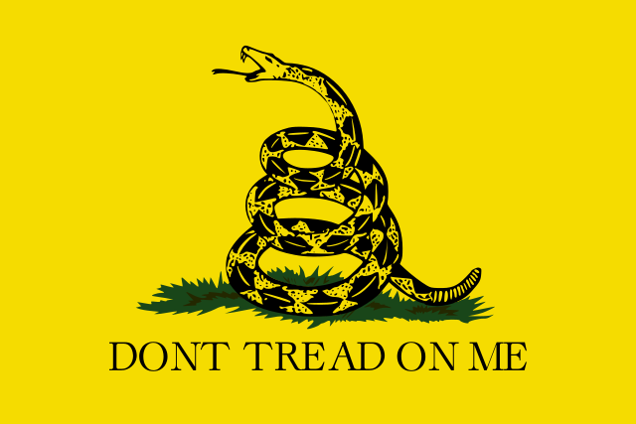
Essential Question
Essential Question: How did growing debate over political and economic control over the colonies contribute to the separation between the English and America?
Gadsden Flag 1775

Slide 9
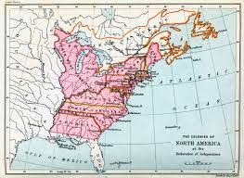
Historical Contextualization
Causation: Evaluating factors from the Colonial Period that cause the Revolutionary period from 1754-1781
Prompt: To what extent was the French and Indian War a turning point in the relationship between the American colonies and their British mother?
CAUSATION factors must be before 1754
Colonization
Salutary Neglect
Westward Expansion
Mercantilism
Navigation Acts 1660
1st Great Awakening

Slide 10
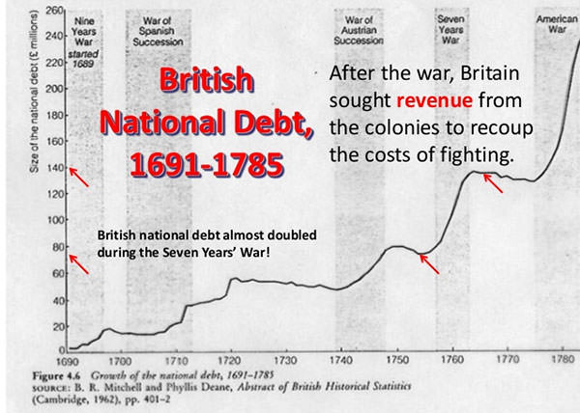
Battle for World’s #1
Increased mercantilism competition: Britain, French, and Spain
- King William’s War, Queen Anne’s War, & King George’s War
French & Indian War (Seven’s Year War) 1754-1763
Defend the colonies ($$$ )

Slide 11
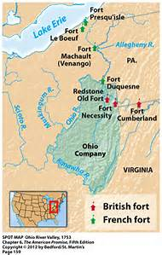
Ohio River Valley
Issues
France vs. English
French connector to their empire
English colonization efforts
Colonists: LAND SPECULTION ($$$) – Ohio Company (George Washington)
Native Americans: Home –losing land to European colonization
1754 French & Indian War
(War actually declared in 1756)

Slide 12
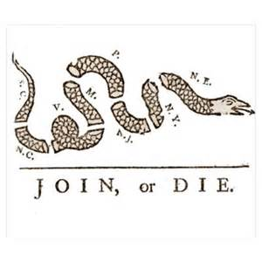
Albany Plan of Union
Albany Plan of Union
1754: (Drafted by Ben Franklin) A plan to unite the colonies under a continental assembly and a royal governor
Failed: (Seeds of future colonial unity)
English Crown & Parliament against it
Colonies not ready to unify under one government
Iroquois Confederation backed out
What does the Albany Plan of Union in 1754 demonstrate about the American identity?
Evaluate whether this is a turning point in the relationship between the British and the Colonies.

Slide 13
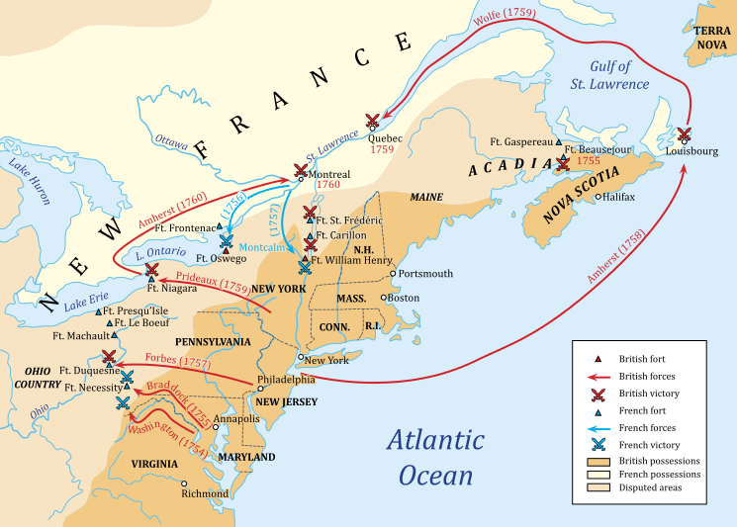
War timeline
Braddock’s Blunder 1755: his failure leaves the American colonial frontier undefended
British invasion of Canada 1756
Lord Pitt replaces Loudoun 1757: promise to reimburse colonial legislature for $$ spent on the war
Fall of Montreal 1760: James Wolfe leads the British to victory

Slide 14
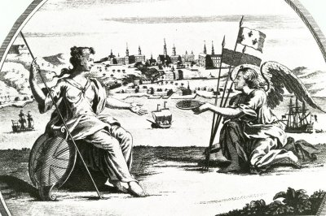
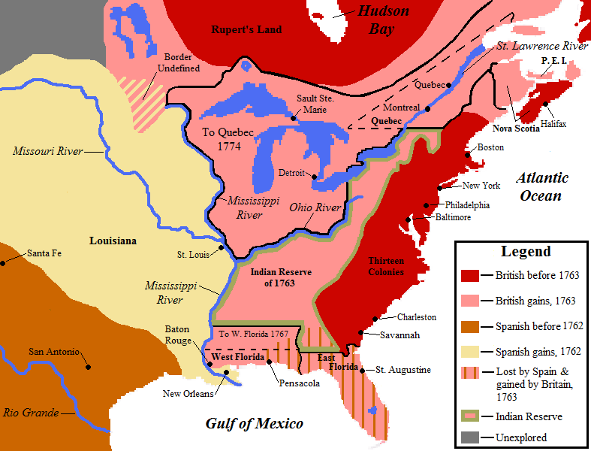
Treaty of Paris 1763
France loses all territorial holdings in America
Treaty of Paris 1763
England gains territory west to the Mississippi River, north into Canada & South to Florida
Spain gains territory west of the Mississippi River.
How will the Treaty of Paris cause conflict between the colonists and the Native Americans and the British and the Colonists?

Slide 15
Turning Point in History
Prompt: The French and Indian War (1754-1763) impacted the relations between the American colonies and the British. Evaluate to what extent the French and Indian War was a turning point in British colonial relations from 1754 to 1781.
1. What type of question is the above prompt?
2. What is the question asking me? (simplify the question)

Slide 16
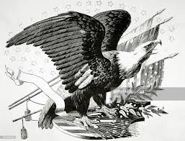
Historical Contextualization
Immediate Effect: Evaluating factors from the Revolutionary Period the feed American separation from England
Prompt: To what extent was the French and Indian War a turning point in the relationship between the American colonies and their British mother?
Immediate Effects factors must be from 1754 -1781
French & Indian War
War Debt
Land Speculation
Tyranny
Populism

Slide 17
The French Connection
What are the Causes of the French & Indian War 1754-1763?
What are effects of the French & Indian War 1754-1763?
Prompt: To what extent was the French and Indian War a turning point in the relationship between the American colonies and their British mother?

Slide 18
Imperialism Control of America
How will the change in control of America from 1754 to 1763 cause a rift in colonial relations between Americans and their English mother?

Slide 19
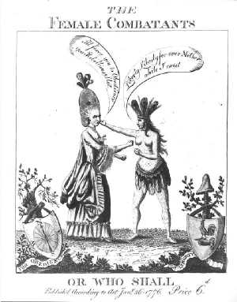
6 Degree of Separation
Connect 6 events after the French & Indian War (1754-1763) that led America to declare independence in 1776
All events must be in chronological order and full the time period from 1763-1776
All 6 events factual and explain how they are encouraging a move towards independence
Develop connections between events to demonstrate how the fracturing of the relationship over time

Slide 20
Essential Question: How did growing debate over political and economic control over the colonies contribute to the separation between the English and America?
Students can:
Evaluate how growing economic and political competition between the British, French, and Indians created conflict in America
Propose arguments as to how increase American interest in self-government in the face of renewed British imperialism led to colonial independence movement and war
AGENDA
A Mad American
French & Indian War effect
Continuity or Change
Homework
Unit III SAQ

Slide 21
Essential Question
Essential Question: How did growing debate over political and economic control over the colonies contribute to the separation between the English and America?
Gadsden Flag 1775

Slide 22
Mad American
Identify and explain TWO actions by the British that have caused problems with the American colonies?
What would the British state justifying as cause to end the policy of salutary neglect?
Explain ONE action that demonstrates the Americans are not seeking independence from 1763 to 1776.

Slide 23
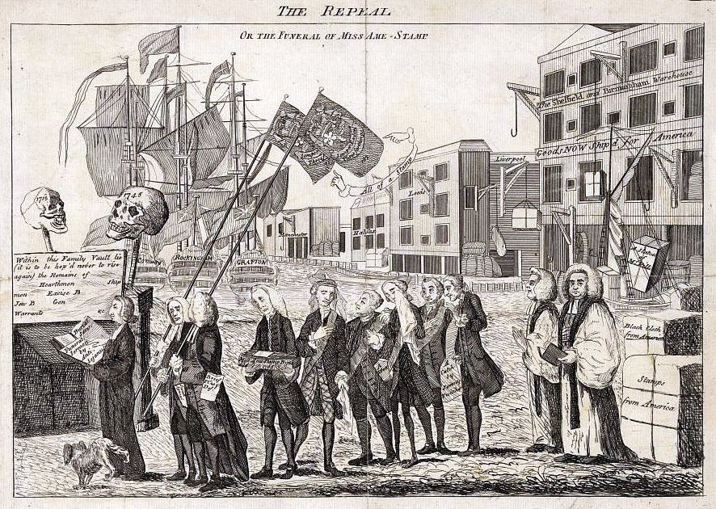
French & Indian War Effect
American colonists’ perspective
Unified the colonies against a common enemy
Bonding experience (soldiers from all the colonies)
Contempt for England (American’s snubbed for leadership jobs)
English debt: $122 million pounds (interest $4.4 million)
Contempt towards the colonies
American colonist turning their back on England

Slide 24
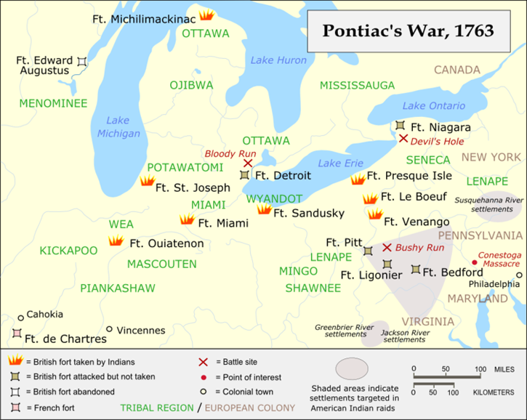
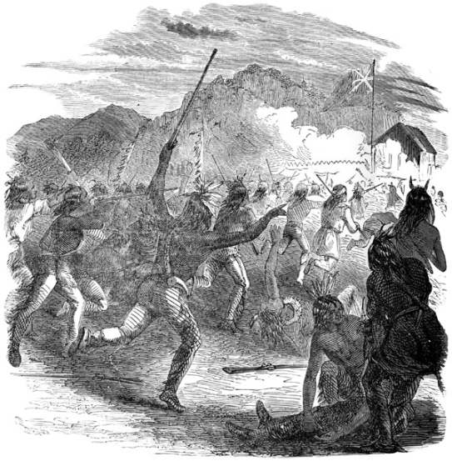
Pontiac’s Rebellion
English Debt: $122 million
American land speculation in Ohio River Valley post French & Indian War
Pontiac’s Rebellion 1763
Proclamation of 1763
(No settling past the Appalachian Mtn.)
Paxton Boys Rebellion 1764
Attack Native Americans in Penn. Frontier (OHIO RIVER VALLEY)

Slide 25
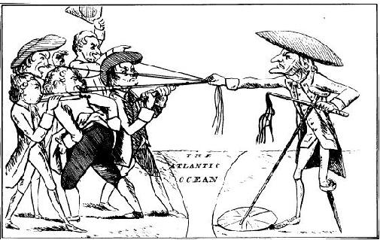
Growing Animosity
Americans
English Crown
English debt impact relations with America (end of salutary neglect)
Effects of English Debt
Mercantilism Navigation Acts – enforcement (Writs of Assistance)
Debt:
Taxation (Sugar Act, Stamp Act, Townshend Duties, Tea Act)
Proclamation of 1763 – NO WESTERN MIGRATION

Slide 26
Continuity or Change
Prompt: The French and Indian War (1754-1763) impacted the relations between the American colonies and the British. Evaluate to what extent the French and Indian War was a turning point in British colonial relations from 1754 to 1781.
Canassatego
Robert Moses
Minavavana
Join or Die

Slide 27
Turning Point
Analyze the effect of the French and Indian War and its aftermath on the relationship between Great Britain and the British colonies. Confine your response to the period from 1754 to 1776.
Historic Contextualization
Thesis – Persia (CCOT – what has changed what has not)

Slide 28
Essential Question: How did growing debate over political and economic control over the colonies contribute to the separation between the English and America?
Students can:
Evaluate how growing economic and political competition between the British, French, and Indians created conflict in America
Propose arguments as to how increase American interest in self-government in the face of renewed British imperialism led to colonial independence movement and war
AGENDA
Who is at FAULT????????
A Divided Population
DBQ Poster
Homework
Declaration of Independence – Get HIPP

Slide 29
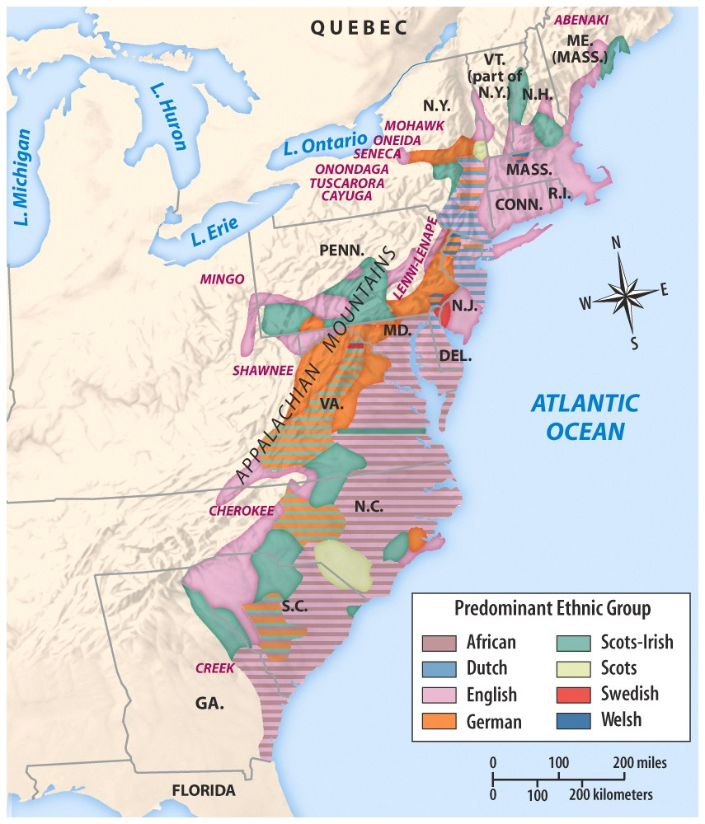
Being American
Diverse American population
Average age: 18 years old
Factors feeding American identity:
Salutary Neglect led to the creation of an American identity
American trade had become prosperous
Age of Enlightenment
1st Great Awakening

Slide 30
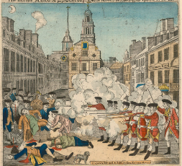
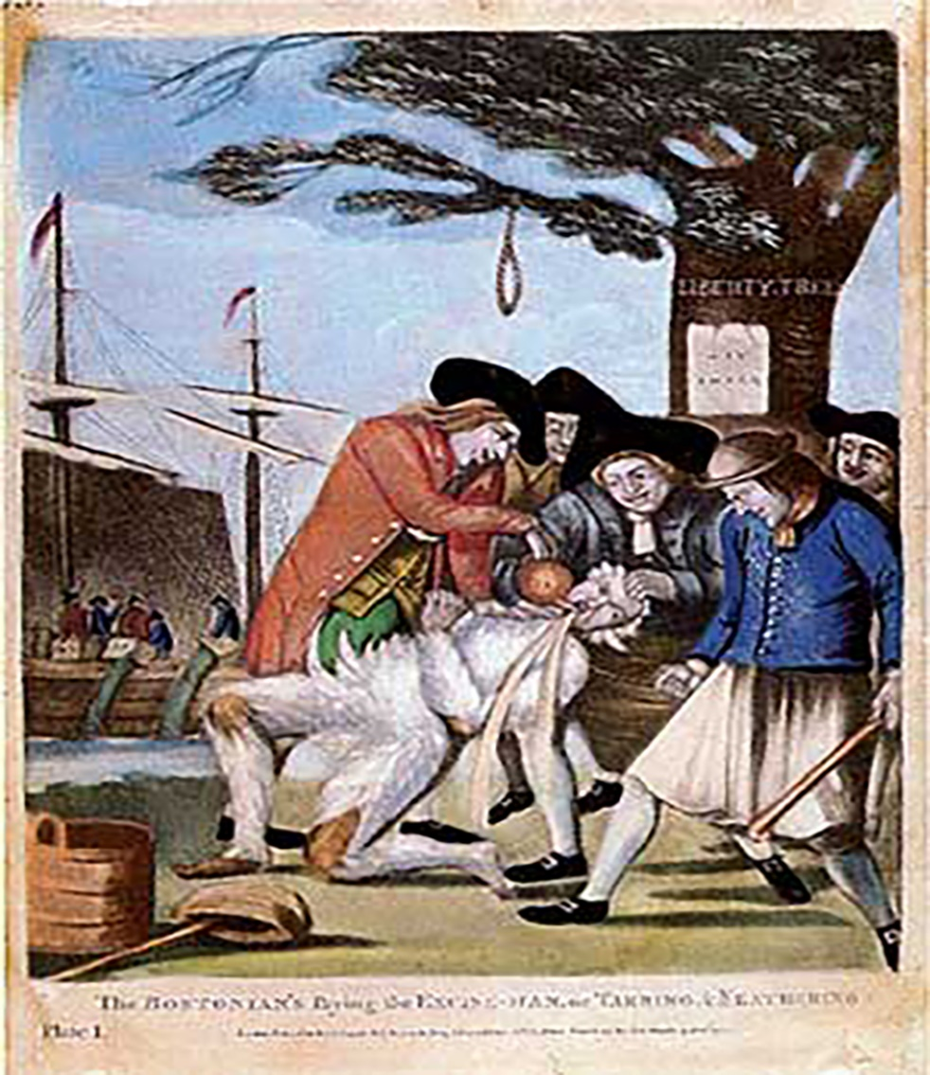
A Picture Paints 1000 Words
Explain who is at fault for causing American independence
The Bloody Massacre on King Street by Paul Revere 1770
Bostonians Paying the Excise Man by Phillip Dawe, 1774

Slide 31
A Long Train of Usurpation
But when a long train of abuses and usurpations, pursuing invariably the same Object evinces a design to reduce them under absolute Despotism, it is their right, it is their duty, to throw off such Government, and to provide new Guards for their future security.
- Declaration of Independence
Index card – term on one side but an explanation for another term
Find your match
Identify and explain factors that CAUSES the desire for independence. (Categorize them and give examples)

Slide 32
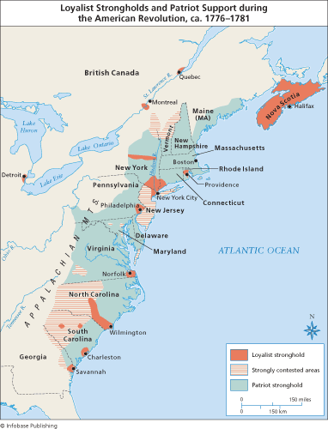
Demographics of Patriots vs. Loyalists
Divided Population
LOYALISTS: about 30% of the population – personal gain or loyalty to the Crown
PATRIOTS: less than 28% of the population – No alternative but to support independence
Fence Setters: 32% of the population – undecided and had to be persuaded
Training the Mob:
Committee of Correspondance: - convince America that independence is necessary (Ex. Common Sense by Thomas Paine)

Slide 33
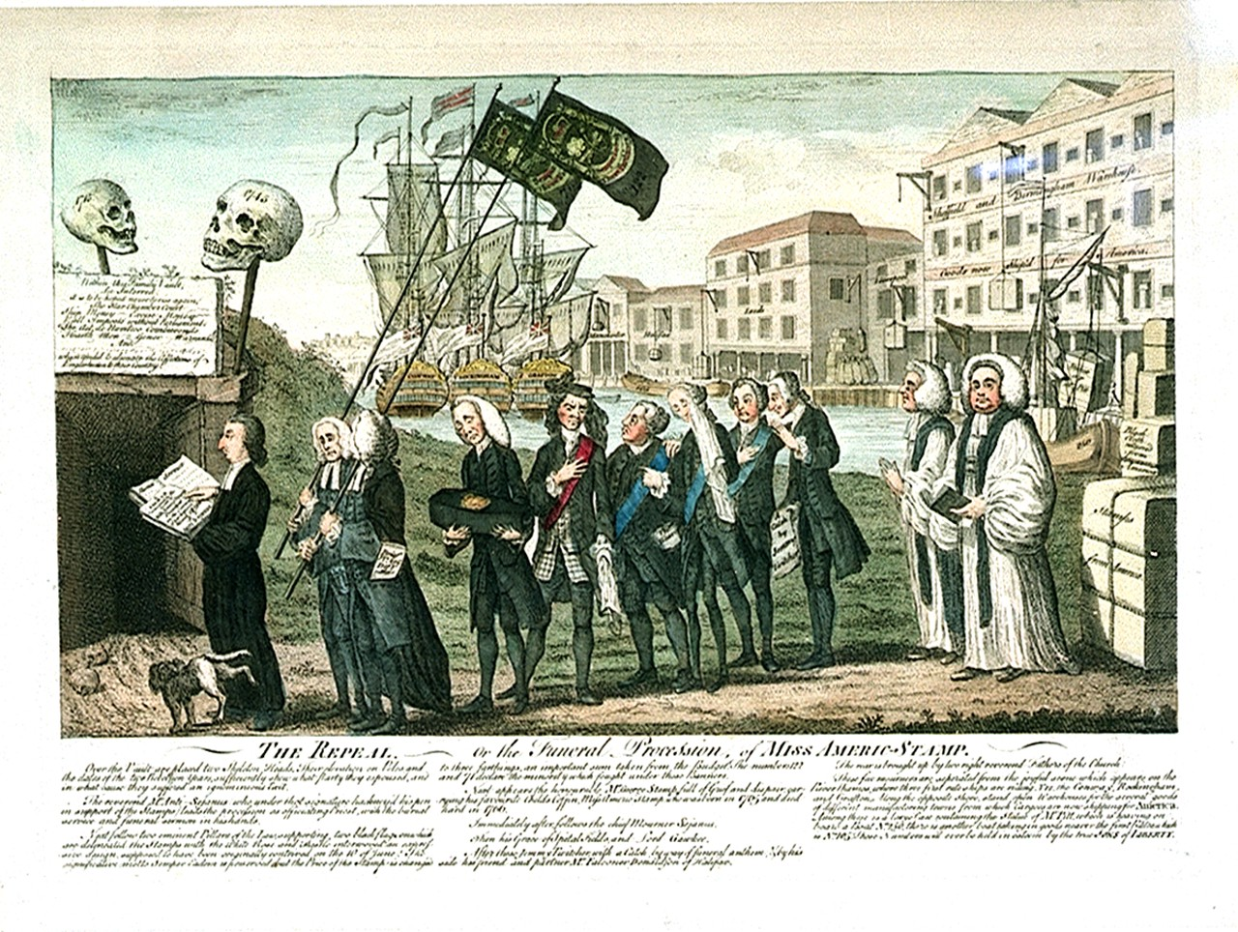
Seeking Redress
Americans seek to maintain peaceful relations with Britain (Civil disobedience)
Stamp Act Congress 1765– “No Taxation without Representation”
Petition: Declaration of Rights 1765, Declaration of Rights & Grievances 1774, & Olive Branch Petition 1775
Non-importation Agreements (boycott) Home spun movement
Declaratory Act 1766: Virtual Representation –(English Response)

Slide 34
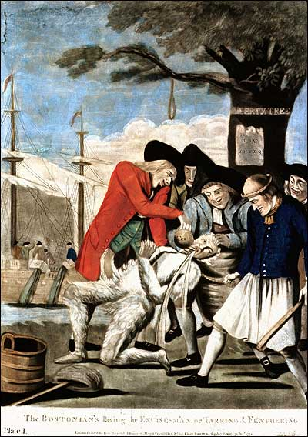
Training of the Mob
Sons of Liberty – Encourage Americans to seek independence
Committee of Correspondence (train the mob)
Tar & Feathering
Boston Massacre 1770
Bostonians Paying the Exciseman by Philip Dawe
Bloody Massacre on King St. by Paul Revere

Slide 35
DBQ Poster
Prompt: The French and Indian War (1754-1763) impacted the relations between the American colonies and the British. Evaluate to what extent the French and Indian War was a turning point in British colonial relations from 1754 to 1781.
What is the question asking me? (simplify the question)
Remember AP = Answer the Prompt
2. Brainstorm ideas that are reflex what it the prompt is asking and the historic thinking skills.
3. Read and annotate the documents

Slide 36
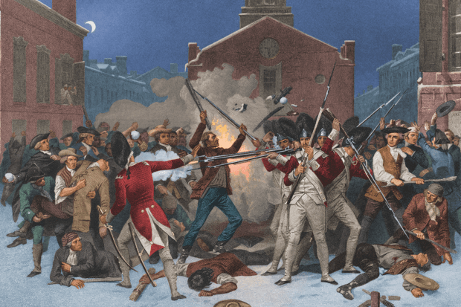
The Truth is in the Eye of the Beholder
HIPP ANALYSIS – Explain the POINT OF VIEW of each document
“The Bloody Massacre Perpetuated in King Street, By Paul Revere, 1770
Alonzo Chapel “The Boston Massacre”, 1868

Slide 37
Evaluation of a Historic Impact
Prompt: To what extent was the French and Indian War a turning point in the relationship between the American colonies and their British mother?
What type of prompt is this? (Cause, Comparison, or Change)
Side 1
Side 2

Slide 38
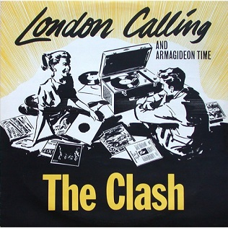
Should I Stay, or Should I Go
Prompt: To what extent was the French and Indian War a turning point in the relationship between the American colonies and their British mother?
Identify and explain TWO ways that colonists demonstrated that independence from Britain was necessary.
Identify and explain TWO ways that colonists demonstrated that they did NOT desire independence
One question – Should I Stay, or Should I Go?

Slide 39
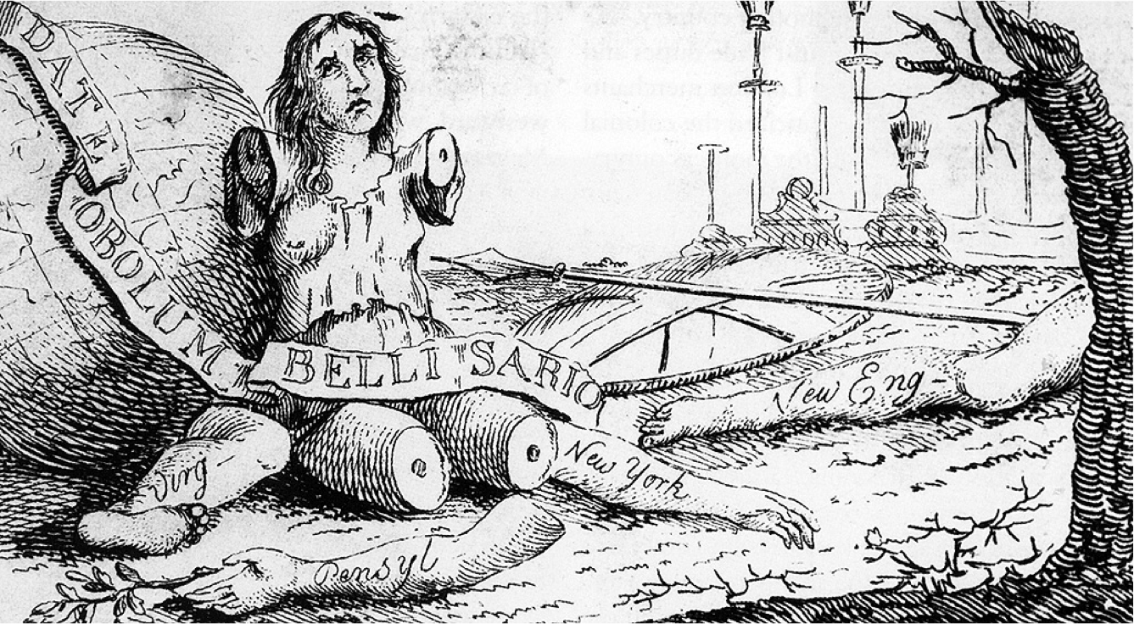
America post French & Indian War
How does the political cartoon reflect America’s situation post French & Indian War?
America
Roman hero reduced to a beggar when accused of treason
England
“Magna Britannia, Her Colonies Reduced”, 1766 Ben Franklin

Slide 40
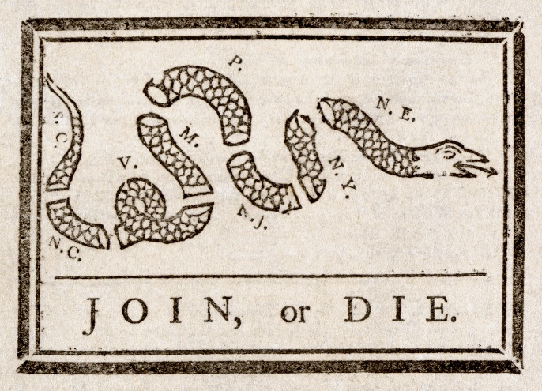
“Join or Die”
Explain the relevance of Ben Franklin’s perspective in his famous political cartoon “Join or Die” from the Pennsylvania Gazette May 9, 1754 (Use HIPP)
Prompt: To what extent had the colonists developed a sense of their own identity as Americans by the eve of the Revolution?

Slide 41
CCOT – America & England
Prompt: To what extent had the colonists developed a sense of their own identity as Americans by the eve of the Revolution?
Time period: 1650 – 1763
Continuities: How has the relationship stayed the same?
Changes: How has the relationship changed?

Slide 42
SAQ
1. From 1754 to 1776 America considered itself a very loyal part of the English Empire despite actions taken by the British monarchy and parliament.
Demonstrate two ways that the British violated what American’s viewed as their natural rights espoused in the Declaration of Independence.
Explain one action by the American colonists that demonstrates that they were not actively seeking independence prior to the creation of the Declaration of Independence in 1776.
Explain one action by colonists that demonstrate that they were actively seeking independence prior to 1776.

Slide 43
Essential Question: How did growing debate over political and economic control over the colonies contribute to the separation between the English and America?
Students can:
Evaluate how growing economic and political competition between the British, French, and Indians created conflict in America
Propose arguments as to how increase American interest in self-government in the face of renewed British imperialism led to colonial independence movement and war
AGENDA
Historical Moment of the Revolution
Conflicting Visions of Loyalty
In 50 Words or Less
Homework
Annotate the Declaration of Independence

Slide 44
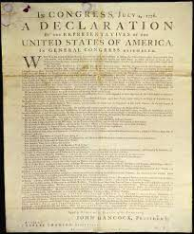
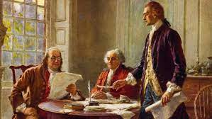
Debating the Legitimacy of a Claim
Evaluate the legitimacy of American claims stated in the Declaration of Independence based on the time period from 1754 to 1776.
Declaration of Independence

Slide 45
Historic Contextualization
Prompt: To what extent was the French and Indian War a turning point in the relationship between the American colonies and their British mother?
Refers to the political, social, economic, and religious conditions that existed during a specific moment in history
Allows us to interpret why historic events happen in a certain time period
Example – The creation and signing of the Declaration of Independence, The passage of the Civil Rights Act, or even the Civil War
Grade component of essay writing (found in the introduction)
“The peculiar institution of slavery had been a part of America’s identity since the founding of the original English colony at Jamestown. In the early years, compromise was key to avoiding the moral question, but as America entered the mid 19th century sectional tensions and crises with popular sovereignty, Kansas, and fugitive slaves made the issue increasingly unavoidable. When the Civil War began, the war was transformed from one to simply save the Union to a battle for the future of slavery and freedom in the United States.”
What is the historic contextualization for the Revolutionary period from 1763-1781?

Slide 46
American Response
Tea Act: Lowers tax on East India Tea Co. (Monopoly on Tea)
Boston Tea Party (Sons of Liberty)

Slide 47
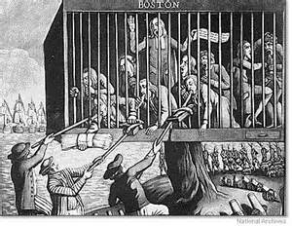
Coercive Acts January 1774 (AKA Intolerable Acts)
Port Bill: Closed Boston Harbor
Government Act: Town meetings forbidden, Gov. Council
Administrative Justice Act: trials involving royal officials out of England
New Quartering Act: uncompensated quartering of troops in colonists’ homes
Colonial response? Why?
“Bostonians in Distress” attributed to Philip Dawe

Slide 48
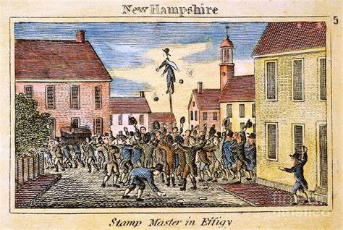
Burning the English Effigy
.
Analyze the effect of the French and Indian War and its aftermath on the relationship between Great Britain and the British colonies. Confine your response to the period from 1754 to 1776.
Explain how the following impacted the relationship between England and the American colonies after 1763. Your response needs to connect the following terms in 50 words or less.
Salutary neglect
Proclamation of 1763
Stamp Act of 1765
Declaration of Rights and Grievances
Declaratory Acy of 1766

Slide 49
Essential Question: How did growing debate over political and economic control over the colonies contribute to the separation between the English and America?
Students can:
Evaluate how growing economic and political competition between the British, French, and Indians created conflict in America
Propose arguments as to how increase American interest in self-government in the face of renewed British imperialism led to colonial independence movement and war
AGENDA
Should I Stay, or Should I Go?
Influence the Argument for Independence
Debating the Legitimacy of Independence
Homework
Annotating the Declaration of Independence

Slide 50
Should I Stay, or Should I Go
Prompt: To what extent was the French and Indian War a turning point in the relationship between the American colonies and their British mother?
Identify and explain TWO ways that colonists demonstrated that independence from Britain was necessary.
Identify and explain TWO ways that colonists demonstrated that they did NOT desire independence
One question – Should I Stay, or Should I Go?

Slide 51
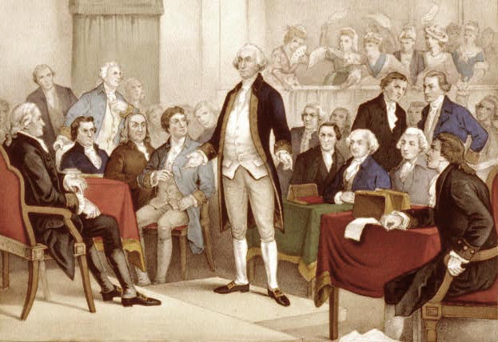
First Continental Congress
“Had our creator been pleased to give us existence in a land of slavery, the sense of our condition might have been mitigated by ignorance and habit; but, thanks be to his adorable goodness, we were born the heirs of freedom and ever enjoyed our rights under the auspices of your royal ancestors whose family was seated on the British throne to rescue and secure a pious and gallant nation from the popery and despotism of a superstitious and inexorable tyrant”
- The First Continental Congress, Petition to King George III
1st Continental Congress 1774, met in
response to the Intolerable & Quebec Acts
Petition to King George the III
(petitions for the return of their rights)
Non-importation Agreements
Britain – Colonies are in a
State of REBELLION

Slide 52
Battle of Lexington & Concord
•Paul Revere
•William Dawes
•Minutemen
•Battle of Lexington
•Battle of Concord

Slide 53
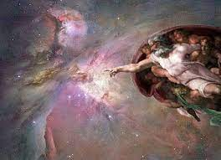
God’s Plan
Deism: The religious belief that God created natural laws that govern the universe, therefore did not intervene in human affairs
Influences in the Age of Enlightenment
Influences in the Founding Fathers (Patrick Henry)

Slide 54
Enlightenment Thought
Age of Enlightenment: 17th & 18th Century intellectual movement based on reason. (All things could be explained using rational thought)
“MEN being . . . by nature, all free, equal, and independent, no one can be put out of this state, and subjected to the political power of another, without his own consent. The only way whereby anyone divests himself of his natural liberty, and puts on the bonds of civil society, is by agreeing with other men to join and unite into a community for their comfortable, safe, and peaceable living one amongst another”
- John Locke’s “Two Treatise on Government”
How does the Age of Enlightenment influence the American Revolution?
Government power comes from the consent of the people – SOCIAL CONTRACT
Government purpose is to protect life, liberty, and property
If government fails in its purpose – The people must abolish it

Slide 55
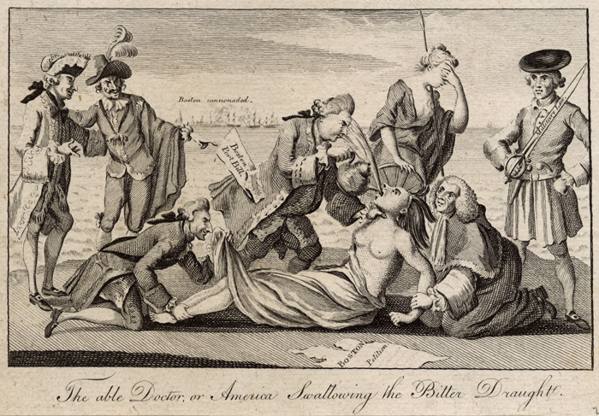
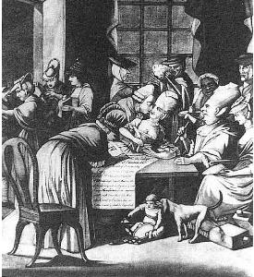
Conflicting views on Citizenship
American Colonists
English Parliament
Full English citizens with full rights
Ex.
No Taxation without representation
Petition parliament through state and continental legislative bodies
Declaration of Rights and Grievances
Olive Branch Petition
Patriots vs. Loyalists vs. Fence sitters
Colonists are not citizens who are out of control & subject to English rule
Ex.
Declaratory Act (Virtual representation)
Quartering Act
Coercive Acts (Intolerable Acts)

Slide 56
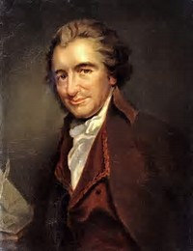
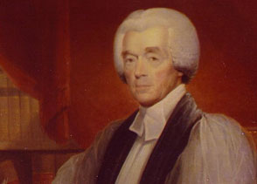
Dueling Perspectives
PATRIOT – Thomas Paine’s “Common Sense”
LOYALIST – Rev. Charles Inglis’ “Cracked Brain Zealot”
A government of our own is our natural right. . . . Ye that oppose independence now, ye know not what ye do: ye are opening the door to eternal tyranny. . . . There are thousands and tens of thousands, who would think it glorious to expel from the Continent, that barbarous and hellish power, which hath stirred up the Indians and the Negroes to destroy us. . . .
By a Reconciliation with Great Britain, peace  that fairest offspring and gift of Heaven  will be restored. In one respect, peace is like health: we do not sufficiently know its value but by its absence. What uneasiness and anxiety, what evils has this short interruption of peace with the parent state brought on the whole British empire!

Slide 57
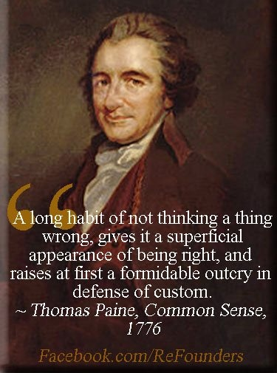
Second Continental Congress
2nd Continental Congress: Not ready for Independence
Olive Branch Petition 1775
Patriots vs. Loyalists (America a divided population)
Thomas Payne’s “Common Sense” convinces the public that independence is necessary
Declaration of Independence 1776:
Based on Enlightenment Philosophy of John Locke
Argued that the King had violated American identity

Slide 58
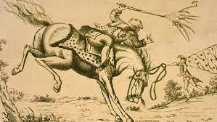
Debating the Legitimacy of Independence
America Swallowing the Bitter Draught
The Horse of America Throwing Off King George III
Evaluate whether the chargers of the Declaration of Independence are legitimate.

Slide 59
Thesis THUNDER DOME
Prompt: Analyze the effect of the French and Indian War and its aftermath on the relationship between Great Britain and the British colonies. Confine your response to the period from 1754 to 1776.
Compete against your table mate to determine who has the better thesis
Write out your reasons for your selection
Winner advances to another face off (repeat process)
THERE CAN ONLY BE ONE

Slide 60
Essential Question: How did growing debate over political and economic control over the colonies contribute to the separation between the English and America?
Students can:
Evaluate how growing economic and political competition between the British, French, and Indians created conflict in America
Propose arguments as to how increase American interest in self-government in the face of renewed British imperialism led to colonial independence movement and war
AGENDA
Periodization Challenge
Declaration of Independence
Prove your point
Homework
Outline for Long Essay Question

Slide 61
The Declaration of Independence
“endowed by their Creator with certain unalienable Rights, that among these are Life, Liberty and the pursuit of Happiness. governments are instituted among men, deriving their just powers from the consent of the governed; that whenever any form of government becomes destructive of these ends, it is the right of the people to alter or to abolish it, and to institute new government, laying its foundation on such principles, and organizing its powers in such form, as to them shall seem most likely to effect their safety and happiness.”
“A long train of abuses and usurpations”
“In every stage of these Oppressions We have Petitioned for Redress in the most humble terms: Our repeated Petitions have been answered only by repeated injury.”
“that all political connection between them and the State of Great Britain, is and ought to be totally dissolved; and that as Free and Independent States”
Looking at the Revolution through the Colonist’s eyes
How has Jefferson defined the character of American colonists in the opening statement?
Connect the idea of tyranny and long train of usurpations with the American colonists’ experience with Britain from 1763-1776

Slide 62
Debating Independence
The history of the present King of Great Britain is a history of repeated injuries and usurpations, all having in direct object the establishment of an absolute Tyranny over these States.
- Thomas Jefferson, Declaration of Independence, 1776
Break down the quotes and provide factual support for each side of the debate between Loyalists and Patriots over American Independence.
You have now pointed out to you, Gentlemen, two Roads  one evidently leading to Peace, Happi-ness and a Restoration of the public Tranquility  the other inevitably conducting you to Anarchy, Misery, and all the Horrors of a Civil War. Your Wisdom, your Prudence, and your Regard for the true Interests of the People, will be best known when you have shown to which Road you give the Preference. .
- Gov. William Franklin, 1775

Slide 63
America post French & Indian War
How does the political cartoon reflect America’s situation post French & Indian War?
America
Roman hero reduced to a beggar when accused of treason
“Magna Britannia, Her Colonies Reduced”, 1766 Ben Franklin

Slide 64
Essential Question: Why did the Revolution encourage the American colonies to experiment with differing forms of government during the Critical Period?
Students can:
Evaluate how growing economic and political competition between the British, French, and Indians created conflict in America
Evaluate how ideas that inspired the revolutionary cause reflected new beliefs about politics, religion, and society that had developed during the 18th century.
AGENDA
Periodization Challenge
Enlighten ideas of government
Thesis under construction
Homework

Slide 65
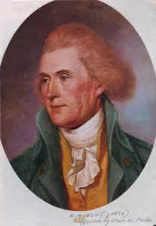
A Statement of Independence
“but when a long train of abuses and usurpations pursuing invariably the same object, evinces a design to reduce under absolute Despotism, it is the right, it is the duty, to throw of such government & to provide new guard for their future security.” Thomas Jefferson, Declaration of Independence, 1776
Explain how the Declaration of Independence establishes specific views of American government.

Slide 66
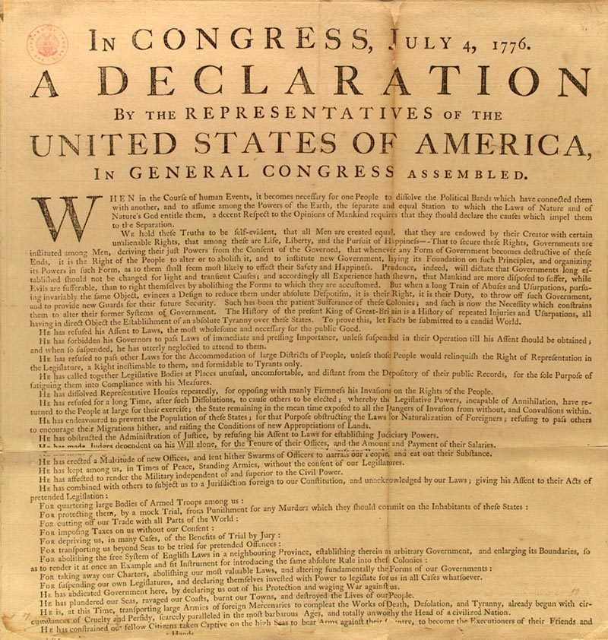
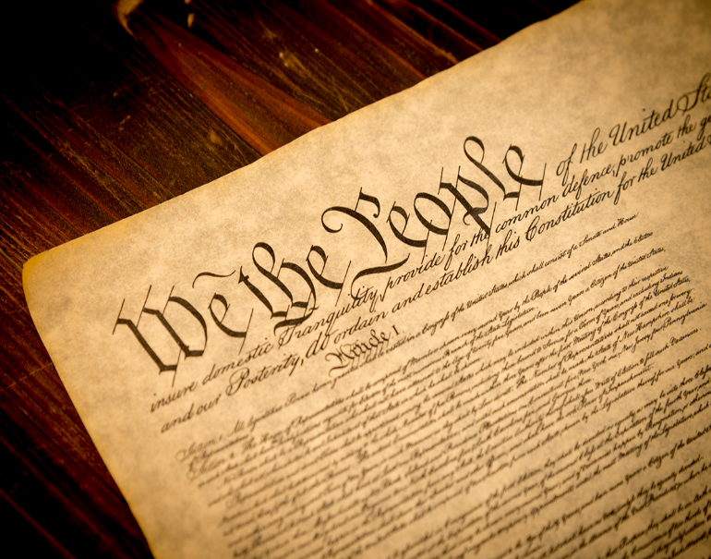
The Enlightenment
The Age of Enlightenment -1700s (Age of Reasons)
Intellectual & philosophical movement of Europe
John Locke (Social contract)
Jean Jacques Rousseau (Social contract)
Thomas Hobbes (tyranny of the mob)
Baron von Montesquieu (Separation of powers)
Adam Smith (Free market system – Laissez Faire)
Influenced – Declaration of Independence, Constitution, & Laissez Faire
Government philosophers

Slide 67
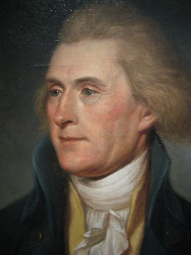
The Social Contract
"But if a long train of abuses, prevarications and artifices, all tending the same way, make the design visible to the people, and they cannot but feel, what they lie under, and whither they are going, 'tis not to be wondered, that they should then rouse themselves, and endeavour to put the rule into such hands, which may secure to them the ends for which government was at first enacted".
- John Locke, Second Treatise of Civil Government, 1690
But when a long train of abuses and usurpations, pursuing invariably the same Object evinces a design to reduce them under absolute Despotism, it is their right, it is their duty, to throw off such Government, and to provide new Guards for their future security.
- Thomas Jefferson, The Declaration of Independence, 1776

Slide 68
The Declaration of Independence
“endowed by their Creator with certain unalienable Rights, that among these are Life, Liberty and the pursuit of Happiness.”
“A long train of abuses and usurpations”
“In every stage of these Oppressions We have Petitioned for Redress in the most humble terms: Our repeated Petitions have been answered only by repeated injury.”
“that all political connection between them and the State of Great Britain, is and ought to be totally dissolved; and that as Free and Independent States”

Slide 69
Turning Point
Analyze the effect of the French and Indian War and its aftermath on the relationship between Great Britain and the British colonies. Confine your response to the period from 1754 to 1776.

Slide 70
Essential Question: Why did the Revolution encourage the American colonies to experiment with differing forms of government during the Critical Period?
Students can:
Evaluate how growing economic and political competition between the British, French, and Indians created conflict in America
Evaluate how ideas that inspired the revolutionary cause reflected new beliefs about politics, religion, and society that had developed during the 18th century.
AGENDA
MCQ Practice
Say you want a REVOLUTION
Debating a turning point
Homework
DBQ Poster

Slide 71
Practice MCQ
1. The publication of Sharp’s essay for the colonial American audience best reflect which of the following developments in the 1770?
The growing appeal of Loyalism among many colonists
The influence of religion on colonists’ ideas about natural law
The mobilization of ordinary men and women to pressure British colonial officials
The strategy emphasizing the rights of British subjects to oppose colonial taxation.
“When the natural rights of any of our fellow subjects are apparently at stake, every man has a right to judge for himself and to declare his sentiments, as far as plain conclusions of reason and common sense will fairly warrant. . .
“. . . As British subjects, whether in the Great Britain, Ireland, or the colonies, are equally free by the laws of Nature, they certainly are equally entitled to the same Natural Rights that are essential for their own preservation. . . .
“In every point of view, the making [of] laws for the subjects of any part of the British Empire, without their participation and assent, is INQUITOUS and therefore unlawful.”
Granville Sharp, British social activist, “A Declaration of the People’s Natural Rights to a share in the Legislation” Pamphlet originally published in London and reprinted in British American newspapers, 1774

Slide 72
The Horse America throwing his Master
HIPP ANALYSIS: “The Horse AMERCIA, Throwing His Master” published by William White, 1779
HIPP STATEMENT – must connect FOUR vocabulary terms and explain the POV of the political cartoonist
HIPP Statement: POV + historic context + intended audience + purpose (YOU MUST USE FACTS within and implied in the document

Slide 73
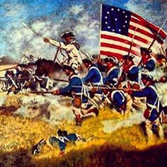
Winning the Revolution
Evaluate the following factors from most important to least important for assisting America in achieving victory in the Revolutionary War.
Support of the Radical Whigs in English Parliament
Distance between England & America
Fighting for a cause
America’s home field advantage
Leaders: Washington, Friedrich von Stuebben, Marquis de Lafayette, Ben Franklin
Alliance with France
British Debt

Slide 74
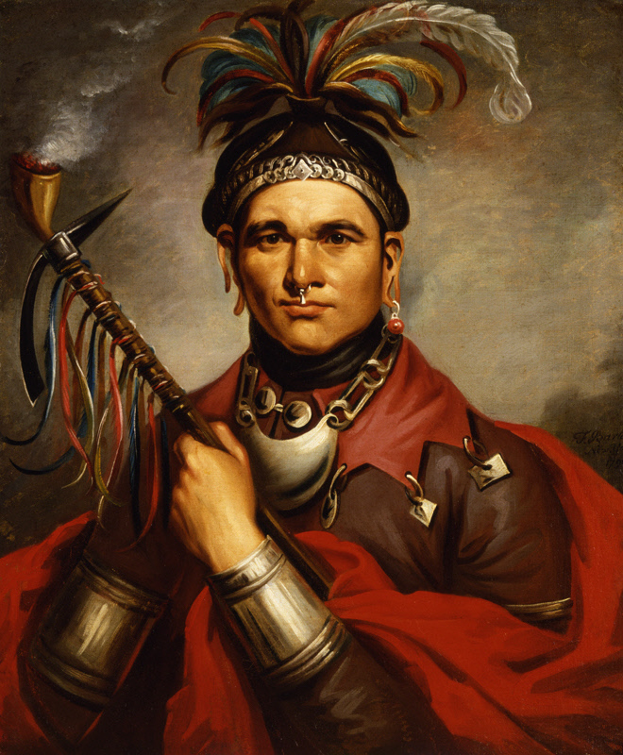
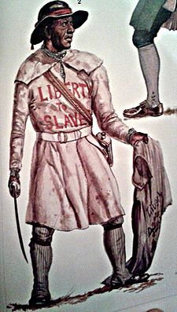
Phase I of the War of Independence
New England 1775-1776
Early victories – Bunker Hill & Ft. Ticonderoga
Failed invasion of Canada (Benedict Arnold)
Declaration of Independence
Chief Corn Planter of the Seneca Tribe
Lord Dunmore’s Proclamation 1775 – slaves fight for England to earn your freedom

Slide 75
Phase II
War in the North 1776-1777
Setbacks in America’s fight for Independence
Articles of Confederation adopted
Marquis de Lafayette
Battle of Saratoga victory (France allies with America – FRANCO AMERMICAN ALLIANCE)
Winter in Valley Forge

Slide 76
Phase III
The War in the South 1778-1781
Friedrich von Stuebben
Yorktown victory

Slide 77
DBQ Poster
Prompt: The French and Indian War (1754-1763) impacted the relations between the American colonies and the British. Evaluate to what extent the French and Indian War was a turning point in British colonial relations from 1754 to 1781.
Complete annotation of documents
Develop your thesis and outline
Cut out documents

Slide 78
DBQ Poster
Prompt: The French and Indian War (1754-1763) impacted the relations between the American colonies and the British. Evaluate to what extent the French and Indian War was a turning point in British colonial relations from 1754 to 1781.
Category 1
Category 2
Category 3
Evidence:
Evidence:
Evidence:

Slide 79
Essential Question: Why did the Revolution encourage the American colonies to experiment with differing forms of government during the Critical Period?
Students can:
Evaluate how growing economic and political competition between the British, French, and Indians created conflict in America
Evaluate how ideas that inspired the revolutionary cause reflected new beliefs about politics, religion, and society that had developed during the 18th century.
AGENDA
Cultural Questions of the Revolution
Debating a turning point
Homework
AOC a Decentralized Nightmare

Slide 80
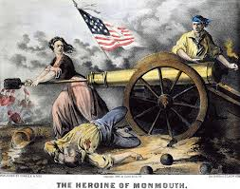
Remember the LADIES!
Ladies actively participants in the American Revolution
Daughters of the Revolution
Home Spun Movement (Boycott)
Served in the military (Molly McCauley & Deborah Sampson)
“I desire you would remember the ladies and be more generous and favorable to them than your ancestors”
Abigail Adams
Republican Motherhood: educating women so they could teach children the values of a new republic

Slide 81
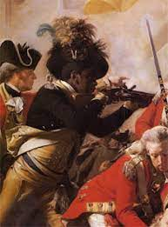
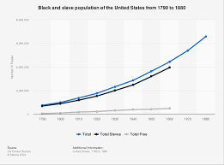
Equality = Revolutionary Values
“We hold these truths to be self-evident, that all men are created equal”
- Declaration of Independence
Slave population of the colonies = 21.5% population
Dunmore’s Proclamation 1775
Confederation Congress bans slave trade
Northern States end slavery

Slide 82
DBQ Poster
Prompt: The French and Indian War (1754-1763) impacted the relations between the American colonies and the British. Evaluate to what extent the French and Indian War was a turning point in British colonial relations from 1754 to 1781.
Category 1
Category 2
Category 3
Evidence:
Evidence:
Evidence:

Slide 83
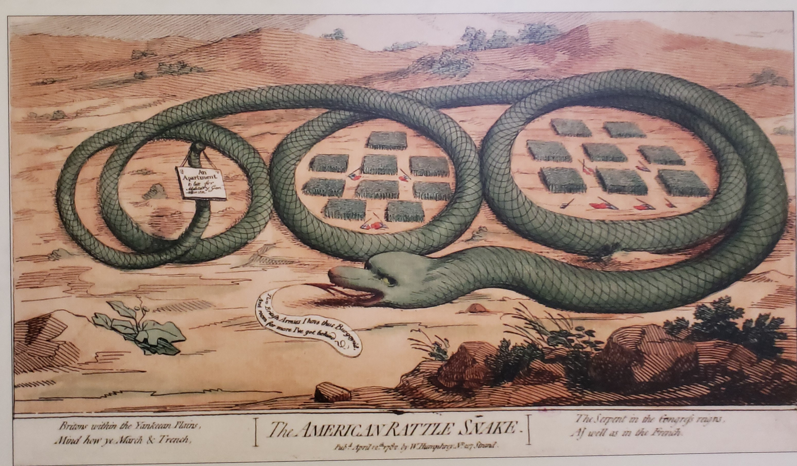
Thesis Challenge
Prompt: The French and Indian War (1754-1763) impacted the relations between the American colonies and the British. Evaluate to what extent the French and Indian War was a turning point in British colonial relations from 1754 to 1781.
Thesis formula: Although X HOWEVER, A and B THEREFORE Claim (Use your THREE boxes as your line of reasoning)

Slide 84
Thesis that ain’t feces
Prompt: Analyze the effect of the French and Indian War and its aftermath on the relationship between Great Britain and the British colonies. Confine your response to the period from 1754 to 1776.
THREE RULES:
Thesis must respond to the prompt
Cannot re-state the prompt – example: The French & Indian War and its aftermath had a big impact on the relationship between Great Britain and the British colonies
Must have a line of reasoning – layout how you will argue your point
Formula for thesis writing: X. However, A and B. Therefore, Y.
X = represents the strongest point against your argument. We call this the counter-argument
A and B = represent the two strongest points for your argument. We call these your organization categories.
Y = represents the position you will be taking – in other words, your stand on the prompt. (your claim that responds to the prompt)

Slide 85
Thesis Challenge
Prompt: The French and Indian War (1754-1763) impacted the relations between the American colonies and the British. Evaluate to what extent the French and Indian War was a turning point in British colonial relations from 1754 to 1781.
Although there was a loyalists’ movement within the colonies that rejected independence, ______________ and _______________ (claim-respond to the prompt) __________________
Change words:
Altered - Adjusted - Break
Morphed - Modified - Reversal
Abolished - Destroyed
Thesis formula: Although X HOWEVER, A and B THEREFORE Claim (Use your THREE boxes as your line of reasoning)

Slide 86
DO I SCORE
Prompt: Evaluate the extent to which debates over slavery in the period from 1830 to 1860 led the United States into the Civil War.
Sample I: Slave was the main reason the Civil War happened
Sample II: The debates over slavery somewhat caused the Civil War, because the North and South disagreed over it.
Sample III: The rise of industrialism caused differences between northern and southern states, however arguments over free vs. slave territory and the rise of radical abolitionism were the main contributors to the Civil War in 1861.

Slide 87
Thesis DISSECTION
Prompt: Evaluate the extent to which debates over slavery in the period from 1830 to 1860 led the United States into the Civil War.
The rise of industrialism caused differences between northern and southern states (X-however – counter argument), however arguments over free vs. slave territory (Category A) and the rise of radical abolitionism (category B) were mainly (adverb modifier) the contributors to the Civil War in 1861. (Y – Claim)

Slide 88
Historic Contextualization
Prompt: The French and Indian War (1754-1763) impacted the relations between the American colonies and the British. Evaluate to what extent the French and Indian War was a turning point in British colonial relations from 1754 to 1781. Historic contextualization: what was going on during the period that caused the historic event. How did that historic event impact America, and what was its long-term effects?
Remember your historic contextualization needs to connect to the ideas of setting up core values of American political culture
Explain what caused French and Indian War to start happen before 1754?
How did French & Indian War influence the development of the of the relationship between Britain and the colonies?
How did French & Indian War change the America after 1781?

Slide 89
Historic Contextualization
Big picture/zoom OUT
1-2 facts that explain HOW and WHY the picture connects to the question
Statements, not an argument here
Before, during, or after time period

Slide 90
Historic Contextualization
The Market revolution, a time marked by technological advancements, such as the cotton gin, infrastructure advancements, such as canals, and societal changes, resulted in a growing middle class, and greater connectivity of the nation as well as the globe. With this the Second Great Awakening was able to occur. Religion, and the mindset that all
people, men, women, and all races, were equal in the eyes of god, were spread to more people than ever before. Power and knowledge were coming to groups that hadn’t had that privilege before and the foundation for the age of reform was set.

Slide 91
THESIS TOUGH!!
Prompt: Analyze the effect of the French and Indian War and its aftermath on the relationship between Great Britain and the British colonies. Confine your response to the period from 1754 to 1776.
THREE RULES:
Thesis must respond to the prompt
Cannot re-state the prompt – example: The French & Indian War and its aftermath had a big impact on the relationship between Great Britain and the British colonies
Must have a line of reasoning – layout how you will argue your point
Formula for thesis writing: X. However, A and B. Therefore, Y.
X = represents the strongest point against your argument. We call this the counter-argument
A and B = represent the two strongest points for your argument. We call these your organization categories.
Y = represents the position you will be taking – in other words, your stand on the prompt. (your claim that responds to the prompt)

Slide 92
Synonyms for Worlds
Prompt: Analyze the effect of the French and Indian War and its aftermath on the relationship between Great Britain and the British colonies. Confine your response to the period from 1754 to 1776.
Replace the words
Political: (governing and government)
Social: (Cultural icons)
Economy: (money or trade)

Slide 93
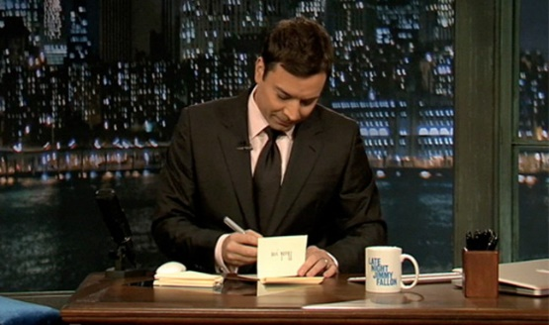
The Horse America throwing her Master
Thank you Britain for - ______________________
Thank you note – write a Jimmy Fallon thank you to the British for their influence on American independence

Slide 94
Debate Roles
Roles – everyone must take one
Opener (1 per side) – 2 minutes
Crossfire #1 – (2-4 per side) – 5 minutes of open debate
Summarizer #1 - (1 per side) – 2 minutes
Crossfire #2 – (2-4 per side) – 5 minutes of open debate
Summarizer #2 - (1 per side) – 2 minutes
Crossfire #3 – (2-4 per side) – 5 minutes of open debate
Closer - (1 per side) – 2 minutes

Slide 95
Essential Question: How did growing debate over political and economic control over the colonies contribute to the separation between the English and America?
Students can:
Evaluate how growing economic and political competition between the British, French, and Indians created conflict in America
Propose arguments as to how increase American interest in self-government in the face of renewed British imperialism led to colonial independence movement and war
AGENDA
Debate setup
Debate the legitimacy of the Independence Movement
Summary of viewpoints
Homework
Complete comparison of government
Read pages 117-120 in AMSCO

Slide 96
Debate Summary
That to secure these rights, governments are instituted among men, deriving their just powers from the consent of the governed, that whenever any form of government becomes destructive of these ends, it is the right of the people to alter or to abolish it, and to institute new government, laying its foundation on such principles, and organizing its powers in such form, as to them shall seem most likely to effect their safety and happiness.
- Declaration of Independence, 1776
Identify and explain three factors that supports the patriots claim that Independence is a necessary response to the actions of British authority?
Identify and explain three factors that supports the British and Loyalists claims that British action was appropriate, therefore invalidating American claims to independence.

Slide 97
Essential Question: How did growing debate over political and economic control over the colonies contribute to the separation between the English and America?
Students can:
Evaluate how Americans' ideas about government changed from the colonial period to the creation of the U.S. Constitution.
Evaluate how debates over state versus national power shaped the development of the United States from 1781 through 1800.
AGENDA
A Dangerous Mob
Governing under the AOC
DBQ Poster
Homework
Quiz on the Revolutionary & Critical Period Thursday 10/3

Slide 98
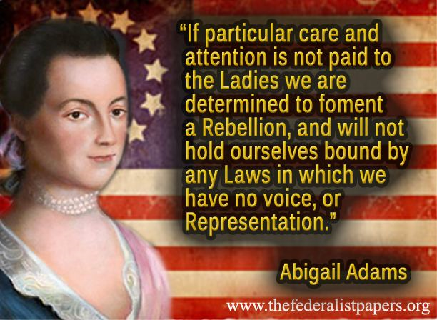
A Government of Revolutionary Ideas Part II – Unit III
Essential Question: How effective was post-Revolutionary America at instilling the ideas of the liberal movement that supported Independence in the governance of American society?

Slide 99
Perspective of the Critical Period
That Great Britain will be an unconcerned Spectator of the present insurrections (if they continue) is not to be expected. That she is at this moment sowing the Seeds of jealousy and discontent among the various tribes of Indians on our frontier admits of no doubt, in my mind. And that she will improve every opportunity to foment the spirit of turbulence within the bowels of the United States, with a view of distracting our governments, and promoting divisions, is, with me, not less certain. Her first Maneuvers will, no doubt, be covert, and may remain so till the period shall arrive when a decided line of conduct may avail her. Charges of violating the treaty, and other pretexts, will not then be wanting to color overt acts, tending to effect the great objects of which she has long been in labour....We ought not therefore to sleep nor to slumber. Vigilance in watching, and vigour in acting, is, in my opinion, become indispensably necessary. If the powers are inadequate amend or alter them, but do not let us sink into the lowest state of humiliation and contempt, and become a byword in all the earth.
- George Washington to Henry Knox, 1786
Identify a piece of evidence that the document implies but never states and explain its connection to the document
HIPP Analysis: Explain Washington’s point of view about America during the critical period
HIPP STATEMENT: POV + Historic Context + Intended Audience + purpose (use 3-4 fact to support)
Shays’ Rebellion
British in the frontier
Paris Peace Treaty 1783
Articles of Confederation

Slide 100
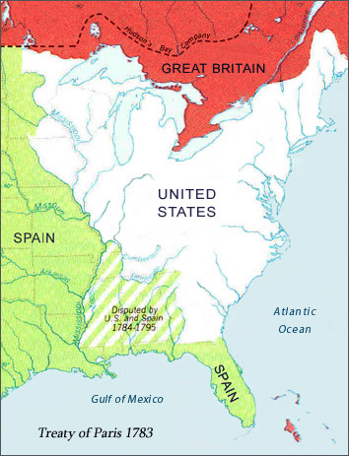
Independence Achieved
Paris Peace Treaty 1783 (John Jay negotiates without the French)
TERMS
Independence recognized
American boundaries (Great Lakes,
Mississippi River, & Florida)
Recommended no persecution of
Loyalists
What issues does America face as a new nation?

Slide 101
Articles of Confederation
Articles of Confederation (1777-1789) = alliance of 13 states (not unified nation)
AOC Structure
Unicameral Confederation Congress
Equal representation (1 vote per state)
Powers
Wage War & Negotiate Peace
Foreign diplomacy
Borrow Money
How effectively demonstrate the core values of the American identity formed in the colonial period?

Slide 102
Achievements under the AOC
Confederation Congress land reform
Land Ordinance 1784: The west organize into 10 States
Land Ordinance 1785: Established a system for sales and settlement
Northwest Land Ordinance 1787****
How territories become states
Rights of territories
NO SLAVERY allowed

Slide 103
DBQ Poster
Title – American Revolution DBQ
Write Historic Contextualization
Cut out and organize the documents
Underneath document: explain how the document answers the prompt
For 4 of the documents complete a HIPP analysis for one letter (i.e. H, I, P or P)
For each of the document highlight an additional piece of evidence (not stated in the document) and explain how it answer the prompt
Attach your brainstorm and outline to the poster
Thesis at the bottom of the poster
Make sure all group members are written on the back of the document

Slide 104
Structure of AOC
Decentralize government – state sovereignty
Unicameral congress with equal representation
Weaknesses:
Cannot Tax
Cannot Enforce Laws
Cannot Regulate Commerce (Annapolis
Convention 1787
No Standing Military (Shays Rebellion)
No Leader
No Courts
Constructed out of fear of tyranny of a
centralized government
Type of Government: Confederation (alliance of states)

Slide 105
Fear of Tyranny
ARTICLES OF CONFEDERATION - Decentralize Government (power resides with the states)
Evaluate how British governance influenced the setup of the Articles of Confederation
British Monarchy abused power = No National Leader
Stamp Act, Townshend Duties = Confederation Congress Can’t Tax
Quarter Act/Boston Massacre = No National Military in Peace time
Navigation Acts = Confederation can’t regulate commerce

Slide 106
No Tyranny Allowed
Critical Period 1781-1800
Analyze the Articles of Confederation to determine how the founders established a decentralized government.
Structure of government (setup)
Explain why experiences with British Tyranny caused the founders to build a weak decentralized government
Identify the AOC weaknesses and their side-effects on America during the critical period
Develop a medicine advertisement that explains how the AOC was the cure for TYRANNY, but has nasty side-effects

Slide 107
Governing in the Critical Period
The Articles of Confederation – the response to Tyranny of the British Government
Analyze the Articles of Confederation to determine how it was a setup to prevent the abuse of central government authority (national gov.)
Structure of government: setup of government (Branches, State power vs. national power)
Find an examples of English tyranny that explains why the AOC was an outgrowth of the American Revolution
Identify the Articles of Confederation weaknesses that caused it to fail.
How did specific events and developments at home and abroad create a call to strengthen the Articles of Confederation?

Slide 108
Essential Question: How did growing debate over political and economic control over the colonies contribute to the separation between the English and America?
Students can:
Evaluate how Americans' ideas about government changed from the colonial period to the creation of the U.S. Constitution.
Evaluate how debates over state versus national power shaped the development of the United States from 1781 through 1800.
AGENDA
Awakening to the Failures of the AOC
Rethinking Government
DBQ Poster
Homework
Plans and Compromises (Read pages 123-126)
Quiz on the American Revolution and French and Indian War – Thursday 10/3

Slide 109
Governing America
Prompt: Evaluate the extent to which the ratification of the United States Constitution fostered change in the function of the federal government in the period from 1776 to 1800.

Slide 110
The SHAYSITE’S WARNING
Shay’s Rebellion 1786-1787
I hold it that a little rebellion now and then is a good thing, and as necessary in the political world as storms in the physical
- Thomas Jefferson, 1787
How does Shay’s Rebellion demonstrate that the Articles of Confederation decentralized government has failed?
How was Shay’s Rebellion similar to the American Revolution?

Slide 111
Post Revolution issues
The Crisis of the Articles of Confederation
Debt: America owes $77 Million between state and national government (national gov. cannot tax)
Shays Rebellion 1786-1787 (no national military in peace time)
Annapolis Convention 1786 (national gov. cannot regulate interstate commerce, no standard currency, no court system)
Constitutional Convention 1787 – Goal edit the Articles of Confederation
We need a new government!
Ben Franklin’s 1754 cartoon applies to America in 1781-1789

Slide 112
Governing in the Era of Independence
The Power of the State Government
Mecklenburg Declaration of Independence - 1775
Commonalities of State Government
Forming their Constitution
Debate liberty vs. security
Creation of Bills of Rights
Establish separation of powers (3 Branches)
Voting qualifications – white, male, property owners
Govern by elites (Wealth rule)
Halifax Resolves - 1776
How does the Enlightenment influence the creation of state governments?

Slide 113
DBQ Poster
Title – American Revolution DBQ
Write Historic Contextualization
Cut out and organize the documents
Underneath document: explain how the document answers the prompt
For 4 of the documents complete a HIPP analysis for one letter (i.e. H, I, P or P)
For each of the document highlight an additional piece of evidence (not stated in the document) and explain how it answer the prompt
Attach your brainstorm and outline to the poster
Thesis at the bottom of the poster
Make sure all group members are written on the back of the document

Slide 114
Constitutional Scavenger Hunt
U.S. Constitution (September 17, 1787)
“It’s a REPUBLIC, if you can keep it!”
Utilize the Interactive Constitution from the U.S. Constitution Center
Evaluate the choices the founding fathers made in creation of a new social contract

Slide 115
Evaluating Parts of the Constitution
U.S. Constitution (September 17, 1787)
Explain THREE ways the U.S. Constitution repaired issues of the Articles of Confederation.
Explain ONE way that the U.S. Constitution is different from the unitary government (King & Parliament) of the British.
Identify and explain how the original U.S. Constitution upholds the following core value.
Popular Sovereignty

Slide 116
Temperament of America
Critical Period 1781-1800
Analyze the Jefferson’s view of Shay’s Rebellion and the plans to revise the Articles of Confederation
Things to Remember
Events that happened in the Critical Period 1781-1787
Arguments made during the Revolutionary Period about self government
We hold theses truths to be self-evident . . . That to secure these rights, Governments are instituted among Men

Slide 117
Essential Question: How did growing debate over political and economic control over the colonies contribute to the separation between the English and America?
Students can:
Evaluate how Americans' ideas about government changed from the colonial period to the creation of the U.S. Constitution.
Evaluate how debates over state versus national power shaped the development of the United States from 1781 through 1800.
AGENDA
Let’s Make A Deal
Building a Constitution
Ratification Rap Battle
Homework
Study For Revolutionary Period Quiz

Slide 118
Let’s Make a Deal
Explain ONE factor that led to Founder’s to hold a Constitutional Convention.
Identify a compromise and explain how it balanced competing interest in the design of the U.S. Constitution in one of the following areas
Representation
Sectional differences
Trade
Voice of the people in
government

Slide 119
A Convention for the AOC
Constitutional Convention 1787
Purpose to repair the Articles of Confederation
Guidelines
Washington chosen as Chair
Rule of Secrecy
Simple majority decides issues
The members of the [constitutional] convention were certainly human, which is to say they were complex, unpredictable, paradoxical, compounded by rationality and irrationality, moved by selfishness and by altruism, by love and by hate and by anger—and by principle. If the convention succeeded, it was not simply because the members possessed a common economic or class interest but because they held common principles, principles learned in twenty years of British tyranny and American seeking, in colonial assemblies, in state legislatures and in Congress. . . . They agreed, to begin with, on the urgency of their task. - Edmund S. Morgan, The Birth of the Republic, 1763-89

Slide 120
Compromise is KEY
Plans of Government
NJ Plan
Virginia Plan
Bicameral Legislature - Representation by population
Add executive and judiciary
Unicameral Legislature
Equal Representation
Add executive & judiciary
The Great Compromise: Bicameral legislature – one house representation by population & one house with equal representation

Slide 121
Compromise is KEY
Issue that forced compromise:
Great Compromise – issue: representation in Congress
Let’s make a DEAL!
3/5th Compromise – issue: slavery & representation
Commerce Compromise – issue: slavery & trade
Electoral College Compromise – issue: choosing the President
What issue was not resolved by the Constitutional Convention that will lead to future division in the United States?

Slide 122
Principles of the Constitution
How did James Madison design the U.S. Constitution to prevent the abuse of power from a centralized government?
“If Men were angels, no government would be necessary. If angels were to govern men, neither external nor internal controls on government would be necessary. In framing a government which is to be administered by men over men, the great difficulty lies in this: you must first enable the government to control the governed; and the next place, oblige it to control itself.”
- James Madison, Federalist 51, 1788
Auxiliary Precautions of the Constitution
Separation of Powers (three branches of government)
Checks & Balances – restraints on the powers of the branches
Federalism – division of power between the state and national governments

Slide 123
Demographics of Ratification
Ratification debate: Federalists v. Anti-federalist arguments over whether the U.S. Constitution established a proper government
Federalists: urban & industrial society
Anti-federalist: agrarian society
Agrarian vs. industrial economy a continuous debate in America

Slide 124
DBQ Poster
Title – American Revolution DBQ
Write Historic Contextualization
Cut out and organize the documents
Underneath document: explain how the document answers the prompt
For 4 of the documents complete a HIPP analysis for one letter (i.e. H, I, P or P)
For each of the document highlight an additional piece of evidence (not stated in the document) and explain how it answer the prompt
Attach your brainstorm and outline to the poster
Thesis at the bottom of the poster
Make sure all group members are written on the back of the document

Slide 125
Anti-federalist Quorums with Ratification
Evaluate why Anti-federalists feared ratification of the U.S. Constitution despite the failures of the Articles of Confederation
Sourcing document: Read the following excerpts from Brutus, Montezuma, Patrick Henry, and A Farmer
Explain their POINT OF VIEW using at least ONE implied fact

Slide 126
Madisonian Model
“If Men were angels, no government would be necessary. If angels were to govern men, neither external nor internal controls on government would be necessary. In framing a government which is to be administered by men over men, the great difficulty lies in this: you must first enable the government to control the governed; and the next place, oblige it to control itself.”
- James Madison, Federalist 51, 1788
3 GOALS OF THE U.S. CONSTITUTION
1. Separate the powers of government (3 branches of government & federalism)
2. Checks & balances (presidential veto, Congressional override, & judicial review)
3. Stop the tyranny of the mob (Shays Rebellion) (republicanism, Electoral College)

Slide 127
Essential Question: How did growing debate over political and economic control over the colonies contribute to the separation between the English and America?
Students can:
Evaluate how Americans' ideas about government changed from the colonial period to the creation of the U.S. Constitution.
Evaluate how debates over state versus national power shaped the development of the United States from 1781 through 1800.
AGENDA
The Power of Point of View
Meet the Federalists & Anti-federalists
Ratification Rap
Homework
A Washingtonian Presidential Review read pages of 135 -141 and explain the significance of the terms

Slide 128
Describe the POV of the following statements
__ 1. "The powers given by the proposed Constitution to the federal government are few and defined.
__ 2. "I am confident it must be, and that it is, the sincere wish of every true friend to the United States, that there should be a confederated national government, but that it should be one which would have a control over national and external matters only, and not interfere with the internal regulations and police of the different states in the union.
__ 3. "...the power vested in congress of sending troops for suppressing insurrections will always enable them to stifle the first struggles of freedom.“
___ 4. House of Representatives . . . can make no law which will not have its full operation on themselves and their friends, as well as the great mass of society. This has always been deemed one of the strongest bonds by which human policy can connect the rulers and the people together. It creates between them that communion of interest, and sympathy of sentiments, of which few governments have furnished examples; but without which every government degenerates into tyranny.

Slide 129
Constitutional Debate
Issues between the Federalists & Anti-federalists
“a general convention of the United States was proposed to be held, and deputies were accordingly appointed by twelve of the states charged with power to revise, alter, and amend the Articles of Confederation. When these deputies met, instead of confining themselves to the powers with which they were entrusted, they pronounced all amendments to the Articles of Confederation wholly impracticable; and with a spirit of amity and concession truly remarkable proceeded to form a government entirely new, and totally different in its principles and its organization. Instead of a congress whose members could serve but three years out of six-and then to return to a level with their fellow citizens; and who were liable at all times, whenever the states might deem it necessary, to be recalled-- Congress, by this new constitution, will be composed of a body whose members during the time they are appointed to serve, can receive no check from their constituents.”
- Anti-federalist 8, A Federal Republican, 1788
Constitution Convention
Article of Confederation
Confederation Congress delegate must be re-elected every three years
Senate terms are 6 years & not directly elected by the people
“The powers delegated by the proposed Constitution to the federal government, are few and defined. Those which are to remain in the State governments are numerous and indefinite. The former will be exercised principally on external objects, as war, peace, negotiation, and foreign commerce; with which last the power of taxation will, for the most part, be connected. The powers reserved to the several States will extend to all the objects which, in the ordinary course of affairs, concern the lives, liberties, and properties of the people, and the internal order, improvement, and prosperity of the State”
- Federalist 45, James Madison, 1788
Enumerated powers
U.S. Constitution
Reserved powers
Federalism

Slide 130
Madison’s Argument
“The Ratification of the Conventions of nine States, shall be sufficient for the Establishment of this Constitution between the States so ratifying the same.”
- Article VII, U.S. Constitution
Ratification Debate: Federalists vs. Anti-federalists over the adoption of the U.S. Constitution
Ratification Rap – use the arguments in documents provided to demonstrate the different perspectives of the Federalists and Anti-federalist
FEDERALISTS (James Madison, Alexander Hamilton, & John Jay)
Beliefs:
Strong central government
Support the US Constitution
No Bill of Rights
ANTI-FEDERALISTS (Robert Yates, John Lansing, & Richard Lee)
Beliefs:
Strong state government
Against the US Constitution
Want a Bill of Rights

Slide 131
Constitutional issues for the future
Ratification debate brought forth many issues dealing with the U.S. Constitution and its ability to govern the nation
How will the ratification debate over the powers of government under the U.S. Constitution influence Washington as he implements the powers of the national government?
“We should not look back unless it is to derive useful lessons from past errors and for the purpose of profiting by dearly bought experience.”
1st President: George Washington

Slide 132
Objections of Brutus
Summarize the objections to the Constitution
Brutus:
Montezuma:
Patrick Henry:
A Farmer:

Slide 133
In the Mind of the Framers
"Time and changes in the condition and constitution of society may require occasional and corresponding modifications." --Thomas Jefferson to Edward Livingston, 1825.
Evaluate how we have altered the Constitution to fit our modern times and determine whether that upholds the Conservative view of the Constitution (We need government to control the masses because they are untrustworthy) or a Liberal view (Constitution upholds the American core values and prevent tyrannical government encroachment upon them)

Slide 134
SHE Statements
SHE (Specific Historic Evidence) statements – use FACTS to support claim
Example: President George Washington supported the constitutional principle of limited government by establishing the two-term presidency precedent and returning power to the people.
Same idea for short answer questions – you must always write statements using factual evidence.

Slide 135
Essential Question: How did growing debate over political and economic control over the colonies contribute to the separation between the English and America?
Students can:
Evaluate how Americans' ideas about government changed from the colonial period to the creation of the U.S. Constitution.
Evaluate how debates over state versus national power shaped the development of the United States from 1781 through 1800.
AGENDA
Events of a 1st President
America’s First Executive
Achieving Goals of Stabilization
Homework
A Washingtonian Presidential Review

Slide 136
A Constitutional Reality Part III – Unit III
Essential Question: Evaluate to what extent the new republic, formed by the United States Constitution, demonstrate a continued argument over the ideas of proper government.

Slide 137
Washington’s Challenges
Identify challenges Washington face as President of the United States
Native Americans
Debt
Trade
Rebellion
Foreign Relations
Interpreting the Constitution
Establishing the Executive
Compromise

Slide 138
The Threats to a New Nation
Issues Washington faces
Advantages
Vague Constitution
Debt - $54 Million
Agriculture based economy
Weak army & No Navy
USA = No Respect
British in America
Mississippi closed
Strong leadership (Washington)
Few rules on how to govern
All Hail, Cincinnatus

Slide 139
Washington Defines the Presidency
Precedents of Washington
Establishes the Cabinet
Two term presidency
Proclamation of Neutrality “avoiding entangling alliances”
Bill of Rights added to the Constitution in 1791

Slide 140
Building a Sound Economy
Promote the interest of the Wealthy
America owes $54 Million
National Bank (Necessary & Proper Clause) – loose constructionist view
Finance the debt
Pay all debts in full
Hamilton’s Debt Refinance Plan
Tax– Excise tax on whiskey & Tariff of 1789 (promote an industrial economy)
Assumption Plan: Federal government assumes all state debts ($21 million)
Evaluate whether Hamilton’s use of the Constitution meets a liberal revolution or conservative rejections

Slide 141
Division in Politics
Impact of the Hamilton Debt Re-finance Plan
Hamilton/Jefferson Compromise 1790: (Assumption plan)
Federal gov. assumes state debts
Washington DC the Capital – the seat of government in the South
National Bank
Jefferson quits Washington’s administration
Forms the Democrat Republicans platform strict constructionist (Beginning of America’s TWO-PARTY SYSTEM)
Excise Tax: Whiskey Rebellion tar & feathering of tax collectors
Washington use military to crush the rebellion

Slide 142
Evaluating Washington
Prompt: Evaluate to what extent George Washington, as the nations first president, maintained the proper balance of power under the U.S. Constitution.
Side 1
Side 2

Slide 143
Essential Question: How did growing debate over political and economic control over the colonies contribute to the separation between the English and America?
Students can:
Evaluate how Americans' ideas about government changed from the colonial period to the creation of the U.S. Constitution.
Evaluate how debates over state versus national power shaped the development of the United States from 1781 through 1800.
AGENDA
President Review
Foreign policy
Achieving Goals of Stabilization
Homework
A Washingtonian Presidential Review
Unit III Test – Tuesday, October 31

Slide 144
Presidential Review
Construct specific historic evaluation of George Washington for the following two categories.
Evaluate to what extent President George Washington was able to stabilize the nation economy.
Evaluate to what extent President George Washington was able to unite the nation under his presidency

Slide 145
French Revolution
French Revolution – England declares war on France execution of their Monarch
Jefferson Democrat-Republicans pro French
Federalist pro-English
Proclamation of Neutrality1793
America is too weak
British seize American ships (impressment: kidnapping of American sailors)
Citizen Genet Affair

Slide 146
Controlling America
Fighting for Respect
Battle of Fallen Timbers 1794 – Controlling
the NW Territory against Native Americans
Treaty of Greenville: US controls the
Ohio River Valley
Pinckney Treaty 1795 (establish trade route
via the Mississippi River & Port of
New Orleans)
Jays Treaty 1794 (England & America)
Washington use executive privilege
(expands the power of the Presidency) to
block Congress access to the negotiations
Quasi War 1789-1800 (Undeclared war
with the French)

Slide 147
Oh, Hail Cincinnatus
Prompt: Evaluate to what extent President Washington stabilized the nation from 1789-1797.
America is a united nation at the end of Washington’s two terms
America is protected itself from European influenced by 1796
The powers of the Constitution have been strictly defined by the founding fathers by the end of Washington’s presidency
The United States has gone from being unstable to a highly stable republic
Washington has maintained a proper balance between the ideas of the Federalists and those of the Anti-federalists.
The national economy must be changed from unstable to stable and promote growth for years
Washington was the perfect first president for the United States

Slide 148
The Father of our Nation
President Washington has been given the title of “Father of our Nation”
Is this an appropriate title considering the work he did as President of the United States
Factors to evaluate
Securing our nation
Building a nation economy
Promoting unity
Using Constitutional authority
Apotheosis of Washington
Apotheosis: rise of a person to the rank of god

Slide 149
Evaluating Washington
Prompt: Evaluate to what extent George Washington, as the nations first president, maintained the proper balance of power under the U.S. Constitution.
Side 1
Side 2

Slide 150
Evaluating Washington
Prompt: Evaluate to what extent George Washington, as the nations first president, maintained the proper balance of power under the U.S. Constitution.
Thesis Statement: Jackson weaken the plight of the common man because he expanded federal power and drove the economy into a panic. However, Jackson did extend the representation of the common man in the national government.
Expanded federal power (A bases)
Ignore SCOTUS decision in Georgia v. Worchester
Chief Justice John Marshall
5 Civilized Tribes
Indian Removal Act of 1830
Trail of tears

Slide 151
Constitutional Challenge
“The Constitution is the guide which I will never abandon.”
Maintaining a Revolutionary Establishing Tyrannical
Government Government

Slide 152
The Legacy of Washington
Evaluate whether Washington was able to uphold the idea of balance government instead tyranny in fifty words or less. Your response must include the following terms.
Hamilton’s Debt Refinance Plan
Whiskey Rebellion
Jay’s Treaty
Proclamation of Neutrality
Two Terms Precedent

Slide 153
Essential Question: How did growing debate over political and economic control over the colonies contribute to the separation between the English and America?
Students can:
Evaluate how Americans' ideas about government changed from the colonial period to the creation of the U.S. Constitution.
Evaluate how debates over state versus national power shaped the development of the United States from 1781 through 1800.
AGENDA
Unit III Check-in
Washington’s Farewell
Heeding Washington’s Warning
Homework
An American Identity – read pages 145-147, 149-153 respond to the discussion prompt
Unit III Test – Tuesday, 10/31

Slide 154
Farwell Address 1796
Read Washington’s Farewell Address and HIPP the document
Why is Washington’s Farewell Address a significant statement at the time it was given?
What are some issues with the address as given?
“Political parties are likely to become potent engines, by which cunning, ambitious and unprincipled men will be enabled to subvert the power of the people and to usurp for themselves the reins of government”

Slide 155
Farwell Address 1796
Read excerpts under Washington’s Farwell Warnings Link
Construct a Hipp analysis statement on the focus of Washington’s message
HIPP statement formula: POV + Historic Contextualization + intended audience + purpose (must use three facts to support it)
“Political parties are likely to become potent engines, by which cunning, ambitious and unprincipled men will be enabled to subvert the power of the people and to usurp for themselves the reins of government”
Washington’s Warnings
Avoid Political Parties
Maintain Neutrality – avoid entangling alliances
Avoid sectional differences

Slide 156
Heeding Washington’s Warnings
“The unity of Government which constitutes you one people . . . is a main pillar in the edifice of your real Independence, the support of your tranquility at home, your peace abroad; of your safety; of your prosperity; of that very liberty which you so highly prize.”
Contrast Washington’s Farewell Address to the following:
Monroe Doctrine 1823
Roosevelt Corollary 1907
Truman Doctrine 1947
Eisenhower Doctrine 1957
Evaluate how well we heeded Washington’s warnings using examples from the other four documents.

Slide 157
The Legacy of Washington
Presidential Approval Rating:
Evaluate Washington’s presidency and his ability to guide the nation towards the liberal hopes of the Revolutionary period
2 ways that he upheld the idea of the American Revolution
2 ways that he failed to maintain ideas of the American Revolution

Slide 158
Essential Question: How did growing debate over political and economic control over the colonies contribute to the separation between the English and America?
Students can:
Evaluate how growing economic and political competition between the British, French, and Indians created conflict in America
Propose arguments as to how increase American interest in self-government in the face of renewed British imperialism led to colonial independence movement and war
AGENDA
Warnings for America
Conservativism vs. liberalism
The Legacy of Washington
Homework
Study for the Critical Period Quiz

Slide 159
Heed the Warning
POV PRACTICE
Summarize what Washington’s three warnings in his Farewell Address promoted within the U.S.?
Evaluate whether that supported or rejected the ideology of the American Revolution.
You should have listen to my advice!

Slide 160
Washington’s administration
Prompt: Evaluate to what extent the Federalists Era was a conservative move away from the more liberal Revolutionary period.
From groups of four
Two categories
Evaluate terms as evidence

Slide 161
Enacting Self Government
Prompt: Evaluate to what extent the Federalist Era was a conservative move away from the more liberal Revolutionary period.
Construct a claim to the prompt:
Answer the question (Don’t answer yes or no)
Give a clear statement
Ex. The Civil War represented a revolution in American society

Slide 162
SHE Statements
SHE (Specific Historic Evidence) statements – use FACTS to support claim
Example: President George Washington supported the constitutional principle of limited government by establishing the two-term presidency precedent and returning power to the people.
Same idea for short answer questions – you must always write statements using factual evidence.

Slide 163
Essential Question: How did the new republic, formed by the United States Constitution, demonstrate a continued argument over the ideas of proper government?
Students can:
Evaluate how effective the Federalist were in instituting our republic and developing a new nation
Decipher factors that contributed to the Revolution of 1800
AGENDA
Heeding Washington’s Warning
Adam’s Falls on the Sword of the Greater Good
Political Controversy
Homework
Document Analysis
UNIT III TEST – Tuesday 10/31

Slide 164
Heeding Washington’s Warning
Evaluate whether the United States heeding Washington’s Warnings in his farewell address
Washington’s Warnings
Monroe Doctrine (1823)
Roosevelt Corollary (1907)
Truman Doctrine (1947)
Eisenhower Doctrine (1957)
Explain whether these foreign policy plans follow the ideas of Washington. Provide evidence that supports your conclusion.

Slide 165
A War Response
Requires a longer naturalization process and easies protections for immigrants (Democrat-Republican supporters)
SEC. 1 Be it enacted . . .That it shall be lawful for the President of the United States at any time during the continuance of this act, to order all such aliens as he shall judge dangerous to the peace and safety of the United States, or shall have reasonable grounds to suspect are concerned in any treasonable or secret machinations against the government thereof to depart out of the territory of the United States ….. - Alien Act 1798
SEC. 2. That if any person shall write, print, utter. Or publish, or shall cause or procure to be written, printed, uttered or published, or shall knowingly and willingly assist or aid in writing, printing, uttering or publishing any false, scandalous and malicious writing or writings against the government of the United States, or either house of the Congress of the United States, or the President of the United States, with intent to defame the said government, . . . . or to excite against them, or either or any of them, the hatred of the good people of the United States,. . . . to resist, oppose, or defeat any such law or act, or to aid, encourage or abet any hostile designs of any foreign nation against the United States, . . . . convicted before any court of the United States having jurisdiction thereof, shall be punished by a fine not exceeding two thousand dollars, and by imprisonment not exceeding two years.….. - Sedition Act 1798
Limits 1st Amendment free speech & press
Evaluate whether the federal government can deny rights in response to crisis??????

Slide 166
Growth of the TWO-Party System
1796 John Adams (Federalist) elected President (Thomas Jefferson Vice President – Democrat-Republican)
Alexander Hamilton – leader of the Federalist Party
Party Division (Sectional Economy)
Industrial north (Federalist)
Agrarian south (Democrat-Republicans

Slide 167
A National Security Threat
Franco-American Alliance of 1778 ends with the Jays Treaty 1794
Granted limited trading rights with England
America refusal to pay war debts to France
Impact:
Impressment of American merchant ships
XYZ Affair (France demands bribes to negotiate peace)
Quasi War
How will the Adams administration to the Quasi War in order to secure the United States?

Slide 168
Constitutional Challenge
Evaluate how President Adam’s (Federalist Party) use of federal power leads to a constitutional debate over federalism.
Passages of the of:
Alien & Sedition Acts of 1798
Naturalization Acts
Democrat-Republican (Thomas Jefferson & James Madison)
Virginia & Kentucky Resolutions: state can NULLIFY a federal law if it’s unconstitutional
State Compact Theory: state created the Constitution

Slide 169
End of the Quasi War
Conventions of 1800: ends the Quasi War and maintains U.S. Proclamation of Neutrality
Officially ends the Franco-American Alliance
Reasons
U.S. Navy success in sinking French ships
Rise of Napoleon during the French Revolution

Slide 170
Defining a Constitution
Prompt: Explain the issues that created the greatest controversies during the ratification of the United States Constitution (1787–1788) and analyze how those issues continued to divide the nation during the two decades following ratification (1789–1800).
The purpose of the Constitution is to restrict the majority’s ability to harm a minority.

Slide 171
Essential Question: How did the new republic, formed by the United States Constitution, demonstrate a continued argument over the ideas of proper government?
Students can:
Evaluate how effective the Federalist were in instituting our republic and developing a new nation
Decipher factors that contributed to the Revolution of 1800
AGENDA
Get Happy About Documents
A Revolution in 1800
Political Controversy
Homework
Document Analysis – E, F, G, H
UNIT III TEST – Tuesday 10/31

Slide 172
The Campaign for 1800
Americans must choose between following the lead of the Federalists Party under John Adams or making change to the Democrat-Republicans Party under Thomas Jefferson. Construct a campaign ad and weigh in on the election of 1800.
Campaign slogan – Thesis that responds to the prompt
Historic Contextualization paragraph – set the time period
Write four argumentative SHE statements supporting your thesis
Argue which party is better for the United States at the turn of the century
Federalist John Adams
Dem-Republican Thomas Jefferson
Prompt: To what extent did political differences over domestic and foreign affairs shape the government of the United States in the 1790s.

Slide 173
Happy about Documents
For your assigned document construct a HIPP statement that explains the document and demonstrate the relevance of the document in responding to the prompt.
Prompt: Explain the issues that created the greatest controversies during the ratification of the United States Constitution (1787–1788) and analyze how those issues continued to divide the nation during the two decades following ratification (1789–1800).
The purpose of the Constitution is to restrict the majority’s ability to harm a minority.

Slide 174
Contrasting Elections
Adams (F) 71 Electoral Votes
Jefferson (D) 69 Electoral Votes
Washington (F) 69 Electoral Votes
Contrast the election results from 1789 to 1796:
Brief explain why division has grown in the United States from 1789 to 1796
Brief explain ONE way division will influence Adam’s presidency from 1797 to 1800.

Slide 175
CCOT
Explain why Americans shifted their political party preference from 1796 to 1800.
Include why John Adams won in 1796
Include why America’s preferred Jefferson in 1800

Slide 176
Hamilton’s Political Play
Election of 1800 – A Constitutional Crisis

Slide 177
Election of 1800
The Election of 1800 -
Federalist – Adams defeated & lost control of Congress
Democrat-Republicans:
Thomas Jefferson: 73 Electoral votes
Aaron Burr: 73 Electoral Votes
House of Representatives choose the President (Hamilton sways vote to Jefferson)

Slide 178
Election of 1800
Election of 1800 (Tie between Thomas Jefferson & Aaron Burr) – 1st presidential election not decided by the Electoral College
Revolution of 1800 – Peaceful transition of power between political parties
Impact of the Election
House of Representatives breaks Electoral College tie - Jefferson WINS
12th Amendment (President & Vice President run together)
Revolution of 1800: peaceful transition of power between parties
Begins the death of the Federalist Party

Slide 179
Defining a Constitution
Prompt: Explain the issues that created the greatest controversies during the ratification of the United States Constitution (1787–1788) and analyze how those issues continued to divide the nation during the two decades following ratification (1789–1800).
The purpose of the Constitution is to restrict the majority’s ability to harm a minority.

Slide 180
Constitutional Government
Federalists Developed the United States
Demonstrate how the Federalists’ president maintained and developed the United States through one of the following:
Developing a national economy
Maintaining the madisonian model of government
Protecting the national security of the U.S.
In your answer you must demonstrate connections between three to five facts

Slide 181
Fall of the Federalists
1. Why did America reject the Federalist Party in the Election of 1800s after leading the successful development of a nation? (Be sure to include historic facts to support your conclusions)
I am the forgotten revolutionist!!!!!

Slide 182
Essential Question: How did the new republic, formed by the United States Constitution, demonstrate a continued argument over the ideas of proper government?
Students can:
Evaluate how effective the Federalist were in instituting our republic and developing a new nation
Decipher factors that contributed to the Revolution of 1800
AGENDA
SAQ in Unit III
Adams Last Shot at Jefferson
Political Controversy
Homework
Progress Check
UNIT III TEST – Tuesday 10/31

Slide 183
Defining a Constitution
Describe a significant event that assisted in defining the authority granted to the federal government by the Constitution during the period from 1789 to 1800.
Explain how the Federalist Era from 1789 to 1800 resolved an issue of the critical period from 1781 to 1789.
Explain how the Federalist Era promoted growing division in the United States from 1789 to 1800

Slide 184
Midnight Federalists
It is every point of view of such primary importance to carry the laws into prompt and faithful execution, and to render the part of administration of justice which the Constitution and laws devolve on the federal courts as convenient to the people as may consist with their present circumstance.”
- John Adams, 1800
Judiciary Act of 1801: expand the federal courts by creating 16 circuit courts
Expanding federal power in the age Dem. Reps.
John Adams appoints federalist judges (Midnight Judges)
Loose constructionist view dominates the court

Slide 185
Marshalling the Power of Constitution
Marbury v. Madison 1803: Judicial Review – US Supreme Court can declare laws unconstitutional (nullify a law)
Loose Constructionism (new power added to the Supreme Court)
“It is emphatically the province and duty of the judicial department to say what the law is”
– Marbury v. Madison 1803
Marshall precedents (decisions) expand federal power

Slide 186
Defining a Constitution
Prompt: Explain the issues that created the greatest controversies during the ratification of the United States Constitution (1787–1788) and analyze how those issues continued to divide the nation during the two decades following ratification (1789–1800).
Complete HAPPY Analysis of Documents I & J
Develop a historic contextualization and thesis for the prompt

Slide 187
Essential Question: Essential Question: How did the new republic, formed by the United States Constitution, demonstrate a continued argument over the ideas of proper government?
Students can:
Evaluate how effective the Federalist were in instituting our republic and developing a new nation
AGENDA
Adams is a Patriot or Leviathan
Federalist Era Review
Peer edit
Homework
Federalist Era Review
Unit III Test – November 4

Slide 188
Federalist Era Review
Guidelines for the Federalist Era Review
Must have a thesis answers the prompt and provides general reasons for the rating of the overall performance
Overall rating: you may use facts that you plan to use in other parts
Evaluation part:
Must explain how it supports the thesis
Must include three facts
Facts can only be used one time only
Historic Synthesis
Must counter your thesis
Must be based on three facts that have not been used in your support evaluations

Slide 189
The Father of our Nation – Foreign Policy
President Washington protected the United States as young nation from foreign intervention through proclaiming and defending neutrality. Washington first passed the Proclamation of Neutrality in 1793 when France and England went to war with each other in response of the French Revolution, despite the Franco-American Treaty of 1787. In order to further keep America neutrality, Washington signed the Jays Treaty in 1794 to remove British troops from the United States insuring that we would not have renewed hostilities between us and England. Lastly, President Washington remind us of the importance of staying out of foreign entanglements during his Farwell Address in 1797. This established a precedent that the United States would follow for over 100 years granting us time to develop as nation that could defend itself.

Slide 190
The Father of our Nation – Domestic Tranquility
In order to promote a peaceful society in America President Washington focused on protecting the security and expanding the nation. During Washington’s Presidency he did not allow rebellion to damage our nation during a critical time of development. In 1794 Washington used the power of the commander-in-chief to put down the Whiskey Rebellion in Pennsylvania. This demonstrates the federal government willingness to use appropriate power, unlike the same circumstances in Shays Rebellion in 1786, which gripped the nation in fear. He further used the military to stop Native American rebellion at the Battle of Fallen Timbers. He then signed the Treaty of Greenville opening up the Ohio River Valley for expansion and to provide new opportunities, such as land speculation or agriculture, to a growing population.

Slide 191
Review Assessment
Which of the following most accurately describes the attitudes of the Founding Fathers towards political parties?
Political parties are vehicles of ambition and self-interest that threaten the existence of republican government
Parties are vehicles of democracy that provide citizens a voice in government
Parties are necessary evils in any republic
In a large republic; parties are the best means of creating effective coalitions of interest groups
The two-party system is essential for a stable republic

Slide 192
Review Assessment
2. The Virginia and Kentucky Resolutions took the position that ___________.
The only the Supreme Court had the power to restrict freedom of the press and speech
The authority of state governments include the power to decide whether or not an act of Congress was Constitutional
Only fiscal measures enacted by state legislatures could be acted on by Congress
Congress was responsible for maintaining the validity of a loyal opposition
The supremacy clause of the Constitution only applied to foreign nations

Slide 193
Review Assessment
3. A major weakness of the Articles of Confederation was that they ___________.
Created a too powerful chief executive
Did not include mechanisms for their own amendment
Made it difficult for the government to raise revenues through taxes and duties
Denied the federal government the power to mediate disputes between states
Required the ratification of only a simple majority of states

