Slide 1
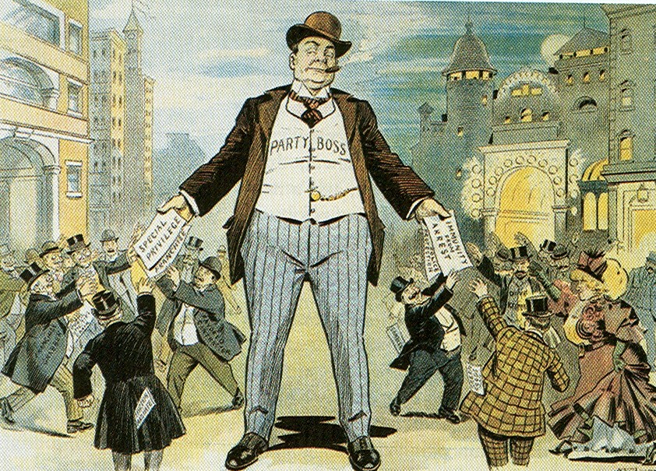
Political Paralysis of the Gilded Age
Democracy in crisis

Slide 2
Essential Question
Discern how industrialization change Americans’ lives during the Gilded Age
Evaluate how and why did Americans struggle over the power and purpose of government
Assess whether this era should be considered the Gilded Age

Slide 3
Today’s Focus
Period 6: 1865 – 1898 - The transformation of the United States from an agricultural to an increasingly industrialized and urbanized society brought about significant economic, political, diplomatic, social, environmental, and cultural changes.
Essential Question: How did rapid mechanization in industrial and agriculture American society transform the United States and bring it into the modern age?
Students can:
Discern how industrialization change Americans’ lives during the Gilded Age
Evaluate how and why did Americans struggle over the power and purpose of government
Agenda:
DBQ Guidelines
Evaluation of Reconstruction
Homework:
Read pages 380-392 (Chpt. 19) Amesco Book
Unit V Test – Wed. 1/15

Slide 4
Today’s Focus
Period 6: 1865 – 1898 - The transformation of the United States from an agricultural to an increasingly industrialized and urbanized society brought about significant economic, political, diplomatic, social, environmental, and cultural changes.
Essential Question: How did rapid mechanization in industrial and agriculture American society transform the United States and bring it into the modern age?
Students can:
Discern how industrialization change Americans’ lives during the Gilded Age
Evaluate how and why did Americans struggle over the power and purpose of government
Agenda:
Under the Thumb
Gilded Politics
Campaign of Plutarchy
Homework:
Research your candidate
Unit V Test, Wednesday 1/15

Slide 5
Under the Thumb
Use HIPP to analyze how American’s viewed politics during the Gilded Age (Focus on POV)
“Under the Thumb” The Boss. “Well, what are you going to do about it”, Thomas Nast

Slide 6
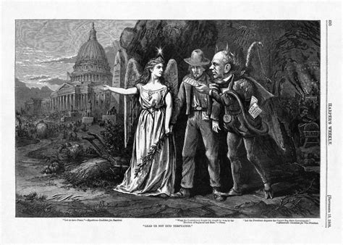
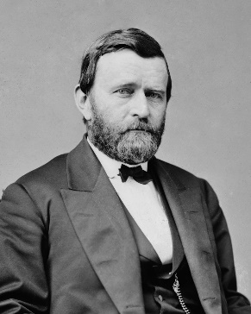
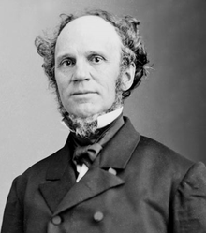
Election of 1868
Wave the Bloody Red Shirt Campaign
Ulysses Grant
Horatio Seymour
African American vote critical to the election victory of Grant
American supported Radical Reconstruction
Factors in Republican victories
Grand Army of the Republic (GAR)

Slide 7
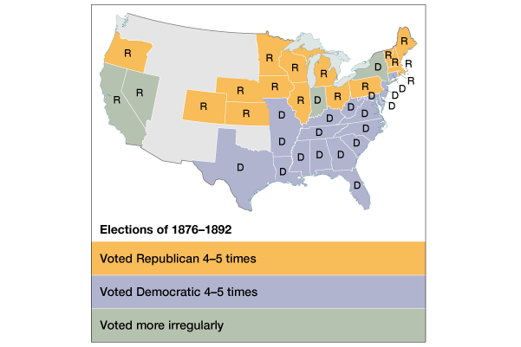
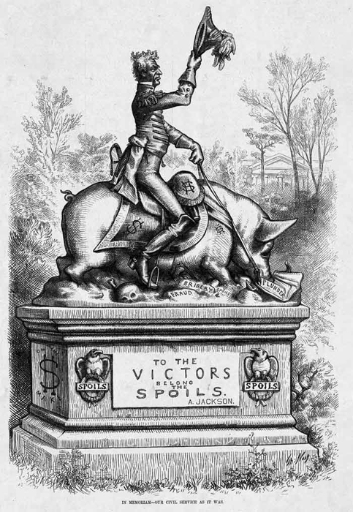
Contributor to Political Paralysis
Politics of the Gilded Age
Graft (Grantism) - corruption
Party Boss Rule
Spoil System
Weak “laissez faire” government
Tariffs
Currency Battles
Two party stalemate
Intense party loyalty
Growth of Inequality
BUILDS MOMENTUM FOR REFORM

Slide 8
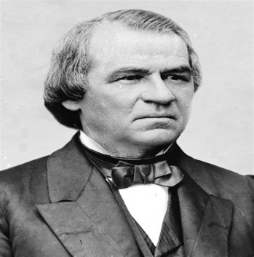
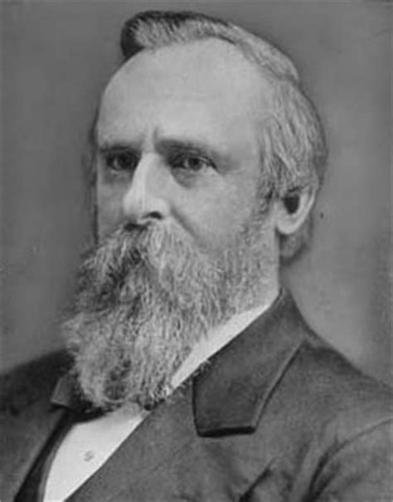
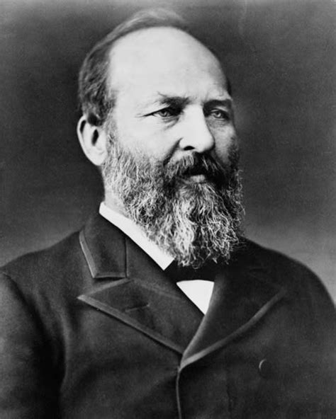
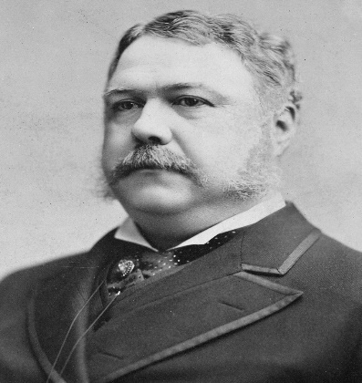
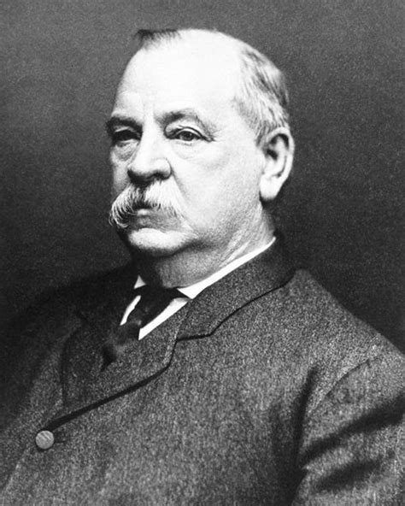
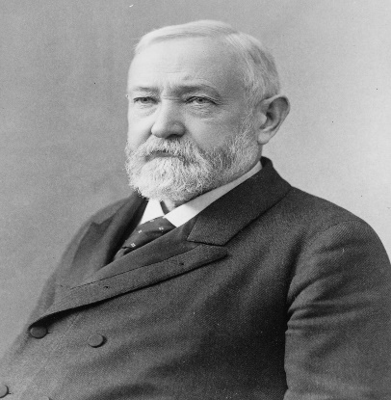
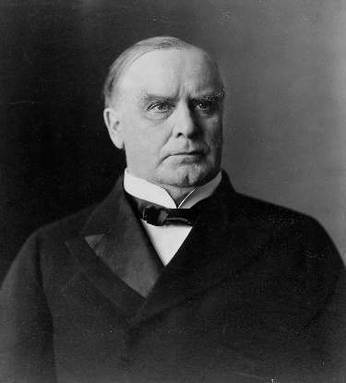
So Forgettable
Forgettable Presidents 1865-1898 (Republican Ascendency)
Assassinated
Andrew Johnson 1865-1869
Ulysses Grant
1869-1877
Rutherford Hayes 1877-1881
James Garfield
1881
Democrat
Assassinated
Chester Arthur
1881-1885
Grover Cleveland
1885-1889 & 1893-1897
Benjamin Harrison
1889-1893
William McKinley
1897- 1901

Slide 9
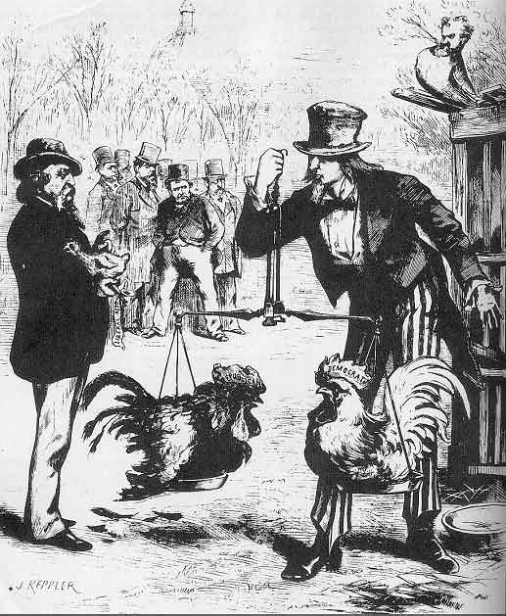
Who Runs America
Congress – flips back forth between Republican & Democrat control from 1870 1900
Republicans
Democrats

Slide 10
Intense Loyalty
Democratic Bloc
Republican Bloc
White southerners (preservation of white supremacy)
Catholics
Recent immigrants (esp. Jews)
Urban working poor (pro-labor)
Most farmers
Northern whites (pro-business)
African Americans
Northern Protestants
Old WASPs (support for anti-immigrant laws)
Most of the middle class

Slide 11
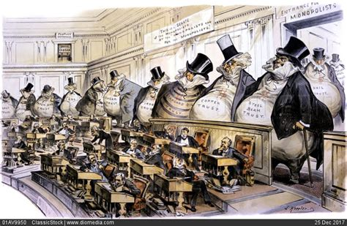
Very Laissez Faire Federal Govt.
From 1870-1900 → Govt. did very little domestically.
Main duties of the federal govt.:
Deliver the mail.
Maintain a national military.
Collect taxes & tariffs.
Conduct a foreign policy.
Exception → administer the annual Civil War veterans’ pension.

Slide 12
Planks of Plutocracy
“The external glitter of wealth conceals a corrupt political core that reflects the growing gap the very few rich and the very many poor”
- Mark Twain, America in the 1870s-1890s
Explain Mark Twain’s point of view of the Gilded Age from 1870-1890.
Be sure to include at least two facts in your explanation that support his POV

Slide 13
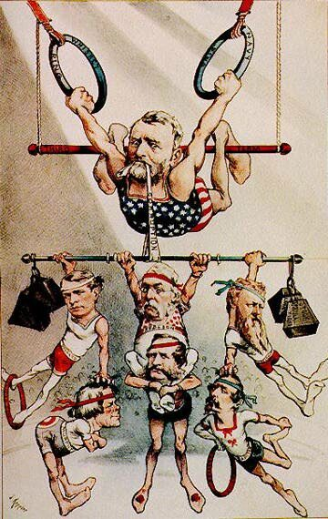
Political Paralysis
Waving the Bloody Shirt Campaign – Effectiveness of President Grant
President Grant was a forgettable president as a result of no political experience and rampant corruption during his administration. The Radical Republicans selected Grant because of hero status and sought the vote of the Grand Army of the Republic. They already had control of Reconstruction, as a result of the Military Reconstruction Act 1867 and thought Grant’s connections with the military would garner further support for their actions. But Grant proved ineffective in dealing with graft, which can be seen through the Credit Mobilier and Whiskey Ring scandals. Due to his lack of action in punishing political corruption, graft was renamed grantism.

Slide 14
Today’s Focus
Period 6: 1865 – 1898 - The transformation of the United States from an agricultural to an increasingly industrialized and urbanized society brought about significant economic, political, diplomatic, social, environmental, and cultural changes.
Essential Question: How did rapid mechanization in industrial and agriculture American society transform the United States and bring it into the modern age?
Students can:
Discern how industrialization change Americans’ lives during the Gilded Age
Evaluate how and why did Americans struggle over the power and purpose of government
Assess whether this era should be considered the Gilded Age
Agenda:
Reform in the Gilded Age
The Crisis of the Gilded Age
Forgettable Democracy in the Gilded Age
Homework:
Study for Unit V Test – Manifest Destiny, Sectional Crisis, Civil War, & Reconstruction

Slide 15
Reform
“competitive examinations for testing the fitness of applicants for the public service now classified or to be classified here- under. . . that no person in the public service is for that reason under any obligations to contribute to any political fund, or to render any political service, and that he will not be removed or otherwise prejudiced for refusing to do so. . . that no person in said service has any right to use his official authority or influence to coerce the political action of any person or body.”
- Pendleton Act of 1883
Prompt: To what extent was the power of the federal government diminished during the Gilded Age?
Complete a HIPP analysis of document in contexts of the prompt above

Slide 16
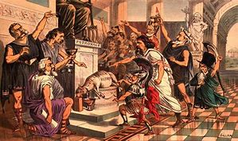
HIPP Analysis - Purpose
President Chester Arthur sought the passage of the Pendleton Act to establish the Civil Service Commission to end the political practice of patronage during the Gilded Age. The hope was to end political corruptions, such as the Whiskey Ring, and make the institutions of government work for the people. However at first the Pendleton Act did not apply to many federal positions and nor did it deal with the issue of political machines, such as Tammany Hall in New York.

Slide 17
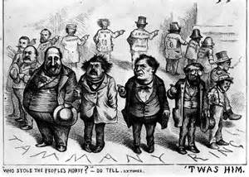
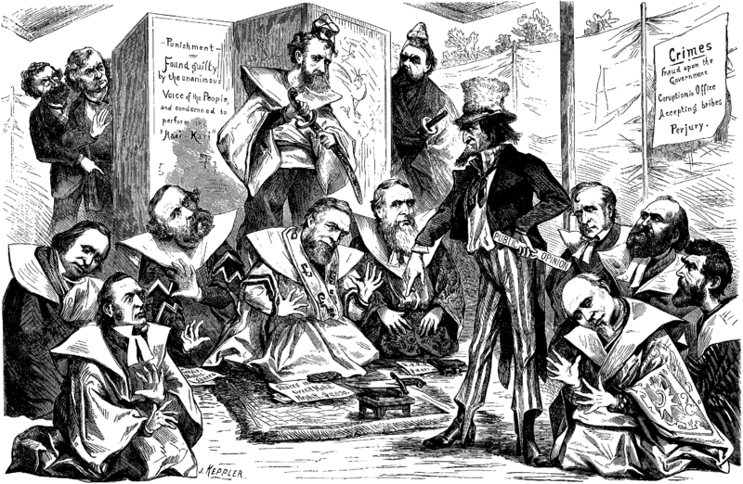
Political Conflicts
Democracy is a government of the people “The Common Man”, but from 1870s to 1890s government becomes a Plutocracy government of the wealth
Politics of the Gilded
Congress flips between Republican and Democrat control several times between 1870 -1900
Forgettable Presidents
Political Corruption (THE ERA OF GOOD STEALINGS)
(Graft – Grantism): Credit Mobilier & Whiskey Ring
Political Machines: Tammany Hall & Boss Tweed (Ward Boss)
Credit Mobilier Scandal

Slide 18
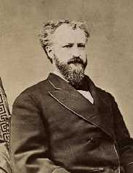
Symbolic Presidency
Party Boss Rule
President should avoid offending factions within the party
Spoil System – dole out gov’t jobs
Growth of Patronage
1865 → 53,000 people worked for the federal govt.
1890 → 166,000 “ “ “ “ “ “
Senator Roscoe Conklin
Leader of the Stalwarts

Slide 19
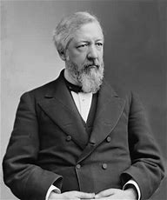
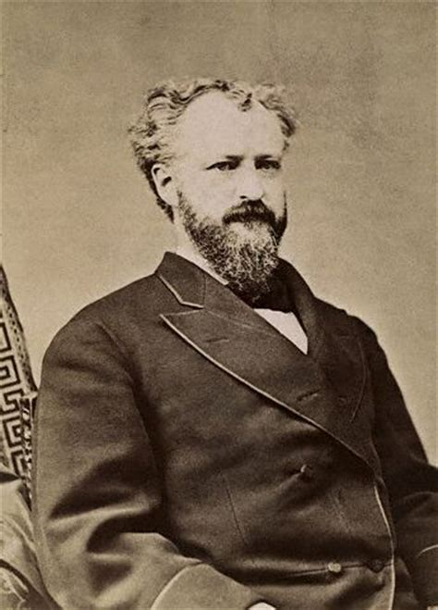
The Politics of Gilded Age
Republican Party divided over control of patronage
VS.
James Blaine – Party Boss
Half-Breed
Roscoe Conkling – Party Boss
Stalwart

Slide 20
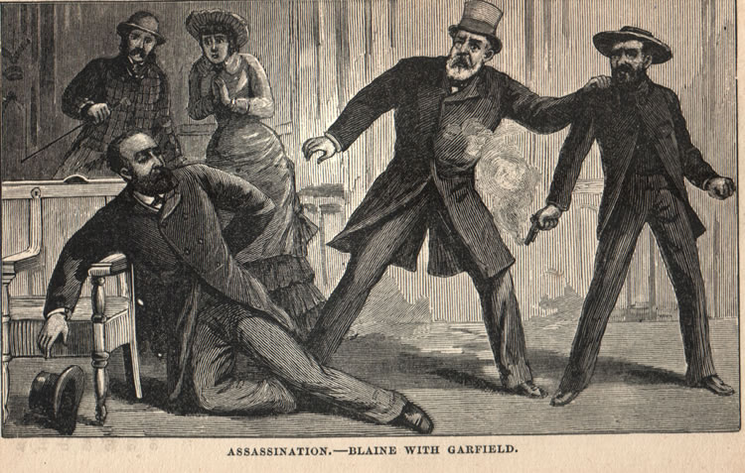
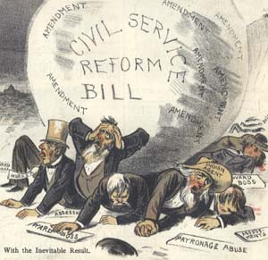
Death of the Spoil System
James Garfield assassinated by Charles Guiteau – (Spoil System)
President Chester Arthur (Stalwart) – Pendleton Act 1883 (Reform)
Established Civil Service Commission
Govt. jobs based on merit
Only effects 14,000 out of 117,000 jobs (1883)
100,000 out of 200,000 by (1900)

Slide 21
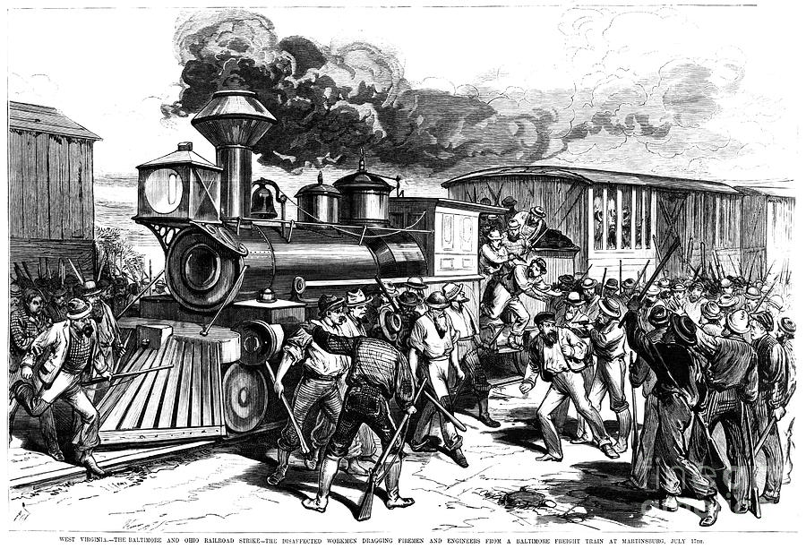
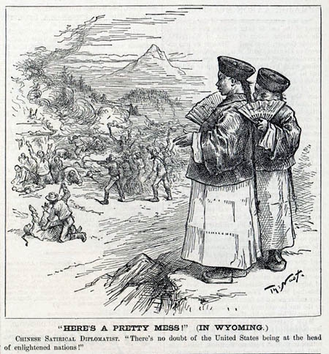
Social conflict
Class Conflict
Great Railroad Strike of 1877: growing collusion between Corporate owners and labor (Presidents sides with entrepreneurs)
Ethic Conflict
Chinese v. Irish (job competition)
Denis Kearney
Chinese Exclusionary Act 1882:
1st act to limit immigration to the
United States

Slide 22
Class Conflict
Great Railroad Strike of 1877
4 Railroad companies cut workers’ wages by 10%
Strike put down by federal troops (President Hayes)
Labor movement ineffective

Slide 23
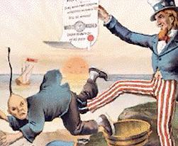
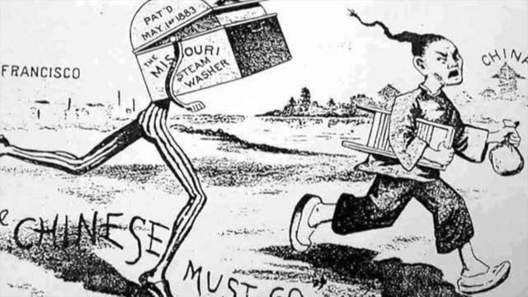
Class Conflict
Railroad Boom – new immigrant: Chinese
Issue: wage suppression & job competition for Irish
San Francisco: Irish (Beefeaters) vs. Chinese (Rice eaters)
1882 Chinese Exclusion Act: 1st Anti-immigration Law

Slide 24
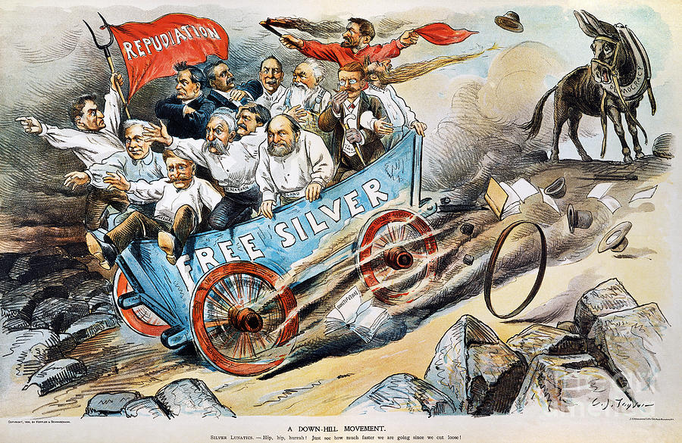
Economic Conflicts
Economic division over tariffs, currency, and laissez faire economics
Tariffs: McKinley Tariff 1890, Wilson-Gorman Tariff, and Dingley Tariffs (industrialism vs. farming)
Currency: paper currency (Greenbacks) and Gold v. Silver (wealth inequality and farmers vs. industrialism)
Laissez faire: should government regulate monopolies, working conditions, & set minimums for wages

Slide 25
Forgettable Politics
Candidate:
Planks: describe the either the failures or how they supported wrongs, such political corruption, inequality, currency issues, tariffs, etc.
Document: Primary source document that represents how your candidate let down American during the Gilded Age – political cartoons are a good source
Slogan – should represent the idea American prosperity and democracy is tainted

Slide 26
Historic Parallels
Making historic connections across time periods and locations
Must be written as a direct comparisons in paragraphs
Requires three direct comparisons
Ex. Age of Reform idea of combating immorality in America from 1820 to 1840 was similar to Progressive reforms of the late 1800s.
Gilded Age Politics | Modern Politics

Slide 27
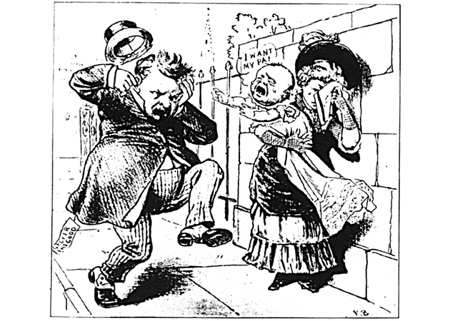
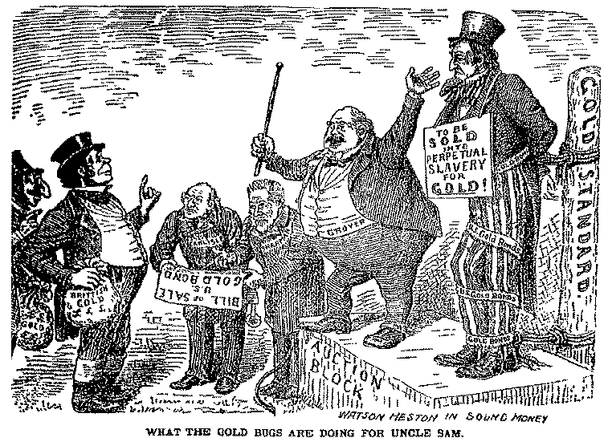
Politics in the Gilded Age
Tournament of Democratic Champions
Demonstrate one way your candidate championed democracy in the Gilded Age.
Demonstrate one way your candidate reflected the darkness of the Gilded Age.

Slide 28
Today’s Focus
Period 6: 1865 – 1898 - The transformation of the United States from an agricultural to an increasingly industrialized and urbanized society brought about significant economic, political, diplomatic, social, environmental, and cultural changes.
Essential Question: How did rapid mechanization in industrial and agriculture American society transform the United States and bring it into the modern age?
Students can:
Discern how industrialization change Americans’ lives during the Gilded Age
Evaluate how and why did Americans struggle over the power and purpose of government
Assess whether this era should be considered the Gilded Age
Agenda:
Drawing Parallels
Yellow Brick Road Littered with Farmers
Candidate for political paralysis
Homework:
- Candidate for political paralysis due Friday

Slide 29
Drawing Parallels
Second.—Wealth belongs to him who creates it, and every dollar taken from industry without an equivalent is robbery.
Third.—We believe that the time has come when the railroad corporations will either own the people or the people must own the railroads, and should the government enter upon the work of owning and managing all railroads
We demand free and unlimited coinage of silver and gold at the present legal ratio of l6 to 1.
LAND.—The land, including all the natural sources of wealth, is the heritage of the people, and should not be monopolized for speculative purposes, and alien ownership of land should be prohibited.
National Greenback Labor 1875
Omaha Platform, the People’s Party, 1892

Slide 30
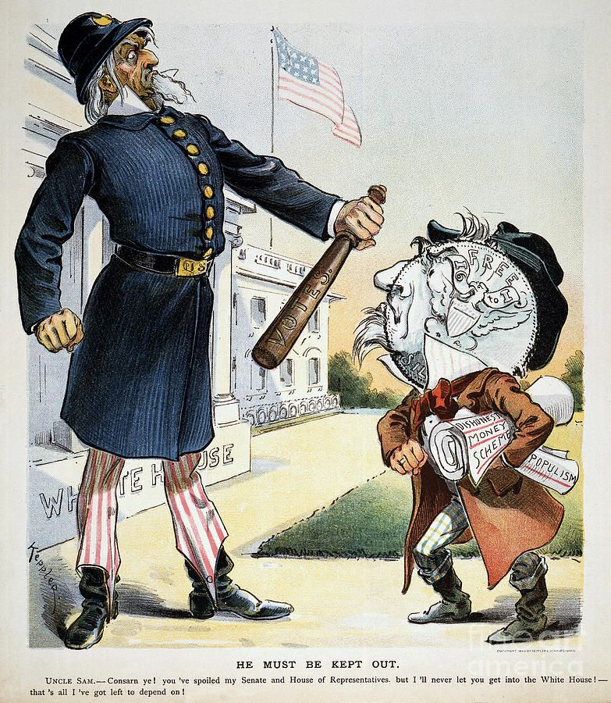
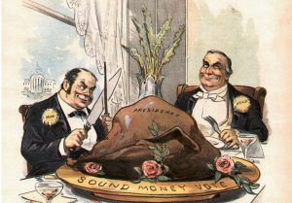
The Goldbrick Road littered with FARMERS
“It’s always best to start at the beginning. And you do is follow the Yellow Brick Road”
- The Wonderful Wizard of OZ, L. Frank Baum

Slide 31
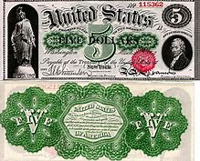
Farmer’s Dirty $$$
Civil War 1861-1865 – federal government floods the market with GREENBACKS (paper currency)
Supply is $ Value is $ = INFLATION
Good for farmers = easy to borrow $ & pay it back

Slide 32
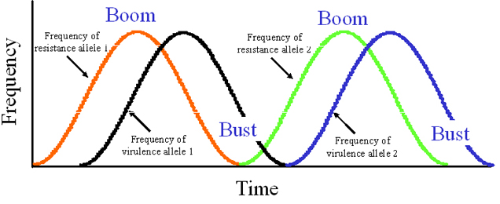
Panic of 1873
Causes: over speculation by railroads and factories
Cycle of Boom & Busts – a cycle of panics every 20 caused by over speculation and ease of credit by banks (laissez faire – No one is regulating lending) (Panics 1819, 1837, 1857, 1873, & 1893)

Slide 33
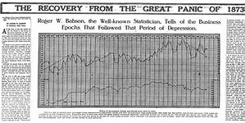
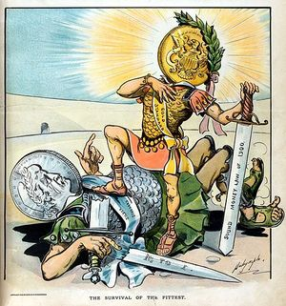
A Death of a Greenback
Panic of 1873
Over speculation on land for RRs
Easy of credit by BANKS
HARD CURRECY (GOLD)
Bankers and industrialists want – stabilize currency
Bland Allison Act (Crime of 73) – limits circulation of silver coinage
Resumption Act of 1879: redeem paper money

Slide 34
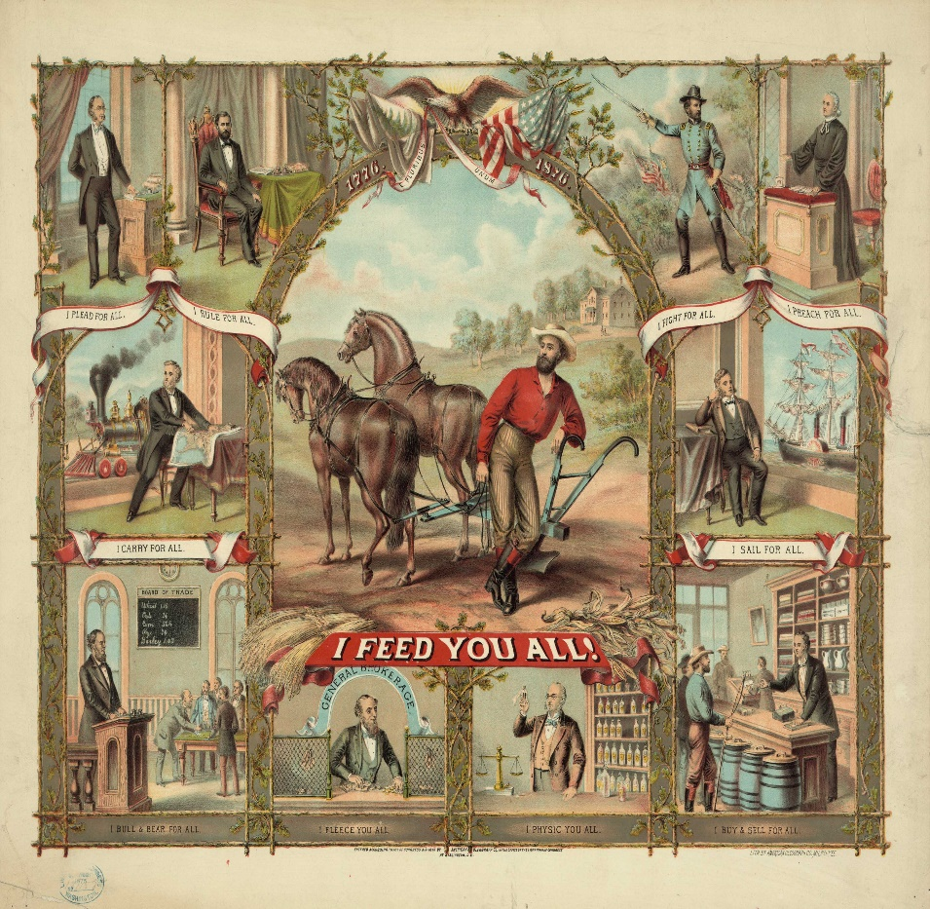
Not Friends of Farmers.com
Less money in circulation = No loans for farmers
Crops sell for less
Mortgages increase in cost
Farmers organize:
Patrons of Husbandry 1867
The Grange 1874
Farmer’s Alliance 1877
The Populist Party 1890

Slide 35
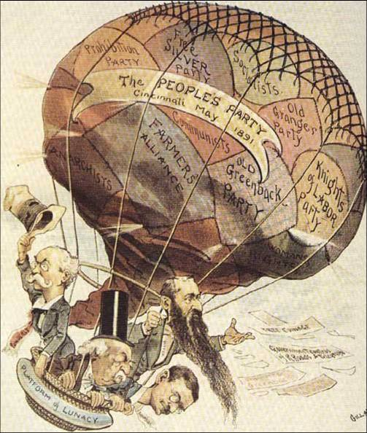
Plight of the FARMER
Platform
Graduated income tax
Government regulation of railroads, telegraph, and grain elevators
Soft money policies (SILVER)
Political reform – initiative & referendum
Populist Party 1892 – Farmers and REFORM
Failed to get southern votes (reached out to black farmers)
- Literacy test & poll taxes

Slide 36
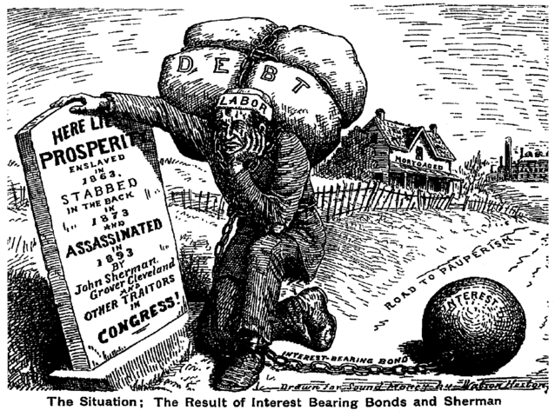
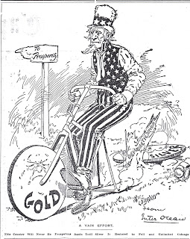
Jam to some Bimetallism
Sherman Silver Purchase Act 1890: allowed for a limited amount of coinage of silver and gold
Not enough to assist farmers
Panic of 1893:
Repeal of the Sherman Silver Purchase Act
U.S. Treasury running out of good

Slide 37
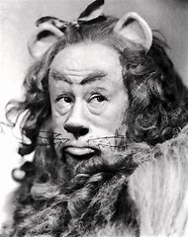
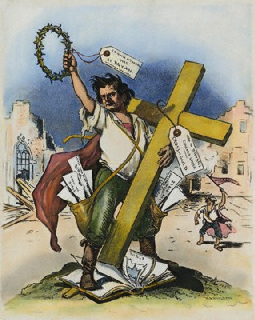
Cross of Gold
Panic of 1893
Debate over silver William Jennings Bryan “Cross of Gold Speech” – speaks for the common man
William Jennings Bryan
“You shall not press down upon the brow of labor this crow of thrones; you shall not crucify mankind upon this cross of gold”
- William Jennings Bryan, 1895
Democrat & Populist Nominee in 1896 for President

Slide 38
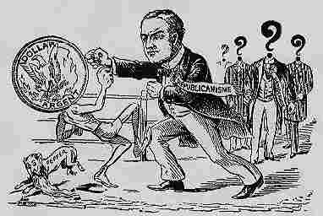
Follow the Yellow Brick Road
Election of 1896: William McKinley (R) defeats William Jennings Bryan (D)
Gold Standard Act 1900: Gold the national currency of America
Republican Party – Champions of Industry

Slide 39
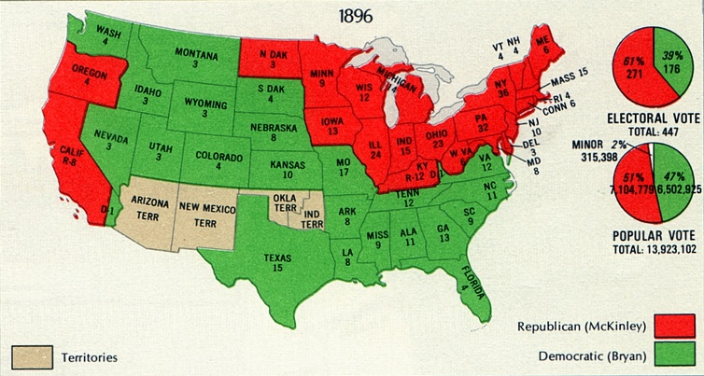
Gold Standard Act 1900
Election of 1896 – (R) McKinley v. (D/Populist) Bryan
Debate – Gold bugs: supported the Gold standard for economic stability vs. Silverites: Money redeemable in Gold or Silver to increase money in circulation
Farmer debts and contractionary policies of the US government caused currency to be a major issue
Mckinley’s victory meant gold is the victor
Gold Standard’s Act 1900 – Allows paper to be trade for gold
Klondike Gold Rush (Alaska)

Slide 40
Today’s Focus
Period 6: 1865 – 1898 - The transformation of the United States from an agricultural to an increasingly industrialized and urbanized society brought about significant economic, political, diplomatic, social, environmental, and cultural changes.
Essential Question: How did rapid mechanization in industrial and agriculture American society transform the United States and bring it into the modern age?
Students can:
Gage how the influx of immigration in search of economic opportunity transform America culturally, economically, and politically
Appraise cultural responses to the rise of the Gilded Age in the United States
Agenda:
Gilded Age Misnomer?????
Inequality of social status
The Power of Political Paralysis
Homework:
- Read Chapter 16 The Rise of Industrial America p. 319-332

Slide 41
Prompt: To what extent was Mark Twain’s description of the United States during the latter half of the 18th Century as the Gilded Age an accurate description of American politics?
Political Paralysis
Progressive Government Reform

Slide 42
Gilded Age Politics or Progressive Thinking
Gilded Age Politics
Progressive Government
The Era of Good Stealings
Political Machines
Grantism (Graft)
Stalwarts
Forgettable Presidents
Jim Crow
Chinese Exclusion Act
Laissez Faire (Robber Barons of Industry)
Liberal Republican Party
Greenback Labor Party
Pendleton Act
Civil Service Commission
Farmers Alliance
Populist Party
Booker T. Washington
Thomas Nast

Slide 43
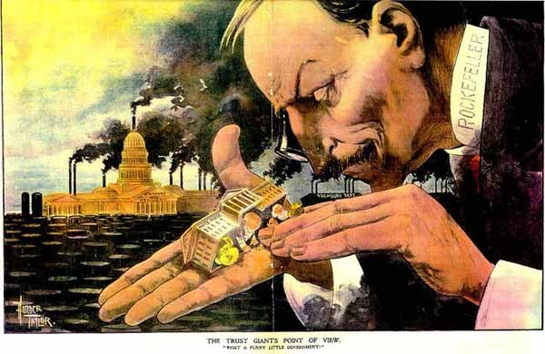
Era of Good Stealing
Era of Good Stealing – common theme from 1865-1900
Graft (Grantism)
Stock price meddling
Railroads (rebates & pooling)
Robber Barons (industrialist)

Slide 44
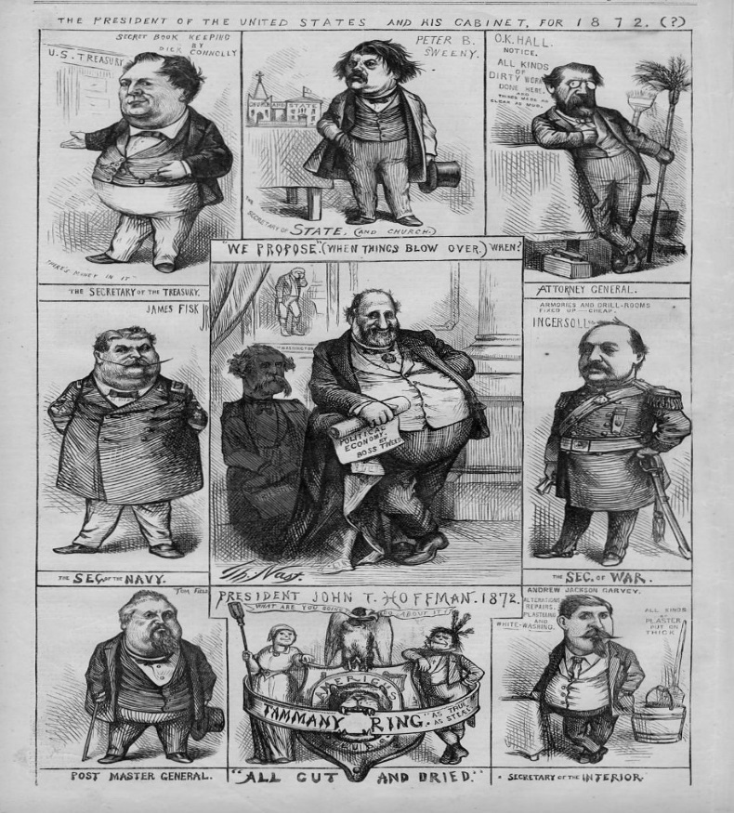
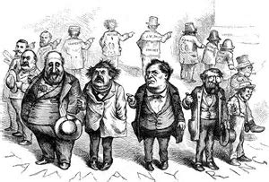
Tammany Tiger
Local political corruption – Boss Tweed & Tammany Hall
Used patronage, graft, exploitation of Irish immigrants, and fraudulent elections to steal over $2,000,000 from NYC in late 19th century
Political Reform: Thomas Nast, political cartoon

Slide 45
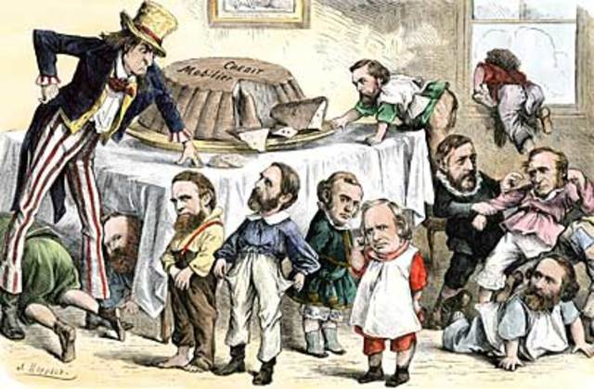
Carnival of Corruption
Grant Administration weakened by political corruption (Grantism)
Credit Mobilier Scandal – Transcontinental railroad graft
Whiskey Ring – graft: Folks steals whiskey tax money
Sec. of War, William Belknap – graft: selling trinkets to Native Americans

Slide 46
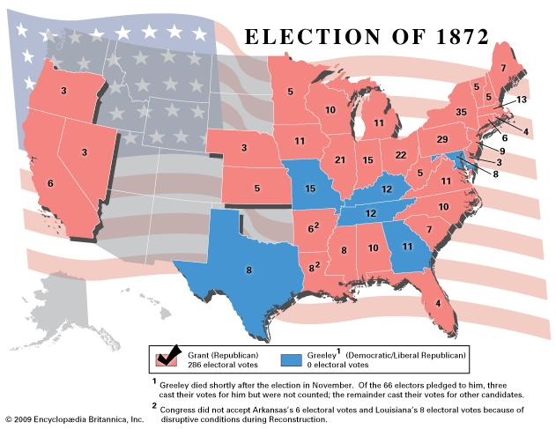
Liberal Republican Reform
Election of 1872: Grant vs. Horace Greeley (Liberal Republicans)
Liberal Republicans Reform Platform
Impact
Amnesty Act of 1872
(Redeemers)
Reduce tariff
End Reconstruction
Civil Service Reform

Slide 47
The 14th Says WHAT
Interpreting the 14th Amendment:
Slaughter House Cases 1873: upholds a monopoly on slaughterhouse cases stating the 13th & 14th Amendment only applies freedmen rights
U.S. v. Cruikshank 1873: 14th Amendments is meant to restrict federal actions & doesn’t apply to the states
Citizens’ rights under control of the state governments

Slide 48
Pallid Politics = Inequality
Election of 1876: R.B. Hayes vs. Samuel Tilden (Electoral Tie)
Compromise of 1877: End of Reconstruction & Redeemers (Solid South – Democrats)

Slide 49
Jim Crow & Segregation

Slide 50
Jim Crow & Segregation
Jim Crow Plessy v. Ferguson (1896)
Poll Tax effects
“literacy” test - lynching (Ida B. Wells) - reformer
grandfather laws
Growth of Sharecropping

Slide 51
Today’s Focus
Period 6: 1865 – 1898 - The transformation of the United States from an agricultural to an increasingly industrialized and urbanized society brought about significant economic, political, diplomatic, social, environmental, and cultural changes.
Essential Question: How did rapid mechanization in industrial and agriculture American society transform the United States and bring it into the modern age?
Students can:
Discern how industrialization change Americans’ lives during the Gilded Age
Evaluate how and why did Americans struggle over the power and purpose of government
Agenda:
The Gilded Age Concept
Democracy in Crisis
Debating the concept of Laissez Faire
Homework:
Debating Laissez Faire
CRE 1/24/18 (Unit IV and Unit V)

Slide 52
The Gilded Age
Mark Twain satirized the time period of 1866 to 1898 as an era covered in a thin layer of gold, but barely scratch the surface and you would fine darkness
“No country can be well governed unless its citizens as a body keep religiously before their minds that they are the guardians of the law, and that the law officers are only the machinery for its execution, nothing more.” – Mark Twain, The Gilded Age, A Tale of Today, 1873
Mark Twain called the period from 1865 to 1900 the Gilded Age, but is an accurate reflection of this era?
5 ways it is
5 ways it is not

Slide 53
A Reflection on the Gilded Age
Build a defense – develop a one paragraph defense of your assign bases
Topic sentences
Gilded Age led to greater inequality in America
Democracy in crisis is a misnomer (false point of view) during the Gilded Age
Gilded Age demonstrated an overall lack of executive leadership in America
The Era of Good Stealing was an accurate reflection of America during the Gilded Age
Industrialist controlled American politics during the Gilded Age
Economic crisis re-enforced political divisions during the Gilded Age

Slide 54
Mudslinging in 1884
James Blaine (R) vs. Grover Cleveland
Mugwumps abandon Blaine
Cleveland wins despite having a child out of wedlock scandal

Slide 55
Old Grover
Issues (Can’t unite the party)
Civil Service Reform
GAR military pension (vetoed)
Tariff (Budget surplus): Democrats want to lower it vs. Republicans (industrialists) against it
Cleveland loses 1888 to Benjamin Harrison (tariff battle)

Slide 56
Billion Dollar Congress
Republican Congress passes BILLION DOLLAR BUDGET 1888
Military Pensions raised
Sherman Silver Purchase Act 1890
McKinley Tariff 1890 (raise 48%) – (protect industry)

Slide 57
Plight of the FARMER
Platform
Graduated income tax
Government regulation of railroads, telegraph, and grain elevators
Soft money policies (SILVER)
Political reform – initiative & referendum
Populist Party 1892 – Farmers and REFORM
Failed to get southern votes (reached out to black farmers)
- Literacy test & poll taxes

Slide 58
Cross of Gold
Panic of 1893
Debate over silver William Jennings Bryan “Cross of Gold Speech” – speaks for the common man
Sherman Silver Purchase Act repealed
“You shall not press down upon the brow of labor this crow of thrones; you shall not crucify mankind upon this cross of gold”
- William Jennings Bryan, 1893

Slide 59
Cleveland kills the Dems
Down with Cleveland
Blamed for Panic of 1893
Defends the Gold Standard
Use military to end the Pullman Strike
Refuses to annex Hawaii
Wilson Gorman Tariff 1894
Barely changed McKinley Tariff
2% income tax (Pollock vs. Farm Loan & Trust – declared unconstitutional)

Slide 60
Today’s Focus
Period 6: 1865 – 1898 - The transformation of the United States from an agricultural to an increasingly industrialized and urbanized society brought about significant economic, political, diplomatic, social, environmental, and cultural changes.
Essential Question: How did rapid mechanization in industrial and agriculture American society transform the United States and bring it into the modern age?
Students can:
Discern how industrialization change Americans’ lives during the Gilded Age
Evaluate how and why did Americans struggle over the power and purpose of government
Agenda:
There is strength in counting
Democracy in Crisis
Defense initiative
Homework:
Study for CRE
CRE 1/24/18 (Unit IV and Unit V)

Slide 61
Politics of the Gilded Age
Complete a HIPP analysis of the political cartoon
Prior knowledge
Historic contextualization
Intended Audience
Purpose
POV
Boss Tweed “As long as I count the votes, what are you going to do about it? Say?”

Slide 62
Reforming Politics
Liberal Republican Party 1872 (Horace Greeley) – ran against political corruption
Greenback Labor Party 1878 – fought for cheap currency (Panic of 1873)
Pendleton Act & Civil Service Commission – hire government employees based on merit (James Garfield assassination 1881)
Mugwumps (Reformer Republicans 1884)

Slide 63
“No country can be well governed unless its citizens as a body keep religiously before their minds that they are the guardians of the law, and that the law officers are only the machinery for its execution, nothing more.” – Mark Twain, The Gilded Age, A Tale of Today, 1873
__ 1. Why have many historians labeled the period following the Civil War until the turn of the century the Gilded Age?
Most Americans saw a rise in the standard of living and greater prosperity
The idea of equality becomes an achievable goal during this time period
While the U.S. saw great prosperity many American’s lived in poverty and were taken advantage of by industrialization
Labor unions were able to achieve improved working conditions, such as the eight hour work day
America had survived a major internal conflict and look forward to the rebirth of Democracy

Slide 64
“No country can be well governed unless its citizens as a body keep religiously before their minds that they are the guardians of the law, and that the law officers are only the machinery for its execution, nothing more.” – Mark Twain, The Gilded Age, A Tale of Today, 1873
__ 2. Which of the following demonstrates politics of the Gilded Age at the national level of government?
The Republican Party dominated both Congress and the presidency
Democrats supported many reforms to make the national government more democratic
Government was devoid of corruption and scandal from 1867 to 1897
Democrats control both houses of Congress during this time period
There was major gridlock between both parties in governing the United States

Slide 65
Point of View
“My Dear Nephew,
“Never allow yourself to lose sight of that fact that politics, and not poker, is our great American game. If this could be beaten into the heads of some presumably well meaning but glaring unpractical people, we would hear less idiotic talk about reform in connection with politics. Nobody ever dreams of organizing a reform movement in poker . . .
“Mr. Lincoln, a very estimable and justly popular, but in some respects an impracticable man, formulated widely different error regard to politics. He held that ours is a government of the people, by the people, for the people. I maintain, on the contrary, that it is government of politicians, by politicians, for politicians. If your political career is to be a success, you must understand and respect this distinction and difference.”
- William McElroy, journalist, “An Old War Horse to a Young Politician,” published anonymously in the Atlantic Monthly, 1880

Slide 66
1800 Connections
1. John L. O’Sullivan, Louisiana Purchase, and Treaty of Guadalupe Hidalgo
2. Liberator, Denmark Vesey Rebellion, and Uncle Tom’s Cabin
3. Compromise of 1850, Virginia and Kentucky Resolves, and Pet Banks
4. Annexation of Texas, Adam-Onis Treaty, and Macon’s Bill #2
5. Gag rule, Indian Removal Act, and Kansas Nebraska Acts
6. Bank veto, Nullification Crisis, and Redeemers
7. Brigham Young, German immigration, and King Cotton
8. Sam Slater, American System, and Tariff of Abomination

Slide 67
Today’s Focus
Period 6: 1865 – 1898 - The transformation of the United States from an agricultural to an increasingly industrialized and urbanized society brought about significant economic, political, diplomatic, social, environmental, and cultural changes.
Essential Question: How did rapid mechanization in industrial and agriculture American society transform the United States and bring it into the modern age?
Students can:
Discern how industrialization change Americans’ lives during the Gilded Age
Evaluate how and why did Americans struggle over the power and purpose of government
Assess whether this era should be considered the Gilded Age
Agenda:
Gilded politics
Overview of $$$$ in the Gilded Age
Economic Battle
Homework:
Reading 1 (pages 530-538) and related terms (APUSH Link)
Industrialization Journal due Tuesday 1/31
Quiz on Chapter 23 & 24 Wed, Feb. 1

Slide 68
The Ballot
That’s What’s the Matter
Boss Tweed, “As long as I count the Votes, what are you going to do about it?”
Use the image to answer A, B, and C
Explain ONE way Thomas Nast’s political cartoon demonstrates the period from 1870-1900.
Explain how Nast’s political cartoon demonstrates past experiences for ONE of the following groups.
Women
African Americans
Native Americans
C. Explain ONE way that Nast’s view of the period from 1870-1900 is a misnomer.

Slide 69
Today’s Focus
Period 6: 1865 – 1898 - The transformation of the United States from an agricultural to an increasingly industrialized and urbanized society brought about significant economic, political, diplomatic, social, environmental, and cultural changes.
Key Concept 6.1: Technological advances, large scale production methods, and the opening of new markets encouraged the rise of industrial capitalism in the United States
Key Concept 6.2: The migration that accompanied industrialization transformed both urban and rural areas of the United States and caused dramatic social and cultural change
Key Concept 6.3: The Gilded Age produced new cultural and intellectual movements, public reform effort, and political debates over economic and social policies
Essential Question: How did rapid mechanization in industrial and agriculture American society transform the United States and bring it into the modern age?
Students can:
Gage how the influx of immigration in search of economic opportunity transform America culturally, economically, and politically
Appraise cultural responses to the rise of the Gilded Age in the United States
Agenda:
Champions of Democracy Tourney
Homework: Read pages 558-572 add comparison of immigrants to graphic organizer

