Slide 1
EPF
Unit 7
Wealth Building

Slide 2
Part I
Building Wealth

Slide 3
Why should you invest?
Investing is a way to have your money make money and build wealth
That wealth can be used to satisfy wants and plan for retirement

Slide 4
Why should you invest?
Beating inflation- investing helps counteract inflation
Passive income- your money generates returns

Slide 5
Risk v Reward Ratio
The risk/reward ratio is used by traders and investors to manage their capital and risk of loss.
The ratio helps assess the expected return and risk of a given trade.
In general, the greater the risk, the greater the expected return demanded.
An appropriate risk reward ratio tends to be anything greater than 1:3.

Slide 6
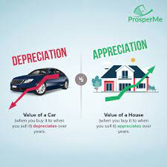
Appreciation v Depreciation
Appreciation is the eventual increase in value and/or usefulness of an asset over time
Ex: An older generation Ford mustang will yield high value due its rare nature
Depreciation is the loss of value or usefulness (utility) of an asset
Ex: With the emergence of streaming services, RedBox kiosks became depreciated in their desirability to consumers
Two key elements to appreciation and depreciation is time and the wants and needs of consumers

Slide 7
Diversification
Buying different types of investments to reduce the risk of marked decline
Ex- investing in stocks and bonds
Owning a variety of assets minimizes the chances of any one asset hurting your portfolio

Slide 8
Compound Interest
This type of interest can be either beneficial or problematic depending on what the principal is related to
Compounding interest is the continued growth of interest as it builds off of the original principal and interest amount
A snowball effect
Ex: Credit card debt constantly absorbing interest amounts and fees/penalties

Slide 9
Video: Understanding Compound Interest
https://www.youtube.com/watch?v=7kVQtQEUMoQ

Slide 10
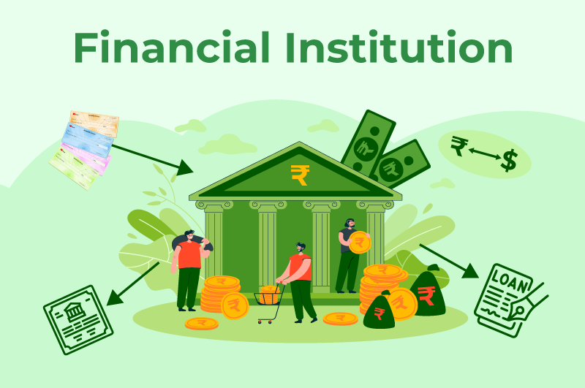
Financial Investing Institutions
These are locations that serve to guide and manage consumers in decisions revolving around short and long term growth goals as related to finances
Goals such as: education, vehicles, personal growth, retirement, or lifestyle
Such locations would be Savings & Loan (S&L) Banks, Credit Unions, Stock Brokerages, Certified Personal Accountants (CPA), Insurance Companies, real-estate agencies, and/or lending companies

Slide 11
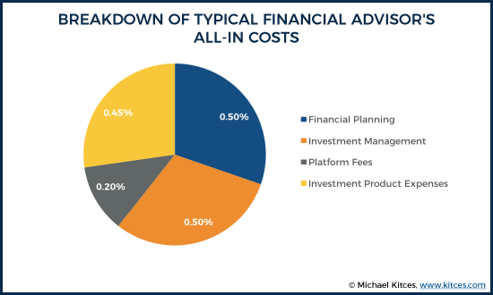
Money Management Fees
Financial planning requires consistent diligence, feedback, and personal support
As an on-going service, the management of one’s financial accounts will require customers to continually pay for the maintenance and progression their advisor(s) give

Slide 12
Part II
Investment Strategies

Slide 13
401K
Retirement savings plans where monetary amounts are pulled from your pre-taxed income month to month, year by year
Can often be matched to a certain amount/% by employer
Penalties galore if you withdraw early!

Slide 14
Bonds
Specific type of investment of funds into the government instead of an independent business
Bonds remain locked for a period of time until you can reclaim their appreciated value
Value will grow due to the bond value accruing interest
Remember: tied to the business cycle and monetary policy of the Fed
Some might say this type of investment is a knock out of the park.
Heh.

Slide 15
Stocks
Buying a stock serves as a form of unique investment strategy where money is paid to own a percentage of a publicly-traded business
The value of the stock rises and falls (Appreciates and depreciates) on a daily basis depending on market valuation
The more shares one owns, the stronger their voice is in the company itself
This is a risky method of investment as many factors dictate the value of a business

Slide 16
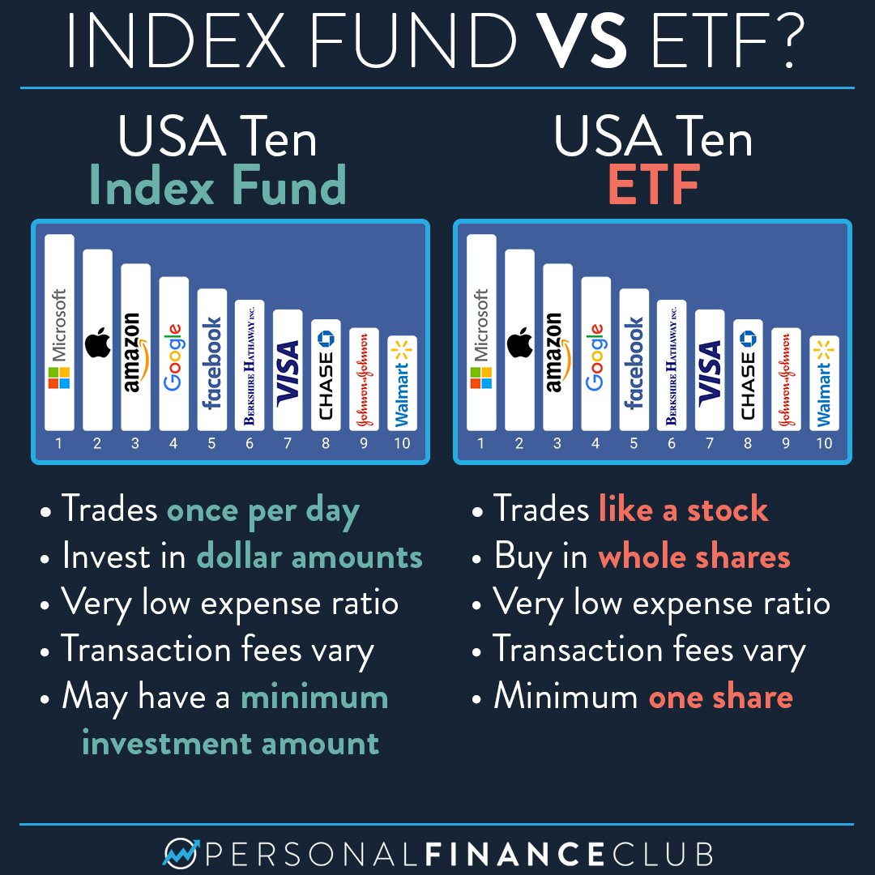
Index Funds
Index Funds are unique forms of stock purchases where money invested aligns with a list of companies related to a certain category or industry, not a singular business
Typically Index Funds bring great value because of the diversity in businesses existing in the account
Drawbacks to these however is that there isn’t much flexibility - you can’t change which funds are in the index specifically

Slide 17
Mutual Funds
Think stock trading with friends
Money from investors is pooled under the guidance of stock brokers who manage a massive account
The success is shared rather than individual
Can invest in equities, gold, bonds, etc.

Slide 18
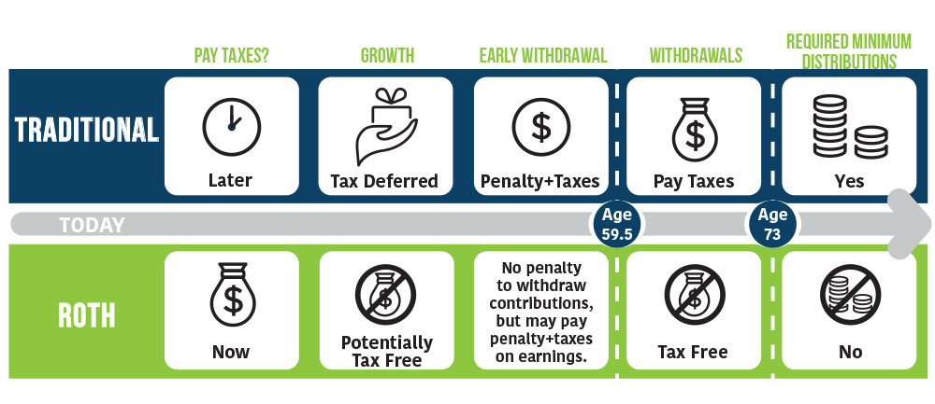
Roth v. Traditional IRA
Both of these accounts serve as retirement funds that draw a percentage of income
The strategy focuses on the question of when you want taxes to be taken out from the money
A Traditional IRA will not apply taxes until you start the actual withdrawal of funds
A Roth IRA will apply taxes as the money is deposited into the account and is “tax free” when withdrawn

Slide 19
Savings Accounts and Money Market Accounts
Simple purpose: to hold money, grow interest, and provide for future goals
Interest rates can/will dictate speed of growth depending on how much is in the account
Money Market Accounts can be drawn from similar to a checking account but with higher interest rate growth
Drawback to a Money Market is there are usually monthly limits on how much can be pulled for spending

Slide 20
Hedge Funds
Another group-based investment approach
Hedge funds are investors pooling capital ($) to a hedge manager who will make aggressive investment practices
Hedge funds, unlike Mutual Funds, deal in high amounts of money whereas mutual fund accounts cater to the average citizen
Greater risk, though with experience comes greater rewards…most of the time

Slide 22
Cryptocurrency
A new-ish approach to financing and investment
Utilizes the premise of a digital medium to serve as a store of value and wealth that can be recognized over a network of computers
In theory, it offers immunity from government or bank authority
The digital currency can be used to buy goods/services or trade for profit
HIGHLY volatile (appreciates and depreciates rapidly) over short and long term

Slide 23
Video
An Introduction to Cryptocurrency

Slide 24
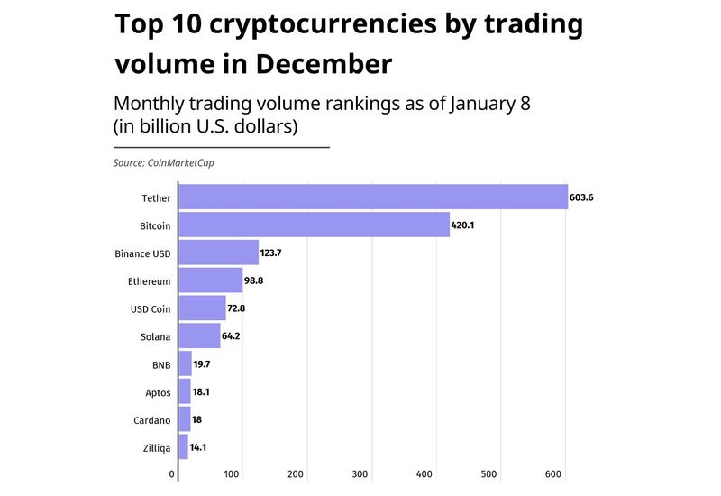

Slide 25
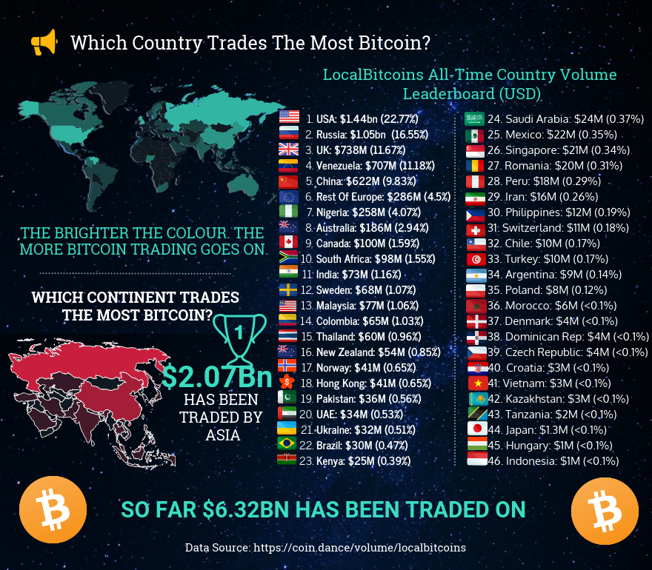

Slide 26
Alternative Forms of Investing
Art/Collectibles
NFTs (Non-Fungible Tokens) a digital marker of value that cannot be reproduced or sub-divided - basically a cryptocurrency in the form of a picture
Real Estate
Commodities; gold/silver, corn, coal, sugar

Slide 27
Part III
The Stock Market

Slide 28
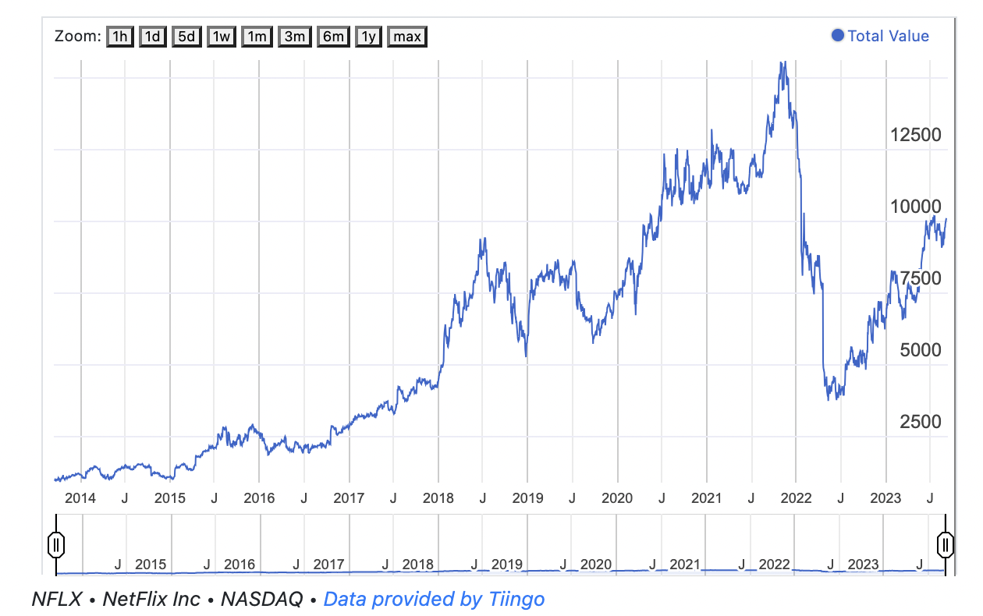
If you invested $1,000 in Netflix stock 10 years ago, what do you think it would be worth today?
Answer: $10,131

Slide 29
Video
Investing Basics: Stocks

Slide 30
What is the Stock Market?
Purchasing a portion/share of a company
This is a way for the corporation to raise money

Slide 32
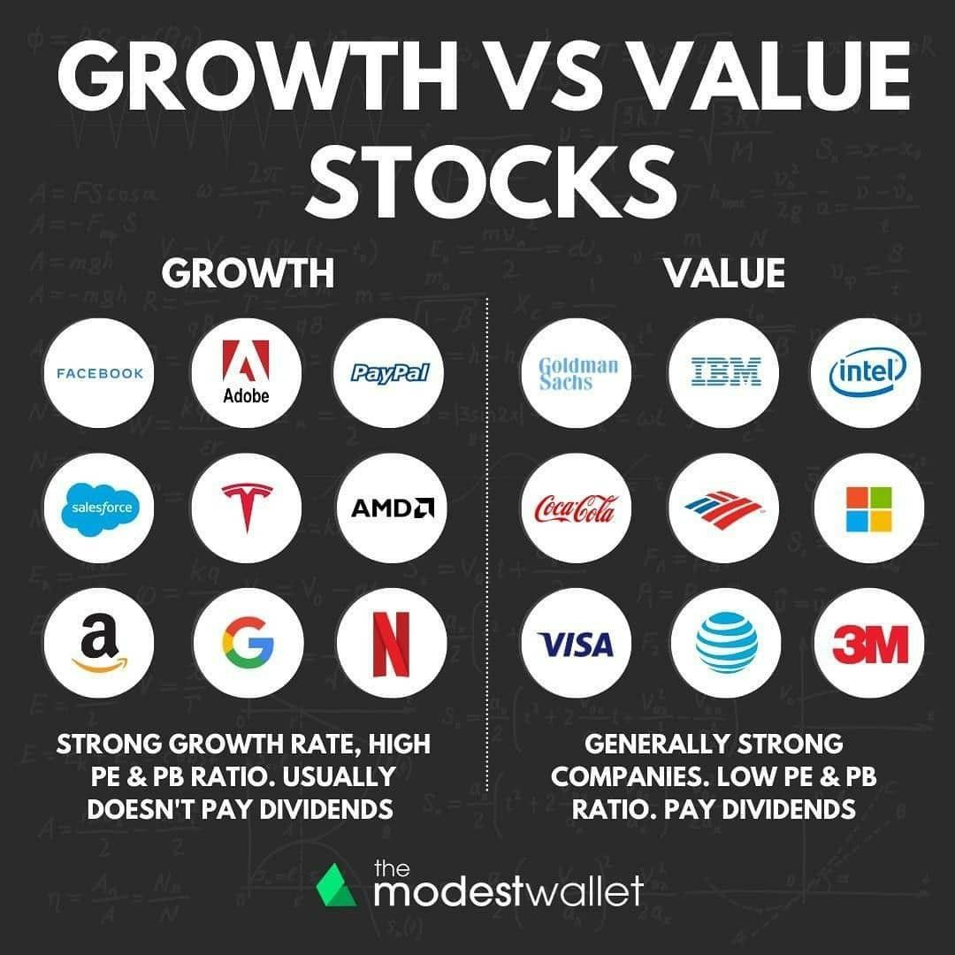
How do you earn money from the stock market?
By 1 of 2 ways
Income/Value stocks- which pay dividends
Dividends- when a corporation pays out every quarter
Growth stocks- all profit reinvested into the business
Capital Gain- when you sell stock for more than you paid for it
If you sell for less it its referred to as a capital loss

Slide 33
Ownership of a Company
Stockholders are part owners, some have a say in the company, but most don’t
Having a controlling share of a company means you control more than 50% of a company's stock

Slide 34
How are stocks traded?
Stockbroker- licensed seller of stocks
Brokerage firm- businesses that specialize in trading stock
Day trader- people who buy and sell stock quickly to turn a fast profit

Slide 35
What is a stock split?
A stock split is when a company increases the number of its outstanding shares to boost the stock's liquidity.
A company elects to perform a stock split to intentionally lower the price of a single share, making the company's stock more affordable without losing value.

Slide 37
Easy to Use Stock Apps
Robinhood
SoFi
J.P. Morgan
Acorns
E Trade

Slide 38
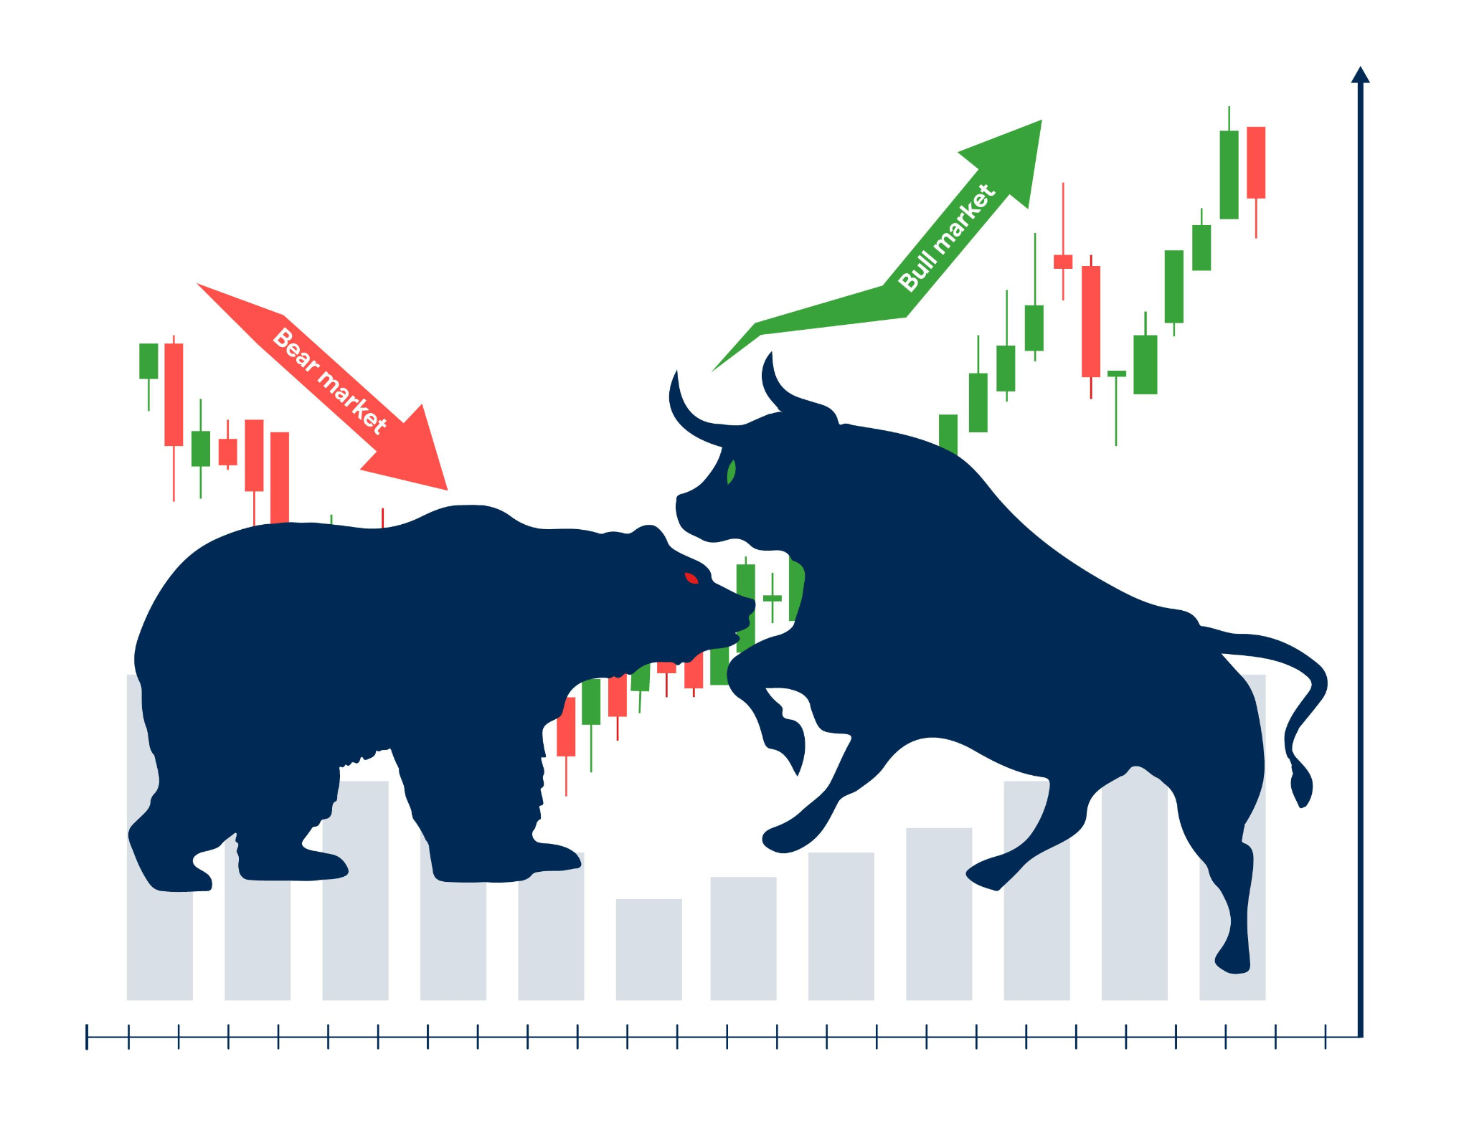
Bull v. Bear Market
Bull Market- steadily rising stock market
Bear Market- steadily failing stock market over time

Slide 39
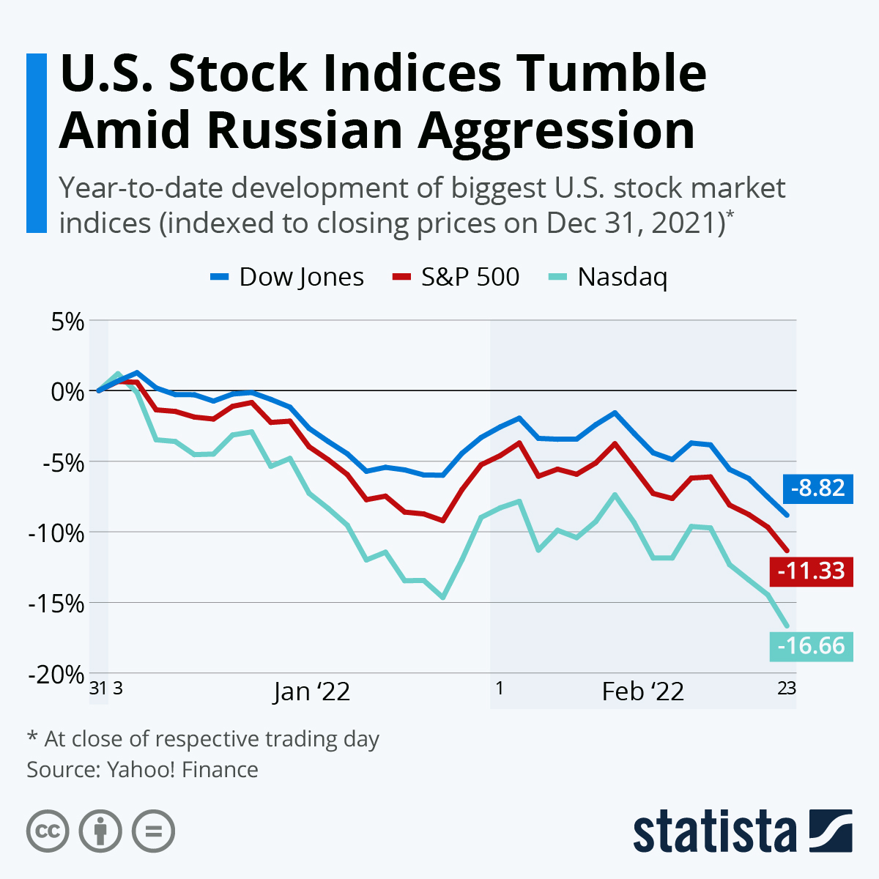
Stock Performance Indexes
Used to look at parts of the stock market to make a generalization about the market as a whole

Slide 40
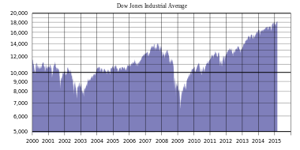
Stock Performance Indexes
The Dow Jones Industrial Average (DIJA) is an index that shows how 30 companies in various industries change value from day to day

Slide 41
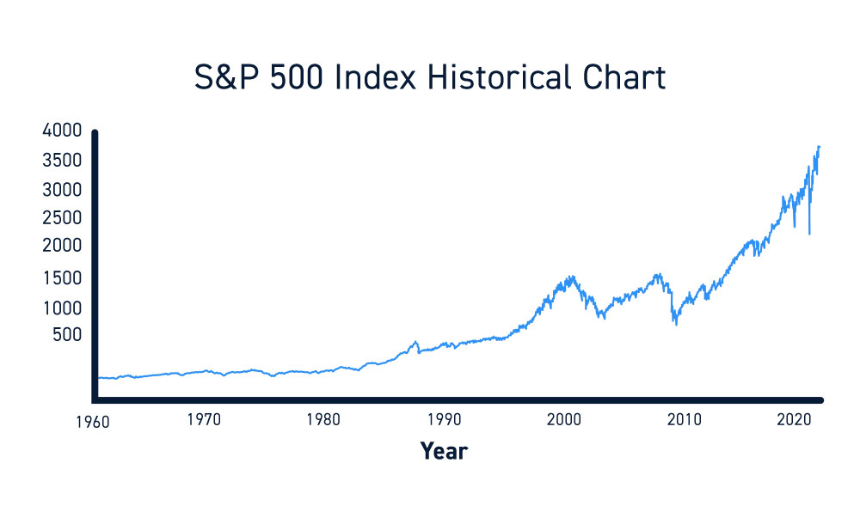
Stock Performance Indexes
S&P 500 tracks the performance of 500 different stocks

Slide 42
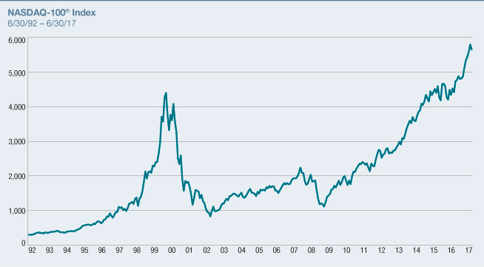
Stock Performance Indexes
The NASDAQ Composite is a stock market index that includes almost all stocks listed on the Nasdaq stock exchange. Along with the Dow Jones Industrial Average and S&P 500

Slide 43
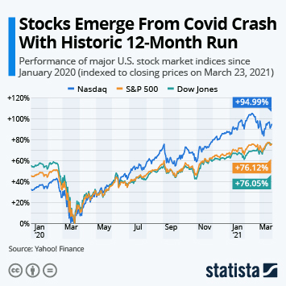
So is it safe to invest in the stock market?
For the most part, yes. Especially if you have long-term goals (more than 5 years)
The average stock market return is around 10% a year

Slide 44
Part IV
Protecting Your Wealth/Estate Planning

Slide 45
Generational Wealth
Assets passed from one generation to the next
The wealth is typically passed down after death in the form of an inheritance
Between 1995-2016 more than 55% of inheritances were under $50,000
Historically this has contributed to the wealth gap between the rich and the poor
In the U.S. the top 10% of the population holds 76% of the wealth, the bottom 50% holds only 1% of the wealth

Slide 46
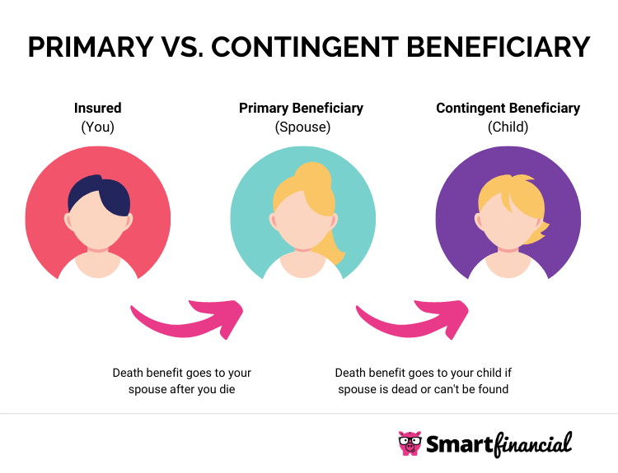
What is a beneficiary?
The person(s) or entity designated by the owner of assets who will receive the benefits in the form of an inheritance via a trust, a will, or life insurance policy

Slide 47
Estate Planning
The act of assessing how someone’s property, debts, and investments will be distributed in the event of their death or incapacitation
Items frequently distributed as part of one’s estate would be their:
Vehicle(s)
Home(s)
Stocks
Pension
Art
Debts

Slide 48
Last Will and Testament
Your will and testament is a legally-established document that spells out specifically how your estate will be distributed upon your passing away/death
Also establishes who will manage the document and execute the provisions when the time arises
A Living Will serves to provide instructions for how you are to be cared for medically while you’re alive; degree of life-saving measures, event of a coma or brain death
A Last Will And Testament gives the final instructions as explained above once life has ended*
*Correlates with stipulations in your life insurance policy

Slide 49
Living Will v Living Trust
Living Will
Begin on time of death, easily adjusted/altered, can become public since it is handled in probate court, affordable in cost
Living Trust
Occurs while you’re alive, difficult to alter or change, remains private and out of probate court, costly
Can grant power of ownership and decision-making ability

Slide 50
Codicil to Will
Process of adjusting provisions of your will without re-writing an entirely new document
Compare this to an amendment to the Constitution
EX: Might adjust beneficiaries as grandkids are born, amounts, ownership of property, etc.

Slide 51
Death Benefit
The asset distributed to a beneficiary upon the passing away of a life insurance policy holder or guarantor of a last will and testament
EX: Upon Jessie’s death, she left behind in her will that each grandchild would receive 12% of her total wealth – the dollar amount is the death benefit each grand child receives

Slide 52
Transfer on Death Deed
This document ensures that immediately upon death, the beneficiaries to someone’s estate receive the death benefits
Will circumvent the lonnnnnnnnng process common when a will must be reviewed in the courts (along with giving all related parties a chance to question or challenge provisions of a will

Slide 53
Power of Attorney
A legal document allowing someone to act on your behalf
There are 2 main types, financial and medical
Ultimately, both revolve around the concern that in the event of your incapacitation or inability to be reached, decisions can be made on your behalf by a close loved one familiar with your wishes

