Slide 1
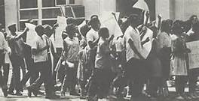
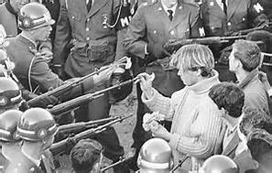
Stormy 60s Liberal Challenge to the Status Quo
Unit VIII

Slide 2
Agenda
Period 8: 1945 – 1980 – After World War II, the United States grappled with prosperity and unfamiliar international responsibilities, while struggling to live up to its ideals.
Key Concept 8.2: New movements in civil rights and liberal efforts to expand the role of government generated a range of political and cultural responses.
Essential Question: How was America’s national identity transformed domestically and international, as a result of the Cold War era?
Students can:
Evaluate the rise of new liberalism influence American domestic policy both in the area of civil rights and the limited welfare state
Demonstrate how post WWII world transformed America socially, politically, and economically
Agenda:
Turning points in African American History
Why now?
Homework
Vietnam Cold War Confrontation - 912-916, 928-932, 940-942, 946-947, & 952-953 – Vietnam, A Cold War Nightmare due April 19: Re-evaluating Cold War containment

Slide 3
Essential Question
How did new liberalism influence American domestic policy dealing with Civil Rights and social welfare?

Slide 4
Key Turning Points in Black History
1619
1793
1877

Slide 5
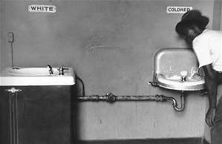
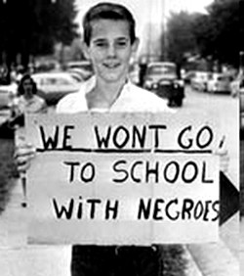
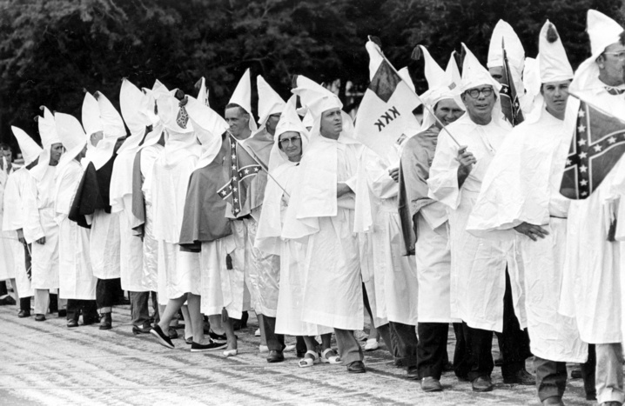
Jim Crow
De jure segregation: legal codes of segregation
Plessy v. Ferguson 1892: separate but equal is Constitutional (limits the 14th Amendment)
Societal intimidation: KKK
Institutional blocks to African American Rights
Poll taxes
Literacy Test
Grandfather Clause

Slide 6
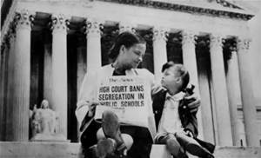
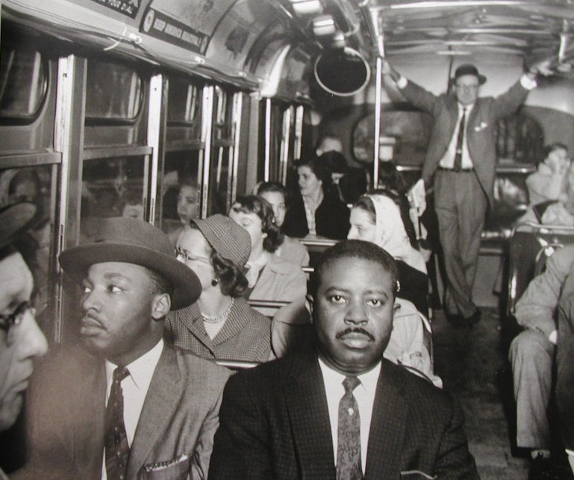
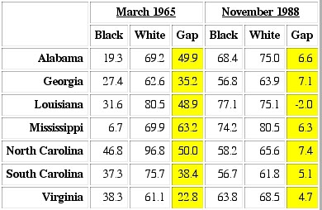
Breaking the Grip of Jim Crow
Ending Segregation and discrimination
Executive Order 9 – End segregation in the military
SCOTUS Precedents
Sweatt v. Painter 1951
Brown v. Board I 1954 & II 1957
Rosa Parks & the Montgomery Bus Boycott
Little Rock Nine
JFK slow to act (needs southern votes
for social welfare program)

Slide 7
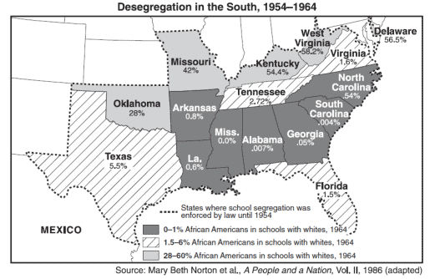
School desegregation

Slide 8
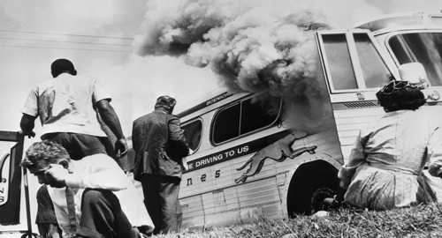
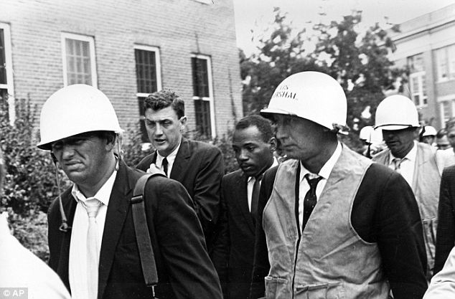
Early 1960s Activism
"As news spread of the brutality faced by Freedom Riders in Anniston and
Birmingham, Alabama, the American public had to make a choice: Would it support democracy or mob rule?” Adam Storm
Grassroots Activism forces government action (power of the Media)
Promoting Activism
Freedom Riders 1961: protesting
segregated bus terminals
JFK Response
Voter Education Project (register
southern voters)
James Meredith (integrates Uni. of Miss)

Slide 9
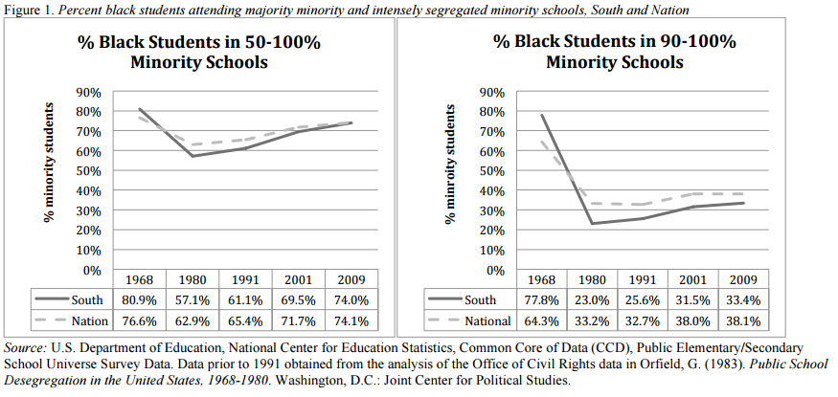
Education Segregation

Slide 10
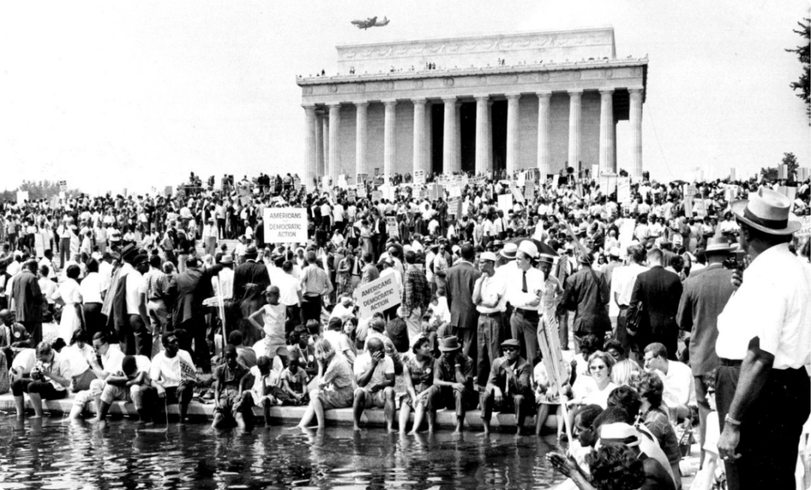
March on Washington 1963
“Now is the time to make real the promises of democracy. Now is the time to rise from the dark and desolate valley of segregation to the sunlit path of racial justice. Now is the time to open the doors of opportunity to all of God's children. Now is the time to lift our nation from the quick sands of racial injustice to the solid rock of brotherhood.”
- MLK, “I have A Dream Today” 1963

Slide 11
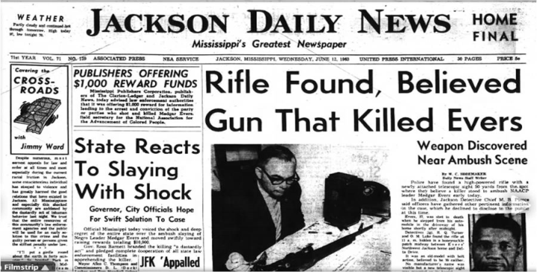
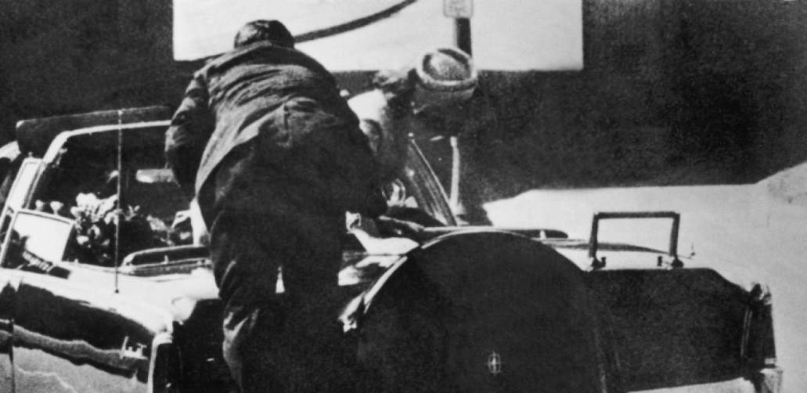
Setbacks to Civil Rights
“You can kill a man, but you can’t kill an idea” – Medgar Evers
Civil Rights loses leaders
Medgar Evers 1963
JFK assassination 1963
Kennedy Assassination
Warren Commission – Lee Harvey Oswald
acted alone
President Lyndon B. Johnson promise to
keep the Kennedy legacy alive

Slide 12
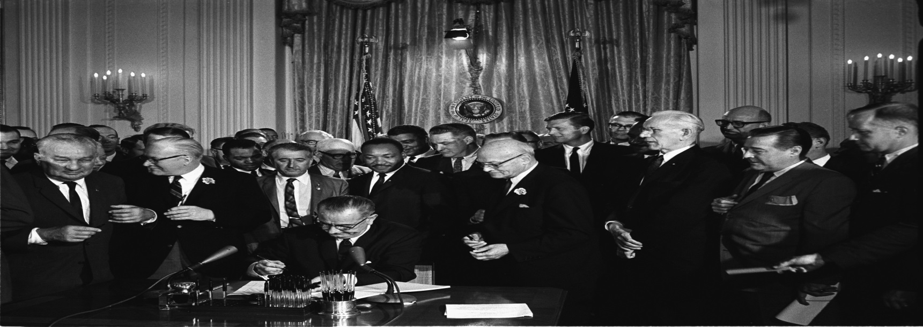
Civil Rights Act of 1964
Liberal Johnson Agenda
Civil Rights Act of 1964 (Kennedy Legacy) – no discrimination in public places & increased federal power to stop it
Equal Employment Opportunity Commission
Title VII bans gender discrimination
Executive Order 11246– Affirmative Action in hiring gov. contract

Slide 13
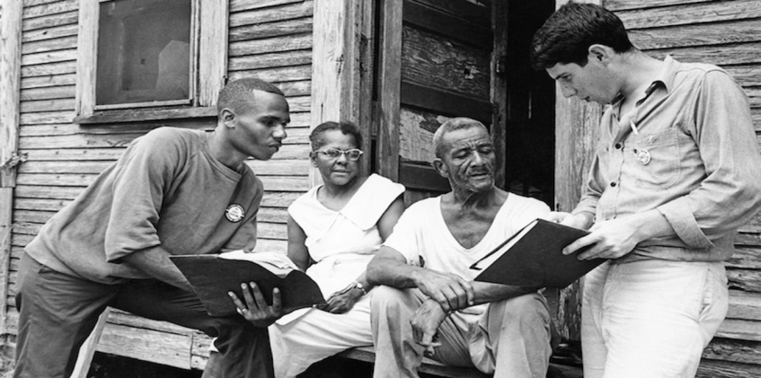
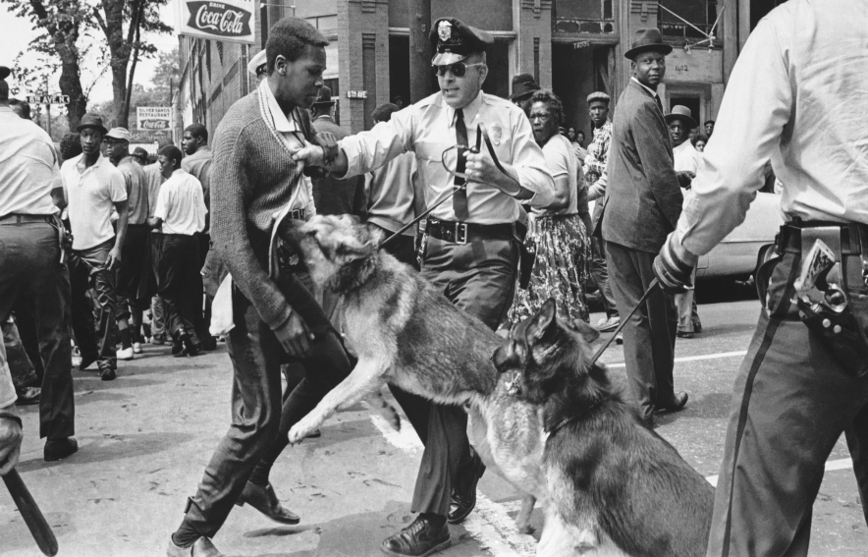
African American vote
Winning the right to vote
Freedom Summer of 1964
Massive voter registration drive in Mississippi
Mississippi Freedom Democrats denied at National Convention
Selma March
Bloody Sunday
Voting Rights Act of 1965
24th Amendment (No poll taxes)

Slide 14
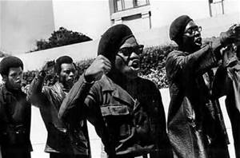
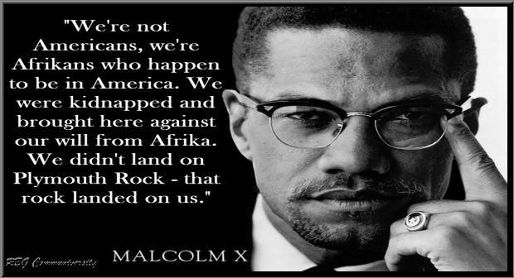
Black Militancy
Watts & Los Angeles Riots 1965 (issue poverty)
Black Power Movement
Black Panthers – Stokely Carmichael “ right to exercise new political & economic rights”
Nation of Islam & Malcolm X: preached African American separation & violent defense of their rights
Martin Luther King assassinated 1968
Black Panthers

Slide 15
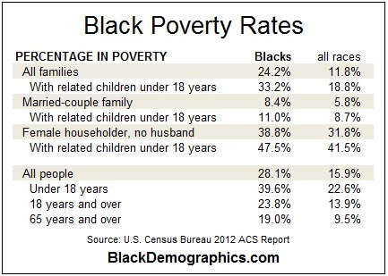
Economic Inequality

Slide 16
Why NOW
Why was the end of segregation and discriminatory practices within the United States achieved in the 1960s despite being afforded the rights of citizenship almost 100 years before?
Factors:
Grassroots Movements (the people took action)
Mass media
Black militancy (Black Power Movement)
Federal government intervention
Racism itself (the darkness of hate)

Slide 17
Vietnam Conflict
Cold War Division

Slide 18
Agenda
Period 8: 1945 – 1980 – After World War II, the United States grappled with prosperity and unfamiliar international responsibilities, while struggling to live up to its ideals.
Key Concept 8.2: New movements in civil rights and liberal efforts to expand the role of government generated a range of political and cultural responses.
Essential Question: How was America’s national identity transformed domestically and international, as a result of the Cold War era?
Students can:
Decipher how the rise Cold War brinksmanship impacts the United States power internationally and domestically
Evaluate the rise of new liberalism influence American domestic policy both in the area of civil rights and the limited welfare state
Agenda:
Vietnam War opinion
Rise of a protest culture
Homework
933-937, 943-946 – Social Change in America due April 20: Determine how the idea of liberalism, established by FDR in the New Deal, challenges the ideas of conformity, liberty, equality, and environmental protection. (Don’t forget Civil Rights Movement)
Protest propaganda due Thursday

Slide 19
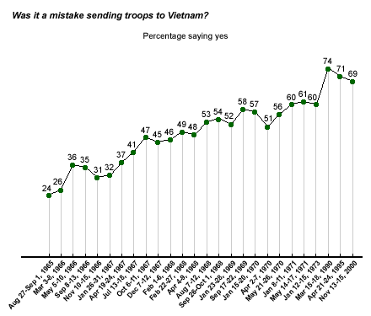
Public Opinion Poll

Slide 20
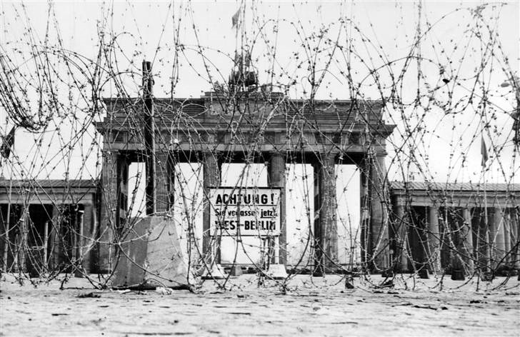
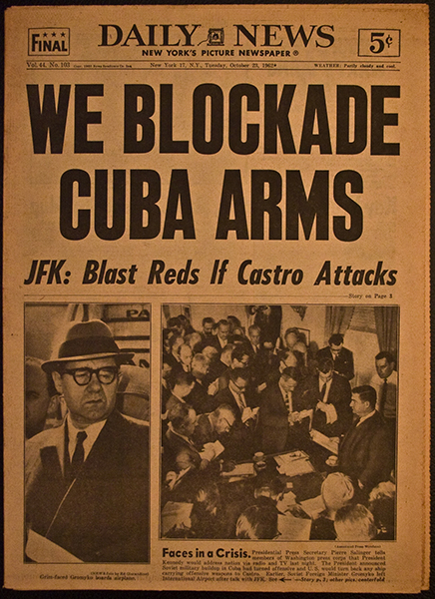
1960s Cold War
1961 – Berlin Wall
Latin America
Alliance for Progress (Marshall Plan)
Bay Pigs Invasion (Cuba) 1961
Cuban Missile Crisis 1962
USSR promises no nuclear missiles in Cuba
US promises never to attack Castro again
US removes nuclear missiles from Turkey
US – USSR relations
Khrushchev out of power
Détente policy – USSR not the devil
Brandenburg Gate – Berlin Wall

Slide 21
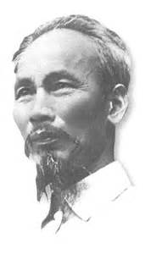
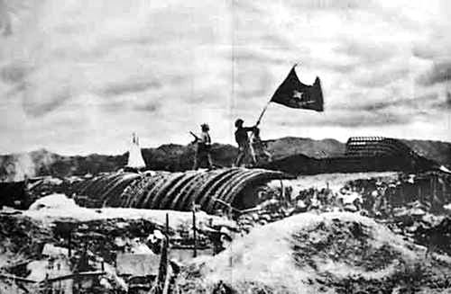
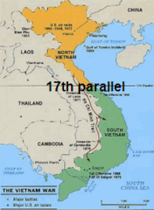
Vietnam Conflict Beginnings
1st Indo-China War (Ho Chi Minh v. France)
Eisenhower send military aid
Dien Bien Phu 1954
Geneva Peace Accord 1954 – Vietnam divided at the 17th parallel
US involvement escalates
President Diem – S. Vietnam
Ho Chi Minh
Dien Bien Phu – “Hell in a Small Space”

Slide 22
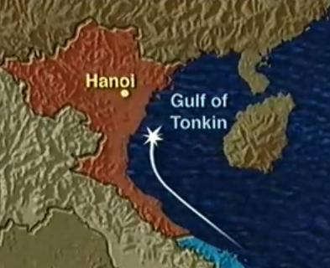
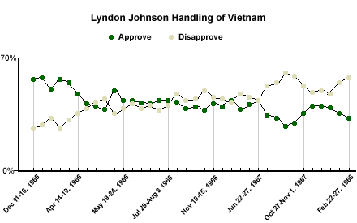
2nd Indo-China War
President Diem violates the Geneva Accords 1956 (Rise of the Viet Cong)
Kennedy’s Flexible Response (Green Berets)
Gulf of Tonkin Incident 1964 (USS Maddox Incident)
Gulf of Tonkin Resolution
2nd undeclared war by United States
Imperial presidency (use all means necessary to
defend Southeast Asia Collective Defense Treaty

Slide 23
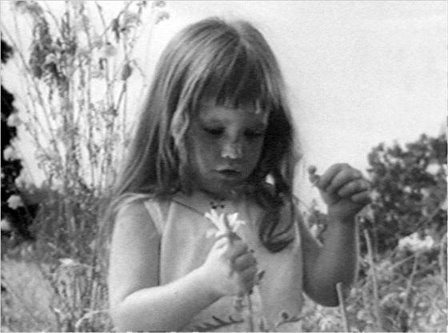
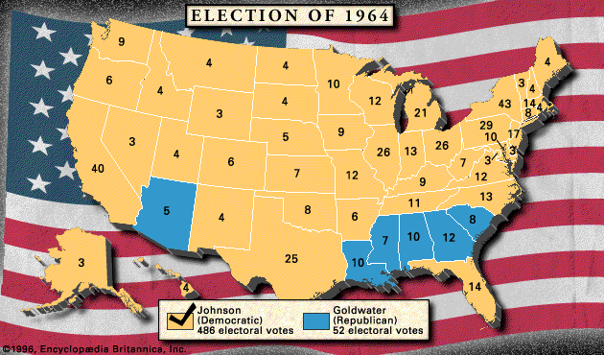
Election of 1964
Lyndon Johnson defeats Barry Goldwater (Conservative Revolution) attack against Johnson: expanding the welfare state, civil rights legislation, & nuclear test ban
Daisy political attack ad

Slide 24
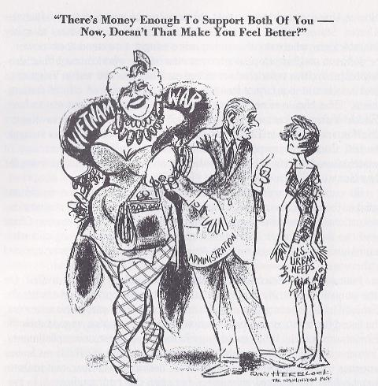
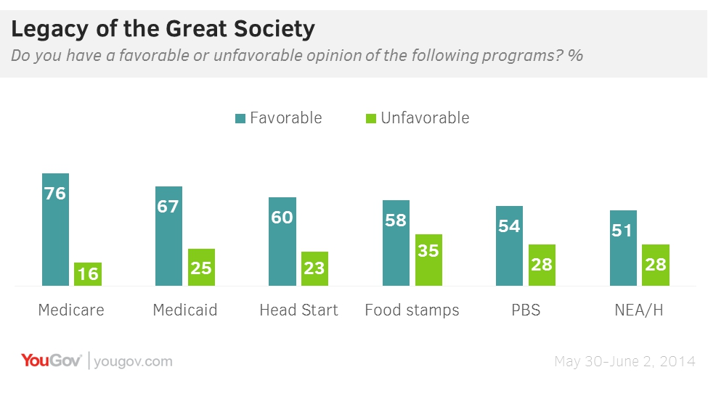
Great Society
The Great Society (New Deal program)
Programs (Expansion of the welfare state)
War on poverty (Michael Harrington’s
“The Other America”)
Medicare & Medicaid insurance
Immigration & Nationality Act
(no more quotas)
Voting Rights Act of 1965
Impact
Infant mortality reduced
Poverty reduced
Head Start program
Increase deficit spending
Ultimate fails due war spending

Slide 25
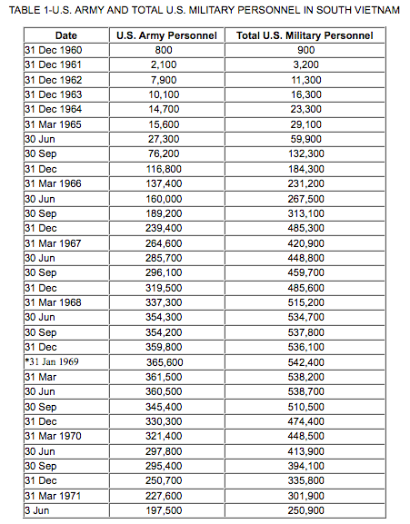
Americanization of Vietnam
Domino Theory If South Vietnam falls then Southeast Asia would fall to Communist (1964)
U.S. escalation of the Vietnam Conflict
Americanization of the Vietnam Conflict

Slide 26
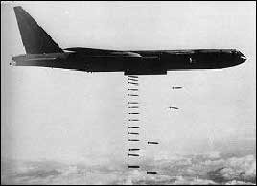
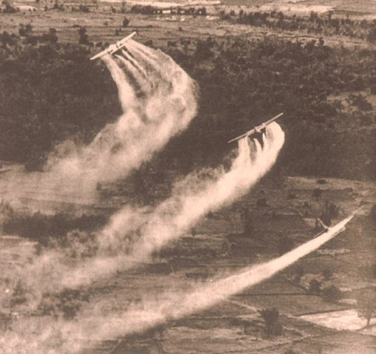
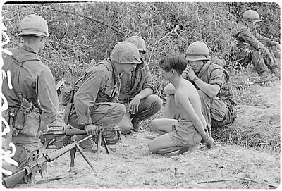
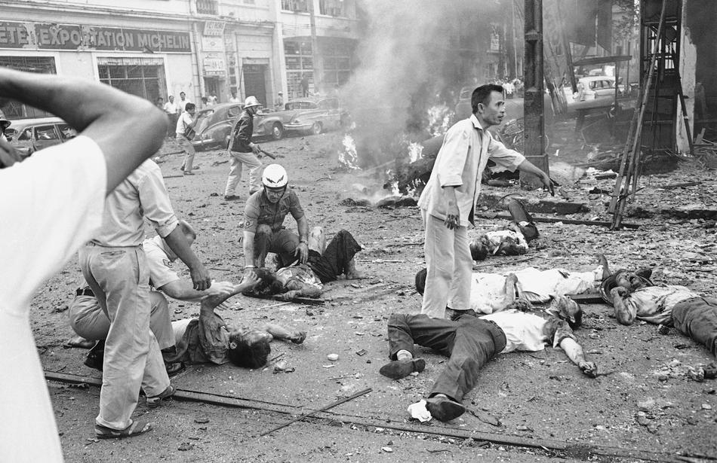
Escalating the War
Operation Rolling Thunder: Bombing of N. Vietnam 1965-1968
Impact
Expanded Viet Cong attacks
Search & destroy missions (Agent Orange)
Growing Anti-war sentiment
(Vietnam – America’s 1st TV War)
Agent Orange
Bombing of N. Vietnam
Search & Destroy Missions

Slide 27
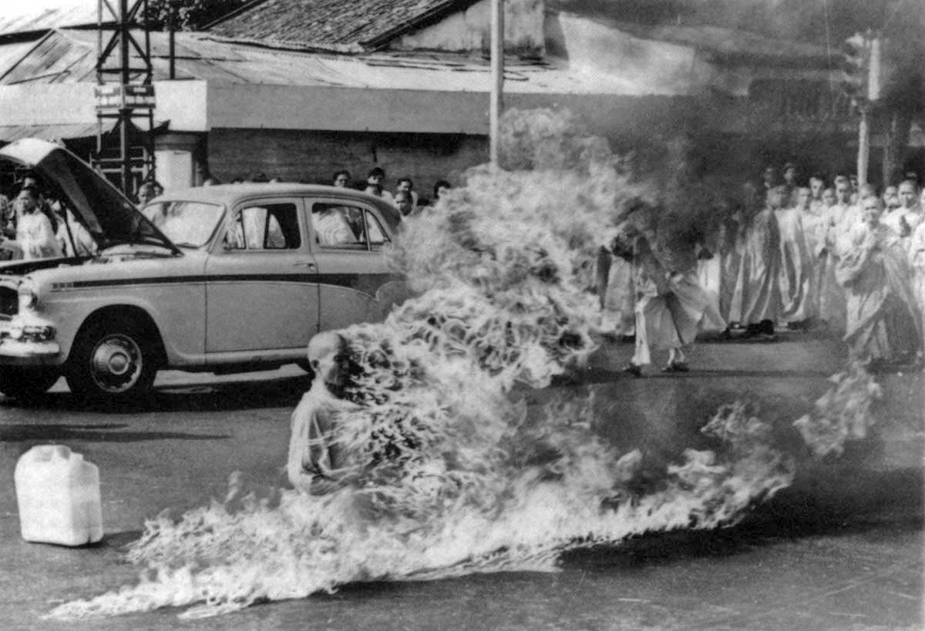
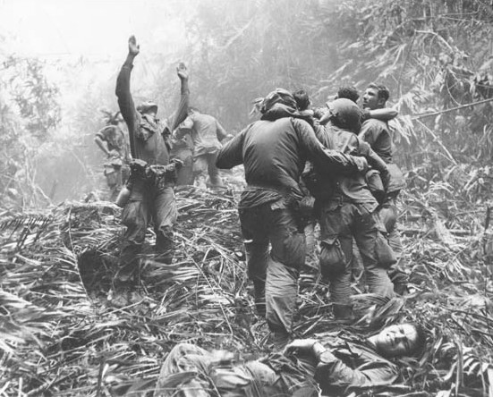
Images from Vietnam TV War
Buddhist Monk protest in Saigon
Death cards

Slide 28
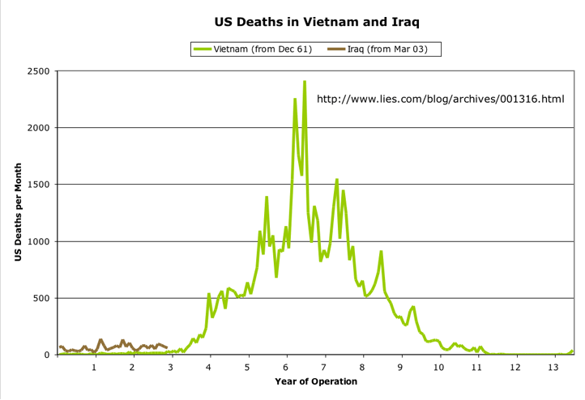
Death Toll Stats

Slide 29
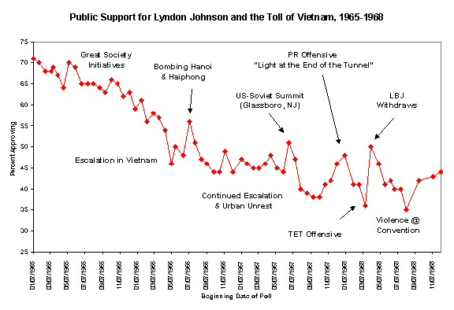
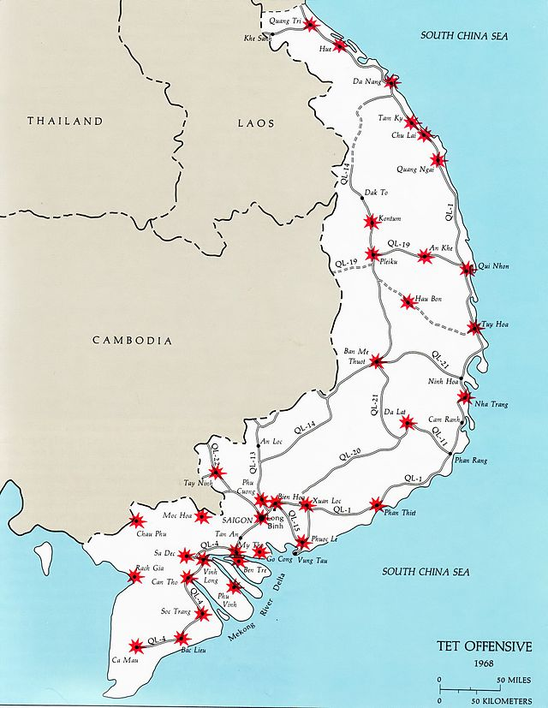
Tet Offensive
General Westmoreland “The light at the end of the tunnel”
Tet Offensive 1968 (an all out offensive by the NVA & VC)
Failed to achieve its objectives
Turned American public opinion against the war

Slide 30
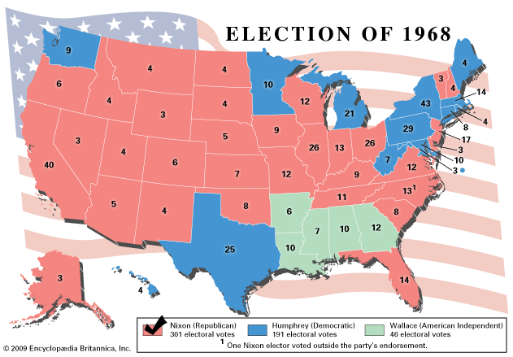
Election of 1968
“With America's sons in the fields far away, with America's future under challenge right here at home, with our hopes and the world's hopes for peace in the balance every day, I do not believe that I should devote an hour or a day of my time to any personal partisan causes or to any duties other than the awesome duties of this office--the Presidency of your country. . . .Accordingly, I shall not seek, and I will not accept, the nomination of my party for another term as your President” President Johnson 1968
Nixon elected President of the US
Factors:
Nixon promise “end the war with honor”
Bob Kennedy assassinated by Sirhan, Sirhan
Humphrey’s block of McCarthy’s anti-war plank
George Wallace’s pro war, pro segregation campaign

Slide 31
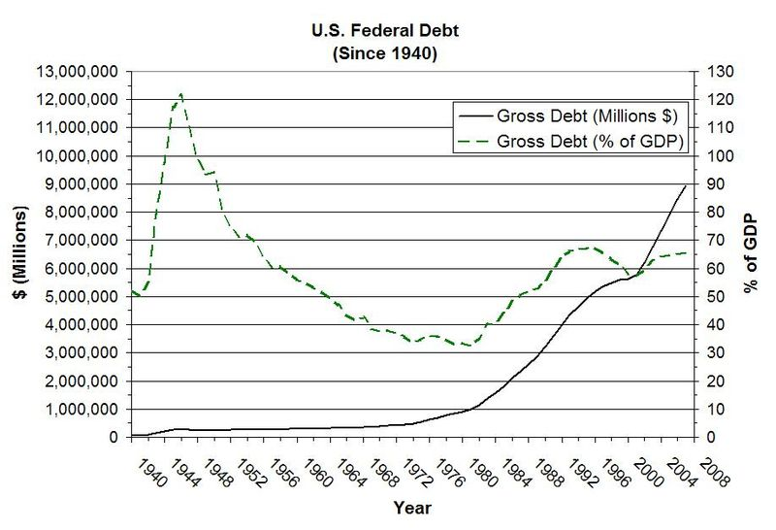
Cost of Vietnam & the Great Society
US Debt
US Tax Rate

Slide 32
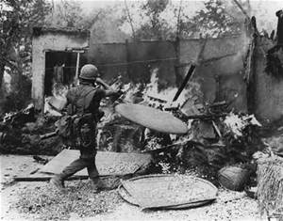
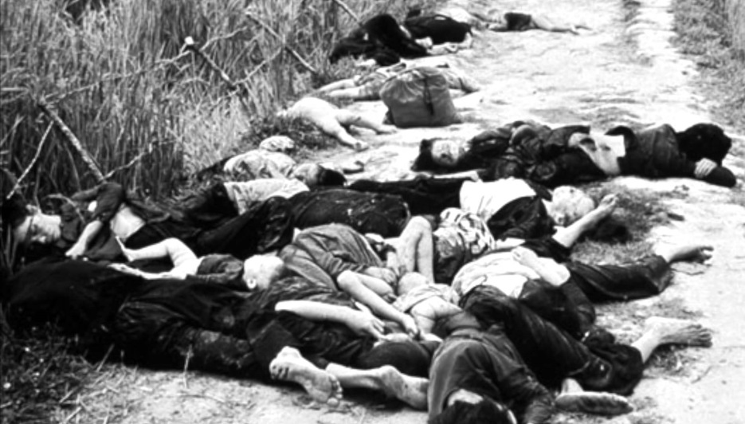
Ending the Vietnam Nightmare
Nixon’s policy: Vietnamization of the war (US soldiers withdrawn & S. Vietnam fights the war with U.S. aid)
Hawks v. Doves
Hawks - Nixon’s appeals to the “silent majority” (pro-war & stop shouting for change)
Doves – antiwar advocates (soldiers included)
Mai Lai Massacre 1968 (public 1970)
Search & Destroy Mission
Mai Lai Massacre

Slide 33
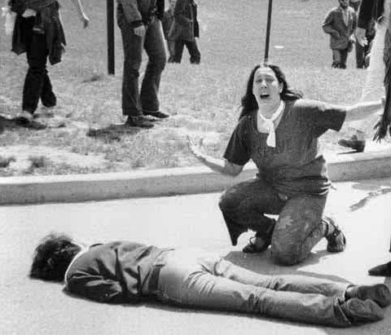
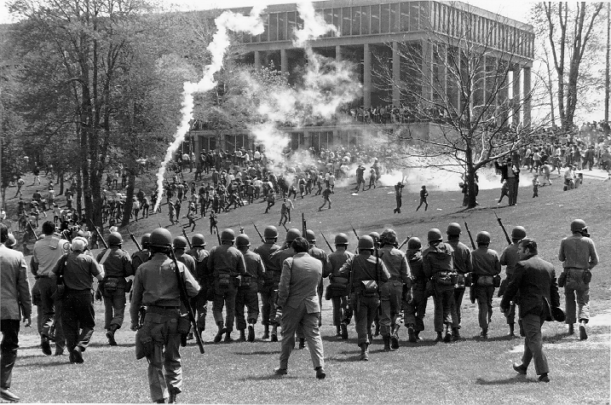
Unrest in the US – 4 dead in Ohio
Pentagon Papers (NY Times v. U.S)
Nixon’s expansion of Vietnam Conflict
1970s Christmas Day bombings in Cambodia
Kent State Massacre 1970

Slide 34
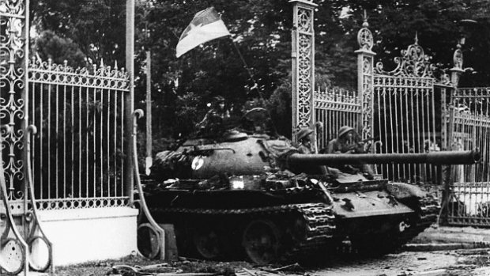
The War is Over
1973 US Vietnam cease fire
Fall of Saigon to N. Vietnam April 29, 1975
U.S. loses pride, confidence, & power

Slide 35
Youth counter-culture – AKA Hippies
Anti-conformity based on the three P’s –population boom, protest, and prosperity

Slide 36
Agenda
Period 8: 1945 – 1980 – After World War II, the United States grappled with prosperity and unfamiliar international responsibilities, while struggling to live up to its ideals.
Key Concept 8.2: New movements in civil rights and liberal efforts to expand the role of government generated a range of political and cultural responses.
Essential Question: How was America’s national identity transformed domestically and international, as a result of the Cold War era?
Students can:
Decipher how the rise Cold War brinksmanship impacts the United States power internationally and domestically
Evaluate the rise of new liberalism influence American domestic policy both in the area of civil rights and the limited welfare state
Agenda:
The White Rabbit in the Room
Rise of a protest culture
Homework
938-940,942 – 943, & 948-952 – The rise and fall of Nixon leads to growing discontent due April 21: answer questions 16-22 on the study guide
Protest propaganda due Thursday

Slide 37
Youth Counter-culture
“Turn on, Tune in, & Drop out” – Timothy Leary, 1967
Non-conformity in the 1960s America divided by Vietnam, Civil Rights, values & morals
Hippies values: anti-racism, anti-imperialism, & anti-oppression (disillusionment with American society)
Built on the three Ps
Population boom
Protest
Pre-eminence of lasting prosperity

Slide 38
Social Change
Impact of Youth Counter-Culture
Protest
Berkley Free Speech Movement
Teach-ins
Kent State Massacre
Sexual Revolution: (Margret Sanger effect)
Drugs
Supported the use of psychedelics
Rise of the drug cartels
Sexual Revolution
Berkley Free Speech Movement

Slide 39
Social Movements
Feminist Movement
Feminist Mystique by Betty Friedan 1963
Creation of NOW – National Organization
of Women
Gay Rights Advocacy
Stonewall Riots 1969
Environmentalism
Rachel Carson’s “Silent Spring” 1962
Earth Day 1970

Slide 40
Culmination of Distrust in America
“I am not a crook” Richard Nixon

Slide 41
Agenda
Period 8: 1945 – 1980 – After World War II, the United States grappled with prosperity and unfamiliar international responsibilities, while struggling to live up to its ideals.
Key Concept 8.2: New movements in civil rights and liberal efforts to expand the role of government generated a range of political and cultural responses.
Essential Question: How was America’s national identity transformed domestically and international, as a result of the Cold War era?
Students can:
Evaluate the rise of new liberalism influence American domestic policy both in the area of civil rights and the limited welfare state
Agenda:
60s factor on the 70s
Distrust in America
Rise of Conservatism
Homework
952-953 & 957- 965 – Ford and Carter due April 22: answer questions 23-28 on the study guide
Protest propaganda due Friday

Slide 42
Election of 1968
“With America's sons in the fields far away, with America's future under challenge right here at home, with our hopes and the world's hopes for peace in the balance every day, I do not believe that I should devote an hour or a day of my time to any personal partisan causes or to any duties other than the awesome duties of this office--the Presidency of your country. . . .Accordingly, I shall not seek, and I will not accept, the nomination of my party for another term as your President” President Johnson 1968
Nixon elected President of the US
Factors:
Nixon promise “end the war with honor”
Bob Kennedy assassinated by Sirhan, Sirhan
Humphrey’s block of McCarthy’s anti-war plank
George Wallace’s pro war, pro segregation campaign

Slide 43
Nixon’s keys to victory
Richard Nixon’s reaches new Republicans
Strategy:
“Southern Strategy” (Barry Goldwater) turn conservative Democrats in the South to loyal Republicans by arguing against a strong federal government (replace the African American votes)
Silent Majority: reach voters that were tired of the protest
Vote for Nixon

Slide 44
Growth of Distrust in Government
Americans lack faith in federal government
Factors:
Pentagon Papers
Vietnam Conflict
Social injustice (Civil Rights,
Women, Environmental issues)
Youth counter-culture
Economic issues

Slide 45
Nixon’s grows mistrust in government
Vietnam – “End the war with honor”
Vietnamization of the War: US provides training & economic aid
Christmas Day Bombings –
Secret War in Cambodia (1970)
Kent State Massacre (1970)
Mai Lai Massacre becomes public (1970)
New York Times v. United States decision
(1971) – pentagon papers)
Political Response:
26th Amendment
Gulf Tonkin Resolution Repealed
War Powers Act 1973

Slide 46
The War is Over
1973 US Vietnam cease fire
Fall of Saigon to N. Vietnam April 29, 1975
U.S. loses pride, confidence, & power

Slide 47
Economic Downturn
1970s ends American prosperity
Factors:
More workers seeking jobs
Government regulation increase
business cost
No $$$ for improvements Vietnam
Inflation (rising oil prices,
manufacturing sector stagnate growth)
Foreign economic competition

Slide 48
Watergate Scandal
Nixon caught in criminal activity
June 1972 – 5 CREEP workers caught bugging Democrat headquarters
Watergate Scandal - Woodward and Bernstein
Secret tapes of the Oval office
Saturday Night Massacre – firing of special prosecutions by Nixon
Nixon v. US: Executive privilege cannot be used to protect tapes
Nixon’s resigns

Slide 49
Conservative Revolution
Explain the reasons why a new conservatism rose to prominence in the United States between 1960 and 1989.
Factors:
Response to New Liberalism
Expansion of the limited welfare state
Protecting morals and values
National Security
Promoting a growing economy

