Slide 1
Rise of Sectionalism
Leading towards disunion

Slide 2
Essential Question: How did the development of America expansionism lead to greater sectionalism and the unresolved issues of federal power and citizenship in the United States?
Students can:
Determine how Manifest Destiny contributes to the growth of sectionalism within the United States
Evaluate whether slavery is a contributing cause of the Civil War
Agenda:
Polarization in the Antebellum Period
Balancing the scales of Congress
Manifesting Sectionalism
Homework:
Rise of Antebellum Tensions – read pages 417-431

Slide 3
Guiding Questions
Why were Americans unable to resolve sectional tensions during the 1850s?
(What has changed/what is different?)
To what extent was slavery a cause of the Civil War?

Slide 4
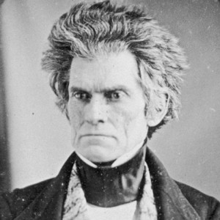
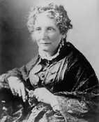
Polarization of the Antebellum Period
"Yes, Mas'r," said Tom, putting up his hand, to wipe the blood, that trickled down his face. "I'm willin' to work, night and day, and work while there's life and breath in me; but this yer thing I can't feel it right to do; -- and, Mas'r, I never shall do it, -- never!"
Legree looked stupeﬁed and confounded; but at last burst forth, -- "What! ye blasted black beast! tell me ye don't think it right to do what I tell ye! What have any of you cussed cattle to do with thinking what's right? I'll put a stop to it! Why, what do ye think ye are? May be ye think ye'r a gentleman master, Tom, to be a telling your master what's right, and what ain't! So you pretend it's wrong to ﬂog the gal!“
- Uncle Tom’s Cabin, Harriet Beecher Stowe, 1852
But let me not be understood as admitting, even by implication, that the existing relations between the two races in the slaveholding States is an evil:–far otherwise; I hold it to be a good, as it has thus far proved itself to be to both, and will continue to prove so if not disturbed by the fell spirit of abolition. I appeal to facts. Never before has the black race of Central Africa, from the dawn of history to the present day, attained a condition so civilized and so improved, not only physically, but morally and intellectually.
look at the sick, and the old and infirm slave, on one hand, in the midst of his family and friends, under the kind superintending care of his master and mistress, and compare it with the forlorn and wretched condition of the pauper in the poorhouse.
- Slavery a Positive Good, John C. Calhoun, 1837

Slide 5
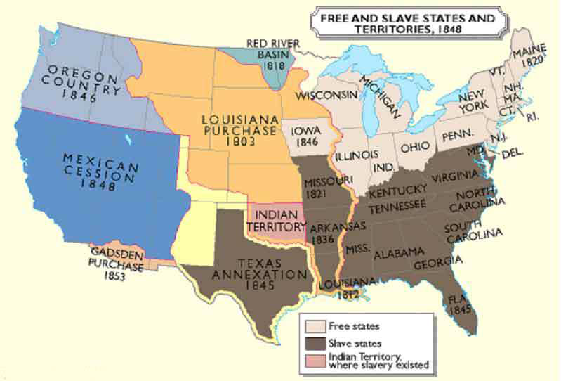
1848 Free v. Slave States & Territories

Slide 6
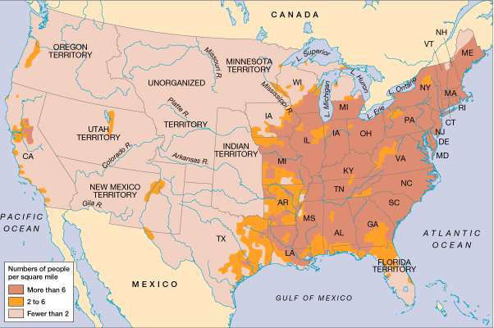
US population & settlement 1850

Slide 7
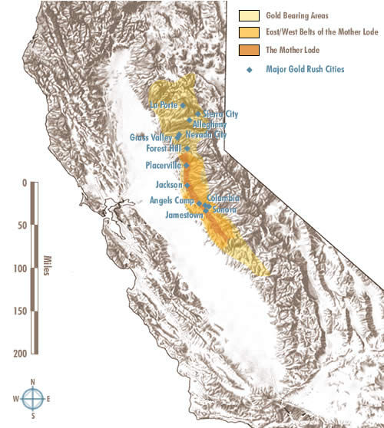
California Gold Rush
GOLD RUSH
1849 – Sutter’s Mill (Gold!!!)
Speculators rush to California
1850: California applies for statehood

Slide 8
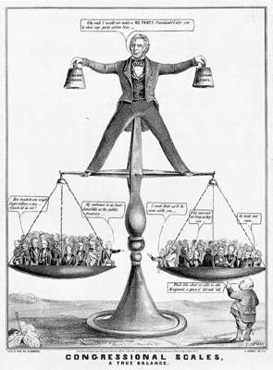
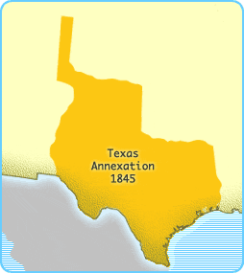
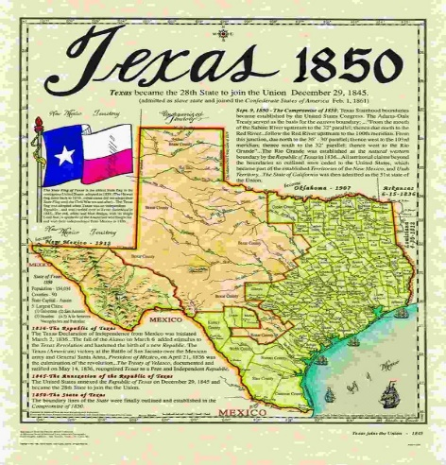
Congressional Scales, “A True Balance”, 1850
Cause: California Gold Rush
Deal – COMPROMISE OF 1850
California enters as a free state
Popular sovereignty
Fugitive Slave Act (1850)
Slave trade banned in Washington D.C.
Texas $10 million for border dispute

Slide 9
Essential Question: How did the development of America expansionism lead to greater sectionalism and the unresolved issues of federal power and citizenship in the United States?
Students can:
Determine how Manifest Destiny contributes to the growth of sectionalism within the United States
Evaluate whether slavery is a contributing cause of the Civil War
Agenda:
Antebellum Tensions
Chain reaction of sectionalism
Two Chains of Slavery
Homework:
Long Essay Final due Friday

Slide 10
Antebellum Tensions
Put the following in chronological order
Dred Scot Decision
Crimes against Kansas
Lincoln Douglas Debate
Mexican American War
Kansas-Nebraska Acts
Explain how two of them lead to expansion of sectionalism in the United States

Slide 11
Three Degrees of Sectionalism
Find two people to link your sectional fact to
Write fact on one strip of paper and form a paper chain
Write a statement that links all three facts together and explains the connect
Add statement to the chain (record statement in your notes & mark on map

Slide 12
Six Degrees of Separation
Connect events to explain how the United States went from building a nation in 1800 to disunion in 1860
Louisiana Purchase 1803 – President Jefferson sought to gain access to the Mississippi River and the Port of New Orleans to give western farmers, the common man, the opportunity to trade. As a result of land butchery, because the explosion of King Cotton, due to Eli Whitney’s Cotton Gin, farmers began to move westward to seek new fertile lands and support the expansion of the Cottoncracy based on slave labor.
Event A:
Event F:
Election of 1860 – Abraham Lincoln was elected bring the Republican Party to power without a single southern vote. Further divisions were created by the Republican Party support of the Transcontinental Railroad and arguments against the expansion of slavery in western territories by rebuking the Kansas Lecompton Constitution. Lincoln’s election lead to the immediate secession of deep south states, such as South Caroline.

Slide 13
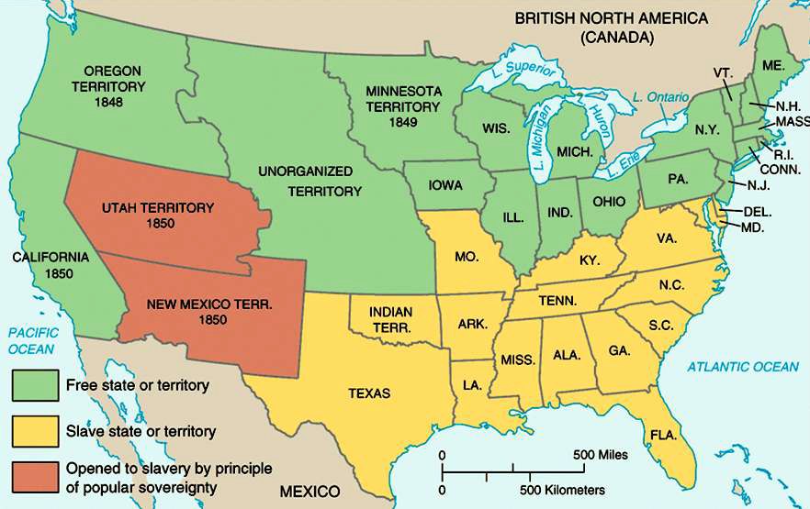
Compromise of 1850

Slide 14
Issues in America by 1854

Slide 15
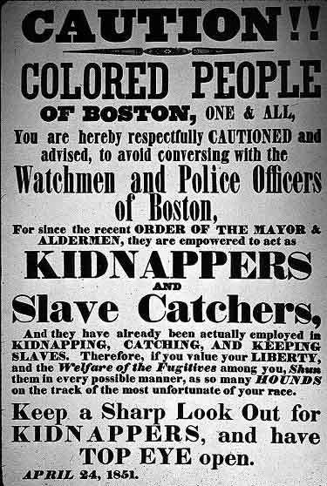
Responses to the Compromise of 1850
Change in national leadership
(Clay, Webster, Calhoun replaced by
Douglas, Seward, & Davis)
Northern opposition to
Fugitive Slave Act 1850
Priggs v. Pennsylvania 1842
Personal Liberty Laws "unless
prohibited by state legislation"
Ableman v. Booth (1859)
Growth of Free-Soil Party
(founded 1848)
Whig Party?
Gadsden Purchase (1853)
Ostend Manifesto (1854)

Slide 16
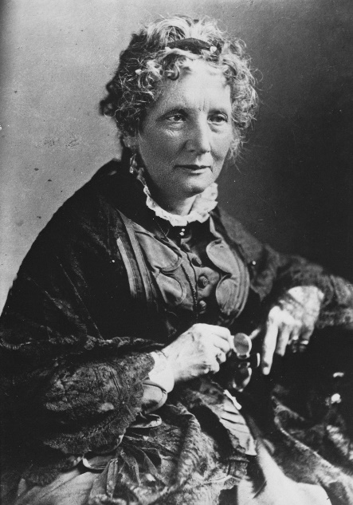
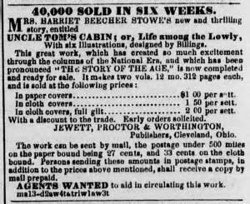
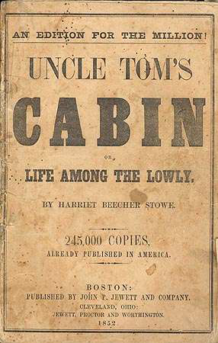
Cultural Attack on Slavery
1852 Uncle Tom’s Cabin by Harriet Beecher Stowe attack the Fugitive Slave Act turning Northern towards abolition
Impending Crisis of South – statistical impact of slavery on non-slave holding population

Slide 17
Pro and Anti-slave Conflict
Sectional Controversy Hardened Attitudes:
South – “Positive Good‖ Thesis”
Good for slaves, southern society, the U.S.
North – “Free Labor ideology”
Slavery is bad for white Americans
American democracy=property, opportunity for advancement
• “free soil”
• “slave power conspiracy”

Slide 18
Prompt: Manifest Destiny was viewed by Americans as a benevolent movement during the 1800s, but it drove a wedge between North and South leading to the Civil War. Assess the validity of this statement.
Lone Star Republic - Mexican American War - 54-40 or Fight
Treaty of Guadalupe Hidalgo - Gadsden Purchase - Wilmot Proviso
California Gold Rush (49ers) - Manifest Destiny - Expansionists
Compromise of 1850 - Kansas-Nebraska Acts - Fugitive Slave Act 1850
Gag rule - Ostend Manifesto - Underground Railroad
Uncle Tom’s Cabin - Bleeding Kansas - Spot Resolution
Expansion of US trade into Central America and Asia (China and Japan)
Priggs v. Pennsylvania 1842 - Impending Crisis in the South - Beecher’s Bibles
Border Ruffians - Free Soilers - Lawrence, Kansas
Lecompton Compromise - Caning of Charles Sumner - Republican Party
Dred Scot v. Sanford - Panic of 1857 - Lincoln-Douglas Debate
Freeport Doctrine - John Brown’s Raid - Election of 1860
Constitutional Unionist Party - Crittenden Compromise

Slide 19
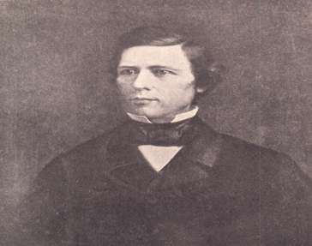
Pro and Anti-slave Conflict
Provided, territory from that, as an express and fundamental condition to the acquisition of any the Republic of Mexico by the United States, by virtue of any treaty which may be negotiated between them, and to the use by the Executive of the moneys herein appropriated, neither
slavery nor involuntary servitude shall ever exist in any part of said territory, except for crime, whereof the party shall first be duly convicted.
Slave & the Territories
“Gag rule”
Wilmot Proviso

Slide 20
Essential Question: How did the development of America expansionism lead to greater sectionalism and the unresolved issues of federal power and citizenship in the United States?
Students can:
Determine how Manifest Destiny contributes to the growth of sectionalism within the United States
Evaluate whether slavery is a contributing cause of the Civil War
Agenda:
Validation of Sectionalism
Chain reaction of sectionalism
Thesis Defense
Homework:
Long Essay Final due Friday

Slide 21
Prompt: Manifest Destiny was viewed by Americans as a benevolent movement during the 1800s, but it drove a wedge between North and South leading to the Civil War.

Slide 22
Validation of Sectionalism
Manifest Destiny led to sectional divisions, as a result of growing violence:
Kansas-Nebraska Acts – Answer 1
Kansas-Nebraska Acts allowed people who settled in Kansas to decide whether it become slave or free state leading to violence.

Slide 23
Validation of Sectionalism
Manifest Destiny led to sectional divisions, as a result of growing violence:
Kansas-Nebraska Acts – Answer 2
Stephen Douglas wrote the Kansas-Nebraska Acts used the concept of popular sovereignty in order allow the state’s population to determine whether Kansas and Nebraska would be free or slaves states. Kansas became a battleground between northern abolitionists, such as John Brown, and Southern pro-slave supporters, such as the border ruffians, fought to legitimize their constitution creating Bleeding Kansas.

Slide 24
Validation of Sectionalism
Manifest Destiny led to sectional divisions, as a result of growing violence:
Kansas-Nebraska Acts – Answer 3
In seeking the northern route of the transcontinental railroad, in order to expand America’s ability to carry out commerce from east to west, Stephen Douglas wrote the Kansas-Nebraska Acts. He allowed popular sovereignty to determine whether they would be free or slave states. This caused Bleeding Kansas, as pro-slave advocates from Missouri, the border ruffians, fought with Free Soilers, such as John Brown, in places like Lawrence, to determine the outcome of free versus slave.

Slide 25
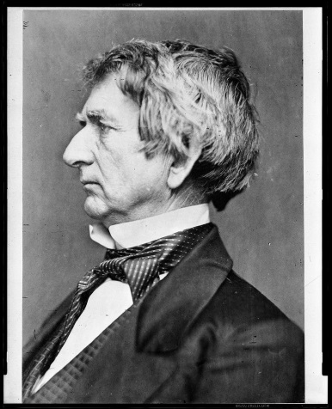
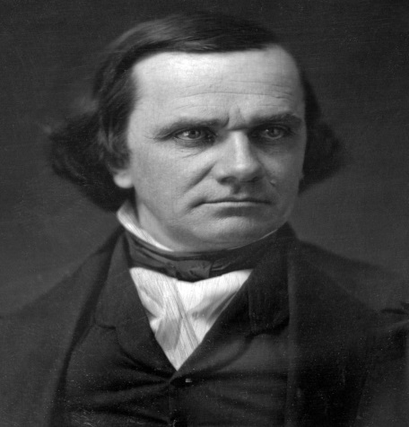
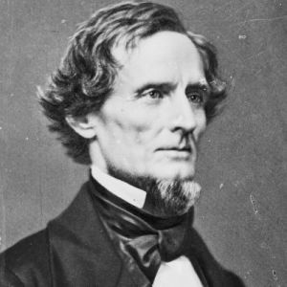
Political Change of Compromise of 1850
Signaled End of Period of Political Leaders Seeking National Interest
Clay – tired, disappointed after his national compromise bill defeated
John C. Calhoun – had sought compromise bill that heavily favored the South; would never have passed, but still seeking national compromise; died before passage of Compromise
Daniel Webster – left Congress for diplomatic post in course of debate
Replaced by Leaders with personal or sectional interests: Douglas, Seward, & J. Davis

Slide 26
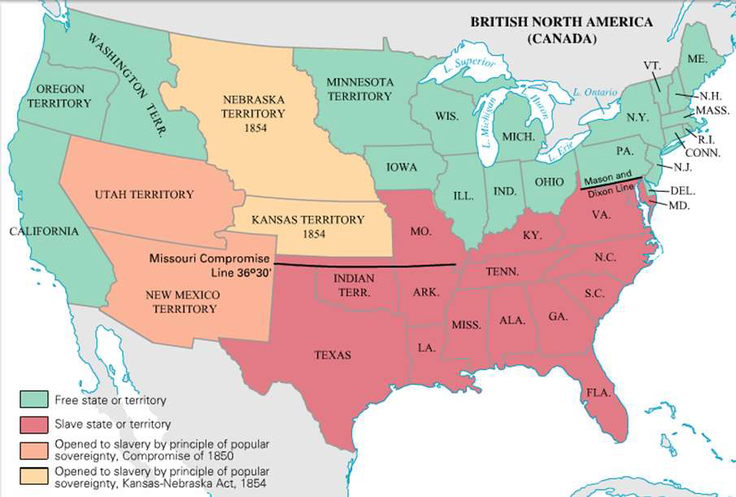
Kansas Nebraska Act, 1854

Slide 27
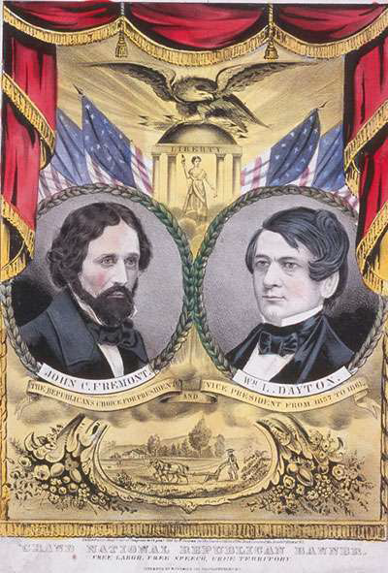
Republican Party
Formed in 1854; result of
Kansas-Nebraska Act
Beliefs: Free Soil, Free labor
Opposed spread of slavery
Quickly powerful in North;
purely sectional party
Who joined
Northern Whigs
Many Northern Democrats
Free Soilers
Know-Nothings
Other various opponents of the Kansas-Nebraska Acts

Slide 28
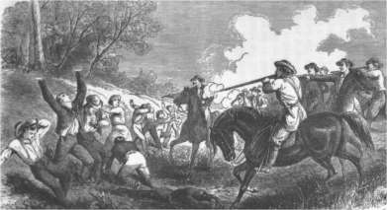
“Bleeding Kansas” 1854-58
John Brown & Becher's Bibles
Pottawatomie Massacre (1856)
Lecompton Constitution (1857)
Bleeding Kansas
Border Ruffians – proslave Missourians

Slide 29
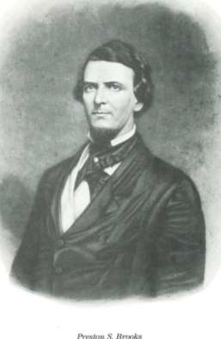
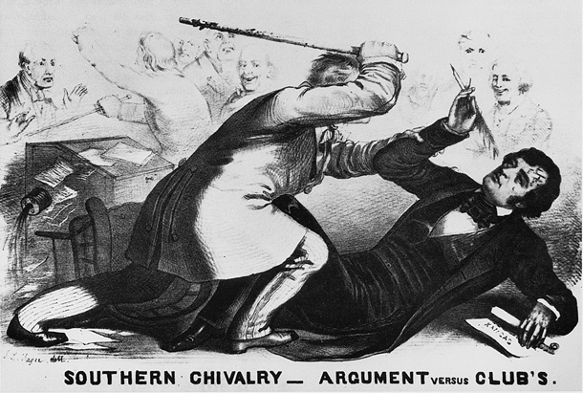
Douglas (who was present in the chamber) was a "noise-some, squat, and nameless animal...not a proper model for an American senator." Butler was a pimp who
took "a mistress who, though ugly to others, is always lovely to him; though polluted in the sight of the world, is chaste in his sight—I mean, the harlot, Slavery."
Crimes Against Kansas

Slide 30
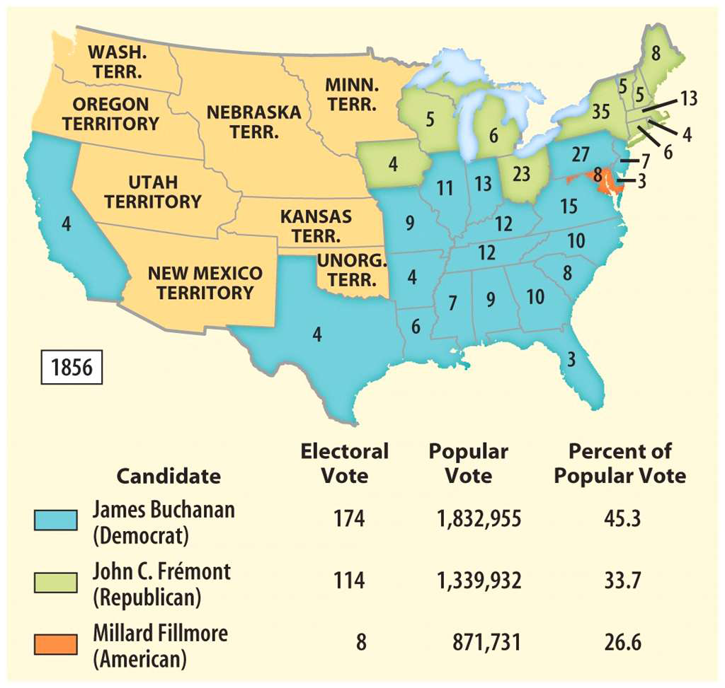
Election of 1856
Results
Driving issue: popular sovereignty in the territories
Popular sovereignty to determine slave v. free: Democrats – yes Republicans – No
Lecompton Compromise: Democrats - yes Republican - No

Slide 31
Essential Question: How did the development of America expansionism lead to greater sectionalism and the unresolved issues of federal power and citizenship in the United States?
Students can:
Determine how Manifest Destiny contributes to the growth of sectionalism within the United States
Evaluate whether slavery is a contributing cause of the Civil War
Agenda:
Highlighting a LEQ
Chain reaction of sectionalism
Election of 1860
Homework:
Civil War reading: Read pages 434-449 – complete statements 1-8
Civil War FRQ’s due 12/20/17

Slide 32
Federalism issue
Dred Scot v. Sanford 1857:
Justice Taney
rules that slaves are property and therefore have not rights
Missouri Compromise was unconstitutional
Empowers states to take control of the issue of slavery
Lincoln-Douglas Debate 1858
US Senate race for Illinois – focus on the issue of slavery in the US
Freeport Doctrine: (Stephen Douglas – in response to the Dred Scot decision) argue states could keep slavery out their state by not writing laws or establishing enforcement agencies to deal with it
Establishes Lincoln as the Republic candidate for president in 1860

Slide 33
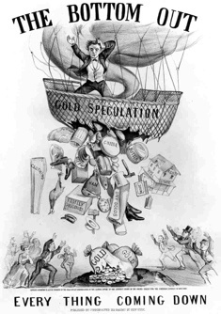
Economics sectionalism
Panic of 1857
Causes: Gold Rush inflates currency value, land speculation for transcontinental railroad, and over production of grain
Majorly effects Northern industrial economy boosting Southern confidence in themselves to be independent
Remedy
Homestead Act – 160 acres of land .25 cents an acre (Northern industrialist and Southern slaveholders against it)
Tariff of 1857 was lowered – industrialist want it raised

Slide 34
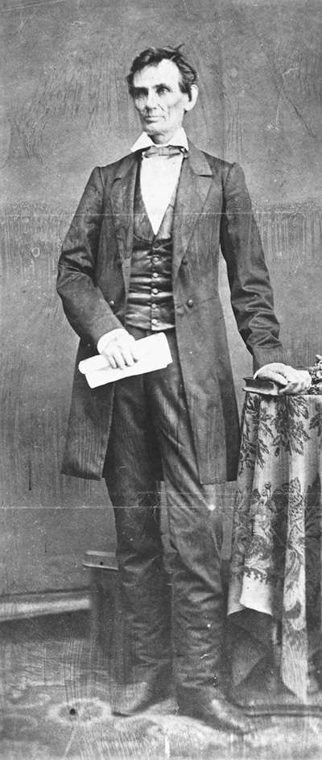
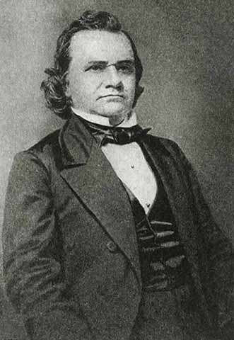
Lincoln Douglas Debates
Douglas:
• won reelection - Senate
• ―Freeport Doctrine‖-
territorial legislatures
could exclude slavery by
simply not passing laws to
protect it (Dred Scott)
Lincoln:
• gained a national reputation
• Supported free soil and
free labor; condemned
Dred Scott

Slide 35
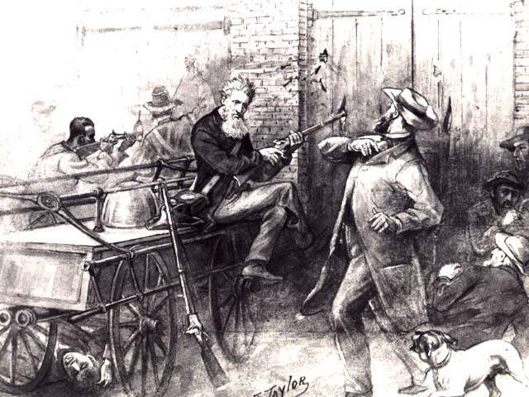
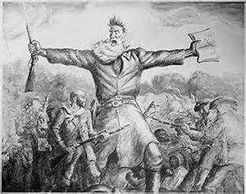
John Brown’s Raid 1859
John Brown and 21 men attacked the federal arsenal in Harper’s Ferry, VA to obtain guns for a slave rebellion

Slide 36
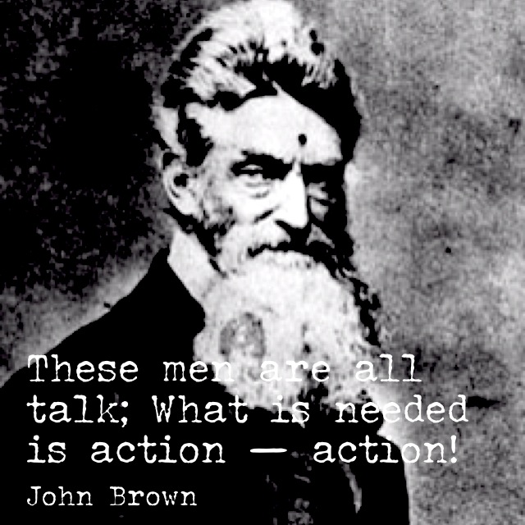
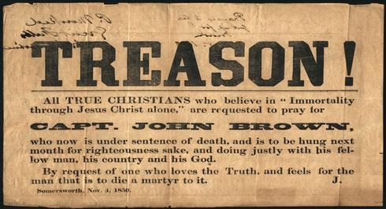
Legacy of John Brown
Northern attitude: John Brown a
martyr for abolition (fighting injustice)
Southern attitude: justice had been
served by executing a person who
had committed treason.

Slide 37
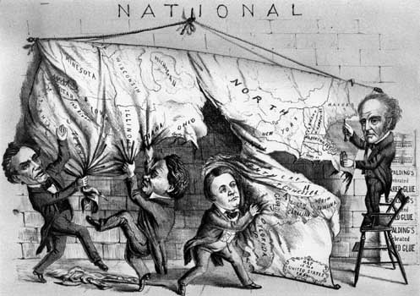
Dividing the Nation, 1860
Use APPARTS to analyze the political cartoon “Dividing the Nation”
Explain how the cartoon reflects the United States during the sectional crisis.
Be sure to use historic facts to support your conclusions.

Slide 38
Republican platform 1860
1. Non-extension of slavery [for Free-Soilers].
2. Protective tariff [for No. Industrialists].
3. No abridgment of rights for immigrants [a disappointment for the “Know-
Nothings”].
4. Government aid to build a Pacific RR [for the Northwest].
5. Internal improvements [for the West] at federal expense.
6. Free homesteads for the public domain [for farmers].

Slide 40
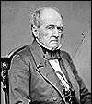
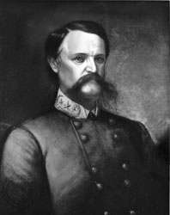
John Bell
Constitutional Union
Abraham Lincoln
Republican
Election of 1860
√
Stephen A. Douglas
Northern Democrat
John C. Breckinridge
Southern Democrat

Slide 41
Period 5: 1844 – 1877 – As the nation expanded and its population grew, regional tensions, especially over slavery, led to civil war – the course and aftermath of which transformed American society.
Key Concept 5.1: The United States became more connected with the world, pursued an expansionist foreign policy in the Western Hemisphere, and emerged as the destination for many migrants from other countries.
Key Concept 5.2: Intensified by expansion and deepening regional divisions, debates over slavery and other economic, cultural, and political issues led the nation into Civil War.
Essential Question: How did the development of America expansionism lead to greater sectionalism and the unresolved issues of federal power and citizenship in the United States?
Students can:
Analyze contributing factors that lead to the Civil War
Tasks: Analyze the Election of 1860, other factors of Civil War, develop thesis and outline
Homework: Essay Rough Draft
Focus for Today

Slide 42
Prompt
Manifest Destiny was viewed by Americans as a benevolent movement during the 1800s, but it drove a wedge between North and South leading to the Civil War. Assess the validity of the statement.
Outline
Introduction – Thesis and overview
Paragraph 1 & 2 support thesis
Main idea
5-6 facts linked together
Paragraph 3 However – counter arguments
Main idea
5-6 facts linked together
Conclusion – ties ideas all together & demonstrate proof

Slide 43
M.E.A.L. Body paragraph format
Main idea: State your main argument which is the answer to the question you were asked
Evidence: provide historic facts to support your premise
Analyze: Analyze the facts be explaining how they support your answers
Link: Tie your evidence and analysis back to your thesis

Slide 44
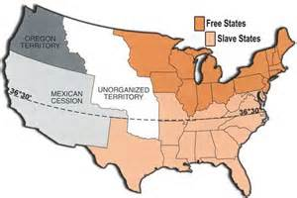
Manifest Destiny or NOT
Causes of the Civil War
Explain how each of the following caused the Civil War with the support of at least one historic fact
State v. Federal government power (federalism)
Cultural attitudes about slavery
Democracy
Economic

Slide 45
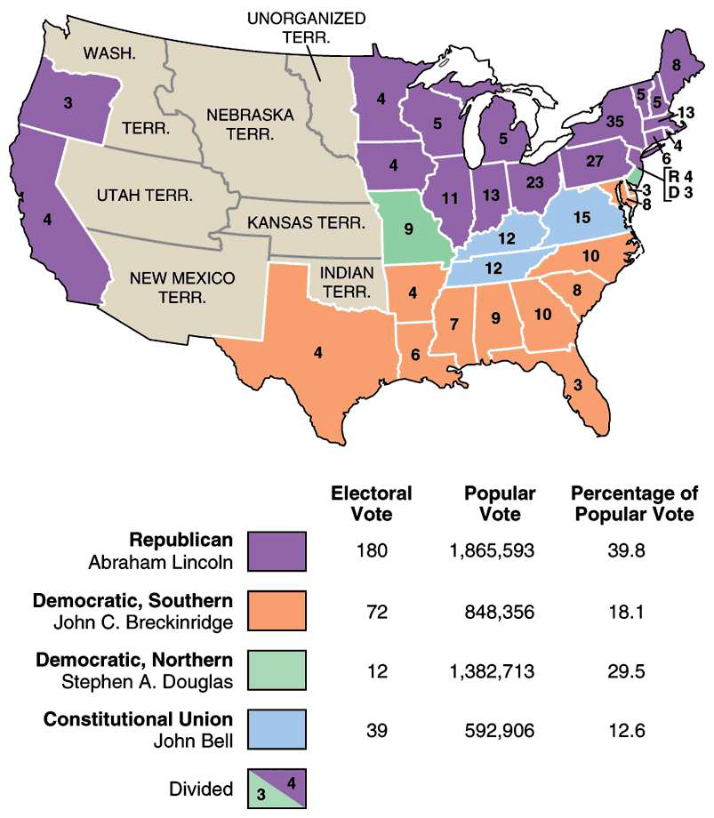
Election Results from 1860

Slide 46
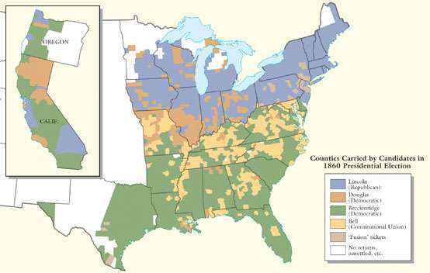
Election of 1860 by County

Slide 47
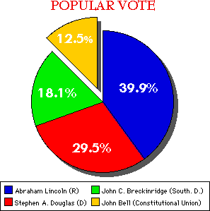
Election of 1860

Slide 48
Election of 1860
Destruction of the Union
Candidates:
Abraham Lincoln (R)
Stephen Douglas (D)
John Breckinridge (D)
John Bell (Constitutional Unionist Party)
Abraham Lincoln wins despite not receiving one southern vote
Impact: Southern secession (SC, TX, AL, MS, GA, FL, & LA)

Slide 49
Assess the election results of 1860

Slide 50
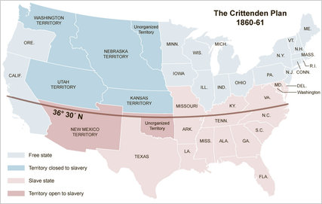
Save the Union
Crittenden Compromise
Return the 36’30 line (expansion of the US into Cuba and Latin America)
Slavery protected by the federal government
Free v. Slave determined by popular sovereignty
Lincoln vetoes the idea

Slide 51
Essential Question: How did the development of America expansionism lead to greater sectionalism and the unresolved issues of federal power and citizenship in the United States?
Students can:
Decipher contributing factors that support U.S. acceptance of Manifest Destiny
Determine how Manifest Destiny contributes to the growth of sectionalism within the United States
Evaluate whether slavery is a contributing cause of the Civil War
Agenda:
Review
Manifesting Sectionalism Quiz
First Shots of the Civil War
Homework:
No Homework – Happy Holidays

Slide 52
Driving America Towards War
1. Harriett Beecher Stowe mentally changed Northern attitudes about slavery.
2. Stephen Douglas caused political division to happen in the United States preventing any chance of political compromise between North and South
3. Federalism was a major driving force in causing the Civil War
4. Civil War would have been prevented if John Bell from the Constitutional Unionist party would have won the election of 1860.
5. John Brown martyrdom lead to growing abolition attitudes in the North creating more reason for the Civil War to resolve the issue of free or slave.
6. Desire to protect America’s growing industry provided a reason for the North with a larger population to back Abraham Lincoln as president of the United States

