Slide 1
Where do I sit? You choose a seat, but…
Each Table Group must have at least 5 students

Slide 2
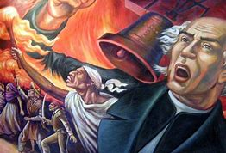
Happy Hump Day Wednesday March 6 Ash Wednesday
Let’s start with Bad Jokes!
Teacher: “Can you describe for me Napoleon's origin?”
Student: “’Course I can!!”
What ARE we doing today?
Revolutions warm-up
Notes on Enlightenment Revolutions
Group Work on 5 Revolutions
How is the reading going??
French & Indian War; Declaration of Independence; George Washington; federalists system: can anyone connect these Bold Terms?

Slide 3
“So You Say You Wanna Revolution?” Cold Group opener
Your table will work together to
Choose a Reader, a Writer, and 3 Speakers
1. Read aloud the Intro (Revolutions are major turning points…)
2. Review each of the three elements listed.
3. Follow the directions in ITALICS, writing out your group’s response.
4. Prepare to share your responses to the class.

Slide 4
Elements necessary for a successful revolution
1. At least two opposing sides You gotta have an enemy after all! Generally, they come from the below groups of people:
YOU are ONE of these groups. Which other group do you think (reason) would be your enemy in a situation where Revolution has broken out? So, LISTEN for which you are, circle that group, then circle your likely enemy. Write a brief explanation for your choice.
Conservatives | Liberals | Radicals
Usually wealthy property owners and nobility. They argued for protecting the traditional monarchies in Europe and wanted to maintain the status quo. | Mostly middle-class business leaders and merchants. They wanted to give more power to elected parliaments, but only the educated and landowners would vote. | Favored drastic change to extend democracy to all people. They believed that governments should protect all people, not just the wealthy and upper-class.

Slide 5
2. Conditions or ailments One group feels wronged or that their rights are infringed in some way. This is normally the minority group. Those problems can include:
Use 3 of the boxes above to create a brief scenario of the conditions that led to the current Revolution that broke out and explain why this group (YOU) feels wronged…
Social | Political | Economic | Time of development
Unequal rights, minority persecution, religious persecution, etc | Abuses of power, foreign controls, overstepping of governmental power, etc | Extreme debt, heavy taxes, poverty, etc | This does not happen overnight. Usually, it is after years of abuse.

Slide 6
Philosophical or political goals All good revolutions are thought out and have clear goals in mind. While those goals aren’t always achieved, as we will see, they generally include:
Based on what you have written so far, come up with the name of your Declaration or Manifesto, create a catchy slogan, and sketch out some clearly defined (as best as you can in the time given!) changes you want to see to the social norm.
Literature | Slogans | Goals
Declarations, manifestos, etc. | “No taxation without representation” | Clearly defined changes to the social norm

Slide 7
Welcome back class. The Revolution will be televised. Agenda: finish notes on Enlightenment Revolutions Work in small groups for the detailed elements of 5 Revolutions
“It’s getting cloudy!”
Can you link these events?
--National Assembly -- Reign of Terror – Napoleon Bonaparte – Napoleonic Code – Congress of Vienna

Slide 8
YIPPEE! I LOVE TAKING NOTES
LET’S ALL GET OUT OUR NOTEBOOKS!!

Slide 9
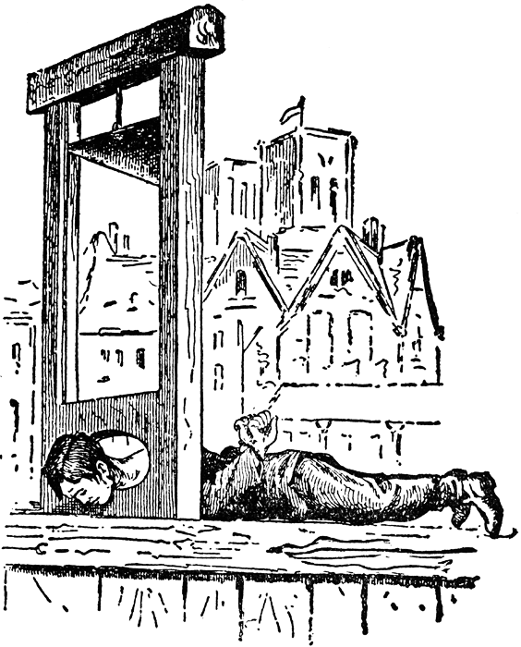
I. Revolutions in France, Haiti, Mexico
All 3 were inspired by the Enlightenment.
A. From 1789-1795 the French Revolution was a true revolution, led by elements of the middle class (bourgeoisie)
1. Louis XVI was beheaded using a guillotine
2. revolutionaries issued a Declaration of the Rights of Man and Citizen, proclaiming many of the same ideas as the American Declaration did 13 years earlier.

Slide 10
July 14, 1789
Bastille Day

Slide 11
Tennis Court Oath
Middle Class Leaders vowing to form a united Third Estate with the lower class
Ending the Old Regime (Ancien Regime)

Slide 12
B. Haitian Revolution (1803)
1. Haiti was a rich French Caribbean sugar colony
2. Revolt was led by slaves inspired by the French Revolution
3. History’s only successful lower-class led revolution
4. Toussaint L’Ouverture leader
Globally, liberal movements led the Reform Movements (Tanzimat, Self-Strengthening), which typically led to a Conservative Backlash

Slide 13
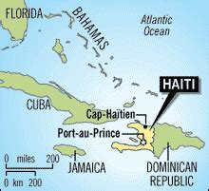

Slide 14
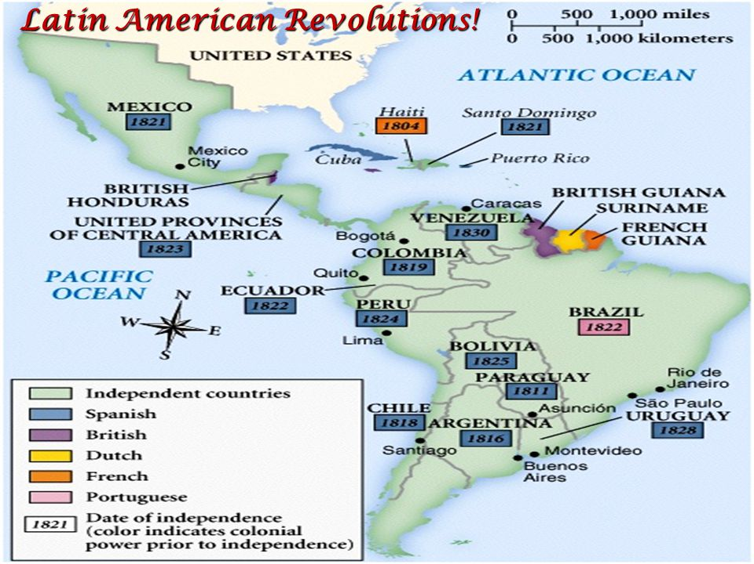
C. Mexican Revolution (19th century)
Napoleon’s invasion of Spain (1810) incited Latin America to revolt.
Three Leaders/Stages Mexico case study
1. Miquel Hildago, a priest, led Amerindians against the Establishment (Spanish, Creoles) Failed after 1 year (1810-11)
2. Jose Morelos, anther priest, picks up from there with the same goals, and the same result. Morelos is executed (1815)
3. Finally a Creole military officers leads the rebellion, winning independence in 1821; Augustin de Iturbide declared himself emperor, offending liberals, was overthrown and executed.
This mess created an atmosphere of instability and military coups that have characterized Mexico’s politics ever since (p. 353)

Slide 15
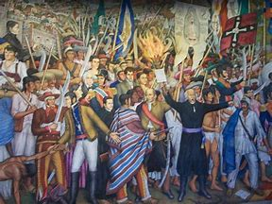
“Cry of Delores” 1810 Hidalgo

Slide 16
ELEMENTS NECESSARY FOR A SUCCESSFUL REVOLUTION Revolutions are major turning points in history, and usually radically change the political, social, and economic aspects of a nation. Regardless of where they occur, some common factors are present: a great divide between the social classes, a crisis that negatively impacts the masses (famine, drought), increasing unhappiness or loss of faith in the government or ruling power, and the desire for equality, ideals, and philosophies, which provide a common rallying ground for the unhappy class.
1. At least two opposing sides You have to have an enemy, after all! Generally, they come from the below groups of people:
Conservatives | Liberals | Radicals
Usually wealthy property owners and nobility. They argued for protecting the traditional monarchies in Europe and wanted to maintain the status quo. | Mostly middle-class business leaders and merchants. They wanted to give more power to elected parliaments, but only the educated and landowners would vote. | Favored drastic change to extend democracy to all people. They believed that governments should protect all people, not just the wealthy and upper-class.

Slide 17
2. Conditions or ailments One group feels wronged or that their rights are infringed in some way. This is normally the minority group. Those problems can include:
Social | Political | Economic | Time of development
Unequal rights, minority persecution, religious persecution, etc | Abuses of power, foreign controls, overstepping of governmental power, etc | Extreme debt, heavy taxes, poverty, etc | This does not happen overnight. Usually, it is after years of abuse.

Slide 18
3. Philosophical or political goals All good revolutions are thought out and have clear goals in mind. While those goals aren’t always achieved, as we will see, they generally include:
Literature | Slogans | Goals
Declarations, manifestos, etc. | “No taxation without representation” | Clearly defined changes to the social norm

Slide 19
4. Accomplished leadership
You need people to initiate and lead every revolution. They include:
Key Individuals | Organized Groups
Main leaders, organizers, or players | Coalitions, unions, factions, etc

Slide 20
5. Critical events
Important steps or stages of the revolution! They can include:
Symbolic Action | Significant Crisis | Spread of Ideologies | Spread of Weapons
The “big event” that makes everyone mad | Violence, terror, punishment, and/or abuses or power | Call for freedoms, equal rights, etc | Because you’re going to need to fight somehow

Slide 21
You will now work together to find the information needed to identify and explain Each of the 5 Revolution’s Elements Necessary for a Successful Revolution!
Steps:
PART One
Thumb through the packet, noting the 5 Revolutions, and common elements
Divide up the revolutions among your group members
Use your ‘look it up skills’; Wood text, Google, class texts on shelf, Freemanpedia, your AP World teacher, others?? to fill out all 16 boxes
SO when you finish your boxes, turn to your teammates and see how you can help.
PART TWO → break out and re-form. Listen for those instructions soon.

Slide 22
PART 2: Discuss with your new table partners your Revolution
We will go in order and have 5 minutes for each. Listen for the bell.
EVERYONE is graded based on getting all 5 revolutions' boxes correctly filled.
Part 3 – Return to your original, HOME table to help each other turn in a perfect packet for BONUS points!

