Slide 1
The
Agricultural/Industrial
Revolution

Slide 2
Key terms
Urbanization- movement of people from the farms to the cities
Factors of production—land, labor, capital aka $

Slide 3
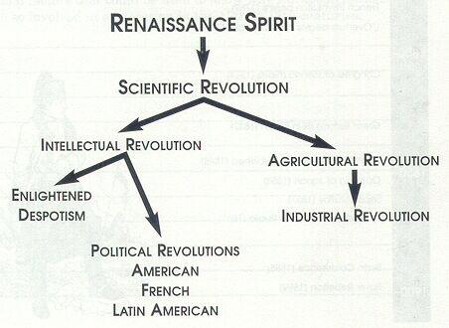
16c-18c: New Ideas Brewing

Slide 4
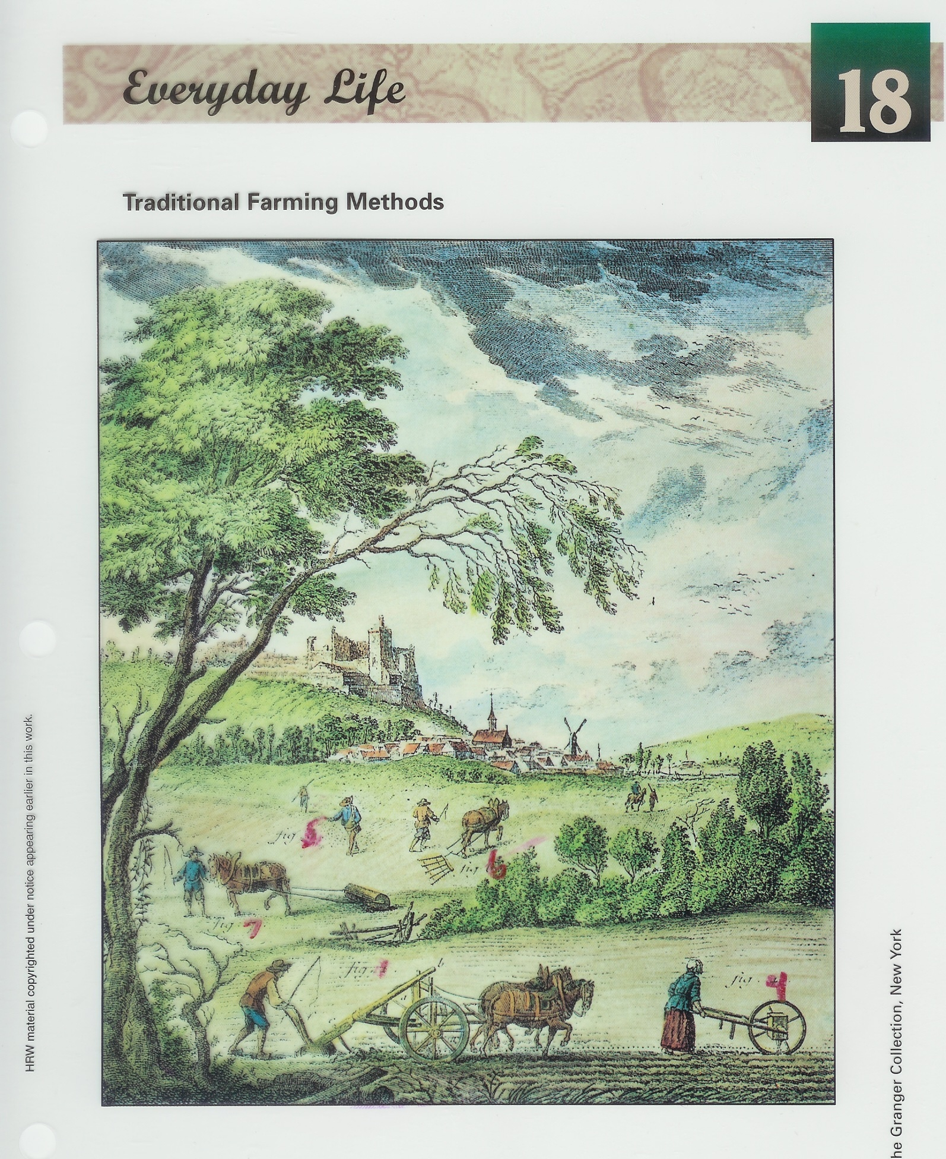

Slide 5
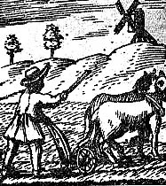
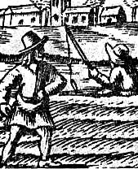
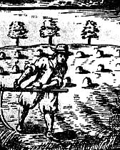
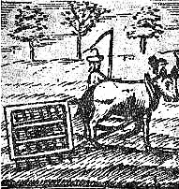
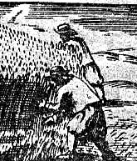
17c European Farming

Slide 6
The Industrial Revolution
STEP 1- Improvements in Farming. These are …….
Crop rotation (switching up crops). This stopped the soil’s nutrients from being “used up”
Seed drill (1701), invented by Jethro Tull * video time!

Slide 7
Cotton Gin

Slide 8
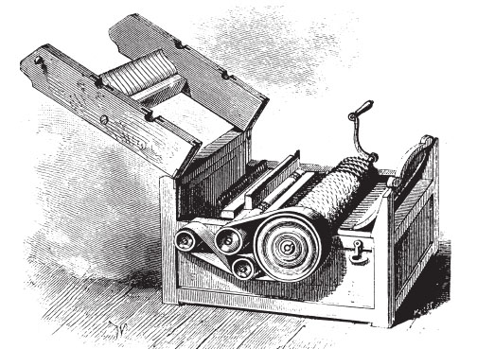
Early Version

Slide 9
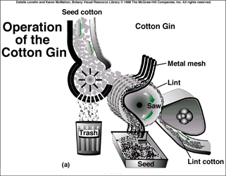
How does it work?

Slide 10
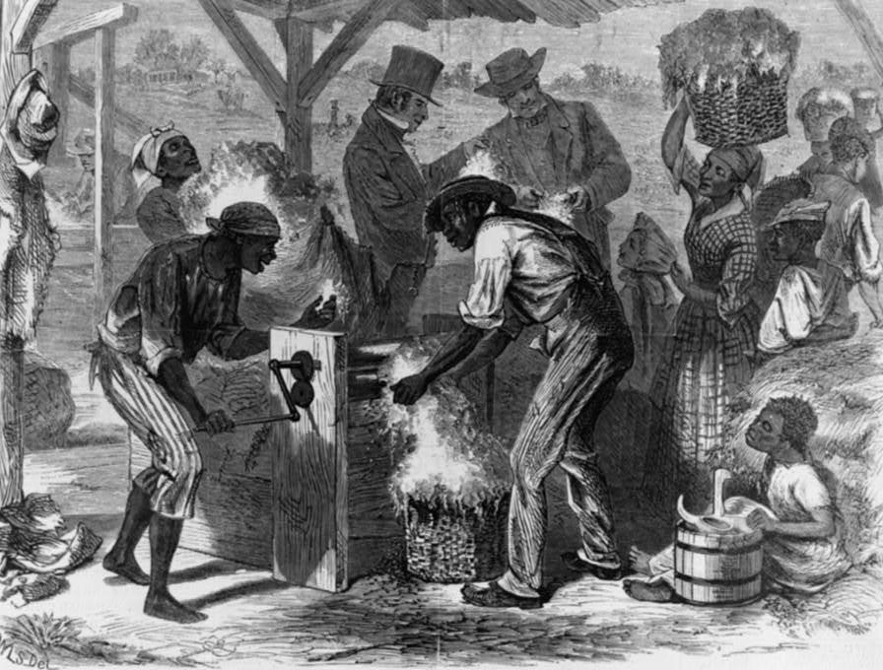
Unfortunate Result
Slavery in the South was dying out, but the creation of the cotton gin led to slavery coming back to life.

Slide 11
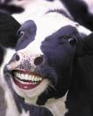
The Industrial Revolution
Improved Livestock- By letting only the best animals breed, bigger and healthier animals were produced.
Which cow would you want to
Breed? The sick cows, or the healthy cows?
The results are healthier and
Happier Cows and people!

Slide 12
The Industrial Revolution
improved livestock and farming = ?
STEP 2 - Increased population. More people meant the creation of……..
STEP 3 – Larger Towns and a middle class,
A good banking system- loans were made to those who wished to start businesses.

Slide 13
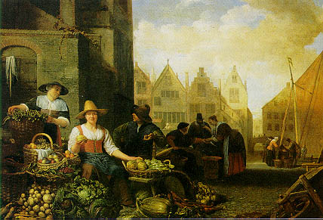
Small Town “Farmer’s Markets”

Slide 14
Industrial Revolution
1750-???? changes in agriculture, manufacturing, mining, transportation, + tech. had a profound impact on social, econ. and cultural conditions of the times.

Slide 15
Why might some people fear technology?
Hint: think jobs…
Less people are needed to work on farms as a result of new technology

Slide 16
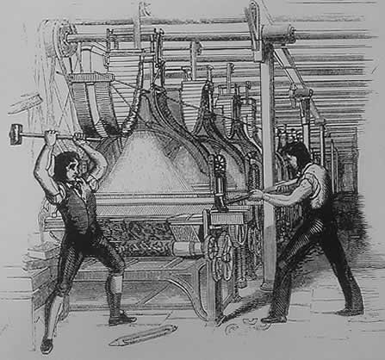
The Luddites: 1811-1816
Luddites hated the new “machines.” Attacked machines at night to protect jobs
Ned Ludd [a mythical figure supposed to live in Sherwood Forest]

Slide 17
Working Conditions
New jobs created for workers
Workers try to keep pace w/ machines
Factories dirty + unsanitary = disease
Ran dangerous machines up to 14 hours 6 days per week in unsafe conditions
Harsh and severe discipline (whipped)
Eventually received better hours, conditions + $

Slide 18
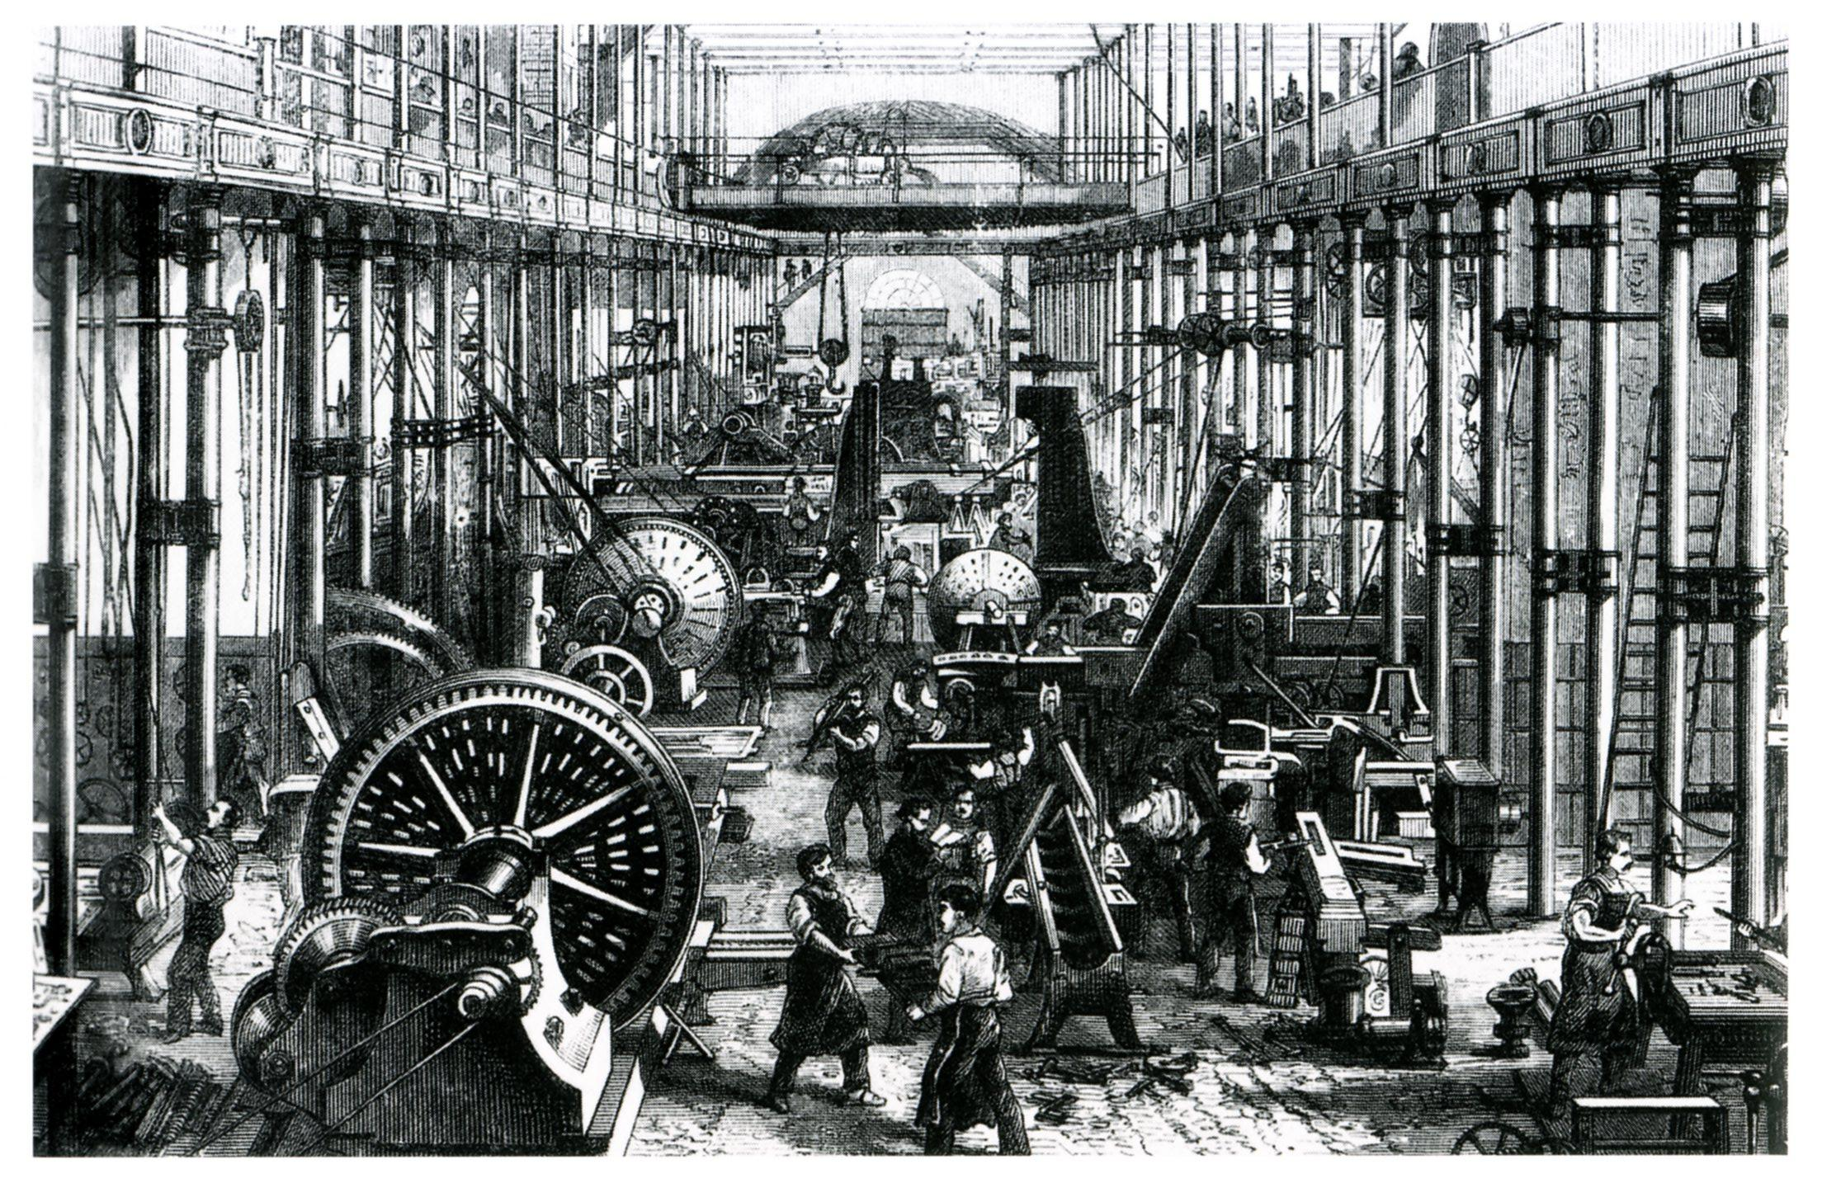

Slide 19
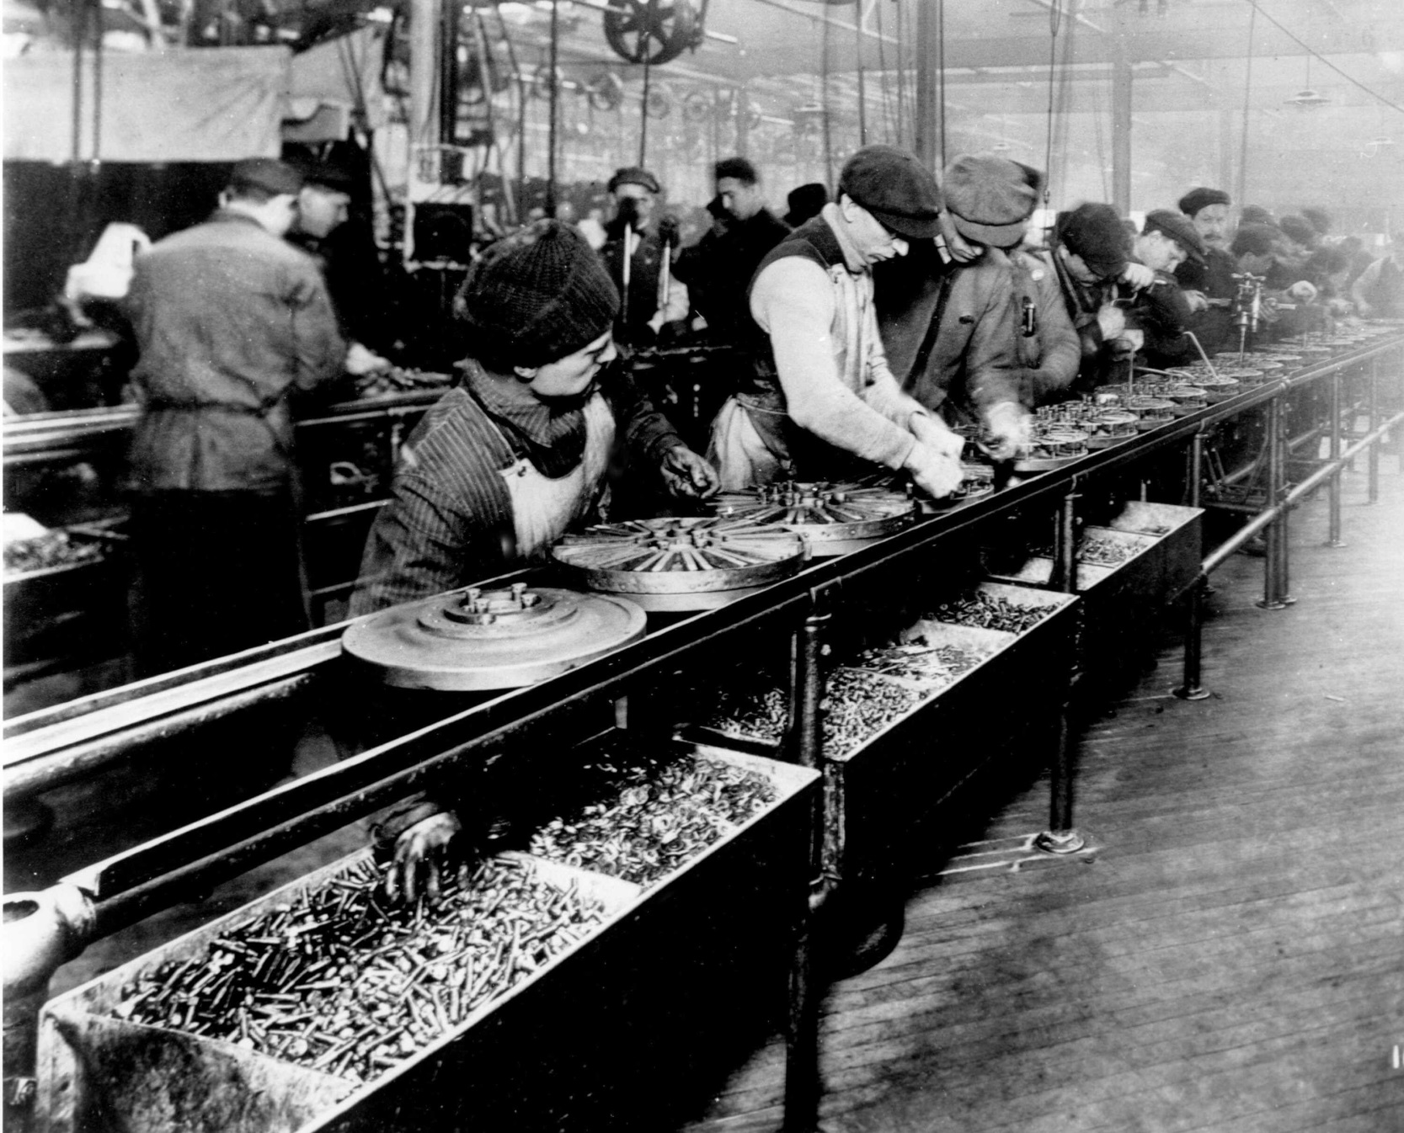
The Assembly Line

Slide 20
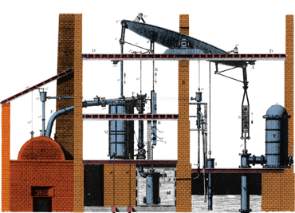
Watt steam engine
Watt steam engine
In the early 1760s, a gifted young Scot named James Watt (1736-1819) was called on to repair an engine being used in a physics course. He saw that this engine's waste of energy could be reduced by adding a separate condenser. Watt went into partnership with a wealthy English toymaker who provided the risk capital and manufacturing plant. Twenty years of constant effort and the help of skilled mechanics enabled Watt to create an effective vacuum and regulate a complex engine. (Science Museum, London)

Slide 21
Steam Tractor

Slide 22
Steam Ship

Slide 23
An Early Steam Locomotive

Slide 24
Later Locomotives

Slide 25
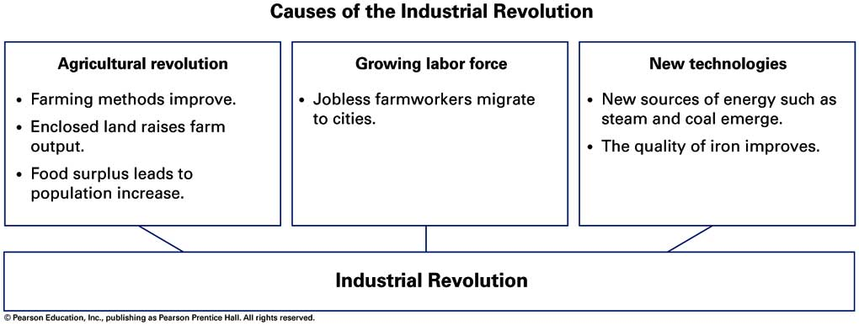

Slide 26
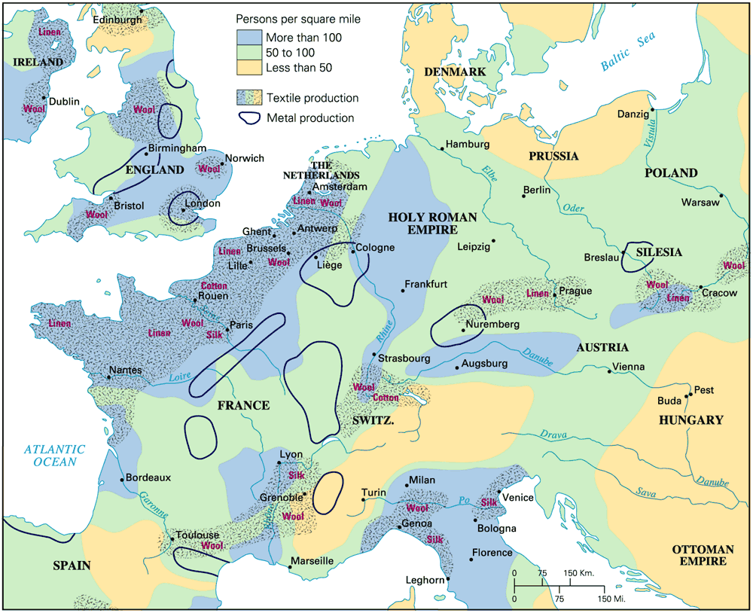
Industry & Population: 18c Europe

Slide 27
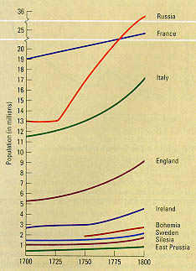
18c Population Growth Rate

Slide 28
Population Takeoff in Europe

Slide 29
Why Was England
Different?

Slide 30
The Industrial Revolution in GB 1st Why??
Stocks – buying shares of a business and getting a % of the profit. Ex. Apple (the company) stock.
Political Stability- No wars were fought on British soil.
Britain has natural resources—coal, iron, rivers,
harbors
Britain has all the needed factors of production—land, labor, capital

Slide 31
Why not the French? Economic Disadvantages
Years of war
Supported the American Revolution. $$$
French Revolution $$$.
Early 19c → Napoleonic Wars
Heavy debts.(Palace of Versailles
High unemployment → soldiers returning from the battlefronts.
French businessmen were afraid to take risks.

Slide 32
Innovation… REMEMBER?
the introduction of something new such as a new idea, method, or device

Slide 33
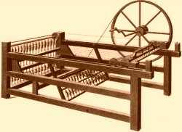
New inventions shape the world…..
Spinning Jenny Wheel- Did the work of 8-16 people! It became such a big deal that the British built specific buildings just to house them. (These buildings became know as)…
Factories!!!!!
Also… new amount of Freedom people had *
Instead of 24/7, they had a day off, or a few hours free each day

Slide 34
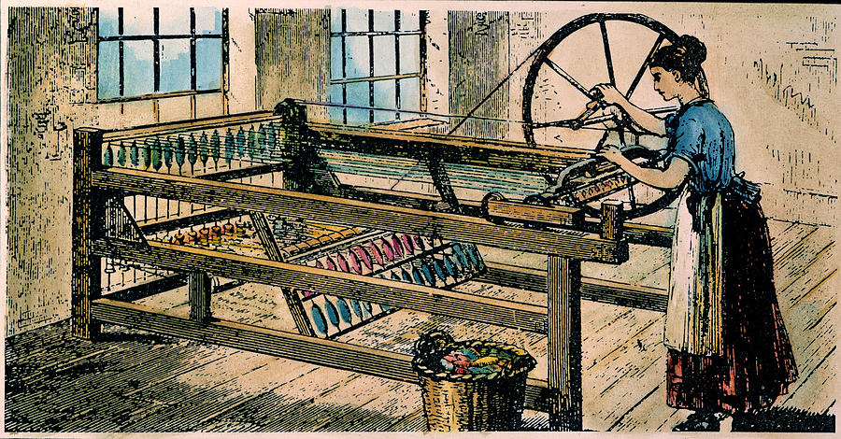
Spinning Jenny in use

Slide 35
The Power Loom

Slide 36
Factory Production
Now production is in one place [materials, labor].
Location focused near sources of power [rather than near labor or markets].
Requires a lot of capital investment [factory, machines, etc.] more than skilled labor.

Slide 37
The Industrial Revolution
Step 4- Factories
Eli Whitney – {Cotton Gin} allowed cotton to be picked at 10x the speed as men could.
James Watt - improved the Steam engine. There was now something other than water to power the machines in factories.
New inventions lead to a 5000% increase in production!!!!!!!
Cotton, Coal, Pig Iron, cloth, tools, books are produced at incredibly fast levels
Entrepreneurs- A person who organizes, manages, and takes on the risks of business.

Slide 38
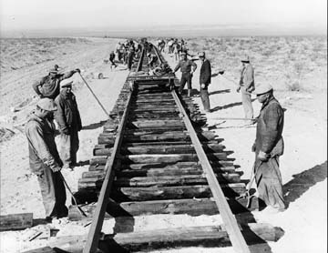
Canals, Roads, Railroads built
Rail Roads - The steam engine is put on rails.
Pulls large loads, transports food to cities, Industrial goods to the country, makes the world smaller.
Cities get BIGGER this causes problems.
Over crowded
Disease
Possible starvation

Slide 39
RURAL - Countryside.
Positives- Social Mobility, jobs, education,
Social Mobility: is the movement of individuals or groups in social position/class over time
Industrial Rev - Good for business, bad for people*

Slide 40
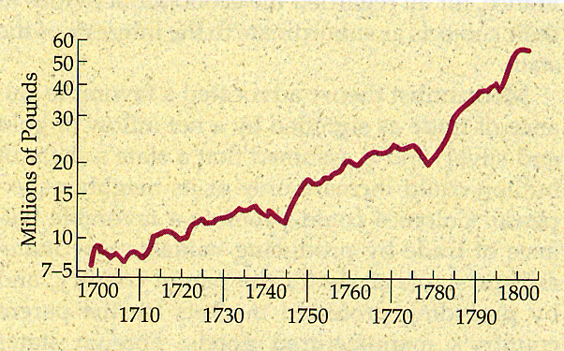
The Growth of England’s Foreign Trade in the 18c

Slide 41
Early Canals
Britain’s Earliest Transportation Infrastructure

Slide 42
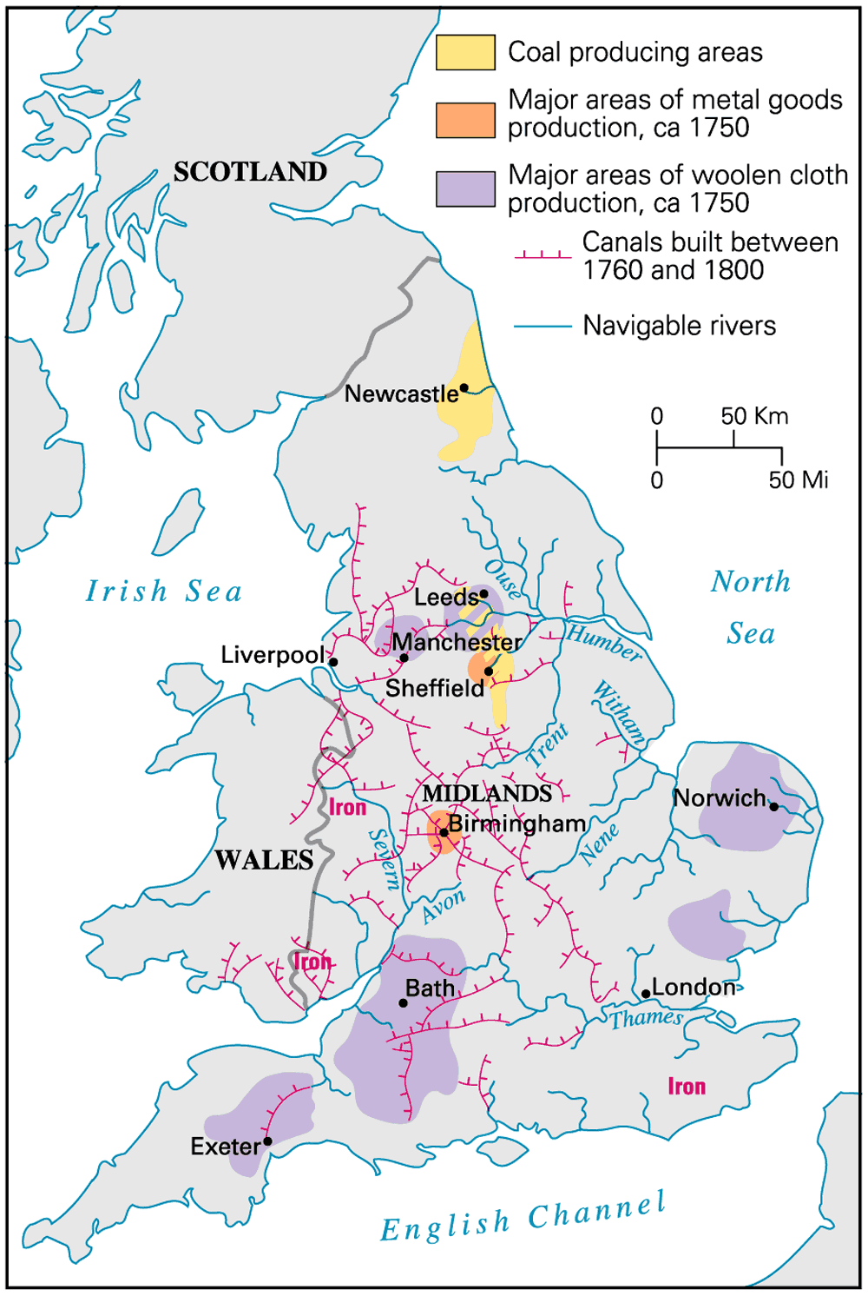
Metals, Woolens, & Canals

Slide 43
Coal Mining in Britain: 1800-1914
1800 | 1 ton of coal | 50, 000 miners
1850 | 30 tons | 200, 000 miners
1880 | 300 million tons | 500, 000 miners
1914 | 250 million tons | 1, 200, 000 miners

Slide 44
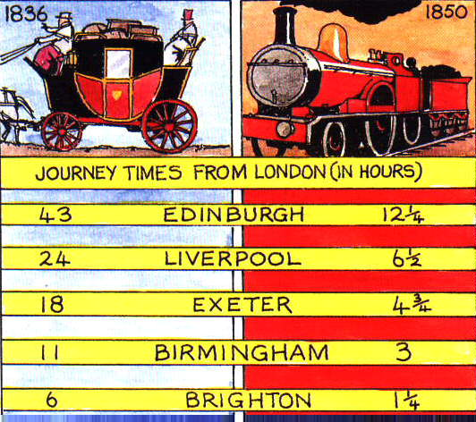
The Impact of the Railroad

Slide 45
Mine & Forge [1840-1880]
More powerful than water is coal.
More powerful than wood is iron.
Innovations make steel feasible. * Bessemer process [1856] – strong, flexible steel.
Problem with Bessemer Process?
Workers start to lose vision and hearing

Slide 46
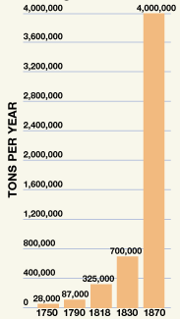
British
Pig Iron Production

Slide 47
Textile Factory Workers in England
1813 | 2400 looms | 150, 000 workers
1833 | 85, 000 looms | 200, 000 workers
1850 | 224, 000 looms | >1 million workers

Slide 48
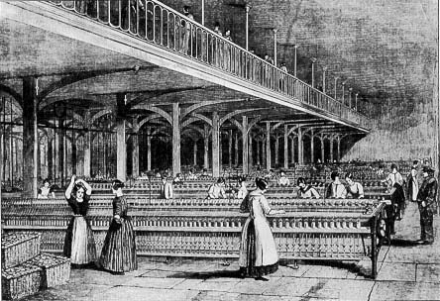
Textile Factory Workers in England

Slide 50
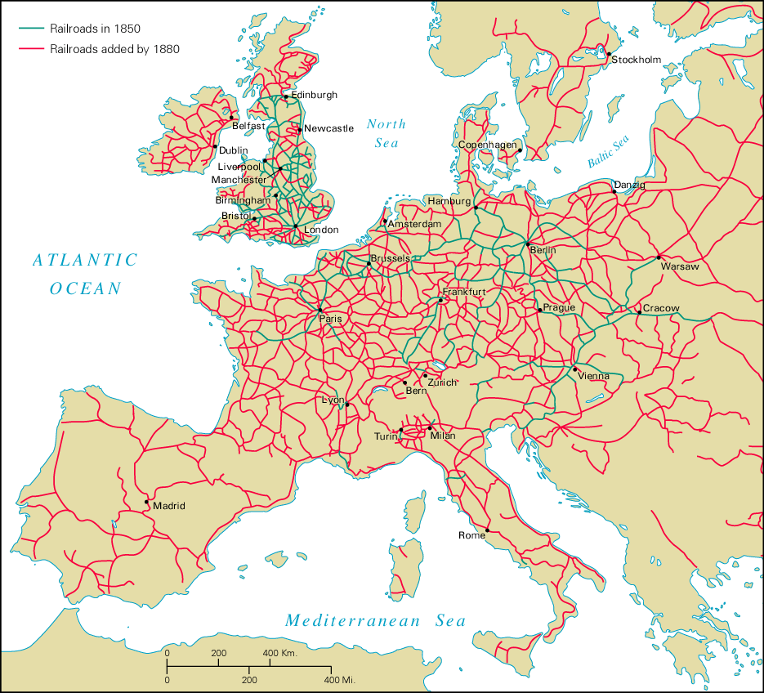
Railroads on the Continent

Slide 52
The "Haves":
Upper Class Life
Thrived on the
Profits of the
Industrial Revolution

Slide 53
New Social Classes
Upper Class: Very rich industrial & business families. Old Noble class.
Upper Middle Class: Business people & professionals such as, lawyers & doctors.
Lower Middle Class: Other professionals such as, teachers, shop owners, and office workers.
Working Class: Factory workers and small farmers

Slide 54
The Industrial Revolution
Negatives- Sanitation, illness, epidemics, no housing, little education, Crime, Working conditions-
In the early Ind Rev, Hours- dawn to dusk, 6 days a week.
Kids worked just like the parents were paid 25% of the parents wages.

Slide 55
What do you think the artist is thinking?

Slide 56
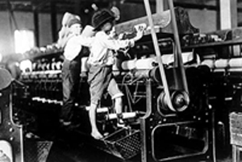
Factory Workers… Wanna join?

Slide 57
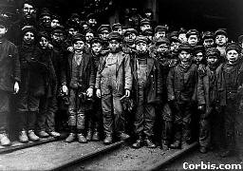
Young Coal Miners

Slide 58
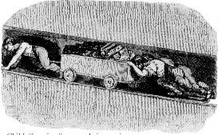
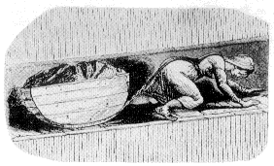
Child Labor in the Mines
Child “hurriers”

Slide 59
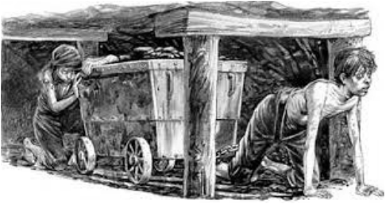

Slide 60
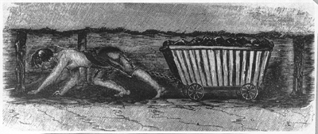
Girl dragging coal wagon in mine
Girl dragging coal wagon in mine
This engraving of a girl dragging a coal wagon in the mines was one of several that accompanied a parliamentary report on working conditions in the mines. They shocked public opinion and contributed to the Mines Act of 1842. (British Library)

Slide 61
Children- Very useful in the mines. They were small, fit into tunnels and tight spaces.
Middle Class expands - The middle class gets bigger, Tensions between classes arise.
The Government adopts a Laissez-faire (hands off)*
They did not want to get involved in private business problems or regulating business rules.

Slide 62
Stereotype of the Factory Owner

Slide 63
Industrial Staffordshire

Slide 64
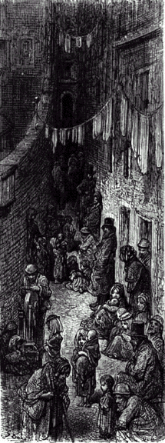
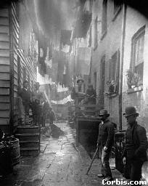
The New Industrial City

Slide 66
Worker Housing in Manchester

Slide 67
Factory Workers at Home

Slide 68
Protests / Reformers
The “upper class” didn’t like what was going on with society.
They learned about it from writers like…
(Charles Dickens - Upton Sinclair)

Slide 69
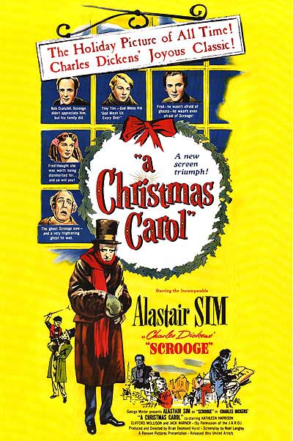
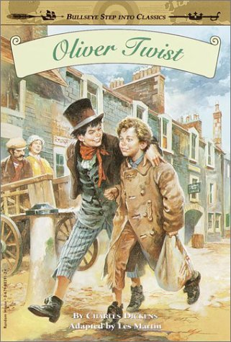
The New Urban Poor: A Nightmare!

Slide 70
New Ways
of
Thinking

Slide 71
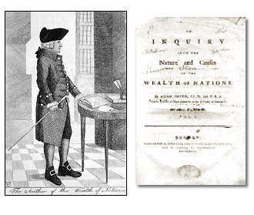
3 ways to run an economy and society-
1.CAPITALISM- ($$$)The Goal of making profit. (little or no regulations aka laws about businesses)
The idea? Leave business alone and we will all be better off. Competition will solve economic problems
Adam Smith- Wealth of Nations. Rule of supply and demand

Slide 72
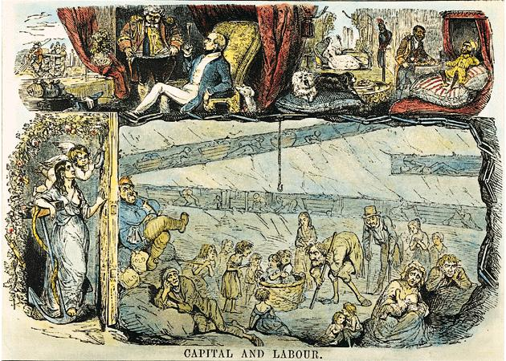
“Upstairs”/“Downstairs” Life

Slide 73
Private Charities: Soup Kitchens

Slide 74
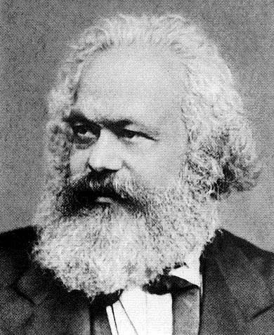
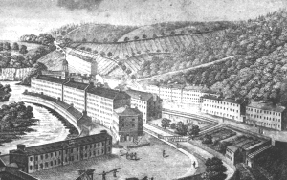
The Socialists: Utopians & Marxists
2. SOCIALISM- Do what is good for the social order. Factories are owned by the government.
Karl Marx- Communist Manifesto-
3. COMMUNISM- EVERYTHING, land, factories, mines, RRs, and businesses would be owned by the government.
“We all work for the better good”
Tried to build perfect communities [utopias].

Slide 75
New Ideas
How can a factory worker protect themselves against bad conditions?
1. Sabotage 2. strike 3. picket 4. Unions
The Gov’t steps in and tries to reform problems.
Child Labor, long hours, safety conditions, school is required, women’s rights.*

Slide 76
GB Govt Response
* Factory Act [1833] – child labor.
No child under 9 allowed to work
At least 2 hours schooling every day for kids
Children not to work at night
4 inspectors per factory to ensure law is followed

Slide 77
The Results of
Industrialization
at the end of the 19c

Slide 79
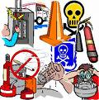
The Industrial Revolution
Phase II in the Ind Rev, Life improved.
Reforms spread to cities, and life in general improves.
Safety of buildings, More housing, health codes, FDA, construction codes, Hospitals, plumbing, electricity, easy access to life items. etc.
Socially, Life is now changed. You have rights, a chance to move up, and more free time than ever. (Social Mobility)
NOT like the “caste system, or Estates,
Europeans think because they are “better” that their ideas and culture is superior* What do we call this?* Ethnocentrism

Slide 81
Life In the Industrial Age: Section 2
Progress Monitoring Transparency (1 of 2)
6 of 7

Slide 82
7 of 7

Slide 83
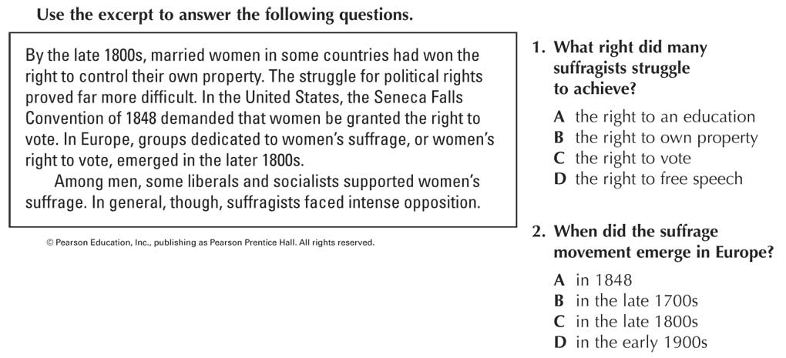
6 of 6

Slide 84
Test comes next…..

