Slide 1
Unit III
Federalism & the Federal Government

Slide 2
Unit III – Federalism & The Federal Government
CL.C&G.1.1 Explain the influence of the founding principles on state and federal decisions using primary and secondary source documents.
CL.C&G.2.1 Compare how national, state, and local governments maintain order, security, and protect individual rights.
Essential Question: How did Founders establish government with the authority to govern will limiting its ability to abuse power under the U.S. Constitution?
Students can:
Explain how powers are separated in order to prevent abuse of power
Agenda:
Preventing Abuse of Power
Constitutional Principle Superhero
Homework:

Slide 3
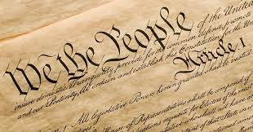
Restrains on Authority
“Liberty must at all hazards be supported. We have a right to it, derived from our Maker. But if we had not, our fathers have earned and bought it for us, at the expense of their ease, their estates, their pleasure, and their blood.”
– John Adams, 1765
Upholding the ideas of the American Revolution
Important principles of the Constitution (restraints on power)
Federalism
Limited Government
Republicanism
Popular sovereignty
Rule of Law
Separation of Powers
Checks & Balances

Slide 4
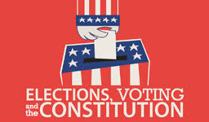
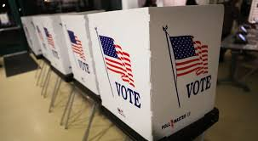
Power of the People
Popular sovereignty = the people govern (consent of the govern) & majority rules
Enlightened Philosopher – John Locke (Social Contract – We agree to form government)
Ex. Voting & Elections
"We the People of the United States, in Order to form a more perfect Union, establish Justice, insure domestic Tranquility, provide for the common defense, promote the general Welfare, and secure the Blessings of Liberty to ourselves and our Posterity, do ordain and establish this Constitution for the United States of America.”
- Preamble to the U.S. Constitution

Slide 5
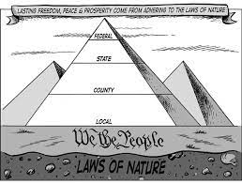
Federalism
Federalism – division of power between the national, state and local governments
National Government power
Declare war
Print $$$
Enumerated Powers
State Government power (10th Amendment)
Driver’s license
Education
Reserve Powers
Shared powers (both national & state)
Taxation
Lawmaking
Concurrent Powers

Slide 6
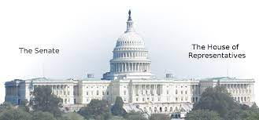
Representing
Republicanism – representative democracy
Article I – Congress
Bicameral (Great Compromise)
House of Representatives – representation by population
Senate – equal representation (2 per state)
“If a faction consists of less than a majority, relief is supplied by the republican principle, which enables the majority to defeat its sinister views by regular vote. It may clog the administration, it may convulse the society; but it will be unable to execute and mask its violence under the forms of the Constitution.”
- James Madison, Federalists 10

Slide 7
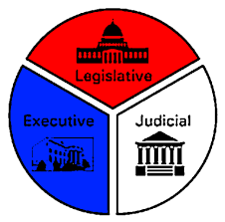
Montesquieu’s Rule
Separation of Powers: establishing three separate branches of government (Executive, Legislative, & Judiciary)
Article I: Legislative branch (Congress) – lawmaking power
Article II: Executive branch (President) – law enforcing power
Article III: Judiciary branch (Supreme Court) – law interpreting power

Slide 8
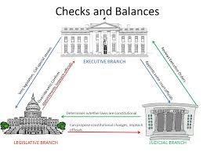
Limit Gov. Power
Checks & Balances – ways that each branch of government can stop the power of another branch
Congress
Checks against the President – override vote
Check against the Court – change laws or reject appointees
President
Checks against Congress– Veto
Check against the Court – refuse to enforce a court decision
Supreme Court
Checks against the President – can declare presidential actions unconstitutional
Check against Congress – Can declare laws unconstitutional

Slide 9
Samples of the Madisonian Model
Organize the following ideas from the Constitution under one of the three categories of the Madisonian Model
Separation of Powers
Checks & Balances
Stopping the Tyranny of the Mob
Direct elections of HOR members every two years
Presidential veto
Electoral College choose the president
Bicameral legislature
The Supreme Court interprets the law
Federalism
President is commander & chief of the military and Congress has the power to declare war
Nine justices can declare legislation passed by Congress unconstitutional

Slide 10
Principles of the Constitution
Identify the Constitutional Principles
Checks and Balances - Federalism
Popular Sovereignty - Republicanism
Separation of powers
___ 1. The House of Representatives shall be composed of members chosen every second year by the people of the several states, and the electors in each state shall have the qualifications requisite for electors of the most numerous branch of the state legislature.
__ 2. The President shall have Power, by and with the Advice and Consent of the Senate, to make Treaties, provided two thirds of the Senators present concur
__ 3. Congress shall have the power To regulate Commerce with foreign Nations, and among the several States, and with the Indian Tribes – The states shall have the power to regulate intrastate commerce.
__ 4. The Senate of the United States shall be composed of two Senators from each State, chosen by the Legislature thereof, for six Years; and each Senator shall have one Vote.
__ 5. All legislative Powers herein granted shall be vested in a Congress and The executive Power shall be vested in a President

Slide 11
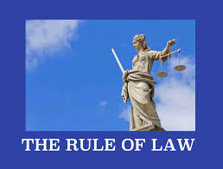
No ONE is ABOVE THE LAW
Rule of Law - everyone, including those that govern must follow the laws of our nation
Examples of rule of law in the Constitution
Impeachment – removing the President or federal official from office
House of Representatives - Articles of Impeachment
Senate – Jury for the trial
Expulsion – Congress can remove its members

Slide 12
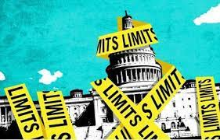
Limited Government
Limited Government – restricting the authority of the government
Bill of Rights: limits government power to interfere with natural rights of citizens
Congress shall make no law respecting an establishment of religion, or prohibiting the free exercise thereof; or abridging the freedom of speech, or of the press; or the right of the people peaceably to assemble, and to petition the Government for a redress of grievances
Denied Powers of Article I: Congress cannot suspend writ of habeas corpus, pass bills of attainder, or ex post-facto laws

Slide 13
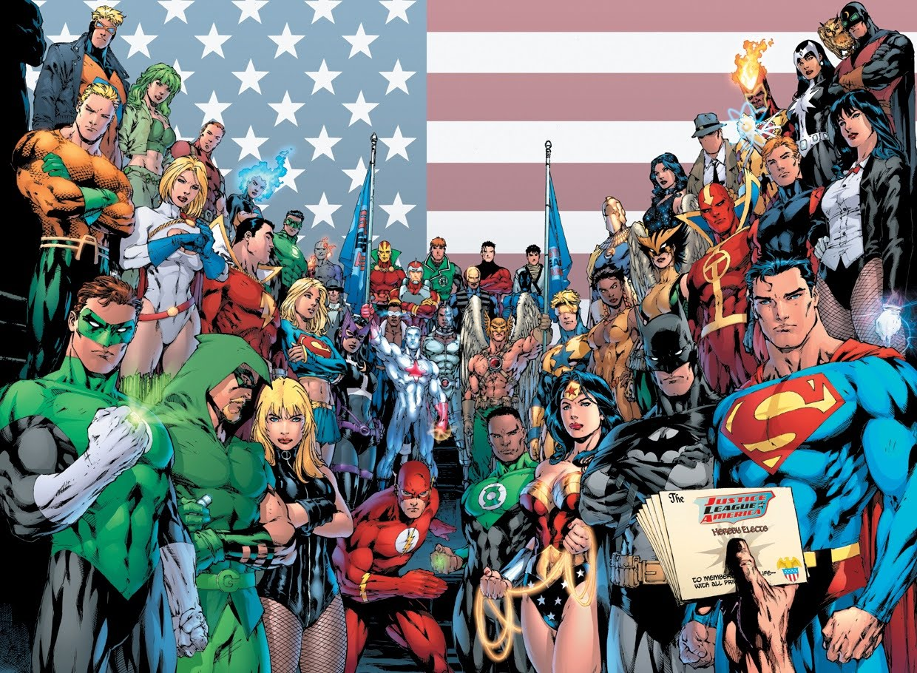
Constitutional Principle Superhero
Design a Constitutional Principle Superhero
The Big 7 Principles
Popular sovereignty
Federalism
Republicanism
Separation of Powers
Checks & Balances
Rule of Law
Limited Government

Slide 14
A Gallery of Principles
Create a chart in your notebook
Principles of the Constitution | Definition | Example in the Constitution
1. Popular sovereignty
2. Federalism
3. Republicanism
4. Separation of powers
5. Checks & balances
6. Limited government
7. Individual liberty
8. Rule of law

Slide 15
Principles of the Constitution
Enabling government without creating tyranny
Popular sovereignty B. Separation of Powers C. Republicanism
Checks & balances E. Federalism F. Rule of Law
Individual liberties H. Limited government
__ 1. The Tenth Amendment grants all powers not listed in the U.S. Constitution to the states.
__ 2. Bicameral U.S. Congress
__ 3. The House of Representatives draws the articles of impeachment and the Senate is the jury for impeachment trial
__ 4. Congress may not suspend the writ of habeas corpus unless in cases of rebellion
__ 5. The President may negotiate and establish treaties with the consent of Senate
__ 6. Congress can override a presidential veto with a 2/3rds majority in both houses
__ 7. Federal officials maybe impeached for committing high crimes and misdemeanors
__ 8. The Constitution can be amended with a proposal passed by Congress via a 2/3rd vote and being ratified with a 3/4th vote of state legislatures

Slide 16
Unit III – Federalism & The Federal Government
CL.C&G.1.1 Explain the influence of the founding principles on state and federal decisions using primary and secondary source documents.
CL.C&G.2.1 Compare how national, state, and local governments maintain order, security, and protect individual rights.
Essential Question: How did Founders establish government with the authority to govern will limiting its ability to abuse power under the U.S. Constitution?
Students can:
Explain how the founders built the U.S. Constitutions on auxiliary precautions to prevent abuse of government authority
Agenda:
Who Decides
Federalism
Dividing Powers of Government
Homework: NO Homework

Slide 17
Unit III – Federalism & The Federal Government
CL.C&G.1.1 Explain the influence of the founding principles on state and federal decisions using primary and secondary source documents.
CL.C&G.2.1 Compare how national, state, and local governments maintain order, security, and protect individual rights.
Essential Question: How did Founders establish government with the authority to govern will limiting its ability to abuse power under the U.S. Constitution?
Students can:
Explain how the founders built the U.S. Constitutions on auxiliary precautions to prevent abuse of government authority
Agenda:
Who Decides
Federalism
Dividing Powers of Government
Homework: Constitutional Principle Superhero

Slide 18
Who Decides
Make a list of items that reflects who has the power in your family
What are things you get to decide
What are things you and your parents decide together
What are things your parents decide

Slide 19
Types of Government System
Federal system: Division of power to govern between state and federal government (Blends a centralize and decentralize gov.)
Federal government determines public policy
States carry out public policy
Unitary System
Highly centralized government
National government can share or remove power with state & local gov.
Confederation
An alliance amongst state government
Decentralized government – Articles of Confederation
Other systems of government

Slide 20
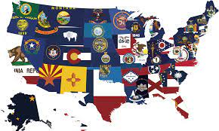
Federal System
“A good Government implies two things: first, fidelity to the object of Government, which is the happiness of the People; secondly, a knowledge of the means by which that object can be best attained.”
- James Madison, Federalist 62
Federalism repairs a weakness of the Articles of Confederation – unifies the nation
Setting a National Standard
Full Faith & Credit Clause (contracts are good in all 50 states – Driver’s License)
Interstate Commerce Clause allows Congress to set rules for trade between states

Slide 21
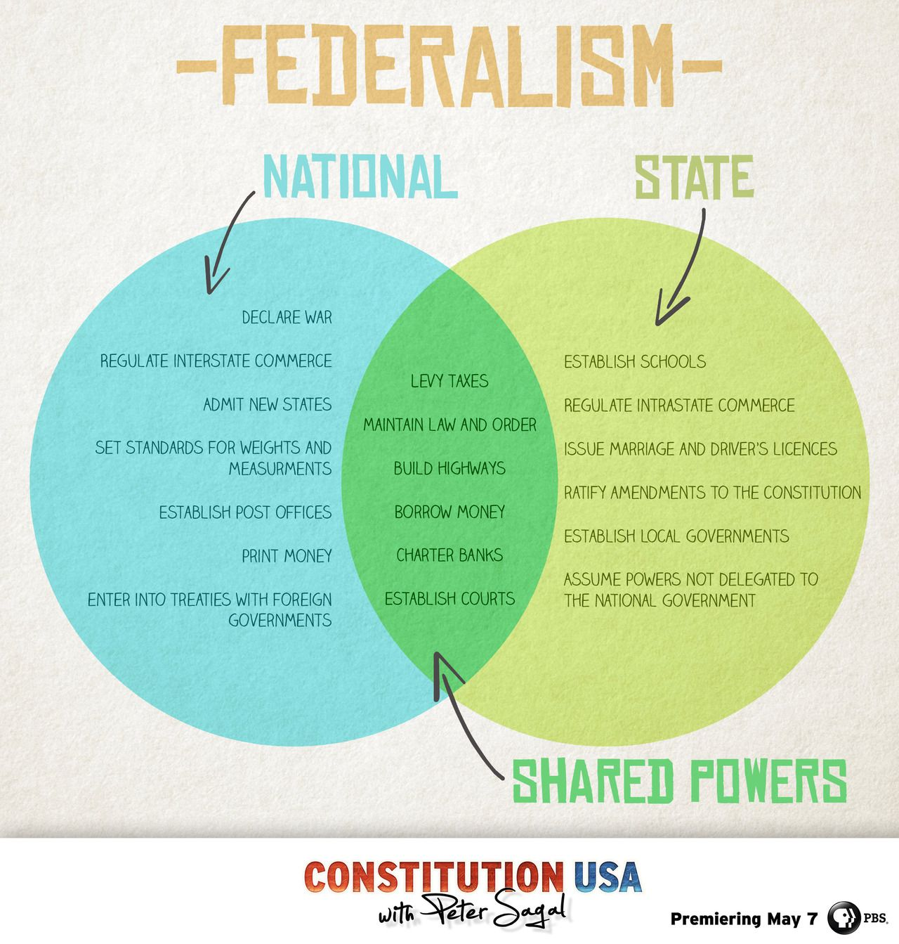
Federal system (Federalism)
Federalism – division of power to govern between national and state governments (Constitutional principle)
Reserve powers – state government powers (10th Amendment)
Enumerated powers – federal government powers (written in the U.S. Constitution)
Concurrent powers – both state & federal powers
Advantages of Federalism
Allows states to meet the needs of their people
Limits the power of the federal government
Laboratories of Democracy - experimentation

Slide 22
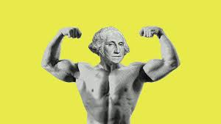
Expanding Federal Power
“I HAVE THE POWER!
State Government
Federal Government
Superior Federal Power
Supremacy Clause: The Constitution and its laws are the supreme law of the land – states cannot supersede federal power
Necessary & Proper Clause: Allows Congress to stretch its power (Elastic Clause) to make laws
Example: enumerated power (oversee the military) IMPLIED POWER (create an Airforce)
Federal Government

Slide 23
Dividing Powers of Government
Categorize the powers of government into one of the following areas
Enumerated Powers (National Government Only)
Concurrent Powers
(Both National & State Gov.)
Reserve Powers
(State Government Only)

Slide 24
Dividing Powers of Government
Categorize the powers of government into one of the following areas
Enumerated Powers (National Government Only)
Concurrent Powers
(Both National & State Gov.)
Reserve Powers
(State Government Only)
Denied Powers
(Government not allowed to use)

Slide 25
Unit III – Federalism & The Federal Government
CL.C&G.1.1 Explain the influence of the founding principles on state and federal decisions using primary and secondary source documents.
CL.C&G.2.1 Compare how national, state, and local governments maintain order, security, and protect individual rights.
Essential Question: How did Founders establish government with the authority to govern will limiting its ability to abuse power under the U.S. Constitution?
Students can:
Explain how the founders built the U.S. Constitutions on auxiliary precautions to prevent abuse of government authority
Explain how the structure of Congress allows it to achieve the goals of the U.S. Constitution
Agenda:
Federalism Recall
Dividing Powers of Government
Preamble 6
Homework:
- Make up missing assignments

Slide 26
Public Policy Issues
Evaluate the following issues and determine whether the NC State Government or U.S. Federal Government should handle them. Type (R) for Reserved Power and (E) for Enumerated Power or (C) for Concurrent.
__ 1. Taxation and spending
__ 2. Education
__ 3. Coin & print $$$$
__ 4. Overseeing an army and navy
__ 5. Lawmaking
__ 6. Drivers’ license
__ 7. Declare war
__ 8. Establish courts
__ 9. Conducting elections
__ 10. Making treaties

Slide 27
Unit III – Federalism & The Federal Government
CL.C&G.1.1 Explain the influence of the founding principles on state and federal decisions using primary and secondary source documents.
CL.C&G.2.1 Compare how national, state, and local governments maintain order, security, and protect individual rights.
Essential Question: How did Founders establish government with the authority to govern will limiting its ability to abuse power under the U.S. Constitution?
Students can:
Explain how the founders built the U.S. Constitutions on auxiliary precautions to prevent abuse of government authority
Explain how the structure of Congress allows it to achieve the goals of the U.S. Constitution
Agenda:
Federalism Recall
Dividing Powers of Government
Preamble 6
Homework:
- Achieving the Preamble

Slide 28
Public Policy Issues
Evaluate the following issues and determine whether the NC State Government or U.S. Federal Government should handle them. Type (R) for Reserved Power and (E) for Enumerated Power or (C) for Concurrent.
__ 1. Funding for students in public schools to prepare them for 21st century learning
__ 2. Negotiating trade agreements with European Union
__ 3. Creating jobs for people and promoting economic growth
__ 4. Defending against a potential terrorist attack
__ 5. Defending a NATO ally against Russian aggression
__ 6. Building and improving infrastructure (highways, railroads, airports)
__ 7. Running elections
__ 8. Establishing guidelines for driver’s license

Slide 29
Dividing Powers of Government
Categorize the powers of government into one of the following areas
Enumerated Powers (National Government Only)
Concurrent Powers
(Both National & State Gov.)
Reserve Powers
(State Government Only)

Slide 30
Dividing Powers of Government
Categorize the powers of government into one of the following areas
Enumerated Powers (National Government Only)
Concurrent Powers
(Both National & State Gov.)
Reserve Powers
(State Government Only)
Denied Powers
(Government not allowed to use)

Slide 31
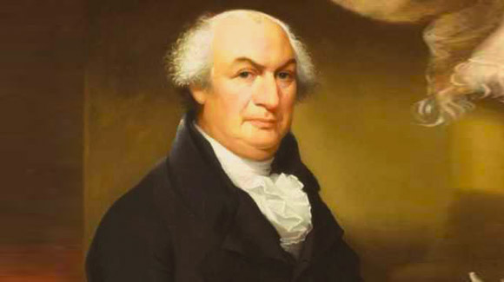
Introduction to the U.S. Constitution
Introducing the Constitution
Preamble = the introduction to the U.S. Constitution
Outlines the goals of the U.S. Constitution
We the People of the United States, in Order to form a more perfect Union, establish Justice, insure domestic Tranquility, provide for the common defence, promote the general Welfare, and secure the Blessings of Liberty to ourselves and our Posterity, do ordain and establish this Constitution for the United States of America.
- Preamble, U.S. Constitution
Identify the 6 goals of the U.S. Constitution

Slide 32
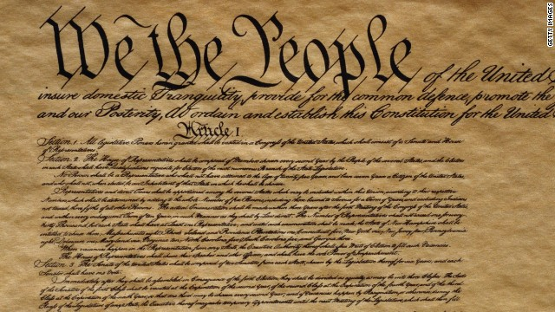
Example of the 6 Goals
Preamble = the introduction to the U.S. Constitution
Find a current event story that displays the U.S. Government carrying out each of the objectives of the Preamble
We the People
Provide for the common defense
To form a more prefect union
Promote the general welfare
Establish justice
Secure the blessings of liberty
Do ordain & establish this Constitution
Insure domestic tranquility

Slide 33
Unit III – Federalism & The Federal Government
CL.C&G.1.1 Explain the influence of the founding principles on state and federal decisions using primary and secondary source documents.
CL.C&G.2.1 Compare how national, state, and local governments maintain order, security, and protect individual rights.
Essential Question: How did Founders establish government with the authority to govern will limiting its ability to abuse power under the U.S. Constitution?
Students can:
Explain how powers are separated in order to prevent abuse of power
Explain how the structure of Congress allows it to achieve the goals of the U.S. Constitution
Agenda:
Achieving the Preamble
Congressional Structure
Bicameral by Design
Homework: Make up missing assignments

Slide 34
Unit III – Federalism & The Federal Government
CL.C&G.1.1 Explain the influence of the founding principles on state and federal decisions using primary and secondary source documents.
CL.C&G.2.1 Compare how national, state, and local governments maintain order, security, and protect individual rights.
Essential Question: How did Founders establish government with the authority to govern will limiting its ability to abuse power under the U.S. Constitution?
Students can:
Explain how powers are separated in order to prevent abuse of power
Explain how the structure of Congress allows it to achieve the goals of the U.S. Constitution
Agenda:
Achieving the Preamble
Congressional Structure
Bicameral by Design
Homework: Dissecting a Bicameral Congress

Slide 35
Achieving the Preamble
Identify the part of the Preamble being achieved in each headline
1. Air Force jets intercept 2 Russian bombers flying close to Alaska
2. House passes Inflation Reduction Act, sends it to Biden
3. US midterm elections: The six races that could decide the US Senate
4. US Supreme Court denies Oklahoma death row inmate’s appeal
5. Biden unveils "Building a Better America" branding giving the country $1.2 Trillion dollars to repair American infrastructure
6. President Biden's anti-crime bill: Will it make America safer?
7. Supreme Court hears challenge to key section of the Voting Rights Act in redistricting case

Slide 36
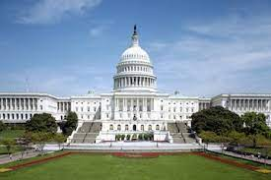
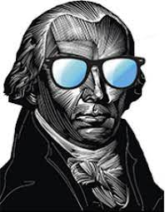
Madison’s Design
U.S. Congress: Bicameral (2 house legislature) with the power to make laws
House of Representatives
Senate
The Madisonian Model of Government
Bicameral by design:
The Great Compromise
Separation of powers – divide the lawmaking power
Check & Balance – laws have to pass both houses in identical forms
Stops tyranny of the mob – 435 members in HOR v. 100 in Senate

Slide 37
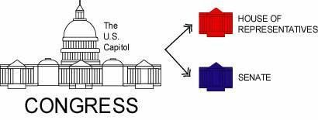
The Republicanism Design
Incorporating the goals of the Madisonian Model of Government
House of Representatives:
Representation by population
2 year term
435 members
Senate:
Equal representation (2 per state)
6 year term with staggered terms (only 1/3 go up for re-election at a time)
100 members
The Great Compromise

Slide 38
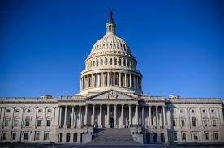
Congressional Authority
Congress is the main body of government = Article I of the U.S. Constitution
“We may define a republic to be … a government which derives all its powers directly or indirectly from the great body of the people, and is administered by persons holding their offices during pleasure for a limited period, or during good behavior.”
- James Madison, Federalist 39
Powers Assigned to Congress:
Lawmaking
Taxing & spending (power of the purse)
Regulating commerce (interstate & foreign)
Foreign relations: (Declare war & treaties)
Amending the Constitution
Approval/removal (impeachment & consent for appointments)
Oversight/investigation

Slide 39
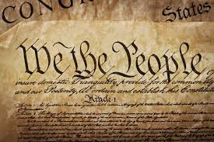
Restraints
Protections against tyranny
DENIED POWERS – Article I, Section 9
Cannot favor one state over another
No suspension of the Writ of Habeas Corpus (due process) – a person must come before a judge if arrested
No Bills of Attainder (due process) – punish a person without a trial
No Ex post facto laws (making crimes after the fact)

Slide 40
Two Distinct House
Identify each of the following statements as either (H) – House of Representatives, (S) – Senate, or (B) – Both
__ 1. Use equal representation (2 per state)
__ 2. Can make laws and regulate interstate commerce
__ 3. Has 435 members
__ 4. Elected to a 6-year term
__ 5. Can start all tax and appropriation laws and draws up the articles of impeachment
__ 6. Can propose Constitutional Amendments
__ 7. Has the power to approve or reject presidential appointments and treaties
__ 8. Can override a presidential veto with a 2/3rds vote

Slide 41
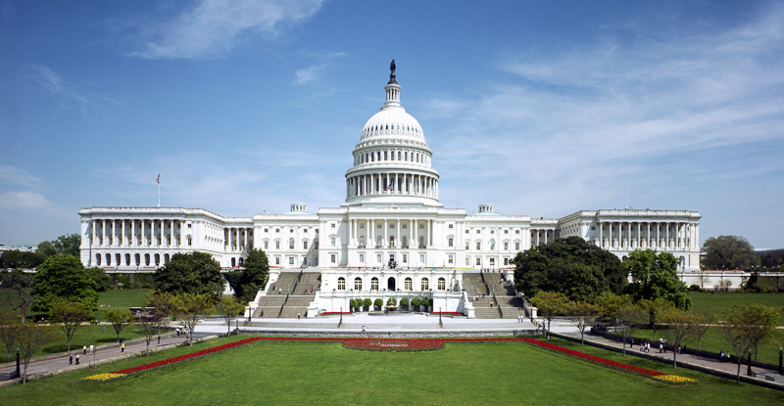
Principles of the Madisonian Legislature
The Constitution was designed to uphold a limited government
Explain how the design of Congress upholds the following Constitutional principles.
Republicanism
Separation of Powers
Checks and balances
Federalism
B. Identify and explain ONE major problem with the design of the U.S. Congress in the process of lawmaking

Slide 42
CL.C&G.1.1 Explain the influence of the founding principles on state and federal decisions using primary and secondary source documents.
CL.H.1.1 Explain how the tensions over power and authority led the founding fathers to create a democratic republic.
CL.C&G.4.4 Assess how effective the American system of government has been in ensuring freedom, equality, and justice for all.
Essential Question: How effectively does the U.S. Constitution balance the authority to govern without violate the rights of the people?
Students Can:
Determine why a decentralized government under the Articles of Confederation failed to effectively govern America during the critical period from 1781-1789
Evaluate how the U.S. Constitution repaired issues with the Articles of Confederation
Decipher how the Madisonian Model of government empowers the national government while restraining abuse of power
AGENDA:
Gerrymandering a district
Gerrymandering 101
Bicameral by Design
HOMEWORK:
Dissecting a Bicameral Congress due Thursday

Slide 43
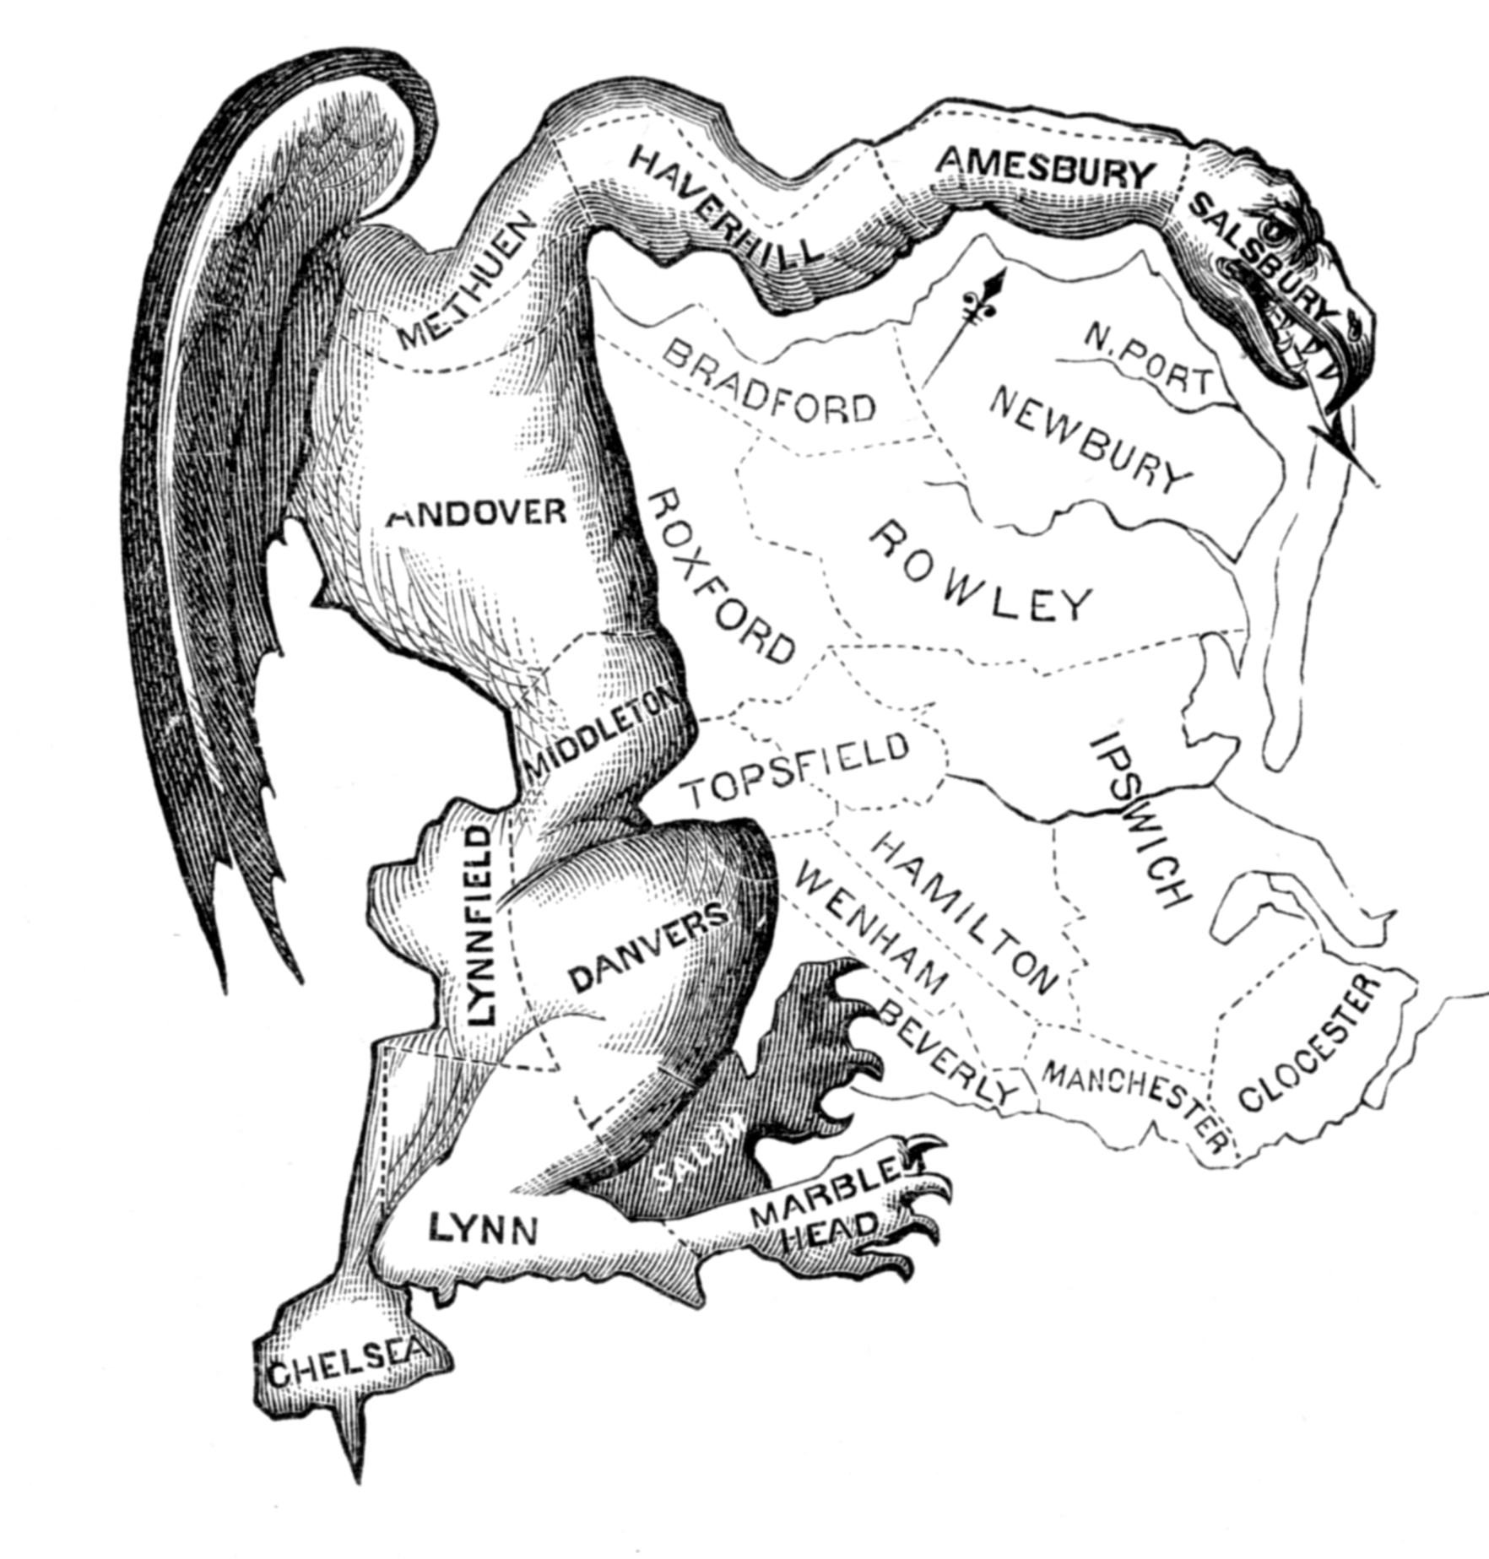
How to Gerrymander
Learn how to gerrymander a voting district
Play the gerrymandering game
Hit mandering a district
Create voting districts that give one side an advantage
Why does gerrymandering deny the principle of popular sovereignty?
Evaluate whether gerrymandering would be unfair if they drew district that represent political parties (Democrats/Republicans)

Slide 44
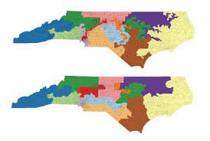
Popular Sovereignty
House of Representative – direct represents the people
Establish representation of the people
Census – Counts the population every 10 years
Re-apportionment – Assigning the seats in the HOR to the states
Re-districting – State legislatures divide their state into districts based on re-apportionment

Slide 45
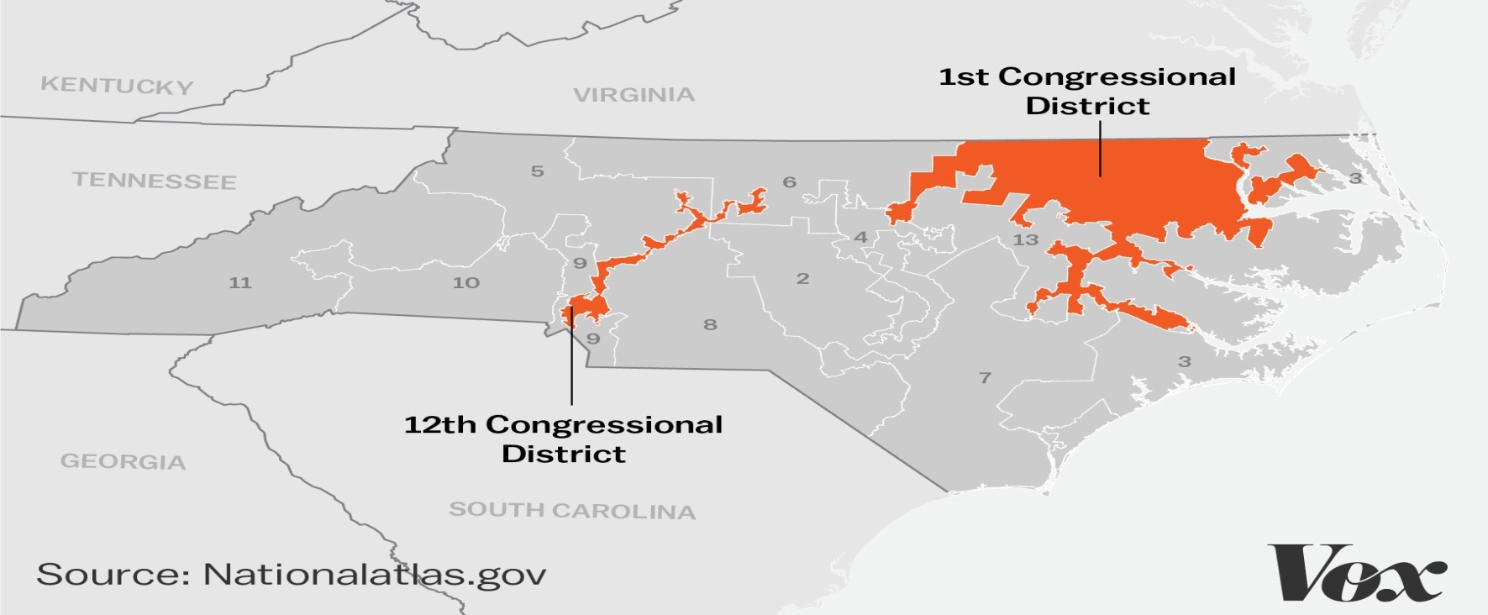
Political Factions
If a faction consists of less than a majority, relief is supplied by the republican principle, which enables the majority to defeat its sinister views by regular vote. It may clog the administration, it may convulse the society; but it will be unable to execute and mask its violence under the forms of the Constitution.
- James Madison, Federalist 10
Issue with redistricting
Gerrymandering – odd shape voting district that gives a political party or group an advantage – violates one person one vote
Denies a group a voice in government
Gerrymandering
Gives a group greater say in government & protects incumbency (re-election)

Slide 46
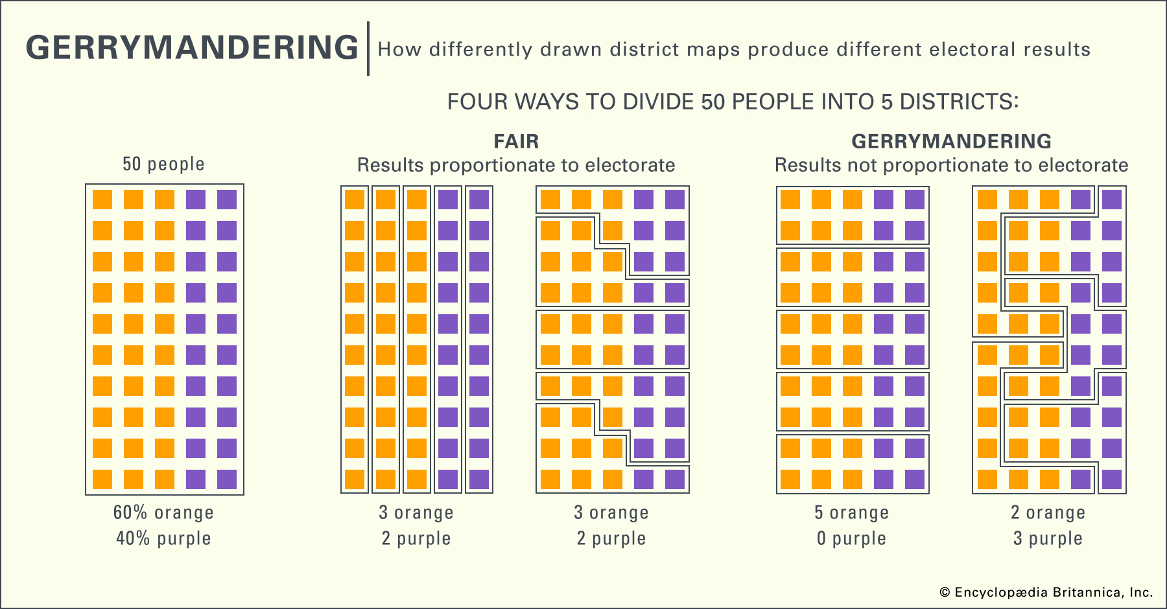
Populism DENIED
How Gerrymandering denies voice in government
Purple groups in each district cannot out vote the orange groups = Gerrymandering

Slide 47
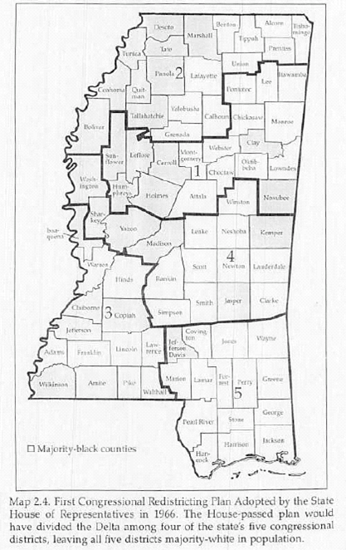
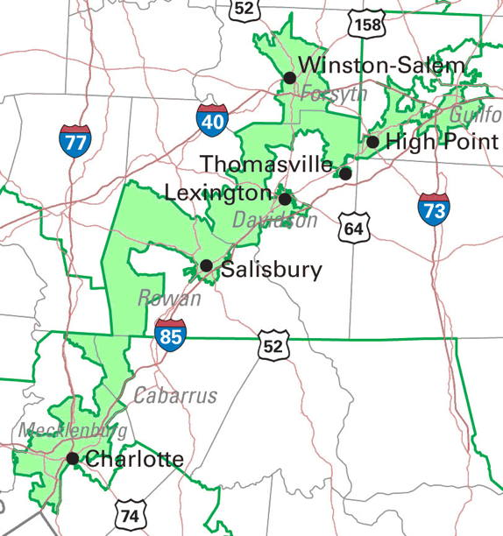
Gerry, MAN!
Two ways to achieve gerrymandering
Baker v. Carr 1962: Gerrymandering is unconstitutional – violates the equal protection clause of the 14th Amendment by denying the principle of one man, one vote
Cracking: drawing districts that split group between different districts
Packing: drawing districts that puts a group in one district

Slide 48
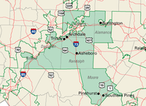
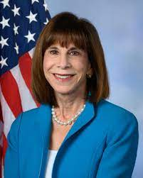
Be Represent-n
Welcome to District 6
You are here
Rep. Kathy Manning

Slide 49
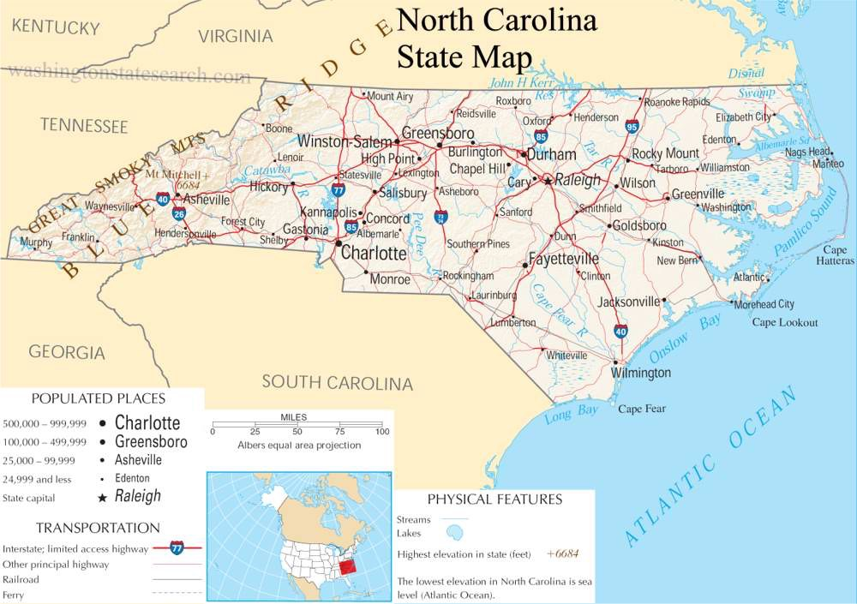
Senate – Higher House
U.S. Senate consider the higher house (longer terms, represent more people, & more special powers)
Staggered terms (1/3 elected at a time) – keeps experience in Congress
17th Amendment: Direct election of Senators
Richard Burr (R)
Thom Tillis (R)

Slide 50
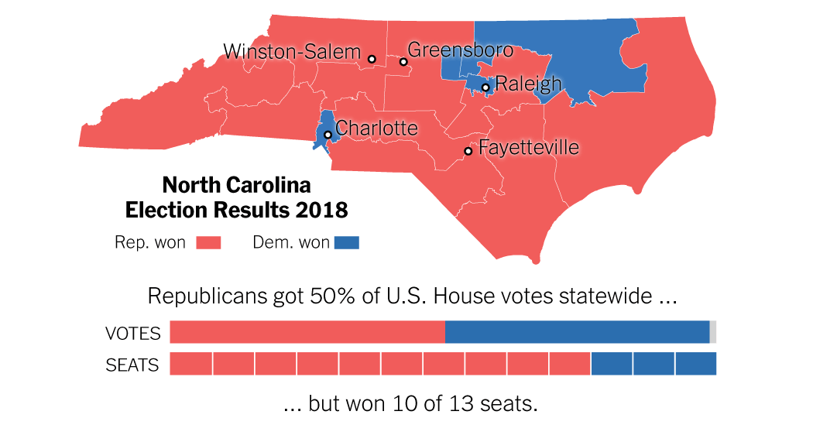
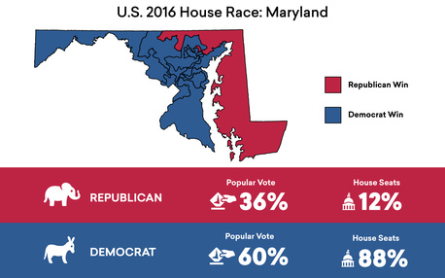
Reform to Congress
Evaluate whether draw in district maps based on political party representation constitutes gerrymandering.
Rucho v. Common Cause 2019

Slide 51
CL.C&G.1.1 Explain the influence of the founding principles on state and federal decisions using primary and secondary source documents.
CL.H.1.1 Explain how the tensions over power and authority led the founding fathers to create a democratic republic.
CL.C&G.4.4 Assess how effective the American system of government has been in ensuring freedom, equality, and justice for all.
Essential Question: How effectively does the U.S. Constitution balance the authority to govern without violate the rights of the people?
Students Can:
Determine why a decentralized government under the Articles of Confederation failed to effectively govern America during the critical period from 1781-1789
Evaluate how the U.S. Constitution repaired issues with the Articles of Confederation
Decipher how the Madisonian Model of government empowers the national government while restraining abuse of power
AGENDA:
Mr Bill’s Goes To Washington
Influencers on Lawmaking
Bicameral by design
HOMEWORK:
No homework

Slide 52
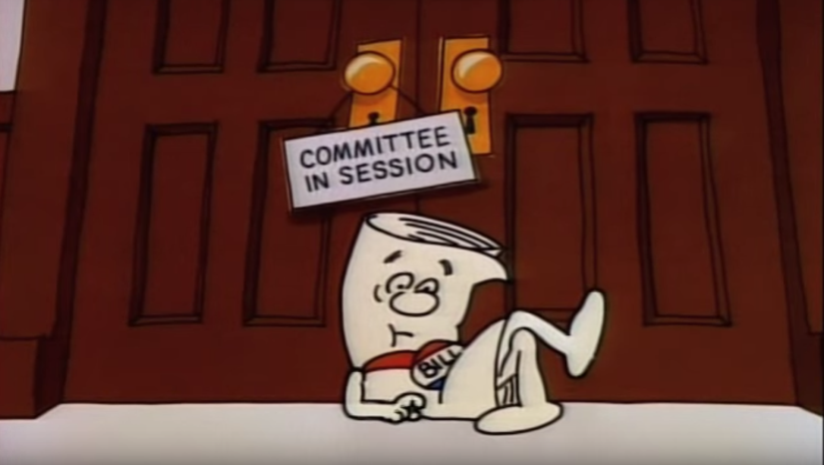
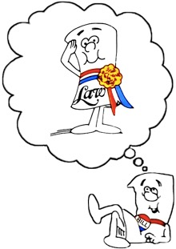
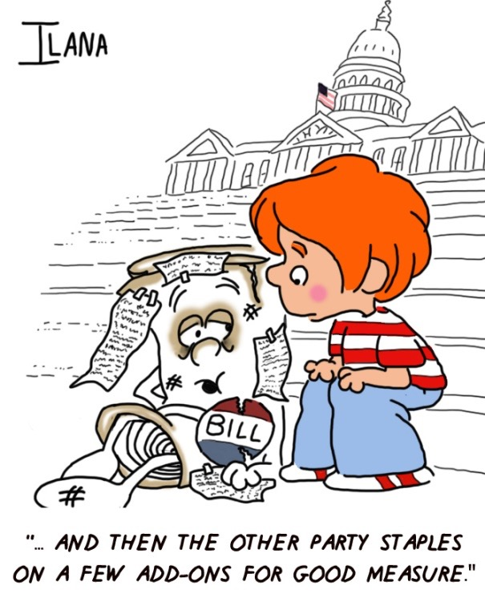
The Story of the Bill that became a LAW
The process to create legislation the governs the United States
How legislation is made?
How is the lawmaking process similar between the two houses?
What some of the ways a bill can die before becoming a law?

Slide 53
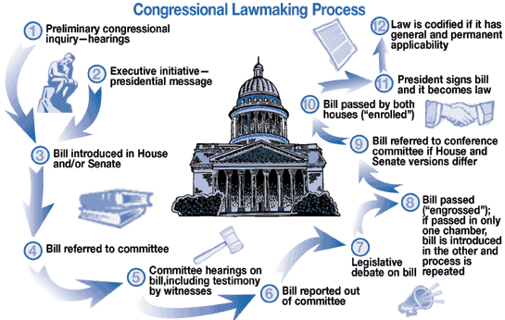
Bicameralism Lawmaking
Congress’ bicameral structure causes lawmaking to be slow & cautious
“Experience has instructed us that no skill in the science of government has yet been able to discriminate and define, with sufficient certainty, its three great provinces the legislative, executive, and judiciary; or even the privileges and powers of the different legislative branches.”
- James Madison

Slide 54
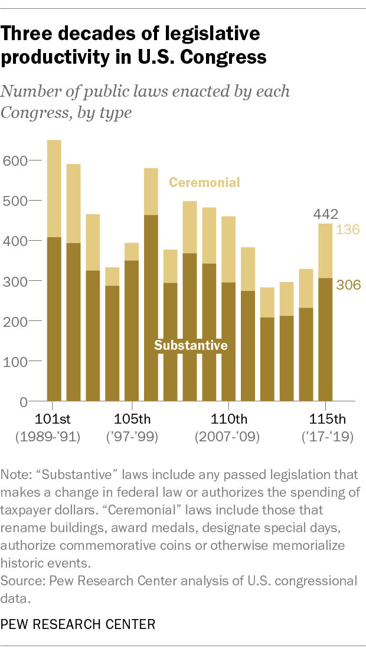
Mr. Bill
Two types of bills
Warning:10,000 bills introduced each term – only a few
100 pass
Private Bills: focus on individuals or places
Grant citizenship to a person who would not usual be eligible
Public Bills: laws that effect the entire nations
Establishing that EPA set tougher standard in protecting America’s drinking water

Slide 55
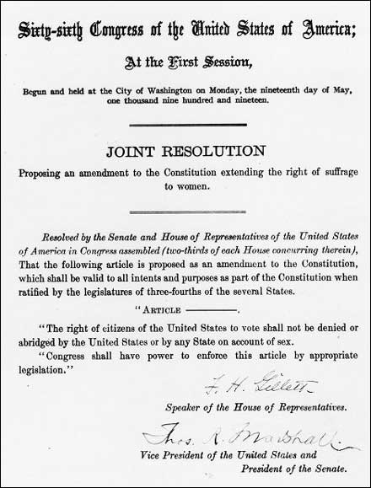
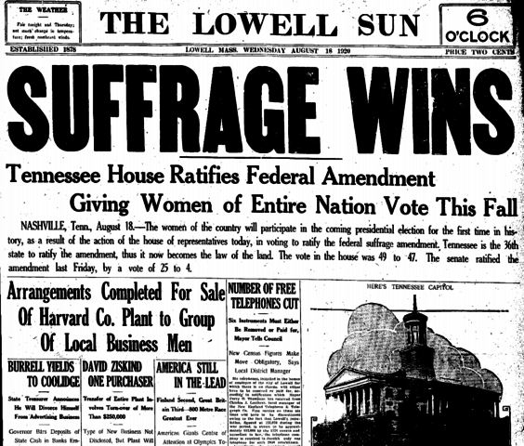
Joint Resolutions
Special type of law
Joint Resolutions: passed by both house of Congress and can be signed into law by the President (Not designated as Acts)
Ex. Propose Constitutional Amendments
- Women Suffrage (19th Amendment)

Slide 56
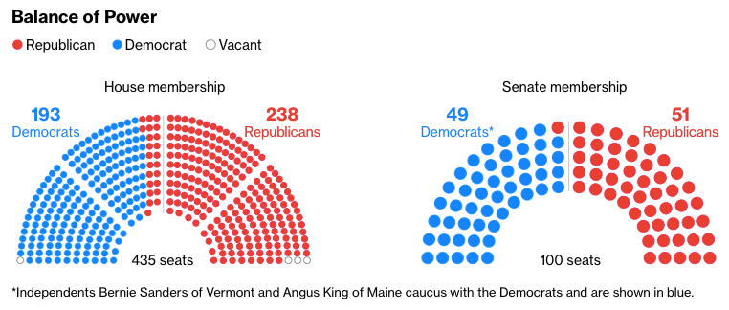
Majority v. Minority PARTY
Congress is organized by political parties
Majority party: the political party that controls the most seats (advantages: control committees, Speaker of the House, and votes on the floor)
Minority party: watch dog (point out mistakes of the majority party)

Slide 57
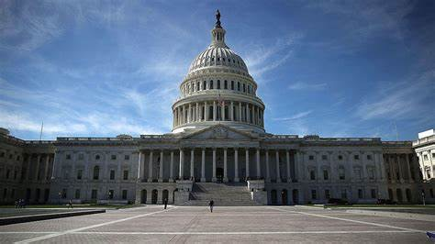
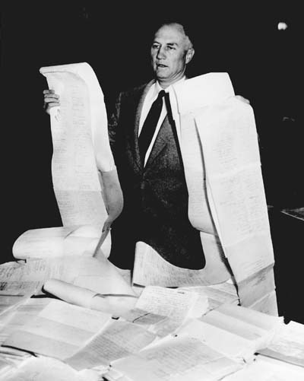
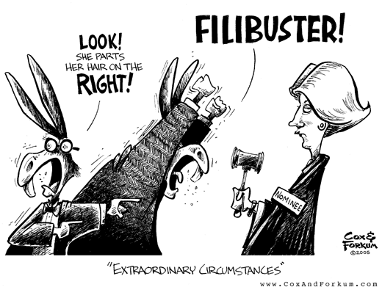
The Bicameral Effect
Two distinct house lawmaking process
Senate
House of Representatives
DECENTRALIZED PROCESS
100 Memberships
Unlimited debate
Filibuster – Talk a bill to death
Cloture Vote – 60 votes to stop a filibuster
CENTRALIZED PROCESS
435 Memberships
Speaker of the House has a lot of influence on lawmaking
Rules Committee: set when and how long debates happen on the full
FILIBUSTER VIDEO

Slide 58
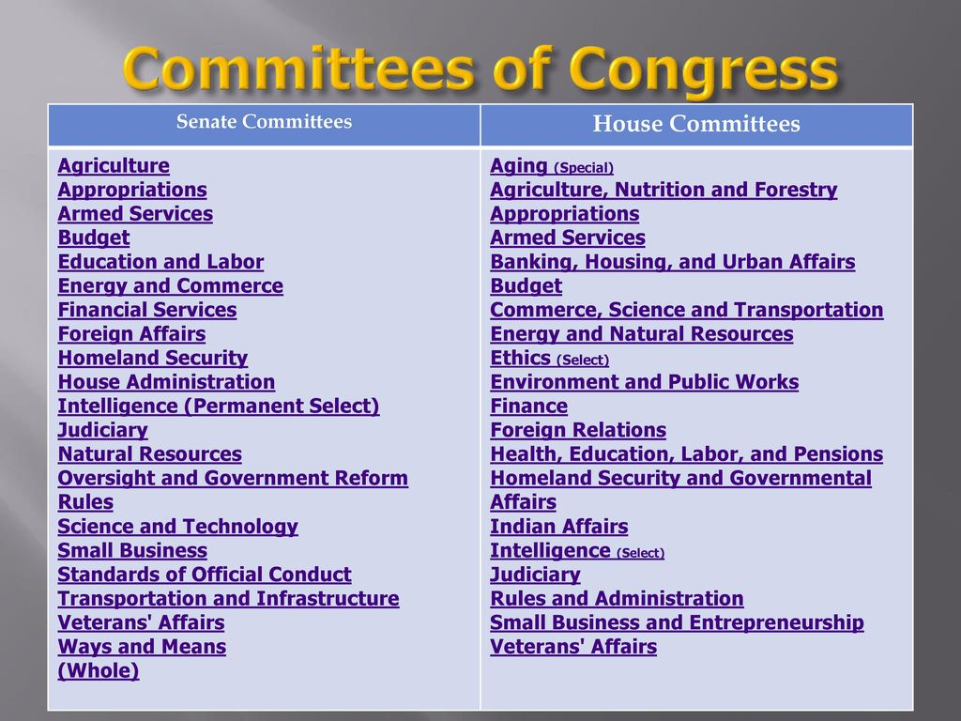
Committees in the Legislative Process
Congress uses committees to make the law making process more efficient
Two Types of Committee
Standing Committees: permanent committees that have members of one house.
Purpose: to evaluate the potential of proposed bills
Conference Committees: temporary committees that have members of both houses.
Purpose: to find compromise between to different bills

Slide 59
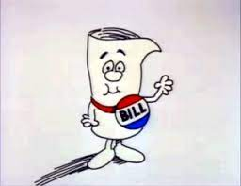
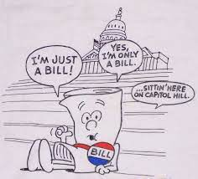
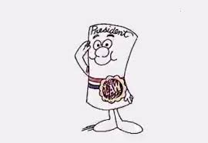
Legislative Race
Demonstrate the process for how a bill becomes of a law. Get checked off once you have the process in the correct order.
Rules for the process
Bills have to pass both houses in identical forms
The process is very similar in both houses (You will two cards that state the same thing)
There are some minor differences between the two houses in the legislative process

Slide 60
Two Distinct House
Identify each of the following statements as either (H) – House of Representatives, (S) – Senate, or (B) – Both
__ 1. Use equal representation (2 per state)
__ 2. Can make laws and regulate interstate commerce
__ 3. Has 435 members
__ 4. Elected to a 6-year term
__ 5. Can start all tax and appropriation laws and draws up the articles of impeachment
__ 6. Can propose Constitutional Amendments
__ 7. Has the power to approve or reject presidential appointments and treaties
__ 8. Can override a presidential veto with a 2/3rds vote
__ 9. Can filibuster a law
__ 10. Uses the rules committee to assign time for debate
__ 11. Must live in the state you represent
__ 12. Can declare war

Slide 61
CL.C&G.1.1 Explain the influence of the founding principles on state and federal decisions using primary and secondary source documents.
CL.H.1.1 Explain how the tensions over power and authority led the founding fathers to create a democratic republic.
CL.C&G.4.4 Assess how effective the American system of government has been in ensuring freedom, equality, and justice for all.
Essential Question: How effectively does the U.S. Constitution balance the authority to govern without violate the rights of the people?
Students Can:
Determine why a decentralized government under the Articles of Confederation failed to effectively govern America during the critical period from 1781-1789
Evaluate how the U.S. Constitution repaired issues with the Articles of Confederation
Decipher how the Madisonian Model of government empowers the national government while restraining abuse of power
AGENDA:
The Power of Influence
Mr Bill’s Goes To Washington
Lawcraft
HOMEWORK:
Study for a quiz on Congress
Quiz on Congress – Friday 11/4

Slide 62
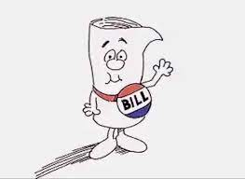
The Power of Influence
Congress = Lawmaking
What is ONE way the majority party has greater influence over the lawmaking process than the minority party?
What is ONE way that Senate handles or influences the law making process differently than the House of Representatives?
What is ONE way that the House of Representatives handles the lawmaking process differently than Senate?

Slide 63
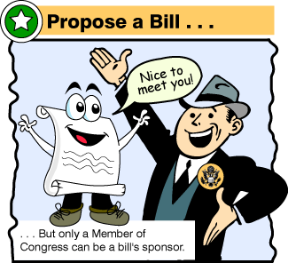
1. Propose a Bill
How A Bill Becomes A Law
Ideas for Bills:
Members of Congress
President
Citizens (1st Amendment – petitioning)
Other bills are suggested by special-interest groups, or organizations of people w/ some common interest who try to influence government decisions.

Slide 64
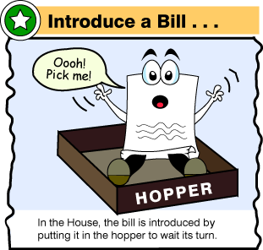
2. Introduce a Bill
How A Bill Becomes A Law
In the House, a bill clerk assigns the bill a number.
House bills begin with "H.R."
Senate bills begin with "S."
Only a member of Congress may introduce a Bill ****

Slide 65
3. Committee Assignment
How A Bill Becomes A Law
The work of standing committee
Researches the bill
Public hearings- citizens can give feedback (Lobbyists – represent special interest)

Slide 66
4. Committee Votes
How A Bill Becomes A Law
Standing committees can:
pass the bill without change,
mark changes and suggest that the bill be passed,
replace the bill with an alternative
pigeonhole the bill (ignore it and let it die), or
kill the bill by majority vote.

Slide 67
5. Bill Goes to the Floor
How A Bill Becomes A Law
Bills approved in committee are put on the schedules to be considered by the full House or Senate.
The Senate usually takes up bills in the order listed.
In the HOR, the Rules Committee can give priority to some bills and not let others get to the floor

Slide 68
6. Voting on a Bill
How A Bill Becomes A Law
Voice vote
Standing vote
HOR uses a computerized voting system
Roll-call vote.

Slide 69
What Now?
How A Bill Becomes A Law
If either house rejects the bill, it dies.
Both houses must pass an identical bill.
If either changes the bill it receives from the other house, a conference committee is formed to work out the differences in the bill.

Slide 70
8. Sent to the President
How A Bill Becomes A Law
After a bill passes both houses, it goes to the president.
Signs the bill IT BECOMES A LAW
If the President does not like it he president may:
1. Veto- Refuse to sign
2. Do nothing for 10 days- Pocket Veto
If in those 10 days Congress is not in session, the bill dies.
If Congress is in session, the bill becomes law without the president’s signature.

Slide 71
9. The Bill is Signed Into Law
How A Bill Becomes A Law
Signs a bill into law
Vetoes: (rejects bill)
(or if he pocket vetoes and congress is in session)
If the bill is vetoed Congress can override a veto with a two-thirds vote of each house.
NO!
YES!

Slide 73
Legislative Labyrinth
Put the step in order for a bill becomes a law
From idea
To Law

Slide 74
Ticket Out the DOOR
Congress = Lawmaking
1. Why are standing committees important in the lawmaking process?

Slide 75
Reforming the lawmaking process
Identify the trend representing in the political opinion poll above.
Explain why that trend remains constant throughout most of the years of the polling data
Evaluate whether the following reforms would improve that trend
Eliminating political parties in Congress
Outlawing the filibuster

Slide 76
Lawmaking Process
I’m Just a Bill!
Explain four ways a law can die in Congress.
What is TWO major difference between the Senate and the House in the lawmaking process?

Slide 77
CL.C&G.1.1 Explain the influence of the founding principles on state and federal decisions using primary and secondary source documents.
CL.H.1.1 Explain how the tensions over power and authority led the founding fathers to create a democratic republic.
CL.C&G.4.4 Assess how effective the American system of government has been in ensuring freedom, equality, and justice for all.
Essential Question: How effectively does the U.S. Constitution balance the authority to govern without violate the rights of the people?
Students Can:
Determine why a decentralized government under the Articles of Confederation failed to effectively govern America during the critical period from 1781-1789
Evaluate how the U.S. Constitution repaired issues with the Articles of Confederation
Decipher how the Madisonian Model of government empowers the national government while restraining abuse of power
AGENDA:
Two distinct houses quiz
Lawmaking scenarios
HOMEWORK: None

Slide 78
What’s the Scenario
Bill to law scenarios
Place the steps how a bill becomes a law in order
Identify and explain THREE Constitutional principles that apply to the lawmaking process
How do I become a law?

Slide 79
Lawmaking Process
I’m Just a Bill!
Explain four ways a law can die in Congress.
What is TWO major difference between the Senate and the House in the lawmaking process?

Slide 80
CL.C&G.1.1 Explain the influence of the founding principles on state and federal decisions using primary and secondary source documents.
CL.H.1.1 Explain how the tensions over power and authority led the founding fathers to create a democratic republic.
CL.C&G.4.4 Assess how effective the American system of government has been in ensuring freedom, equality, and justice for all.
Essential Question: How effectively does the U.S. Constitution balance the authority to govern without violate the rights of the people?
Students Can:
Determine why a decentralized government under the Articles of Confederation failed to effectively govern America during the critical period from 1781-1789
Evaluate how the U.S. Constitution repaired issues with the Articles of Confederation
Decipher how the Madisonian Model of government empowers the national government while restraining abuse of power
AGENDA:
A Congress of two distinct houses
Legislative Leaders
LAWCRAFT
HOMEWORK:
Study for a quiz on Congress
Quiz on Congress – Friday 11/4

Slide 81
Two Distinct House
Identify each of the following statements as either (H) – House of Representatives, (S) – Senate, or (B) – Both
__ 1. Elected to a 6-year term
__ 2. Has the power to approve or reject presidential appointments and treaties
__ 3. Has a rules committee to control debates
__ 4. Can declare war
__ 5. Can override a presidential veto with a 2/3rds vote
__ 6. Can filibuster a law
__ 7. Can make laws and regulate interstate commerce
__ 8. Can start all tax and appropriation laws and draws up the articles of impeachment
__ 9. Can propose Constitutional Amendments
__ 10. Uses the rules committee to assign time for debate
__ 11. Must live in the state you represent
__ 12. Use equal representation (2 per state)
__ 13. Legislative districts can be gerrymandered by state legislatures
__ 14. Has 435 members

Slide 82
Lawmaking Process
I’m Just a Bill!
Explain three ways a law can die in Congress.
Why are standing committees important in the lawmaking process?
What is TWO major difference between the Senate and the House in the lawmaking process?

Slide 83
Congressional Leadership
House of Representatives
House of Representatives Leaders
Speaker of the House: (member of the majority party) – Main leader (assign bills to committee, pick bills from the hopper)
Speaker of the House
Majority Floor Leader
Minority Floor Leader
Other house leaders
Floor Leaders: speaks for the political party on issues and establishes party legislative strategery
Party Whips: encourages party members to vote together (whipping the vote)
Majority Party Whip
Minority Party Whip

Slide 84
Congressional Leadership
Senate
Senate Leaders
Vice President: Tiebreaker vote (only power)
Vice President
President pro Tempore: presiding head of Senate (recognizes who speaks on the floor)
President pro Tempore
Other house leaders
Floor Leaders: speaks for the political party on issues and establishes party legislative strategery
Party Whips: encourages party members to vote together (whipping the vote)
Majority Floor Leader
Minority Floor Leader
Majority Party Whip
Minority Party Whip

Slide 85
House Leaders of Congress
Guide legislation and get party members to work together
Majority Floor Leader
Steny Hoyer (D)
Majority Party Whip
Jim Clyburne (D)
Speaker of the House
Nancy Pelosi (D)
Minority Floor Leader
Kevin McCarthy (R)
Minority Party Whip
Steve Scalise (R)

Slide 86
Senate Leaders of Congress
Guide legislation and get party members to work together
Vice President
Kamala Harris (D)
Minority Floor Leader
Mitch McConnell (R)
Minority Party Whip
John Thune (R)
President Pro Tempore
Chuck Grassley (R)
President Pro Tempore
Patrick Leahy (D)
Majority Floor Leader
Chuck Schumer (D)
Majority Party Whip
Dick Durbin (D)

Slide 87
Incumbency Advantage
Incumbency: members of Congress running for re-elections & winning
Incumbency: members of Congress running for re-elections & winning
Incumbency: running and winning re-elections
Factors
Franking privilege – send mail for free
Name recognition – we know who represents us

Slide 88
Legislative Busters
Identify the following legislative leaders in Congress:
A. Party Whip B. Vice President C. Speaker of the House
D. Floor Leader
Tie breaker vote
Get party ideas into laws and speak for the political party on issues facing the nation
Encourages party members to vote the same on a piece of legislation
Can assign bills to committee, controls floor debate, and has influence over committee assignments

Slide 89
CL.C&G.1.1 Explain the influence of the founding principles on state and federal decisions using primary and secondary source documents.
CL.H.1.1 Explain how the tensions over power and authority led the founding fathers to create a democratic republic.
CL.C&G.4.4 Assess how effective the American system of government has been in ensuring freedom, equality, and justice for all.
Essential Question: How effectively does the U.S. Constitution balance the authority to govern without violate the rights of the people?
Students Can:
Determine why a decentralized government under the Articles of Confederation failed to effectively govern America during the critical period from 1781-1789
Evaluate how the U.S. Constitution repaired issues with the Articles of Confederation
Decipher how the Madisonian Model of government empowers the national government while restraining abuse of power
AGENDA:
Congressional Review
The Job of Being a Congressional Member
Representing Me
HOMEWORK:
Study for a quiz on Congress
Quiz on Congress – Friday 11/4

Slide 90
Work of a Lawmaker
Three jobs of a member of Congress
Lawmaking: propose, research, debate, and vote on laws of the United States
Represent state or district: bring federal projects and money back
Casework: help your constituents deal with issues from the federal government (Ex. find a missing social security check)

Slide 91
CL.C&G.1.1 Explain the influence of the founding principles on state and federal decisions using primary and secondary source documents.
CL.H.1.1 Explain how the tensions over power and authority led the founding fathers to create a democratic republic.
CL.C&G.4.4 Assess how effective the American system of government has been in ensuring freedom, equality, and justice for all.
Essential Question: How effectively does the U.S. Constitution balance the authority to govern without violate the rights of the people?
Students Can:
Determine why a decentralized government under the Articles of Confederation failed to effectively govern America during the critical period from 1781-1789
Evaluate how the U.S. Constitution repaired issues with the Articles of Confederation
Decipher how the Madisonian Model of government empowers the national government while restraining abuse of power
AGENDA:
Congressional Review
Congress Quiz
Representing Me
HOMEWORK:
Representing Me – Due: Monday, 11/7

Slide 92
Representing
Design a Congressional Want-ad
Select either a member of Senate or House of Representatives
Construct an advertisement seeking someone to run for that particular house
Requirements:
Job description – (explain lawmaking, casework, and represent state or district)
Constitutional qualifications
Term of office – how long do they serve
Pay & privileges (identify at least three privileges)
Personal choices (gender, race, ethnicity, political party)
Write two expectations (what are two issues you want your candidate to support)

Slide 93
CL.C&G.1.1 Explain the influence of the founding principles on state and federal decisions using primary and secondary source documents.
CL.H.1.1 Explain how the tensions over power and authority led the founding fathers to create a democratic republic.
CL.C&G.4.4 Assess how effective the American system of government has been in ensuring freedom, equality, and justice for all.
Essential Question: How effectively does the U.S. Constitution balance the authority to govern without violate the rights of the people?
Students Can:
Evaluate whether the creation of the Presidency upheld the Constitutional principle of limited government.
AGENDA:
Washington sets presidential precedents
The Basic of Article II
Establishing a Limited Executive
HOMEWORK: No Homework

Slide 94
A Nation’s First President
President George Washington’s Challenge
What authority do I have?
The executive Power shall be vested in a President of the United States of America.
- The Vesting Clause, Article II, Section 1
How does Washington view the authority granted to him by the U.S. Constitution?

Slide 95
Article II - The Executive Branch
The Executive Branch = enforcement & implementation of the laws
President
Vice President
Bureaucracy (Office of the White House, Cabinet, Independent Agencies, etc.) – NOT in the Constitution

Slide 96
Serving at Present
That magistrate is to be elected for four years; and is to be re-eligible as often as the people of the United States shall think him worthy of their confidence. In these circumstances there is a total dissimilitude between him and a king of Great Britain, who is an hereditary monarch, possessing the crown as a patrimony descendible to his heirs forever; but there is a close analogy between him and a governor of New York, who is elected for three years, and is re-eligible without limitation or intermission.
- Alexander Hamilton, Federalist 69, 1788
President = serving at present (fear of tyrannical government)
Constitutional qualifications:
A natural born citizen
35 years old
14 years residency

Slide 97
Who is Eligible
Evaluate the following candidates – determine whether they are eligible to run for the presidency
___ 1. Born in Austria, he is a self made multi-billionaire who has served as the governor of California, where he has currently has lived for 35 years and is 60 years old.
___ 2. He is the son of a former president and serve as governor of Texas. He is currently 54 years old and lived in the United States all his life. Though in the past he has had arrested and convicted for various misdemeanors he has reformed.
___ 3. She is a 44 year old African American, who has a law degree from Harvard. She was born and raised in Chicago, Illinois
___ 4. He was born in British Leeward island and orphaned at a young age. After rough start, he went on to earn a law degree and serve in the U.S. military as a General and Secretary of Treasury. He currently is 42 years old and resided in the U.S., since he was a teenager.

Slide 98
Hail to Cincinnatus
Founders define a president
I said two terms and NO MORE!
U.S. President elected to a 4-year term
Washington established the two-term limit by tradition
22nd Amendment – two term limit (max of 10 years – if by secession)
25th Amendment – Presidential line of secession

Slide 99
Order of Presidential Succession:
The Vice President
Speaker of the House
President pro tempore of the Senate
Secretary of State
Secretary of the Treasury
Secretary of Defense
Attorney General
Secretary of the Interior
Secretary of Agriculture
Secretary of Commerce
Secretary of Labor
Secretary of Health and Human Services
Secretary of Housing & Urban Development
Secretary of Transportation
Secretary of Energy
Secretary of Education
Secretary of Veterans Affairs
Secretary of Homeland Security
Notes:
99

Slide 100
Checking Executive Authority
The first thing which strikes our attention is, that the executive authority, with few exceptions, is to be vested in a single magistrate. This will scarcely, however, be considered as a point upon which any comparison can be grounded; for if, in this particular, there be a resemblance to the king of Great Britain, there is not less a resemblance to the Grand Seignior, to the khan of Tartary, to the Man of the Seven Mountains, or to the governor of New York.
- Alexander Hamilton, Federalist 69
=
According to Alexander Hamilton in Federalist 69 the Presidency is not a monarchy (king)
Identify four powers that is vested (given) to the President of the United States.
What are three limitations established in Article II that supports Hamilton’s argument?

Slide 101
CL.C&G.1.1 Explain the influence of the founding principles on state and federal decisions using primary and secondary source documents.
CL.H.1.1 Explain how the tensions over power and authority led the founding fathers to create a democratic republic.
CL.C&G.4.4 Assess how effective the American system of government has been in ensuring freedom, equality, and justice for all.
Essential Question: How effectively does the U.S. Constitution balance the authority to govern without violate the rights of the people?
Students Can:
Determine why a decentralized government under the Articles of Confederation failed to effectively govern America during the critical period from 1781-1789
Evaluate how the U.S. Constitution repaired issues with the Articles of Confederation
Decipher how the Madisonian Model of government empowers the national government while restraining abuse of power
AGENDA:
A Constitutionally Define Executive
Limited Exec. v. Imperial Presidency
Limited Executive Branch
HOMEWORK:
Limited Executive Branch
Executive Command remote assignment for Thursday

Slide 102
Presidential Review
“Energy in the executive is a leading character in the definition of good government. It is important to the protection of the nation against foreign attacks; it is not less essential to the steady administration of the laws; to the protection of property against those irregular and high-handed combinations which sometimes interrupt the ordinary course of justice; to the security of liberty against the enterprises and assaults of ambition, of faction, and of anarchy.”
- Alexander Hamilton, Federalist 69, 1788
What are the three Constitutional requirements to run for President of the United States?
What are THREE formal power (expressed in the Constitution) of the President?
What are the jobs of the President? (Use the quote to help you in describing the President’s jobs)

Slide 103
Empowerment of the President
The executive power shall be vested in a President of the United States of America.
Vesting Clause, Article II, Section 1
Formal Powers of the Presidency
Commander in Chief
Sign bills into law
Veto
Make Treaties (w/ Senate consent)
Appointments (w/ Senate consent)
Pardon & reprieves (forgiveness of crimes)
Amnesty – (forgiveness of crimes to a group of people)

Slide 104
Informal Powers
Interpretation and changing times have expanded the power of the Presidency
Informal powers - Imperial Presidency
“he shall take Care that the Laws be faithfully executed”
- Take Care of Clause, Article II, Section 3
Executive orders (make laws w/o Congress)
Executive Agreements (make treaty agreements w/o Senate Consent)
Recess appointments
Executive privilege – keep information top secret
Pocket veto
Bully pulpit
War Powers Resolution (commit military to action for 60 days without a declaration of war)

Slide 105
CL.C&G.1.1 Explain the influence of the founding principles on state and federal decisions using primary and secondary source documents.
CL.H.1.1 Explain how the tensions over power and authority led the founding fathers to create a democratic republic.
CL.C&G.4.4 Assess how effective the American system of government has been in ensuring freedom, equality, and justice for all.
Essential Question: How effectively does the U.S. Constitution balance the authority to govern without violate the rights of the people?
Students Can:
Determine why a decentralized government under the Articles of Confederation failed to effectively govern America during the critical period from 1781-1789
Evaluate how the U.S. Constitution repaired issues with the Articles of Confederation
Decipher how the Madisonian Model of government empowers the national government while restraining abuse of power
AGENDA:
Formal or Informal
President’s Roles
Presidential Roles Sampling
HOMEWORK:
Presidential Roles Scenarios – due Wednesday 11/16
Quiz on the Presidency – Friday, 11/18

Slide 106
Powers of the Presidency
Identify whether the following powers are (F) formal powers listed in the Constitution or (I) informal powers interpreted out of the Constitution?
__ 1. veto power
__ 2. executive orders
__ 3. commander-in-chief
__ 4. grant pardons or amnesty
__ 5. executive privilege
__ 6. send troops into action for 60 days without a declaration of war
__ 7. sign bills into law
__ 8. appoint judges to the federal court

Slide 107
Crisis Manager
Lead the nation when we face a major challenge
President FDR asking for a Declaration of War
President George W. Bush at Ground Zero after 9/11
Powers: Promoting national security & general welfare
Commander in Chief: head of the military
War Powers Resolution: President can commit troops to action for 60 days, as long as Congress is notified within 48 hours
Chief Diplomat: send aid ($$) to foreign nations in crisis

Slide 108
Lifting Morale of America
Morale Leader: President act as a representative of American democratic ideas and unifying as one nation
“The test of our progress is not whether we add more to the abundance of those who have much; it is whether we provide enough for those who have too little.”
- President Franklin D. Roosevelt
Bully-pulpit: addressing the nation in difficult times
Symbolic leadership
Honoring historic moments

Slide 109
Presidential Roles
Demonstrate how the President utilizes a variety of roles and powers to carry out the job of the federal executive.

Slide 110
Roles of the President
Demonstrate how the President plays a variety of roles in executing the responsibilities and duties of the executive branch
Presidential Role | Define the role | Two examples of the role
1. Chief Executive
2. Chief Diplomat
3. Commander in Chief
4. Legislative Leader
5. Head of State
6. Economic Leader
7. Party Leader

Slide 111
Roles of the President
Demonstrate how the President plays a variety of roles in executing the responsibilities and duties of the executive branch
President Roles | Definition | Examples | Powers Used
1. Chief Executive
2. Chief Diplomat
3. Commander-in-Chief
4. Legislative Leader
5. Head of State |  |  | No formal or informal powers
6. Economic Leader
7. Party Leader

Slide 112
Chief Executive
The President enforces of the laws of the United States by working with the bureaucracy and explaining how laws are to be carried out.
Powers as Chief Executives:
Appointing heads of the bureaucracy
Signing Executive Orders
Granting pardons (forgiveness for criminal conviction)
Appointing the head of the FBI
Signing executive order to end segregation in the military

Slide 113
The Executive of the Law
The president oversees the enforcement of the law
"shall take Care that the Laws be faithfully executed." Article II, Section 3, U.S. Constitution
Powers to enforce:
Appointment w/ consent of Senate: (heads of agencies, such as the FBI, and Cabinet positions
Removal – fire appointed heads (except federal judges)
Executive Orders: a rule that has the authority of law, but doesn’t require Congressional approval
Appointment of Neil Gorsuch to the Supreme Court 2017

Slide 114
By Executive Order
Use of informal powers

Slide 115
Chief Diplomat
The President carrying out foreign policy (working with other nations)
“He shall have Power, by and with the Advice and Consent of the Senate, to make Treaties, provided two thirds of the Senators present concur; and he shall nominate, and by and with the Advice and Consent of the Senate, shall appoint Ambassadors,”
- Article II, section 2, U.S. Constitution
Chief Diplomat Powers
Signing Treaties
Signing Executive Agreements
Appointing Ambassadors
Meeting with foreign leaders
The President meeting with foreign leaders at a NATO Summit
President Carter signing the Camp David Peace Accords Treaty

Slide 116
The Art of Diplomacy
Carrying out foreign policy – protecting national security, promoting democracy, establishing trade relations, & promoting world peace
Making treaties (w/ Senate consent)
Executive agreements: international agreement dealing with routine matters (No Senate consent(
NATO, Group of 7, & United Nations (international organizations)
"General Secretary Gorbachev, if you seek peace, if you seek prosperity for the Soviet Union and Eastern Europe, if you seek liberalization: Come here to this gate! Mr. Gorbachev, open this gate! Mr. Gorbachev, tear down this wall!“
- President Ronald Reagan, 1987

Slide 117
Commander in Chief
The President using the military to defend our national security or help the nation during times of crisis
“The President shall be Commander in Chief of the Army and Navy of the United States, and of the Militia of the several States, when called into the actual Service of the United States;”
- Article II, section 2, U.S. Constitution
Operation Desert Storm
War Powers Act of 1973: The President can order the military into action for 60 days, as long as he notifies Congress within 48 hours.
Military rescues during Hurricane Katrina in Louisiana
Military guarding students during integration in the 1950s

Slide 118
Legislative Leader
The President influencing the lawmaking process (The PERSUADER)
Ways the President can persuade (ask) Congress and the lawmaking process
Signing a law
Vetoing a law (Veto Threat)
STATE OF THE UNION ADDRESS
Person phone call to Congressmen
President giving a State of the Union Address
Flying Congressmen to their home state on Airforce I

Slide 119
Head of State
The President act as a symbol of the United States through photo ops and upholding traditions
Examples
Lighting the White House holiday tree
Pardoning a Thanksgiving Turkey
Throwing out the ceremonial first pitch of Major League Baseball

Slide 120
Economic Leader
The President prepares the federal budget or tries to promote economic growth

Slide 121
Party Leader
The President is the leader of his political party and supports his party in elections
Supporting the Political Party
Campaigning for fellow party members (Speeches)
Hosting campaign fundraisers
Patronage: giving government jobs to political supporters
The President Barrack Obama campaigning for Democrat Senators
President Trump appoints his campaign manager, Kelly Conway as a senior Presidential advisor

Slide 122
John Q’s Power to Check the Presidency
Evaluate how the authority of the Presidency can be expanded or contracted by his public approval.
What factors can weaken the president’s authority to govern and lower his approval rating?
What factors can strengthen the president’s authority to govern raise the president’s approval rating?

Slide 123
President Roles
Commander in Chief B. Chief Diplomat C. Economic Leader
Chief Executive E. Head of State F. Party Leader
Legislative Leader
__ 1. The President of the United States meets with the Office of Management and Budget to prepare the 2021 federal budget.
__ 2. President Johnson orders more U.S. military troops into South Vietnam to help protect it from invasion.
__ 3. President Trump gives the State of the Union Address and asks Congress to pass legislation to fund new highway construction.
__ 4. President Barrack Obama appoints John Kerry as Secretary of State
__ 5. President Reagan host a campaign fundraisers for the Republican Party

Slide 124
CL.C&G.1.1 Explain the influence of the founding principles on state and federal decisions using primary and secondary source documents.
CL.H.1.1 Explain how the tensions over power and authority led the founding fathers to create a democratic republic.
CL.C&G.4.4 Assess how effective the American system of government has been in ensuring freedom, equality, and justice for all.
Essential Question: How effectively does the U.S. Constitution balance the authority to govern without violate the rights of the people?
Students Can:
Determine why a decentralized government under the Articles of Confederation failed to effectively govern America during the critical period from 1781-1789
Evaluate how the U.S. Constitution repaired issues with the Articles of Confederation
Decipher how the Madisonian Model of government empowers the national government while restraining abuse of power
AGENDA:
Roles of the Presidency
270 To Win
Presidential Roles Scenarios
HOMEWORK:
Complete Presidential Roles Scenarios
Quiz on the Presidency – Friday, 11/18

Slide 125
President Roles
Commander in Chief B. Chief Diplomat C. Economic Leader
Chief Executive E. Head of State F. Party Leader
Legislative Leader
__ 1. The President of the United States meets with the Office of Management and Budget to prepare the 2021 federal budget.
__ 2. President Johnson orders more U.S. military troops into South Vietnam to help protect it from invasion.
__ 3. President Trump gives the State of the Union Address and asks Congress to pass legislation to fund new highway construction.
__ 4. President Barrack Obama appoints John Kerry as Secretary of State
__ 5. President Reagan host a campaign fundraisers for the Republican Party

Slide 126
Running for the President
The steps in for the Presidency
Step 1: Nominating Elections: elections held in each state to select the political party candidate
Step 2: National Convention: officially nominate the President & Vice President candidate & decides the party platform
Step 3: General Election: Political party candidates will campaign in all 50 states to win the office of the president (Election held on the 1st Tuesday after 1st Monday in November)

Slide 127
270 to WIN!!!
Electoral College Compromise – Check on the TYRANNY of the MOB!!!
Electoral College elects the President (Majority vote = 270 Electoral votes)
States electoral value = Number of Representatives + 2 Senators
Winner-take-all system (popular vote chooses the slate of electors)

Slide 128
Popular VOTE = LOSER?
5 Times the Presidential candidates have won without winning the popular vote
Who knew?
John Quincy Adams
Rutherford B. Hayes
Benjamin Harrison
George W. Bush
Donald J. Trump
3 Presidents have been selected by the House of Representatives

Slide 129
A Constitutional Presidency
Evaluate whether the United States should continue the use of electing the President of the United States via the Electoral College or abandon it for another way.

Slide 130
A Constitutional Presidency
Test your knowledge of the guidelines the Constitution set in order to establish the Presidency of the United States
What are the three qualifications the Constitution requires for anyone person who wants to be President of the United States?
What Amendment established the two term Presidency?
According to the U.S. Constitution, who elects the President of the United States?

Slide 131
CL.C&G.1.1 Explain the influence of the founding principles on state and federal decisions using primary and secondary source documents.
CL.H.1.1 Explain how the tensions over power and authority led the founding fathers to create a democratic republic.
CL.C&G.4.4 Assess how effective the American system of government has been in ensuring freedom, equality, and justice for all.
Essential Question: How effectively does the U.S. Constitution balance the authority to govern without violate the rights of the people?
Students Can:
Determine why a decentralized government under the Articles of Confederation failed to effectively govern America during the critical period from 1781-1789
Evaluate how the U.S. Constitution repaired issues with the Articles of Confederation
Decipher how the Madisonian Model of government empowers the national government while restraining abuse of power
AGENDA:
Electoral College Debate
Bureaucratic Purpose
Bureaucratic World
HOMEWORK:
Complete Presidential Roles Scenarios
Quiz on the Presidency – Friday, 11/18

Slide 132
CL.C&G.1.1 Explain the influence of the founding principles on state and federal decisions using primary and secondary source documents.
CL.H.1.1 Explain how the tensions over power and authority led the founding fathers to create a democratic republic.
CL.C&G.4.4 Assess how effective the American system of government has been in ensuring freedom, equality, and justice for all.
Essential Question: How effectively does the U.S. Constitution balance the authority to govern without violate the rights of the people?
Students Can:
Determine why a decentralized government under the Articles of Confederation failed to effectively govern America during the critical period from 1781-1789
Evaluate how the U.S. Constitution repaired issues with the Articles of Confederation
Decipher how the Madisonian Model of government empowers the national government while restraining abuse of power
AGENDA:
Electoral College Debate
Bureaucratic Purpose
Bureaucratic World
HOMEWORK:
Quiz on the Presidency – Friday, 11/18

Slide 133
A Constitutional Presidency
Evaluate whether the United States should continue the use of electing the President of the United States via the Electoral College or abandon it for another way.

Slide 134
A Constitutional Presidency
Evaluate whether the United States should continue the use of electing the President of the United States via the Electoral College or abandon it for another way.
Keep the Electoral College
Dump the Electoral College

Slide 135
Enforcement of the Law
Bureaucracy – executive agencies, departments, regulatory boards & commissions
Purpose: Implementation - rule making for enforcement of the law & enforcement of the law (regulation)
Established by Washington (Not in the Constitution)
The Great Debate – REGULATION v. DEREGULATION

Slide 136
Implementation Discretion
Implementation of the law left to bureaucratic agencies
Bureaucratic discretion: federal agencies enforce laws as they see fit. (Ex. Laws against pollutions – Congress does NOT define what pollution is – EPA decides the level of toxicity)
Reasons for bureaucratic discretion:
Experts in the field
Congress can blame them if it goes wrong

Slide 137
White House Staff
400 close aids and advisors that work within the White Houses
None go through Senate confirmation
Provide guidance and advice on issues
If you want to see the President, schedule it with me
Examples:
Chief of Staff: controls access to the president (THE GATEKEEPER)
Press Secretary: Media advisor and gives press briefings
Speech writers
Chief of Staff – The Gate Keeper

Slide 138
CL.C&G.1.1 Explain the influence of the founding principles on state and federal decisions using primary and secondary source documents.
CL.H.1.1 Explain how the tensions over power and authority led the founding fathers to create a democratic republic.
CL.C&G.4.4 Assess how effective the American system of government has been in ensuring freedom, equality, and justice for all.
Essential Question: How effectively does the U.S. Constitution balance the authority to govern without violate the rights of the people?
Students Can:
Determine why a decentralized government under the Articles of Confederation failed to effectively govern America during the critical period from 1781-1789
Evaluate how the U.S. Constitution repaired issues with the Articles of Confederation
Decipher how the Madisonian Model of government empowers the national government while restraining abuse of power
AGENDA:
Presidential Review
Bureaucratic Agencies
Bureaucratic World
HOMEWORK:
Study for Quiz on the Presidency – Friday, 11/18

Slide 139
Executive Office the President
AKA (EOP)
About 1,800 employees
Perform a variety of specialized tasks for President
Ex:
Office of Management and Budget—aids president in developing budget proposal to Congress
National Security Council (NSC)—advises president on foreign and defense policy

Slide 140
Organization of the Federal Branch cont’…
National Security Council
Helps direct US military and foreign policy
National Security Advisor
Council of Economic Advisors
Helps carry out the role of the economic leader
Advice about complex economic matters (unemployment, inflation, taxes, etc.)
Notes:
REPEAT OF INFORMATION

Slide 141
Cabinet Departments
State
Treasury
Interior
Agriculture
Justice
Commerce
Labor
Defense
Health and Human Services
Housing and Urban Development
Transportation
Energy
Education
Veterans Affairs
Homeland Security-last in line of presidential succession

Slide 142
The Cabinet
Dept of State | Plans and carries out the nation’s foreign policy | Mike Pompeo
Dept of Treasury | Collects, borrows, spends, and prints money | Steve Menuchin
Dept of Defense | Manages the military | Mark Esperl
Dept of Justice | Responsible for all aspects of law enforcement | William Barr
Dept of Interior | Manages and protects the nation’s public lands and natural resources | David Bernhardt

Slide 143
Government Corporations
Private businesses owned and operated by the gov’t and not private people
Ex. Postal Service (USPS)

Slide 144
Independent Executive Agencies
Created by Congress to address concerns that go beyond the scope of ordinary legislation.
These agencies are responsible for keeping the gov’t and economy running smoothly.
Ex: NASA (executive Agency- specialized areas), TSA, FEC, CIA

Slide 145
Regulatory Commissions
Independent of all 3 branches
Impartial
Appointed by the pres., approved by the Senate
Unlike Bureaucrats, They do not report to the pres. and cannot be fired or removed by the president
Impact our daily lives
FCC, EPA
Notes:
changed- added ‘the’

Slide 146
Government Workers
Federal Government is the largest employer in the United States
Political appointees: chose by the President and go through Senate confirmation
Civil Servants: permanent employees that are hired based on competitive testing and merit
Civil Service System: Established by the Pendleton Act to remove political corruption created by the spoil system.
- Established the MERIT SYSTEM

Slide 147
Investigating the Enforcers
Evaluate how different types of government agencies assist the President in enforcing the laws of the United States

Slide 148
CL.C&G.1.1 Explain the influence of the founding principles on state and federal decisions using primary and secondary source documents.
CL.H.1.1 Explain how the tensions over power and authority led the founding fathers to create a democratic republic.
CL.C&G.4.4 Assess how effective the American system of government has been in ensuring freedom, equality, and justice for all.
Essential Question: How effectively does the U.S. Constitution balance the authority to govern without violate the rights of the people?
Students Can:
Determine why a decentralized government under the Articles of Confederation failed to effectively govern America during the critical period from 1781-1789
Evaluate how the U.S. Constitution repaired issues with the Articles of Confederation
Decipher how the Madisonian Model of government empowers the national government while restraining abuse of power
AGENDA:
Presidential Review
Executive Quiz
Bureaucratic World
HOMEWORK:
Current Events Journals

Slide 149
President Review
Who elects the President of the United States?
What are the three requirements to be eligible to run for the Presidency?
What role is the president using when he orders the military into action?
What role is the president using when he appoints a person to a government position or signs an executive order?
What role is the president using when he gives campaign speeches for fellow party members?
What is the primary job of the bureaucracy of the United States?

Slide 150
Bureaucratic Agency
Identify the following agencies as (W) White House Office, (E) Executive Office of the President, (GC) Government Corporations, (I) Independent Agencies, (C) Cabinet, or (R) Regulatory Boards
__ 1. U.S. Post Office – charges for stamps and package delivery
__ 2. Council of Economic Advisors – give the president advice on policies to influence the U.S. economy
__ 3. Chief of Staff – known as the gate keeper because he/she controls access to the president
__ 4. State Department – Secretary State advise the president on foreign policy
__ 5. Central Intelligence Agency – collect and analyze information on foreign countries
__ 6. Securities and Exchange Commissions – regulate the sale of stocks

Slide 151
Bureaucratic Agency
Is government too BIG and involved in Americans’ lives
Regulation
Deregulation
Protects consumers and environment from dangerous products and services
Protects market competition (NO Monopolies) to keep prices low
Protects worker safety and wages
Regulations cost the consumers more because businesses raise prices to cover regulation costs
All more businesses to compete cause prices to lower
Cost tax payers less and decreases the national debt

Slide 152
Historic Interpretation of the Presidency
The founding fathers established the role of the Presidency in Article II of the US Constitution.
Evaluate whether the power of the Presidency has surpassed that of U.S. Congress (Article I) over time.
The first thing which strikes our attention is, that the executive authority, with few exceptions, is to be vested in a single magistrate. This will scarcely, however, be considered as a point upon which any comparison can be grounded; for if, in this particular, there be a resemblance to the king of Great Britain, there is not less a resemblance to the Grand Seignior, to the khan of Tartary, to the Man of the Seven Mountains, or to the governor of New York.
- Alexander Hamilton, Federalist 69
Before martial law is declared to be the supreme law of the land, and your character of free citizens be changed to that of the subjects of a military king -- which are necessary consequences of the adoption of the proposed constitution -- let me admonish you in the name of sacred liberty, to make a solemn pause.
- Philadelphiensis, Anti-Federalist 74

Slide 153
Historic Interpretation of the Presidency
The founding fathers established the role of the Presidency in Article II of the US Constitution.
Evaluate whether the power of the Presidency has surpassed that of U.S. Congress (Article I) over time.
Executive = Imperial Presidency
(President = King – like the British Monarchy)
Executive = Limited Government
(The U.S. Constitution: limits the power of the President)

Slide 154
CL.C&G.1.1 Explain the influence of the founding principles on state and federal decisions using primary and secondary source documents.
CL.H.1.1 Explain how the tensions over power and authority led the founding fathers to create a democratic republic.
CL.C&G.4.4 Assess how effective the American system of government has been in ensuring freedom, equality, and justice for all.
Essential Question: How effectively does the U.S. Constitution balance the authority to govern without violate the rights of the people?
Students Can:
Determine why a decentralized government under the Articles of Confederation failed to effectively govern America during the critical period from 1781-1789
Evaluate how the U.S. Constitution repaired issues with the Articles of Confederation
Decipher how the Madisonian Model of government empowers the national government while restraining abuse of power
AGENDA:
Gun Control Debate
Establishing a judiciary
Court jurisdiction
HOMEWORK:
Court jurisdiction

Slide 155
The Power of SCOTUS
New York Rifle & Pistol Association v. Buren 2021
Right to Bear Arms
Gun Control
What factors caused the U.S. Supreme Court to hear the appeal on gun control from New York State?
How would a possible decision in case of New York State Rifle & Pistol Association v. Buren impact the states across the country?

Slide 156
The Structure of a federal judiciary
The judicial power of the United States, shall be vested in one Supreme Court, and in such inferior courts as the Congress may from time to time ordain and establish. The judges, both of the supreme and inferior courts, shall hold their offices during good behaviour, and shall, at stated times, receive for their services, a compensation, which shall not be diminished during their continuance in office.
- Article III, Section I, U.S. Constitution
Judicial Hierarchy
Purpose: interpret laws of the U.S. government & Constitution
Hierarchy – (reason) limits jurisdiction (authority) to hear cases
Cases start in district courts and work their way up to the Supreme Court

Slide 157
Maintaining Separation of Powers
Again, there is no liberty if the judiciary power be not separated from the legislative and executive. Were it joined with the legislative, the life and liberty of the subject would be exposed to arbitrary control; for the judge would be then the legislator. Were it joined to the executive power, the judge might behave with violence and oppression.
- Baron von Montesquieu, The Spirit of Laws, 1748
the judiciary, from the nature of its functions, will always be the least dangerous to the political rights of the Constitution; because it will be least in a capacity to annoy or injure them. The Executive not only dispenses the honors, but holds the sword of the community. The legislature not only commands the purse, but prescribes the rules by which the duties and rights of every citizen are to be regulated.
- Alexander Hamilton, Federalist 78, 1788
The Judicial Branch of Government
Repair a weakness of the Articles of Confederation
Maintain separation of the powers
Weakest branch of government

Slide 158
A Constitutional Court
The judicial Power of the United States, shall be vested in one supreme Court, and in such inferior Courts as the Congress may from time to time ordain and establish. The Judges, both of the supreme and inferior Courts, shall hold their Offices during good Behaviour, and shall, at stated Times, receive for their Services, a Compensation, which shall not be diminished during their Continuance in Office.
- Article III, U.S. Constitution
Article III of the Constitution – defining the federal judiciary
Establishes the U.S. Supreme Court
Checks (limits)its power by granting Congress the authority to create lower courts
U.S. Supreme Court
(Highest Court)

Slide 159
This is NOT a POLITICAL GAME
According to the plan of the convention, all judges who may be appointed by the United States are to hold their offices DURING GOOD BEHAVIOR; which is conformable to the most approved of the State constitutions and among the rest, to that of this State. Its propriety having been drawn into question by the adversaries of that plan, is no light symptom of the rage for objection, which disorders their imaginations and judgments. The standard of good behavior for the continuance in office of the judicial magistracy, is certainly one of the most valuable of the modern improvements in the practice of government. In a monarchy it is an excellent barrier to the despotism of the prince; in a republic it is a no less excellent barrier to the encroachments and oppressions of the representative body. And it is the best expedient which can be devised in any government, to secure a steady, upright, and impartial administration of the laws. - Alexander Hamilton, Federalist 78
We uphold the U.S. Constitution!
Upholding the laws of the United States
Judges serve for life
Keeps qualified people on the courts
Keeps judges loyal to the law (not political pressure)

Slide 160
It’s So Madisonian
The accumulation of all powers, legislative, executive, and judiciary, in the same hands, whether hereditary, self-appointed, or elective, may justly pronounced the very definition of tyranny.
Judicial Powers:
Interpret law
Declare laws and government actions Unconstitutional
Executive Checks
Does not have to enforce decisions
Appoints federal judges
Legislative Checks
Senate consent to judicial appointments
Change laws
Proposal Constitutional Amendments

Slide 161
Judicial Jurisdiction
Evaluate how the jurisdictions of the different courts limits their power
4 Court Federal Jurisdictions | Definition

Slide 162
Choices of our Founders
Dissecting the founders’ beliefs of government
Why did the founders believe life-time tenure (serving for life) was better option than having American electorate (voters) choose justices?
Why did Alexander Hamilton argue the federal judiciary is the weakest of the three branches under the U.S. Constitution?

Slide 163
CL.C&G.1.1 Explain the influence of the founding principles on state and federal decisions using primary and secondary source documents.
CL.H.1.1 Explain how the tensions over power and authority led the founding fathers to create a democratic republic.
CL.C&G.4.4 Assess how effective the American system of government has been in ensuring freedom, equality, and justice for all.
Essential Question: How effectively does the U.S. Constitution balance the authority to govern without violate the rights of the people?
Students Can:
Decipher how the Madisonian Model of government empowers the national government while restraining abuse of power
Determine how the federal judiciary maintains uniformity of law
AGENDA:
Judicial Review
Review Jeopardy
Marbury v. Madison
HOMEWORK: No Homework – Happy Thanksgiving

Slide 164
Choices of our Founders
Dissecting the founders’ beliefs of government
What are the TWO powers of the federal judiciary branch of government?
Why did the founders believe life-time tenure (serving for life) was better option than having American electorate (voters) choose justices?
What are two ways the power of the federal judiciary can be checked by either the President or Congress?

Slide 165
CL.C&G.1.1 Explain the influence of the founding principles on state and federal decisions using primary and secondary source documents.
CL.H.1.1 Explain how the tensions over power and authority led the founding fathers to create a democratic republic.
CL.C&G.4.4 Assess how effective the American system of government has been in ensuring freedom, equality, and justice for all.
Essential Question: How did Founders establish government with the authority to govern will limiting its ability to abuse power under the U.S. Constitution?
Students can:
Determine how the federal courts uphold the uniformity of the law
Explain how court jurisdiction limit the power of the federal court
AGENDA:
Article III
Setting up SCOTUS
Marbury v. Madison
HOMEWORK: Marbury v. Madison

Slide 166
Article III
The judicial power of the United States, shall be vested in one Supreme Court, and in such inferior courts as the Congress may from time to time ordain and establish. The judges, both of the supreme and inferior courts, shall hold their offices during good behaviour, and shall, at stated times, receive for their services, a compensation, which shall not be diminished during their continuance in office.
The judicial power shall extend to all cases, in law and equity, arising under this Constitution, the laws of the United States, and treaties made, or which shall be made, under their authority;--to all cases affecting ambassadors, other public ministers and consuls;--to all cases of admiralty and maritime jurisdiction;--to controversies to which the United States shall be a party
- Article III, U.S. Constitution
According to Article III of the U.S. Constitution how is the judiciary branch of government structured?
What does Article III of the Constitution NOT define about the U.S. Constitution?

Slide 167
SCOTUS – THE 9
Purpose: Ensure uniformity of interpretation of federal law, uphold the national supremacy of law, and resolve disputes between states
Established by Article III of the U.S. Constitution
Make-up: 1 Chief Justice & 8 Associate Justices
Session: October to July
The Robert’s Court

Slide 168
A Lasting Impression
I control the Court!
Appointed by the President w/ Senate consent
Justice serve for life
Establish precedents – interpretations of the Constitution that all courts follow

Slide 169
Court Packing Presidents
All federal court judges are appointed & serve for life

Slide 170
Setting the Law Straight
"The Supreme Court, of course, has the responsibility of ensuring that our government never oversteps its proper bounds or violates the rights of individuals. But the Court must also recognize the limits on itself and respect the choices made by the American people." - Elena Kagan
Primary focus of the SCOTUS (ensuring uniformity of law)
Interpret the laws of the nation
Opinion of the court set precedents that all courts follow
Stare Decisis: allow the precedent to stand (if a prior court ruling is challenged)
Judicial Review - Declaring laws unconstitutional (Marbury v. Madison***)
We conclude that, in the field of public education, the doctrine of “separate but equal” has no place. Separate educational facilities are inherently unequal.
- Chief Justice Earl Warren, Brown v. Board of Education, 1954

Slide 171
Jurisdictional Issues
Jurisdiction of SCOTUS
Appellate (on appeal) – file a writ of certiorari based on a constitutional question
Original Jurisdiction: (4 instances)
State v. state
Foreign diplomats
Controveries between the U.S. & a state
Proceedings of a state against a citizen of another state
or immigrant
Ex. Can a baker refuse to make a wedding cake for a gay couple because of his Christian beliefs, or can the state require that businesses open to the public provide “full and equal” services to customers without regard to their sexual orientation?

Slide 172
Establishing Supreme Court Authority
Marbury v. Madison (1803)
Evaluate how the Supreme Court case Marbury v. Madison influenced the U.S. Constitution and the power granted to the judicial branch.
If the former part of the alternative be true, then a legislative act contrary to the constitution is not law: if the latter part be true, then written constitutions are absurd attempts, on the part of the people, to limit a power . . . Certainly all those who have framed written constitutions contemplate them as forming the fundamental and paramount law of the nation, and consequently, the theory of every such government must be, that an act of the legislature, repugnant to the constitution, is void . . . It is emphatically the province and duty of the judicial department to say what the law is.
- Chief Justice, John Marshall, Marbury v. Madison 1803

Slide 173
CL.C&G.1.1 Explain the influence of the founding principles on state and federal decisions using primary and secondary source documents.
CL.H.1.1 Explain how the tensions over power and authority led the founding fathers to create a democratic republic.
CL.C&G.4.4 Assess how effective the American system of government has been in ensuring freedom, equality, and justice for all.
Essential Question: How did Founders establish government with the authority to govern will limiting its ability to abuse power under the U.S. Constitution?
Students can:
Determine how the federal courts uphold the uniformity of the law
Explain how court jurisdiction limit the power of the federal court
AGENDA:
Influencers of SCOTUS
Guidelines for Acceptance
SCOTUS CASE Assignment
HOMEWORK:
SCOTUS CASE POWERPOINT – due 12/9

Slide 174
The Court of Law
How can the President influence decisions have made by the U.S. Supreme Court, even after he is no longer serving as the President of the United States?
How does the U.S. Supreme Court ensure uniformity of law across both state and federal courts?
What phrase means to let the precedent stand?

Slide 175
Grounds for Cert.
SCOTUS guidelines for accepting a writ of certiorari
Rule of FOUR: four out of nine justices have to agree to accept it
Should we accept?
Constitutional question
It must be a legal NOT a political question
Dispute between 2 sides (adversarial system)
Issue shows importance for the whole nation
Acceptance Debate – see how SCOTUS use the Guidelines

Slide 176
Will it be accepted?
Supreme Court Cases: Use the guidelines the Supreme Court to evaluate which case the Supreme Court will accept
Whether a student has the right to use social media to express her frustrations about school athletics using inappropriate language while not in school.
The criminal insanity trial of Collin Ferguson
A speeding violation
The constitutionality of a pat down search?
Is a state required to give a lawyer to anyone who asks for one, regardless of the crime?
A person charged with kidnapping
Whether a student’s hair length in school is freedom of expression or a safety hazard?
George W. Bush’s asking for the Florida voting ballot recount be stopped
The Susan Gates murder trial
Whether or not students can wear the Confederate flag on school grounds

Slide 177
Public Approval

Slide 178
Opinions of the Court
Majority opinion: establishes precedent & gives explanation for the basis of the decision.
Dissenting opinion: rejects the majority opinion (can be basis for overturning a precedent)
Concurring opinion: agrees with the majority but cites different reasoning.

Slide 179
Setting a Precedent
PRECEDENT– using past court decisions to make future rulings (Common Law)
Purpose: promote equality under the law by keeping it uniform for all
Virginia v. Cohens 1821: Allows the Supreme Court to use its authority of judicial review in case dealing with states when a criminal defendant claims their Constitutional rights have been violated.

Slide 180
Stare Decisis
STARE DECISIS (Latin – for let the decision stand) – Supreme Court upholding past decisions when challenged by modern circumstance
SCOTUS uses precedents in deciding other cases
Promotes
Uniformity of law (other courts know how to rule in similar circumstances)
Efficiency

Slide 181
Brandenburg v. Ohio
Majority Opinion
“The constitutional guarantee of free speech and free press does not permit a State to forbid advocacy … [unless it] is directed to inciting or producing imminent lawless action is likely to incite or produce such action . . . A statue which fails to draw this distinction impermissibly intrudes upon the freedoms guaranteed by the First and Fourteenth Amendment.”
How does this case redefine the First Amendment of the United States Constitution?
The KKK can talk about their views on race, hate, and fighting a war against minorities, even though most Americans find their ideas detestable and out of step with American values

Slide 182
Interpterion of the Law
“The judicial power shall extend to all cases, in law and equity, arising under this Constitution, the laws of the United States, and treaties made, or which shall be made, under their authority”
- Article III, Section 2, U.S. Constitution
?????
How do rights protected by the Bill of Rights apply in our
society?
Select a Supreme Court Case
Read brief an annotate the case
Background of the case
Question before the court?
Amendment(s) and right(s) apply
Decision by SCOTUS (majority opinion)
Impact of the case decision on the United States

Slide 183
SCOTUS CASE POWER POINT
Engel v. Vitale
Case Facts:
The New York State Board of Regents voluntary required public school students to recite a non-denominational prayer every school day. Students who wished not to participate could sit quietly or leave the room.
Steven Engel, a parent of a student, believed that even though it was voluntary prayer it still force his child to participate in religious activity
Constitutional Question: Does the voluntary use of a government written prayer violate the establishment clause of the First Amendment?
Precedent: No Prayer in School, even if it is voluntary

Slide 184
SCOTUS POWERPOINT

Slide 185
Scotus Storybook
Tell the lesson the Supreme Court want Americans to understand about the application of right granted to them under the U.S. or NC Constitution
Part 1:
Part 2:
Create a PowerPoint slide the summarizes the case
Important facts
Question before the court (include the amendment(s)
Precedent (decision by the court)
Storybook:
Must be 6-8 pages in length
Include images (drawn or computer generated
Story must focus on the precedent and include at least 2 to 3 facts in the telling of the story

Slide 186
CL.C&G.1.1 Explain the influence of the founding principles on state and federal decisions using primary and secondary source documents.
CL.H.1.1 Explain how the tensions over power and authority led the founding fathers to create a democratic republic.
CL.C&G.4.4 Assess how effective the American system of government has been in ensuring freedom, equality, and justice for all.
Essential Question: How did Founders establish government with the authority to govern will limiting its ability to abuse power under the U.S. Constitution?
Students can:
Determine how the federal courts uphold the uniformity of the law
Explain how court jurisdiction limit the power of the federal court
AGENDA:
Establishing a Precedent
Argument Wars
SCOTUS Storybook
HOMEWORK:
SCOTUS STORYBOOK PowerPoint due 12/9
SCOTUS Storybook due 12/12
Unit III Test – 12/8

Slide 187
Establishing a Precedent
How many justices must vote for a writ of certiorari for it to be accepted?
What are two major guidelines Supreme Court justices use in determining whether to accept a case?
Why are precedents important in our justice system?
How should we clarify the meaning of the Constitution?

Slide 188
Interpterion of the Law
“The judicial power shall extend to all cases, in law and equity, arising under this Constitution, the laws of the United States, and treaties made, or which shall be made, under their authority”
- Article III, Section 2, U.S. Constitution
?????
How do rights protected by the Bill of Rights apply in our
society?
Select a Supreme Court Case
Read brief an annotate the case
Background of the case
Question before the court?
Amendment(s) and right(s) apply
Decision by SCOTUS (majority opinion)
Impact of the case decision on the United States

Slide 189
SCOTUS CASE POWER POINT
Engel v. Vitale
Case Facts:
The New York State Board of Regents voluntary required public school students to recite a non-denominational prayer every school day. Students who wished not to participate could sit quietly or leave the room.
Steven Engel, a parent of a student, believed that even though it was voluntary prayer it still force his child to participate in religious activity
Constitutional Question: Does the voluntary use of a government written prayer violate the establishment clause of the First Amendment?
Precedent: No Prayer in School, even if it is voluntary

Slide 190
SCOTUS POWERPOINT

Slide 191
CL.C&G.1.1 Explain the influence of the founding principles on state and federal decisions using primary and secondary source documents.
CL.H.1.1 Explain how the tensions over power and authority led the founding fathers to create a democratic republic.
CL.C&G.4.4 Assess how effective the American system of government has been in ensuring freedom, equality, and justice for all.
Essential Question: How did Founders establish government with the authority to govern will limiting its ability to abuse power under the U.S. Constitution?
Students can:
Determine how the federal courts uphold the uniformity of the law
Explain how court jurisdiction limit the power of the federal court
AGENDA:
Lower Federal Courts
Court Jurisdictional Influences
SCOTUS Storybook
HOMEWORK:
Unit III Test – Thursday 12/8
SCOTUS POWERPOINT SLIDE due 12/9
SCOTUS STORY BOOK due 12/12

Slide 192
Court Structure
Adjudicating the Law
Which branch of government has the power to establish lower federal courts?
What are the four jurisdictions of the federal courts?

Slide 193
Building a Court Hierarchy
Lower courts established by Congress (Article III, U.S Constitution)
Laws that establish lower federal courts
Limits the authority of the Supreme Court (checks
& balances)
Judiciary Act of 1789: US District Courts
Evarts Act of 1891: US Appeals Court

Slide 194
Laws are there for your safety - Obey
Types of Law of the Lower Courts (Exclusive Jurisdiction)
Constitutional Law: interpreting Amendments & Constitutional clauses
Criminal Law: violations of federal penal codes (bank robbery, kidnapping, etc.)
Civil Law: lawsuits
Federalism issue: federal courts can hear cases from state that deal with Constitutional issues or state v. state
Ex. Can a Principal search a students bookbag, locker or car on school premises

Slide 195
The Power to Hear
Jurisdiction – authority to hear and evaluate a case – different federal courts have different jurisdictions which impacts how they handle a case
Exclusive Jurisdiction: federal case
Concurrent Jurisdiction: state & federal case
Original Jurisdiction: first to hear
Appellate Jurisdiction: on appeal
What are the three jurisdictions of the District Courts?
What are the three jurisdiction of the Appellate Courts?

Slide 196
Contrast in Courts

Slide 197
Contrasting Courts
Federal District Courts vs. Federal Appellate Courts
Federal District Courts
- Original jurisdiction
Federal Appellate Courts
- Appellate jurisdiction
How does the jurisdiction of lower federal courts impact how they handle a case?

Slide 198
Shaping the action of the Court
How does appellate jurisdiction cause federal appeals court differently than district courts?

Slide 199
Lower Federal Courts
How does the jurisdiction of the lower federal courts shaped how they adjudicate (process) court cases?
District Court
Appellate Court
Main Jurisdiction: Original jurisdiction
Main Jurisdiction: Appellate jurisdiction
Jury trial - 3 to 5 judges - 94 courts
Establish the facts of the case - 12 circuits - Based on constitutional ?s
Witness testimony - decisions remand, overturn, or uphold

Slide 200
CL.C&G.1.1 Explain the influence of the founding principles on state and federal decisions using primary and secondary source documents.
CL.H.1.1 Explain how the tensions over power and authority led the founding fathers to create a democratic republic.
CL.C&G.4.4 Assess how effective the American system of government has been in ensuring freedom, equality, and justice for all.
Essential Question: How did Founders establish government with the authority to govern will limiting its ability to abuse power under the U.S. Constitution?
Students can:
Determine how the federal courts uphold the uniformity of the law
Explain how court jurisdiction limit the power of the federal court
AGENDA:
Two Distinct Courts
SCOTUS Case analysis
SCOTUS PowerPoint Slide
HOMEWORK:
Unit III Test – Thursday 12/8
SCOTUS POWERPOINT SLIDE due 12/9
SCOTUS STORY BOOK due 12/12

Slide 201
Lower Federal Courts
How does the jurisdiction of the lower federal courts shaped how they adjudicate (process) court cases?
District Court
Appellate Court
Main Jurisdiction: Original jurisdiction
Main Jurisdiction: Appellate jurisdiction
Jury trial - 3 to 5 judges - 94 courts
Establish the facts of the case - 12 circuits - Based on constitutional ?s
Witness testimony - decisions remand, overturn, or uphold

Slide 202
A Hierarchy of Justice
Supreme Court | Appellate Courts | District Courts

Slide 203
A Hierarchy of Justice
Evaluate factors that impact the federal judiciary
1. The framers of the U.S. Constitution established the judiciary branch in order to ensure independent interpretation of the laws of the nation.
Explain ONE way that original jurisdiction of district courts causes them to adjudicate (handle) cases differently than appellate courts.
Describe ONE way in which they can check the power of the judiciary branch for each of the following.
Congress
President
C. Explain how each of the following impacts the role the judiciary plays within our system of government.
Lifetime tenure
Marbury v. Madison

Slide 204
Interpterion of the Law
“The judicial power shall extend to all cases, in law and equity, arising under this Constitution, the laws of the United States, and treaties made, or which shall be made, under their authority”
- Article III, Section 2, U.S. Constitution
?????
How do rights protected by the Bill of Rights apply in our
society?
Select a Supreme Court Case
Read brief an annotate the case
Background of the case
Question before the court?
Amendment(s) and right(s) apply
Decision by SCOTUS (majority opinion)
Impact of the case decision on the United States

Slide 205
SCOTUS analysis
Supreme Court Case Name
Background of the case: (Two important factual statements about the case)
Who got in trouble and what did they wrong
What happened to cause this to be a constitutional question
Question before the court: What is question is the Supreme Court being asked to answer. Be sure to include the amendment(s) and right(s)
Precedent: How did the Supreme Court rule regarding the question and circumstances
Image that represent the case

Slide 206
SCOTUS CASE POWER POINT
Engel v. Vitale
Case Facts:
The New York State Board of Regents voluntary required public school students to recite a non-denominational prayer every school day. Students who wished not to participate could sit quietly or leave the room.
Steven Engel, a parent of a student, believed that even though it was voluntary prayer it still force his child to participate in religious activity
Constitutional Question: Does the voluntary use of a government written prayer violate the establishment clause of the First Amendment?
Precedent: No Prayer in School, even if it is voluntary

Slide 207
SCOTUS POWERPOINT

Slide 208
CL.C&G.1.1 Explain the influence of the founding principles on state and federal decisions using primary and secondary source documents.
CL.H.1.1 Explain how the tensions over power and authority led the founding fathers to create a democratic republic.
CL.C&G.4.4 Assess how effective the American system of government has been in ensuring freedom, equality, and justice for all.
Essential Question: How did Founders establish government with the authority to govern will limiting its ability to abuse power under the U.S. Constitution?
Students can:
Determine how the federal courts uphold the uniformity of the law
Explain how court jurisdiction limit the power of the federal court
AGENDA:
Unit III Test Review
SCOTUS Case analysis
SCOTUS Story book
HOMEWORK:
Unit III Test – Thursday 12/8
SCOTUS POWERPOINT SLIDE due 12/9
SCOTUS STORY BOOK due 12/12

Slide 209
Unit III Test Review
Give an example of a check and balance established by the U.S. Constitution?
Identify an enumerated power for the national government?
What agreement established Congress as a bicameral legislature with one house having representation based on population and the other with equal representation?
Which house of Congress is influenced by gerrymandering?
How can the President make a law without Congressional approval?

Slide 210
Interpterion of the Law
“The judicial power shall extend to all cases, in law and equity, arising under this Constitution, the laws of the United States, and treaties made, or which shall be made, under their authority”
- Article III, Section 2, U.S. Constitution
?????
How do rights protected by the Bill of Rights apply in our
society?
Select a Supreme Court Case
Read brief an annotate the case
Background of the case
Question before the court?
Amendment(s) and right(s) apply
Decision by SCOTUS (majority opinion)
Impact of the case decision on the United States

Slide 211
SCOTUS analysis
Supreme Court Case Name
Background of the case: (Two important factual statements about the case)
Who got in trouble and what did they wrong
What happened to cause this to be a constitutional question
Question before the court: What is question is the Supreme Court being asked to answer. Be sure to include the amendment(s) and right(s)
Precedent: How did the Supreme Court rule regarding the question and circumstances
Image that represent the case

Slide 212
SCOTUS CASE POWER POINT
Engel v. Vitale
Case Facts:
The New York State Board of Regents voluntary required public school students to recite a non-denominational prayer every school day. Students who wished not to participate could sit quietly or leave the room.
Steven Engel, a parent of a student, believed that even though it was voluntary prayer it still force his child to participate in religious activity
Constitutional Question: Does the voluntary use of a government written prayer violate the establishment clause of the First Amendment?
Precedent: No Prayer in School, even if it is voluntary

Slide 213
SCOTUS POWERPOINT

Slide 214
CL.C&G.1.1 Explain the influence of the founding principles on state and federal decisions using primary and secondary source documents.
CL.H.1.1 Explain how the tensions over power and authority led the founding fathers to create a democratic republic.
CL.C&G.4.4 Assess how effective the American system of government has been in ensuring freedom, equality, and justice for all.
Essential Question: How did Founders establish government with the authority to govern will limiting its ability to abuse power under the U.S. Constitution?
Students can:
Determine how the federal courts uphold the uniformity of the law
Explain how court jurisdiction limit the power of the federal court
AGENDA:
Unit III Test Review
SCOTUS Storybook setup
SCOTUS Story book
HOMEWORK:
Unit III Test – Thursday 12/8
SCOTUS POWERPOINT SLIDE due 12/9
SCOTUS STORY BOOK due 12/12

Slide 215
Unit III Review
Complete the following parts on the Unit III Test Review
Constitutional principles
Federalism
Legislative branch – stop after gerrymandering

Slide 216
SCOTUS analysis
Supreme Court Case Name
Background of the case: (Two important factual statements about the case)
Who got in trouble and what did they wrong
What happened to cause this to be a constitutional question
Question before the court: What is question is the Supreme Court being asked to answer. Be sure to include the amendment(s) and right(s)
Precedent: How did the Supreme Court rule regarding the question and circumstances
Image that represent the case

Slide 217
Telling the story of a Scotus Case
Setting up you story book
Background of the case | Back of the case | Violation of an Amendment
Question before the court | The Opinion of the Court | The Precedent

Slide 218
CL.C&G.1.1 Explain the influence of the founding principles on state and federal decisions using primary and secondary source documents.
CL.H.1.1 Explain how the tensions over power and authority led the founding fathers to create a democratic republic.
CL.C&G.4.4 Assess how effective the American system of government has been in ensuring freedom, equality, and justice for all.
Essential Question: How did Founders establish government with the authority to govern will limiting its ability to abuse power under the U.S. Constitution?
Students can:
Determine how the federal courts uphold the uniformity of the law
Explain how court jurisdiction limit the power of the federal court
AGENDA:
Review Kahoot
Unit III Review
SCOTUS Story book
HOMEWORK:
Study for Test on Unit III
Unit III Test – Thursday 12/8
SCOTUS POWERPOINT SLIDE due 12/9
SCOTUS STORY BOOK due 12/12

Slide 219
SCOTUS analysis
Supreme Court Case Name
Background of the case: (Two important factual statements about the case)
Who got in trouble and what did they wrong
What happened to cause this to be a constitutional question
Question before the court: What is question is the Supreme Court being asked to answer. Be sure to include the amendment(s) and right(s)
Precedent: How did the Supreme Court rule regarding the question and circumstances
Image that represent the case

Slide 220
Telling the story of a Scotus Case
Setting up you story book
Background of the case | Back of the case | Violation of an Amendment
Question before the court | The Opinion of the Court | The Precedent

